Slide 1
Green Revolution
Academic Year: 2021/2022
Group Members: Areej Imair & Shima Osamah
Department Name: Computer Engineering
Project Type: Hardware
Supervisor Name: Dr. Luai Malhis

Slide 2
Outline:
Whats is Green Revolution.
Motivation.
How does it work
Technical choices
Constraints.
Future work.

Slide 3
Green Revolution:
“Green Revolution” is an IoT system that helps farmers or regular people to take care of their plants.
Arduino uno will process the whole flow of measuring the data of sensors like temperature ,light,humidity and soil humidity and react back with the appropriate action like pump water or change its direction to the light.

Slide 4
Motivation:
Help the agricultural area and improve the technologies in it.
Affect the time and efforts that done by farmers.
Controlled Automatically and manually and keep the data in cloud.

Slide 5
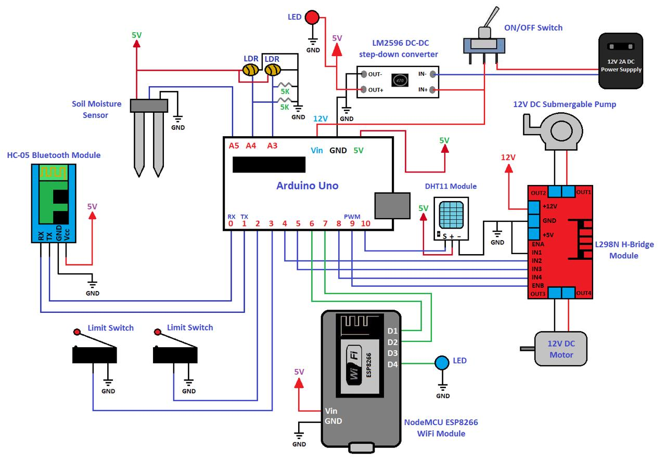
How does it works:

Slide 6
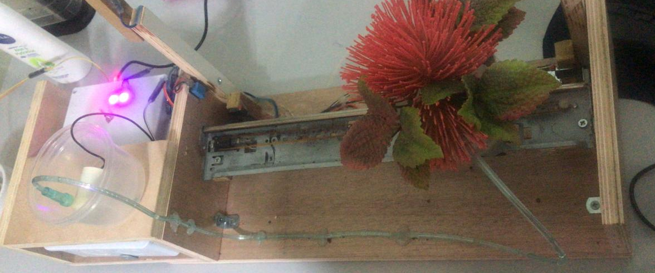

Slide 7
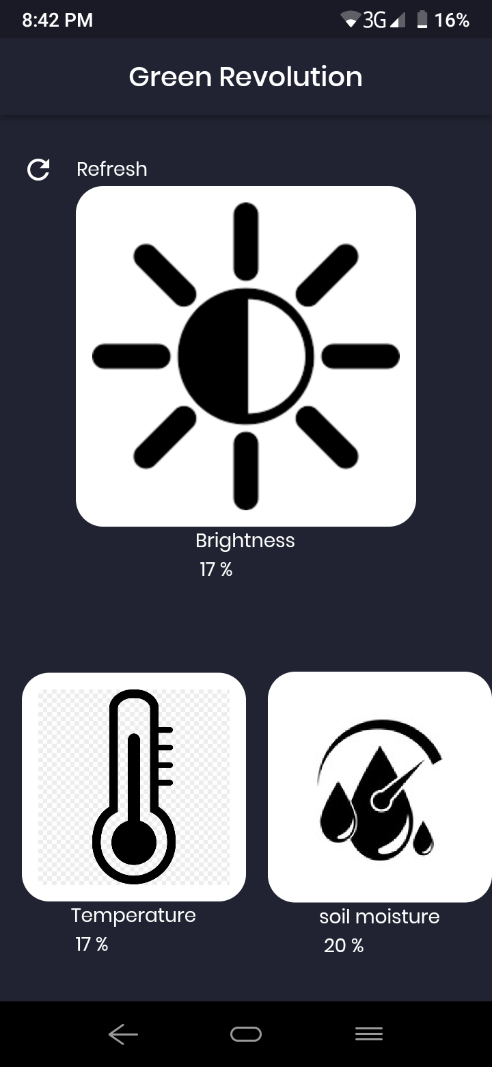
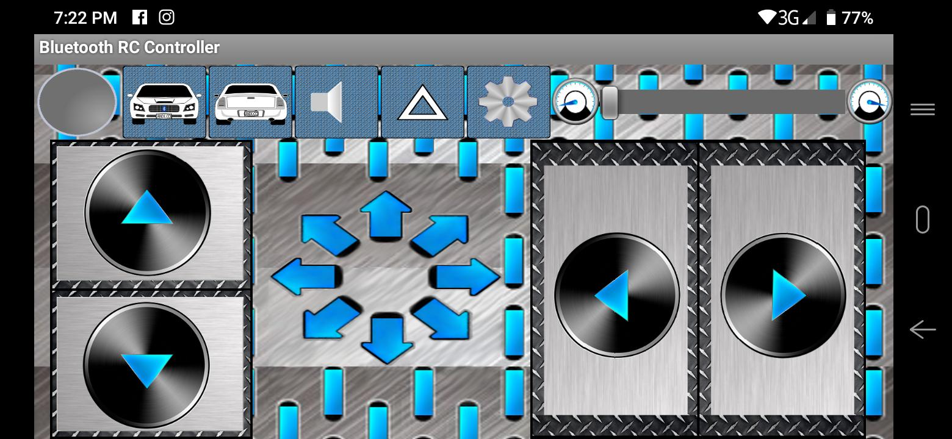

Slide 8
Technical choices:
H-Bridge
Arduino Uno
Printer track
NODEMCU
Flutter
Heroku

Slide 9
Constraints:
Cost
Scope and Time

Slide 10
Future work:
Make the system work in free motion mode(using wheels) rather than a track.
Include artificial intelligence through image processing techniques for free motion.
Control the motion over the cloud.

