Slide 1



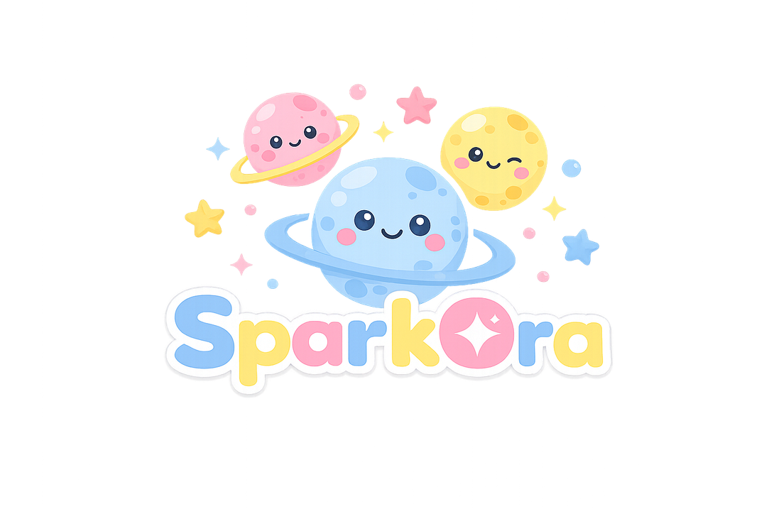




Slide 2





INTRODUCTION
Space Learning
Explore subjects through planets
An interactive space app that helps children learn, play, and grow.
Smart Progress
Track levels and achievements
Safe Access
Parents and roles stay connected

Slide 3


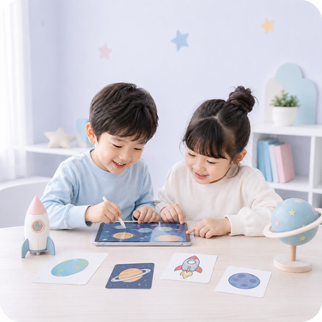
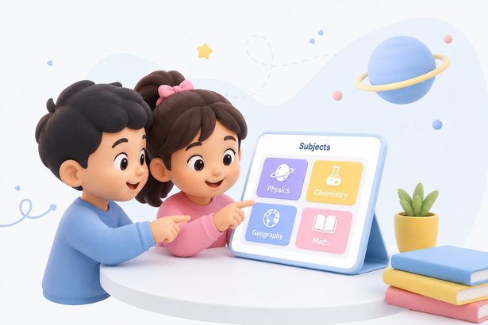
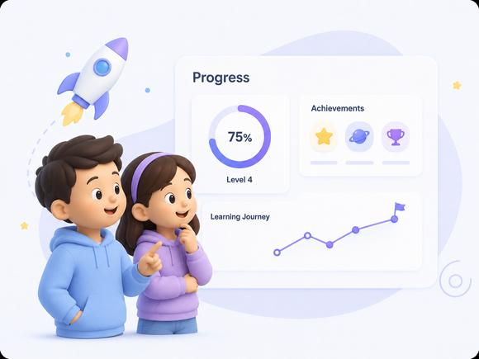
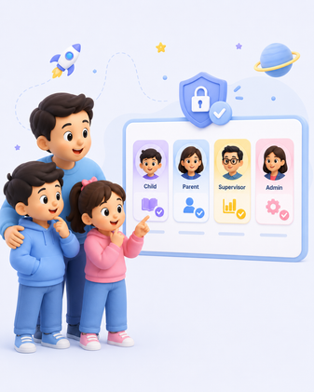


MOTIVATIONS
  Engaging learning
  Visual content structure
  Progress tracking
  Safe role access

Slide 4











PROBLEMS
Key issues our platform solves
1
2
3
Boring Lessons
Limited Practice
No Easy Tracking
Text-heavy content feels less engaging
Students need hands-on activities
Parents need clear progress updates
4
5
Hard Level Control
Role Confusion
Supervisors need simple review tools
Communication needs clear access

Slide 5





GOALS
Space learning worlds
Safe user roles
Building a safe and interactive learning experience for every user.
Save child progress
Parent progress tracking
Supervisor level creation
Admin content review

Slide 6



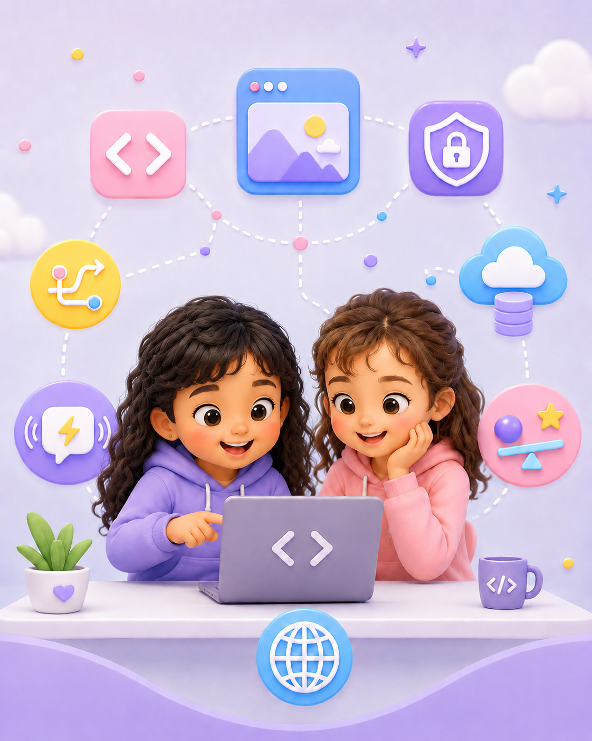
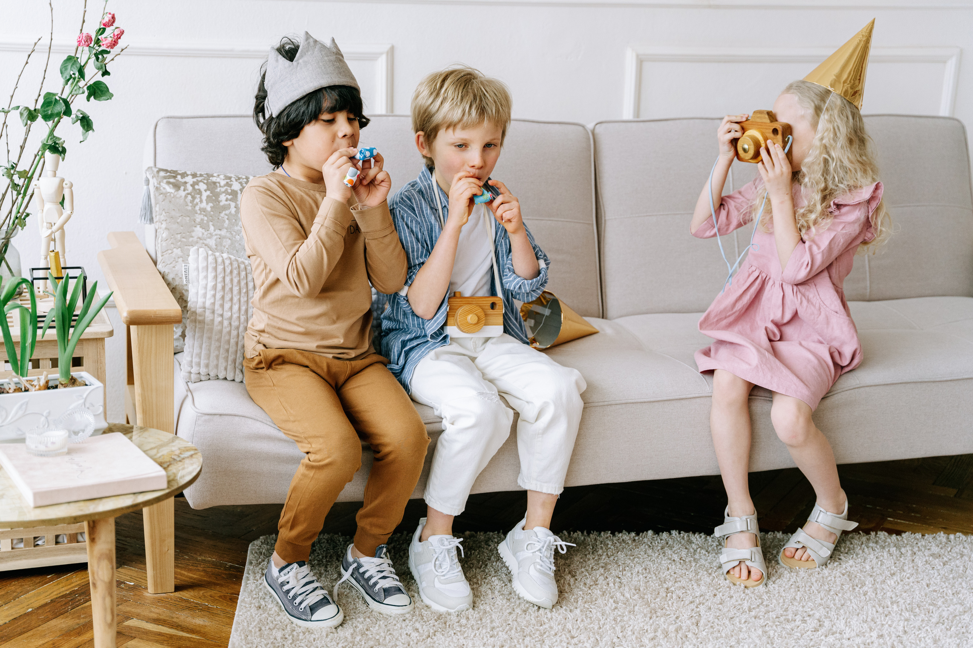


TECHNOLOGIES
USED

Slide 7



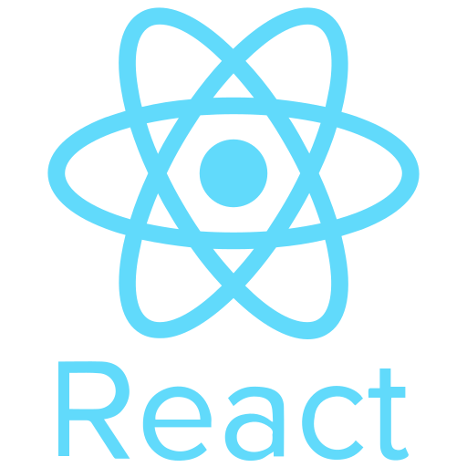


Frontend

Slide 8

Database

Slide 9
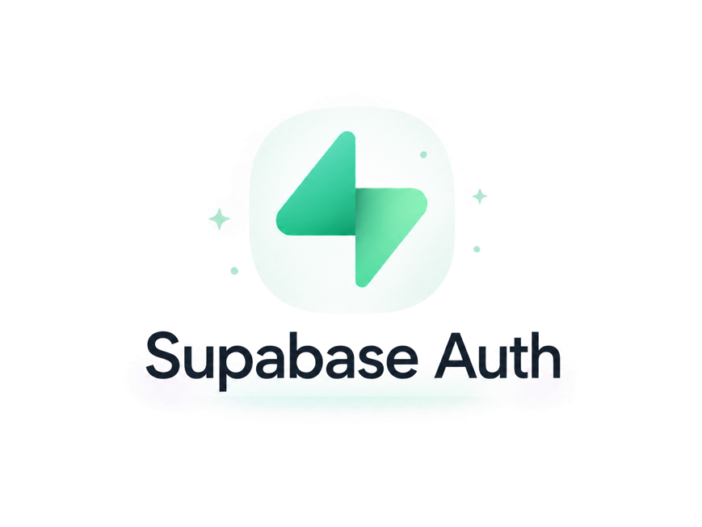

Authentication & Communication

Slide 10

Physics Engine

Slide 11

Canvas / Rendering

Slide 12
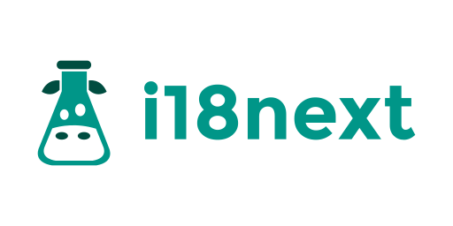
Internationalization

Slide 13
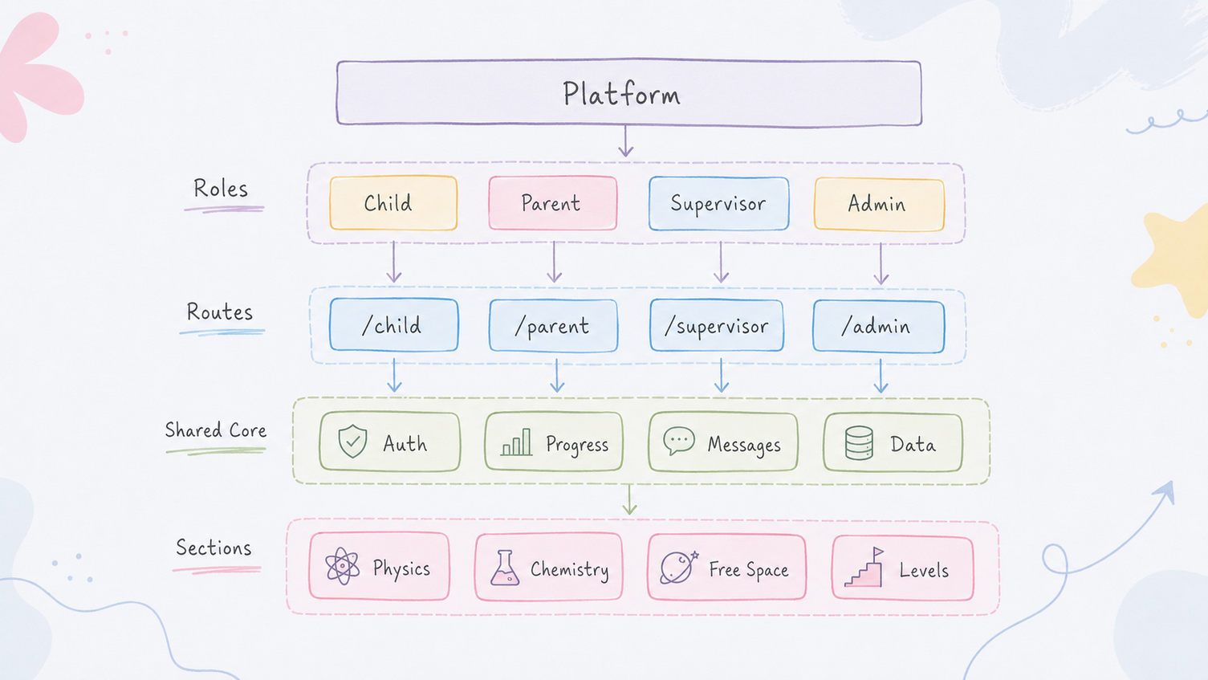
Architecture

Slide 14

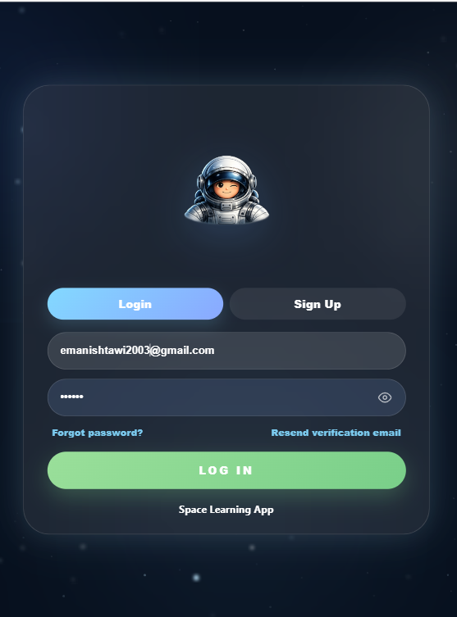
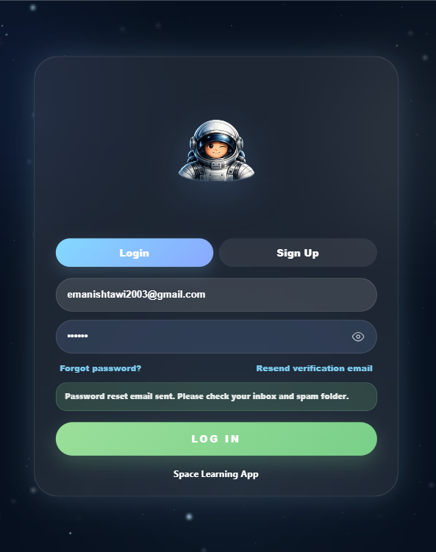
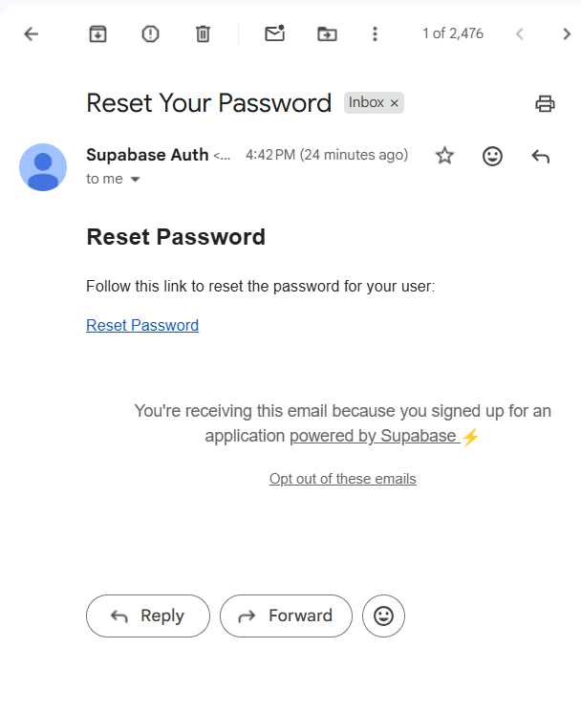
Login

Slide 15
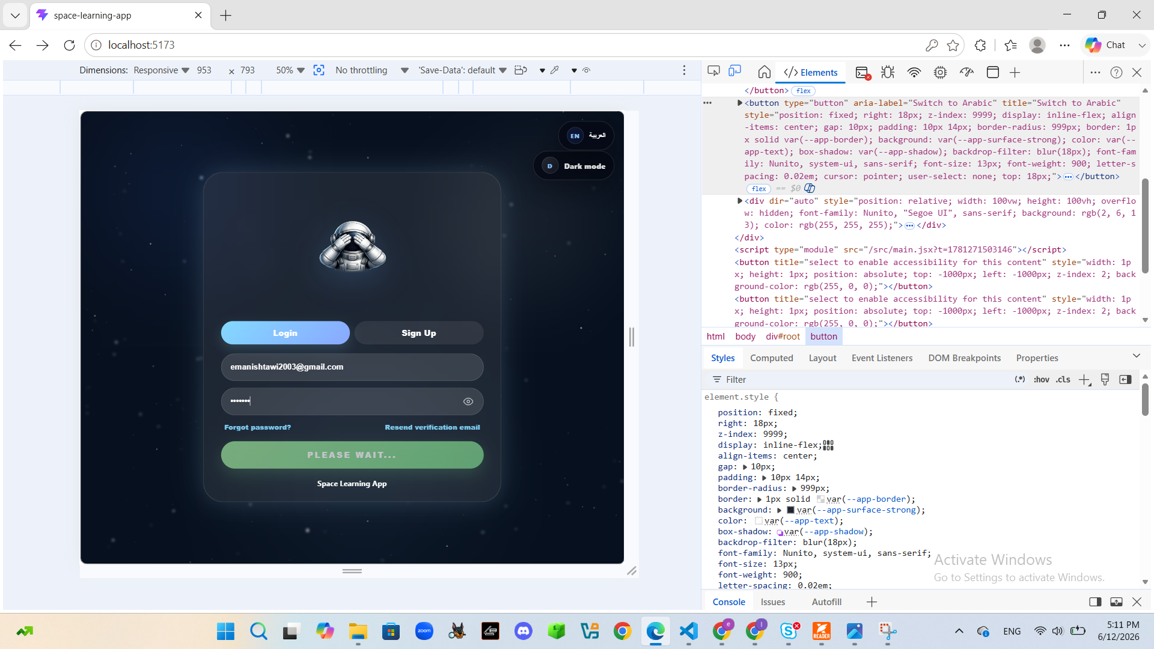
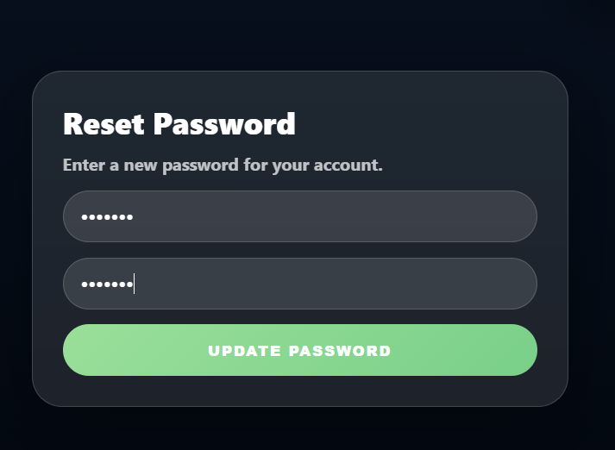
Login

Slide 16
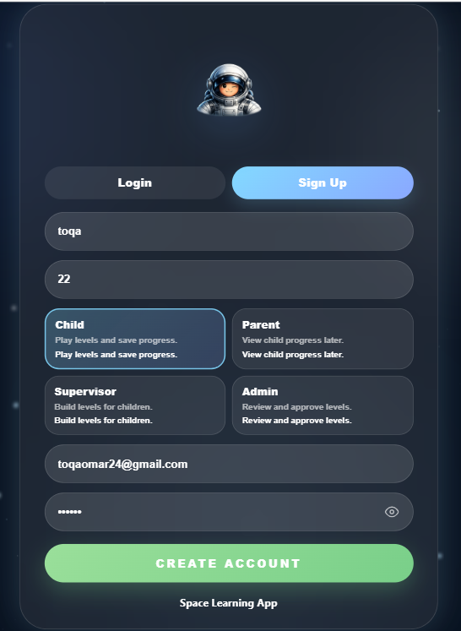
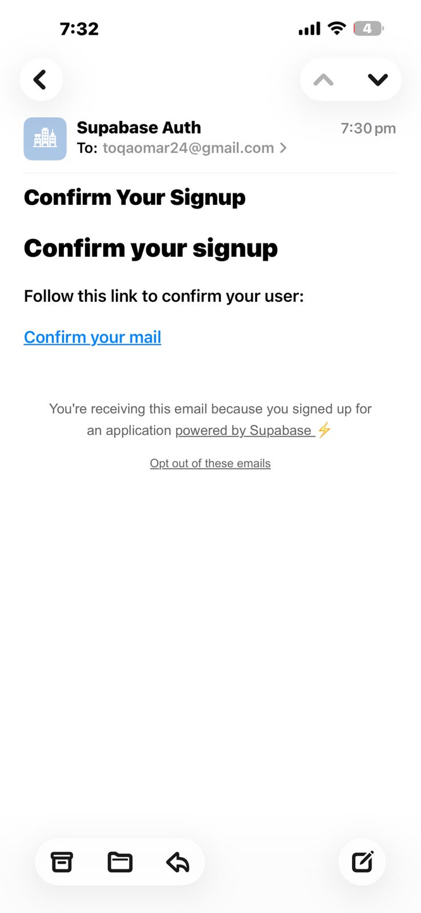
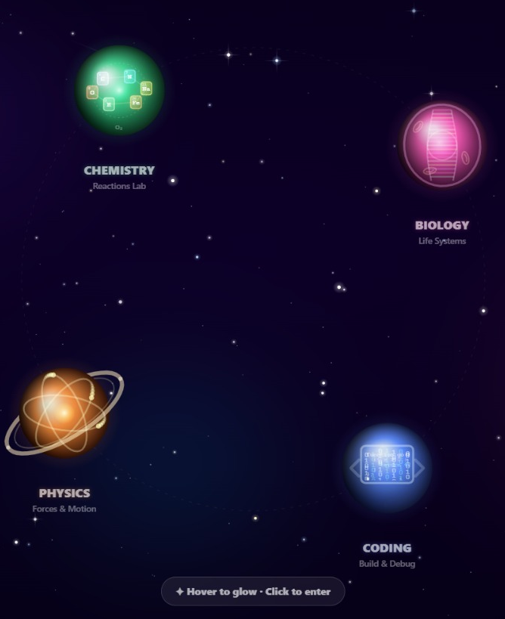
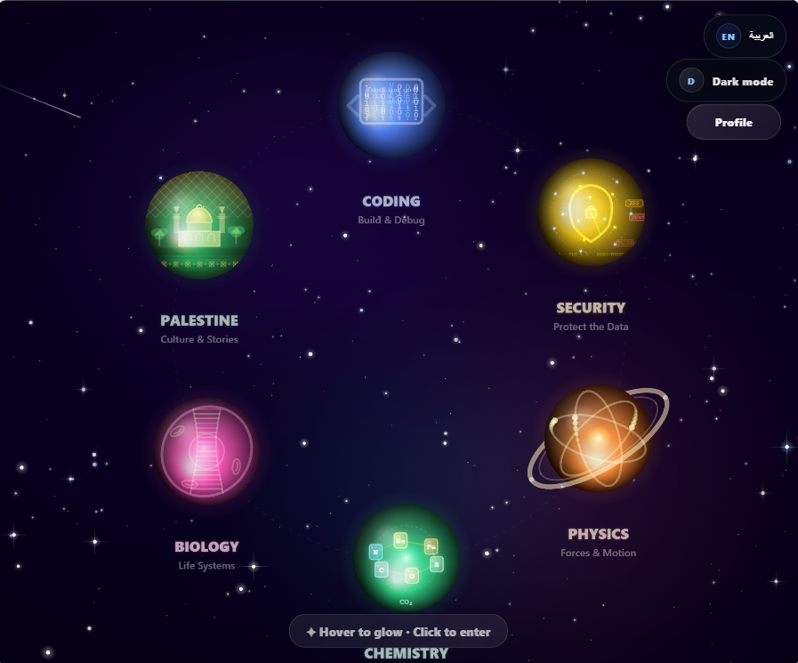
signup

Slide 17
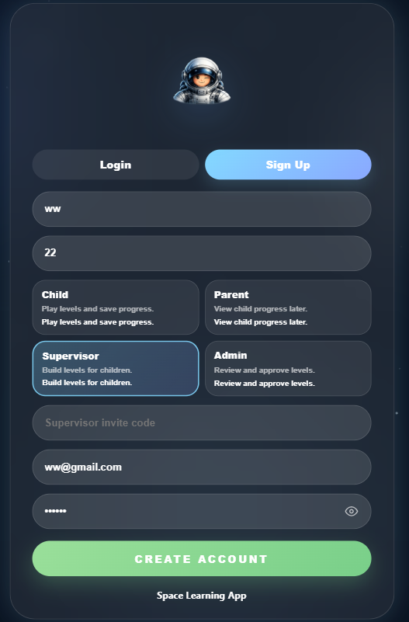
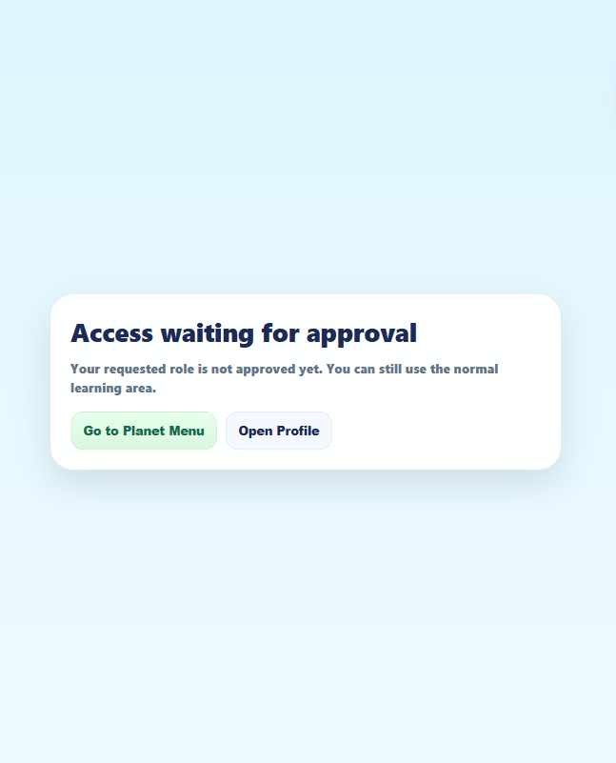
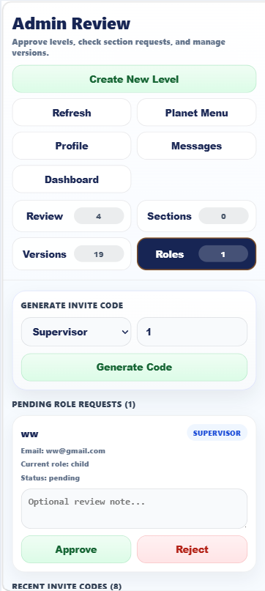
signup

Slide 18
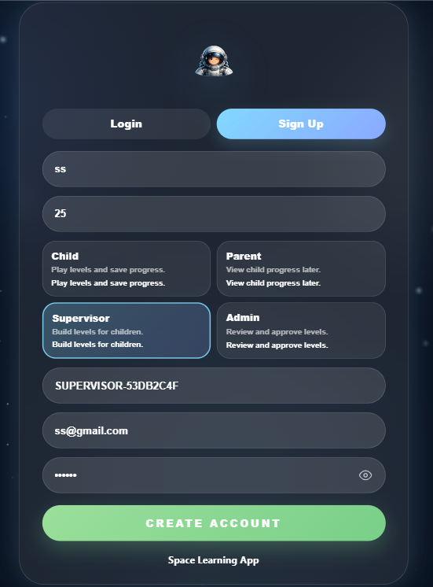
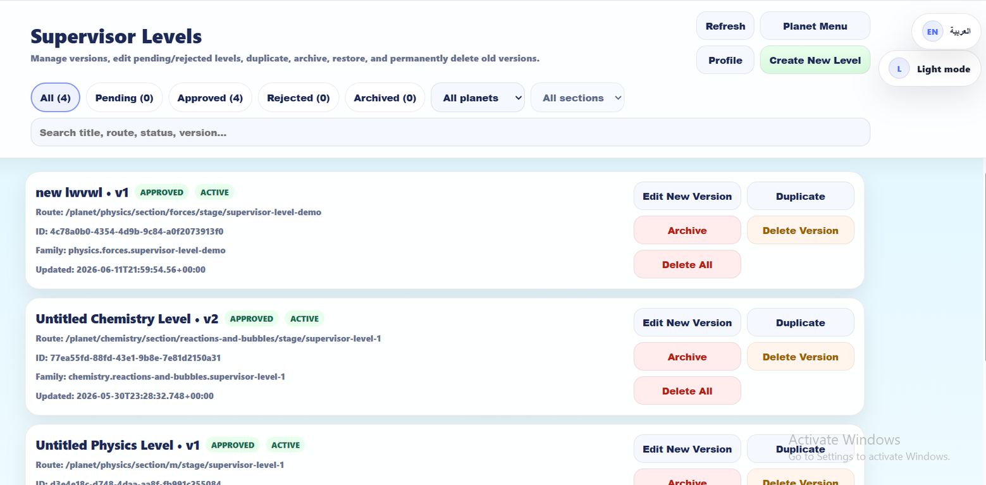
signup

Slide 19
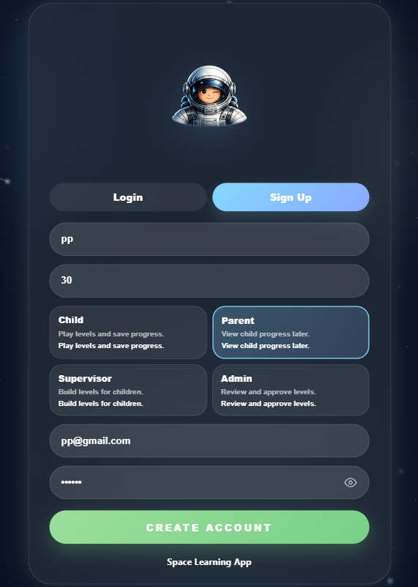
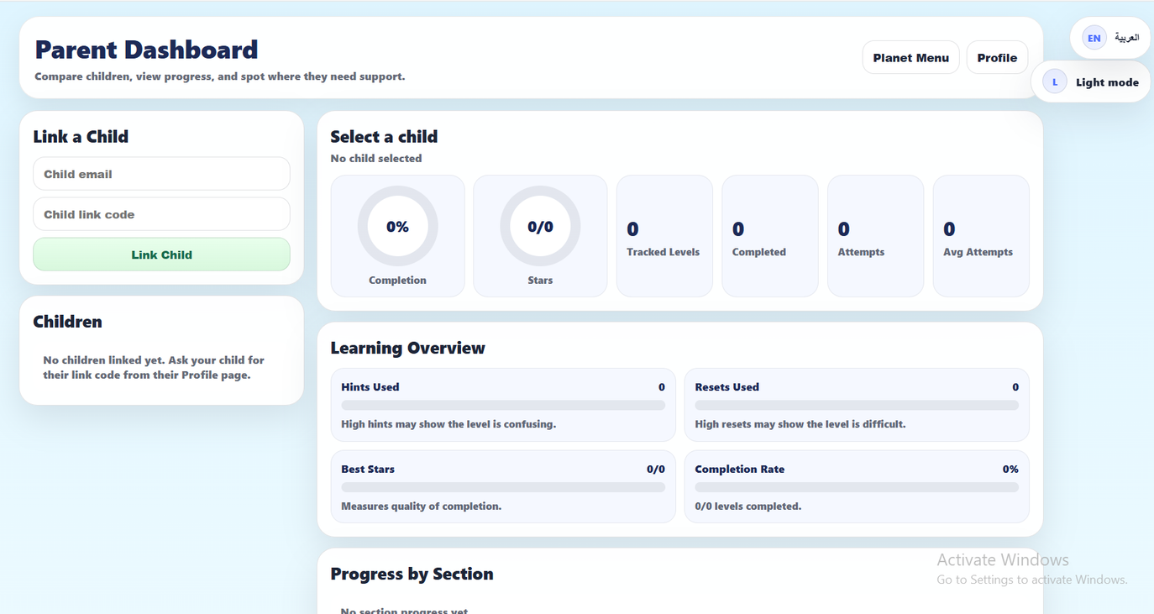
signup

Slide 20
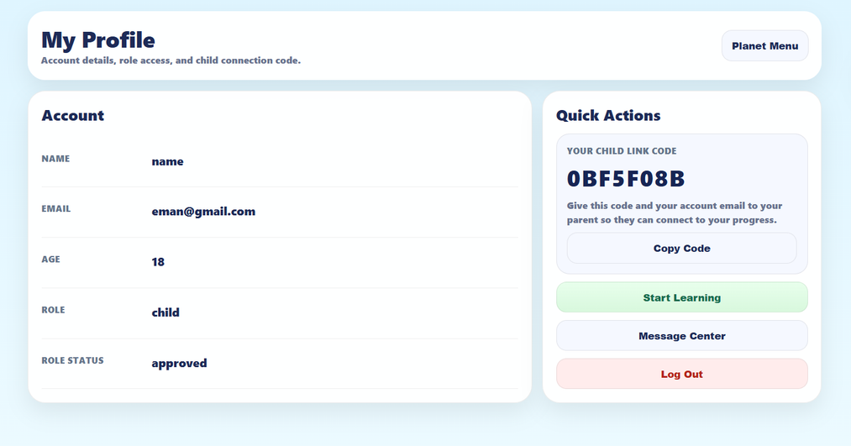
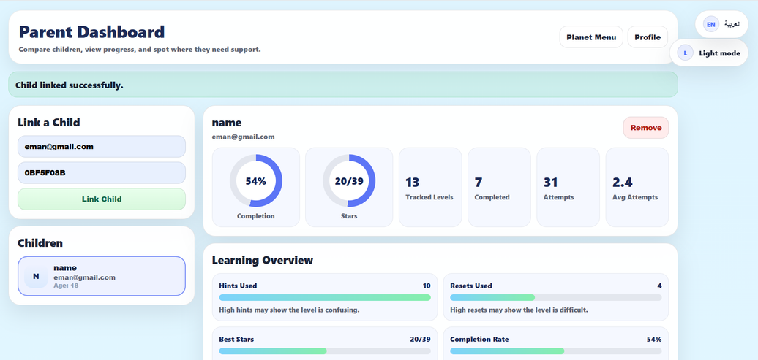
Progress Tracking

Slide 21
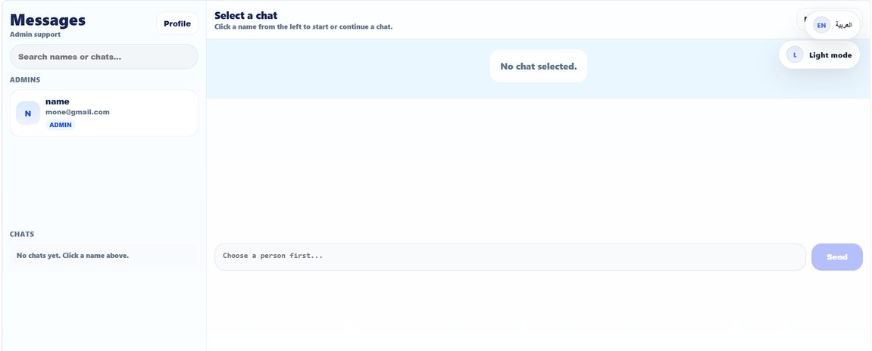
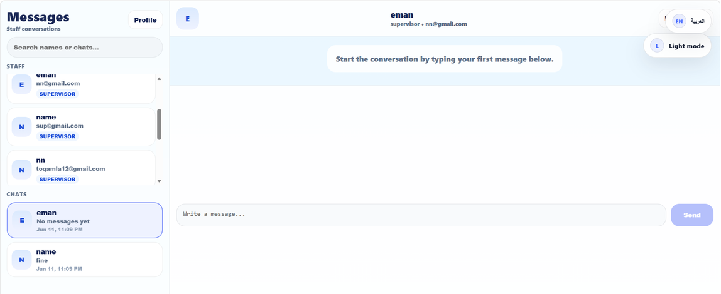
Messaging center

Slide 22
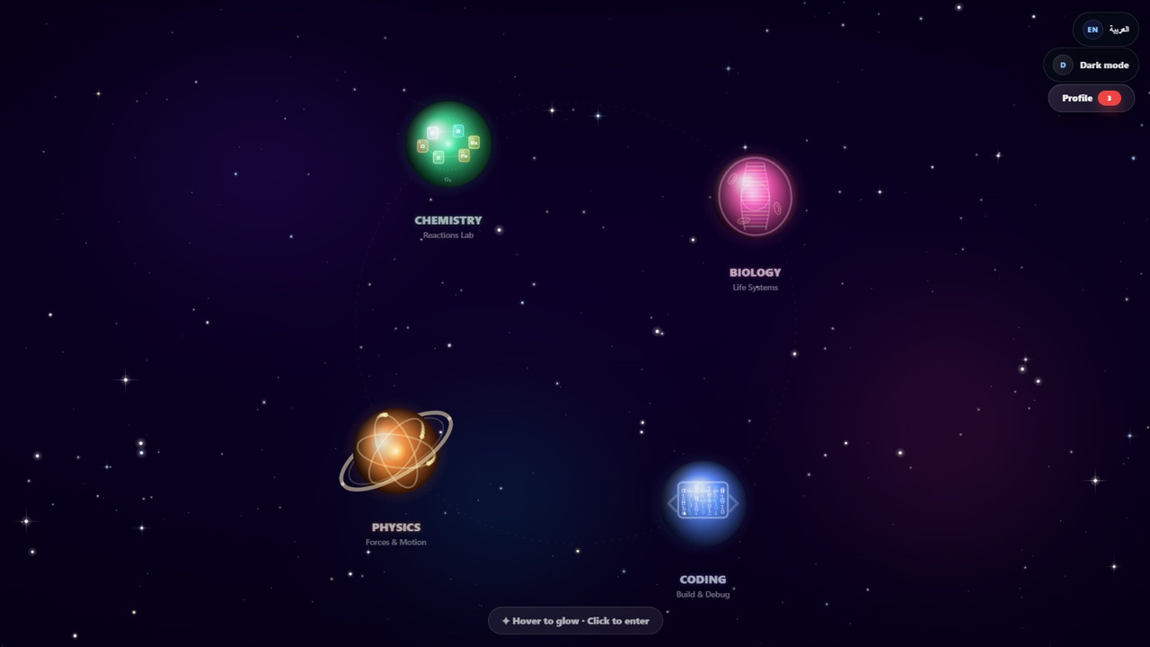
Planet Menu

Slide 23
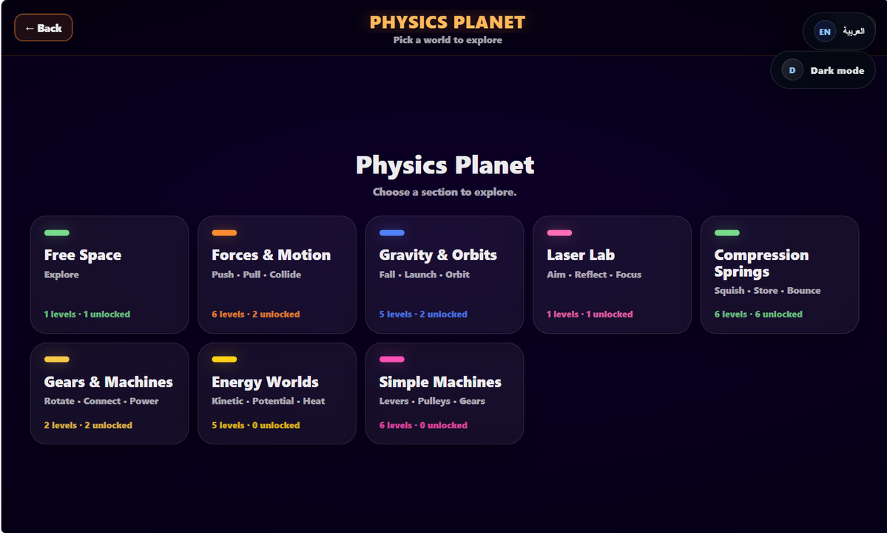
Physics planet

Slide 24
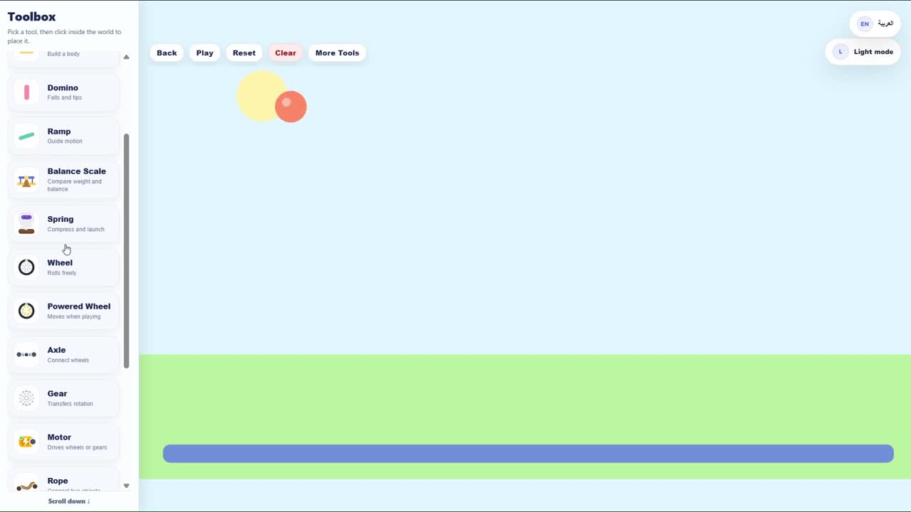
Physics-Free Space

Slide 25
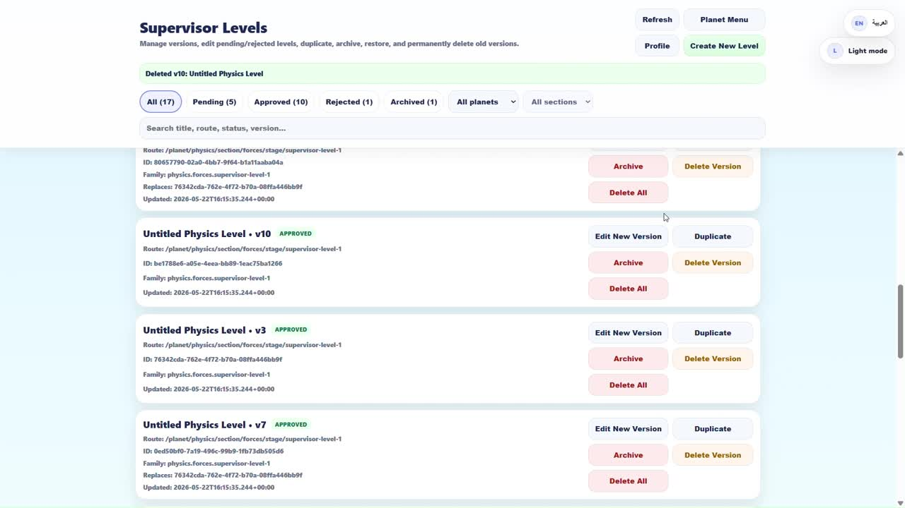
Supervisor

Slide 26
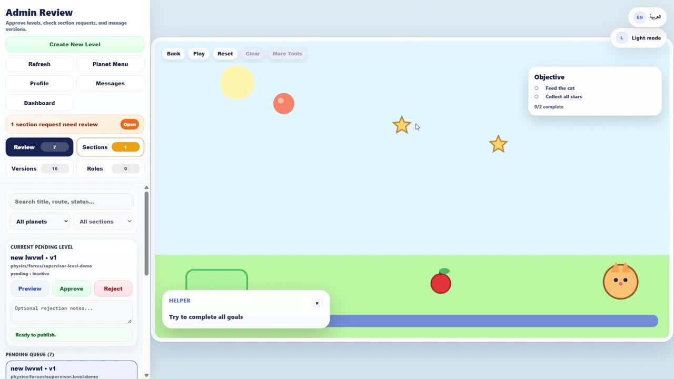
Admin

Slide 27
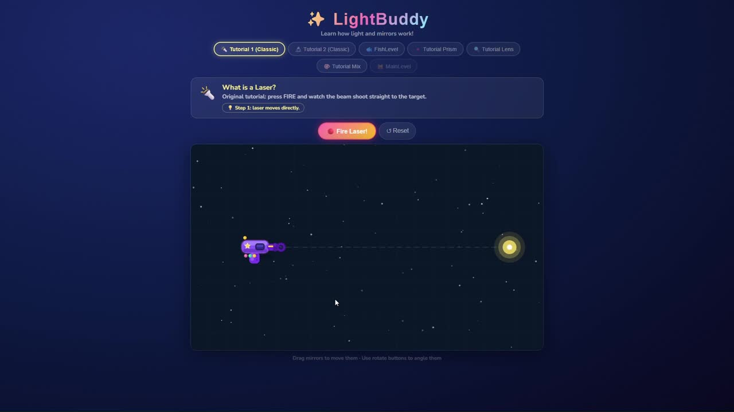
Laser Section

Slide 28
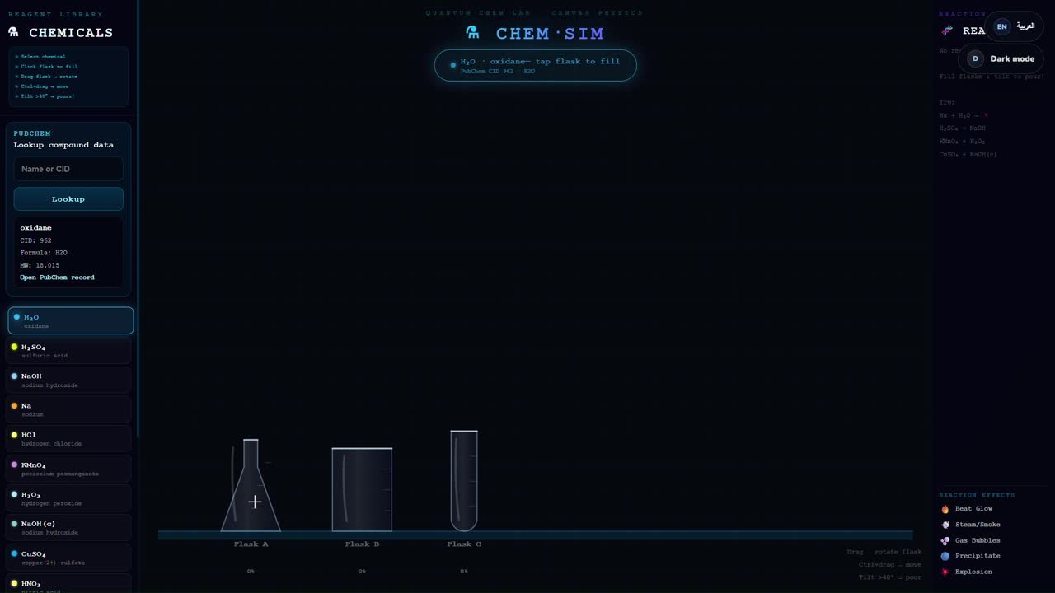
Chemistry-Free Space

Slide 29



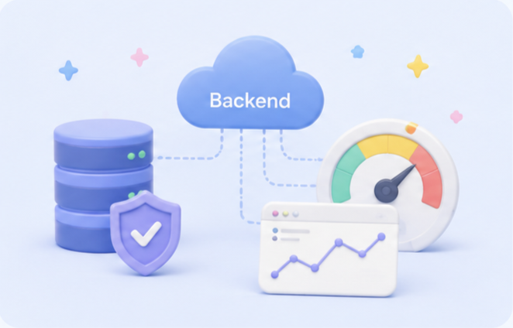
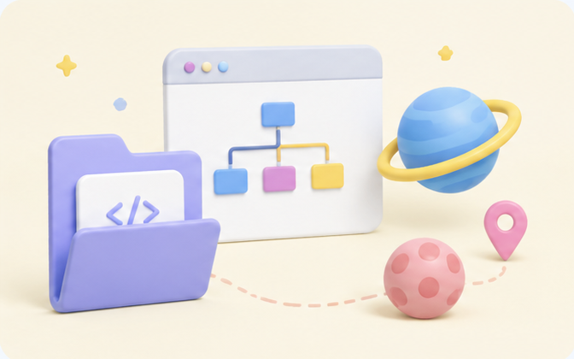

CONSTRAINTS
  Backend setup required
  Performance varies by device
  Modular maintenance needed
  Expansion needs planning

Slide 30




FUTURE WORK
*
Add more planets
*
Improve progress analytics
*
Expand messaging system
*
Add level templates
*
Improve child usability

Slide 31

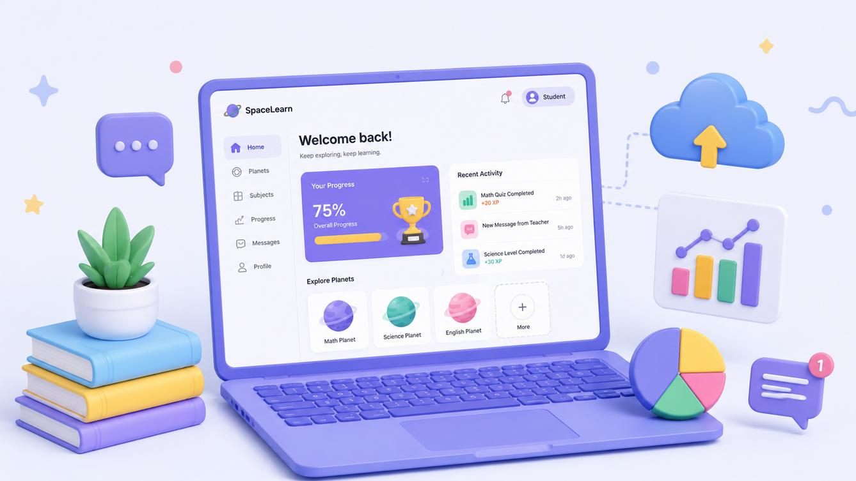


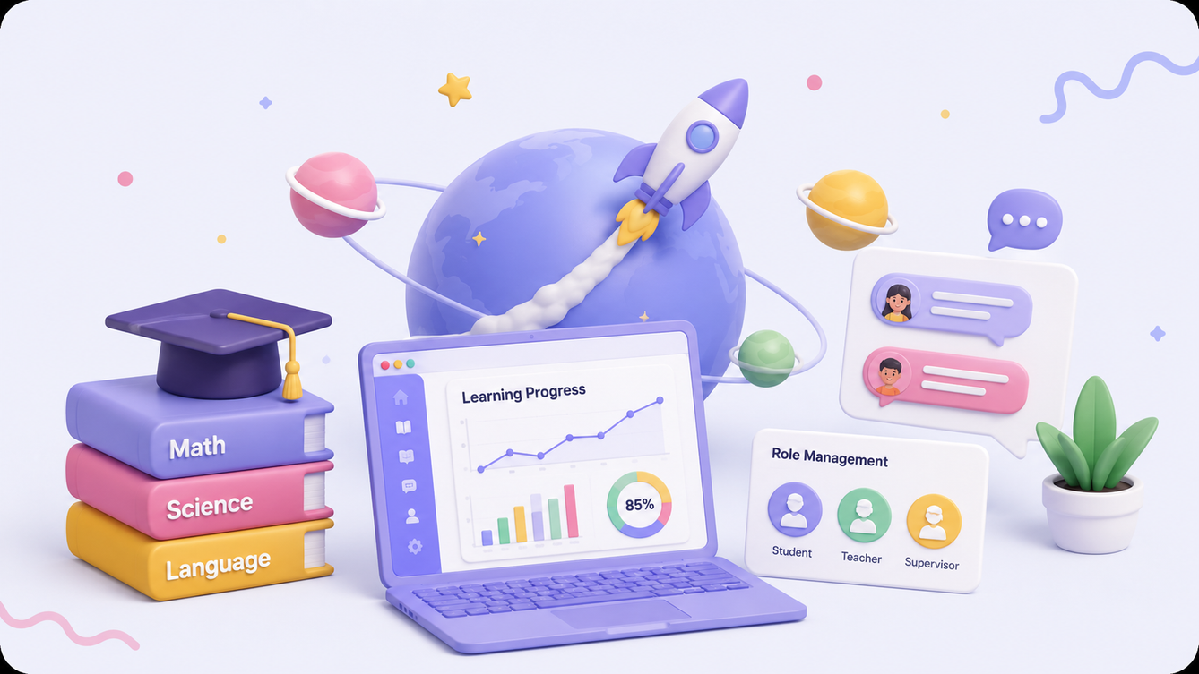

CONCLUSION
This project creates a safe, interactive space-learning app with progress tracking, messaging, and role-based management.

Slide 32


