Slide 1

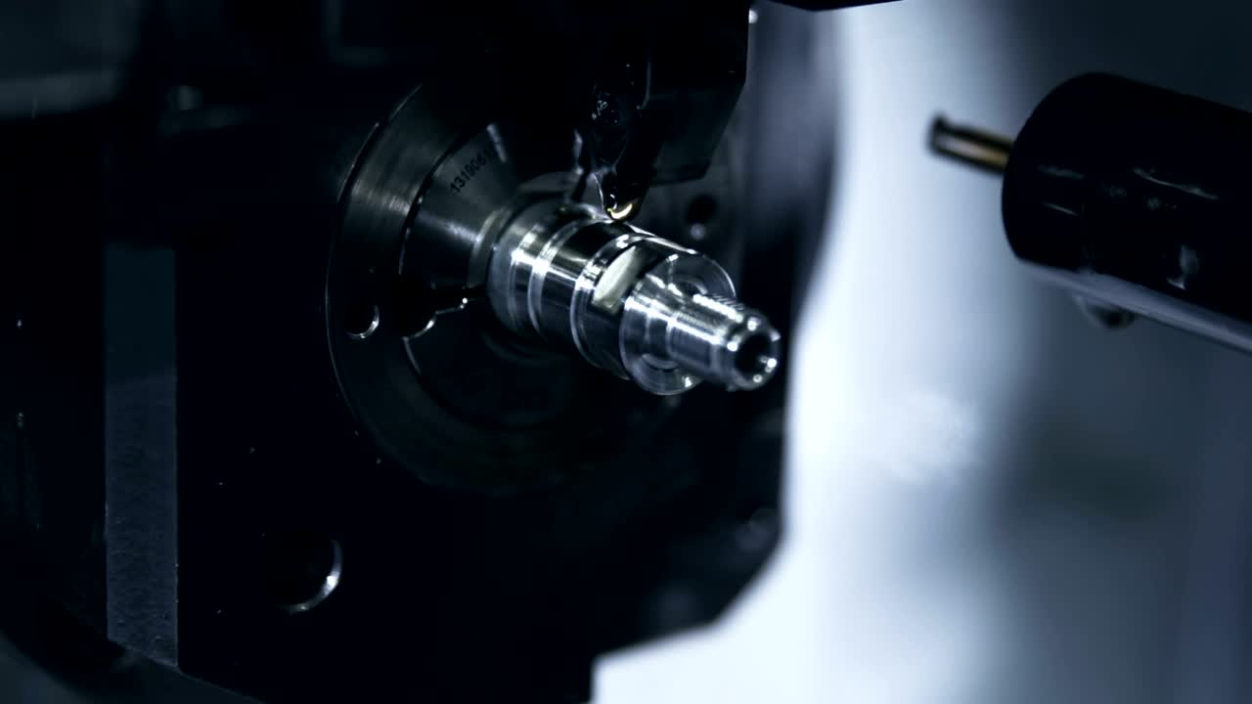

FEBRUARY - 2025
AN-NAJAH NATIONAL UNIVERSITY
CNC FOUR AXES
-FIVE DEGREES OF FREEDOM-
MILLING MACHINE SOFT MATERIAL
STUDENTS:
“MOHAMMAD TARIQ” FARES
YAZAN MOUSA
MOHAMMAD ALLAN
SUPERVISOR:
DR. BASHIR NOURI
01

Slide 2

Table Of Content
1
2
INTRODUCTION
MECHANICAL DESIGN
3
4
ELECTRICAL & CONTROL
DESIGN
TESTING

Slide 3

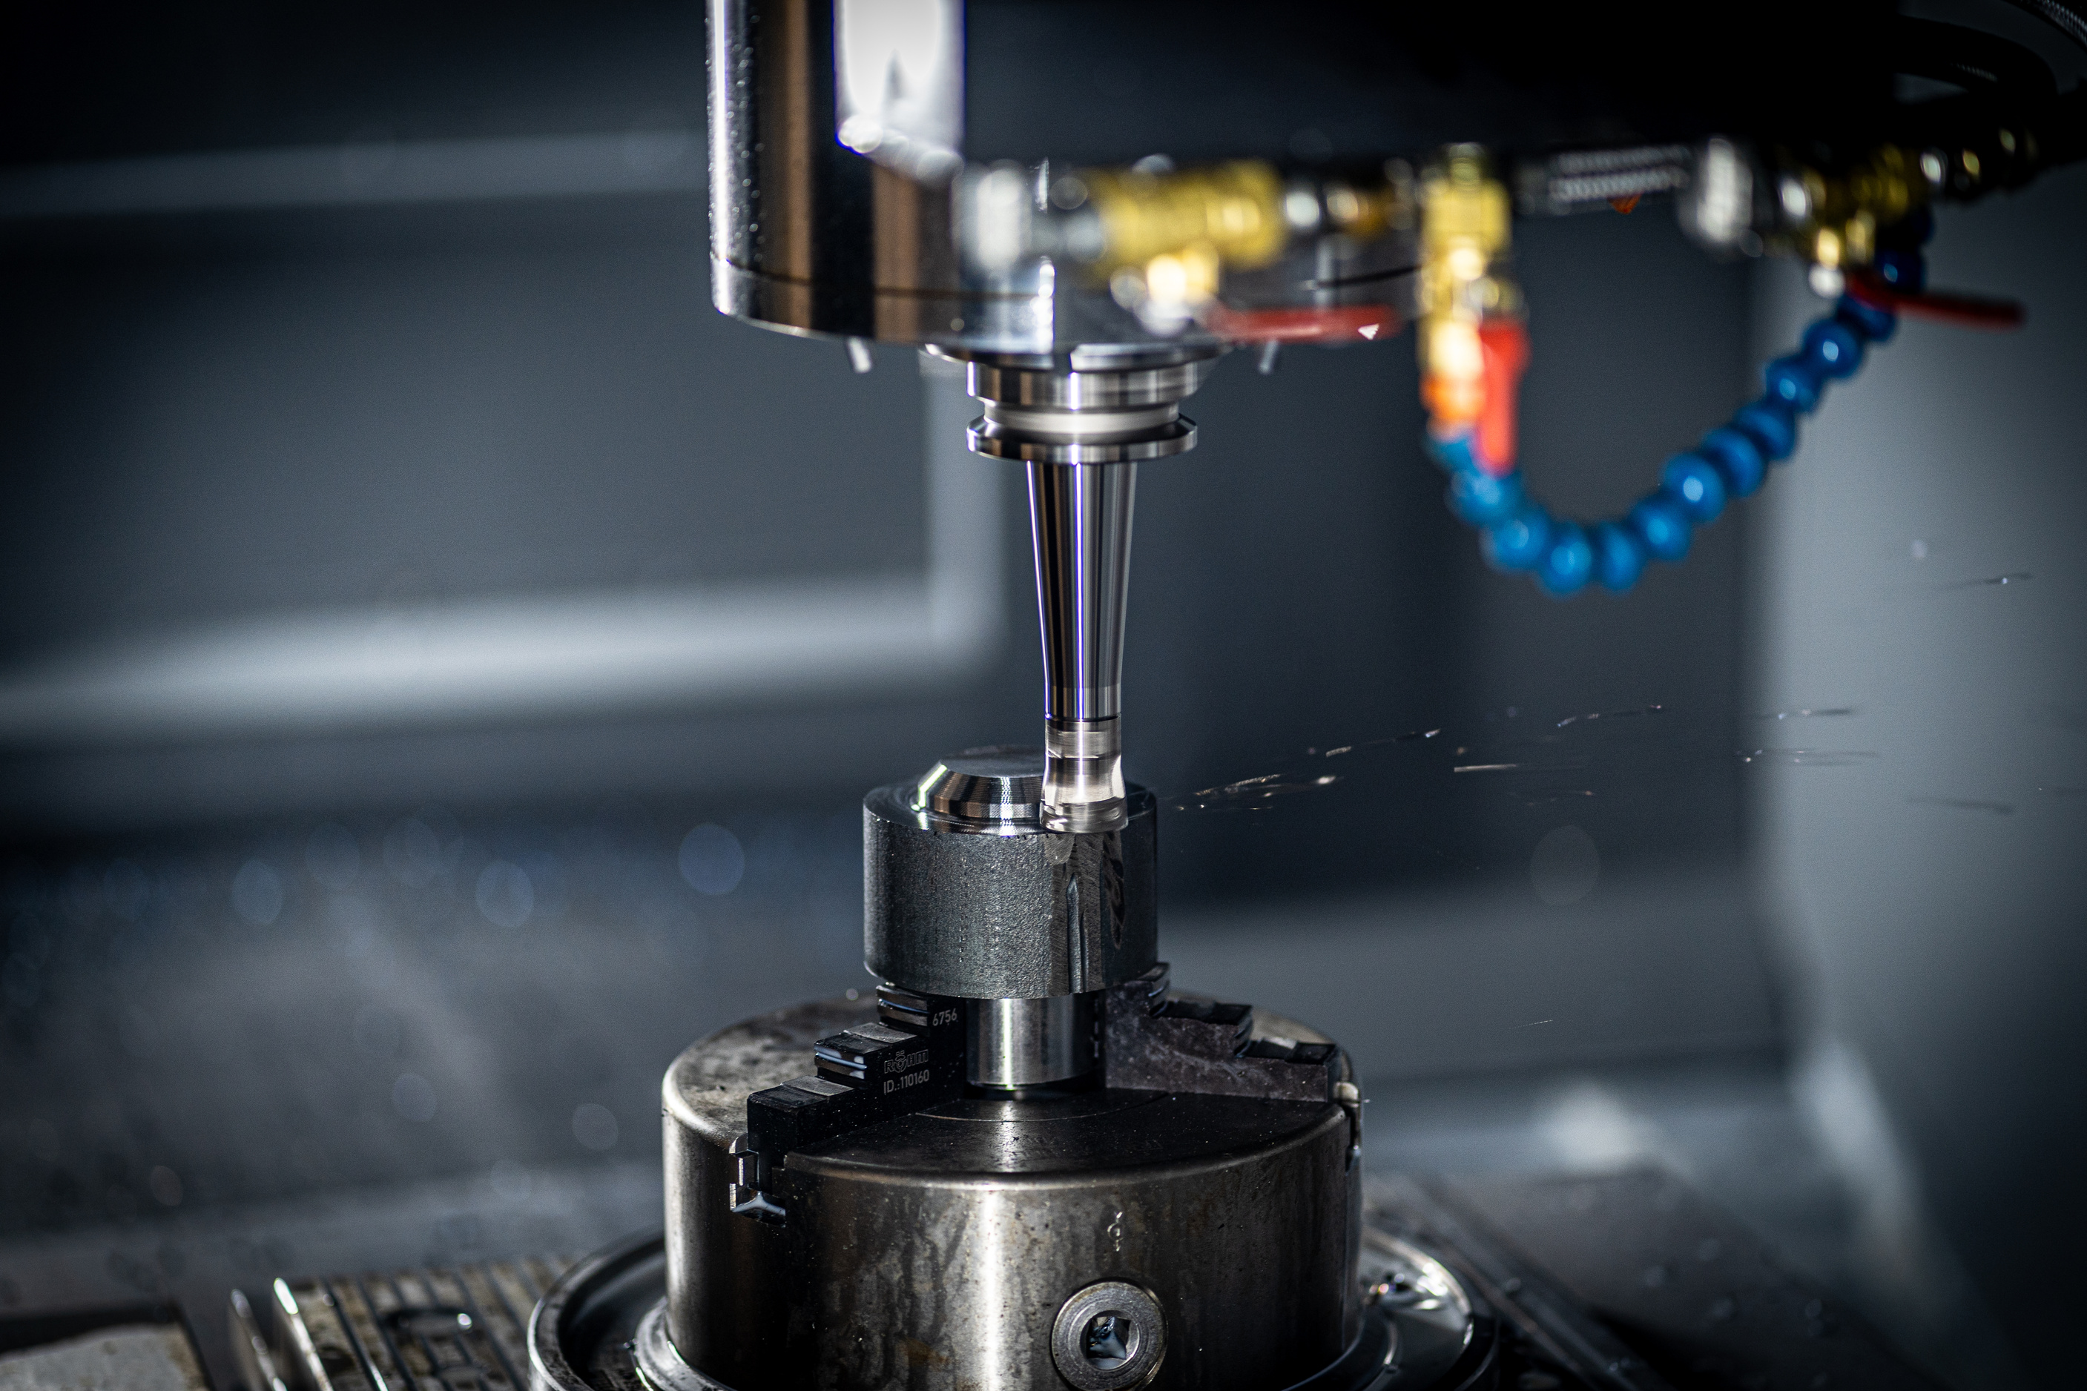

INTRODUCTION

Slide 4
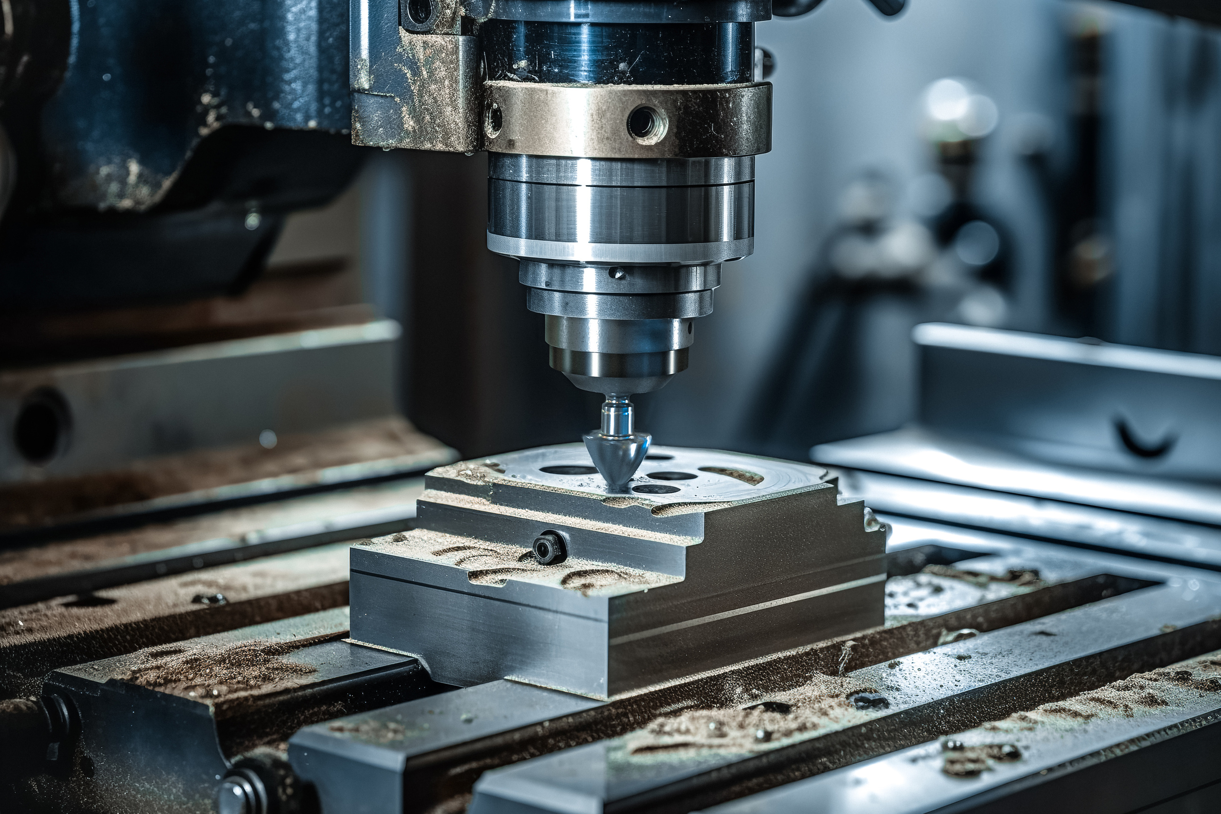
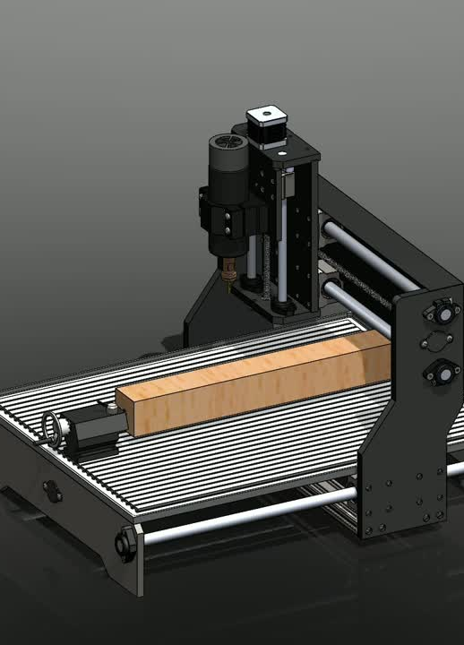
Introduction
This project aims to design a 4-axis CNC milling machine with five degrees of freedom for processing soft materials such as plastic, wood, and aluminum. The project seeks to provide an economic and precise solution for small and medium-sized factories, enhancing production efficiency through modern manufacturing technologies.

Slide 5

Feasibility Study
Option
Customer Cost ($)
Market Price ($)
Customer Savings ($)
Converting 3 to 4 Axis
900-1000
2800-3700
1,900 - 2,700
Purchasing New Machine
1800-2000
2800-3700
1000-1700

Slide 6
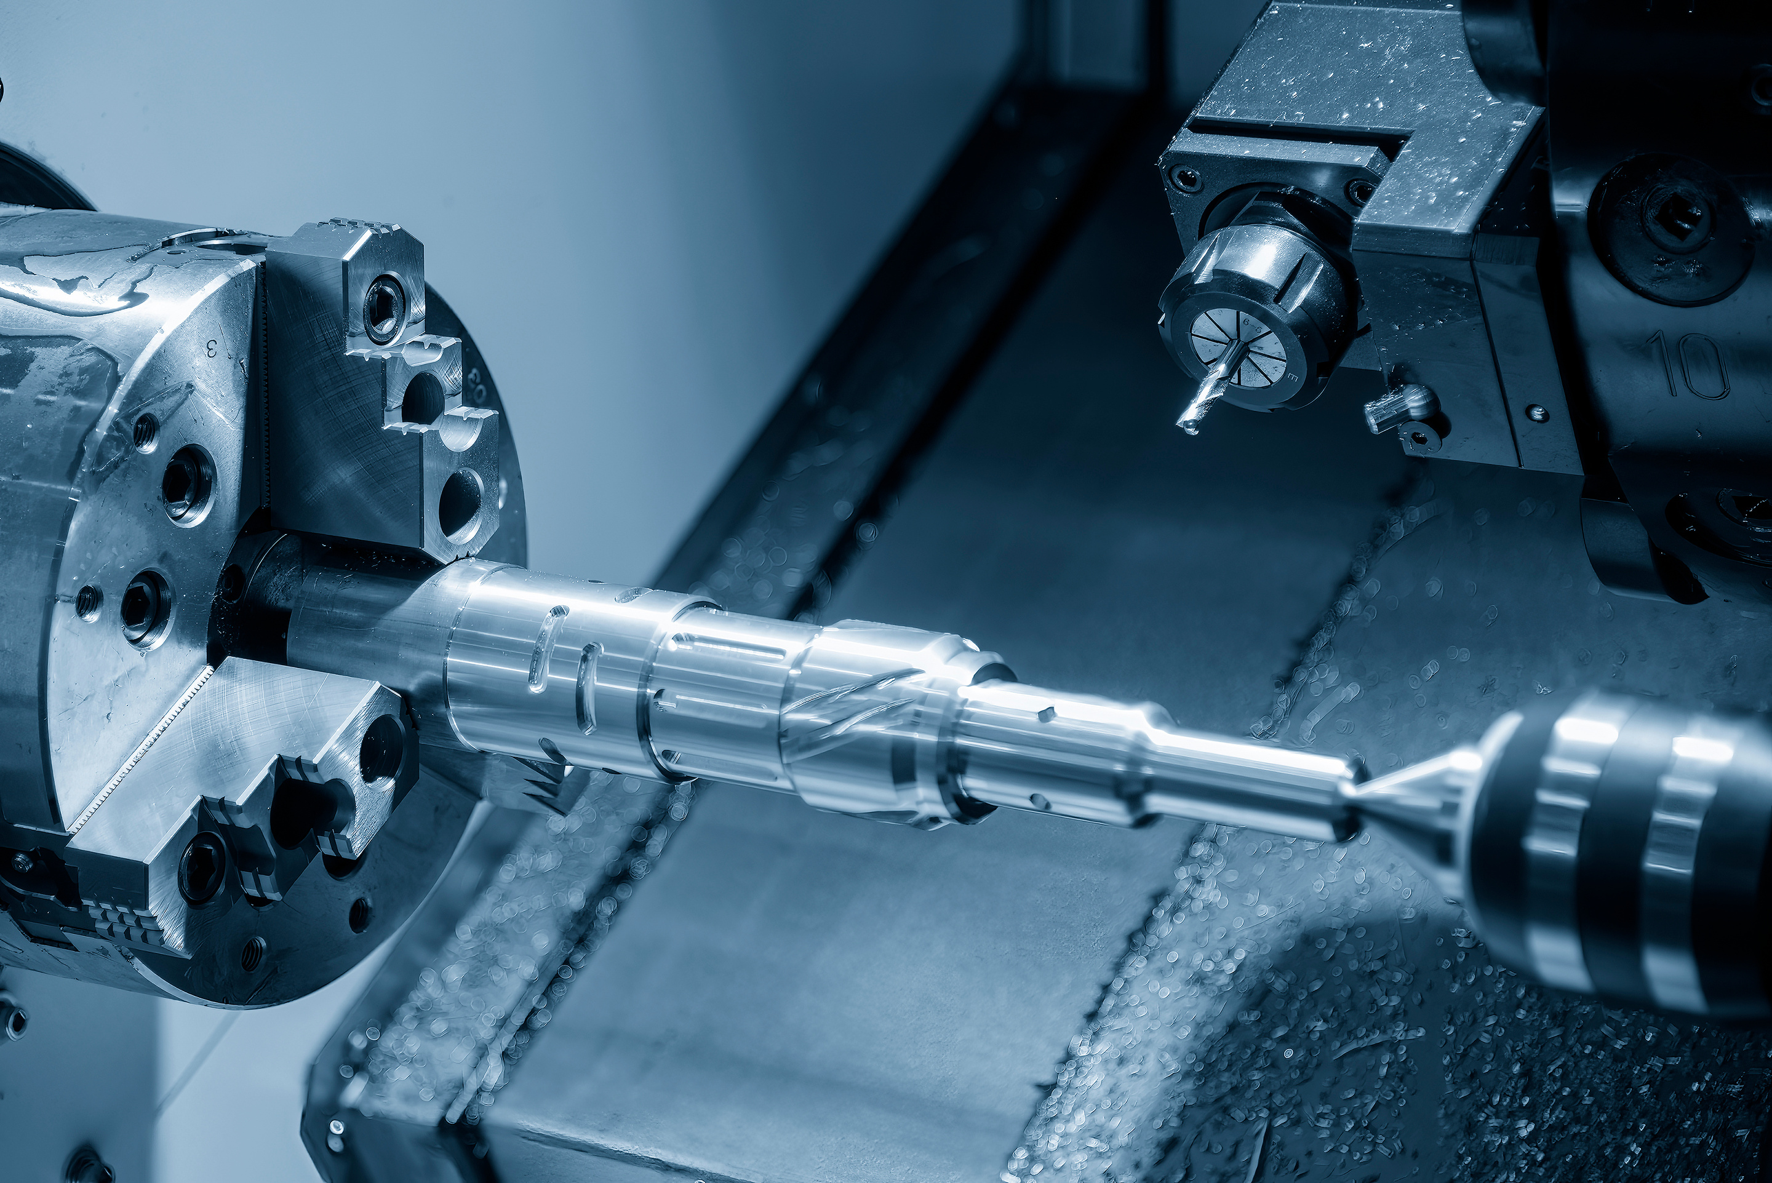
MECHANICAL
DESIGN

Slide 7
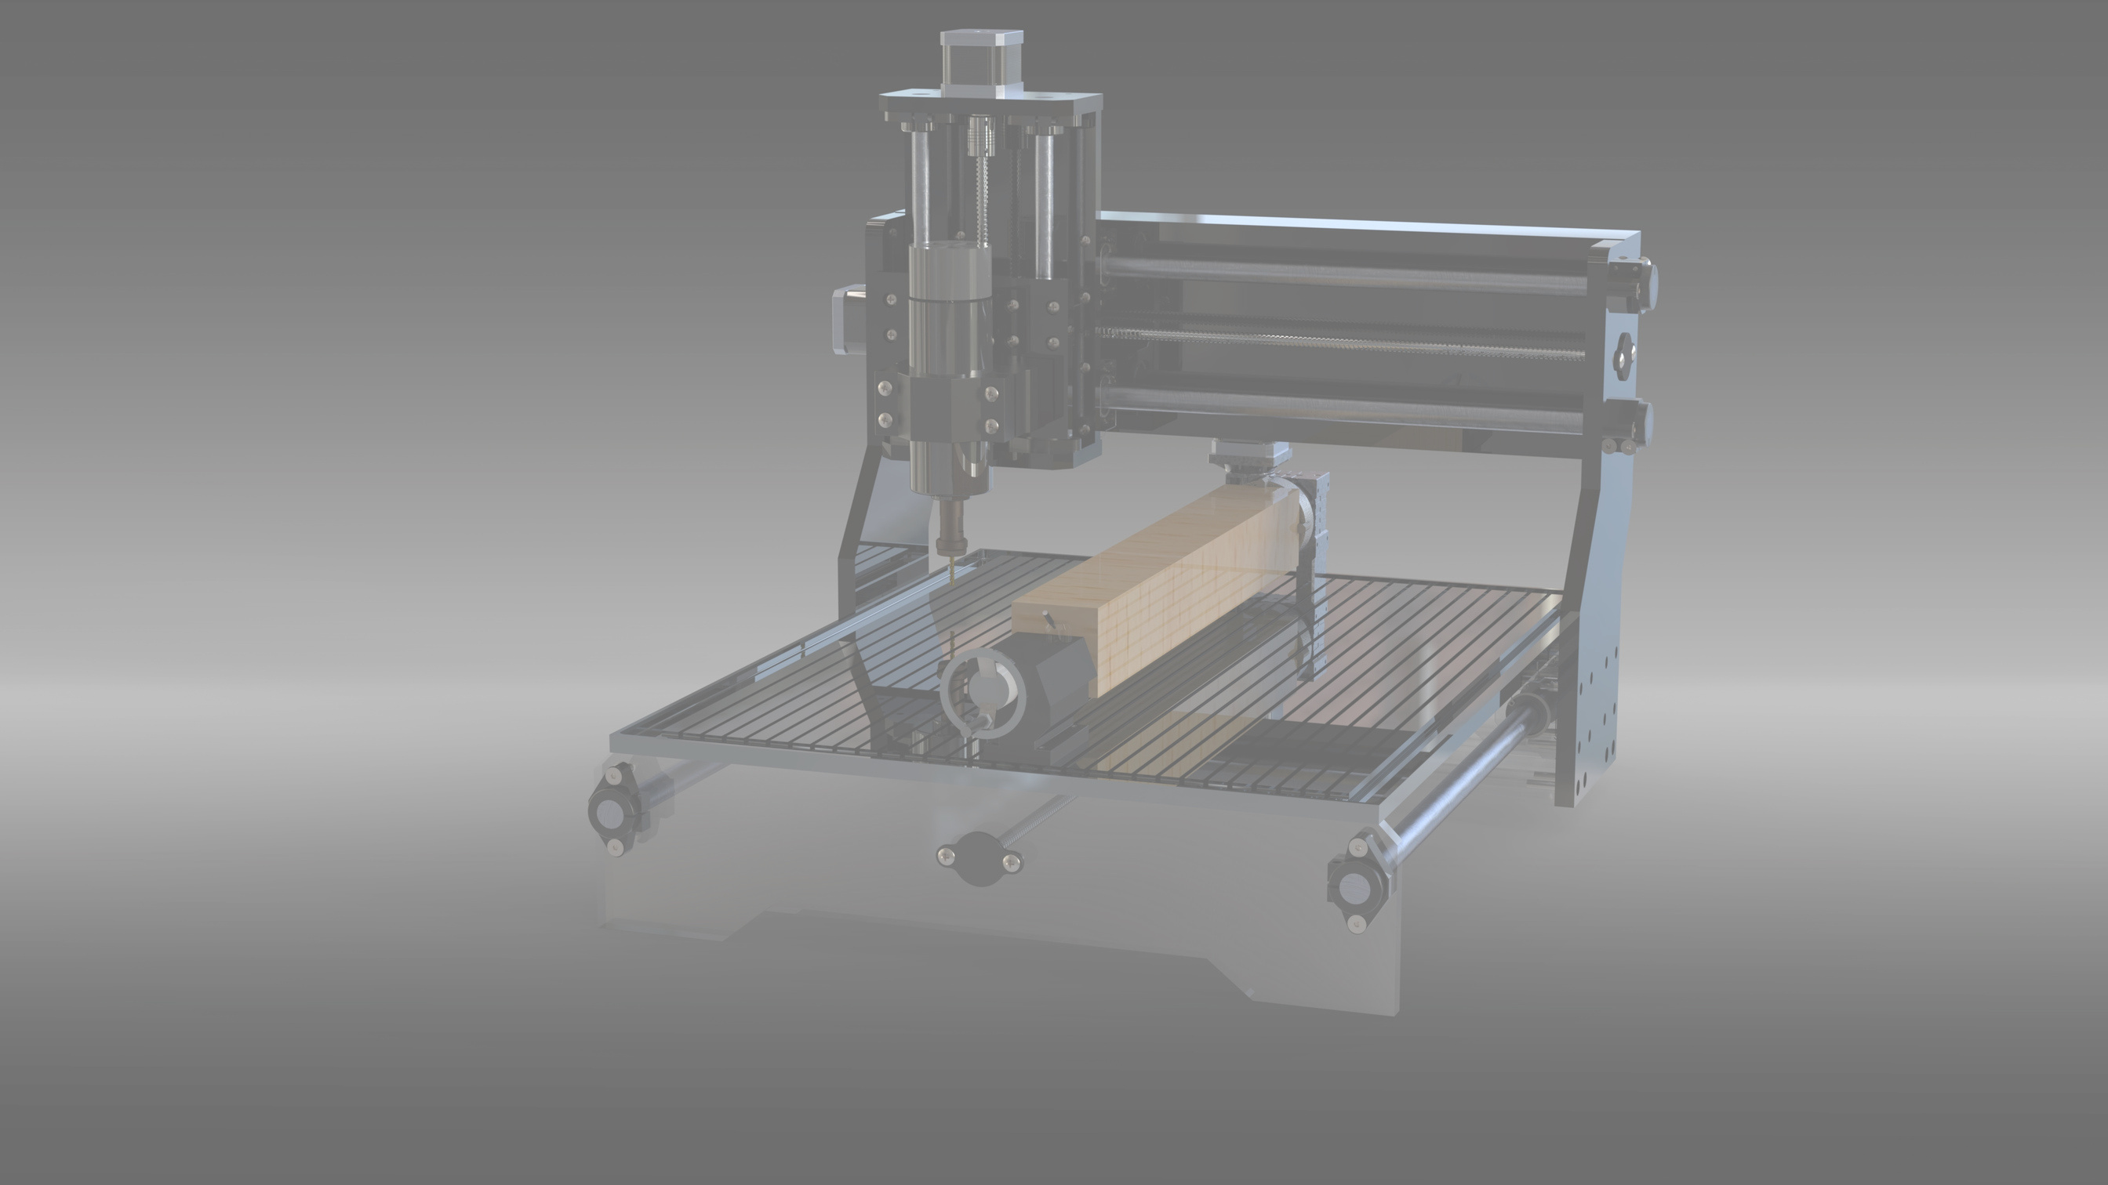
INTRODUCTION
INTRODUCTION
The mechanical design of the CNC machine aims to create a strong and precise system capable of efficiently processing soft materials such as plastic, wood, and aluminum. The traditional 3-axis machine has been enhanced by adding a fourth rotary axis, providing greater flexibility and higher accuracy for complex manufacturing tasks. The design includes selecting appropriate materials, optimal motor choices, and studying forces and torque to ensure stability and performance."

Slide 8
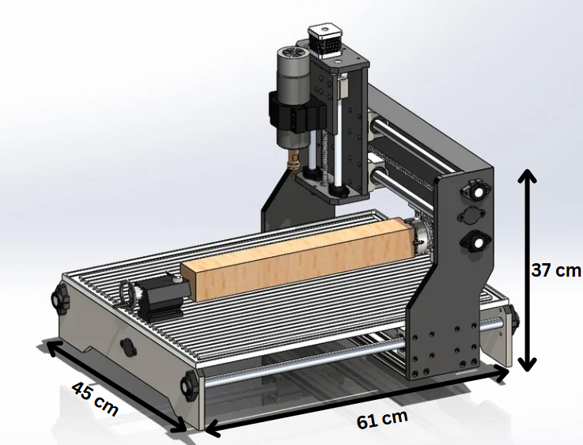
STRUCTURE
DESIGN

Slide 9
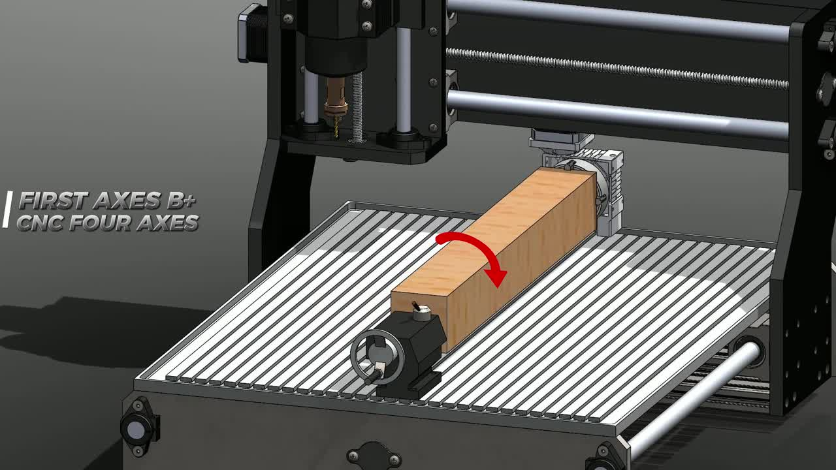
AXIS FOR CNC

Slide 11
Heading
SUBHEADING
BODY

Slide 17
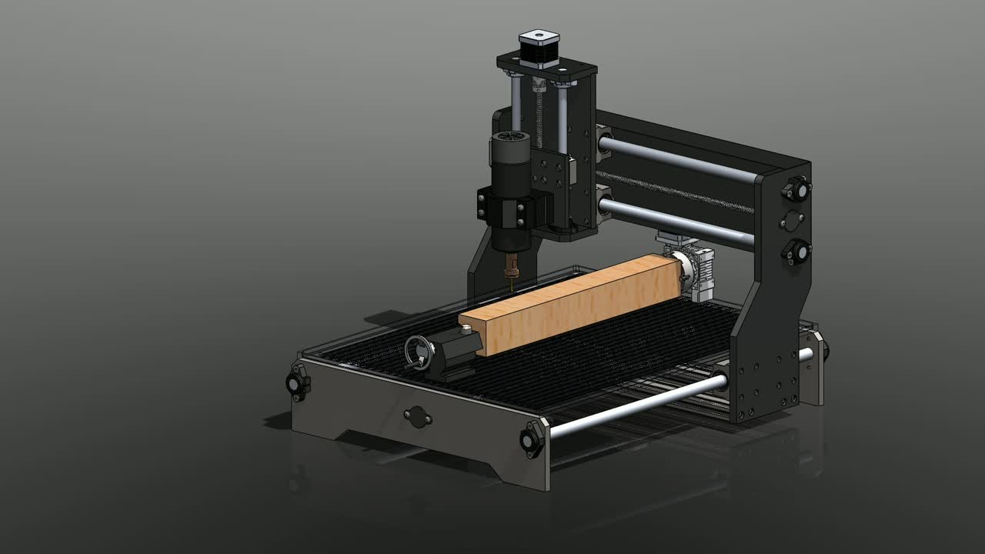
MECHANICAL PARTS

Slide 25
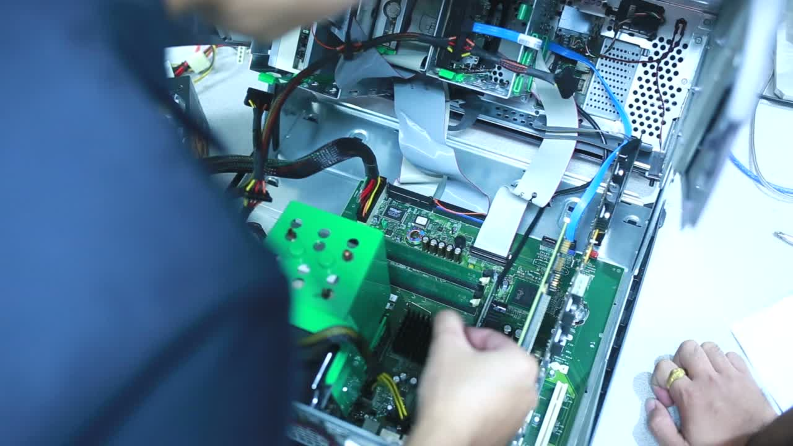
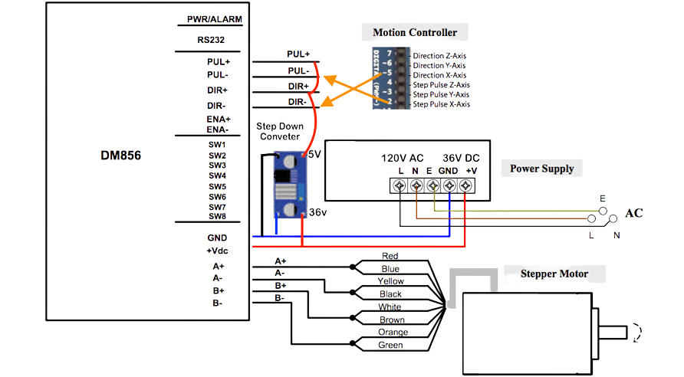
ELECTRICAL &
CONTROL
DESIGN

Slide 26
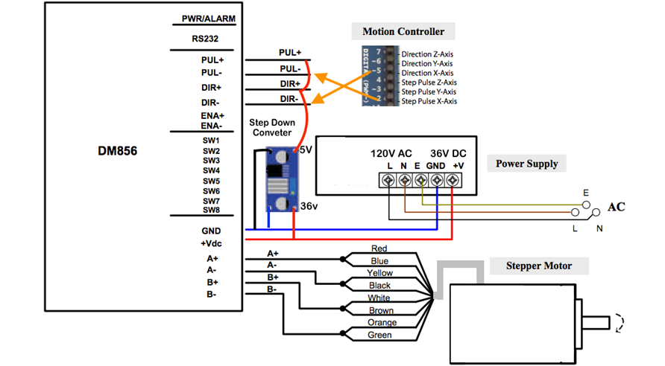
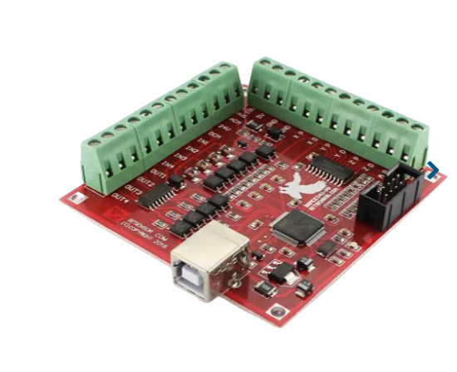
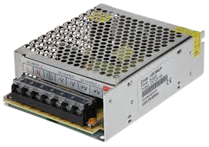
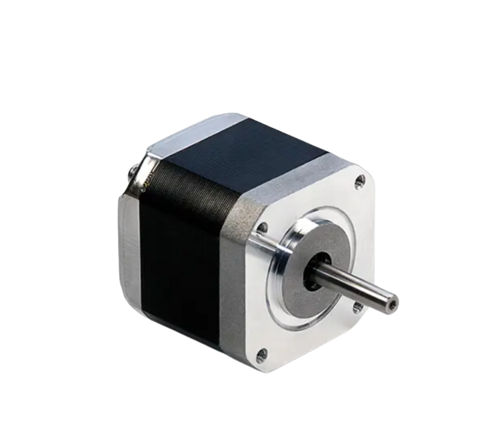
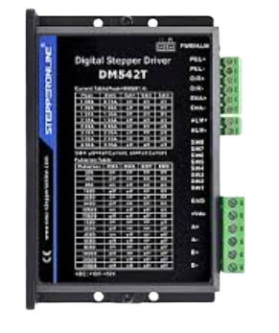
ELECTRONIC COMPONENT
Power Supply
Controller
Stepper Motor Driver
Stepper Motor

Slide 27
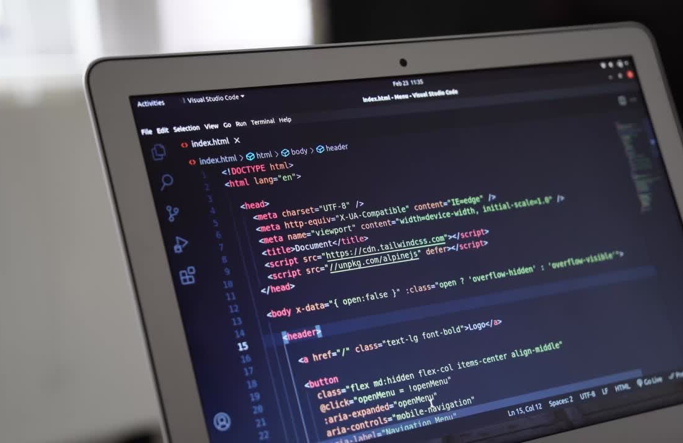
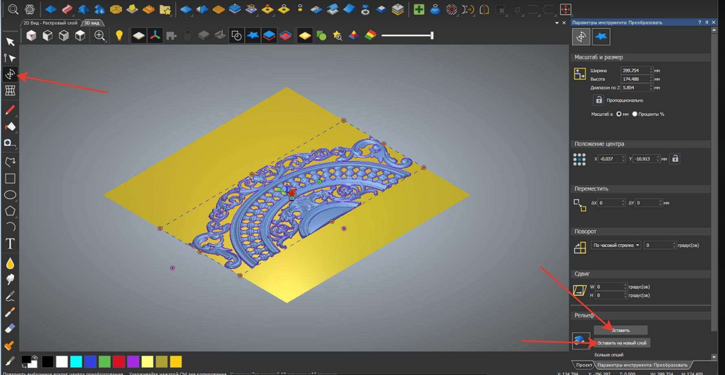


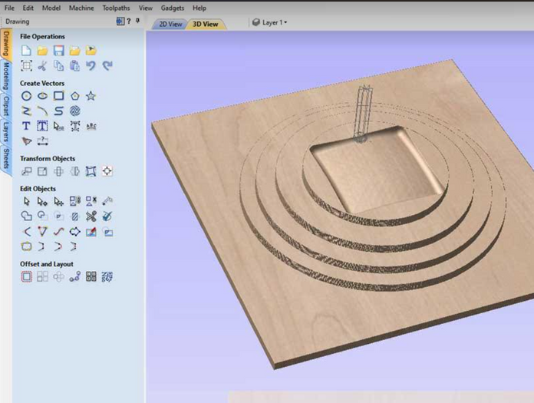
G CODE
G1 X1 Y1 Z1
Movement Order

Slide 28
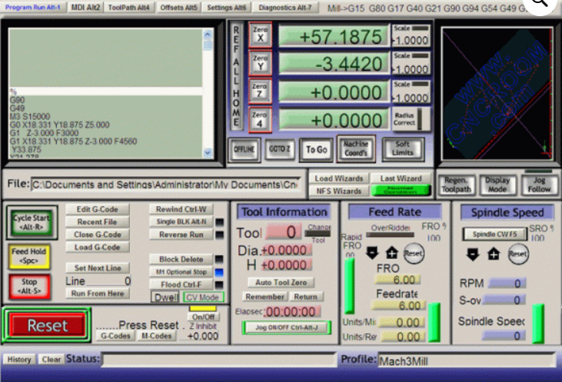

Slide 29
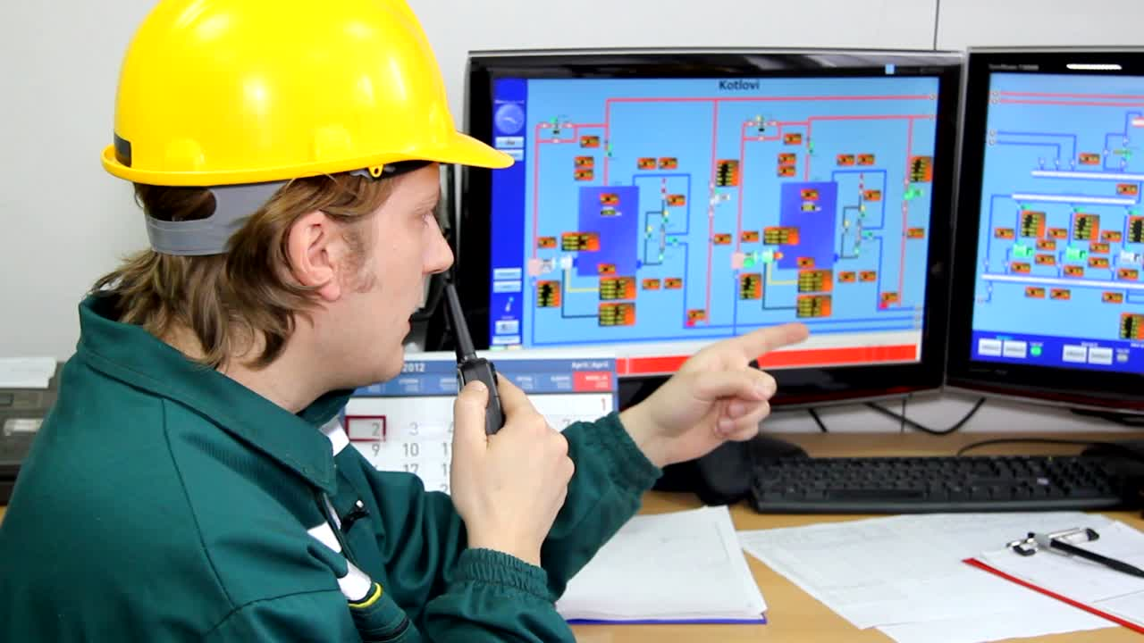
PUL(-,+)
A+
PC
DRIVER
CONTROLLER
DRIVER
A-
MOTOR
B+
DIR(-,+)
B-

Slide 30

PUL(-,+)
A+
PC
DRIVER
CONTROLLER
DRIVER
A-
MOTOR
B+
DIR(-,+)
B-

Slide 31
PUL(-,+)
A+
PC
DRIVER
CONTROLLER
DRIVER
A-
MOTOR
B+
DIR(-,+)
B-

Slide 32
A+
PUL(-,+)
PC
A-
DRIVER
CONTROLLER
DRIVER
MOTOR
B+
DIR(-,+)
B-

Slide 33
A+
PUL(-,+)
PC
A-
DRIVER
CONTROLLER
DRIVER
MOTOR
B+
DIR(-,+)
B-

Slide 34
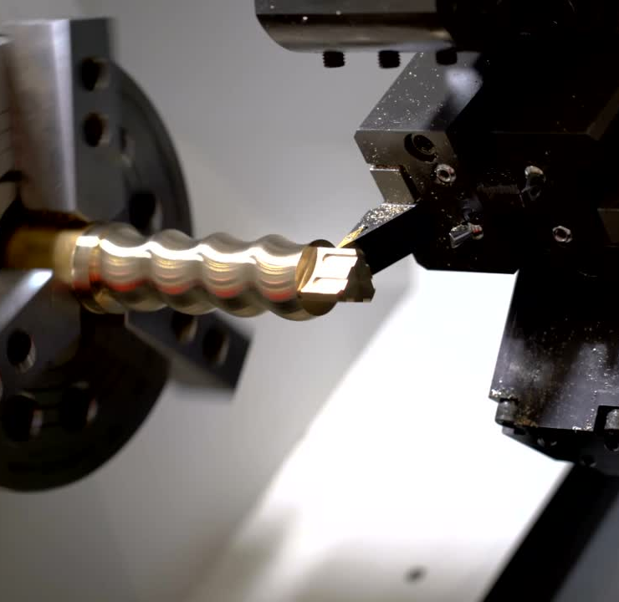
TESTING

Slide 35
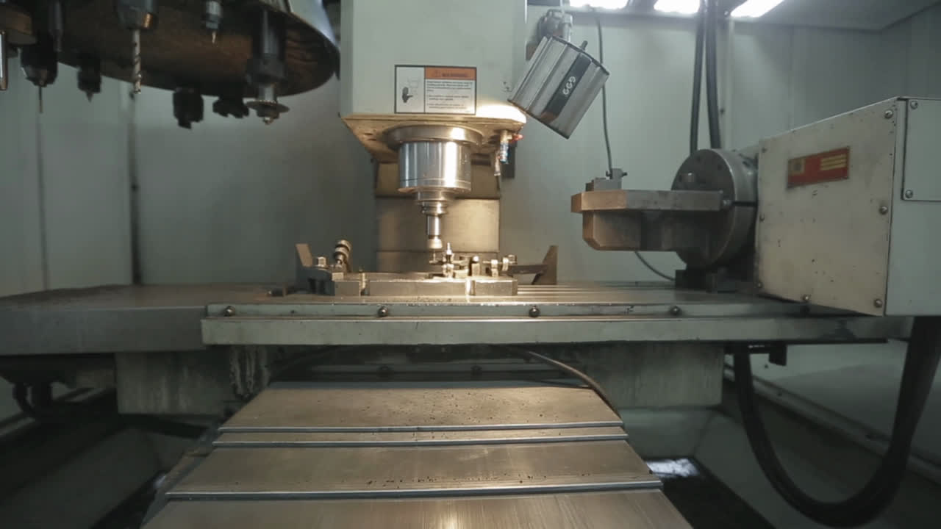
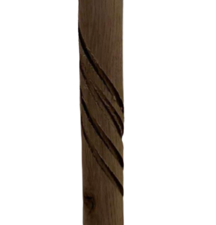
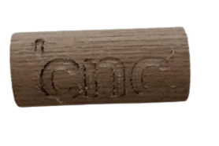
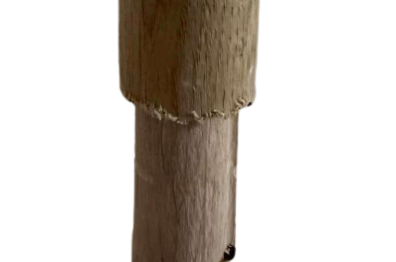
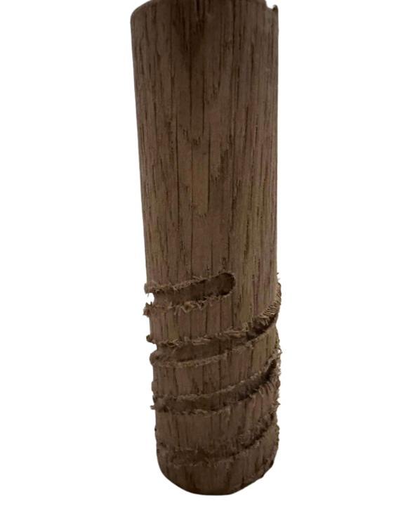
TESTING

Slide 36

Thank You.

