Slide 1
Solving Traffic Problems at the Vicinity of An-Najah National University New Campus
By:
Anan Shaher Joma
Mohammad Anan Jermi
Yacob Youssef Abu Hantash
Supervision: Prof. Sameer Abu - Eisheh

Slide 2
OUTLINE
Introduction
Methodology
Data Collection and Analysis
Evaluation of Alternatives
Evaluation of Alternatives
Design and Cost Estimate
Conclusions and Recommendations

Slide 3
Introduction
Project
( Study Area )
( New Campus )
Nablus
Roads and Intersections
Parking
Vehicles
Pedestrian

Slide 4
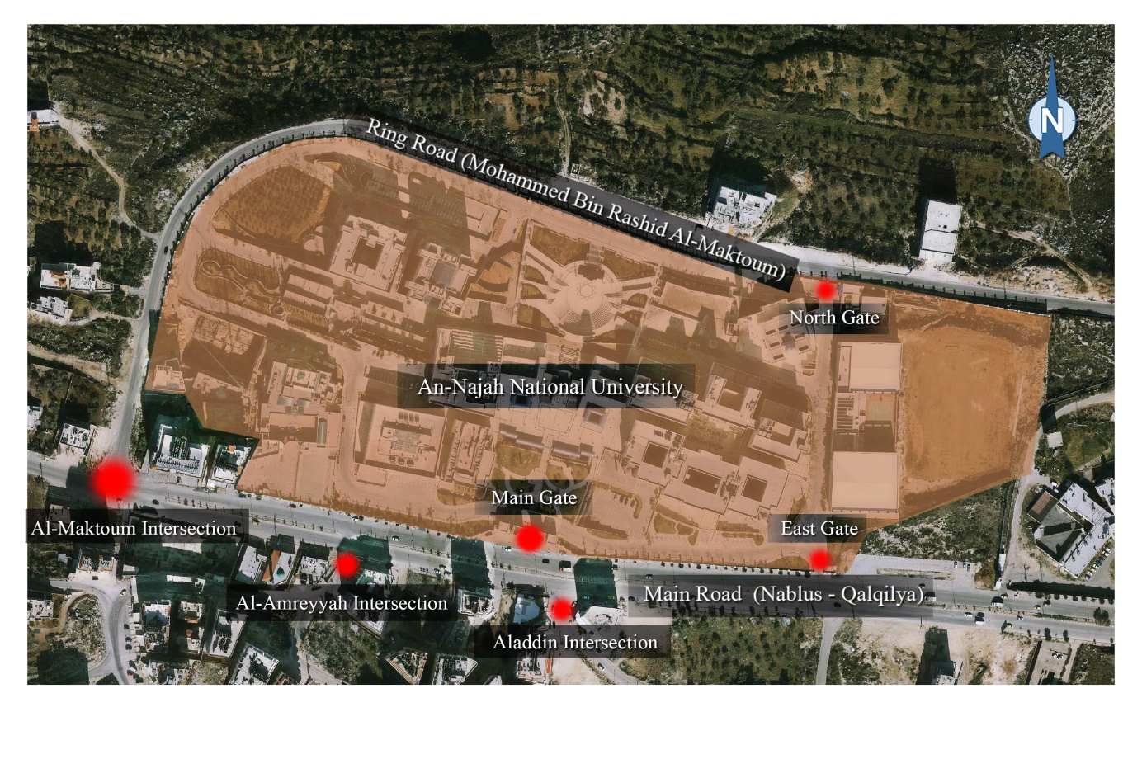
Study Area and Specific Existing Facilities of Interest

Slide 5

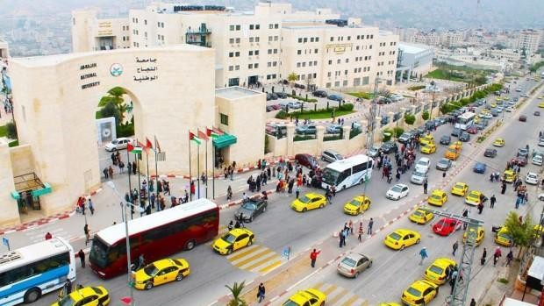
Problem Definition
Congestion on Nablus-Qalqilya Road

Slide 6

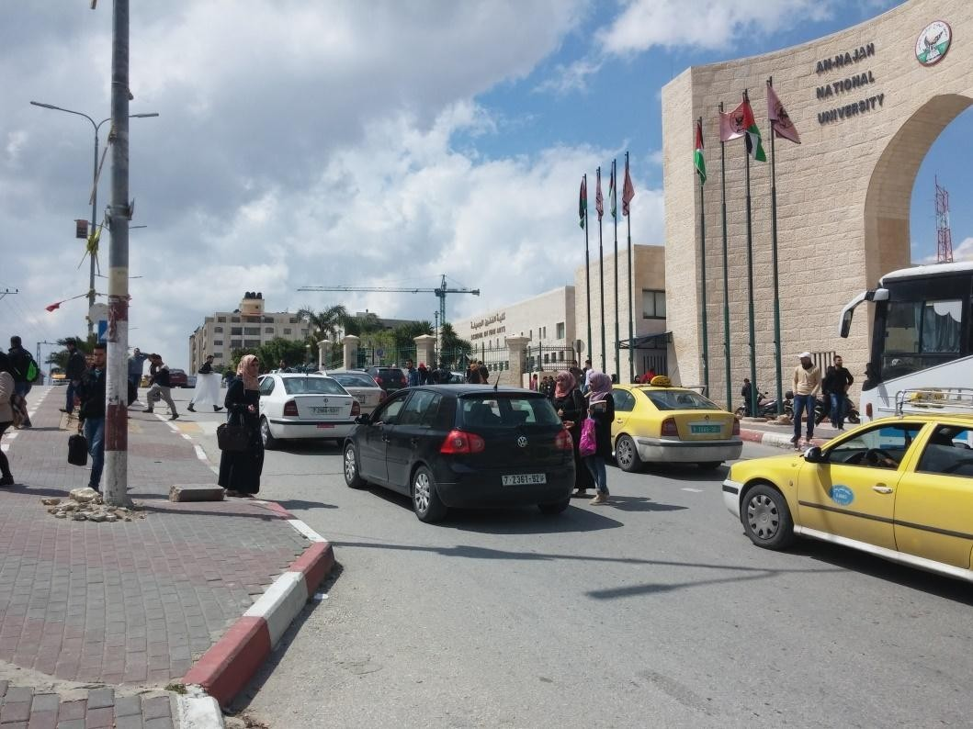
Problem Definition
Pedestrians Crossing between the Vehicles

Slide 7
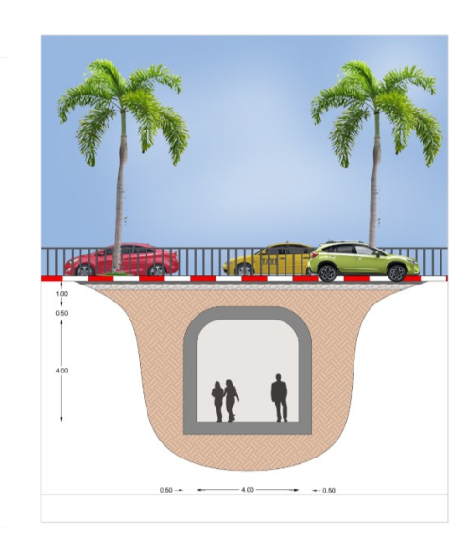
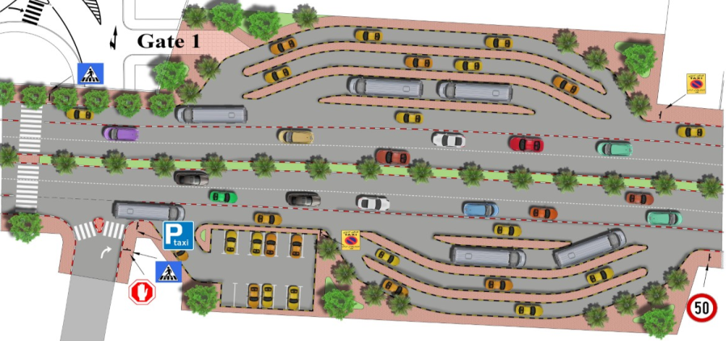
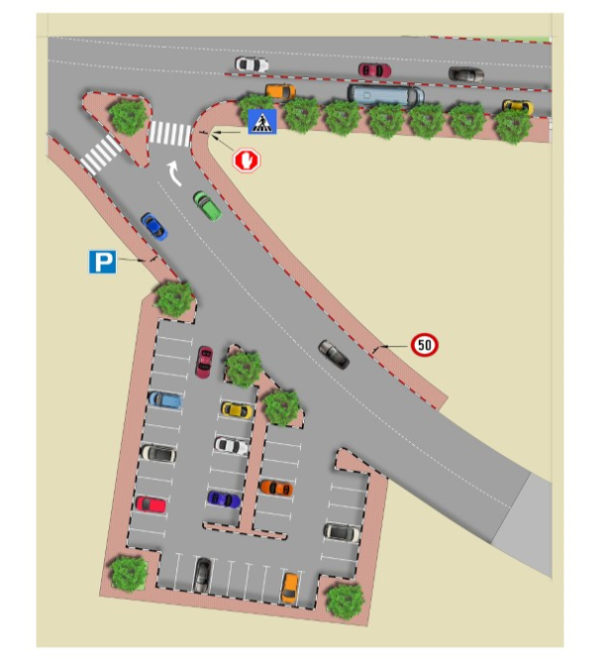
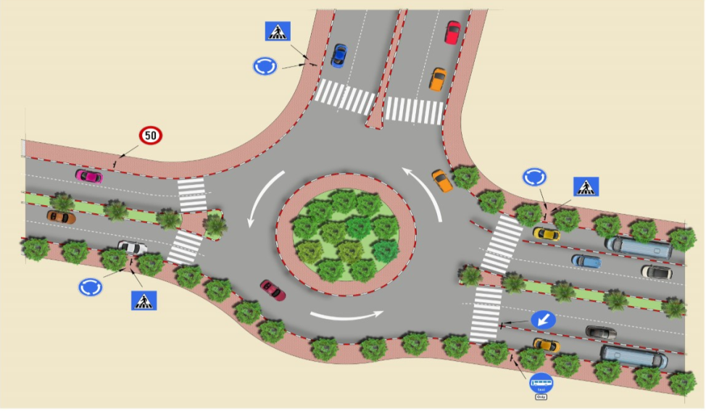
Objectives of the Study

Slide 8
Data Collection
Existing Data
Perform Additional Studies

Slide 9
Vehicles Counting
Data Collection for Nablus-Qalqilya Roadway (veh.)
 | Nablus Qalqilya (Eastbound) | Qalqilya Nablus (Westbound)
Total | 6943 | 6704

Slide 10
Entrances of New Campus
Counting of Cars Leaving and Entering the New Campus (veh.)
Location | Time | Counting of cars Leaving and Entering the New Campus
 |  | Entering | Leaving
East Gate | 7:15am-8:15am | 136 | 30
East Gate | 2:00pm-3:00pm | 36 | 95
North Gate | 7:15am-8:15am | 56 | 8
North Gate | 2:00pm-3:00pm | 9 | 31

Slide 11
Pedestrian Counting
Sidewalk Pedestrian in Peak Hour (ped.)
Location | 2:00pm to 3:00pm | 3:00pm to 4:00pm | Total
On Sidewalk (To West) | 40 | 51 | 597
On Street (To West) | 206 | 300
On Sidewalk (To East) | 52 | 63 | 665
On Street (To East) | 291 | 349
Crosswalk Pedestrian in Peak Hour (ped.)
Period | Direction of movement | Total Pedestrian per hour (flow rate) | Max 15 min interval volume | Peak 15 min
Sun. 7:15am-8:15am | Entering the campus | 2274 | 1220 | 7:30am – 7:45am
Sun. 2:00pm-3:00pm | Leaving the campus | 1778 | 849 | 2:45pm-3:00pm

Slide 12
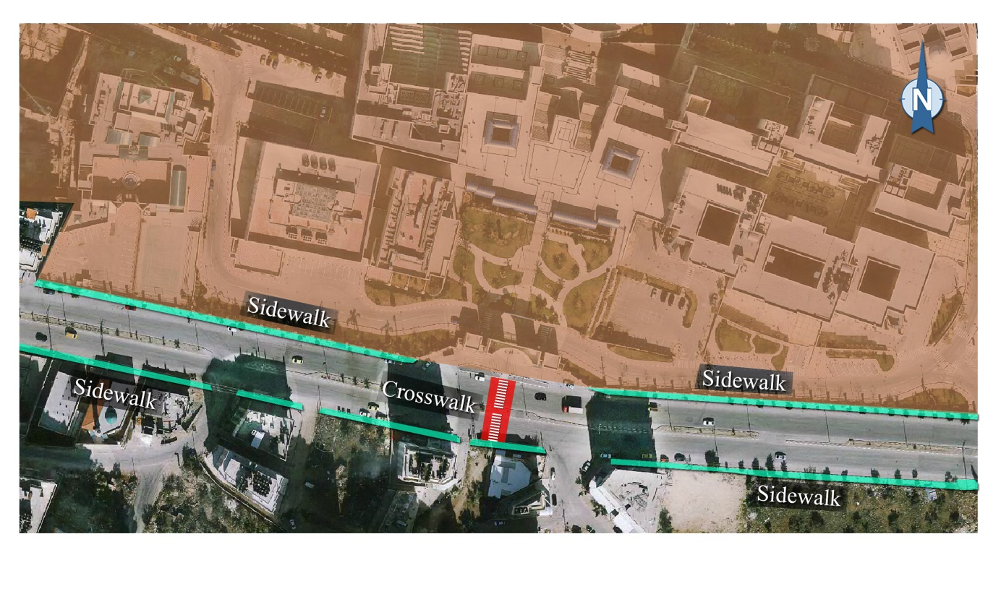
Sidewalks and Crosswalk front New Campus

Slide 13
Public Transportation
Data Collection for Public Transportation (veh.)
Time | Type | No. of Vehicles | Total No. of Passenger | Capacity (Passenger) | Coming From/To
7:15am-8:15am | Bus | 18 | 290 | 450 | Come from Nablus
2:00pm-3:00pm | Bus | 17 | 400 | 400 | Go to Nablus
7:15am-8:15am | Office Taxi | 331 | 1165 | 1324 | Come from Nablus
2:00pm-3:00pm | Office Taxi | 111 | 391 | 444 | Go to Nablus
7:15am-8:15am | Shared Taxi | 268 | 1072 | 1072 | Come from Nablus
2:00pm-3:00pm | Shared Taxi | 261 | 1044 | 1044 | Go to Nablus

Slide 14
Parking Study
Accumulation Curve for Al-Maktoum Parking

Slide 15
Data Analysis
Peak Hour
Peak Volume
Peak Hour Factor
Supply
Demand
LOS
Delay
Frequency
Efficiency

Slide 16
Intersections
PH, PHV & PHF for Al-Amryia Intersection
PH | PHV | PHF
7:15am - 8:15am | 1768 | 0.72
LOS for Al-Amryia Intersection from Vehicles Only
Delay, Queue and level of service
Approach | EB | WB |  | NB
Lane configuration | - | L + U | T | L | R
V(vph) | - | 518 | 499 | 33 | 33
C(vph) | - | 811 | - | 54 | 470
HCM Lane v/c ratio | - | 0.639 | - | 0.736 | 0.246
HCM 95% queue length | - | 4.7 | - | 3.1 | 1
HCM Control delay (sec) | - | 16.941 | - | 172.2 | 15.1
LOS | - | C | - | F | C
Approach delay(sec) | - | 7.4 | - | - | 55.2
Approach LOS | - | C |  | F
Intersection LOS | F

Slide 17
Pedestrian Sidewalk Analysis
LOS for Pedestrian Sidewalk
Direction | To the University
15 min peak (v) | 339
Total width (m) | 2.5
Tree (m) | 1.3
Wall face(m) | 0.5
Effective width (m) | 0.7
(P /min / m) | 32.3
LOS (average condition) | D
LOS (platoon condition) | F

Slide 18
Public Transportation Analysis
Analysis of Shared Taxis
Direction | Average Headway (min) | Frequency (taxi /hr) | Efficiency (ὰ)
to Nablus center | 0.22 | 268 | 1.00

Slide 19
Parking Analysis
Location | Turnover (veh / space) | Demand (space.hr) | Supply (space.hr) | Demand / Supply
Al-Jneid Parking | 1.33 | 214 | 270 | 0.79
Al-Maktoom Parking | 0.98 | 302 | 540 | 0.56
Nablus- Qalqilya Parking | 1.57 | 590 | 756 | 0.78
Alaa-Aldean Parking | 0.76 | 54 | 270 | 0.20
Weighted average | 1.24 | 372 | 550 | 0.63

Slide 20
Growth Rate
6689 veh
6444 veh
2015
2014
Time
Count (veh)

Slide 21
EVALUATION OF ALTERNATIVES
Short Term Solution
Long Term Solution
Three Alternatives
Three Alternatives
Tunnel
Multi Storey
New Street

Slide 22
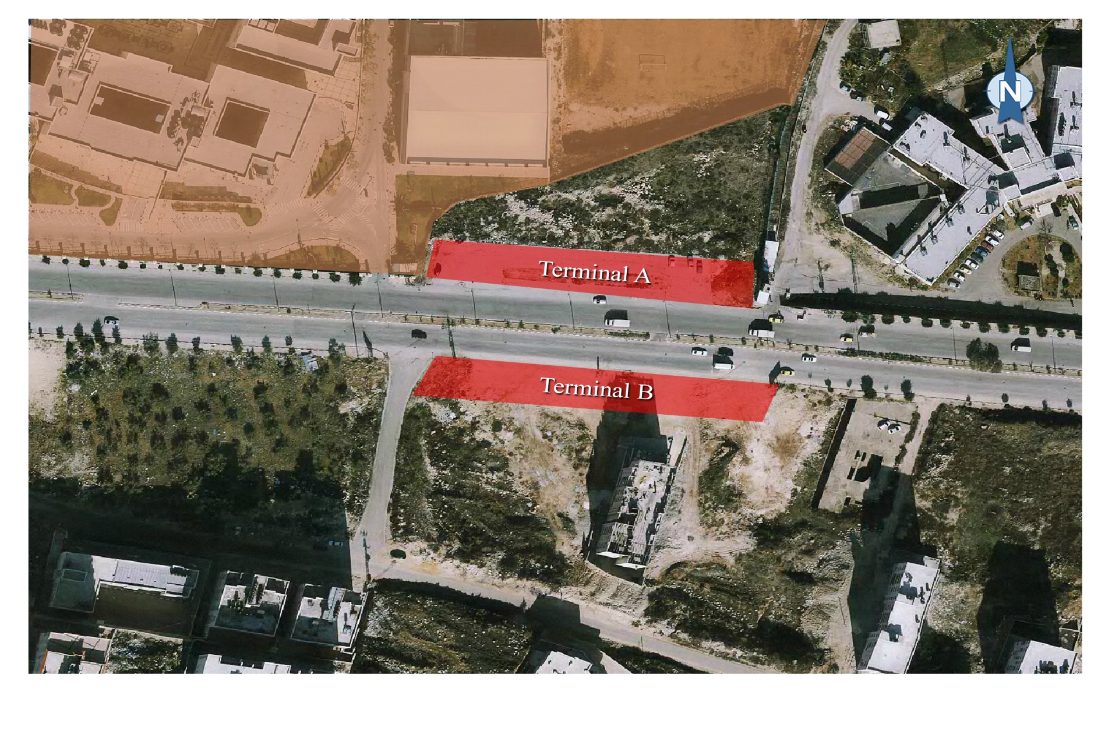
First Alternative

Slide 23
Strengths And Weaknesses Analyses
Strengths
Weaknesses
Enhance the LOS
Less potential of accident
Better traffic circulation
Reducing of the delay
Unexpected behavior of private car drivers toward probable use of the faster public transportation lane.
Congestion at terminal A because it should handle the download and the upload of the students.

Slide 24
Al-Amryia intersection LOS(Before)
LOS for Al-Amryia Intersection from Vehicles Only
Delay, Queue and level of service
Approach | EB | WB |  | NB
Lane configuration | - | L + U | T | L | R
V(vph) | - | 518 | 499 | 33 | 33
C(vph) | - | 811 | - | 54 | 470
HCM Lane v/c ratio | - | 0.639 | - | 0.736 | 0.246
HCM 95% queue length | - | 4.7 | - | 3.1 | 1
HCM Control delay (sec) | - | 16.941 | - | 172.2 | 15.1
LOS | - | C | - | F | C
Approach delay(sec) | - | 7.4 | - | - | 55.2
Approach LOS | - | C |  | F
Intersection LOS | F

Slide 25
Applying the first alternative
Al-Amryia Intersection LOS for the First Alternative with the Current Volume
Delay, Queue and level of service
Approach | EB |  | WB | NB
Lane configuration | T | R | T | R
V(vph) | 1179 | 150 | 1290 | 136
C(vph) | - | - | - | 325
HCM Lane v/c ratio | - | - | - | 0.42
HCM 95% queue length | 0 | 0 | 0 | 16.2
HCM Control delay (sec) | 0 | 0 | 0 | 24
LOS | - | - | - | C
Approach delay(sec) | 0 | 0 | 0 | 24
Approach LOS | - | - | - | C
Intersection LOS | C

Slide 26
First Alternative after Five Years
Al-Amryia Intersection LOS for the New Situation after Five Years
Approach | EB |  | WB | NB
Lane configuration | T | R | T | R
V(vph) | 1438 | 183 | 1574 | 166
C(vph) | - | - | - | 325
HCM Lane v/c ratio | - | - | - | 0.51
HCM 95% queue length | 0 | 0 | 0 | 1.5
HCM Control delay (sec) | 0 | 0 | 0 | 30.7
LOS | - | - | - | D
Approach delay(sec) | 0 | 0 | 0 | 30.7
Approach LOS | - | - | - | D
Intersection LOS | D

Slide 27
For the Pedestrian(Before and After)
LOS for Pedestrian before
Direction | NB & SB
PH | 7:15am-8:15am
PHV | 1342
Avg. Pedestrian Speed (m/s ) | 1.25
Length (m) | 12
Width (m) | 4
LOS (platoon condition) | F
LOS for Pedestrian after
Direction | SB & NB
PH | 7:15am - 8:15am
PHV | 1000
Avg. Pedestrian Speed (m/s ) | 1.25
Length (m) | 13
Width (m) | 4
LOS (platoon condition) | D

Slide 28
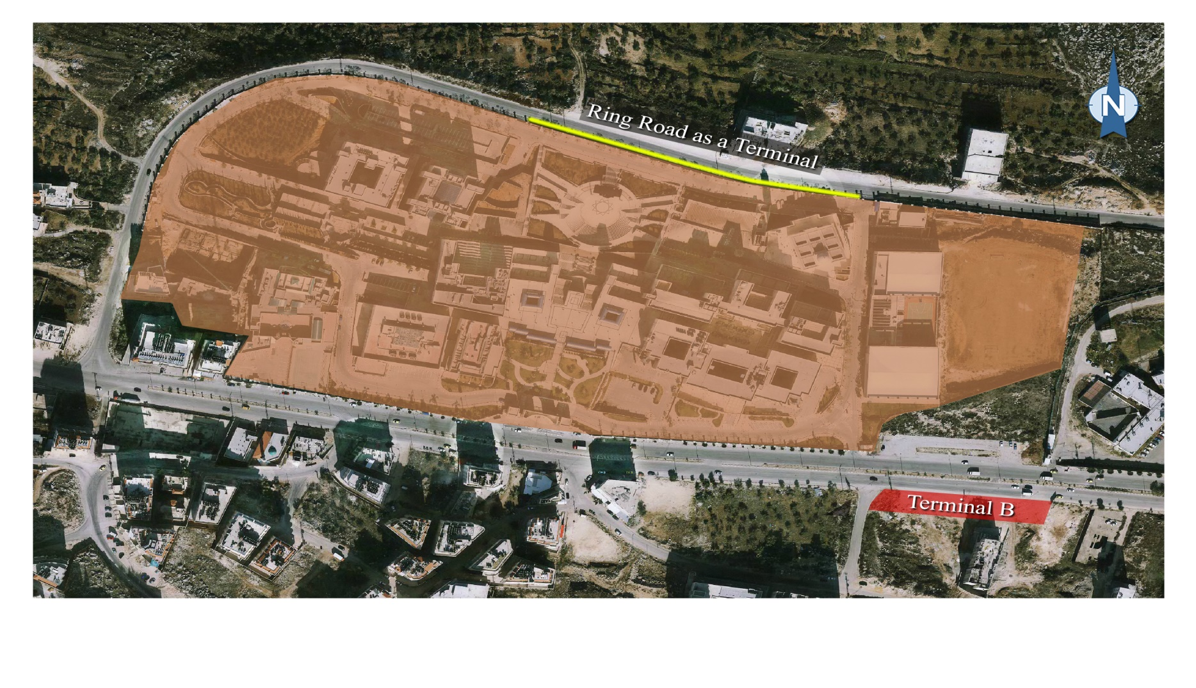
Second Alternative

Slide 29
Strengths And Weaknesses Analyses
Strengths
Weaknesses
Enhance the LOS
Less potential of accident
Better traffic circulation
Reducing of the del ay
Its easer for the student to use the north gate
congestion in the north gate; because there is not enough space to upload and download the passengers in addition to some parking problems

Slide 30
Third Alternative
Download The Passengers From The New Terminal A And The Upload From The Ring Road:

Slide 31
Strengths And Weaknesses Analyses
Strengths
Weaknesses
Enhance the LOS
Less potential of accident
Better traffic circulation
Reducing of the del ay
Its easer for the student to use the north gate
May have parking problem

Slide 32
Long-Term Solution
Tunnel for
Pedestrian
Multi Storey Building for parking
Proposed a New Street

Slide 33
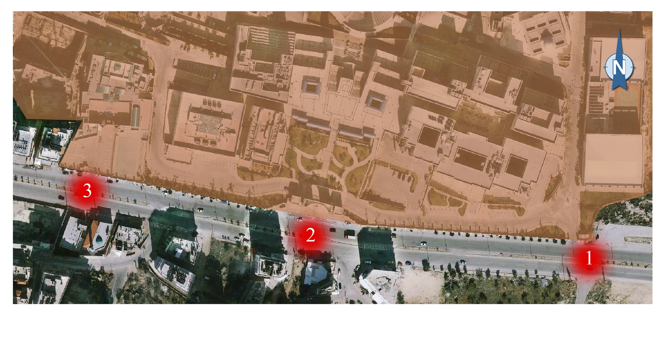
Tunnel for Pedestrian

Slide 34
Benefits of this project
Delay, Queue and level of service
Approach | EB |  | WB | NB
Lane configuration | T | R | T | R
V(vph) | 1438 | 183 | 1574 | 166
C(vph) | - | - | - | 750
HCM Lane v/c ratio | - | - | - | 0.22
HCM 95% queue length | 0 | 0 | 0 | 6.5
HCM Control delay (sec) | 0 | 0 | 0 | 17.3
LOS | - | - | - | C
Approach delay(sec) | 0 | 0 | 0 | 17.3
Approach LOS | - | - | - | C
Intersection LOS | C
Reduction of the number of accidents between vehicles and pedestrians
Increase of the LOS for the highway

Slide 35
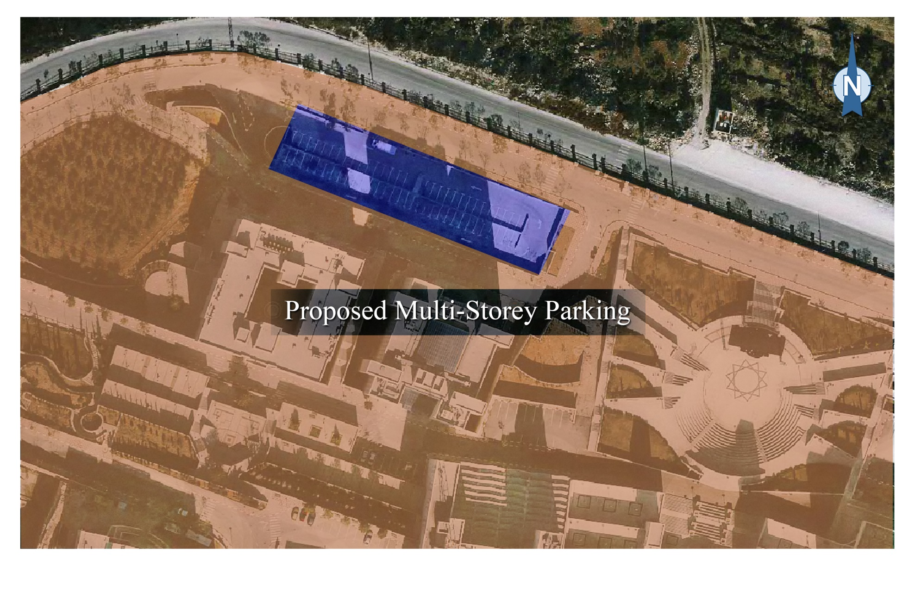
Multi Storey Building for Parking

Slide 36
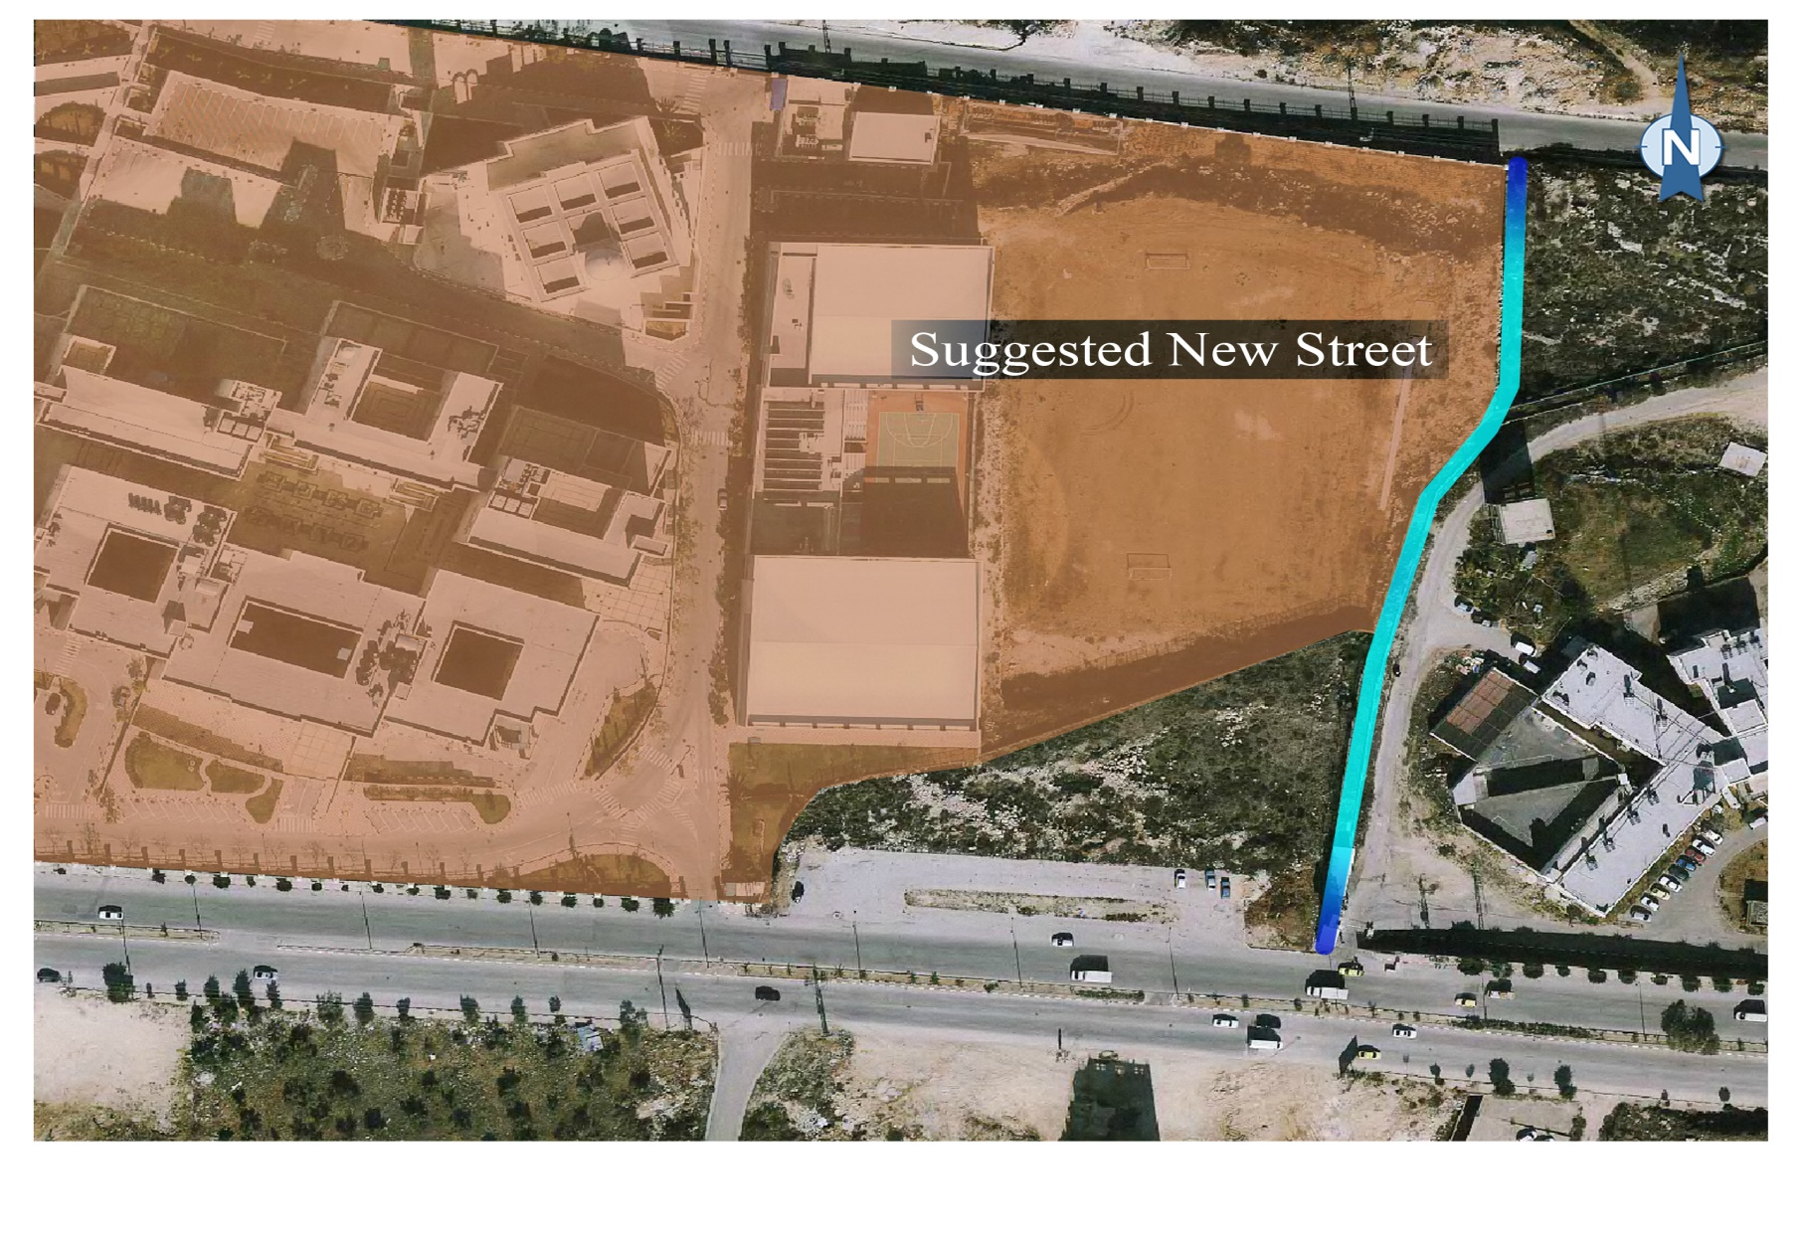
Proposed a New Street

Slide 37
Design of Selected Alternative
Short Term Solution
Long Term Solution
Terminals
Roads
Tunnel
Multi Storey
New Street
Parking
Entrance
Roundabout

Slide 38
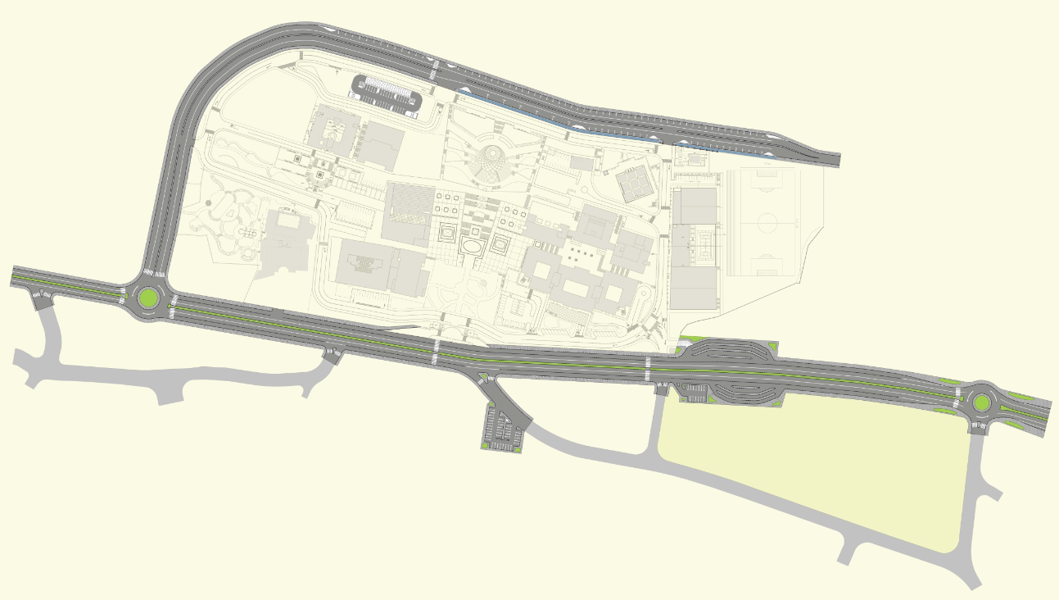

Slide 39
Terminals
Design the Public Space Between the University and Al-Juneid Prison (Terminal A and B)
Design the Terminal on the Ring Road

Slide 40
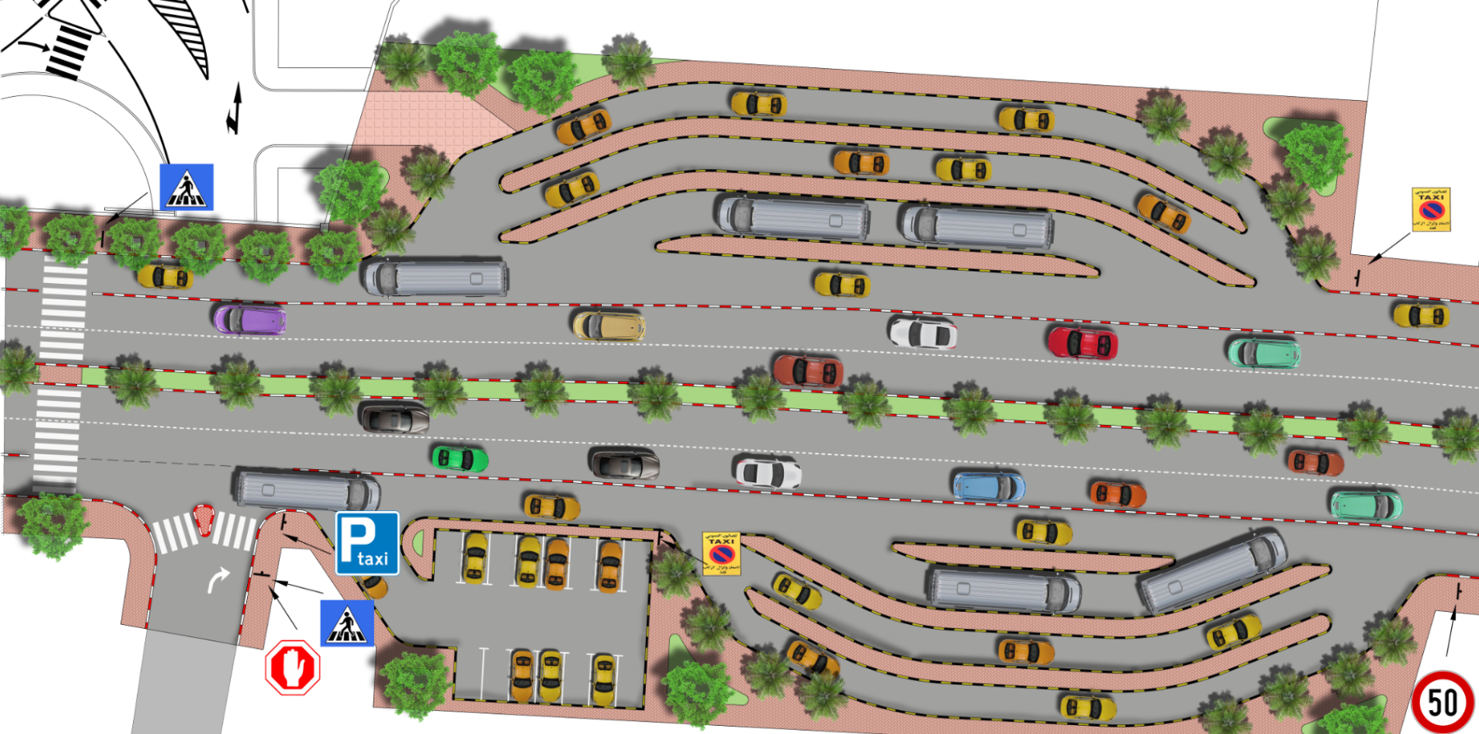
Terminals ( A and B )

Slide 41
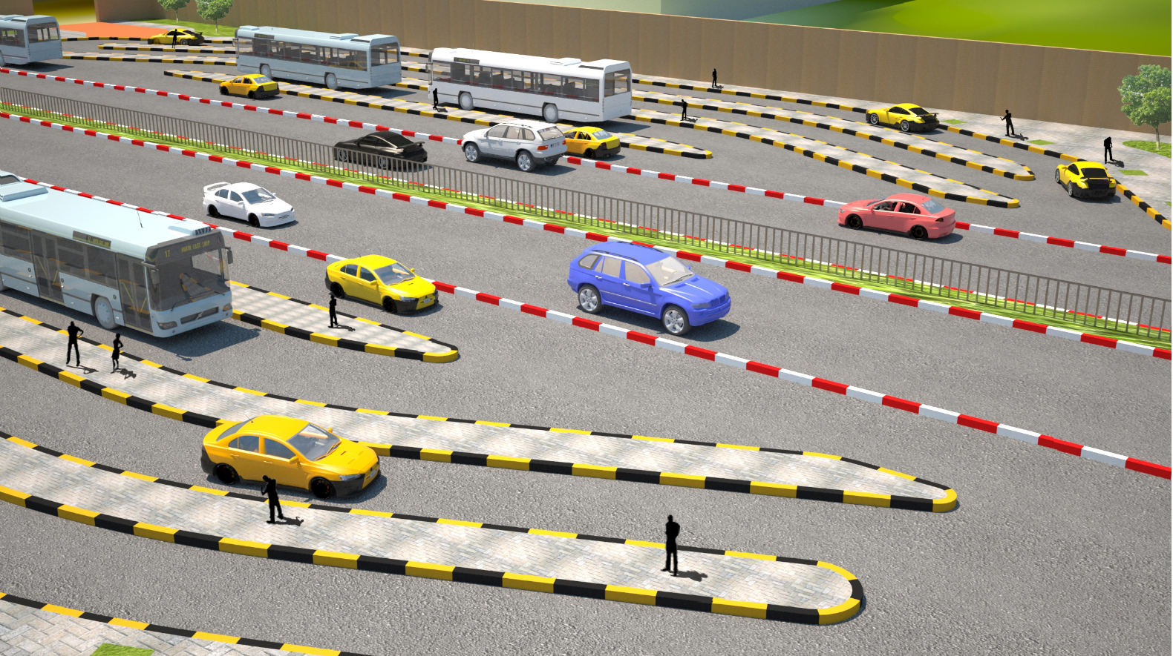

Slide 42
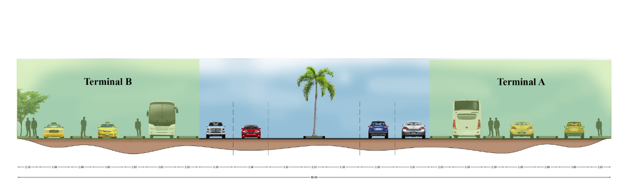
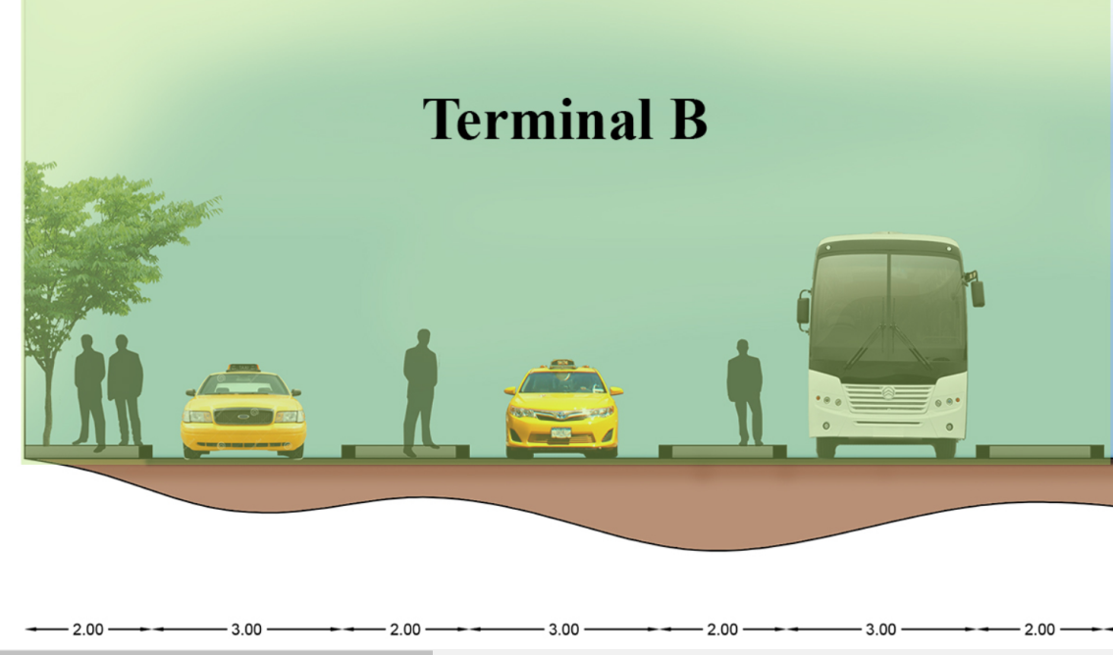
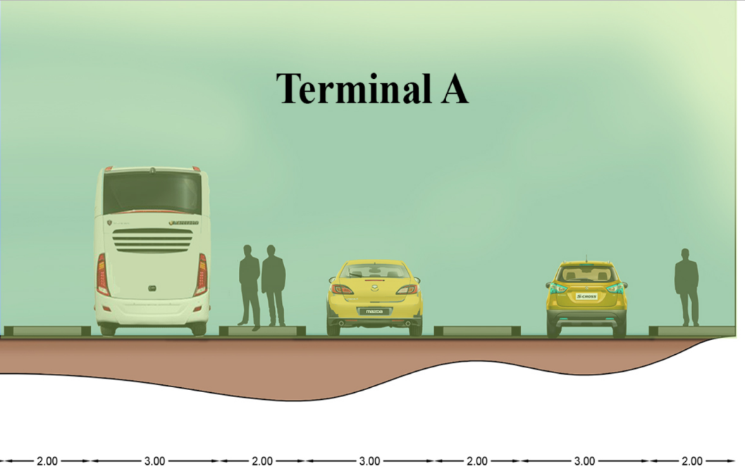

Slide 43
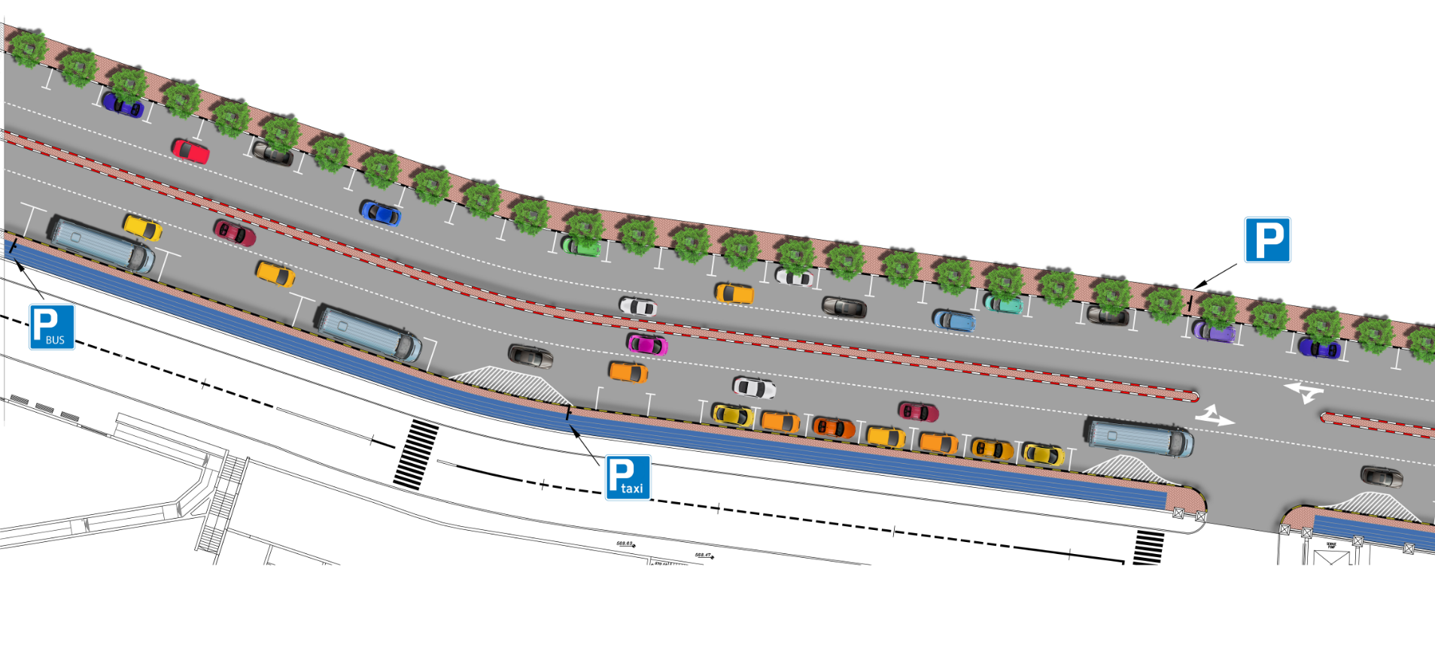
Terminals ( Ring Road )

Slide 44
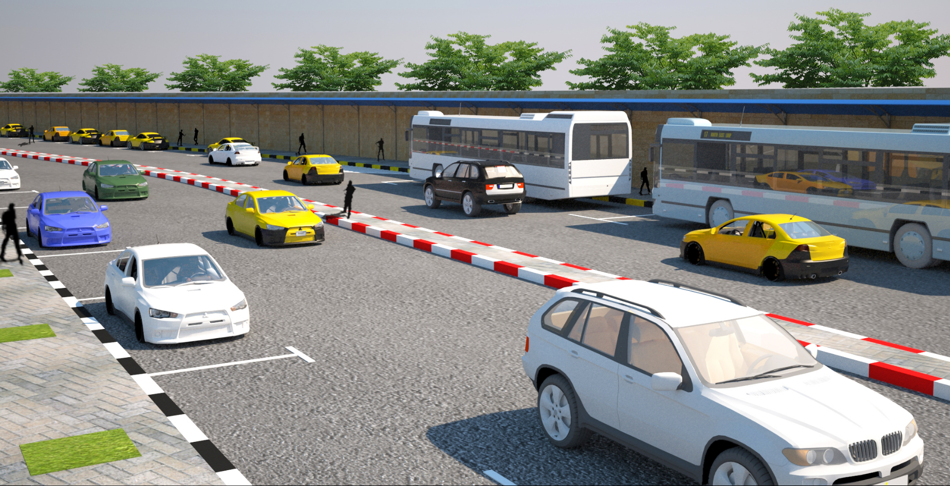

Slide 45
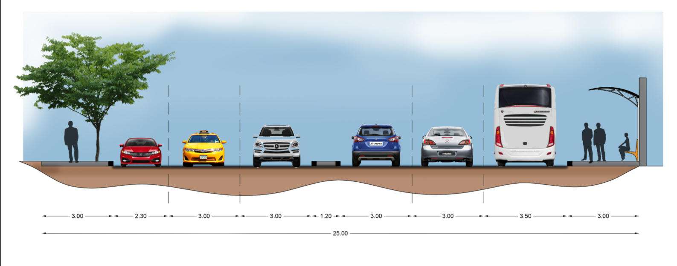

Slide 46
Roads
Nablus-Qalqilya Roadway
Mohammad Bin-Rashid Al-Maktoum Ring Road

Slide 47
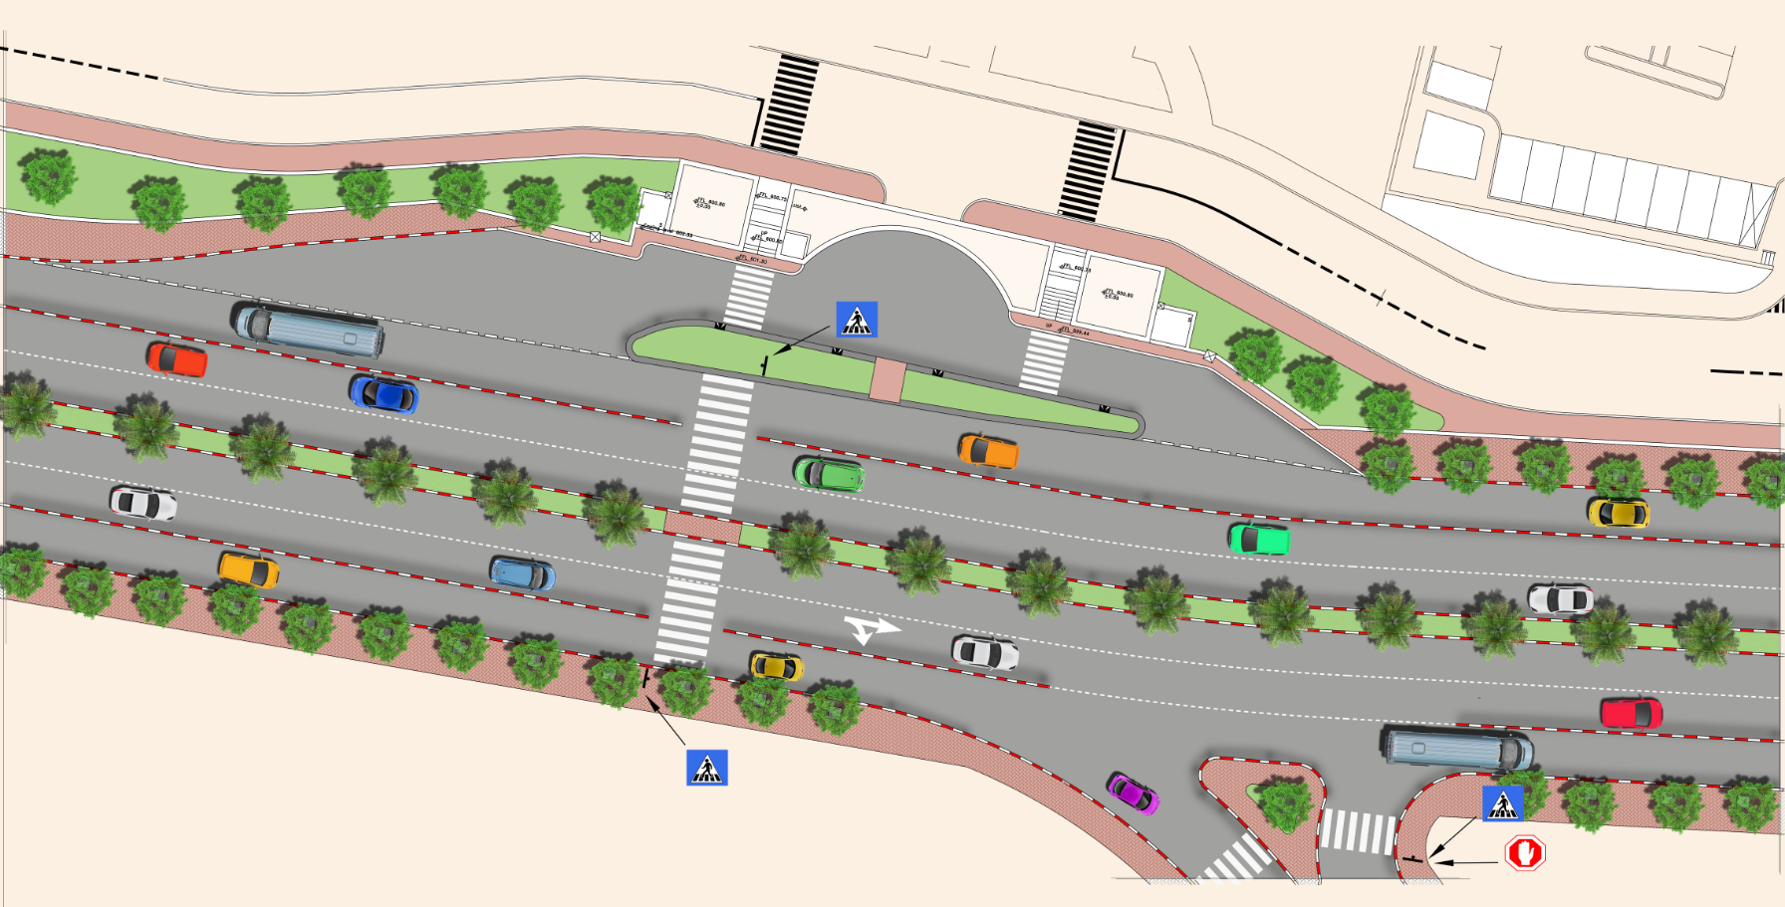
Nablus-Qalqilya Roadway

Slide 48
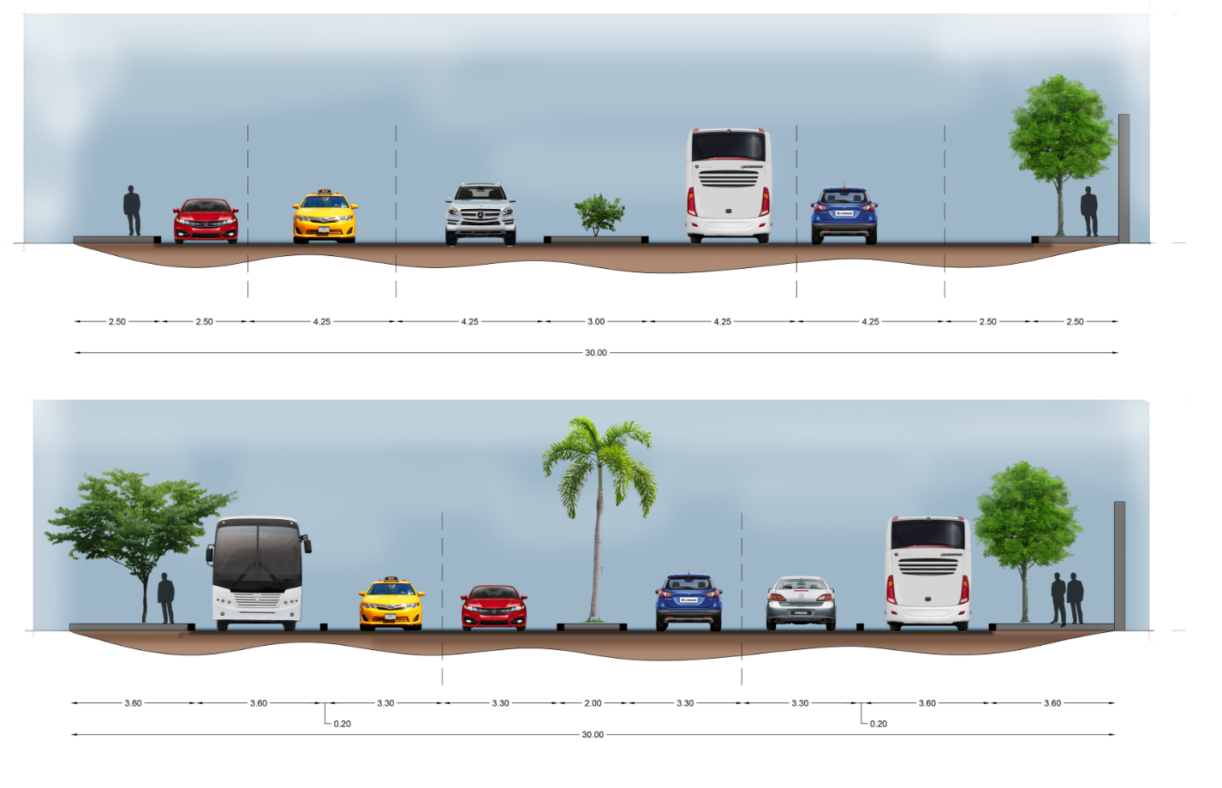

Slide 49
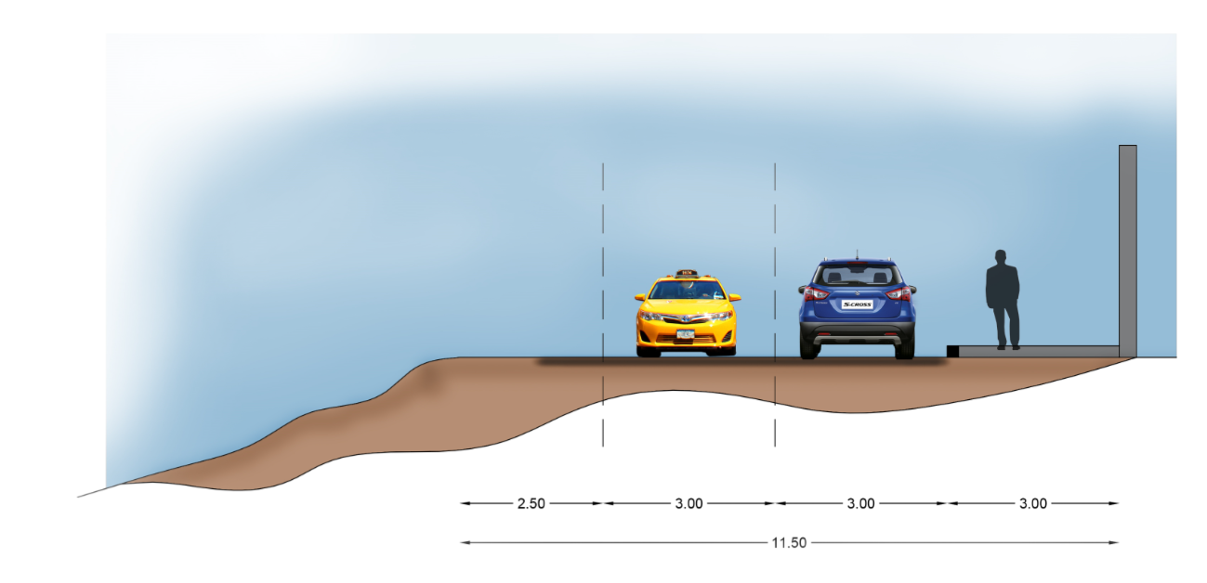
Mohammad Bin-Rashid Al-Maktoum Ring Road

Slide 50
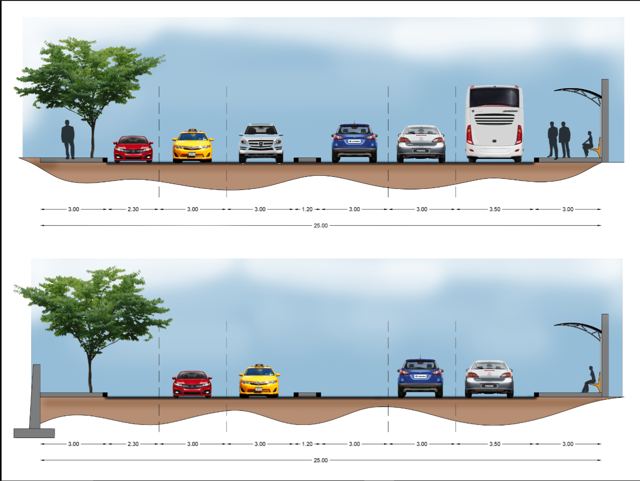

Slide 51
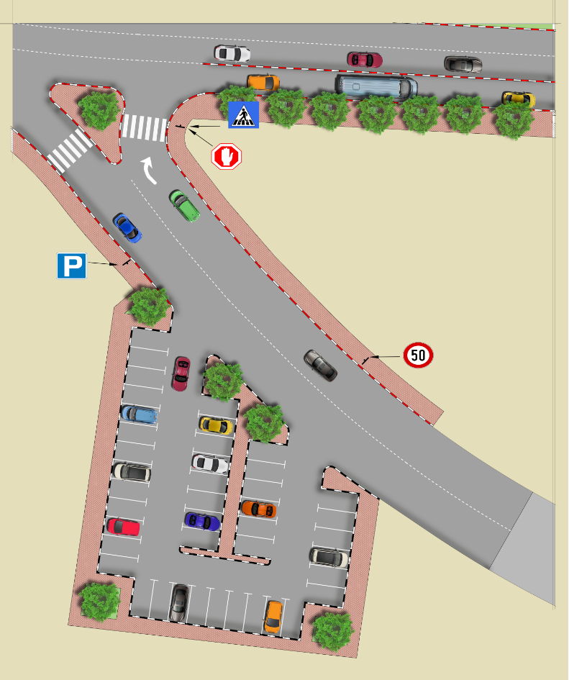
Parking

Slide 52
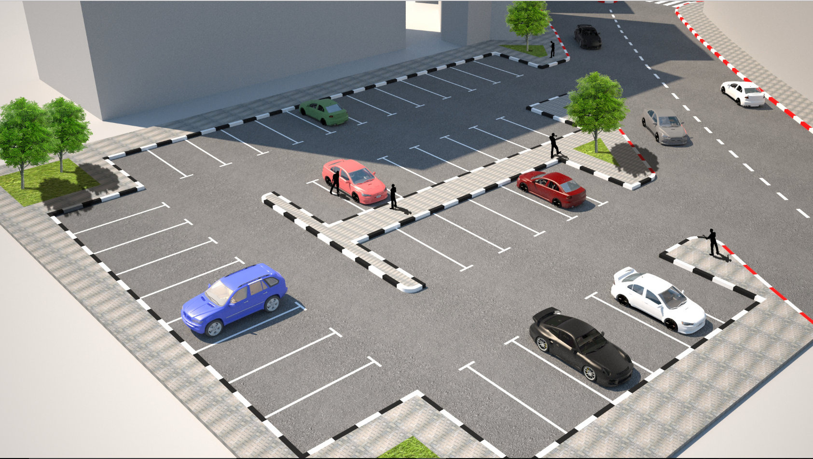

Slide 53
Location | Supply (space.hr)
Alaa-Aldean Parking | 357
Ring Road | 544

Slide 54
Roundabout
Al-Maktoum Roundabout
Al-Juneid Roundabout

Slide 55
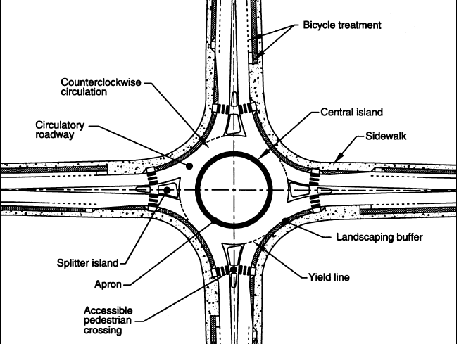
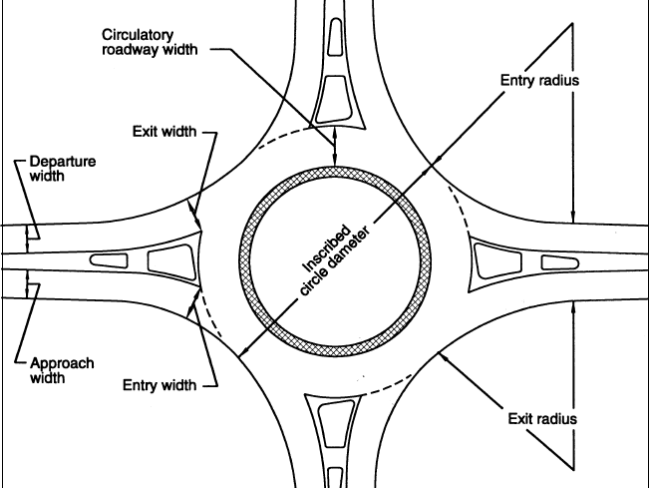

Slide 56
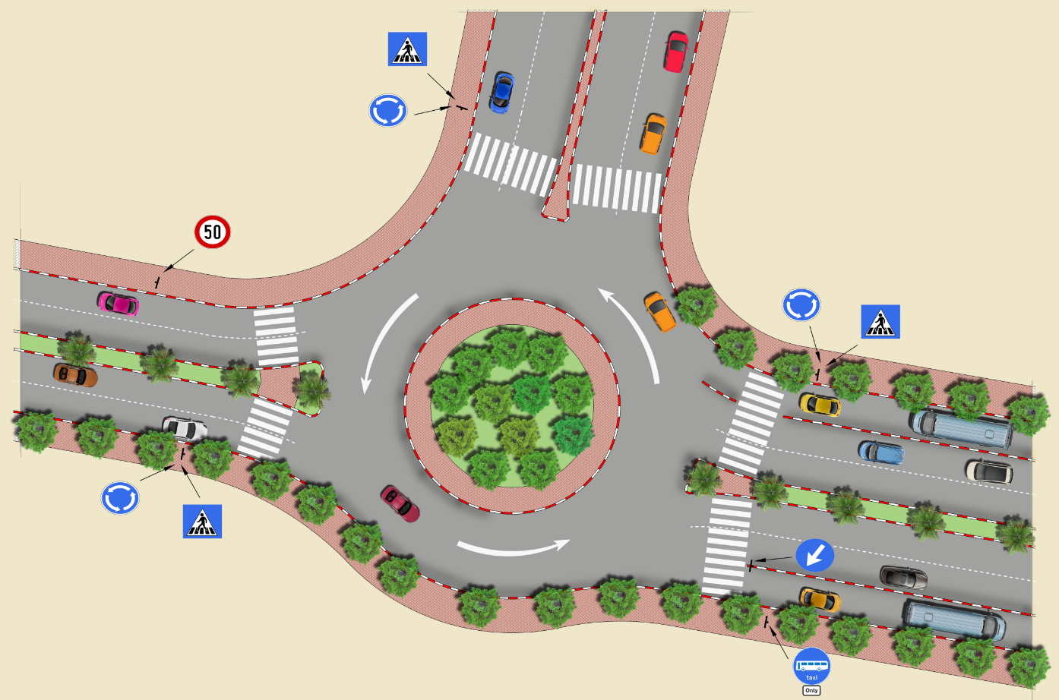
Al-Maktoum Roundabout

Slide 57
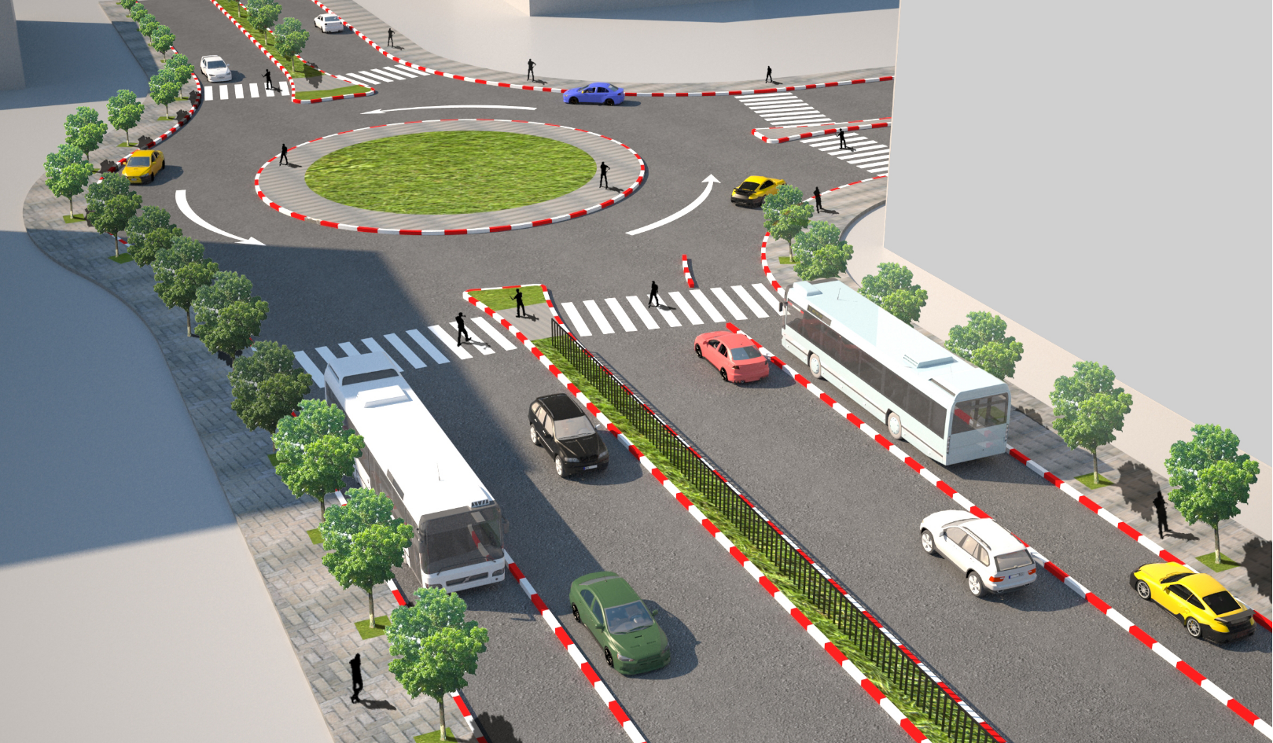

Slide 58
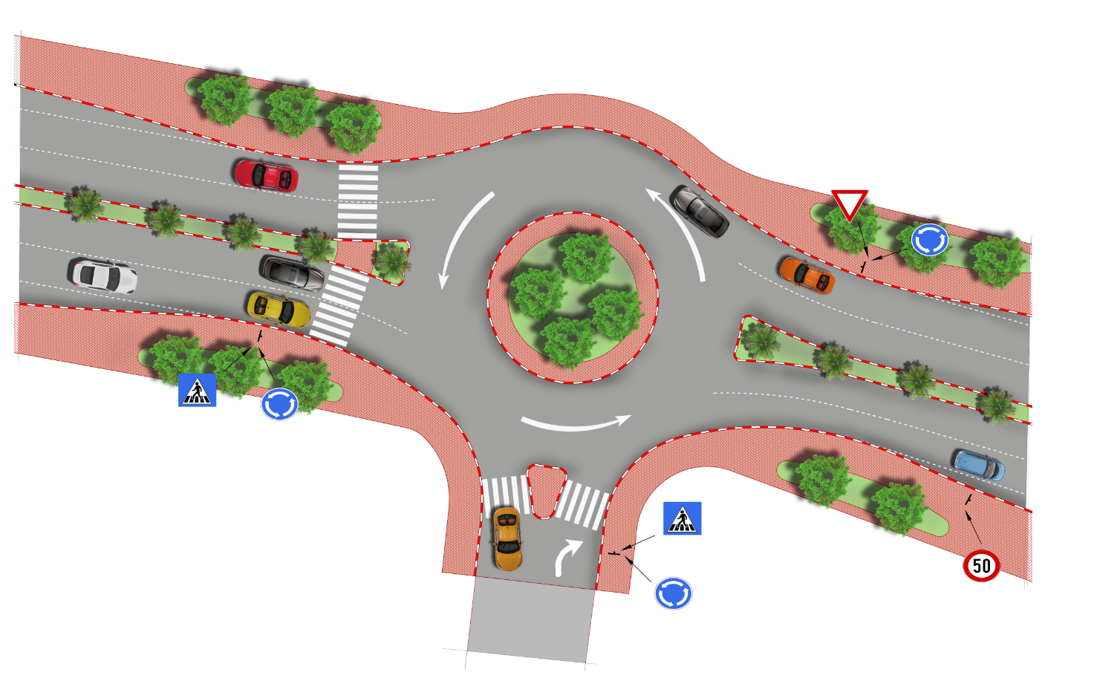
Al-Juneid Roundabout

Slide 59
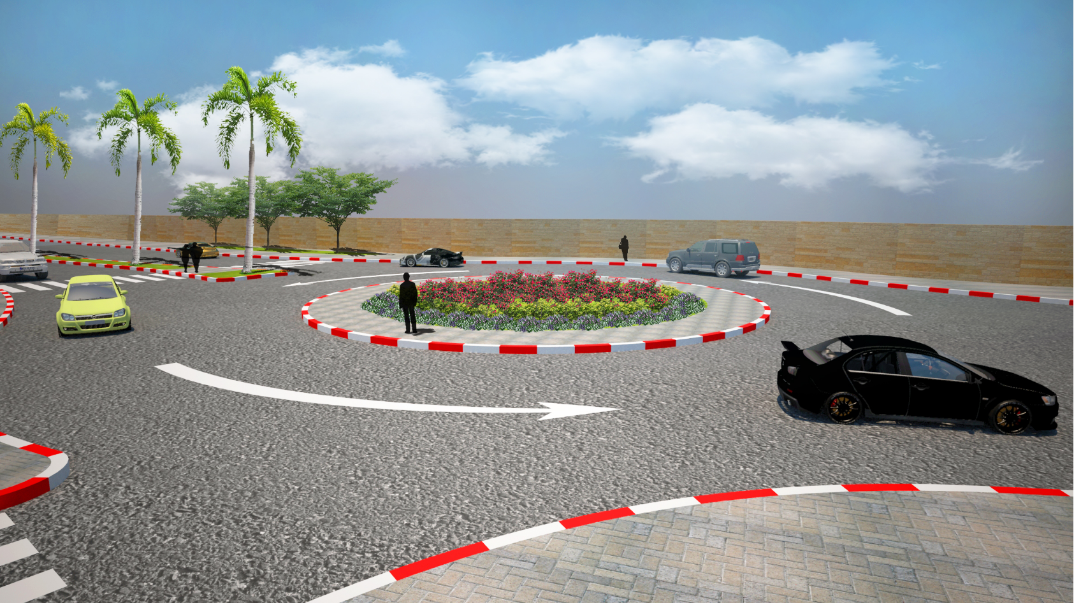

Slide 60
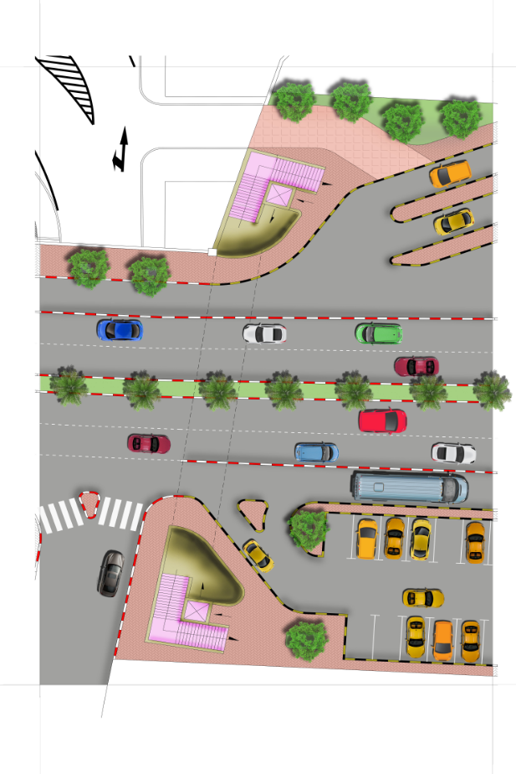
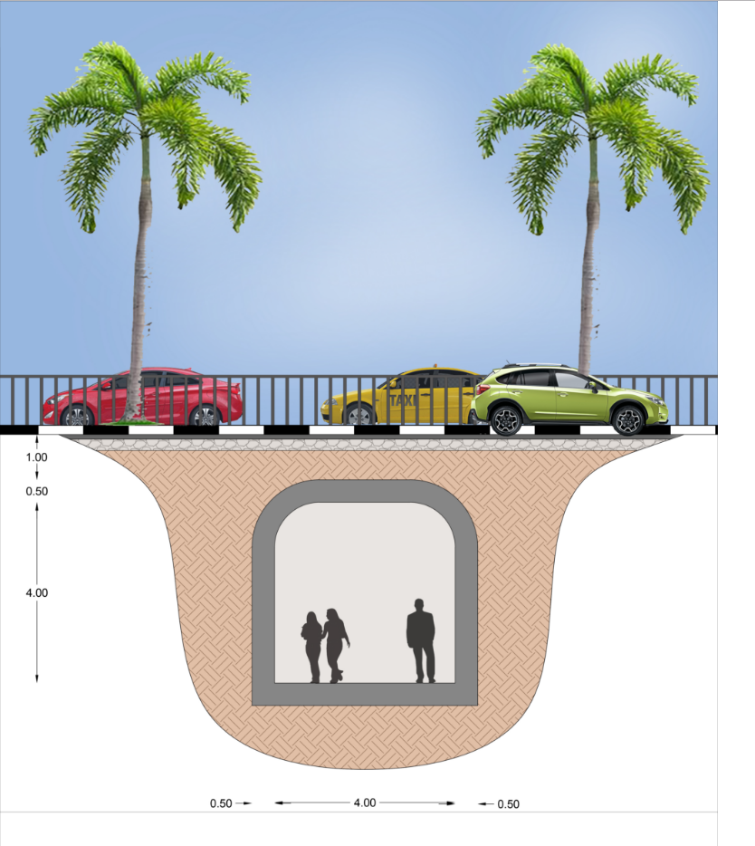
Design for Long Term Solution ( Tunnel )

Slide 61
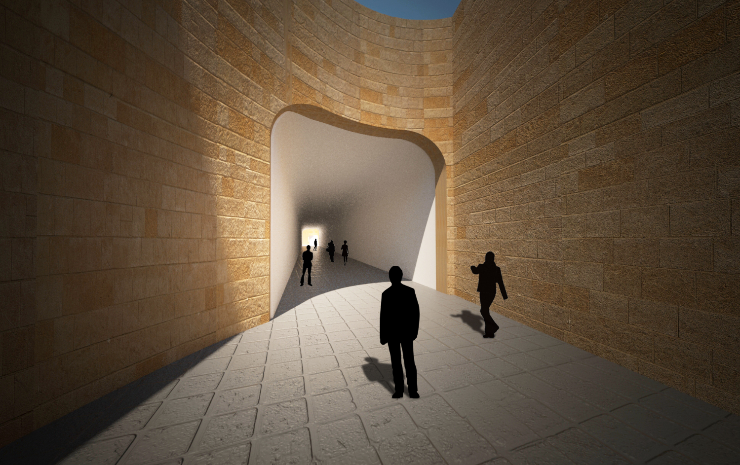

Slide 62
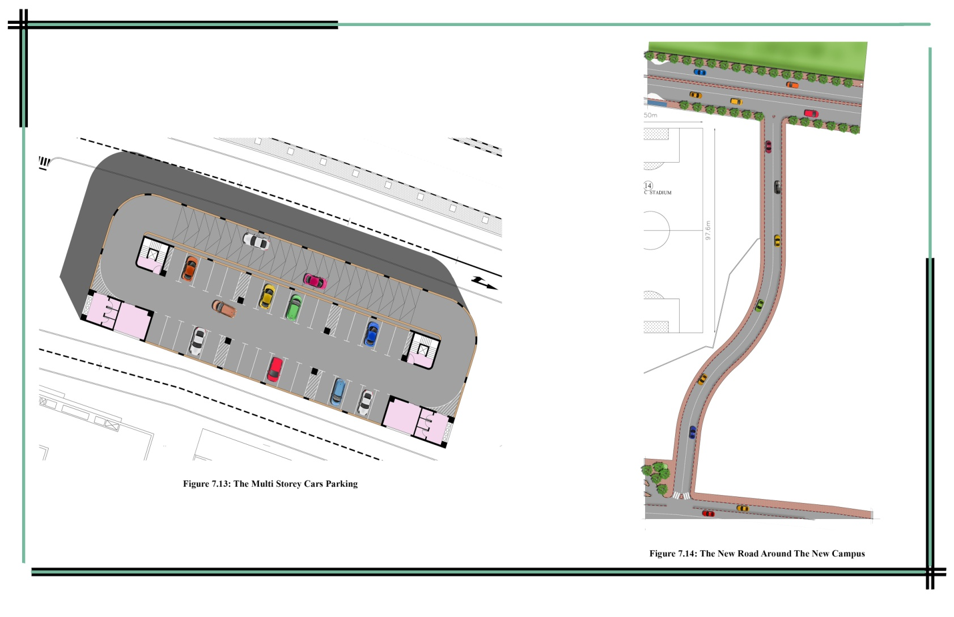
Multi storey Building for Parking & the New Street

Slide 63
Bill of Quantity
No | Item | Quantity | Unit | Unit cost $ | Total coast $
Short Term
1 | Reflective pavement marketing | 3000 | unit | 100 | 300000
2 | Curbstone | 8740 | m² | 25 | 218500
3 | Pedestrian fence | 2210 | m² | 25 | 55250
4 | Pavement | 7360 | m² | 22 | 161920
5 | Plain concrete | 165 | m² | 20 | 3300
6 | Marketing | 3 | Job | 500 | 1500
7 | Sign | 45 | Unit | 800 | 36000
8 | Table speed | 120 | m² | 18 | 2160
9 | Retaining wall | 200 | m | 1700 | 340000
Long Term
10 | New Street | 2400 | m² | 22 | 52800
11 | Tunnel | 300 | m² | 1450 | 435000
12 | Multi storey building for parking | 6000 | m² | 300 | 1800000

Slide 64
Bill of Quantity
Short Term Solution
Long Term Solution
1118630 $
2287800 $

Slide 65

Conclusions

Slide 66
Recommendations
It is recommended to make traffic studies for the ring road
Redesign of Alaa- Aldean parking
Build two pedestrian bridge
Provide an enforcement to organize traffic
Nablus municipality is encouraged to implement the project of constructing public transportation terminal
6. Marking the street to specify travel lanes and parking lanes

Slide 67


