Slide 1
Hand Sign Translator
Superviser :Dr.Kamel saleh Prepared by :
1-Mohammad isam
2-Raed joma
3-Mraweh Herzallah

Slide 2
Outlines
*Introduction
*General view about the project
*Methodology
*Hard ware
*Results
*Conclusions

Slide 3
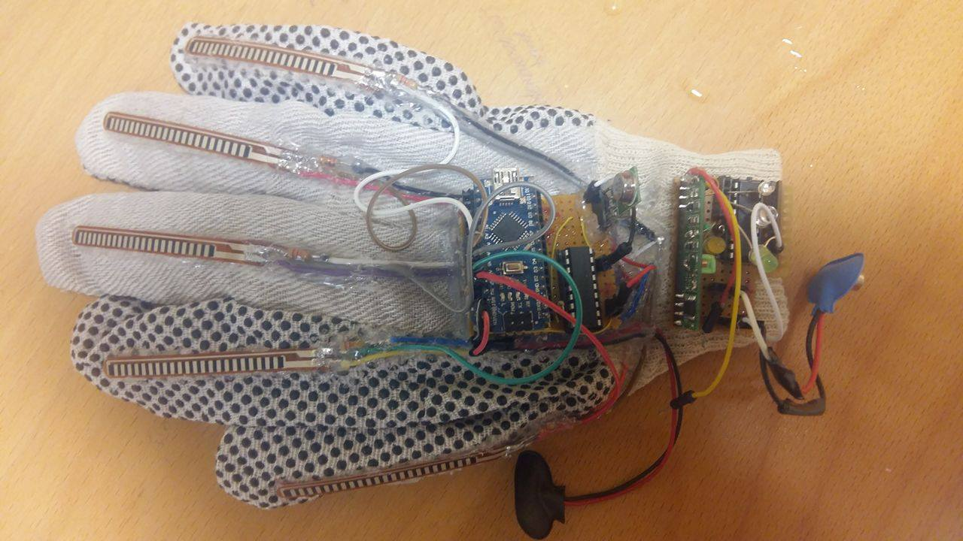
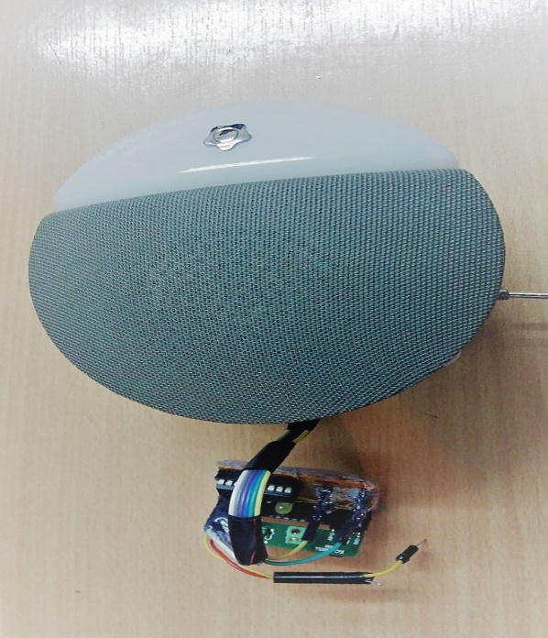
Introduction
The main goal of this project is to convert the sign to voice .

Slide 4
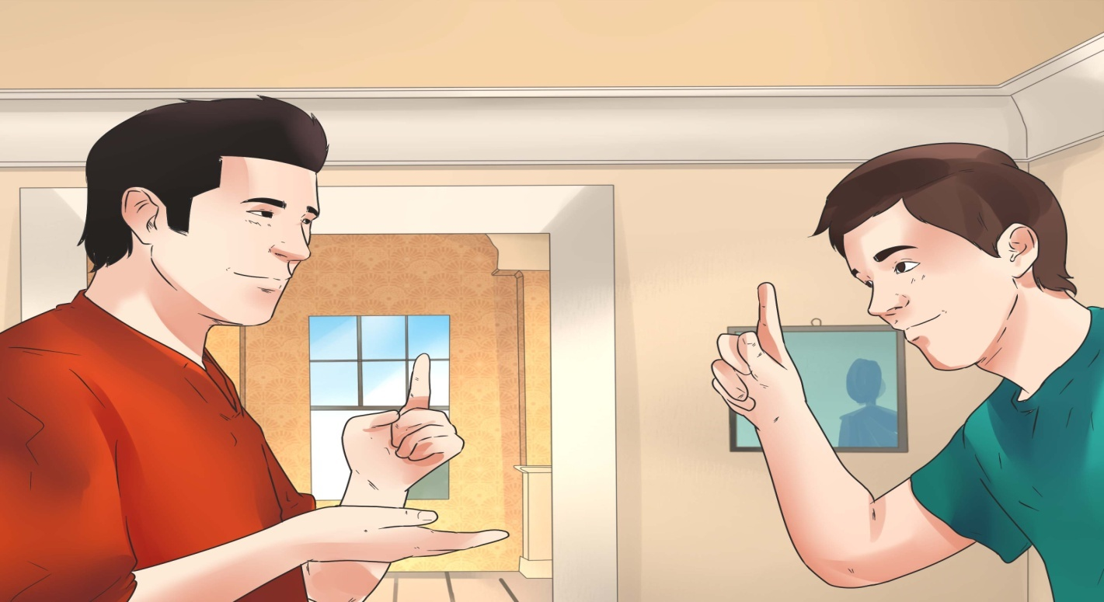
The importance of this project
1- The main objective of this project is to make the dump people & the people who have problem of talking to connect with other people normally .
2-Make the normal people understand what deaf people say when they move their body and hands.

Slide 5
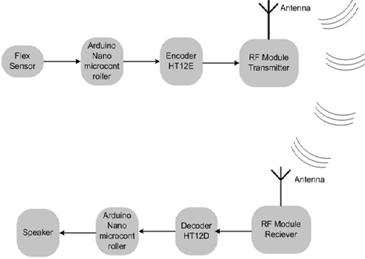
General view about the project
The project work as the below figure show

Slide 6
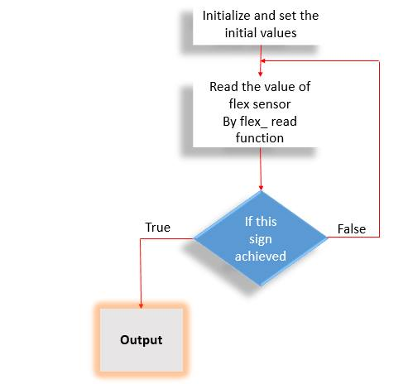
Methodology

Slide 7
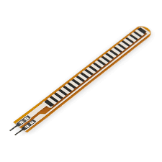
Hard ware
1-flex sensor

Slide 8
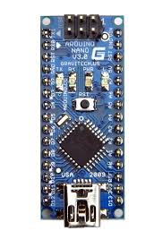
Hardware
2-Arduino Nano
It uses a microcontroller A Tmega 328
It receives the output from the flex
Sensor.

Slide 9
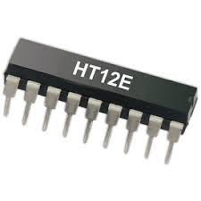
Hardware
3-Encoder(HT12E)

Slide 10
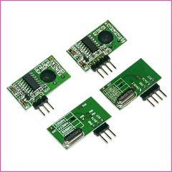
Hardware
4-RF-MODULE

Slide 11
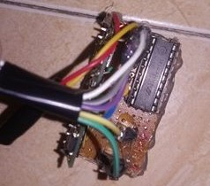
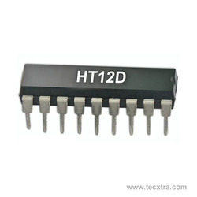
Hardware
5-Decoder(HT12D )

Slide 12
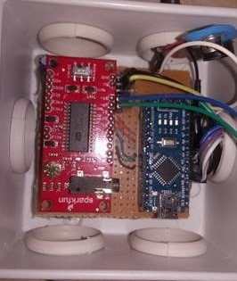
Hardware
6-Arduino Nano
It uses a microcontroller A Tmega 328
It receive the data from the RF-Module.

Slide 13
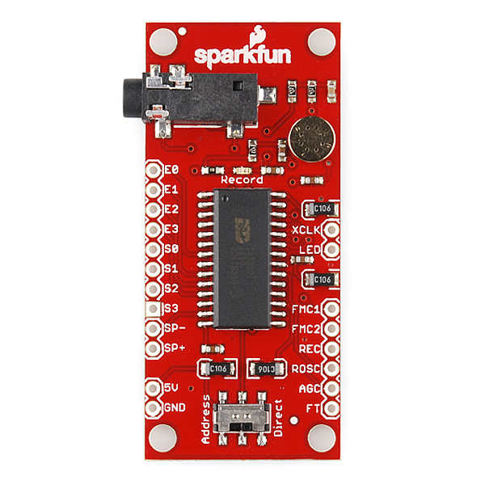
Hardware
7- voice recording ISD1932

Slide 14
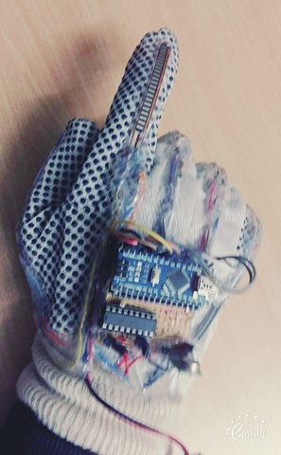
Results
To explain how this project exactly work ,one sign will be explain
1- The sign hand is made as shown below

Slide 15
Results
2- Depending on this sign the flex sensors gives different voltage levels
3- The voltage level are read by the arduino
4- The arduino convert the voltage level into digital signal(0110)
5- The digital signal initiate a sound related to the mean of this sign (اذهب الى هناك )

Slide 16
Conclusions
Summary
Overall, this finished project met all the expectations and more. It was stated in the proposal to design a hand sign translator that eases the daily life of people, especially to those who can’t talk and communicate with ordinary people in our language, which is natural to talk.

Slide 17
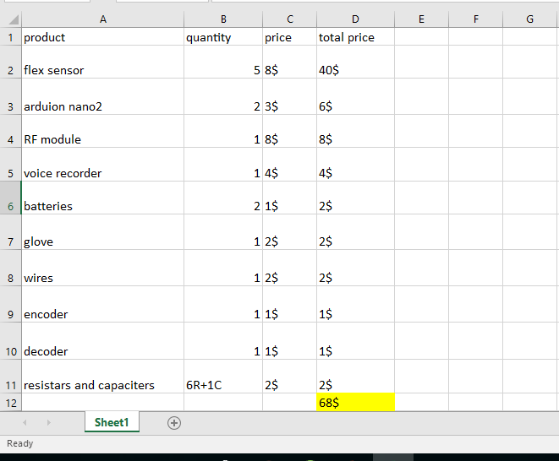
Conclusions
Cost Details and Economical Dimensions
The cost as shown in table

Slide 18
Conclusions
Future Work
It can improve the project in many ways:
1- display the result on LCD
2-use two hand
3-increase the number of signs by change some devices

