Slide 1

The use of WEAP for the assessment of the clustering of the water service providers and the design of a storm water collection network for Anabta
Prepared by:
Ahmad Quzmar
Ahmad Sabobeh
Haitham Estetieh
Omar Al-Qadah
Under the supervision of Dr. Mohammad N. Almasri

Slide 2
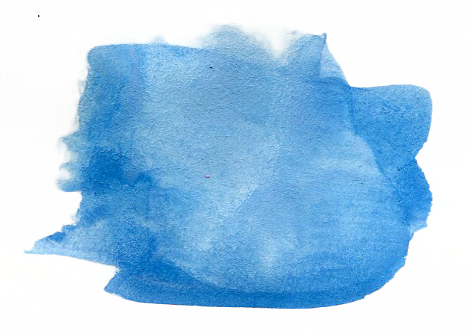
Introduction
Water sector faces many problems in quantity
Problem has exacerbated recently
We have roughly 1000 MCM of water recharges each year
which led to 170 L/c.d
A considerable number of Palestinians don’t get more
than 40 L/c.d
Israeli occupation actions led to Palestinians overuse the
groundwater by 120%

Slide 3
Introduction
Due to the continually changing political situation in the
West Bank, we wanted to study the water current and future
situation based on some predicted milestones called scenarios

Slide 4
Objectives
We aim to provide a tool for stakeholders,
decision-makers and administrators to handle both current
and future situations with preventive procedures
Reduce the problems that the coming generations could
go through

Slide 5
Methodology
Problem identification
Data collection
Create the WEAP model
Processing of scenarios
Development of different scenarios
Develop management option per each scenario
Develop the base case scenario using WEAP
“
“A person who never made a mistake never tried anything new”
Figure 1: steps followed in this GP

Slide 6
Study Area Description
Because of the position of the West Bank, the main source for
Water is groundwater, which can be found in basins
Three basins: eastern, western and northeastern
Annual renewable recharge for these basins ranges between
675~794 MCM

Slide 7
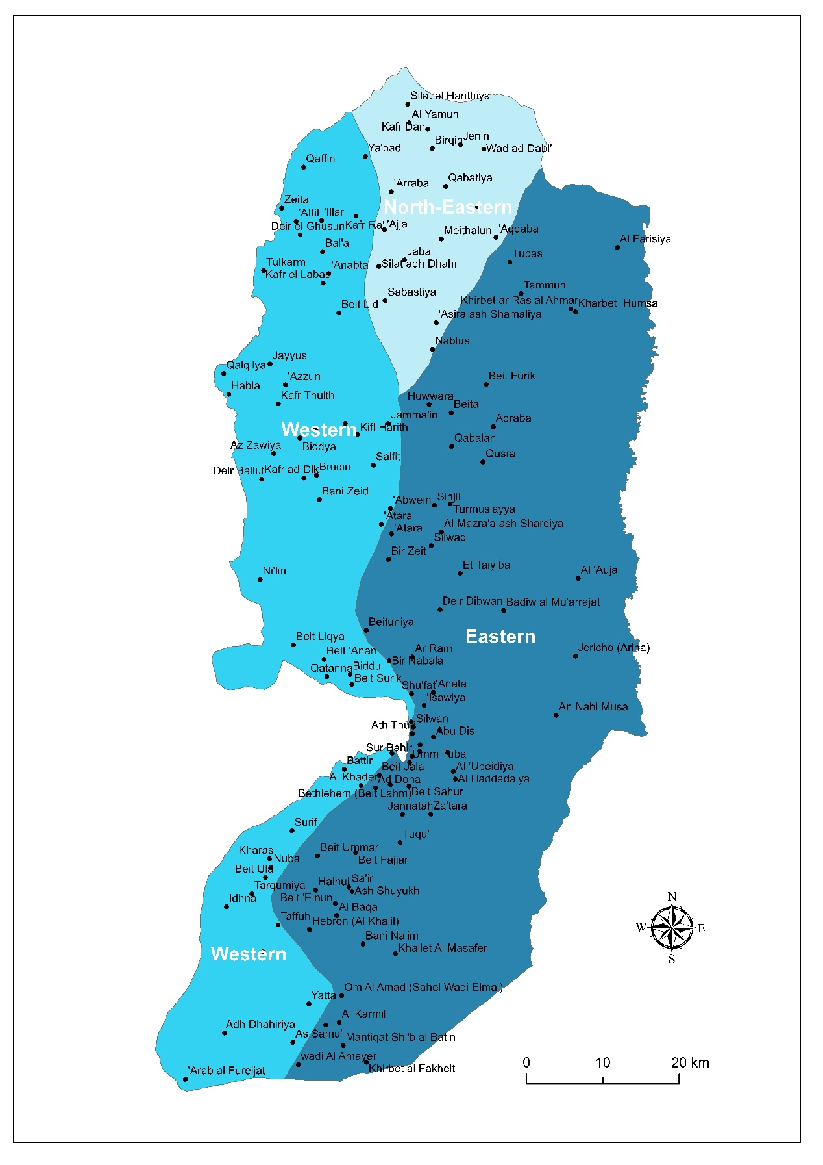
Study Area Description
Table 1: the distribution of recharge in MCM/year for each basin
Basin | Recharge (MCM/year)
Eastern | 318 ~ 420
Western | 125 ~ 195
Northeastern | 145 ~ 170

Slide 8
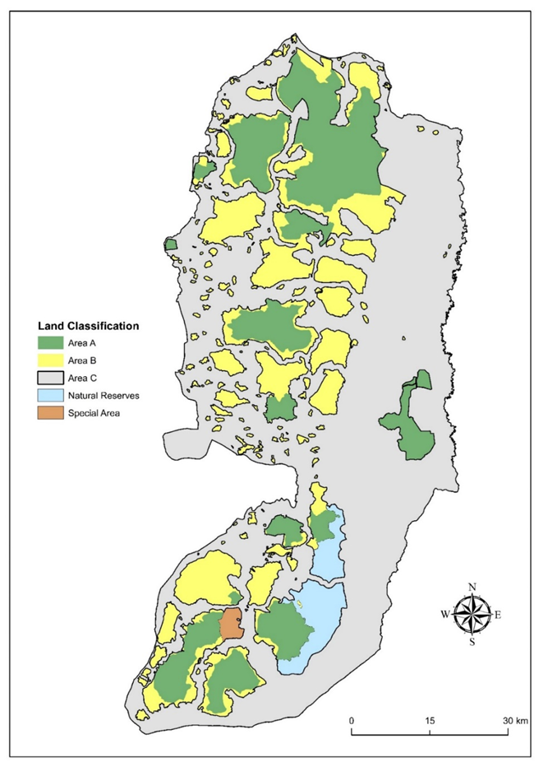
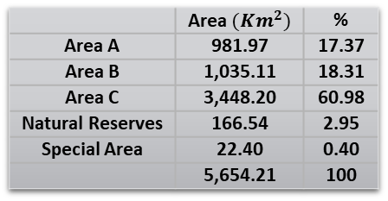
Study Area Description
According to Oslo II Accord, the West Bank was divided into temporary areas that differ in predominance
Table 2: area of each category in the West Bank as Oslo II Accord
 | Area ${(Km}^{2})$ | %
Area A | 981.97 | 17.37
Area B | 1,035.11 | 18.31
Area C | 3,448.20 | 60.98
Natural Reserves | 166.54 | 2.95
Special Area | 22.40 | 0.40
 | 5,654.21 | 100

Slide 9
WEAP
Water Evaluation and Planning (WEAP) is a software that was
developed by Stockholm Environment Institute (SEI).
WEAP could also be used as a tool to deal with the current
situations smartly rather than trying to make changes
for inevitable circumstances.

Slide 10
WEAP
Why WEAP?
Free
User-Friendly
Available with over 25 languages
Used for future planning of water resources
Easy to learn
Fast technical support

Slide 11
Clusters
Clustering is the process of assembling a bunch of LGUs
within one group, called cluster. In our project, we used
a 31-cluster map proposed by specialists.
The following are some of the criteria followed by the specialists
in establishing the clusters:
Existence of shared water source
Acceptance of LGUs to collaborate and share a certain source
Existence of water infrastructure such as pipelines
Catchment (watershed) boundary

Slide 12
Clusters
Advantages
Reduction of the number of water service providers
from over 300 to 31 only.
More centralization and independency for each cluster.
More flexibility in the water distribution process.
A decrease in conflicts and disputes.
LGUs will get water impartially as water resources will be
controlled more efficiently.
Attracting stakeholders to implement water-related projects
in the study area.

Slide 13
Clusters
Challenges
People in a certain LGU refrain to share water existing under
their control with other LGUs.
Conducting the clustering process needs time to persuade people
and maybe resorting to intimidate them might be needed.

Slide 14
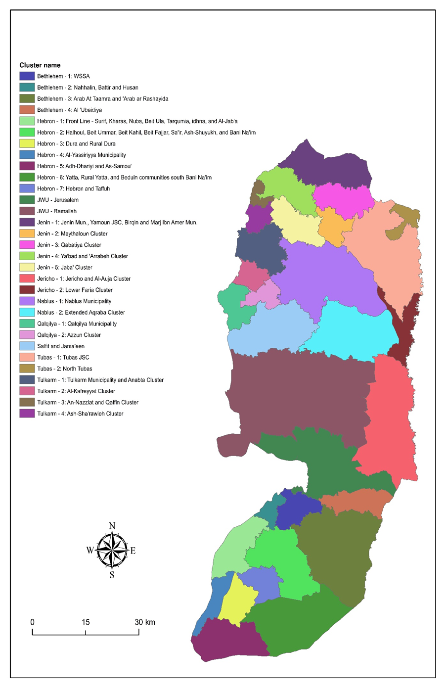
Clusters
The following figure shows the
clusters as proposed in the Road Map

Slide 15
Clusters
Table 1: clusters names and main LGUs
Name (as in WEAP) | Main LGUs | Name (as in WEAP) | Main LGUs
Bethlehem_1 | Bethlehem, Beit Jala, Beit Sahur | Jericho_1 | Al 'Auja, Aqbat Jaber Camp, Jericho
Bethlehem_2 | Nahhalin, Battir, Husan, Wadi Fukin | Jericho_2 | Al Jiftlik, Az Zubeidat
Bethlehem_3 | Beid Falouh, Tuqu', Al 'Ubeidiya, Za'tara | JWU_Jerusalem | Qalandiya Camp, Jerusalem, Al 'Isawiya
Hebron_1 | Surif, Nuba, Bayt Aula, Kharas | JWU_Ramallah | Beituniya, Al Jalazun Camp, Beit Liqya
Hebron_2 | Beit Kahil, Halhul, Beit Ummar, Beit Fajjar | Nablus_1 | Asira ash Shamaliya, Nablus, Beit Furik
Hebron_3 | Sa'ir, Qula Zeita, Ash Shyoukh, Beit 'Einun | Nablus_2 | Aqraba,Qabalan, Beita, Qusra, 'Awarta
Hebron_4 | Ar Rawa'in, Bani Na'im | Qalqilya_1 | Habla, Qalqiliya, Jayyus, Kafr Thulth
Hebron_5 | As Samu', Adh Dhahiriya, Ar Ramadin | Qalqilya_2 | Azzun, Baqat al Hatab, Jinsafut, Hajja
Hebron_6 | Beit 'Amra, Al Karmil, Yatta, Ar Rihiya | Salfit_and_Jama'een | Biddya, Jamma'in, Salfit
Hebron_7 | Taffuh, Hebron, Kharsa, Dura | Tubas_1 | Tubas, El Far'a Camp, Tammun, Tayasir
Hebron_8 | Tarqumiya, Idhna, Beit 'Awwa, Deir Samit | Tubas_2 | Bardala, 'Ein el Beida
Jenin_1 | As Silat al Harithiya, Al Yamun, Jenin | Tulkarm_1 | Anabta, Kafr al Labad, Tulkarm
Jenin_2 | Meithalun, Al Jadida, Siris, 'Aqqaba | Tulkarm_2 | Kafr 'Abbush, Kafr Sur, Kafr Jammal
Jenin_3 | Az Zababida, Qabatiya | Tulkarm_3 | Nazlat 'Isa, Qaffin
Jenin_4 | Ya'bad, Barta'a ash Sharqiya, Arraba | Tulkarm_4 | Illar,'Attil, Deir al Ghusun, Zeita
Jenin_5 | Silat adh Dhahr, Jaba' - Jenin, Kafr Ra'i

Slide 16
Assumptions
This type of projects cannot be proceeded without any
assumptions because it deals with future predictions
The assumptions we used in this GP were:
We have 31 clusters. We are handling each cluster as an
individual entity that represents
Each person in a cluster has the same portion as other people in it
Water in an LGU will be shared within multiple consumers

Slide 17
Assumptions
The population number of a certain cluster is the population
number of all LGUs within it, and the population used is the
population of 2017 projected from 2007 with growth
rate of (2.24 %).
The demand is constant for all clusters and is taken to be
120 L/c.d according to the PWA reports.
The consumption’s percent is 100%.

Slide 18
Assumptions
We are going to conduct some management options for
the West Bank under 1967 borders while neglecting
Israeli settlements.
The loss’s percent is different for each cluster and it's
calculated from reports of PWA, as follows:

Slide 19
Assumptions
Table 3: percentage of loss in each cluster
Name (WEAP) | Governorate | %loss | Name (WEAP) | Governorate | %loss
Bethlehem_1 | Bethlehem & Hebron | 30.3 | Jericho_1 | Jericho & Al-Aghwar | 32.8
Bethlehem_2 | Bethlehem & Hebron | 30.3 | Jericho_2 | Jericho & Al-Aghwar | 32.8
Bethlehem_3 | Bethlehem & Hebron | 30.3 | JWU_Jerusalem | Ramallah & Al-Bireh, and Jerusalem | 19
Hebron_1 | Bethlehem & Hebron | 30.3 | JWU_Ramallah | Ramallah & Al-Bireh, and Jerusalem | 19
Hebron_2 | Bethlehem & Hebron | 30.3 | Nablus_1 | Nablus | 31
Hebron_3 | Bethlehem & Hebron | 30.3 | Nablus_2 | Nablus | 31
Hebron_4 | Bethlehem & Hebron | 30.3 | Qalqilya_1 | Qalqiliya | 25.6
Hebron_5 | Bethlehem & Hebron | 30.3 | Qalqilya_2 | Qalqiliya | 25.6
Hebron_6 | Bethlehem & Hebron | 30.3 | Salfit_and_Jama'een | Salfit | 18.8
Hebron_7 | Bethlehem & Hebron | 30.3 | Tubas_1 | Tubas | 25.8
Hebron_8 | Bethlehem & Hebron | 30.3 | Tubas_2 | Tubas | 25.8
Jenin_1 | Jenin | 29.3 | Tulkarm_1 | Tulkarm | 38. 5
Jenin_2 | Jenin | 29.3 | Tulkarm_2 | Tulkarm | 38. 5
Jenin_3 | Jenin | 29.3 | Tulkarm_3 | Tulkarm | 38. 5
Jenin_4 | Jenin | 29.3 | Tulkarm_4 | Tulkarm | 38. 5
Jenin_5 | Jenin | 29.3

Slide 20
Assumptions
There are two main water resources:
The wells under PWA and municipalities control that are used for domestic purposes and excluding all agricultural wells.
The amount of water purchased from Mekorot according to PWA’s reports.

Slide 21
Table 4: The water amount in m^3 that is either purchased from Mekorot or gained from PWA’s wells per year.
Name (as in WEAP) | Q Mekorot (MCM/year) | Q well (MCM/year) | Name (as in WEAP) | Q Mekorot (MCM/year) | Q well (MCM/year)
Bethlehem_1 | 3.18 | 5.2 | Jericho_1 | 2 | 0.1
Bethlehem_2 | 0.95 | 0 | Jericho_2 | 0.83 | 0
Bethlehem_3 | 4.13 | 9.51 | JWU_Jerusalem | 6.15 | 1.04
Hebron_1 | 0 | 0 | JWU_Ramallah | 17.68 | 5.36
Hebron_2 | 8.46 | 3.42 | Nablus_1 | 3.8 | 7.69
Hebron_3 | 10.77 | 1.04 | Nablus_2 | 1.03 | 3.82
Hebron_4 | 0 | 0 | Qalqilya_1 | 0 | 3.3
Hebron_5 | 0 | 0.23 | Qalqilya_2 | 1.61 | 0.61
Hebron_6 | 0.46 | 0.47 | Salfit_and_Jama'een | 3.89 | 0
Hebron_7 | 0.19 | 0 | Tubas_1 | 0 | 0
Hebron_8 | 0 | 0 | Tubas_2 | 4.91 | 0
Jenin_1 | 2.08 | 1.97 | Tulkarm_1 | 0.2 | 10.69
Jenin_2 | 0 | 1.05 | Tulkarm_2 | 0.33 | 0.28
Jenin_3 | 0 | 1.2 | Tulkarm_3 | 0 | 0.58
Jenin_4 | 0.56 | 2.12 | Tulkarm_4 | 0 | 1.4
Jenin_5 | 0 | 0 | Subtotal | 73.2 | 61.1
 |  |  | total | 134.3

Slide 22
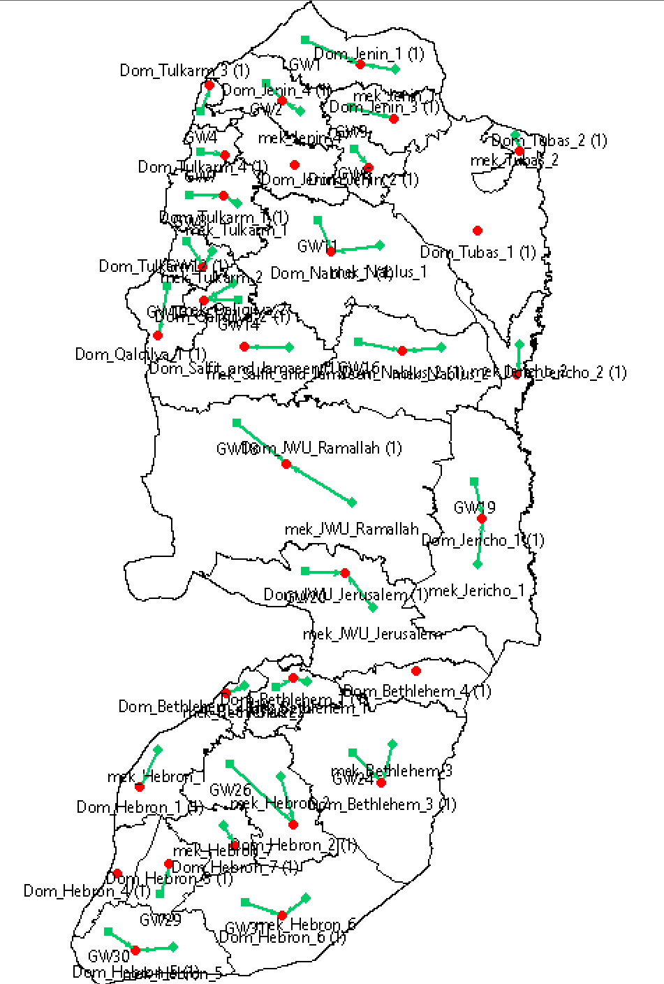
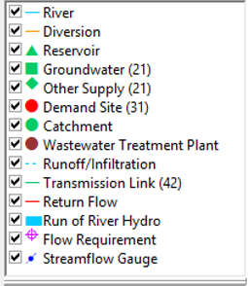
WEAP Modeling
We added 31 Demand Sites, which represents the 31 clusters under study, 21 Groundwater which represent the withdrawal from the wells, 21 other supply which represent the amount bought from Mekorot for each cluster

Slide 23
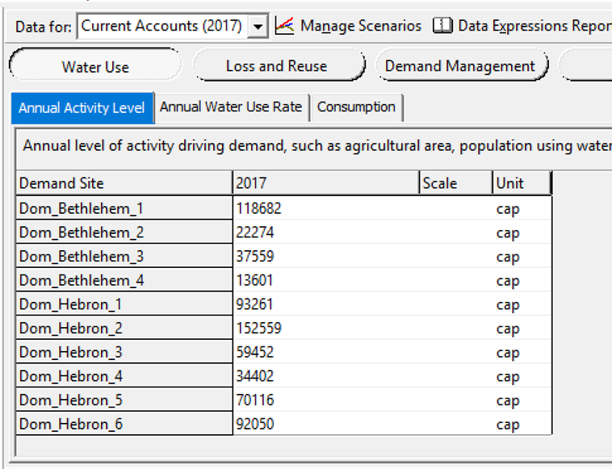
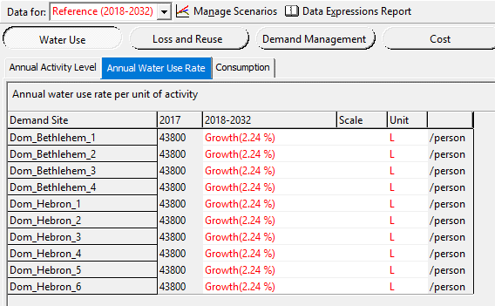
WEAP Modeling
Adding the growth rate
Adding the population of each demand site
Figure 8: Population of 2017 entered to WEAP for each cluster
Figure 9: using a growth rate of 2.4% to predict the population number for each year between 2018 and 2032

Slide 24
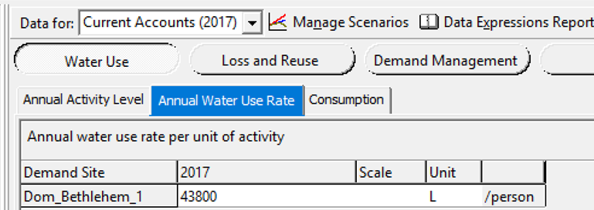
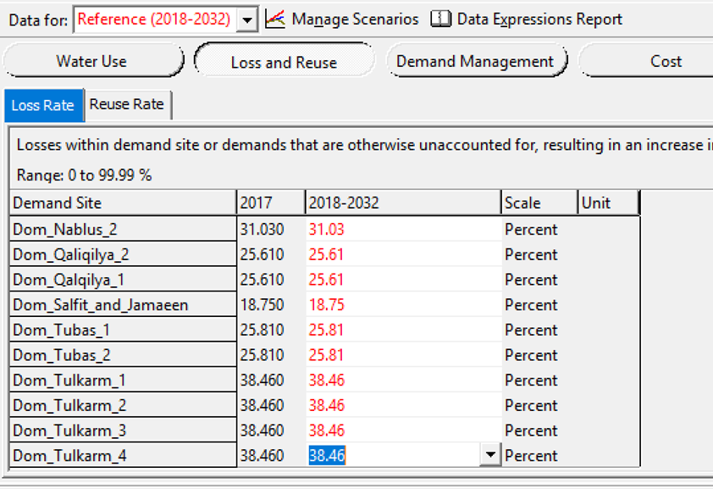
WEAP Modeling
Adding the annual demand rate
Adding the loss percent
for each demand site
Figure 10: water user rate in liters per capita per year
Figure 11: loss rate during the years 2017-2032 a percentage

Slide 25
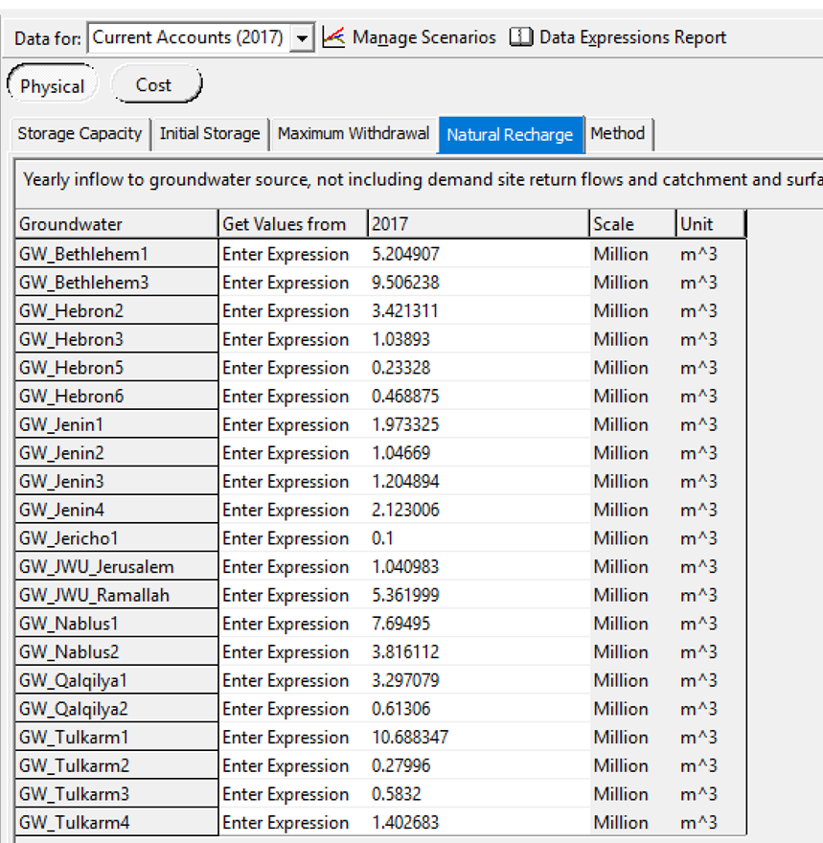
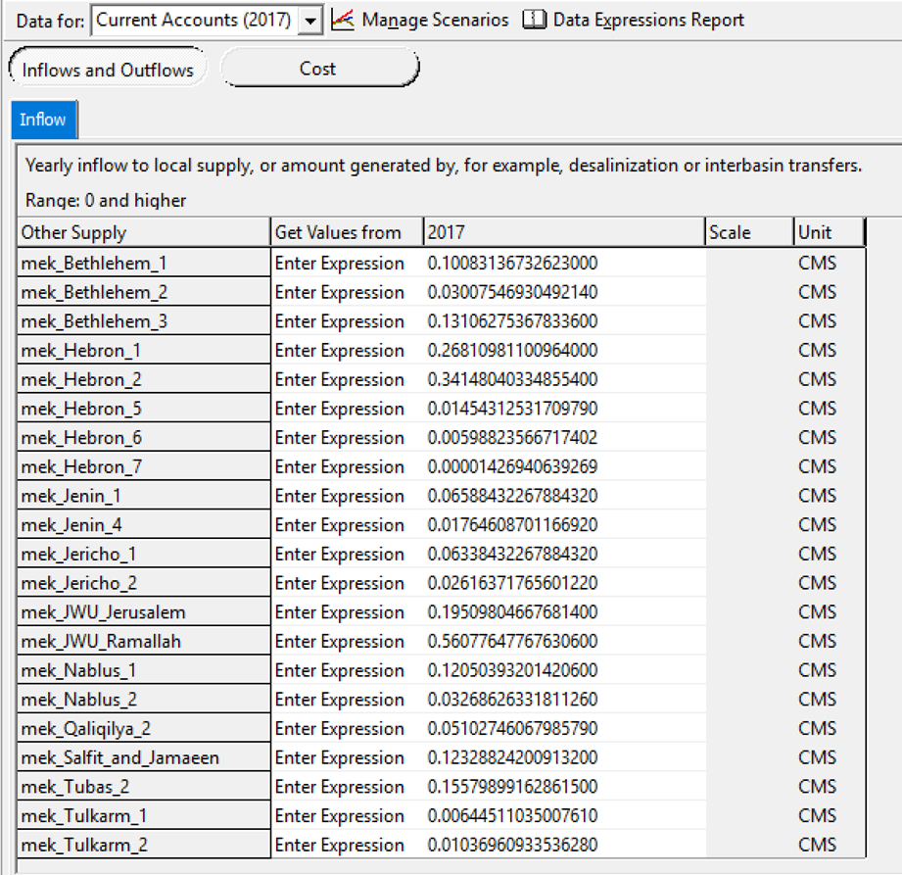
WEAP Modeling
Adding the annual withdrawal
for each demand site.
Adding the bought amount from Mekorot for each deamnd site.
Figure 12: withdrawal from groundwater in ${Mm}^{3}$in 2017
Figure 13: water from Mekorot for each cluster in CMS

Slide 26
Data Analysis
Status quo
It describes the water condition in the West Bank in 2032 assuming no significant change on any parameter, except for the clustering and population growth.

Slide 27
Our main concern in the analysis phase is the amount of unmet demand per capita for each cluster
The values are categorized into 4 classes According to the World Health Organization (WHO):

Slide 28
Data Analysis
Table 7: per capita consumption in each cluster in 2032

Slide 29
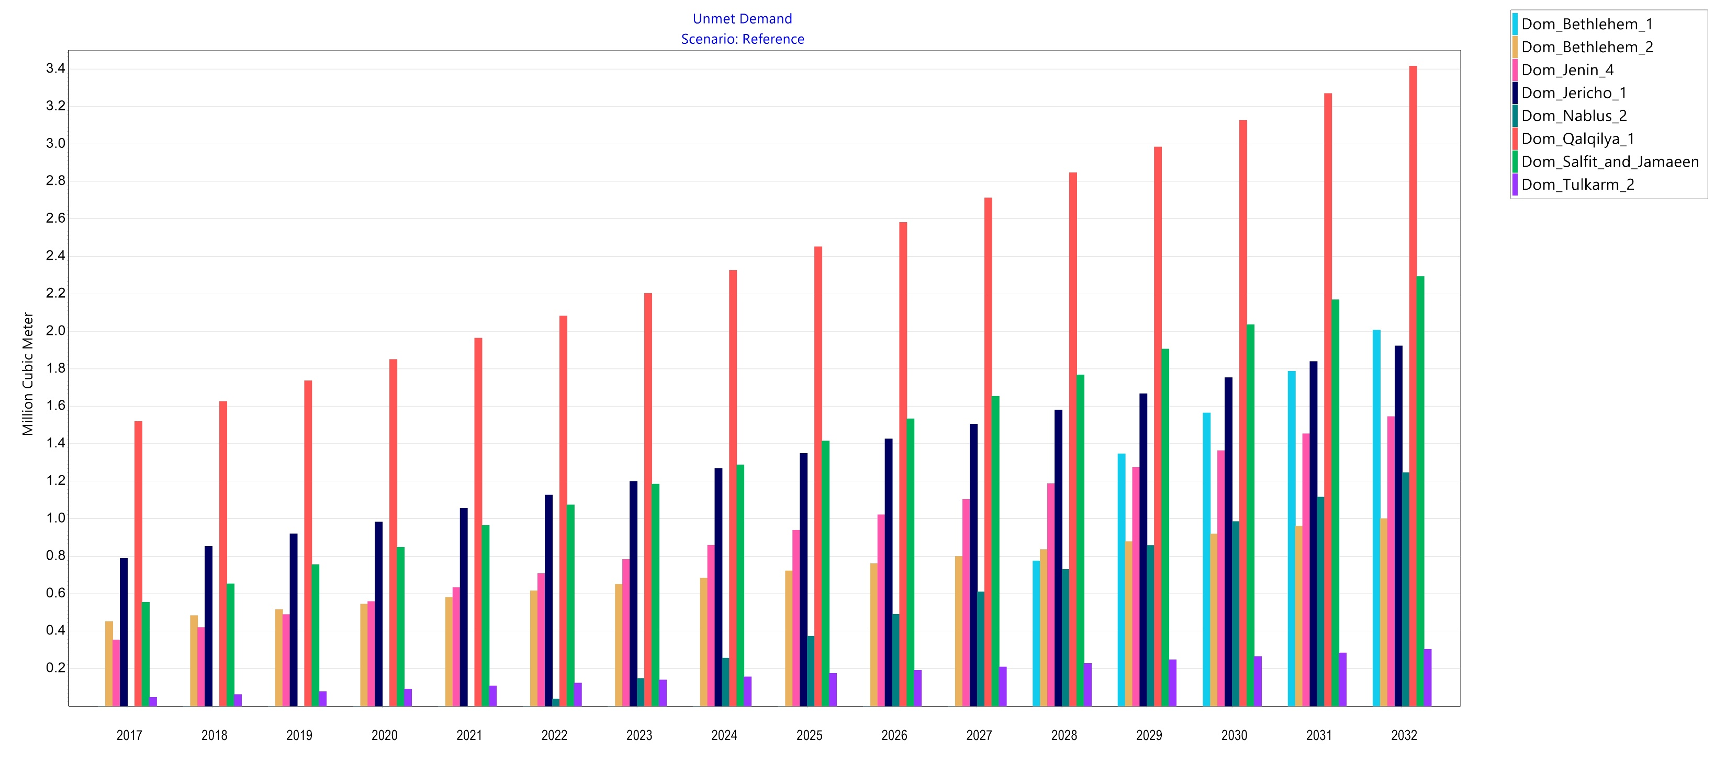
Data Analysis
Figure 14: unmet demand MCM in clusters with 50-120 L/c.d consumption

Slide 30
Table 8 unmet demand MCM in clusters with 50-120 L/c.d consumption

Slide 31
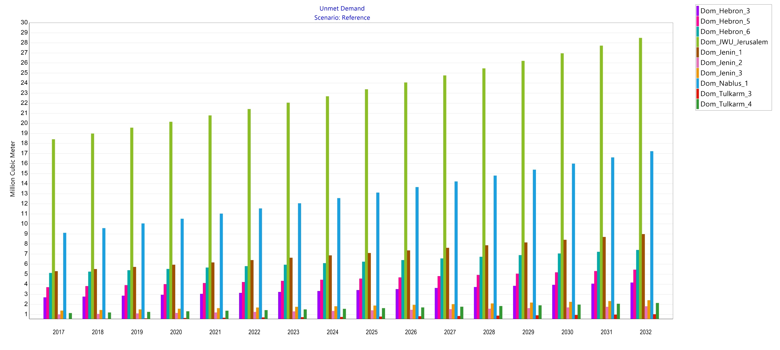
Data Analysis
Figure 15: unmet demand MCM in clusters with 0-50 L/c.d consumption

Slide 32
Table 9: unmet demand MCM in clusters with 0-50 L/c.d consumption

Slide 33
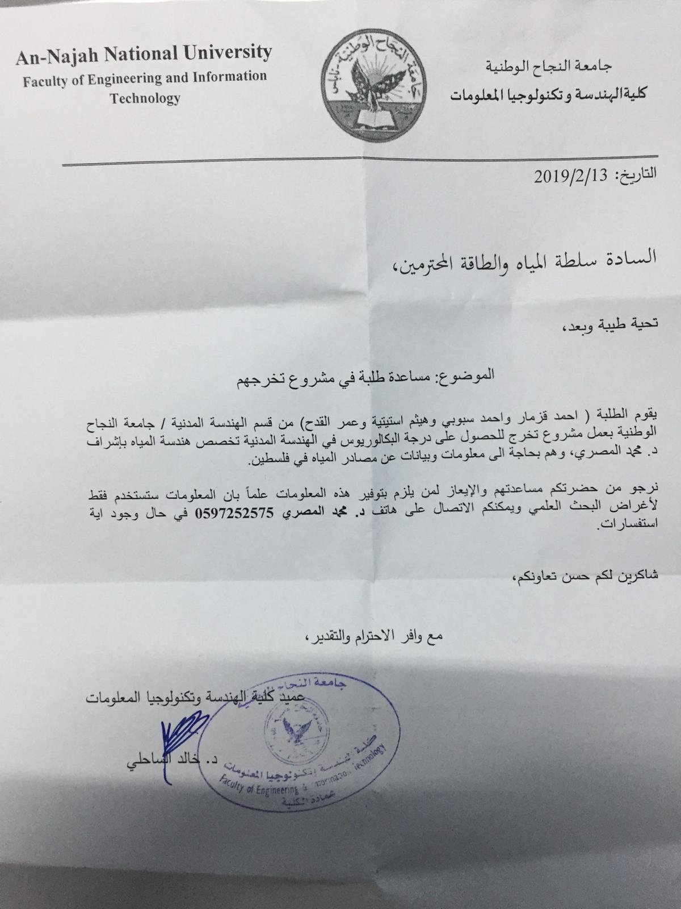
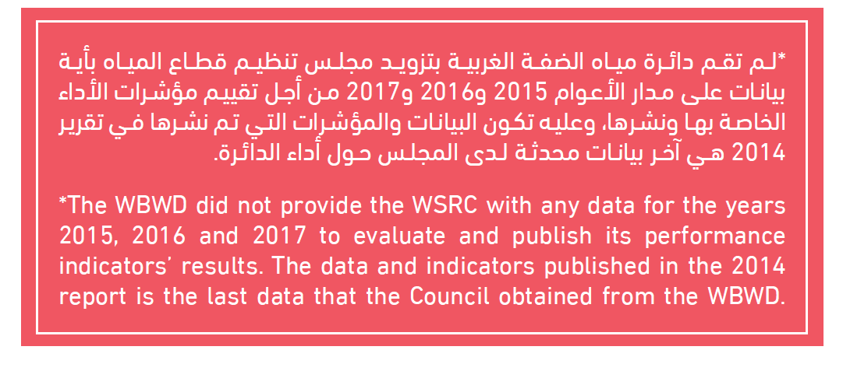
A formal document was sent to PWA without any response yet

Slide 34
Introduction
Because of urbanization, imperviousness increases causing the
generation of runoff. To avoid any related problems we are to design
A storm water network.

Slide 35
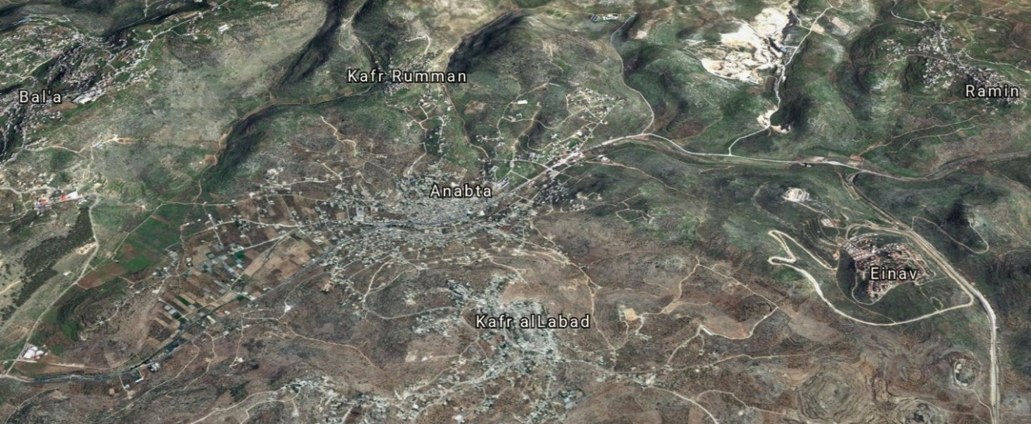
Study Area Description
We chose Anabta because of its vulnerability to floods
Figure 1: Anabta and its neighbouring towns

Slide 36
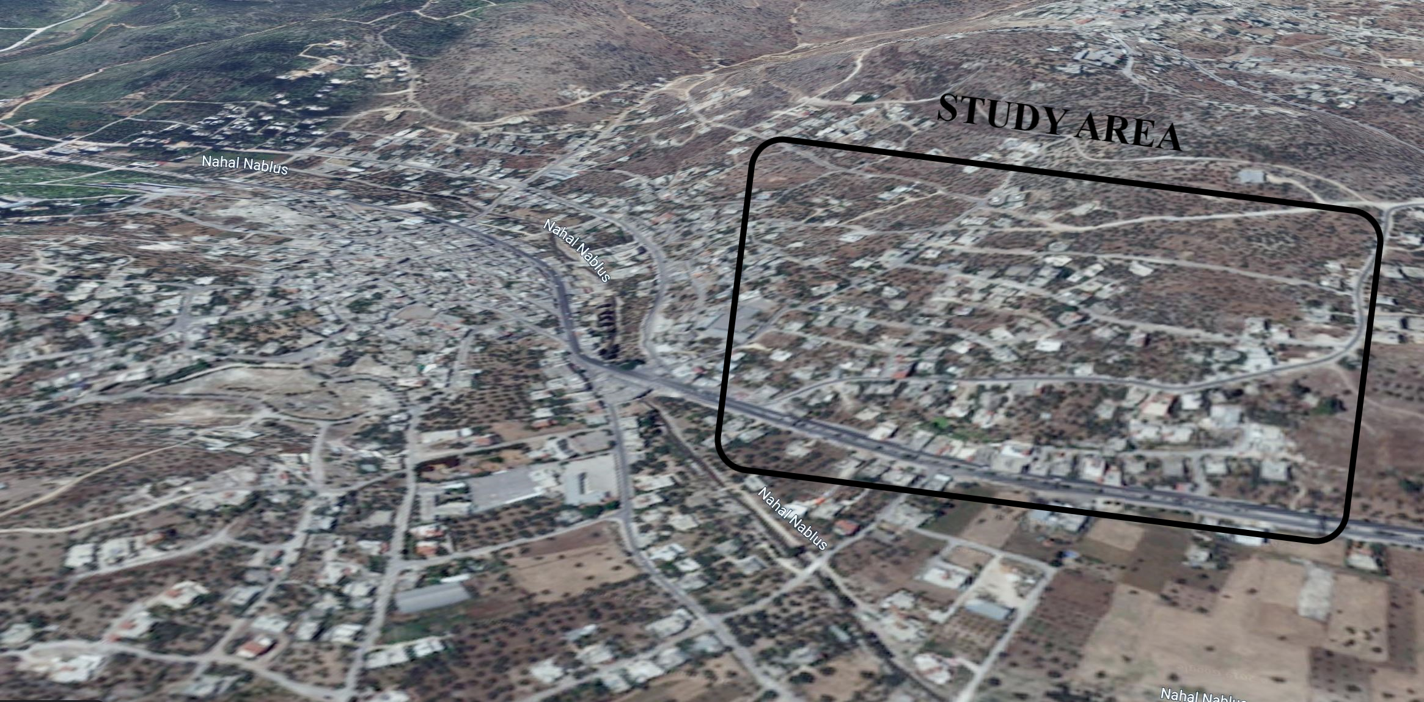
Study Area Description
We chose the shown part of Anabta, whose area is 10.93 ha
Figure 2: The 10.93-hectare area

Slide 37
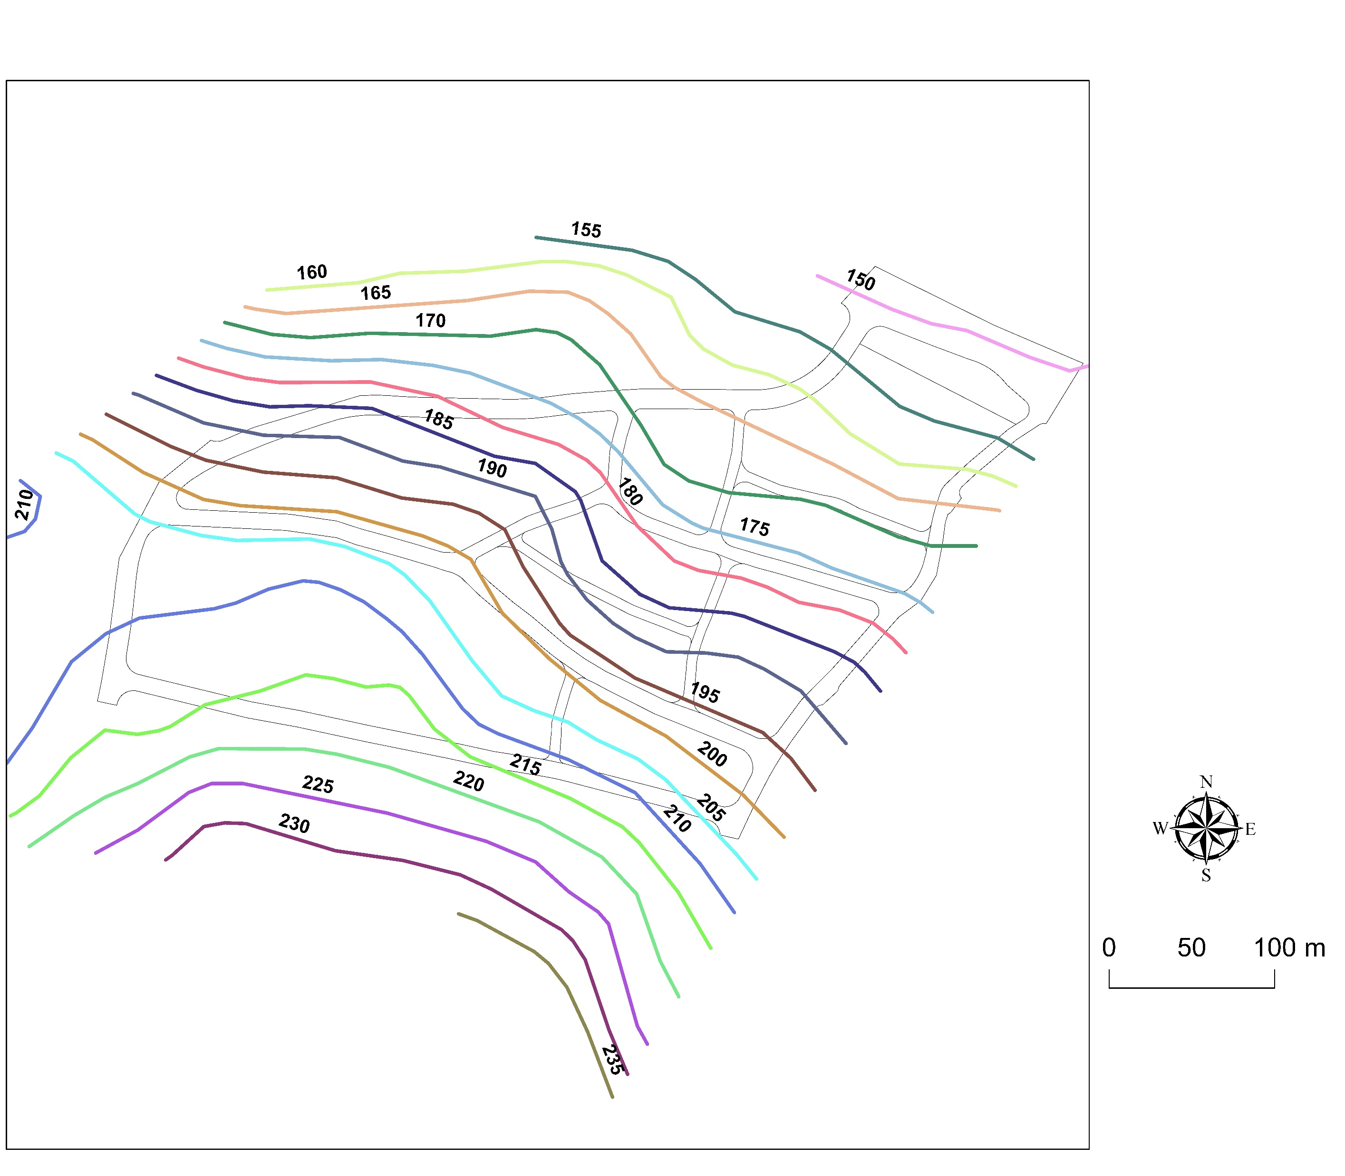
Study Area Description
Figure 3: Contour map for the study area

Slide 38
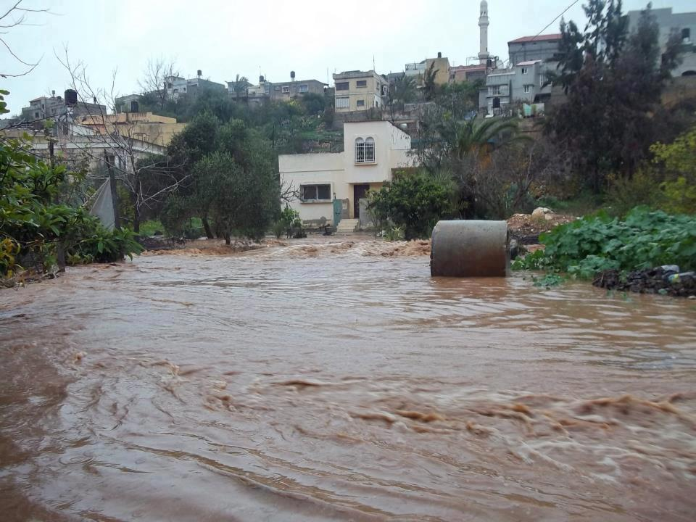
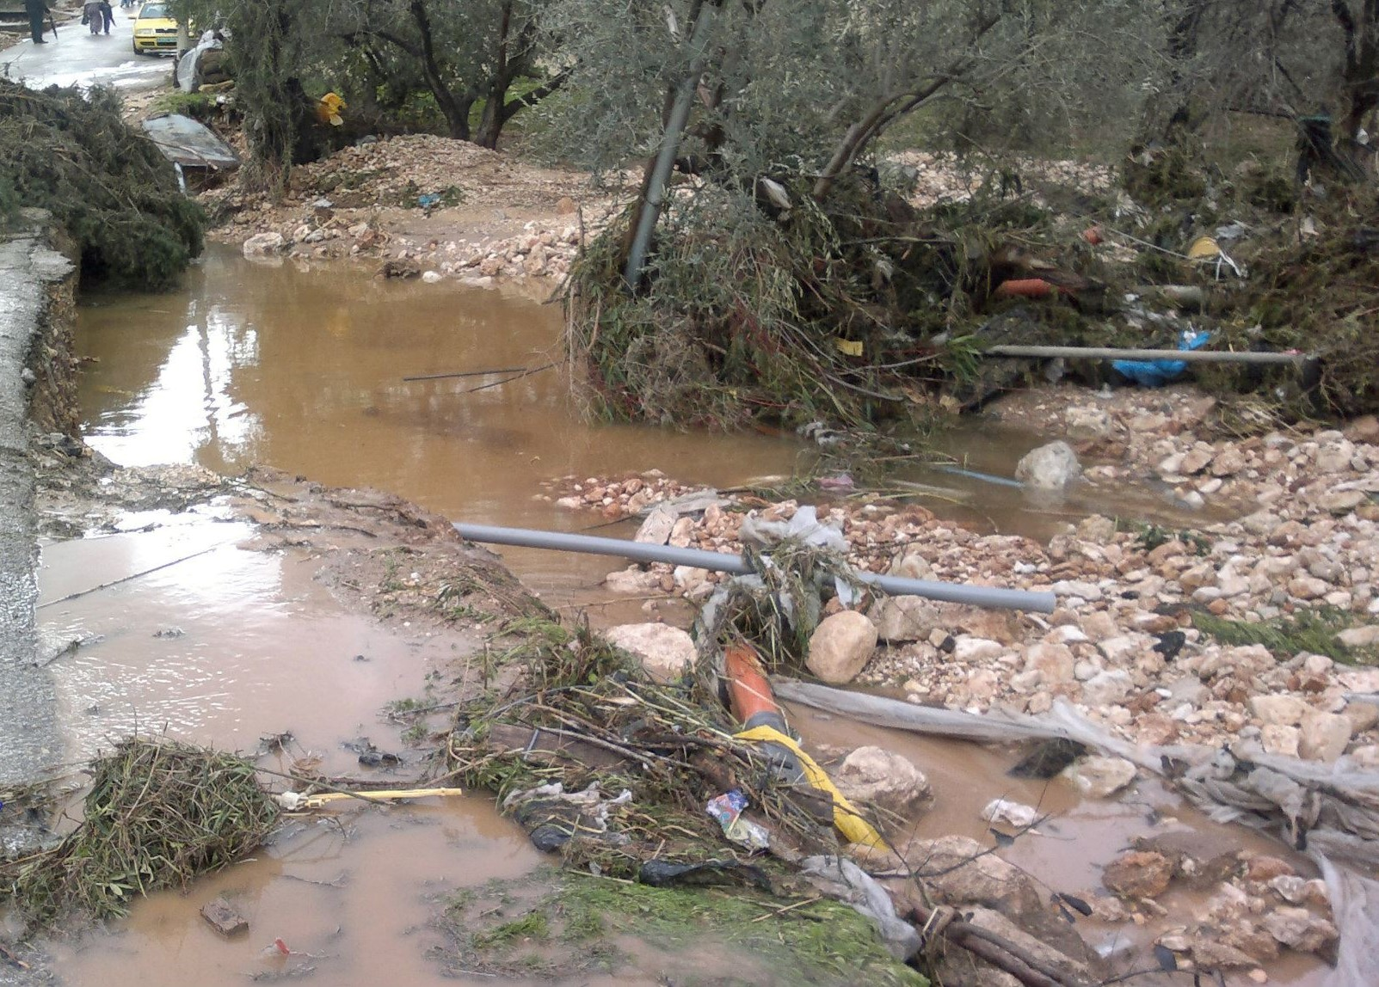
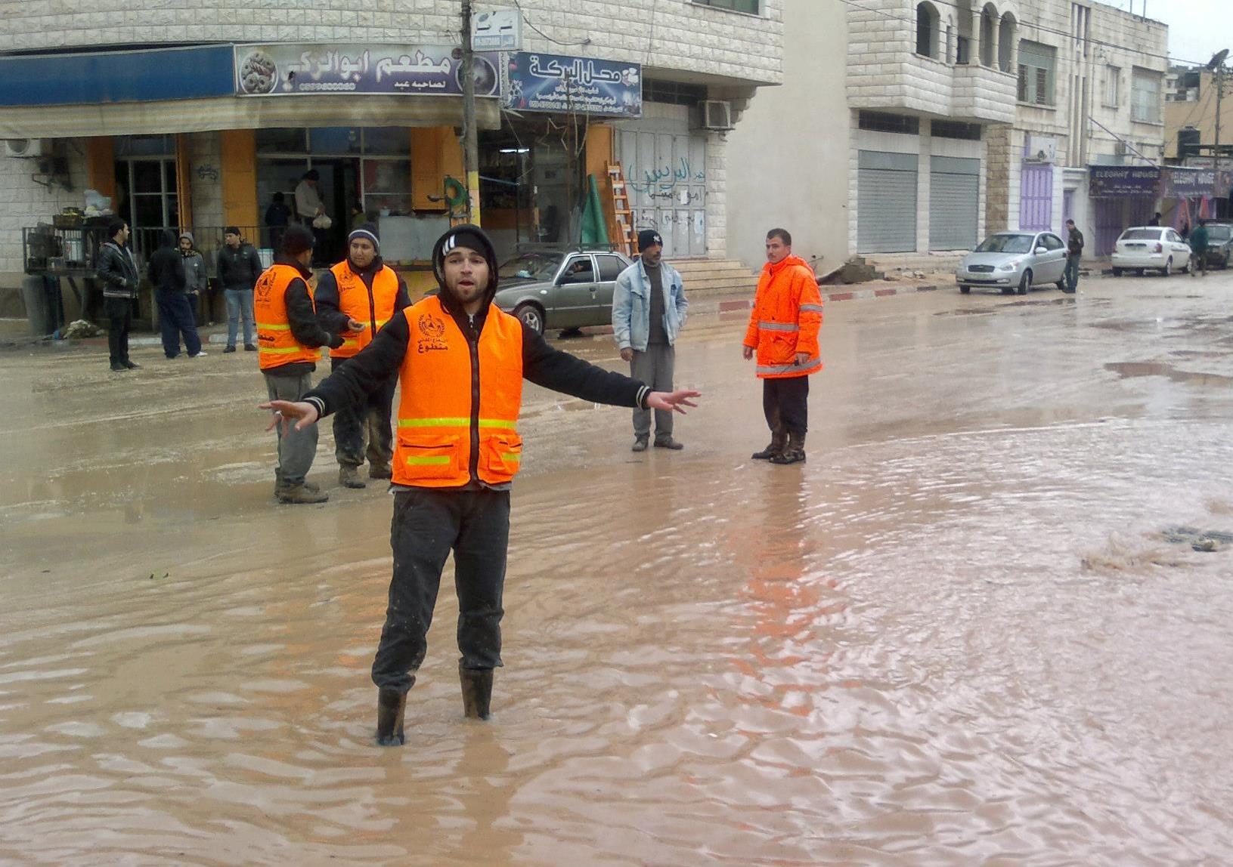
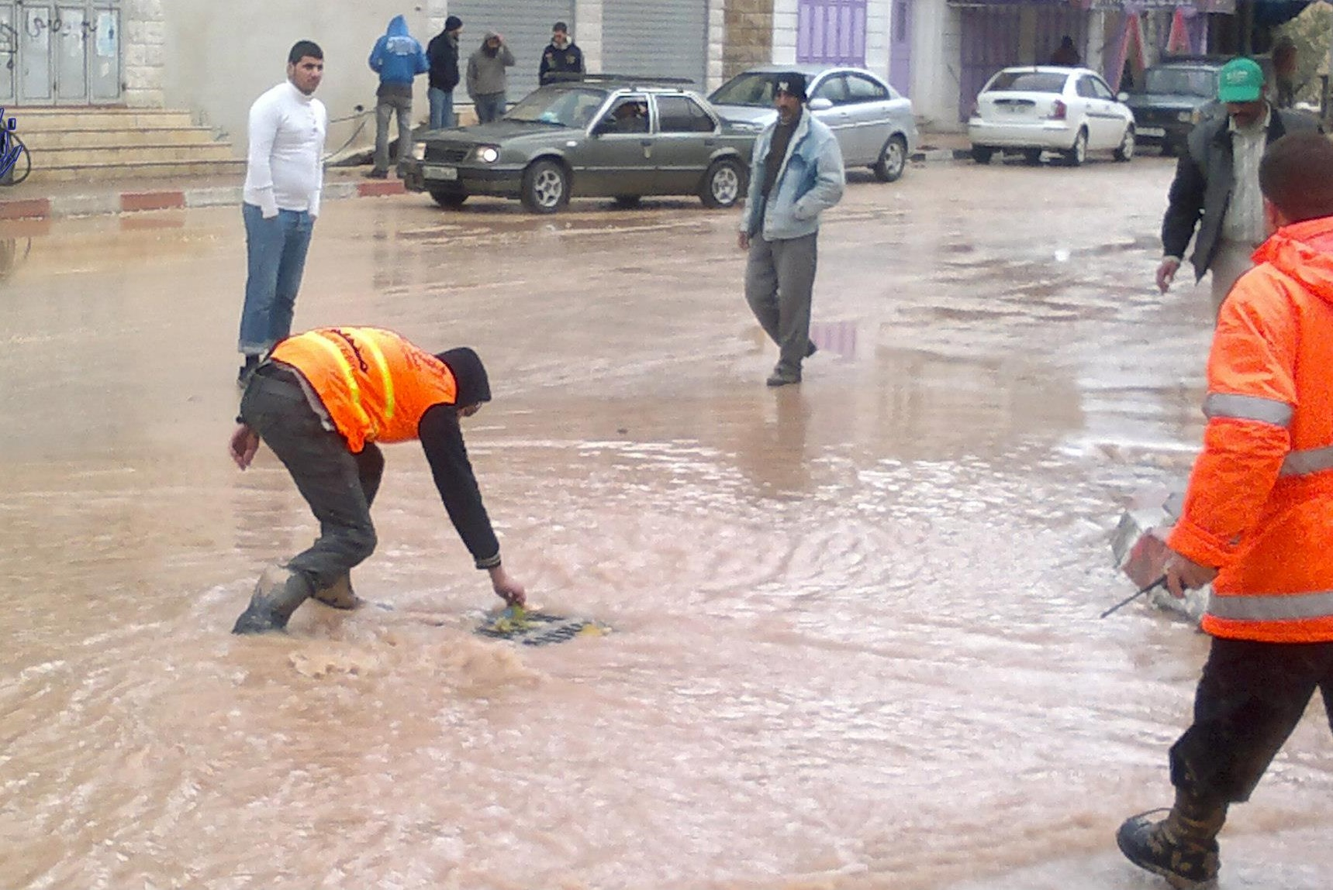
Importance of Work
Figure 4: Floods occur when poor infrastructure exist

Slide 39
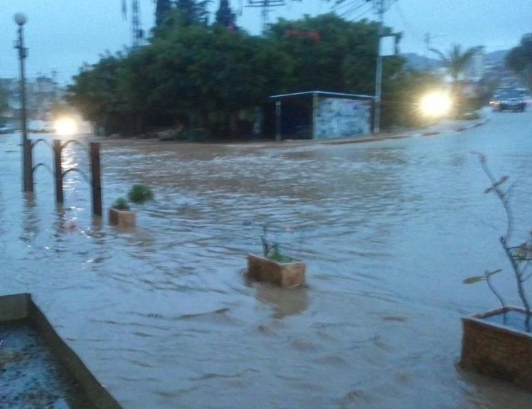
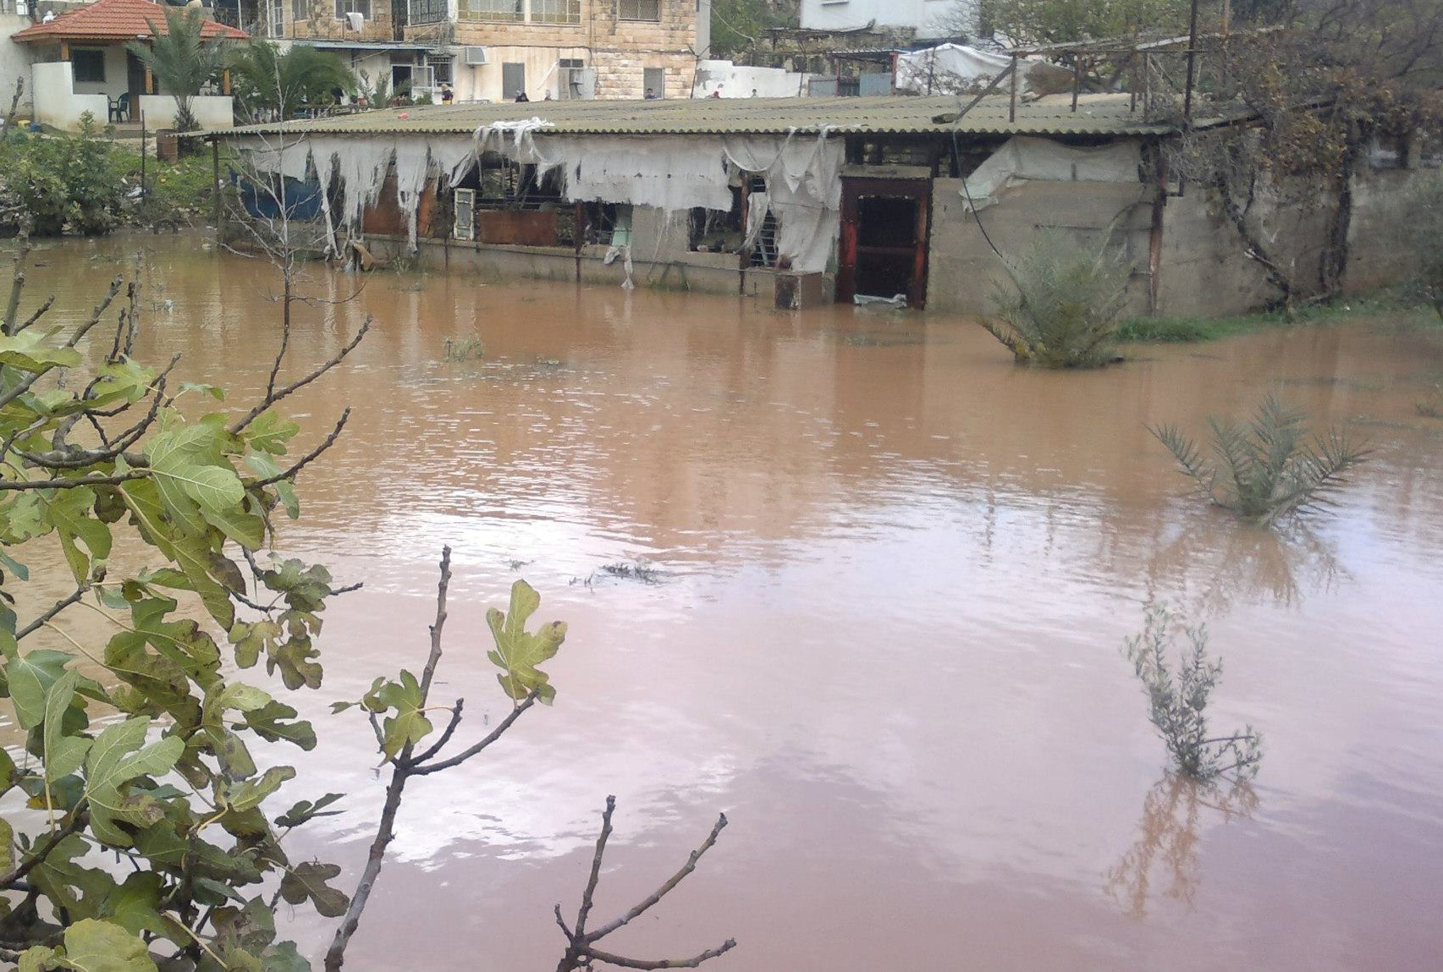
Importance of Work
Figure 5: Floods occur when poor infrastructure exist

Slide 40
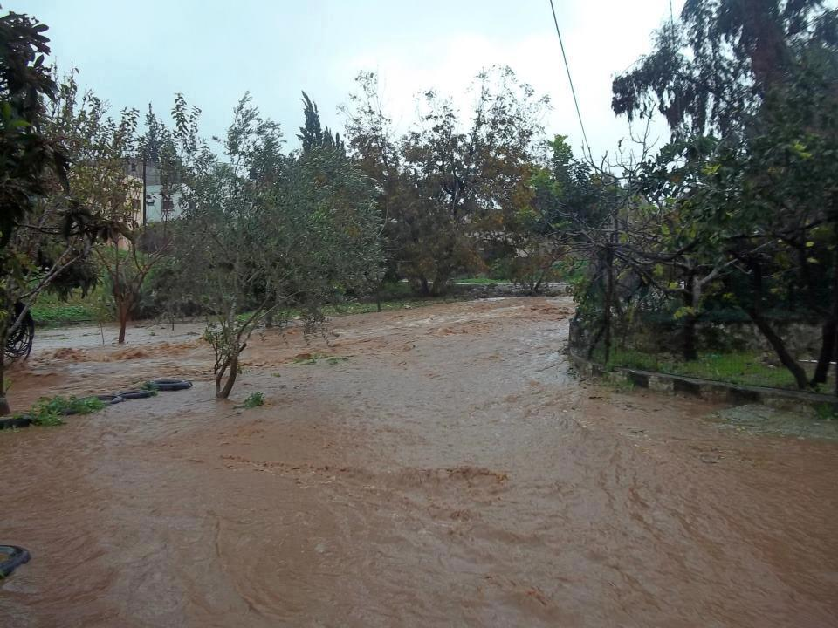
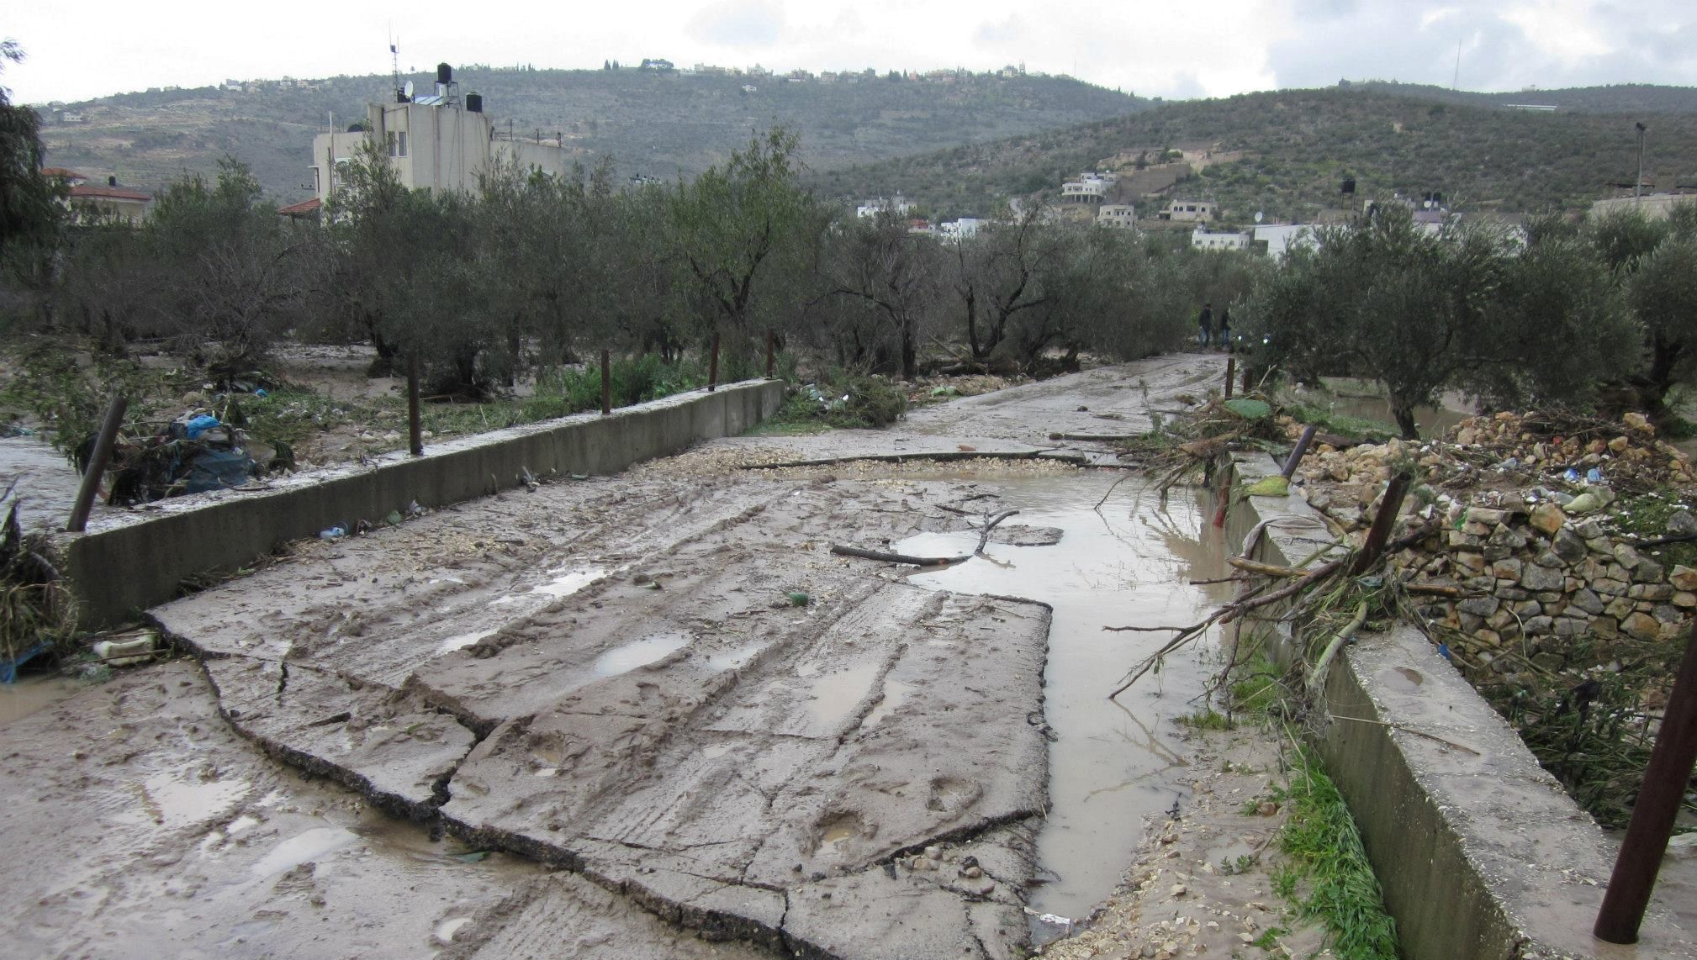
Importance of Work
Figure 6: Floods occur when poor infrastructure exist

Slide 41
Objectives
We want to design a stom water collection network for part of Anabta.

Slide 42
Methodology
Problem identification
Data collection
Conclusions and recommendations
Delineate catchments and catch basins
SewerGEMS modeling
Selection of study area
Figure 7: Methodology

Slide 43
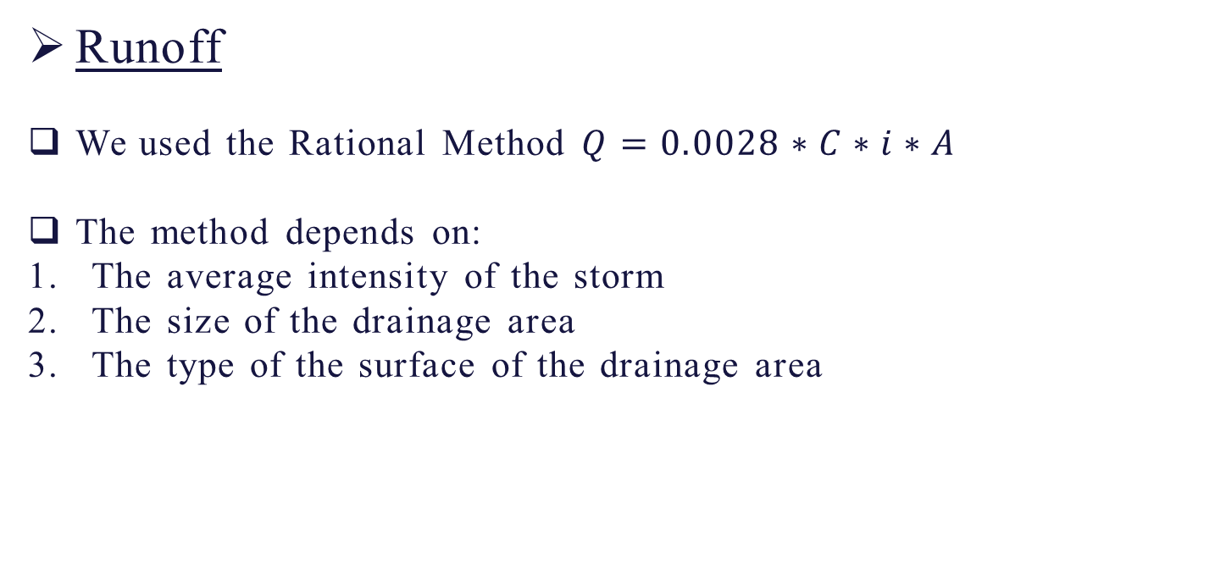
Elements
Runoff
We used the Rational Method $Q=0.0028∗C∗i∗A$
The method depends on:
The average intensity of the storm
The size of the drainage area
The type of the surface of the drainage area

Slide 44
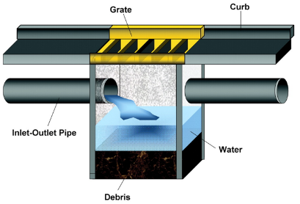
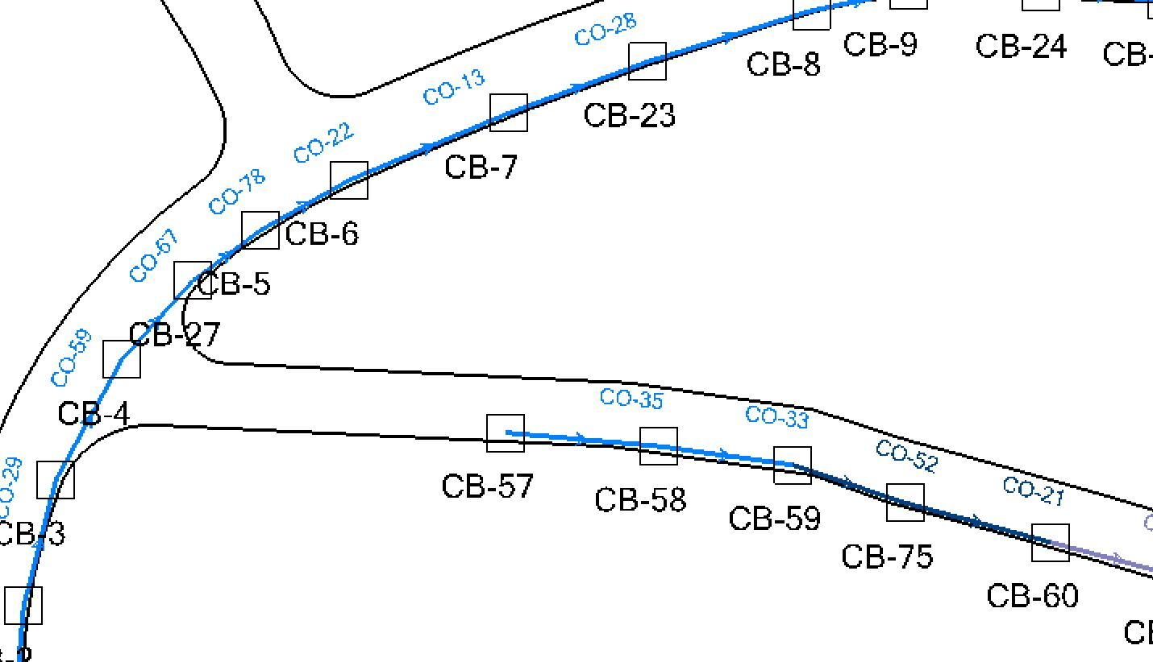
Elements
Catch basins
We used 85 catch basins in our project
Figure 8: Catch basin
Figure 9: A part of the placed catch basins in our network

Slide 45
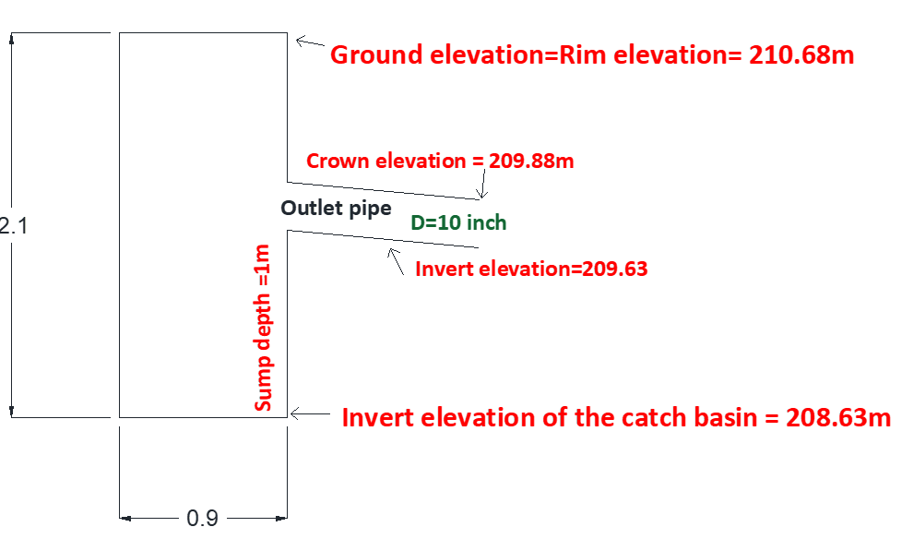
Elements
Catch basins
Figure 10: Catch basin structure design

Slide 46
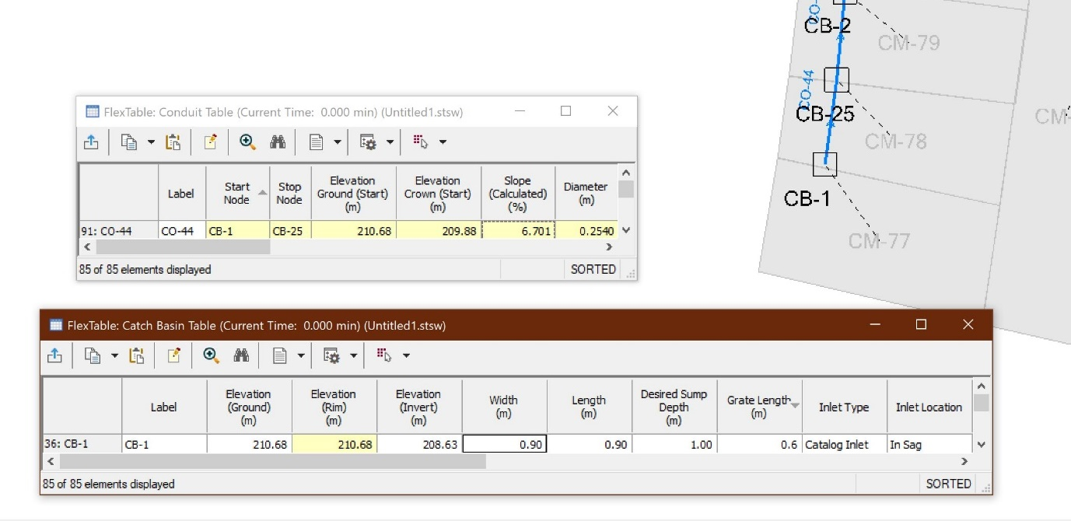
Elements
Catch basins
Figure 11: Catch basins design

Slide 47
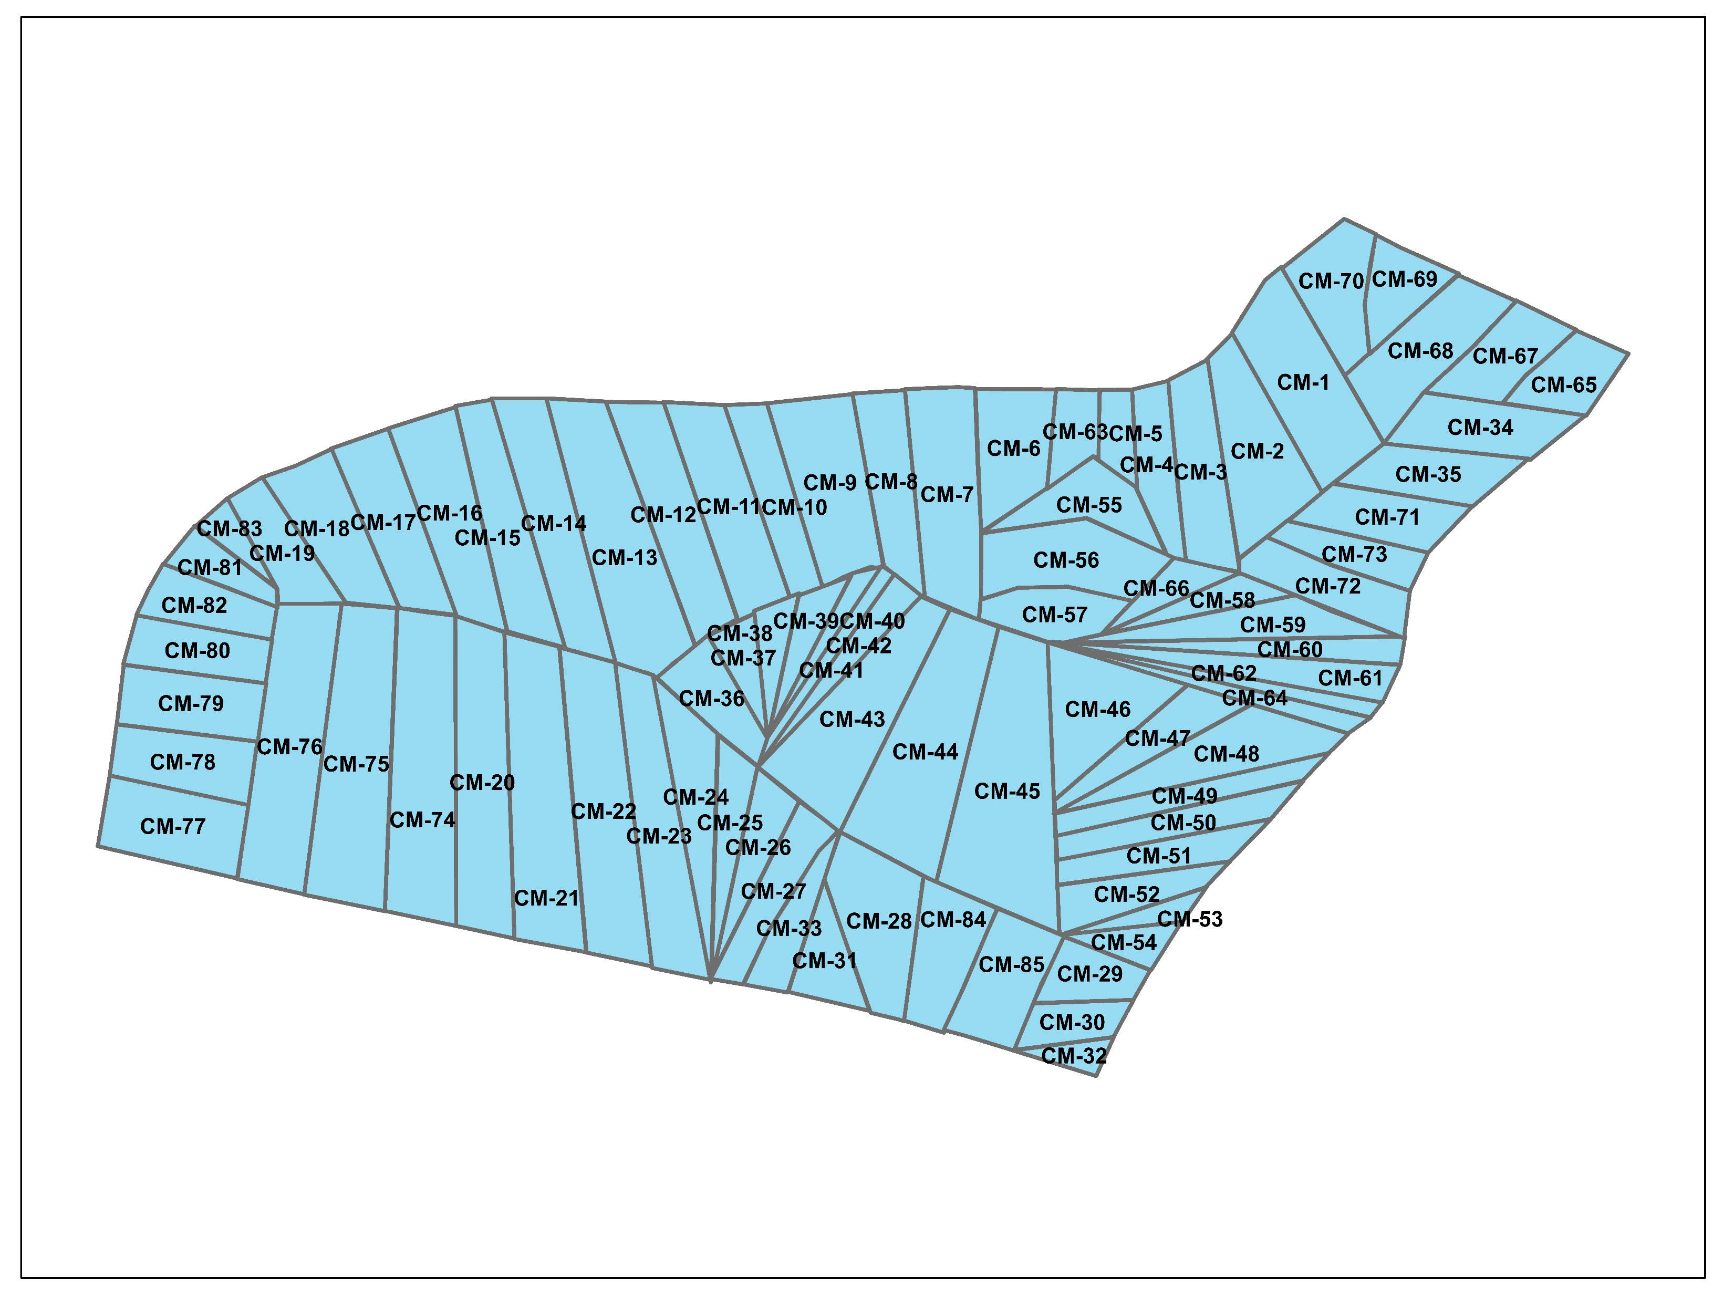
Elements
Catchments
We used 85 catchments
in our project
Figure 12: catchments

Slide 48
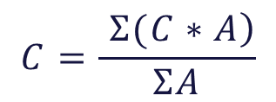
Elements
Runoff Coefficient (C)
An intersection between the physical plan and the catchments leads to calculating C values
Table 1: Runoff coefficients for different land uses
Land Use | C
Approved Road | 0.8
Commercial "Longitudinal" | 0.7
Residence "D" | 0.5
Roads Pedestrians | 0.8
$$C=\frac{\left. Σ(C∗A\right)}{ΣA}$$

Slide 49
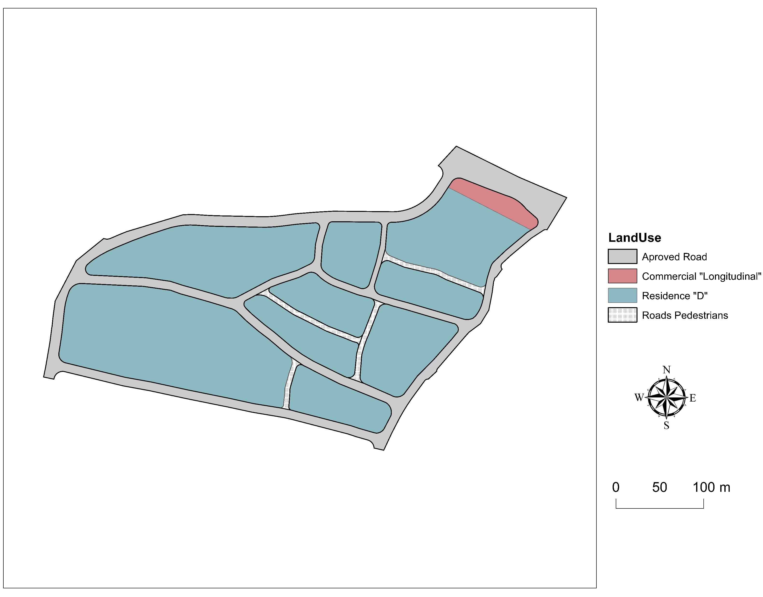
Figure 13: Land use for the 10.93-hectare area

Slide 50
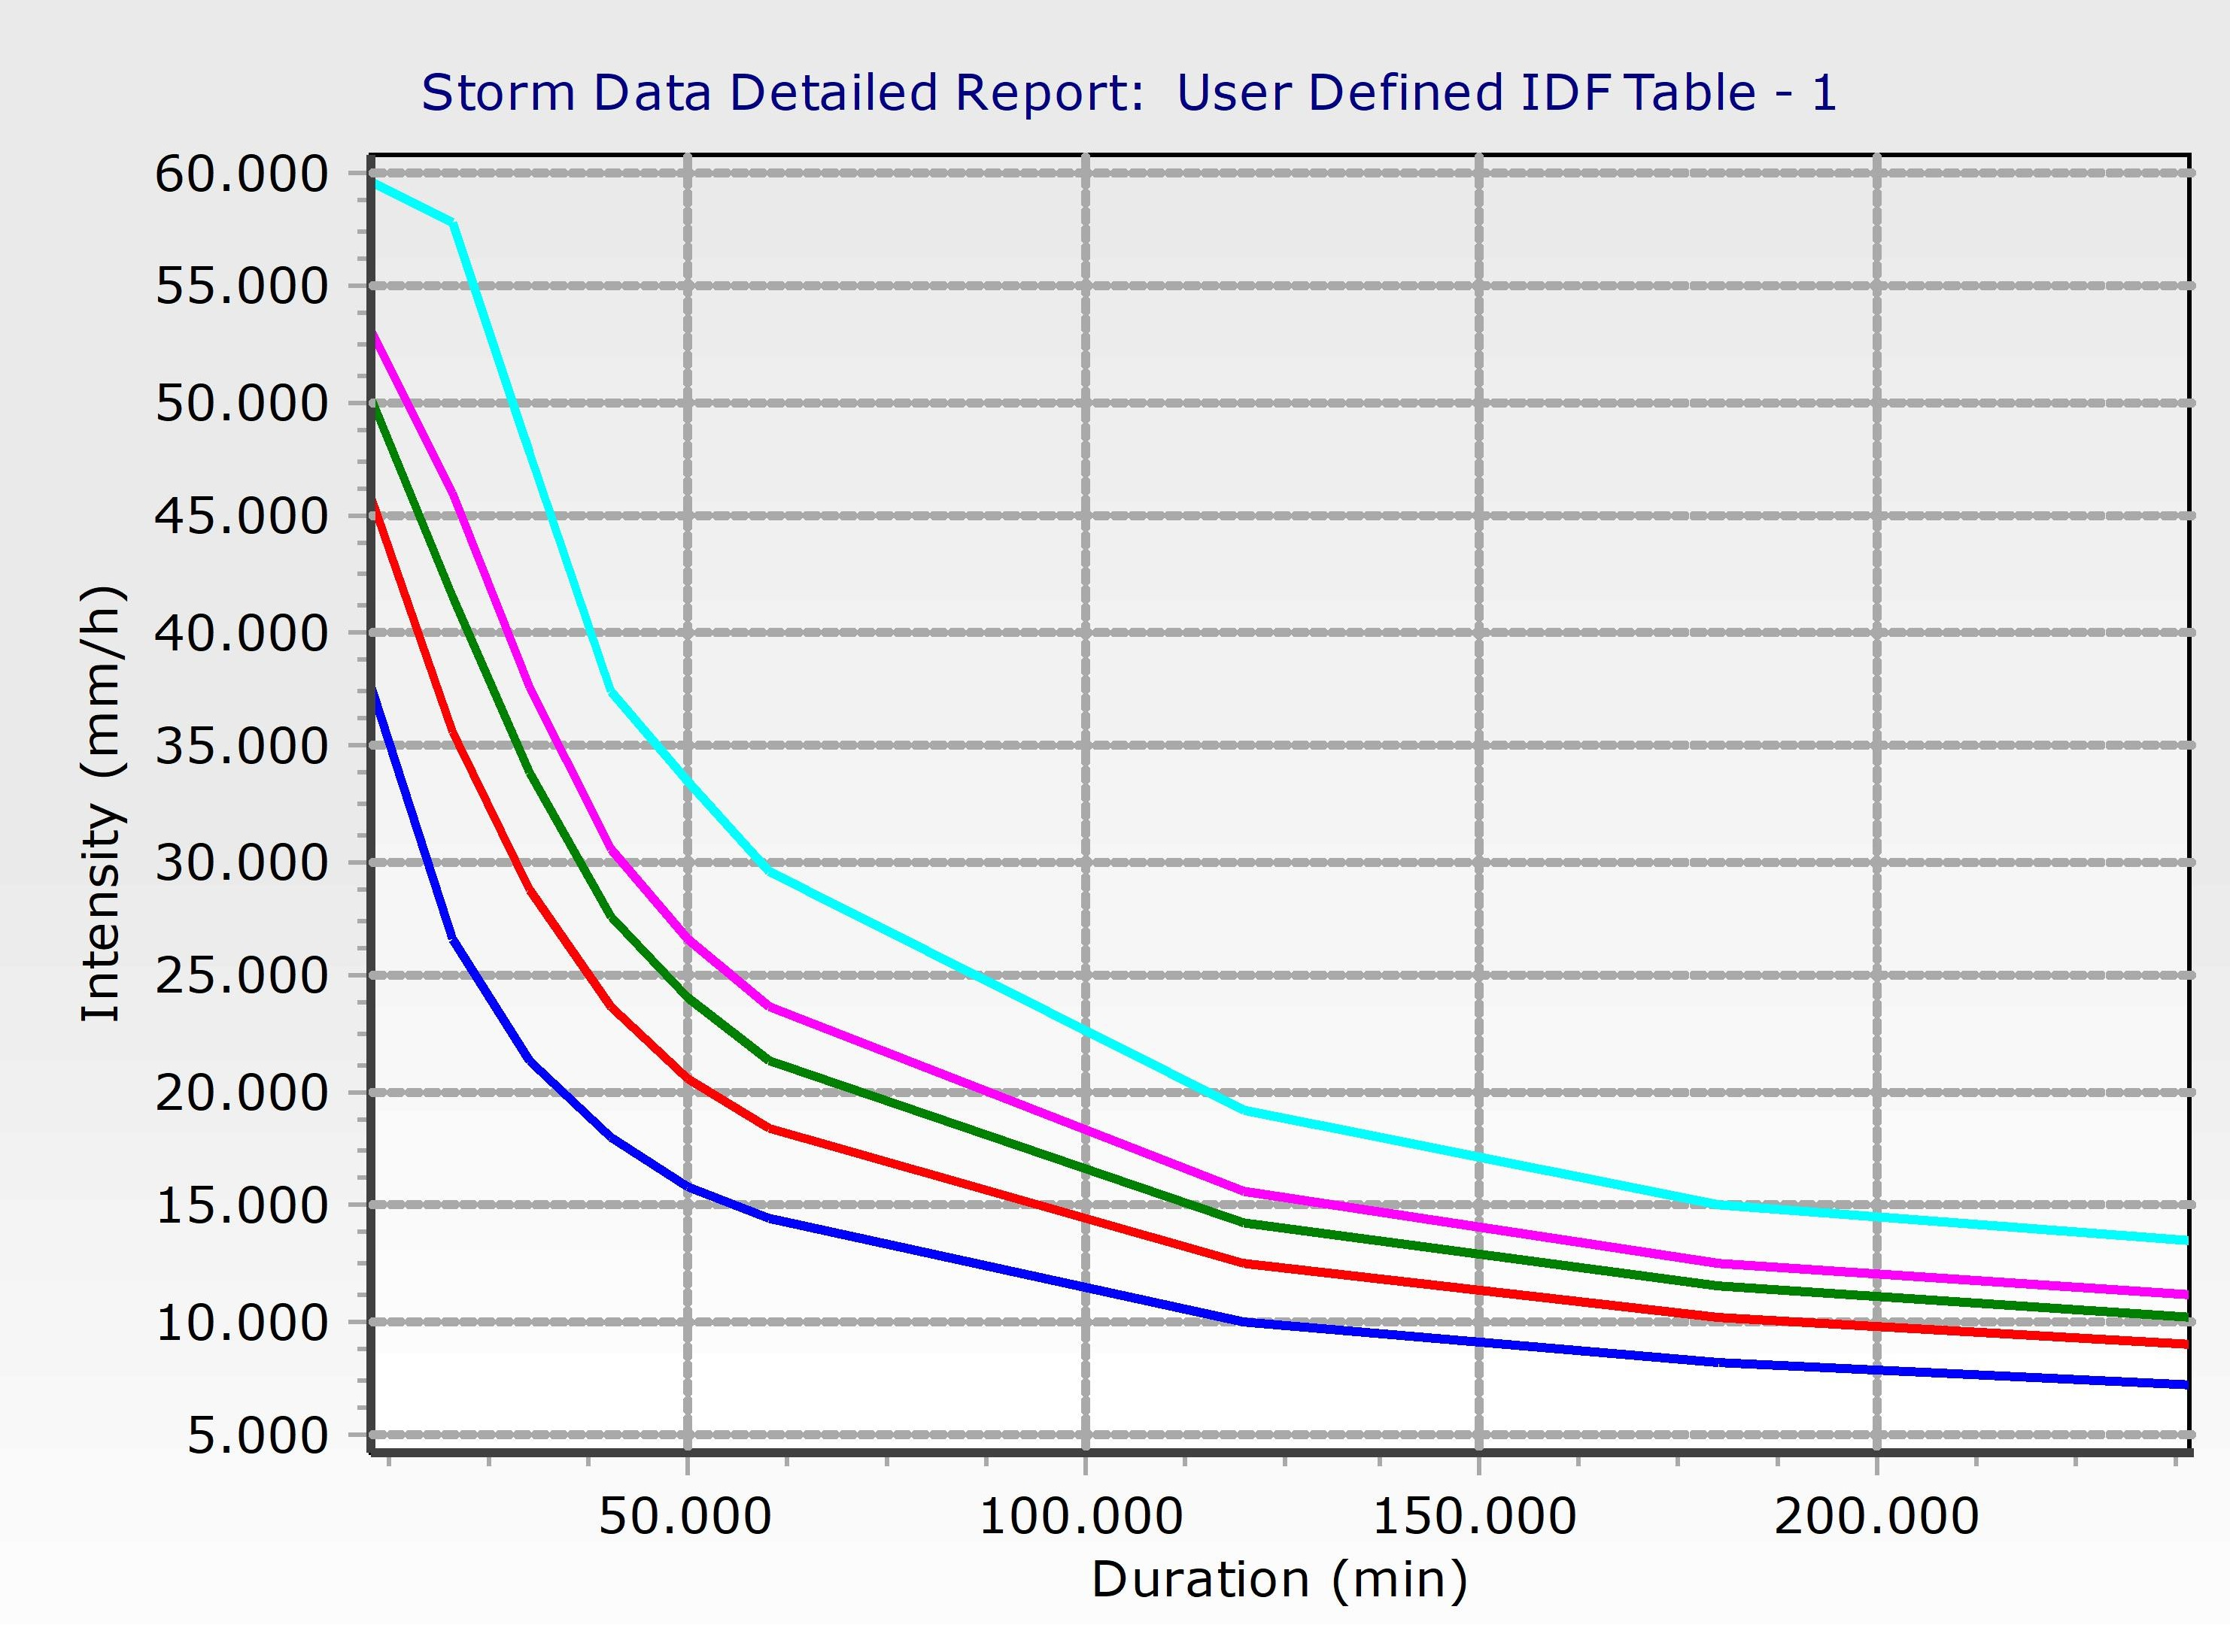
Elements
Intensity (i)
We modified Nablus’s IDF curve to obtain an IDF curve for Anabta
Figure 14: Anabta’s IDF curve modified from Nablus’s

Slide 51
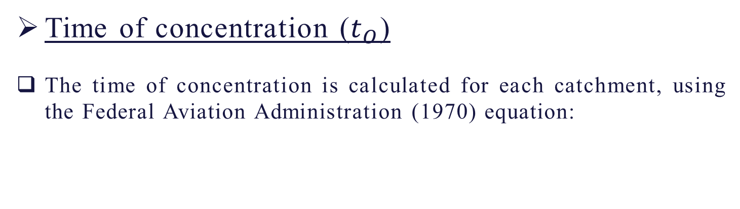
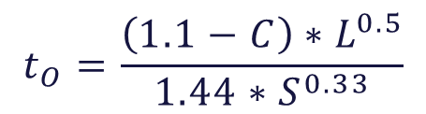
Elements
Time of concentration ($t_{O}$)
The time of concentration is calculated for each catchment, using the Federal Aviation Administration (1970) equation:
$$t_{O}=\frac{\left(1.1−C\right)∗L^{0.5}}{1.44∗S^{0.33}}$$

Slide 52
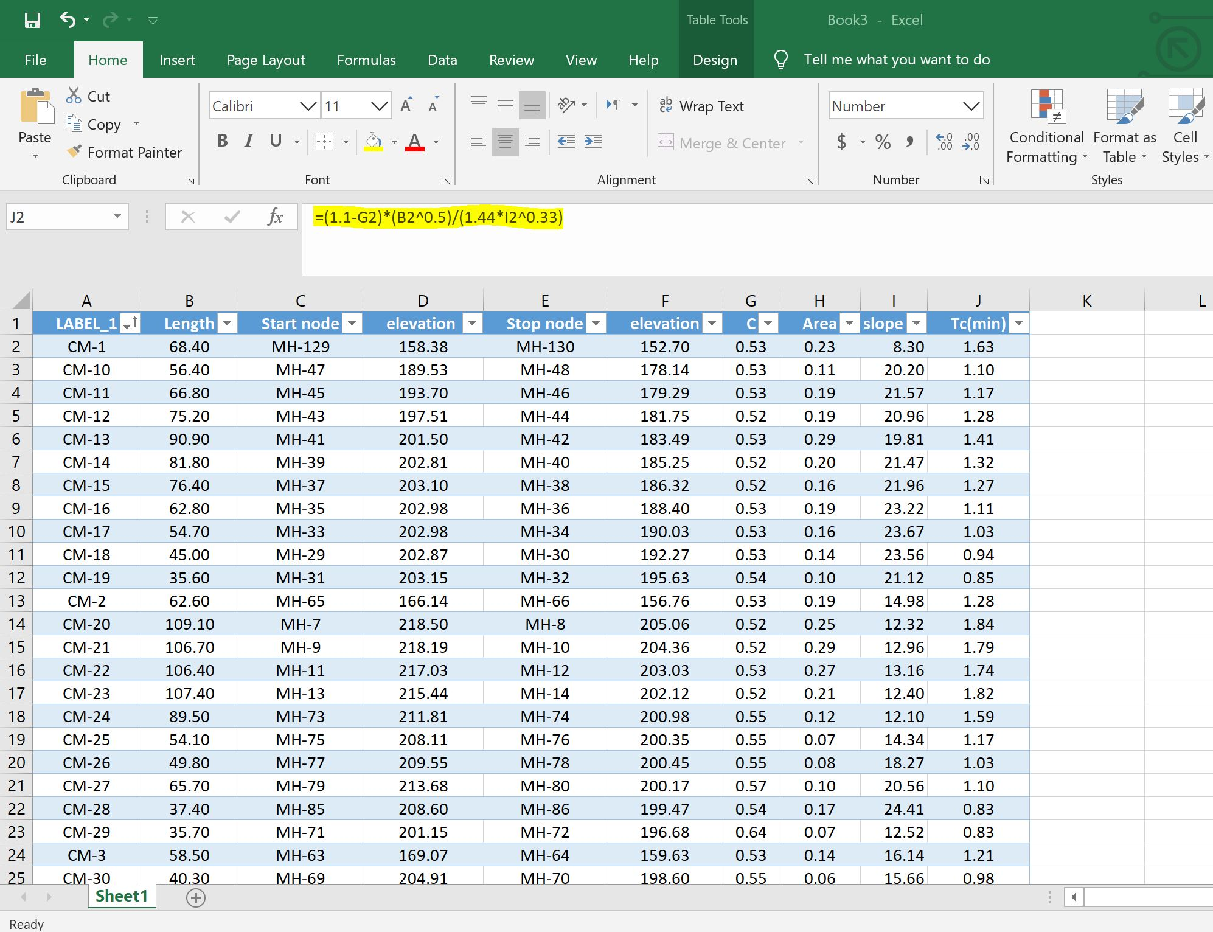
Figure 15: Sample calculation for Tc

Slide 53
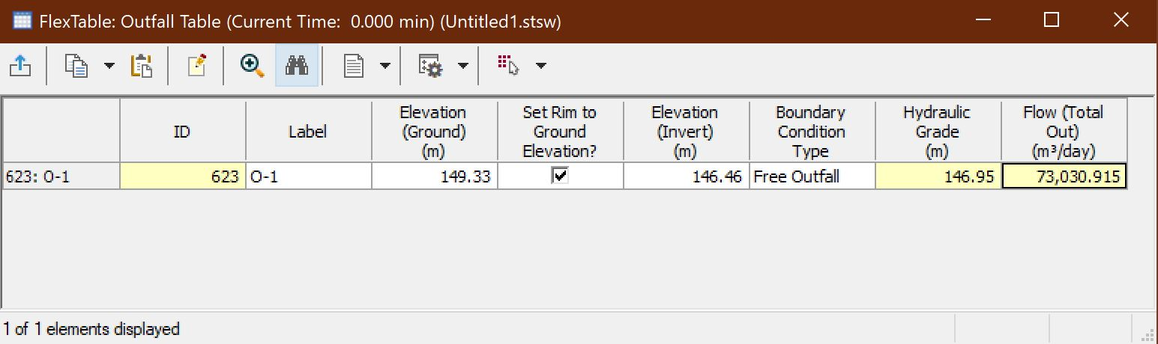

Elements
Outlet
We used 1 outlet in our project with a flow of 73054$m^{3}/day$
Figure 16: Outfall flex table

Slide 54
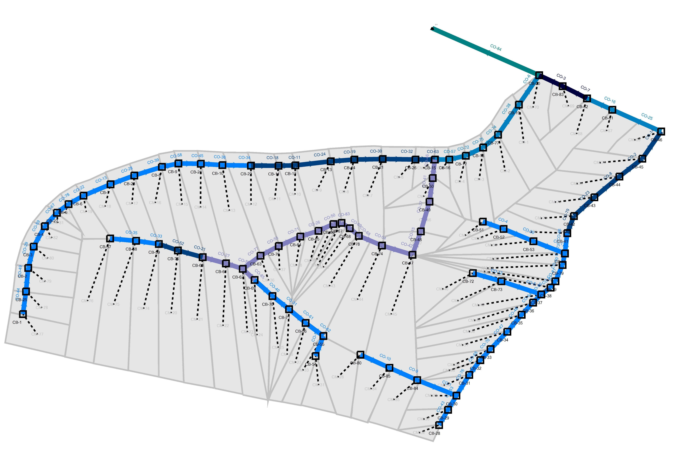
Elements
Conduits
A total of 85 conduits with diameters of 10”, 12”, 15”, 18”, 24”, and 30” were used for the network
Figure 17: Conduits

Slide 55
Elements
Design Constraints
Table 2: Design constraints
Design Constraint | Min.. Value | Max. Value
Slope | 1 % | 15 %
Cover | 0.80 m | 4.50 m/
Velocity | 0.90 m/s | 5.00 m/s

Slide 56
Results
Figure 18: Slope trend

Slide 57
Results
Figure 19: Velocity trend

Slide 58
Results
Figure 20: Cover trend

Slide 59
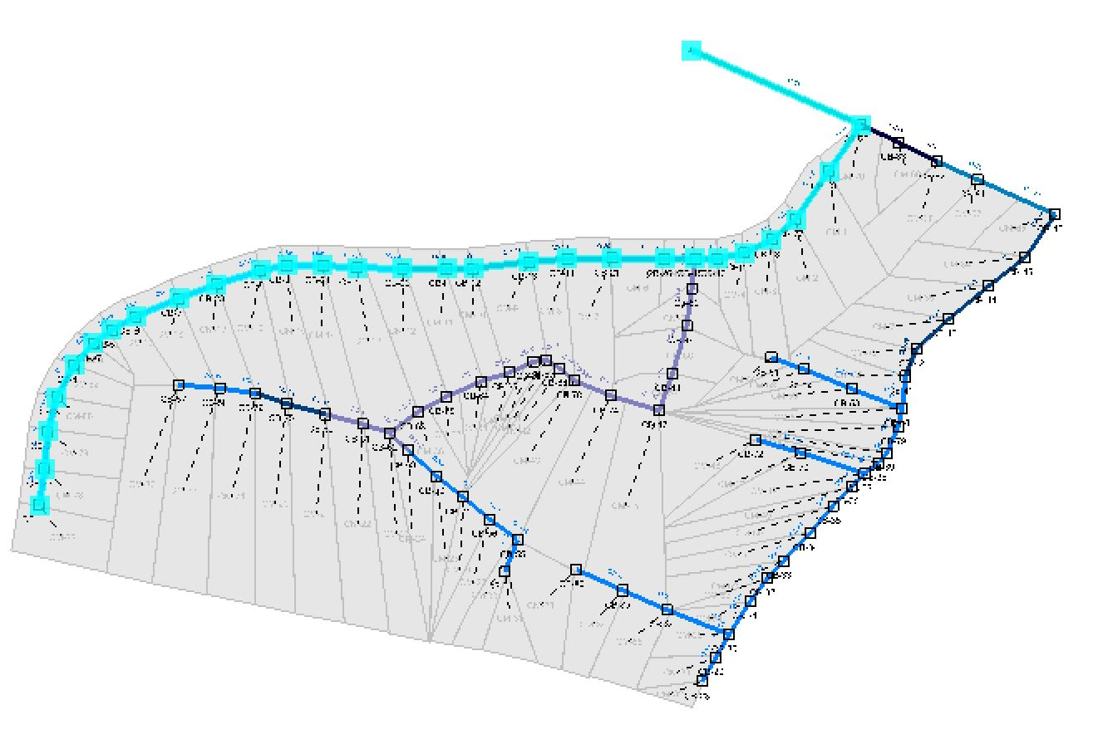
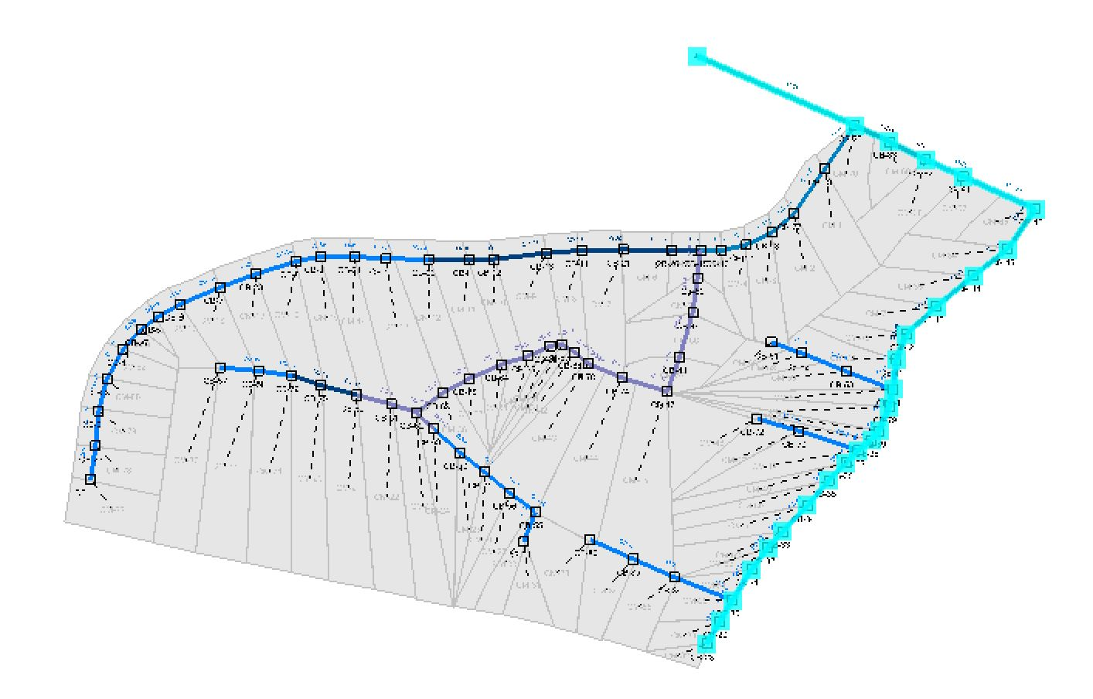
Profiles
Profiles 1 and 2 were taken in the following locations
Figure 21: Profile number 2
Figure 22: Profile number 1

Slide 60
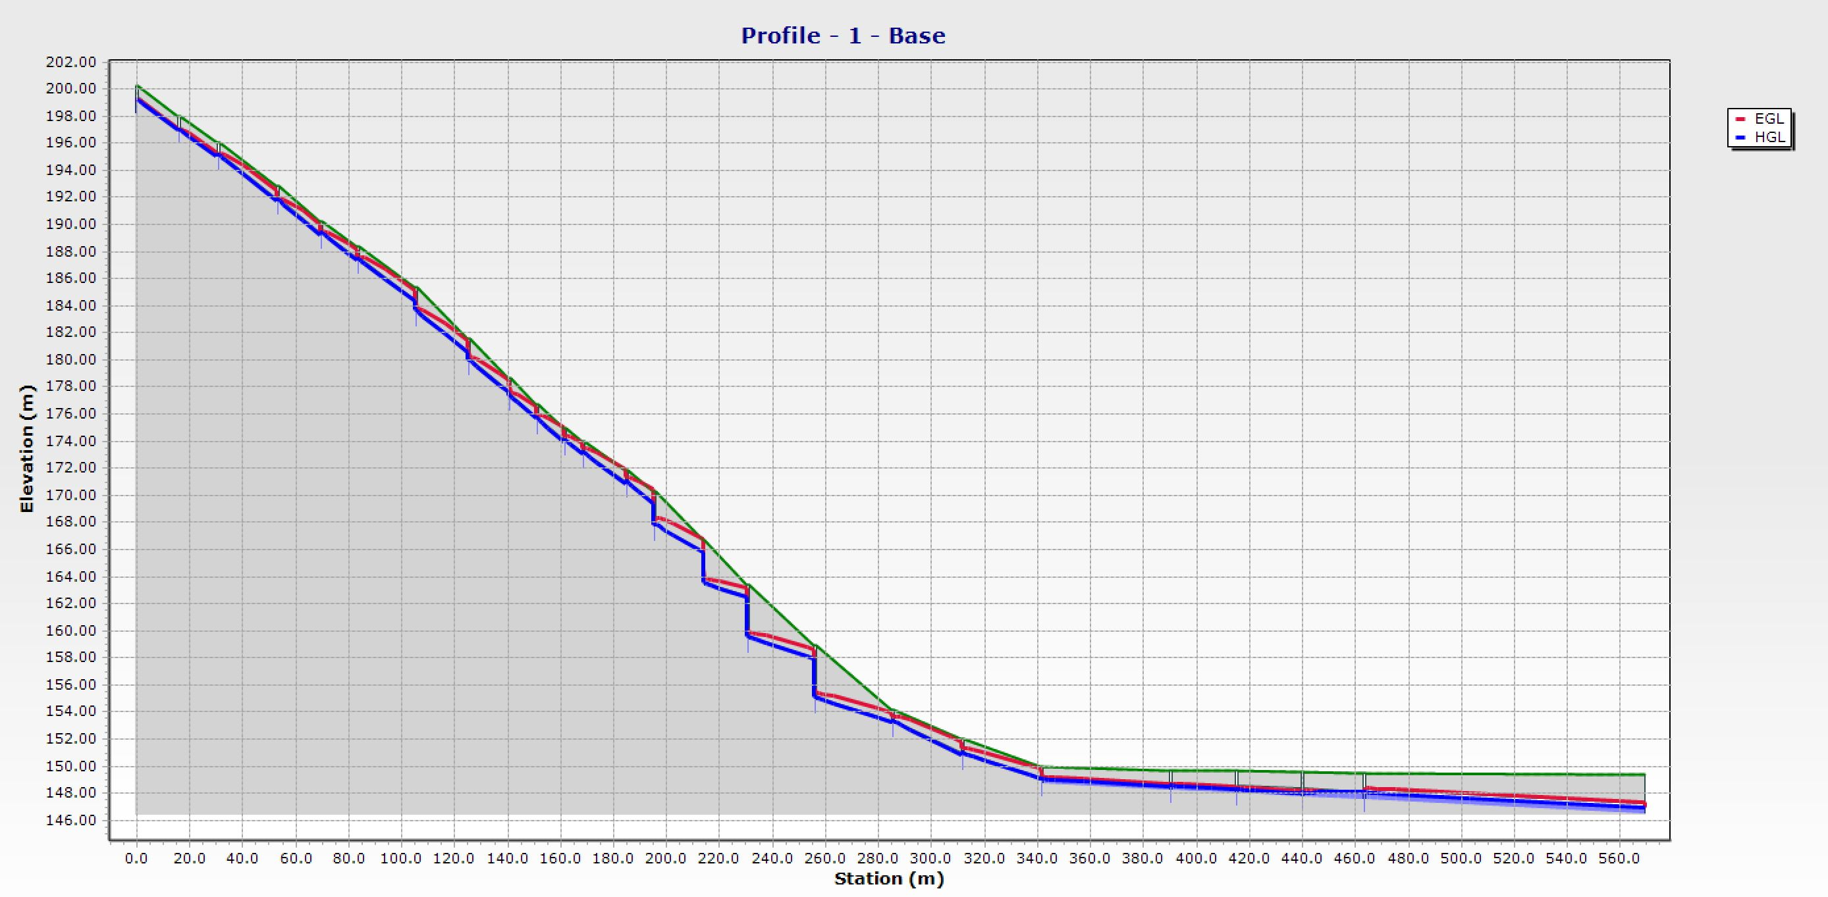
Profiles
Figure 23: Profile number 1

Slide 61
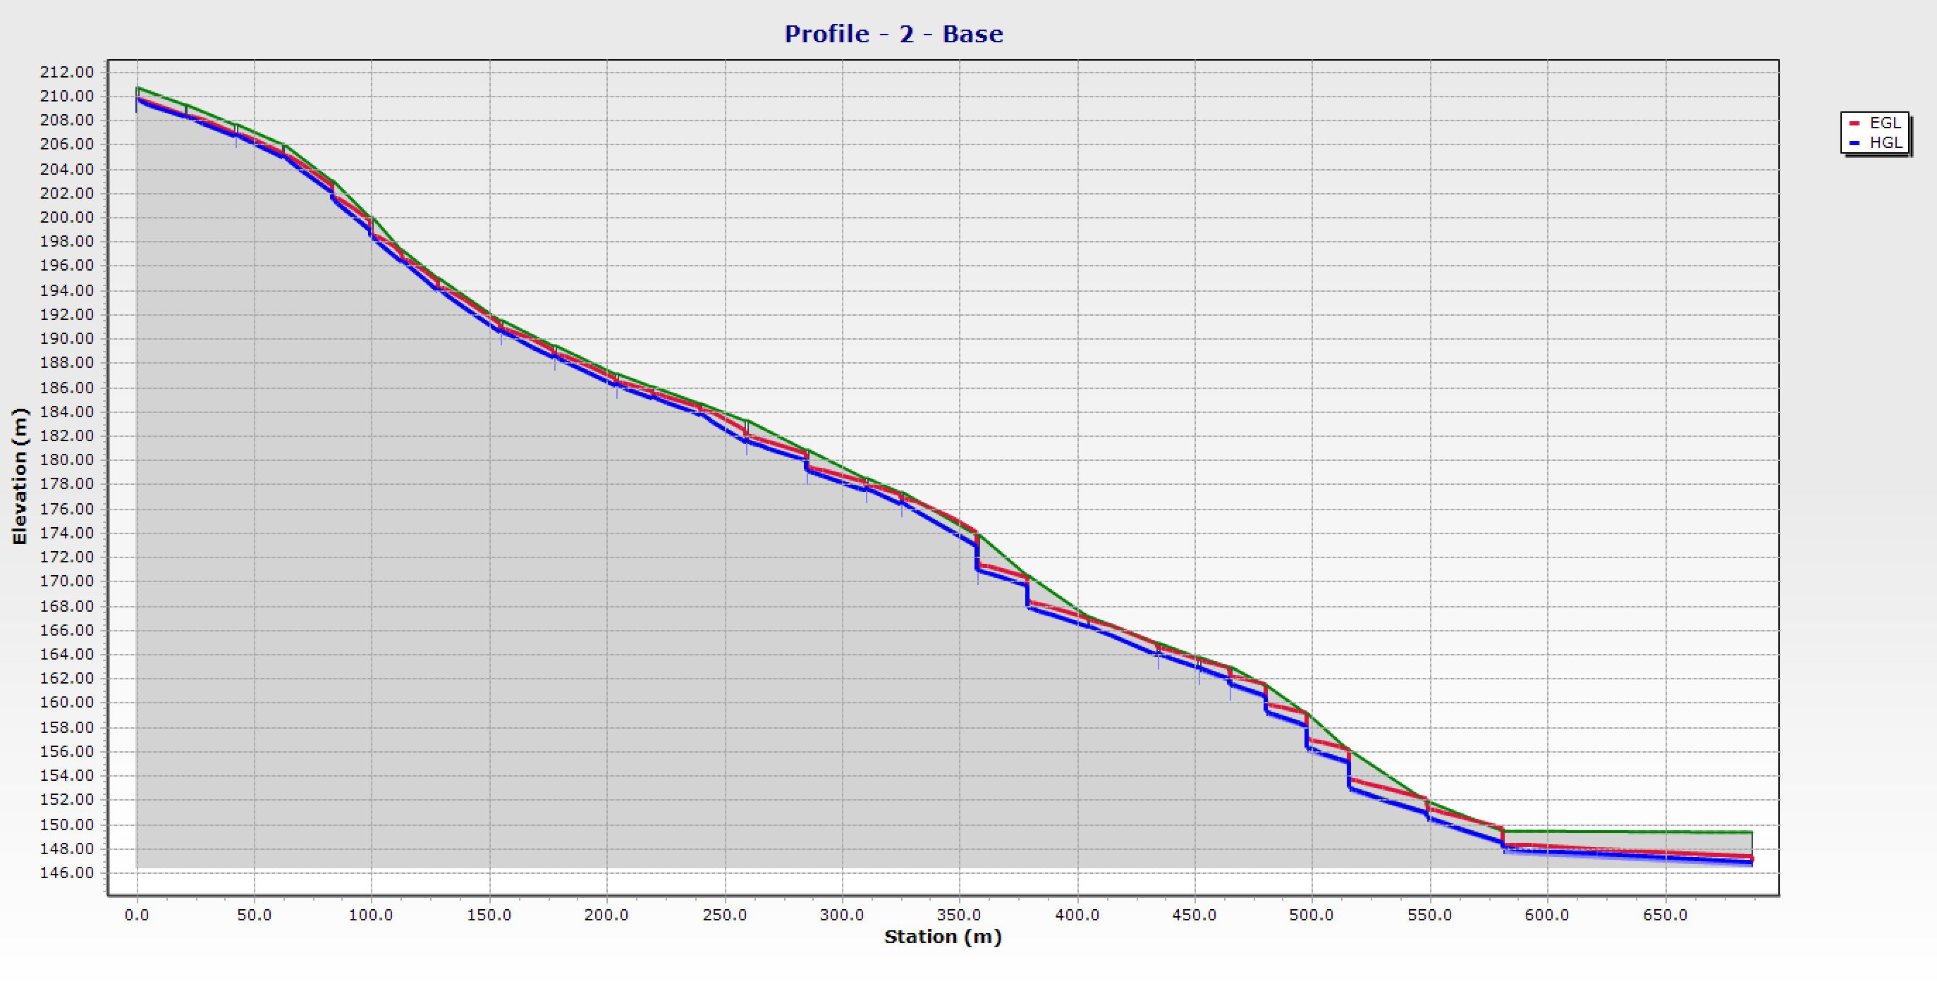
Profiles
Figure 24: Profile number 2

Slide 62
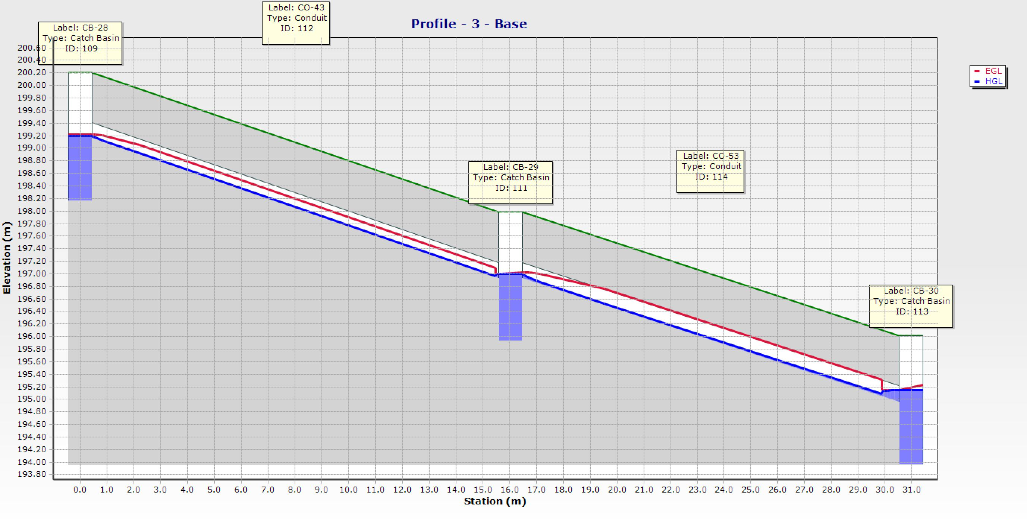
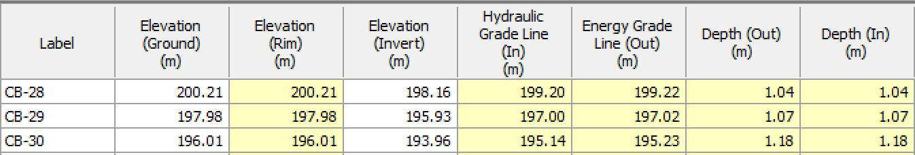
Profiles
Figure 25: Profile

Slide 63
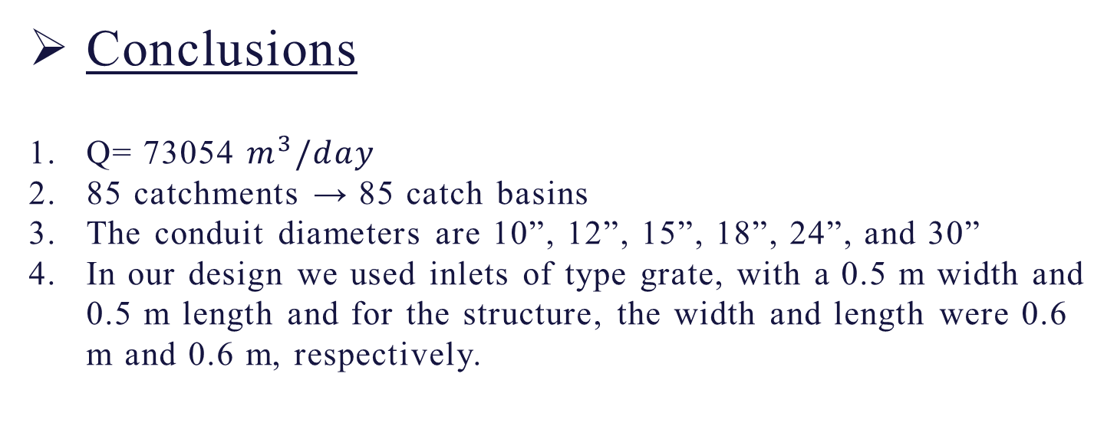
Conclusions and Recommendations
Conclusions
Q= 73054 $m^{3}/day$
85 catchments → 85 catch basins
The conduit diameters are 10”, 12”, 15”, 18”, 24”, and 30”
In our design we used inlets of type grate, with a 0.5 m width and 0.5 m length and for the structure, the width and length were 0.6 m and 0.6 m, respectively.

Slide 64
Conclusions and Recommendations
Recommendations
Construction of storm water collection netwrok in Anabta
Cleaning the current culverts in Anabta
Rehabilitation of roads and maintianing a decent cross slope

Slide 65
Thanks!
Any questions?

Slide 66
References
[1] | "مقدمة عن المصادر المائية في فلسطين," سلطة المياه, 16 1 2018. [Online]. Available: http://www.pwa.ps/ar_page.aspx?id=NgKPUWa2695364496aNgKPUW.
[2] | "المياه الجوفية في الضفة الغربية," 17 1 2018. [Online]. Available: http://www.pwa.ps/ar_page.aspx?id=LuBJw9a2707737285aLuBJw9.
[3] | U.-W. D. P. o. A. a. C. a. W. S. a. S. C. Council, "The Human Right to Water and Sanitation".

Slide 67
References
[4] M. N. Almasri, "Hydrology: Lectures," [Online]. Available: https://docs.google.com/viewer?a=v&pid=sites&srcid=ZGVmYXVsdGRvbWFpbnxoeWRyb2xvZ3ltbmF8Z3g6NDg0ZGQ3ZDJmZjBjODE5Nw. [Accessed 2019].
[5] "The Official Website of the State of Indiana," [Online]. Available: https://www.in.gov/dot/div/contracts/standards/dm-Archived/07%20Metric/Part%204%20Vol.%201/Ch%2029/Ch29.pdf. [Accessed 2019].
6] "Pipeline design consideration and standards," [Online]. Available: https://petrowiki.org/Pipeline_design_consideration_and_standards. [Accessed 2019].

