Slide 1
Electro Gram
Presented By:
Shareef Aalawneh
&
Lina Ennab

Slide 2
Overview
CNC? o.O
Tools
Futer Work
Demo

Slide 3
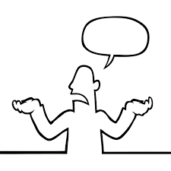
What is CNC mean?

Slide 4
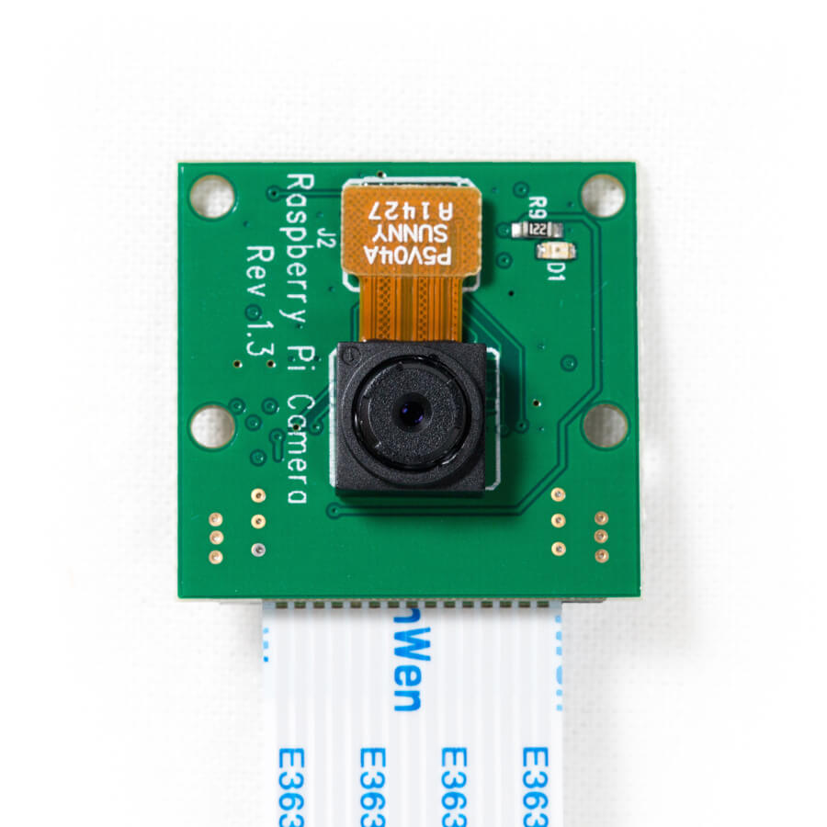
Pi Camera

Slide 5

Raspberry Pi 3

Slide 6


Slide 7
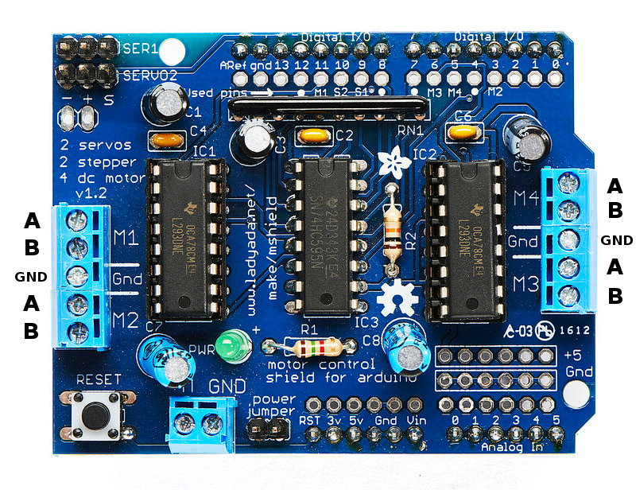
Motor Shield

Slide 8
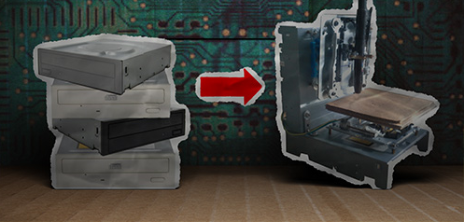
The X,Y Plotter

Slide 9
Future Work

Slide 10
Demo

Slide 11
