Slide 1

WAIRO
(WAITER ROBOT)
BY ADAM AKRAM & QAIS ABUHWEIDI

Slide 2
INTRODUCTION
Imagine walking into a restaurant, placing your order effortlessly, and having your food delivered quickly and accurately without human intervention. This is the future of dining with WAIRO, our autonomous waiter robot!

Slide 3

PROBLEMS
01
Human Limitations in Restaurants:
A
Long wait times during peak hours due to overwhelmed staff.
B
Human errors in order-taking and delivery (e.g., wrong orders, delays).

Slide 4
PROBLEMS
02
Operational Inefficiency
A
Repetitive tasks (order-taking, food delivery) consume staff time.
B
High labor costs for restaurant owners.

Slide 5
PROBLEMS
03
Customer Experience Gaps
A
Lack of interactive dining experiences.

Slide 6

Develop an autonomous robot for order-taking and food delivery using IR navigation, RFID, and voice interaction.
OBJECTIVE

Slide 7
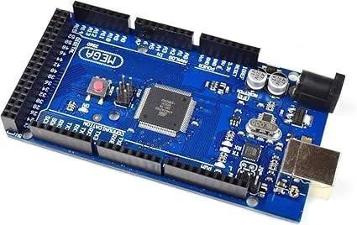
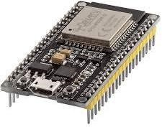
HARDWARE COMPONENTS
MICROCONTROLLERS
ARDUINO MEGA 2560
ESP32

Slide 8
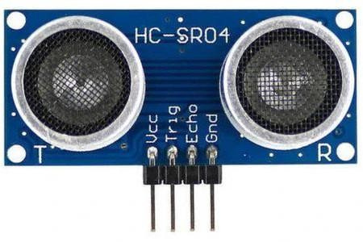
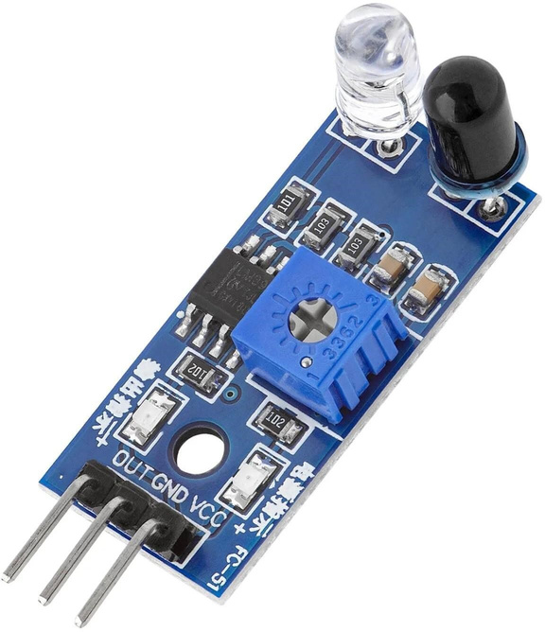
HARDWARE COMPONENTS
SENSORS
ULTRASONIC SENSORS
IR SENSORS

Slide 9
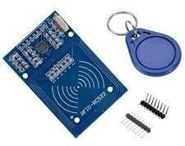
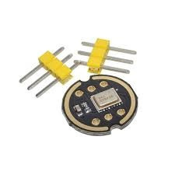
HARDWARE COMPONENTS
SENSORS
RFID MODULE + NFC TAGS
INMP441 MICROPHONE

Slide 10
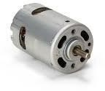
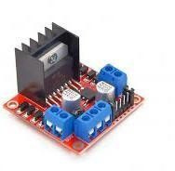
HARDWARE COMPONENTS
ACTUATORS/DRIVERS
DC MOTORS
H-BRIDGE DRIVERS

Slide 11

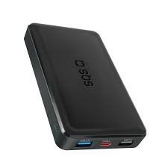
HARDWARE COMPONENTS
POWER
12V 9A BATTERY
POWER BANKS

Slide 12
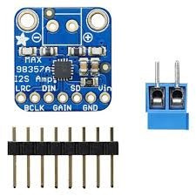
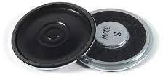
HARDWARE COMPONENTS
SOUND
SPEAKER
AMPLIFIER

Slide 13

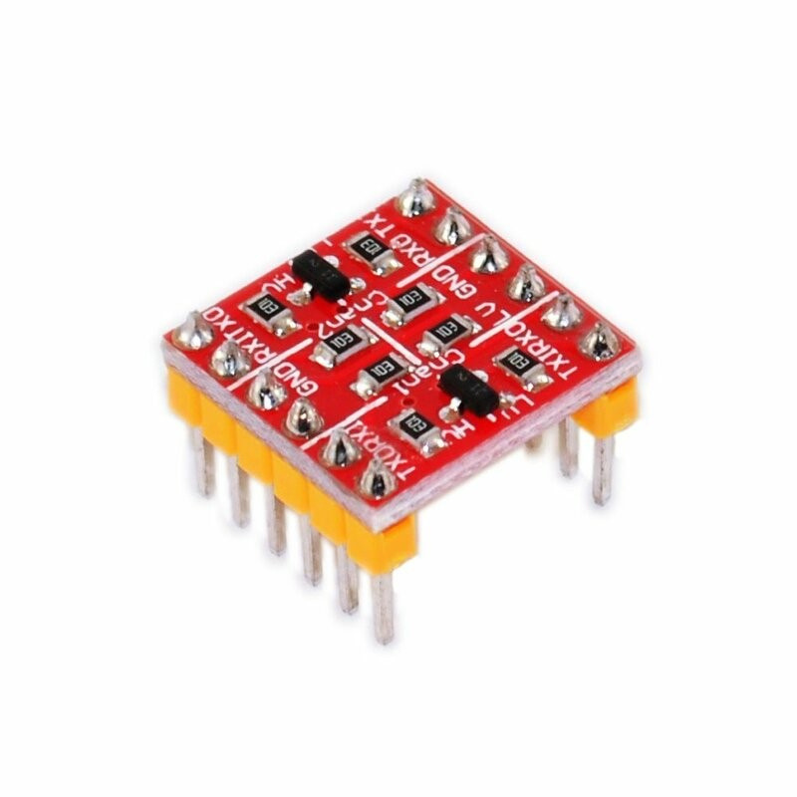
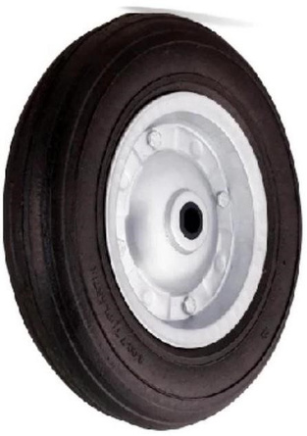
4X4 MATRIX KEYPAD
HARDWARE COMPONENTS
LOGIC LEVEL SHIFTER
RUBBER WHEELS

Slide 14
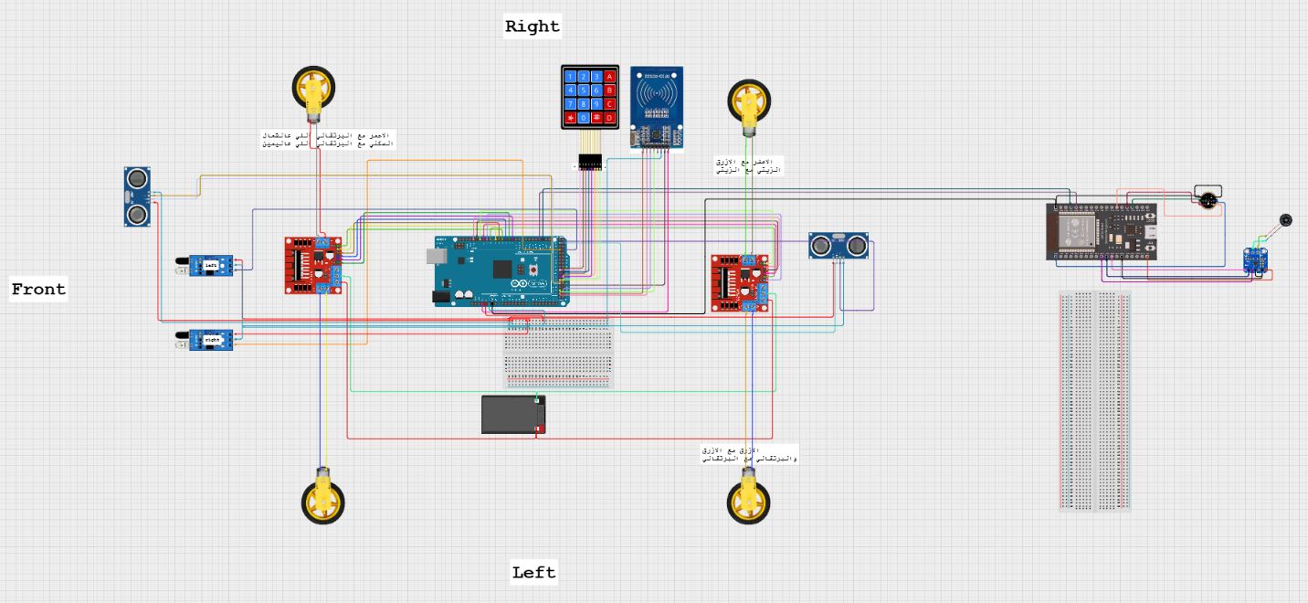
SYSTEM ARCHITECTURE OVERVIEW

Slide 15

SOFTWARE & CLOUD TOOLS
  ARDUINO IDE
  GOOGLE CLOUD SPEECH-TO-TEXT (STT) (CONVERT VOICE TO TEXT).
  LARGE LANGUAGE MODEL (LLM) (PROCESS CUSTOMER ORDERS).
  TEXT-TO-SPEECH (TTS) (ROBOT’S VERBAL RESPONSES).

Slide 16


BRAIN & PROCESSING
THE ROBOT'S COMMAND CENTER THAT MANAGES:
  ORDER PROCESSING FROM CUSTOMERS.
  COMMUNICATION WITH KITCHEN STAFF.
  NAVIGATION INSTRUCTIONS TO MOVEMENT SYSTEM.

Slide 17

  NETWORK DEPENDENCY
  NAVIGATION CHALLENGES
  INTERCITY ROAD CLOSURES
PROJECT LIMITATIONS

Slide 18

FUTURE WORK
  Advanced Navigation
  Offline Voice Processing
  Improved Customer Interface

Slide 19
DEMO VIDEO

Slide 20
THANK YOU

