Slide 1
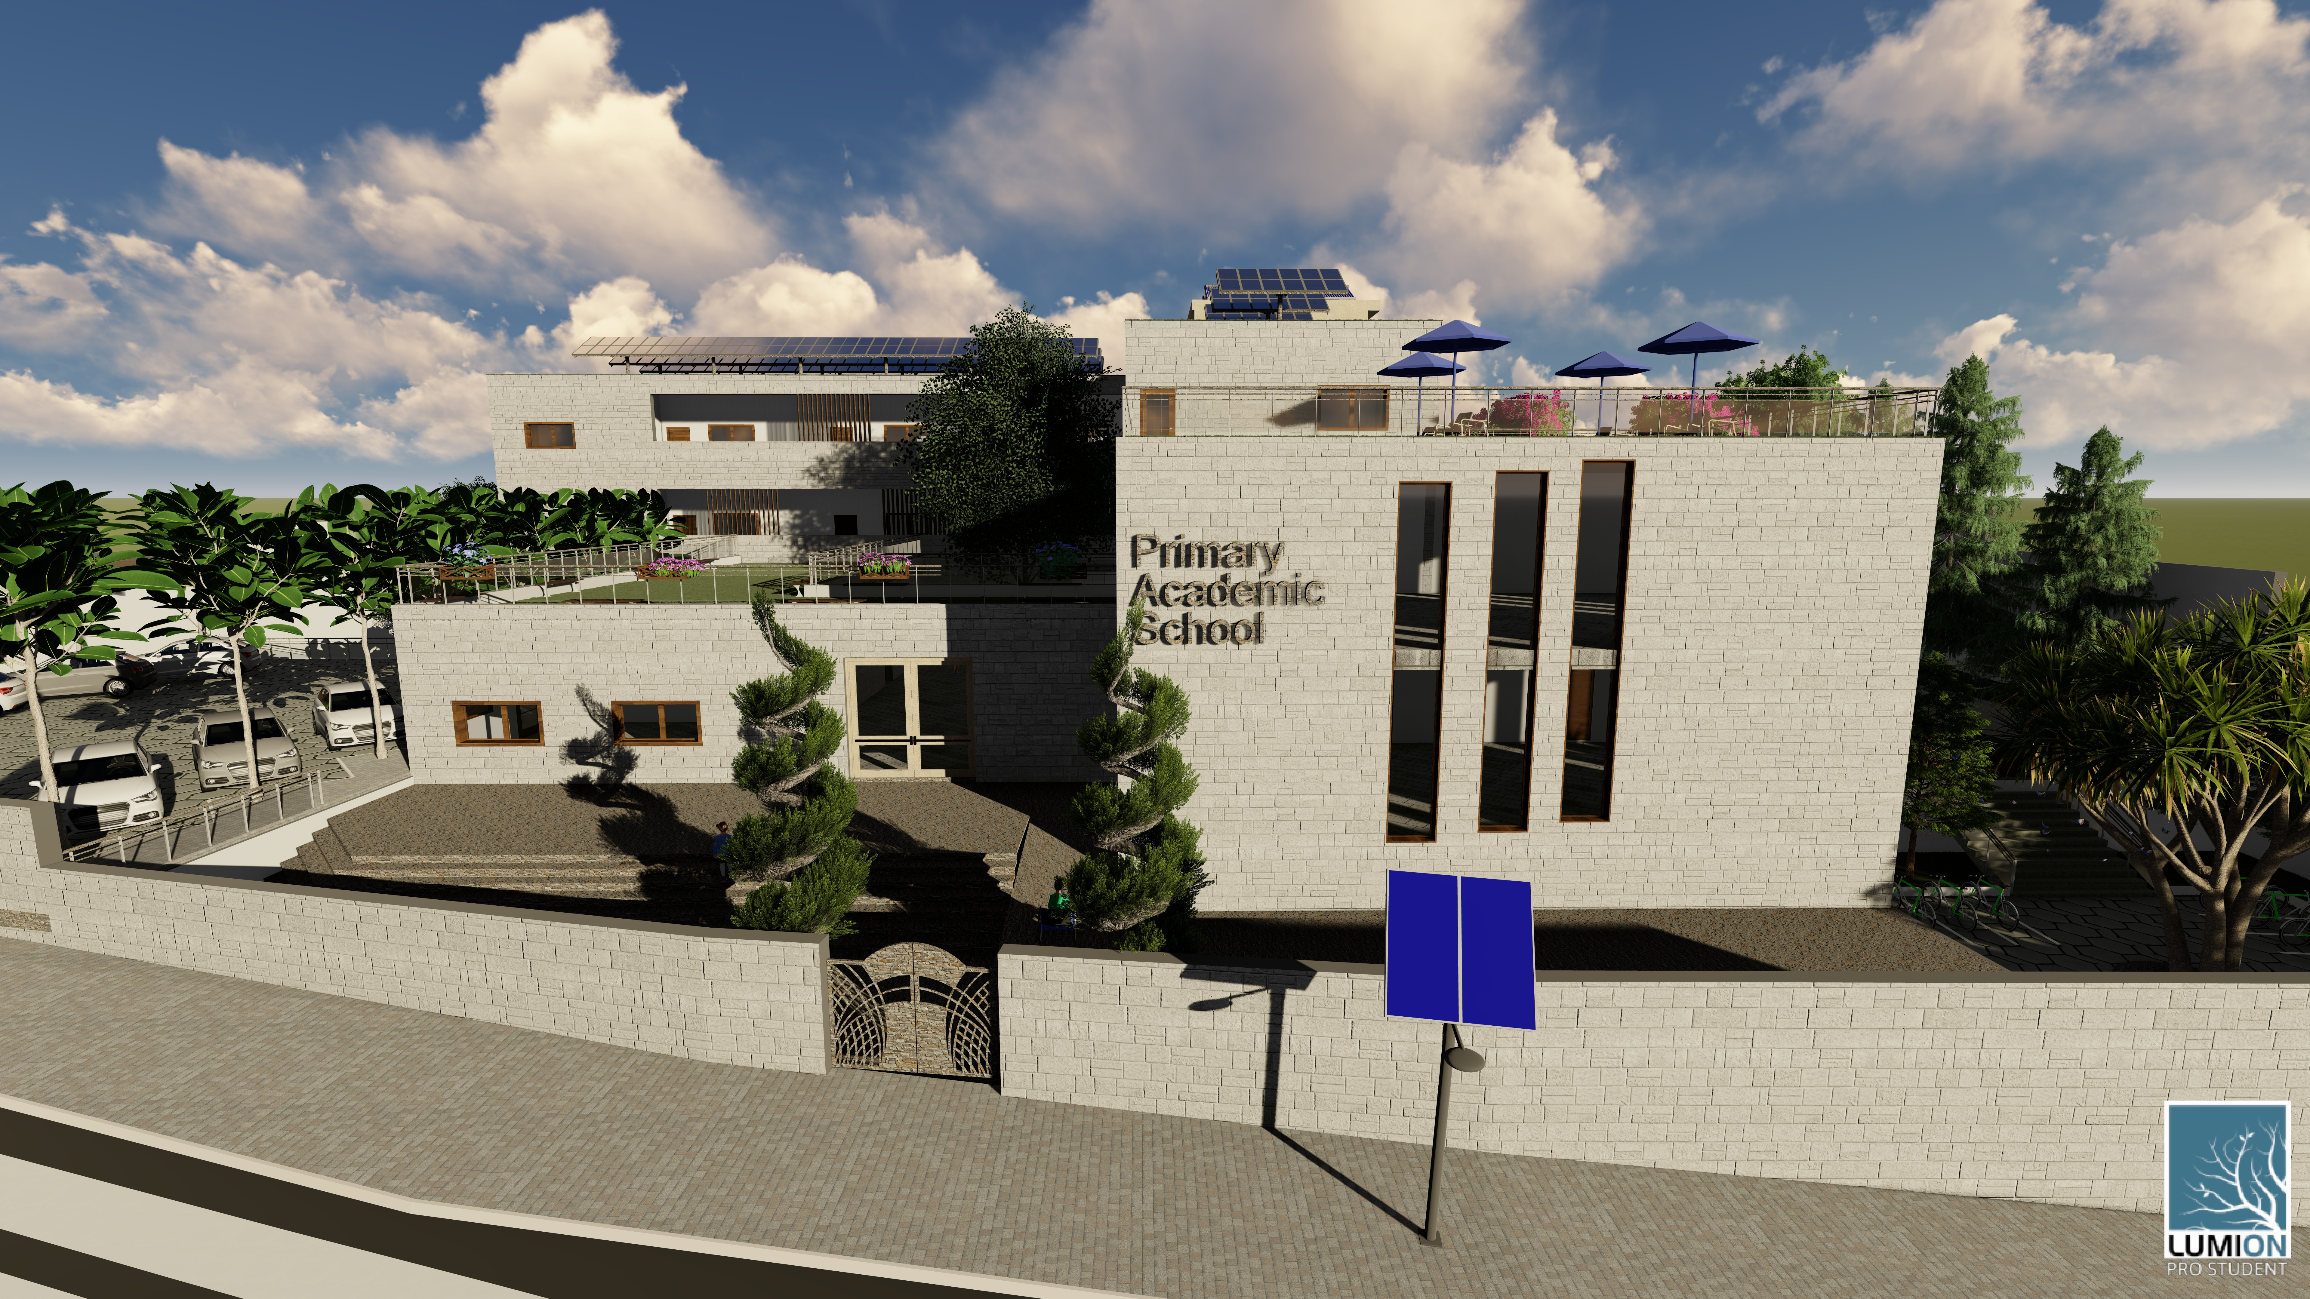

An Najah National University
Engineering College
Building Engineering Department
Students : Noran Malhas
Malak Ghannam
Gharam Odeh
Graduation Project II
Supervisor : Dr.Monther Dwikat

Slide 2
Outline Project
Project Description
Architectural Design
Structural Design
Environmental Design
Electrical Design
Mechanical Design
Project Management & Quality Surveying

Slide 3
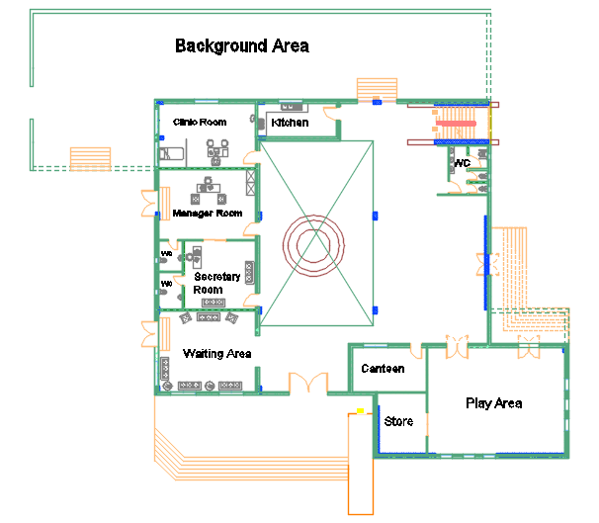
Architectural Design
Ground Floor

Slide 4
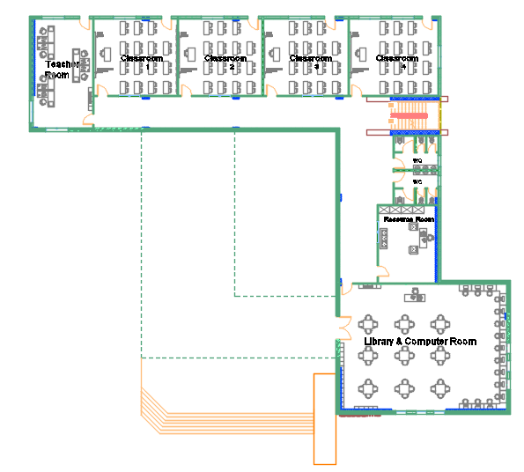
First Floor

Slide 5
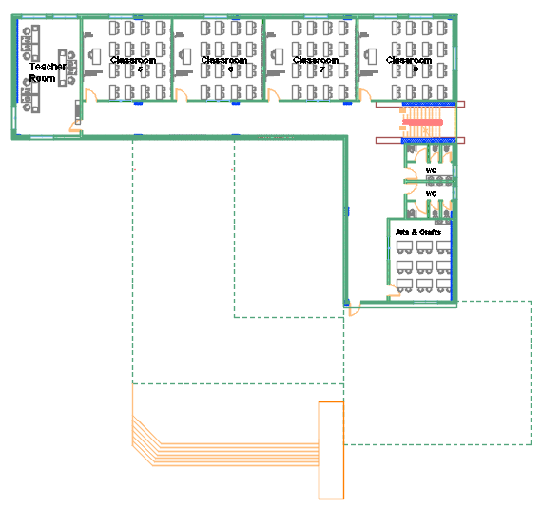
Second Floor

Slide 6
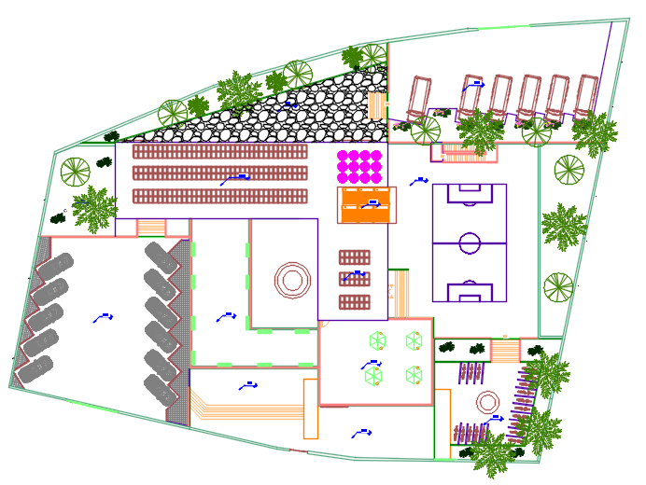
Site Plan

Slide 7
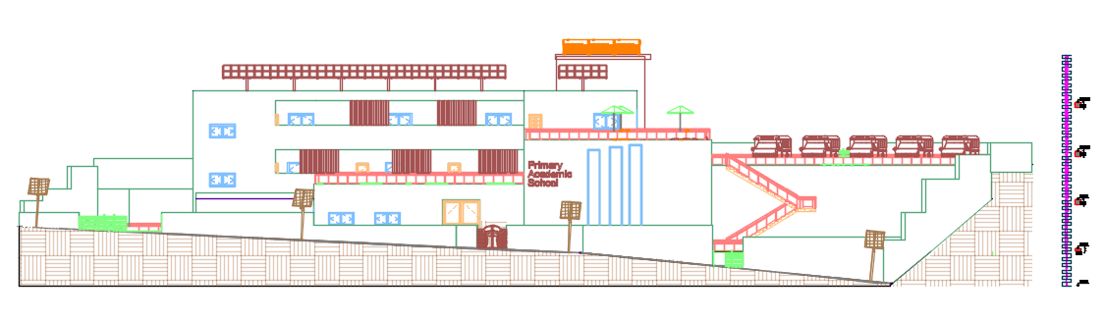
Southern Elevation

Slide 8
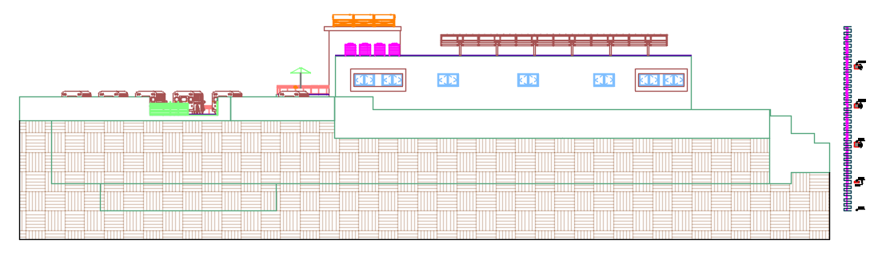
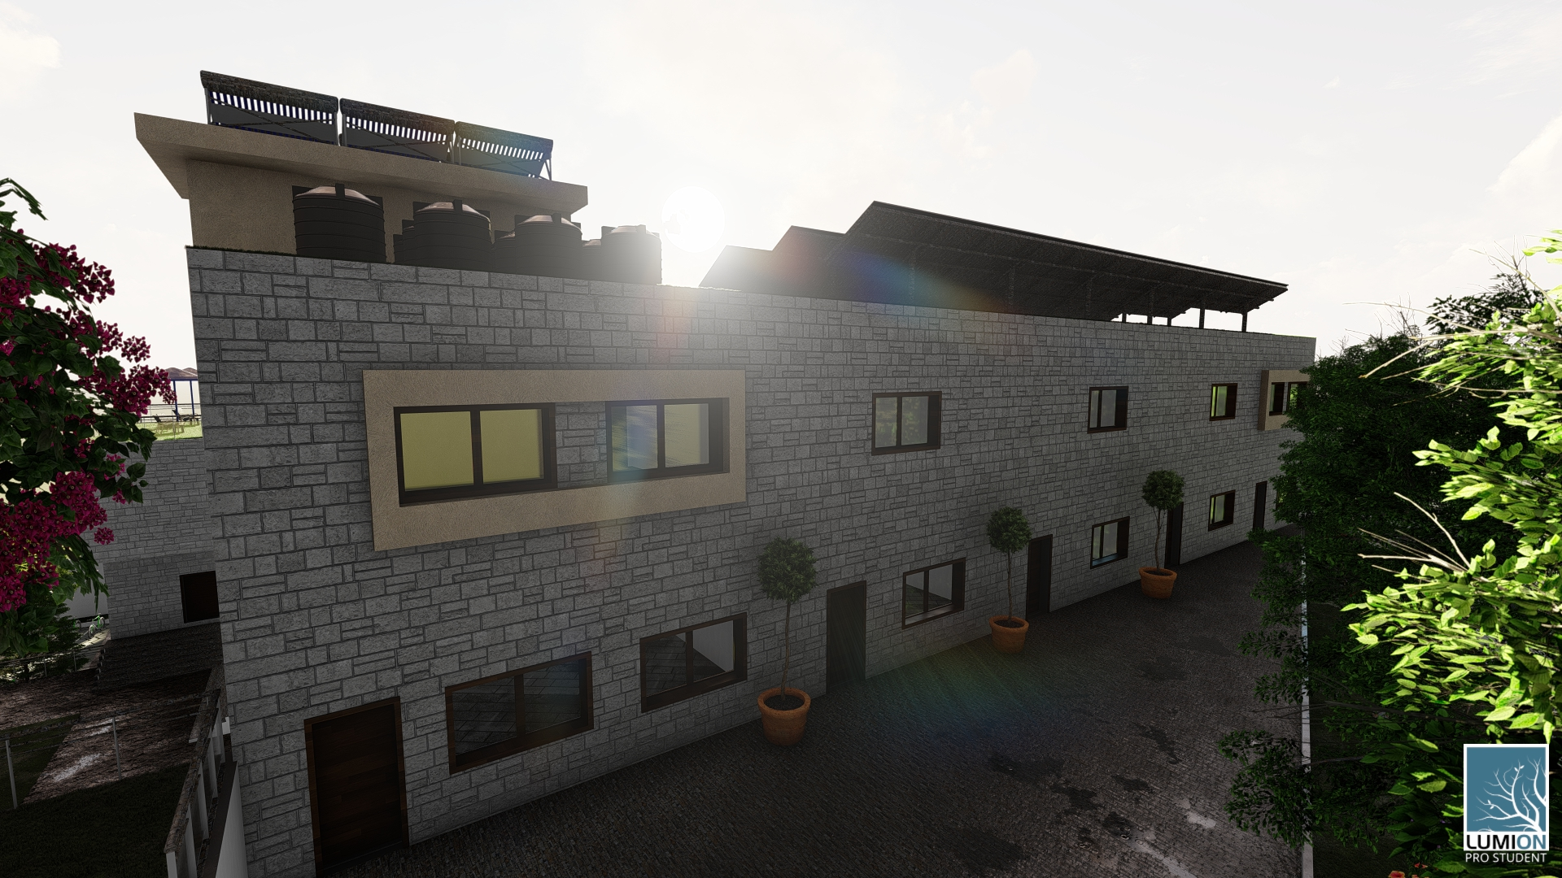
Northern Elevation

Slide 9
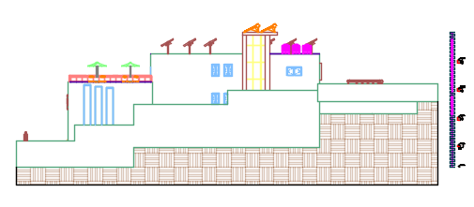
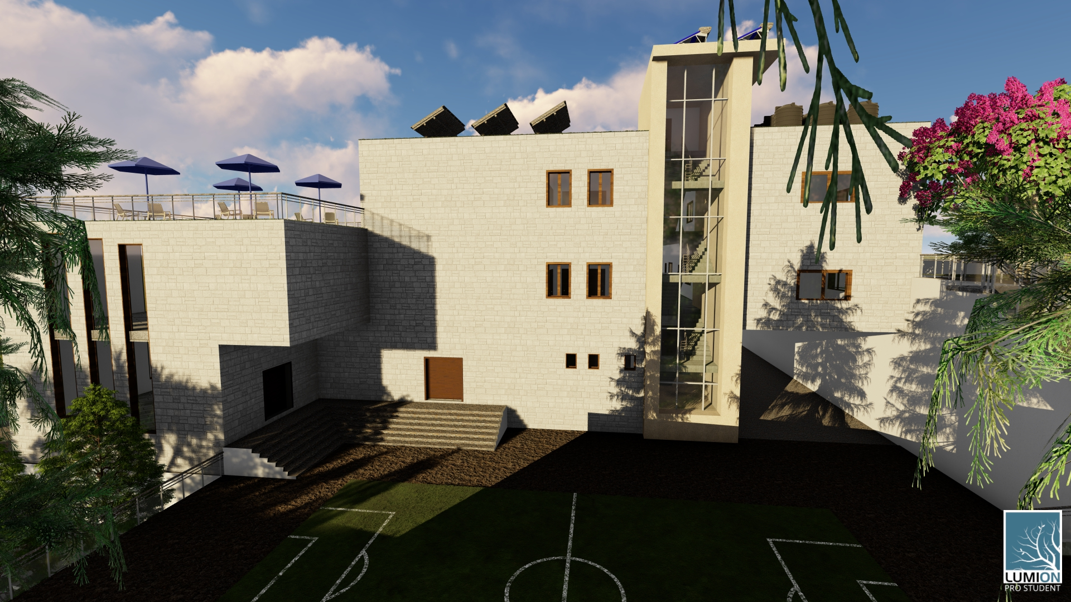
Eastern Elevation

Slide 10
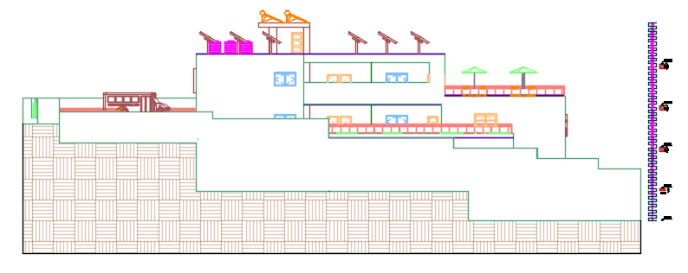
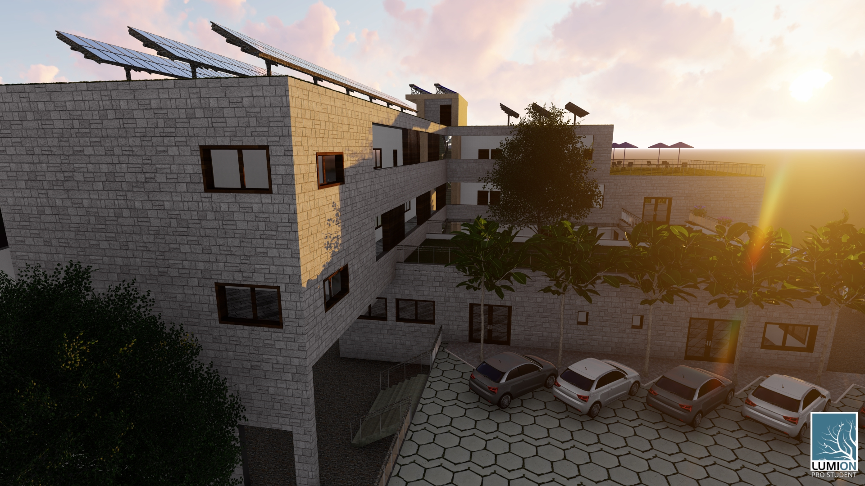
Western Elevation

Slide 11
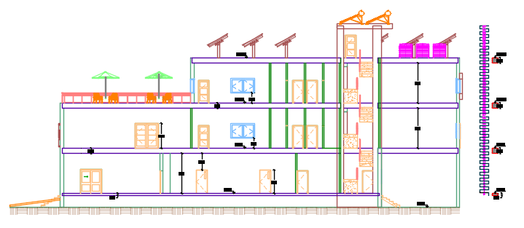
Section A-A

Slide 12
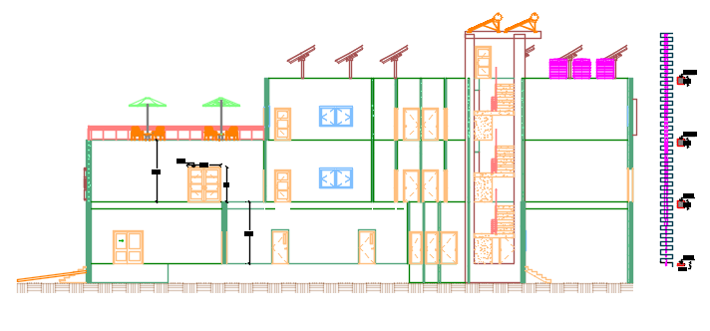
Section B-B

Slide 13
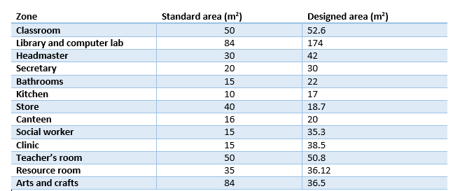
Spaces in the School

Slide 14
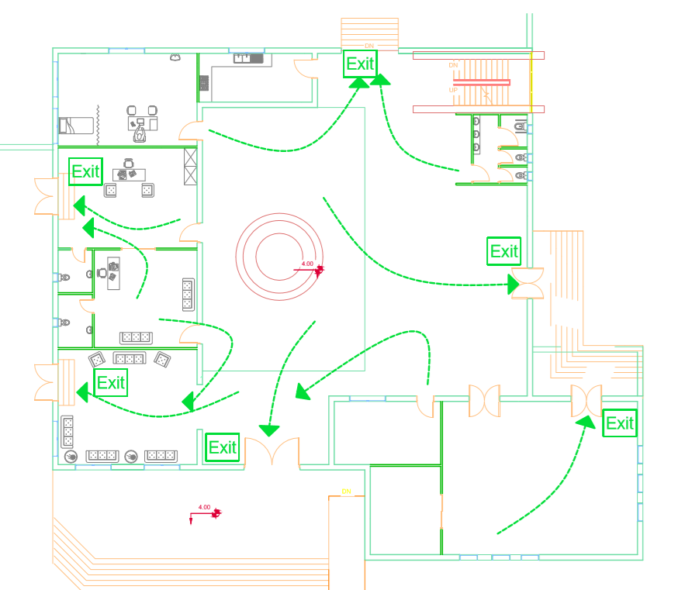
Evacuation Ground floor Plan

Slide 15
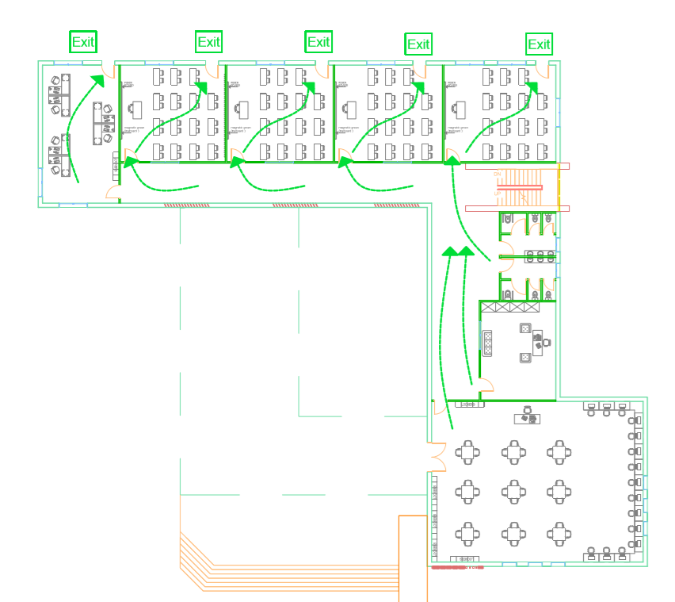
Evacuation First floor plan

Slide 16
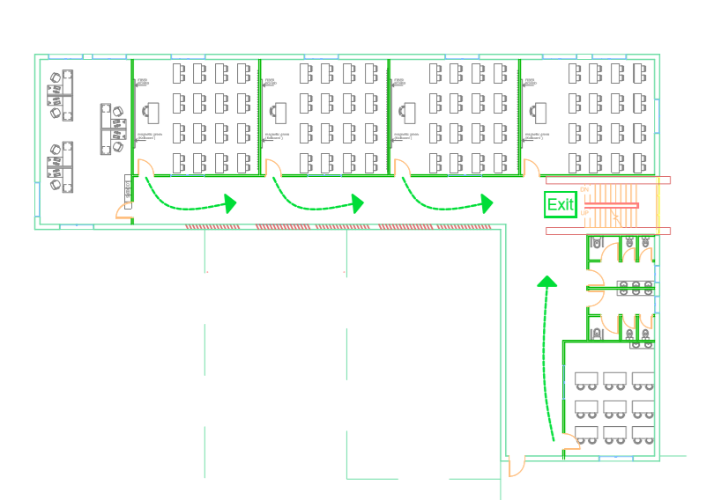
Evacuation Second floor plan

Slide 17
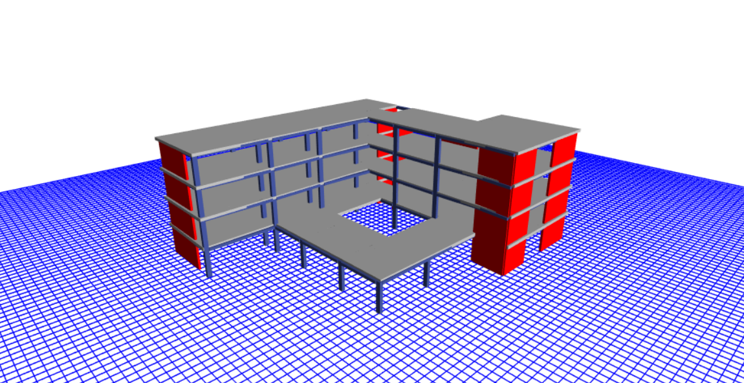
Structural Design
3D Model in ETABS

Slide 18
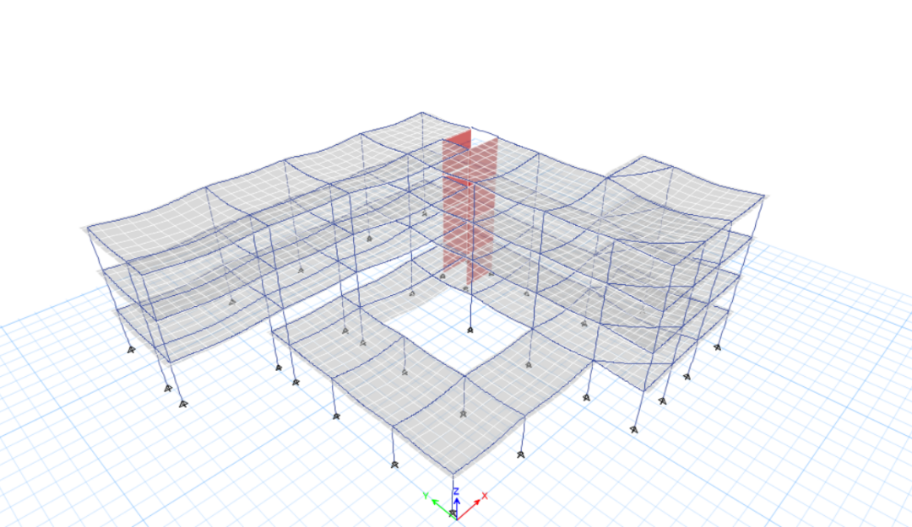
Compatibility check

Slide 19
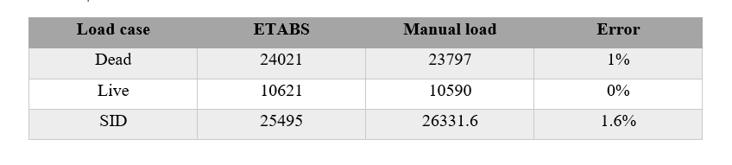
Equilibrium check

Slide 20
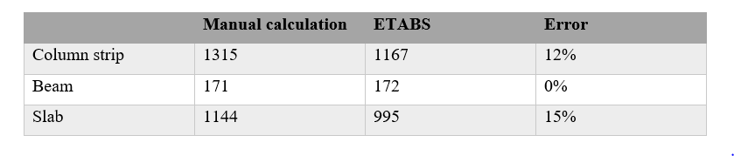
Local Equilibrium check

Slide 21
Seismic Design
According to the projects’ location which is in Nablus, then the seismic zone factor is 0.2
The projects’ soil type (Sc), Acceleration coefficient (Ca) = 0.24, Velocity coefficient (Cv) = 0.32.
Importance factor of the building is I= 1.5
The system which is used in this seismic design is Building Frame system with a response modification factor (R) of 5.5 for both directions.
The response spectrum scale factor = 2675, where the scale factor = (I/R) *g, g=9810.

Slide 22
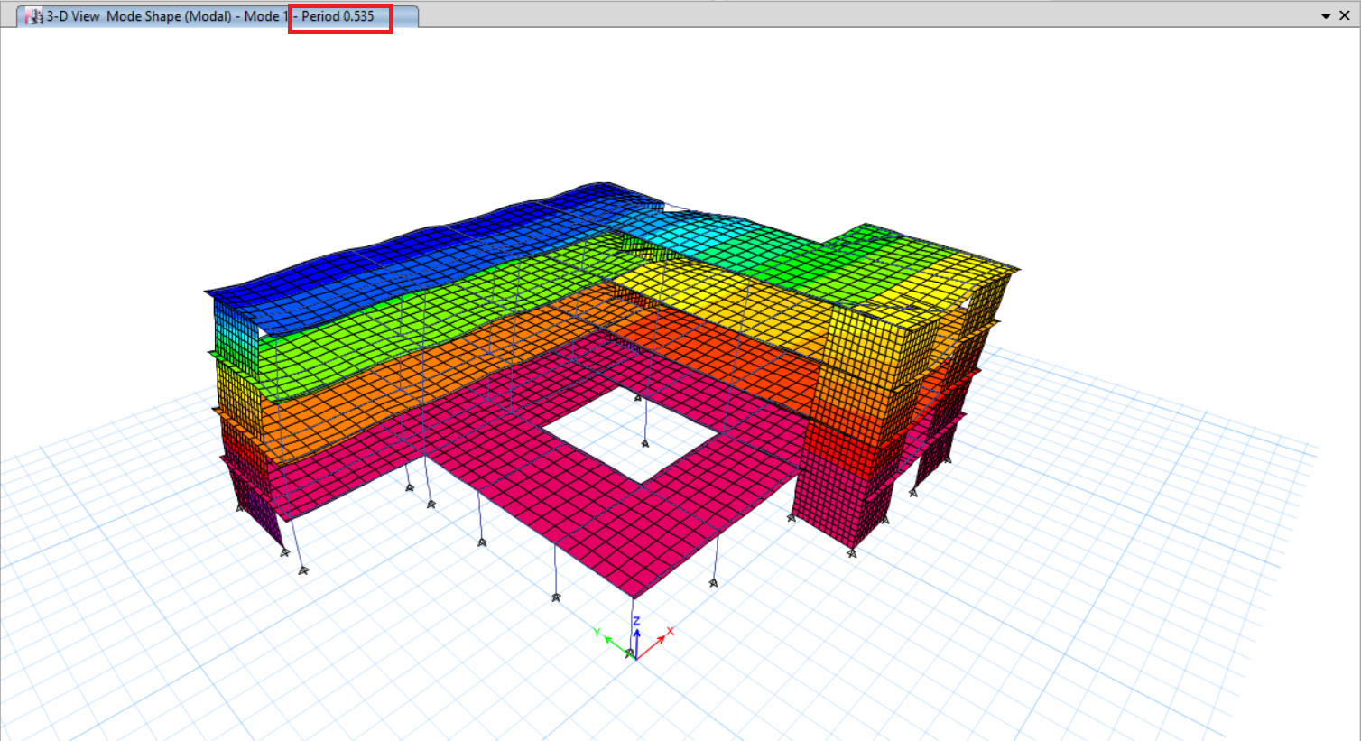
Time period check
Time period manually = 0.55 sec
Time period from ETABS = 0.53

Slide 23
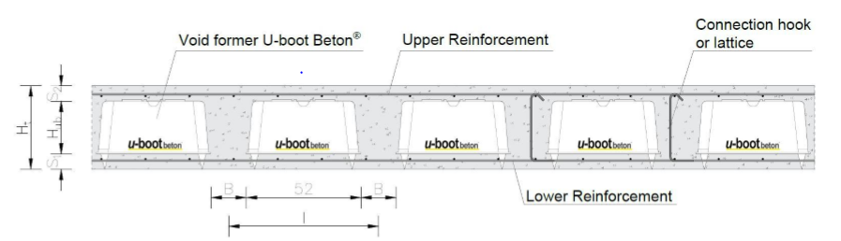
Slab Design
Two-way voided slab(U-Boot) is used in this design, because it uses less concrete, has less deflection, and the U-boot that was used materials that can be recycled
Thickness of slab = 42 cm

Slide 24
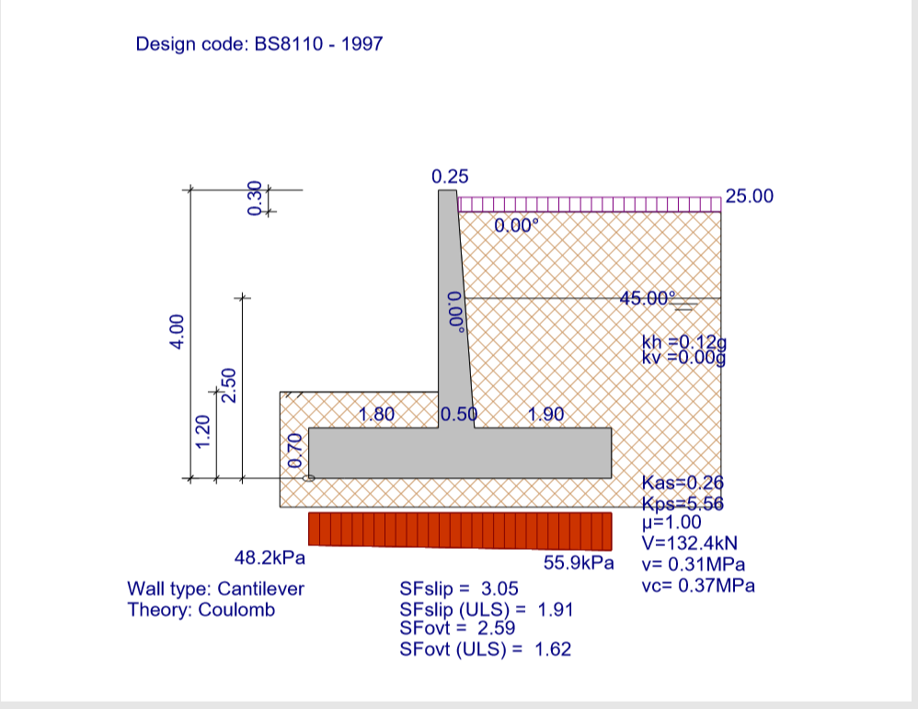
Retaining wall

Slide 25
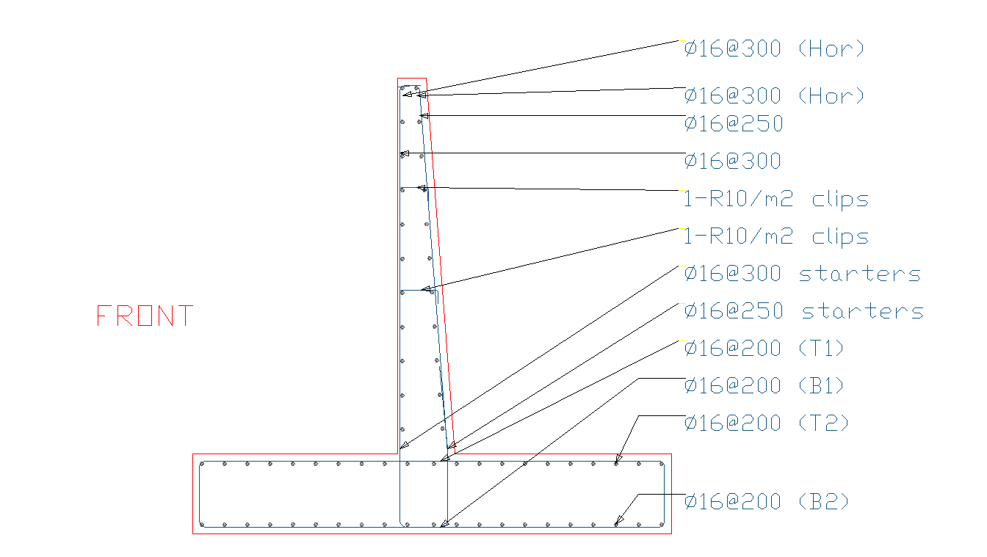
Retaining wall Detailing

Slide 26
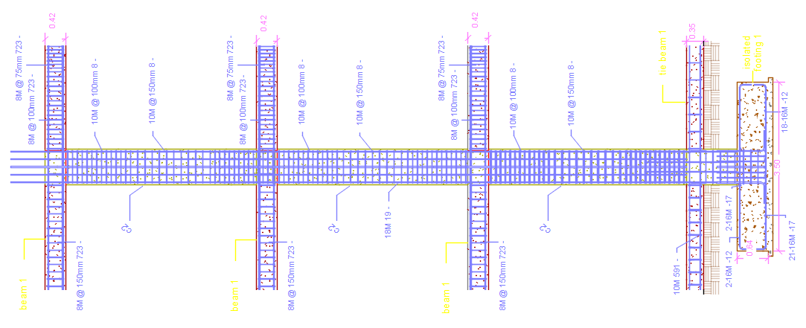
Longitudinal Section

Slide 27
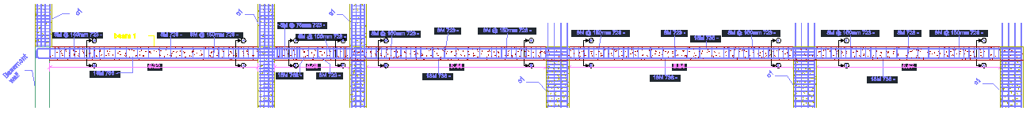
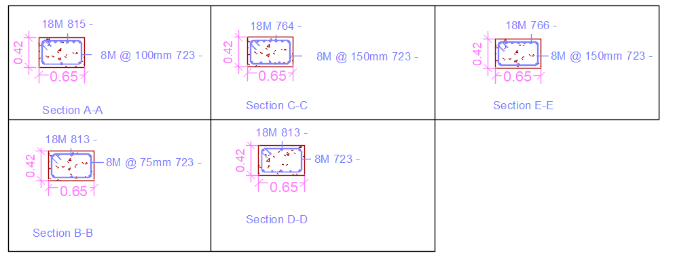
Sections in Beam

Slide 28
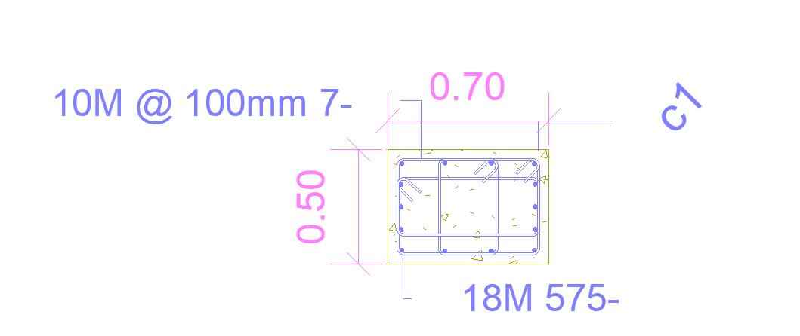
Section In column

Slide 29
Water Tank
Water Pressure

Slide 30
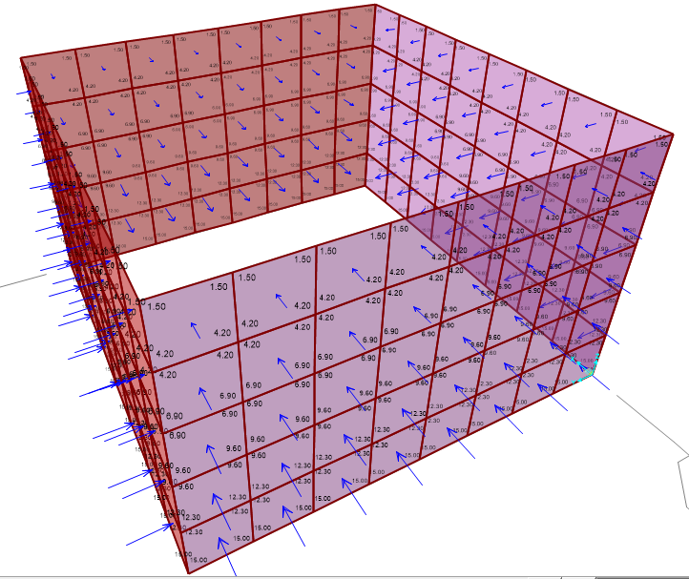
Soil Pressure

Slide 31
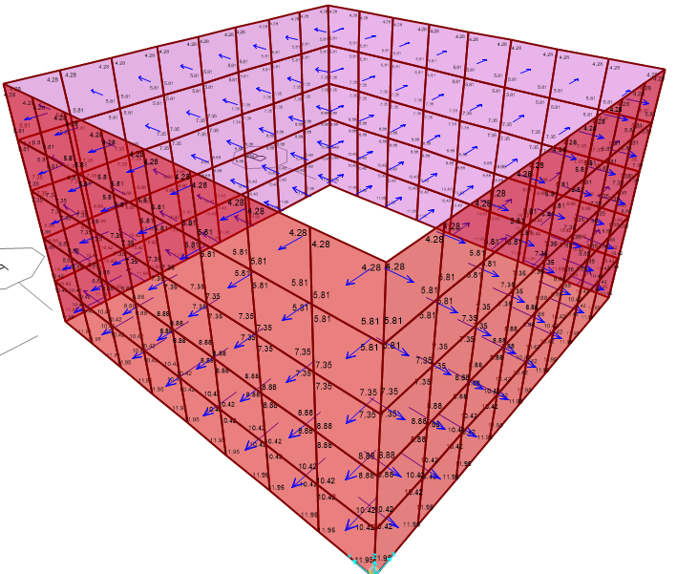
Earthquake Load

Slide 32
Water Tank slab Checks
Compatibility check
Live Load Manually =4*4*5 = 80KN
Equilibrium check

Slide 33
Water Tank Details

Slide 34
Environmental Design
Reverberation time (RT60) was estimated for the following spaces:
Classroom
Library
Teachers’ room
Headmasters’ room

Slide 35
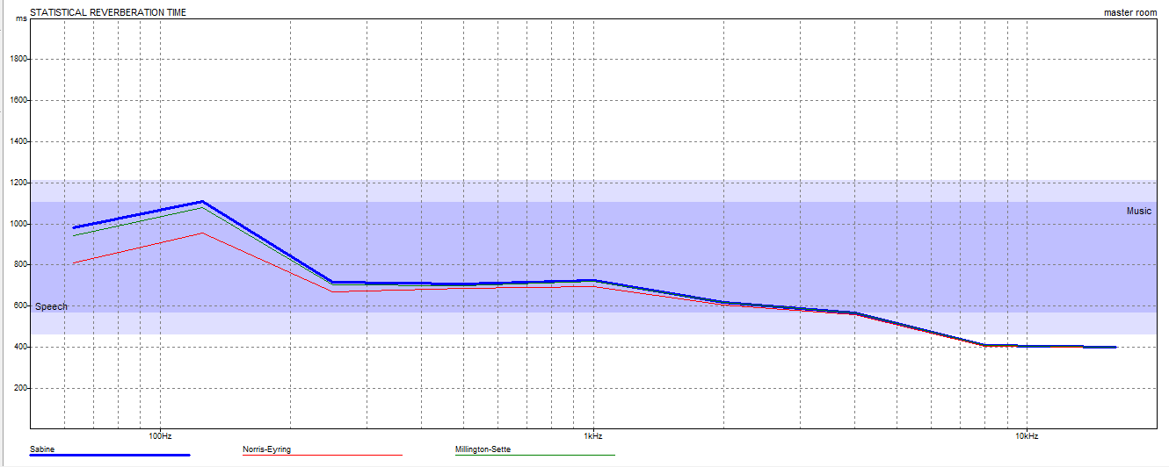
RT60 for headmasters’ room
FREQUNECY | 50% occ | 100% occ
63Hz | 1.06 | 0.98
125Hz | 1.19 | 1.11
250Hz | 0.84 | 0.72
500Hz | 0.82 | 0.71
1kHz | 0.82 | 0.72
2kHz | 0.69 | 0.62
4kHz | 0.59 | 0.57
8kHz | 0.41 | 0.41
16kHz | 0.40 | 0.40
Range For RT60 is between (0.6-1.2)

Slide 36
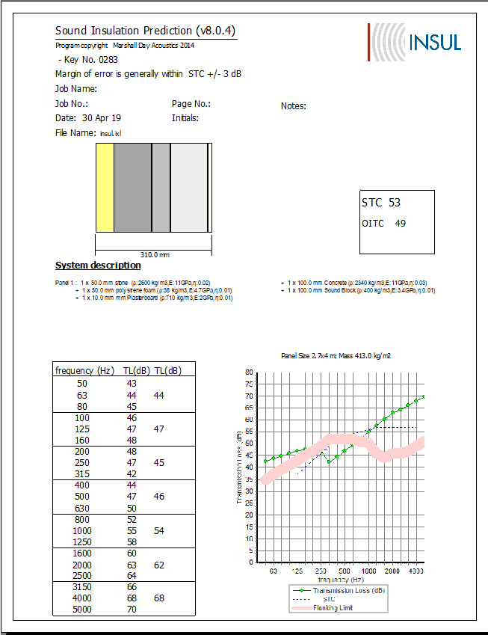
Sound Transmission Class (STC).
By using INSUL program , STC for external wall was founded 53. Whereas, STC standard is 40

Slide 37
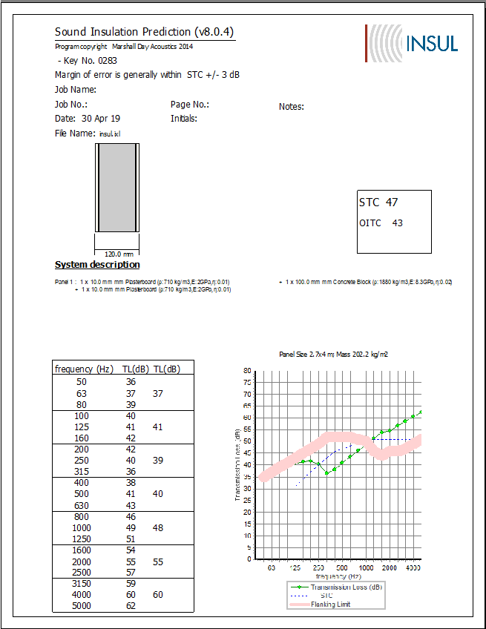
Sound Transmission Class (STC).
By using INSUL program , STC for internal wall was founded 47. Whereas, STC standard is 38

Slide 38
Passive Analysis
Shading
Thermal analysis
Daylight

Slide 39
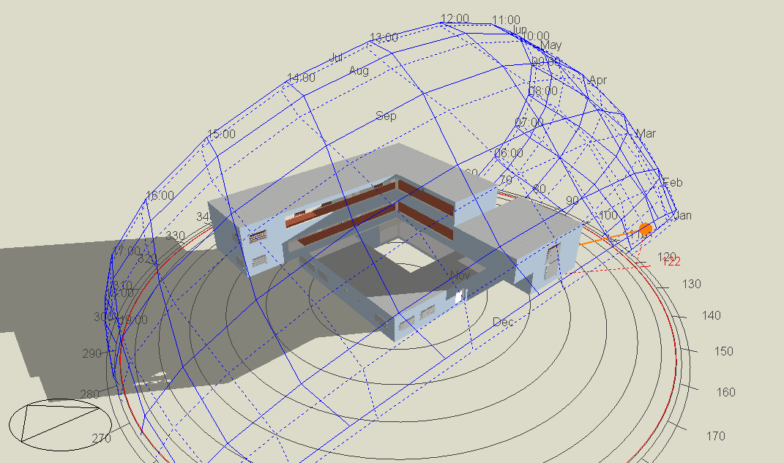
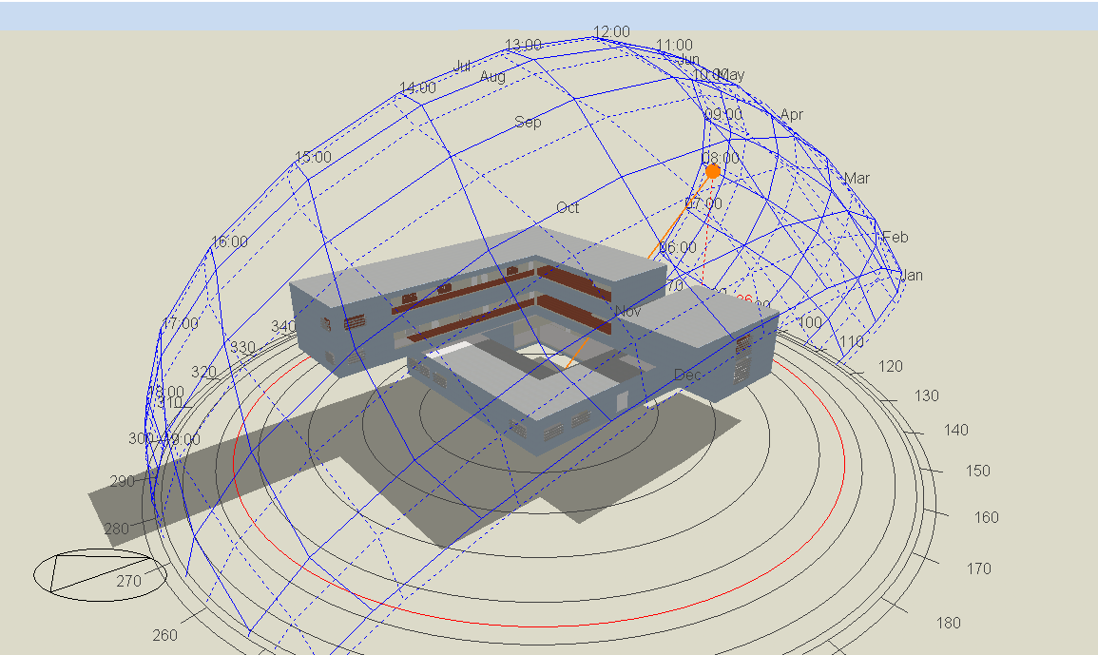
Shading
Shadows from building in 21/1 at 8:00 am
Shadows from building in 21/7 at 8:00 am

Slide 40
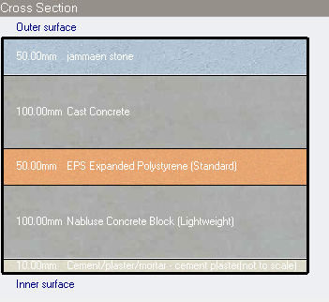
External wall Layer
U-value = 0.377 w/m²-k

Slide 41
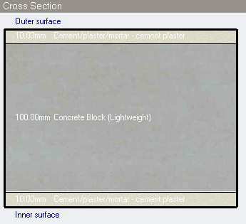
Internal wall Layer
U-value =1. 228 w/m²-k

Slide 42
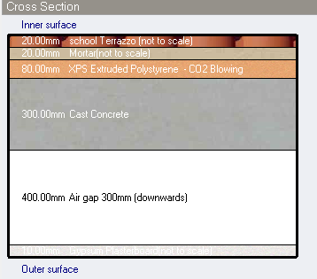
Floor Layer
U-value =0.319 w/m²-k

Slide 43
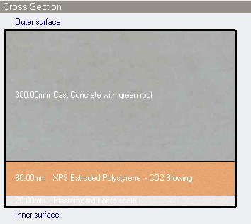
Roof Layer
U-value =0.36 w/m²-k

Slide 44
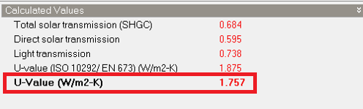
Glazing (triple glazing)

Slide 45
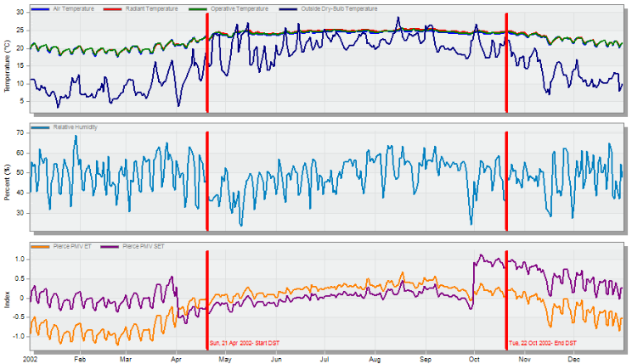
Thermal Analysis
Comfort for the school building

Slide 46
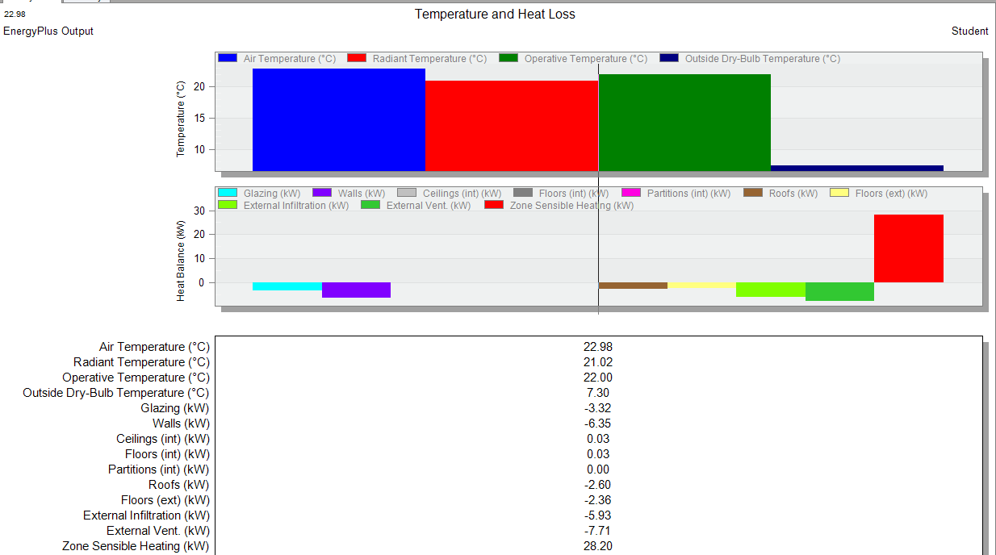
Thermal Analysis
Air, radiant and operative temperatures.

Slide 47
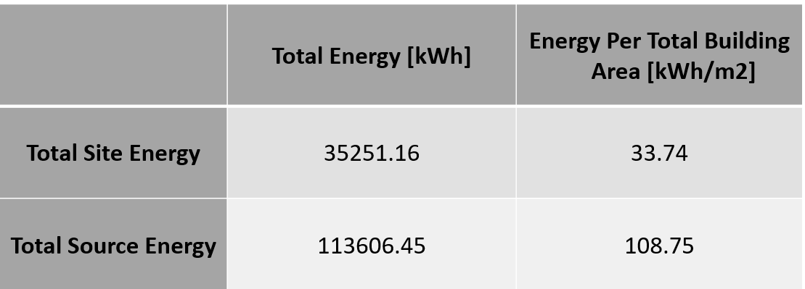
Thermal Analysis
Site and source energy of the school building

Slide 48
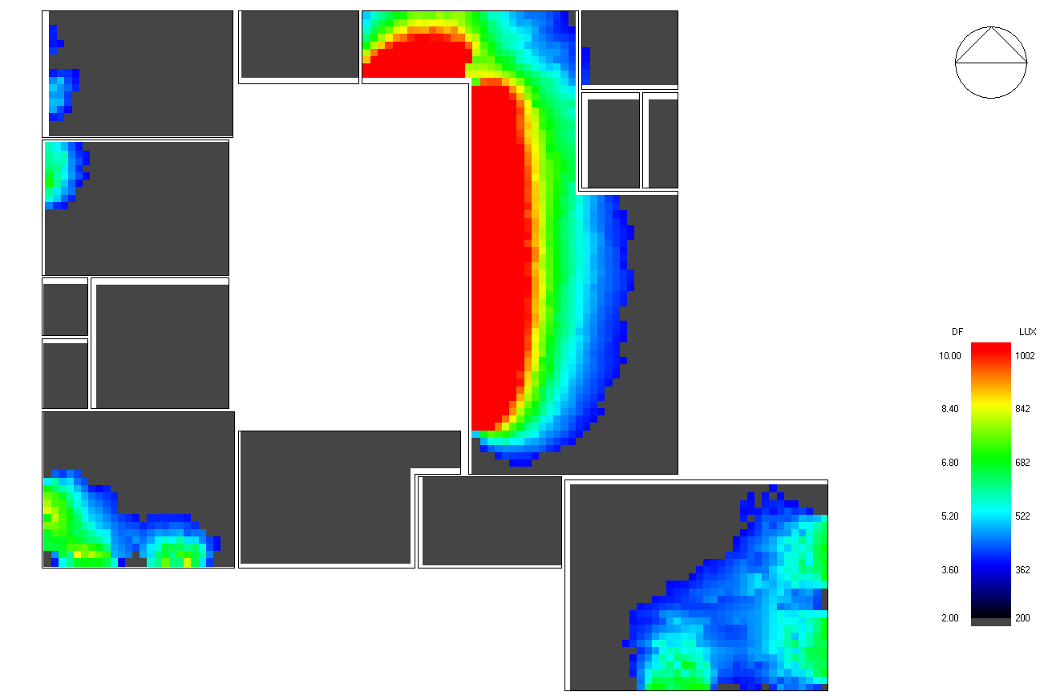
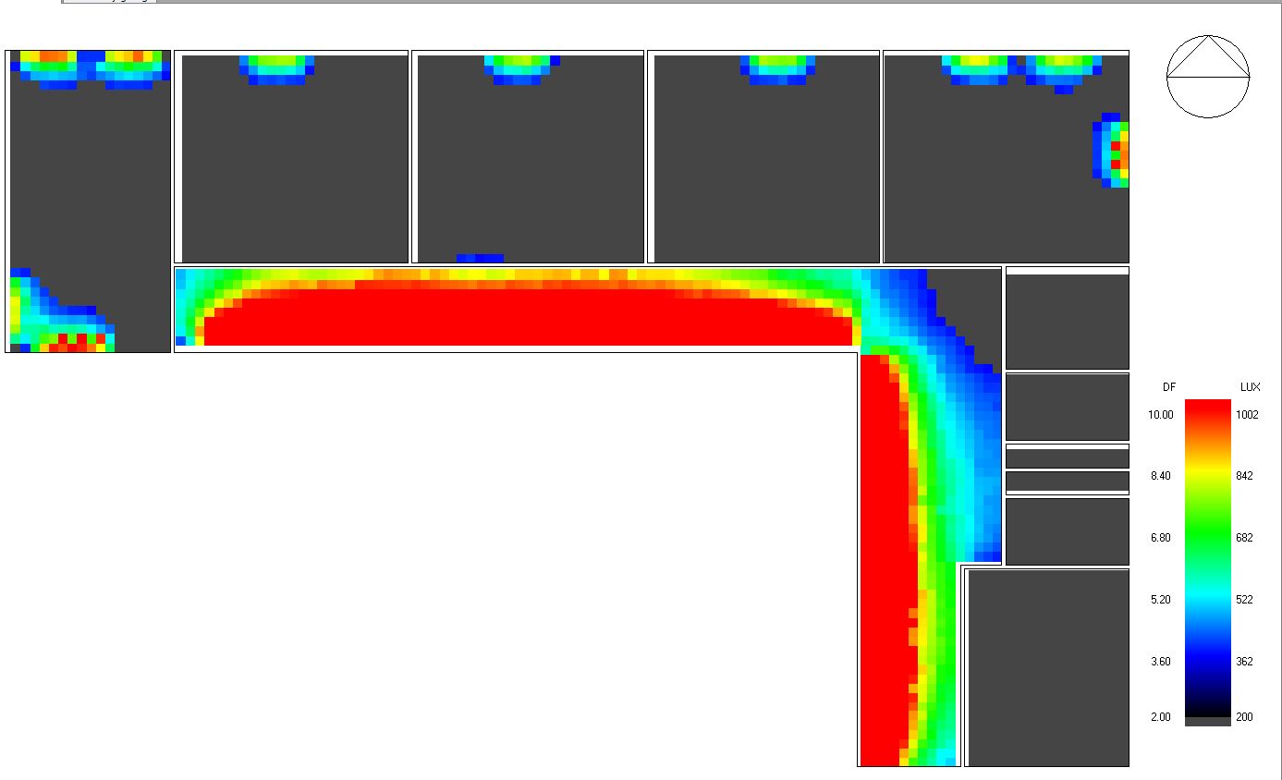
Daylight
Ground floor
First floor

Slide 49
Electrical Design
Lighting was designed by using DIAlux EVO for five spaces:
Headmaster Room
Secretary Room
Waiting Room
Clinic
Classroom

Slide 50
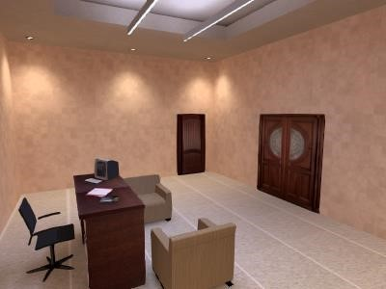
Manager Room
3D Model By DIAlux Evo

Slide 51
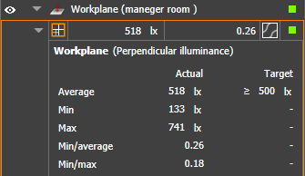
Requirements
500 Lux is required for the Headmaster Room
The Lux that was achieved in the space

Slide 52
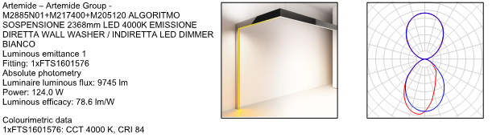

Types of Luminaire
Two Types of luminaires were used in Headmaster room :

Slide 53

Lighting Distribution plan

Slide 54
Number of lighting in each floor
No | Article name | DBG | DBF | DBS
1 | Philips Lighting | - | 56 | 56
2 | Dropper Hi-Flux 2500K Led Strip 200mm | 38 | - | -
3 | D70-S195 LED 3000 840 SI | 14 | 12 | 12
4 | SM540C PSD L1480 OC LED50S/840 NO | 8 | - | 8
5 | ALGORITMO SOSPENSIONE 2368mm LED 4000K EMISSIONE DIRETTA WALL WASHER / INDIRETTA LED DIMMER BIANCO | 4 | 14 | -
6 | CHAL PRO LED3000-840 HFIX RMB W6 [STD] | 34 | 17 | 11

Slide 55
Wattage for each type used
No | Article name | watt
1 | Philips Lighting | 24
2 | Dropper Hi-Flux 2500K Led Strip 200mm | 2.9
3 | D70-S195 LED 3000 840 SI | 28
4 | SM540C PSD L1480 OC LED50S/840 NO | 38
5 | ALGORITMO SOSPENSIONE 2368mm LED 4000K EMISSIONE DIRETTA WALL WASHER / INDIRETTA LED DIMMER BIANCO | 124
6 | CHAL PRO LED3000-840 HFIX RMB W6 [STD] | 26

Slide 56

Ground Floor Lighting Plan

Slide 57

First Floor Lighting Plan

Slide 58

Second Floor Lighting Plan

Slide 59
Number of Outlets in each floor
Distribution boards | Outlets (2Amp) | Special loads (10Amp)
DBG | 21 | 1
DBF | 53 | -
DBS | 25 | -

Slide 60

Ground Floor Socket Plan

Slide 61

First Floor Socket Plan

Slide 62

Second Floor Socket Plan

Slide 63

Photovoltaic system
PV Cells distribution on the roof of the Academic school

Slide 64

Specifications of the PV Cells
Site: Bet Dagan
Tilt angle (α): 32
Cells were oriented to the south
Type of the model: SPR-E20-435-COM
Manufacturer: Sun power
Module area: 2.162$m^{2}$
Total module area: 143 $m^{2}$
Cells area: 1.962 $m^{2}$
Total cells area: 130 $m^{2}$
Number of modules: 66 module

Slide 65

Results

Slide 66

Payback Period
Initial cost of the system: 40,194 $

Slide 67
Mechanical Design
Water supply System
Water Drainage System
HVAC System
Firefighting System

Slide 68


Water supply System

Slide 69


Water drainage System

Slide 70

Manholes distribution

Slide 71

HVAC System
Radiator design
Heating load for each space of building

Slide 72

First Floor
Distribution of radiator in first floor

Slide 73

Fire hoses Ground floor plan

Slide 74

Fire hoses First floor Plan

Slide 75

Fire Extinguisher Ground floor plan

Slide 76


Fire Extinguisher First floor Plan
Fire Extinguisher In the Corridor
Fire Extinguisher In the Computer Lab and Library

Slide 77

Fire Extinguisher Second Floor
Fire Extinguisher In the Corridor
Fire Extinguisher In Arts and Crafts room

Slide 78

Quantity Survey

