Slide 1
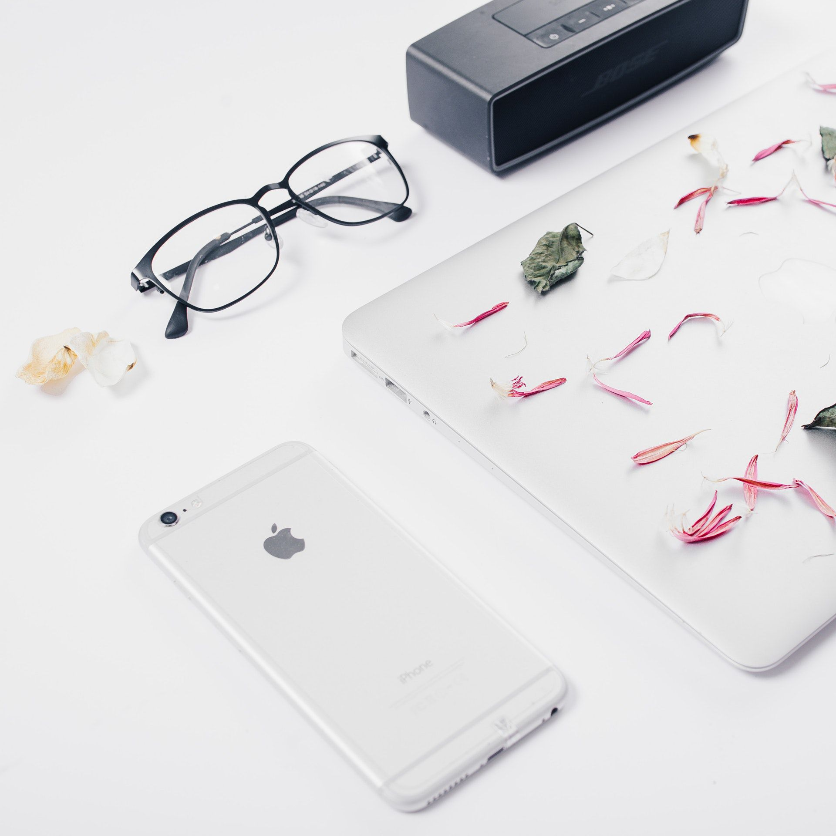
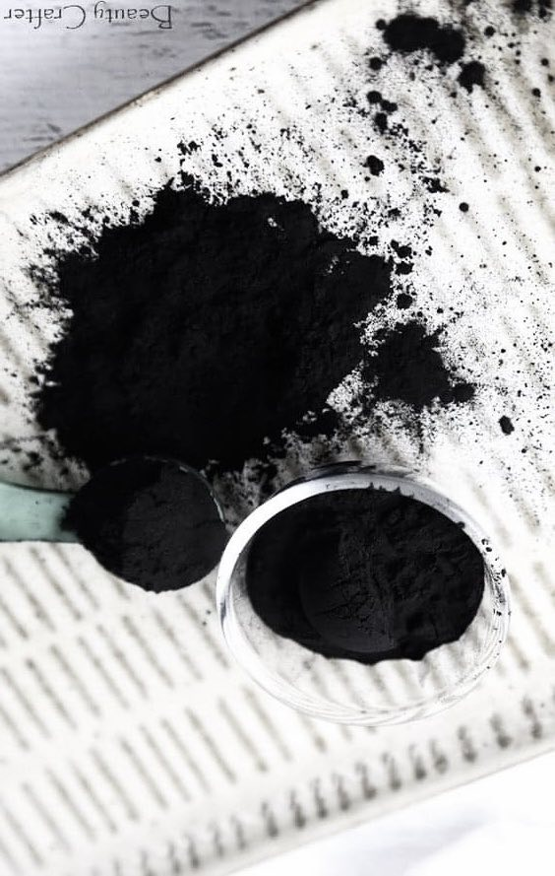

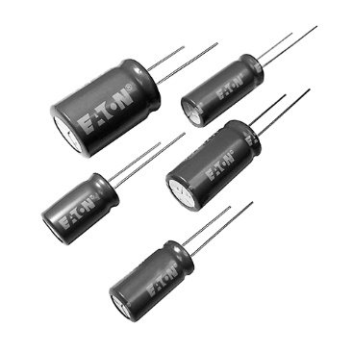
Graduation Project Defense
Synthesis of Watermelon Seed Husk Based
Activated Carbon Ablated by Laser for
Supercapacitor Electrode Material and
Adsorption of Methylene Blue Dye
Supervisors:
Amer El-Hamouz
Iyad Saad Al-Deen
Prepared by:
Anas Draidi
Kareema Dababat
Manal Tuffaha

Slide 2
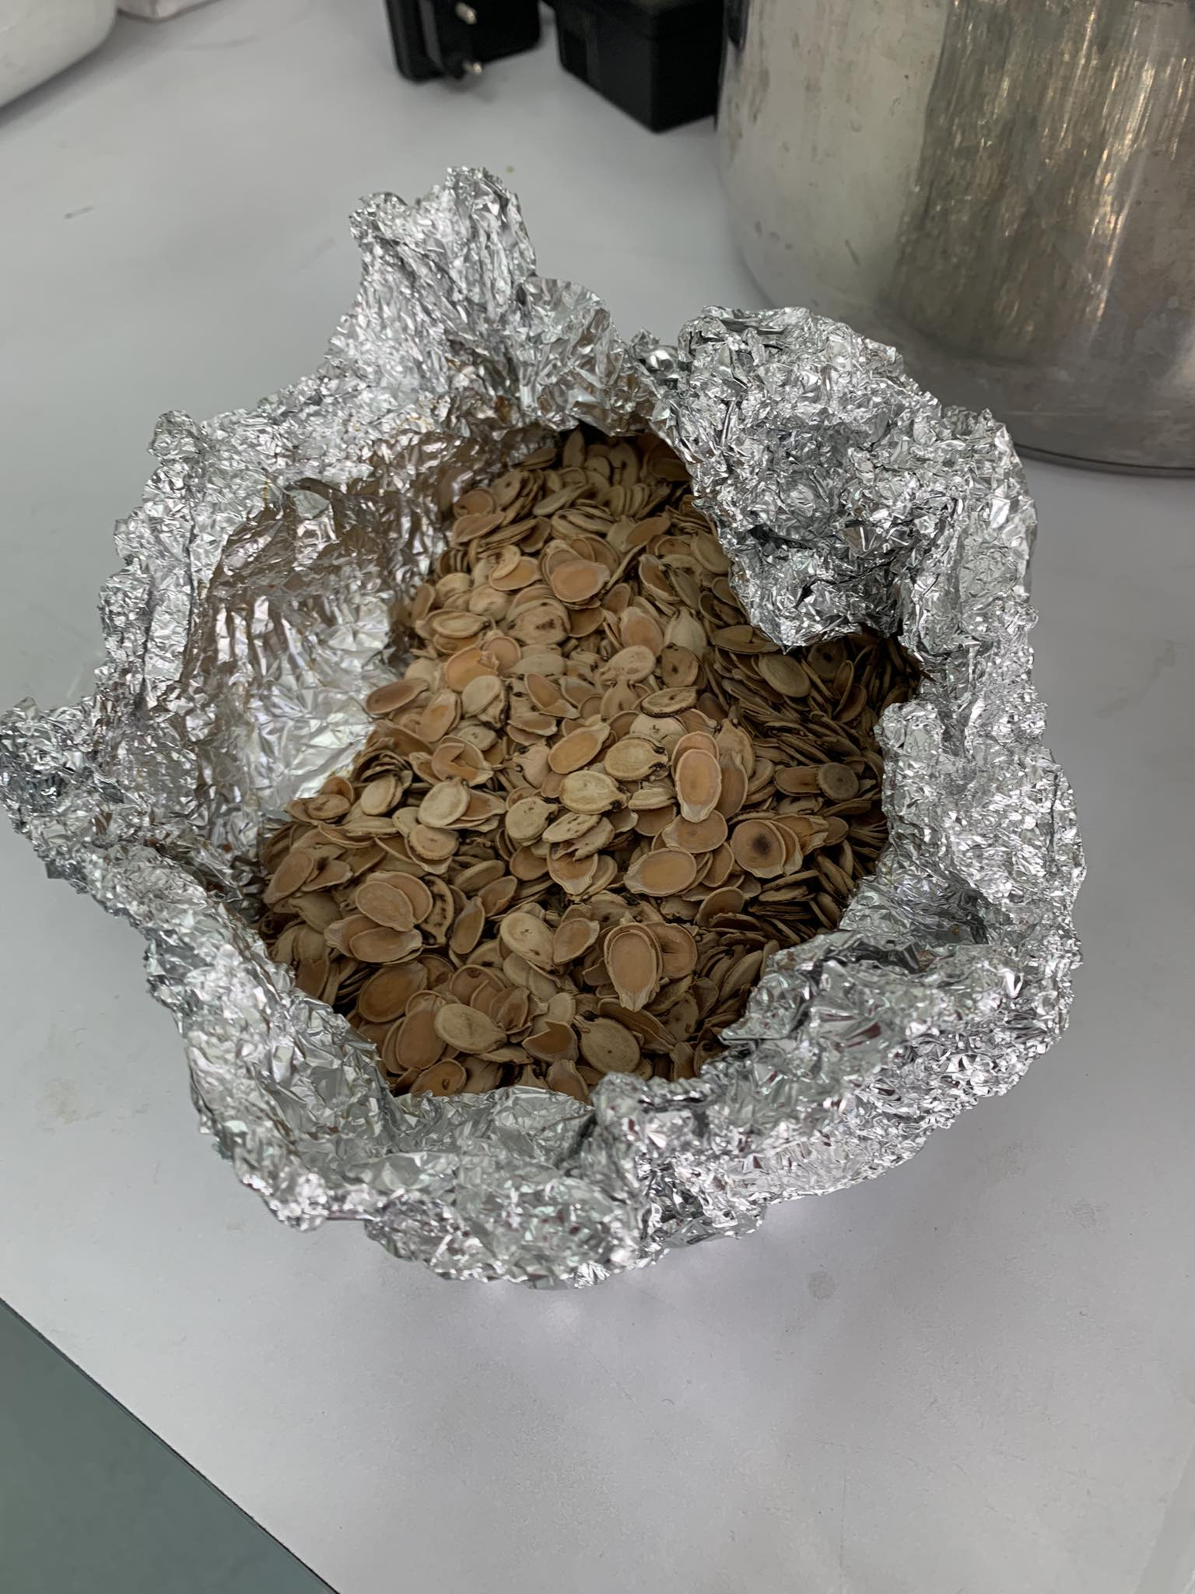

CONTENTS
01
Significance
02
Objectives
03
Introduction
04
Experimental Work
05
Results
06
Future Work

Slide 3
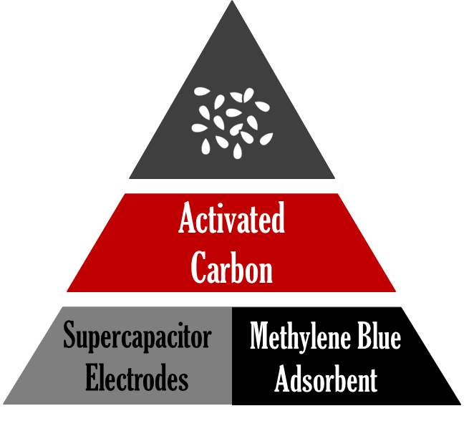
01
Significance
Laser ablation
Synthesis
Properties
Usage
Laser ablation
Methylene blue
What is it
Effects on environment
Removal
Supercapacitor
Differs form traditional capacitor
Types
Material used
01

Slide 4
02
Objectives
1
Synthesize activated carbon.
2
Enhance AC via laser ablation.
3
Fabricate SC electrodes from CC, AC and LAC.
4
Perform electrochemical tests and FTIR.
5
Test CC, AC and LAC as methylene blue adsorbents.
6
Compare the latter’s performance.
02

Slide 5
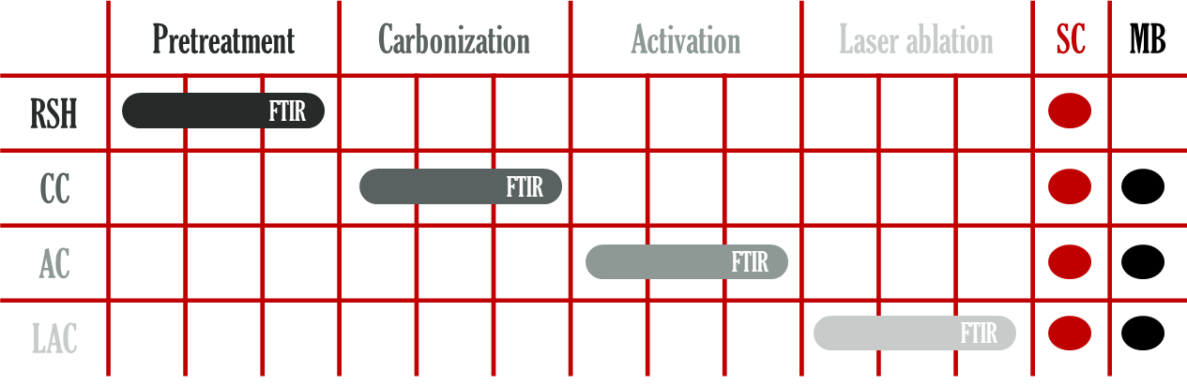
Experimental Work
04

Slide 6
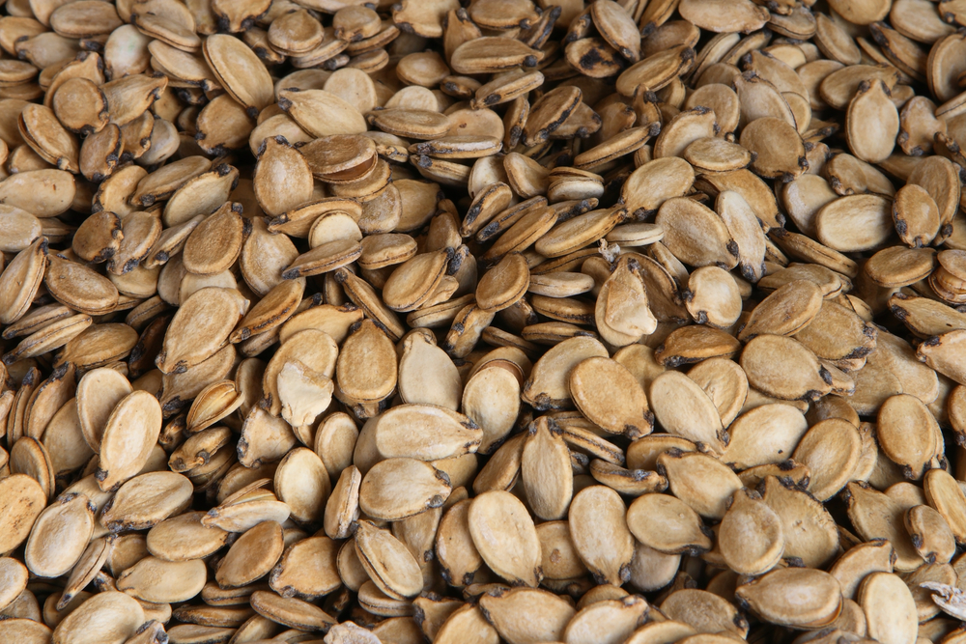
Pretreatment of watermelon seed husks
RSH
05

Slide 7
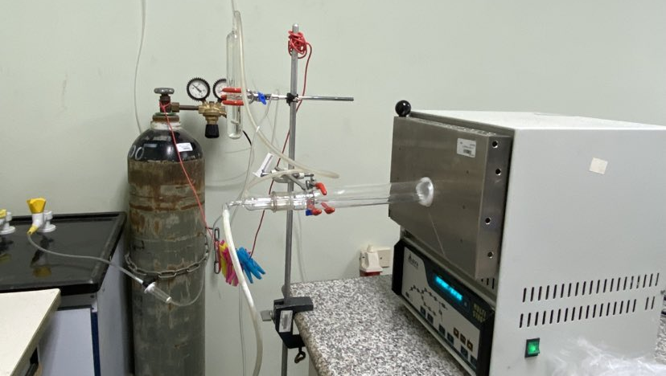
Carbonization
Through
Pyrolysis
500 ℃
N2
2 Hrs
CC
06

Slide 8

Preparation Pre-activation
Washing
Washing with boiling deionized
water
100℃
Soaking in zinc chloride
24 hours
Soaking
ZnCl2
07

Slide 9
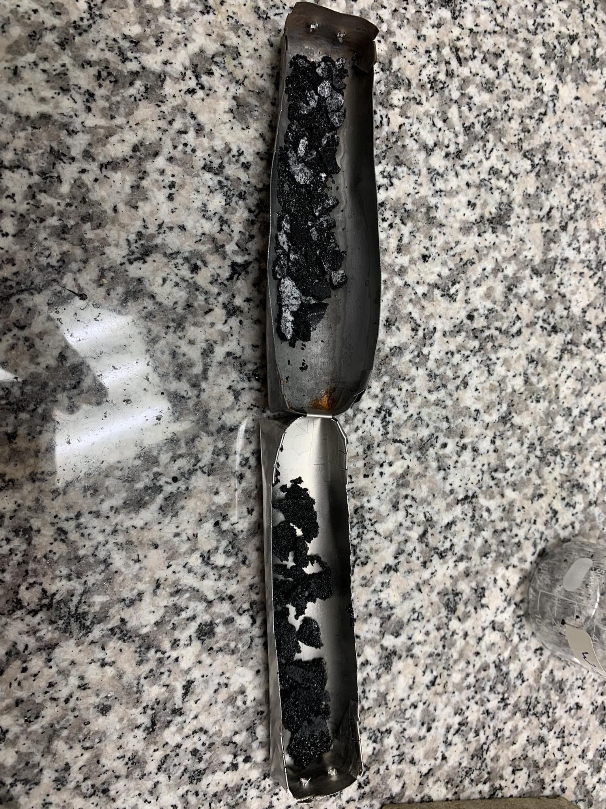
Activation
AC
08

Slide 10
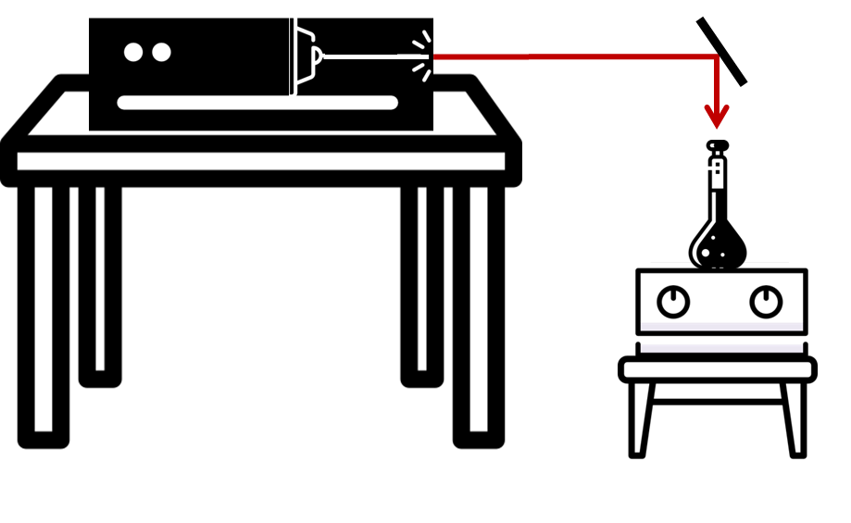
  Laser Ablation
LAC
09

Slide 11
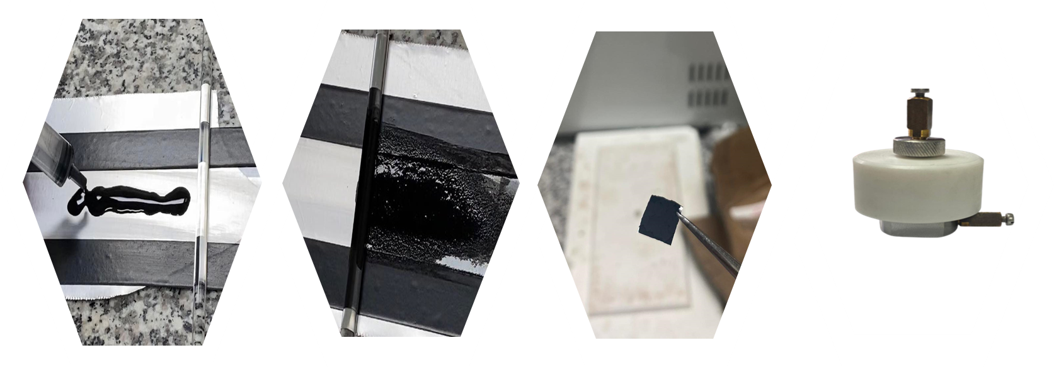

SC
10

Slide 12
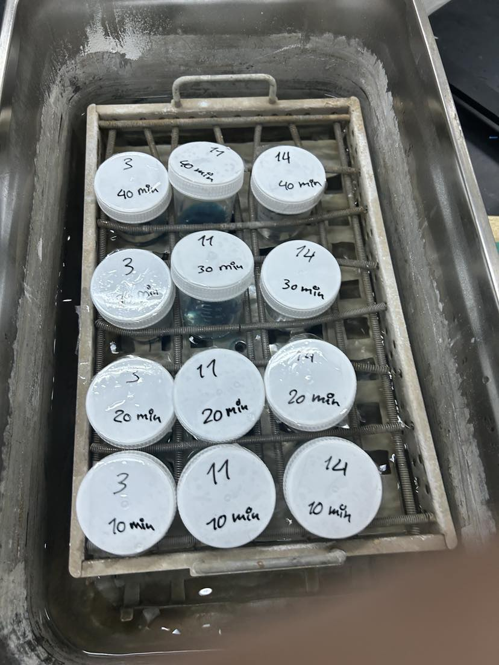

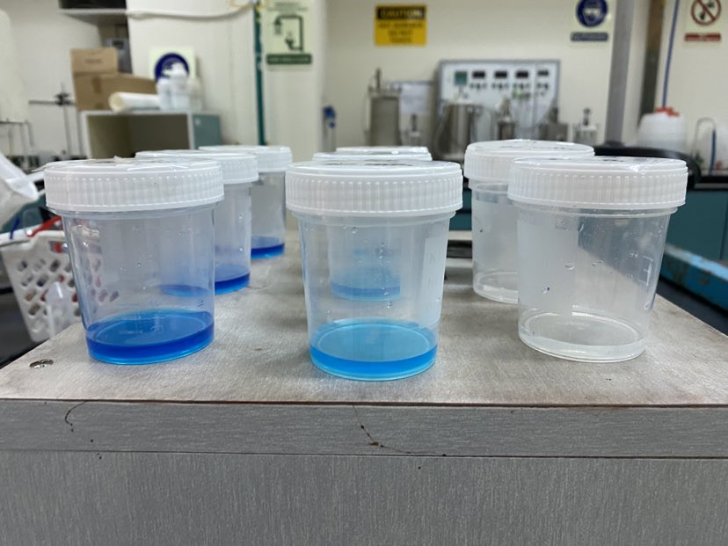
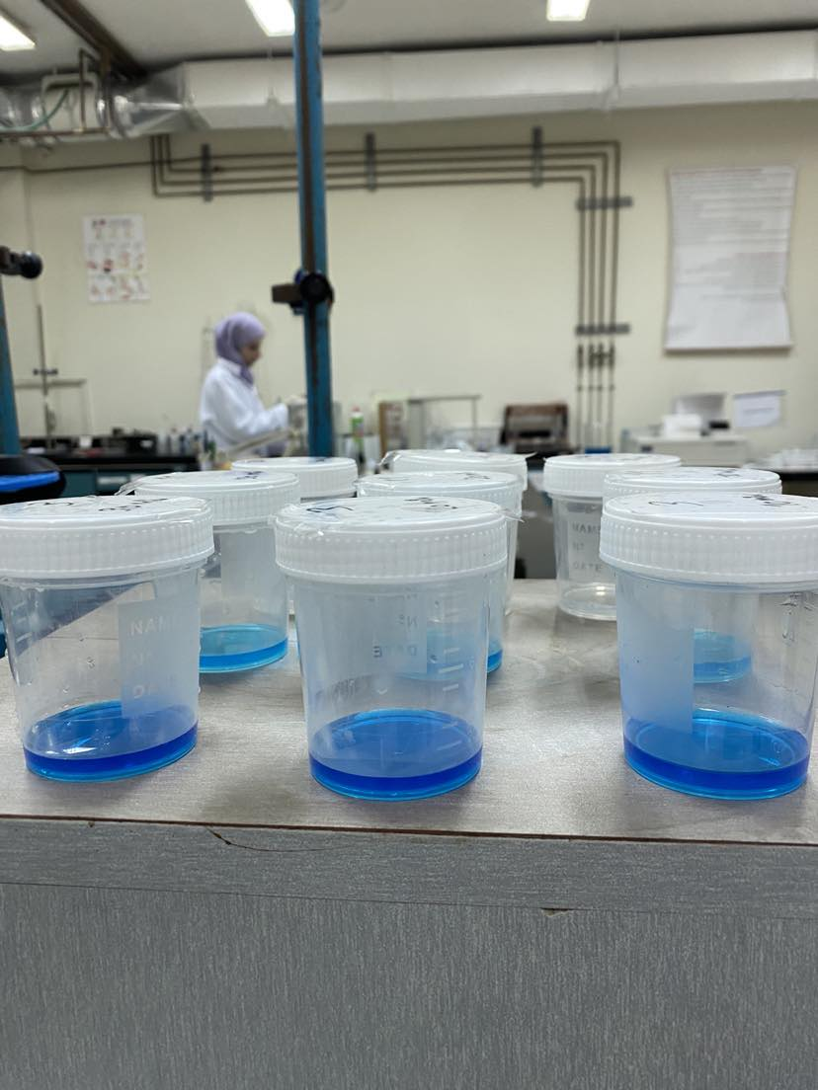
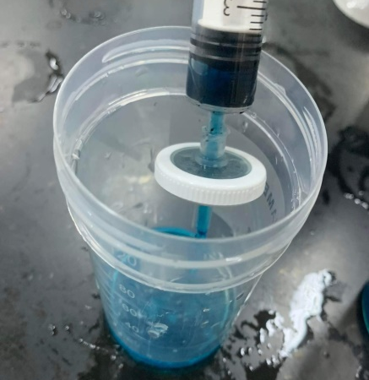
CC
AC
LAC
Methylene
Blue
Adsorption
Adsorbents were inserted
Withdrawn every 10 minutes and filtered
Samples were put in the shaker
Batch
Experiment
Color fading was observed
CC
AC
LAC
11

Slide 13
MB
FTIR
Results and Discussion
SC
CV
GCD
EIS
12

Slide 14
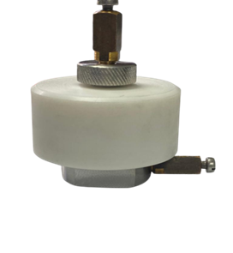
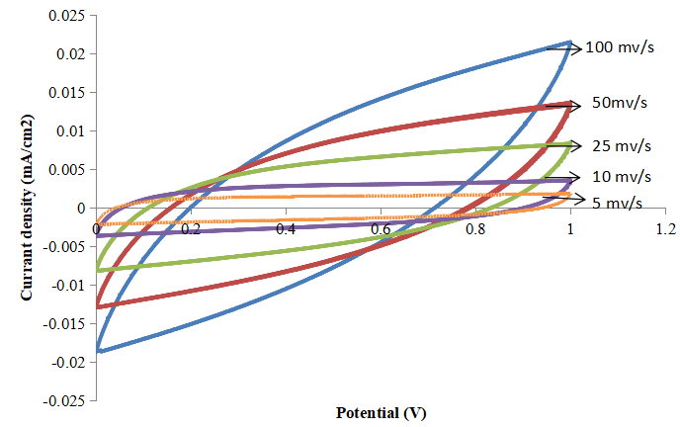
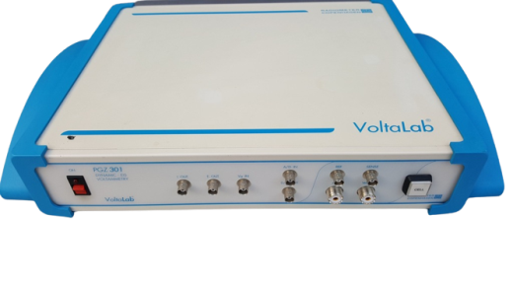
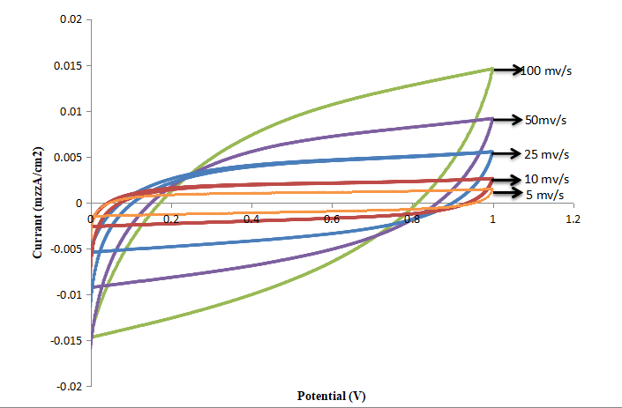
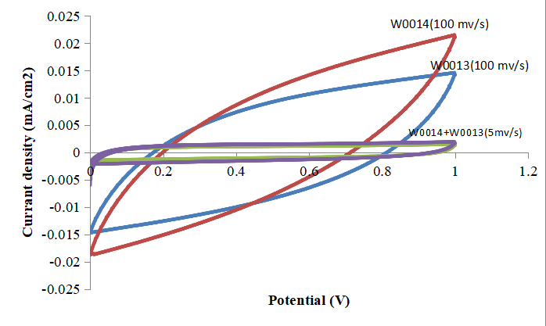
LCC
CC
Cyclic Voltammetry
13

Slide 15
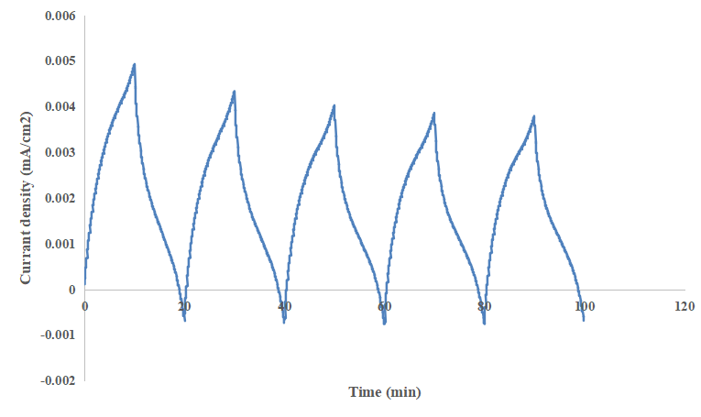
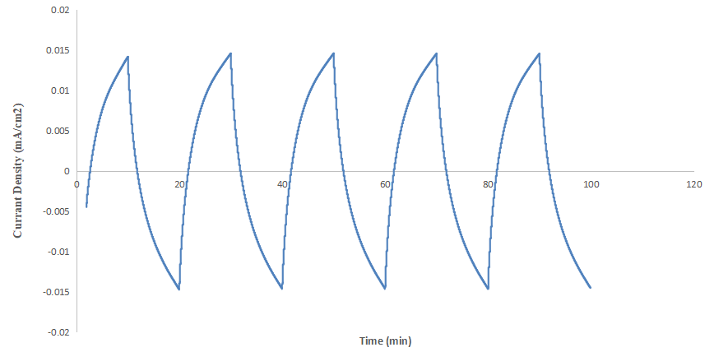
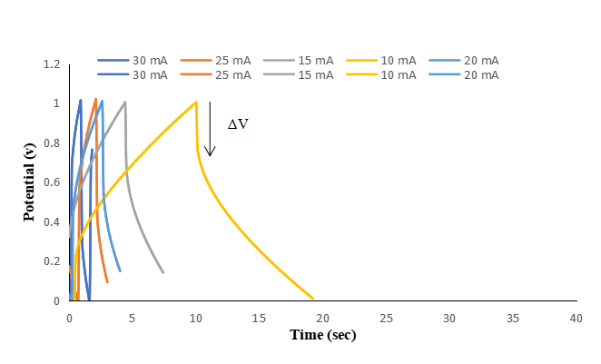
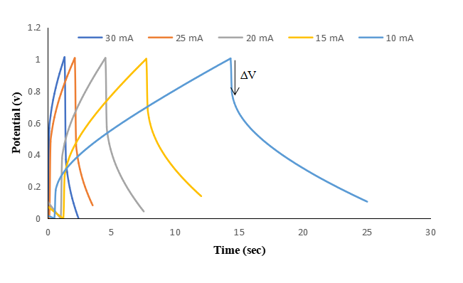
Galvanostatic Charge-Discharge
14

Slide 16
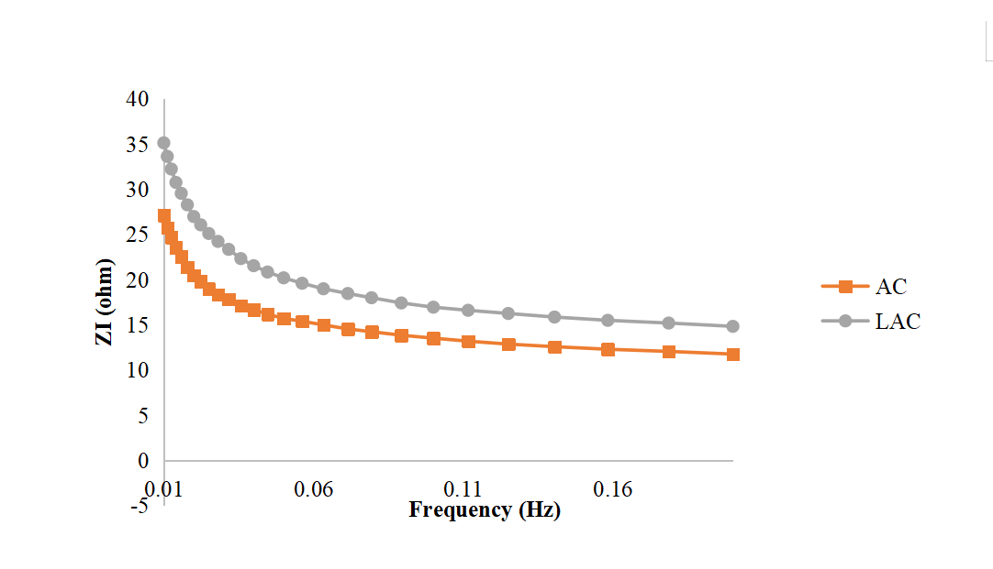
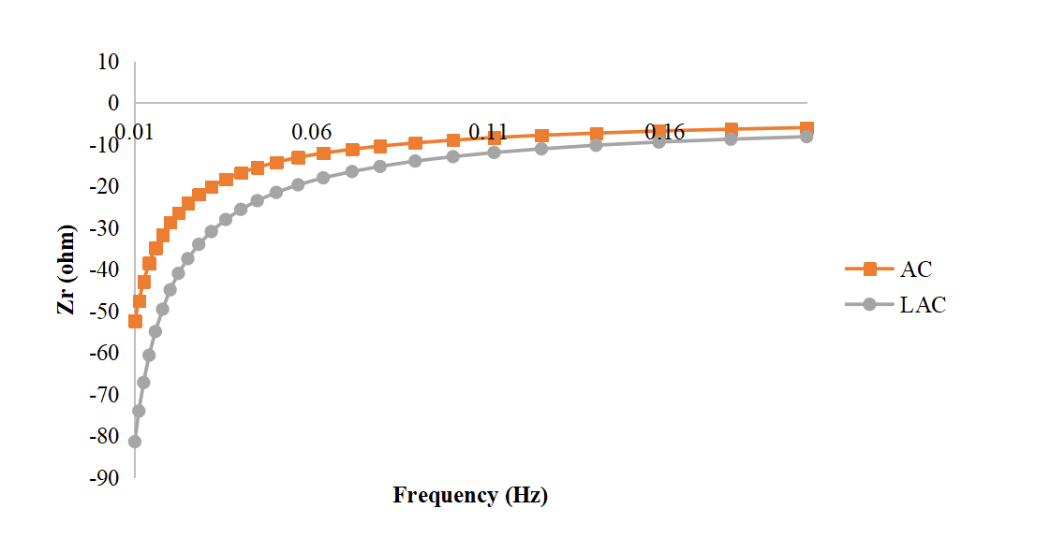
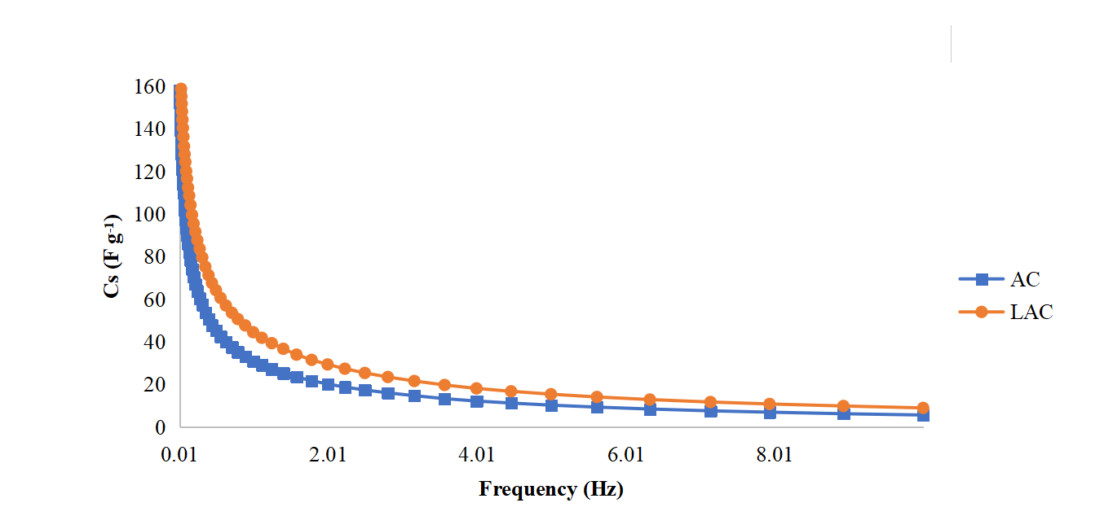
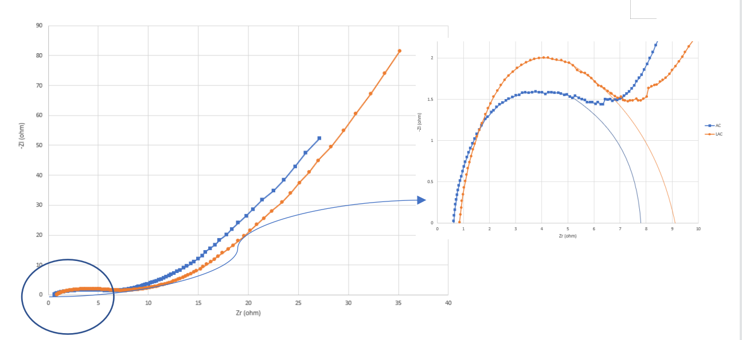
Electrochemical Impedance Spectroscopy
15

Slide 17
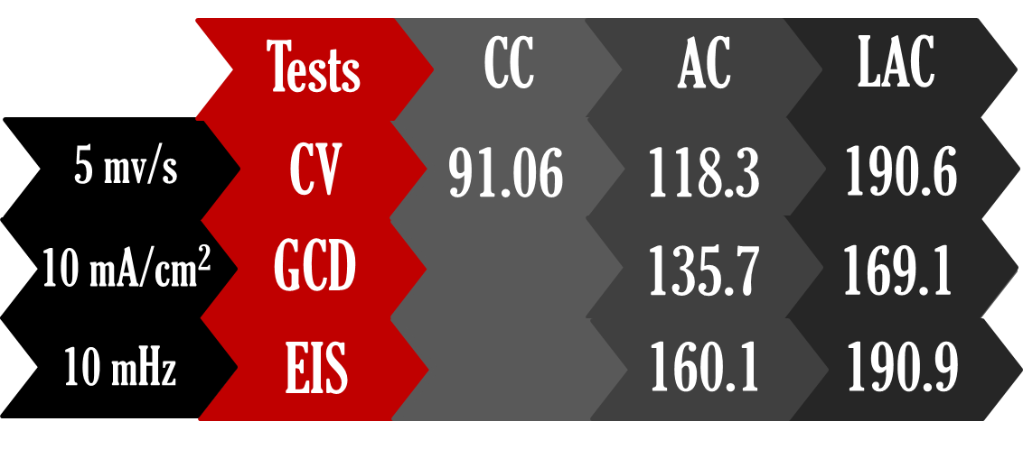
Electrochemical Tests Results
Specific Capacitance Values
Cs (F/g)
16

Slide 18


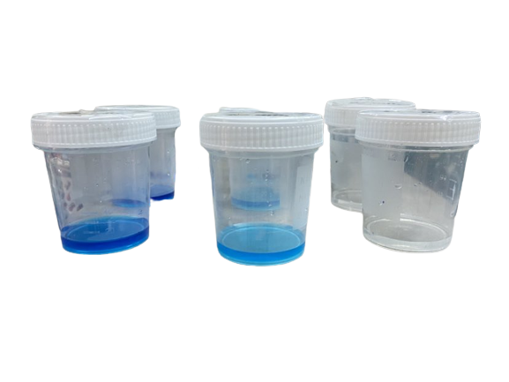
MB
Adsorption
Results
At 40 minutes
CC
R%=0.08%
AC
R%=64.9%
LAC
R%=99.1%
17

Slide 19
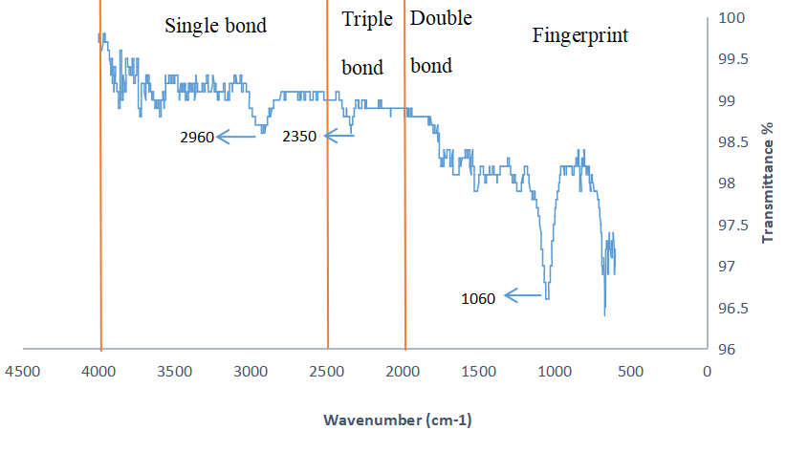
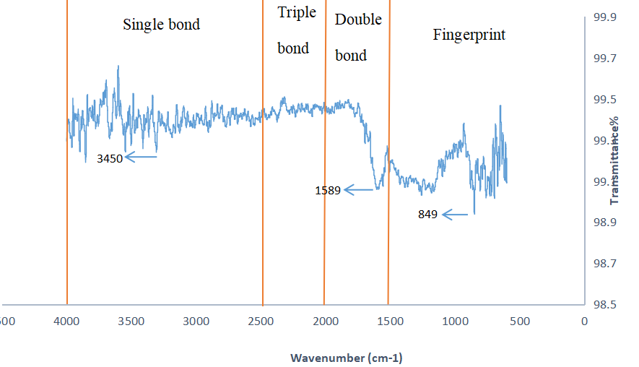
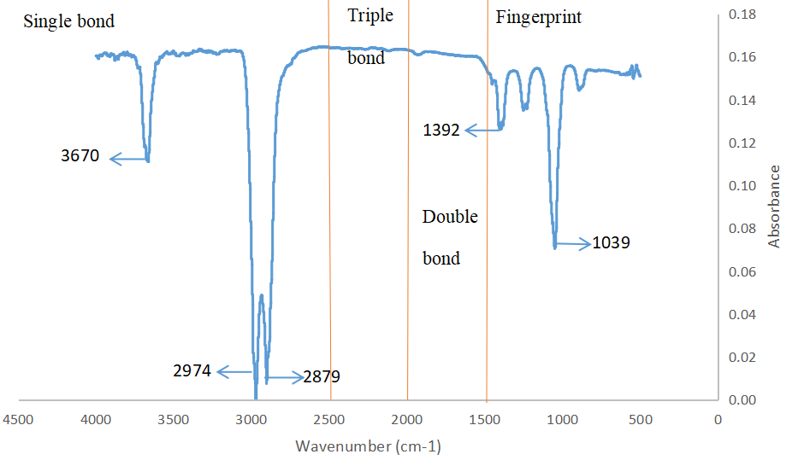
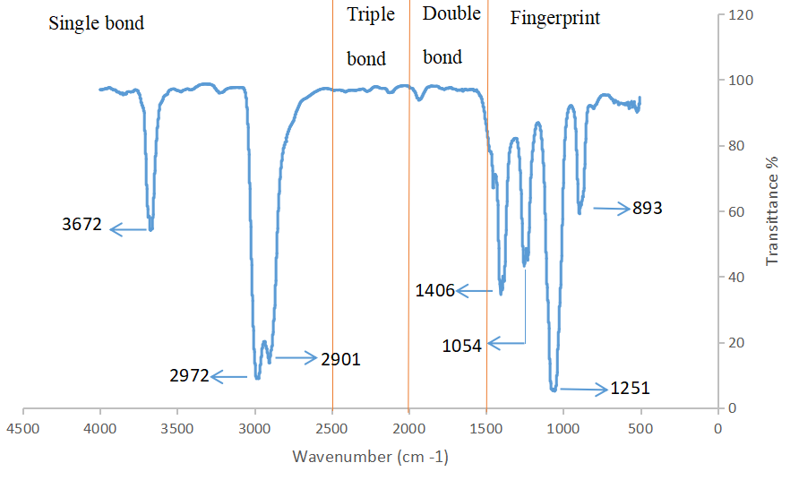
LAC
AC
RSH
CC
FTIR
CC
AC
LAC
RSH
18

Slide 20
Overall Results
LAC
AC
Cs: 190.9 F/g
R%: 99.1%
Approximated
Surface Area: 2247 m²/g
CC
Cs: 160.1 F/g
R%: 64.9%
Approximated
Surface Area: 1473 m²/g
Cs: 91.06 F/g
R%: 0.08%
19

Slide 21
05
Future Work
Study the adsorption
kinetics of MB dye
SEM, TEM, XRD, and BET
Optimize the synthesis parameters
Optimize the laser ablation parameters
Explore different activation methods
Composite materials for SC electrodes.
Explore different post-treatment methods
Conduct long-term cyclic stability tests
Evaluate the economic feasibility
Include the desorption of MB
20

Slide 22
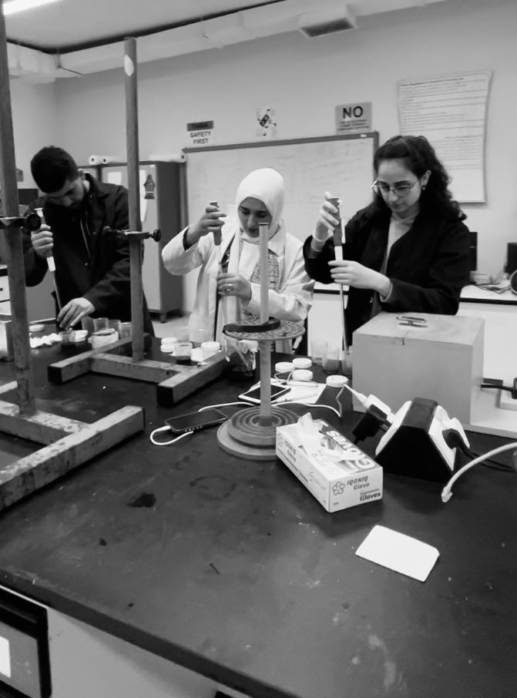

THANK YOU!

