Slide 1

Studying the installation of a solar cell system for Rafidia Hospital
Graduation Project #2
By:
Ahmad Halboni
Qusai Yassen
Supervisor:
Dr. Mohammed Alsayed
10/6/2023

Slide 2
outline
Abstract.
Introduction.
Power shot strategy of EQA.
Description the Project .
PV system components.
Design .
financial accounts of the system.
Equations used in PV system design.
Conclusions .

Slide 3
Abstract
In this study, the idea of installing a solar cell system was discussed for the Rafidia Governmental Hospital building, which is located within the concession of the Northern Electricity Distribution Company.
The net metering system was used according to the company's requirements and in accordance with the Energy Quality Authority laws agreed upon by the Council of Ministers for the year 2015.

Slide 4
Introduction
Our world lacks many low-carbon and low-price alternative energy alternatives to fossil fuels, and until we reach those alternatives, we will continue to face energy problems in this world.
Other energy problems of the same importance are the lack of access by many people to sufficient energy in full, in addition to negative consequences for them and the environment
The problem that dominates the general situation related to energy is climate change the problem of climate change is a great threat to the nature in which we live and affects our well-being and the well-being of those who will live after us.

Slide 5
Power shot strategy of EQA:
It has been pointed out that Palestine's strategy in the year 2030 aims to reach 300 megawatts of energy generated from alternative environmentally friendly sources, especially since there is currently a technology that depends on molten salt technology and not only on solar energy.

Slide 6
Description the Project :
In this project, a solar cell system was designed for Rafidia Governmental Hospital with a capacity of 87 kilowatts to cover part of the exorbitant electricity expenses consumed by the hospital. In this report, we will address several issues related to system design.

Slide 7
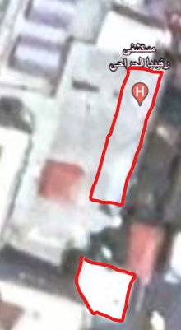

Slide 8
PV system components:
Solar PV:
Inverter
Cables
Accessories

Slide 9
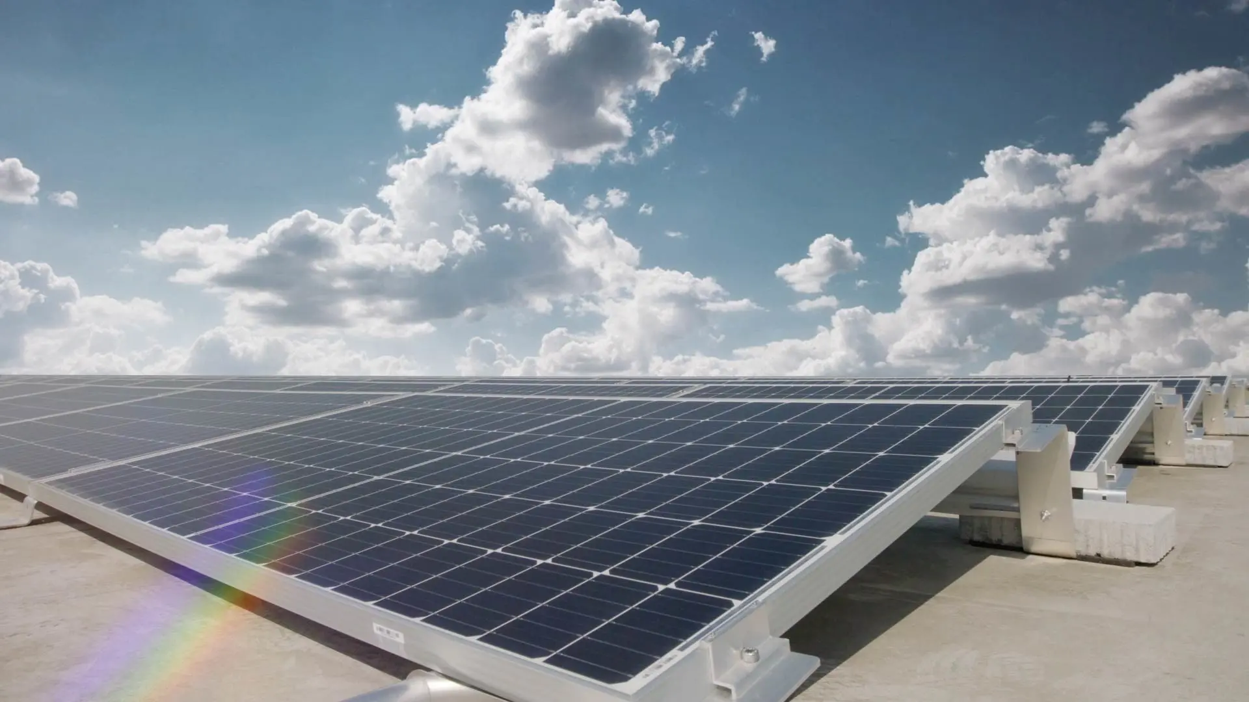
Solar PV

Slide 10
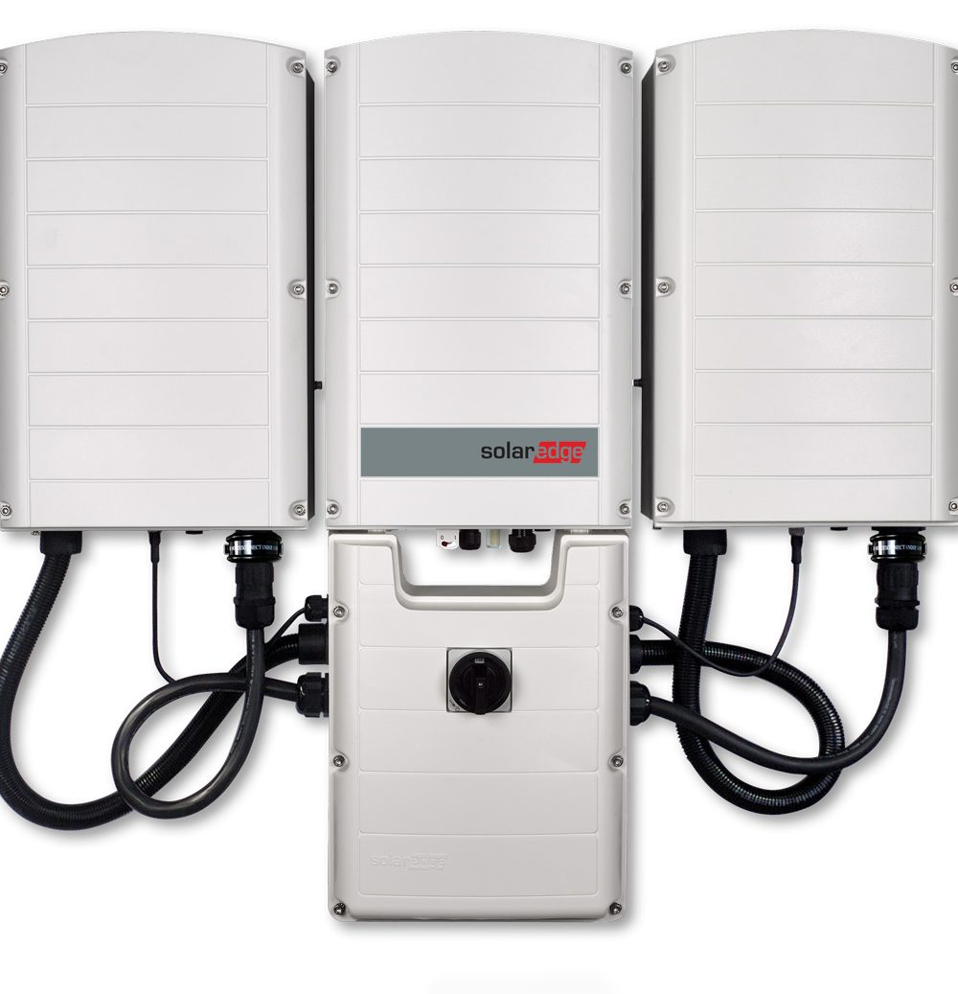
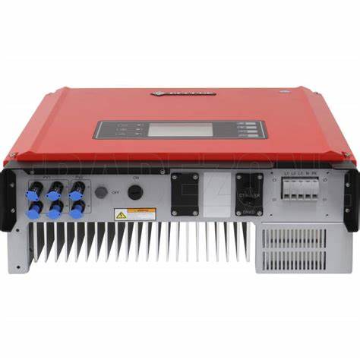
Inverter

Slide 11

cables

Slide 12
Things to keep in mind regarding cables:
It is preferable that the cable lengths in the DC circuit be as short as possible.
To be able to withstand the conditions that may arise due to the external environment, as well as to take into account the voltage and current conditions in the network to which this project will be connected. This includes the heating effect of current and solar generation

Slide 13
Taking into account the temperature when choosing the cable, and it is preferable to choose it at a temperature (-15 to 80 Celsius).
Regarding cable colors, red is for the positive pole and black is for the negative pole.

Slide 14
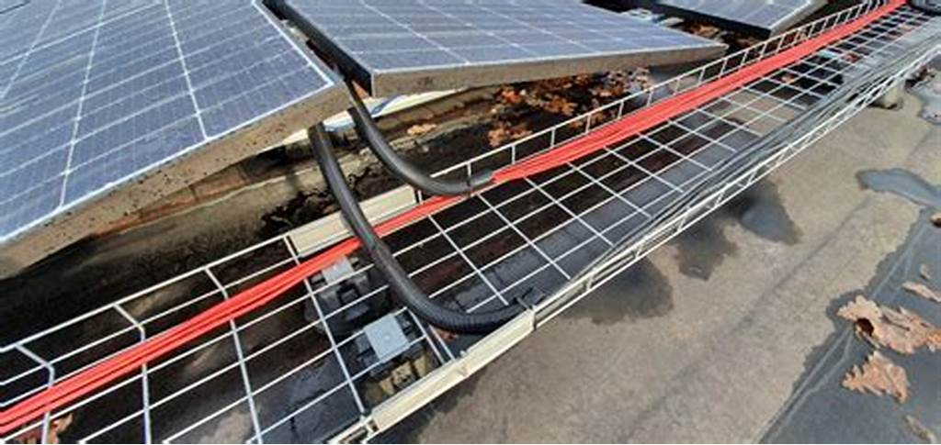

Slide 15
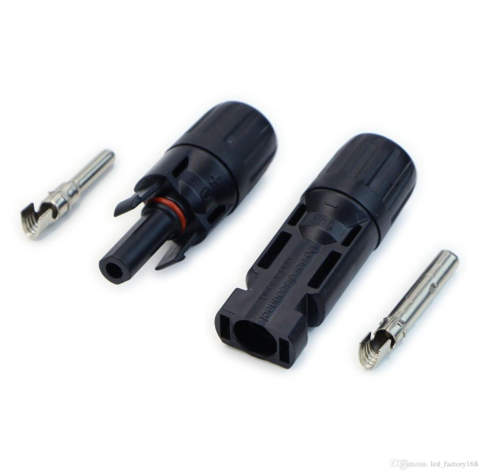
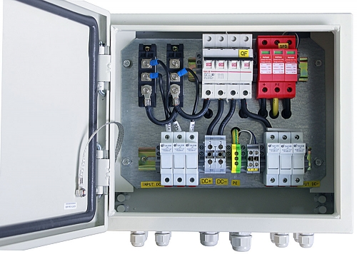
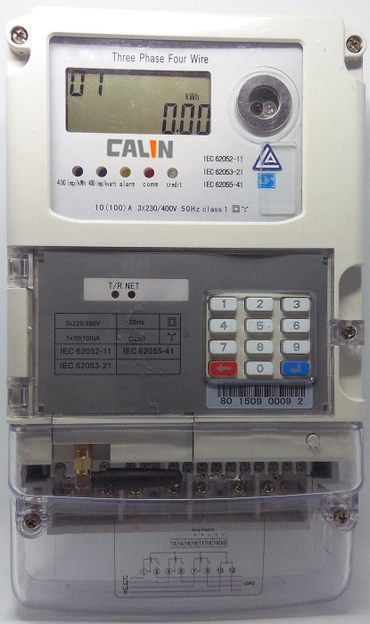
Accessories

Slide 16
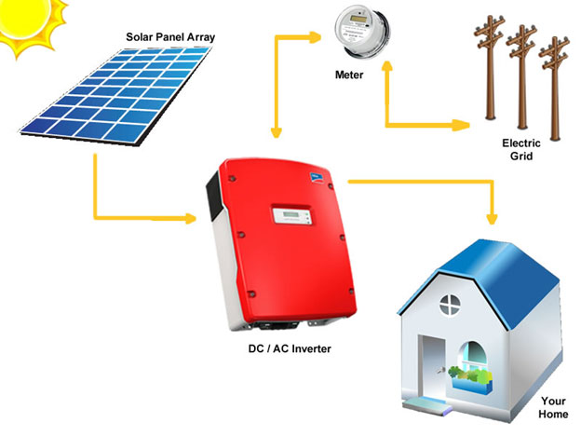
Mechanism for calculating net metering system for NEDCO

Slide 17
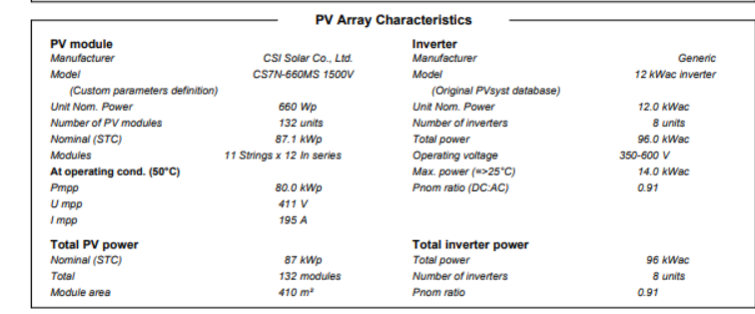
Design

Slide 18
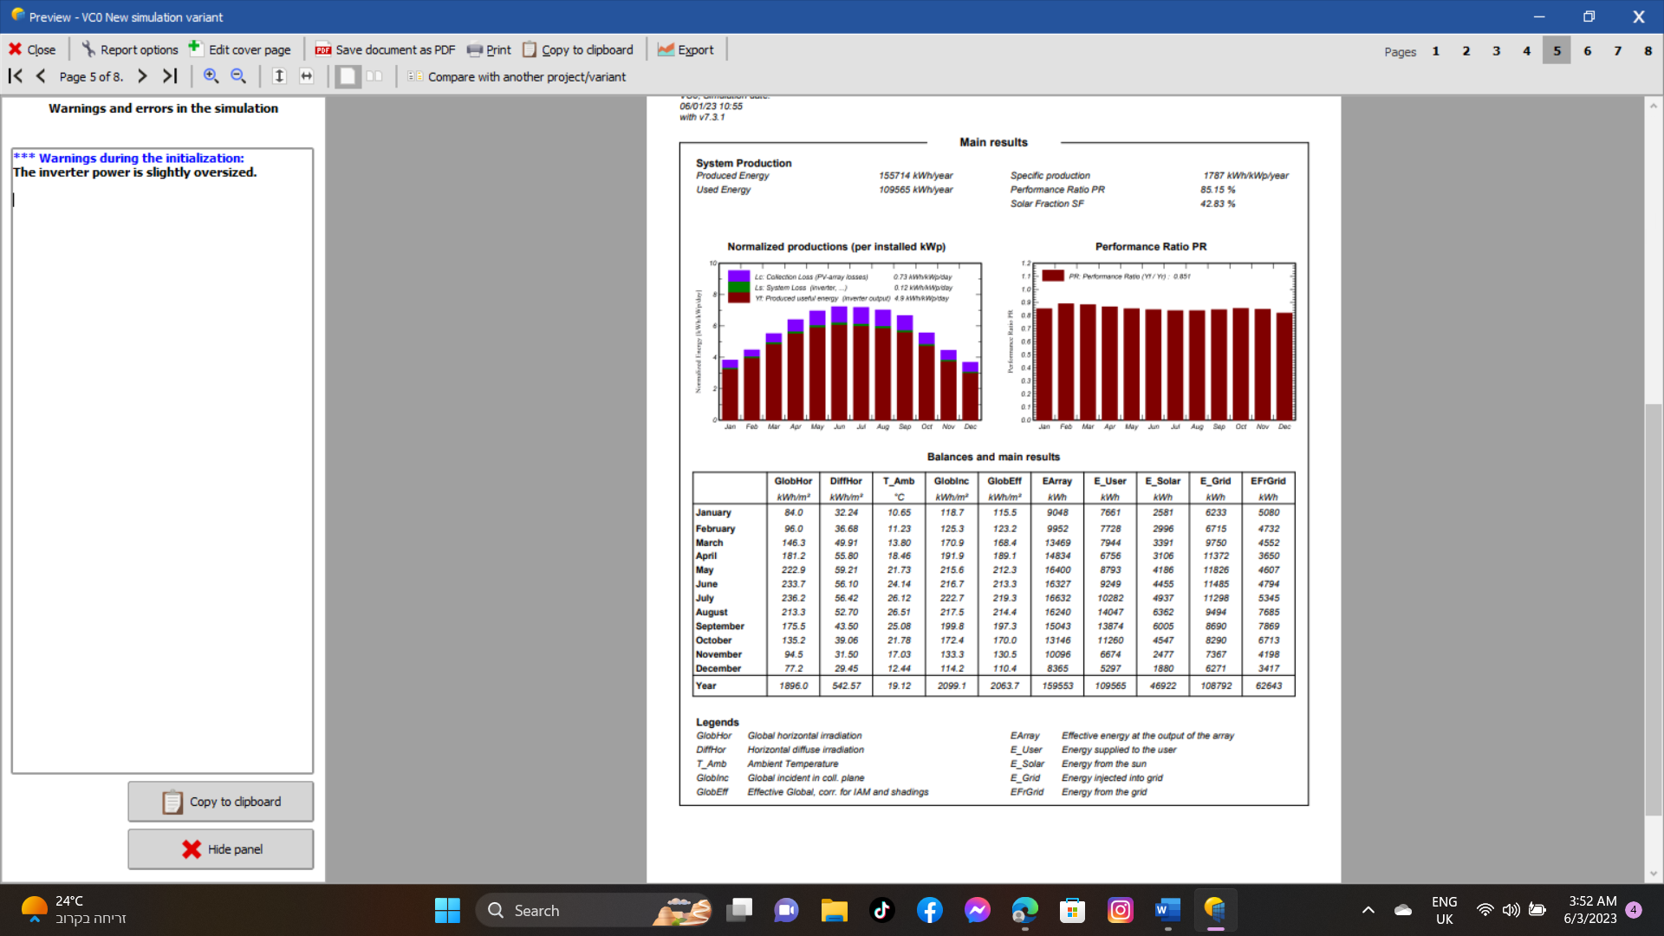
Design

Slide 19
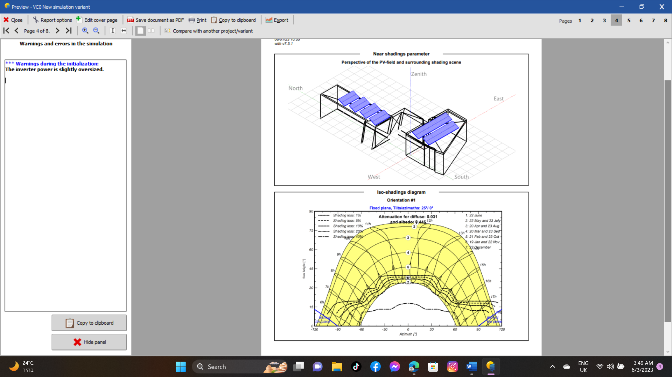
Design

Slide 20
Design

Slide 21
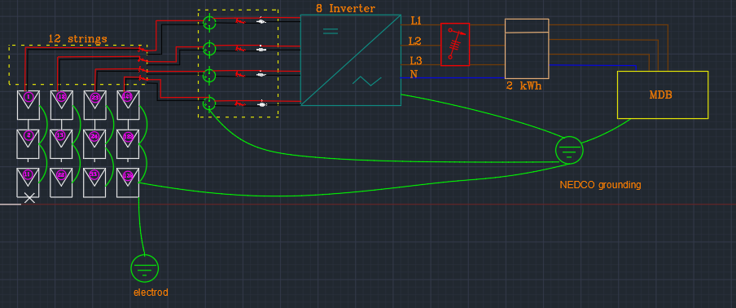
Design

Slide 22
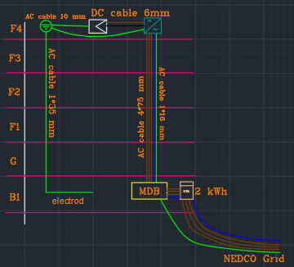
Design

Slide 23
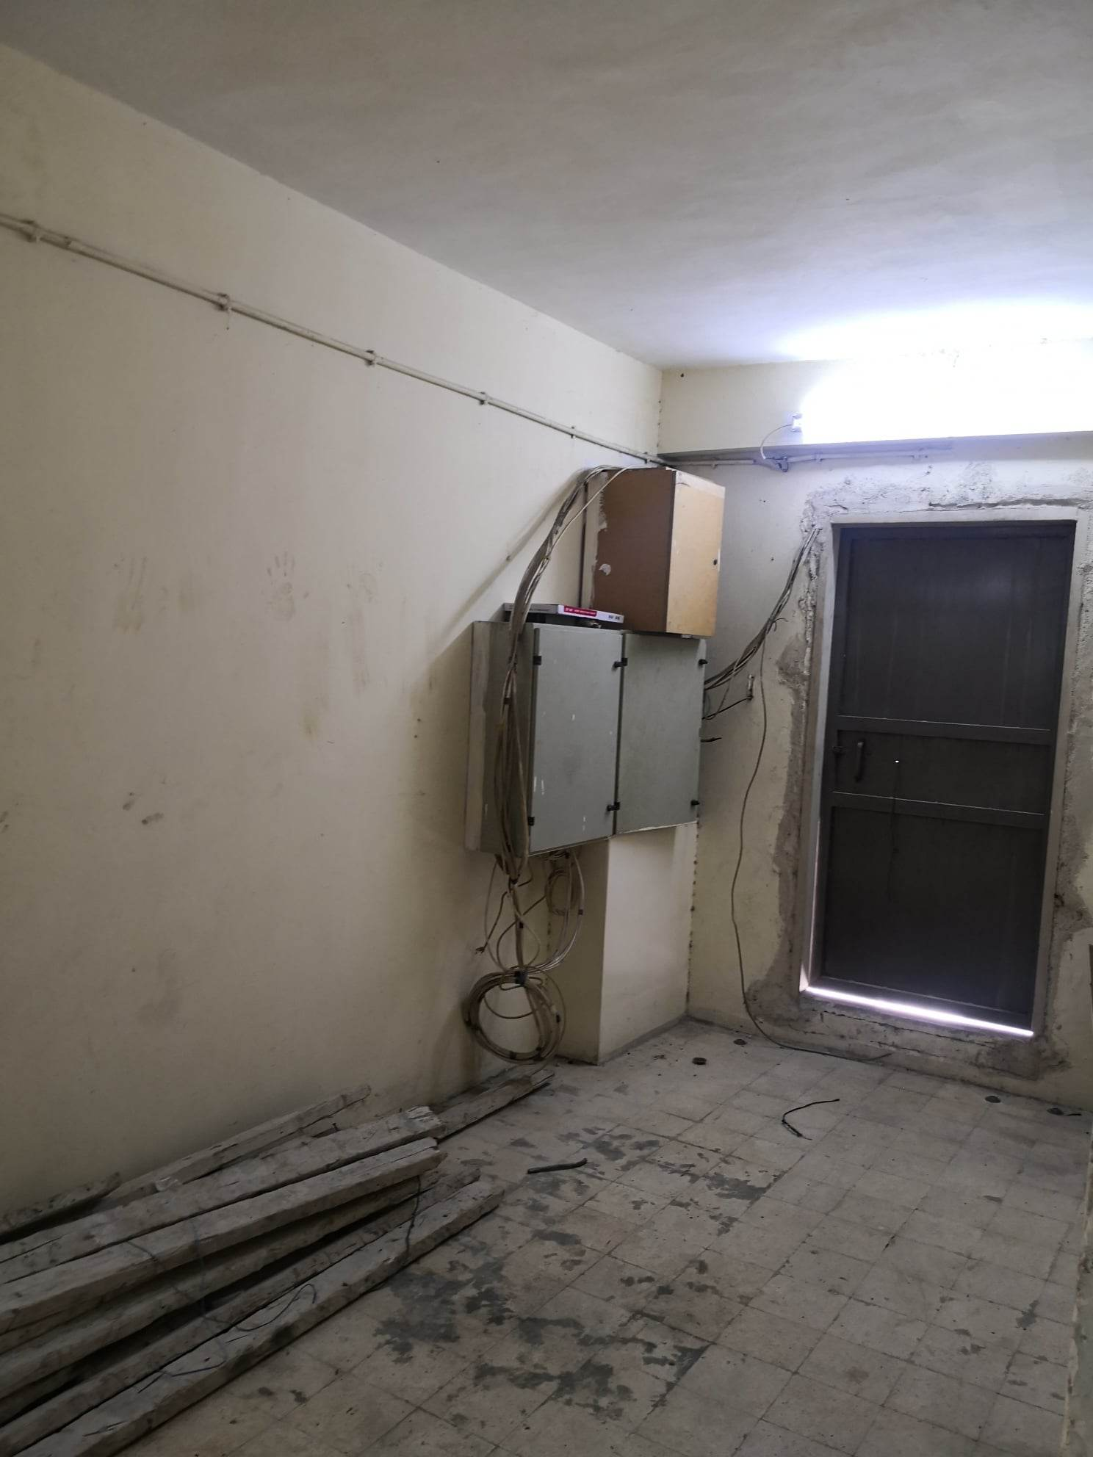

Slide 24
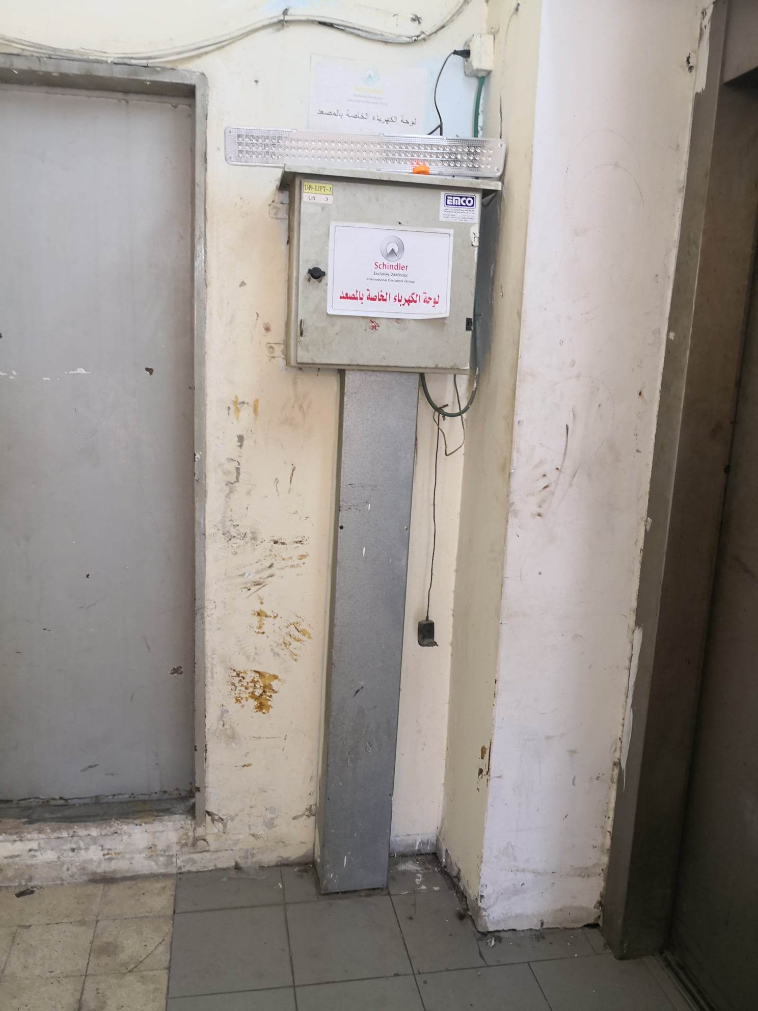

Slide 25
financial accounts of the system
Part | Price/nis | Quantity | Total of price/nis
Pv panel | 780 | 132 | 102960
Inverter | 5600 | 8 | 44800
Earth Cable10 mm | 9 | 110 | 990
Earth Cable 16mm | 16 | 25 | 400
Cable ac 4 *75mm | 95 | 25 | 2375
Earth cable 35mm | 30 | 30 | 900
Cable dc 6mm | 4 | 200 | 800
Earth leakage | 250 | 8 | 2000
Iron box for CB | 350 | 3 | 1050
Surge arresters dc | 125 | 12 | 1500
Surge arresters ac | 165 | 1 | 165
Circet breaker ac | 200 | 8 | 1600
Circet breaker dc | 180 | 24 | 4320
structure | 19000 | 1 | 19000
Clamp | 5 | 264 | 1320
trench | 95 | 15 | 1425
contingency cost | 66711 | 1 | 66711
other | 5000 | 1 | 5000
total |  |  | 257316

Slide 26
financial accounts of the system
The financial engineering calculations of the system show the expenses and revenues of the system for the life cycle of 25 years, and the system needs approximately 4 years to reinvest and with 24% rate of return.

Slide 27

Equations used in PV system design:
$kWp=n∗Wp/1000$
$Number ofPV requierd=\frac{Power PV}{Power PV single}$
$Ep=Ema∗kWp∗ꞃ$
$Fill factor=\frac{Pmax}{Voc∗Isc}$
$PV on series=\frac{PV module voltage }{voltage at operating condition}$
$PV on parallel=\frac{number of PV}{number of PV in sereis}$
Economic equation:
PW=first cost (P/A,i%,n)
SPP=initial investment / net annual cash flow

Slide 28
Conclusions
The use of renewable energy is one of the necessary things these days in order to reduce emissions from the use of fossil fuels.Where the hospital's energy consumption reaches 110 MWh, and the system produces approximately 156 MWh energy per year.it was found that the system that will be installed covers the loads of one of the two meters with a capacity of 87 kilowatts, which is what has been worked on, in addition to that it will bring financial benefit to the hospital after four years, and the money that was spent on this bill will be used to develop the parts of the hospital.

Slide 29
Thank you

