Slide 1

An-Najah National University
Faculty of Engineering
Building Engineering Department
2015-2016
Graduation Project – 2
Design of an integrated 5-Star Hotel
Prepared By:
Alaa Horani
Mosab Hamdan
Nael Sakhen
Yahya Yamin
Project supervisor:
Eng. Hasan Mather

Slide 2
CONTENTS
Introduction
Selected Site
Architectural Design
Structural Design
Environmental Design
Electrical Design
Mechanical Design
Safety Design
Estimated Cost

Slide 3
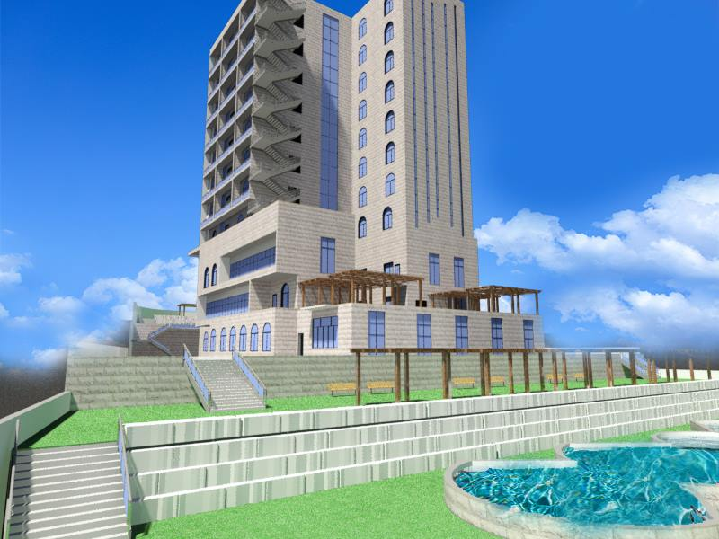
INTRODUCTION
The main concept of our project was to design an integrated 5-Star Hotel, and our focus has been on Structure, Environmental, Electrical, Mechanical and Safety design to make a comfortable hotel.

Slide 4
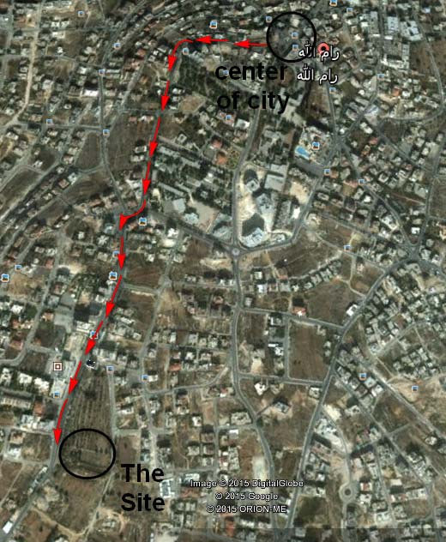
Selected Site
Pelvis No. (رقم الحوض) : 43
Piece no. :18
Site Area : 6770 m²
Rebound from streets : 10m

Slide 5
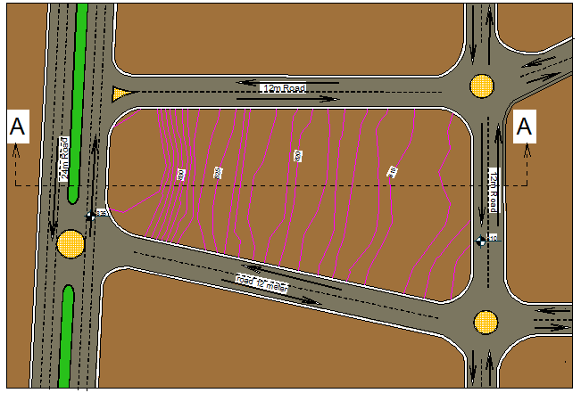
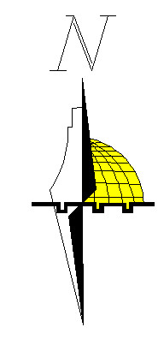
Selected Site

Slide 6
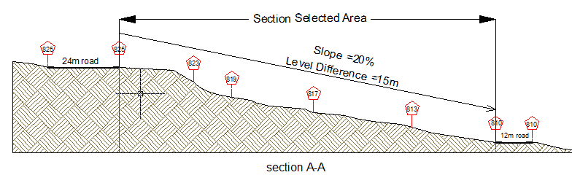
Section A-A
Selected Site

Slide 7
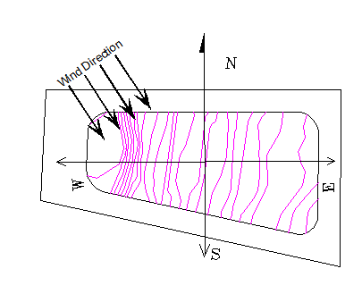
Selected Site

Slide 8
ARCHITECTURAL DESIGN

Slide 9
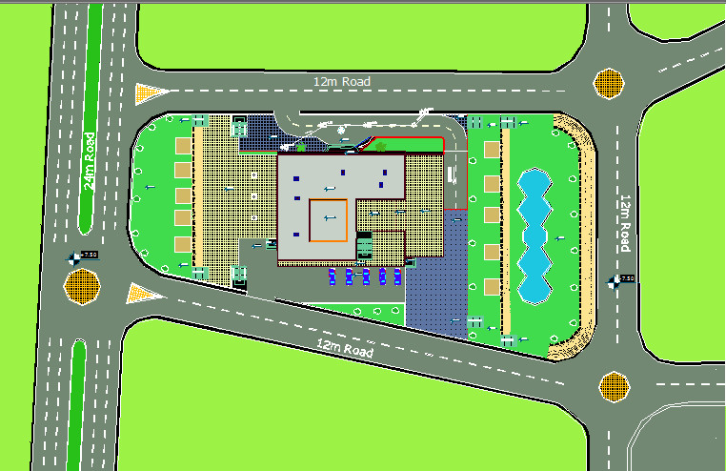

Site Plan
Site Plan

Slide 10
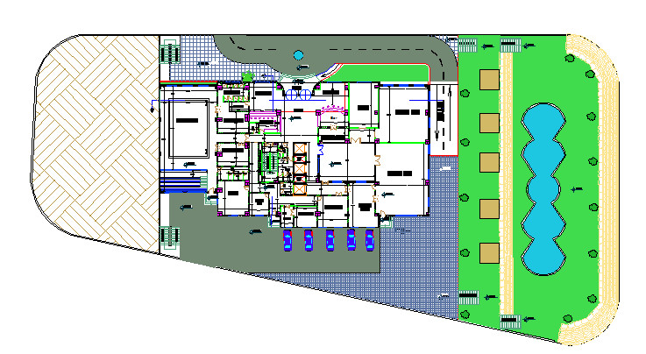
Master Plan
Master Plan

Slide 11
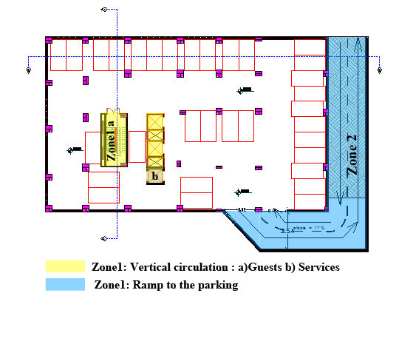

Hotel Plans
B2 plan

Slide 12
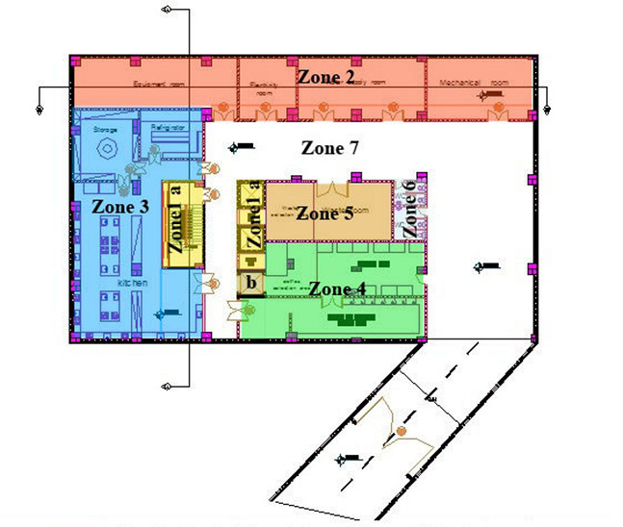
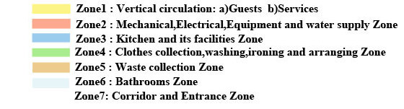
Hotel Plans
B1 Plan

Slide 13
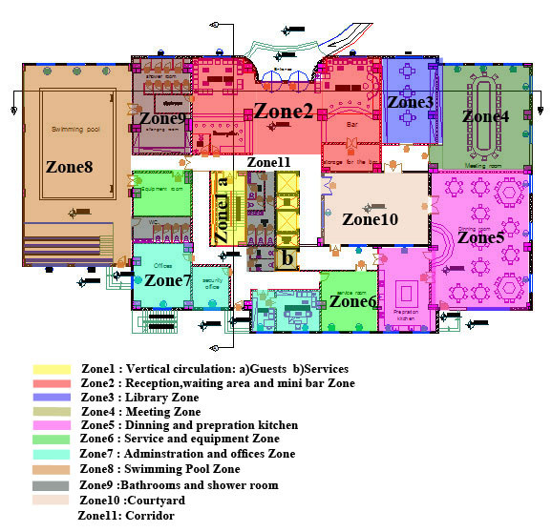
Hotel Plans
GF Plan

Slide 14
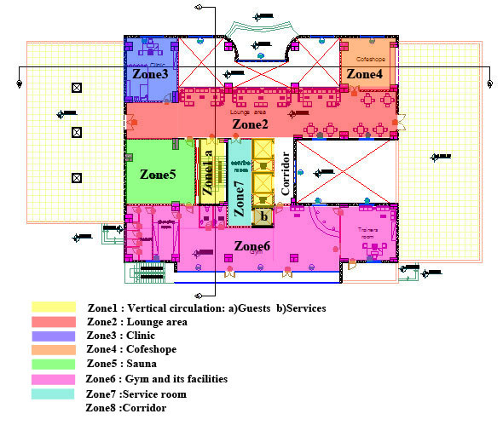
Hotel Plans
F1 Plan

Slide 15
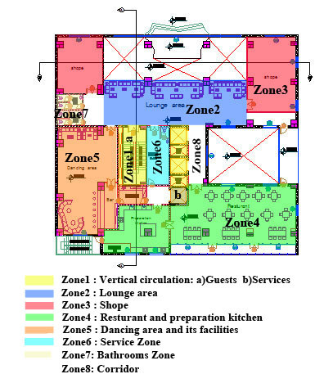
Hotel Plans
F2 Plan

Slide 16
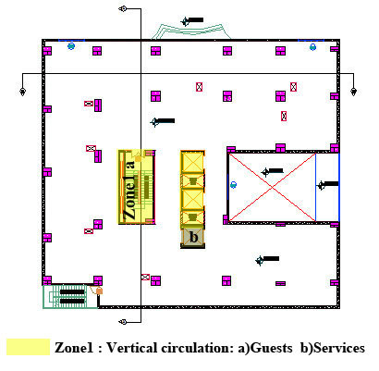
Hotel Plans
F3 Plan

Slide 17
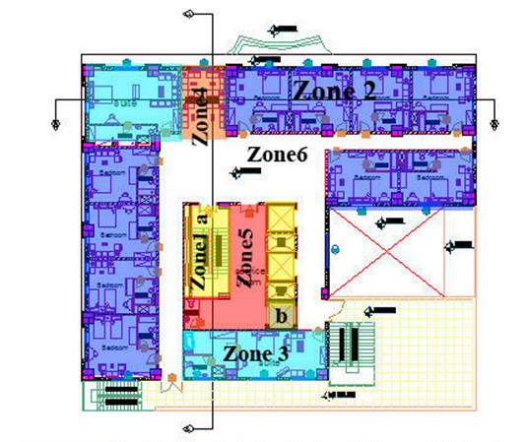
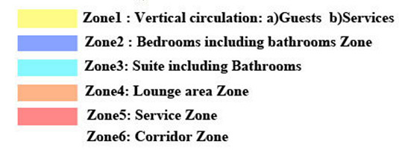
Plans Hotel
F4-11 Plan

Slide 18
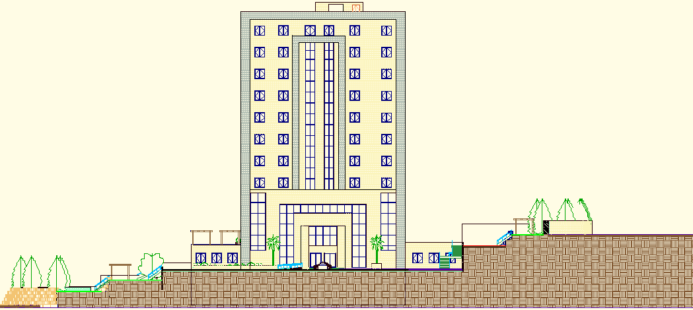
Elevations
North-Elevation

Slide 19
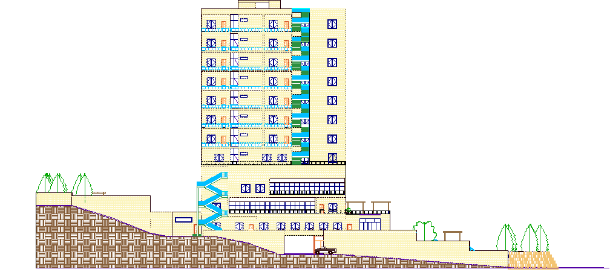
Elevations
South-Elevation

Slide 20
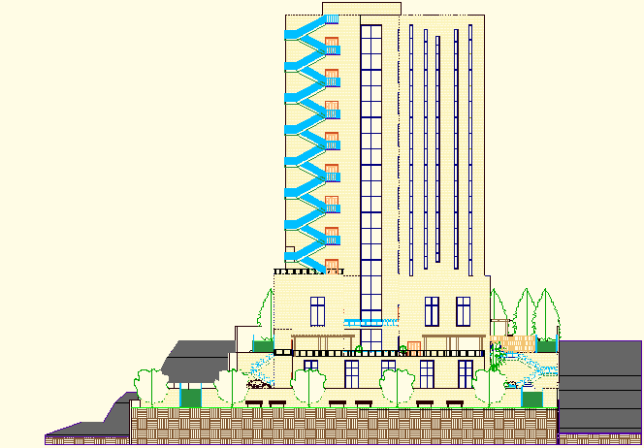
Elevations
East-Elevation

Slide 21
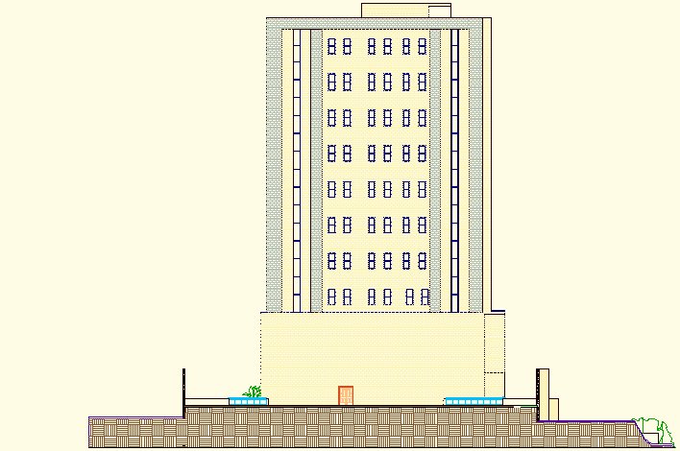
Elevations
West-Elevation

Slide 22
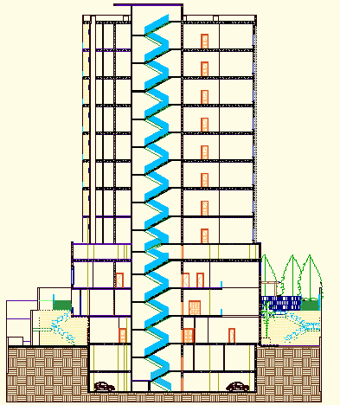
Sections
Section A-A

Slide 23
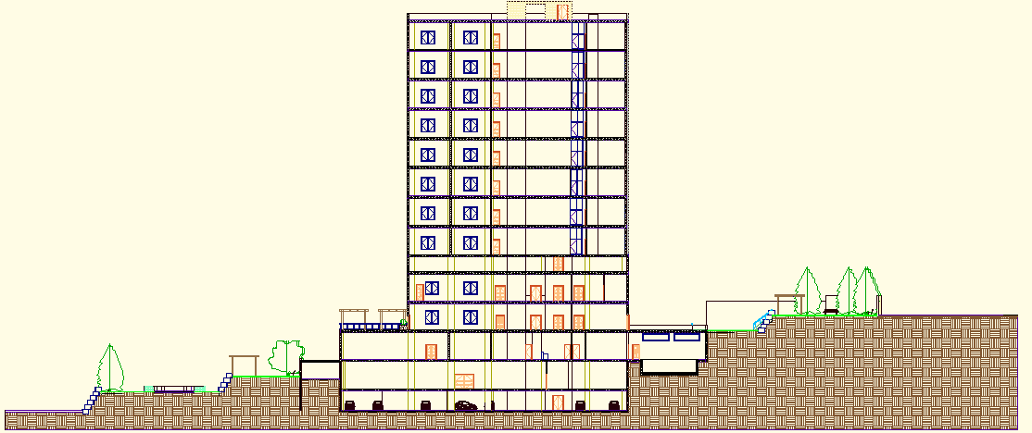
Sections
Section B-B

Slide 24
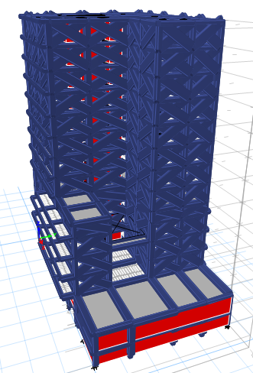
STRUCTURAL DESIGN

Slide 25
Design Codes
ACI -318-08 for reinforced concrete structural design.
ACI -350-3-01 for seismic design of liquid with concrete structure .
ACI -350-3-06 for seismic design of soil pressure with concrete structure .
UBC -97 for earthquake load combinations.
ASCE for load combinations.

Slide 26
Material Property
Compressive strength of Concrete “f′c”.
    For columns and slabs f′c = 28 Mpa
    For all other elements in structure such as blinding and bracing f′c = 12 MPa
Yielding strength of steel fy = 420 MPa.
Soil Property
Soil bearing capacity = 400 KN/m2
Soil profile = S_{B}

Slide 27
Loads
Dead loads (D.L): 5 KN/m²
Super Imposed dead load (SI):4 KN/m²
Live Load (L.L): 5 KN/m² (for first five floor)
3KN/m² ( for other floors)
Lateral loads consider earthquake load.

Slide 28
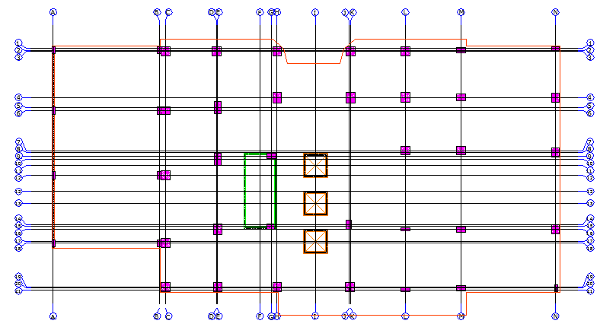
Column Center Lines Grid

Slide 29
Design and Reinforcement of Structural Elements
Slab (one way & two way & solid).
Beams ( drop &hidden).
Columns
Shear wall
Basement wall
Stair
Footings
Swimming pool.

Slide 30
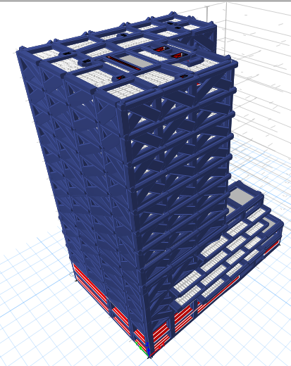
Hotel 3D Model - Etabs

Slide 31
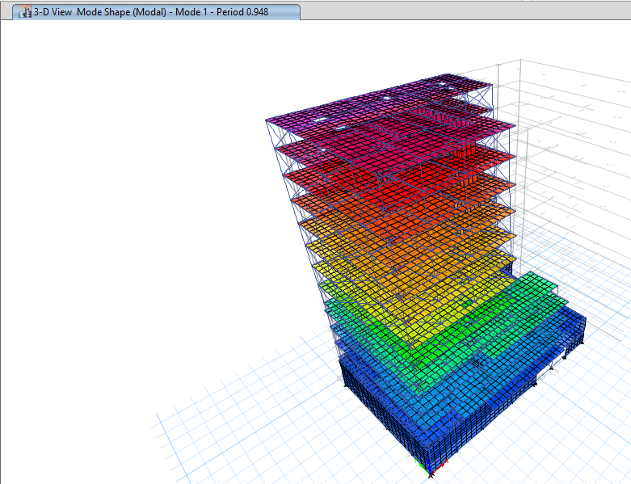
Model Checks
Compatibility

Slide 32
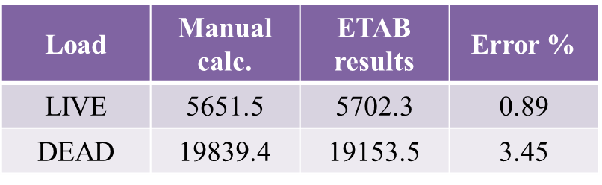

Model Checks
Equilibrium

Slide 33
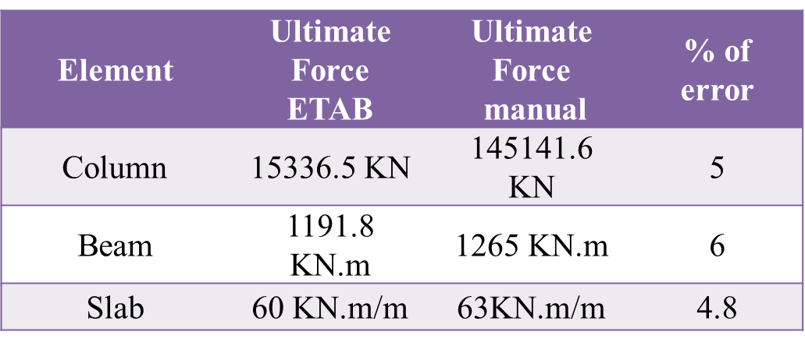
Model Checks
Internal Forces

Slide 34
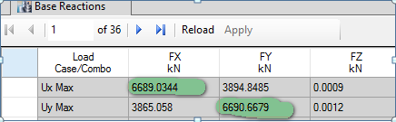
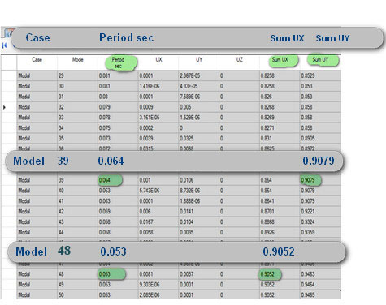
Seismic design
Cv = 0.15
Ca = 0.15
I = 1
R = 5.5
Soil profile S_{B}
Z = 0.15
From Etabs
Base shear ( V ) = 6693.1 KN
Mass participation ratio is larger than 90% in X, Y .

Slide 35
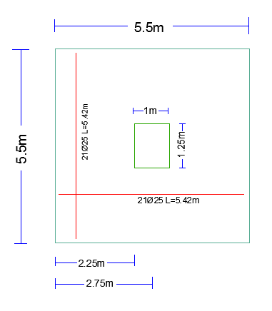
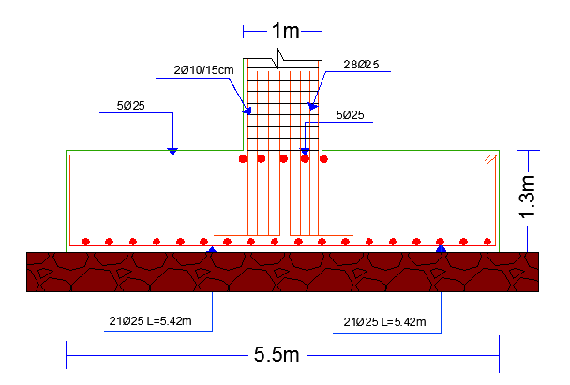
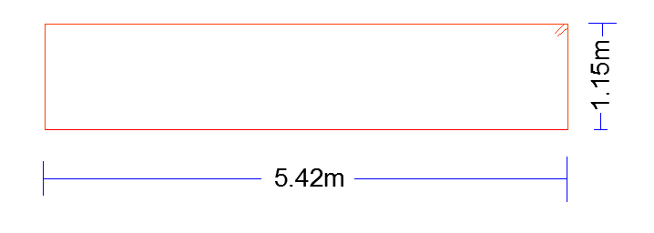
Footing Reinforcement Details
Single Footing

Slide 36
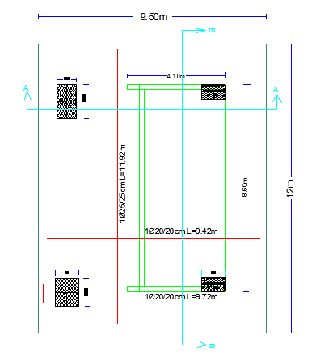
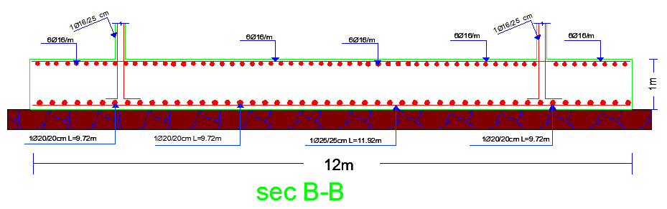
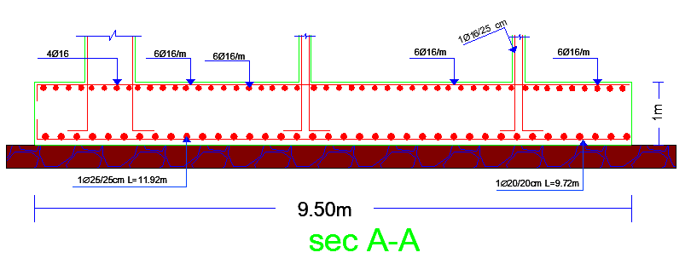
Footing Reinforcement Details
Mat Footing

Slide 37
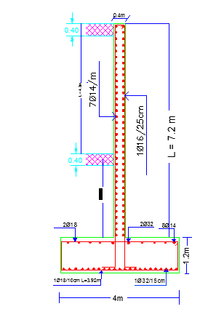
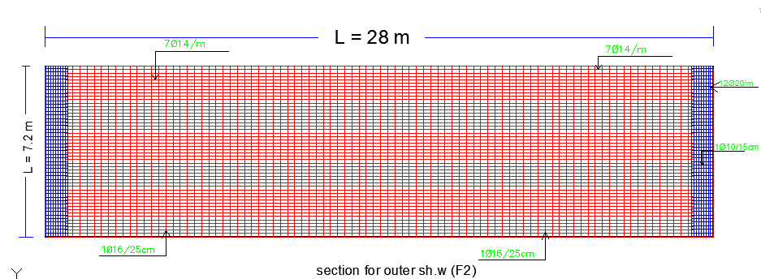
Basement Retaining Wall Details

Slide 38
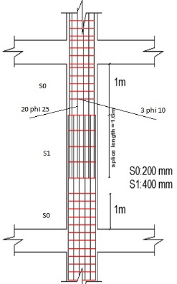
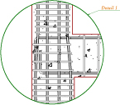
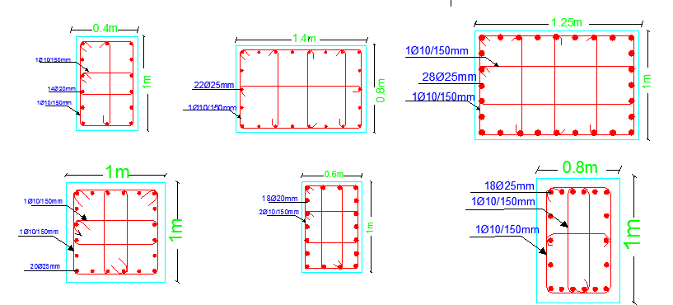
Column Reinforcement Details

Slide 39
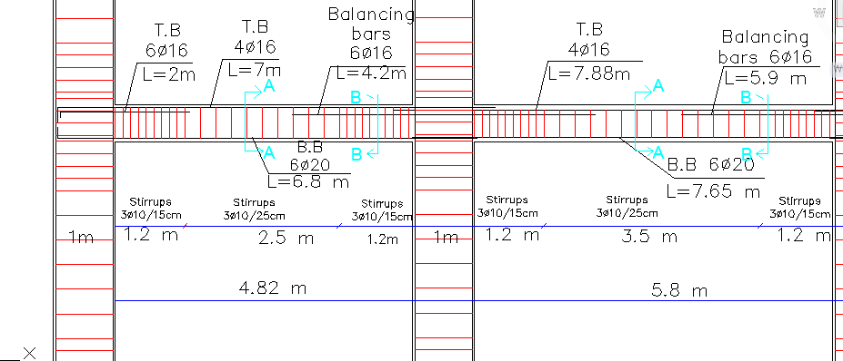
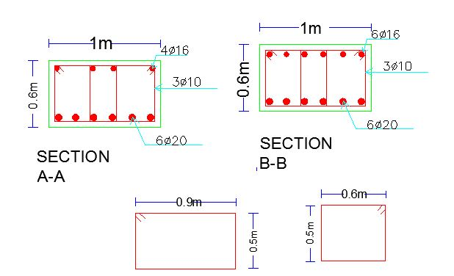
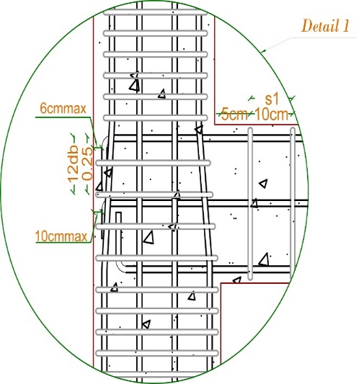
Beam Reinforcement Details

Slide 40
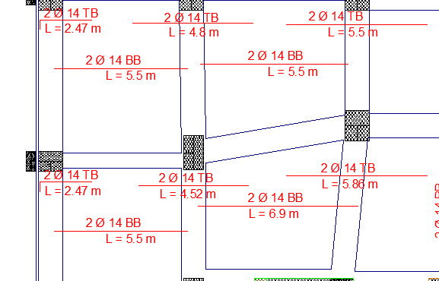
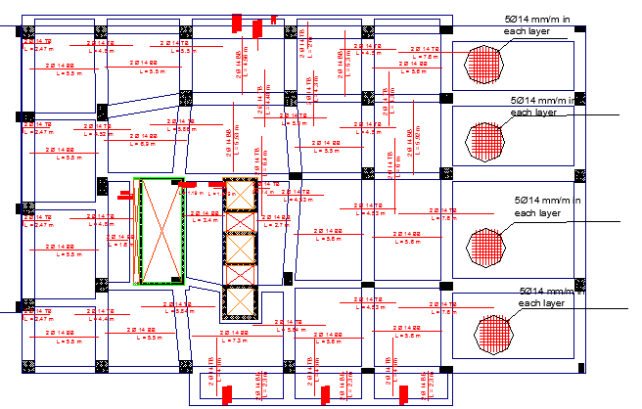
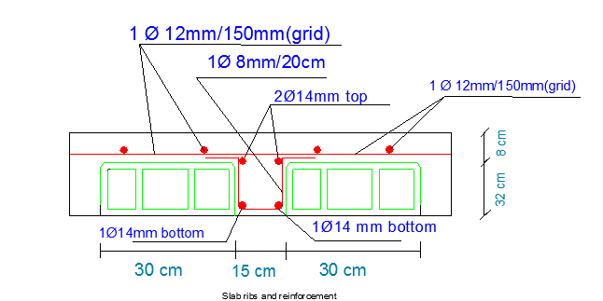
Slab Reinforcement Details

Slide 41
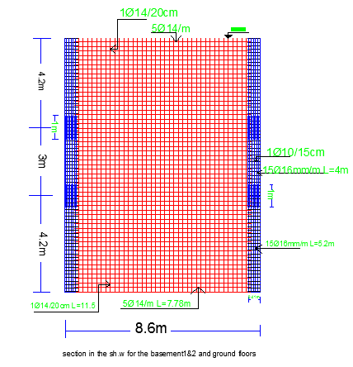
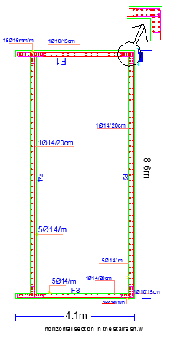
Shear Wall Details

Slide 42


Stair Reinforcement Details

Slide 43



Swimming pool Reinforcement Details

Slide 44

Expansion Joint

Slide 45

Environmental DESIGN

Slide 46


Thermal Insulation
Floor Section
Floor Properties

Slide 47
Thermal Insulation
U-Value Of The Other Elements
Elements | U-Value
External wall | 0.51
Ceiling | 0.57
Partition | 2.31
Roof | 0.37
Window | 2.71

Slide 48

Thermal Insulation
Cooling and heating load for Ground floor
Before add insulation:

Slide 49

Thermal Insulation
After adding insulation:

Slide 50

Thermal Insulation
After adding insulation:

Slide 51

Natural Daylight Analysis

Slide 52



Shading design
summer
winter

Slide 53


Shading design

Slide 54

Acoustical Design
Sound Transmission Class (STC)
STC-Values Between Different Spaces |  | Recommendation
Bedroom to Bedroom | 52 | > 52
Bedroom to bathroom | 58 | > 56
Corridor To Bedroom | 58 | > 52
Impact Insulation Class (IIC)
We used one way ribbed slab with thickness = 400 mm
IIC = 70

Slide 55


    Acoustical Design
    Reverberation Time (RT60)
    Range RT60 for bedrooms 0.4-0.8
    RT60 values for bedroom before improving :

Slide 56


    Acoustical Design
    Reverberation Time (RT60)
    Improving RT60 by add Fiberglass board to the wall and Carpet to the floor with
    Different values of absorptions as follow :

Slide 57


    Acoustical Design
    Reverberation Time (RT60)
    RT60 values for bedroom after improving :

Slide 58

    Acoustical Design
    Transmission loss (TL)
    TL = 40.6 > 40

Slide 59
Electrical DESIGN

Slide 60


    Sockets Arrangement
    Lighting arrangement

Slide 61



    Artificial Lighting
Bar Lighting:

Slide 62

    Artificial Lighting

Slide 63

Mechanical DESIGN

Slide 64

    Water Supply Design

Slide 65


    Water Supply System

Slide 66


    Drainage System
    For Ground Floor

Slide 67

    Rain Drainage System

Slide 68

    Rain Drainage System

Slide 69


    H-VAC System
    VRF system for Bedrooms

Slide 70


    H-VAC System
    VAV system

Slide 71

Safety
DESIGN

Slide 72

    Safety Design
    Egress rout for ground floor

Slide 73

    Safety Design
    Egress rout for 4th floor

Slide 74

    Safety System

Slide 75

Estimated Cost

Slide 76
Estimated Cost
The total cost of the HOTEL is about 26.5 million shekel.
The total cost per meter square for the HOTEL is about 2038 shekel.

Slide 77


