Slide 1
AN-NAJAH NATIONAL UNIVERSITY
FACULTY OF ENGINEERING
MECHANICAL ENGINEERING DEPARTMANT
Mechanical Systems for jenin headquarter building
Supervisor: The Students:
Inc. Ramez Khaldi Malek Abu Al Wafa (10718619)
Mohammed Taffal (10717104)
Bahij Darrouza (10718487)
Samer Yassen (10718598)

Slide 2
Variable Refrigerant Volume
VRV III (Heat Recovery)
Intelligent air-conditioning technology

Slide 3
VRV III system
It is a highly intelligent air-conditioning system uses a gas not water as refrigerant.
it is connected with a control system to give each zone of the building the comfort temperature humidity and air motion it need

Slide 4
VRV. HOW DOES IT WORK
At the heart of our system is a highly intelligent inverter-driven compressor. This advanced technology enables the output of the outdoor unit to be modulated by the cooling or heating demands of the zone that it controls. Available in both heat pump and heat recovery formats, this advanced system allows for individual control of up to 20 indoor units of varying capacities and types at a connection ratio of 50%–130%, compared to outdoor unit capacity.

Slide 5
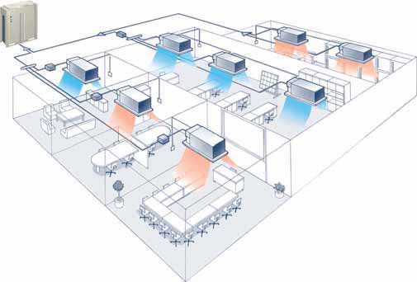
Heat Recovery

Slide 6
system advantages
ADVANCED ZONING CAPABILITIES provide complete control and Absolute Comfort over every square inch of your environment regardless of building size, configuration or function.
ENERGY EFFICIENCY and lower operating costs result from being able to control each zone or room individually.
At temperature below zero the water will freeze but R410A won’t.

Slide 7
system advantages
VRV is simple system, since you can connect one outdoor unit to 64 indoor units.
No need for big shafts for VRV system, since bigger pipe that can be used with VRV system is (1.5) inch.
VRV outdoor units are smaller foot print than any other systems especially with the chiller system.

Slide 8
system advantages
VRV system work with refrigerant R410A that is friendly to environment nature.
In Palestine, you can’t find any person that can make service for chiller system, but for VRV system you can find.
VRV DAIKIN is made in JAPAN.

Slide 9
DESCRIPTION OF THE BUILDING
building in jenin city
building consists of six floors.
each floor has area of 600 m².
building face sits at the north-east orientation.

Slide 10
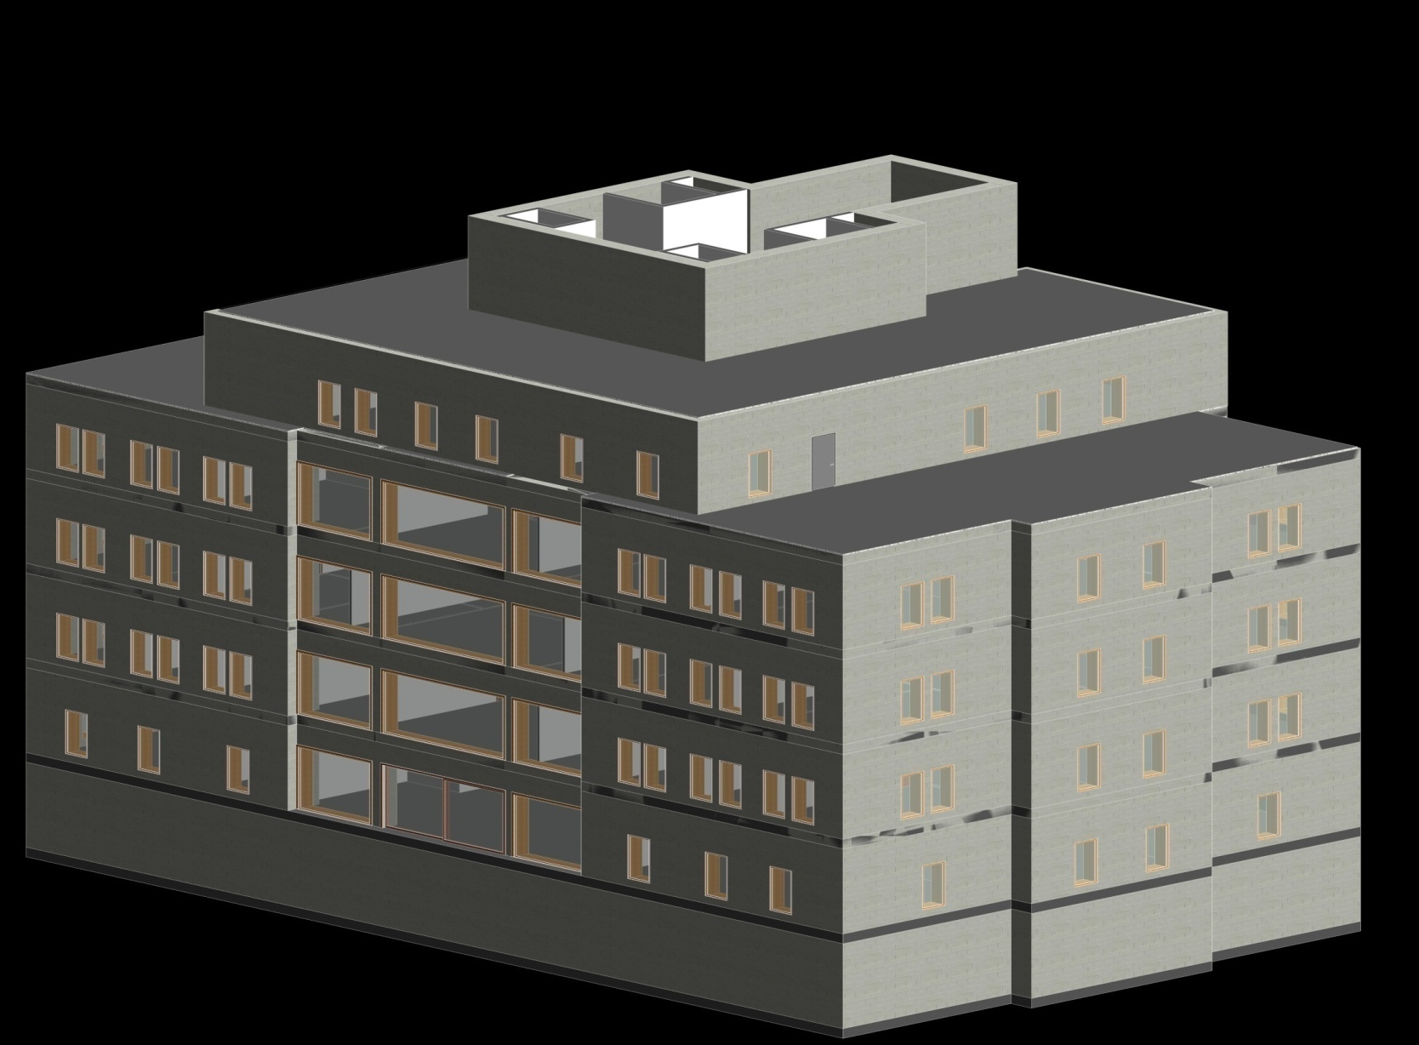
DESCRIPTION OF THE BUILDING

Slide 11
INSIDE AND OUTSIDE CONDITIONS
 | Temperature (°c) | Humidity ratio (%)
Inside building(winter) | 23 | 30
Inside building(summer) | 25 | 50
Outside building(winter) | 8.3 | 73.7
Outside building(summer) | 33.7 | 61.5

Slide 12
UNCONDITIONED TEMPERATURE
Unconditioned winter | 15.65 (°c)
Unconditioned summer | 30.8 (°c)

Slide 13
OVERALL HEAT TRANSFER COEFFICIENT
external walls | 0.81 W/ m². Cº
internal walls | 2 W/ m². Cº
ceiling | 1.1 W/ m². Cº
doors | 5.8 W/ m². Cº
windows | 3.5 W/ m². Cº

Slide 14
HEATING LOAD
FLOOR | HEATING LOAD
GROUND | 44.207KW
FIRST | 31.764KW
SECOND | 25.433KW
THIRD | 35.967KW
ROOF | 22.334KW
TOTAL | 159.705KW

Slide 15
COOLING LOAD
FLOOR | SENSIBLE LOAD (KW) | LATENT LOAD (KW) | TOTAL LOAD (KW)
GROUND | 54.46 | 43.66 | 98.12
FIRST | 38 | 36.62 | 74.62
SECOND | 39 | 39.5 | 78.5
THIRD | 42.22 | 39.3 | 81.52
ROOF | 27.2 | 21 | 48.2
TOTAL | 200.1 | 180 | 380.1

Slide 16
COMPONENT OF THE SYSTEM
INDOOR UNITS
Indoor unit name | Indoor unit total load(W) | CFM
FXSQ-8M-32 | 3600 | 350
FXSQ-8M-50 | 5600 | 550
FXSQ-8M-63 | 7100 | 770
FXSQ-8M-80 | 9000 | 990
FXSQ-8M-100 | 11200 | 1027
FXSQ-8M-125 | 14000 | 1400
Concealed ceiling unit

Slide 17
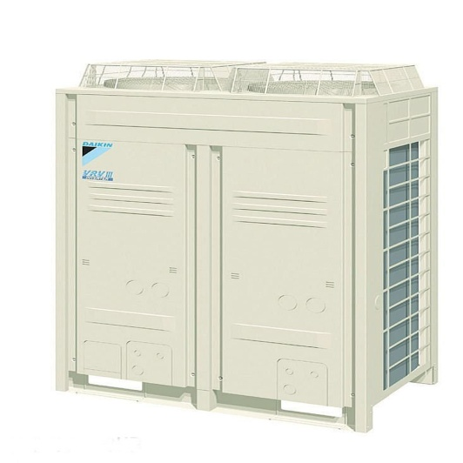
COMPONENT OF THE SYSTEM
OUTDOOR UNITS
Outdoor unit name | Outdoor unit total load(KW) | Floor
REYQ-P-36 | 101 | GROUND
REYQ-P-26 | 73 | FIRST
REYQ-P-28 | 78.5 | SECOND
REYQ-P-28 | 78.5 | THIRD
REYQ-P-18 | 50.4 | ROOF

Slide 18
PIPE SIZING
Using Toshiba software to design the pipe sizing.
Each floor connected Separately to its outdoor units.
Pipe size depend on :-
Desistance between indoor unit and outdoor unit.
The load of the indoor unit.

Slide 20
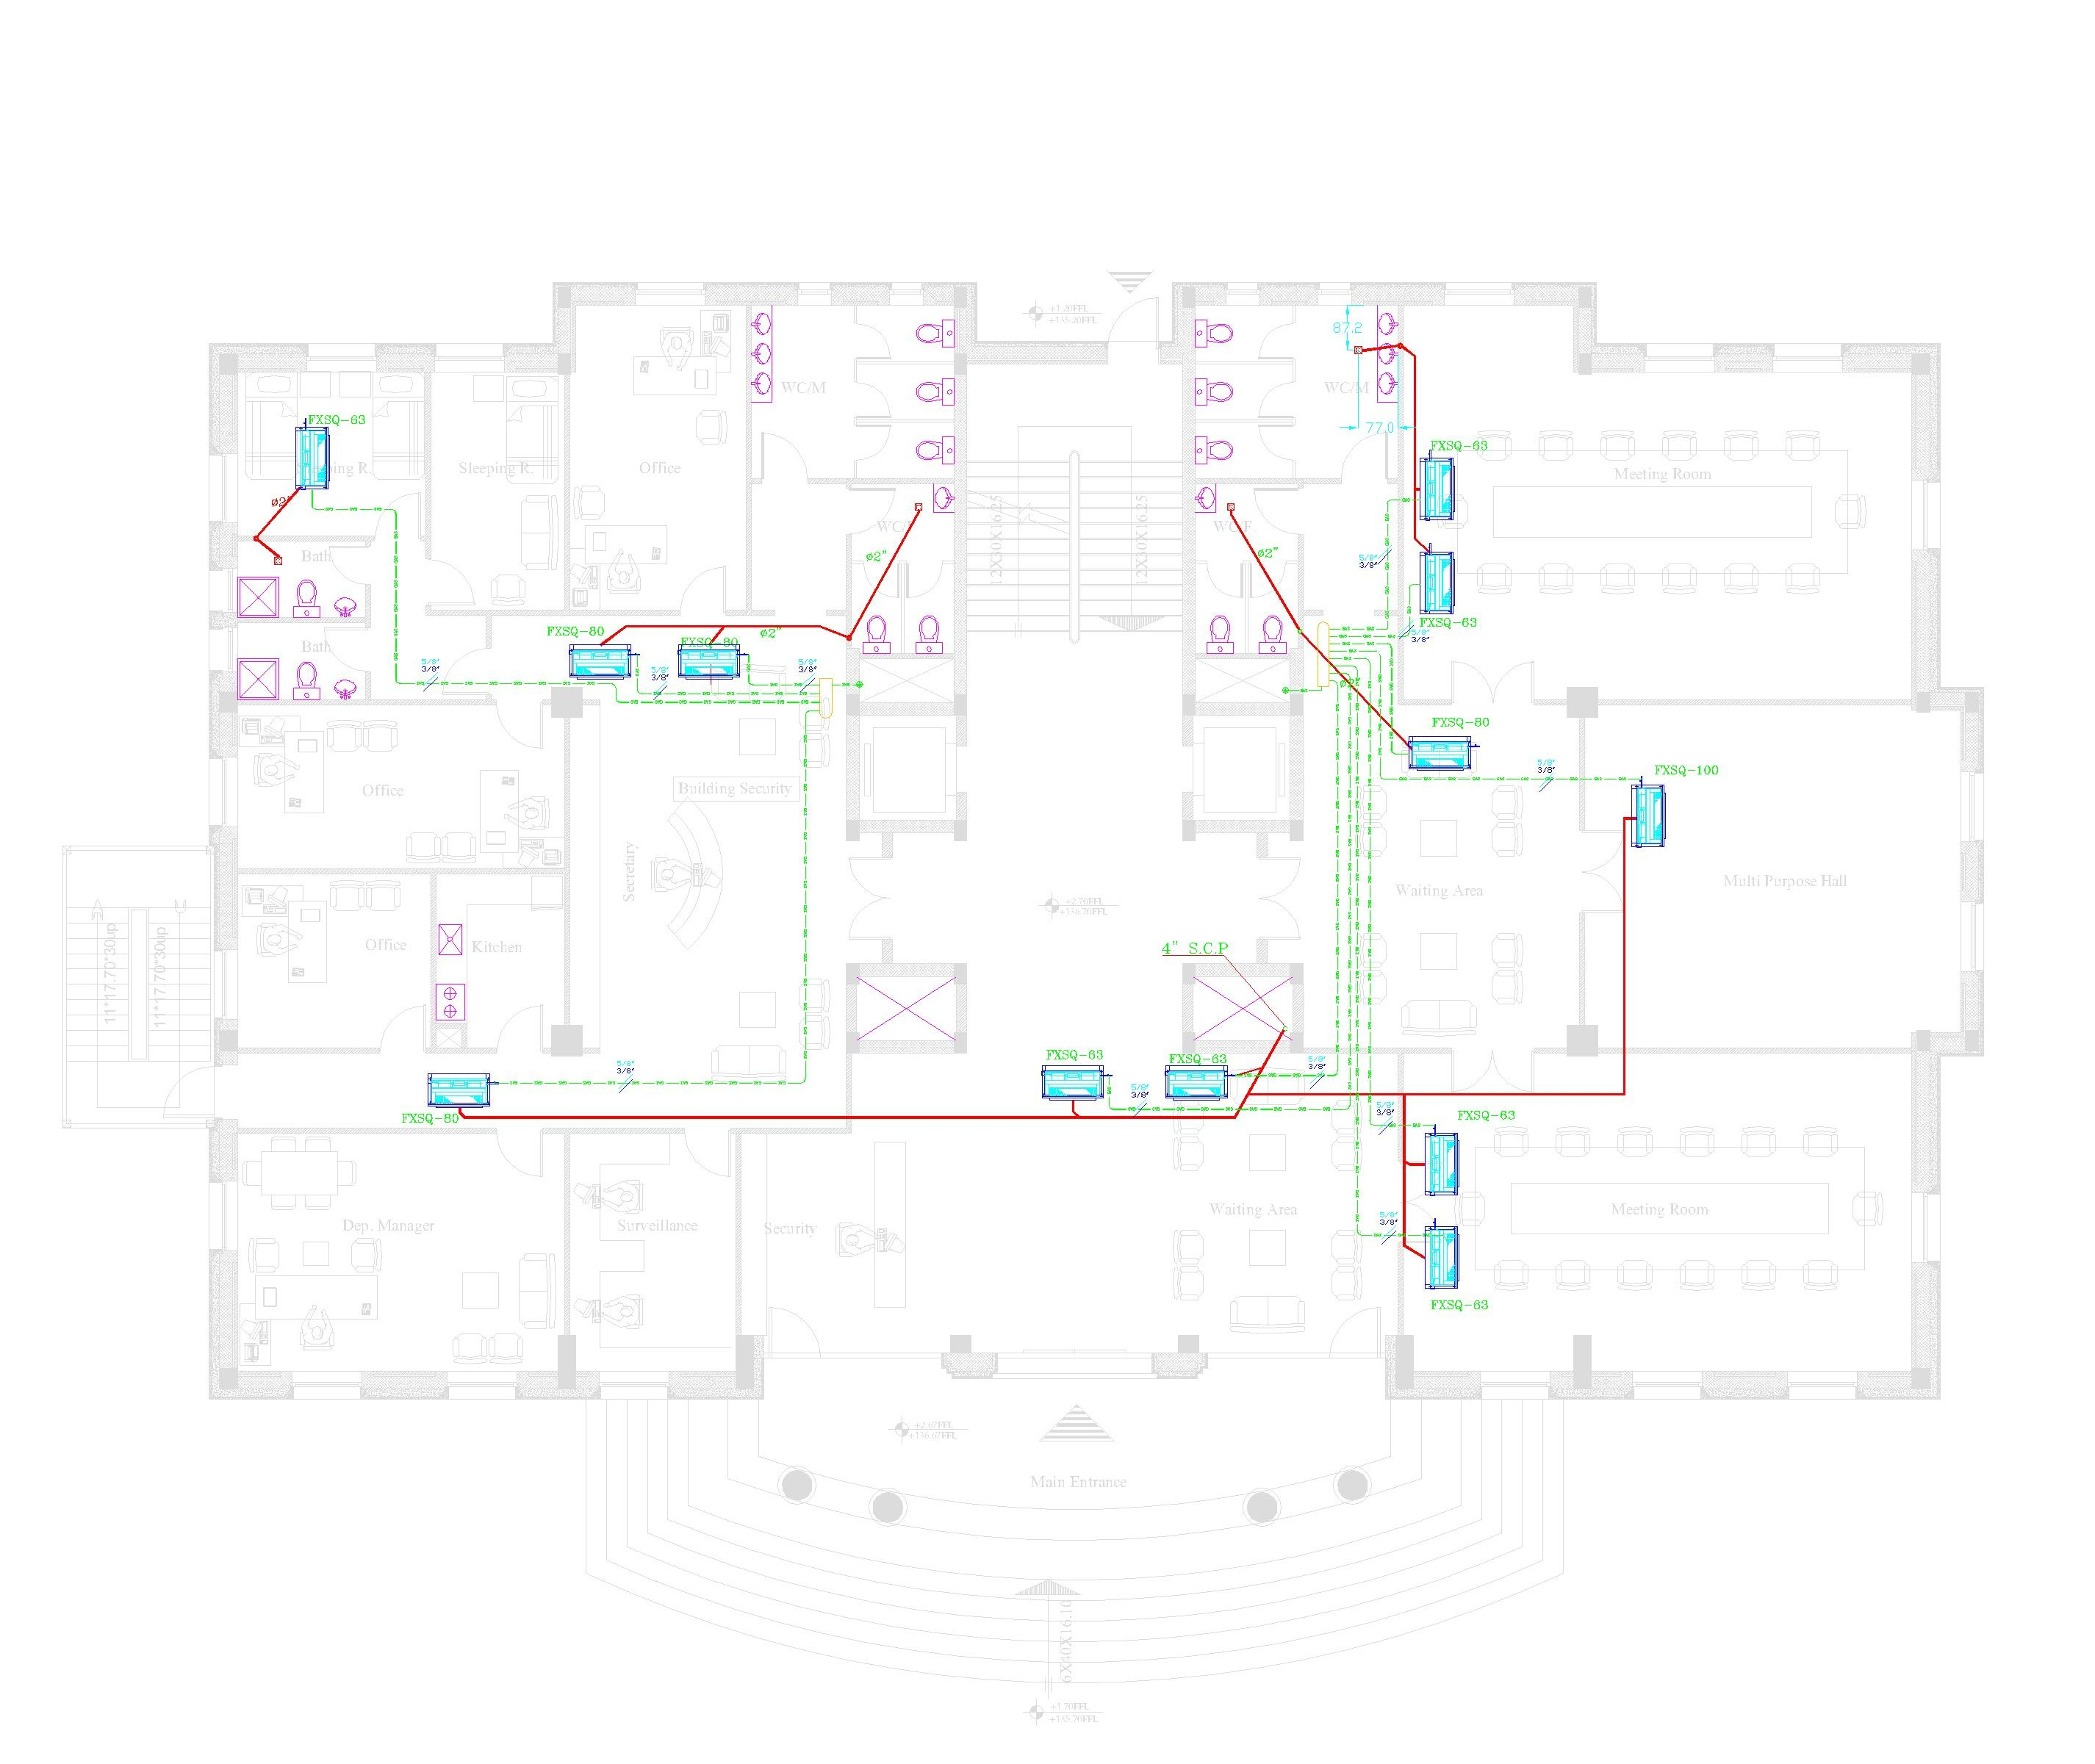

Slide 21
DUCT DESIGN
Duct design using constant pressure drop method.
Section | CFM | V (m3/s) | Velocity | P/L | Area(m²⁾ | D(m) | high(mm) | width
 |  |  | (m/s)
A-B | 770 | 0.35 | 5 | 0.9 | 0.07 | 0.2986 | 300 | 275
B-C | 250 | 0.1136 | 3.9 | 0.9 | 0.0291 | 0.1927 | 300 | 100
C-D | 500 | 0.2273 | 4.2 | 0.9 | 0.0541 | 0.2626 | 300 | 200
D-E | 250 | 0.1136 | 3.9 | 0.9 | 0.0291 | 0.1927 | 300 | 100
from | V*2200 | Equation 6.1 | Fig D-1 | constant | volume flow rate/velocity | from area | From table (D-2)

Slide 22
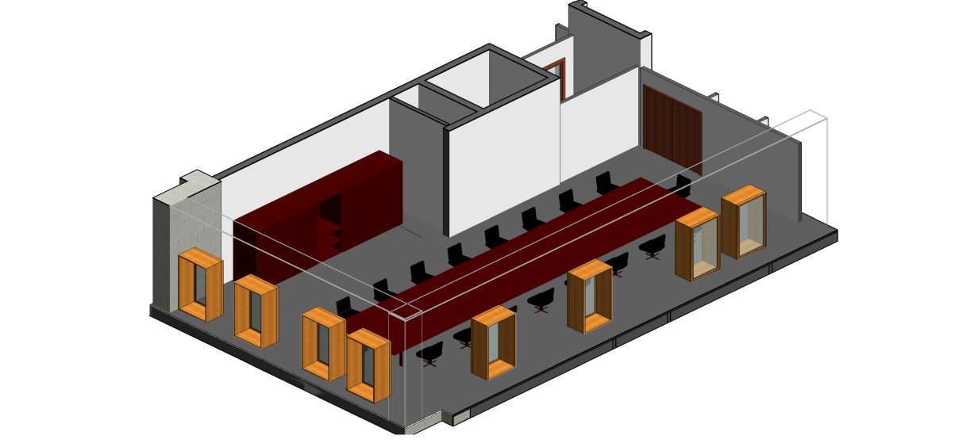
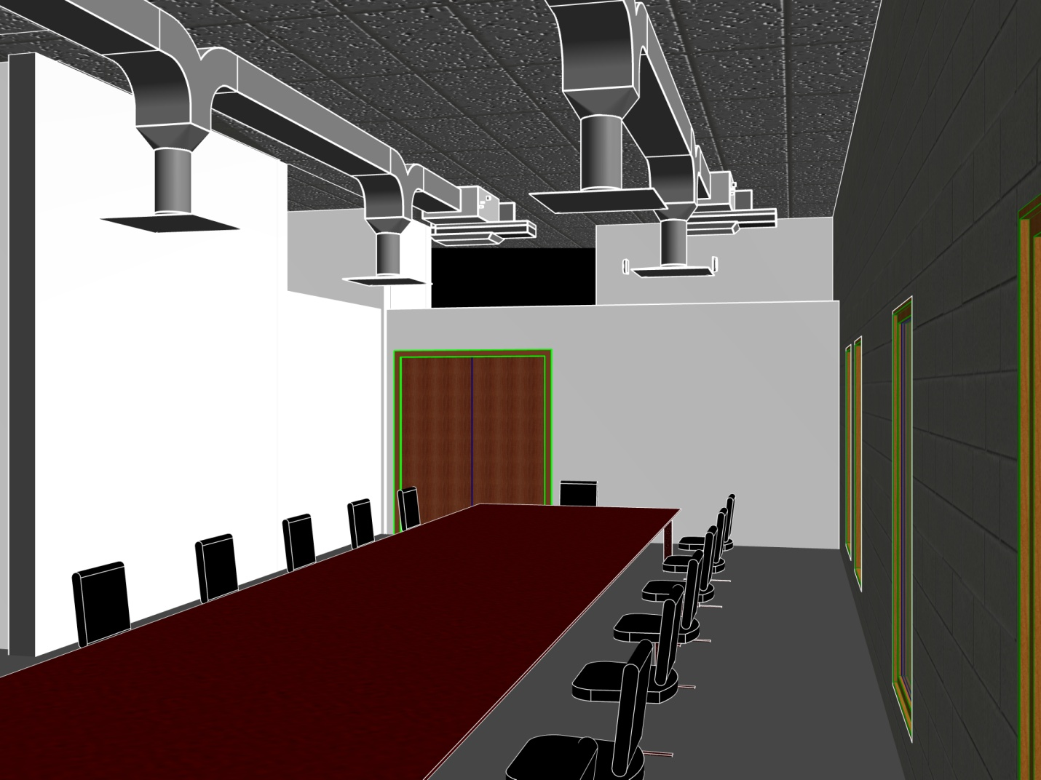

Slide 23
DUCT DESIGN
Three duct systems :-
Supply and return.
Fresh air.
exhaust air (for baths).

Slide 24
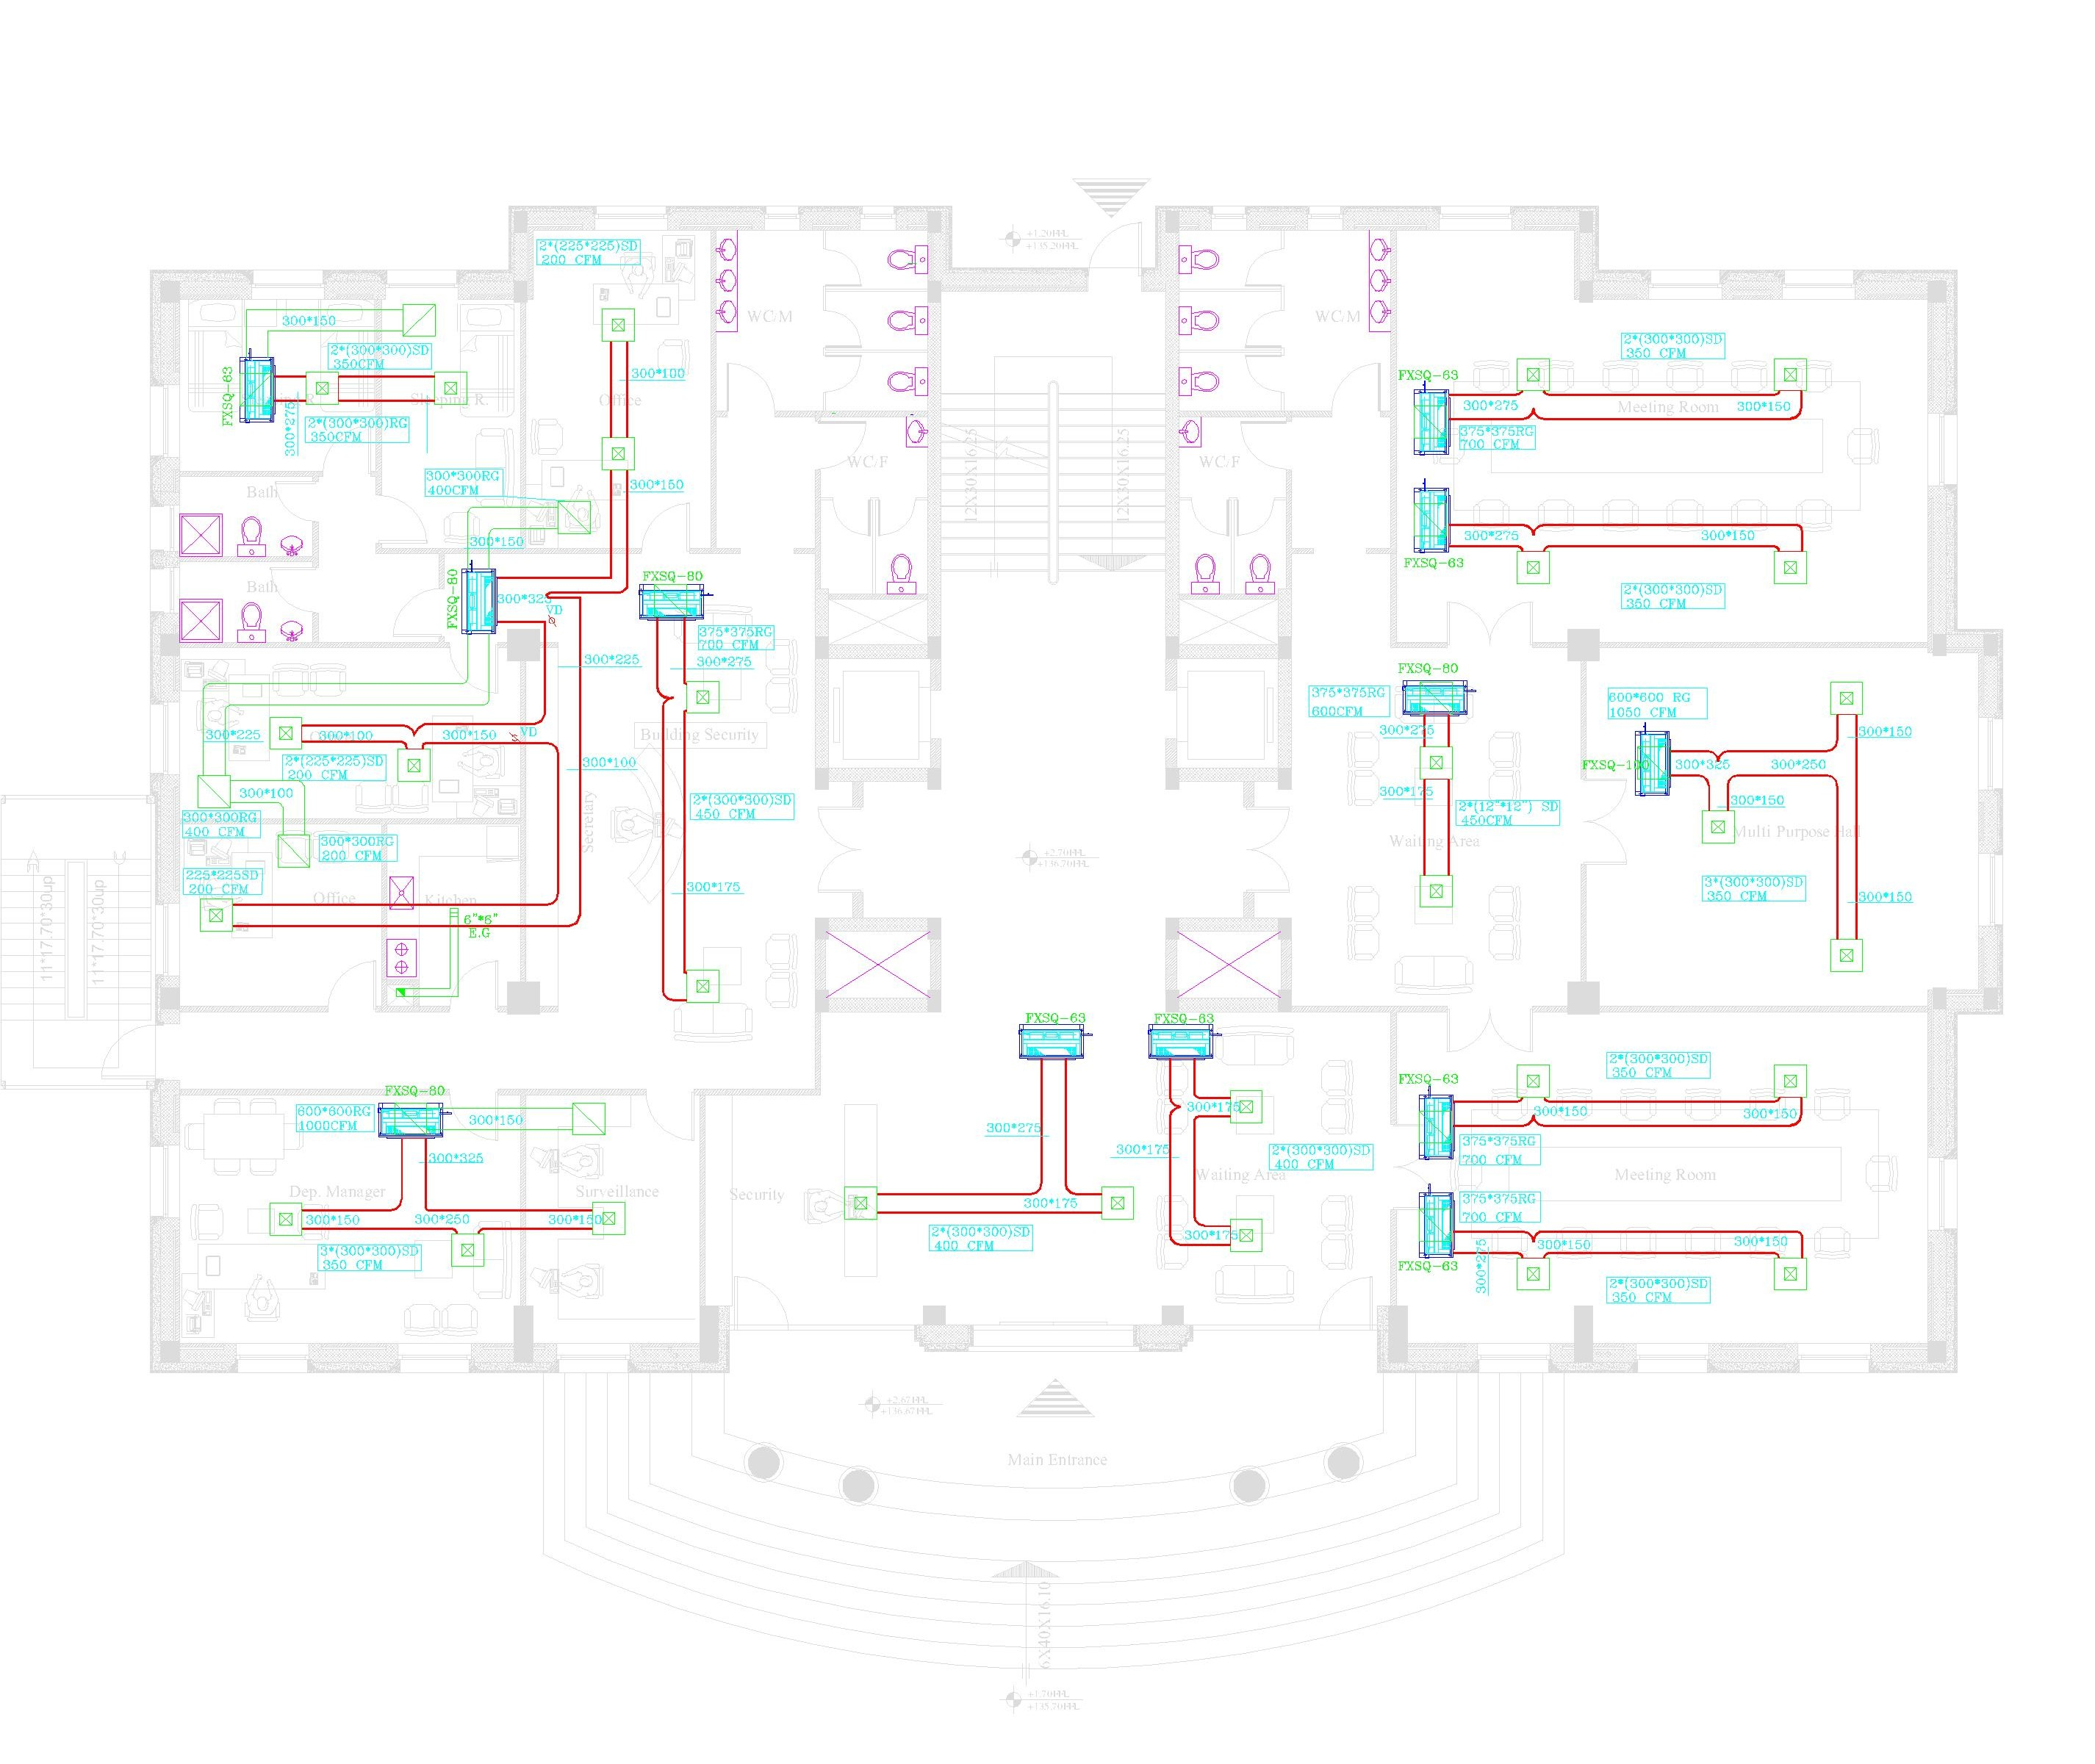

Slide 25
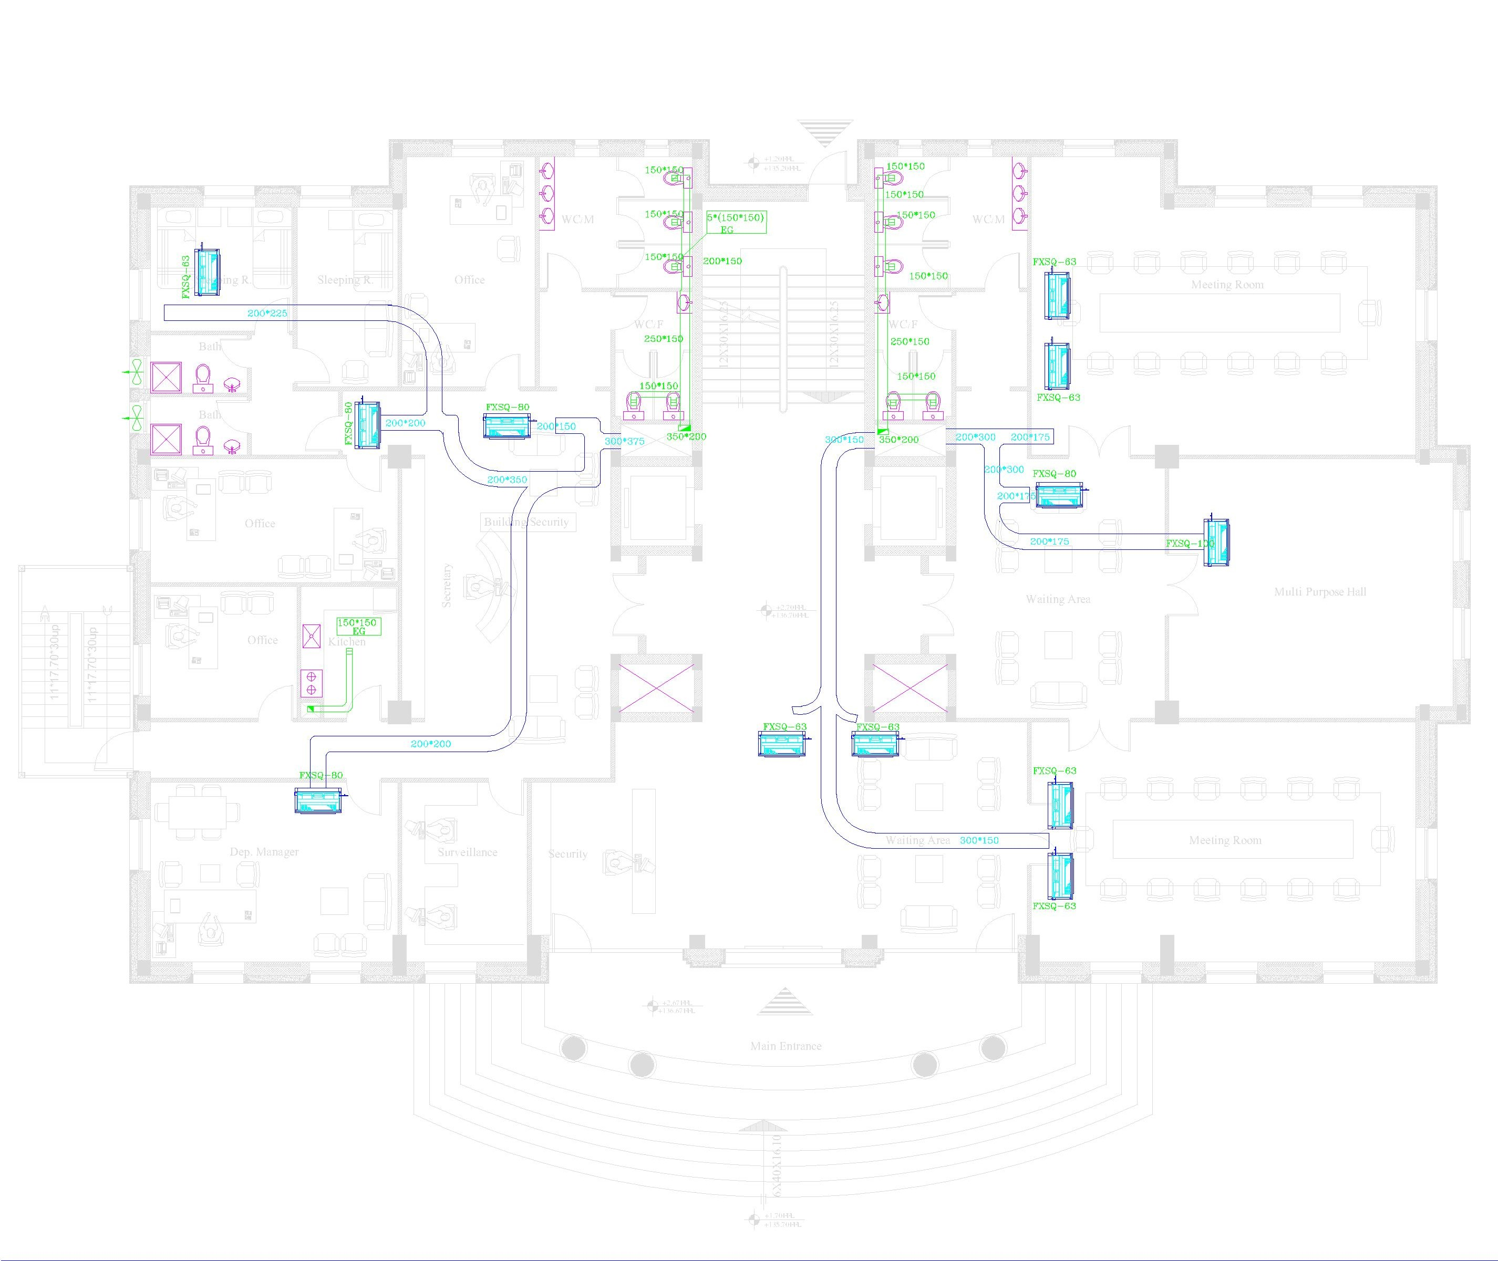

Slide 26
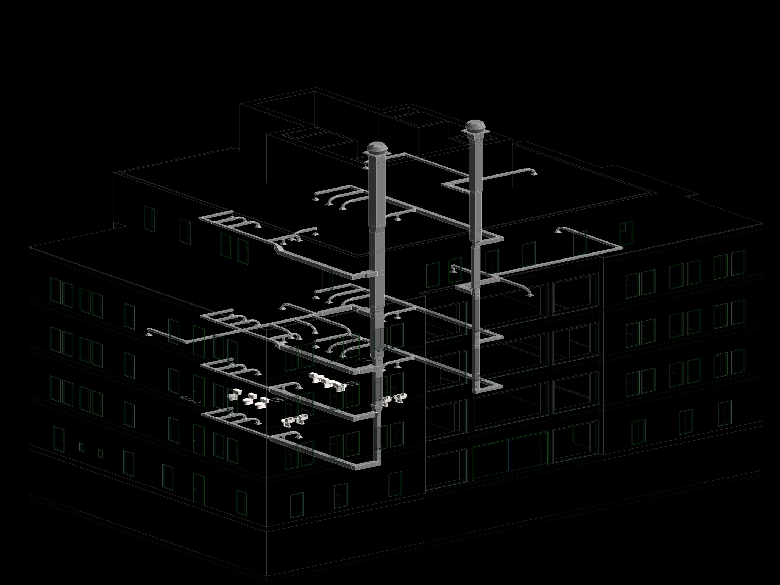

Slide 27
Plumbing System
Potable water system
Domestic Hot water system
Domestic Cold water system
Flush valve system
Water for W.C’s
GREEN HOUSE BUILDING

Slide 28
Plumbing System
Sanitation System
Black water( W.C’s, Kitchen sink)
Gray water (Lavatory's, Showers)
Storm water (Rain)

Slide 29
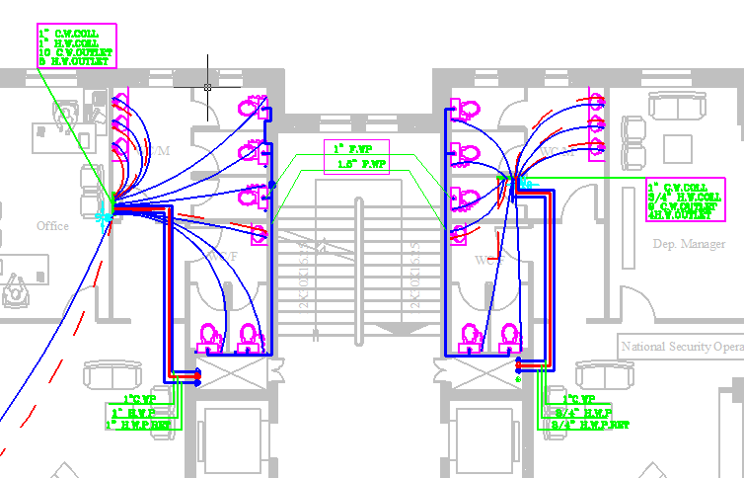
Potable water system
Pressure by gravity.
Dived the building into two zone’s ( Two raisers).

Slide 30
domestic cold water system
Pipe sizing:
Main vertical 2'' for both raiser
Main horizontal feeder to collector
Floor | BY Riser 1 | BY Riser 2
Basement | 1” | 0
ground | 1” | 1”
first | 1” | 1”
second | 1.5” | 1.5”
third | 1” | 1 ¼”
Roof | 1 ¼” | 1.5”
Floor | Critical Fixture Zone 1 | Critical Fixture Zone 2
Basement | 3/8 '' | 0
ground | 1/2" | No change
first | 3/4 '' | No change
second | 3/4 '' | 3/4 ''
third | 3/4 '' | 3/4 ''
Roof | 3/4 '' | 3/4 ''
Other fixture like table 6-15
*Note:Two pumps need for roof floor.
Type Wilo-Stratos 50/1-8 PN 6/10

Slide 31
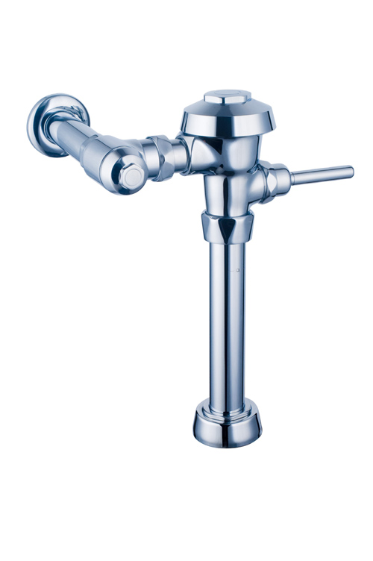
W.C FLUSH VALVE SYSTEM
Using storm water (Rain) .
For public floors.
350 F.U its mean need 120 gpm.
Tanks capacity= 120*3.7*120=53 m³
GREEN HOUSE BUILDING

Slide 32
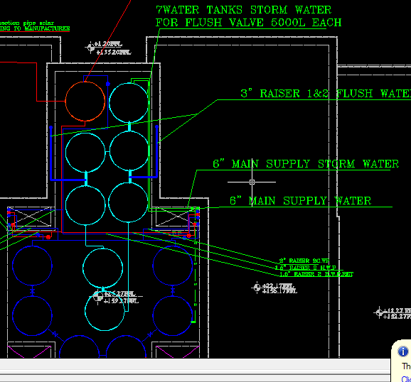
W.C FLUSH VALVE SYSTEM
GREEN HOUSE BUILDING

Slide 33
W.C FLUSH VALVE SYSTEM
Pipe sizing:
Main vertical 3'' for Raiser 1 & 2.5"for Raiser 2
Main horizontal feeder to collector
Floor | BY Riser 1 | BY Riser 2
Basement | 1.5” | None
ground | 1.5” | 1.5”
first | 1.5” | 1.5”
third | 2” | 2”
For all the floor | F.U | Min pipe size
 | W.C FLUSH VALVE | 1"
GREEN HOUSE BUILDING

Slide 34
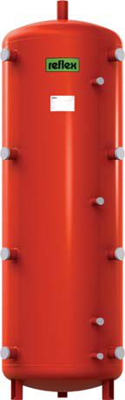
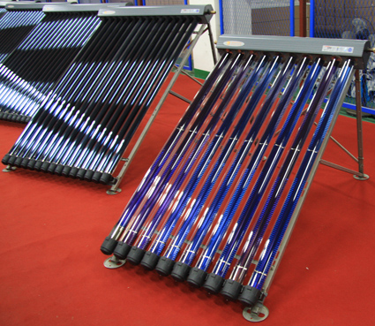
Domestic Hot water system
Daily water demand 4600 liter.
Solar collector 13 plate.
Evacuated type OVSOL,
16 tube collector
storage tank has capacity 2000 liter
total heat need to heat tank |  | 41800 KJ
Average hour operation for solar system=8 hours
time to heat | 28800 sec
total heat | 14.5 KW
GREEN HOUSE BUILDING

Slide 35

Domestic Hot water system
Gross area on the Top=54m².
Heat exchanger
Ribbed-tube heat exchanger with 9KW output.

Slide 36
Domestic Hot water system
Pipe sizing:
Main Vertical 1.5” for both Raiser
Main horizontal feeder to collector
Floor | BY Riser 1 | BY Riser 2
Basement | 3/4 '' | None
ground | 1 ¼” | 1 ¼”
first | 1'' | 3/4 ''
Second | 1 ¼” | 1”
third | 1” | 1”
Roof | 1” | 1”
Floor | Critical Fixture Zone 1 | Critical Fixture Zone 2
Basement | 1/2" | None
ground | 1/2" | 1/2"
first | 3/4 '' | 1/2"
second | 3/4 '' | 3/4 ''
third | 3/4 '' | 3/4 ''
Roof | 3/4 '' | 1/2"
Other fixture like table 6-15
*Note: Need pump for roof floor

Slide 37
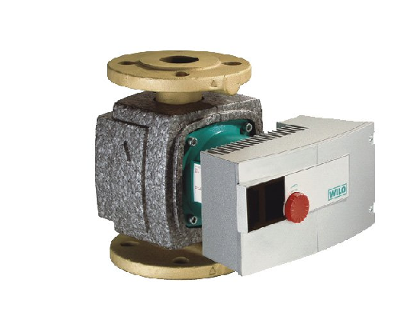
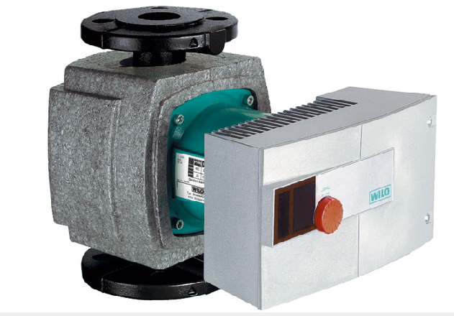
Domestic Hot water system
Circulating pump
Two pumps for roof floor
Wilo-Stratos-Z 40/1-8 PN 6/10
Wilo-Stratos 50/1-9 PN 6/10
All floor circulation pump | 1 gpm | 6 ft | 2030910
Roof hot water zone 1 | 20 gpm | 16.4 ft | 2030600

Slide 38
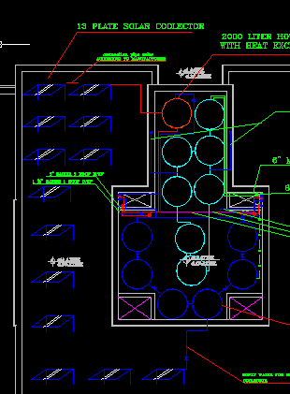
Domestic Hot water system

Slide 39
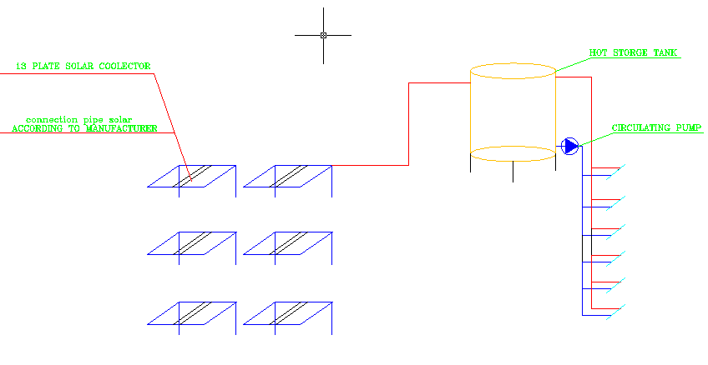
Domestic Hot water system

Slide 40
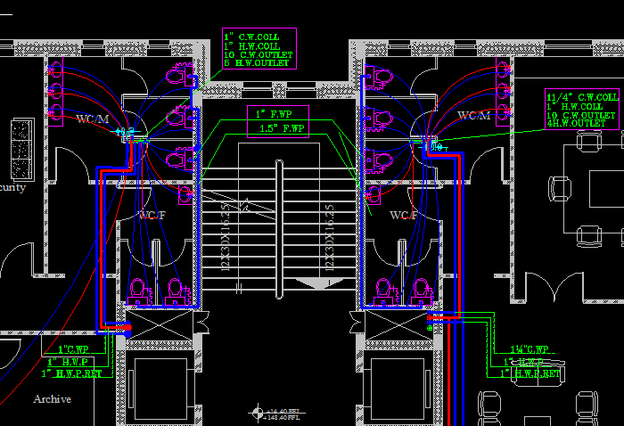
Domestic Hot water system

Slide 41
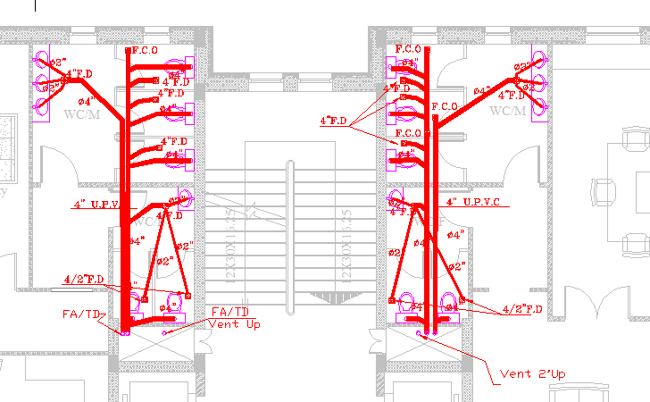
Sanitation System

Slide 42
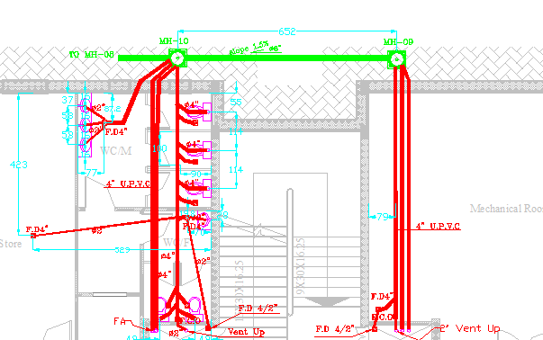
Sanitation System

Slide 43
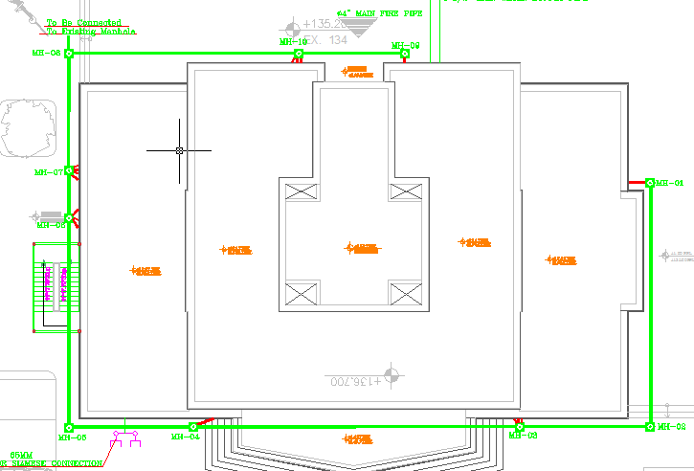
Sanitation System

Slide 44
fire protection
There are two fire protection systems in our design:
1- manual : Fire extinguishers and Fire cabinet .
2- automatic: Sprinklers .

Slide 45
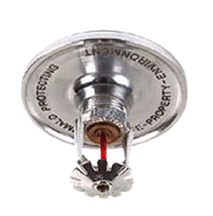
Sprinkler system
we use this system in 2 archive rooms, mechanical room , electrical room and shelter.
Procedure in designing this system we depend on the area and some tables as (number of sprinklers , pipe size of sprinklers )

Slide 46
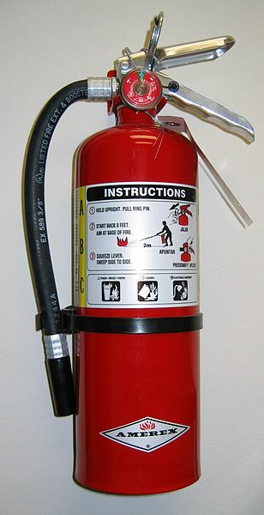
Fire extinguishers
This system is used to maximize the safety of the fire fighting .
We put these extinguishers in each lobby and in the places that can any person use it .

Slide 47
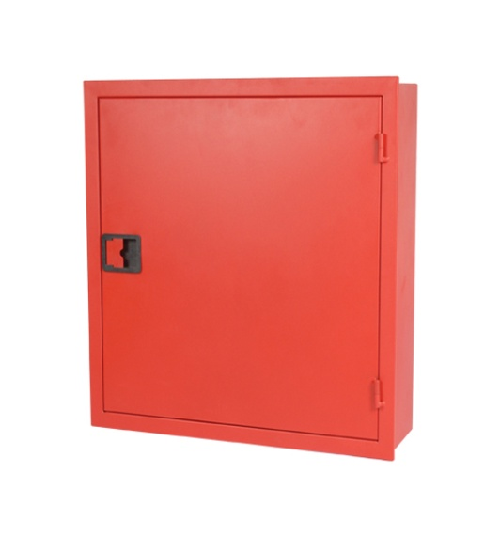
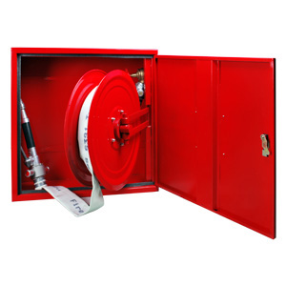
Fire cabinet
We design the Fire cabinet in every floor as a main system of fire fighting .
We design it’s pipe to reach any point in the floor and we find the maximum distance equal 30 m .

Slide 48
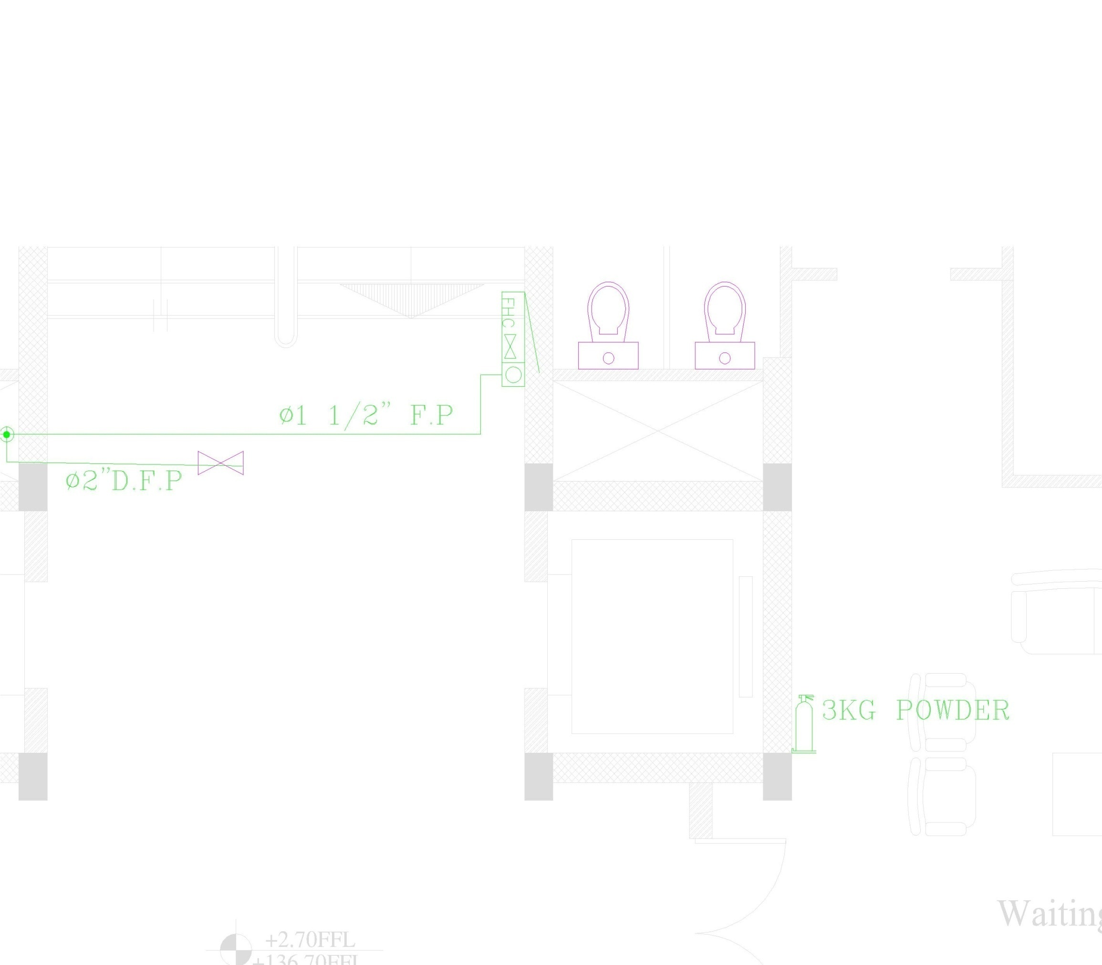

Slide 49
Quantities
We have used a software called “Autodesk RIVIT” and via this software we model the building into 3 dimensions and we make a BOQ schedules for :
Exhaust system
Indoor units

