Slide 1
3d dynamic design of sky face hotel
Prepared by :Ahmad AL-Nuirat
Islam Zuhd
Supervisor: D.Abdul Razzaq Touqan

Slide 2
Tips to be covered
Introduction
Preliminary Design And Checks
Static design
Dynamic checks and design

Slide 3
Chapter 1 :
Introduction

Slide 4
Introduction :
Sky face hotel :
A four story, Nablus city.
story area = 2000 m^{2.}
The first story is 5.5 m height (reception, wedding hall, security, offices, restaurant, prayers room and services).
The upper three stories are 4m height for each, contain 26 living unit, and 18 sweat.
The roof contains a swimming pool ,coffee shop.

Slide 5
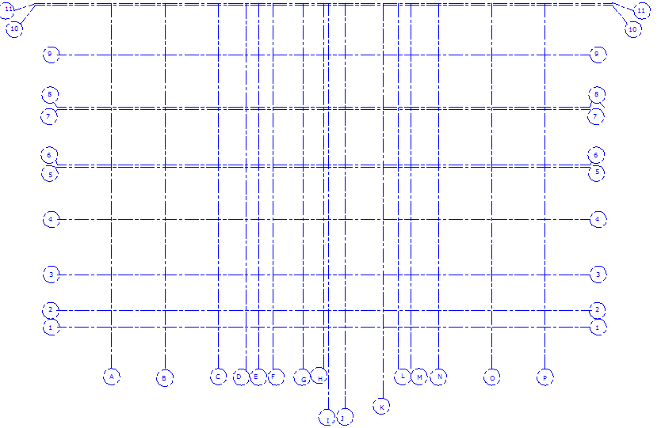
Introduction :

Slide 6
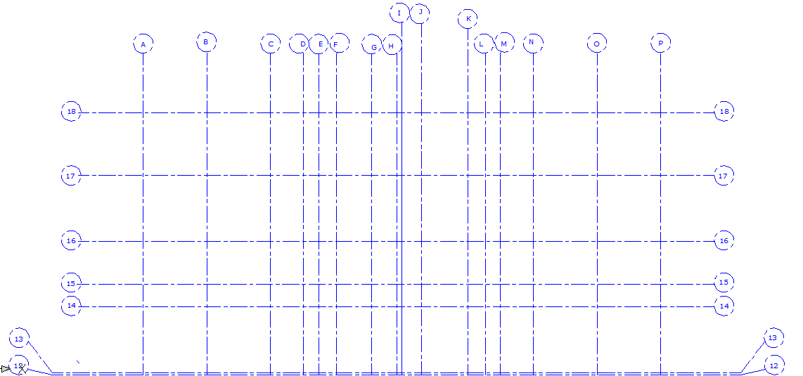
Introduction :

Slide 7
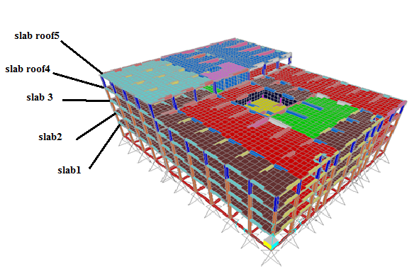
Introduction :

Slide 8
Introduction :
    Site and geology:
    Hard lime stone, bearing capacity = 400kN/m2.
    Design codes:
    ACI -2008 (American Concrete Institute Code 2008 ).
    IBC 2006 (international building code 2006).

Slide 9
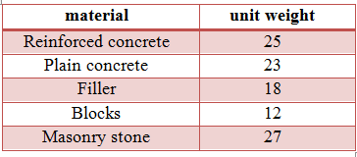
Introduction :
    Materials :
    Structural materials: Non structural materials:
    columns and shear
    walls f’c = 30 MPa.
    beams and slabs f’c = 24 MPa.
    For footing f’c = 40 MPa.
    Steel yield strength fy = 420 MPa.
    weight per unit
    volume fo concrete = 25 kN/m³
    density =2.55 ton/m³

Slide 10
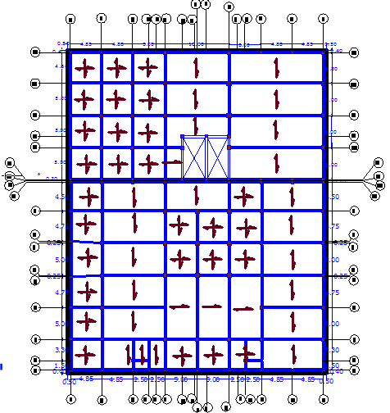
Introduction :
    Structural system :
The structural systems
were used one
way solid slab and
two way with
drop beams in
both directions.

Slide 11
Introduction :
    Loading:
    Vertical loads:
    Dead loads: it consists of weight of all permanent construction
    super imposed dead load = 5.4kN/m²
    Live load :from table 4-1 in ASCE/SEI 7-05 code. For this building, LL = 2 kN/m² for slab_{1,2,3} , LL =4.8 kN/m² for slab _{roof 4} , and LL=10 kN/m² for slab _{roof 5}.
    Lateral load from water pressure .

Slide 12
Introduction :
Computer programs was used :
SAP2000 (v14.2.4) program.
    Loads combination:
    Wu= 1.4D.L
    Wu= 1.2D.L+ 1.6L.L
    Wu= 1.2D.L +1.0L.L ±1.0E
    Wu= 0.9D.L ±1.0E

Slide 13
Chapter 2: Preliminary Design And Checks

Slide 14
Preliminary Design And Checks
  Slabs
  Min thickness:
  Table 9.5(a) in ACI-Code318-11:
  The most critical span is 5 m length
  For one end cont. span: hmin = Ln /24
  For both end cont. span: hmin = Ln /28
  210 mm thickness for slabs1,2,3,roof4 , and 250mm for slab roof5

Slide 15
Preliminary Design And Checks
Check slab for shear:
Own weight of slab_{1,2,3,roof4} =5.25 KN/m².
Own weight of slab_{roof5} =6.25 KN/m².
Wu for slab _{1,2,3} = 15.98 KN/m²
Wu slab _{roof 4} = 20.46 KN/m².
Wu slab _{roof 5} = 29.98 KN/m².
slab_{roof4} Vu =50.85 KN. Φv_{C} =97.98 KN
slab_{roof5} Vu =73.3 KN. Φv_{C} =122.47 KN
Vu< ØVc____________ OK.

Slide 16
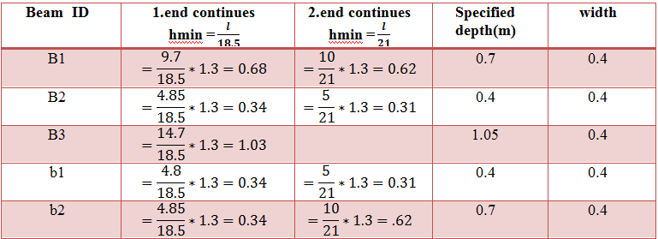
Preliminary Design And Checks
beams depths:
From table 9.5(a) in ACI-Code318-11:

Slide 17
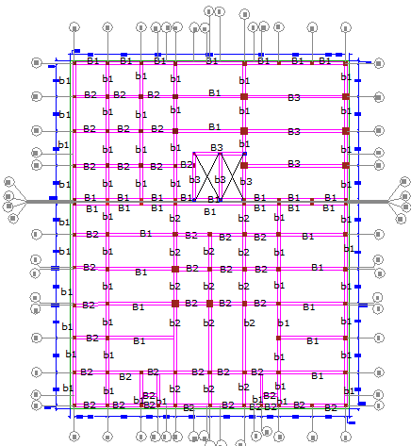

Slide 18
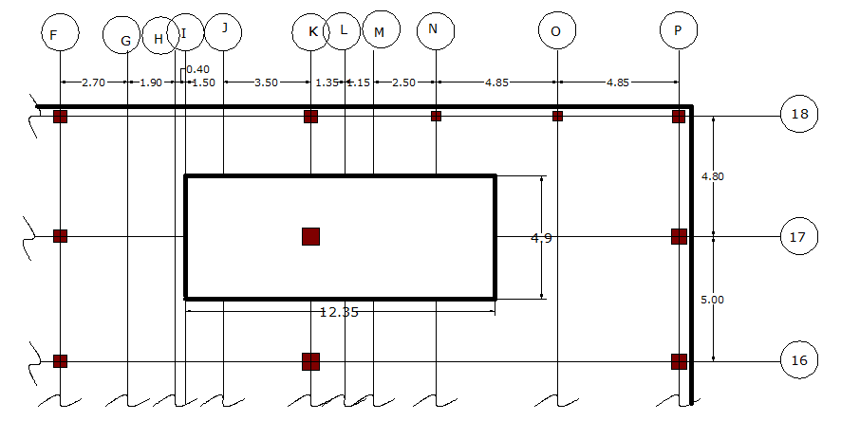
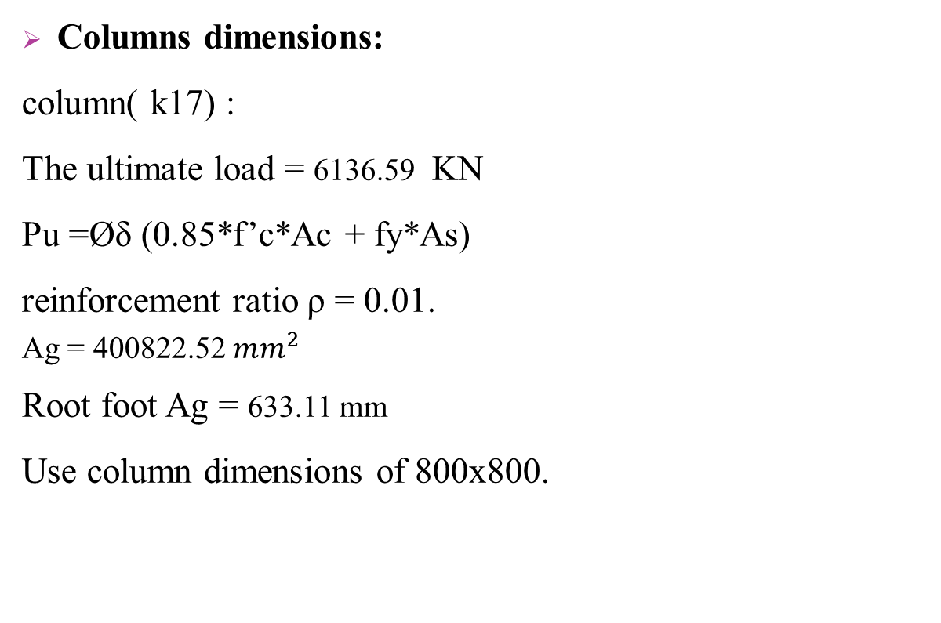
Preliminary Design And Checks
Columns dimensions:
column( k17) :
The ultimate load = 6136.59 KN
Pu =Øδ (0.85*f’c*Ac + fy*As)
reinforcement ratio ρ = 0.01.
Ag = 400822.52 ${mm}^{2}$
Root foot Ag = 633.11 mm
Use column dimensions of 800x800.

Slide 19
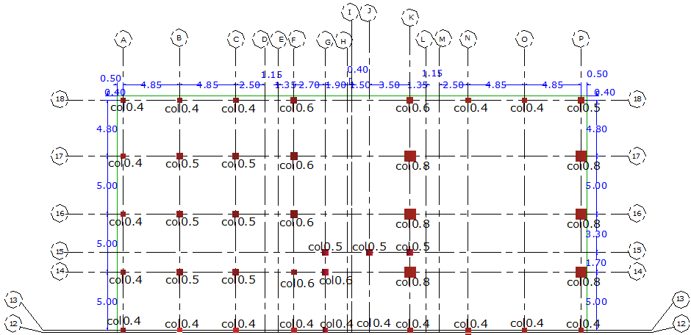
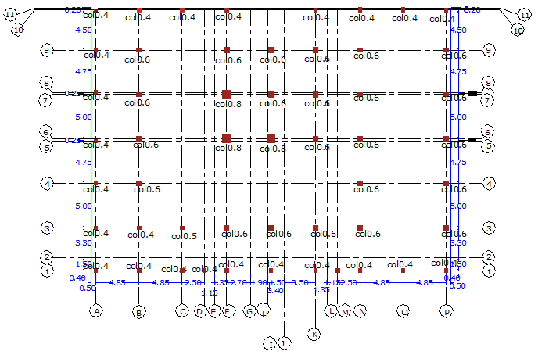

Slide 20
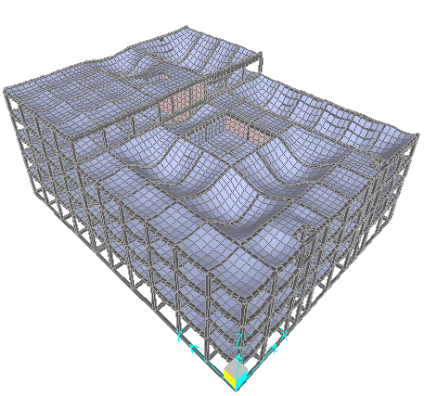
Preliminary Design And Checks
  Checks and SAP model Verification:
  Compatibility:
  The compatibility of the model was checked and it was OK

Slide 21
Preliminary Design And Checks
Checks and SAP model Verification:
Equilibrium :
Equilibrium in the vertical direction (due to gravity loads )
Thus, the errors between hand solution and SAP results are very small and less than 5%, so accept results.
Load type | Hand results (KN) | SAP results (KN) | Error %
live load | 15729.804 | 16264.172 | 3.28
SID load | 20069.856 | 20614.71 | 2.64
dead load | 42479.38 | 42057.665 | 1
Load type | Hand results (KN) | SAP results (KN) | Error %
live load | 11991.84 | 11921.736 | 0.5
SID load | 24943.68 | 25461.972 | 2.03
dead load | 43109.816 | 45355.04 | 4.9
water load | 3000 | 3000 | 0

Slide 22
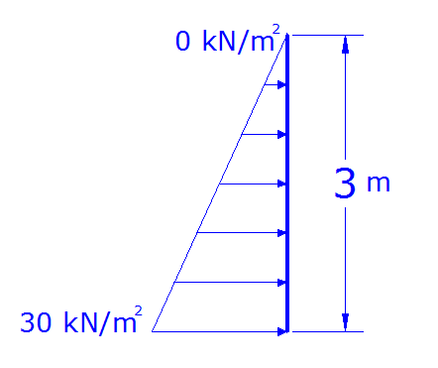
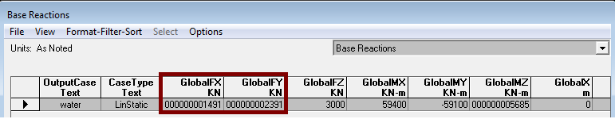
Preliminary Design And Checks
Checks and SAP model Verification:
Equilibrium :
Equilibrium in lateral direction
From hand calculation both x and
Y force =0.

Slide 23
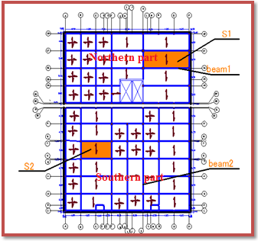
Preliminary Design And Checks
Checks and SAP model Verification:
Stress-strain Relationship:

Slide 24
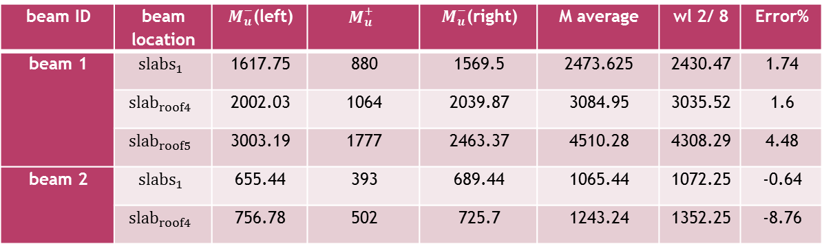
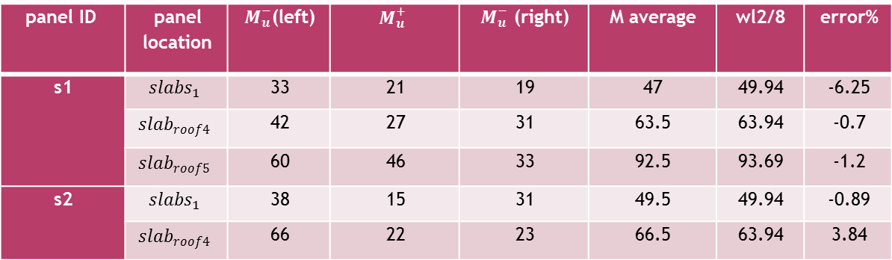
Preliminary Design And Checks
panel ID | panel location | $M_{u}^{−}$(left) | $$M_{u}^{+}$$ | $M_{u}^{−}$ (right) | M average | wl2/8 | error%
s1 | $${slabs}_{1}$$ | 33 | 21 | 19 | 47 | 49.94 | -6.25
 | $${slab}_{roof4}$$ | 42 | 27 | 31 | 63.5 | 63.94 | -0.7
 | $${slab}_{roof5}$$ | 60 | 46 | 33 | 92.5 | 93.69 | -1.2
s2 | $${slabs}_{1}$$ | 38 | 15 | 31 | 49.5 | 49.94 | -0.89
 | $${slab}_{roof4}$$ | 66 | 22 | 23 | 66.5 | 63.94 | 3.84
beam ID | beam location | $M_{u}^{−}$(left) | $$M_{u}^{+}$$ | $M_{u}^{−}$(right) | M average | wl 2/ 8 | Error%
beam 1 | $${slabs}_{1}$$ | 1617.75 | 880 | 1569.5 | 2473.625 | 2430.47 | 1.74
 | $${slab}_{roof4}$$ | 2002.03 | 1064 | 2039.87 | 3084.95 | 3035.52 | 1.6
 | $${slab}_{roof5}$$ | 3003.19 | 1777 | 2463.37 | 4510.28 | 4308.29 | 4.48
beam 2 | $${slabs}_{1}$$ | 655.44 | 393 | 689.44 | 1065.44 | 1072.25 | -0.64
 | $${slab}_{roof4}$$ | 756.78 | 502 | 725.7 | 1243.24 | 1352.25 | -8.76

Slide 25
Chapter 3: Static design

Slide 26
Static design
Slab design
Column design
Footing design
Pool design
Stair case

Slide 27
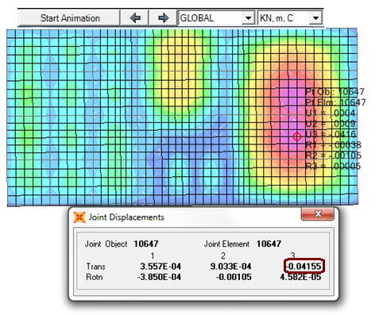
Static design
    Slab Design:
    Check Deflection:
    The max deflection due to dead load was found at the middle of the panel between grid lines 14 and 16 that is 41.6mm.

Slide 28
Static design
    Slab Design:
    Check Deflection:
Δ dead = 4.386 mm.
Δ Live = 4.178 mm.
    Δ long term = 17.128 mm.
    The allowable deflection = L /240 = 5000 /240 = 20.83 mm.
    So the slab deflection = 17.128 mm. < allowable long term def. =20.83mm OK.

Slide 29
Static design
    Slab Design:
check slab for shear :
ØVc= 122.47 KN. ,Vu slab _{roof4} = 78.65 KN/m.
122.47 ≥ 78.65 OK
ØVc= 97.98 KN. ,Vu slab _{roof4} = 56.47 KN/m.
122.47 ≥ 56.47 OK

Slide 30
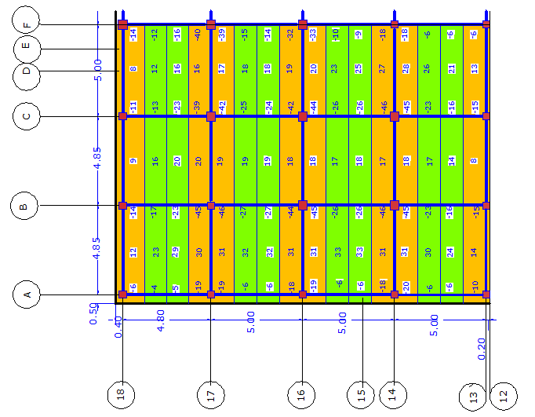
Design for bending moment:
-ve &+ve moment m11 for slabs roof5

Slide 31
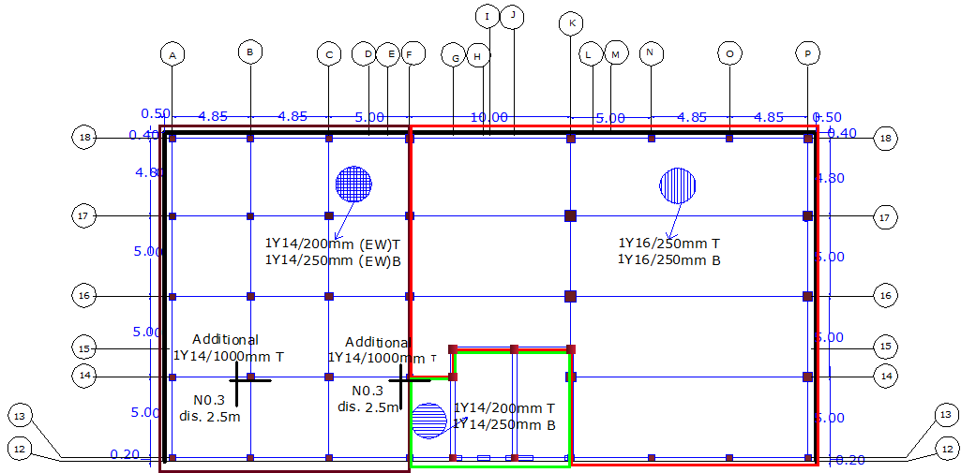
reinforcement for slab roof5

Slide 32
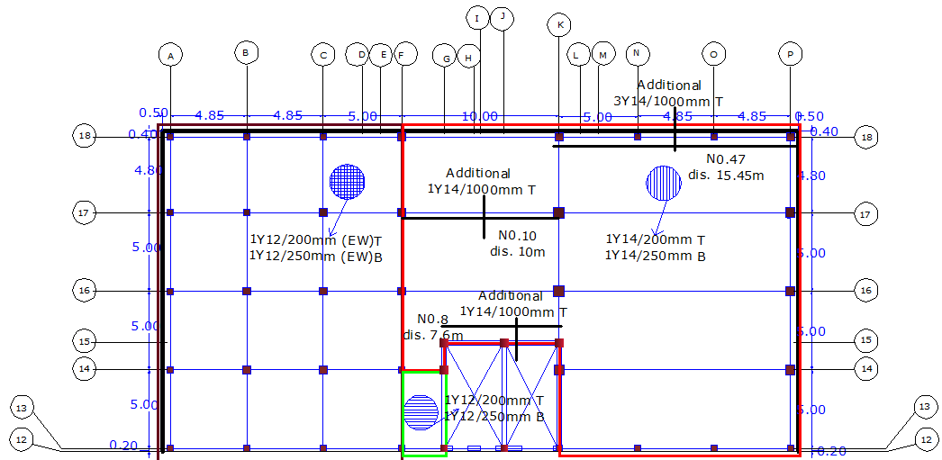
-reinforcement for slab roof4 northern part

Slide 33
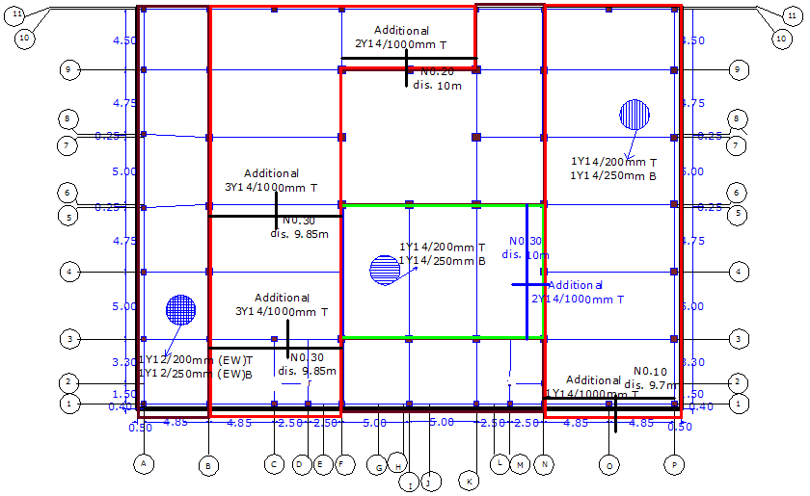
reinforcement for slab roof4 southern part

Slide 34
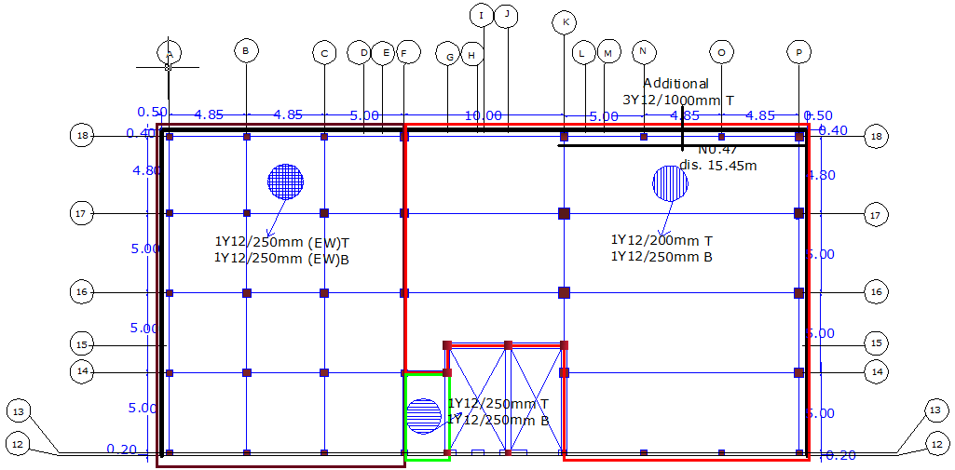
reinforcement for slabs 1,2,3 northern part

Slide 35
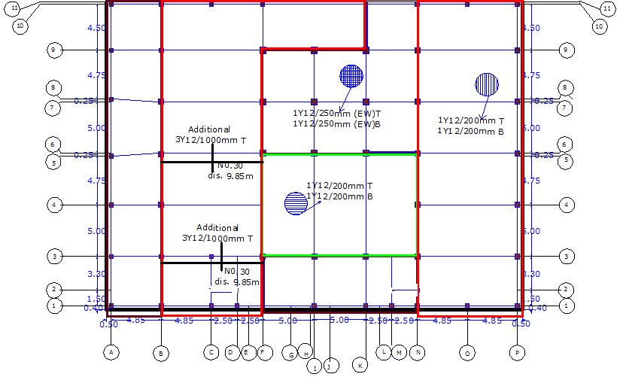
reinforcement for slabs 1,2,3 southern part

Slide 36
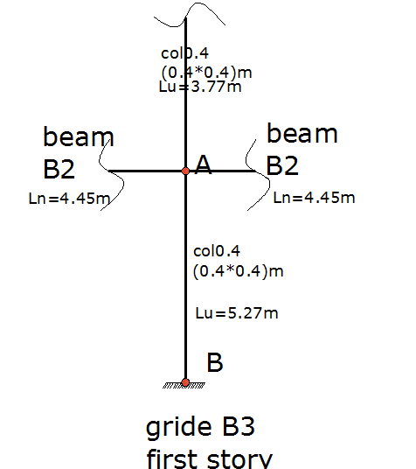
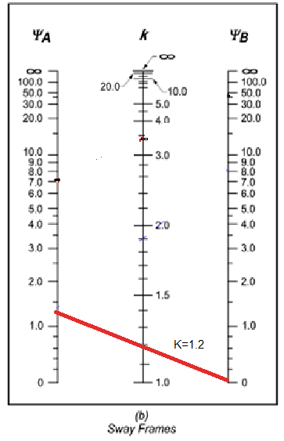
Static design
Design of columns:
For un-braced column:-
Kl/r≤ 22 ……........Short column.
Kl/r≥ 22 ………….Long column

Slide 37
Static design
M _{min} =Pu*e _{min}
e _{min} =0.015+0.03c
Moment M _{min} = 51.78 1 KN.m
Pu =1918 KN , Mc =62.14KN.m
Use =0.01 , fc =30 MPa
Cover in column =0.04m ,ɤ=0.8
Pu/bh =1.74Ksi , Mn/bh² =0.141Ksi.
From interaction diagram the section is adequate to carry the load and moment .

Slide 38
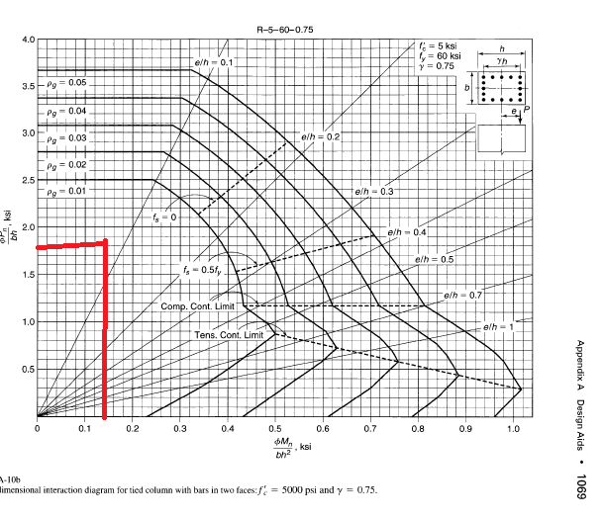

Slide 39
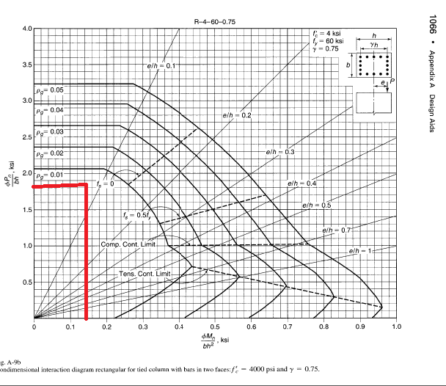

Slide 40
Grouping name | column ID | Dimension(m) | Column identification using grid formation | Longitudinal reinforcement
col0.4 | col0.4-1 | 0.4*0.4 | A-1,A-4-A-18,B-3,B-10,B-13,B-18 | 8Ø16
 |  |  | C-1,C-10,C-13,C-18,D-1 | 8Ø16
 |  |  | F-1,F-10,F-13,G-13,J-13,I-1,K-1, K-10,K-13 | 8Ø16
 |  |  | M-1,N-1,N-10 | 8Ø16
 |  |  | O-1,O-10,P-1,P-10,P-13 | 8Ø16
 | col0.4-2 | 0.4*0.4 | B-1 | 16Ø16
col0.5 | col0.5-1 | 0.5*0.5 | B-14,B-16,B-17,C-3,C-14,C-16,C-17 | 12Ø18
 |  |  | F-3,G-15,J-15,K-15,P-18 | 12Ø18
 | col0.5-2 | 0.5*0.5 | N-18,O-13,O-18,N-13 | 14Ø18
col0.6 | col0.6-1 | 0.6*0.6 | B-6,B-7,B-9,F-9,F-16,G-14,I-3,1-7, I-9,K-3 | 16Ø18
 |  |  | K-6,K-7,K-9,K-18,F-14,F-18,N-3,N-6, N-7,N-9 | 16Ø18
 | col0.6-2 | 0.6*0.6 | B-4,N-4,F-17 | 20Ø18
 | col0.6-3 | 0.6*0.6 | P-3,P-4,P-6,P-7,P-9 | 22Ø20
col0.8 | col0.8-1 | 0.8*0.8 | F-,F-7,I-6,K-17 | 14Ø25
 | col0.8-2 | 0.8*0.8 | K-14,K-16,P-14,P-16,P-17 | 22Ø32

Slide 41

Static design
footing:
Bearing capacity of the soil=400KN/m².
Design of footing for column B-3:
Column dimensions = 0.4x0.4 m
Compressive strength of concrete (fc) = 40MPa.
service load =1640 KN
Area=
Area of footing =4.1m²
The root of area =2.03m L= 2.5 m.

Slide 42
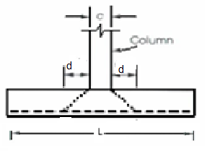
Static design
For design:
Area of footing =6.25m²
Check wide beam shear
ØVc = 0.75fc^0.5 L*d/6
ØVc= 830.09 KN
Vu = q_{u}[ L/2– (c/2+d) ]
Vu= 483.34 KN
Vu < ØVc. Wide beam shear OK.

Slide 43
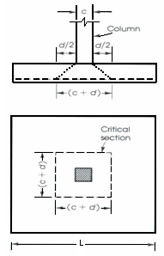
Static design
Check punching shear:
Qu=306.88KN /m²
ØVcp=0.75 fc^0.5 L*d/3
ØVcp=2178.17 KN
Vup=Pu –(c+d)² q_{u} Vup =1803 KN
Vup< ØVcp Punching is OK.

Slide 44
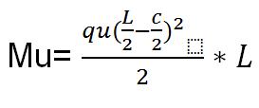
Static design
Flexural design:
Mu =422.92 KN.m
=0.00257
As= *L*d
As =2699mm² So use As 13ɸ18
As shrinkage= 2250mm²

Slide 45
Static design
grouping name | footing ID | dimension | Column identification using grid formation | reinforcement
f1 | f1-1 | 1.5*1.5 | A-1,C-1,D-1,F-1,G-13,J-13,K-1,M-1,N-1,P-1 | 8ɸ16
f2 | f2-1 | 2*2 | A-3,A-4,A-5,A-8,A-9,A-16,A-17, A-18,B-1,C-18,J-15,O-1,P-18 | 10ɸ16
 | f2-2 | 2*2 | I-1,B-18 | 10ɸ18
f3 | f3-1 | 2.5*2.5 | A-14,B-3,B-7,B-9,B-14,B-16,B-17,C-3,C-14, | 13ɸ18
 |  |  | C-16,C-17,F-14,F-18,K-3,N-3,N-9, N-18,O-18,P-3,P-4,P-6,P-7,P-9
 | f3-2 | 2.5*2.5 | K-18 | 13ɸ20
f4 | f4-1 | 3*3 | B-4,B-6,F-16,F-17,I-3,N-4,N-6,N-7 | 15ɸ20
 | f4-2 | 3*3 | F-3,K-14 | 15ɸ25
f5 | f5-1 | 3.3*3.3 | P-14,P-16,P-17 | 17ɸ20
f6 | f6-1 | 3.8*3.8 | K-16,K-17 | 19ɸ20

Slide 46
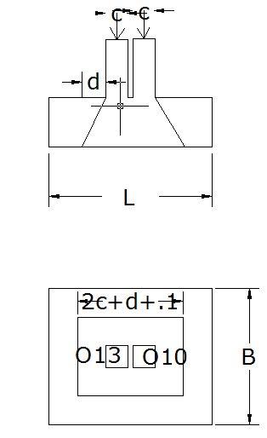
Static design
Design of footing F7 carrying O-10 and O-13 :
Column ID | service load KN(Ps) | Ultimate load KN (Pu)
O-10 | 838 | 1059
O-13 | 1359 | 1751
 | C.S 1.25m | M.S 1.25m | C.S 1.5m | M.S 1.5m
moment/C.S or/M.S | 385 | 295 | 370 | 225
 | 0.0047 | 0.0036 | 0.0037 | 0.0023
As | 2468 | 1890 | 2331 | 1449
As. Bars | 13ɸ16 | 13ɸ14 | 15ɸ14 | 15ɸ12

Slide 47
Static design
Check wide beam shear was satisfied
Check punching shear was satisfied
footing f7 | dimensions | Reinforcement in long direction . | Reinforcement in short direction .
O-10,O-13 | 3*2.5 | 26ɸ16 | 30ɸ14
A-10,A-13 | 3*2.5 | 26ɸ16 | 30ɸ14
C-10,C-13 | 3*2.5 | 26ɸ16 | 30ɸ14
N-10,N-13 | 3*2.5 | 26ɸ16 | 30ɸ14
B-10,B-13 | 3*2.5 | 26ɸ16 | 30ɸ14
P-10,P-13 | 3*2.5 | 26ɸ16 | 30ɸ14
F-10,F-13 | 3*2.5 | 26ɸ16 | 30ɸ14
K-10,K-13 | 3*2.5 | 26ɸ16 | 30ɸ14

Slide 48
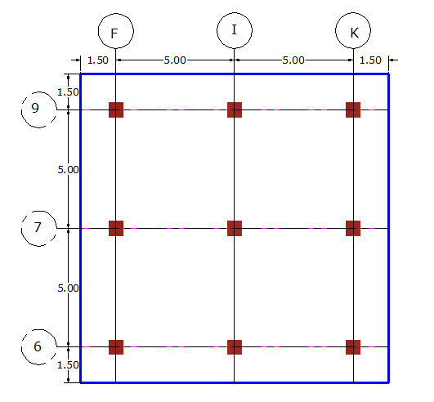
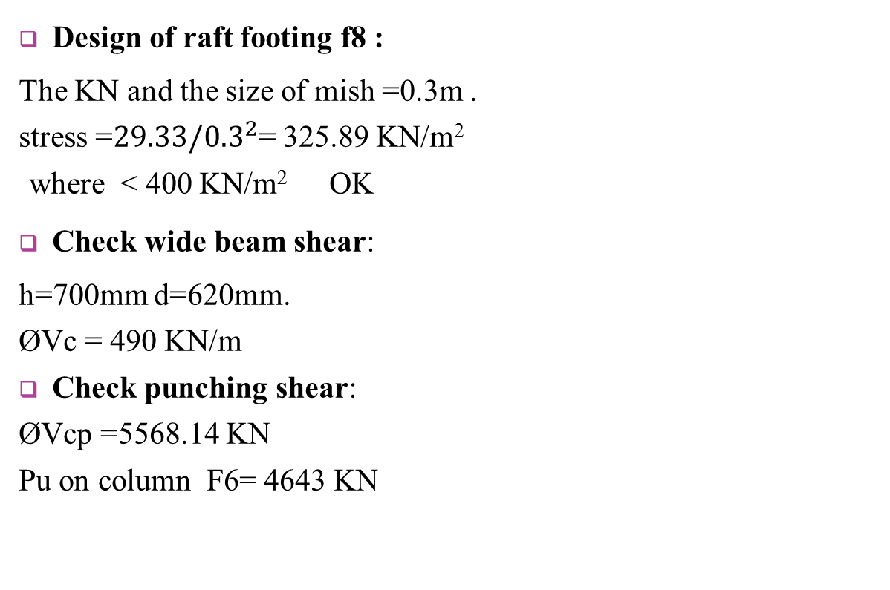
Static design
Design of raft footing f8 :
The KN and the size of mish =0.3m .
stress =${29.33/0.3}^{2}$= 325.89 KN/m²
where < 400 KN/m² OK
Check wide beam shear:
h=700mm d=620mm.
ØVc = 490 KN/m
Check punching shear:
ØVcp =5568.14 KN
Pu on column F6= 4643 KN

Slide 49
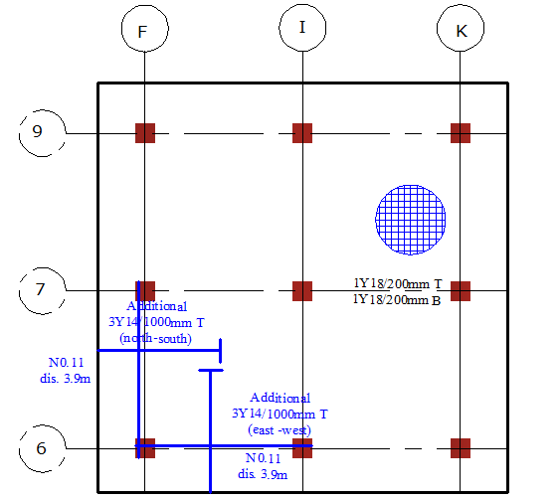
Static design

Slide 50
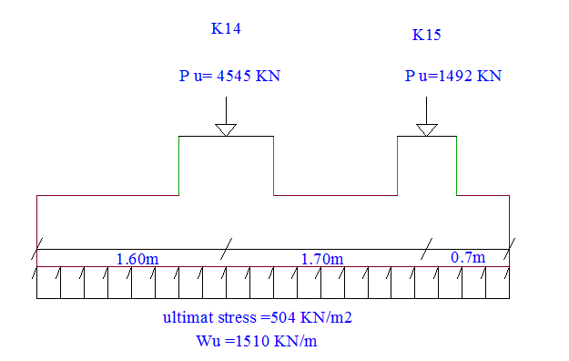
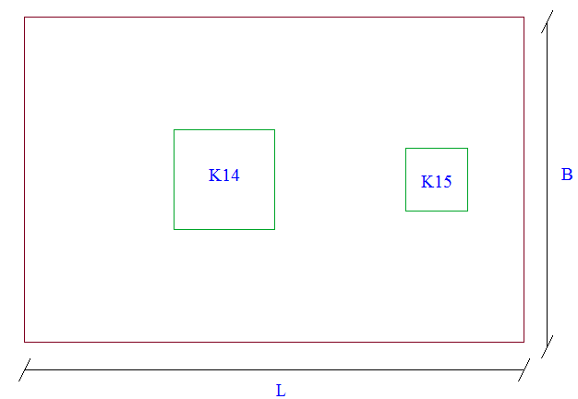
Static design
Design of combined footing f9:
h= 60cm and d = 52cm.
L = 4m. B=3 m.

Slide 51
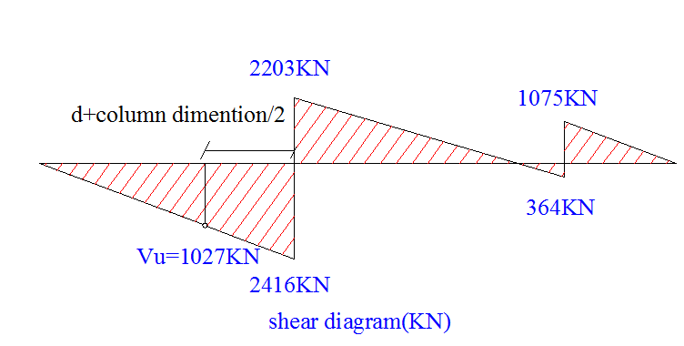
Static design
Check for wide beam shear:
ØVc= 1233.29 KN/m
ØVc > Vu OK.
Check for punching shear:
Column k-14:
Pu=3666.83 KN
ØVcp =4341 KN
ØVcp> Pu OK.

Slide 52
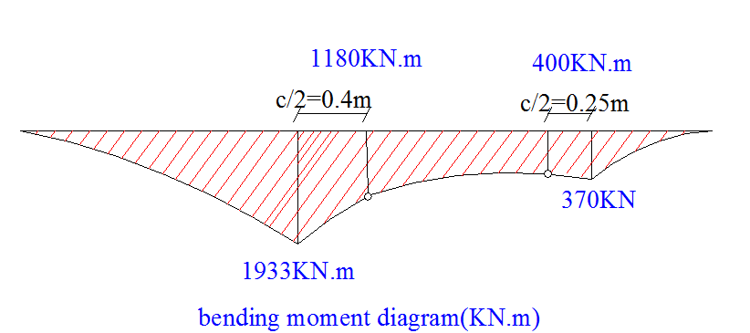
Static design
Longitudinal 20ɸ20, 20ɸ16
TraversUse 26 ɸ20

Slide 53
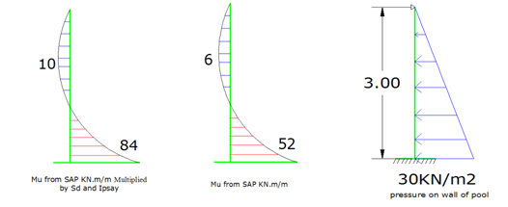
Static design
Pool design :
Pool Wall:
Vu , V₁₃= 13KN/m
V₂₃=50KN/m, both less than 164.3 KN/m Ok.
Flexural design:

Slide 54
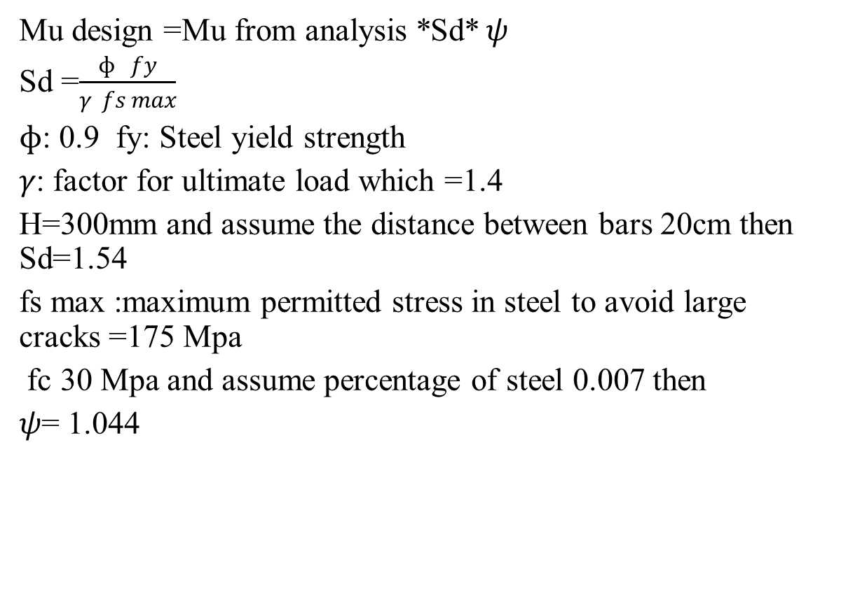
Static design
Mu design =Mu from analysis *Sd*$ψ$
Sd =$\frac{ɸ fy}{γ fs max}$
$ɸ$: 0.9 fy: Steel yield strength
$γ$: factor for ultimate load which =1.4
H=300mm and assume the distance between bars 20cm then Sd=1.54
fs max :maximum permitted stress in steel to avoid large cracks =175 Mpa
fc 30 Mpa and assume percentage of steel 0.007 then
$ψ$= 1.044

Slide 55

Static design
For Mu design =84 KN.m/m
As = 956 mm²/m, So use 7$ɸ$ 14/m
For Mu design =10KN.m/m use As _{min} and 4$ɸ$ 10/m
Also for horizontal

Slide 56
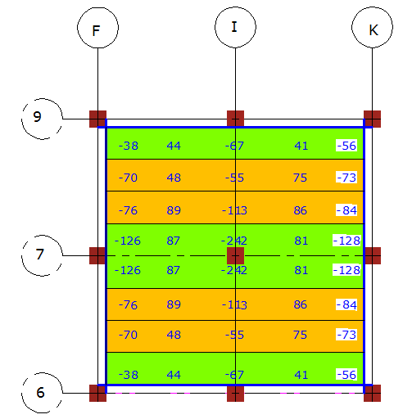
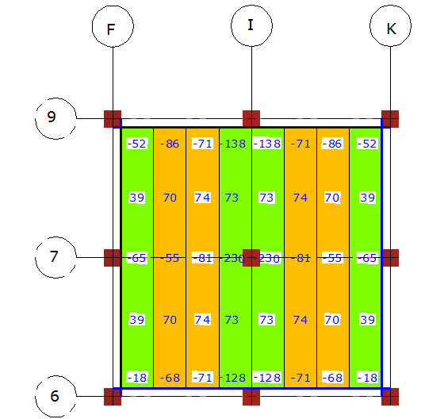
Static design
Pool slab:
Check wide beam shear:
ØVc=239.6 KN /m
Design for flexure:

Slide 57
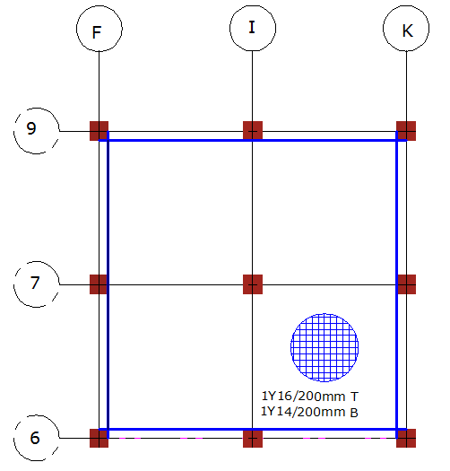
Static design

Slide 58
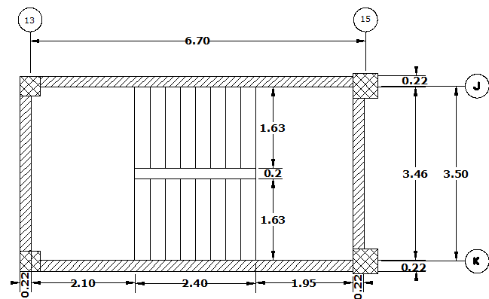
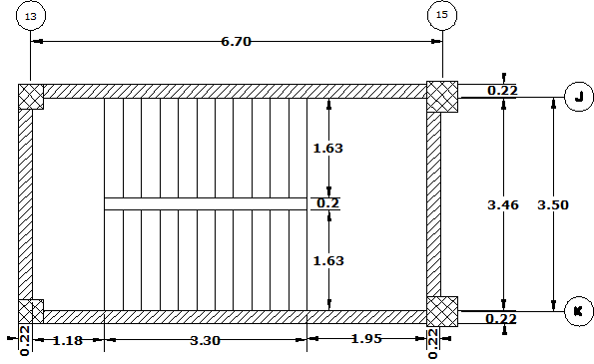
Stair case
2 sections
Dimensions

Slide 59
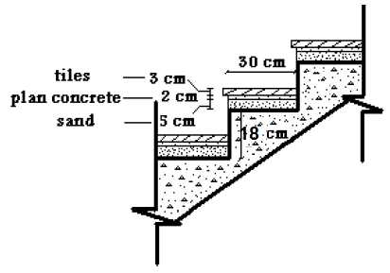

Thickness:
Flight span = 6.7m
h_{min} = $\frac{6.7}{28}$ = 0.239 m
So, se h=0.25m.
Loads
DL= 6.25 KN/m²
LL= 5 KN/m²
SDL=4.07 KN/m²

Slide 60
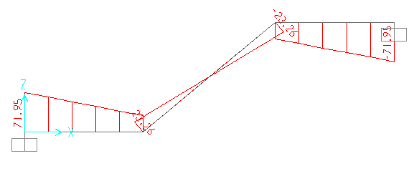

Check for shear: reading shear values from 1D model for both sections
Ø Vc =$\frac{0.75}{6}∗ \sqrt{24 }$ *$\frac{1000∗210}{1000}$ =128.6 KN > Vu for both

Slide 61


Flexure design : moment values from the 1D model as shown for both section , respectively

Slide 62
Final reinforcement for stair case
Model number | Mu | ρ | As | Reinforcement/m
Model 1 | 87.5 | 0.005558 | 1168 | 8 Ø14
 | 40.57 | 0.002494 | 524 | 4 Ø 14
 | 87.5 | 0.005558 | 1168 | 8 Ø14
Model 2 | 43.29 | 0.002666 | 560 | 4 Ø 14
 | 101.23 | 0.006497 | 1365 | 9 Ø14

Slide 63

Staircase detail for section 1

Slide 64

Staircase detail for section 2

Slide 65
Chapter 4: dynamic design

Slide 66

Dynamic design
parameters for dynamic analysis and design using IBC2006 design code :
Importance factor (I) = 1.25
Peak Ground Acceleration (PGA)= 0.2g
Area mass = 0.55 ton/m².
The response spectrum scale factor = $\frac{g I}{R}$ .
Time history scale factor = $\frac{0.01}{R}$ * $\frac{PGA (nablus city)}{PGA (california)}$
The soil class (rock soil) = B
Spectral acceleration at short periods (Ss) =0.5
Spectral acceleration at short periods (S1) =0.2
site coefficients: F_{a} = 1 F_{v} = 1
The structural system to be designed is moment resisting frame system. (Intermediate moment frame)
Response modification factor (R):5

Slide 67

Dynamic design
Period
Period for the structure was taken from SAP checked by Rayleigh method $T=2π\sqrt{\frac{\sum{m∆^{2}}}{\sum{F∆}}}$
For the northern part :
Mode |  | period(sec) | MMPR
1 | transition in y | 1.77 | 0.8186
2 | transition in x | 1.58 | 0.8318
3 | Rz | 1.35 | 0.0322
For the southern part :
Mode |  | period(sec) | MMPR
1 | transition in x | 1.67 | 0.9084
2 | transition in y | 1.56 | 0.8787
3 | Rz | 1.52 | 0.4199

Slide 68
Dynamic design
Earthquake Force:
Methods for determining Earthquake Force :
Equivalent static method.
2. Time history method
3. Response spectrum analysis

Slide 69

Dynamic design
Equivalent static method
The following calculation for the northern in x-direction
V = Cs*W
SD_{s} = $\frac{2}{3}$*F _{a}*S_{s} = $\frac{2}{3}$*1*0.5 = 0.3333.
SD₁ = $\frac{2}{3}$*F _{v}*S₁= $\frac{2}{3}$*1*0.2 = 0.13333.
Cs = $\frac{SD1∗I}{R∗T}$ ≤ $\frac{SDs∗I}{R}$
.
 | SD1 | T(s) | Cs | M(ton) | V(KN)
Northern part x-direction | 0.13333 | 1.59 | 0.01973 | 6489.7 | 1330.57
Southern part x-direction | 0.13333 | 1.66 | 0.02008 | 6748.94 | 1329.44

Slide 70
Dynamic design
Earthquake forces for the structure by the 3 methods:
Method | Value(KN)
Manual(equivalent static) southern -x | 1329.44
response-x southern | 1028.07
elcentro-x southern | 1338.89
Manual(equivalent static) northern -x | 1330.57
response-x northern | 2092.2
elcentro-x northern | 2160.03

Slide 71
Dynamic design
Dynamic Design :
consider time history (elcentro earthquake) for the dynamic design.
Load combinations are:
COMB1 = 1.2D.L + 1.6 LL.
COMB2 = 1.4 D.L.
COMB3 = 1.2D.L + L.L + elcentro-x.
COMB4 = 1.2D.L + L.L + elcentro -y.
COMB5 = 0.9D.L + elcentro -x.
COMB6 = 0.9D.L + elcentro -y.

Slide 72
Dynamic design
Final design :
Slab design
Beams design
Column design
Footing design
Pool design
Shear wall

Slide 73
Dynamic design
Slab design
we found that the values of shear and moment on slabs due to static or gravity load combination are greater than earthquake combination so: static design governs for slab .

Slide 74
Dynamic design
Beams design
Final beam design taken from SAP as follows

Slide 75


Slide 76
Dynamic design
Column design
Grouping name | column ID | Dimension(m) | Column identification using grid formation | Longitudinal reinforcement
col0.4 | col0.4-1 | 0.4*0.4 | A-1-A-17,B-10,B-13,B-18 | 8Ø16
 |  |  | C-1,C-10,C-13,C-18,D-1 | 8Ø16
 |  |  | F-1,F-13,G1-3,J-13,I-1,K-1,K-13 | 8Ø16
 |  |  | M-1,N-1,N-10 | 8Ø16
 |  |  | O-1,P-1,P-10 | 8Ø16
 | col0.4-2 | 0.4*0.4 | B-1,F-10,K-10,O-10 | 16Ø16
col0.5 | col0.5-1 | 0.5*0.5 | B-3,B-14,B-16,B-17,C-3,C-14,C-16,C-17 | 12Ø18
 |  |  | F-3,G-15,J-15,K-15 | 12Ø18
 | col0.5-2 | 0.5*0.5 | N-18,O-13,O-18,N-13 | 14Ø18
col0.6 | col0.6-1 | 0.6*0.6 | B-6,B-7,B-9,F-9,F-6,G-14,I-3,1-7,I-9,K-3 | 16Ø18
 |  |  | K-6,K-7,K-9,K-18,F-14,F-18,N-3,N-6 ,N-7, N-9 | 16Ø18
 | col0.6-2 | 0.6*0.6 | B-4,N-4,F-17 | 20Ø18
 | col0.6-3 | 0.6*0.6 | P-3,P-4,P-6,P-7,P-9 | 22Ø20
col0.8 | col0.8-1 | 0.8*0.8 | F-6,F-7,I-6,K-17 | 14Ø25
 | col0.8-2 | 0.8*0.8 | K-14,K-16,P-14,P-16,P-17 | 22Ø32

Slide 77
Dynamic design
Footing design
Static design govern in most cases
Some of them was covered by dynamic combinations, and despite that they were within the capacity of previous static design

Slide 78
Dynamic design
Pool design:
When comparing results, the gravity combinations controlled for analysis and design for both pool slab and pool walls.

Slide 79



Dynamic design
Shear wall:
Shear wall was designed as a column
Dimensions : (1.5 *0.25 )m
$ρ=$0.01
Within the capacity
Use 16ɸ18 longitudinal
With respect to travers we checked
for shear capacity and required
reinforcement using minimum is
adequate 1ɸ10/250mm

Slide 80
THANK YOU

