Slide 1
ABC
Prepared by:
Aya Thafer
Shatha Abu Hanish
Supervisor:
Dr. Abdullah Rashed
Kids educational game for teaching English

Slide 2
Overview
Introduction
Programs
Main Features
About the game
Constrains
Future Work

Slide 3
Introduction
Project objectives
Statement of the problem

Slide 4
Programs
Unity
Visual studio
MySQL Database
XAMPP web server

Slide 5
Main Features
The game was created in English Language and based on the Palestinian curriculum.
Easy to play and control.
Supported with pronounciacion sounds, music, and timer for quizzes.

Slide 6
About the game
Designed for children 6-8 years old
Consist of 3 levels: Easy, Medium, and Hard.
The player must finish the previous level in order to unlock the next one.
Each level consist of number of sections, and the topic of each section is different from the other.
At the end of each level there is a quiz consistence of 10 questions and supported with timer and score counter.
At the end of the game, the player will get a report with the marks and the time needed.
The player can only get the cerificate if he passed all the quizzes.

Slide 7
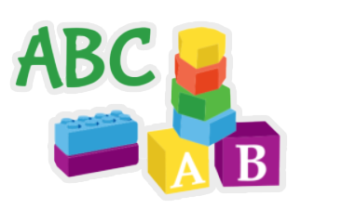
The game logo:

Slide 8
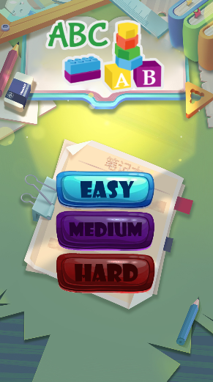
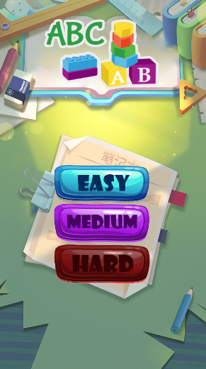
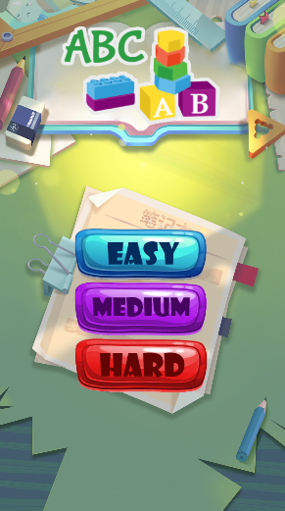
The Levels:
Easy level is unlocked
Easy and Medium levels are unlocked
All levels are unlocked

Slide 9
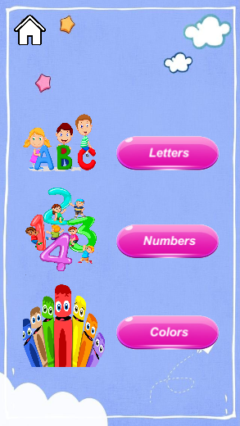
Easy level sections:

Slide 10
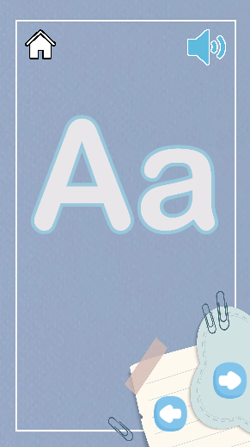
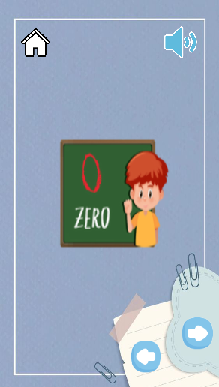
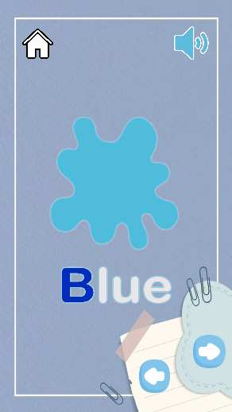
Easy level sections:
Alphapets
Numbers
Colors

Slide 11
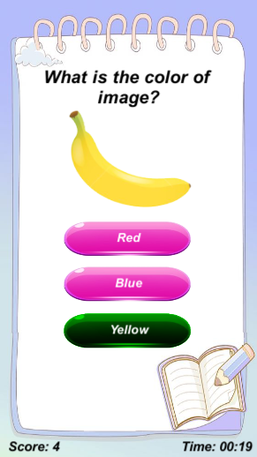
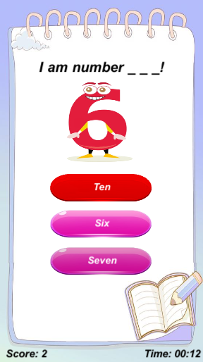
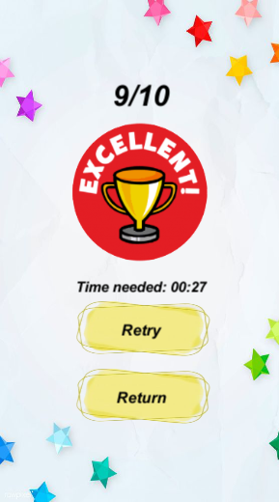
Easy level quiz- some questions and results:

Slide 12
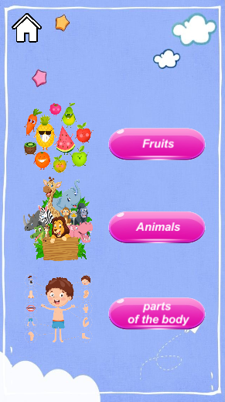
Medium level sections:

Slide 13
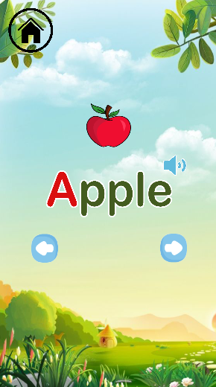
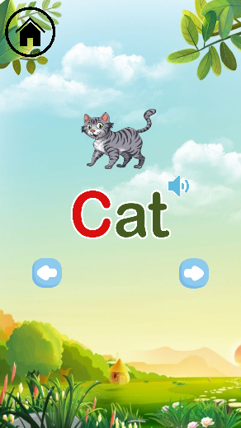
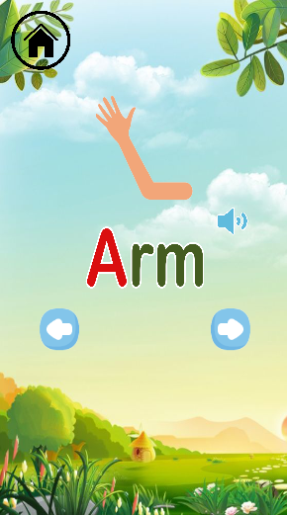
Medium level sections:
Fruits
Animals
Parts of the body

Slide 14
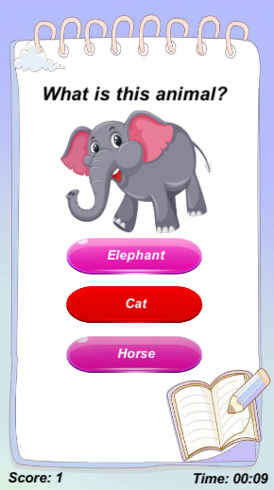
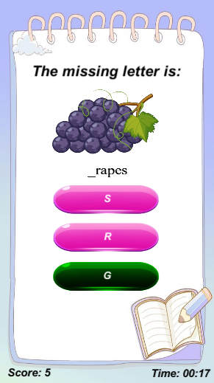
Medium level quiz- some questions :

Slide 15
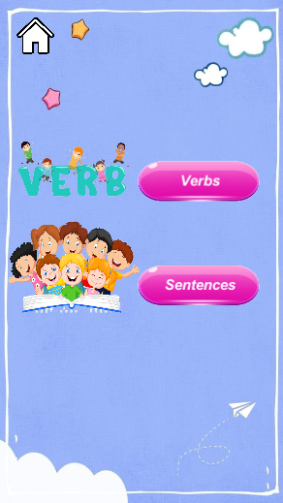
Hard level sections:

Slide 16
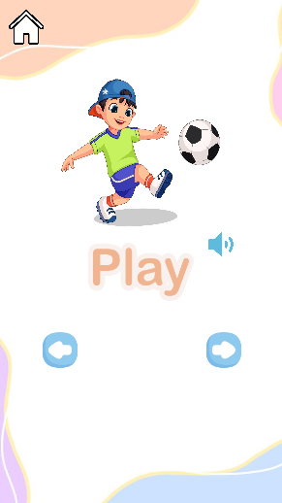
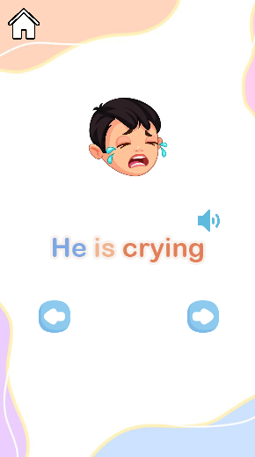
Hard level sections:
Verbs
Sentences

Slide 17
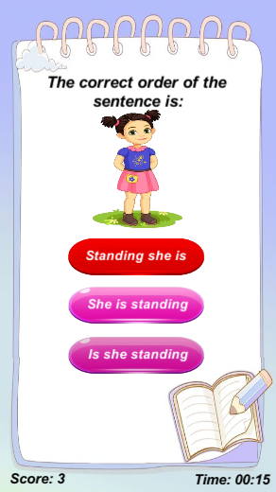
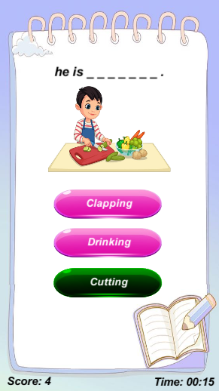
Hard level quiz- some questions :

Slide 18
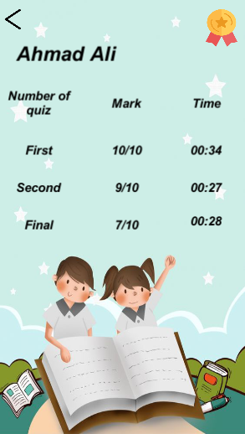
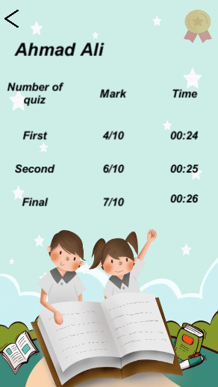
Report – in case passed & failed:
Passed all quizzes
Failed in quiz

Slide 19
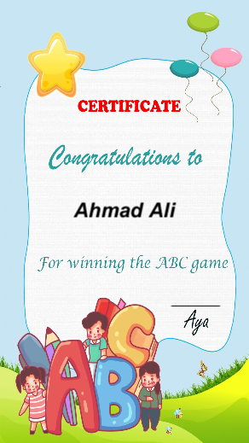
Certificate:

Slide 20
Constrains
Limited number of free available courses to learn Unity.
Non-free assets that is needed to work with unity.
Semester term was short and pressed.

Slide 21
Future work
We want to make this game more inclusive for all school age groups in the future.
Add more features.
Make the game available in both Arabic and English.

Slide 22
Thanks for your attention

