Slide 1

An-Najah National University Engineering Collage Civil Engineering Department
Graduation Project 2
3D Dynamic Analysis And design of
Ministry of Transportation Building
Supervised by: Dr. Munther Diyab
2013

Slide 2


Slide 3
Outline
Introduction
Preliminary Design
3D Modeling analysis and design using SAP2000

Slide 4
Chapter One Introduction

Slide 5
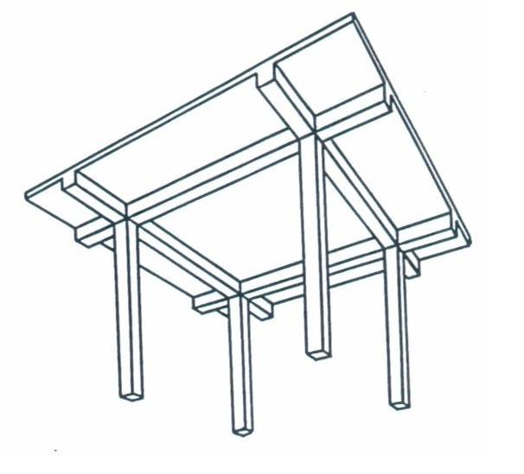
(1) Project Description
The building is composed of five stories above the ground, and no basement. Each story has an area of 1500 squared meter and height of 4.6 m.
The building consists of two parts separated by an expansion joint.
The building will be designed as Solid Slab with drop beams system.

Slide 6
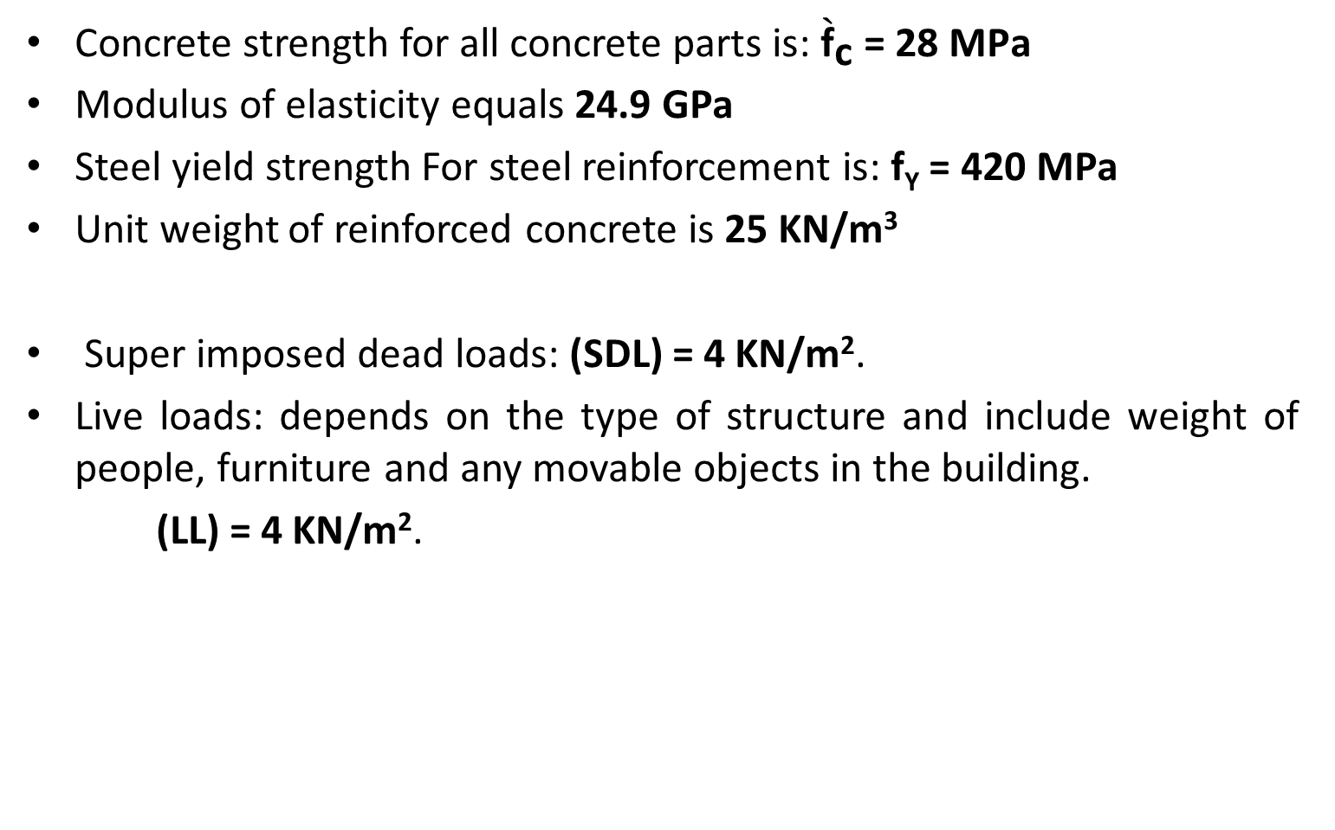
(2) Materials and loads
Concrete strength for all concrete parts is: ${\grave{\text{f}}}_{\text{c}} \text{= }\text{28} \text{MPa}$
Modulus of elasticity equals 24.9 GPa
Steel yield strength For steel reinforcement is: f_{Y} = 420 MPa
Unit weight of reinforced concrete is 25 KN/m³
Super imposed dead loads: (SDL) = 4 KN/m².
Live loads: depends on the type of structure and include weight of people, furniture and any movable objects in the building.
(LL) = 4 KN/m².

Slide 7
(5) Design Codes
For Design:
American Concrete Institute (ACI318-08)
For Loads:
International Building Code (IBC-2000)

Slide 8
Chapter Two Preliminary Design

Slide 9
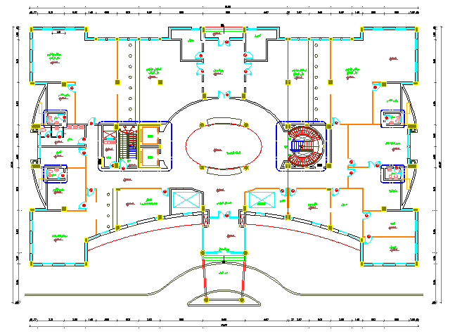
Architectural Plan

Slide 10
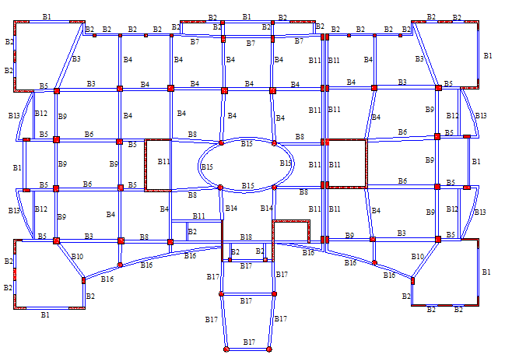
Structural Plan

Slide 11
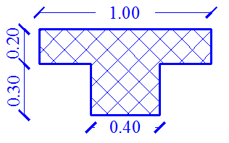
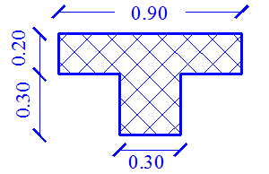
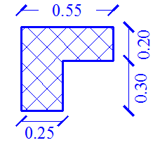
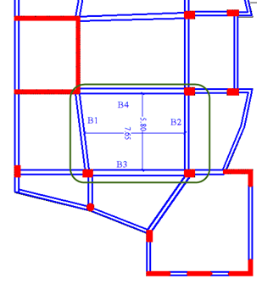
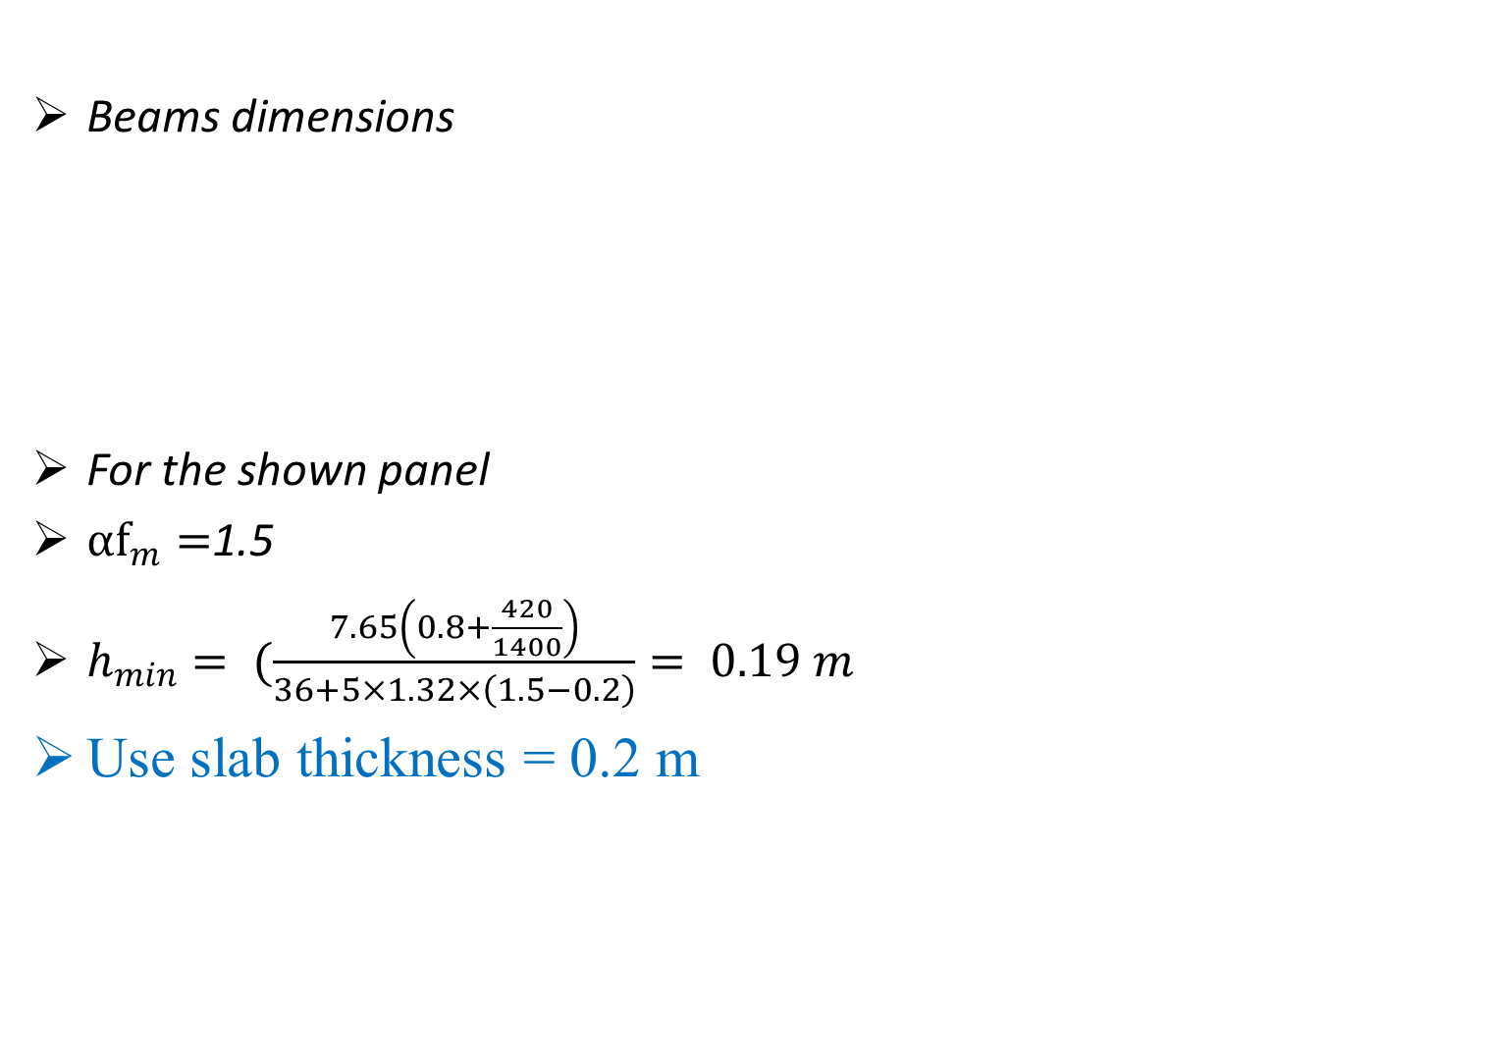
Preliminary Design of The Structure
Beams dimensions
For the shown panel
${αf}_{m}=$1.5
$h_{min}= (\frac{7.65\left(0.8+\frac{420}{1400}\right)}{36+5×1.32×\left(1.5−0.2\right)}= 0.19 m$
Use slab thickness = 0.2 m

Slide 12
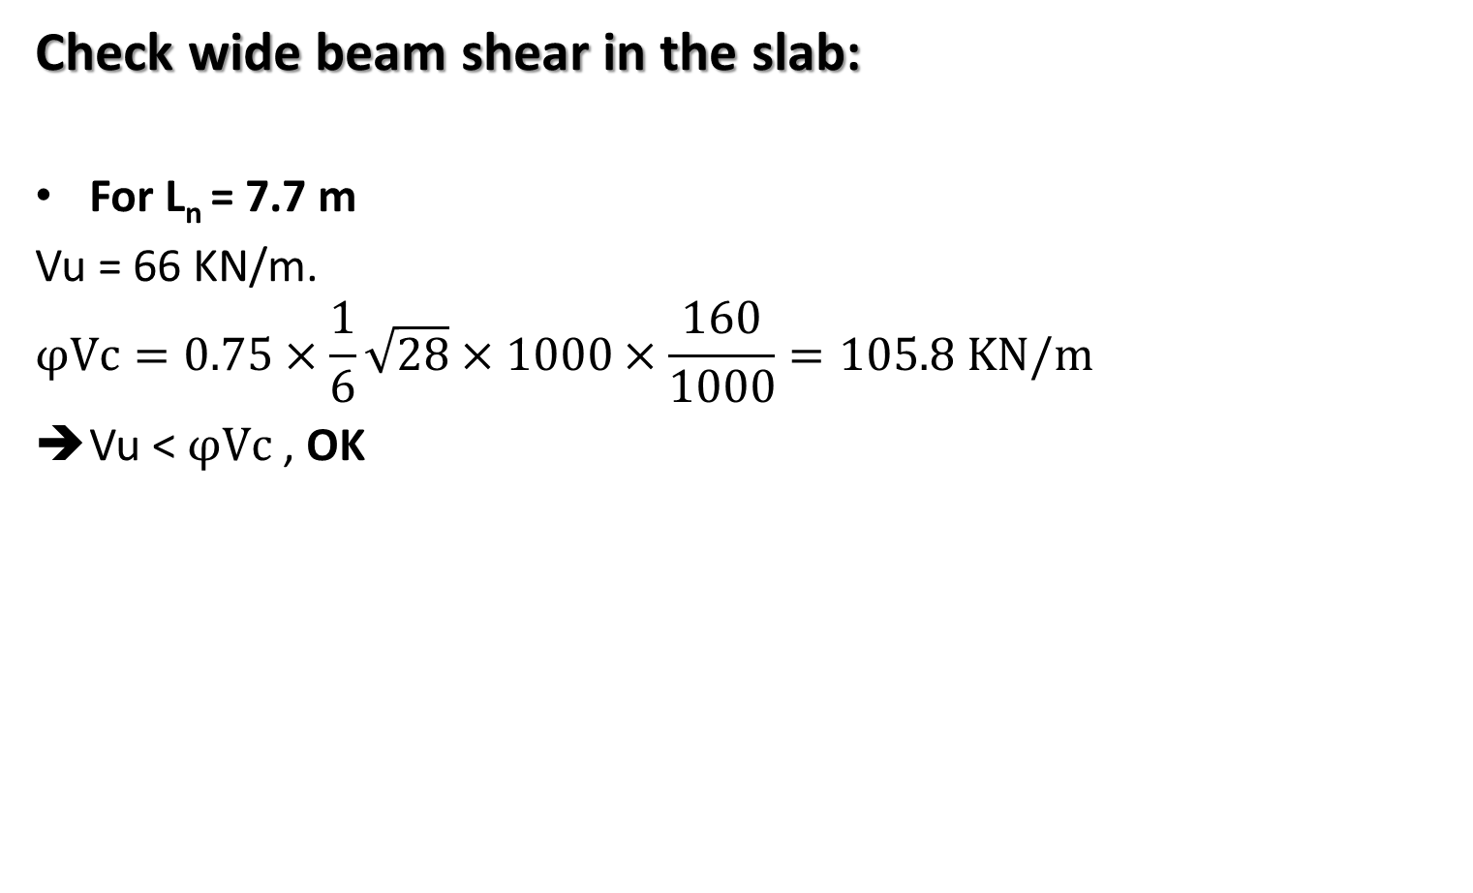
Manual Checks for Dimensions
Check wide beam shear in the slab:
For L_{n} = 7.7 m
Vu = 66 KN/m.
$$φVc=0.75×\frac{1}{6}\sqrt{28}×1000×\frac{160}{1000}=105.8 KN/m$$
Vu < $φVc$ , OK

Slide 13
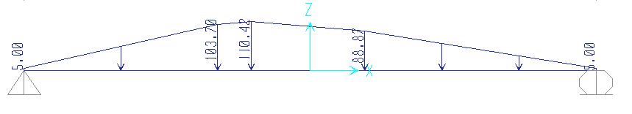
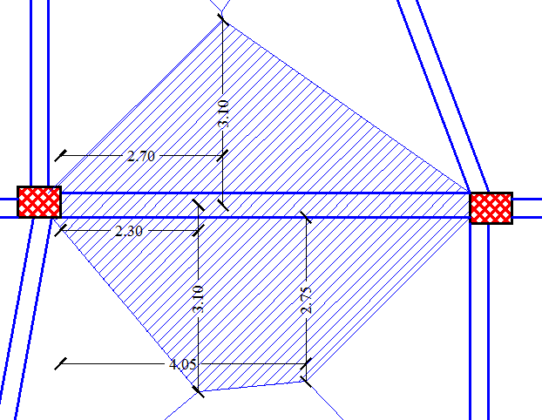
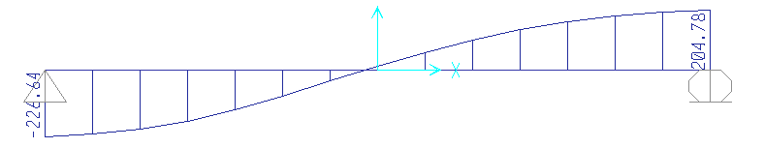
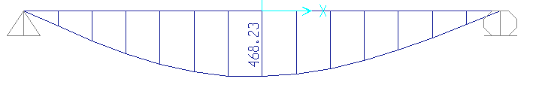
Manual Checks for Dimensions
Check beam dimensions
Load distribution from tributary area
Shear force from tributary area
Moment diagram from tributary area

Slide 14
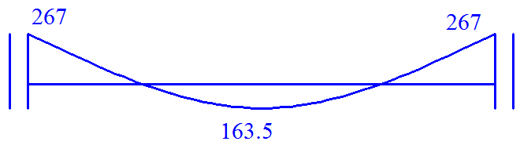
Manual Checks for Dimensions
Check beam dimensions
Moment diagram from tributary area
Moment diagram from direct design method
Total moment = 267+163.5 = 430.5
Difference percentage = 8%

Slide 15
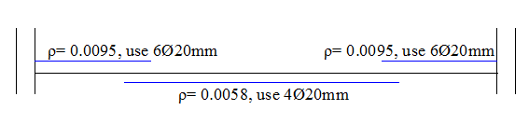
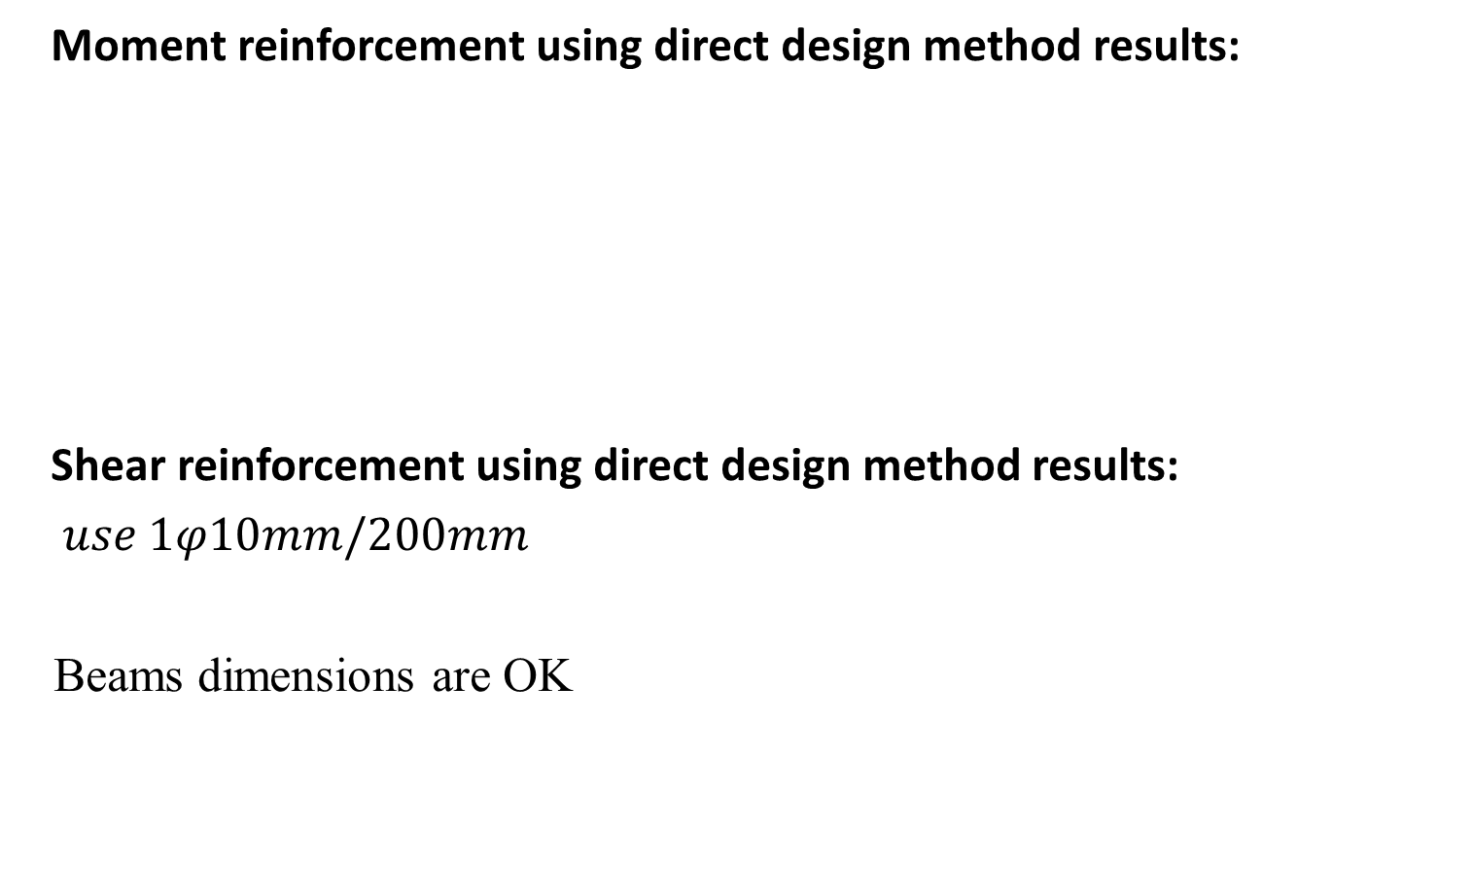
Manual Checks for Dimensions
Moment reinforcement using direct design method results:
Shear reinforcement using direct design method results:
$use 1φ10mm/200mm$
Beams dimensions are OK

Slide 16
Chapter Three 3D Model & Checks

Slide 17
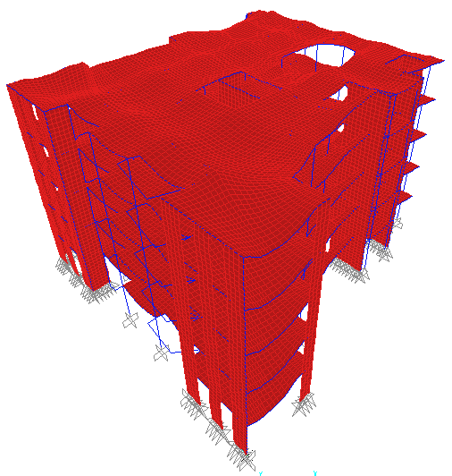
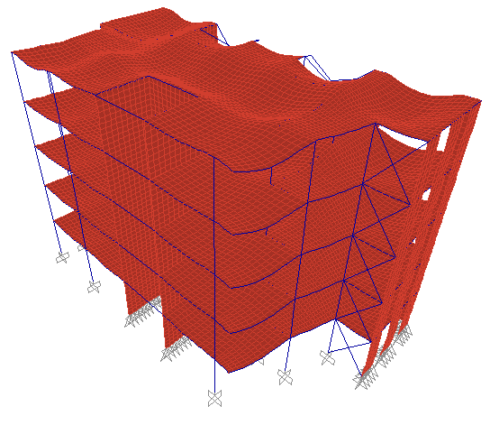
Compatibility Check
→ The model is compatible.

Slide 18

Equilibrium Check
Manual result SAP results
Total live load = 9720 KN
Difference percentage = 0.02%
Member | Weight, KN
Shear walls | 4904
Columns | 2898
Beams | 4415
Slab | 12150
external wall | 11325
Superimposed | 9720
Total | 45412

Slide 19
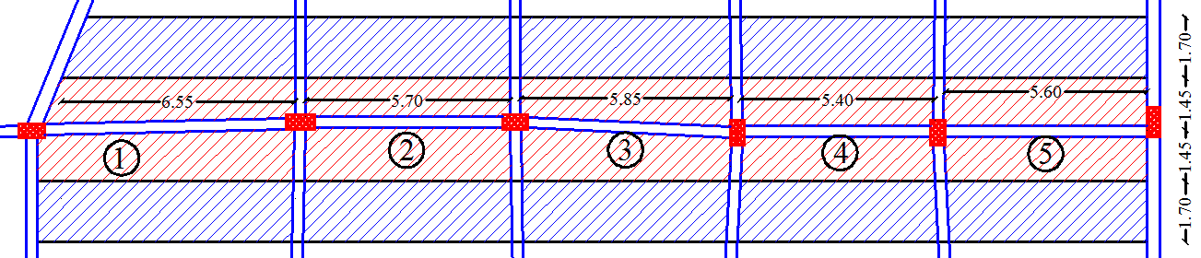
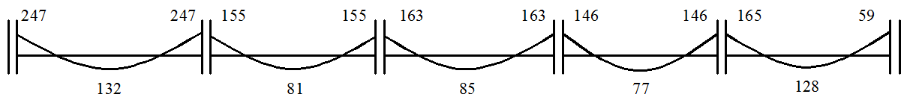

Internal Forces Check
Moment check in beams:
Moment diagram from direct design method:
Moment diagram from SAP results:
Difference is acceptable

Slide 20
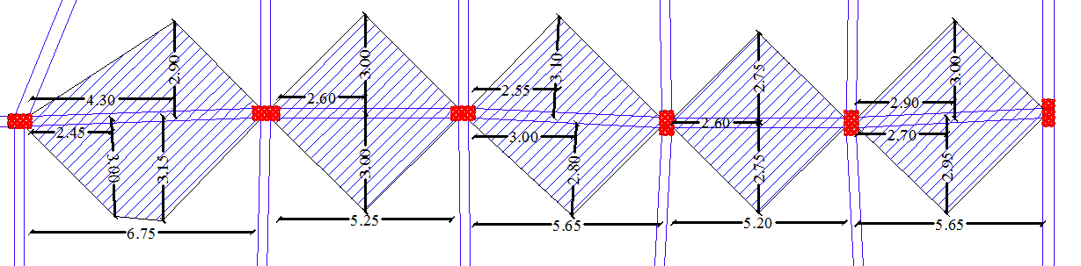
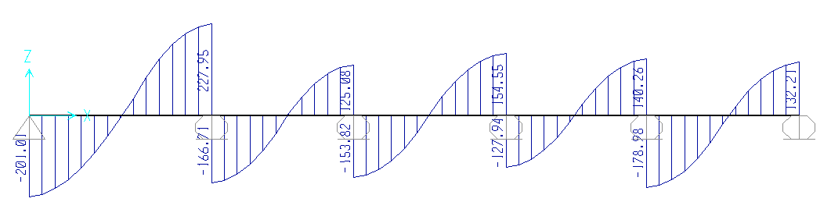
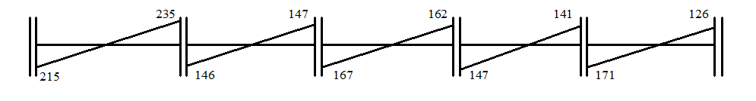
Internal Forces Check
Shear check in beams:
Shear diagram from direct design method:
Shear diagram from SAP results:
Difference is acceptable

Slide 21
Internal Forces Check
Axial Force in column C1 at grid 10-F

Slide 22
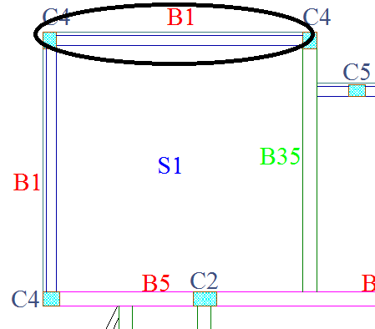
Deflection Check
Deflection In Beams:
Beam (B1) has the largest deflection value.
Immediate Deflection:
Deflection due to service loads,
(D_{service} =D_{D}+D_{L} = 11.11806 mm)
Deflection due to dead loads,(D_{D} = 4.70614 mm)
Deflection due to live loads, D_{L}=D _{service} -D _{dead}
(D_{L}= 11.11806 - 4.70614 = 6.41192 mm)
Allowable deflection according to code for sensitive partitions:
D_{L}= span length (L)/480 = 7700/480 = 16 mm ˃> 6.41192 mm ➔ OK

Slide 23
Deflection Check
Deflection In Beams:
Beam (B1) has the largest deflection value.
Long term Deflection:
Deflection in the structure after 5 years of use
∆LT = ∆L + (λ) ∆D + λ ∆Ls ≤? L/240
= 6.41192+(2×4.70614)+(2×0.5×6.41192)
= 22.24 mm
Allowable deflection according to ACI code.
Allowable ∆LT = L/240
=7700/240 = 32.08 mm ˃ 22.24 mm ➔ OK

Slide 24
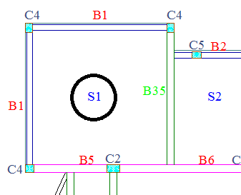
Deflection Check
Deflection In Slabs:
Slab (S1) has the largest deflection value.
Immediate Deflection:
Deflection due to service loads,
(∆_{service} =∆_{D}+ ∆_{L} = 30.97128 mm)
Deflection due to dead loads, (∆_{D} = 12.288 mm)
Deflection due to live loads, ∆_{L}= ∆_{service} - ∆_{D}
(∆_{L} = 30.97128 - 12.288 = 18.68328 mm)
Allowable deflection according to code:
∆_{L}= span length (L)/360
=7700/360 = 21.39 mm ˃ 18.6328 mm ➔ OK

Slide 25
Deflection Check
Deflection In Slabs:
Slab (S1) has the largest deflection value.
Long term Deflection:
Deflection in the structure after 5 years of use
∆LT = ∆L + (λ) ∆D + λ ∆Ls ≤? L/240
= 18.68328 +(2×12.288)+(0.5×2×18.68328)
= 61.94 mm
Allowable deflection according to ACI code.
Allowable ∆LT = L/240
=(7700+7700)/2x240= 32.08 mm ˂ 61.94 mm ➔ NOT OK

Slide 26
Deflection Check
Deflection In Slabs:
This result leads to conclude that slab deflection is NOT OK, but these structural elements have sections large enough to prevent cracks.
Ma < Mcr means no cracks will happen in the section (Ie = Ig), all section will resist deflection, so no need to adjust modifiers to 0.25 value.

Slide 27
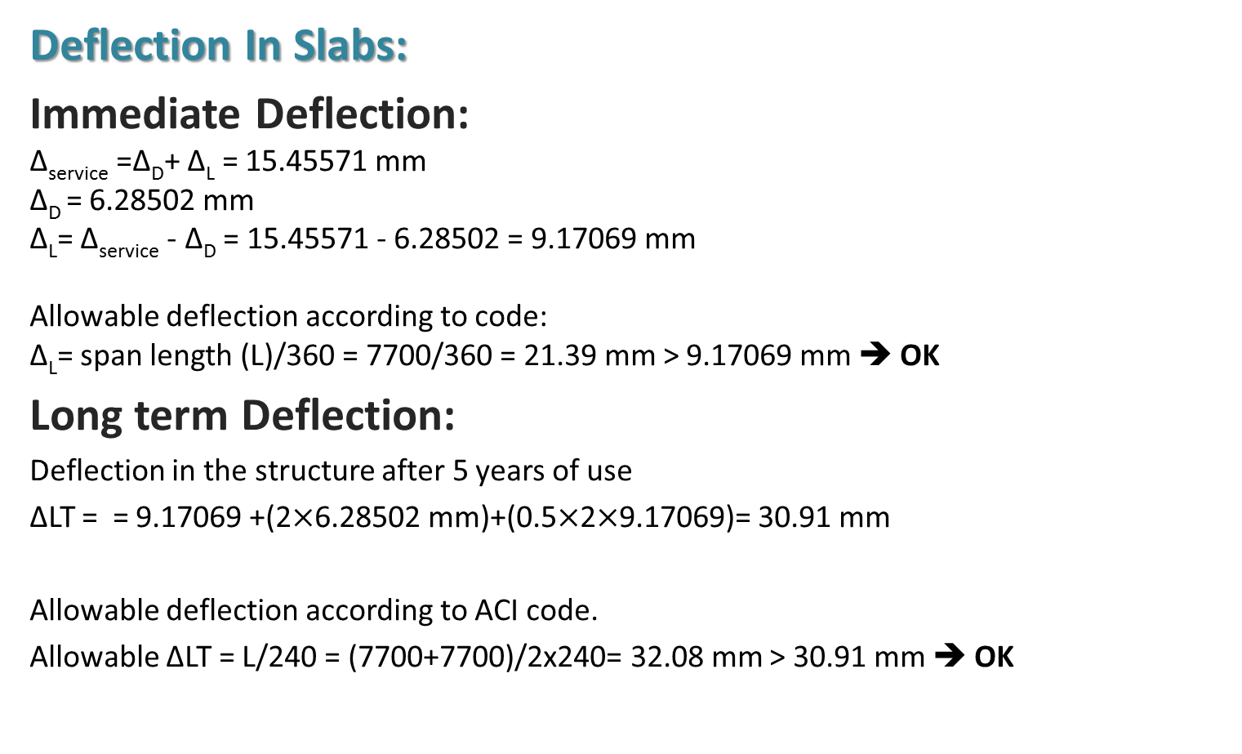
Deflection Check
Deflection In Slabs:
Immediate Deflection:
∆_{service} =∆_{D}+ ∆_{L} = 15.45571 mm
∆_{D} = 6.28502 mm
∆_{L}= ∆_{service} - ∆_{D} = 15.45571 - 6.28502 = 9.17069 mm
Allowable deflection according to code:
∆_{L}= span length (L)/360 = 7700/360 = 21.39 mm ˃ 9.17069 mm ➔ OK
Long term Deflection:
Deflection in the structure after 5 years of use
∆LT = = 9.17069 +(2$×$6.28502 mm)+(0.5$×$2$×$9.17069)= 30.91 mm
Allowable deflection according to ACI code.
Allowable ∆LT = L/240 = (7700+7700)/2x240= 32.08 mm > 30.91 mm ➔ OK

Slide 28
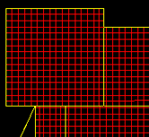
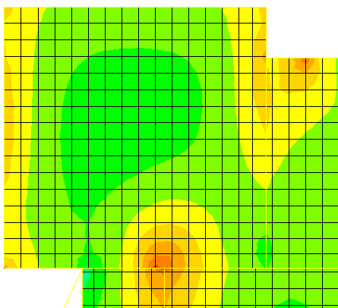
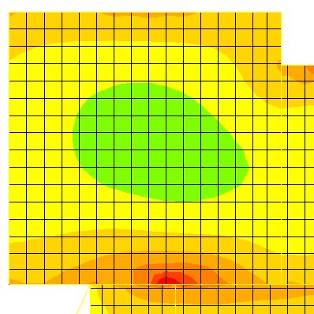
Slabs Analysis and Design
Slab S1
Moment X-Dir.
Moment Y-Dir.

Slide 29
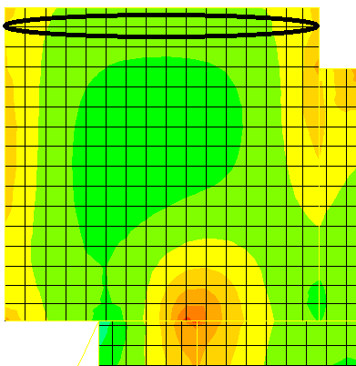
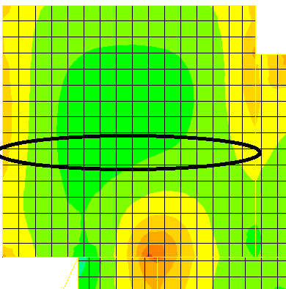
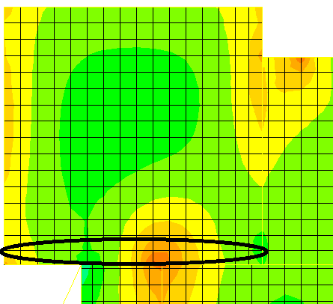
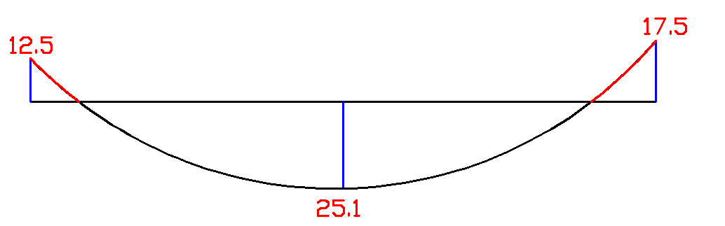
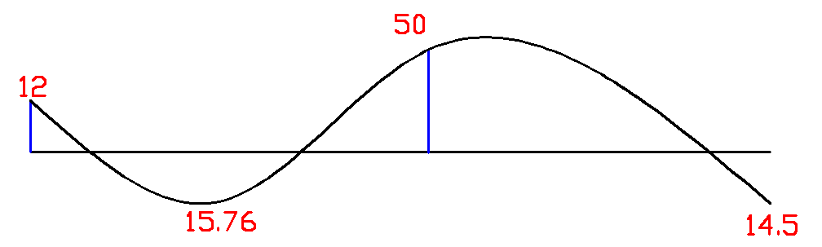
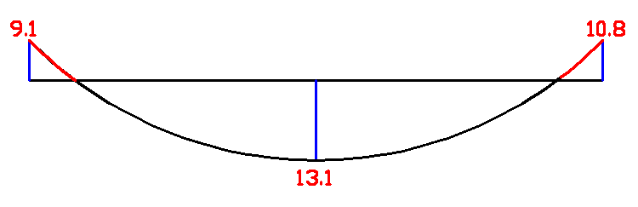
Slabs Analysis and Design
Slab Analysis S1 X-Dir.

Slide 30
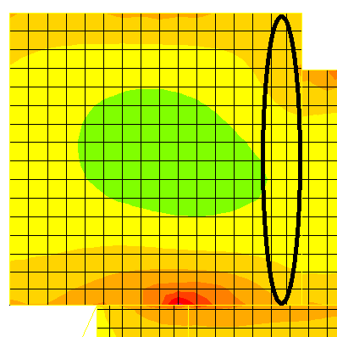
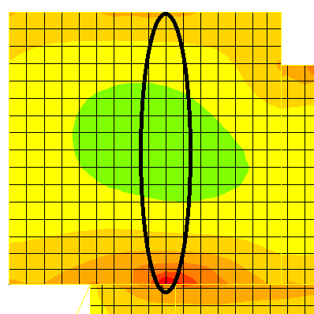
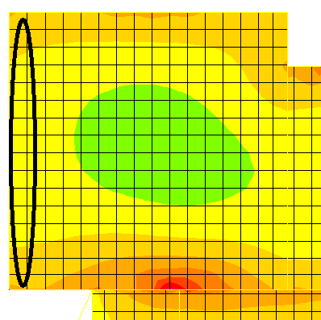
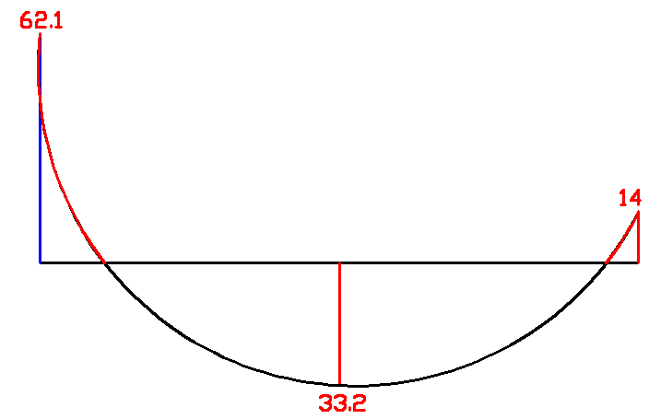
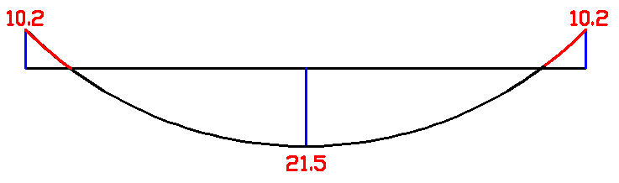
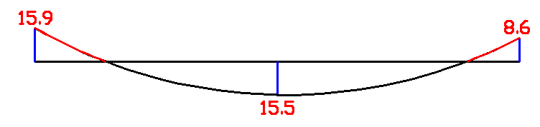
Slabs Analysis and Design
Slab Analysis S1 Y-Dir.

Slide 31
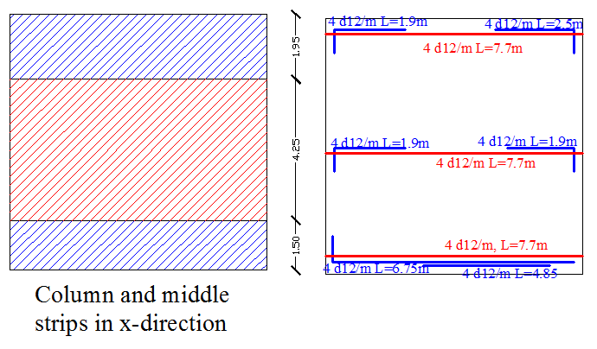
Slabs Analysis and Design
Slab Design S1 X-Dir.

Slide 32
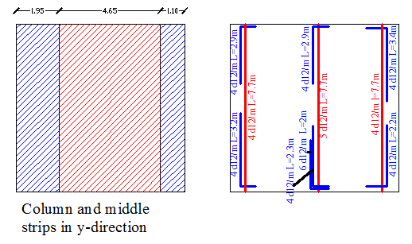
Slabs Analysis and Design
Slab Design S1 Y-Dir.

Slide 33
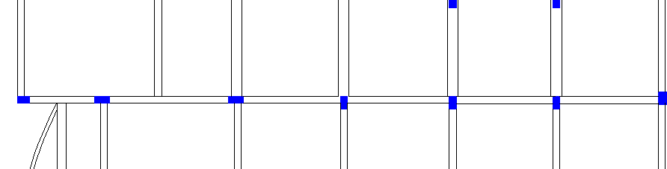
Beams Analysis and Design
Frame 2:
Moment diagram:
Shear diagram:

Slide 34
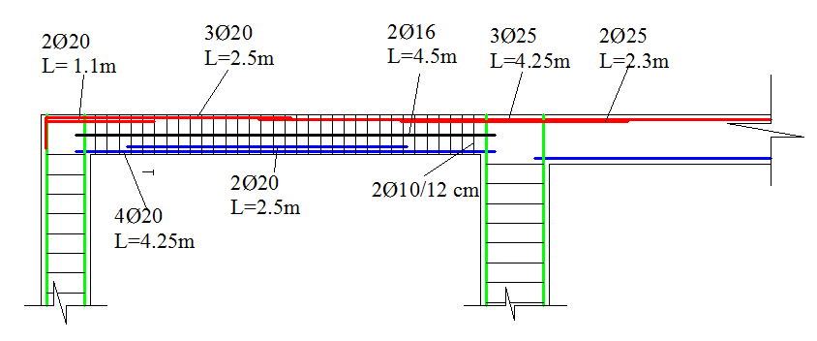
Beams Analysis and Design
Reinforcement distribution in frame 2:
Reinforcement detailing in frame 2:

Slide 35
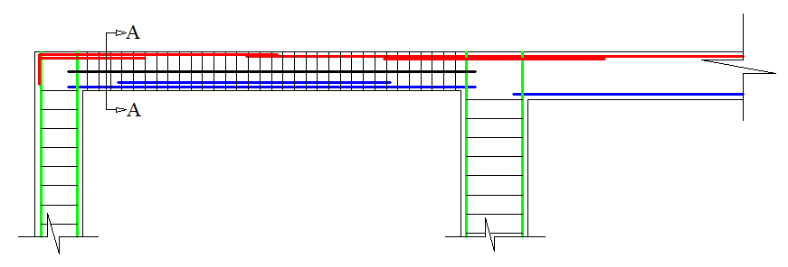
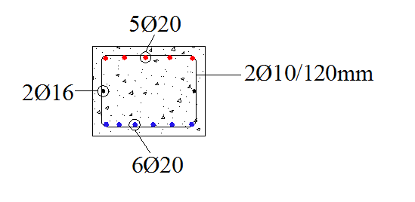
Beams Analysis and Design
Cross section in the beam:

Slide 36
Columns Analysis and Design
Least dimension of columns is 35 cm.
Columns are short.
Range of ultimate load | Symbols
4000 – 4500 KN | C1
3500 – 4000 KN | C2
3000 – 3500 KN | C3
2500 – 3000 KN | C4
0000 – 2500 KN | C5

Slide 37
Columns Analysis and Design
Columns dimensions and reinforcement:
Column Symbols | Dimensions (cm) | steel | Total capacity ØPn _{max}
C1 | 40X80 | 16Ø16 | 4903 KN
C2 | 40X70 | 14Ø16 | 4290 KN
C3 | 40X60 | 12Ø16 | 3677 KN
C4 | 40X50 | 10Ø16 | 3064 KN
C5 | 35X50 | 9Ø16 | 2692 KN
Circular column | 55 cm diameter | 12Ø16 | 2700 KN

Slide 38
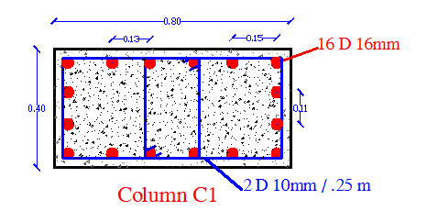
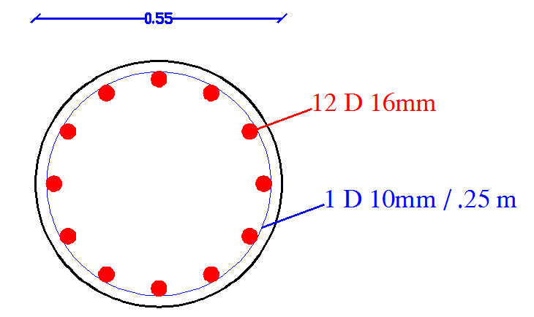
Columns Analysis and Design
Detailing For rectangular column Detailing For Circular column

Slide 39
THANK YOU

Slide 40
Questions
??

