Slide 1
Intelligent Multi-Mode Robotic Platform
Autonomous Pick-and-Place • AI Tic-Tac-Toe • Mobile Control • Xbox Control
Team Members:
Ali Odeh
Izzeddin Asmar
Supervisor: Emad Natsheh
Department: Computer Engineering
June 15, 2026

Slide 2
Project Idea / Our Concept
Overview
A smart robot that can be controlled manually, operated through a mobile application, or run autonomously using vision and AI.
Core Idea
Main Modes
Project Value
Build one integrated robotic platform that connects physical movement with software intelligence. The robot can see objects, make decisions, receive commands, and execute actions through motors and a robotic arm.
The system includes four main functional modes: vision-guided autonomous pick-and-place, OpenAI-based Tic-Tac-Toe gameplay, Flutter mobile application control, and Xbox controller control.
The project demonstrates how robotics, AI, computer vision, embedded systems, wireless communication, and mobile development can be combined in one practical prototype.
👁
Vision & AI
🧠
Decision Logic
⚙
Arduino Control
🤖
Robot Action
Notes:
Explain the project simply: it is not only a robot arm or a remote-control car. It is a complete platform with perception, control, and physical execution. The value is in the integration of several technologies.

Slide 3
Main Objectives
Goals
The project objectives were designed to cover both intelligent autonomy and practical user control.
1. Build the Robot Platform
2. Enable Autonomous Handling
3. Add AI Gameplay
Prepare a mecanum-wheel base, robotic arm, gripper, Arduino control firmware, and Bluetooth communication.
Detect objects, align with them, pick them up, verify the result, and deliver them to the correct box.
Allow the robot to play a physical Tic-Tac-Toe game using camera input and OpenAI-supported decisions.
4. Provide Manual Control
5. Support Xbox Control
6. Improve Reliability
Develop a Flutter mobile application for direct robot movement and arm control through Bluetooth.
Map Xbox controller inputs to the robot and add programmable command sequences for repeated movements.
Use safety stops, command validation, detection stabilization, and visual verification to reduce failures.
Notes:
Walk through the objectives quickly. The key message is that the project aims to produce a complete multi-mode system, not only one isolated feature.

Slide 4
Hardware Components
Implementation
The robot combines embedded control, vision hardware, wireless communication, power regulation, and mechanical actuation.
Arduino Mega
OAK-D Depth Camera
NEMA 17 Stepper Motors
Main hardware controller for motors, servos, and command execution.
Captures frames for object detection, alignment, and board analysis.
Drive the mecanum wheel base for platform movement.
A4988 Motor Drivers
MG996R / SG90 Servos
HC-05 Bluetooth Module
Control the stepper motors from Arduino signals.
Move the robotic arm joints and gripper mechanism.
Provides wireless serial communication with the phone / controller.
Xbox Controller
Buck Converter Xl4015
Power Supply
Provides practical manual control through the mobile app.
Steps down the supply voltage to power the servos and control electronics.
Provides the main electrical power required by motors, servos, and modules.
Notes:
Mention the most important components. Keep it short: Arduino is the execution brain, OAK-D is the vision input, motors and servos provide movement, HC-05 links the phone to Arduino, and the Xbox controller gives an alternative control interface.

Slide 5
Software & Communication
Implementation
The software stack connects AI/vision processing with reliable robot commands.
Python Vision Controller
YOLO + HSV Assist
OpenAI Vision Support
Processes camera frames, runs detection logic, calculates alignment errors, verifies pickup results, and sends commands to Arduino.
YOLO detects target objects and robot references. HSV-based color assist improves reliability when detections are temporarily missing.
Used for high-level visual reasoning such as Tic-Tac-Toe board analysis and pickup verification support.
Flutter / Dart App
Arduino Firmware
Bluetooth Protocol
Provides Bluetooth connection, manual controls, speed sliders, servo feedback display, and Xbox controller integration.
Receives commands and controls wheels, servos, gripper, pickup motion, drop motion, and safety stop behavior.
Uses one-byte commands for low-latency robot control and structured MOVE commands for Tic-Tac-Toe execution.
Notes:
Explain that the project has two software sides: high-level software in Python and Flutter, and low-level execution in Arduino. The communication protocol is intentionally simple to reduce delay and complexity.

Slide 6
Mode 1: Autonomous Pick-and-Place
Autonomous Mode
The robot autonomously detects a target object, aligns itself, picks it up, verifies success, and delivers it to the correct box.
1
Detect Target
2
Align Robot
3
Pick Up
4
Verify
5
Deliver
Target Mapping
Main Goal
Key Benefit
• green-cube → blue-box
• red-car → purple-box
Create a complete autonomous workflow from perception to physical delivery.
The robot can perform an object-handling task with minimal human intervention.
Notes:
This is the most important technical mode. Explain the sequence: detect, align, pick, verify, and deliver. Mention the mapping: green cube to blue box and red car to purple box.

Slide 7
Mode 1: Detection & Alignment
Autonomous Mode
Accurate pickup depends on detecting both the object and the robot references, then converting visual information into motion commands.
Alignment Errors
OAK-D camera captures the arena from a fixed viewpoint.
YOLO detects target objects, gripper, pink marker, and destination boxes.
HSV color assist improves detection when the model temporarily misses visual elements.
The pink marker is used as a body reference, while the gripper midpoint represents the front direction.
Lateral Error
Object is left or right of the robot centerline.
Forward Error
Robot is too close or too far from the desired pickup distance.
Angular Error
Robot must rotate to face the object correctly.
Movement commands: forward, backward, strafe, rotate, diagonal, stop.
Notes:
Explain that alignment is not only image coordinates. It is robot-relative geometry. The controller estimates lateral, forward, and angular errors and converts them into movement commands.

Slide 8
Mode 1: Pickup, Verification & Delivery
Autonomous Mode
The robot verifies the physical result after pickup before starting delivery.
1. Stable Alignment
2. Pickup Command
3. Visual Verification
The robot waits briefly after alignment to make sure the object is centered and the robot is not moving.
Python sends the pickup command through Bluetooth. Arduino controls the servos and gripper motion.
Several frames are captured after pickup to classify the result as confirmed, failed, or uncertain.
4. Delivery Stage
5. Drop Action
If pickup is confirmed, the robot searches for the correct destination box and aligns with it.
After holding alignment with the box, Arduino releases the object using the drop command.
Why verification matters: a robot may look aligned but still fail because of slippage, collision, or gripper position errors.
Notes:
Focus on the importance of verification. The robot does not assume the pickup succeeded. It checks the result and only continues delivery if the pickup is confirmed.

Slide 9
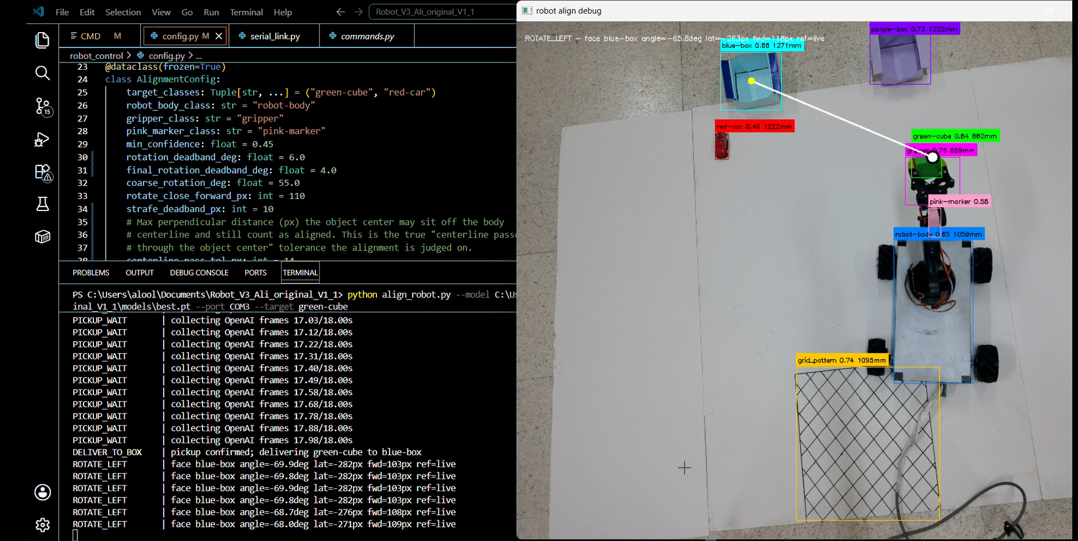
Mode 1: Vision-Guided Autonomous Pick-and-Place
Autonomous Mode
This mode allows the robot to detect a target object, align with it, pick it up, verify the pickup, and deliver it to the correct destination box.
Key Points
Real-time object detection using OAK-D camera and YOLO.
Robot-relative alignment using the gripper, robot body, and pink marker.
Arduino executes movement, pickup, and delivery commands through Bluetooth.
Figure: Live autonomous alignment and pickup process with detection labels and debugging output
Notes:
Use this slide while presenting real screenshots or photos of Mode 1. Point to the image and explain what the robot is doing: detecting, aligning, picking up, verifying, or delivering.

Slide 10
Mode 2: OpenAI-Based Tic-Tac-Toe
AI Game Mode
The robot plays a physical Tic-Tac-Toe game against a human player by reading the board and placing X pieces.
Game Setup
Board Analysis
Turn Handling
The human player uses O, while the robot/OpenAI uses X. The board is a numbered 3×3 grid with cells from 1 to 9.
A camera captures the board image. OpenAI analyzes the current board state and supports choosing the next X move.
The system waits for the human move, scans the board, updates the internal state, and continues until win, loss, or draw.
Startup Logic
Scan after 5 seconds → If O exists, robot responds → If board is empty, wait and scan again → Robot may start first.
Notes:
Explain this as the AI mode. The interesting point is that the game is physical, not only software. The robot reads a real board, decides the next move, and places an X piece physically.

Slide 11
Mode 2: Robot Execution
AI Game Mode
After selecting the move, the robot physically places an X piece in the selected board cell.
AI
OpenAI selects
cell number
Python sends
MOVE command
Arduino executes
pickup motion
🤖
Arm places X
in target cell
Command Format
MOVE <pickup_index> <cell_number>
Execution Result
The pickup index changes because X pieces are stacked, so the pickup height changes after each move.
The arm picks an X from the stack, moves to the selected numbered cell, releases it, and returns home.
Smart Retry Note:
If the robot fails to reach the required X piece due to servo angle inaccuracies or mechanical tolerance, it automatically retries the pickup motion until the piece is successfully reached, with a maximum limit of 10 attempts.
Notes:
Explain the execution side. Once the decision is made, the problem becomes a physical motion problem: pickup from the stack and placement into a cell. The command carries both pickup index and cell number.

Slide 12
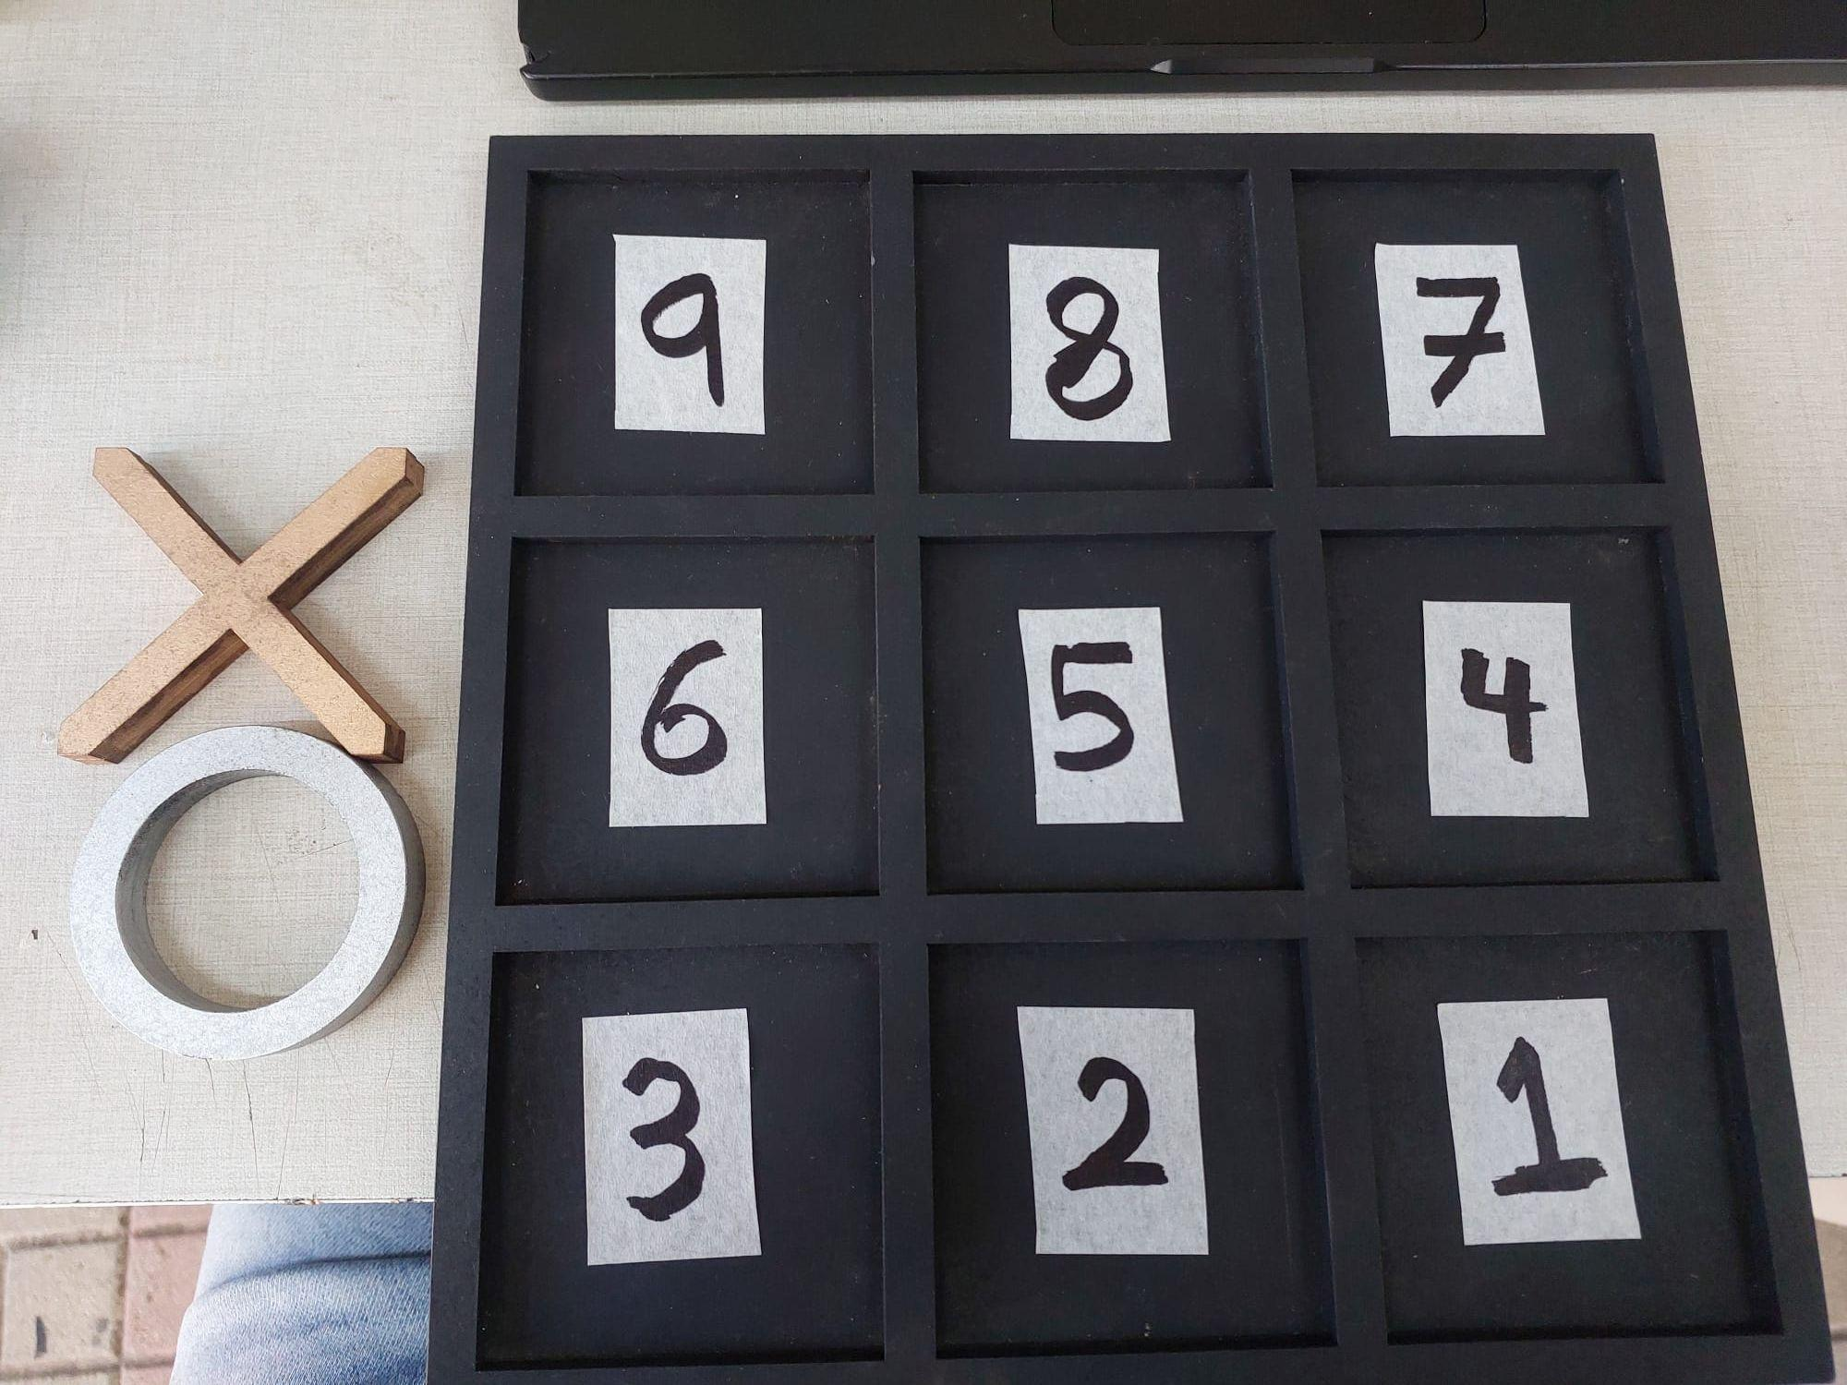
Mode 2: AI-Based Robotic Tic-Tac-Toe
AI Game Mode
The robot plays Tic-Tac-Toe physically by analyzing the board state and placing the next X move.
Key Points:
The human player uses O, while the robot uses X.
The camera scans the numbered 3×3 board after each move.
OpenAI analyzes the board state and selects the robot’s next cell.
Physical numbered board used for AI analysis and robot move execution
Notes:
Use this slide to show real evidence of the Tic-Tac-Toe mode. Explain the board image, the selected move, and the physical placement of the X piece.

Slide 13
Mobile Application Control
Manual Control
The Flutter mobile application provides direct wireless control of the robot through Bluetooth Classic and the HC-05 module.
Connection
Robot Movement
Arm Control & Feedback
• Requests Bluetooth and location permissions
• Lists paired devices
• Connects to the HC-05 Bluetooth module
• Sends commands wirelessly to Arduino
• Controls mecanum wheel movement
• Supports forward, backward, sideways, diagonal, and rotation commands
• Uses press-and-hold control
• Sends stop immediately when the button is released
• Controls waist, shoulder, elbow, wrist roll, wrist pitch, and gripper
• Includes wheel and arm speed sliders
• Displays servo angle feedback from the robot
The application acts as a practical user interface between the operator and the Arduino-based robot controller.
Notes:
Explain the mobile app as the main manual-control interface. Mention that it is not only buttons; it also handles Bluetooth connection, command sending, speed control, and servo feedback.

Slide 14
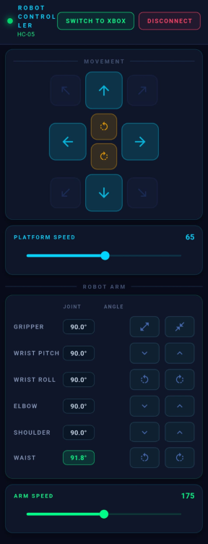
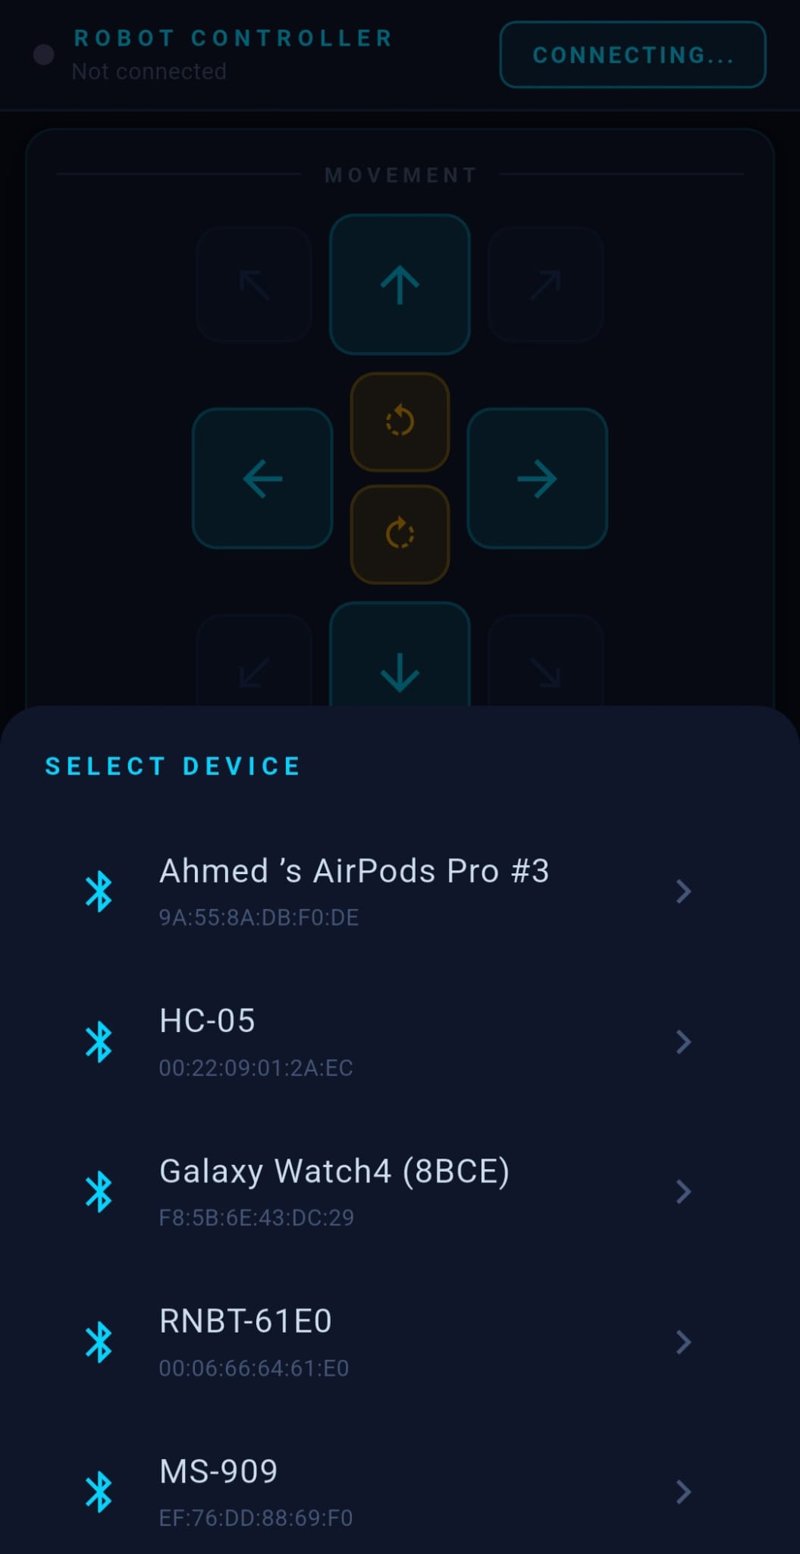
Mobile Application Screenshots
Manual Control
Flutter-based mobile interface for Bluetooth connection, movement control, arm control, and speed adjustment.
Bluetooth Device Selection
Robot Movement and Arm Control
Notes:
Use this slide to show the actual app UI. Briefly explain the connection page, movement buttons, arm controls, and speed sliders.

Slide 15
Xbox Controller Control
Manual Control
The Xbox controller provides a more flexible manual-control method through the Android phone and Flutter application.
Control Path
Safety & Programming
Xbox Controller → Android Phone → Flutter App → HC-05 Bluetooth → Arduino → Robot
• Emergency stop button
• Joystick dead zone to avoid accidental motion
• Sends stop if released or disconnected
• Programmable buttons can replay saved movement sequences
Input Mapping
• Left joystick controls platform movement
• Right joystick controls arm joints
• Bumpers control waist
• Triggers control gripper
• D-pad controls wrist movements
The Xbox mode improves usability because the operator can control the robot more naturally than using only touch buttons.
Notes:
Explain that the Xbox controller does not connect directly to Arduino. It connects to the phone, and the app translates controller inputs into the same robot commands.

Slide 16
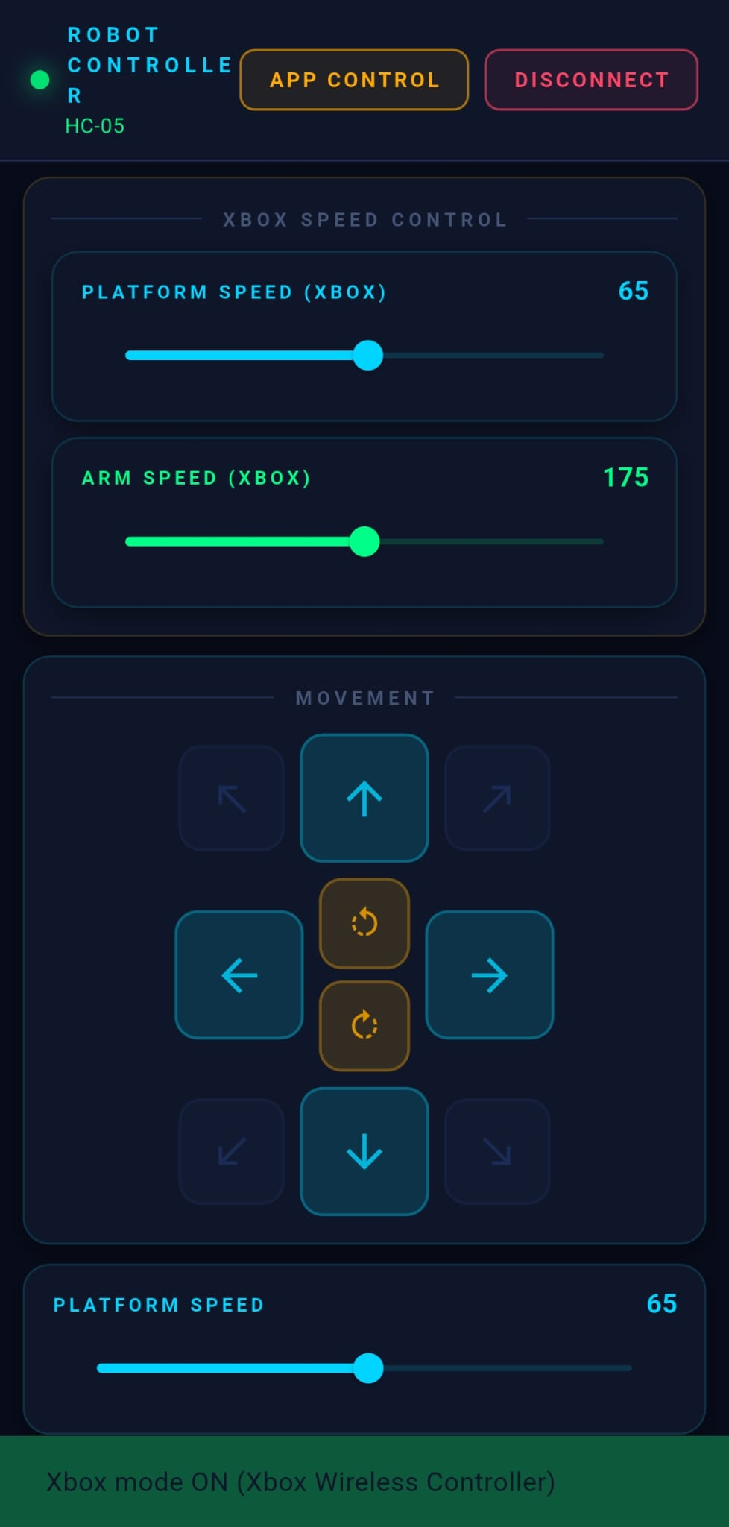
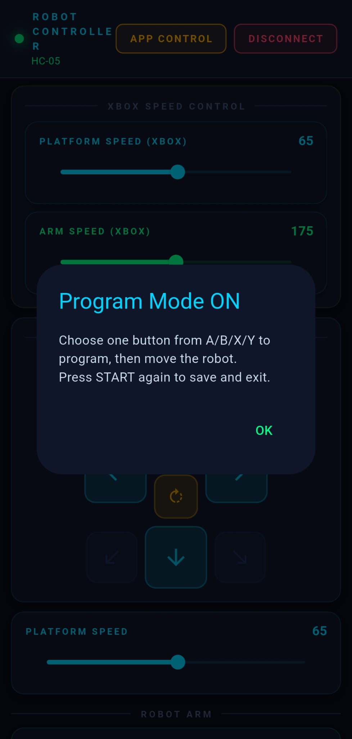
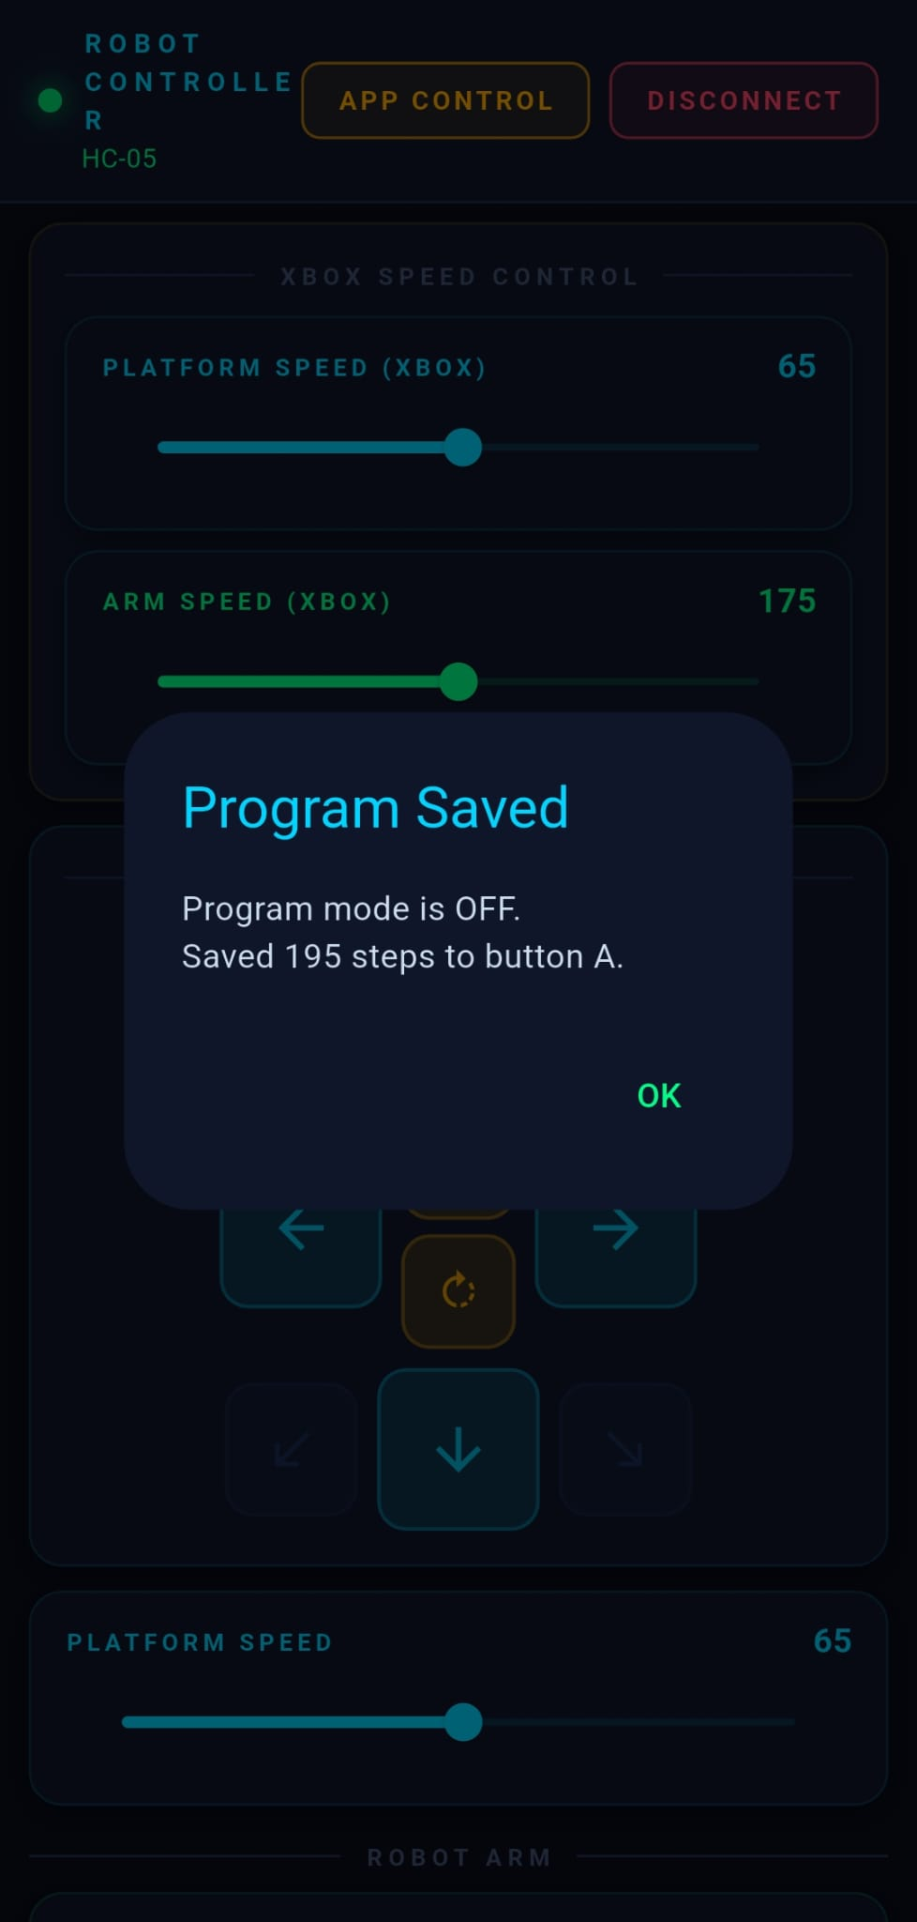
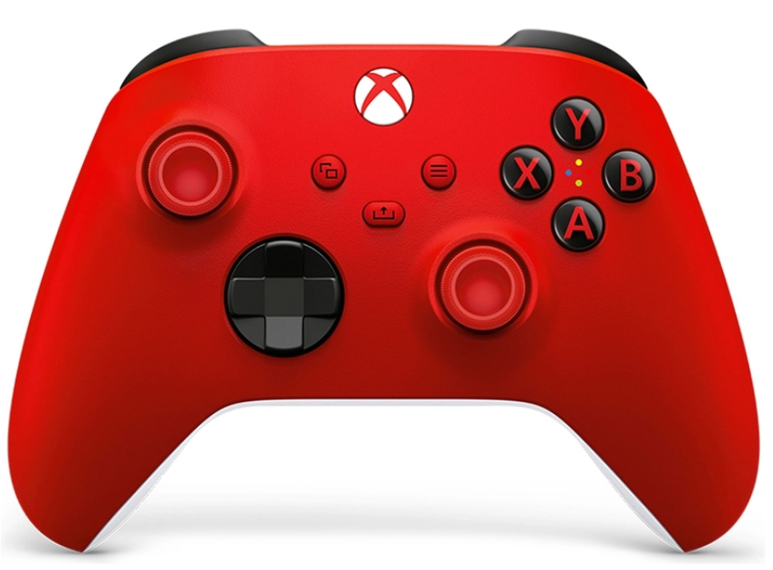
Xbox Controller Mode & Macro Programming
Manual Control
The Xbox controller is connected through the mobile app to control the robot manually and record programmable movement sequences.
Xbox controller
Key Points
The Xbox controller sends commands through the mobile application.
Joysticks and buttons control the robot base, arm joints, and gripper.
Program Mode records a movement sequence and replays it using a selected button.
Program mode screens for recording and saving command sequences.
Notes:
Use this slide to show the Xbox controller setup. Point out the controller, phone, Bluetooth link, and the robot receiving commands.

Slide 17
Constraints, Future Work & Conclusion
Wrap-Up
The current prototype works as an integrated platform, while future improvements can make it more independent and accurate.
Current Constraints
Future Work
Conclusion
• Lighting sensitivity
• Gripper collision during pickup
• Bluetooth range limitations
• Fixed camera field of view
• Power supply dependency
• 3D-printed mechanical limitations
• Onboard processing
• Expanded object recognition
• Improved arm precision
• Depth-based grasping
• Expanded game modes
• Full wireless mobility
This project presents a complete multi-mode robotic platform that integrates computer vision, AI reasoning, mobile development, Bluetooth communication, embedded control, and robotic manipulation into one practical system.
Thank You
Questions?
Notes:
End strongly. Mention that the limitations are expected in a prototype, and the future work shows clear improvement directions. Conclude that the system successfully connects software intelligence with physical robotic action.

