Slide 1


An Najah National University
Faculty of Engineering
Computer Engineering Department
( Beauty )
Graduation Project

Slide 2

Beauty
Supervisor :
Dr.luai Malhis
Prepared by :
Ahmad Shwahna
Shadi Awad

Slide 3
Contents
Music editing program
Abstraction
The Goals of our Project
Implementation:
Writing and Editing part .
Virtual Keyboard
Playing.
Save and open.

Slide 4
Music editing program
programs that facilitate interaction with musical symbols editing, writing and playing
in virtual piano keyboard.

Slide 5
Abstraction
Overcomes hand out technique problems such as accuracy , misarranged .
powerful transcribing and editing capabilities.
Fast, accurate, easy to use application.
Develops beauty applications using Microsoft Visual Studio.NET software.

Slide 6
The Goals of our Project
Useful for musicians with different level .
Enhanced Lack of features problems in other programs .
Enables students writing musical notation in eastern and western style together according to the standard rules, also played easily in very attractive way.
Notes:
From students to profisionals in music fields
Such as Eastern music symbols and some type of clef
which enables them writing musical notation in eastern and western style together according to the standard rules, played easily and in very beautiful way

Slide 7
The Goals of our Project
Emulate the playing on virtual keyboard Used for learning issues.
Play on piano by computer keyboard .
Enable eastern music students specially ours at An-Najah National University to write ,edit , and developing musical notation
Notes:
which helps low level music students to learn easily

Slide 8
Implementation
Main Parts of our program design:
Writing and Editing part .
Keyboard.
Playing.
Save and open.

Slide 9





Writing and editing
Clef : affects all octave’s symbols in the staff dynamically .
Time signature : very important to specify measure duration and number of notes depends on it’s type.
Figure 1: Treble Clef
Figure 2: Bass Clef
Figure 3: Alto Clef
Figure 4: Tenor Clef
Figure 5: Mezzo Soprano Clef
Notes:
Flat ,half flat

Slide 10
Writing and editing
Key signature :efficient ,flexibility and creative compared to other related programs , also More control options custom pattern with special composition of articulations.
Barline:
divide staff into multi measures and each measure has it’s own rules.
Allow changing the barline type as we want.

Slide 11
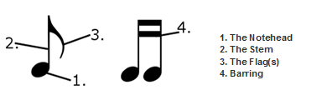
Writing and editing
Rest :silent period during playing , with different types according to duration.
Note :classify to seven types of notes according to their durations and each note contains of many parts
Figure 6: Note Parts

Slide 12

Note establishing .
Note consist of three main parts
1- Note head: depend on time duration .
2- Note Stem : stem direction depend on note location on staff
up or down stem.
3- Note Flag : Flag shape change according to time duration .
Now to draw any note we have to specify the location for all previous parts.
Figure 7: Up Direction
Of Beam

Slide 13
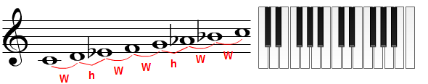
Position effect on notes .
The position of note determine in which octave and step depending on it’s previous clef.
We use Octave and step to determine the frequency for note .
Figure 8: Step in octave

Slide 14
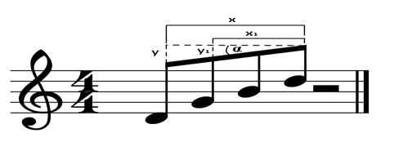
Note beaming
Note beam : connecting between notes in continuous form.
Note beaming must be done by specific standard, so we develop our own algorithm that allow applying this standard rules .
Figure 9: Beam Calculations

Slide 15
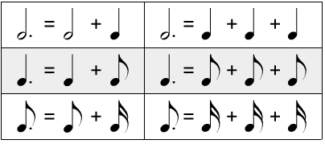
Specific Symbols
They are auxiliary symbols affect the note and they can’t added in individual way , but we add them to modify the note properties.
Specific symbols examples:
Dot
Figure 10: Specific Symbols

Slide 16
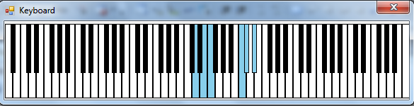
Virtual Keyboard
Similar to actual piano keyboard contains 88 buttons with special shape.
Each button has unique frequency.
Support multi event triggered .
Figure 10: Virtual Keyboard

Slide 17
Playing
All notes and rests on the digital music sheet played by Keyboard.
Converting Note to tone:
Every Note have special properties ,throw this properties we can determine the frequency and period of pressing.

Slide 18
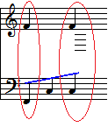

Playing
Our program provide playing more than one note at the same time.
In one part in digital music sheet contain two staff and these staff played at same time, or in same staff can play multi note at same time called chord .

Slide 19
Save and open
Able us saving all musical symbol in digital musical sheet and keep all format and properties for each symbol.

Slide 20


Slide 21


