Slide 1
GRADUATION PROJECT 2026
MindQuest
Intelligent LMS
AI-Powered Learning Management System
AI Integration
Full-Stack Platform
Cross-Platform
Supervisor: Sufyan Samara
2026-01-28
Students: Ahmad Dardouk & Sayed Qutob

Slide 2






Table of Contents
01
02
03
Introduction
System Architecture
Core Features Part 1
04
05
06
Core Features Part 2
Future Work
Acknowledgments
MindQuest LMS
Contents

Slide 3
2026
PROJECT OVERVIEW
MindQuest
P1
Static Content Delivery
Traditional LMS lack intelligent content generation and interactive learning elements.
Platform Type
Full-Stack
Intelligent LMS
P2
Limited Cross-Platform Experience
Students face fragmented learning experiences across web and mobile devices.
Key Features
P3
Inefficient Workflows
Multi-Platform Support
Complex course creation processes and poor teacher-student communication channels.
AI-Powered Content
P4
No Progress Tracking
Real-Time Communication
Lack of comprehensive analytics and real-time progress monitoring systems.
MindQuest LMS
01 Project Overview
PAGE 03

Slide 4
SYSTEM ARCHITECTURE
Technology Stack
System Components
Architecture Overview
Backend
Node.js + Express
MongoDB + MySQL
Socket.IO
•
Core
RESTful API
WebSocket
JWT Auth
Frontend
React 19 + Vite
Tailwind + DaisyUI
TipTap Editor
Data
Document Store
Relational DB
Stripe
•
Mobile
Features
React Native
Expo SDK + Router
iOS & Android
AI Integration
Notifications
Messaging
MindQuest LMS
02 System Architecture
PAGE 04

Slide 5
CORE FEATURES PART 1
User Management & Course Builder
Multi-Role User Management
Advanced Course Builder
Students
SUPPORTED CONTENT TYPES
• Course enrollment & tracking
• Progress analytics dashboard
• Cross-platform synchronization
Rich Text Editor
Image Embedding
Video Integration
Code Snippets
Teachers
• Course creation & management
• Admin approval workflow
• Student communication tools
Interactive Quizzes
Mini Games
Administrators
• System-wide management
• Teacher/course approval
• Platform oversight
AI-Powered Creation: Automated quiz generation via OpenAI GPT integration with manual review and editing capabilities.

Slide 6
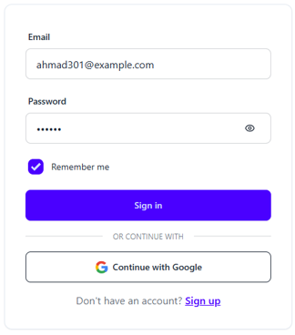
CORE FEATURES PART 1
Project Pages Overview (Authentication Pages)

Slide 7
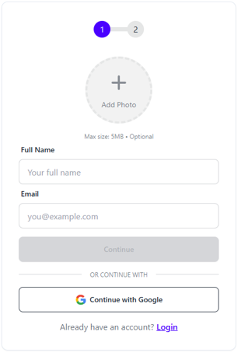
CORE FEATURES PART 1
Project Pages Overview (Authentication Pages)

Slide 8
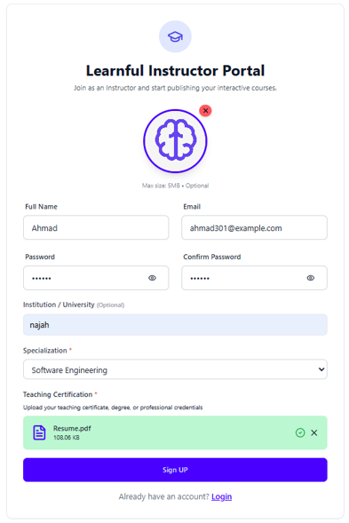
CORE FEATURES PART 1
Project Pages Overview (Authentication Pages)

Slide 9
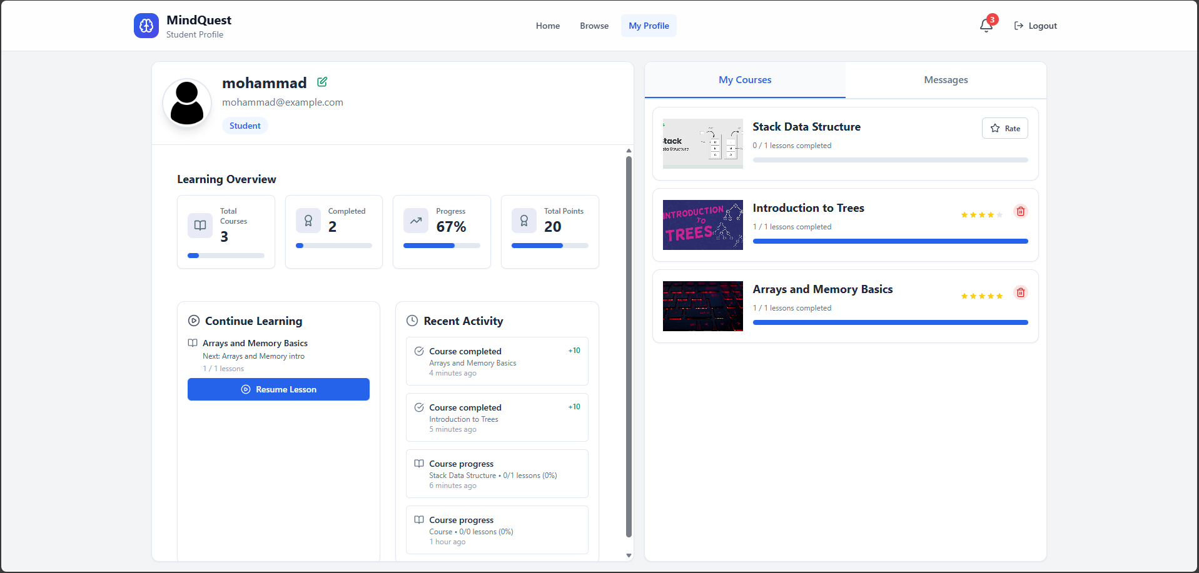
CORE FEATURES PART 1
Project Pages Overview (Dashboard)

Slide 10
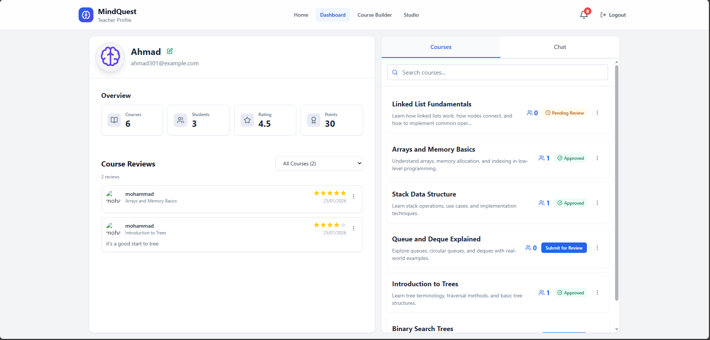
CORE FEATURES PART 1
Project Pages Overview (Dashboard)

Slide 11
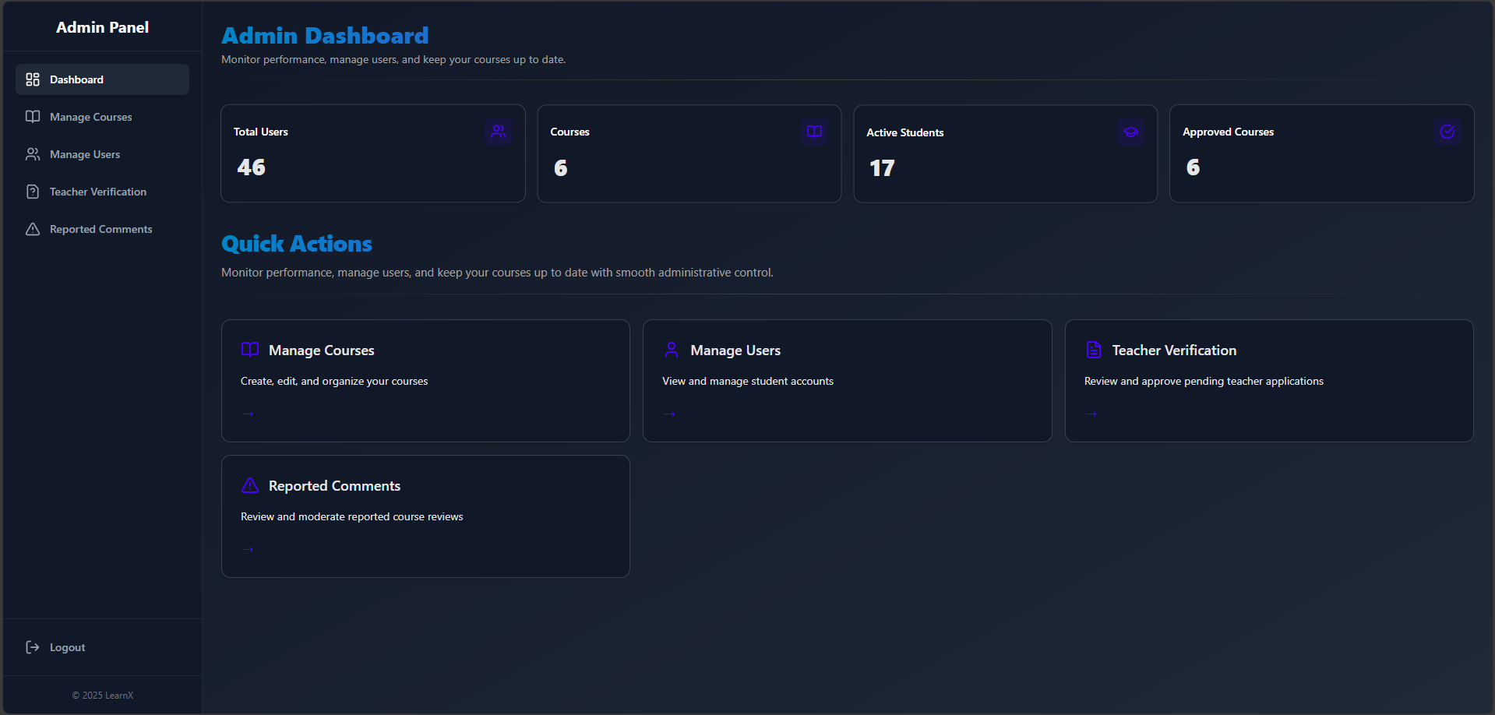
CORE FEATURES PART 1
Project Pages Overview (Dashboard)

Slide 12
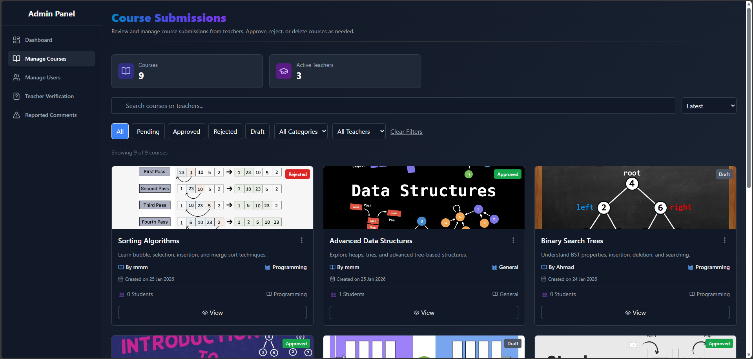
CORE FEATURES PART 1
Project Pages Overview (Dashboard)

Slide 13
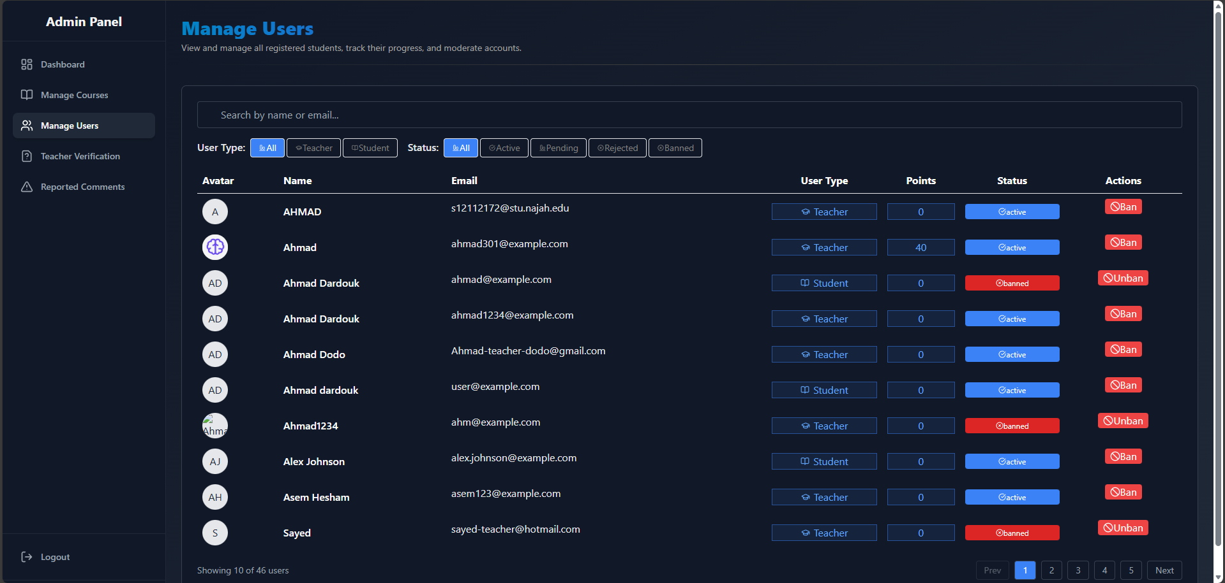
CORE FEATURES PART 1
Project Pages Overview (Dashboard)

Slide 14
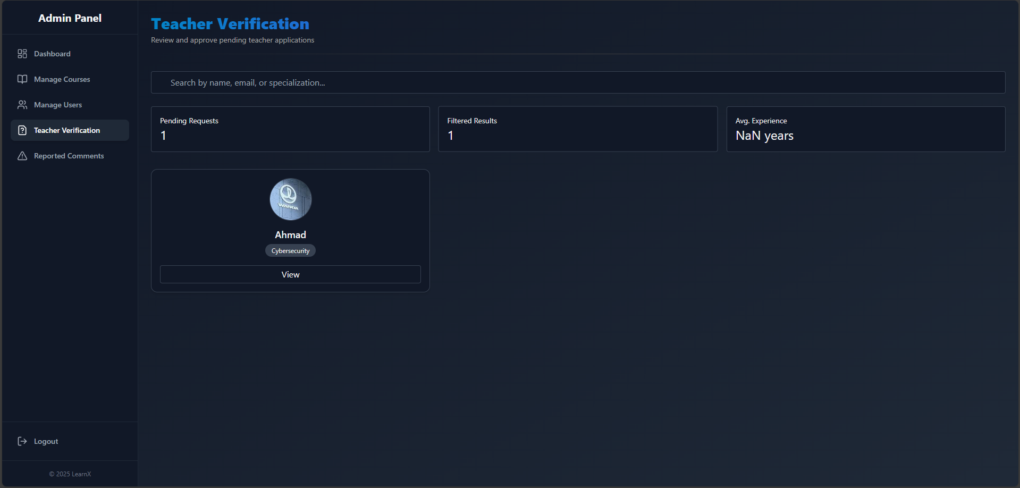
CORE FEATURES PART 1
Project Pages Overview (Dashboard)

Slide 15
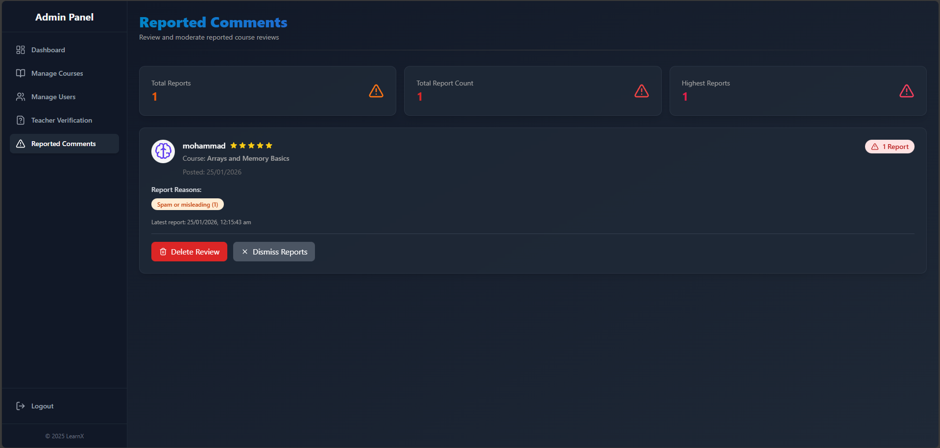
CORE FEATURES PART 1
Project Pages Overview (Dashboard)

Slide 16
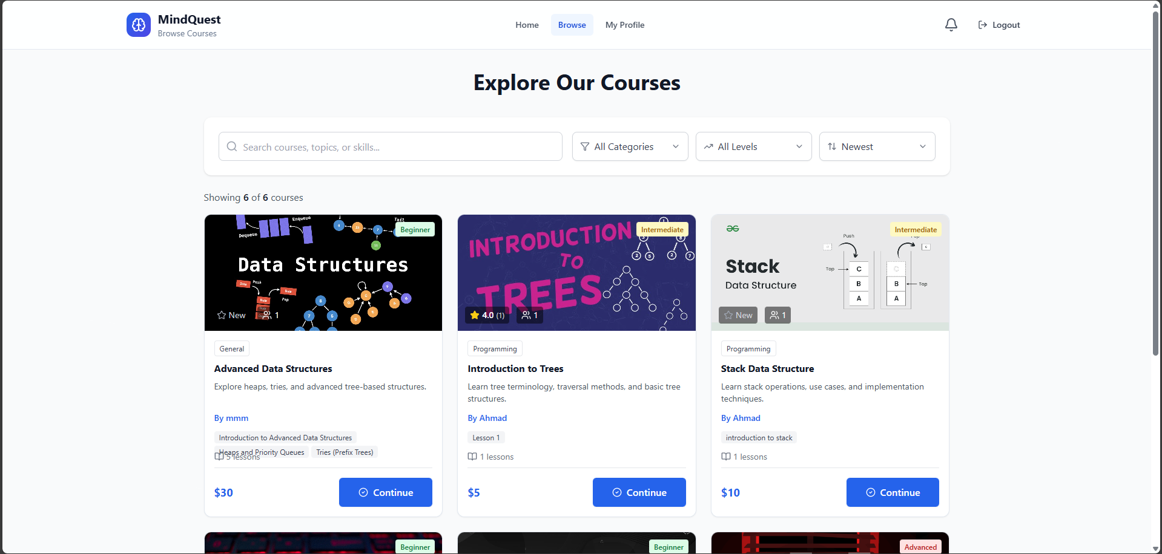
CORE FEATURES PART 1
Project Pages Overview (Course Explore Pages)

Slide 17
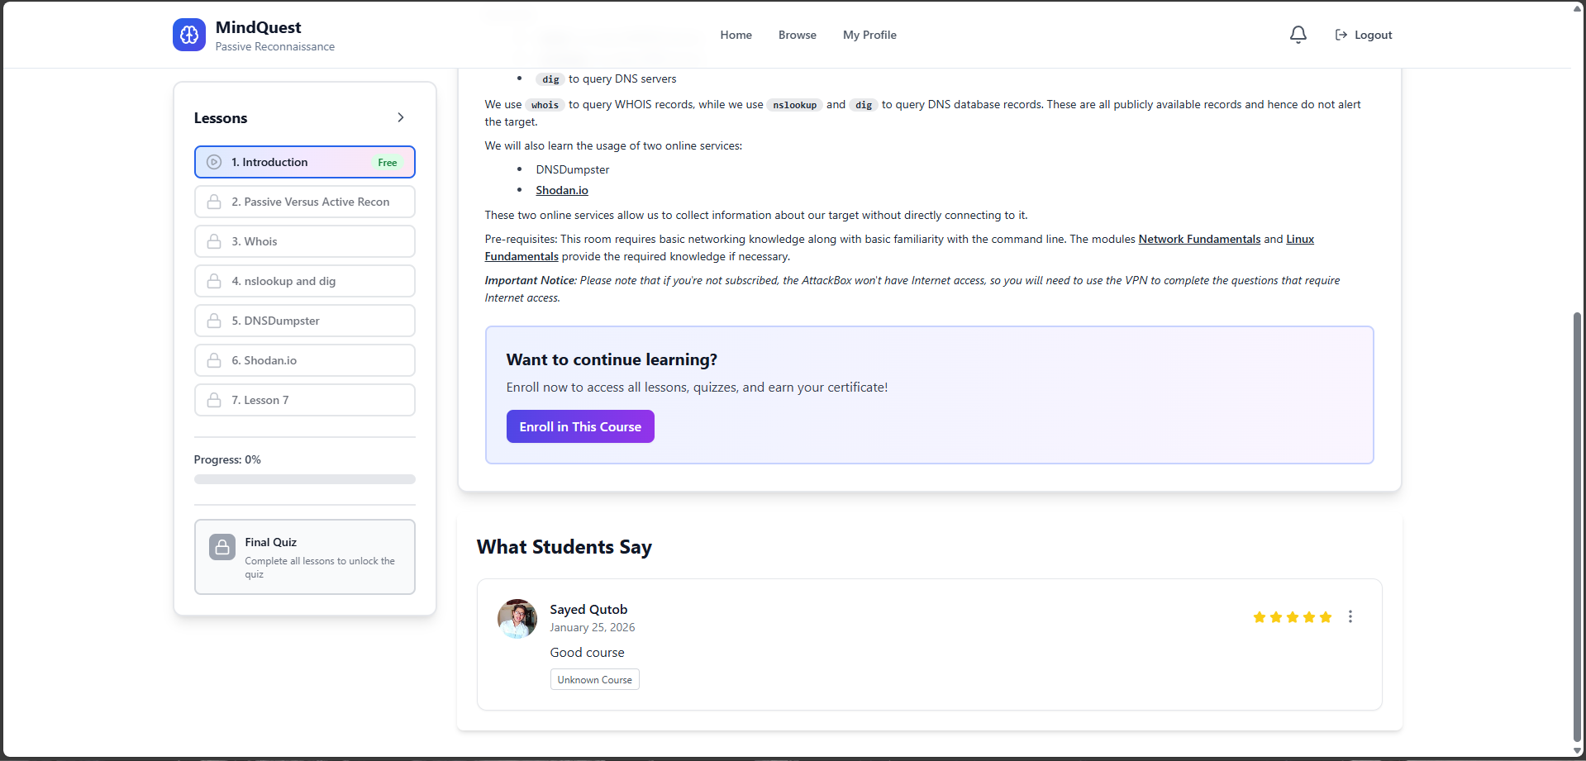
CORE FEATURES PART 1
Project Pages Overview (Course Enrollment)

Slide 18
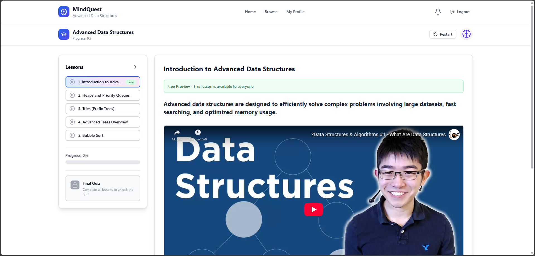
CORE FEATURES PART 1
Project Pages Overview (Course Progress)

Slide 19
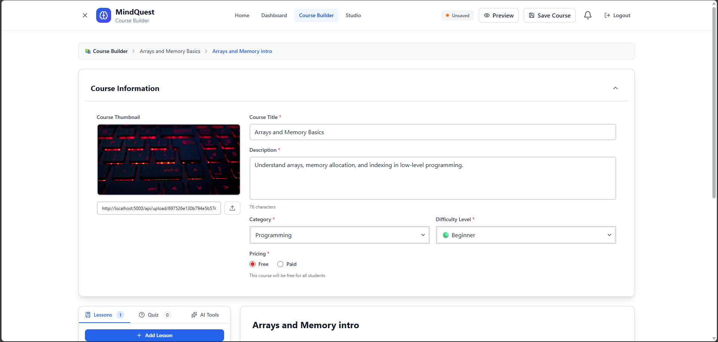
CORE FEATURES PART 1
Project Pages Overview (Course Creation)

Slide 20
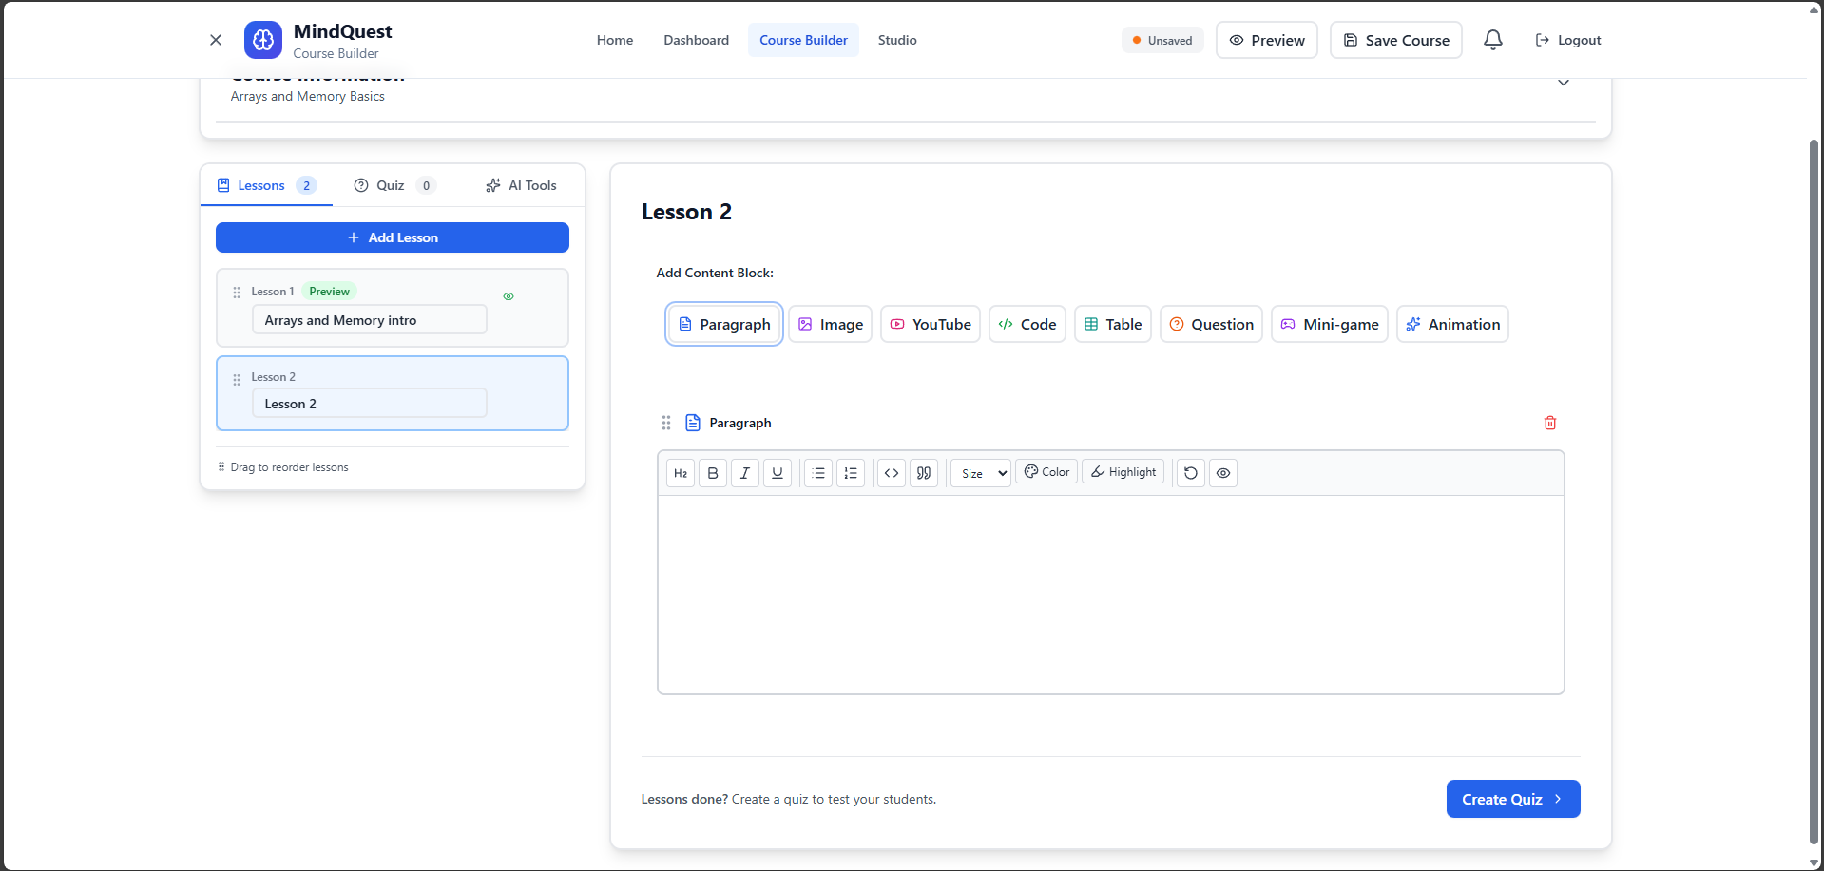
CORE FEATURES PART 1
Project Pages Overview (Course Creation)

Slide 21
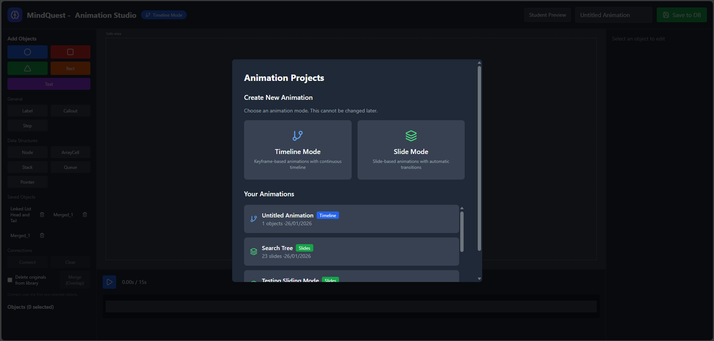
CORE FEATURES PART 1
Project Pages Overview (Animation Studio)

Slide 22
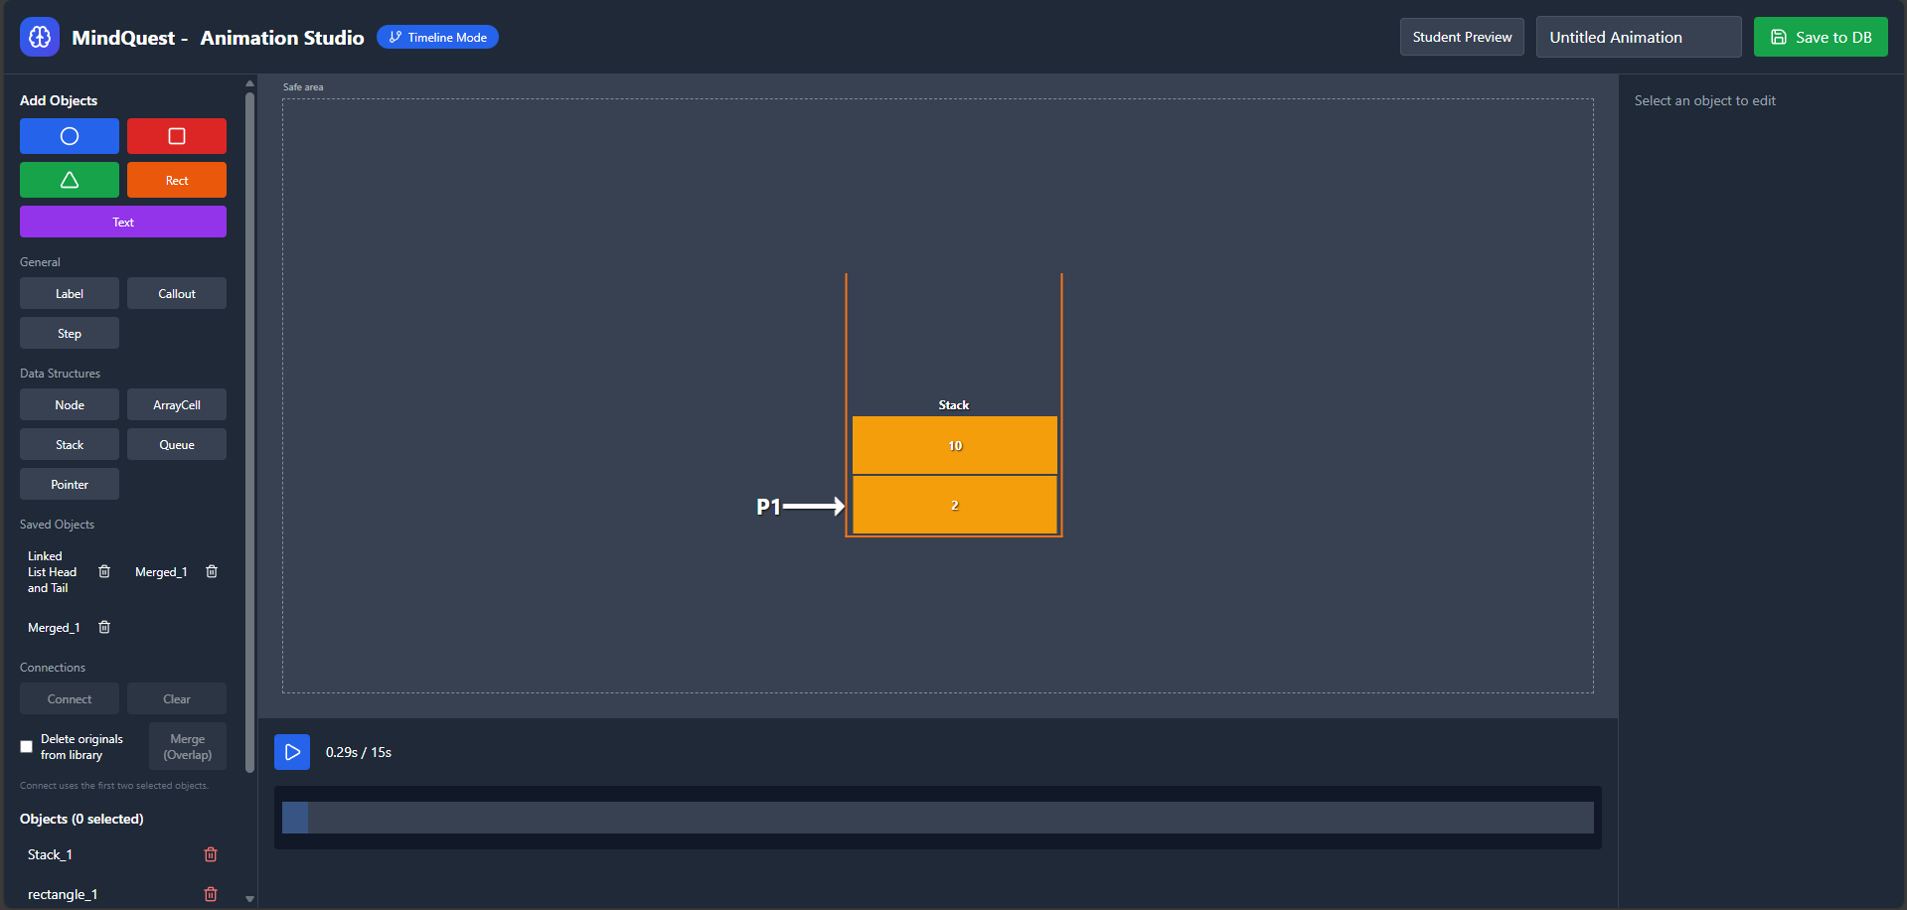
CORE FEATURES PART 1
Project Pages Overview (TimeLine Mode)

Slide 23
CORE FEATURES PART 1
Project Pages Overview (Animation Studio)

Slide 24
CORE FEATURES PART 2
AI Integration & Real-Time Systems
AI-Powered Quiz Generation
Real-Time Communication
CAPABILITIES
FEATURES
OpenAI GPT integration
Teacher-student messaging
Multiple question types
Real-time notifications
Topic-based automation
Socket.IO architecture
Fallback mechanisms for API failures
Message history persistence
Payment Integration
Progress Tracking
STRIPE IMPLEMENTATION
METRICS & ANALYTICS
Secure payment processing
Lesson completion tracking
Price configuration
Quiz score monitoring
Auto-enrollment on success
Cross-platform sync
Transaction tracking system
Visual dashboards for all users

Slide 25
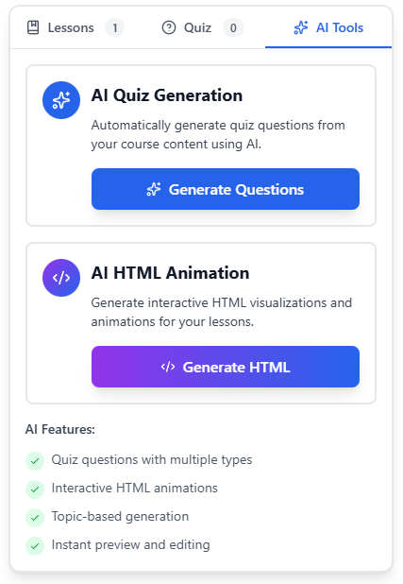
CORE FEATURES PART 2
Project Pages Overview (AI-Tools)

Slide 26
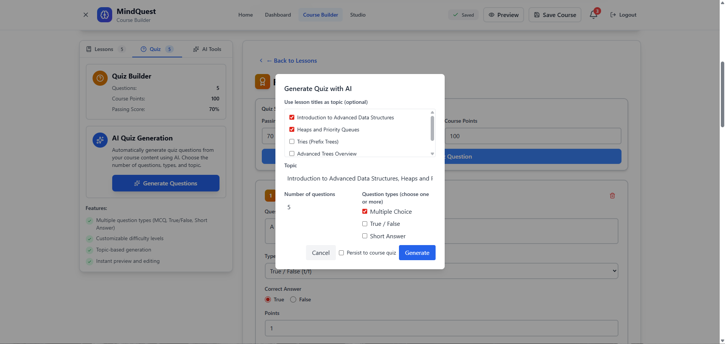
CORE FEATURES PART 2
Project Pages Overview (AI-Powered Quiz Generation)

Slide 27
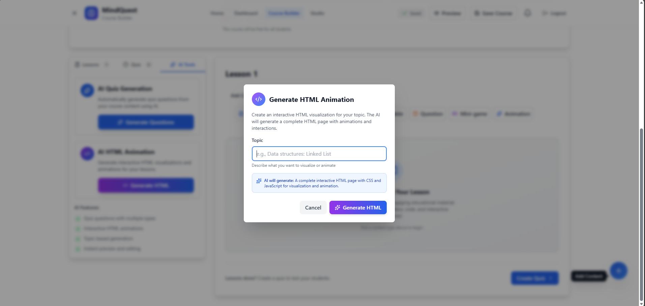
CORE FEATURES PART 2
Project Pages Overview (Topic-based automation)

Slide 28
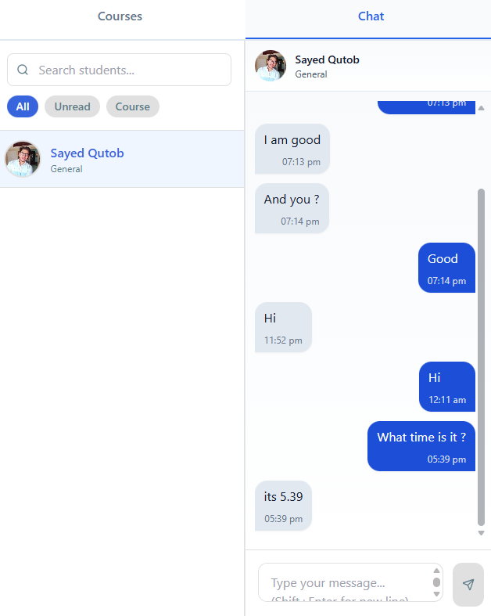
CORE FEATURES PART 2
Project Pages Overview (Real-Time Communication)

Slide 29
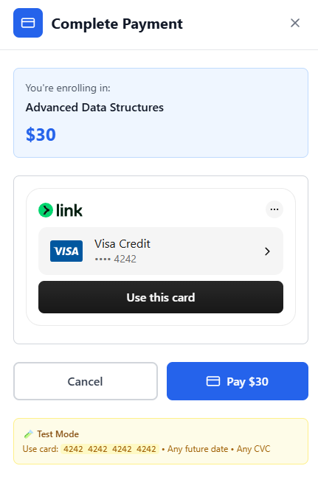
CORE FEATURES PART 2
Project Pages Overview (Payment Integration)

Slide 30
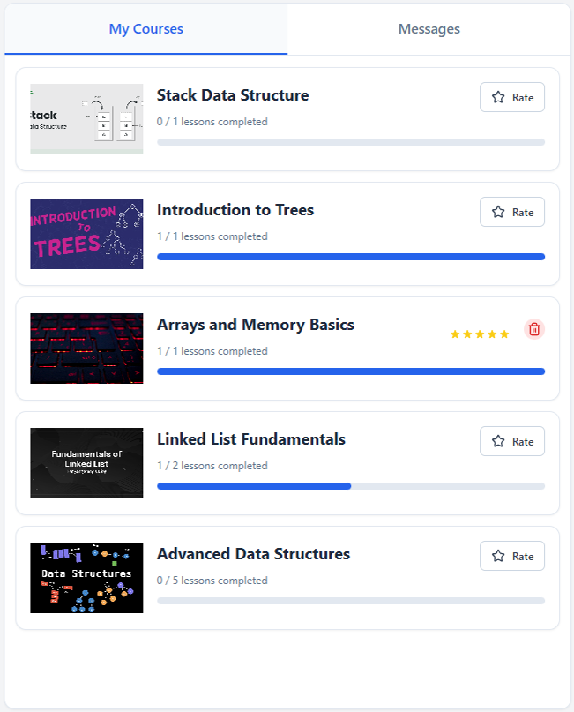
CORE FEATURES PART 2
Project Pages Overview (Progress Tracking)

Slide 31




FUTURE ROADMAP
Future Work
ML Recommendation
Advanced Analytics
Video Conferencing
Gamification
Predictive insights dashboard
Achievements & leaderboards
Personalized course discovery engine
Live classes integration

Slide 32
Acknowledgments
Thank You
MindQuest
Ahmad Dardook (ID: 12112172)
Sayed Qutob (ID: 12111977)
Under the supervision of: Dr. Sufyan Samara
Computer Engineering Department
An-Najah National University
June 2025-2026

