Slide 1


Slide 2
Little Hands overview
Table of contents
1
Project Overview
2
Technologies used
3
Features
4
Constraints
5
Future Work

Slide 3
Little Hands overview
The project:
Little hands is a digital platform for child care.
Designed to connect parents with trusted caregivers.
It offers access to essential services, whether at home, school, or online.

Slide 4

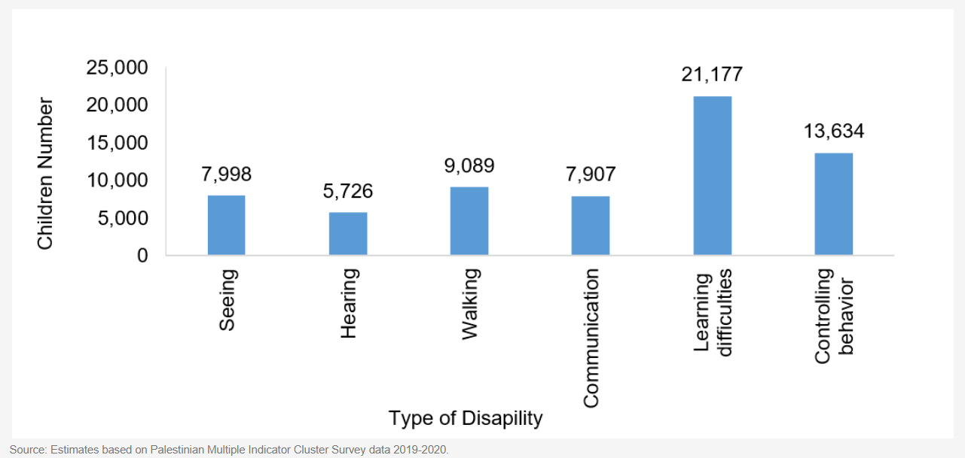
Why Little Hands ?
According to the Palestinian Central Bureau of Statistics (PCBS) :
About 12% of children in Palestine (1 from 8 child) have one or more functional difficulties or disabilities.
321 licensed nurseries for approximately 718,923 children under age 4.
70% of Palestinian children under the age of 4 do not receive good childcare.
This highlights a critical need for more trained helpers so that children with challenges aren’t left out of class or play

Slide 5








Software Technologies used
Flutter
Node JS
MongoDB
Firebase
Postman
React
Stripe
Gemini api

Slide 6
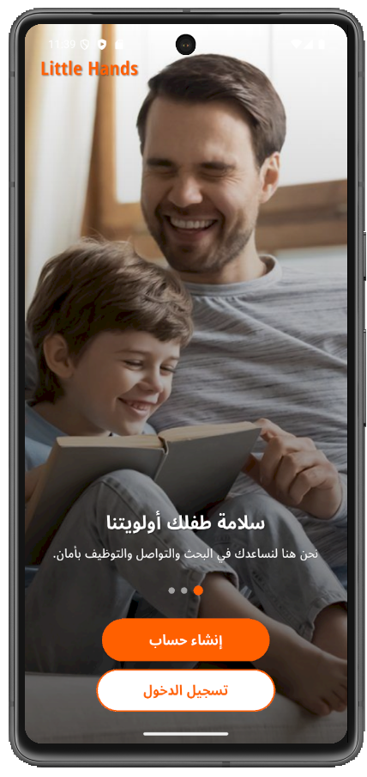
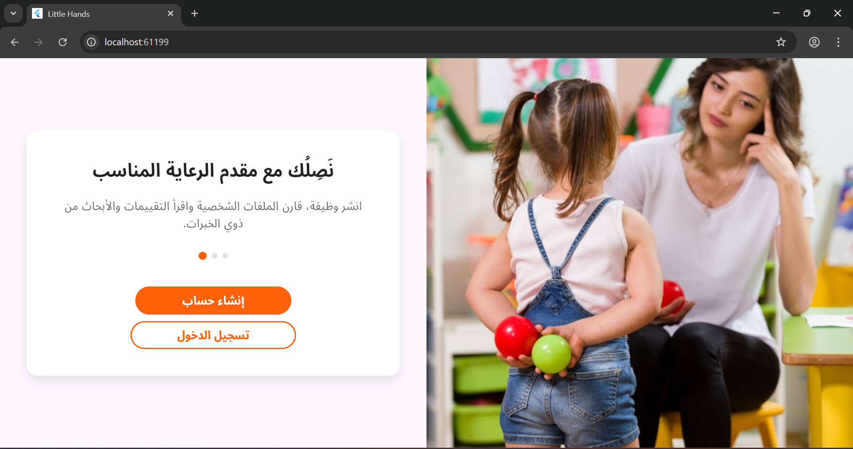
Features

Slide 7
Account creation for users and service providers.
Personal Data Collection.
Identity Verification.
Subscription.
Profile settings.
Settings of the sessions.
Account creation &
login

Slide 8
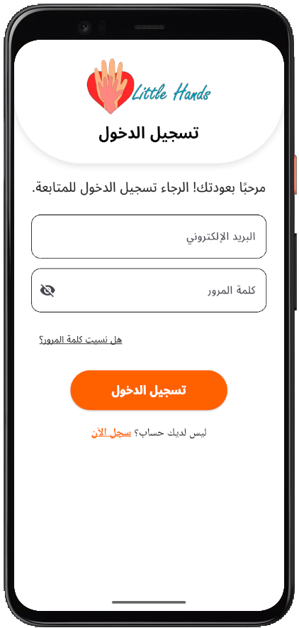
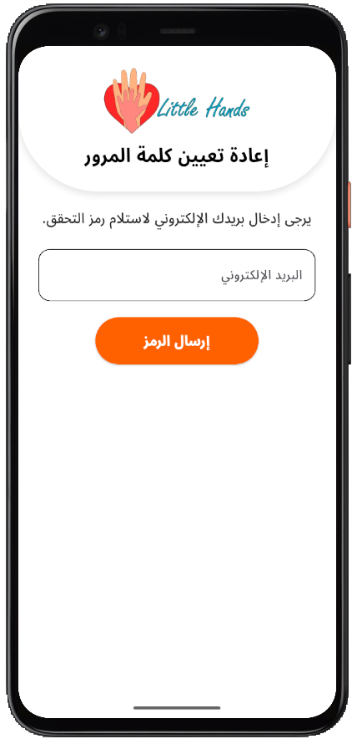
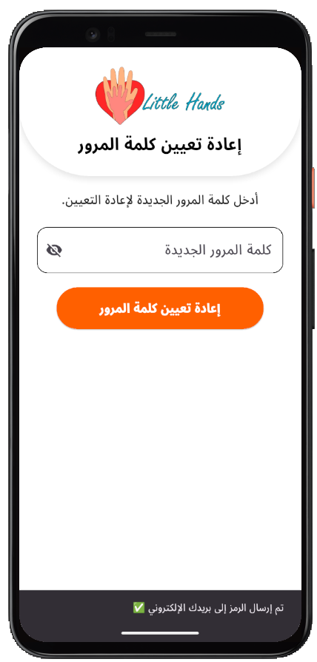
Log In &Password recovery
Login
Request password reset
Password recovery

Slide 9
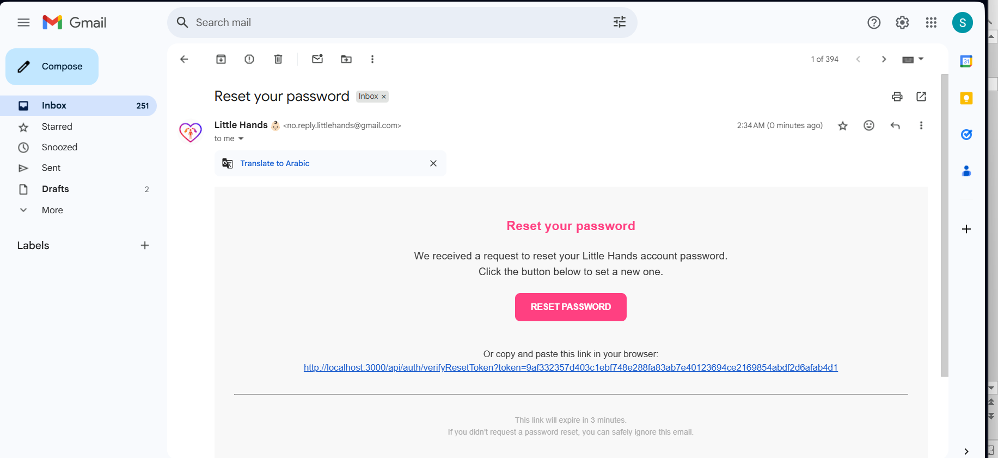
Password reset email
Request a password reset email

Slide 10
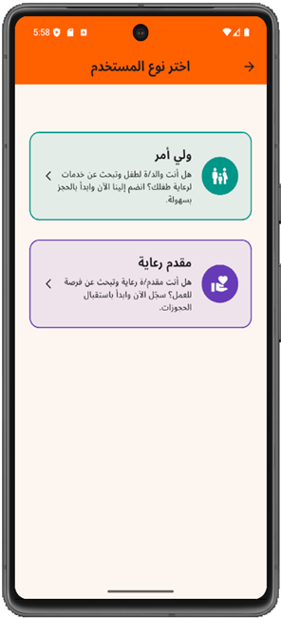
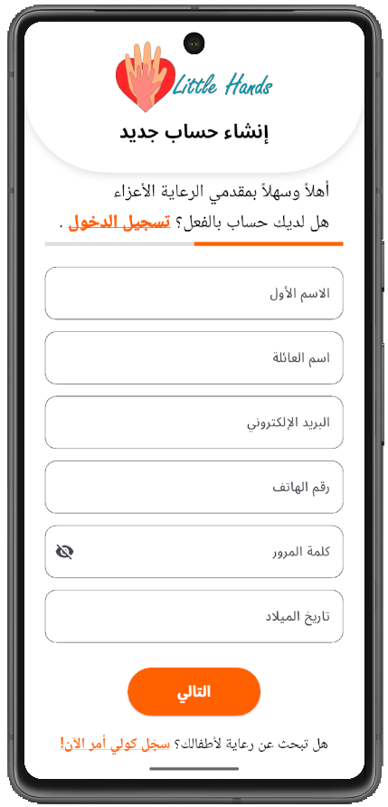
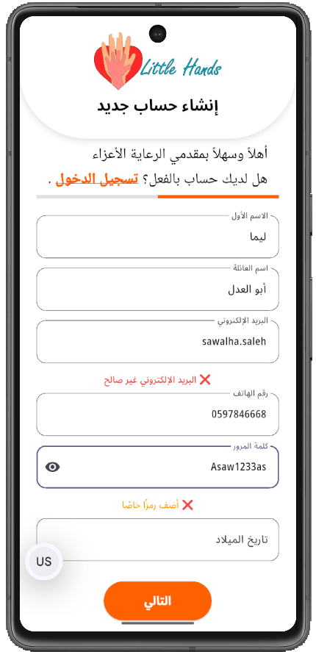
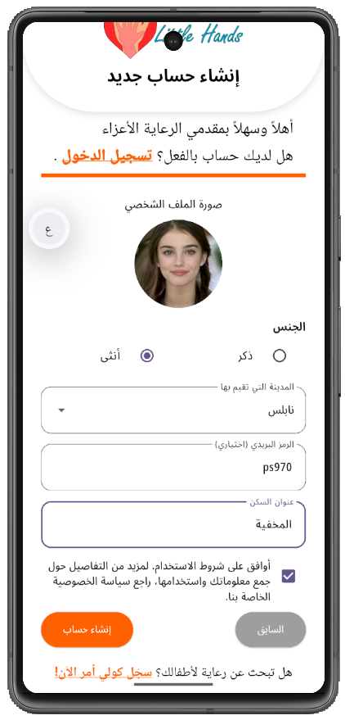
Sign up - as a caregiver
Caregivers account creation and information registration.

Slide 11
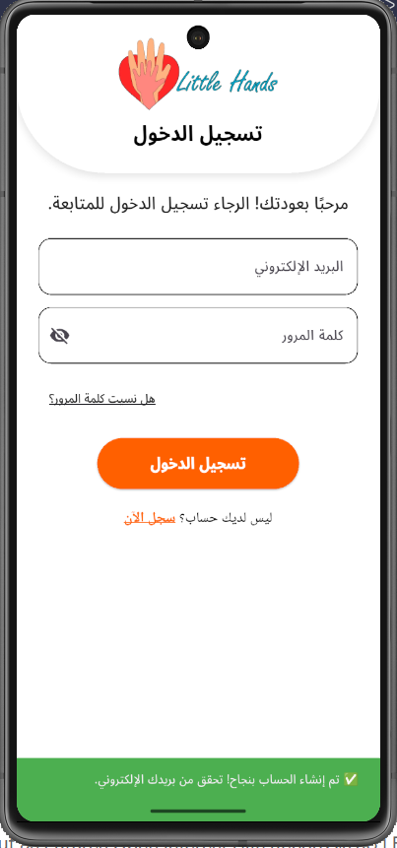
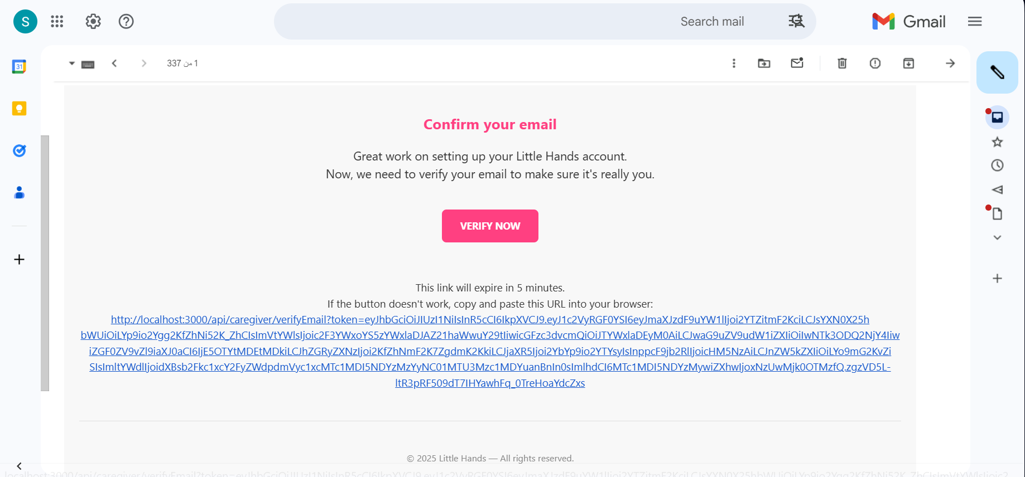
Sign up as a caregiver
Account registration confirmation
Caregiver account login

Slide 12
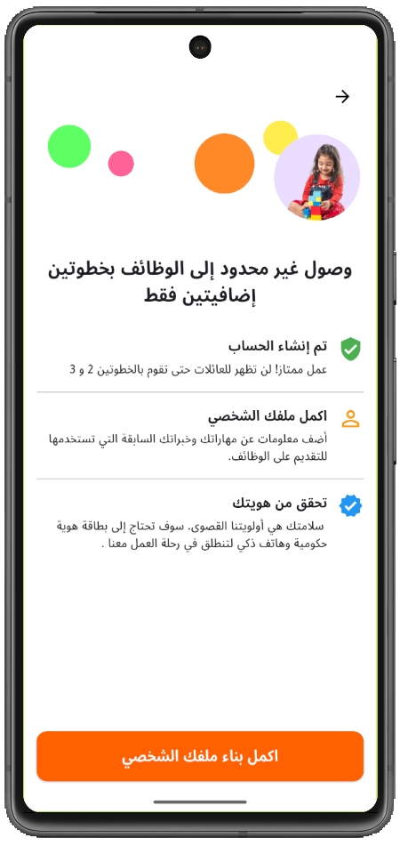
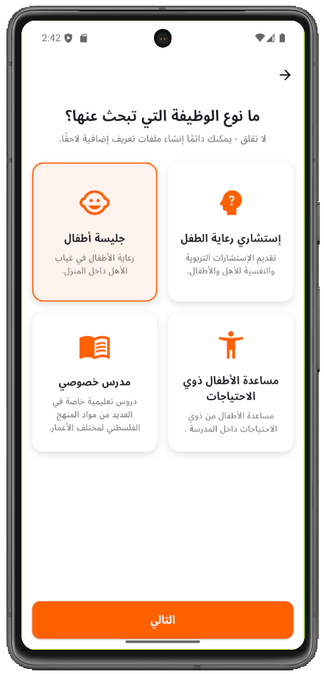
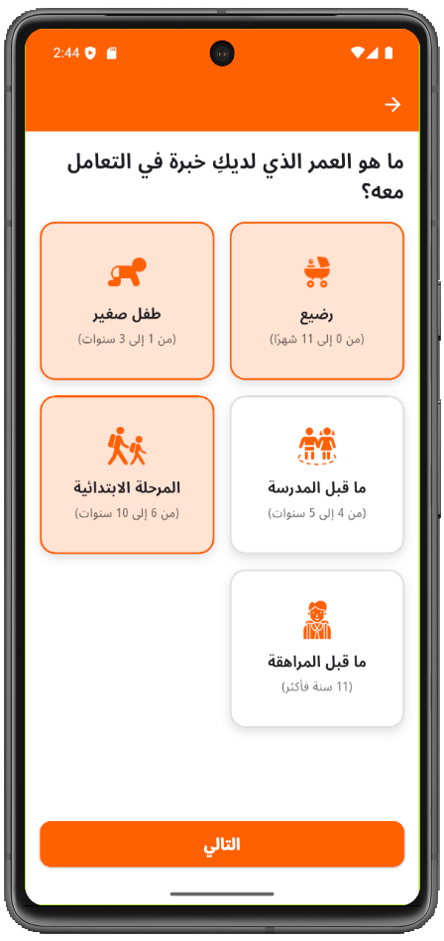
Caregiver profile setup

Slide 13
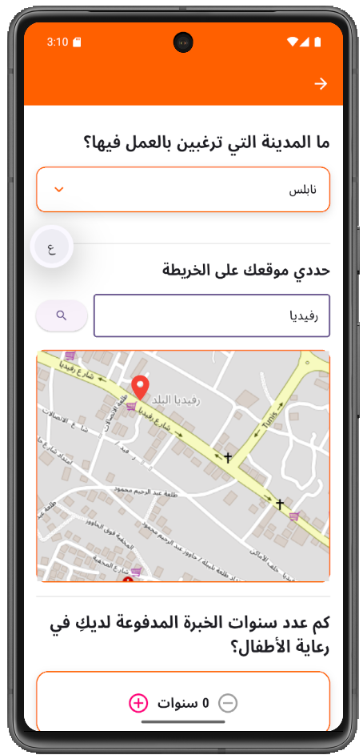
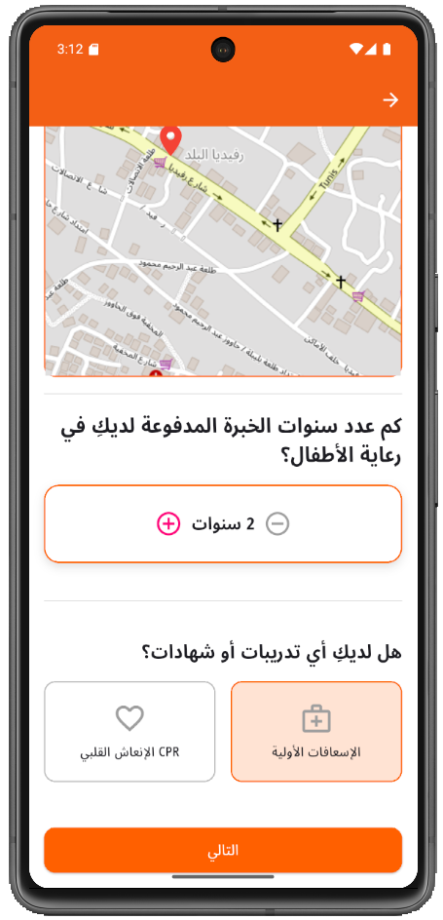
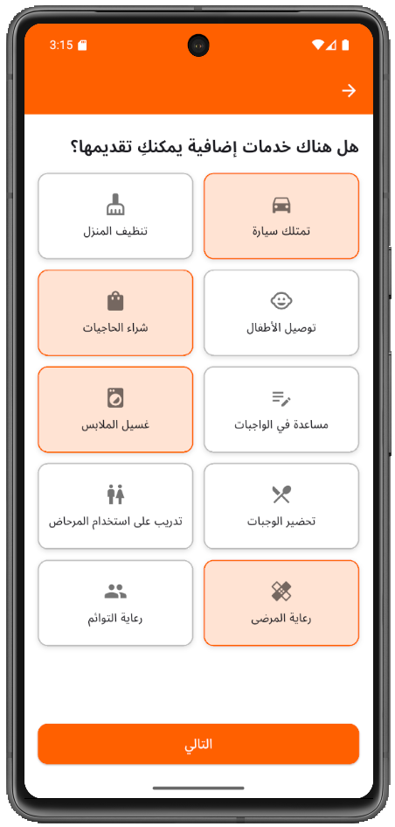
Profile Details – Babysitter

Slide 14
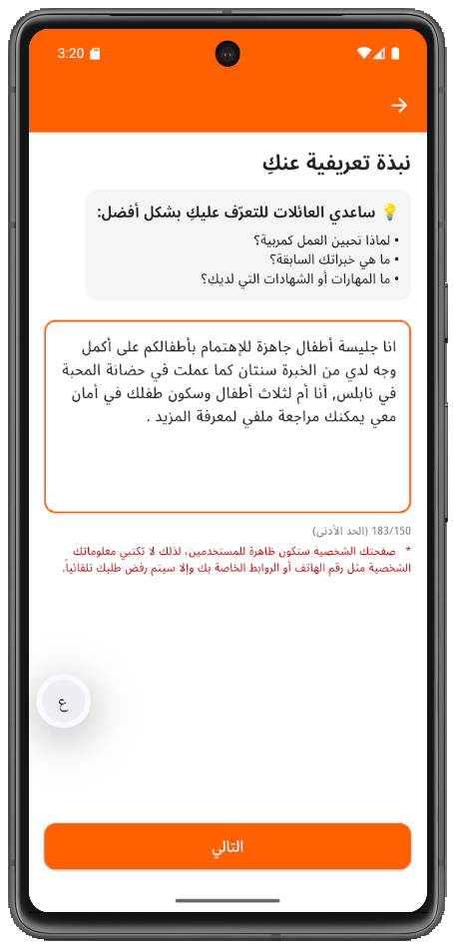
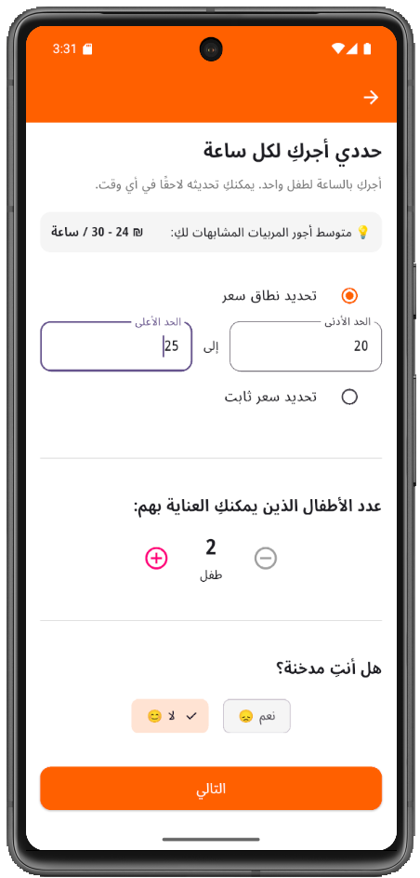
Profile Details – Babysitter

Slide 15
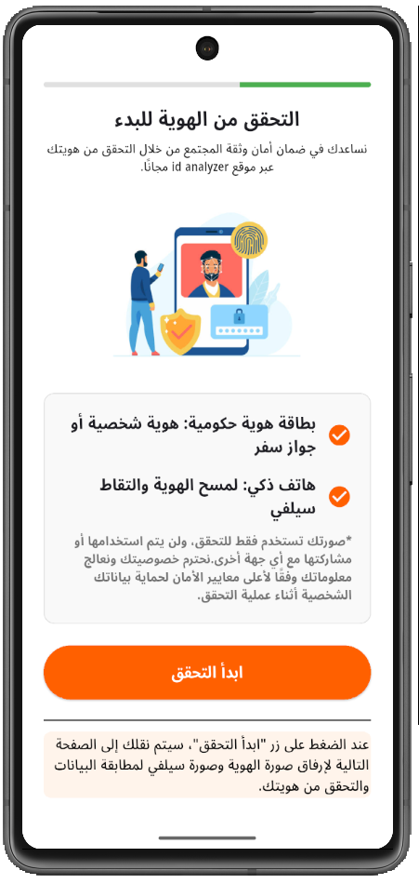
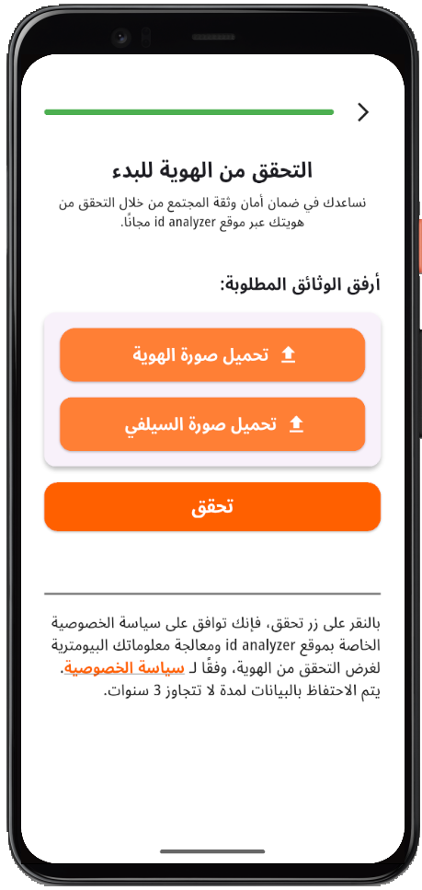
ID Verification with ID Analyzer

Slide 16
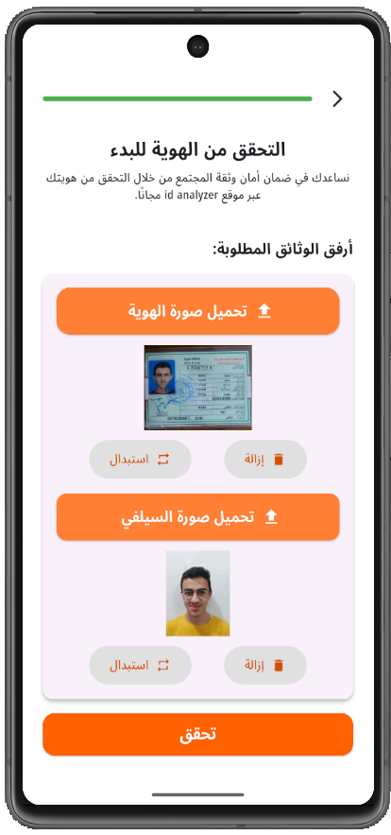
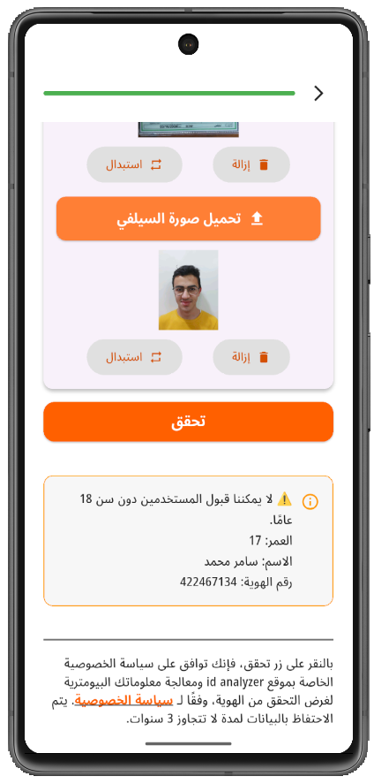
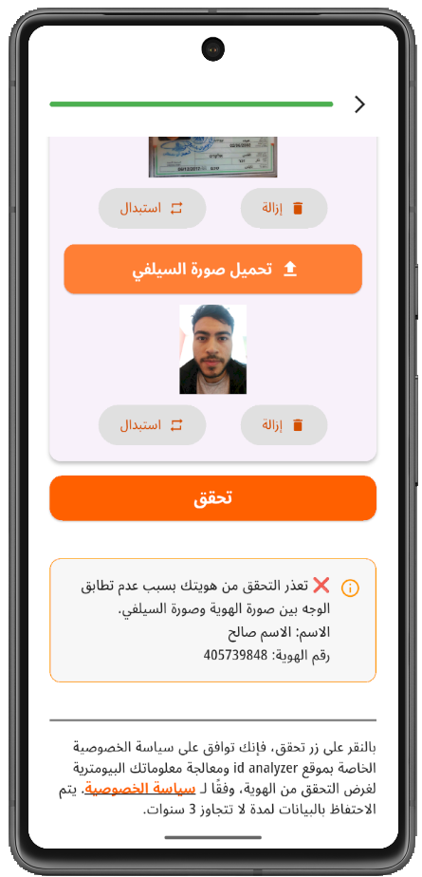
ID Verification with ID Analyzer

Slide 17
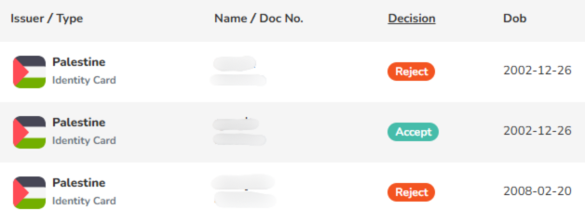
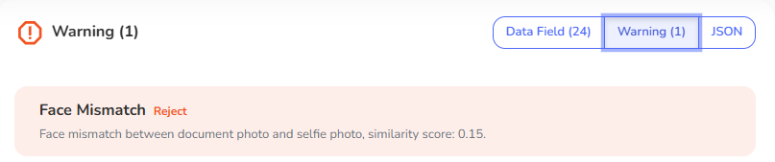
ID Analyzer

Slide 18
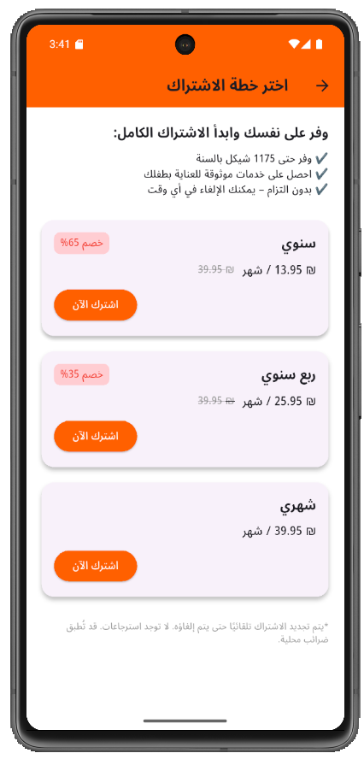
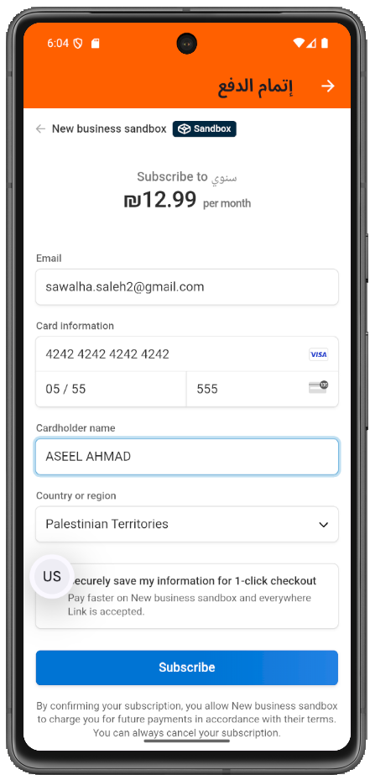
Subscription :

Slide 19
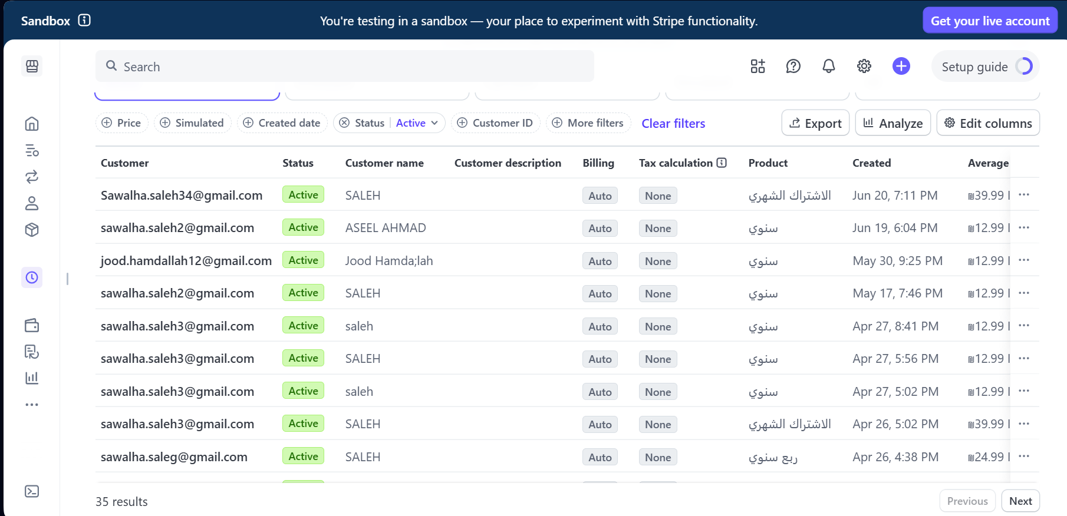
Stripe subscriptions :

Slide 20
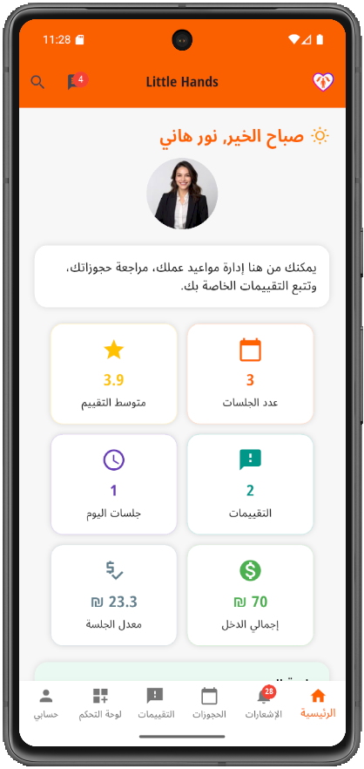
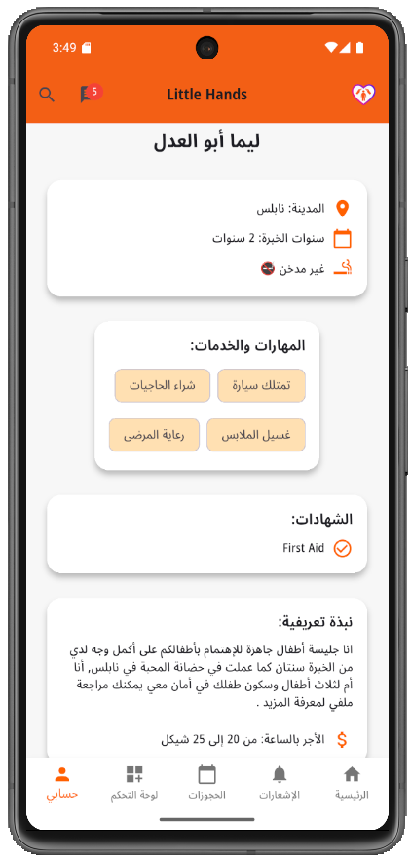
Profile Information

Slide 21
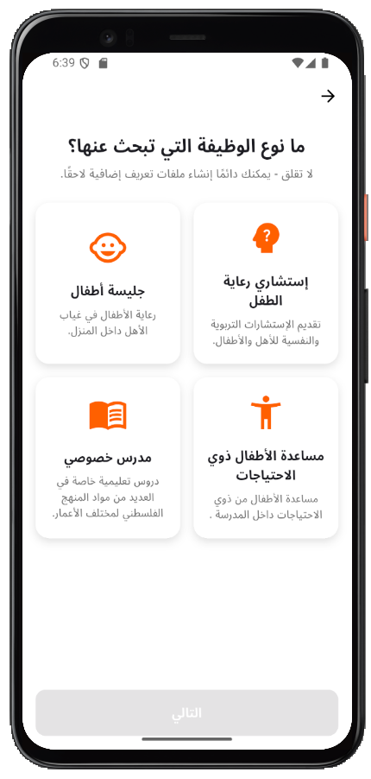
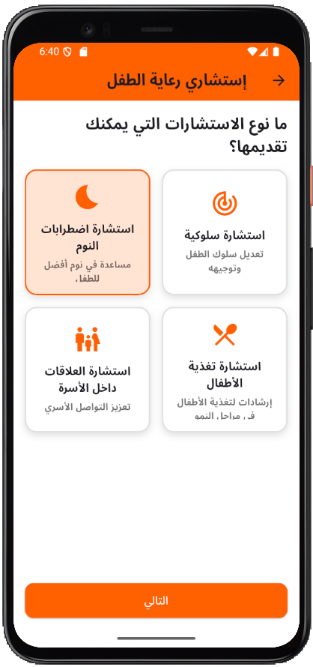
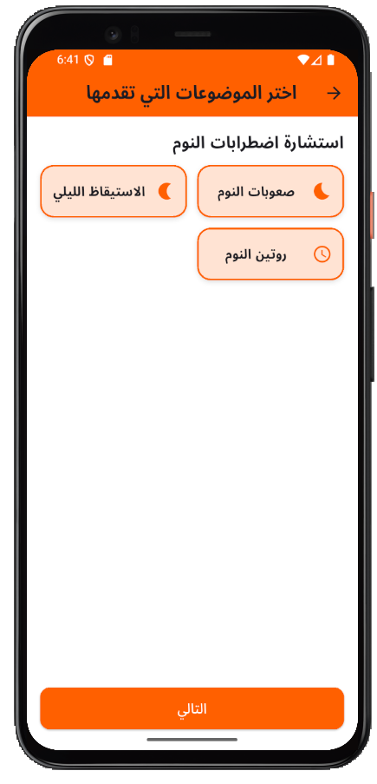
Profile Details – Expert

Slide 22
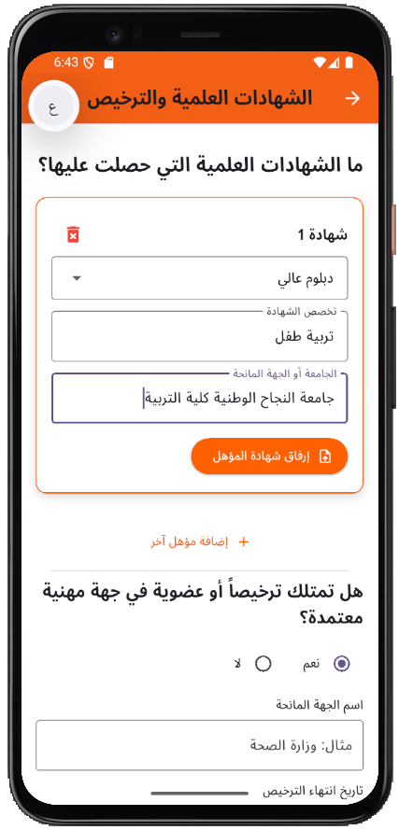
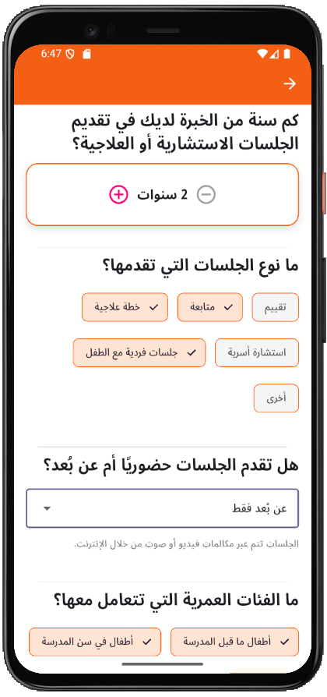
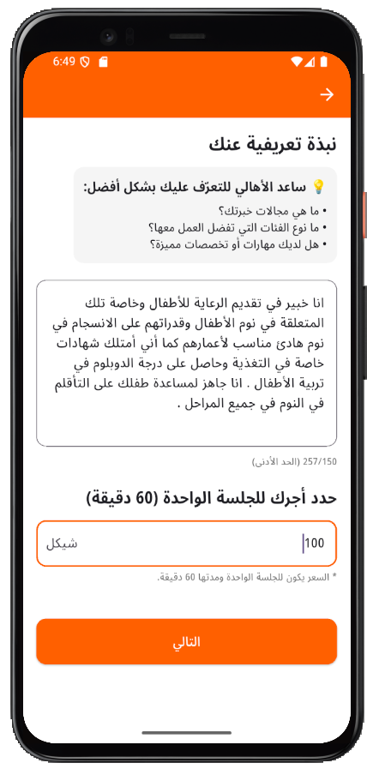
Profile Details – Expert

Slide 23
Sessions Management settings
Session availability features includes: working hours, dates.
Meeting invitation (optional after booking).

Slide 24
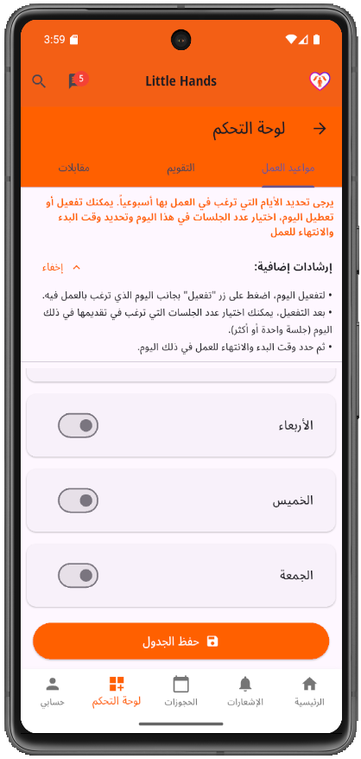
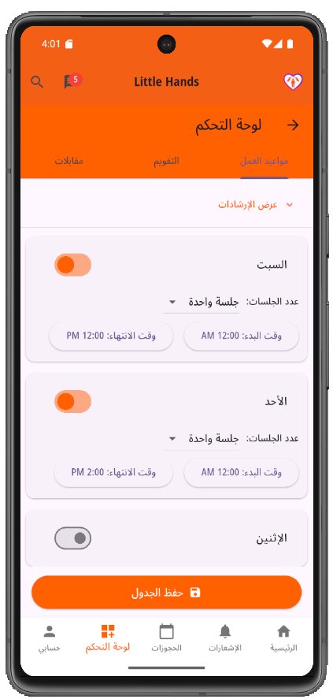
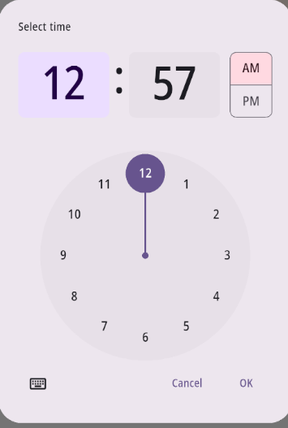
Session availability: Working hours

Slide 25
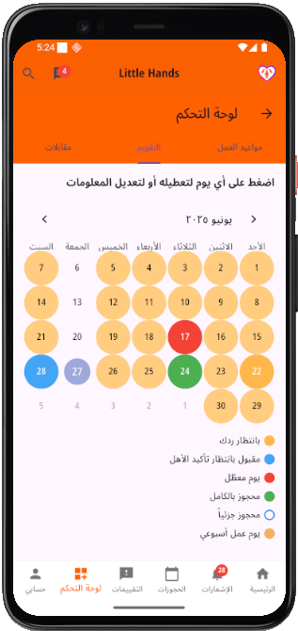
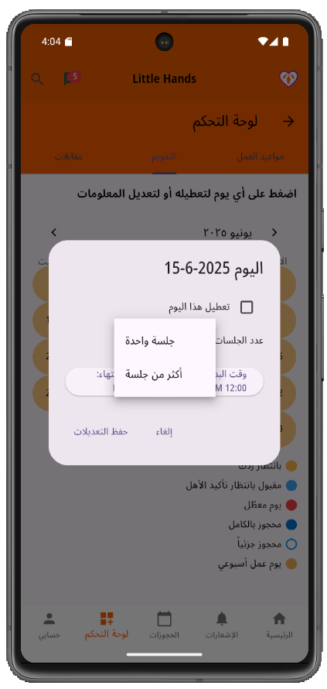
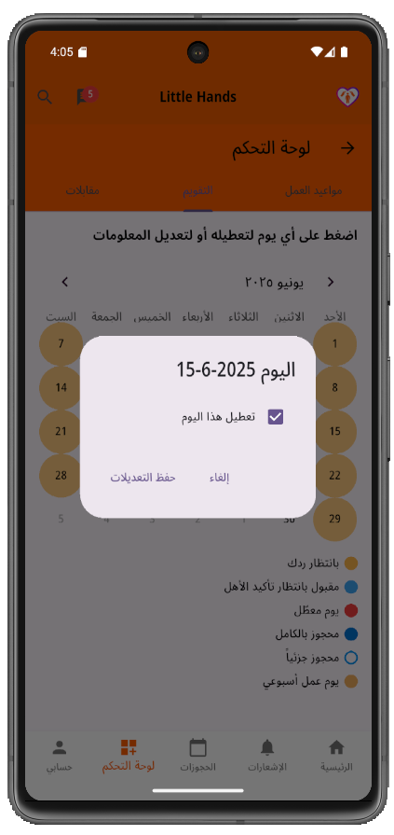
Calendar View: customizing availability dates

Slide 26
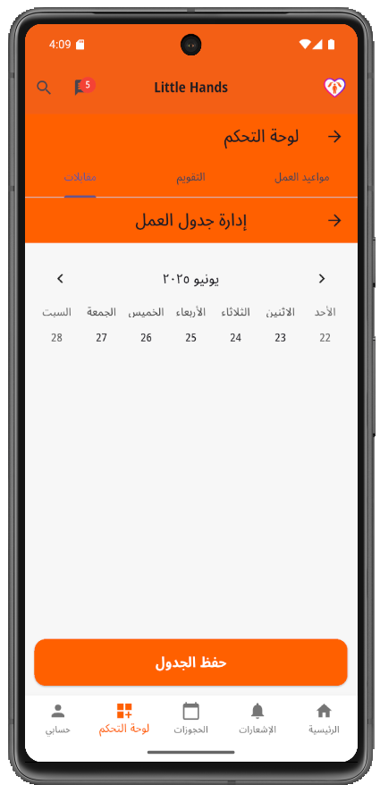
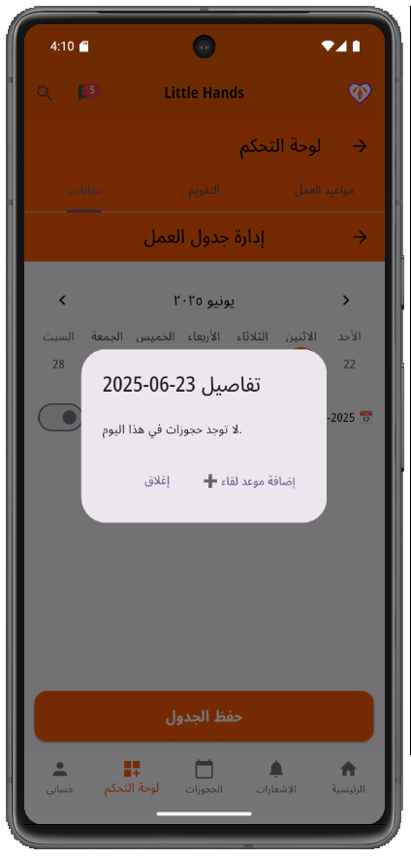
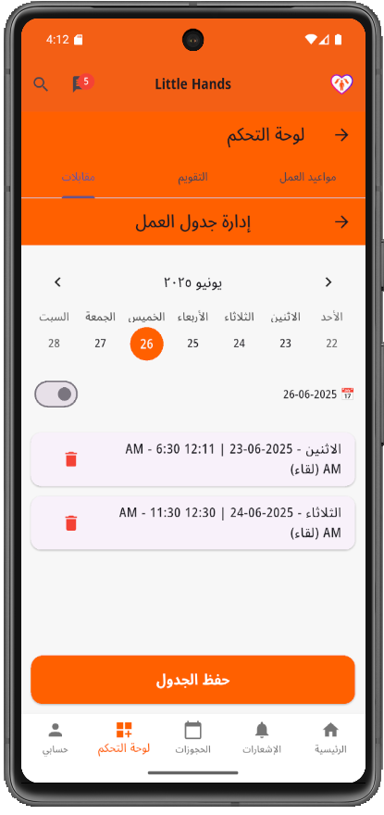
Meeting Availability: add dates

Slide 27
Service search interface.
Exploring available potential services & service providers.
Personal Data Collection.
Matching with a caregiver.
Session booking.
Meeting booking and invitation.
Proceeding to payment.
Official confirmation!
Parents interface

Slide 28
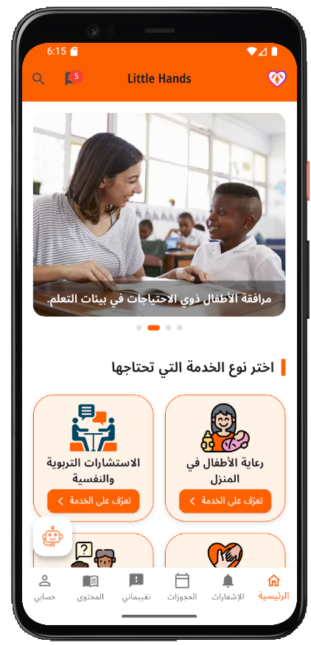
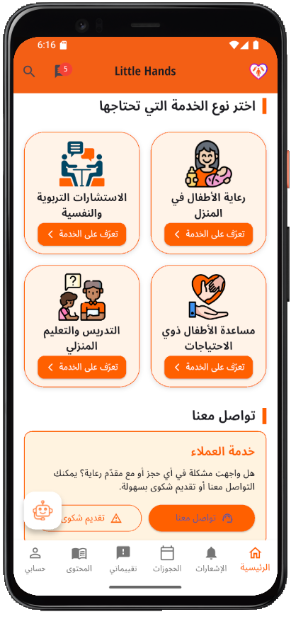

Parents search interface

Slide 29




Available services & caregivers

Slide 30




Parent’s Data collection

Slide 31



Matching with potential caregiver

Slide 32



Booking a session

Slide 33


Booking & Notifications
P
C

Slide 34



Booking status: pending
Parent
P
Caregiver

Slide 35



Booking status: accepted
P
P
C

Slide 36




Booking status: meeting booked

Slide 37


Meeting invitation email
P
C

Slide 38

Zoom meeting

Slide 39




Payment details

Slide 40


Booking confirmation

Slide 41
Booking cancellation.
Searching for an alternative caregiver.
Rating of service – after cancellation.
Rating of service – after successful completion.
Bookings quick access.
After confirmation and booking

Slide 42



Booking cancellation
C
C
P

Slide 43



Booking cancellation
P
P
C

Slide 44


Finding an alternative caregiver

Slide 45



Post-service completion rating

Slide 46



Filtering and easy access

Slide 47




Consultations from experts

Slide 48




Helping special needs people

Slide 49
Consultations.
Educational content.
Chatbot helper.
Experts services

Slide 50



Educational content : cards by AI

Slide 51



AI Chat-bot

Slide 52
Bookings.
Users.
Experts posts.
Admin Dashboard

Slide 53

Admin Dashboard

Slide 54

Admin Dashboard

Slide 55

Admin Dashboard

Slide 56

Admin Dashboard

Slide 57

Admin Dashboard

Slide 58

Admin Dashboard

Slide 59
Constraints
Critical Nature of the Service.
Lack of Local References.
Booking Logic Complexity

Slide 60
Future Work
Security and Trust Measures improvement
Automated Matching and Suggestions.
Expand Childcare Services

Slide 61
Thanks!
Do you have any questions?
no.reply.littlehands@gmail.com
LittleHands.com

