Slide 1
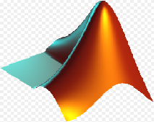

Automatic Class Attendance System Based On Face Detection And Recognition
Submitted by:
Ala Berawi
Sujod Makhlof
Samah Hanani
Supervisor:
Dr.Naser Abu-Zaid

Slide 2
Outline :
Introduction to our project
Algorithm ( flow chart )
Functional Block Diagram
Result
On Going Work ( Second Project Work)
Conclusion

Slide 3
Introduction :
Traditionally attendance is marked manually by teachers and they must make sure correct attendance is marked for respective student.
This whole process waste a lot of time of lecture duration and due to large strength of students fraudulent and proxy cases are not intercepted.

Slide 4
In order to determine classroom attendance, face detection and face recognition are performed. Face detection is used to determine the location of the faces in the classroom image and extract sub images for each face. Then, in face recognition, the face images detected will be compared with the data base consists of images of students in the class and attendance will be recorded accordingly.

Slide 5
Significance:
1-Automated
2- Economically
3-Effective remainder
4- Keep extra time

Slide 6
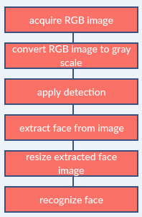
Image processing:

Slide 7
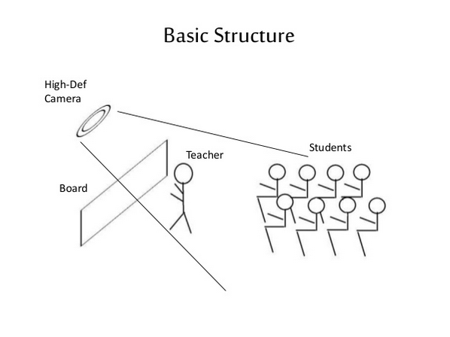

Slide 8
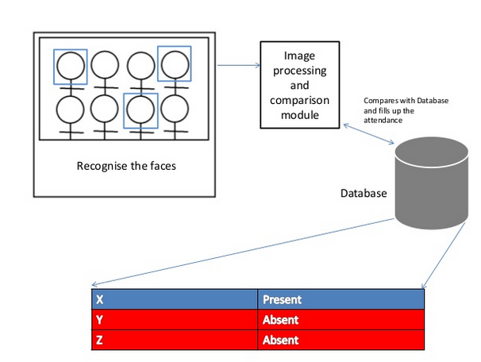

Slide 9
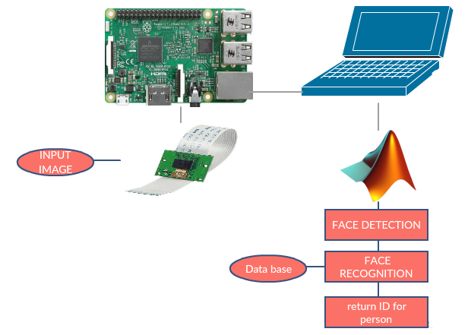
Functional Block Diagram:
The whole system should consist of:

Slide 10
Face detection:
Face detection is a computer technology being used in a variety of applications that identifies human faces in digital images.So, the face detection is used to determine the location of the faces in the classroom image and extract sub images for each face.
A Viola Jones algorithm will be implemented to learn face and non-face patterns and will be able to identify the locations of the faces in the image.

Slide 11
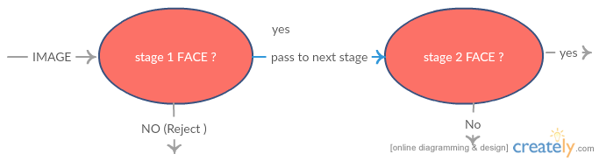

Slide 12
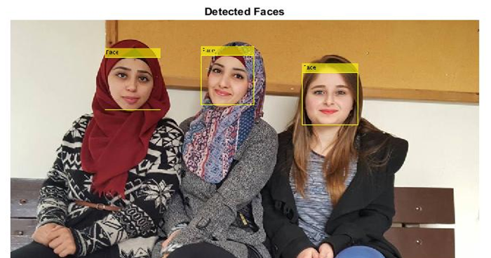
Example for detect face :

Slide 13
How do we create data base?
Database is the collection of face images and extracted features at the time of enrollment process, and the database includes names of students & register number for each student.
We created data base for 11 person we took 10 images per person by using a camera for raspberry pi B+, these images were taken at different times and with variations in lighting, facial expressions, and facial details.

Slide 14
Eigenfaces for recognition face:
1-Create a training set.
3-Normalized the images
2-Concatenate columned images into one matrix.

Slide 15
5-Calculate the covariance matrix.
6- Calculate the eigenvalue.
7- Calculate weights for all images.

Slide 16
8- Given an unknown face image.
9- Normalize the input image.
10- Calculate weights for input image
11- Calculate the distance.

Slide 17
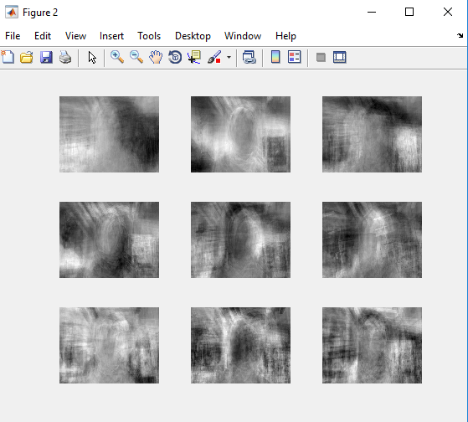
Top 9 Eigenfaces from our Images
By using a matlab code, it used Eigenfaces method to recognized the faces. We entered the data base for 11 person, we got this results

Slide 18
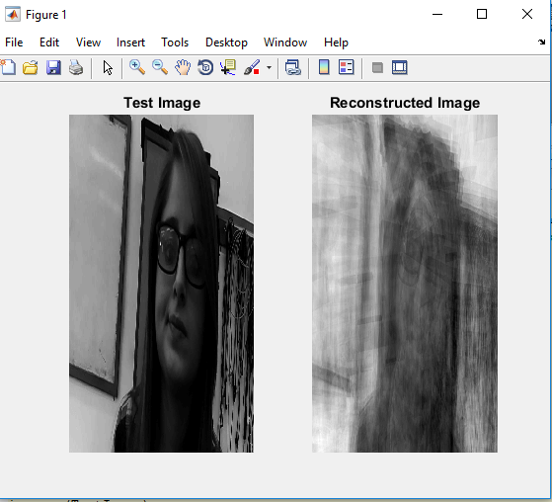
Reconstructed Image from our Images
We input a new image for the person in class 1 we got this result:

Slide 19
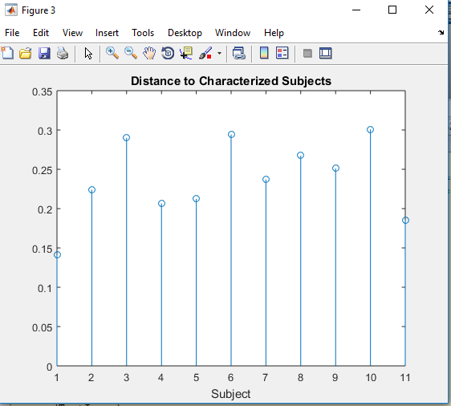
Distance to Characterized Subject for our Images:

Slide 20
The problems that we faced:
In our project we have faced many of problems and we have overcome some of them,
1-Download Matlab on Rasbppery Pi.
2-Raspberry camera.

Slide 21
Conclusion:
several methods for face detection and recognition. We decided to implement in our project , Viola-Jones algorithm to detect the face and Eigen faces to recognize it.so we focus in viola algorithms to minimizes computation time while achieving high detection accuracy and Eigenface to recognition the face in various expressions and to decreased number of images that stored in data base.

Slide 22
On Going Work ( Second Project Work):
In this project we have been able to detect the faces from the images and recognize it to identify the persons in each image by using data base. In the second graduation project we are going to send the list of attendance automatically to server, also we will connect wirelessly instead of wire between Raspberry and Laptop.
Also we will work on detecting motion and tracking heads for persons in videos, which means that we will apply our project in video instead of images

Slide 23


