Slide 1

Graduation Project 1
Package4U
Students : Supervisor:
1-Abdallah Adas Dr. Manar Qamhieh
2-Mohammad Zaied

Slide 2
Presentation Content:
Motivation and Importance.
Software APIs.
Presenting Package4U Application:
    a. Login & Registration b. Customer
    c. Employee d. Driver
    e. Manager f. Admin
Future Work.

Slide 3

Motivation and Importance
Delivery apps facilitate commerce, provide convenience, and simplify the process of sending and receiving packages. It is an efficient and convenient way for users to track their shipments and receive real-time updates on the status of their packages.

Slide 4


Software APIs
Firebase Messaging API
Google Maps API

Slide 5
Login & Registration

Slide 6
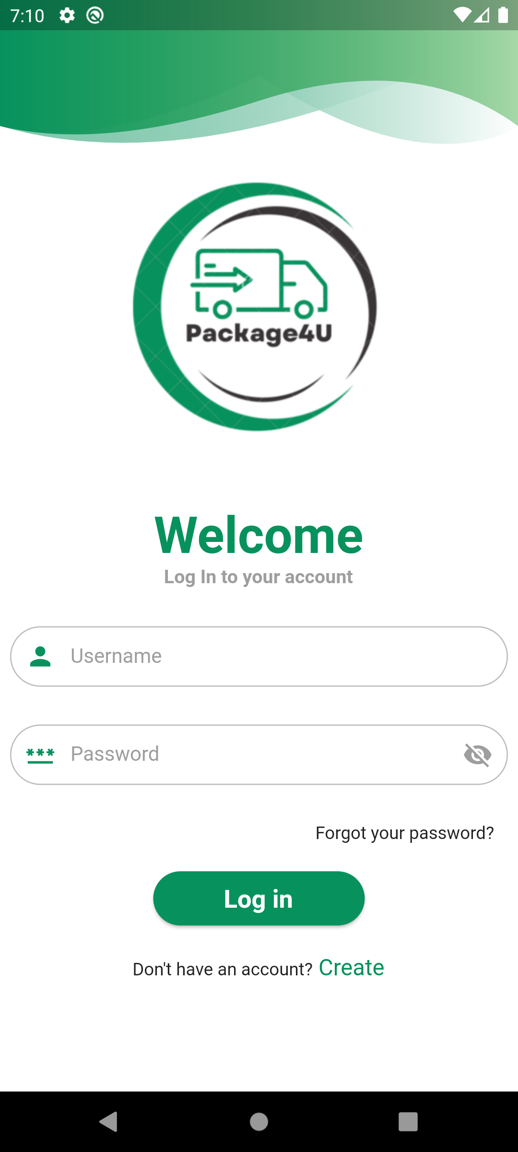
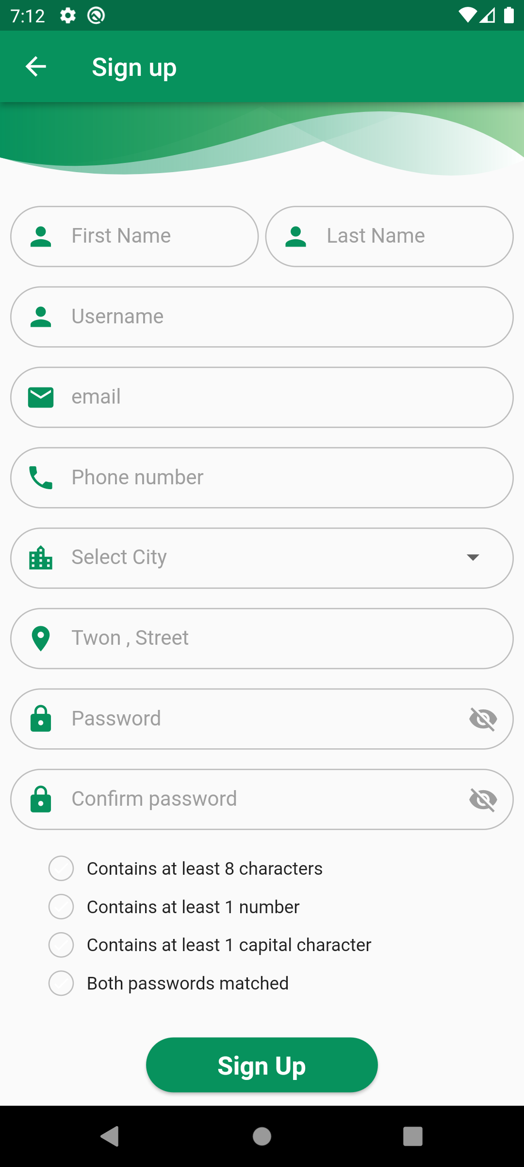
Login & Sign Up

Slide 7
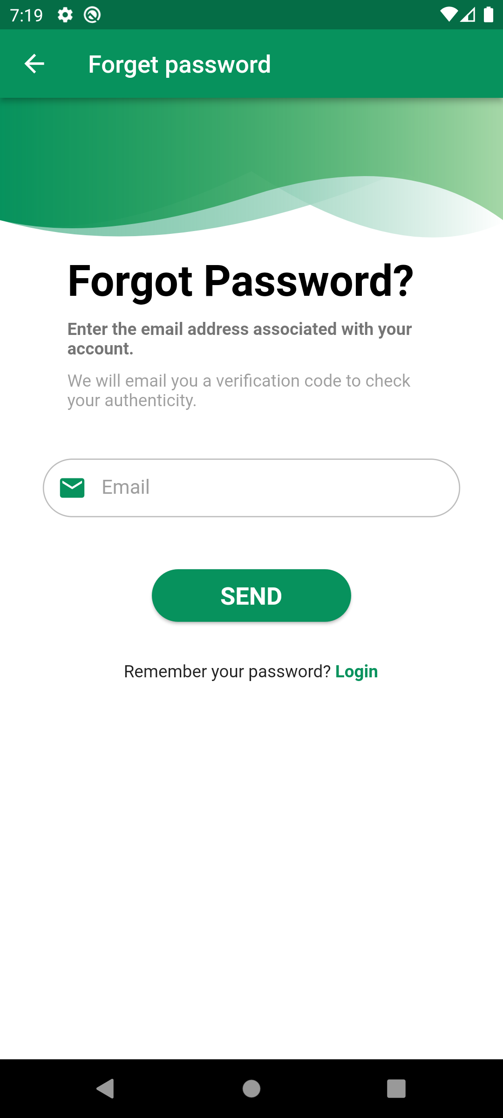
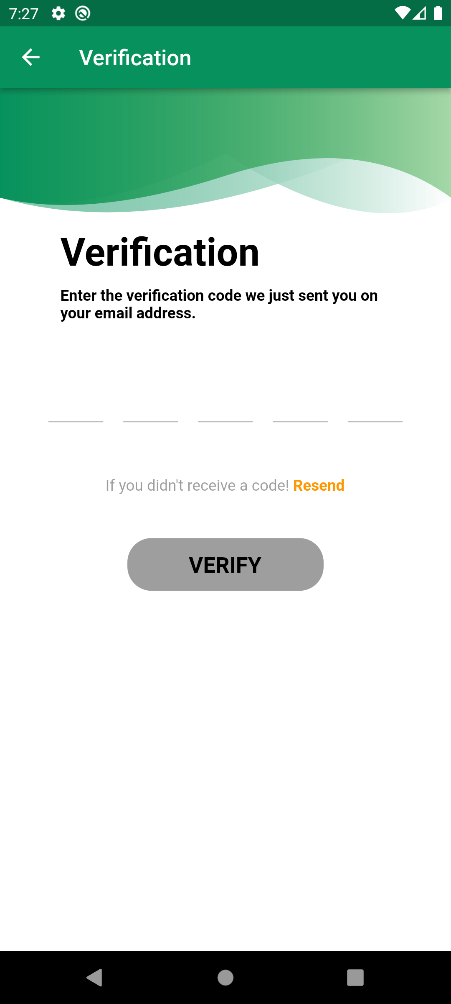
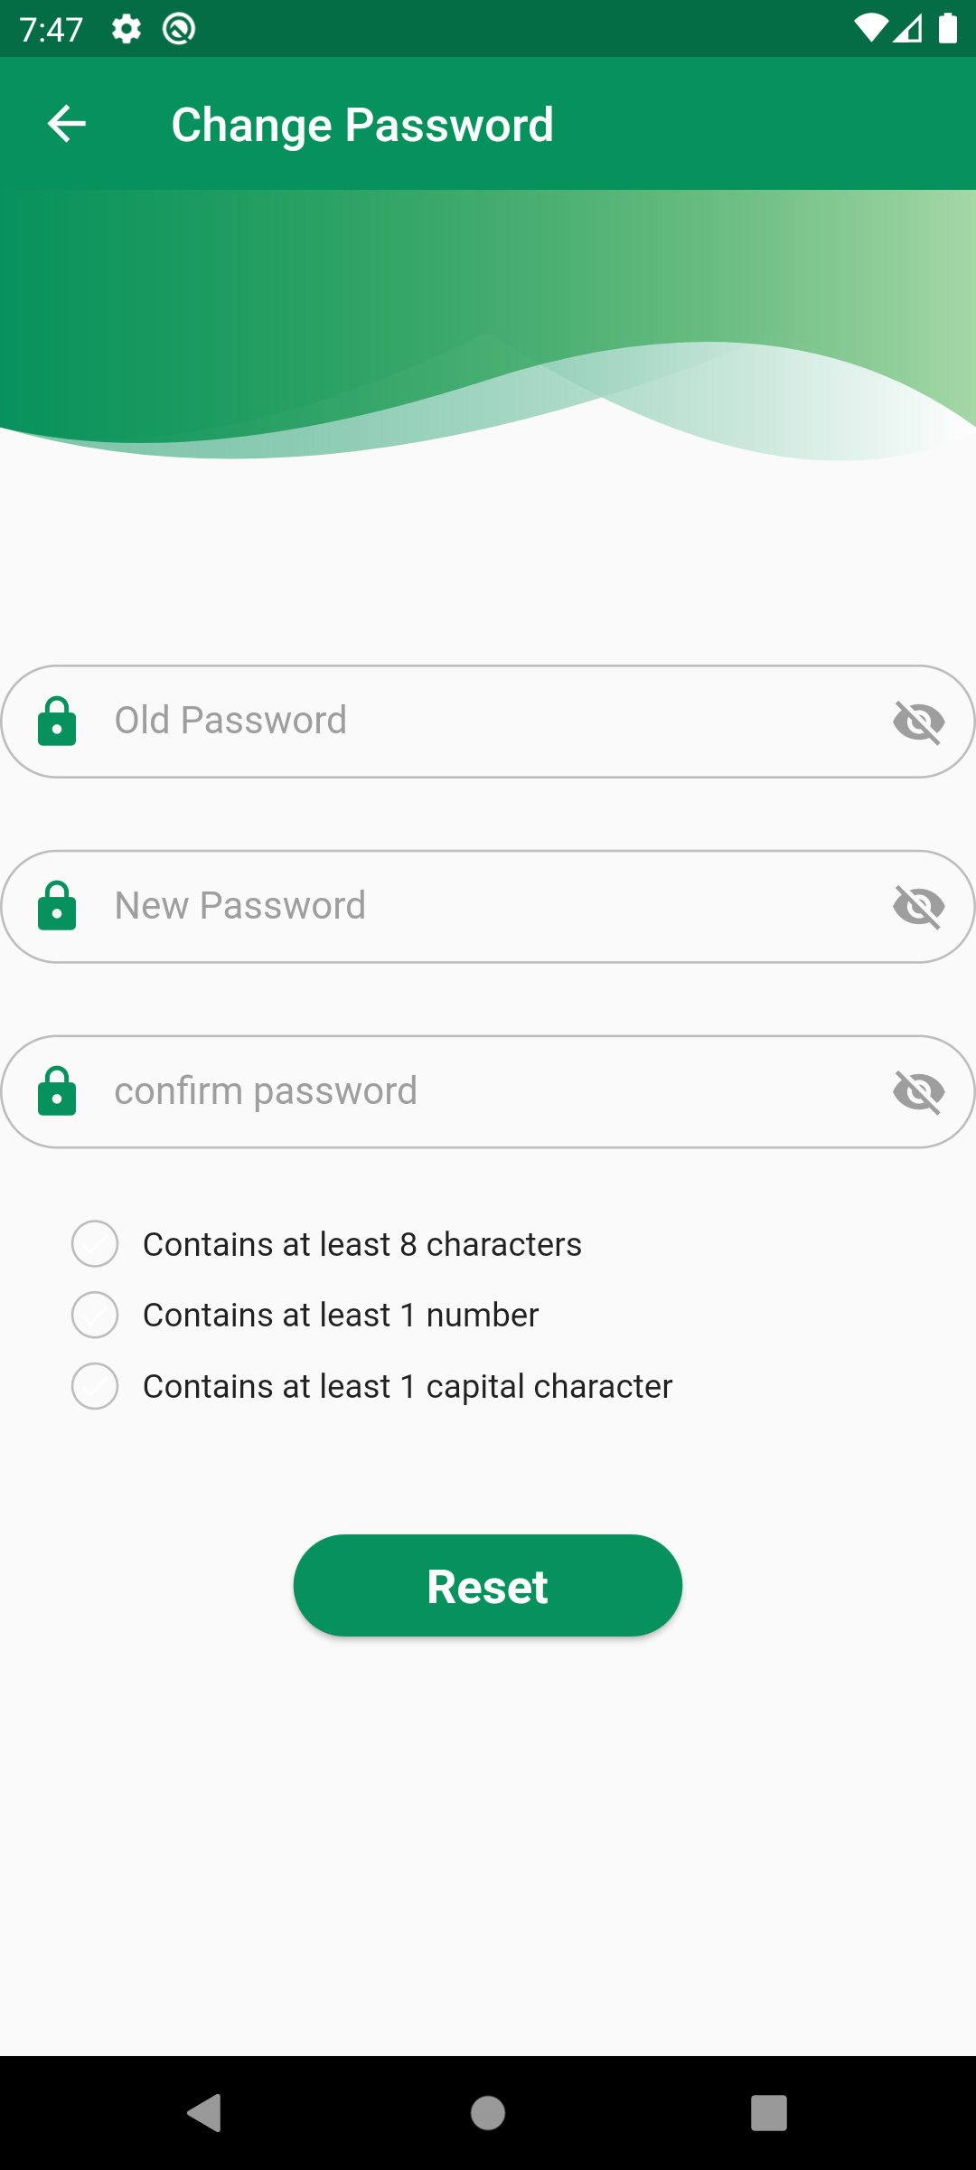
Forgot Password

Slide 8
Customer

Slide 9
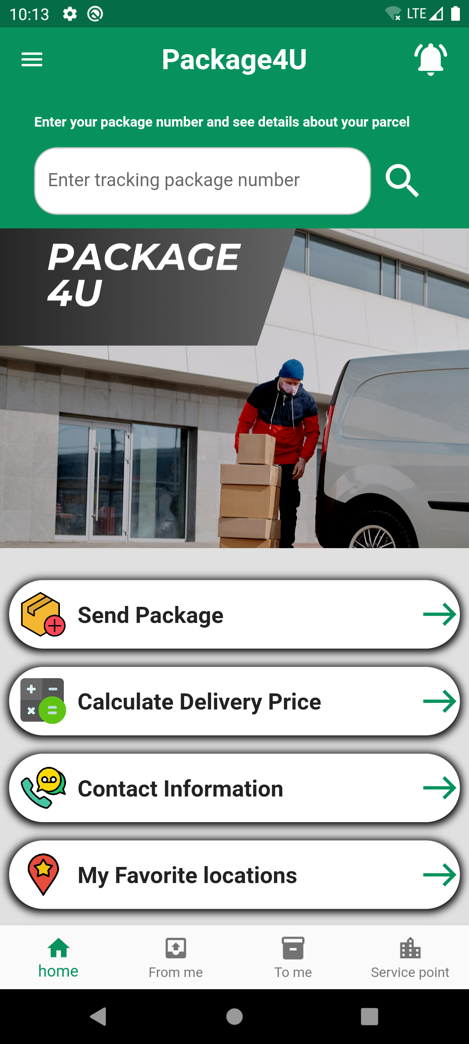
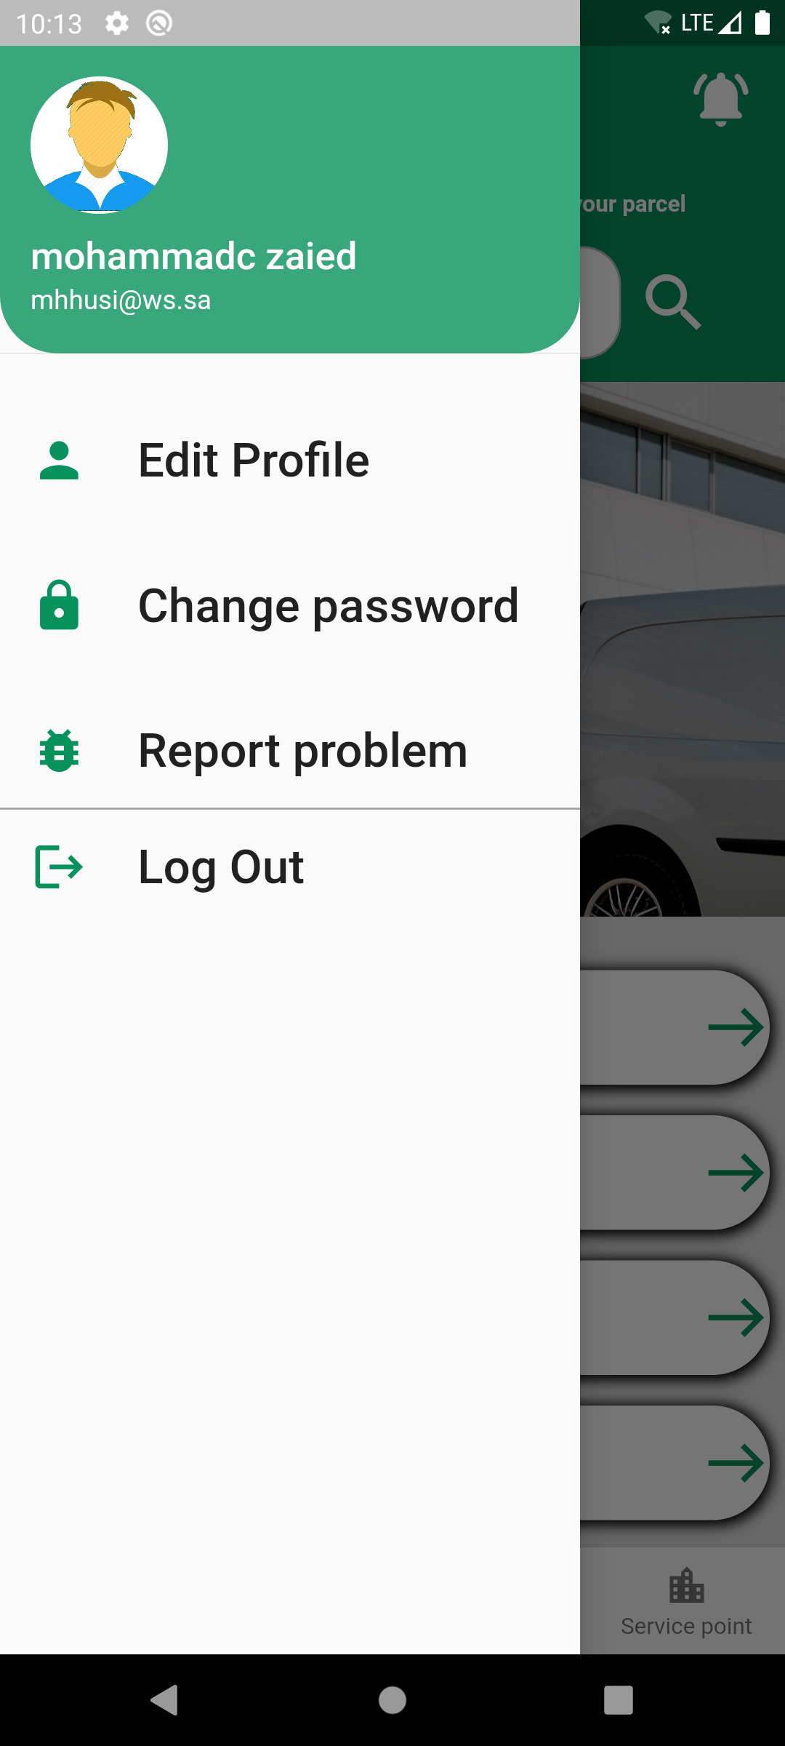
Customer Home Page

Slide 10
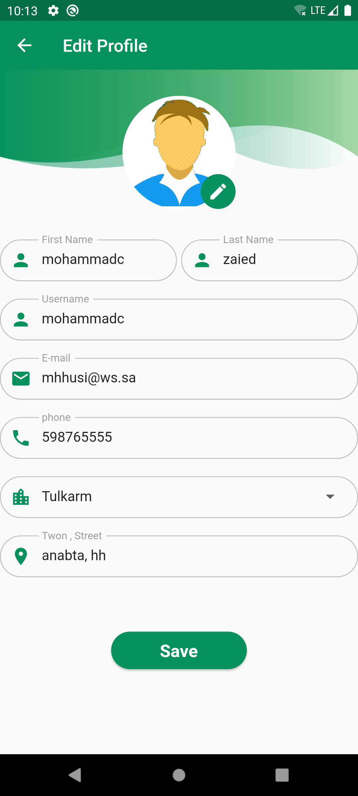
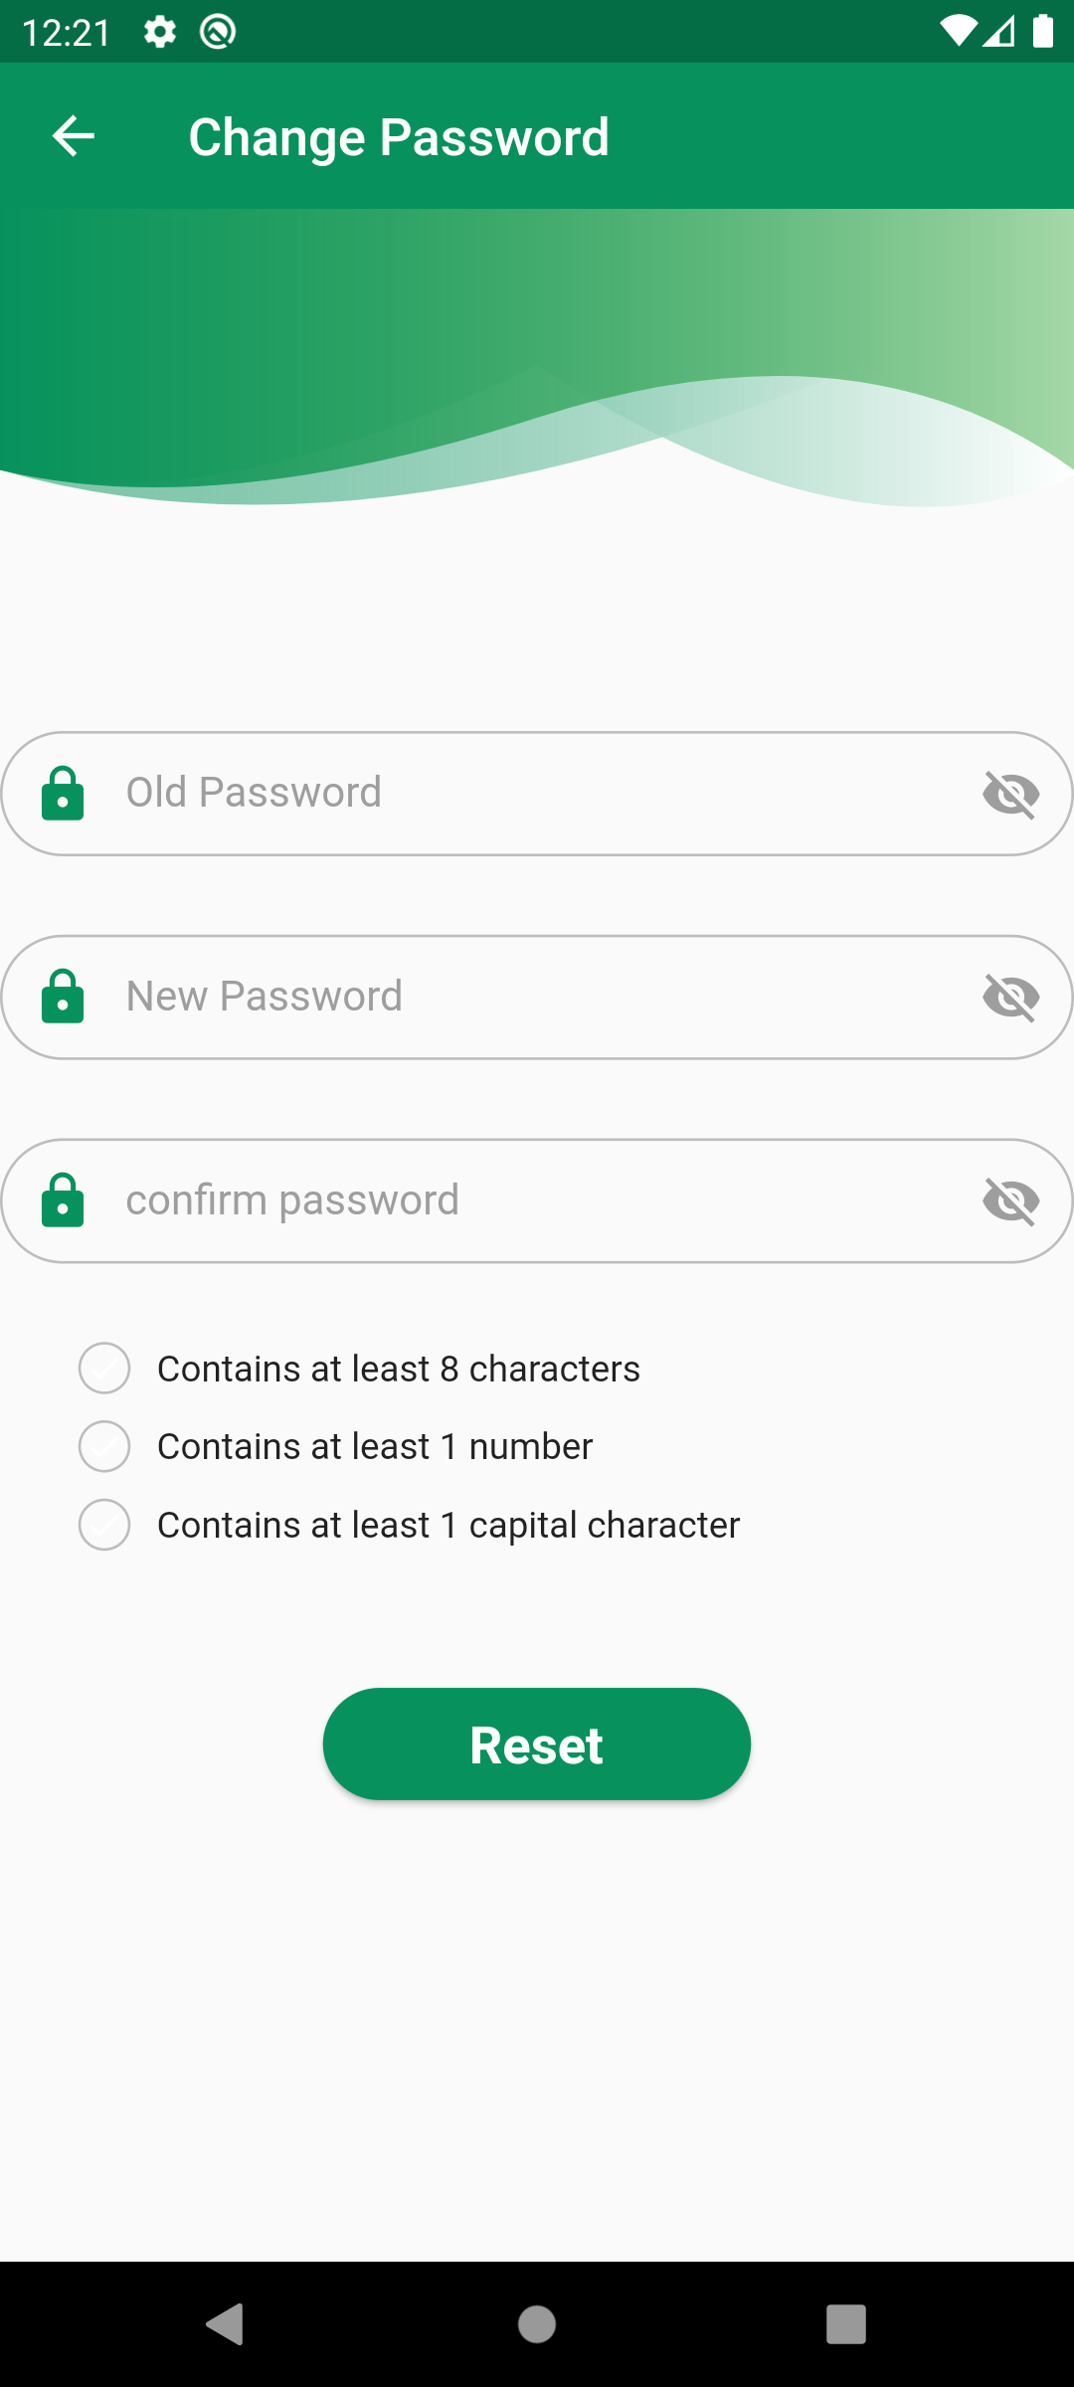
Edit profile & Change Password

Slide 11
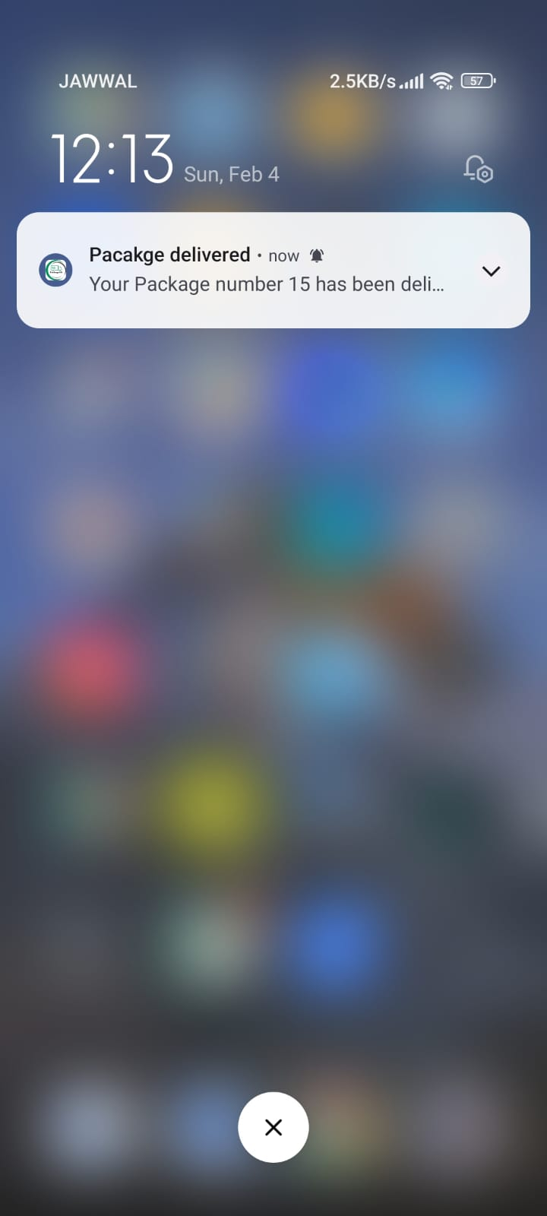
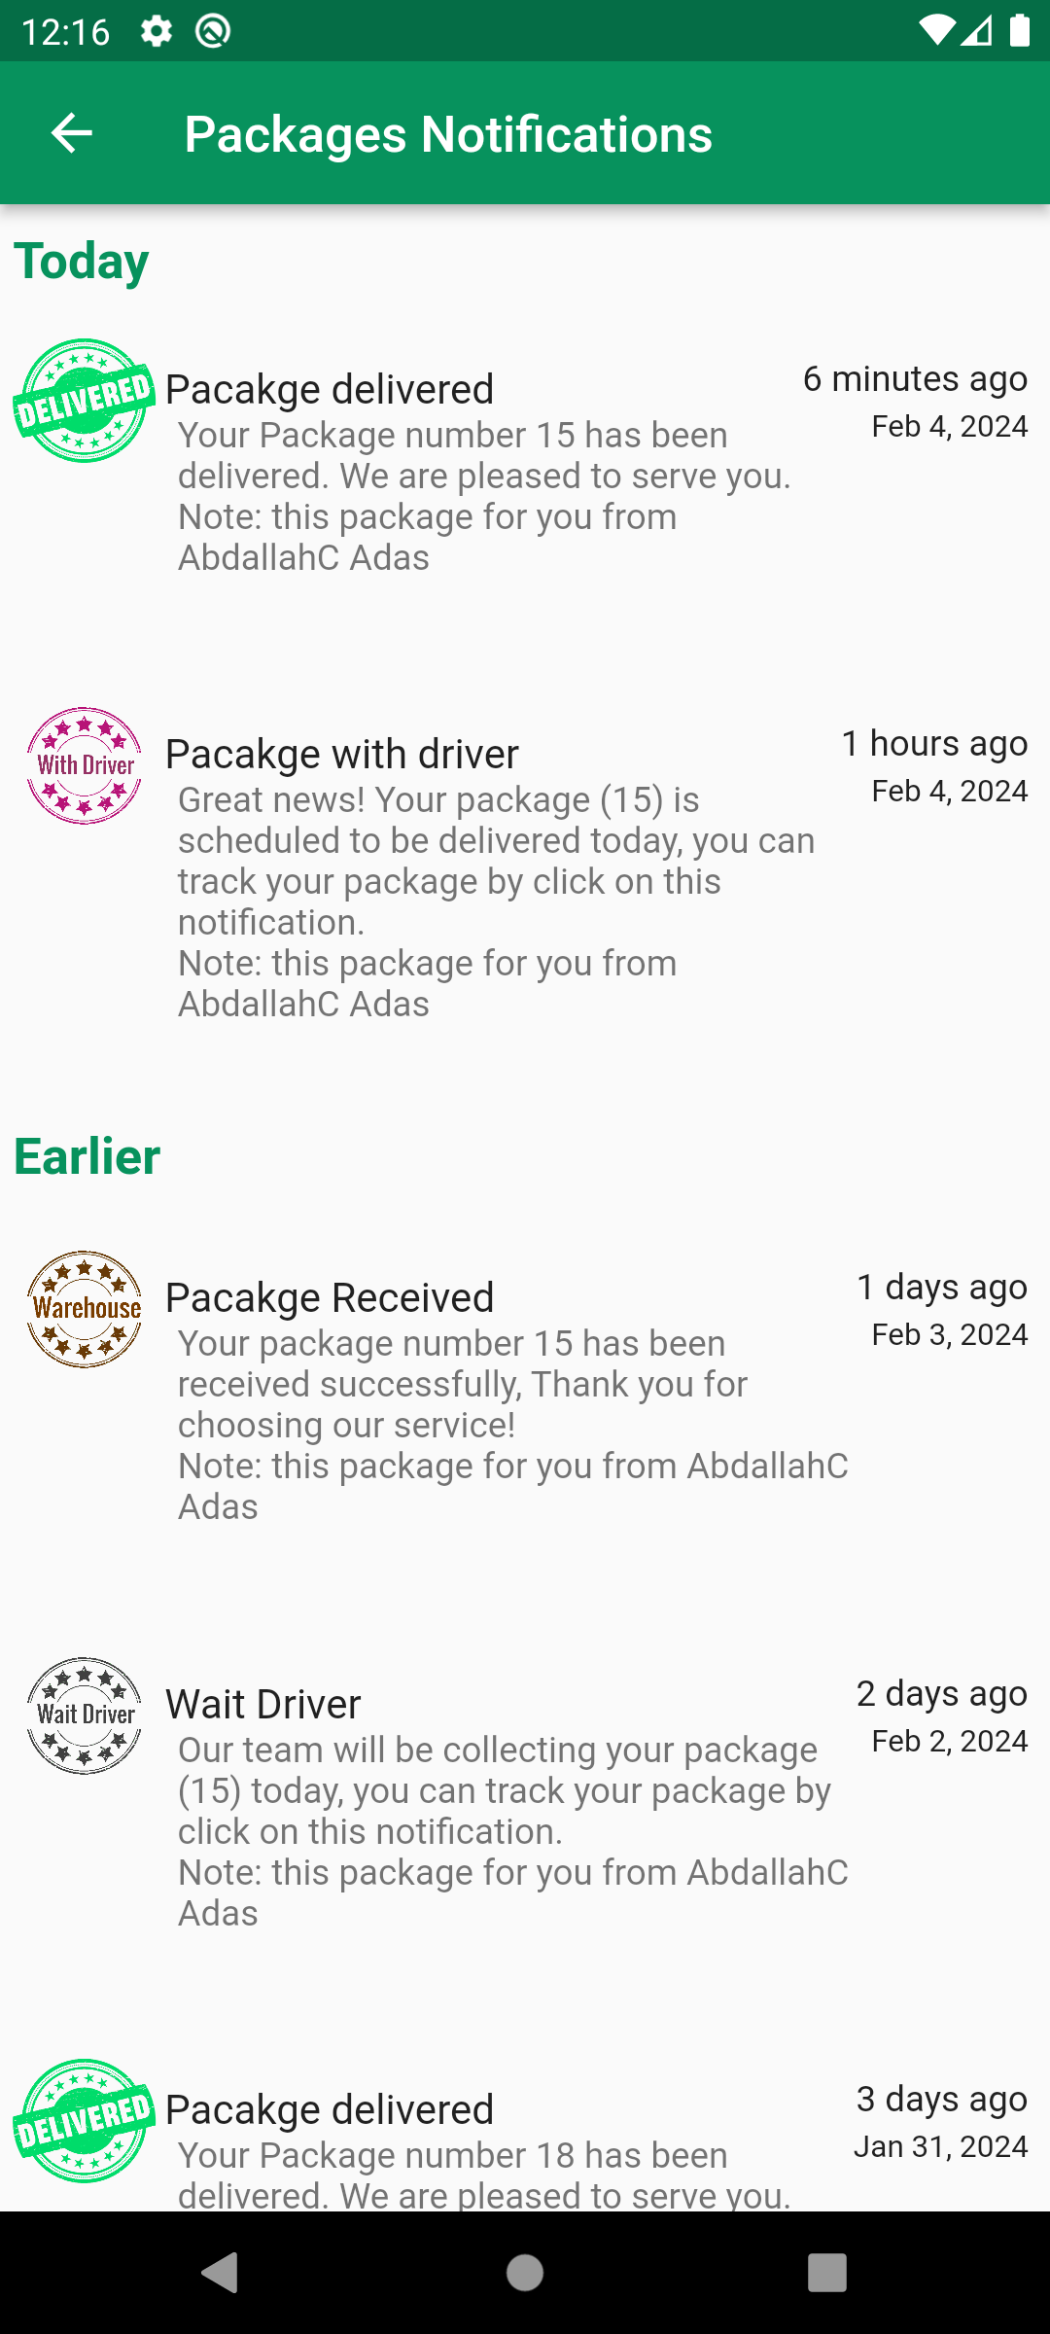
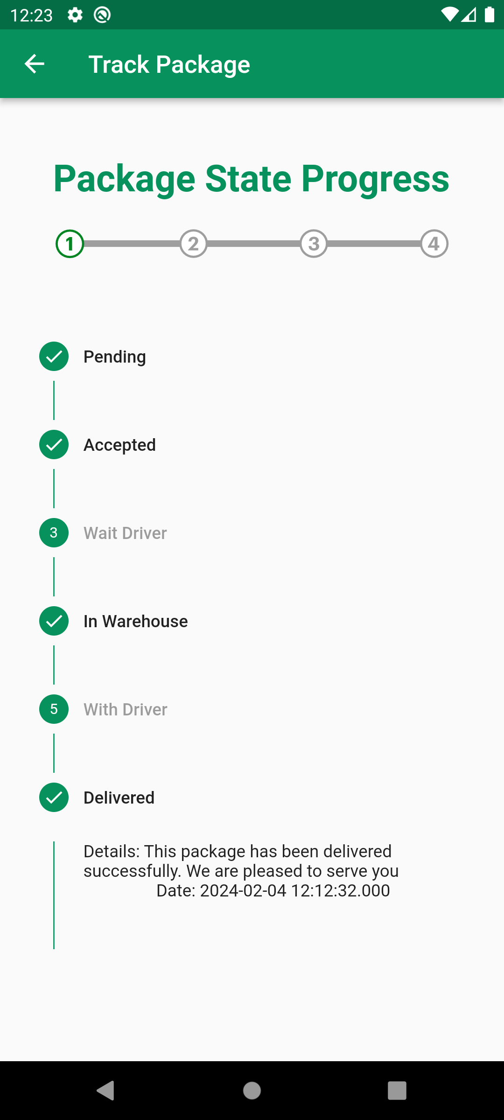
Packages Notification

Slide 12
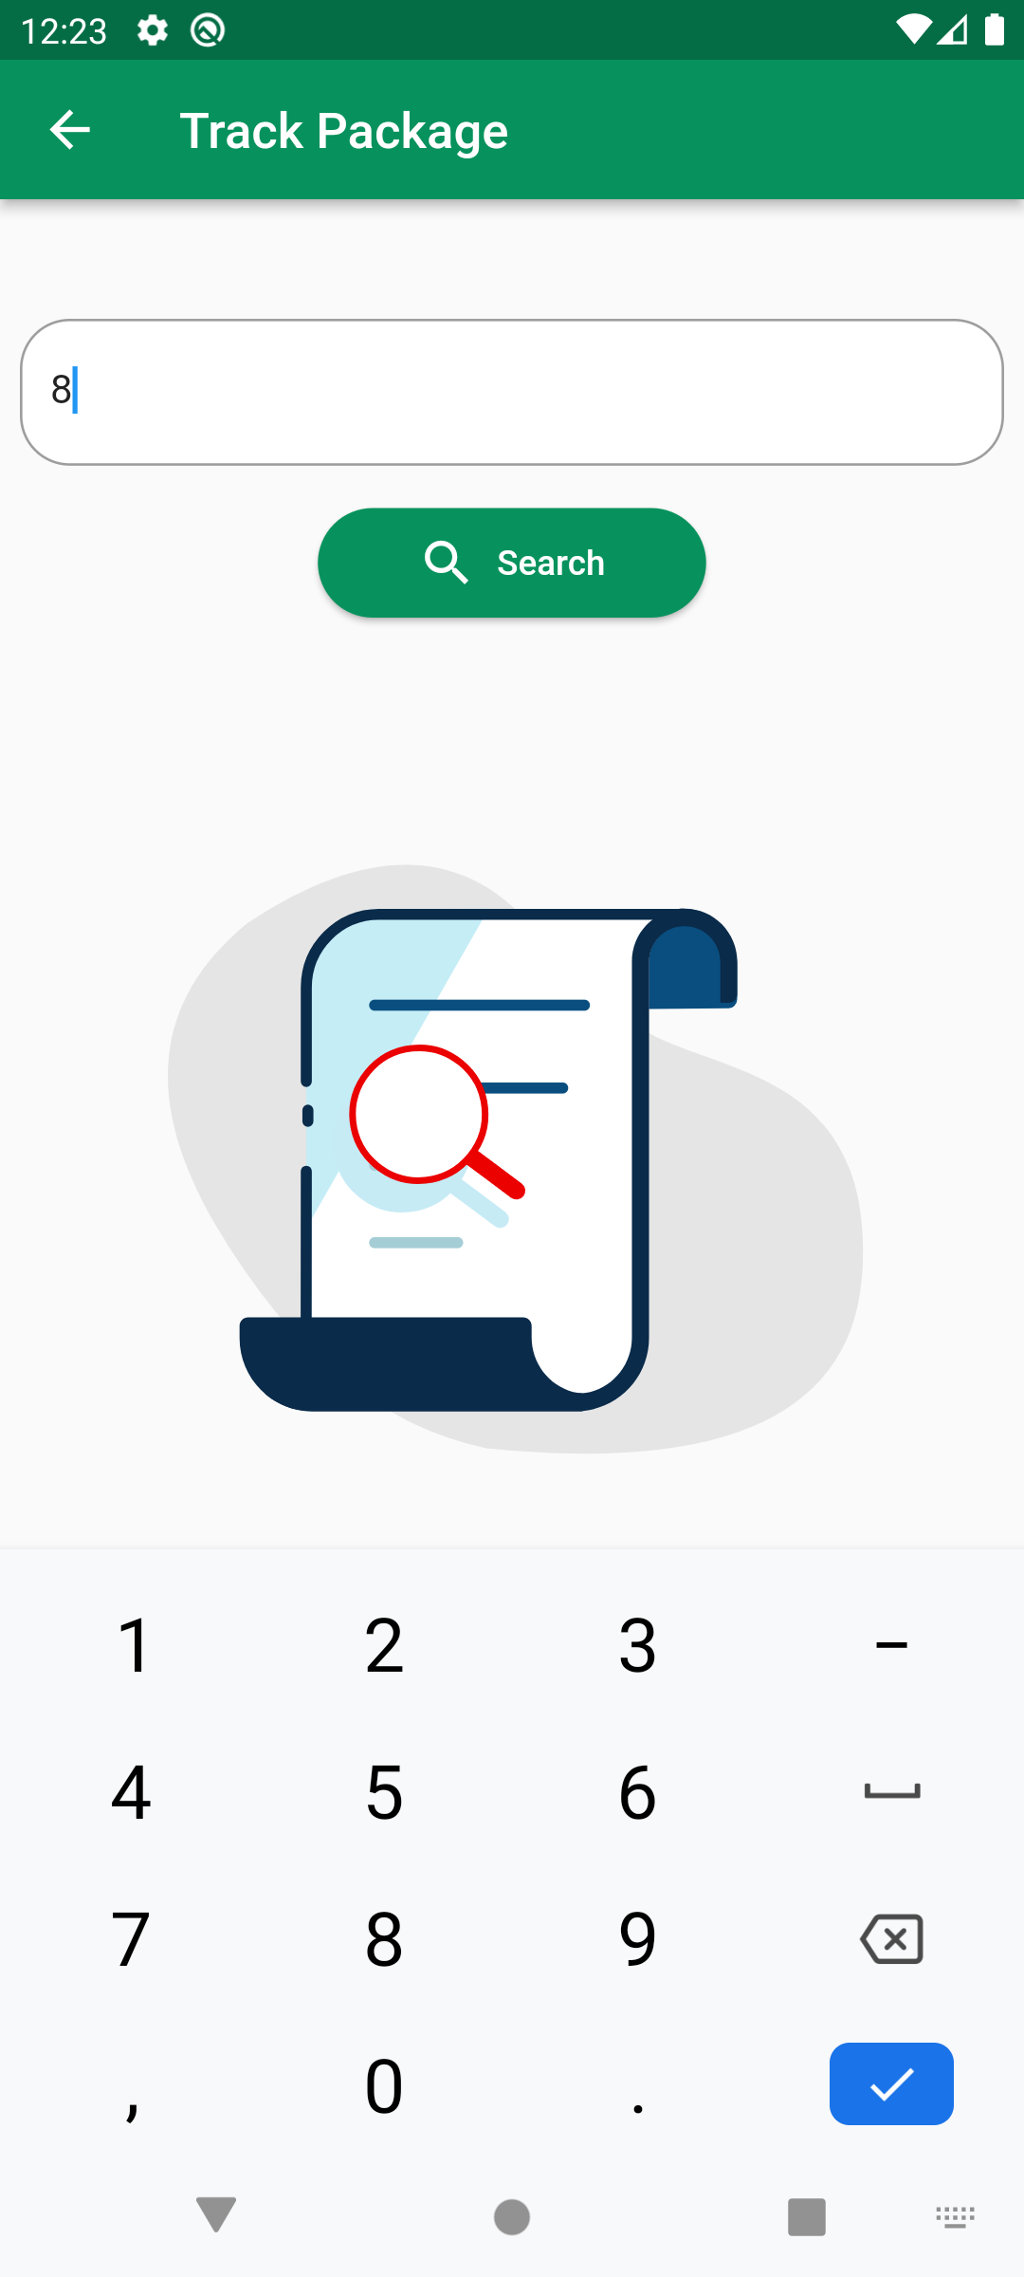
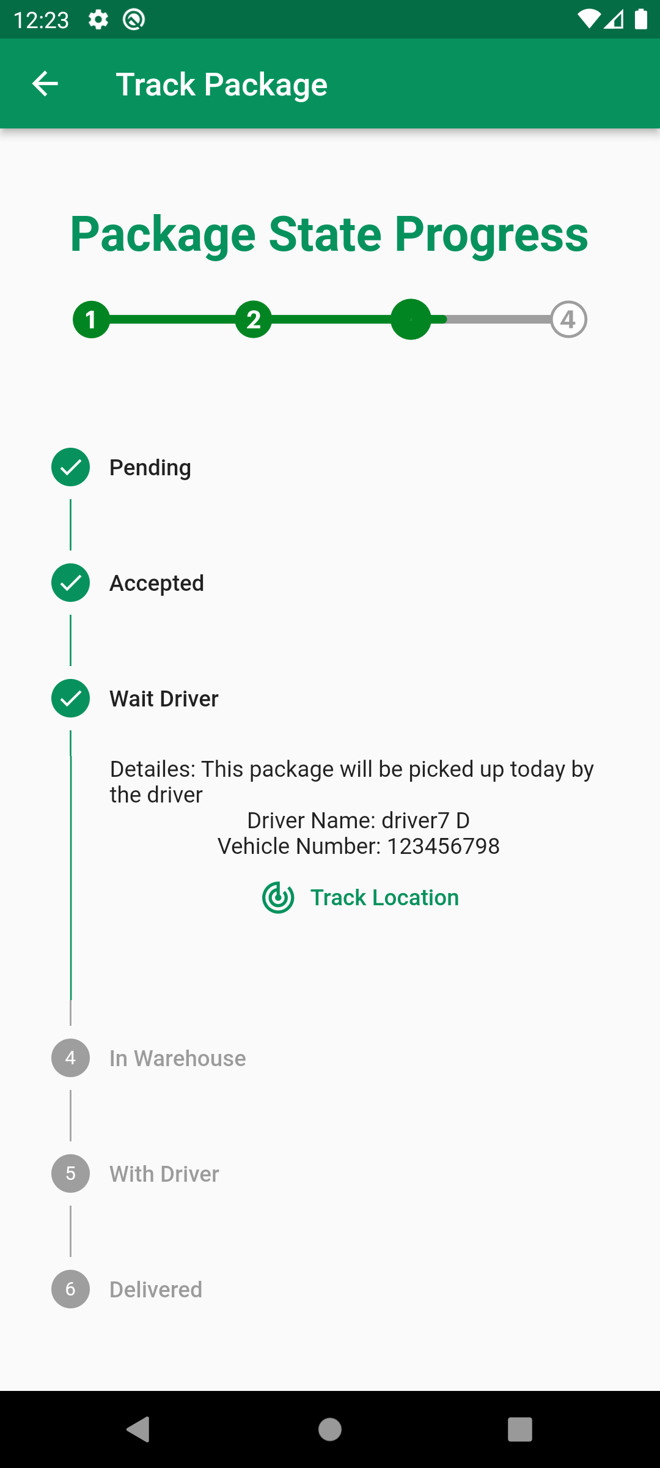
Track Packages

Slide 13
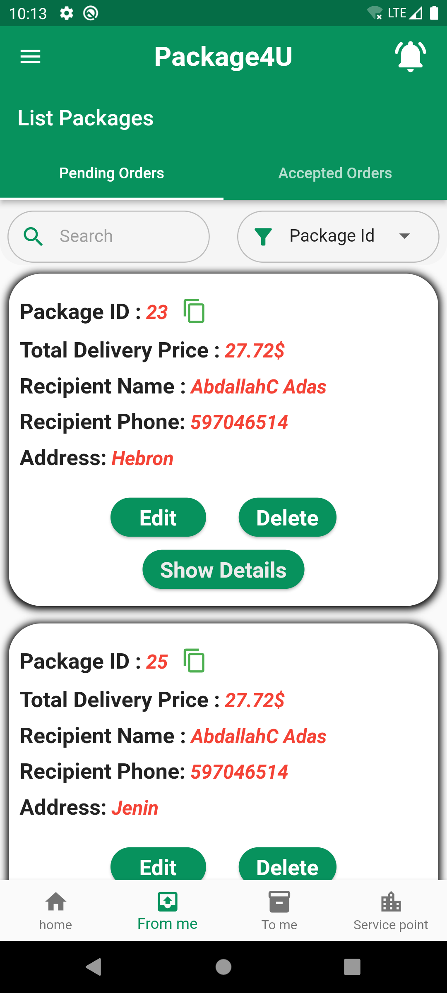
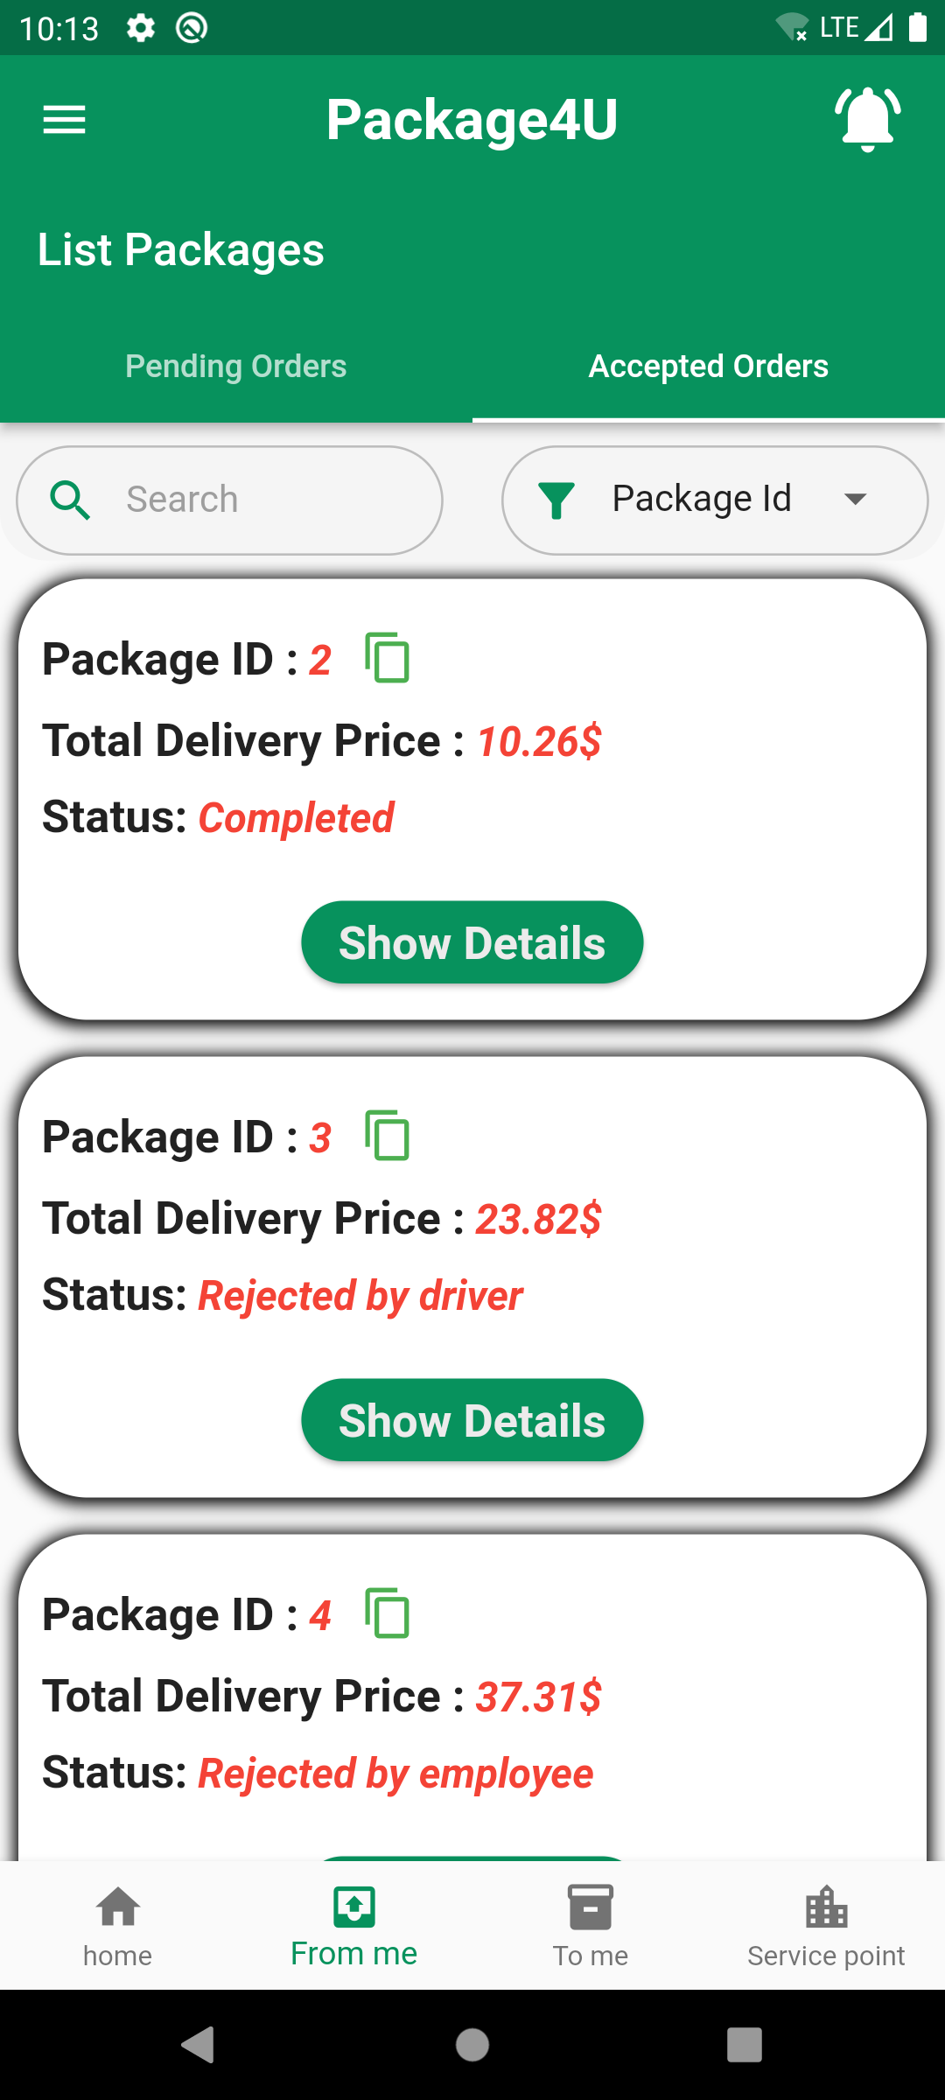
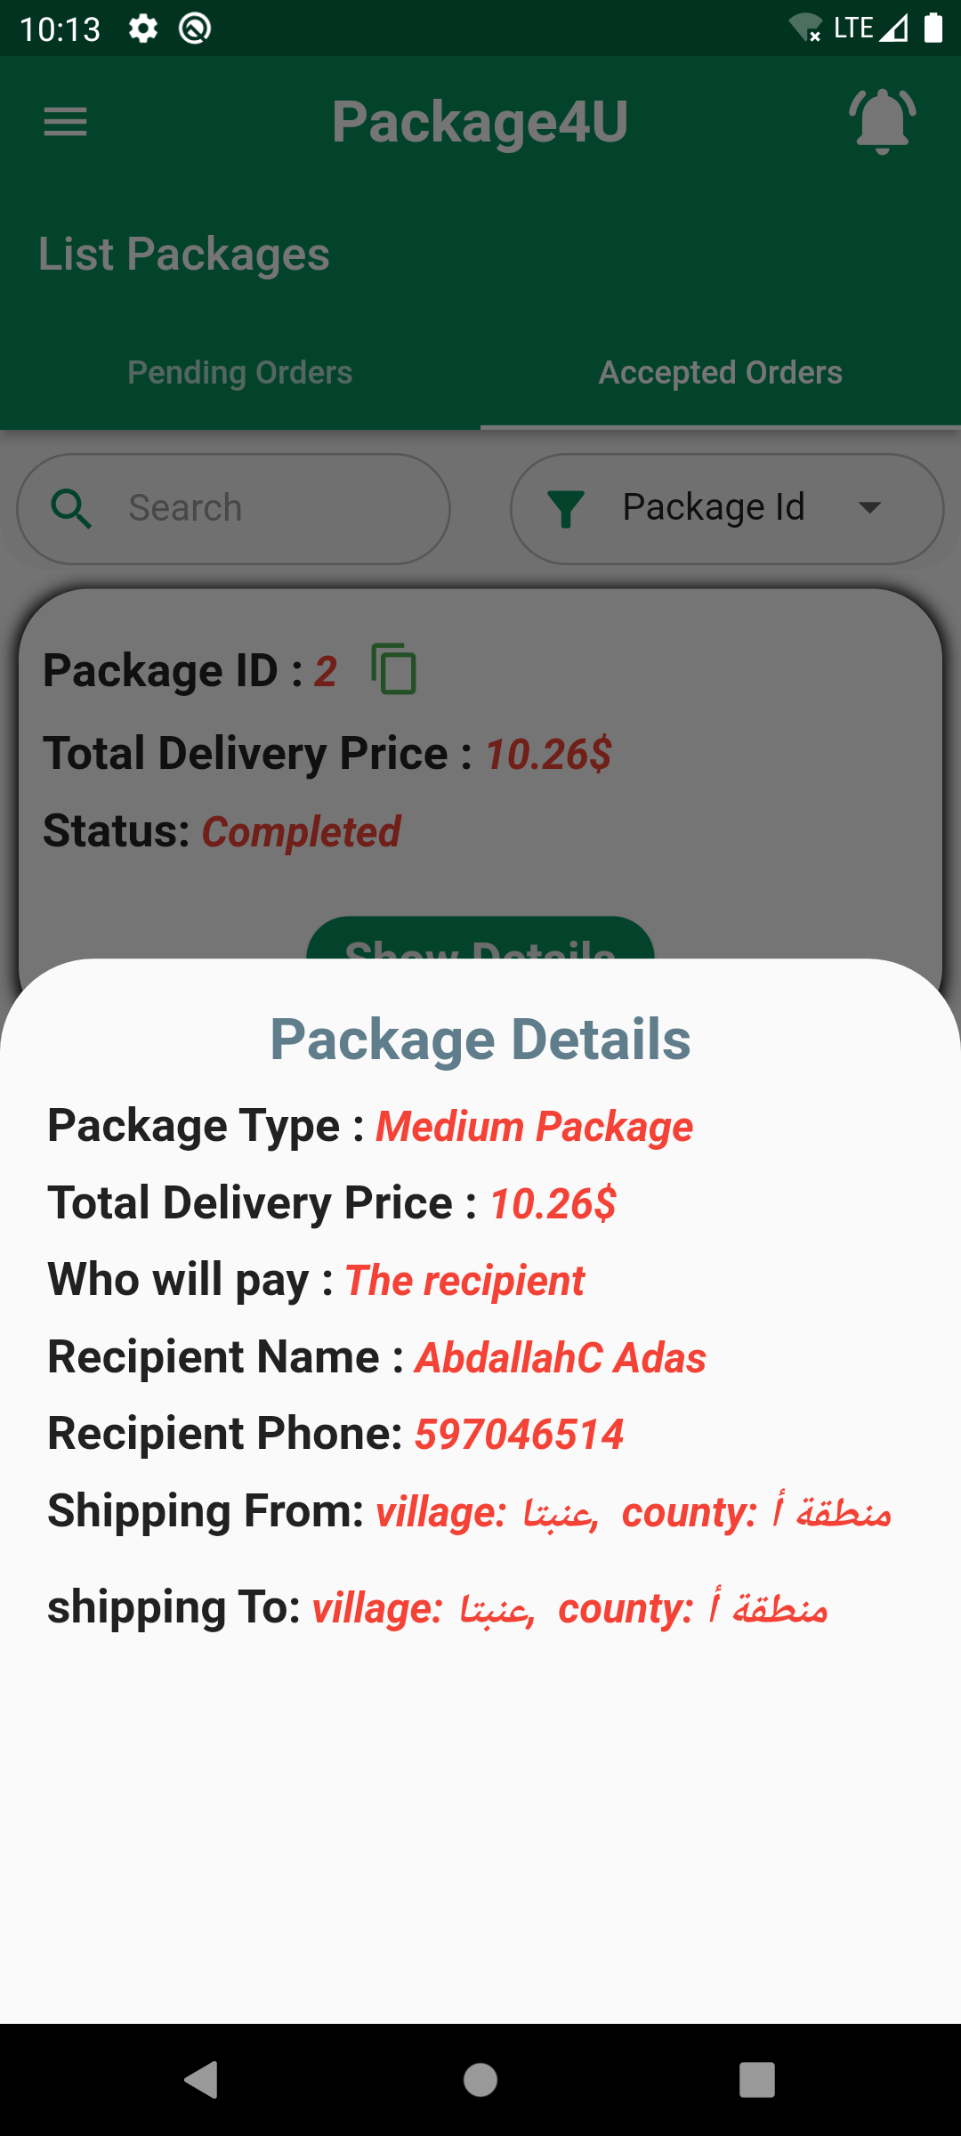
Packages From Me

Slide 14
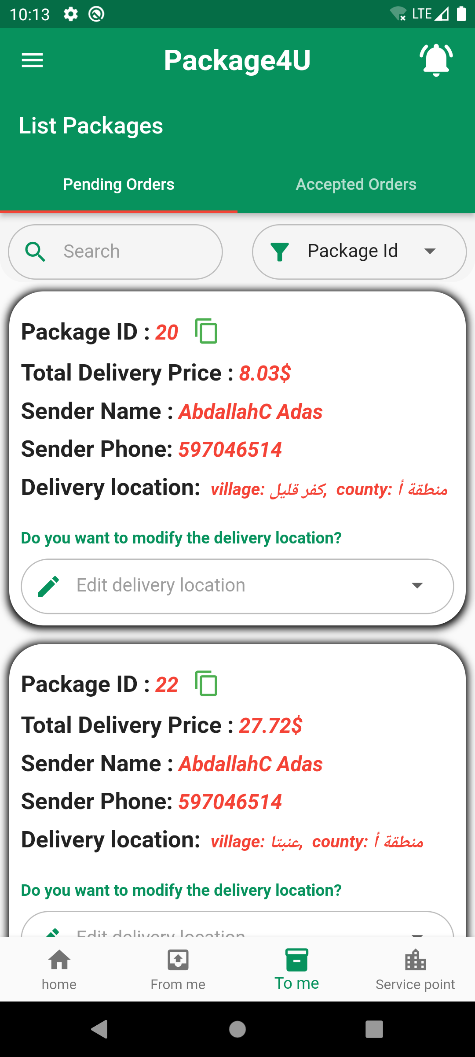
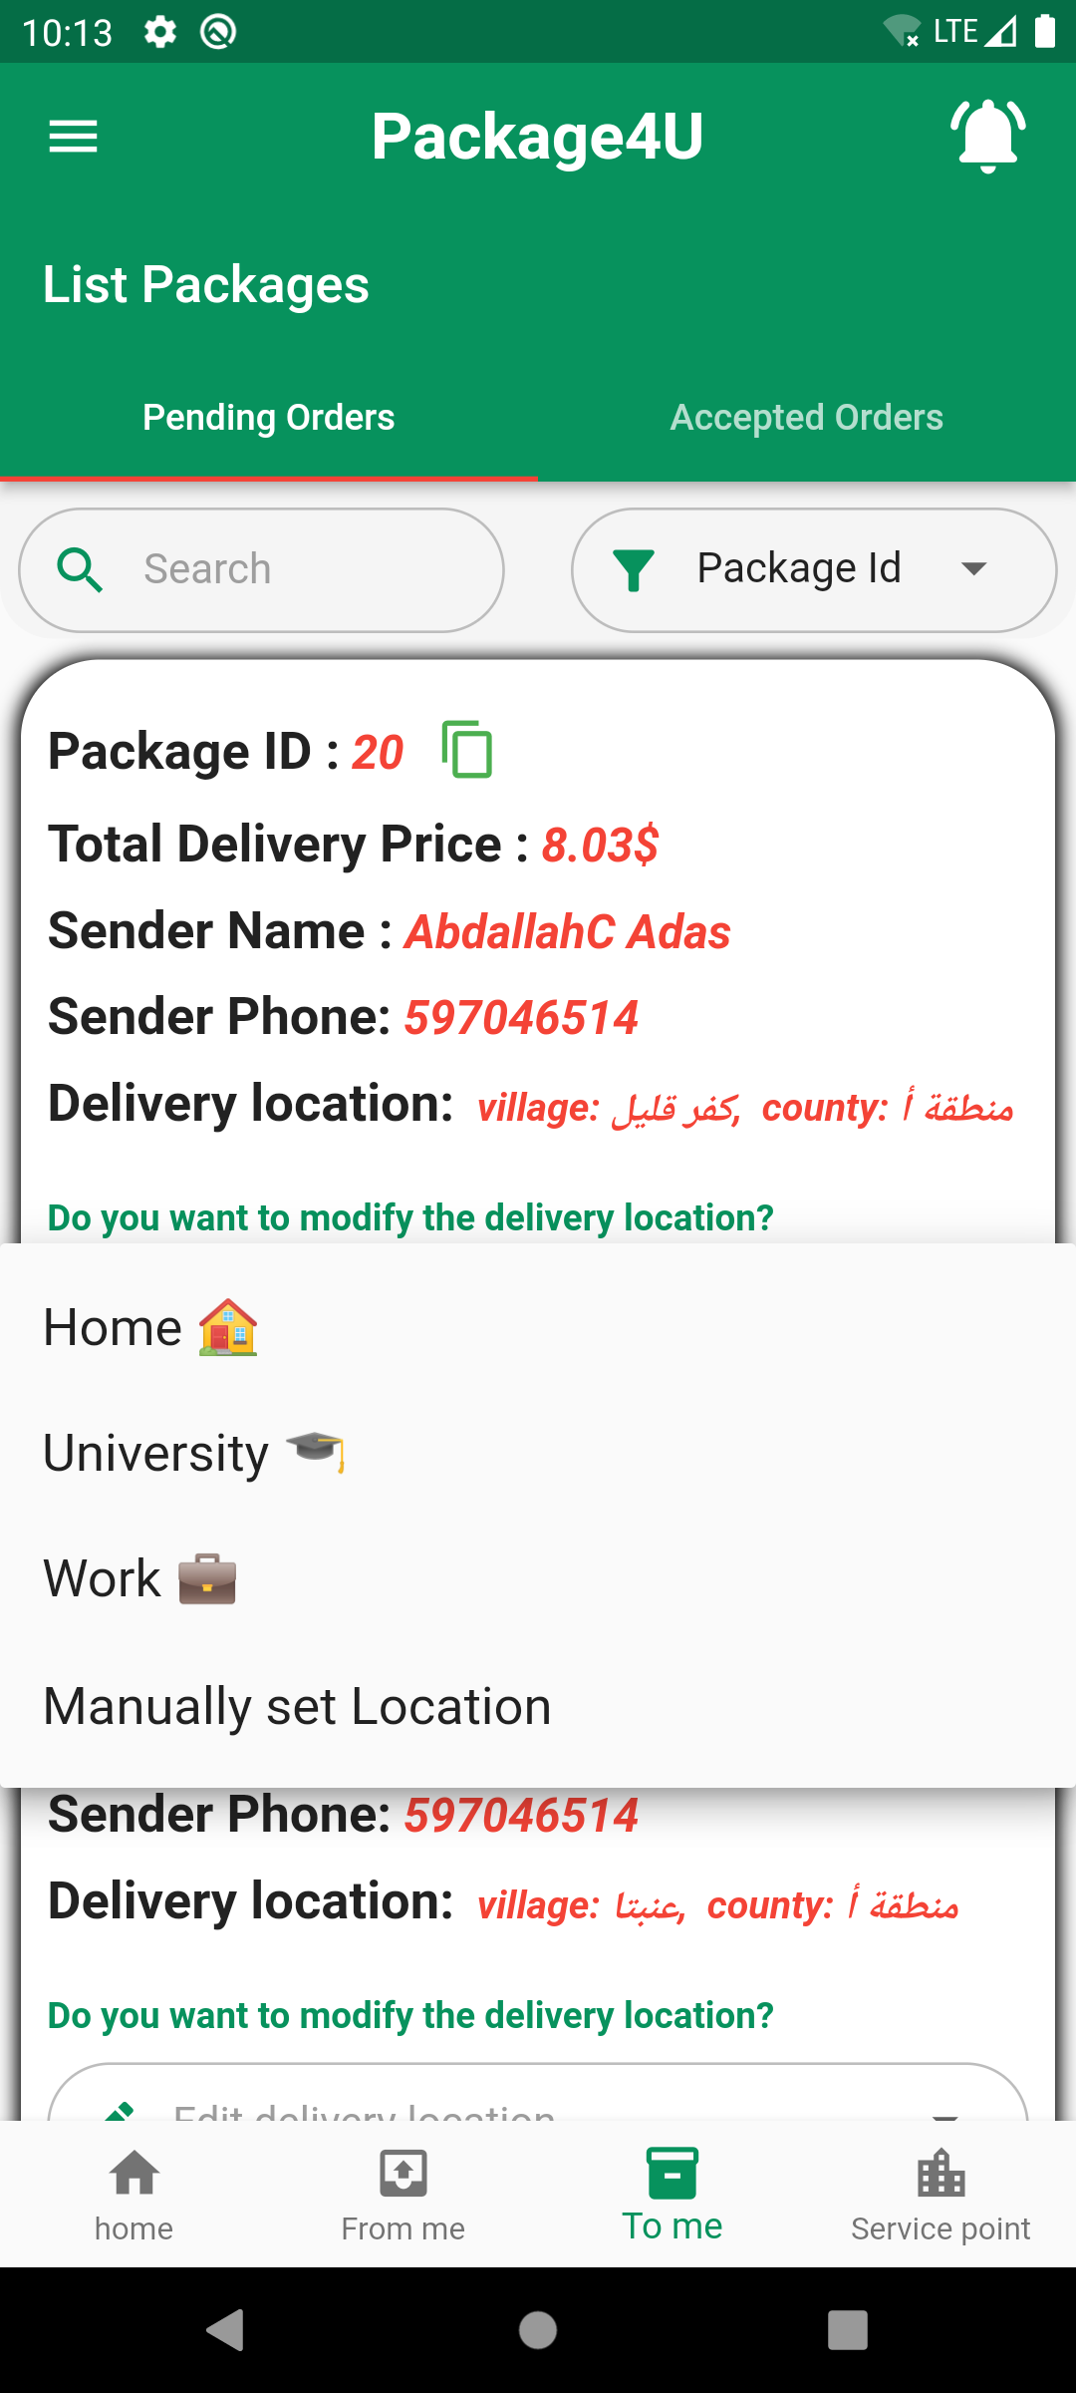
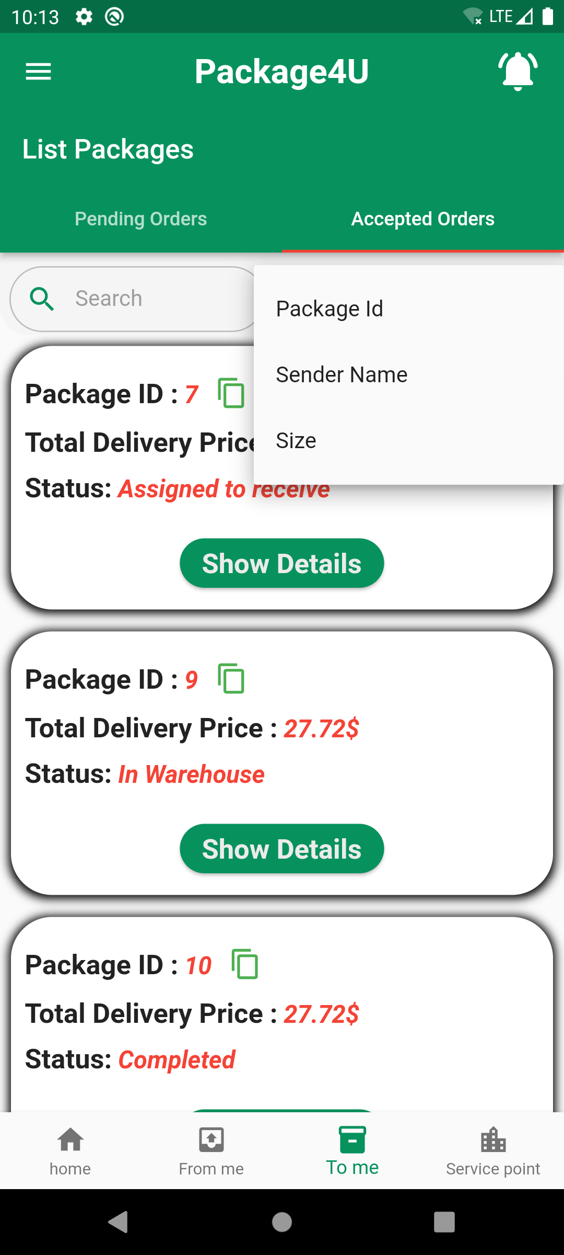
Packages To Me

Slide 15
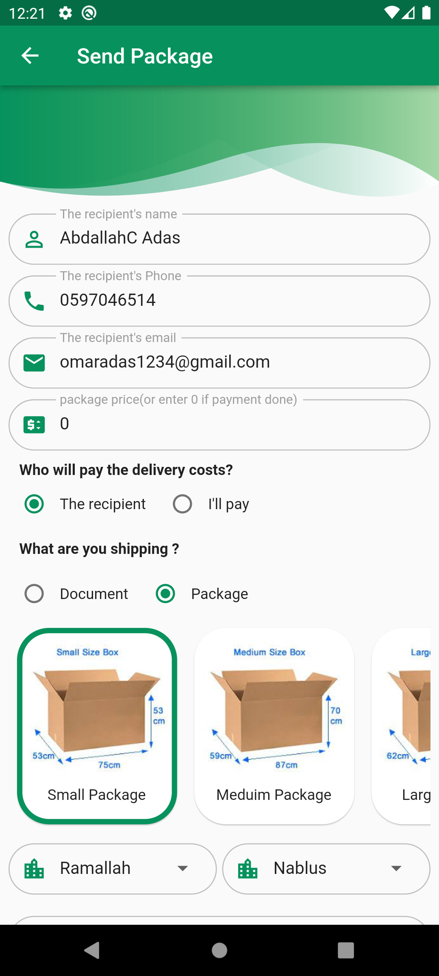
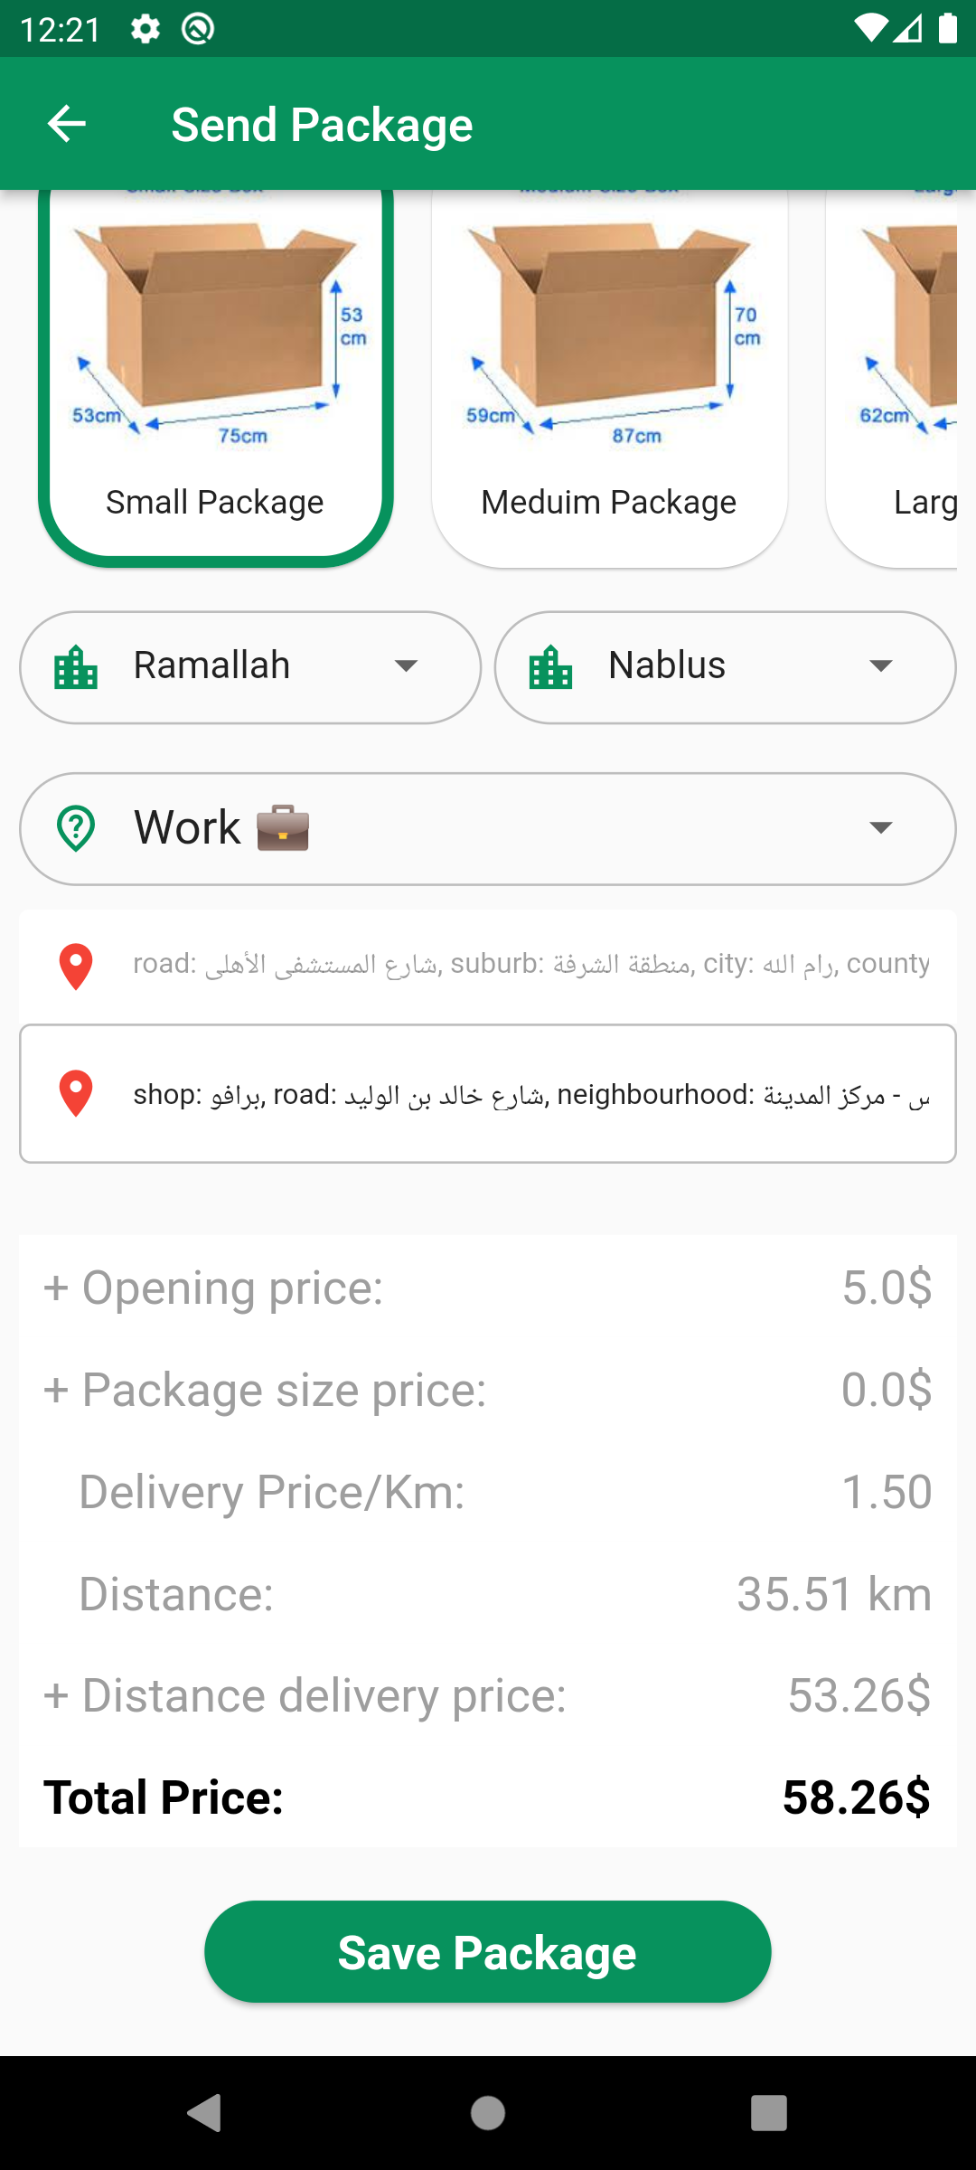
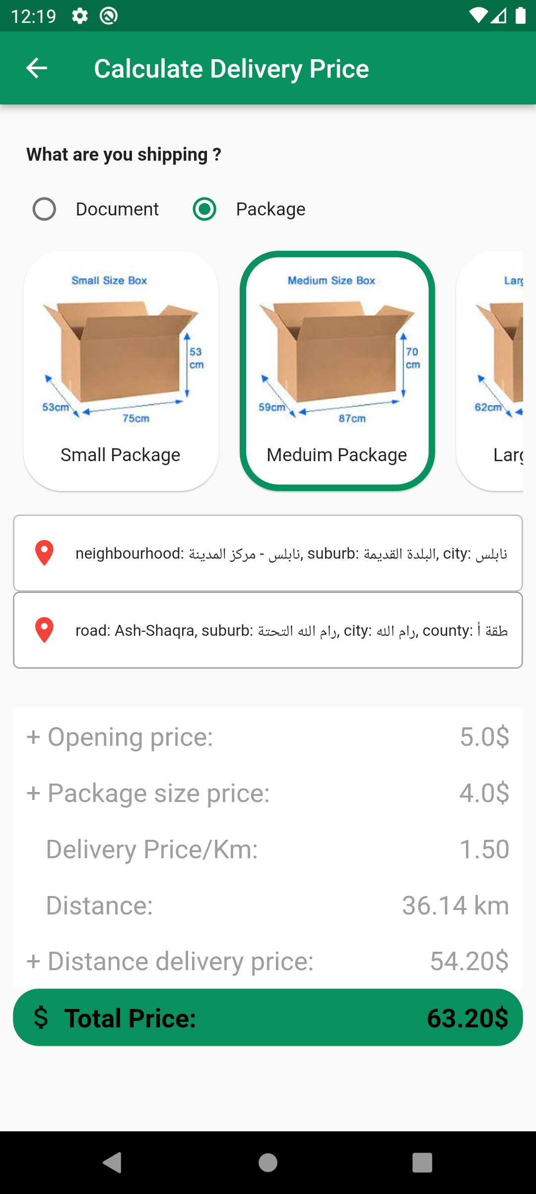
Send Package & Delivery Price

Slide 16
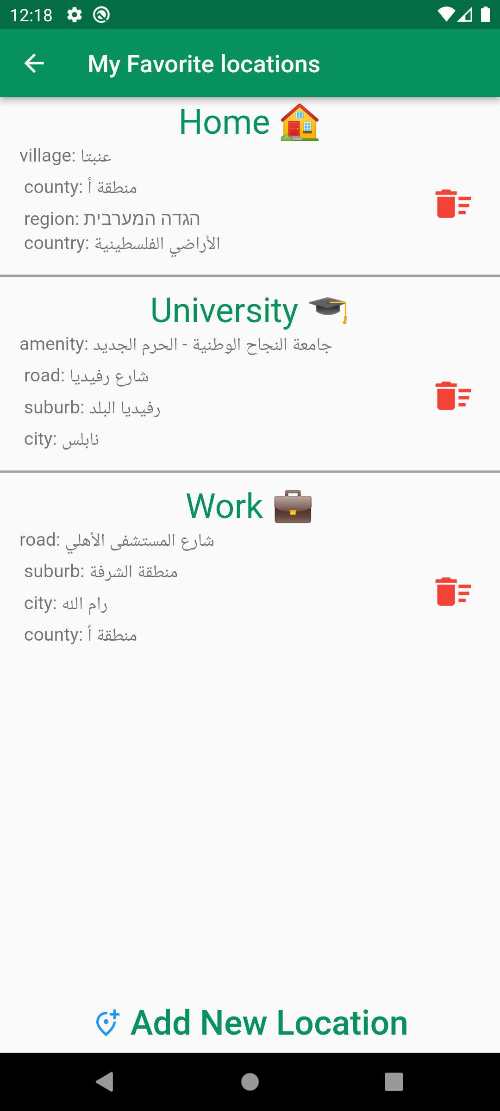
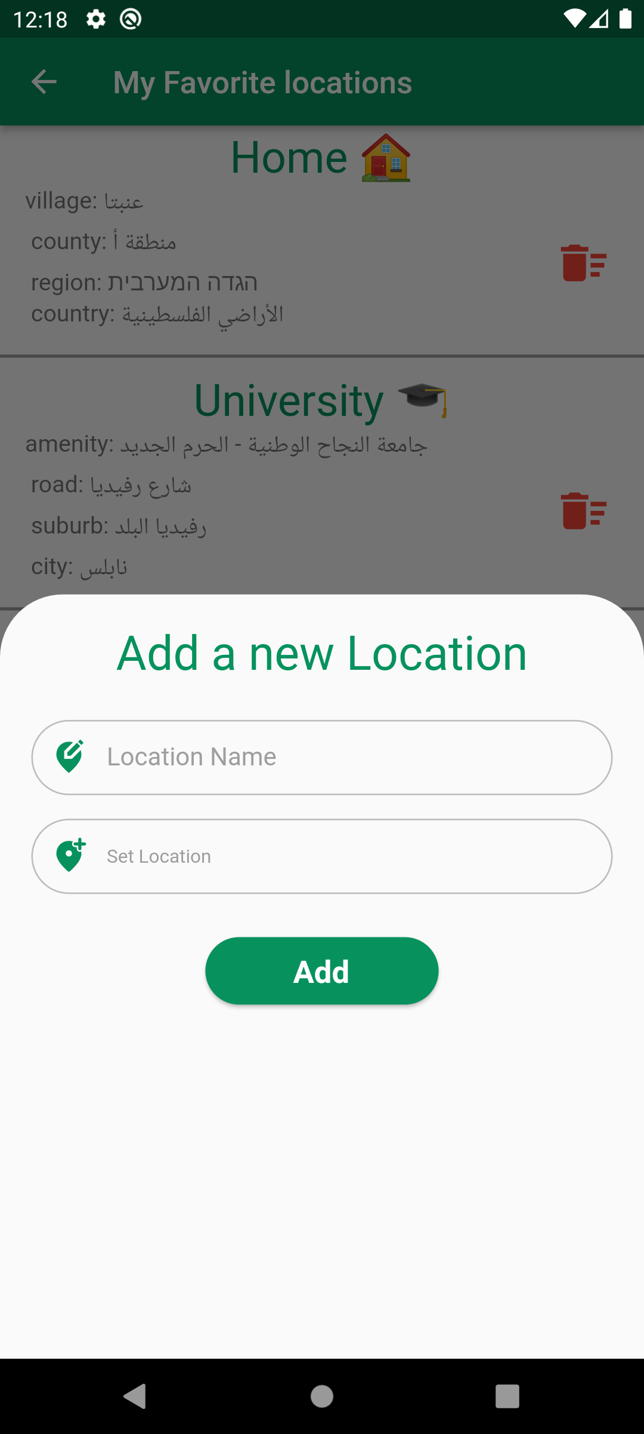
My Favorite Locations

Slide 17
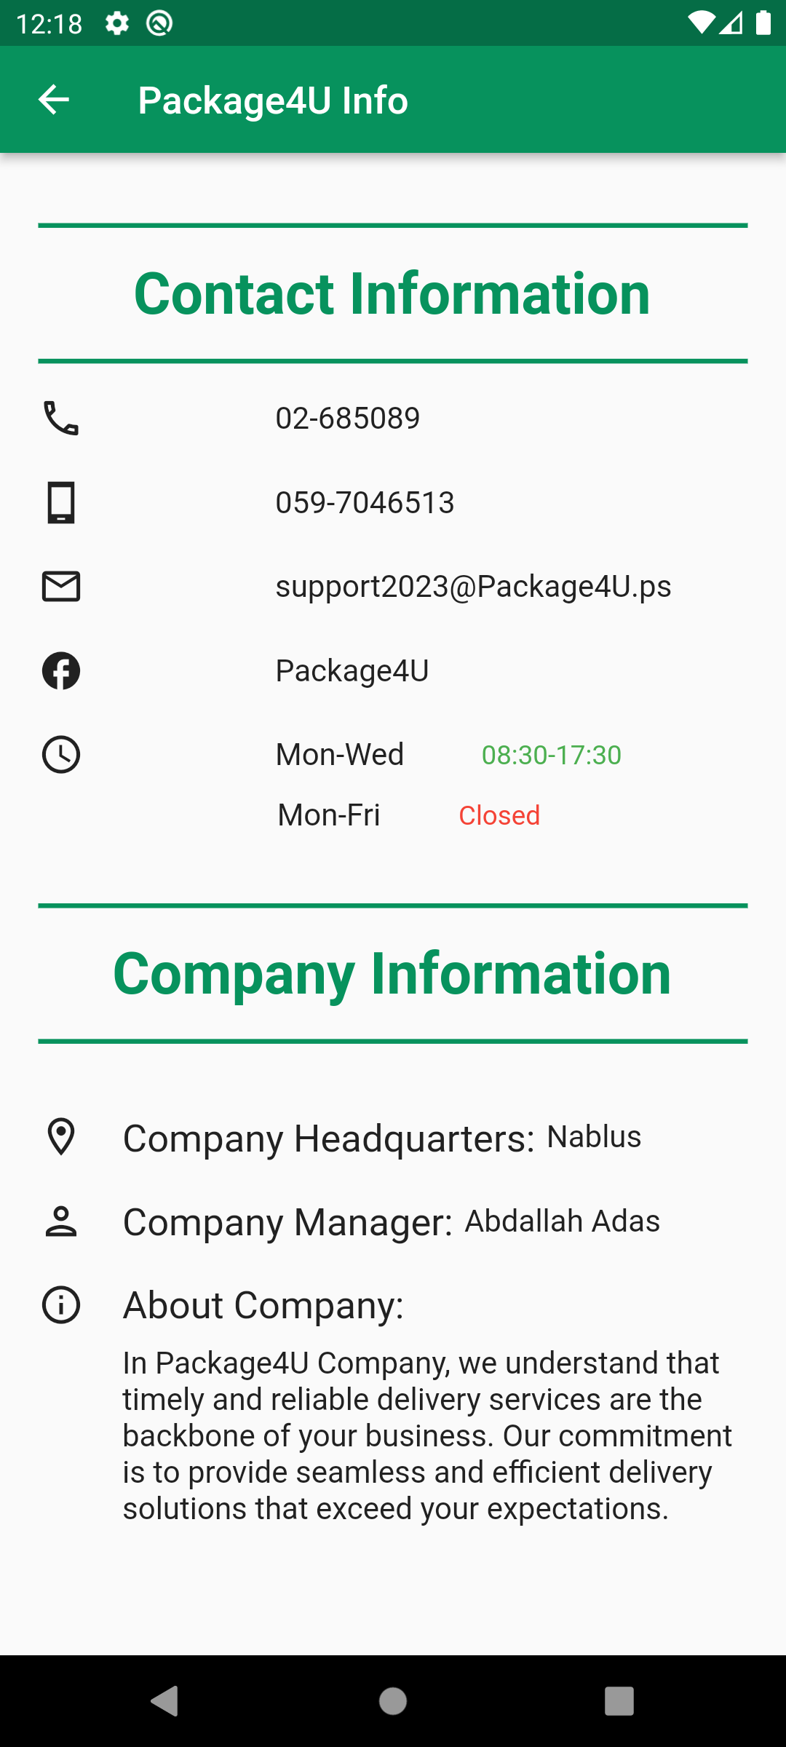
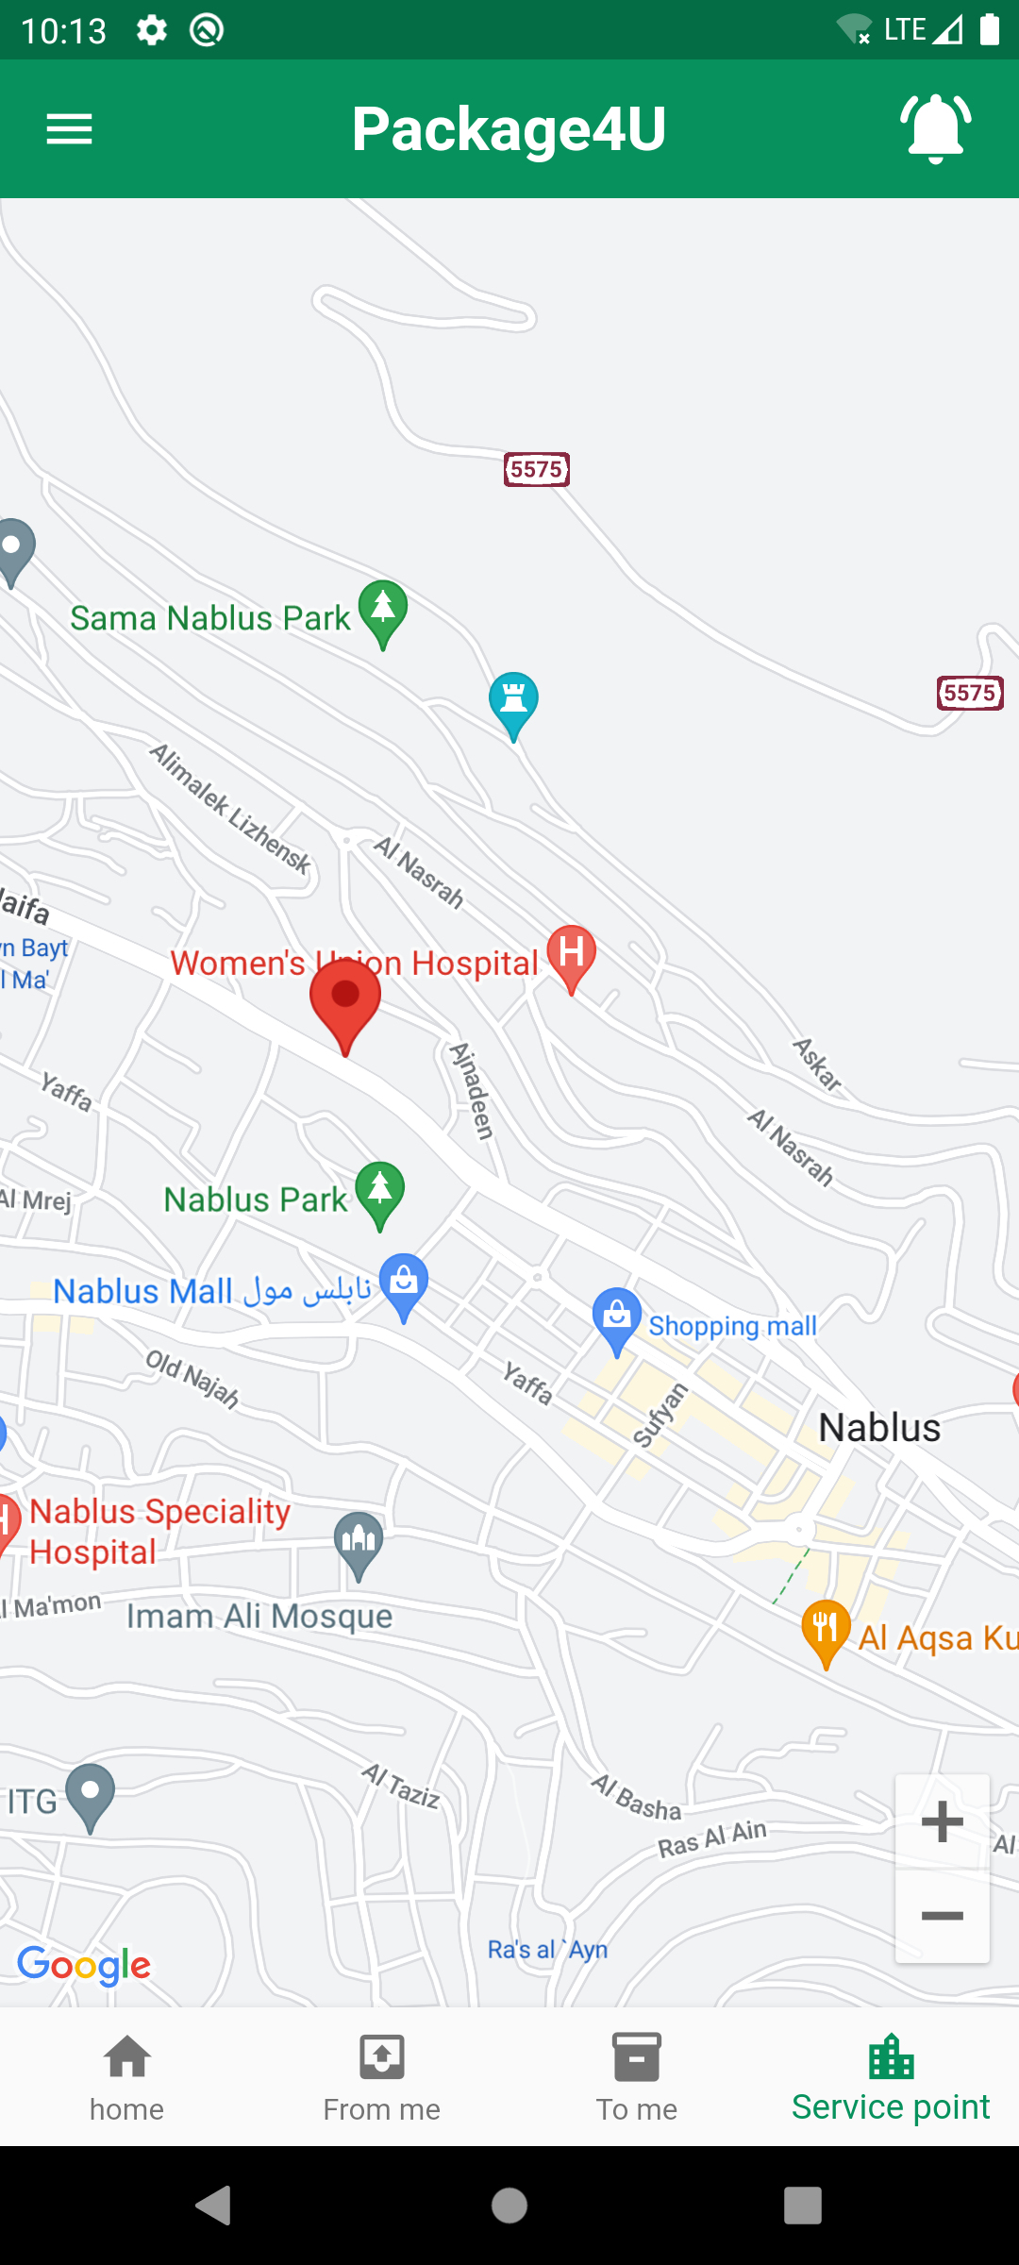
Company information

Slide 18
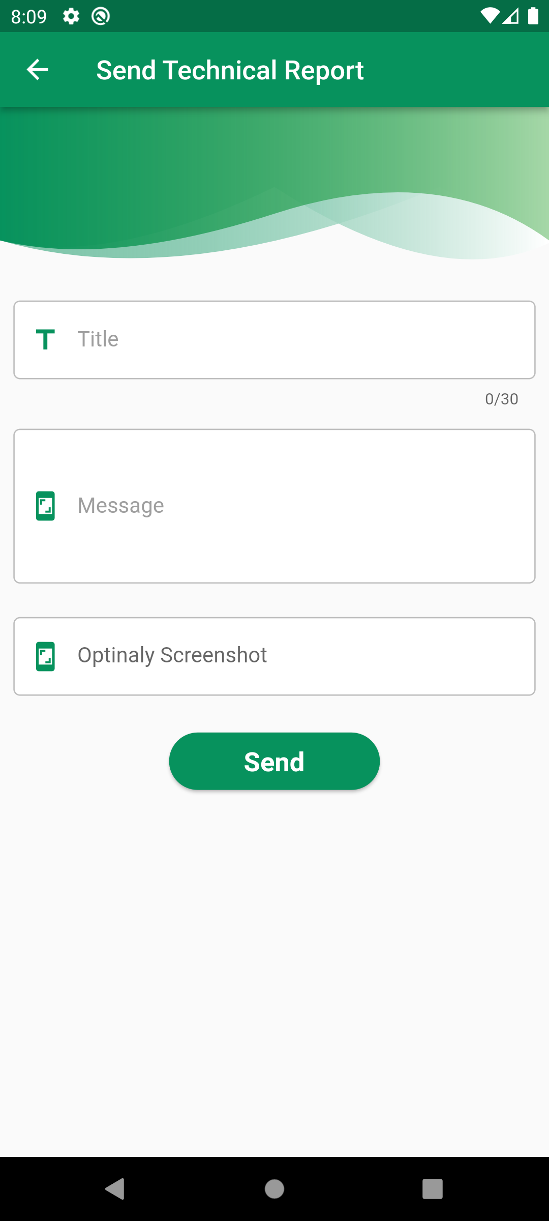
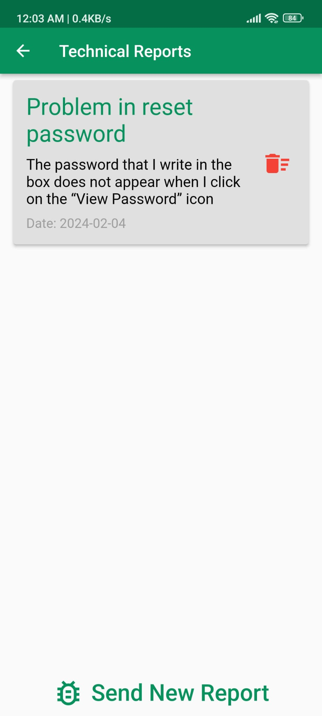
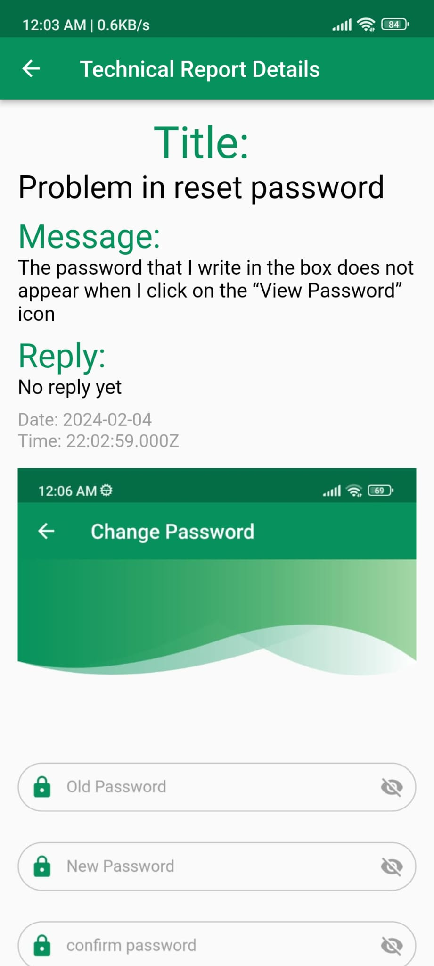
Report a problem or provide feedback

Slide 19
Employee

Slide 20
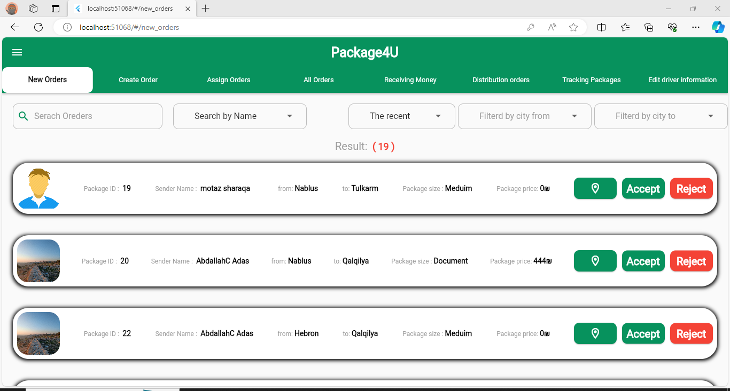
New Packages

Slide 21
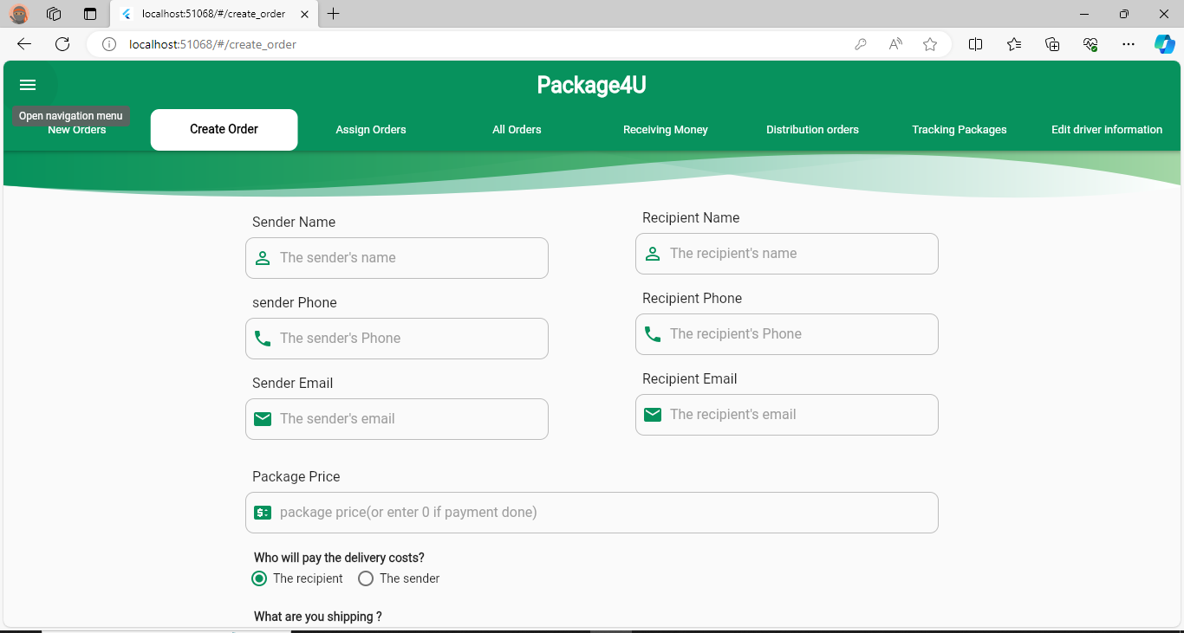
Create Package

Slide 22
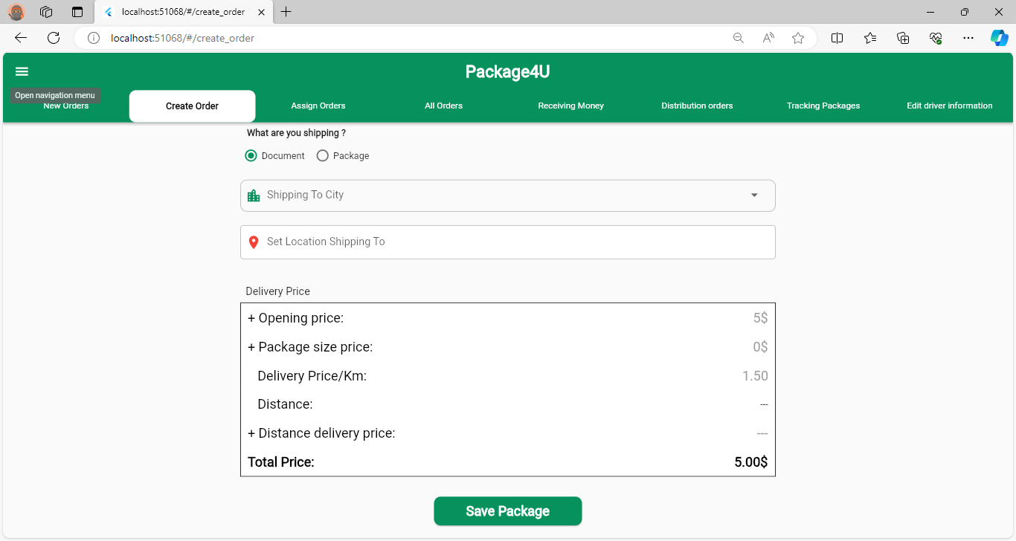
Create Package

Slide 23
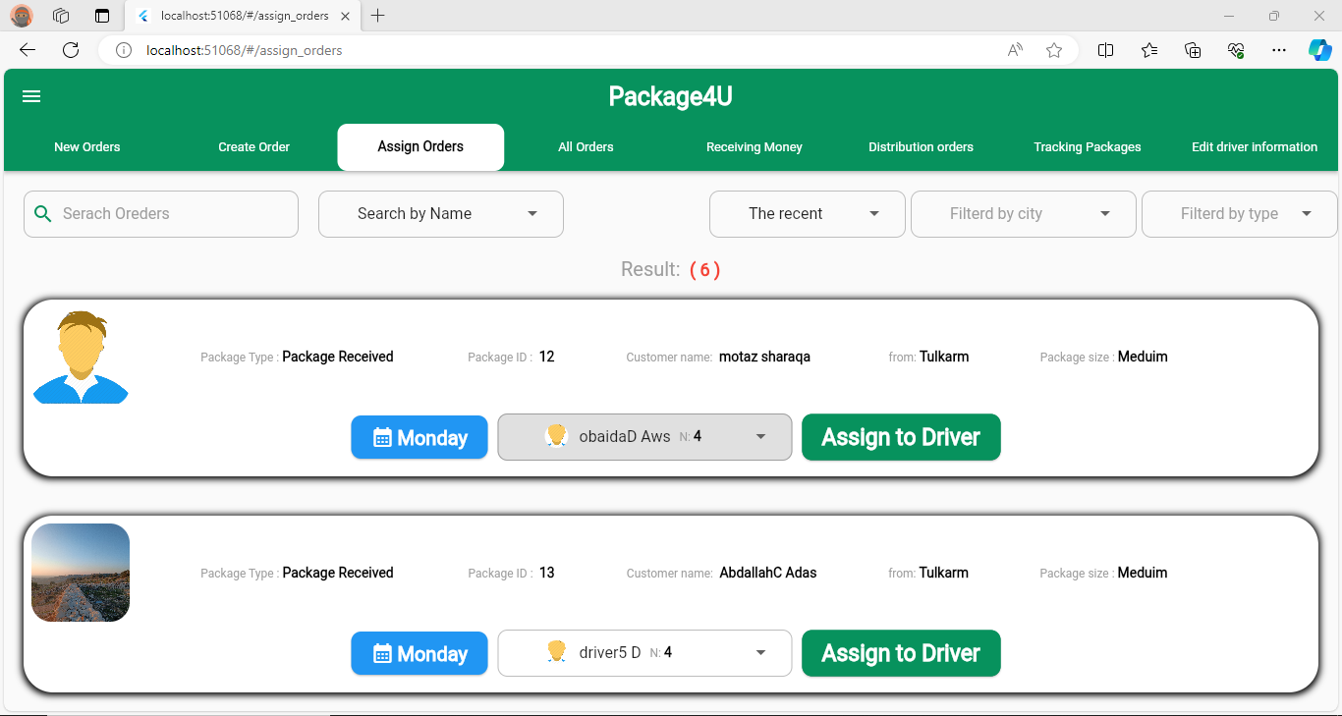
Assign Packages To Drivers

Slide 24
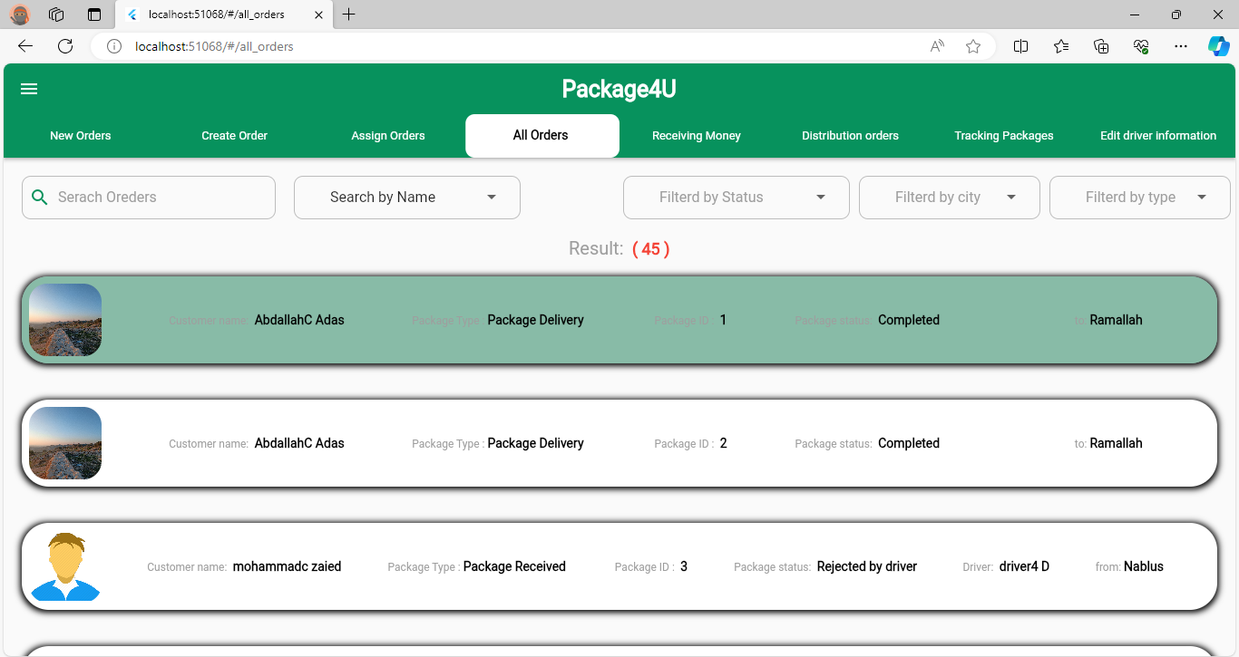
All Packages

Slide 25
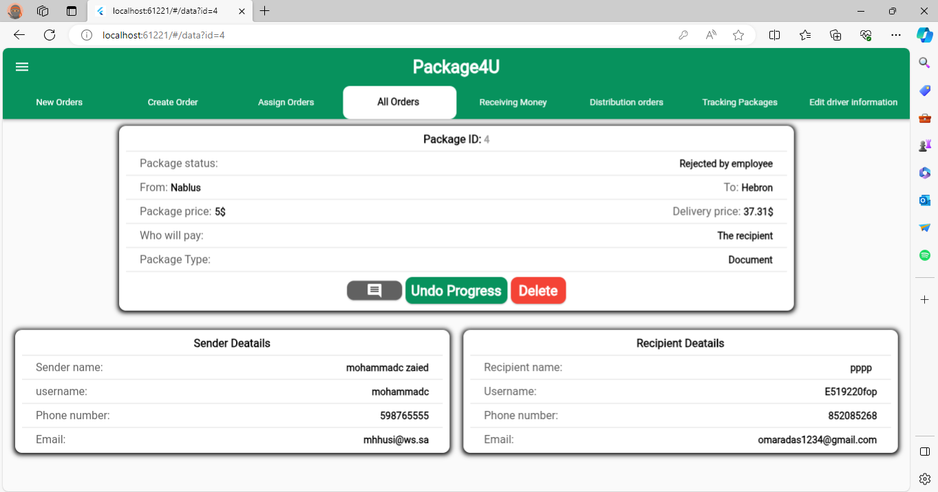
Package Details

Slide 26
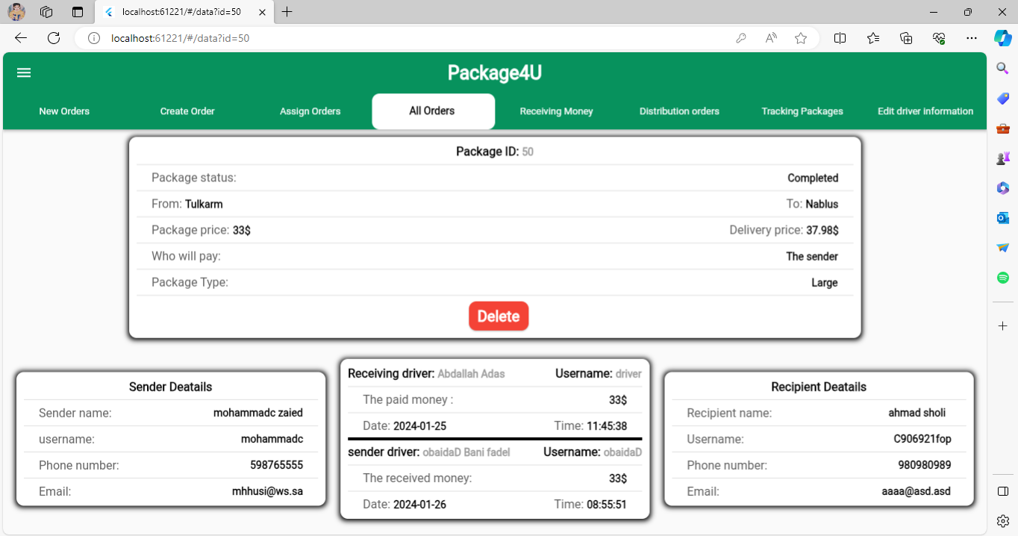
Package Details

Slide 27
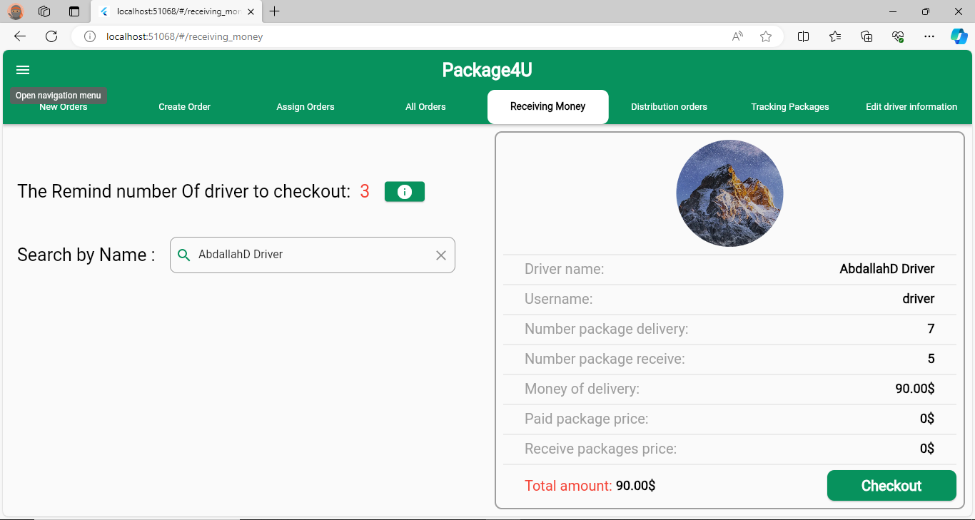
Receive Money & Packages From Drivers

Slide 28
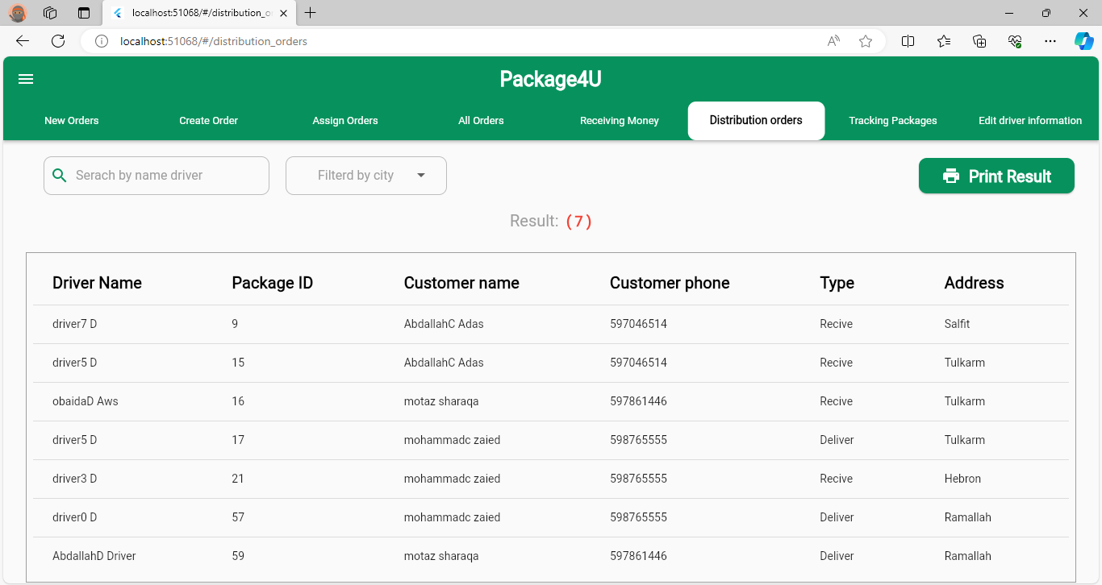
Print Packages sheets for workers and drivers

Slide 29
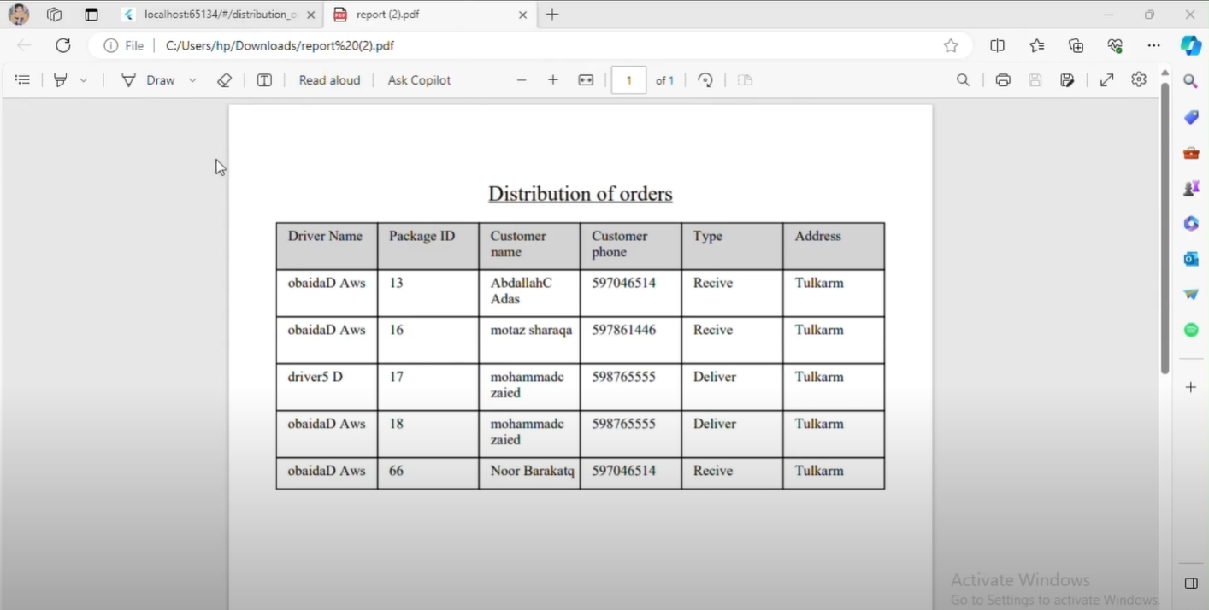
Print Packages sheets for workers and drivers

Slide 30
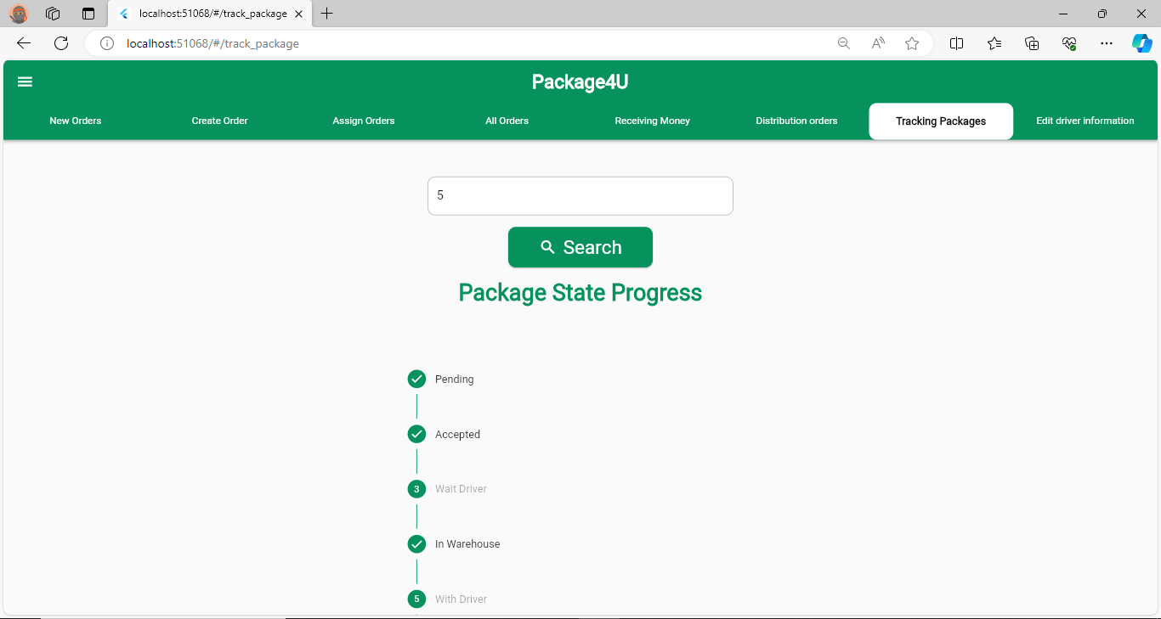
Packages Status

Slide 31
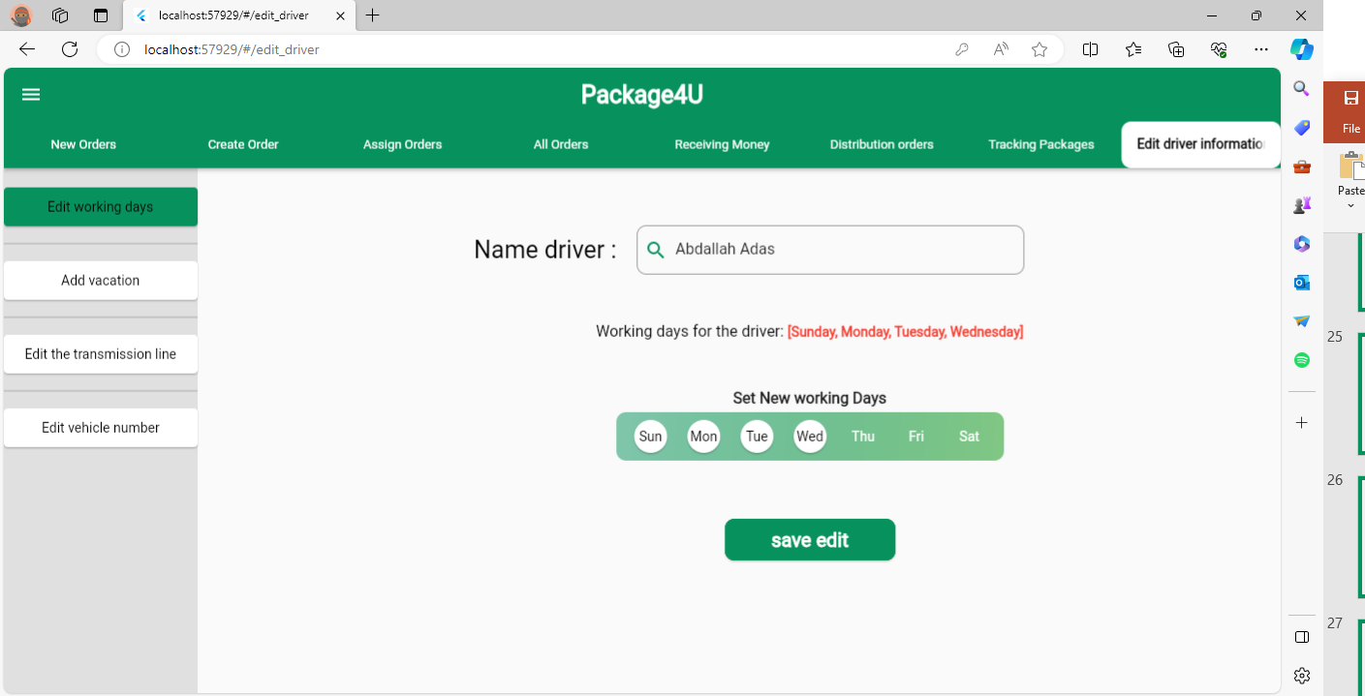
Edit Driver’s Working Days

Slide 32
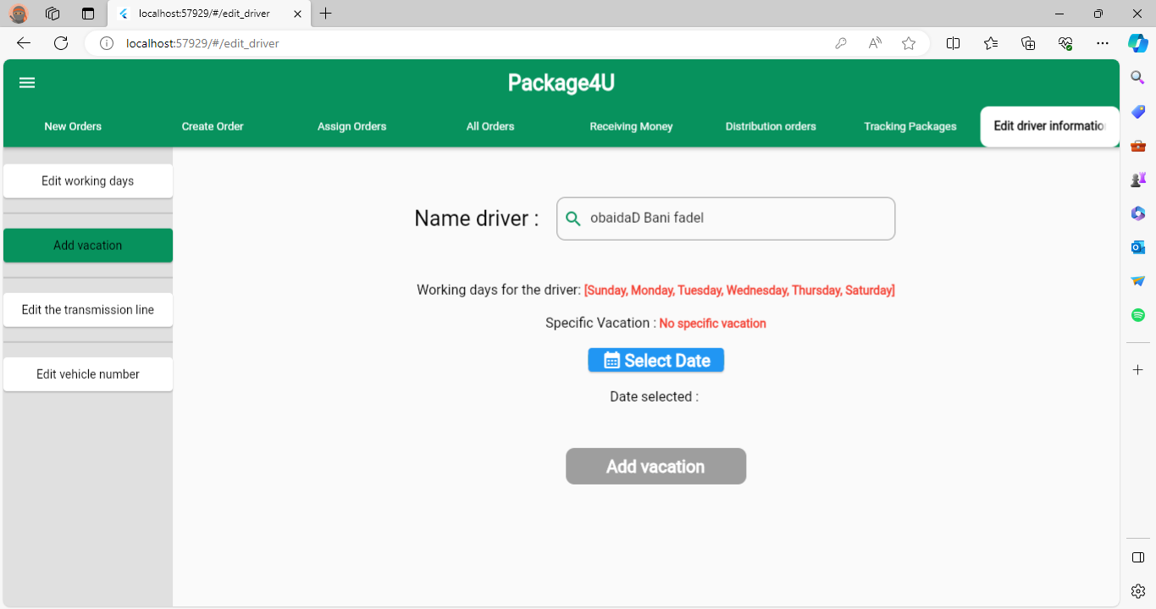
Add Vacation

Slide 33
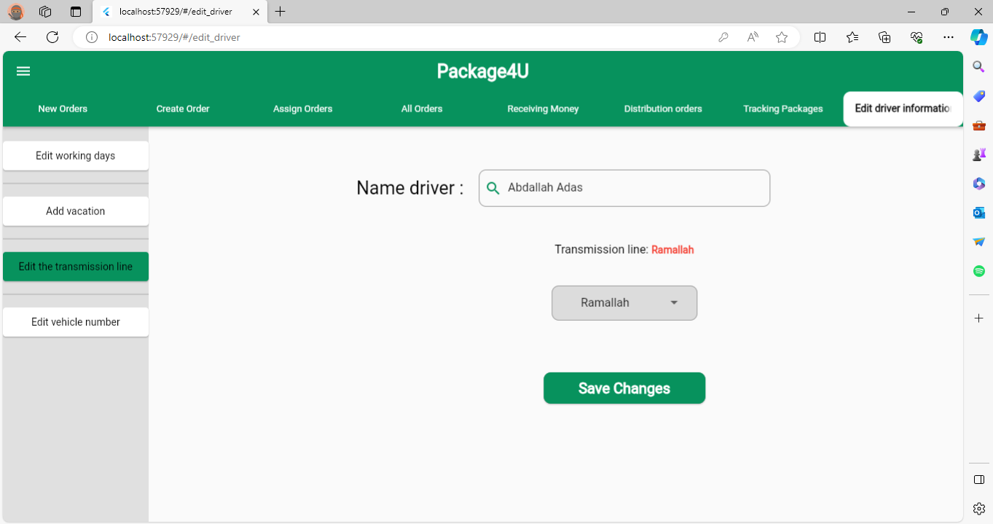
Edit Transmission Line

Slide 34
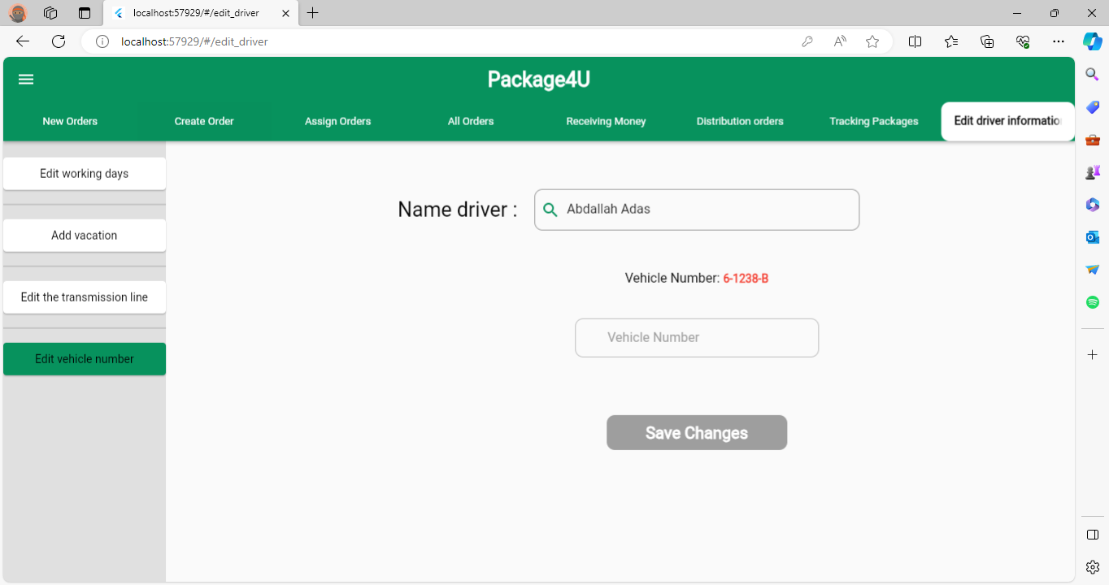
Edit Vehicle Number

Slide 35
Driver

Slide 36
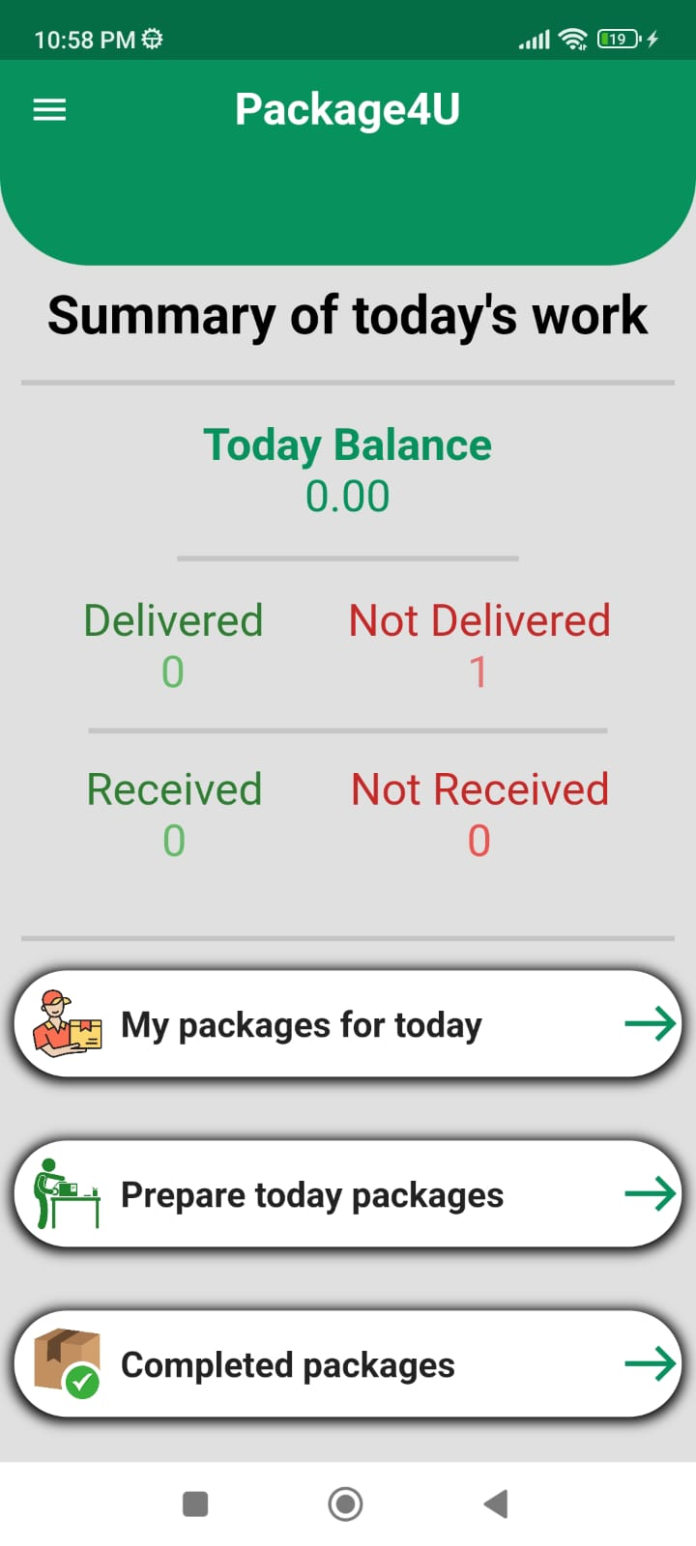
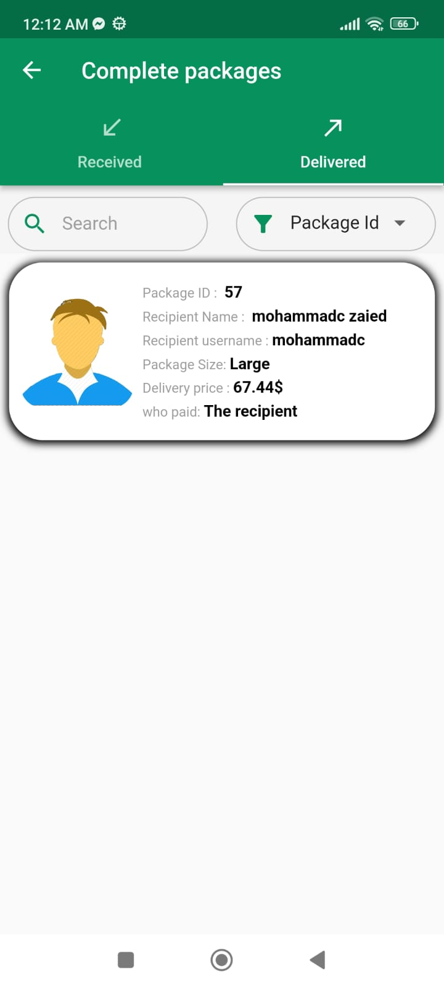
Driver Home Page & Completed Packages

Slide 37
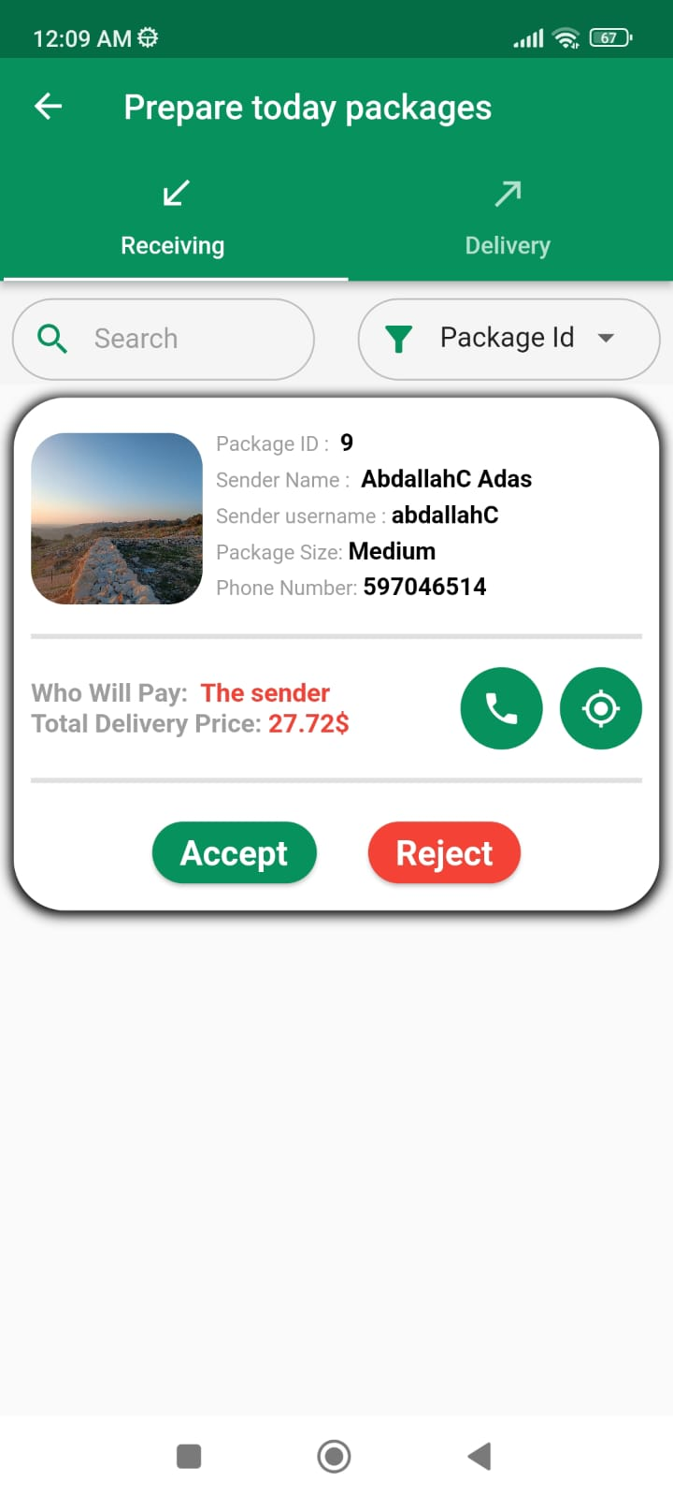
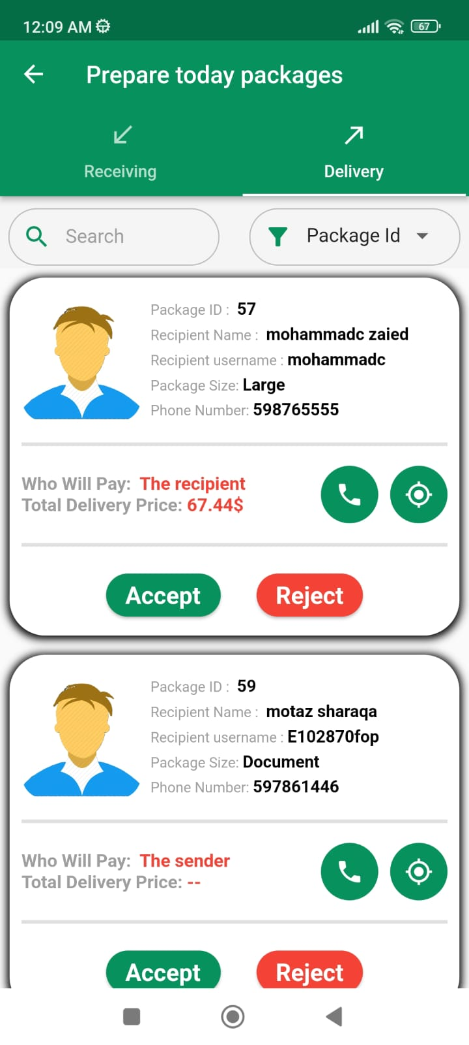
Prepare Today Packages

Slide 38
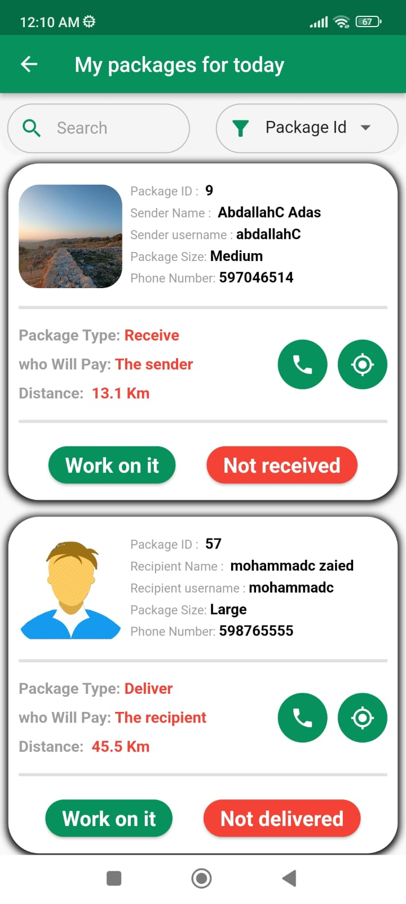


Today’s Packages

Slide 39


Receive Package

Slide 40
Manager

Slide 41


Manager Home Page & Drawer

Slide 42


Company Information

Slide 43


Edit Costs & Served Cities

Slide 44


Employees Management

Slide 45


Drivers Management

Slide 46


Track Drivers

Slide 47


Manager Reports

Slide 48


Daily & Monthly Reports

Slide 49


Yearly & Interval Report

Slide 50
Admin

Slide 51

All Managers

Slide 52

Add Manager

Slide 53

Users Problem Reports

Slide 54

Show Problem

Slide 55
Future Work
Adding payment methods via bank cards.
Expanding the program to have the ability to deal with multiple warehouses.

Slide 56


