Slide 1

Development of an Intelligent Smart Distribution Board for Advanced Power Monitoring and Control in Residential Settings
A Graduation Project 2 Submitted By:
Eng . Doha daghlas
Eng. Hamza Yassin
Eng. Mohammad zakarneh
Eng. Fayez nasassrah
Supervisor: Dr. Moin Omar

Slide 2
Introduction
Smart power distribution project using Wi-Fi using ESP8266 board is a project to monitor and control the electricity distribution in your home or office intelligently via the Internet.

Slide 3
The system will be equipped to measure key electrical parameters, provide real-time data via Wi-Fi connectivity, and offer intelligent control of energy across circuit break.

Slide 4
Objectives
a. Smart Distribution Board capable of measuring: Current, Voltage, Power Factor, Power and Energy Consumption
b. To integrate Wi-Fi connectivity for remote access and control.
c. To enable live power monitoring and real-time data visualization.
d. To implement energy management for saving power consumption.

Slide 5
The project idea
The project idea come from multiple sources and be the result of the need for more efficient and sustainable solutions in the field of energy management , Personal need is one of the most important drivers that can push individuals and innovators to develop new projects

Slide 6
Here is how to interpret personal need in the context of an intelligent energy management system project:
a. High Electricity Bills
b. Desire for sustainability
c. Save time and effort
d. Reduce excess consumption

Slide 7
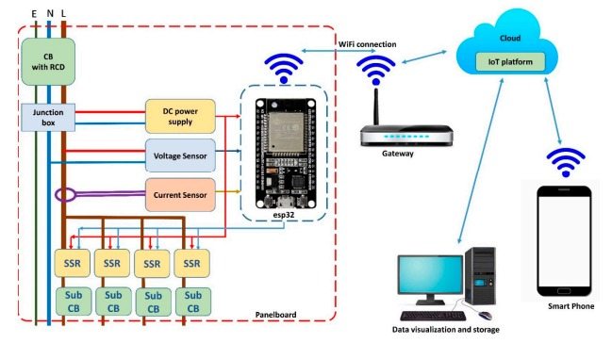
1.Integrate Wi-Fi connectivity for remote access and control.

Slide 8
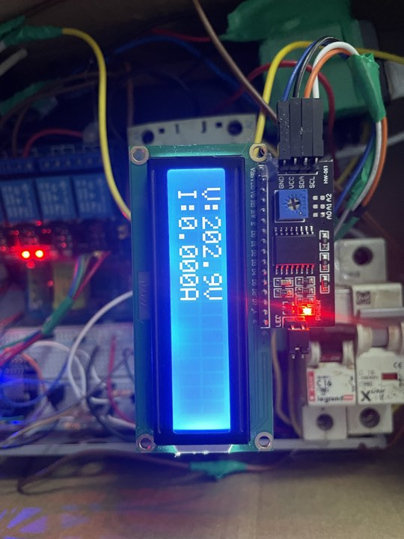
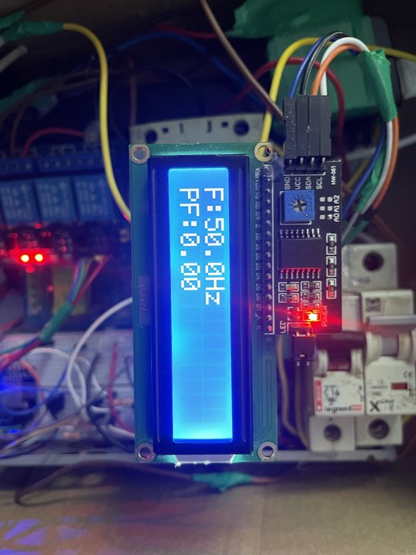
2. Enable live power monitoring and real-time data visualization.

Slide 9

3. Implement energy management for saving power consumption.

Slide 10
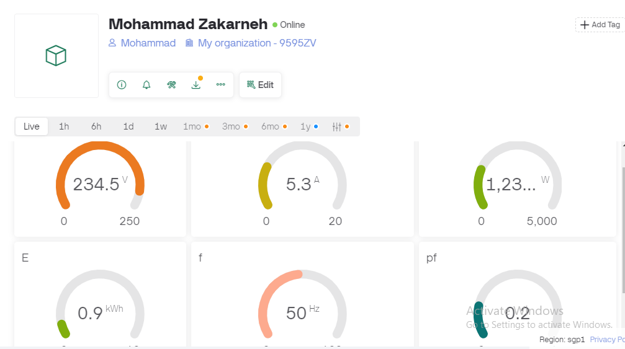
4. Connect the device to an application that shows the reading values ​​and control buttons

Slide 11
METHODOLEGY
Software
Selection of appropriate sensors and microcontrollers for accurate measurement and data processing
Integration of Wi-Fi module for wireless connectivity.
Possibility of monitoring and controlling energy

Slide 12
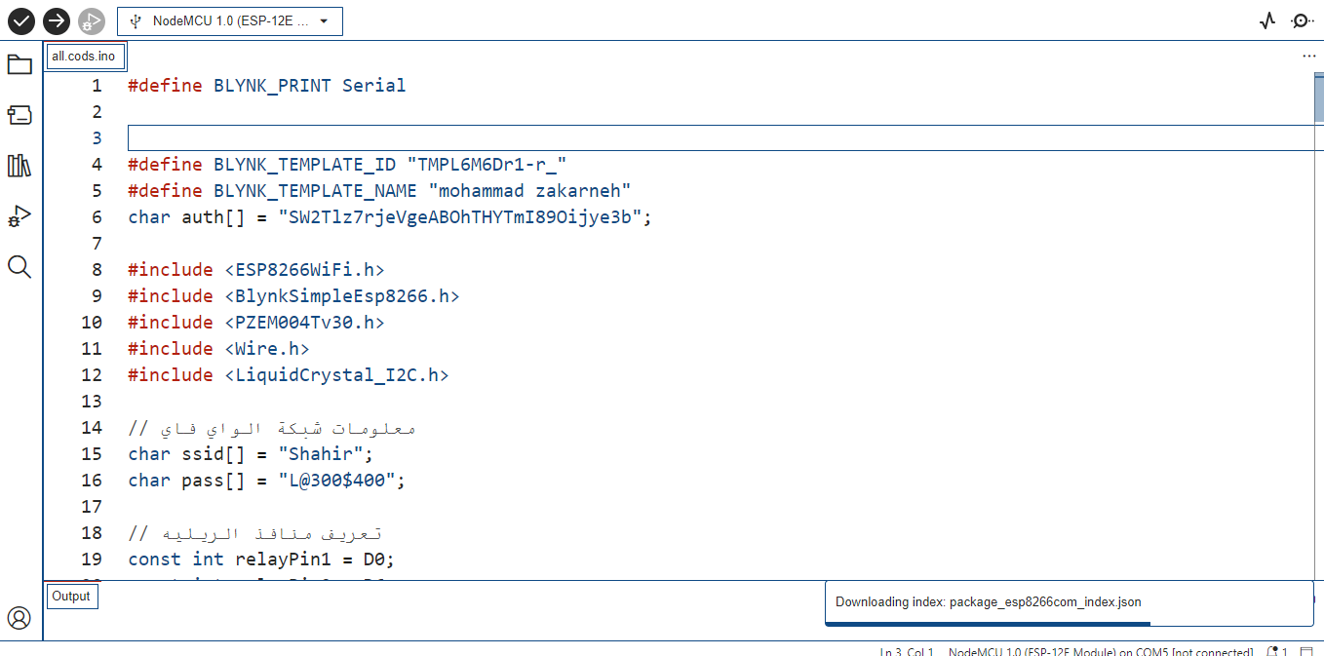
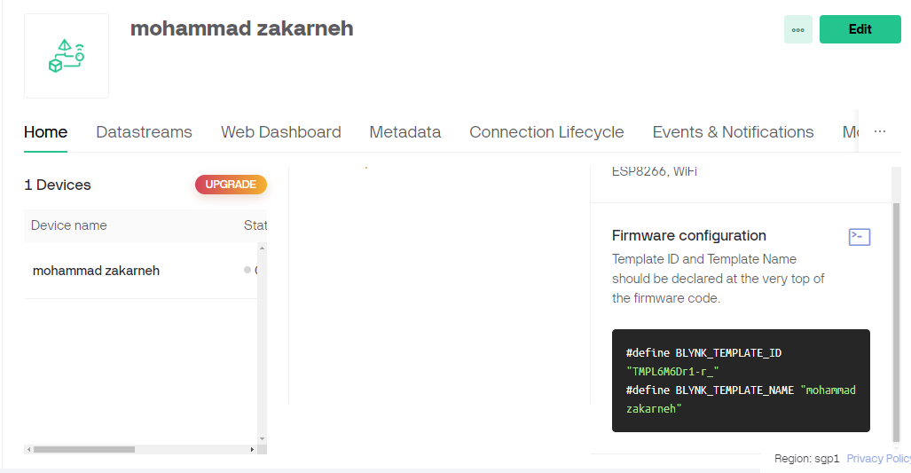
Software
We wrote the code for the project on the Arduino ide, and the code included defining the libraries, defining the Wi-Fi network, and connecting the Blynk application to the device. Then we wrote the parts for taking values ​​from pzem-004t and displaying them and the last thing is the part for controlling the relays.

Slide 13
Hardware
Creation of firmware to interface with sensors and microcontrollers. Implementation of communication protocols for Wi-Fi connectivity.
Development of a user-friendly interface for data visualization and control.
We will provide a simple explanation of the project parts and how they work

Slide 14
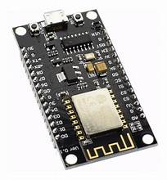
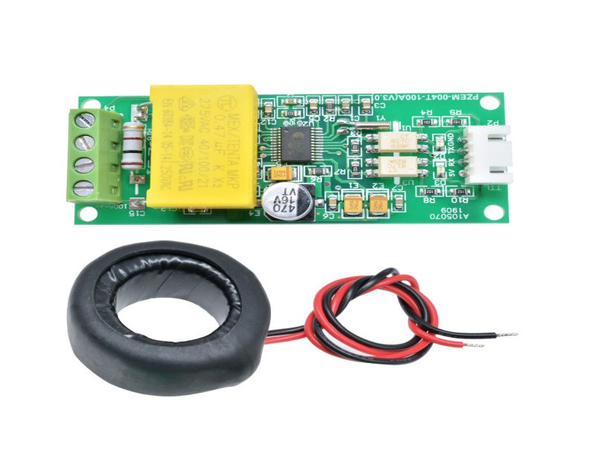
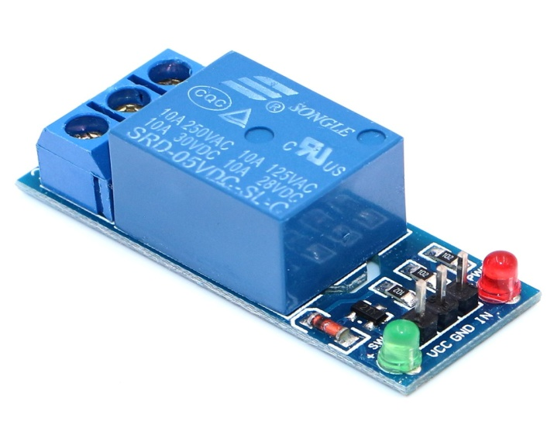
Hardware
These are the tools and equipment’s to implement this project by testing, measuring and evaluating data.
ESP8266
PZEM-004T
The PZEM-004T is a versatile electrical parameter measuring module commonly used in various applications.
5V relay module
Is a low-cost Wi-Fi microchip, with built-in TCP/IP networking software, and microcontroller capability, produced by Express if Systems in Shanghai, China
.
a 5V relay module is a device that controls electrical loads remotely using a 5-volt signal.

Slide 15
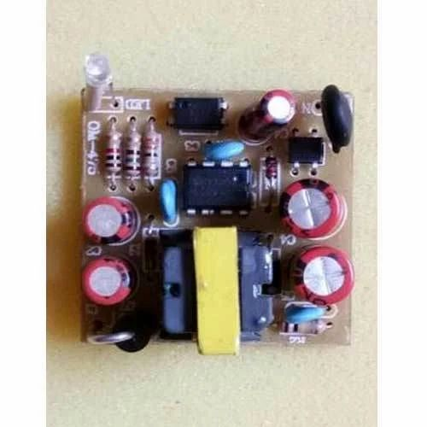
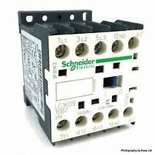
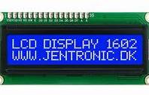
Hardware
These are the tools and equipment’s to implement this project by testing, measuring and evaluating data.
1602 I2C Display
Mobile phone charger
Contactor
The 1602 I2C display is a 16x2 character LCD with an I2C interface, commonly used in electronics projects.
We need to convert voltage from 220V AC to 5V DC, so we will use a mobile phone charger to power the circuit components with 5V DC.
We used the contactor because it can withstand the current of high loads, unlike the relay

Slide 16
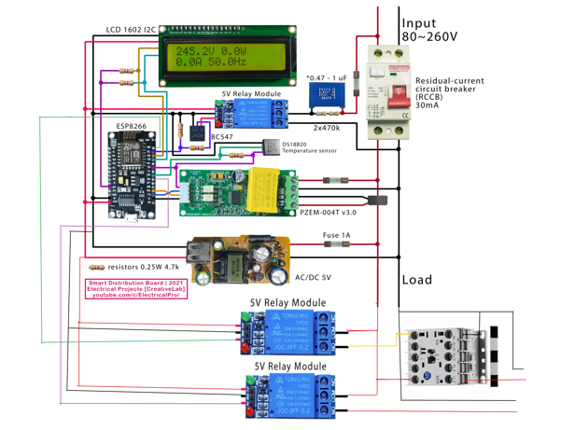
Main circuit of project

Slide 17
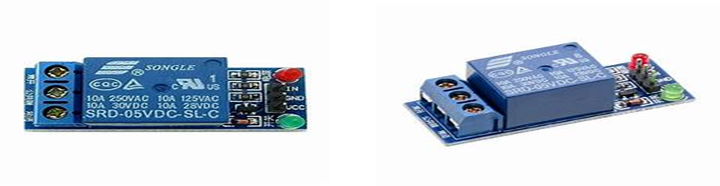
Implementation and solution phase
Individual Load Control
we enhanced the functionality of our smart distribution board by integrating a series of relays connected to an ESP8266 microcontroller
to provide us with the ability to control the load separately
without the need to cut off the current from the entire circuit

Slide 18
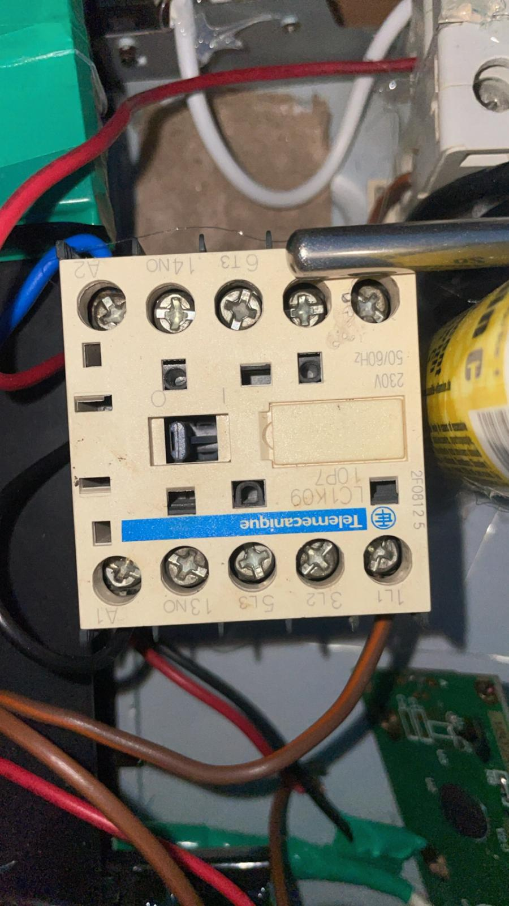
Technical implementation details
Handling High Current Loads
To solve the problem of loads that consume high current, we connected Its relay is on the contactor, and thus we have provided the control feature in our project for all types of loads

Slide 19
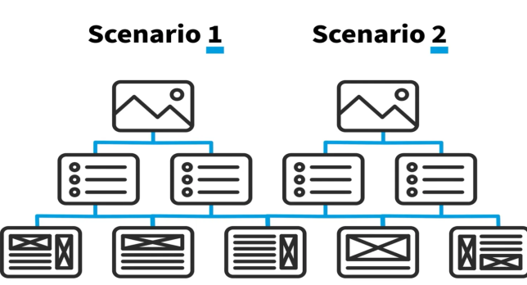

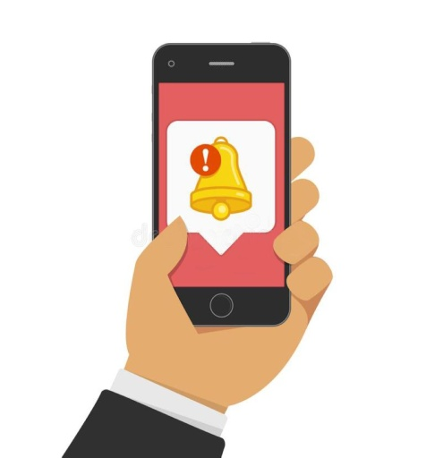
Possible developments on the project
User-defined scenarios
scenarios are created by the user and saved
For example, a Night Mode scenario might turn off all lights and reduce heating after 11 p.m.
Users can set timers for specific devices to only work during specific hours
Users can set timers for specific devices to only work during specific hours.
development on the application and adding software codes.
For example, to develop software to provide in-app notifications
to send notifications when important events such as high power consumption or power outages occur.

Slide 20
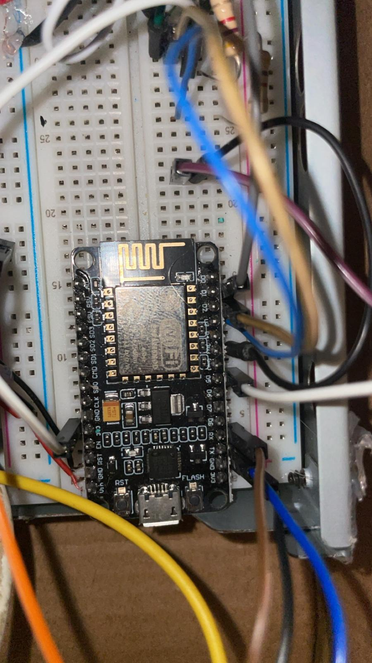
The challenges
Integration between different devices
such as ESP8266, relay modules and connectors requires significant effort and complete hardware compatibility.
The control software that communicates between the mobile application and the ESP8266 to turn the relay on and off was a difficult and debugging-intensive challenge.
Easy and simple user interface design enables users to control loads individually.
Compatibility with different electronic systems: Ensure that the application works on different operating systems

Slide 21
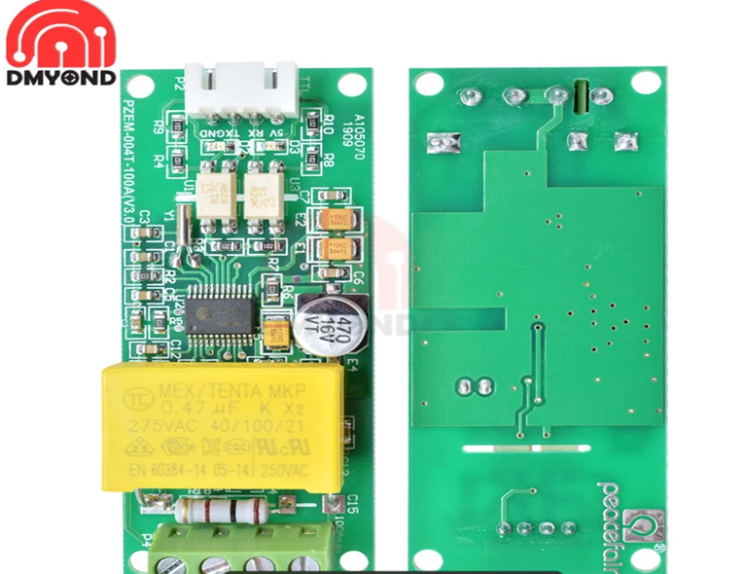
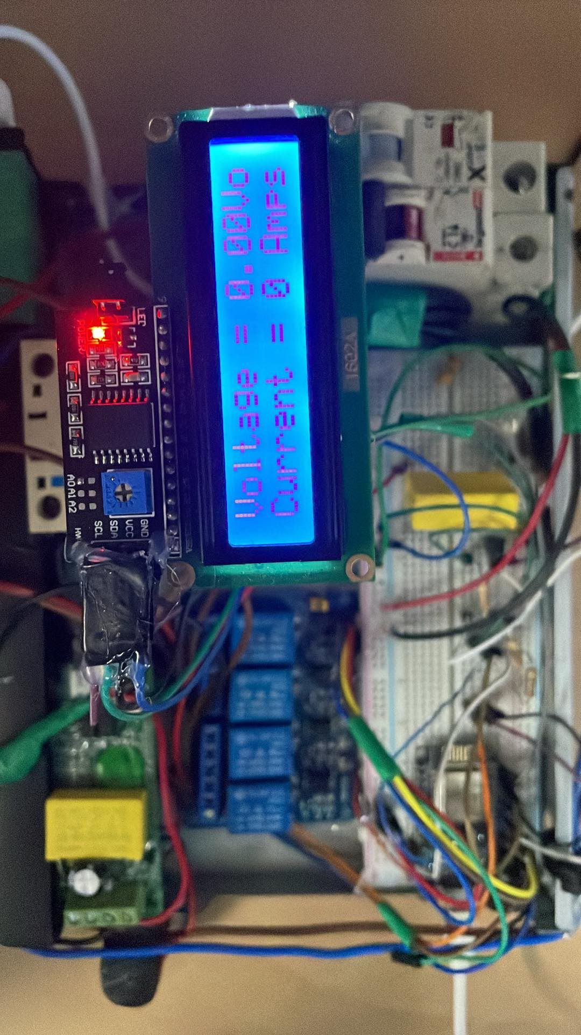
The biggest challenge was the difference between the version of the component and the libraries on the Arduino, so we replaced the PZEM-004 with the third generation version of it to match the libraries available from the code.
Wireless connectivity and connection stability
Ensuring the stability of the wireless connection between the ESP8266 and mobile applications in the presence of interference and other signals was a challenge that required the use of simple interference prevention techniques, as high voltage wires introduce interference.

Slide 22
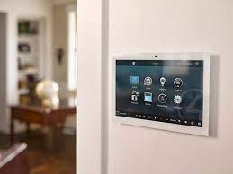
Future aspirations and recommendations
1- Smart integration
as the smart distribution panel system can be integrated with smart home systems and increase its effectiveness
2- Participate in pilot tests in residential environments to collect real-world feedback, make the necessary adjustments,
3- Continuous improvement by obtaining the necessary certificates and approvals to put the product on the market

Slide 23
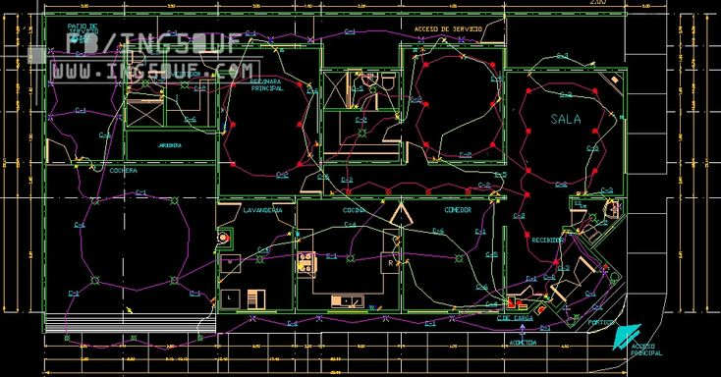
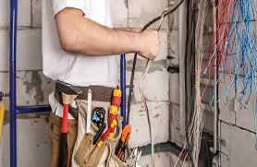
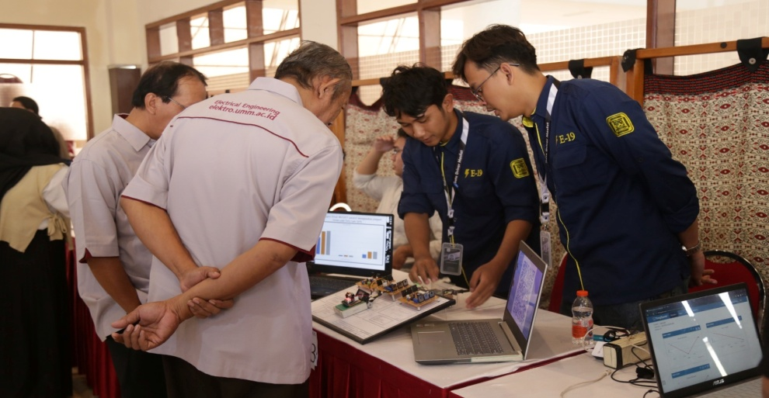
4-Partnerships with installers and builders
5- Community participation
Participating in local community events and exhibitions to display our project’s smart distribution panels

Slide 24
