Slide 1

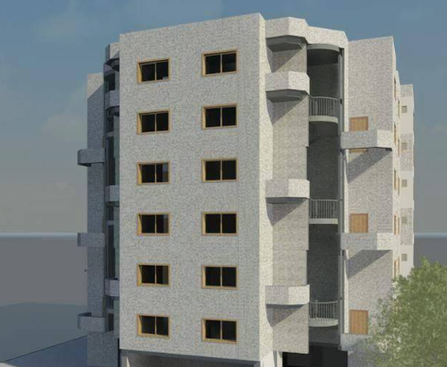
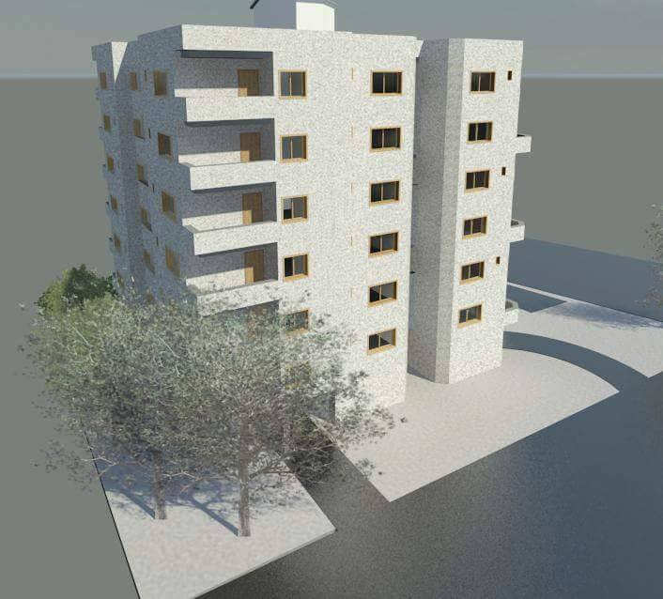
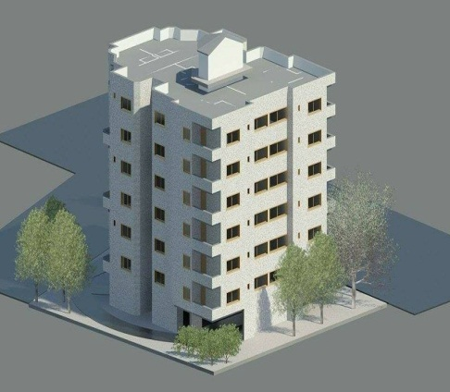
An-Najah National University
Faculty of Engineering
Department of Building Engineering
Graduation Project-II
An Integrative Design Of Residential Building
Prepared by:
Nuzha Atare
Issam Ishtayeh
Ashraf Atteih
Project Supervisor:
Eng. Ameer Al-Aker

Slide 2
Outline:-
Introduction.
Methodology
Project Design
Architectural design .
Environmental design .
Structural design .
Electrical design .
Mechanical design .
Cost estimation .
The time scheduling .
Conclusion

Slide 3
Introduction:
The main objective for the project is to design an integrated residential building in all aspects (architectural, structural, mechanical, HVAC system, environmental, public safety and electrical aspects)

Slide 4
Methodology:
METHODOLOGY
PART 1
PART 2
Literature Review
Specifications
Questionnare
Cases study
Site selection and it analysis
Design data
Project Design
Results Discussion

Slide 5
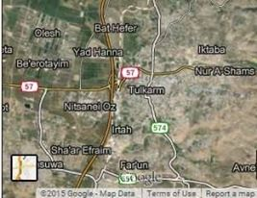
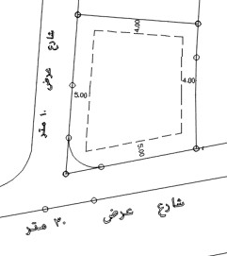
Site Location:
The building is located onTulkarem and its located
in the Northern direction .
Total used Area from the site:770 m2

Slide 6
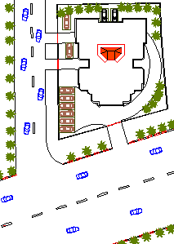

Architectural Design
The Site plan

Slide 7
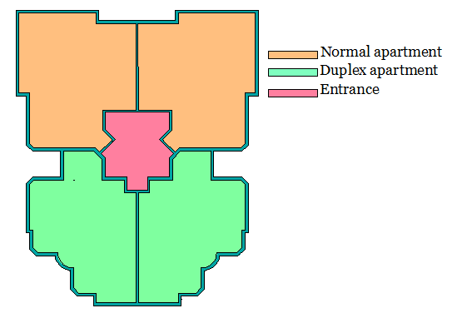
Architectural Design
apartment 1 +2
normal
Total used Area from the site:770 m²
The area distributed to 7 floors
the building include parking in the ground floor and the rest floors are apartments .
Each floor area is about 550 m²
Apartment 3+4
Duplex
Each floor is divided into four apartments.
Two apartments are designed as normal (one house in one story ) with area of 128 m² each apartment .
Another two apartments is designed as duplex (one house in two story ) with area of 147 m² each apartment .

Slide 8
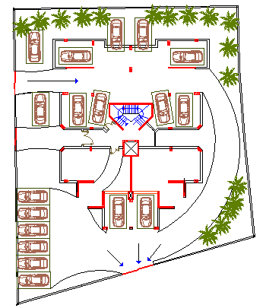
Ground floor (Parking)
Architectural Design

Slide 9
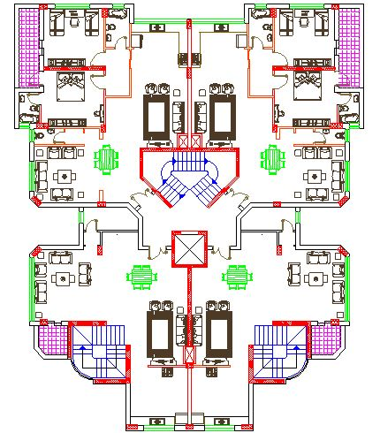
First floor plan :

Slide 10
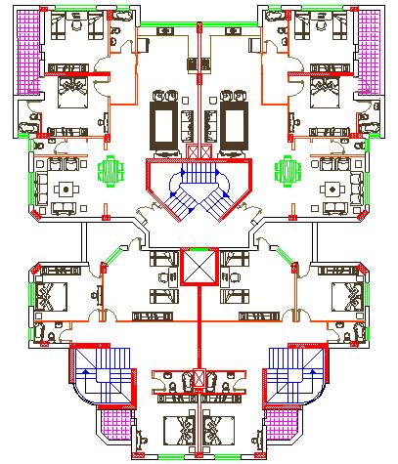
Second floor plan :

Slide 11
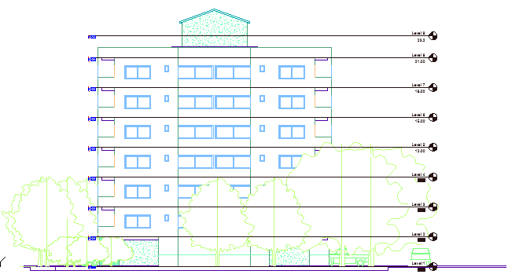
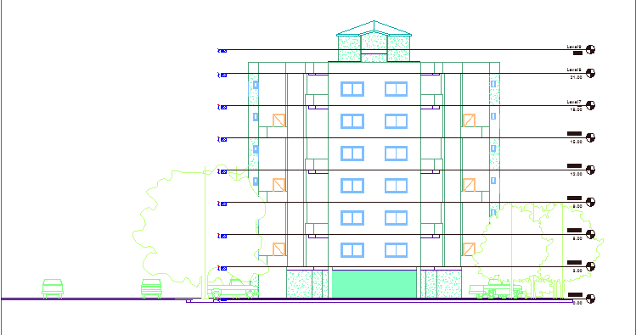
North Elevation
Architectural Design
South Elevation

Slide 12
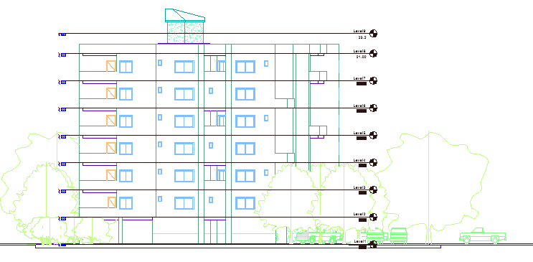
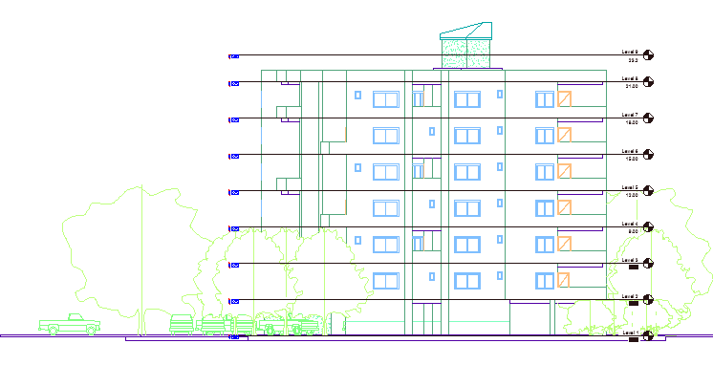
Architectural Design
West Elevation
East Elevation

Slide 13
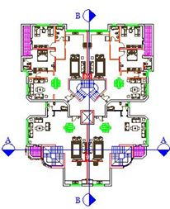
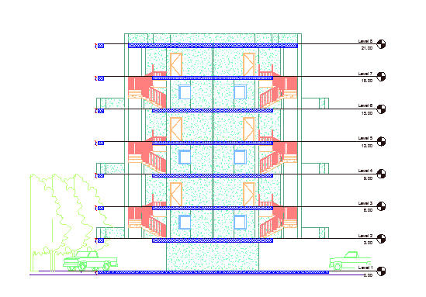
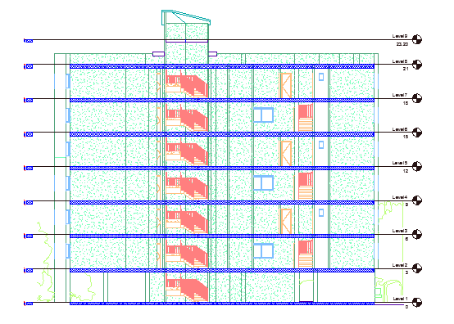
Section A-A
Architectural Design
Section B-B

Slide 14

3D Picture of the building
Architectural Design

Slide 15
Environmental System
Environmental design
Thermal Calculations
Daylight
Acoustical Design

Slide 16
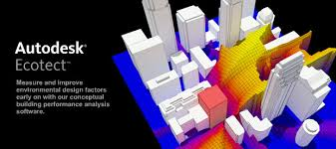
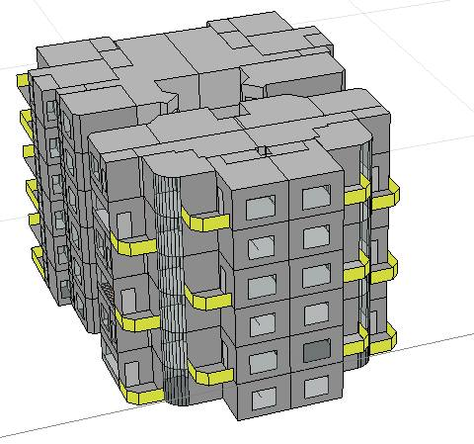
Environmental System
Analysis the building environmentally by ECOTECT program
ECOTECT Program was used to: 1. Analyze sun movement and natural lighting. 2. Calculate heating and cooling loads

Slide 17
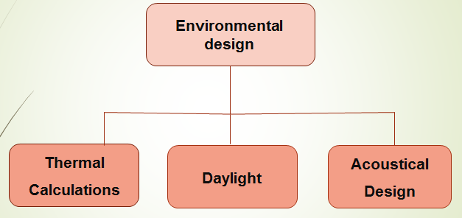
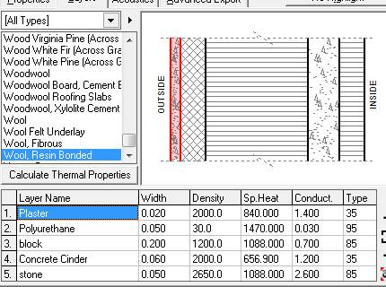
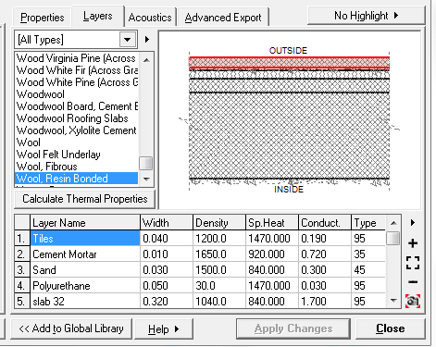
Thermal Calculations
The properties for the external wall
the properties Ceiling interaction with floor
U=0.45 w/m2.k
U=0.42 w/m2.k

Slide 18
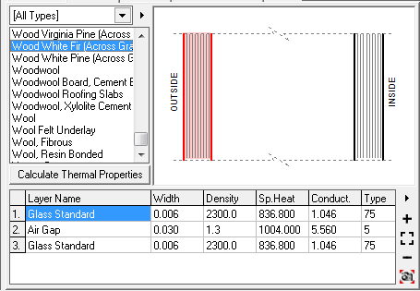
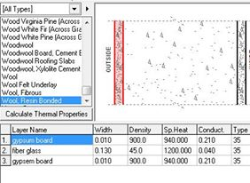
Thermal Calculations
Properties for double tented glazed window
The properties for the partition is :
U=0.28 w/m2.k

Slide 19
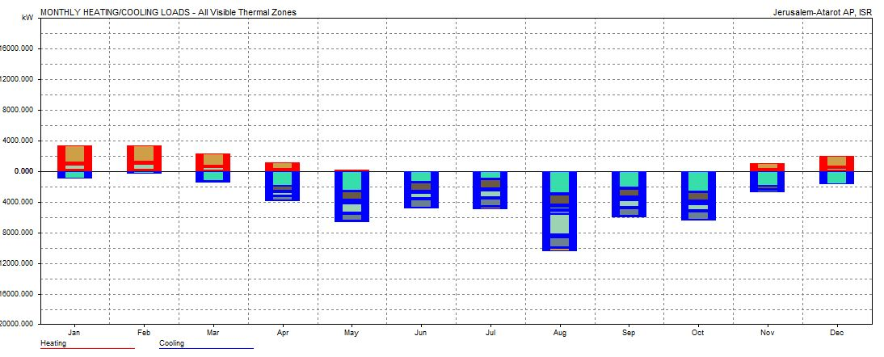
Total heating load and cooling load per m^2 = 49.003 KWh The acceptable range from 30 to 80 KWh
Thermal Calculations

Slide 20
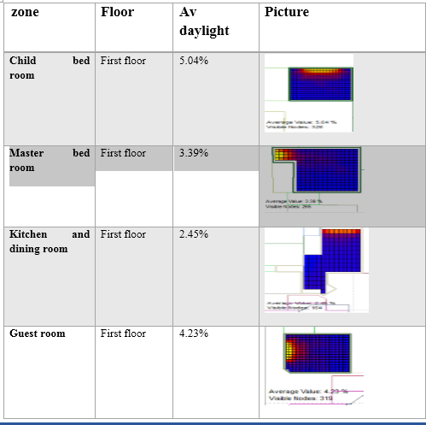
Daylight factor
The daylight factor must be within the range which is (3-5).
D.F for Left apartment in the first floor

Slide 21
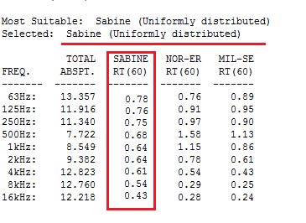
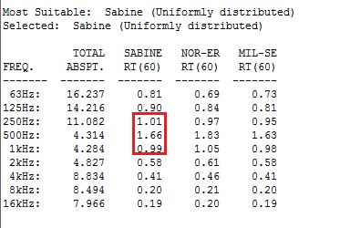
Reverberation time for guest room :
Acoustical Design
Total STC of inside wall = 54db.
Total STC of external wall = 59db
IIC =55 db
RT60 for residential building should be .6-.8 sec
Before modification
After modification

Slide 22

Structural System
The structural design was made by ETABS program

Slide 23
Structural design
Structural design
Design data & code
Gravity Loads
&
Seismic loads
Checks
Results

Slide 24
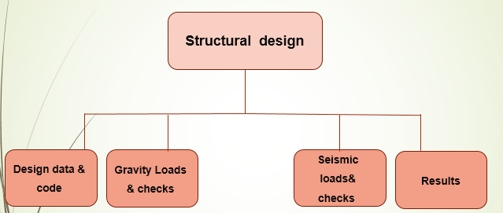
Structural Design
Design data
Compressive strength of concrete (fc)
beams
shear walls
columns
slabs
footing
240 kg/cm2
Bracing
160 kg/cm2
2. Yielding strength of steel (fy) 4200 kg/cm2
3. Bearing capacity of soil(q) 2.5kg/cm2

Slide 25
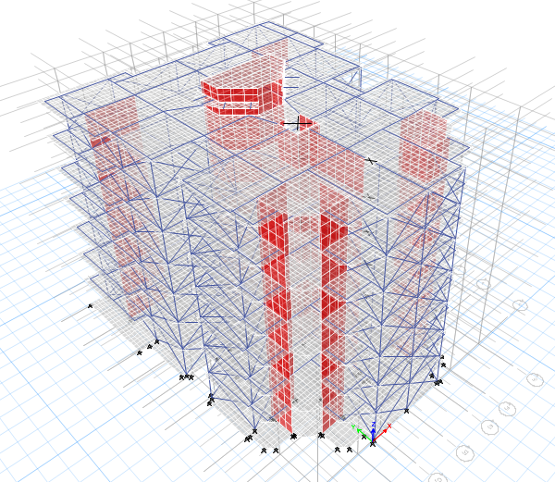
Structural Design
Design Code:
The structural design will be according to :
1) the American Concrete Institute code ACI 318 .
2) the seismic design according to UBC-97
3D modeling

Slide 26
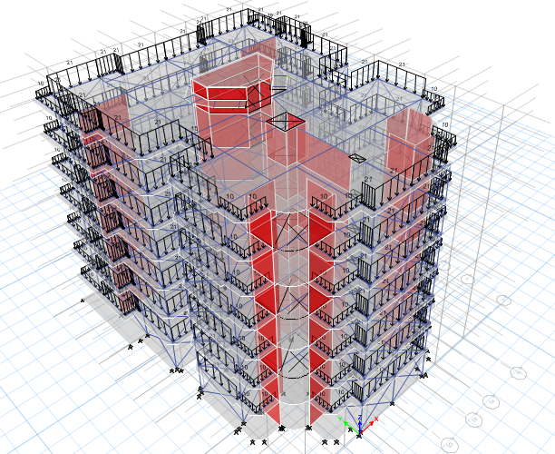
Structural Design
Loads
Gravity loads
Superimposed dead load= 4KN/m²
Live load =3 KN/m²
External wall load =21 KN/m
ETABS model (Loads)

Slide 27
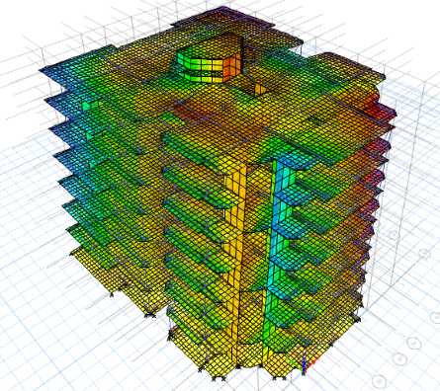
Structural Design
ETABS model
(after run)
Checks
 | ETABS | Standard (ACI 318)
Ok | T(period)=0.343 sec | T(period)=2 sec | Compatibility check
Ok | D = 17.9 mm | D= 21.25 mm | Deflection check
Ok | 4.2% error | 5% error | Equilibrium check
Ok | 3.64% | 10% error | Stress-strain check

Slide 28
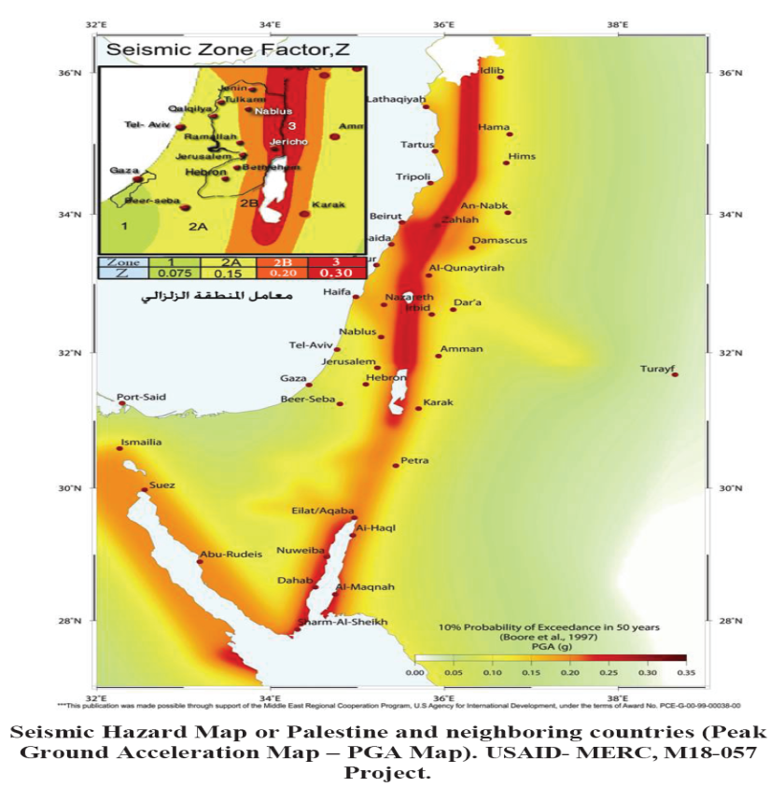
Structural Design
Seismic data
The UBC97 code seismic parameters are as follows:
The seismic zone factor, Z= 0.15
The importance factor, I=1.0
The ductility factor, R= 5.5
The seismic coefficient, Ca=0.18
The seismic coefficient, Cv=0.25

Slide 29
Structural Design
ETABS model
(after run)
Seismic Checks
 | ETABS | Standard (ACI 318)
Ok | T (x)=0.343 sec T (y) = 0.042 sec | T(manual)=0.478 sec | Time period
Ok | 91.52% 91.43% | Larger than 90% | Mass Participation Ratio
Ok | VETABS (X max) = 8353.8 KN VETABS (Y max) =89464.6 KN | 7723 KN | Seismic shear force check

Slide 30
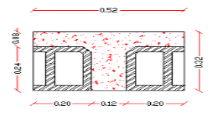
Structural Design
Preliminary dimensions:-
Slab dimensions
Thickness → 32 cm
Flange width →52 cm
Web width →12 cm
Flange thickness → 8 cm
Beam dimension
Main beam → (70*32) cm
Secondary beam → (50*32) cm
Column dimension
group 1→ (50*30) cm
group 2→ (60*30) cm
group 3→ (70*30) cm
group 4→ (80*30) cm

Slide 31
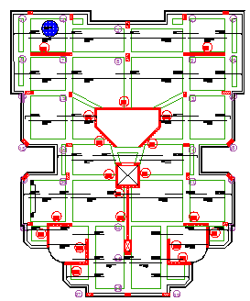
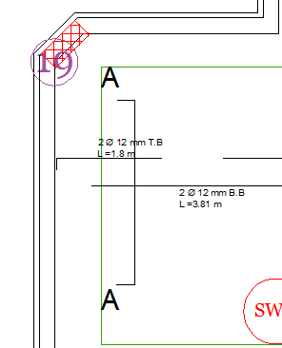
Structural Design
Slab Design

Slide 32
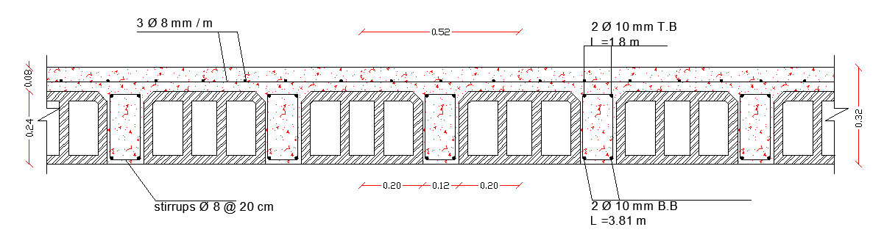
Structural Design
Slab Design
Bottom 2Ф10mm/rib
Top 2Ф10mm /rib
Shrinkage 3Ф8mm/m

Slide 33
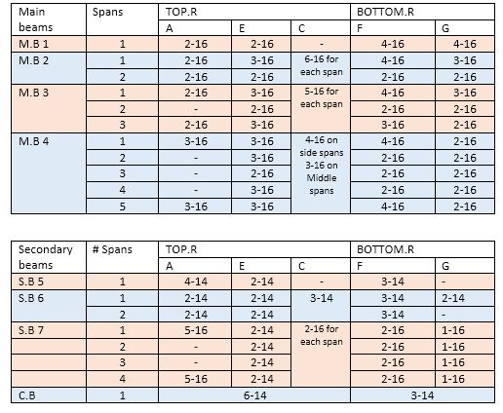
Structural Design
Beams Design
Beams divided to groups according to number of spans
Main beams divided to 4 groups
Secondary beams divided to 4 groups

Slide 34
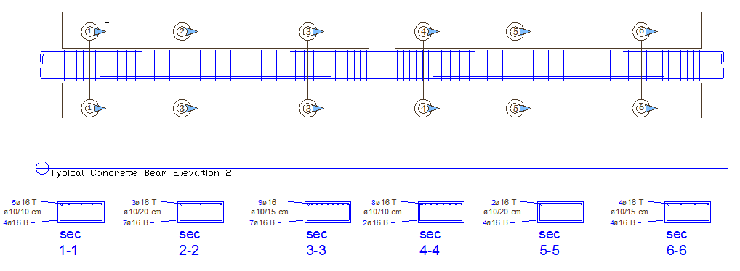
Structural Design
Beams Design

Slide 35
Structural Design
Columns Design
columns divided to groups according to the dimensions
Columns divided to 4 groups

Slide 36
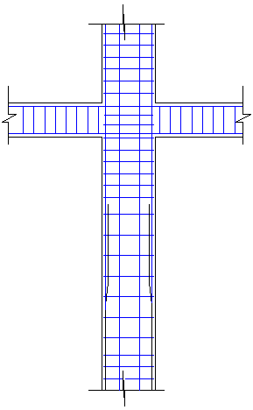
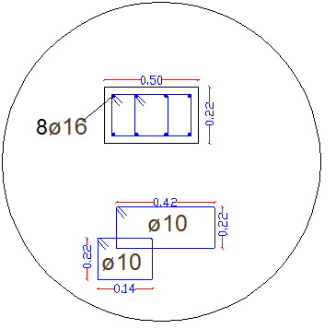
Structural Design
Columns Design
Sample

Slide 37
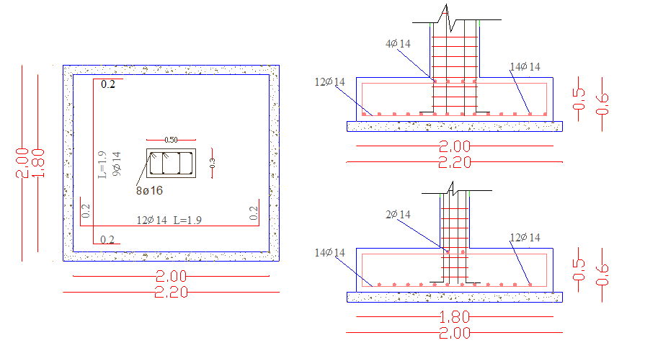
Structural Design
Footings Design
The reinforcement for each footing has been calculated according to the ultimate loads

Slide 38
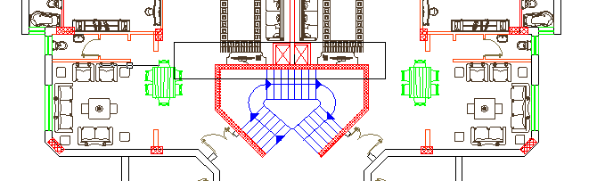
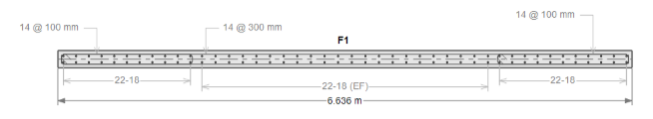
Structural Design
Shear walls Design
The reinforcement for each wall has been calculated by ETABS

Slide 39

Electrical Design
The artificial lighting
DIALUX software was used to design the lighting system

Slide 40
Electrical Design
For artificial lighting
Technical values for design :
1. illuminance value(Lx)
2. Work plane
Type of room | Luminance at work plan(lux)
Bed room | 250-280
kitchen | 300
Living | 300
Guest room | 300
Function | Height
Bed room | 75cm
kitchen | 95cm
Living | 75cm
Guest room | 75cm

Slide 41
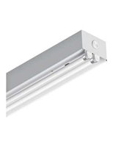
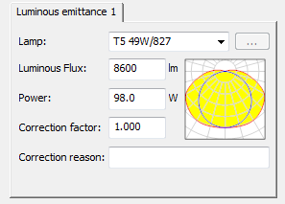
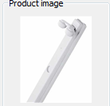
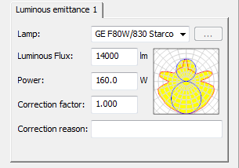
Electrical Design
Lighting design
Artificial lighting
Types of Lamps are used in our building floors:
OSRAM 4008321629388
OSRAM 4008321629455
BEGA 5127 2 TC-D 26W

Slide 42
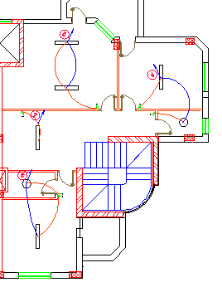
Electrical Design
Lighting design
Artificial lighting
SAMPLE:. Bedroom
distribution of light units
Illumenance =280 lux
Work plane =75cm
T5-49w/827Florescent Lamps used

Slide 43
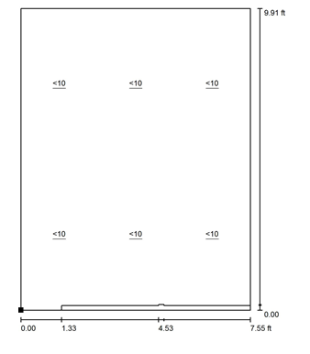
Electrical Design
Lighting design
Artificial lighting
SAMPLE:. Master Bedroom
CHECKS | Standard | result
Uniformity | 0.6-0.8 | 0.67 | ok
Glare | smaller than10 | Smaller than10 | ok
Glare

Slide 44
Mechanical Design
Elevator design
HVAC design
Sanitation system

Slide 45

Mechanical Design
A-Elevator design system
The design consists two things:
The type of the elevator
The number of the elevator
The type of the elevators
(2000 Ib/100 Ft/min)-one elevator

Slide 46

Mechanical Design
B. HVAC design
The used system in HVAC design is Panasonic VRF

Slide 47
Mechanical Design
B. HVAC design
The used unit | Heating load | Cooling load | Summer
One unit with 1 tone | 1.01 kw | 1.33 kw | Master room in duplex
1 tone =3.57 KW

Slide 48
Mechanical Design
C. Sanitation system
Clean water supply
Drainage water

Slide 49
Mechanical Design
Sanitation system
Clean water
Normal apartments
Duplex apartments
Required pipe diameter | Pipe type
3” | Meter
2” | Vertical
2” | Horizontal
2” | branch
Required pipe diameter | Element
2” | Meter
2” | Vertical
2” | Horizontal
2” | branch

Slide 50


Water supply plane for normal apartment

Slide 51
Mechanical Design
Sanitation system
Drainage Systems.
Required pipe diameter | Element
4” | stack
2” | Lavatory
2” | shower
2” | Kitchen sink
2” | Dish washing machine
2” | Washing machine

Slide 52


Drainage system plane for supply for normal apartment

Slide 53
Quantity Surveys & Cost
Cost (NIS) | Element
61745 | Excavation works
2464246.4 | Structural works
3320067.6 | Architectural works
Total cost foe the building= 5846059 NIS
The cost per meter square = 282 DJ

Slide 54

Project planning and Scheduling
The planning and scheduling was made by primavera –p6 program

Slide 55
Project planning and Scheduling
Assumptions
Primavera is a program that divide the activities in the project by using work down structure method (WBS), and determine the reliability of these activities, and calculate the full life of the project and determine the critical path,
The project divide into two parts:
Sub structure: which include (excavation ,footing ,neck column ,tie beam and base slab)
Super structure: which include (column, shear wall, floor slab, external wall, internal wall, electro-mechanical, plastering, door and painting).

Slide 56


Slide 57

حبايبنا..... منورين..... هندسة البناء.....الشغل نظيف ☺

