Slide 1

Lactic Acid Production from Whey Using Lactobacilli Bacteria
A Graduation Project Submitted to the Chemical Engineering Department in Partial Fulfillment of the Requirements for B. Sc/Degree in Chemical Engineering
Supervisor: Dr. MAJD ESHTAYA

Slide 2
SUBMITTED BY:
Hussam Saleh
Syndia Hardan
2

Slide 3
1
2
  Introduction and overview
  METHODOLGY
CONTENTS
3
4
  RESULTS AND DISCUSSIONS
  CONCLUSIONS AND FUTURE WORK
3

Slide 4
Project Objectives
Isolating And Identifying The Lactic Acid Bacteria (LAB) From Dairy Products
Deciding The Optimal Substrate For LAB to produce LA
Explore The Isolated Lab's Growth Rate
Detection Of Lactic Acid Formation
4
Notes:
<a href='https://www.freepik.com/vectors/work'>Work vector created by stories - www.freepik.com</a>

Slide 5
1
Introduction and Overview
the introduction includes the following sections: General background, Objectives (Purpose or Aims) of the work. Organization of the presentation. how the presentation is divided and organized.
5

Slide 6



General Background
Palestine has 14 plant for dairy products manufacturing
Certainly lead to a large number of waste
Environmental Problems
The number increases
with the passage of time
Waste results mainly from the production of whey.
6

Slide 7
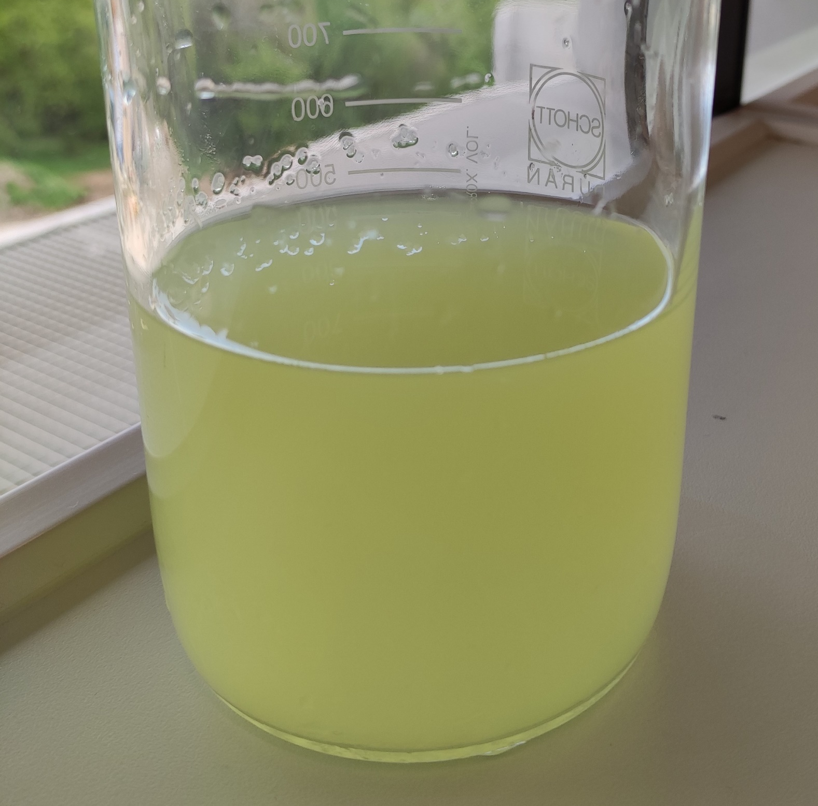
Whey and its effect on the environment
Dissolution of Iron and Manganese present in the soil and thus pollute the Groundwater supply
Highly Polluting by-product of cheese manufacture
Rich in Protein
Damage the Soil and reduced crop yield
higher BOD and COD values
7

Slide 8

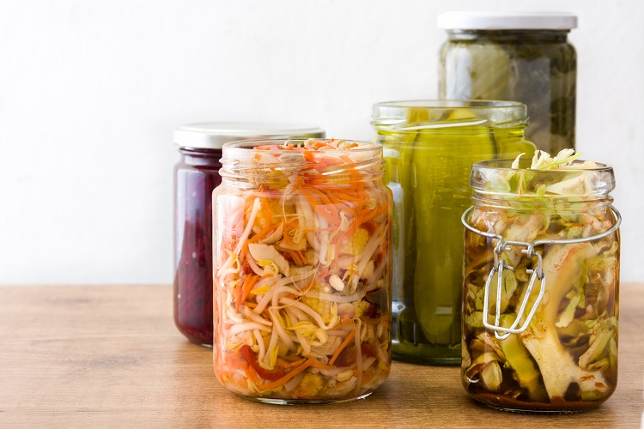
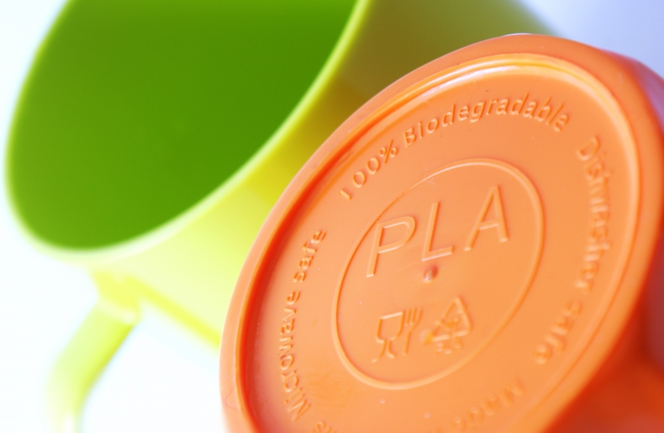
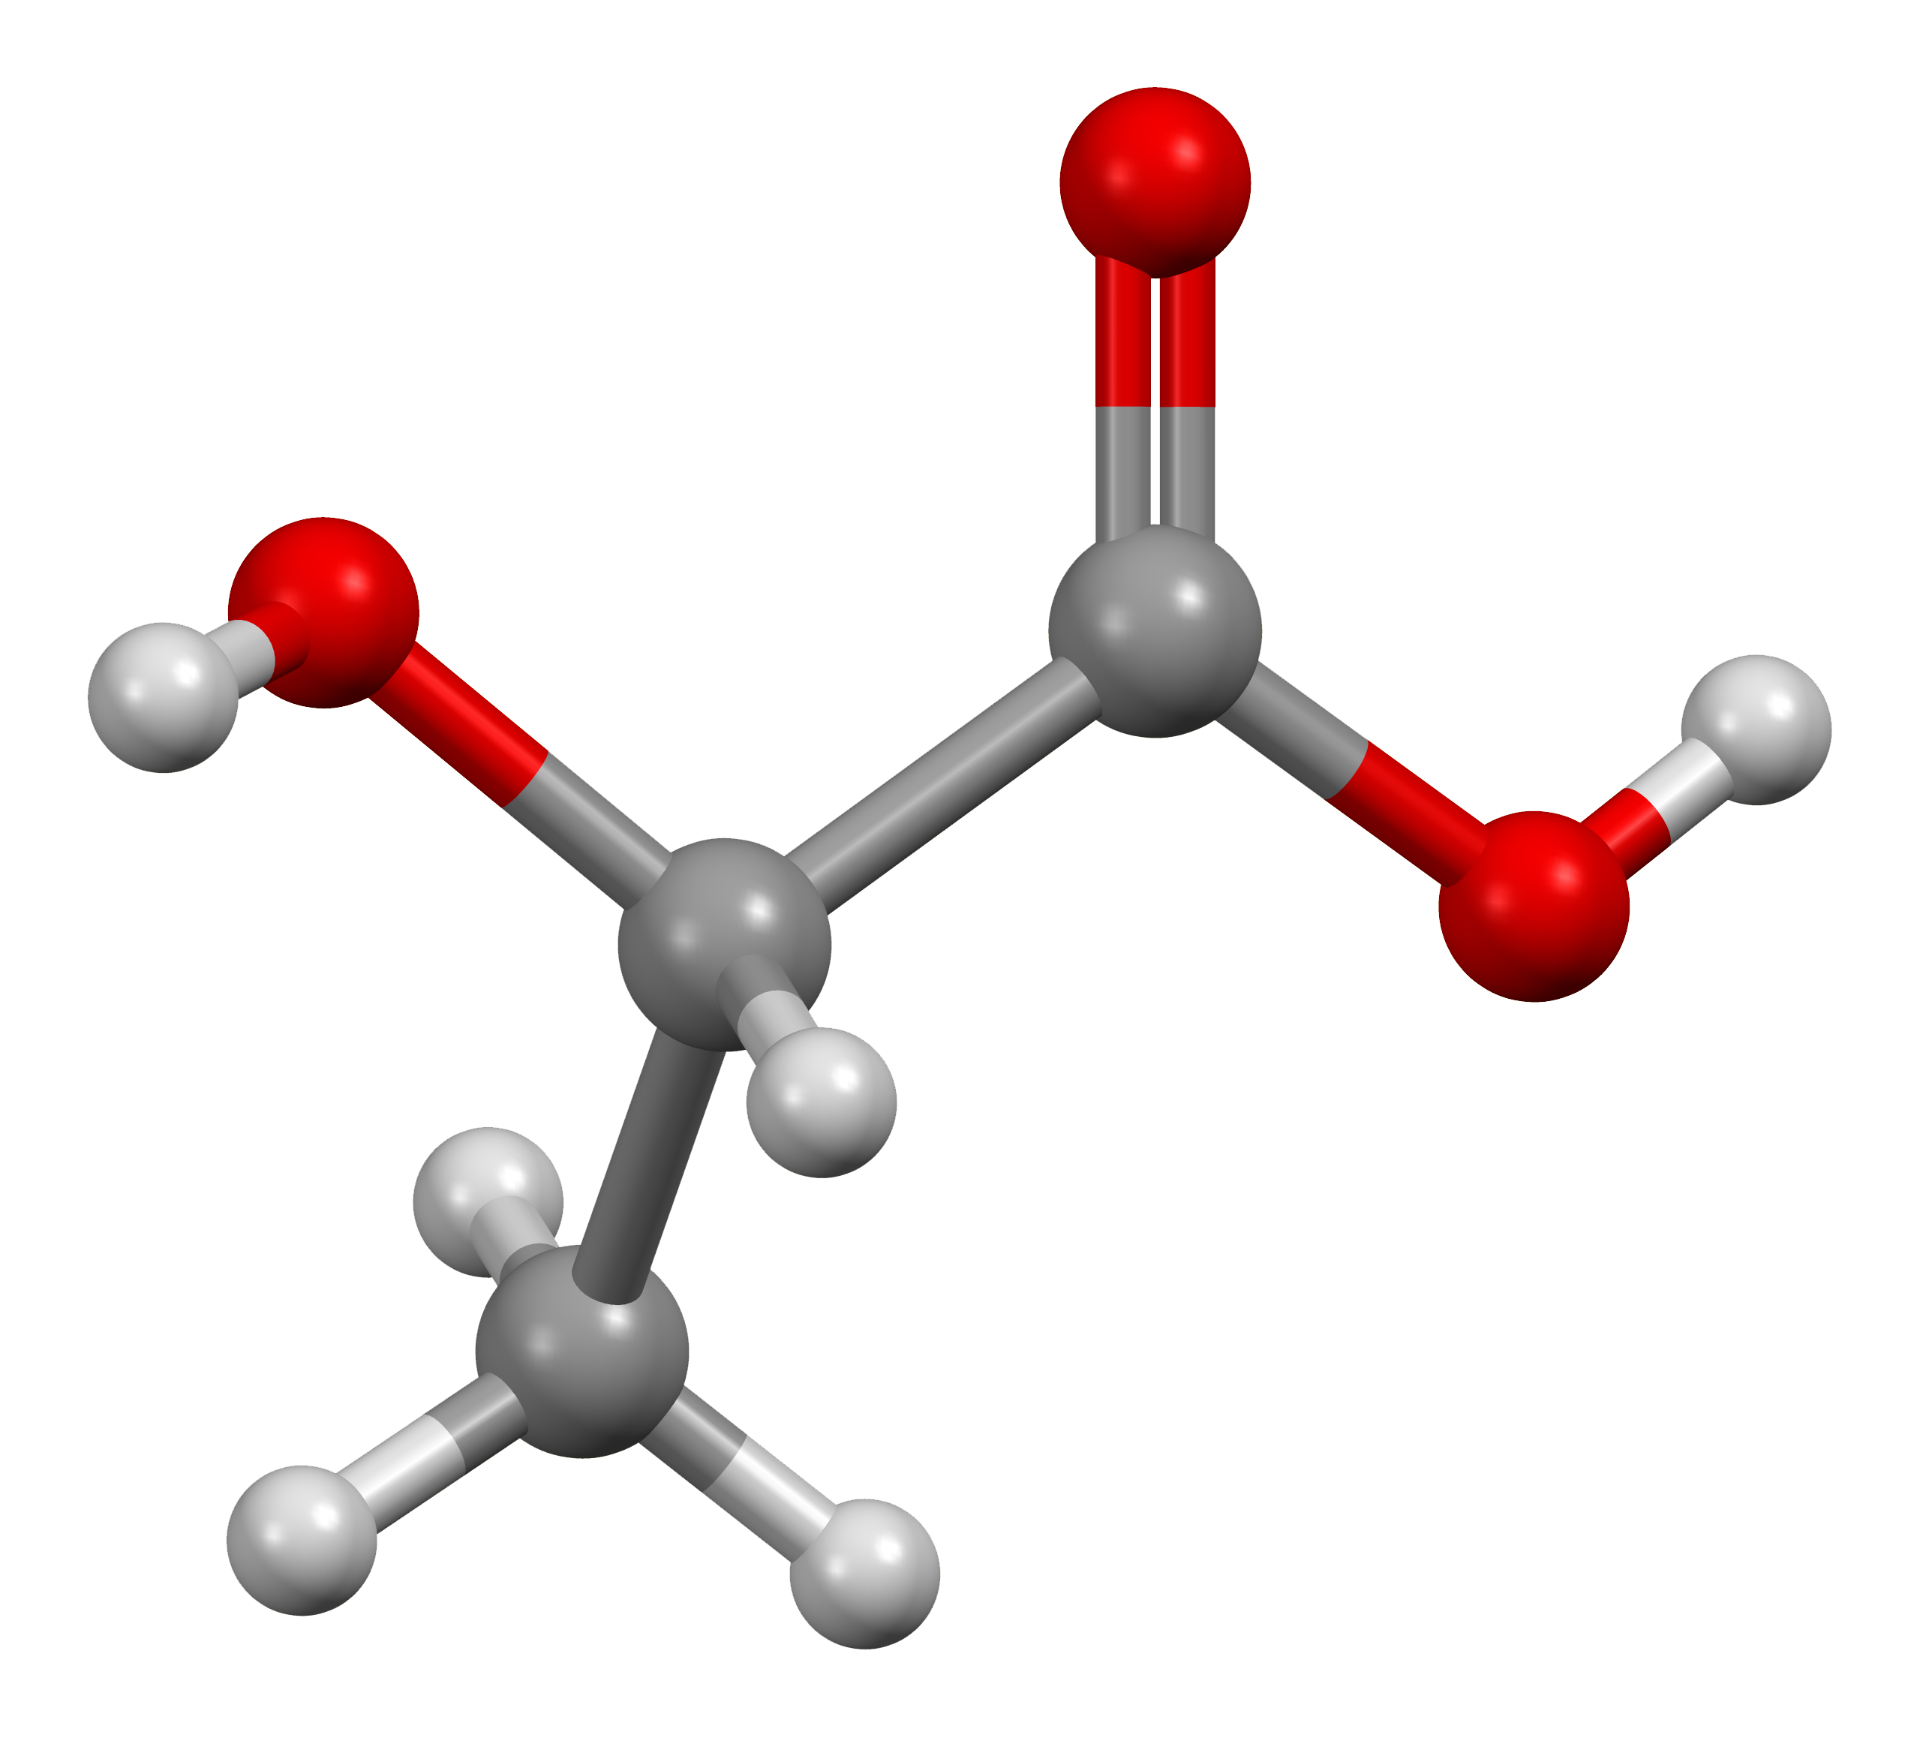
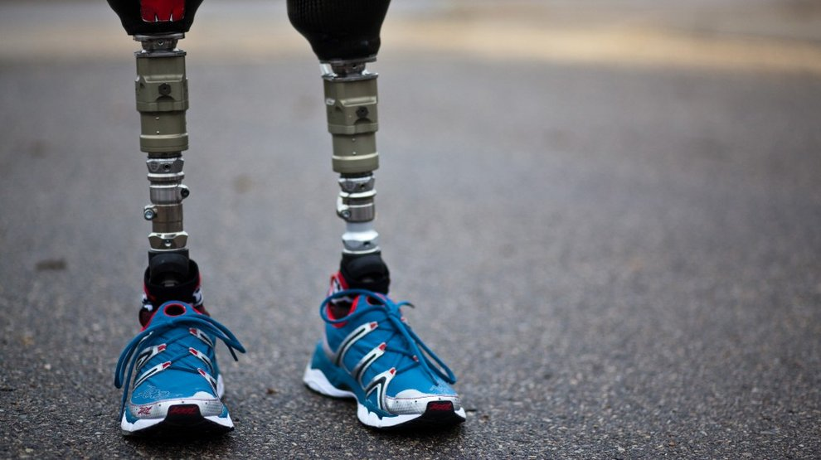
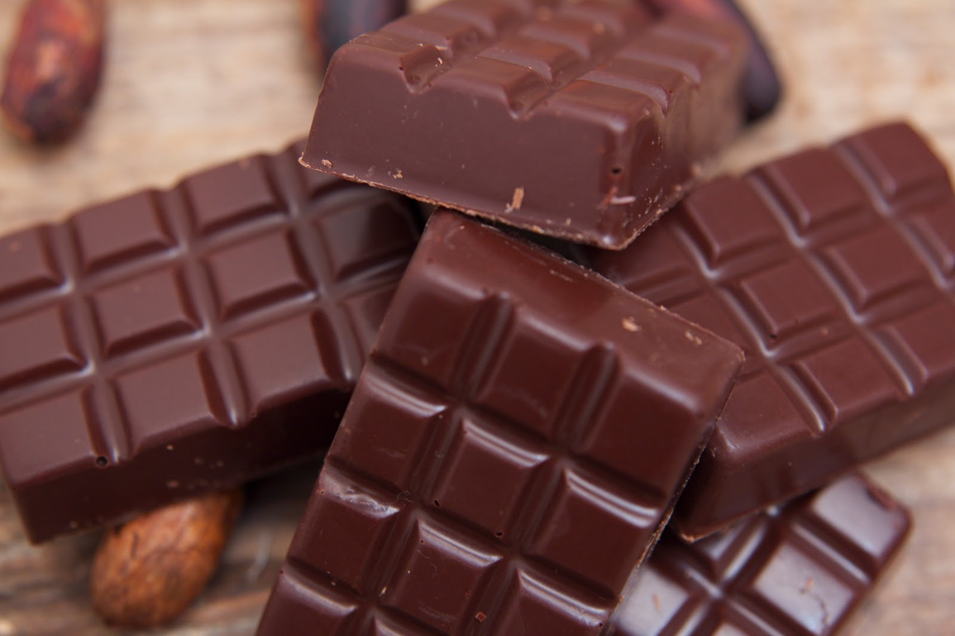
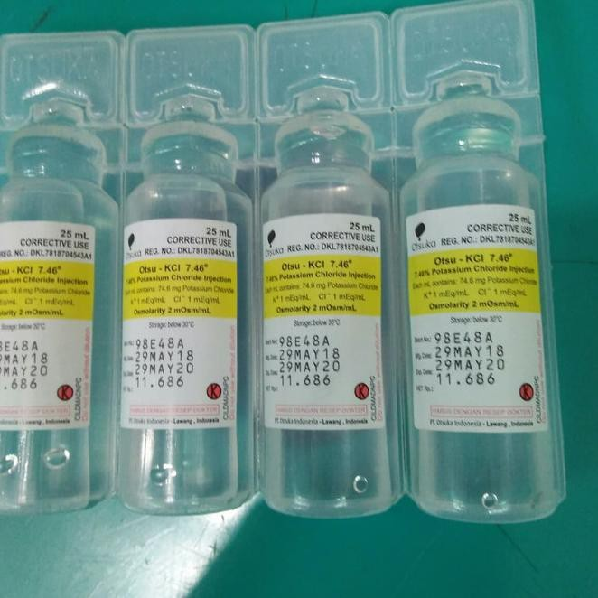
LACTIC ACID
  In cosmetics
  as a preservative
Organic Acid with molecular formula CH3CH(OH)COOH
  Polylactic acid (PLA)
  used in chocolates and sweets for the flavor
LA
  involved in mineral preparations, tablets, prostheses,
  used as an electrolyte in various parenteral solutions.
8

Slide 9
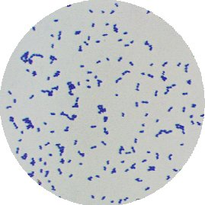
LACTIC ACID BACTRIA
GRAM-POSITIVE BACTERIA
ANAEROBES ROD-SHAPED BACTERIA
NON-SPORE-FORMING BACTERIA
9

Slide 10
2
METHODOLGY
The user print the presentation and make it into a it into a film to be used in a wider field.The user print the presentation and make it into a it into a film to be used in a wider field.
10

Slide 11
1
2
ISOLATION OF LAB
3
IDENTIFICATION OF LAB
4
FERMENTATION BY BIXED CULTURE MEDIA
LAB GROWTH
5
FERMENTATION BY PURE LAB STRAINS
11

Slide 12
ISOLATION
1
The user print the presentation and make it into a it into a film to be used in a wider field.The user print the presentation and make it into a it into a film to be used in a wider field.
12

Slide 13
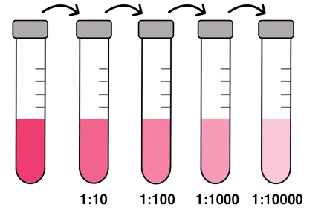
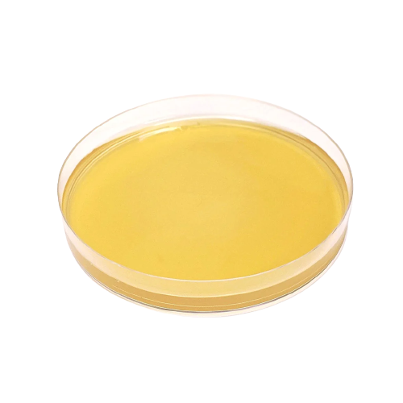


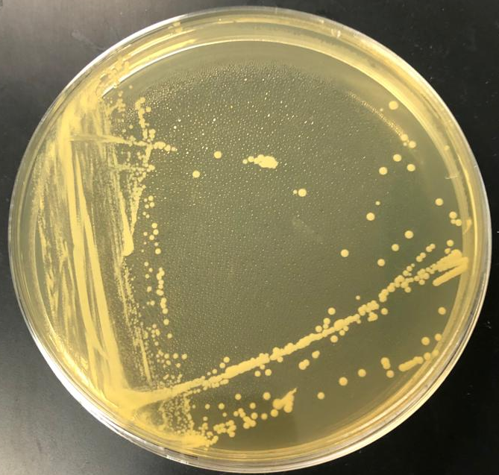
ISOLATION OF LAB
44h
37°C
13

Slide 14
IDENTIFICATION
1
The user print the presentation and make it into a it into a film to be used in a wider field.The user print the presentation and make it into a it into a film to be used in a wider field.
14

Slide 15
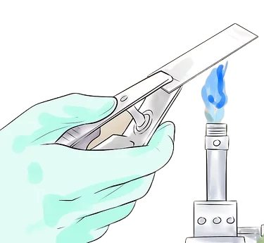
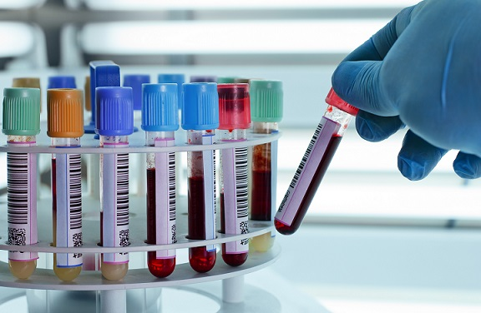
IDENTIFICATION OF LAB
GRAM STAINING TEST
BIOCHEMICAL TESTS
15

Slide 16
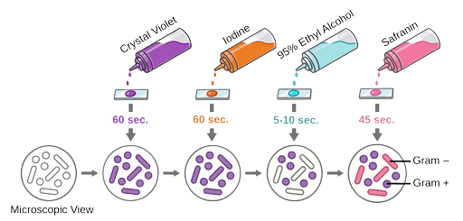
GRAM STAINING
16

Slide 17
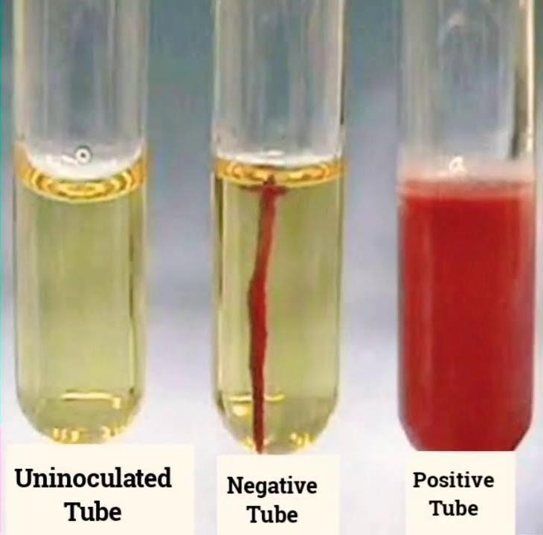
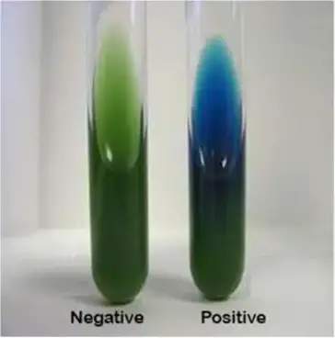
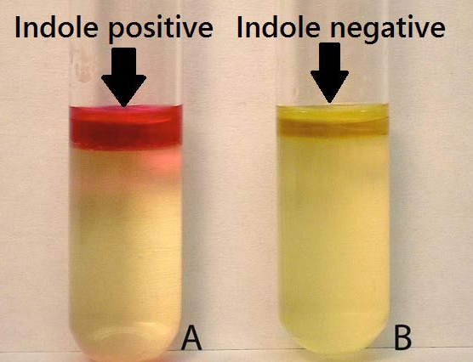
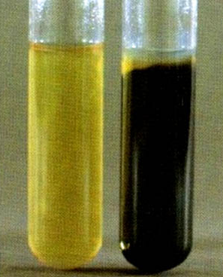
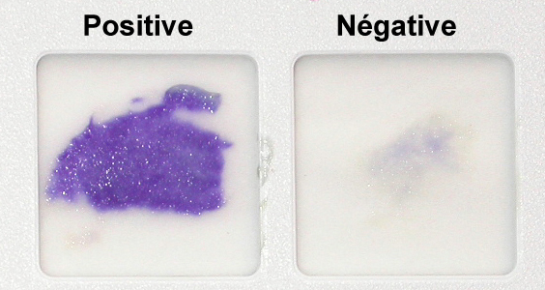
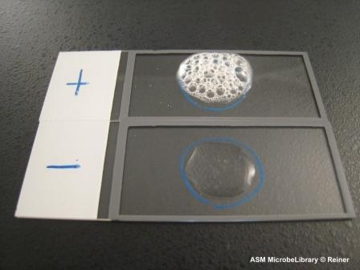
BIOCHEMICAL TESTS
MOTILITY TEST
CITRATE TEST
INDOLE TEST
OXIDASE TEST
CATALASE TEST
HYDROGEN SULFIDE TEST
17

Slide 18
Fermentation By Mixed Culture Media
3
The user print the presentation and make it into a it into a film to be used in a wider field.The user print the presentation and make it into a it into a film to be used in a wider field.
18

Slide 19
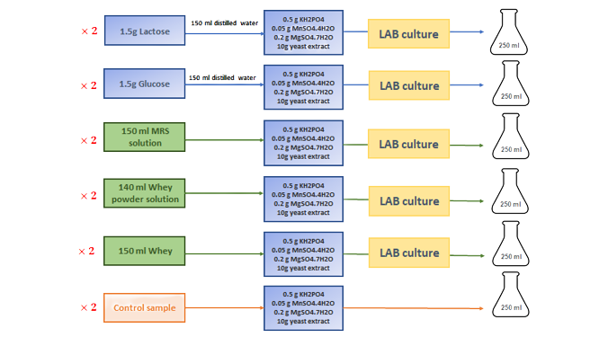
Fermentation By Mixed Culture Media
19

Slide 20
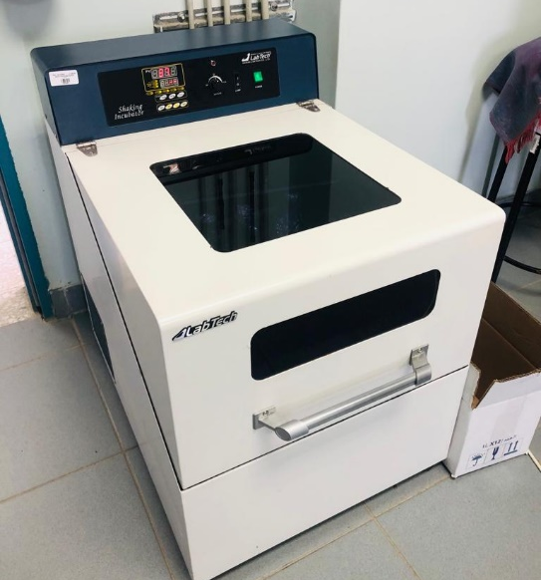
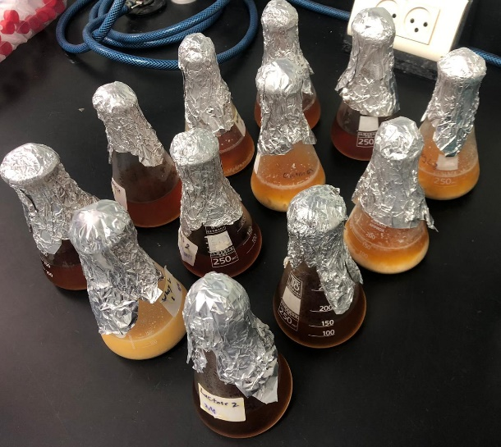
Fermentation By Mixed Culture Media
Samples Packaging
Shaking Incubator
20

Slide 21
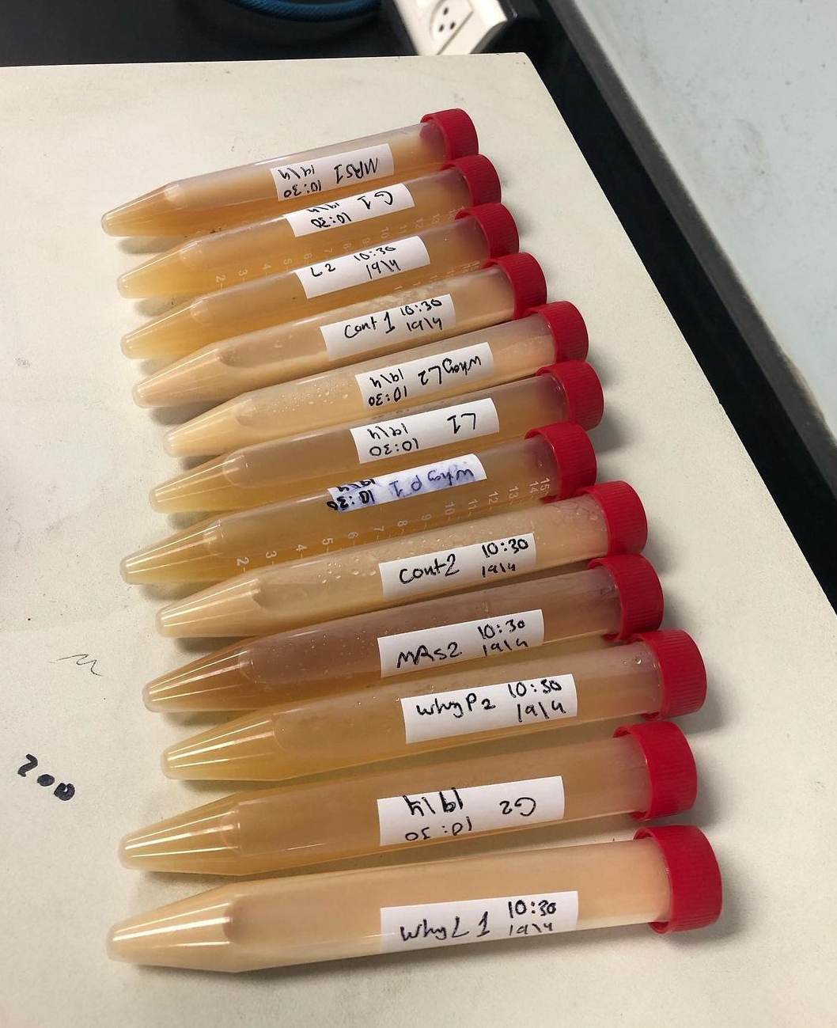
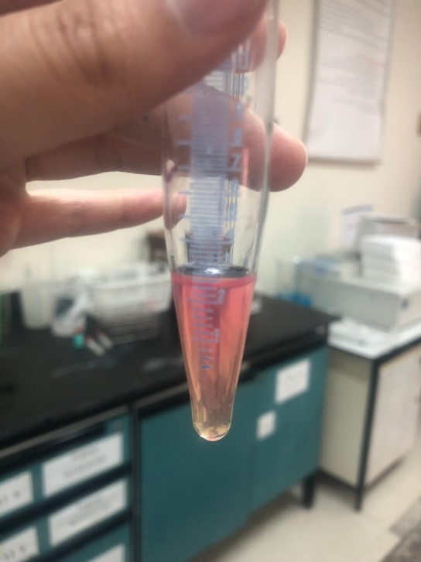
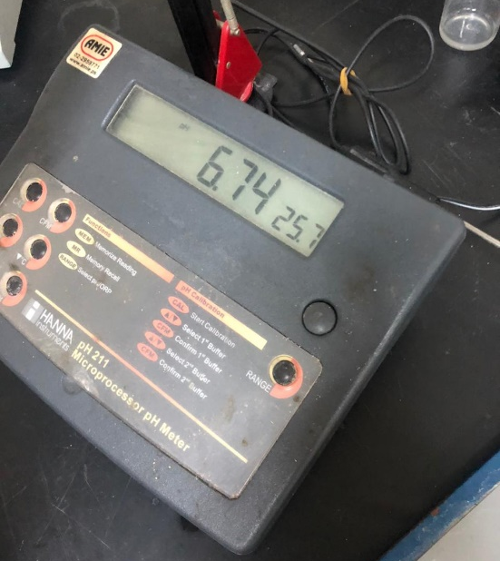
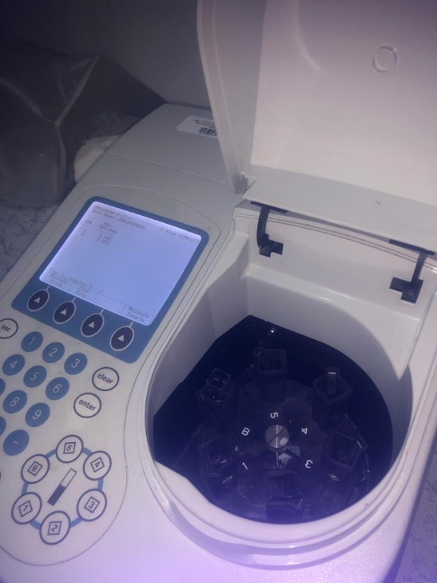
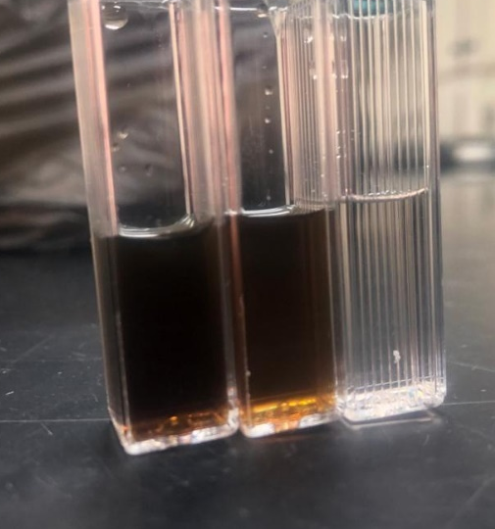
Fermentation By Mixed Culture Media
Detection of lactic acid
pH meter
UV Spectrophotometer
Sugar content test
21
Notes:
<a href='https://www.freepik.com/vectors/watch-icon'>Watch icon vector created by macrovector - www.freepik.com</a>

Slide 22
Growth Rate
4
The user print the presentation and make it into a it into a film to be used in a wider field.The user print the presentation and make it into a it into a film to be used in a wider field.
22

Slide 23
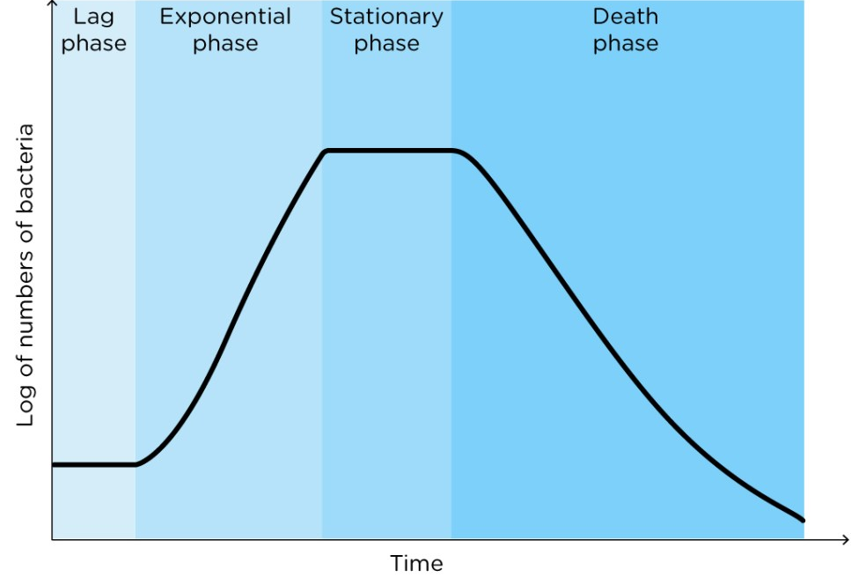
4
Growth rate
to generate a growth rate curve for lactobacilli bacteria
the expected shape of the growth rate curve
23

Slide 24

Two Methods Have Been Followed
Whey Solution
MRS standard
Cell Dry Weight
Optical Density
Taking a Sample
Vacuum at 0.4 atm for drying
- Weighting total dry mass have by mass balance
taking 1 sample at each hour and draw the curve
Taking a Sample
- Using calorimeter for determining the absorbance different
taking 1 sample at each hour and draw the curve
24

Slide 25
Production By Pure Lactobacilli Strains
5
The user print the presentation and make it into a it into a film to be used in a wider field.The user print the presentation and mae it into a it into a film to be used in a wider field.
25

Slide 26
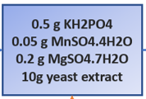
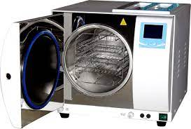


Two Methods Have Been Followed
Whey
Autoclave
LAB
Shaker
The Tests
26

Slide 27
3
Results And Discussions
The user print the presentation and make it into a it into a film to be used in a wider field.The user print the presentation and make it into a it into a film to be used in a wider field.
27

Slide 28
1
2
Isolation And Identification Results
Fermentation By Mixed Culture Results
3
4
Growth Rate Results
Production By Pure LAB Results
28

Slide 29
Isolation And Identification Results
1
The user print the presentation and make it into a it into a film to be used in a wider field.The user print the presentation and make it into a it into a film to be used in a wider field.
29

Slide 30
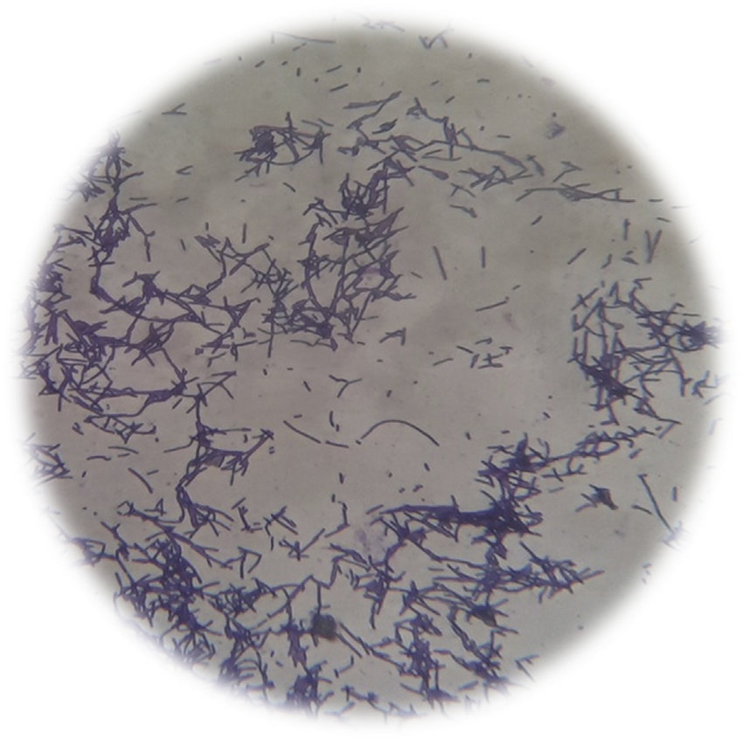
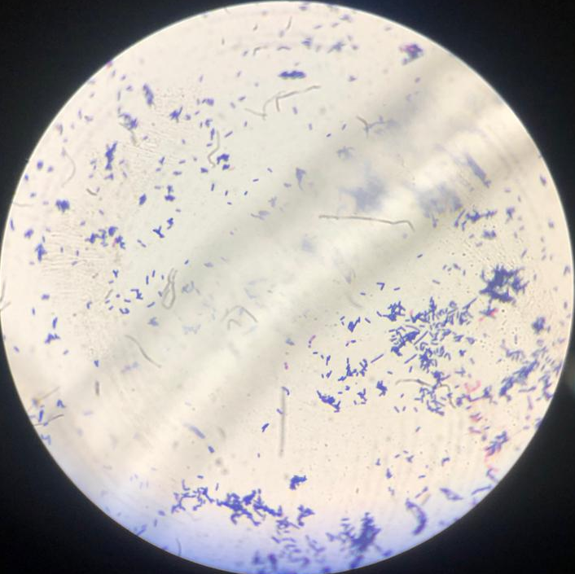
Isolation And Identification Results
Large bacteria
Small bacteria
30

Slide 31
BIOCHEMICAL TESTS Results
Test | catalase | citrate | gas | Gram staining | Hydrogen sulfide | indole | motility | oxidase
Standard | - | - | - | + | - | - | - | -
Small bacteria | - | - | - | + | - | - | - | -
Large bacteria | - | - | - | + | - | - | - | -
31

Slide 32
BIOCHEMICAL TESTS Results
Fermentation test | Glucose test | Lactose test | Sucrose test
Small bacteria | + | + | +
Large bacteria | - | - | -
Small bacteria: lactobacilli acidophilus
32

Slide 33
Fermentation By Mixed Culture Results
2
The user print the presentation and make it into a it into a film to be used in a wider field.The user print the presentation and make it into a it into a film to be used in a wider field.
33

Slide 34
Mixed Culture Results
34

Slide 35
Mixed Culture Results
35

Slide 36
Growth Rate Results
3
The user print the presentation and make it into a it into a film to be used in a wider field.The user print the presentation and make it into a it into a film to be used in a wider field.
36

Slide 37
Growth Rate Results
37

Slide 38
Production By Pure LAB Results
4
The user print the presentation and make it into a it into a film to be used in a wider field.The user print the presentation and make it into a it into a film to be used in a wider field.
38

Slide 39
Growth Rate Results
The fail of fermentation by pure LAB strains
Nitrogen sources and other minerals may not be sufficient to sustain the bacteria's survival.
Bacteria were added to the solutions after the autoclave before cooling to take advantage of the time
fermentation started under aerobic conditions; as a result, the growth of the anerobic LAB began after the solution's oxygen was consumed, resulting in a protracted lag phase
39

Slide 40

The Constraints
Ethics
Economic
Environment
Time limits
40

Slide 41
CONCLUSIONS
1
The user print the presentation and make it into a it into a film to be used in a wider field.The user print the presentation and make it into a it into a film to be used in a wider field.
41

Slide 42
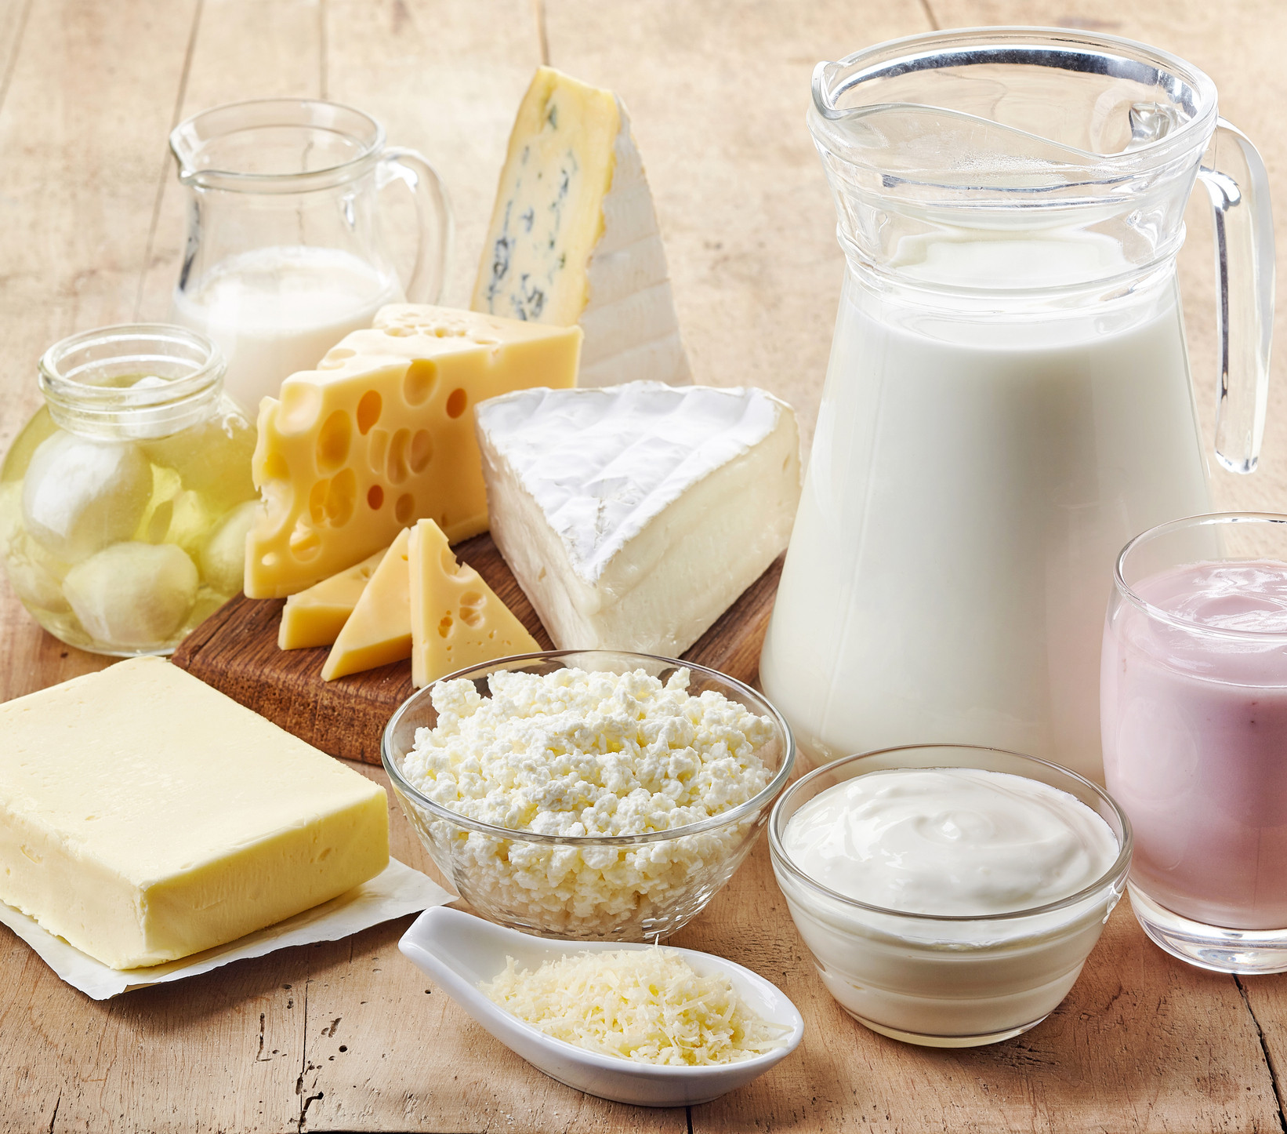
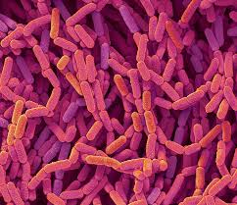
CONCLUSIONS
1
Dairy products are suitable for isolating LAB. The genus of LAB that was isolated and used for the fermentation was lactobacilli
42

Slide 43
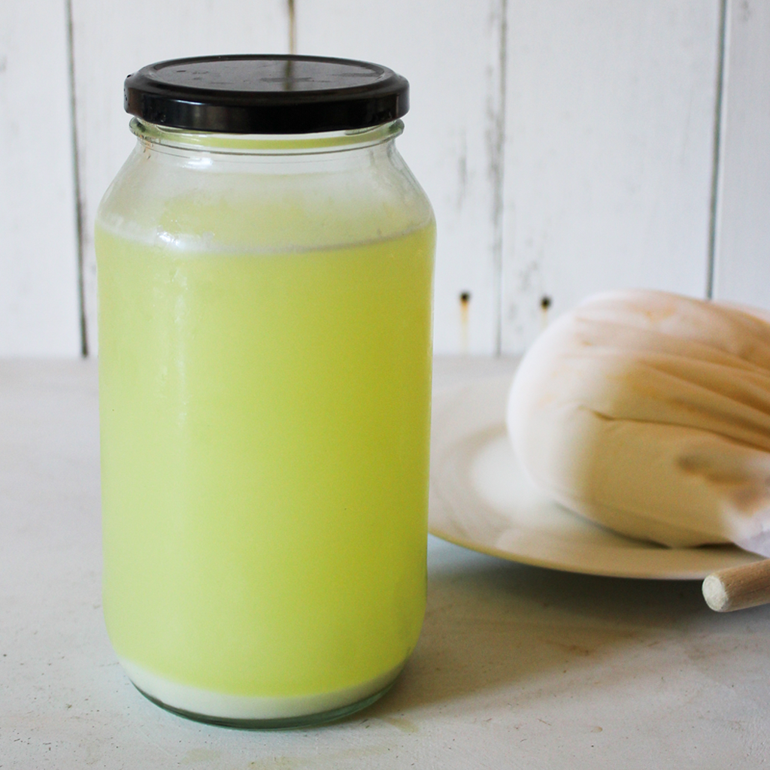

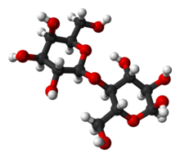
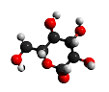
CONCLUSIONS
2
Whey liquid is an efficient substrate for LAB to produce lactic acid compared to other Sugar solutions.
LACTOSE
43
GLUCOSE

Slide 44
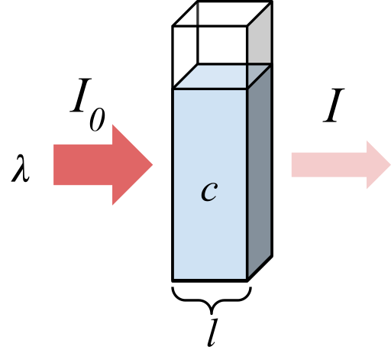
CONCLUSIONS
3
The OD method is a quick and reliable method for determining the growth curve of LAB
44

Slide 45
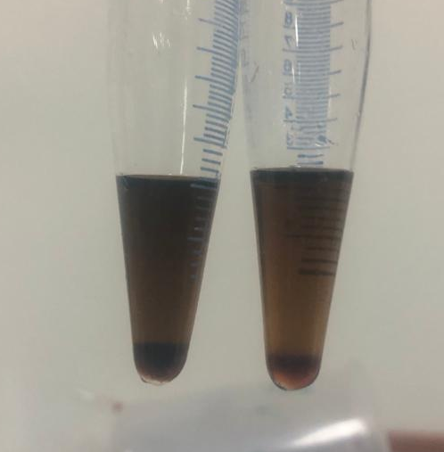
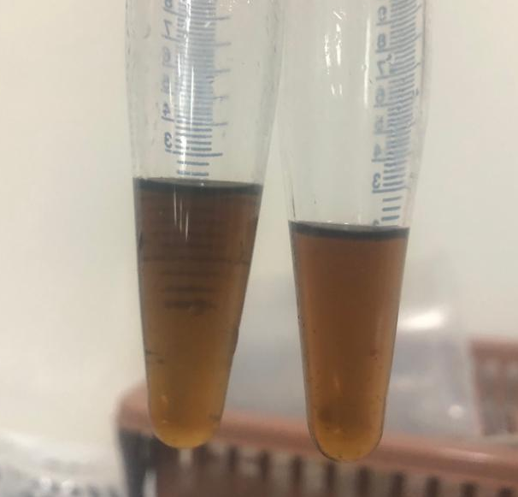
CONCLUSIONS
4
The removal of Protein from whey does not affect the total sugar content in the whey.
AFTER
BEFORE
45

Slide 46
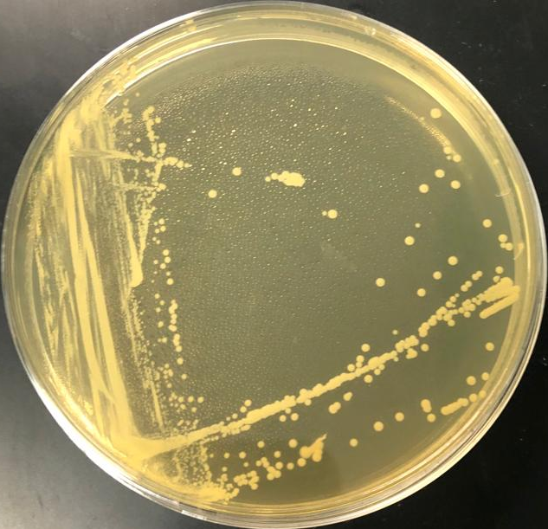
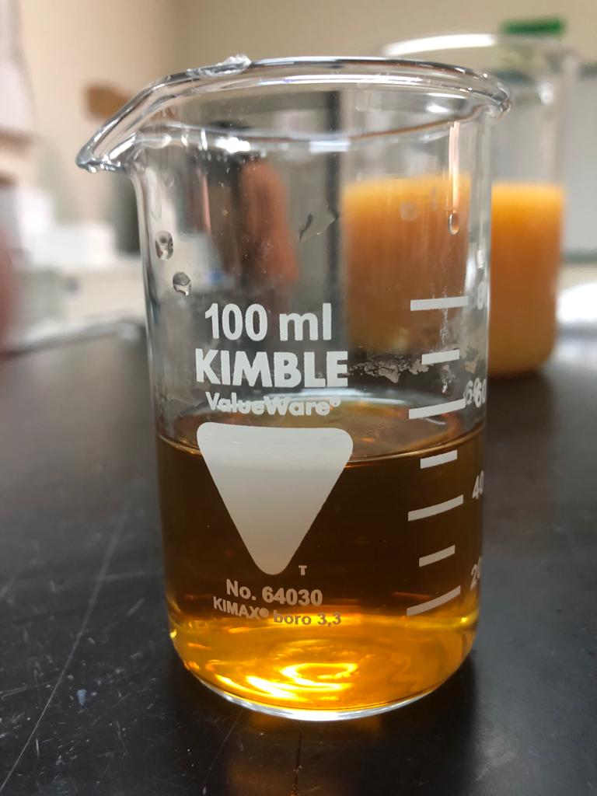
CONCLUSIONS
5
MRS both agar and broth are the best media for the growth of LAB.
46

Slide 47
CONCLUSIONS
6
When the bacteria are still in the lag phase, their output is poor and invisible.
when the bacteria are in the logarithmic or stationary phase, it is profitable and effective.
47

Slide 48
FUTURE WORK
growth rate curve by using Cell Number Density
Effect of pH and whey conc. On the production
Production by aerobic and anerobic
Investigating the influence of
whey protein on
production
HPLC for the concentrations
Identification by PCR
designing a purification process
Production by pure LAB strains
48

Slide 49
THANKS

