Slide 1

Structural Analysis and Design of
Tubas Secondary School
By:
Mosab Badran Nassar
Sayed Abdullah Qawareeq
Sohaib Mohammad Abu-Qubaita
Supervisor : Eng. Ibrahim Arman

Slide 2
Graduation project content :
The preliminary dimension for elements such as slabs, beams and columns were analyzed using both hand calculations and verifications from sap.
The seismic base shear and wind loads were calculated and distributed all over the structural levels using UBC-97 and IBC-2012.
The snow load was determined using Jordanian code.

Slide 3
The structural elements such as slabs, beams and columns were designed.
Footings were analyzed and designed using hand calculations and sap2000.
The column interaction diagram was drawn.
Slab diaphragms and collectors were designed.

Slide 4
1. Introduction
Description of the project
Tubas secondary school is located in Tubas city.
The school is composed of two parts, A and B.
Part A consists of three floors, part B consists of two floors.
The total area of structure is 2568 m².
floor height is 3.38m

Slide 5
1. Introduction
Methodology
- Preliminary design was calculated for every elements
- A 3D model was used for analysis and design considering gravity and lateral loads. Moreover, hand calculations were used for some elements for verification of the model.

Slide 6
1. Introduction
Design codes and design method
The design was accomplished according to ACI 318-2011 code, and IBC 2012 code.
UBC 97 and IBC 2012 was used for earthquake and wind loads
The ultimate strength method is used for structural design.
For seismic design both static and response spectrum methods were used.

Slide 7
1. Introduction
Material Properties
Structural materials:
Concrete of various strengths according to functions:
Beams, slabs and footings, f’c = 28MPa. E = 2.478x10⁷ KN/m²
Columns f’c = 35MPa, E = 2.78x10⁷ KN/m².
Unit weight of concrete, ϫ = 25 KN/ m^{3.}
Reinforcing Steel yielding strength, fy = 420 MPa, modulus of elasticity, E = 200 GPa.

Slide 8
1. Introduction
Non-structural elements with the following unit weights:
Table 1.1 Unit weight(ϫ) of various materials
Material | Unit weight(ϫ)(KN/m³)
Blocks | 12
Plastering | 23
Mortar | 23
Marble | 27
Filling material | 20
Insulation | 0.4
Masonry stone | 27

Slide 9
1. Introduction
Loads
1. Gravity loads
Dead loads:
Own weight of structural elements.
Super imposed dead load
W_{SD} = 5 KN/m²

Slide 10
1. Introduction
2. Live loads:
From IBC 2012 ( Table 1607.1) as follows:
Classrooms = 1.9 KN/m.
Corridors above first floor = 3.83 KN/m².
First floor corridor = 4.78 KN/m²
According to UBC 97 code live load in classroom = 1.9 KN/m² (table 16-A).
As the schools in Palestine are used as emergency places, use live load.
WL = 5 KN/m².

Slide 11
1. Introduction
3.Horizontal loads
Seismic load and wind load that expected for the whole structure were computed according to IBC 2012 and UBC 97 as will be illustrated in Chapters 3 and 4.

Slide 12
1. Introduction
Soil Properties
The site soil has an allowable bearing capacity of 330 KN/m². The soil is classified as rock soil.

Slide 13
2. Preliminary Design
Introduction
Preliminary analysis and design of slabs, beams and columns based on gravity loads to determine the preliminary sizes of the different elements.
The building is composed of two parts, and each part was analyzed and designed individually.

Slide 14
2. Preliminary Design
Building and slabs structural systems
The building structural system is composed of
1- Special shear walls
2- Intermediate frames

Slide 15
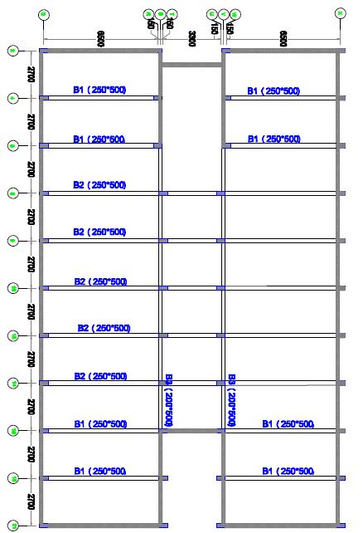
2. Preliminary Design
Figure 2. 1 Part (A) plan

Slide 16
2. Preliminary Design
Table 9.5(a) in ACI-318 code was used to compute the thickness of beams and slabs.
Table 9.5(b) in ACI-318 code was used to check deflection.
The deflection for every load was computed using sap and then compared with a value from table 9.5(b) ,the check was ok
Thickness of slab =150mm
Depth of beam=500mm

Slide 17
2. Preliminary Design
Dimensions for columns were found depending on the ultimate axial gravity load that subjected to, and according to this equation:
ФPn = 0.8 Ф [0.85 f'c (Ag-As) + Fy*As]
Ф= 0.65 for tied columns
The dimensions of every column were 250mm x 500mm
The slab is one way solid in y-direction.

Slide 18
3.1 Seismic Loads using UBC-97
Part-A
Table 3.1 Seismic parameters
Soil type | Zone factor | Seismic coefficients | Importance factor | R | T = C_{t}(h_{n})^{3/4}
S_{B} | 0.2 | C_{a} = 0.20 C_{v} = 0.20 | 1.25 | 5.5 | .33

Slide 19
3.1 Seismic Loads using UBC-97
Part-A
Part A weights calculations
Table 3.2 Weight calculations
Floor | Weight (KN)
Weight at level 0.0 | 2248.71
Ground floor | 7063.175
First floor | 7074.015
Second floor | 5236.718
Staircase | 834.95
Total weight | 22457.56

Slide 20
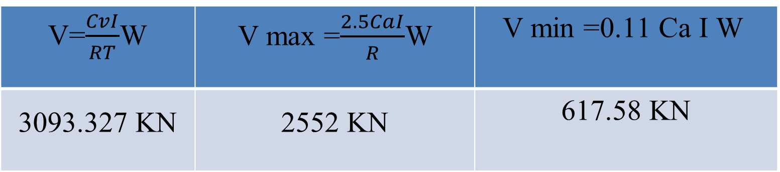
3.1 Seismic Loads using UBC-97
Part-A
Design base shear
Take V = 2552 KN
Because T = 0.33 sec < 0.70 sec, so F_{t}=0
3093.327 KN | 2552 KN | 617.58 KN

Slide 21
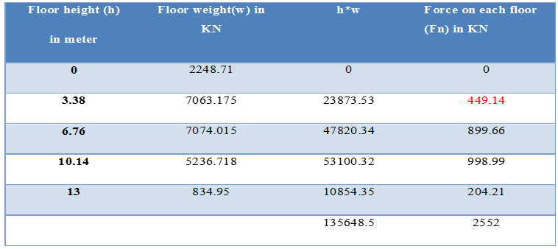
3.1 Seismic Loads using UBC-97
Part-A
Table 3.4 Base shear distribution

Slide 22
3.1 Seismic Loads using UBC-97
Part-B
Table 3.5 Base shear distribution
Floor height (h) in meter | Floor weight(w) in KN | h*w | Force on each floor (Fn) in KN
0 | 1027.55 | 0 | 0
3.38 | 5837.45 | 19730.58 | 463.99
6.76 | 4325.71 | 29241.80 | 687.66
8.52 | 1383.85 | 11790.40 | 277.27
 |  | 60762.78 | 1428.92
Base shear =1428.92 KN

Slide 23
3.3 Seismic Loads using IBC-2012
Part-A
Table 3.6 Siesmic parameters
Zone factor | S1=1.25*Z | Ss=1.25*Z | SMS = Fa Ss | SM1= FV S1
0.3 | 0.375 | 0.75 | 0.75 | 0.375
SDS=2/3 SMS | SD1 =2/3 SM1
0.5 | 0.25

Slide 24
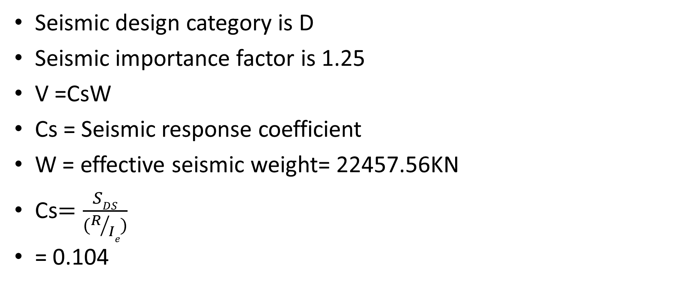
3.3 Seismic Loads using IBC-2012
Part-A

Slide 25
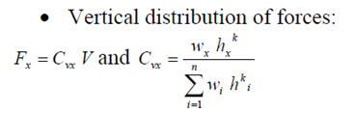
3.3 Seismic Loads using IBC-2012
Part-A
R = response modification factor
The value of R is 6
I_{e} = importance factor = 1.25
T_{a} = 0.0488 * 13.75 = 0.334sec
The seismic base shear V
V =CSW = 0.104 * 22457.56 = 2335.6KN

Slide 26
3.3 Seismic Loads using IBC-2012
Part-A
K=1 because of T = 0.334<0.5
Table 3.7 Base shear distribution
level | Weight W_{X}(kn) | h_{x(m)} | W_{X}*h¹_{x} | C_{VX} | F_{X}
4 | 834.95 | 13 | 10854.35 | .080 | 186.85
3 | 5236.71 | 10.14 | 53100.24 | .391 | 913.22
2 | 7074.01 | 6.76 | 47820.30 | .352 | 822.13
1 | 7063.17 | 3.38 | 23873.51 | .177 | 413.4
0 | 2248.71 | 0.00 | 0.00 | 0.00 | 0.00
∑at level0 | 22457.56 | 0.00 | 135648.40 | 1.00 | 2335.6

Slide 27
3.4 Seismic Loads using IBC-2012
Part-B
The seismic base shear V:
V = C_{s}W
W = effective seismic weight= 12574.55KN
T_{a} = 0.0488*8.60.75 = 0.245sec
The seismic base shear V
V = C_{S}W = 0.104*12574.56 = 1307.75

Slide 28
3.4 Seismic Loads using IBC-2012
Part-B
Table 3.8 Base shear distribution
level | Weight W_{X}(kn) | h_{x(m)} | W_{X}*h¹_{x} | C_{VX} | F_{X}
3 | 1383.85 | 8.69 | 12025.65 | .1984 | 259.4
2 | 4325.71 | 6.76 | 28852.48 | .4760 | 622.49
1 | 5837.45 | 3.38 | 19730.58 | .3256 | 425.86
0 | 1027.55 | 0.00 | 0.00 | 0.00 | 0.00
∑at level0 | 12574.56 | 0.00 | 60608.71 | 1.00 | 1307.75

Slide 29
4. Structural Analysis Of Part A Using SAP 2000
UBC-97
Equivalent static and response spectrum analyses were used
Ritz vectors mode is used to get modal mass participation ratio more than 90%
Table 4.1 Base shear comparison
Equivalent static using hand calculations | Equivalent static using sap2000 | Response spectrum X-direction | Response spectrum Y-direction
2552 | 2546.7 | 1933 | 1796

Slide 30
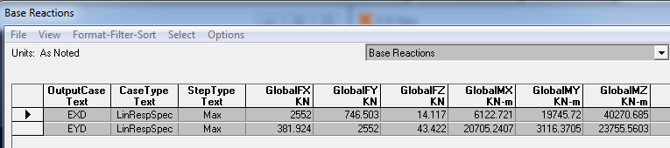
4. Structural Analysis Of Part A Using SAP 2000
UBC-97
Response spectrum base shear must not be less than 100 percent of the base shear determined in equivalent static method
The new scale factor would be (I g / R) * static base shear / response-spectrum base shear

Slide 31
4. Structural Analysis Of Part A Using SAP 2000
IBC-2012
Table 4.2 Base shear comparison
Equivalent static using hand calculations | Equivalent static using hand calculations | Response spectrum X-direction | Response spectrum Y-direction
2334.6 | 2334.47 | 1763.7 | 1618.9
Response spectrum base shear has to be more than 85 percent of the base shear determined in equivalent static method

Slide 32
4. Structural Analysis Of Part A Using SAP 2000
IBC-2012
The new scale factor would be 0.85* (I g / R) * static base shear / response-spectrum base shear
Table 4.3 Dynamic base shear after modification
EXD | EYD
1984.7 | 1980

Slide 33
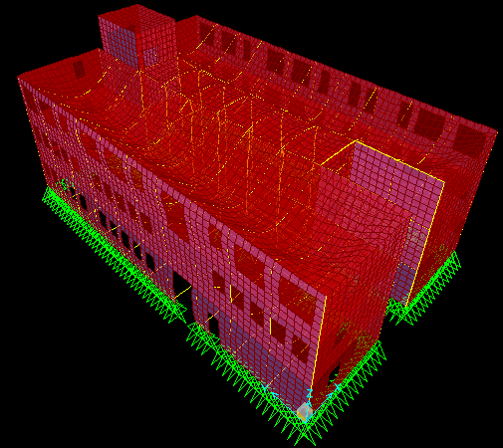
4.Verification of Structural Analysis for Part A model
Compatibility
The structure and its joints are moving in one unit

Slide 34
4.Verification of Structural Analysis for Part A model
Period (T) checked From sap
Modal x analysis (T) = (0.123)
Modal y analysis (T) = (0.096)
Reylof method (T_{x} =0.13)
Reylof method (T_{y} = 0.0988)

Slide 35
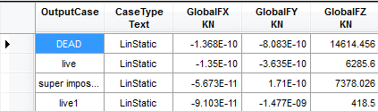
4.Verification of Structural Analysis for Part A model
Equilibrium check
Total loads (by hand) = Dead + live + super imposed + live1 = 28750.35 KN
From Sap 2000 v14.2.4.
Table 4. 2 Base reaction from load cases
Total loads (by sap) = 28697 KN
% difference = 0.2 %

Slide 36
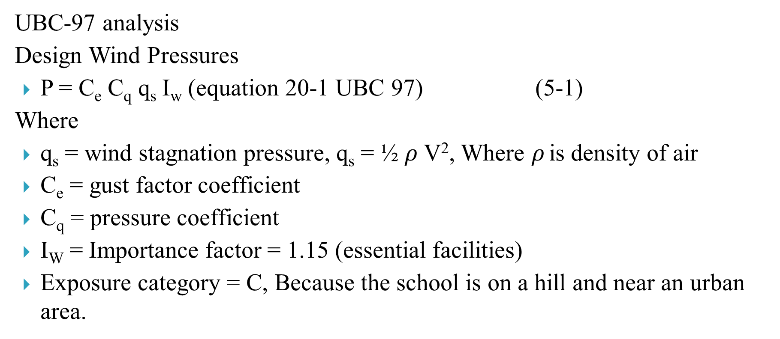
5. Wind And Snow Loads
(General UBC 97)
UBC-97 analysis
Design Wind Pressures
P = C_{e} C_{q} q_{s} I_{w} (equation 20-1 UBC 97) (5-1)
Where
q_{s} = wind stagnation pressure, q_{s} = ½ $ρ$V², Where $ρ$ is density of air
C_{e} = gust factor coefficient
C_{q} = pressure coefficient
I_{W} = Importance factor = 1.15 (essential facilities)
Exposure category = C, Because the school is on a hill and near an urban area.

Slide 37
5. Wind And Snow Loads
(UBC 97 Part A)
Table 5. 1 calculation for floor-by-floor loads in KN UBC-97 south-east side of part A
Width | Area | Windward pressure KN/m² | Leeward Suction KN/m² | Design pressure KN/m² | Floor-by-floor load, KN
4.65 | 6.65 | 0.82 | 0.51 | 1.34 | 8.89
27.0 | 52.28 | 0.77 | 0.51 | 1.29 | 67.26
27.0 | 91.26 | 0.71 | 0.51 | 1.22 | 111.7
27.0 | 91.26 | 0.67 | 0.51 | 1.18 | 107.7
27.0 | 45.63 | 0.67 | 0.51 | 1.18 | 53.83
Total |  |  |  |  | 349.3

Slide 38
5. Wind And Snow Loads
(General ASCE 7-10 )
ASCE 7-10 Analysis
Design Wind Pressure
Category of building is C
Basic wind speed = 185 Km/hr
The velocity pressure, q_{z} = 0.613 K_{z} K_{d} K_{zt} V² (N/m²)
Where:
K_{z} = velocity pressure exposure coefficient at any height
K_{h} = velocity pressure exposure coefficient at mean roof hieght

Slide 39
5. Wind And Snow Loads
(General ASCE 7-10 )
K_{d} = Wind Directionality factor = 0.85
K_{zt} = Topographic factor = 1.0
C_{p} = external pressure coefficient
G = gust factor = 0.85
V in m/sec = 185 Km/hr = 51.39 m/sec

Slide 40
5. Wind And Snow Loads
(ASCE 7-10 Part A)
Table 5.3 calculation for floor-by-floor loads in KN ASCE 7-10 south-east side part A
Width | Area | Windward pressure KN/m² | Leeward Suction KN/m² | Design pressure KN/m² | Floor-by-floor load, KN
4.65 | 6.65 | 0.99 | 0.62 | 1.61 | 10.7
27.0 | 52.28 | 0.94 | 0.62 | 1.56 | 81.4
27.0 | 91.26 | 0.86 | 0.62 | 1.48 | 135.2
27.0 | 91.26 | 0.75 | 0.62 | 1.36 | 124.5
27.0 | 45.63 | 0.75 | 0.62 | 1.37 | 62.4
Total |  |  |  |  | 414.2

Slide 41
5. Wind And Snow Loads
Jordanian code 2006
Site snow load (S0): Snow load at site land level in KN/m2
H = 230m
S₀= 0 KN/m2
Table 5.5 Snow load at site level
S₀(KN/m²) | Height of construction site above sea level in meters.
0 | 250 > h
(h-250)/800 | 500 > h > 250
(h-400)/320 | 1500 > h > 500

Slide 42
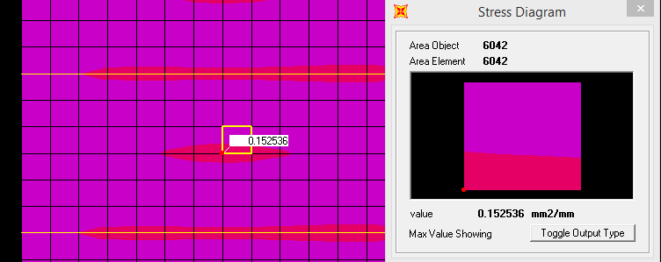
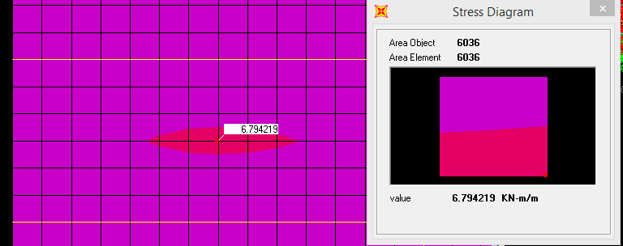
6. Final design (slabs)
Figure 6. 1 Area Of Steel From SAP
Figure 6. 2 Positive Envelope Ultimate Moment

Slide 43
6. Final design (slabs)
From hand calculations A_{s} = 165 mm², %difference = 7.8%
A_{s} min = 0.0018 * b * h = 270 mm²
Use 4φ10 mm/m
Check for shear, V_{u} is less than φV_{c}
V_{u}=22.7 KN from sap
φV_{c}=72.8 KN No need for stirrups

Slide 44
6. Final design (beams)
Figure 6.3 First and second and third floors framing plan
of part a

Slide 45
6. Final design (beams)
Table 6.1 Final design of beams
Beam name | Depth mm | Width mm | Negative steel mm² | Number of bars (Top) | Positive steel mm² | Number of bars (Bottom) | Av/S End | Av/S Middle
B1 | 500 | 250 | 782 | 4φ18 | 724 | 4φ18 | 0.318 | 0.208
B2 | 500 | 250 | 912 | 4φ18 | 850 | 4φ18 | 0.54 | 0.208
B3 | 500 | 200 | 360 | 4φ12 | 360 | 4φ12 | 0.17 | 0
Check for B2 ( hand calculations)
As (Top) = 850 mm², % difference = 6.8%
As(Bottom) = 831 mm², % difference = 2%
Av/S (End) = 0.53 mm²/mm, % difference = 1%

Slide 46
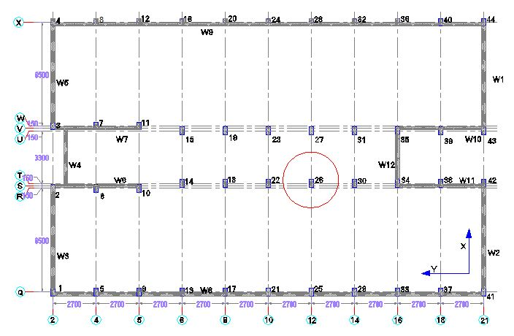
6. Final design (columns)
For 500 mm in x-axis, and 250 mm in y-axis
Check A_{s} for column T-12
P_{u} = 875.8 KN
M_{u1} = 50.3 KN.m around y-axis, at 3.38 m height
M_{u2} = 23.9 KN.m around y-axis, at 0 m at height
Figure 6. 4 columns layout

Slide 47

6. Final design (columns)
Assume $ρ=0.01$, the interaction diagram of this column will be as shown in the following figure:
The intersection of represents P_{u} and M_{u} is In the curve so use $ρ$ of 0.01 Which has an area of 1250 mm².

Slide 48
6. Final design (columns)
Spacing s_{o} shall not exceed the smallest of the following:
- 8*d_{b} = 8*16 = 128 mm
- 24 d_{t} = 24*10 = 240 mm
- ½ of smallest dimension = 125 mm
- 300 mm
- Use s_{o} = 100 mm
The first hoop shall be located at not more than 50 mm from the joint face.

Slide 49
6. Final design (columns)
Table 6.2 Final design of column
Column Name | Dimension (mm) | A_{s} required (mm²) | Number of bars | Diameter of bars(mm) | Ties
T-12 | 500*250 | 1250 | 8 | 16 | 2Ø10/100mm

Slide 50
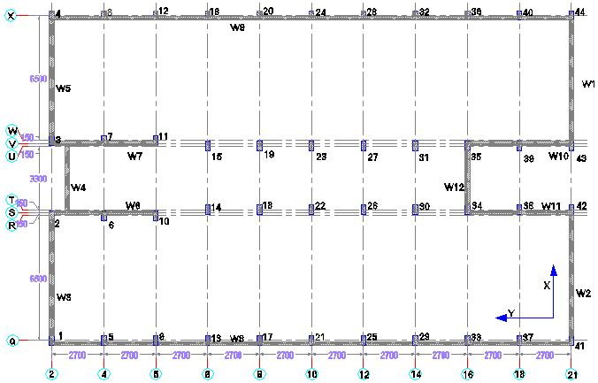
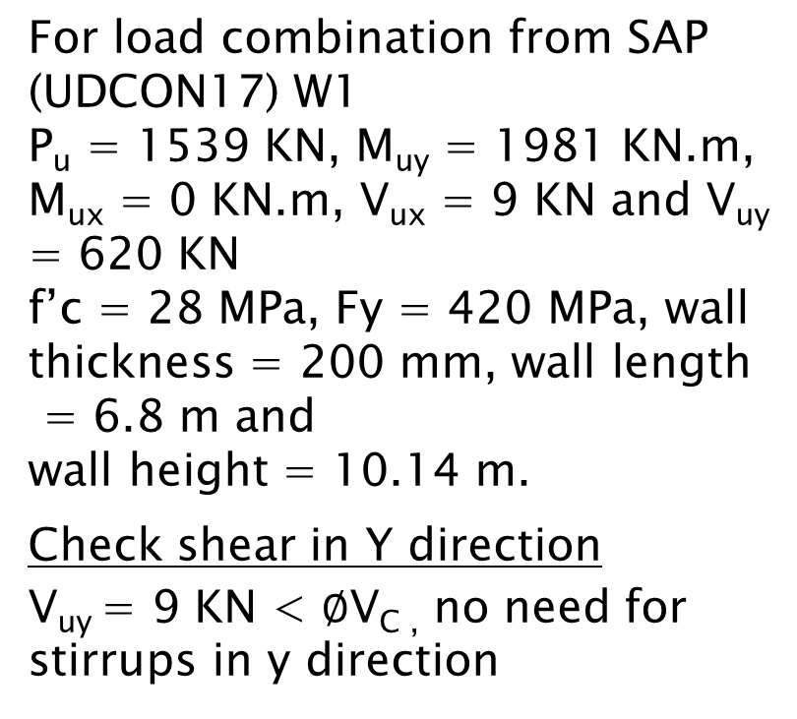
6. Final design (shear wall)
For load combination from SAP (UDCON17) W1
P_{u} = 1539 KN, M_{uy} = 1981 KN.m, M_{ux} = 0 KN.m, V_{ux} = 9 KN and V_{uy} = 620 KN
f’c = 28 MPa, Fy = 420 MPa, wall thickness = 200 mm, wall length
= 6.8 m and
wall height = 10.14 m.
Check shear in Y direction
V_{uy} = 9 KN < $∅$V_{C ,} no need for stirrups in y direction
Figure 6.5 Shear wall layout

Slide 51
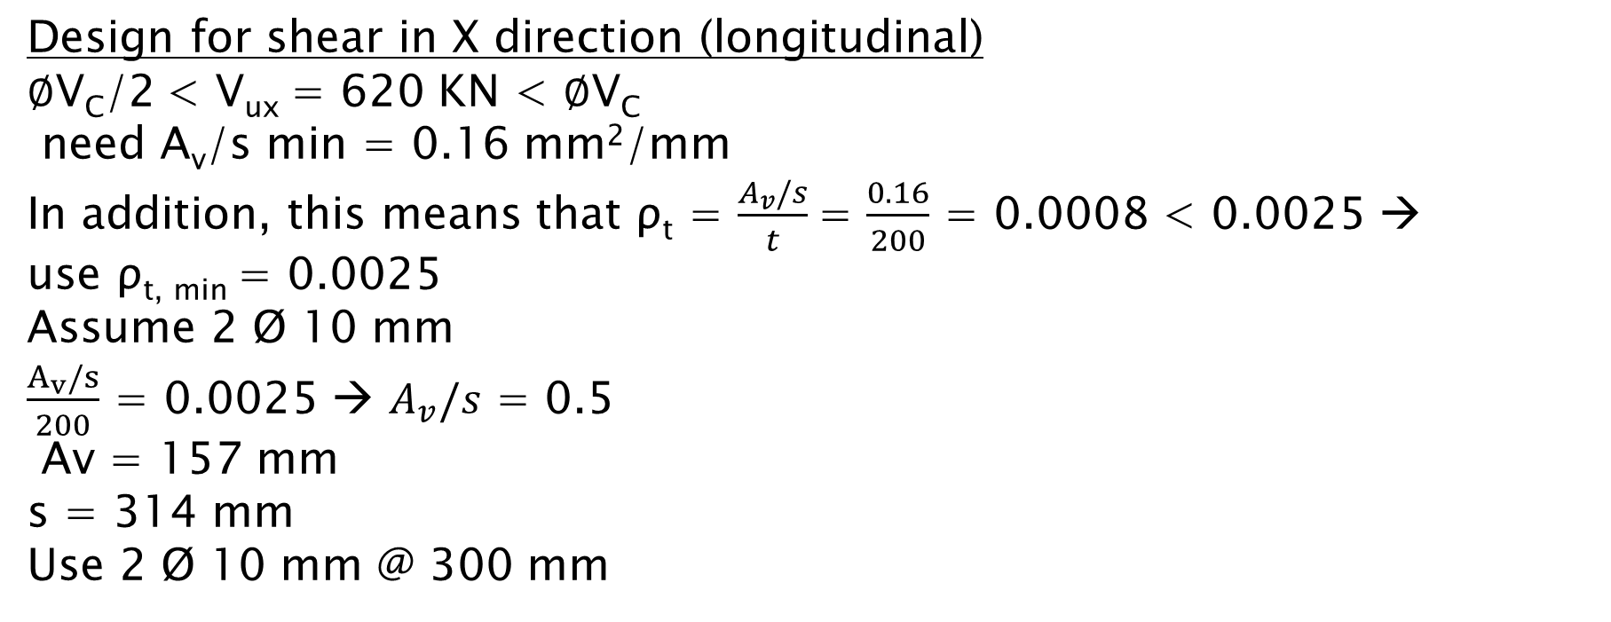
6. Final design (shear wall)
Design for shear in X direction (longitudinal)
$∅$V_{C}/2 < V_{ux} = 620 KN < $∅$V_{C}
need A_{v}/s min = 0.16 mm²/mm
In addition, this means that ρ_{t} = $\frac{A_{v}/s}{t}$= $\frac{0.16}{200}$ = 0.0008 < 0.0025 →
use ρ_{t, min} = 0.0025
Assume 2 Ø 10 mm
$\frac{A_{v}/s}{200}$ = 0.0025 → $A_{v}/s$ = 0.5
Av = 157 mm
s = 314 mm
Use 2 Ø 10 mm @ 300 mm

Slide 52
6. Final design (shear wall)
Design for axial force and moment around Y axis
M_{uy} = 2507 KN.m
P_{u} = 1597 KN
b = 200 mm Using the interaction diagram shown the following values for steel ratio of 0.0025 and area of steel are obtained: = 6800 mm²

Slide 53
6. Final design (shear wall)
ρ_{min} = 0.0025
As = 0.0025 × 200 × 6800 = 3400 mm²
Use 2 Ø 10 mm @ 250 mm
For opening in the walls the same area of steel distribution are used

Slide 54
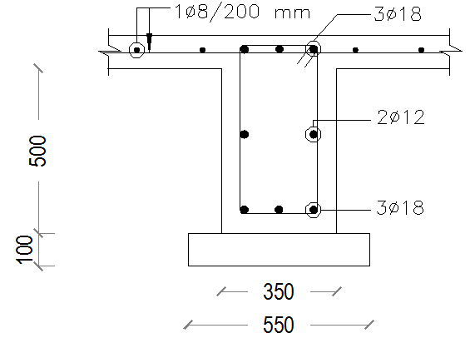
6. Final design (Tie beams)
H = 600 mm, d = 530 mm
In the internal tie beams the area of steel found is less than the minimum, Asmin =0.00333 * 350 * 530 = 617 mm².
- A_{s} from + A_{s} of 10% of P_{u} on column, which is T_{n}*10³ = ФA_{s}f_{y}

Slide 55
6. Final design (diaphragm)
Diaphragm is a horizontal system acting to transmit lateral forces to vertical-resisting elements (slab system).
Types of diaphragms:
Rigid diaphragm
Flexible diaphragm

Slide 56

6.1 Final design (diaphragm)
The diaphragm design force
F_{px} = the diaphragm design force
F_{i} = the design force applied to Level I
w_{i} = the weight tributary to Level i
w_{px} = the weight tributary to the diaphragm at Level x

Slide 57
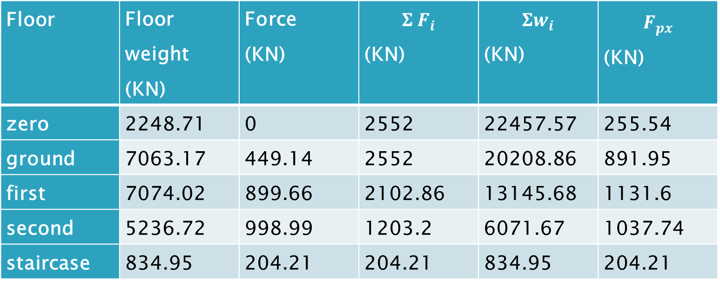
6. Final design (diaphragm)
Table 6.3 Diaphragm forces determination
Floor | Floor weight (KN) | Force (KN) | $$Σ F_{i}$$ (KN) | $$Σw_{i}$$ (KN) | $$F_{px}$$ (KN)
zero | 2248.71 | 0 | 2552 | 22457.57 | 255.54
ground | 7063.17 | 449.14 | 2552 | 20208.86 | 891.95
first | 7074.02 | 899.66 | 2102.86 | 13145.68 | 1131.6
second | 5236.72 | 998.99 | 1203.2 | 6071.67 | 1037.74
staircase | 834.95 | 204.21 | 204.21 | 834.95 | 204.21

Slide 58
6. Final design (diaphragm)
Table 6.4 Diaphragm calculations from x-direction force
Floor | Moment from force in x-direction | Force (KN) | Number of steel bars
ground | 2340 | 148 | 2ϕ20
first | 2340 | 148 | 2ϕ20
Second | 2340 | 148 | 2ϕ20
staircase | 71 | 23.67 | neglect

Slide 59
6. Final design (collectors)
Transferring the seismic forces to the element providing the resistance

Slide 60
6. Final design (horizontal structural irregularity)
Torsional Irregularity
Extreme Torsional Irregularity
The torsional irregularity is not exited
The extreme torsional irregularity is not exited

Slide 61
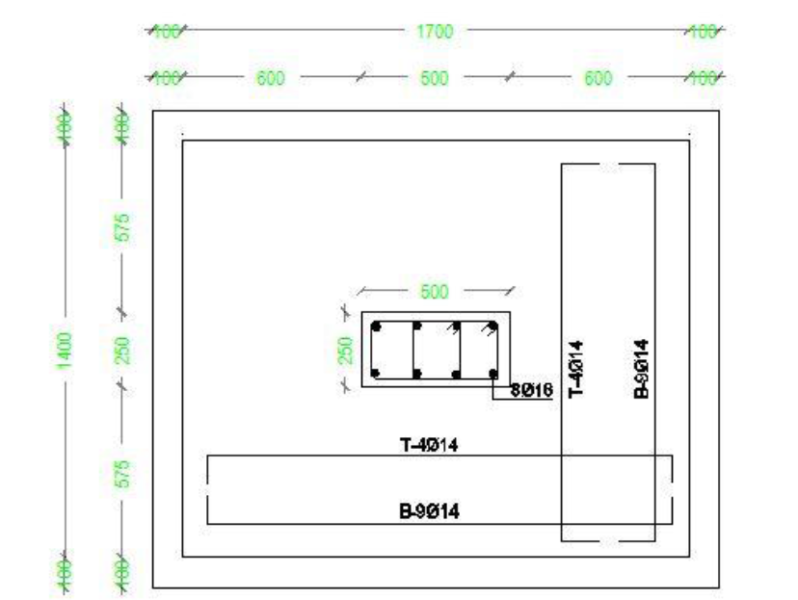


6. Final design (footings)
Final Design of single Footings
Ps(service reaction) = 709 KN
Pu(Ultimate reaction) = 933 KN
Footing dimensions = 1700*1400 mm
Try h = 400 mm
Wide beam shear check is OK
Punching check is OK
In both direction
Figure 6.7 Dimension of single footings

Slide 62
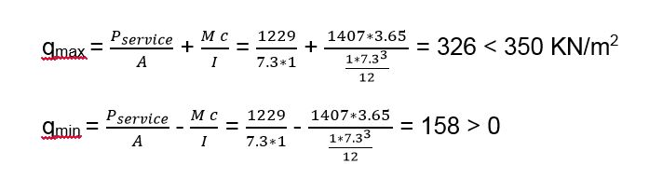
6. Final design (wall footings)
Service reaction (Ps) = 1229 KN, service moment(Ms) = 1407 KN.m
Ultimate reaction (Pu) = 1571 KN, Ultimate moment (Mu) = 2555 KN.m
B = 𝑃𝑠𝑒𝑟𝑣𝑖𝑐𝑒/𝑞𝑎𝑙𝑙 = 1229/7.3330 = 0.5 m use B= 1m
Try h=350 mm
Wide beam shear and punching is OK

Slide 63
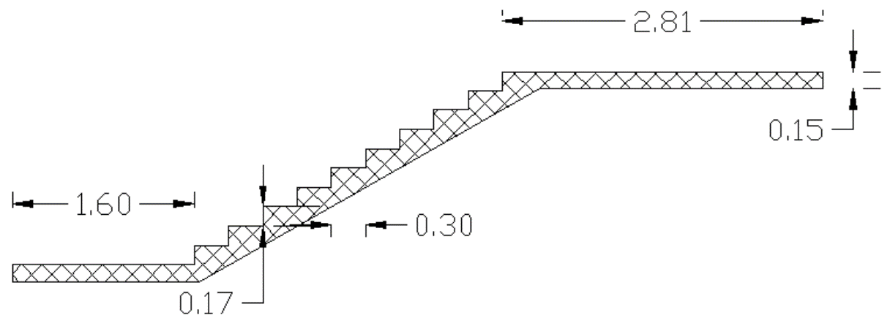
6. Final design (stairs)
Staircase was designed by building 3D-model using SAP2000 14
Table 6.5 Stair weight
Step weight | Slab weight | Marble finish | Plaster finish | Live load
1.91 KN/m2 | 3.75 KN/m2 | 1.1 KN/m2 | 0.64 KN/m2 | 5 KN/m2

Slide 64
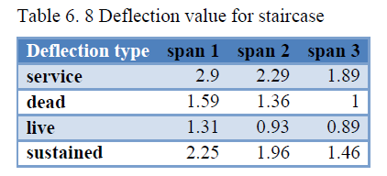
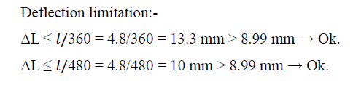
6. Final design (stairs)
Check for deflection
ΔLT = 1.31 + (2 × 1.59) + (2 × 2.25) = 8.99 mm

Slide 65
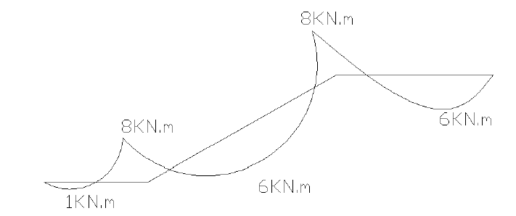
6. Final design (stairs)
Check for shear
No need for shear reinforcing.
Design for flexure

Slide 66
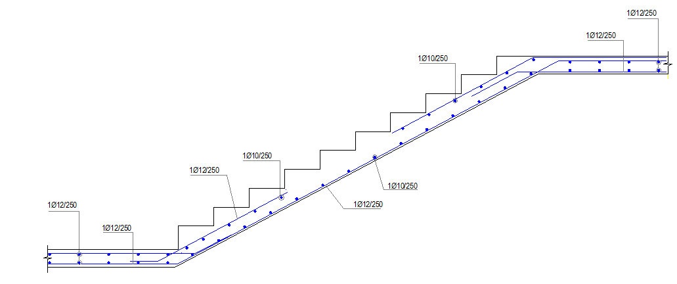
6. Final design (stairs)
Typical detail in stairs

Slide 67
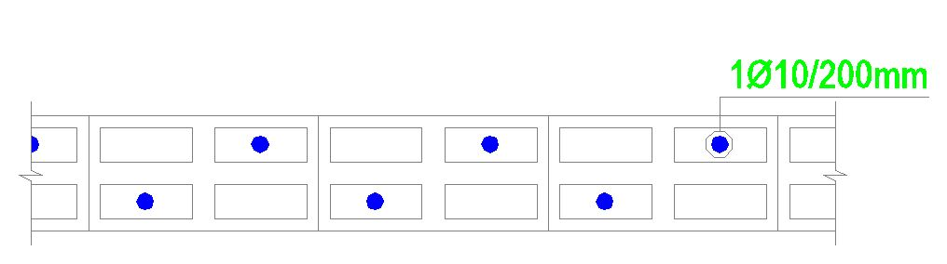
6. Seismic Demands on Non-Structural Components
Internal partition analysis and design
Fp = seismic design force
Fp=5.7KN
Mu=2.4 KN.m
As = 65 mm2
As min = 360mm2
Use 5 ∅ 10 at 1 m

Slide 68
Thank You

