Slide 1
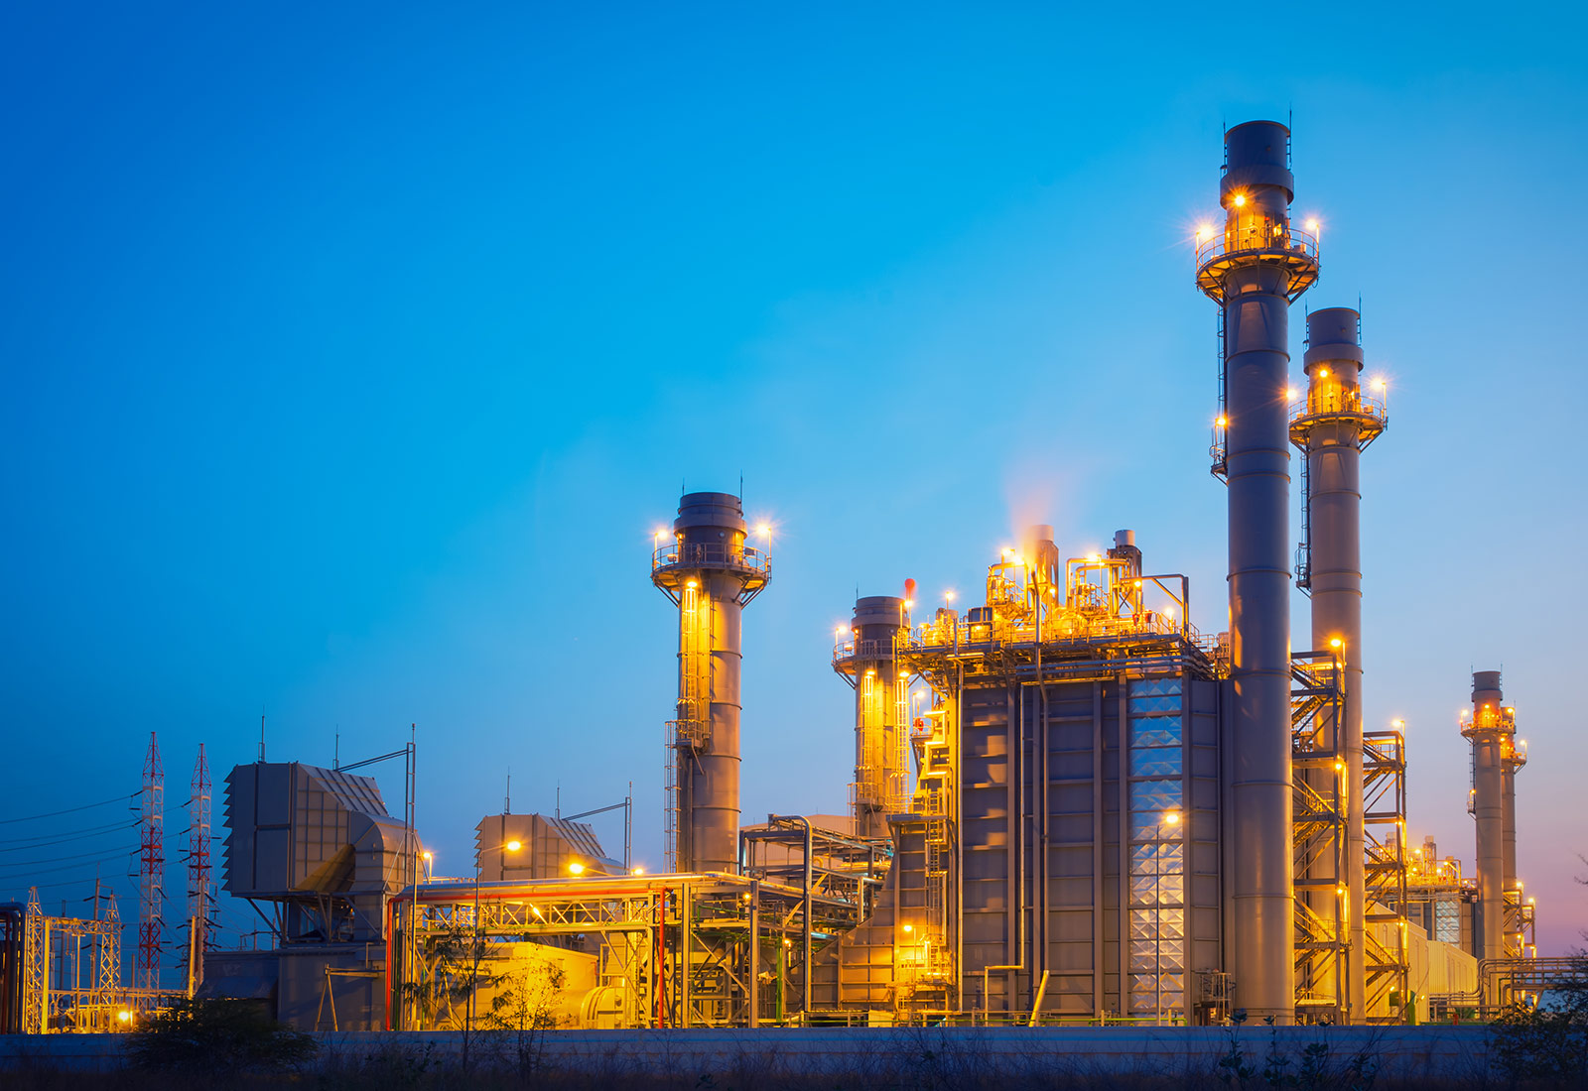
Power Plant Cycle
By :
Zaid Khraim
Maen Melhem
Mohamed Abu Asedeh
Supervised by :
Dr. Salameh Abd Alfatah

Slide 2
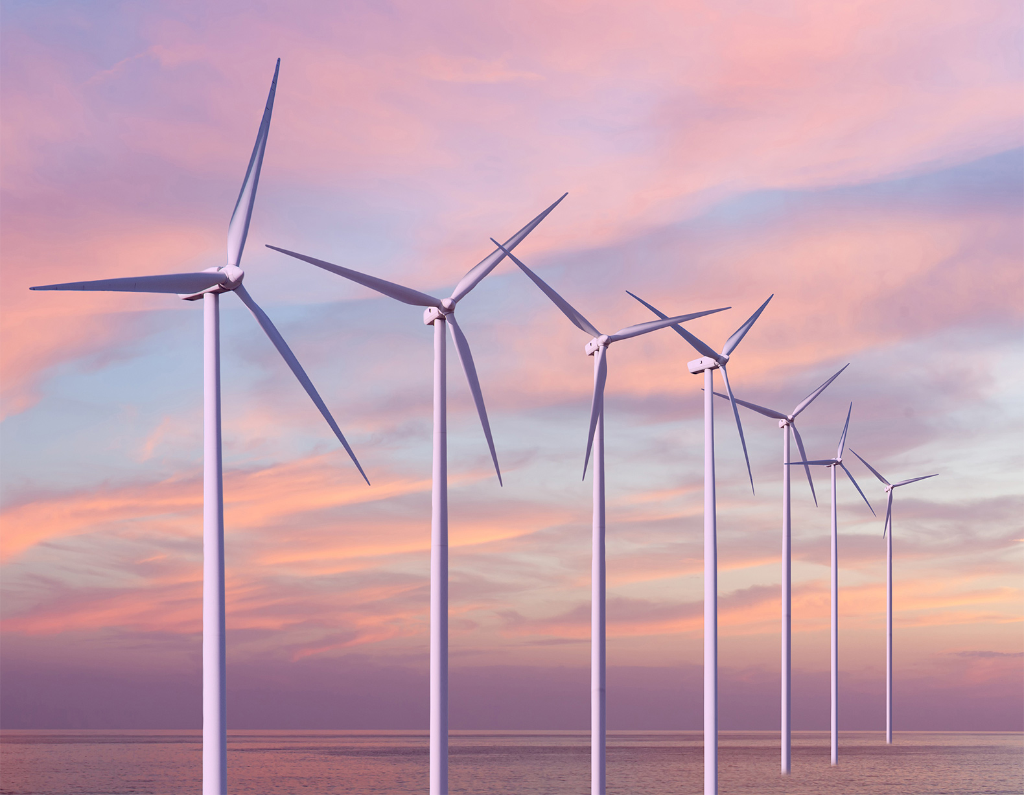

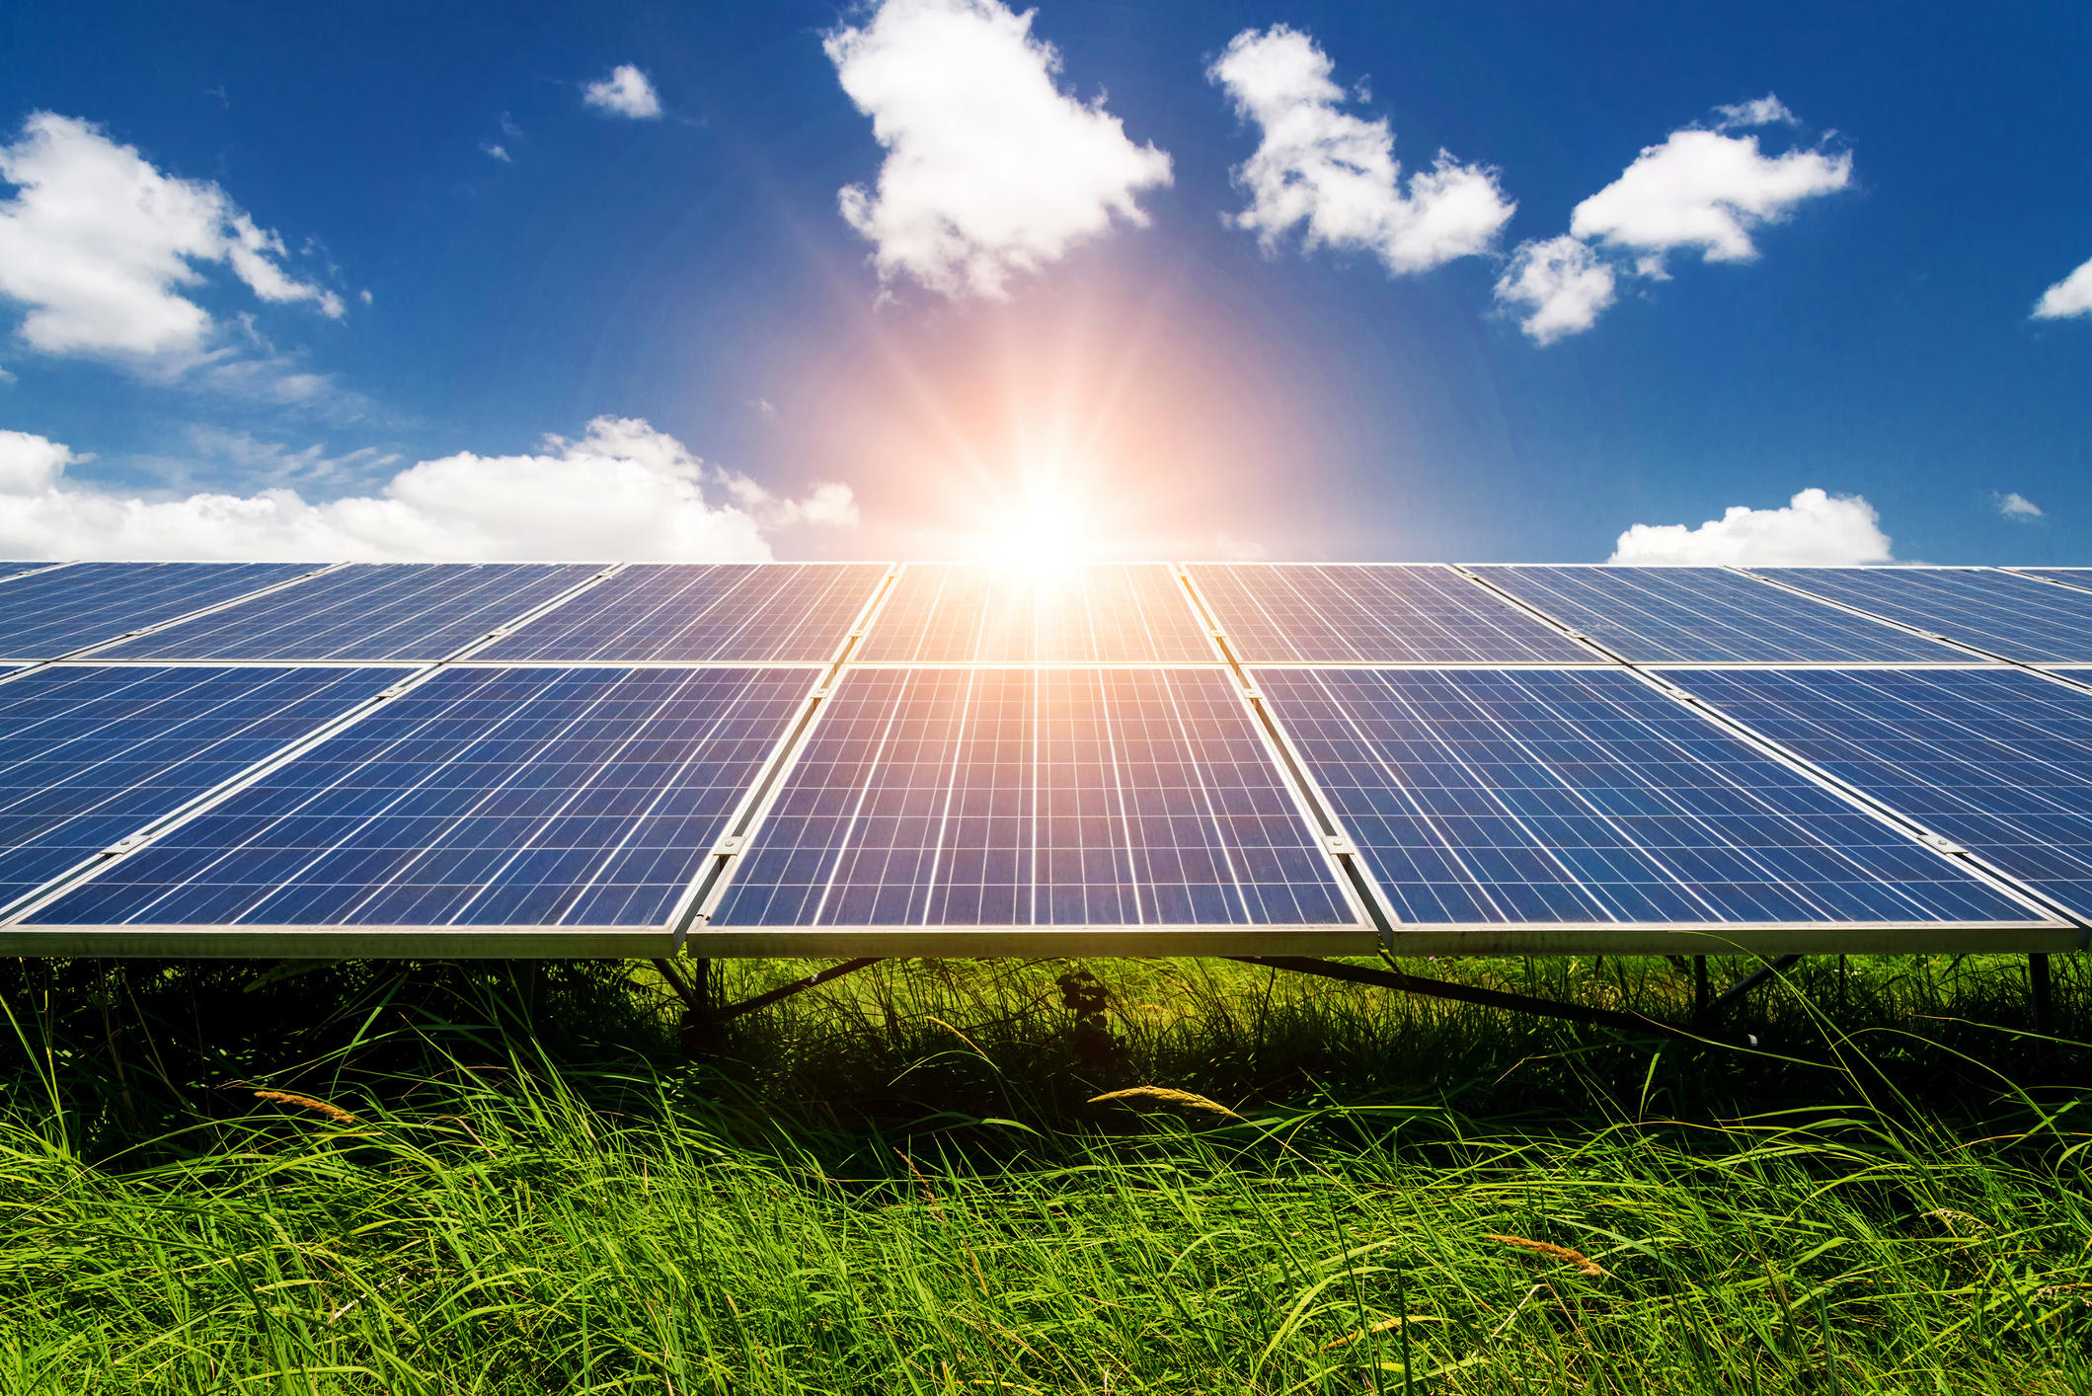

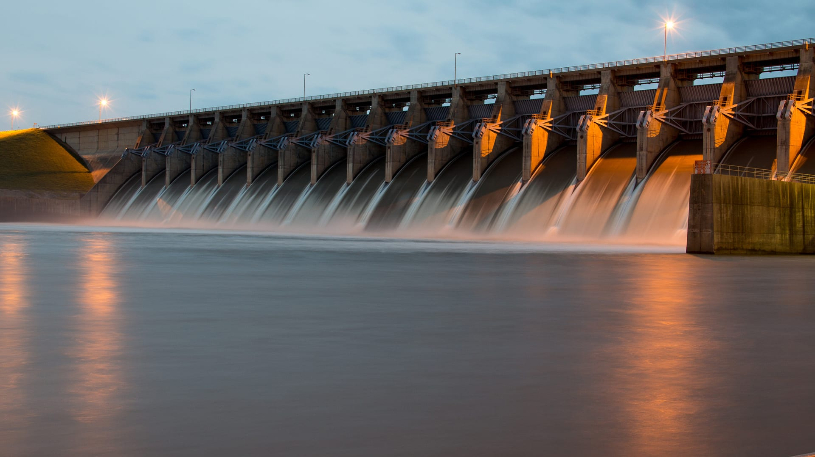

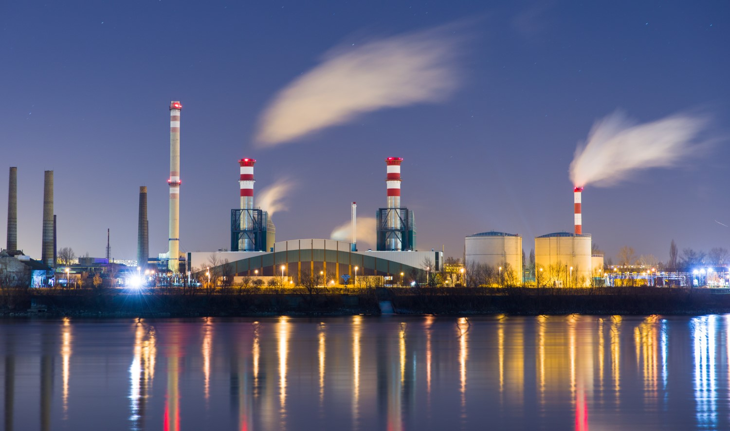

What are the methods of generating electric energy ?
Wind Energy
Solar Energy
Energy from dams
power plant energy

Slide 3
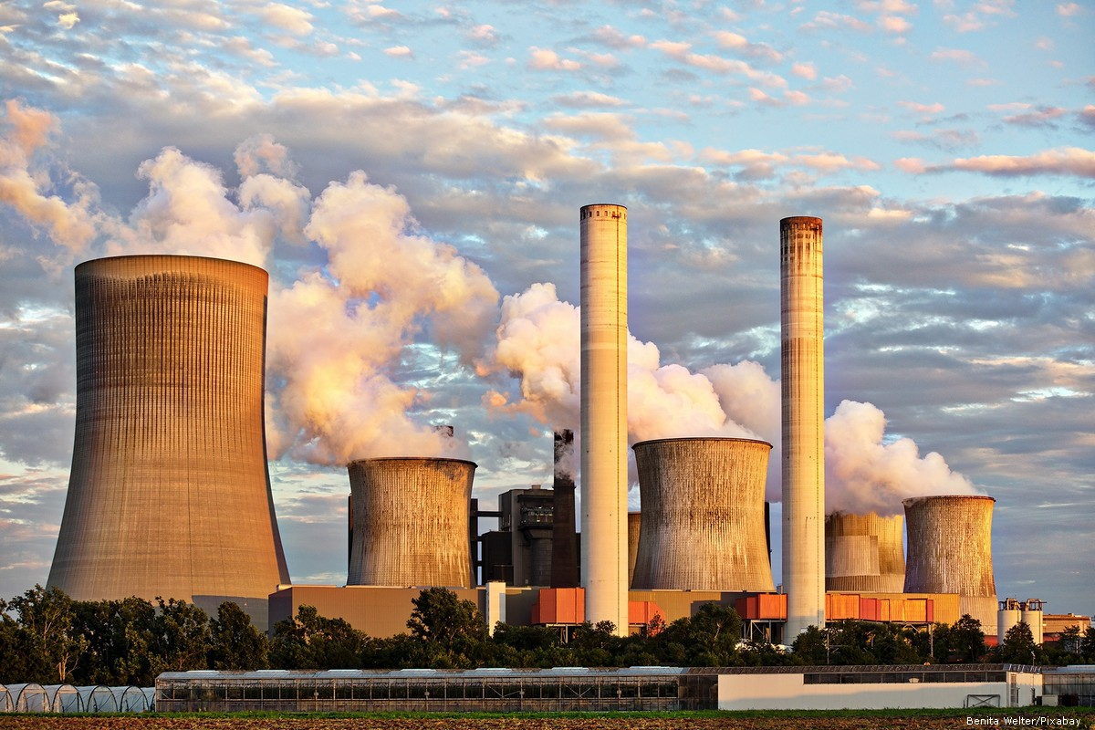
What is a power plant cycle?
An industrial way to generate electricity
One of the most important sources of energy generation in the world

Slide 4
Objective
The main goal of this project is to provide an electric power from different types of fuels
choose the best fuel that provides the most efficiency.
It may be through the disposal of waste which is a fuel.
Using the system for university study .
Reducing pollution by isolating the system .
It can work to make the system on a larger scale .

Slide 5
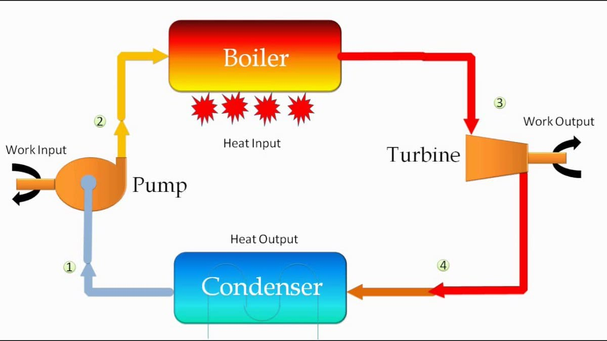
Component of Power Plant Cycle
Pump
Boiler
Turbine
Condenser

Slide 6
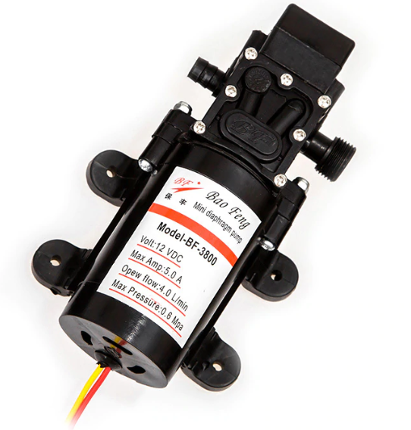
Pump
A suitable pump has been selected for this project so that it meets the right requirement specifications
specifications
gives high head (high pressure) and low flow rate.
The specifications of this pump are flow rate of 4.0 L/min and maximum pressure of 0.6 MPa.

Slide 7
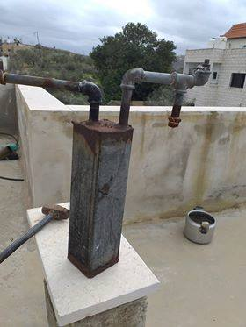
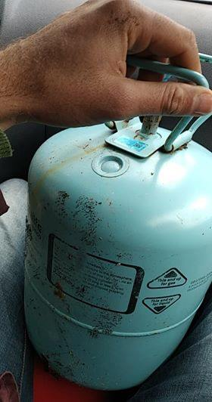
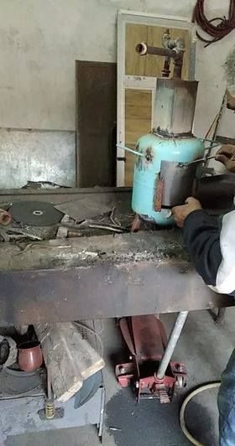
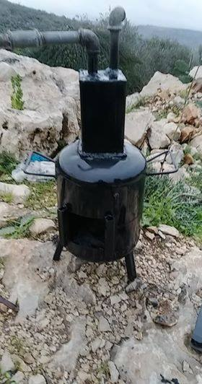
Boiler
STEP 1
STEP 2
STEP 3
FINAL STEP

Slide 8
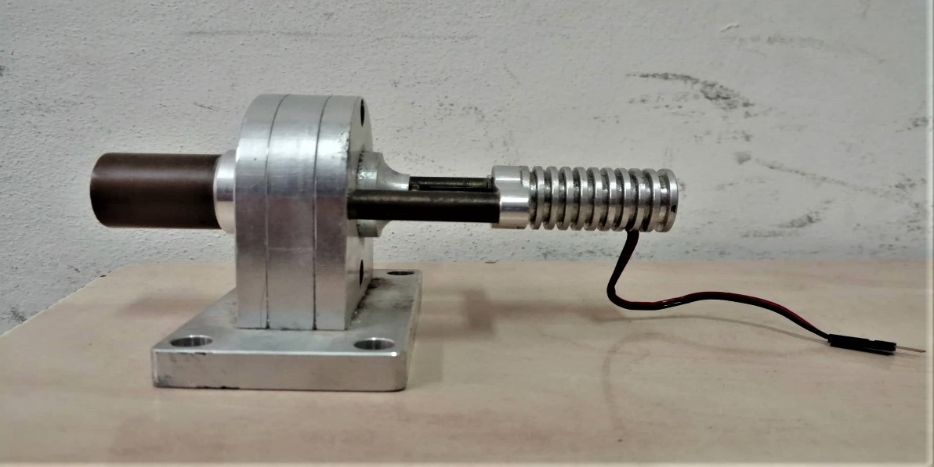
Turbine
Specification:
The type of this turbine is a steam turbine.
connected with electrical generator to generate electricity.
used in a small scall for experimental purposes.

Slide 9
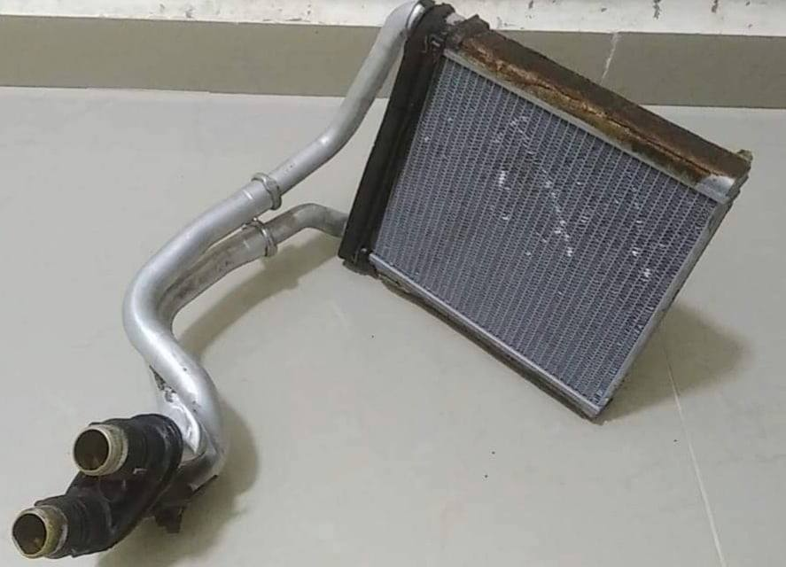
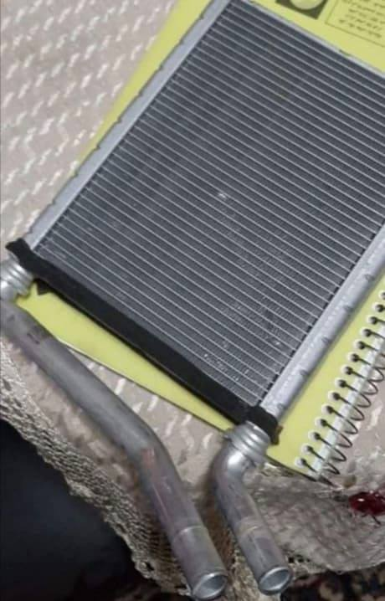
Condenser
Bad condenser has a leak problem
Good condenser
The condenser converts the water from vapor phase to liquid phase after coming out from the turbine .
This condenser has been obtained from an air conditioner that used in cars.

Slide 10
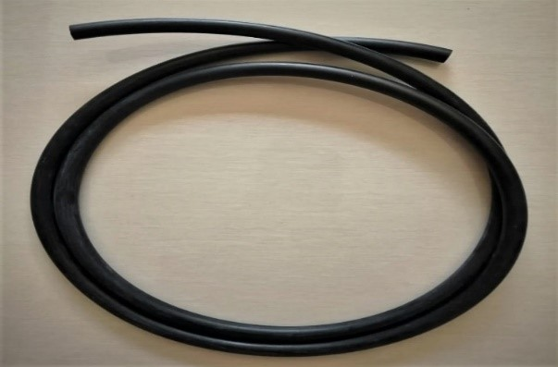
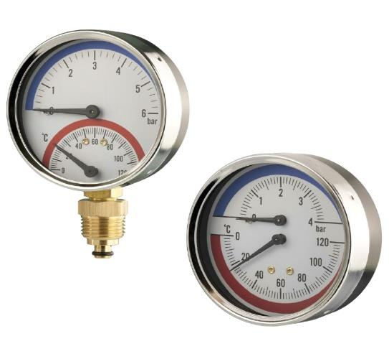
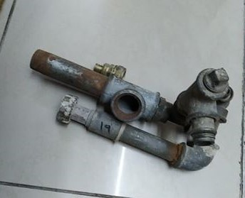
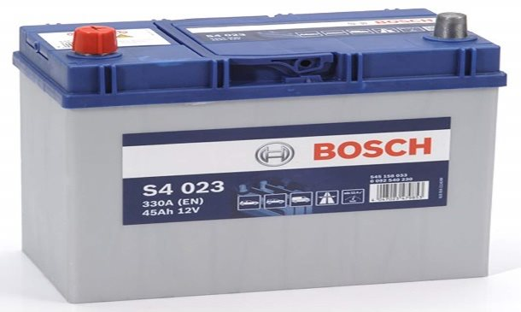

Tools that have been used in this project
Pipes that resist high pressure and temperature
Pressure and temperature gauges
Pipes conversions
Small car battery
Fasteners

Slide 11
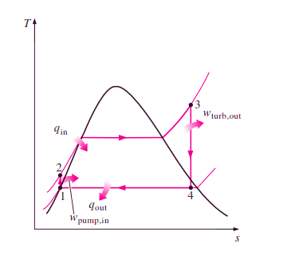
T-S Diagram
Pump : Compression of the fluid to high pressure using a pump (this takes work) (Steps 1 to 2).
Boiler : The compressed fluid is heated to the final temperature (which is at boiling point), therefore, a phase change occurs—from liquid to vapor. (Steps 2 to 3).
Turbine : Expansion of the vapor in the turbine. (Steps 3 to 4).
Condenser : Condensation of the vapor in the condenser (where the waste heat goes to the final heat sink (the atmosphere or a large body of water (ex. lake or river). (Steps 4 to 1).

Slide 12

Limitation

Slide 13
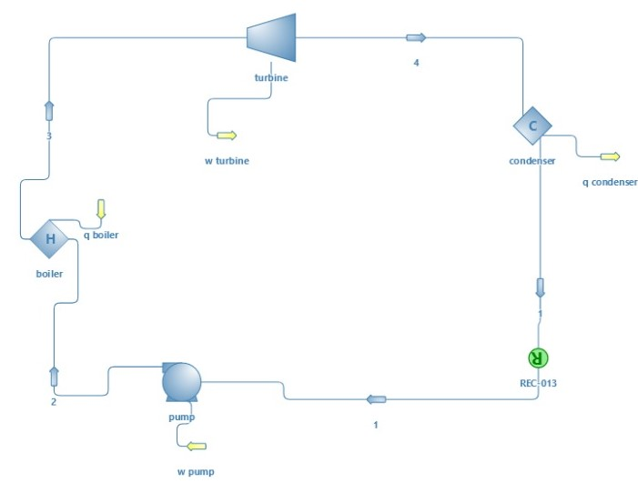
Power Plant Simulation
Software : DWSIM
Working fluid : R245fa
Property package : Steam tables
Draw the system : Pump, Boiler, Turbine, Condenser, 4 streams, 4 energy flows.
System condition : Inlet at 1= 2bar,
Pump = 6bar, Boiler = 350 KW

Slide 14
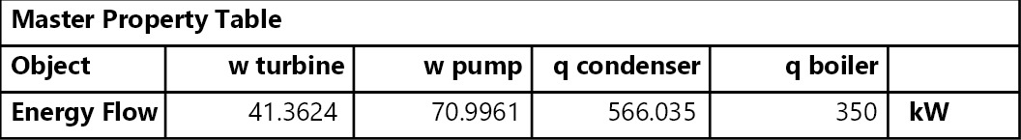
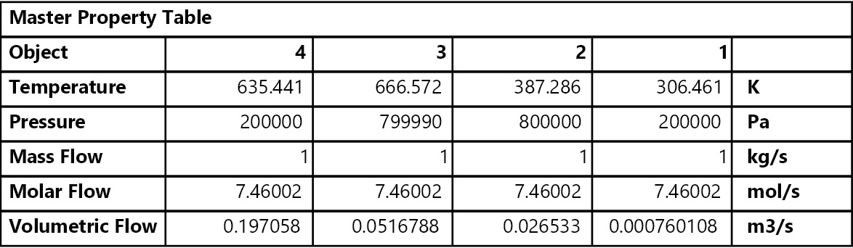

Some of the results that have been obtained from the simulation
The efficiency of the cycle cane be calculated from this equation:
$$η_{th}=\frac{w_{net}}{q_{in}}=1−\frac{q_{out}}{q_{in}}=1−\frac{566.035}{350}=61.7\%$$

Slide 15
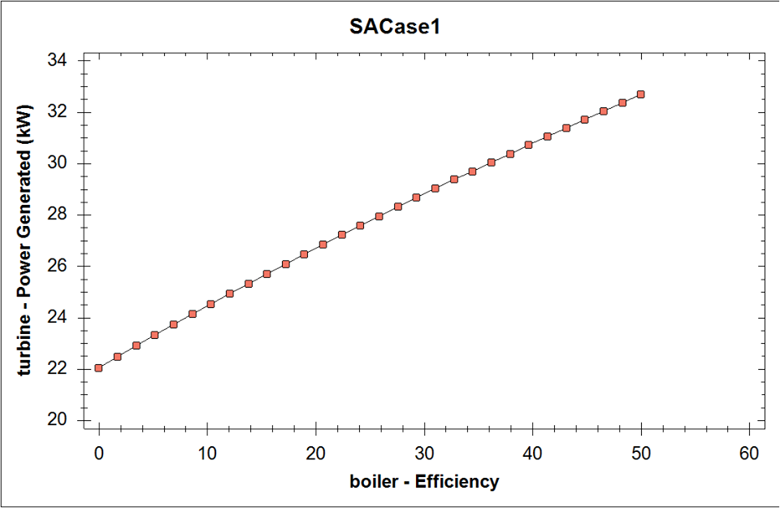
Case1 : The effect of the boiler efficiency on the power generated by the turbine

Slide 16
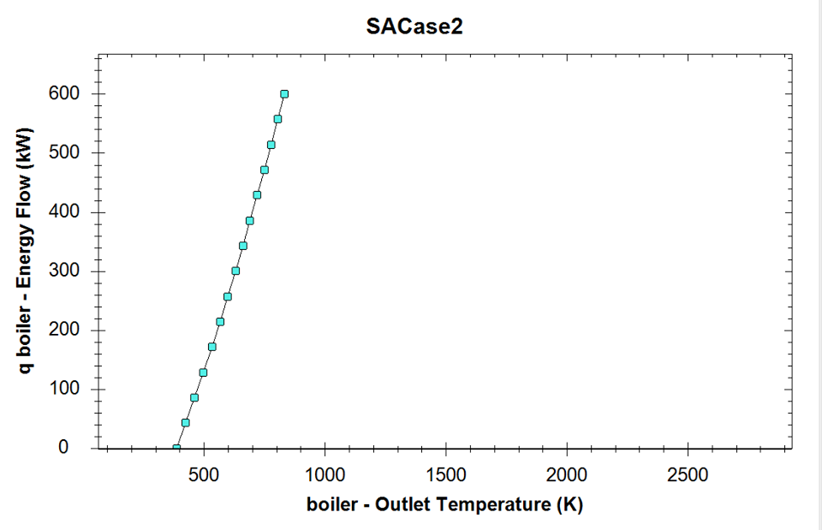
Case2 :The effect of the Q (boiler) (KW) on the outlet temperature (K)

Slide 17

Future Work

Slide 18

Any Question ?

Slide 19


