Slide 1
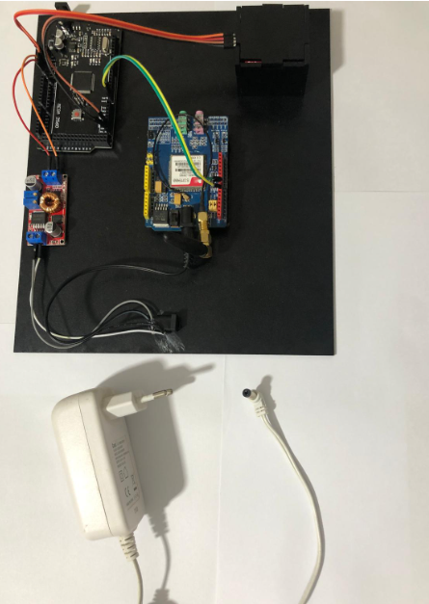
GSM based non-invasive
glucose monitoring system base on
NIR spectroscopy
and
Microstrip resonator
By: Muhammad danoun
Anas AL Sheihkh
Supervisor: Dr. Omar Tamimi

Slide 2
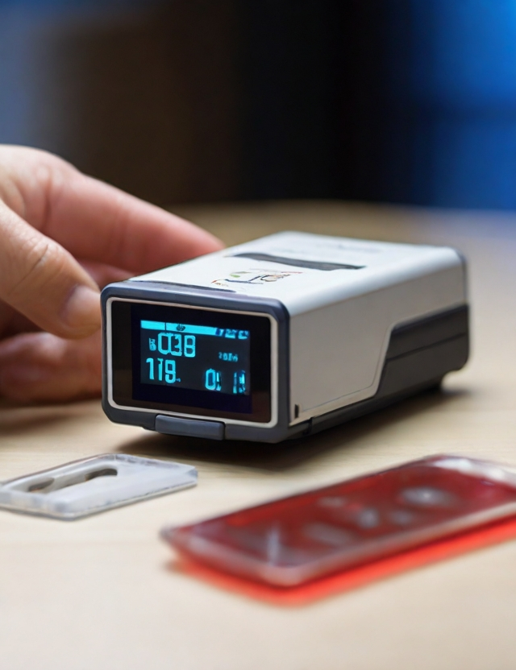
Background of the Project
The presentation proposes a new approach to non-invasive blood glucose monitoring in response to the growing number of people with diabetes globally. Traditional glucose meters often use invasive techniques, leading to discomfort and infection. Near-infrared (NIR) transponders and Microstrip resonators to glucose concentration changes, integrated into a GSM-based system, allowing continuous monitoring of blood glucose levels are being studied.

Slide 3
Objectives and Goals
Study of the response of NIR and Microstrip resonator changes in blood sugar concentration.
Non-Invasive Monitoring Technology Development: Design and implement a robust system capable of non-invasively monitoring blood glucose levels using NIR spectroscopy combined with Microstrip resonator technology.

Slide 4
Methods for Monitoring Blood Glucose Concentration :
Invasive Blood Glucose Monitoring At present
Non-Invasive Blood Glucose Monitoring

Slide 5
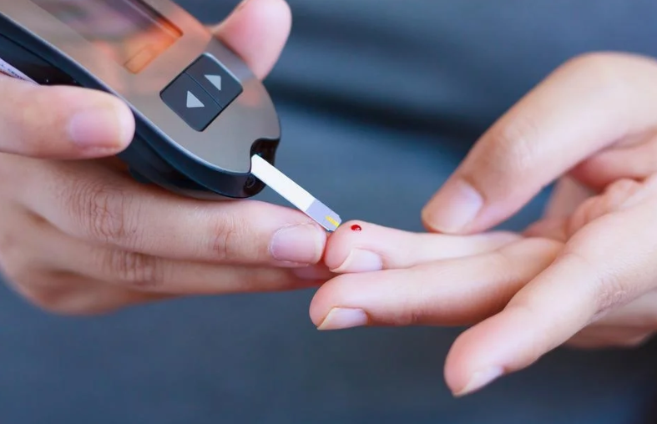
Invasive Blood Glucose Monitoring:
The current method for invasive blood glucose monitoring relies on drawing blood for analysis, commonly done in medical facilities and using household glucometers. This approach, while accurate, is not conducive to continuous monitoring due to its cumbersome process and potential discomfort.

Slide 6
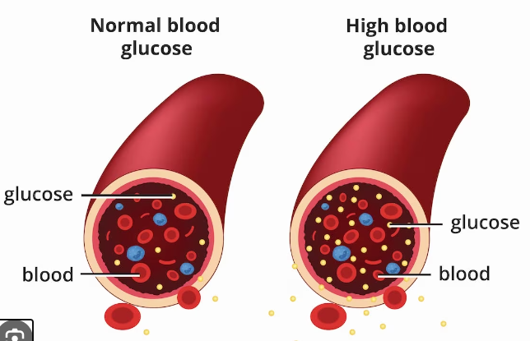
A look at the problems of surgical glucose measurement:
Problems with surgical glucose measurement include:
risk of infection.
patient discomfort.
Need for frequent calibration and maintenance.
The permanent cost of screening strips.
It causes problems for children
These issues highlight the need for non-invasive CGM solutions.

Slide 7
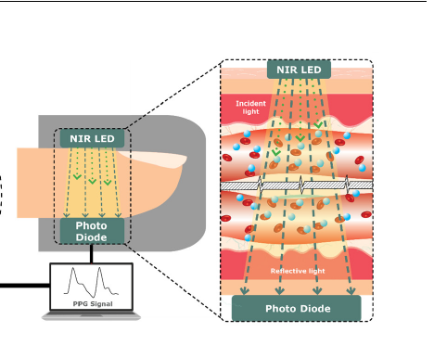
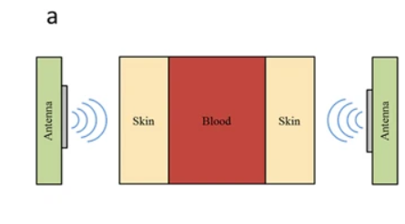
Non-Invasive Blood Glucose Monitoring
Microstrip resonator
NIR sensors

Slide 8
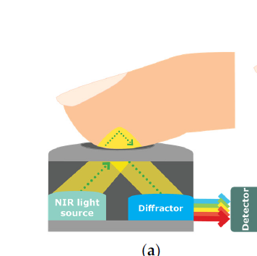
What are Infrared Waves?
Infrared waves are a type of electromagnetic radiation with longer wavelengths than visible light but shorter than microwaves. Their wavelength range typically falls between 700 nanometers and 1 millimeter. Infrared waves are commonly used in technologies like infrared spectroscopy and thermal imaging due to their ability to detect heat and molecular vibrations.

Slide 9
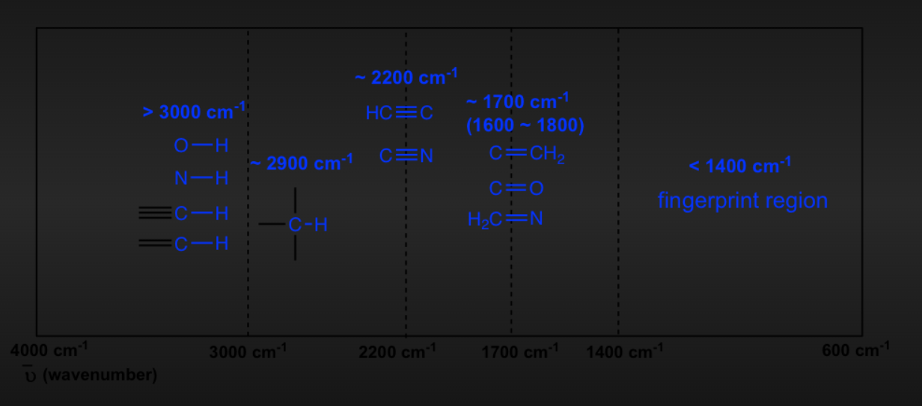
Absorption Spectroscopy Overview:
Sugar molecules absorb infrared rays through vibrational transitions. The infrared radiation causes the bonds within the sugar molecules to vibrate at specific frequencies. These vibrations correspond to the absorption peaks in the infrared spectrum, allowing for the identification and quantification of sugar molecules based on their unique absorption characteristics.

Slide 10
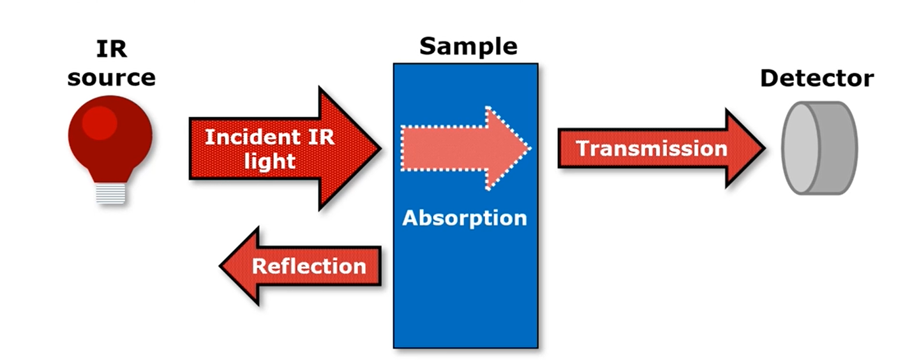
Using the Near Infrared (NIR) Spectroscopy in glucose monitoring devices:
Near-Infrared (NIR) Spectroscopy is an optical method that studies scattered, transmitted, or reflected light in the electromagnetic bandwidth of 700–2500 nm. Widely applied in various fields, including medicine, NIR spectroscopy has been explored for glucose estimation. Unlike Mid-Infrared (MIR) waves, NIR waves penetrate deeper, reaching the dermis layer of the skin and interacting with blood components. This makes NIR spectrometry a viable method for estimating blood glucose levels.

Slide 11
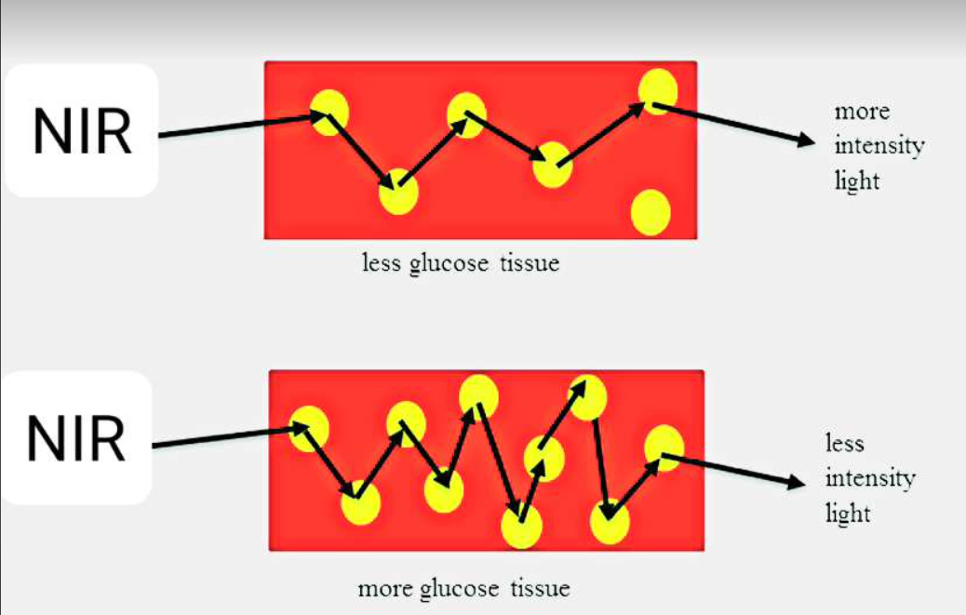
Effect of near infrared radiation (NIR) on tissue and blood:
Near-Infrared (NIR) spectroscopy, a technique involves the interaction of molecules in a sample with electromagnetic waves. NIR waves have optimal skin penetration compared to other infrared waves, being minimally absorbed by water and hemoglobin. This allows easy spectral measurements from the skin or body surface. Glucose, a key carbohydrate, exhibits specific molecular vibrations when NIR waves pass through skin tissue. The absorption or scattering of NIR waves by these vibrations can be leveraged to measure the concentration of essential biological functional groups in the blood, such as C–H, N–H, C–O, and O–H.

Slide 12
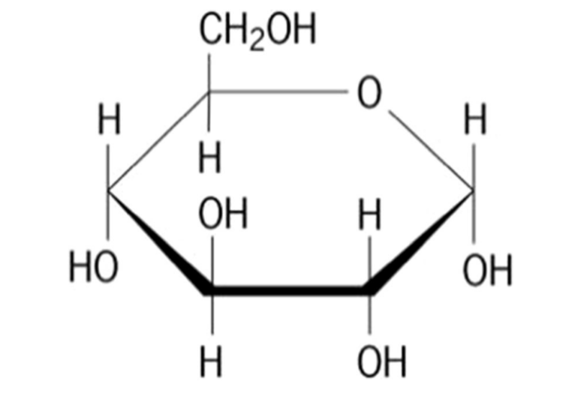
Selection of the NIR absorption wavelength
according to the reference of the spectral region of the near-infrared wavelength As in the following figure. Glucose known to have more than one absorption point in NIR wavelength regions and these peaks can help to overcome the difficulty in determine the glucose reading.
Importantly, these wavelengths do not coincide with the wavelength (940 nm) at which glucose absorption is being detected. Therefore, the presence of these isomers does not significantly affect the detection of glucose.
Molecular structure of d-glucose

Slide 13
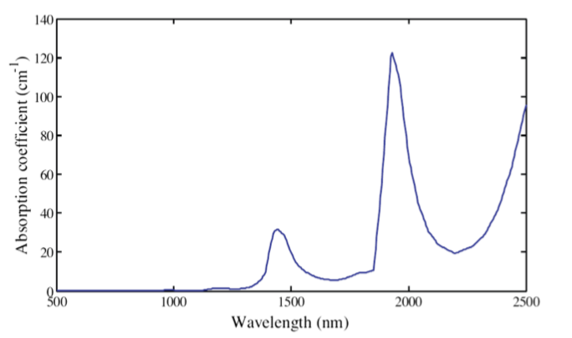
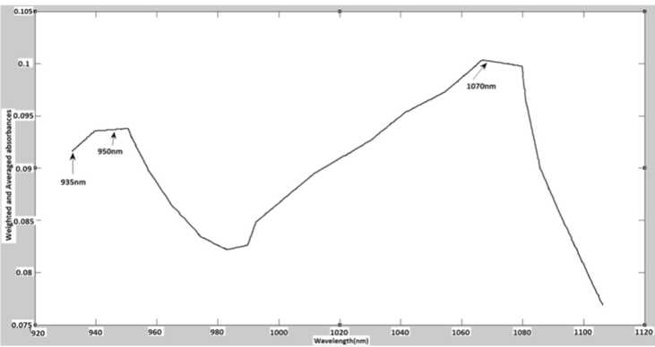
Water and glucose spectra in NIR region
Water spectra in NIR region
Spectrum showing the absorbance of the glucose

Slide 14
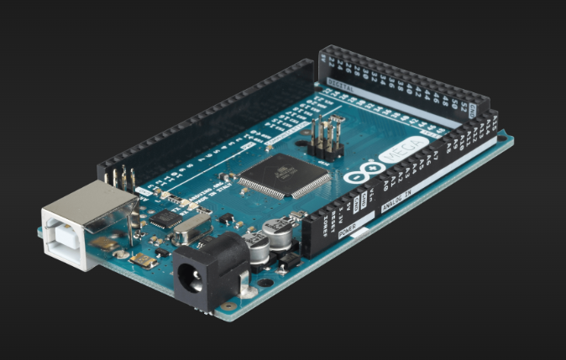
Microcontroller (Arduino Mega)
ARDUINO MEGA

Slide 15
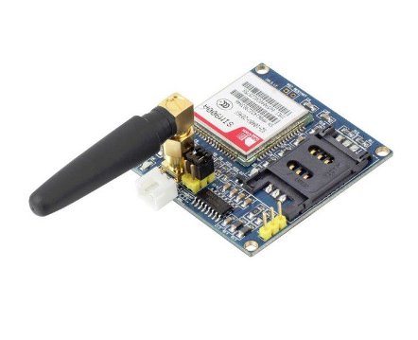
GSM MODULE (SIM900A)
SIM900A Module

Slide 16
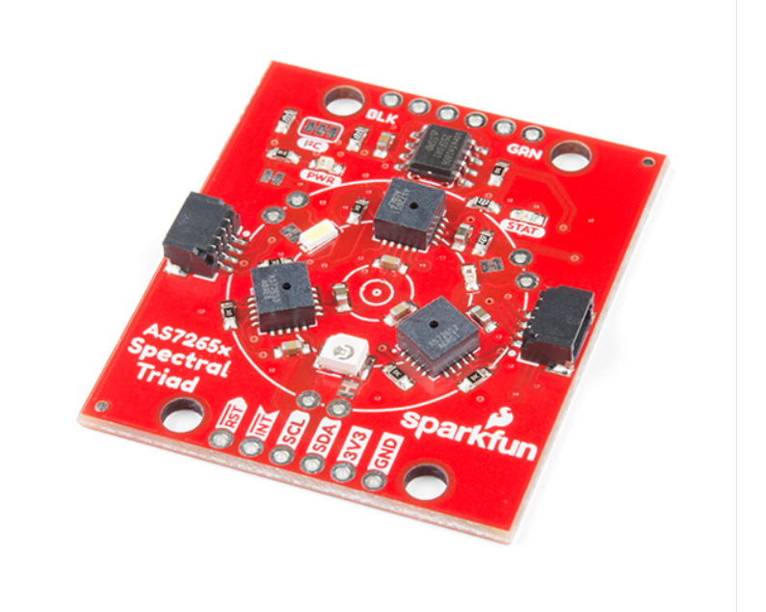
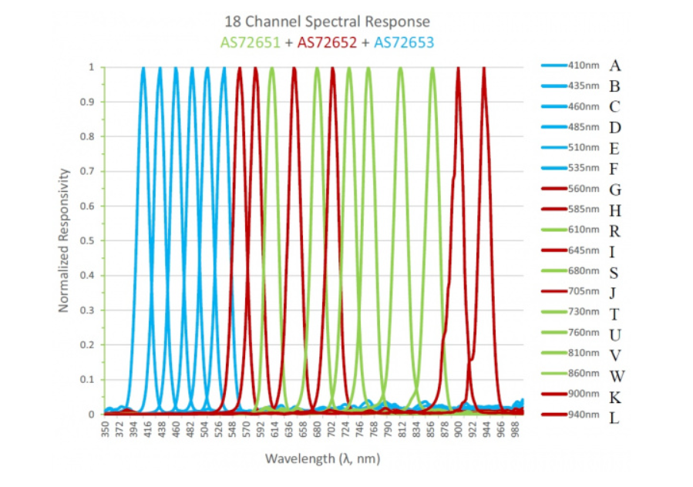
Triad Spectroscopy Sensor - AS7265x
AS7265x 18-Channel Spectral Responsivity
The sensor has the ability to measure and characterize how various types of materials absorb or reflect 18 different frequencies of light ranging from 410nm to 940nm.

Slide 17
non-invasive glucose monitoring system base on NIR spectroscopy Design
The figure shows the arduino connected to the gsm module and the as7265x sensor and fed through a step-down convertor that is fed using a power adapterوThe GSM module is also fed directly from power adapter.

Slide 18
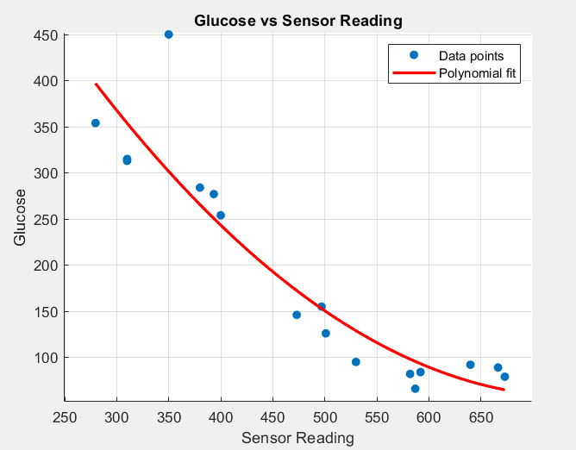
NIR spectroscopy results
Glucose vs Sensor Reading

Slide 19
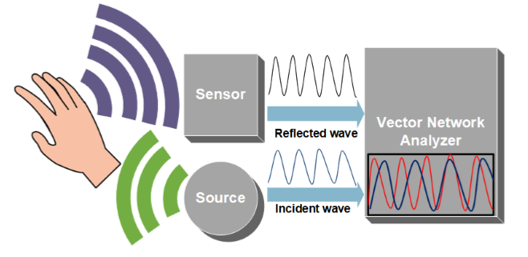
Microwave Spectroscopy (MWS):

Slide 20
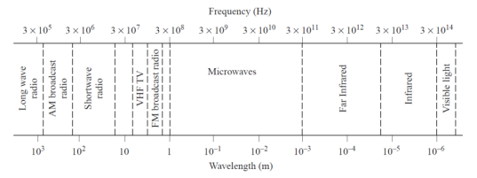
Microwave Sensors
The term microwave is typically used for frequencies between 300 MHz and 300 GHz, with a corresponding electrical wavelength between 1mm and λ = 1 m, respectively.
the range of microwave wave length

Slide 21
Measuring glucose with MICROWAVE RESONATORS and how glucose interacts with and MICROWAVE RESONATORS:
Variation in tissue permittivity allows dielectric characterization in medical applications such as to monitor blood pressure, blood glucose levels, cardiac activity and respiratory activity .
Microwave sensors can measure the parameter within the volume non-destructively. Therefore, when the blood glucose concentration varies, the permittivity of the blood will change.

Slide 22
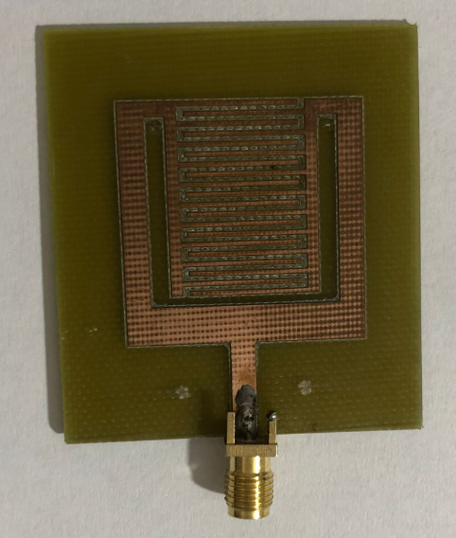
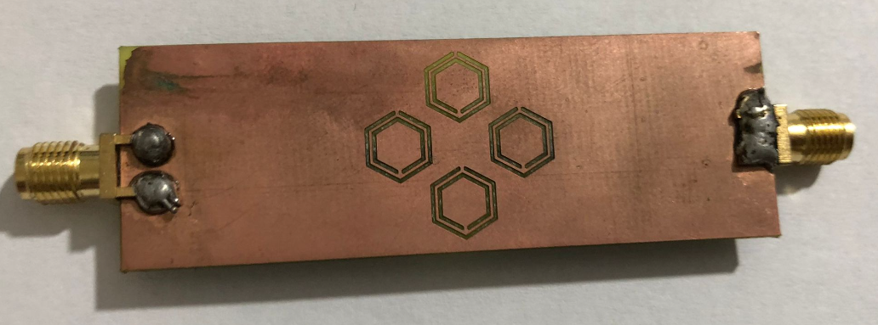
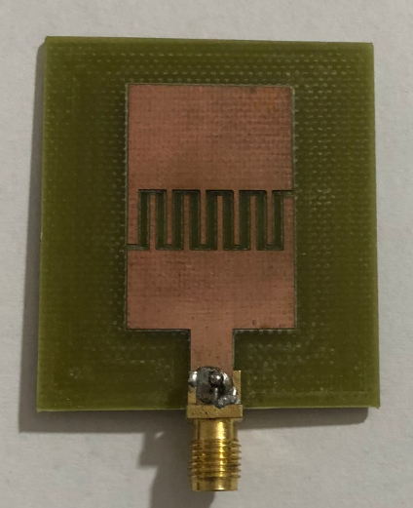
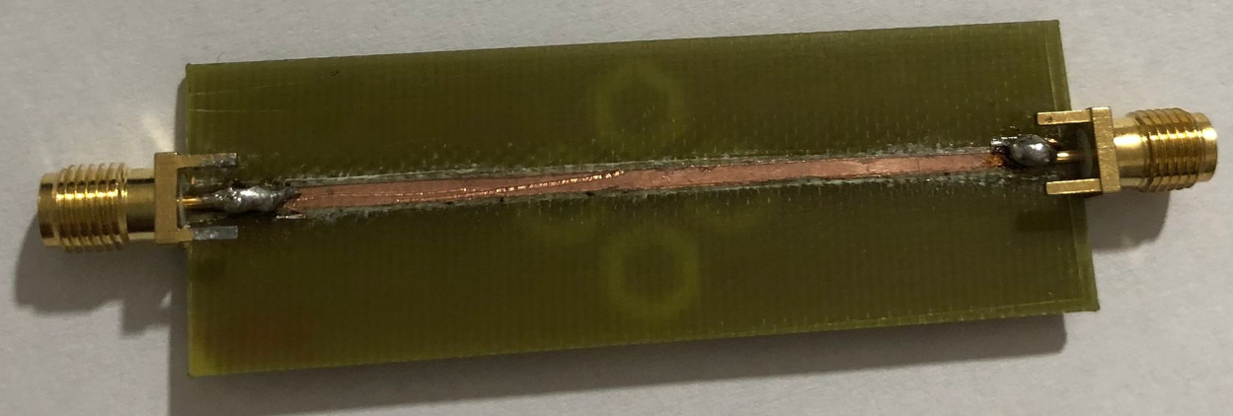
Mircostrip resonators Design
We designed 3 resonators to measure blood glucose levels
Stepped Impedance Resonator Sensor
hexagonal CARR
microwave sensor
CCSRs sensor

Slide 23
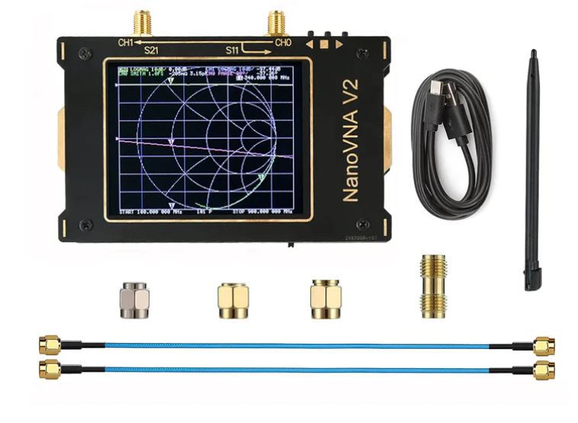
NanoVNA V2 3G: A Comprehensive Overview
NanoVNA V2 3G is a micro resonant device crucial for data collection in our project.
In the context of our project, the NanoVNA V2 3G is utilized to capture resonant data from microstrip resonators. Changes in these resonant characteristics are then correlated with glucose levels.
NanoVNA V2 3G

Slide 24
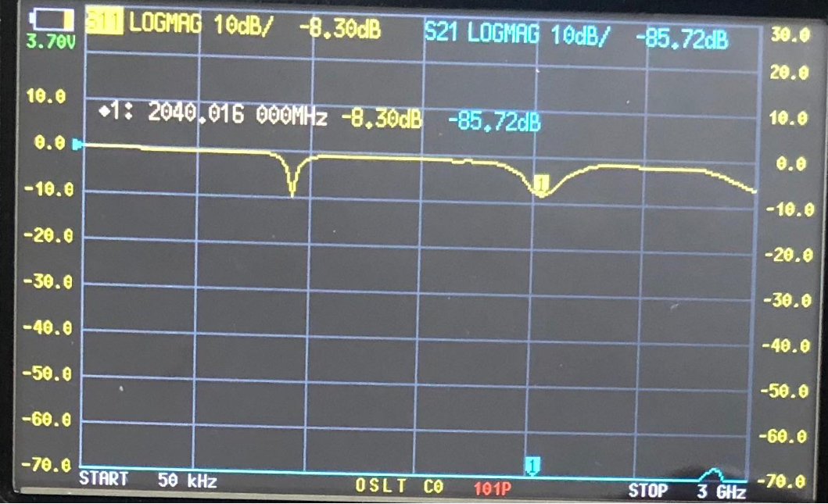
Microstrip resonator results:
CCSRs sensor
result was 110 mg/dL

Slide 25
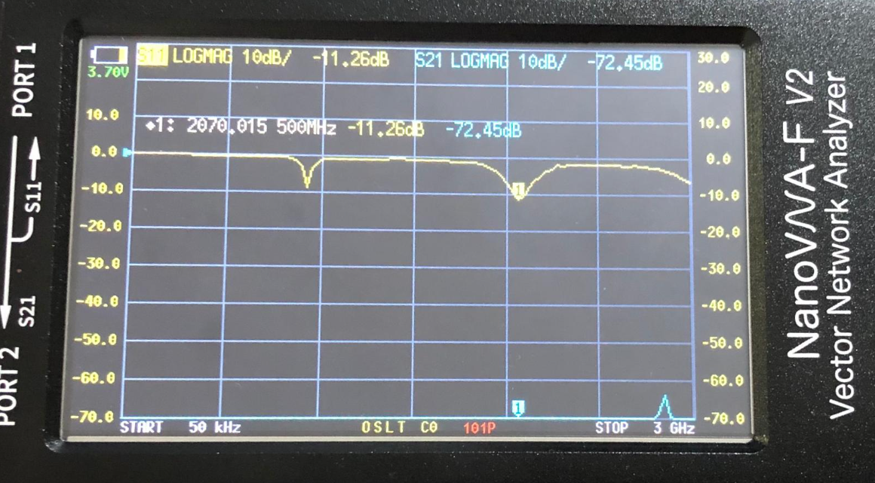
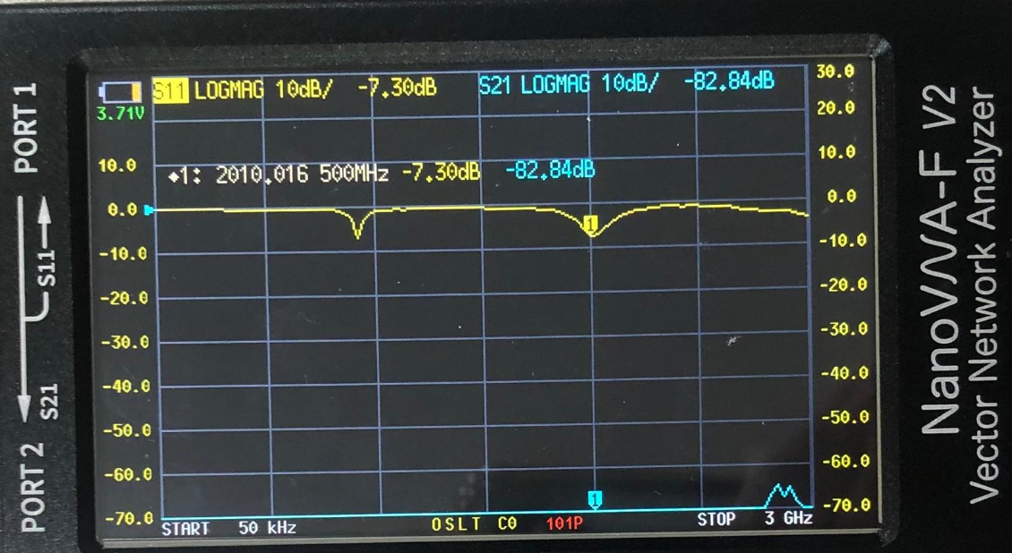
result was 89 mg/dL
result was 310 mg/dL

Slide 26
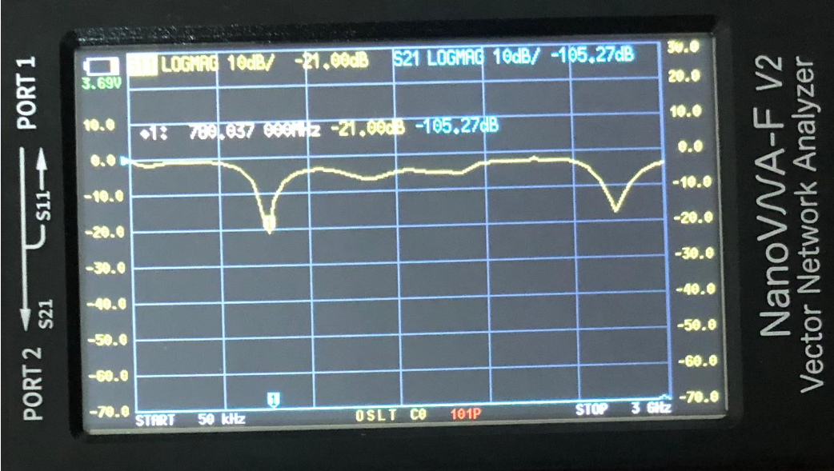
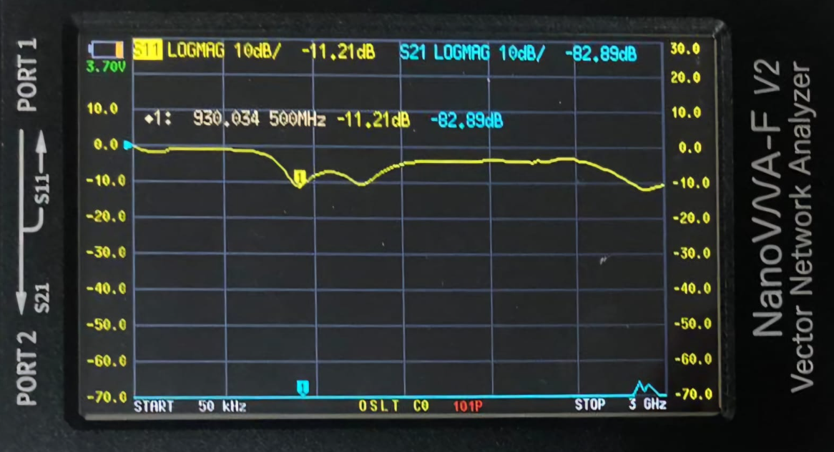
Stepped Impedance Resonator Sensor
result was 89 mg/dL
result was 310 mg/dL

Slide 27
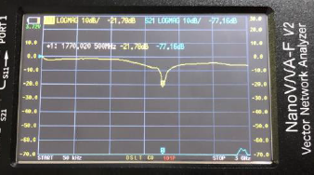
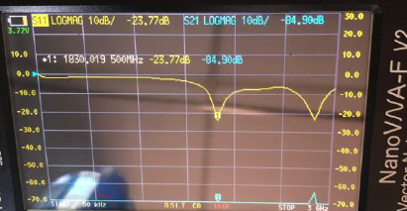
hexagonal CARR
microwave sensor
result was 89 mg/dL
result was 310 mg/dL

Slide 28
A future vision for the project
1- Increase the number of results to increase the accuracy of the device
2- Using techniques such as machine learning and artificial intelligence to process data
3- Adding a calibration feature to the device enables the device to be calibrated for each patient individually
4- After achieving the best possible result for each method, the two methods used can be combined into one device using calibration models

Slide 29
Thank you!
Any question?

