Slide 1
REHABILITATION OF QABATIA – ARAB AMERICAN UNIVERSITY OF PALESTINE – JENIN STREET
Graduation project ІІ

Slide 2
CONTENTS:
Project description
Methodology
Data Collection
Traffic Analysis
Geometric Design
Pavement Design
Intersection Design
Traffic Control Devices
Bill Of Quantities
Conclusion & Recommendation

Slide 3
CH 1 PROJECT DESCRIPTION
1.1 Location
The street extends from Qabatia (West) to the AAUP (East), and lies in the north of Jenin governorate as shown in the next slide.

Slide 4
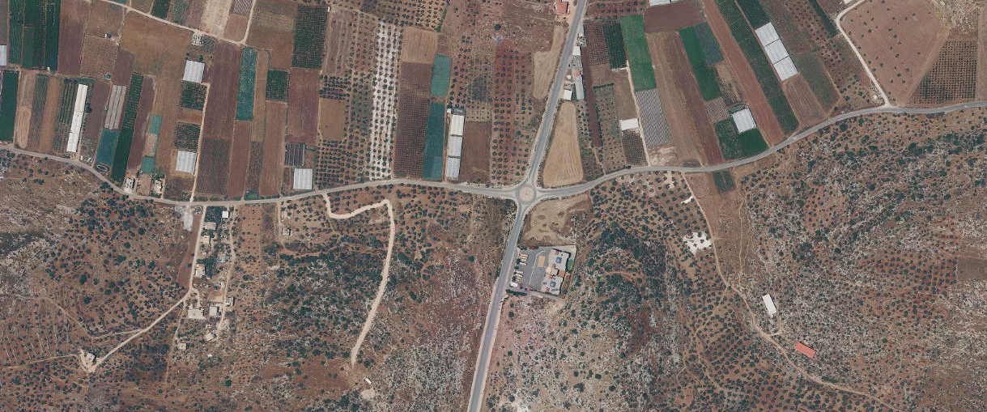
Figure 1.1 : Geographical Map for The Intersection

Slide 5
1.2 OBJECTIVES OF THE PROJECT
It is intended to improve the capacity and serviceability of the street through providing the required geometric, traffic, and pavement enhancing designs.

Slide 6
1.3 General Information
 | Segment 1 | Segment 2
Length | 3.0 Km | 2.8 Km
Pavement Condition | Poor | Poor
Traffic Devices | None | None
# of Lanes Each of 3.6 m | 2 | 2
Shoulders, Medians | None | None
Current LOS | A | D
Width | 7.2 m | 7.2 m

Slide 7
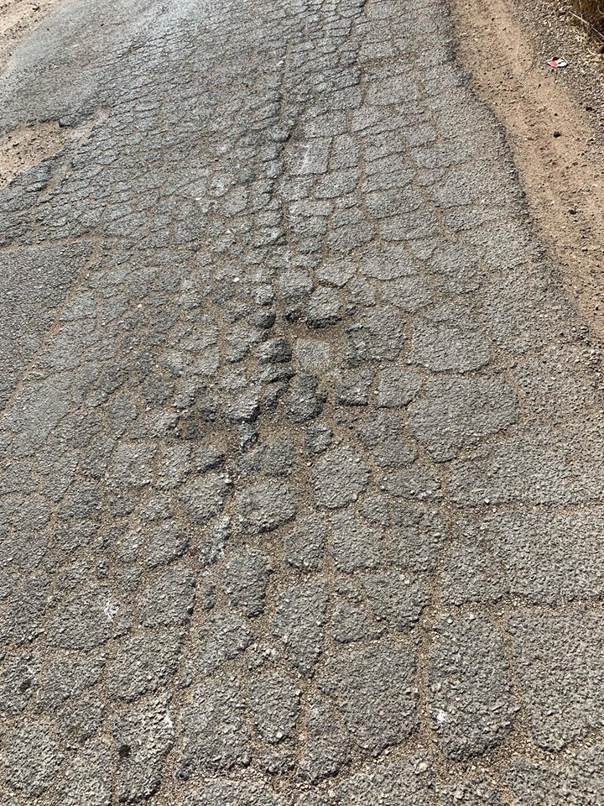
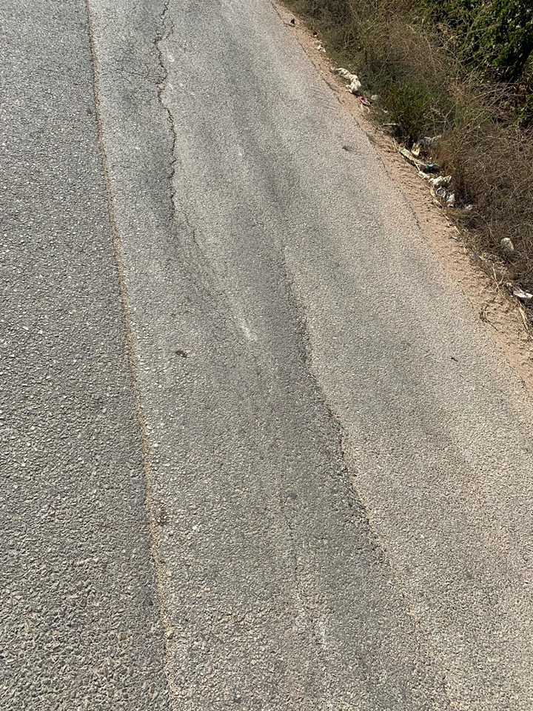
Figure 1.2 (a) : Alligator Cracks
Figure 1.2 (b) : Longitudinal Cracks

Slide 8
CH 2 METHODOLOGY
2.1 STANDARDS AND SPECIFICATIONS
AASHTO (For pavement and geometry design)
HCM (For traffic analysis)
MUTCD (For traffic control devices)

Slide 9
2.2 SOFTWARE PROGRAMS
Civil 3D (For geometric and pavement design)
HCS (For traffic analysis)

Slide 10
2.3 DATA COLLECTION
Traffic count
Inventory Study
Maps
Markets

Slide 11
2.3.1 DESIGN SPEED
Determined the design speed to be 80Km/h
The design speed is determined due the classification and nature of the study area

Slide 12
2.3.2 LEVEL OF SERVICE
Determined the desired LOS to be C
The road is rural collector of class II

Slide 13
2.4 PROJECT DESIGN CONSTRAINTS
Difficulties in getting surveying.
Expansion and growth rate information of students and cars attending AAUP.
Getting soil samples from site.
Some of the existing buildings encroach the master plan of the street, and thus minimize the right of way of the street and hinders the geometric design process.

Slide 14
CH 3 DATA COLLECTION
3.1 DATA COLLECTION AND SITE VISIT
The very first step in every engineering project is to visit the place of the problem that needs to be solved, and gather general information that may guide to the problem causes.

Slide 15
DATA COLLECTED:
Master Plan – From the Ministry of public works.
Growth rates in the study area – From AAUP.
Estimated future Population Is 25000 person.
5 hours of intersection count including the whole work time.
Costs of execution

Slide 16
3.2 TRAFFIC STUDY
This is a major step to start analyzing the situation to get into the problem.

Slide 17
Table 3.1 : Traffic Count Results
 | PH | PHV (veh/hr) | PHF | DHV (veh/hr)
First Segment | 1-2 pm | 106 | 0.82 | 130
Second Segment | 7:45-8:45 am | 691 | 0.86 | 813
Intersection | 7:45-8:45 am | 1015 | 0.89 | 1141
Table 3.2 : Vehicles Classification
 | PC | TAXI | MINIBUS | BUS | TRUCK | OTHERS
TOTAL | 3182 | 413 | 120 | 66 | 230 | 111
PERCENTAGE | 77.2% | 10% | 2.9% | 1.6% | 5.6% | 2.7%

Slide 18
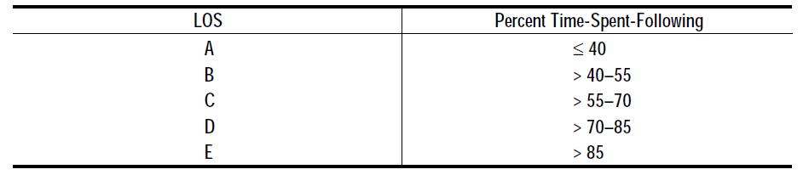
CH 4 TRAFFIC ANALYSIS
Analysis will be in two stages:
Segment 1
Segment 2
Each segment will be analyzed as existing and future conditions. Since the street is of CLASS ІІ, PTSF governs.
Table 4.1 : LOS Criteria for Class ІІ streets

Slide 19
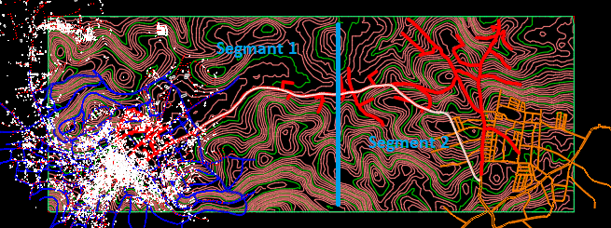
Figure 4.1 : Street’s Master Plan with Details

Slide 20
Segment 1 ( Existing condition )
The terrain is level, with length equals 3040 m and right of way = 12 m.
First, we need to determine all the required input data from data collected and tables of HCM, then adjust them with the equations.
We get that:
The shoulder width is 1m and the lane width is 3.6 m, so f_{LS} = 4.2 Km/h.
There are 6 access points, while the length of segment is approximately 3 Km, so f_{A} = 1.33 Km/h.

Slide 21
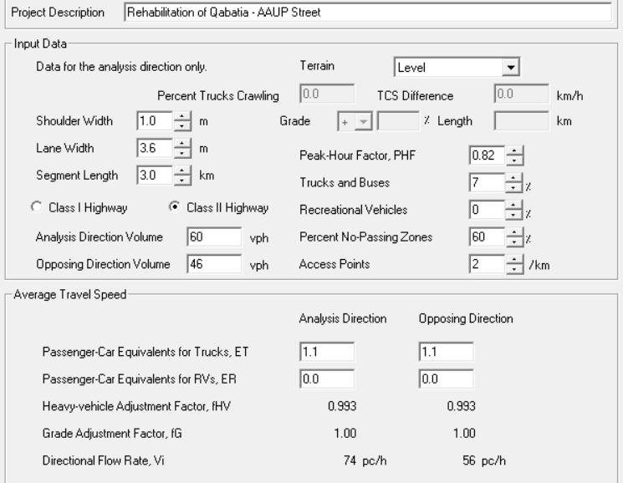
Percent of no-passing zones is about 60% of the total segment.
V_{d} = 60 veh/h, V_{O} = 46 veh/h, PHF = 0.82.
P_{T} = 7.2%, P_{R} = 0%, so E_{T} = 1.1.
Figure 4.2 : Input Data

Slide 22
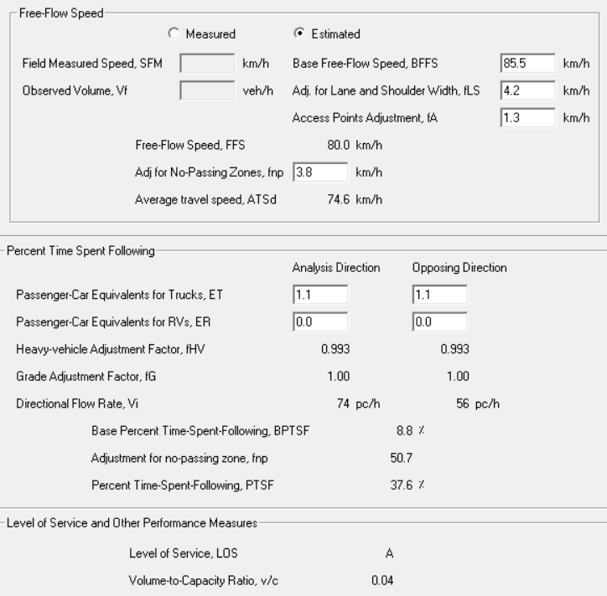
Figure 4.3 : Output Data

Slide 23
Comments:
The resulted LOS ( A ) was absolutely reasonable; it was predicted to be A since the volume is currently very light.

Slide 24
With the same procedure we get that:
Segment 1:
Existing condition LOS: A
Future condition LOS: B
Although the increase of number of vehicles, it will still serve as two-lane highway for 20 years with LOS B, which is great.

Slide 25
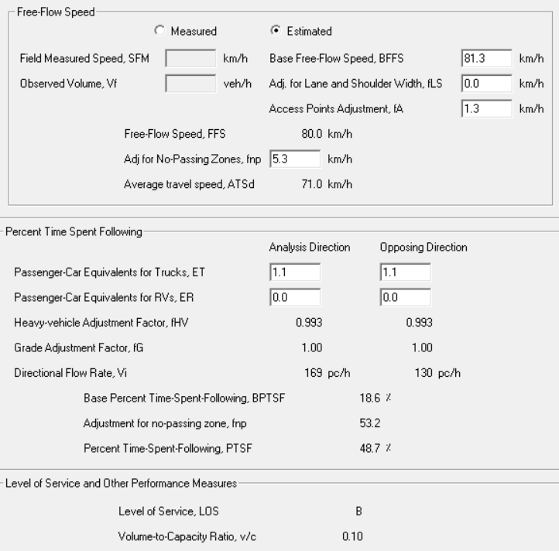
Figure 4.4 : Future LOS for Segment 1

Slide 26
Segment 2:
Existing condition LOS: D
Since the LOS result was worse than desired LOS after 20 years (C; From AASHTO), the two-lane highway will turn into a multilane highway in future analysis and design.
Future condition LOS: B
The result is satisfying.

Slide 27
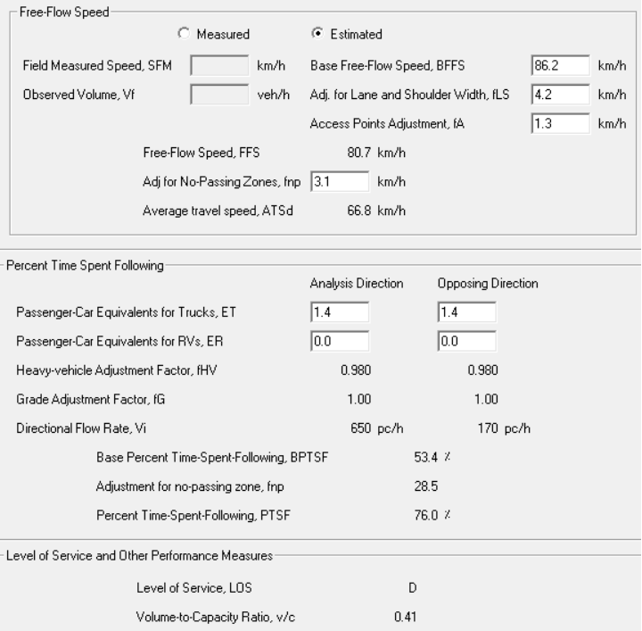
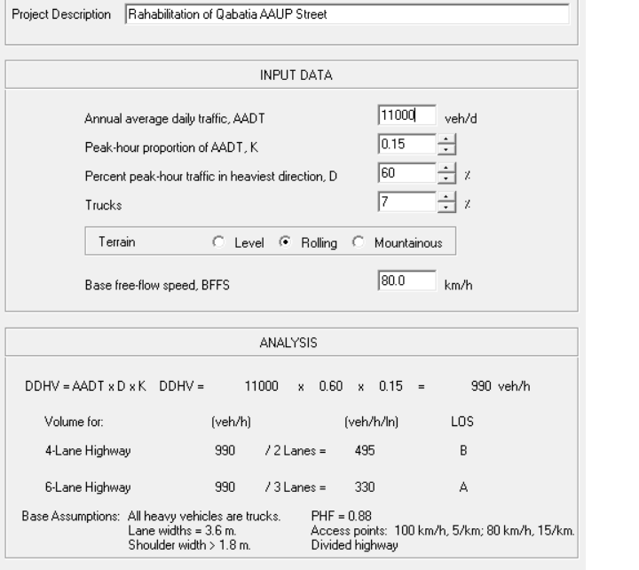
Figure 4.5 : Current LOS for Segment 2
Figure 4.6 : Future LOS for Segment 2

Slide 28
CH 5 GEOMETRIC DESIGN
5.1 Horizontal Alignment Design Criteria
In the design process, the center line was laid out using Civil 3D program, and then curves were designed such that the radius of designed curves is not smaller than the minimum required radius.

Slide 29
5.1.1 Design Speed
The preliminary design speed was chosen to be 80 km/h, but a reduction of this speed at some curves is needed because of the limited right of way, and existence of some sharp horizontal and vertical curves.

Slide 30
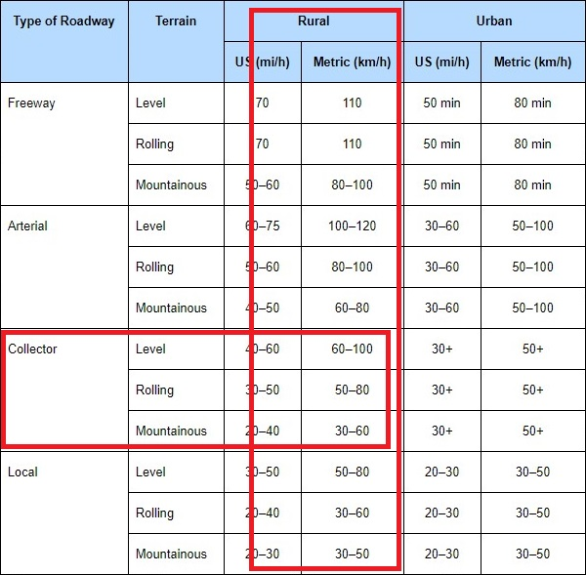
Table 5.2 : Design Speeds in terms of Terrain & Type of Roadway

Slide 31
5.1.2 Super Elevation
For roads located in rural areas with no snow or ice, a maximum super elevation rate of 6% is generally used based on AASHTO (2011).
5.1.3 Side Friction Factor
The coefficient of side friction (f_{s}) is the friction force divided by the mass perpendicular to the road surface.
For design speed of 80 km/h, the (f_{s}) is (0.14) based on AASHTO (2011).

Slide 32
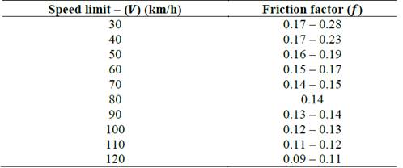
Table 5.2 : Coefficient of Side Friction for Different Design Speeds

Slide 33

5.1.4 Minimum Radius
The minimum radius is the limiting value of curvature for a given design speeds.
The minimum radius can be calculated by the following equation:
        $Rmin=\frac{v^{2}}{127(e+fs)}$

Slide 34
So the minimum radius of the horizontal curves for design speed of 80 km/h equals 252 m.
All curves in the road satisfy the minimum value of radius as shown in the next slide.

Slide 35
5.2 Horizontal Curves
In order to connect straight tangent sections of roadway with a horizontal curve, several options are available. The most suitable option is the simple curve, which is just a standard curve with a single constant radius that satisfies the design speed of the road.

Slide 36
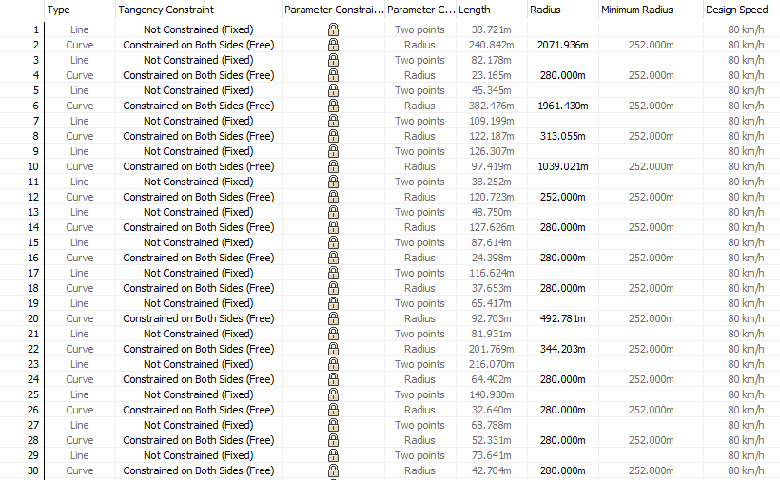
Table 5.3 : Horizontal Curves Radius

Slide 37
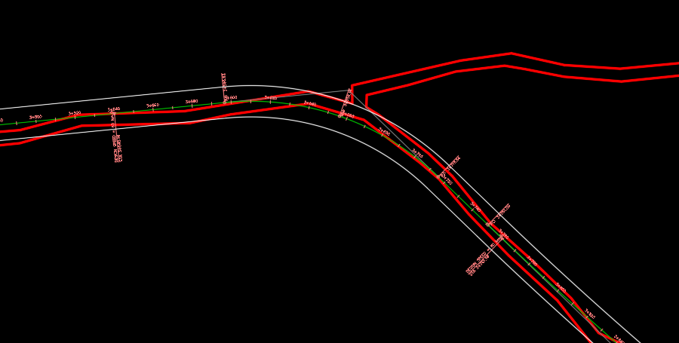
Figure 5.1 : Example on Horizontal Curves

Slide 38
5.3 Vertical Alignment
The vertical alignment of a highway consists of straight segments of highway known as grades connected by vertical curves.
Vertical Curves
A vertical curve provides a transition between two slopes roadways, allowing the vehicle to cross the elevation rate change at a gradual rate rather than a sharp cut.
There are two types of vertical curves: sag curves and crest curves.

Slide 39
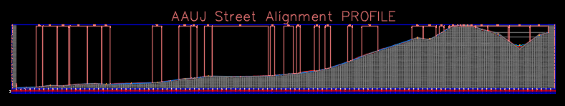
Figure 5.2 : Vertical Alignment (Curves)

Slide 40
5.4 Cross Section
Road width should be sufficient to carry the traffic load safely and to meet the design speed of the road. Also, there must be a commitment not to violate private land property surrounding the road.
The available ROW in segment 1 of the road is 12 m, and 20 m in segment 2.

Slide 41
There are factors that need to be taken into account when selecting the width of the road:
    • Functional classification of the road
    • Traffic volume
    • Vehicle classification
    • Design speed

Slide 42
5.4.1 Travel Lanes
Lane width usually varies from 3.0 m to 3.6 m. Based on the factors above and the available right of way, the recommended lane width was chosen to be 3.6 m in both segments.

Slide 43
5.4.2 Shoulders
Shoulders are contiguous with the travel lanes providing space along the highway for vehicles to stop especially during emergencies.
Shoulders width was chosen to be 1.8 m in segment 1, and 2 m in segment 2.

Slide 44
5.4.3 Curbs
Curbs were used only in the roundabout area because of the small volume of pedestrians on the road. Curbs width was chosen to be 1.5 m in segment 1, and 1.35 m in segment 2.
5.4.4 Side Slopes
Side slopes were taken to be 3H:1V to maintain roadside soil stability.

Slide 45
5.4.5 Guard Rails
  In the this road, guardrails are used at sharp curves and sections with high fills as illustrated in appendix H and design sheets.
5.4.6 Retaining Walls
  Retaining walls were used in the road at stations where high fill values demand the need to support (2 m),briefly explained in appendix H.

Slide 46
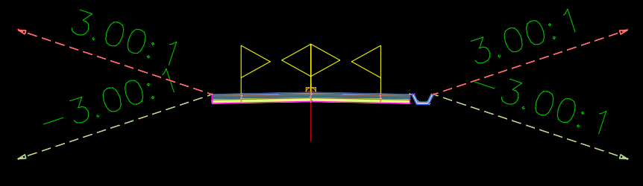
Figure 5.3 : Cross Section for Segment 1

Slide 47
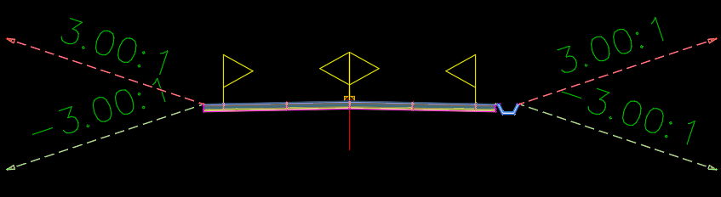
Figure 5.4 : Cross Section for Segment 2

Slide 48
CH 6 PAVEMENT DESIGN
6.1 Introduction
Pavement design is the major component in the road construction.
Nearly one-third of the total cost.
Highway pavement is divided into three main categories, flexible, semi-rigid and rigid pavements.
Due to the nature of the street area and relevance of the street, a flexible pavement will be designed for.

Slide 49
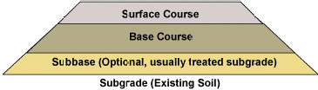
6.2 Structural Components of Flexible Pavement
The flexible pavement consists of wearing surface (asphalt layer), base coarse, sub base coarse, and subgrade material as shown below.
Figure 6.1 : Structural Components of Flexible Pavement

Slide 50
6.3 Geotechnical Report Analyses
The geotechnical report is a tool used to match the site conditions with the design process.
Soil Tests Results
Along the street area, five samples of subgrade soil have been taken every 1 Km. Each sample weighs 10 Kg, excavated from depth more than 60 centimeters. The following table shows the results of the tests on each sample.

Slide 51
Table 6.1: Soil Tests Results
Sample No. | %finer sieve # 200 | Liquid Limit % | Plasticity Index | Soil Classification | CBR Value
1 | 72 | 40 | 16 | A-6 | 4.80
2 | 65 | 54 | 11 | A-7-5 | 8.02
3 | 56 | 44 | 12 | A-7-5 | 8.03
4 | 51 | 57 | 13 | A-7-5 | 9.00
5 | 47 | 34 | 18 | A-6 | 8.75

Slide 52
6.4 Soil Treatment
It was intended to improve the strength of the overall pavement using two techniques, rock fill and geotextile.
6.4.1 Rock-Fill
It was desired to replace the existing soil with rock material to a certain depth. This depth depends on the size of the material itself, which is practically about 0.80 meter.

Slide 53
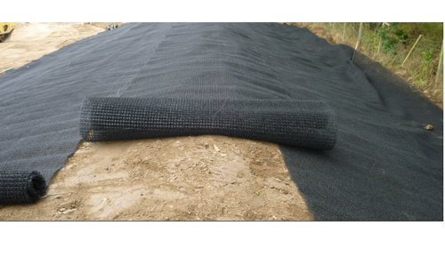
6.4.2 Geotextile
A geotextile is defined as a permeable geosynthetic made of textile materials (see Figure 6.2).
The geotextile was placed between the subgrade and rock fill layers as this the most appropriate option due to the nature of the study area.
Figure 6.2: Geotextile

Slide 54
6.5 Structural Design
AASHTO design method will be used to determine the thickness of each layer. Many factors are considered in AASHTO procedure such as:
• Pavement performance
• Traffic
• Subgrade material
• Materials of construction
• Environment
• Drainage
• Reliability

Slide 55
6.5.1 Pavement Performance
Pavement performance modeling is the study of pavement deterioration throughout its lifecycle and the evaluation in terms of comfort riding.
It is assessed using Present Serviceability Index (PSI) indicator
PSI = Pi – Pt = 4.5 – 2 = 2.5.

Slide 56

6.5.2 Traffic Load
In AASHTO design method, the traffic load is determined in terms of the number of repetitions of an 80 KN single axle load applied to the pavement on two sets of dual tires, which is referred to as ESAL.
ESAL can be calculated from the following equation:
$ESALi = fd ×Grn ×AADTi ×365 ×Ni ×Fei$

Slide 57
Load Equivalency Factor:
Based on vehicles classification, the load equivalency factor is taken from the Ministry of Public Works and Housing ESAL table. The total ESAL is computed as illustrated in the following table.

Slide 58
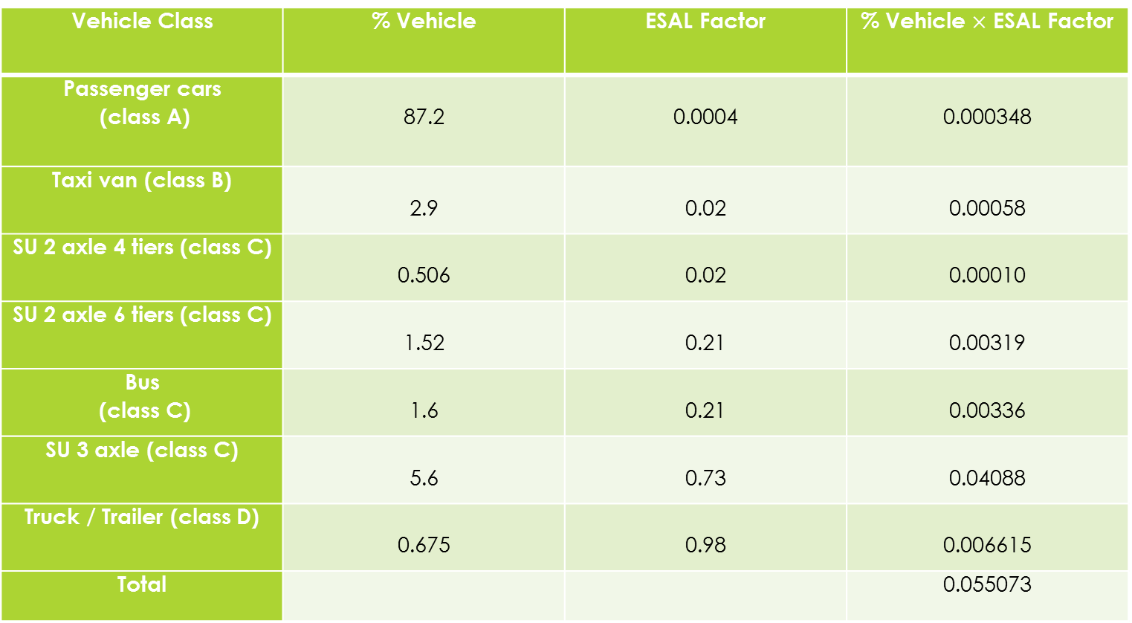
Table 6.2: ESAL Table
Vehicle Class | % Vehicle | ESAL Factor | % Vehicle $×$ ESAL Factor
Passenger cars (class A) | 87.2 | 0.0004 | 0.000348
Taxi van (class B) | 2.9 | 0.02 | 0.00058
SU 2 axle 4 tiers (class C) | 0.506 | 0.02 | 0.00010
SU 2 axle 6 tiers (class C) | 1.52 | 0.21 | 0.00319
Bus (class C) | 1.6 | 0.21 | 0.00336
SU 3 axle (class C) | 5.6 | 0.73 | 0.04088
Truck / Trailer (class D) | 0.675 | 0.98 | 0.006615
Total |  |  | 0.055073

Slide 59

Growth factor:
$Grn$= ${[(1+r)}^{n}−1]$ / r
For both segments, r = 4.19 % … $Grn$= 30.38.
Design Lane Factor:
It depends on the number of lanes.
For the first segment equals 0.50, for the second one it is 0.45.

Slide 60

AADT
  AADT = $PHV$/ K
  K = 0.15 for a rural collector road
  For the first segment:
  AADT = 106 / 0.15 = 707 veh/day.
  For the second segment:
  AADT = 691 / 0.15 = 4607 veh/day.

Slide 61

Total ESAL
For the first segment ESAL = 0.23$×$10⁶
and for the second segment ESAL = 1.28 $×$10⁶
It is preferable to take ESAL = 1.51$×$10⁶ for all the road.

Slide 62
6.5.3 Subgrade Material
Rock materials were used as new subgrade material of the site, with Mr equals the minimum of sub base layer's modulus, which equals 17.5 ksi.

Slide 63

6.5.4 Materials of Construction
Asphalt layer, base coarse material and sub base material are imported to be constructed with specific properties where:
$Mr for asphalt layer=450,000 \frac{Ib}{{in}^{2}}$, a₁ = 0.44
$Mr for base coarse layer=28,000 \frac{Ib}{{in}^{2}}$, a₂ = 0.14
$Mr for sub base layer=17,500 \frac{Ib}{{in}^{2}}$, a₃ = 0.13.

Slide 64
6.5.5 Drainage
By assuming that the quality of drainage is good, the water is removed within one day, and the percent saturation condition is
(5-25) %.
The result of drainage coefficient m _{i} for base coarse and sub base equals 1.075.

Slide 65
6.5.6 Reliability
Reliability of R = 0.90 is considered for a rural collector road.
Standard deviation of a flexible pavement is assumed to be S_{o} = 0.45.

Slide 66

6.5.7 Structural Number (SN)
It represents the overall structural requirement needed to sustain the design's traffic loading.
$SN=a1D1+a2D2m2+a3D3m3$
Using this equation and the AASHTO design Nomo graph, the results of layers’ thicknesses are as follows:

Slide 67
For the first segment:
SN for base course SN₁ = 1.4
SN for sub base SN₂ = 2.13
SN for subgrade SN₃ = 2.13
The corresponding thicknesses are as follows:
D₁ = 2.36 inches = 6 cm … (thickness of asphalt layer)
D₂ = 8.0 inches = 20 cm… (thickness of base coarse layer)
D₃ = 0.0 inches… (no need for sub base layer).

Slide 68
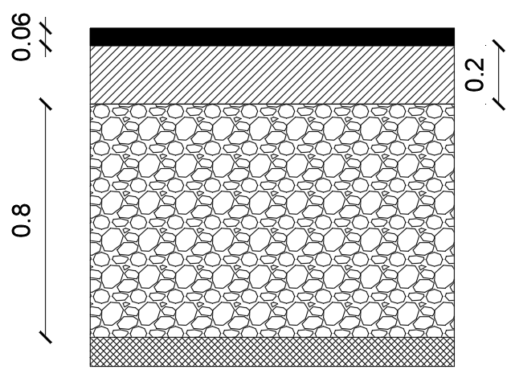
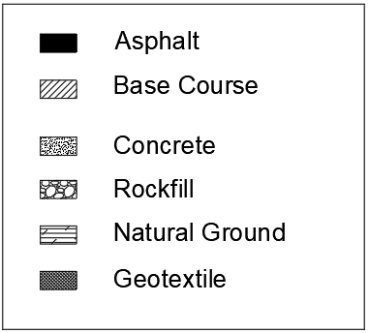
Legend
Figure 6.3: First segment layers' thicknesses

Slide 69
For the second segment:
SN for base course SN₁ = 2.25
SN for sub base SN₂ = 2.83
SN for subgrade SN₃ = 2.83
The corresponding thicknesses are as follows:
D₁ = 2.75 inches = 7 cm… (thickness of asphalt layer)
D₂ = 12.0 inches = 30 cm… (thickness of base coarse layer)
D₃ = 0.0 inches… (no need for sub base layer).

Slide 70
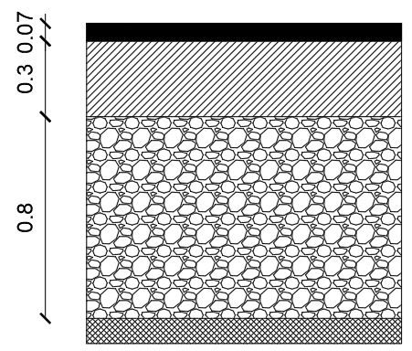
Legend
Figure 6.4: Second segment layers' thicknesses

Slide 71
CH 7 INTERSECTION DESIGN
7.1 Introduction
An intersection is an at-grade junction where two or more roads or streets cross, whose main function is to provide for the change of route directions. They vary from simple intersections to complex ones.

Slide 72
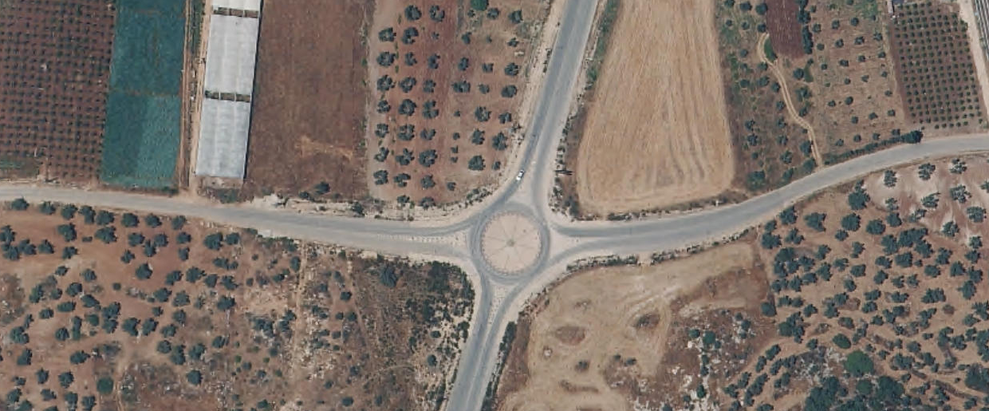
Segment 1
Segment 2
Figure 7.1: Existing intersection of the area

Slide 73
7.2 Geometric Design
The proper geometric design of an intersection improves traffic safety, increase capacity and accommodate all vehicles' movements.
There are many factors that have an impact on this process such as:
• Design Vehicle: which is WB-19
• Intersection angle: which equals 75 degree
• Approach width
• Channelization
• Allowable speed reduction: the speed at the intersection is 30 Km/hr.

Slide 74
7.2.1 Minimum Design Criteria
The fundamental objective is to minimize the severity of potential conflicts among different streams of traffic. At the same time, it is necessary to provide for the smooth flow of traffic across the intersection.
7.2.1.1 Corner Radius
  The corner radius of an intersection pavement should not be less than either the turning radius of the design vehicle or the radius required for the design velocity of the turning roadway under construction.

Slide 75

For this intersection, simple curve with taper will be used in design.
Since the speed at the intersection is 30 Km/hr (exceeds 20 Km/hr), the radius required for this speed was considered as a minimum criterion.
$Rmin=\frac{V^{2}}{127 ( e+fs )}$
→ $Rmin$ = 26 m.

Slide 76
7.2.1.2 Minimum Pavement Width of the Turning Roadway
For this intersection, Case 1 and traffic condition C are considered.
Case 1: one-lane, one-way operation with no provision for passing a stalled vehicle
Traffic condition C: design vehicle is WB-12, WB-15 or higher.

Slide 77
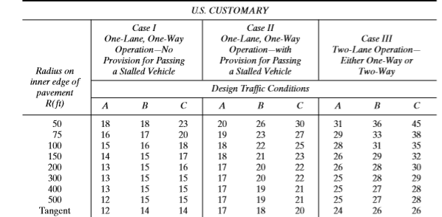
From the following table, the minimum pavement width of the turning roadway = 6 m.
Table 7.1: Minimum pavement width of turning roadway

Slide 78
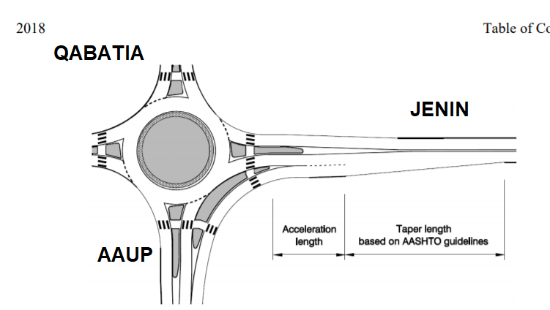
7.2.2 Intersection Design
The proposed design for this intersection is as shown in the figure below.
Figure 7.2: Intersection proposed design

Slide 79
Additional right-turn-lane width is added due to high right turn volumes form the east approach to the north approach.
Inscribed circle diameter: 47 meter diameter.
Central island diameter: 34 meter diameter including the truck apron.
Corner radius: multiple values satisfy the minimum required value.
Turning roadway pavement width: 6.5 m.
Entry and exit width with a minimum value of 4.5 m.
Taper length of 54 m with 1:15 slope.

Slide 80
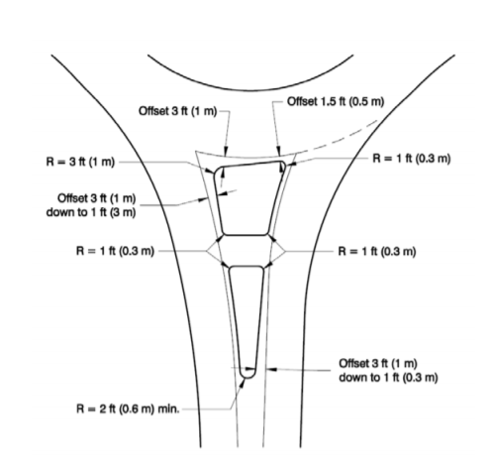
Acceleration length of 30 m.
Splitter island dimensions: length of 25 m and other dimensions are shown in the figures below.
Figure 7.3 (a): Splitter island dimensions

Slide 81
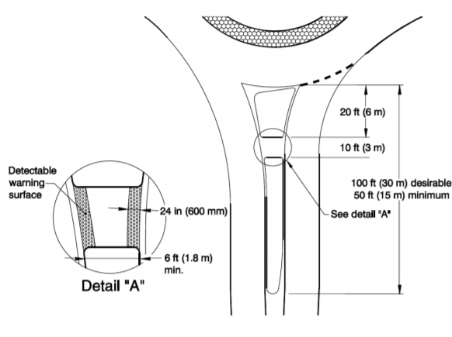
Details are in Appendix G
Figure 7.3 (b): Splitter island dimensions

Slide 82
CH 8 TRAFFIC CONTROL DEVICES
8.1 Introduction
They are critical features of trafﬁc control and operation that the designer considers in the geometric layout of such a facility. The potential for future operational efﬁciency can be signiﬁcantly enhanced if signs, markings, and signals were treated as an integral part of design

Slide 83
8.2 Traffic Signs
The functions of signs are to provide regulations, warnings and guidance information for road users.
8.2.1 Regulatory Signs
  Regulatory signs provide information about road rules and traffic laws.
These rules are: Right of way, Speed, Movement, Parking, Pedestrians and Miscellaneous.

Slide 84
8.2.2 Warning Signs
  A warning sign is a type of signs which indicates a potential hazard, obstacle or an unexpected condition requiring special attention.
Must be placed sufficiently in advance of the hazard conditions to allow the driver to see the sign.

Slide 85
8.2.3 Guidance Signs
  Guide signs are essential to direct road users along streets and highways, to inform them of intersection routes , and generally to give such information as will help them along their way in the most simple, direct manner possible.

Slide 86
8.3 Pavement Markings
Pavement markings are any kind of device or material that was used on a road surface in order to convey important information to drivers.
8.3.1 Longitudinal Markings
  Longitudinal markings are placed along the direction of traffic on the roadway surface, for the purpose of indicating to the driver his proper position on the roadway. They were also provided for separating traffic flow in the same and opposing direction.

Slide 87
8.3.2 Transverse Markings
Transverse markings are marked across or partly across the road in association with certain traffic control devices, in order to indicate that an immediate action is required by the vehicle operator. The primary types of these markings are stop lines, yield lines and crosswalks.
8.3.3 Word and Symbol Markings
Word, symbol and arrow markings serve the purpose of guiding, warning or regulating the traffic as they help in converting the information to the driver.

Slide 88

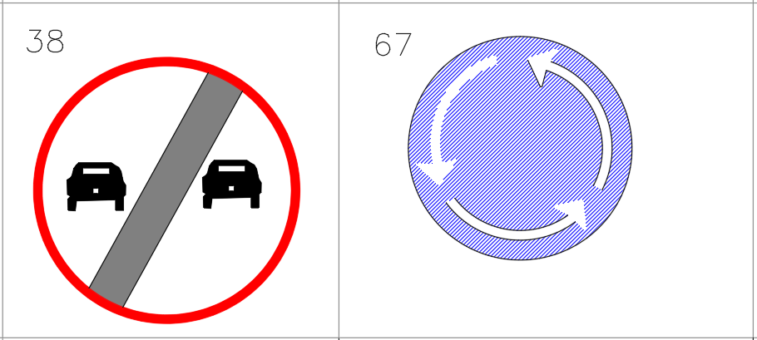
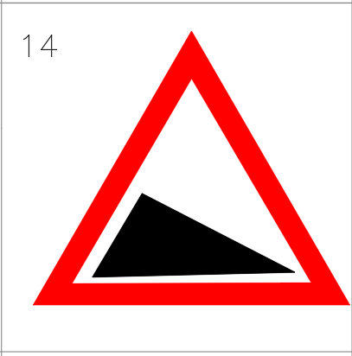

8.4 Application of Traffic Control Devices
8.4.1 Application of Traffic Signs
  A wide variety of signs will be used in the traffic control process over the street. Each sign will be set on its suitable place as shown in appendix H.
Figure 8.5: Examples on Traffic signs

Slide 89
8.4.2 Application of Traffic Markings
  8.4.2.1 Application of Longitudinal Markings
  White longitudinal lines are used at the middle of the road separating between opposing traffic directions, being solid where passing is prevented, broken where passing is permitted, or dotted where tapered acceleration lane exists. Yellow longitudinal lines are used at the right edges of the travel lanes.

Slide 90
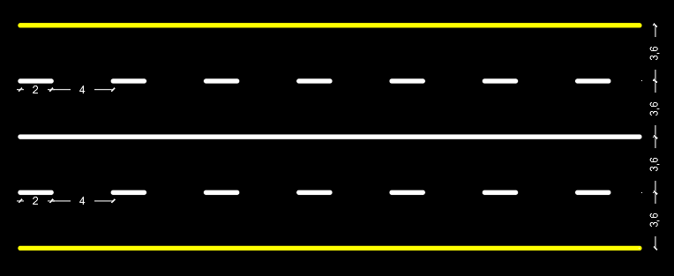
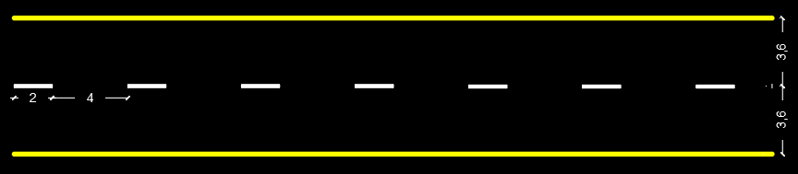
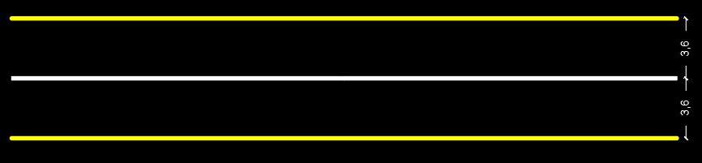
Figures 8.2, 8.3, 8.4: Examples on Longitudinal Markings

Slide 91
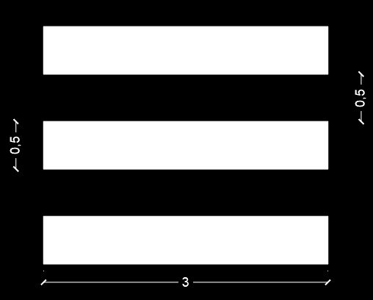
  8.4.2.2 Application of Transverse Markings
  Crosswalks are set at the intersection in case of existence of pedestrians.
Figure 8.5: Example on Symbol Markings

Slide 92
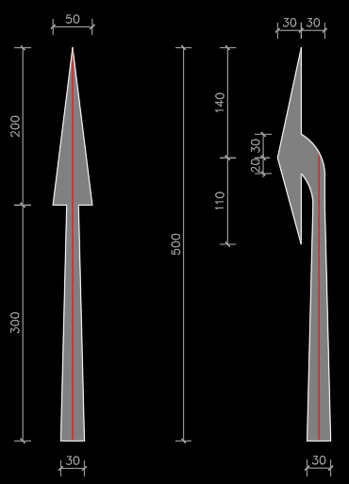
  8.4.2.3 Application of Word and Symbol Markings
  Arrow markings are set before and on the intersection to show the desired turning path for each approaching vehicle.
Figure 8.6: Example on Symbol Markings

Slide 93
CH 9 BILL OF QUANTITY AND COST
Table 9.1: BOQ & Cost
Item | Unit | Quantity | Unit Price ($) | Total Price ($)
Earthwork
Excavation | m³ | 163,320 | 7.0 | 1,143,240
Embankment Construction | m³ | 37,975 | 8.0 | 303,800
Earthwork |  |  |  | 1,447,040
Rock fill, base coarse and geotextile
Rock fill | m³ | 75,132 | 10.0 | 751,320
Base course | m³ | 24,527 | 25.0 | 613,175
geotextile | m² | 93,915 | 4.80 | 450,792
Rock fill, base course and geotextile |  |  |  | 1,815,287

Slide 94
Bituminous construction
Prime Coat | m² |  | 59,800 | 0.20 | 11,960
Asphalt (6 & 7 cm depth) | m² |  | 59,800 | 9.0 | 538,200
Bituminous construction |  |  |  |  | 550,160
Concrete works
Concrete shoulder |  | m² | 20,600 | 17.0 | 350,200
Concrete ditches |  | m² | 9,612 | 23.0 | 221,076
Concrete works |  |  |  |  | 571,276

Slide 95
Miscellaneous Works
Traffic Signs | No. | 50 | 120.0 | 4,560
Pavement markings | m² | 3,812 | 21.0 | 80,052
Curb stones | m.r | 363 | 18.5 | 6,716
Guard rail | m | 1,260 | 55.0 | 69,300
Retaining walls | m³ | 7,453 | 225.0 | 1,676,925
Miscellaneous Works |  |  |  | 1,838,993
Drainage system works
Drainage pipes | m | 92 | 340.0 | 31,280
Drainage system works |  |  |  | 31,280
Total cost |  |  |  | 6,254,036

Slide 96
CH 10 CONCLUSION AND RECOMMENDATIONS
10.1 Conclusion
The rehabilitation process of the street has gone through several steps.
We can sum up the change in both segments as follows in the two next tables:

Slide 97
Table 8.1: Conclusion of Future Condition
 | Segment 1 | Segment 2
Length | 3.0 Km | 2.8 Km
Pavement Condition | Excellent | Excellent
Traffic Devices | All the Needed Signs and Markings | All the Needed Signs and Markings
# of Lanes Each of 3.6 m | 2 | 4
Shoulders, Medians, etc.. | Shoulders and ditch, but no Medians | Shoulders and ditch, but no Medians
Future LOS | B | B
Width | 12 m | 20 m

Slide 98
Table 8.2: Conclusion of Future Condition
 | Segment 1 | Segment 2
Asphalt | 6 cm | 7 cm
Base Coarse | 20 cm | 30 cm
Sub Base | - | -
Rock Fill | 80 cm | 80 cm
Shoulders | 1.8 m | 2 m
Ditch | 1.2 m | 1.6 m

Slide 99
10.2 Recommendations
Both horizontal curves and vertical curves (profile) should be made as flat as practical at intersections where sight distance along either roads is important where vehicles may have to slow or stop.
It is necessary to have nearly the same surface elevations at intersections so that there will be no need to change entrances surfaces’ elevations.
Layers' materials should be imported with specific properties and tested to achieve the predicted results.

Slide 100
The Ministry of Public Works and Housing should fund enough money to achieve all design specifications.
The Ministry of Public Works and Housing or the AAUP must take into consideration the new design for the road in all their future projects to attain the maximum benefit and serviceability.

Slide 101
THANK YOU FOR LISTENING

