Slide 1
Enlighten your mind (3d educational game)
Students:
Ghadeer Bdair.
Anwar sholi.
Supervisor:
Dr.Ashraf Armoush.

Slide 2
Outline
The objective of the game.
Game life-cycle.
Tools.
Constraints.
Future Work.
Demo.

Slide 3
The objective
To make the educational process more attractive and encourage school students to learn topics that they did not want to learn before.
facilitate the educational process
activates mental abilities and improve the creative talent of students.

Slide 4
Game life-cycle
3D Main Menu
Start Video
Levels
Start
Design the environment

Slide 5
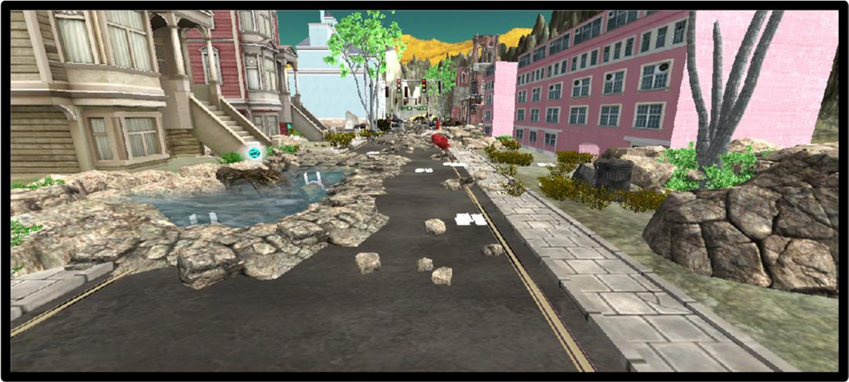
Design the environment

Slide 6
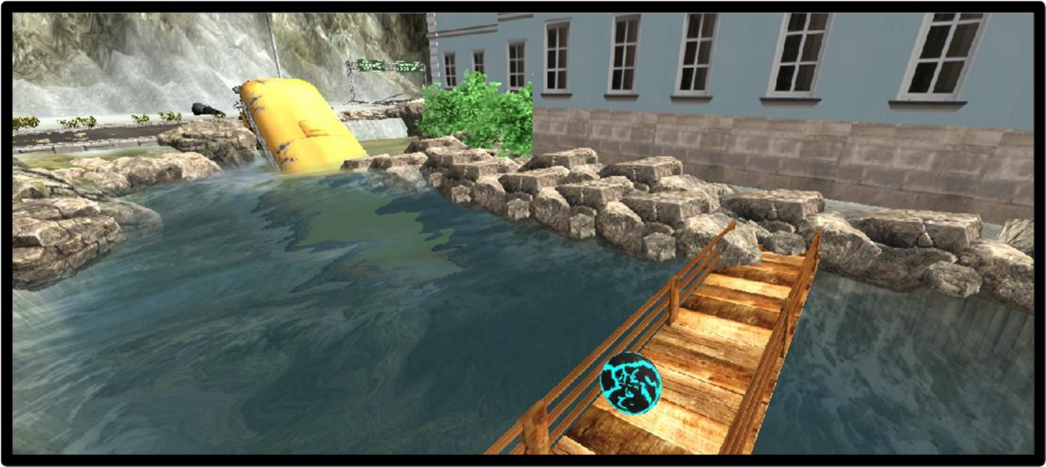

Slide 7
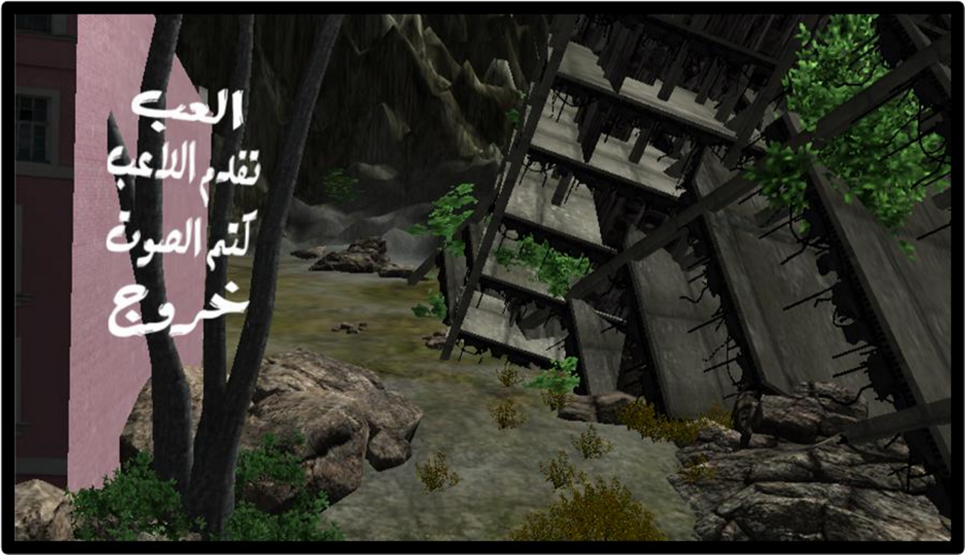
3D Main Menu

Slide 8
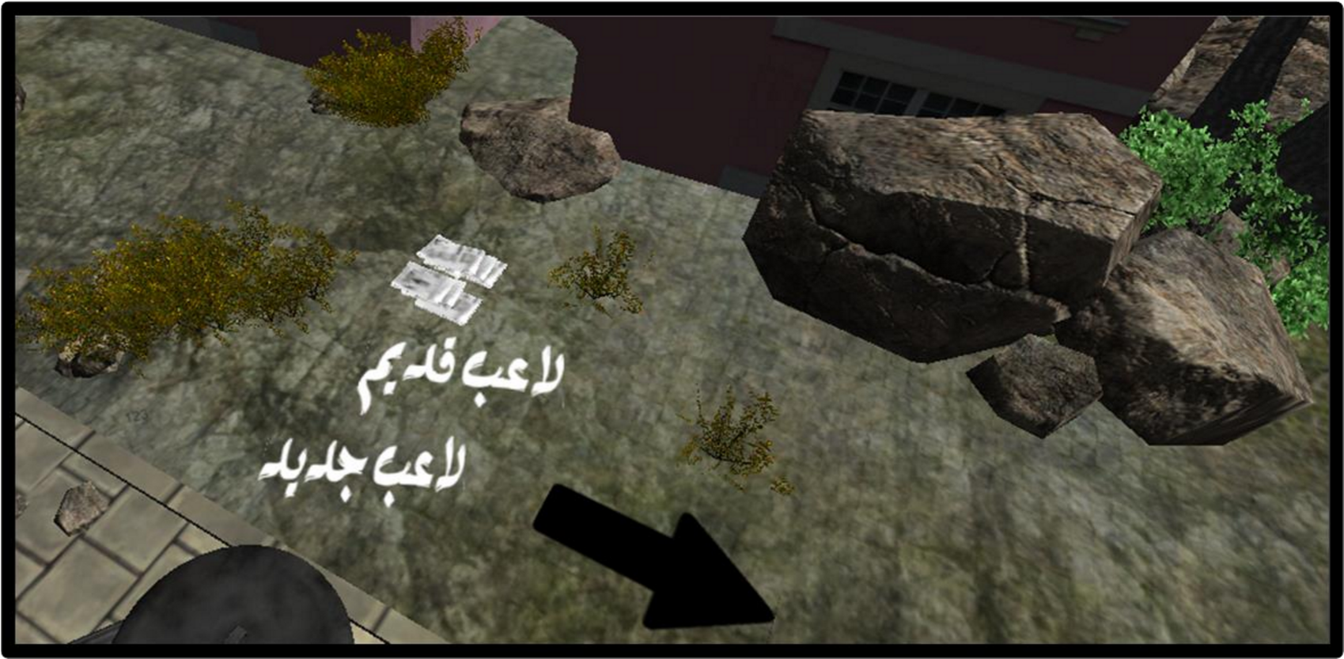
Move camera to new view

Slide 9
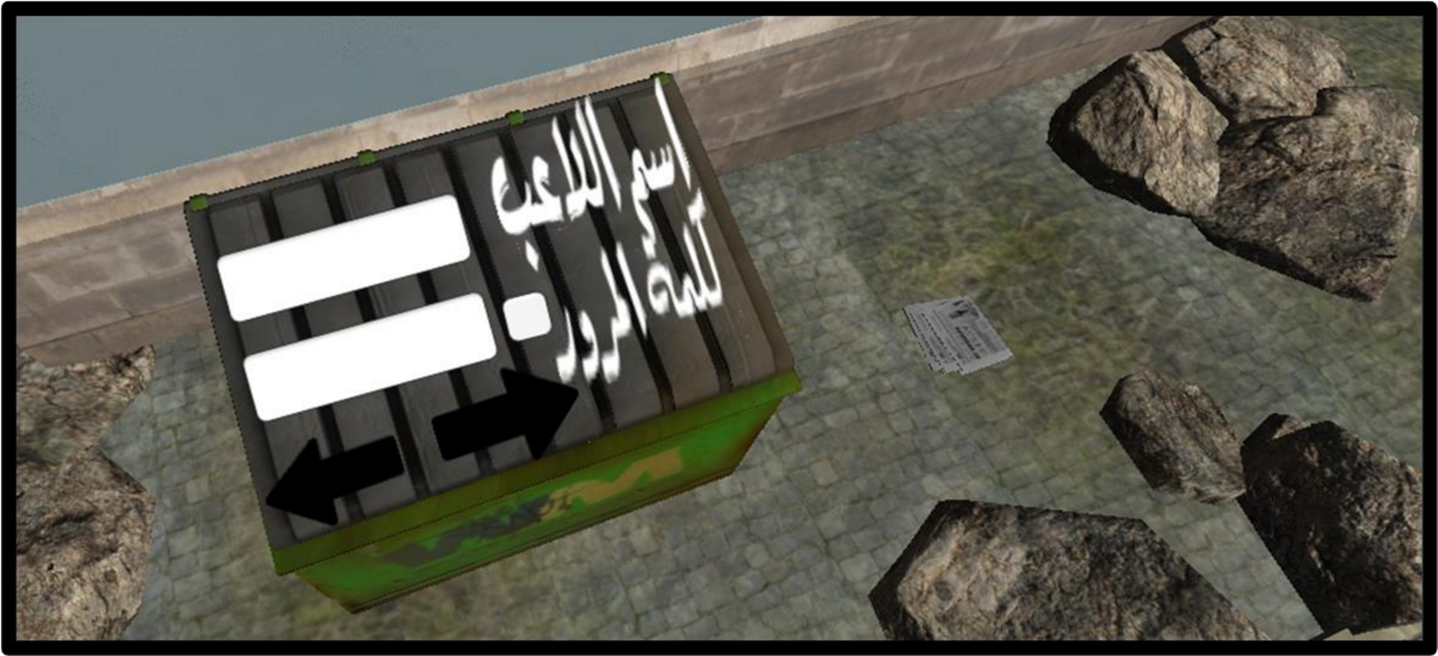
GUI

Slide 10
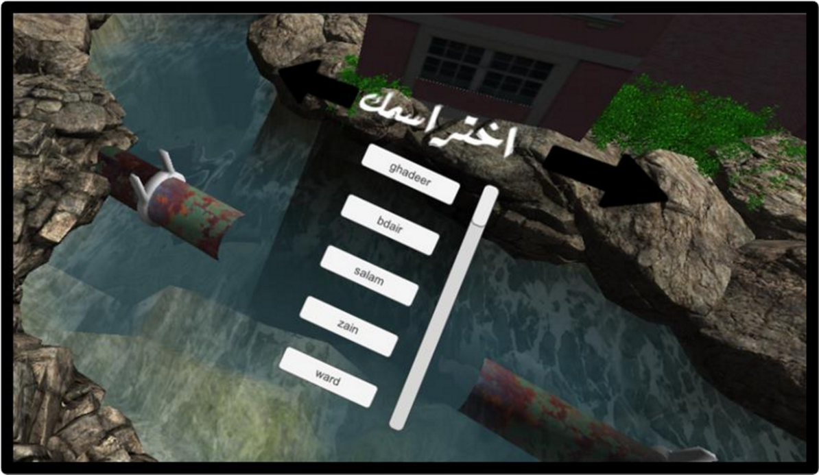
GUI

Slide 11
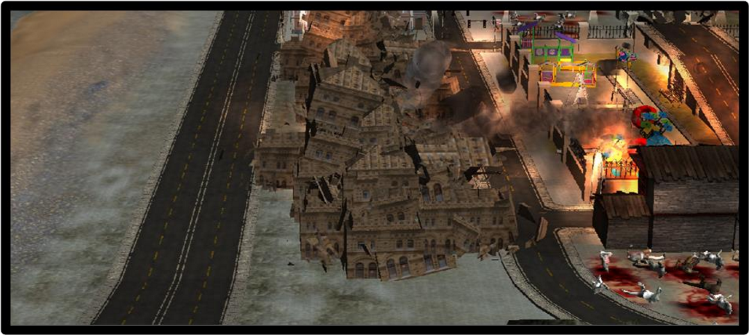
Start Video

Slide 12
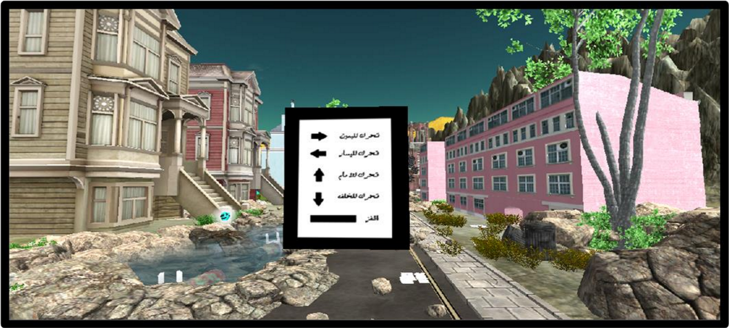
Levels
Level1

Slide 13
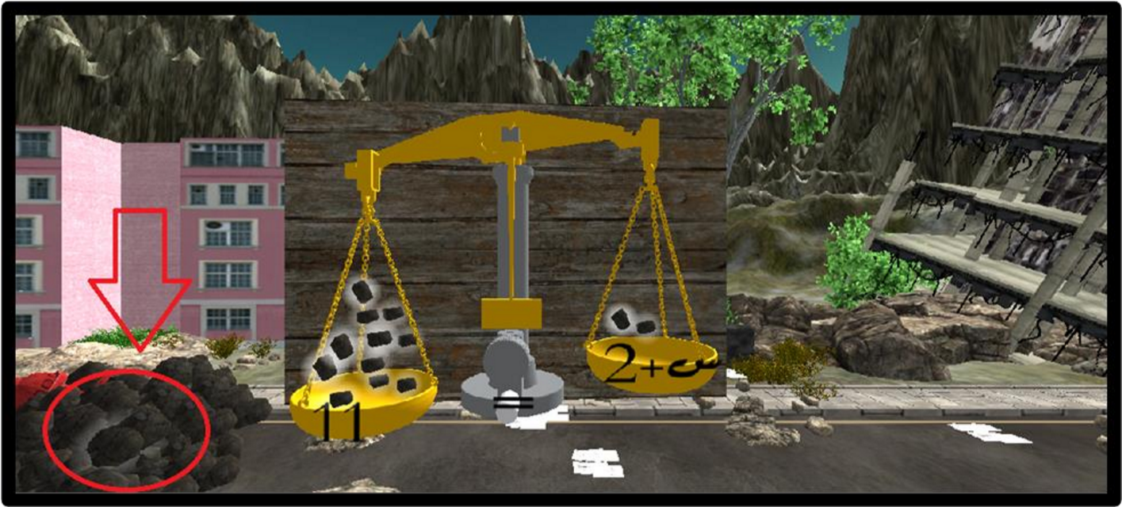
Levels
Level1

Slide 14
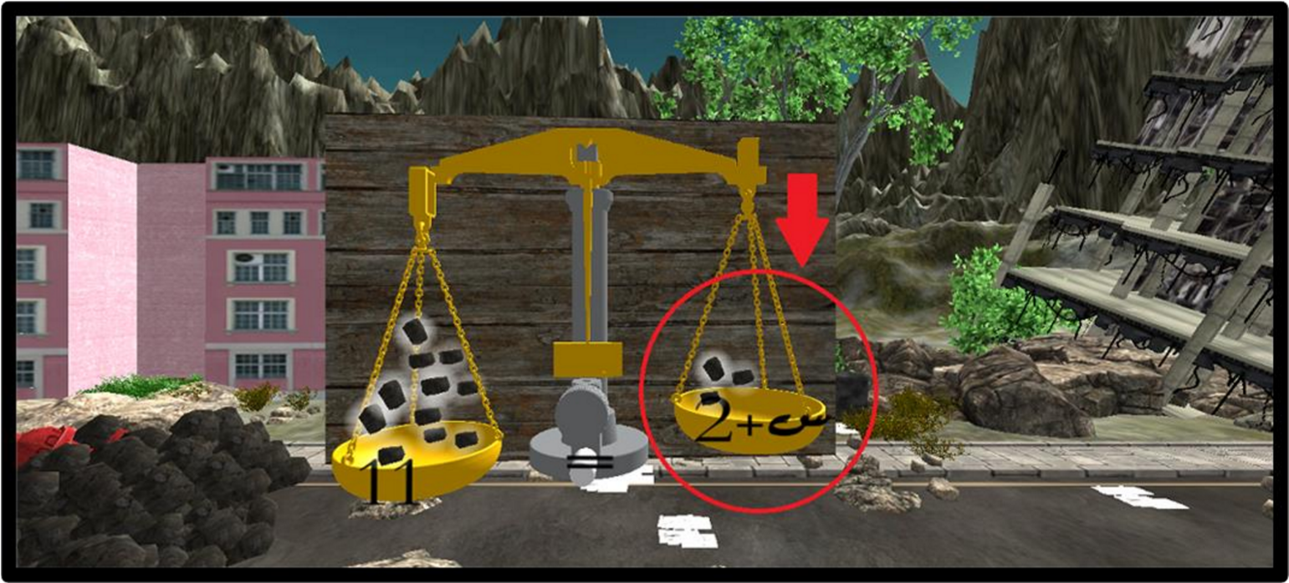
Levels
Level1

Slide 15
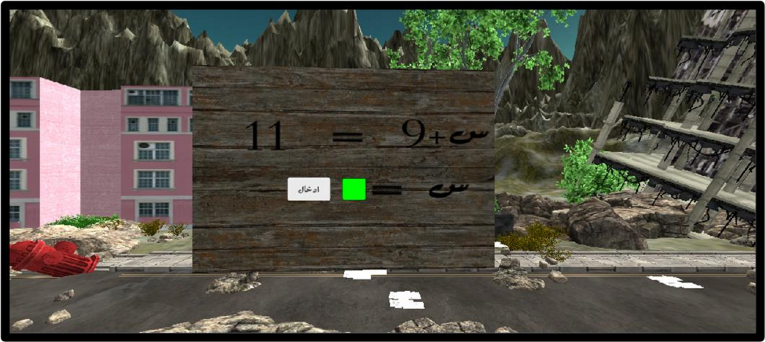
Levels
Level1

Slide 16
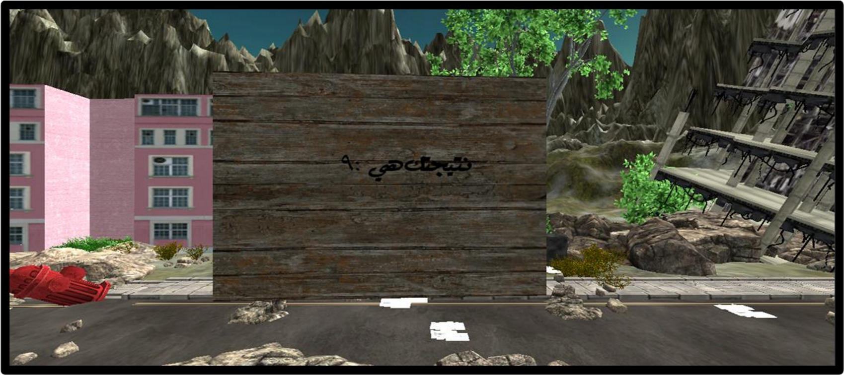
Levels
Level1

Slide 17
Tools
Unity.
3DMax.
Blender.
Audacity.
Paint.
Inkscape.
SQLite Manager Extension.

Slide 18

Unity
Unity is the main program that we used to develop our game.

Slide 19

3DMax
We used 3DMax (version 2015) in order to modify objects and change the extension of its files to be suitable with Unity to be used freely

Slide 20

Blender
We used this program (version 2.78c) to add the effect of bombs used in the video of our game.

Slide 21

Audacity
This program is to edit and modify the sound.

Slide 22

Inkscape
Unity does not support Arabic language. Therefore, we used this free program to make fonts in Arabic

Slide 23

SQLite Manager Extension
We used this extension added to Mozilla Fire Fox to deal with database used in the game.

Slide 24
Constraints
We faced a problem with our computers that they can't bear unity software.
Heavy design caused a lot of vertices, which led to make the character even cannot move and the camera just moves too slowly.
Using a cracked version of unity led the program to be crashed repeatedly.

Slide 25
Future Work
Developing more difficult levels of solving equations with two variables or more.
Converting the game to Android application.
Sharing in the competition 'IEEEmadC'.

Slide 26
Demo

Slide 27
Any Questions?
Thank you!

