Slide 1

An-Najah National University
Faculty Of Engineering
Civil Engineering Department
Foundation design for high rise building
Prepared by :
Faisal Mohammad Hassouna
Submitted to:
Dr. Sami Hijjawi

Slide 2
Chapter One General Definition of the Project
The aim of this project is to design a foundation of a residential building (AL-khalel housing project) which consists of six Flores.
A sample unit of the housing project was designed.
The site has an area of 8950 m² and the proposed building will have a plan of about 462 m².

Slide 3
Chapter Two Review Of Engineering Foundations
It’s function is to transfer the load of the structure to the soil on which it’s resting.

Slide 4
Types of Foundation
There are two main types of foundations:
Shallow Foundations:
    Isolated (Spread) Foundations.
    Combined Foundation.
    Continuous(Wall) Foundation.
    Strip Foundation.
    Mat Foundation.
  Deep Foundations:
      Piles.

Slide 5
Chapter 3:Summary of laboratory test results
Allowable bearing capacity = 2.5 Kg/cm².
Cohesion= 8 Kg/cm².
Angle of internal friction ф= 23º
Unconfined compressive strength of the rock located 8m under ground level= 27500 KN/m² .

Slide 6
Chapter four
Structural calculations
The main objective of this chapter is to find the loads applied on columns using two methods which are:
Tributary area method and analysis using software called SAP2000 v14.

Slide 7
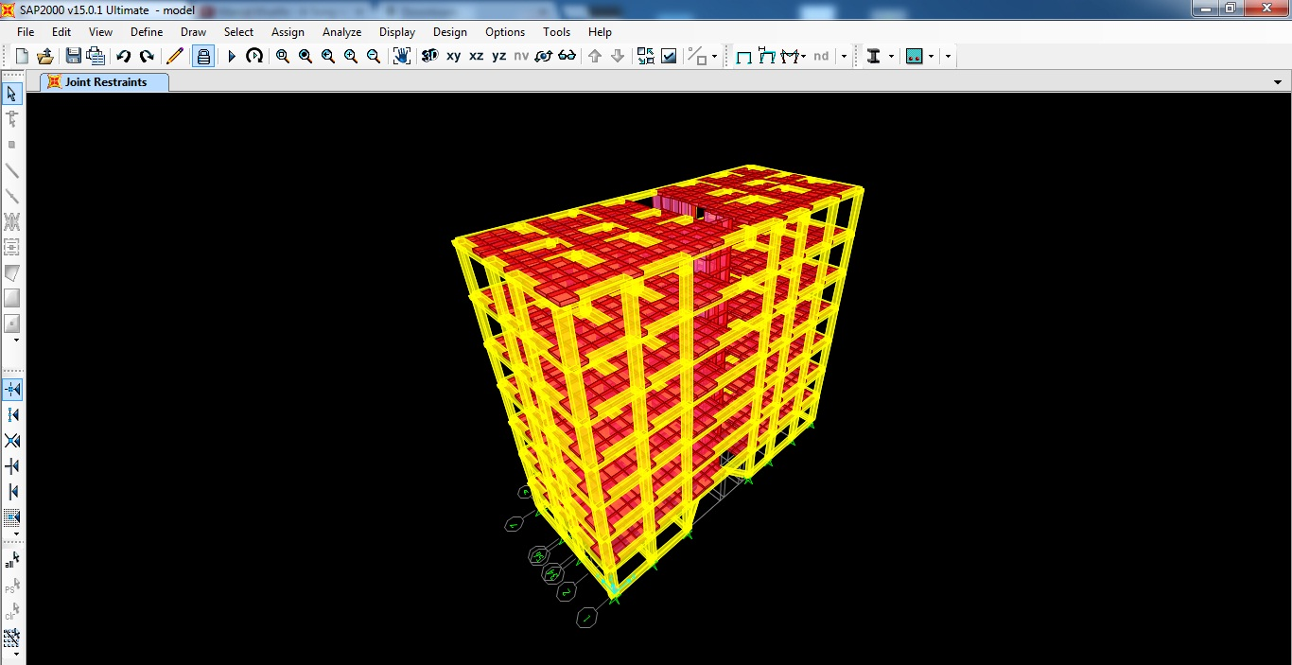

Slide 8
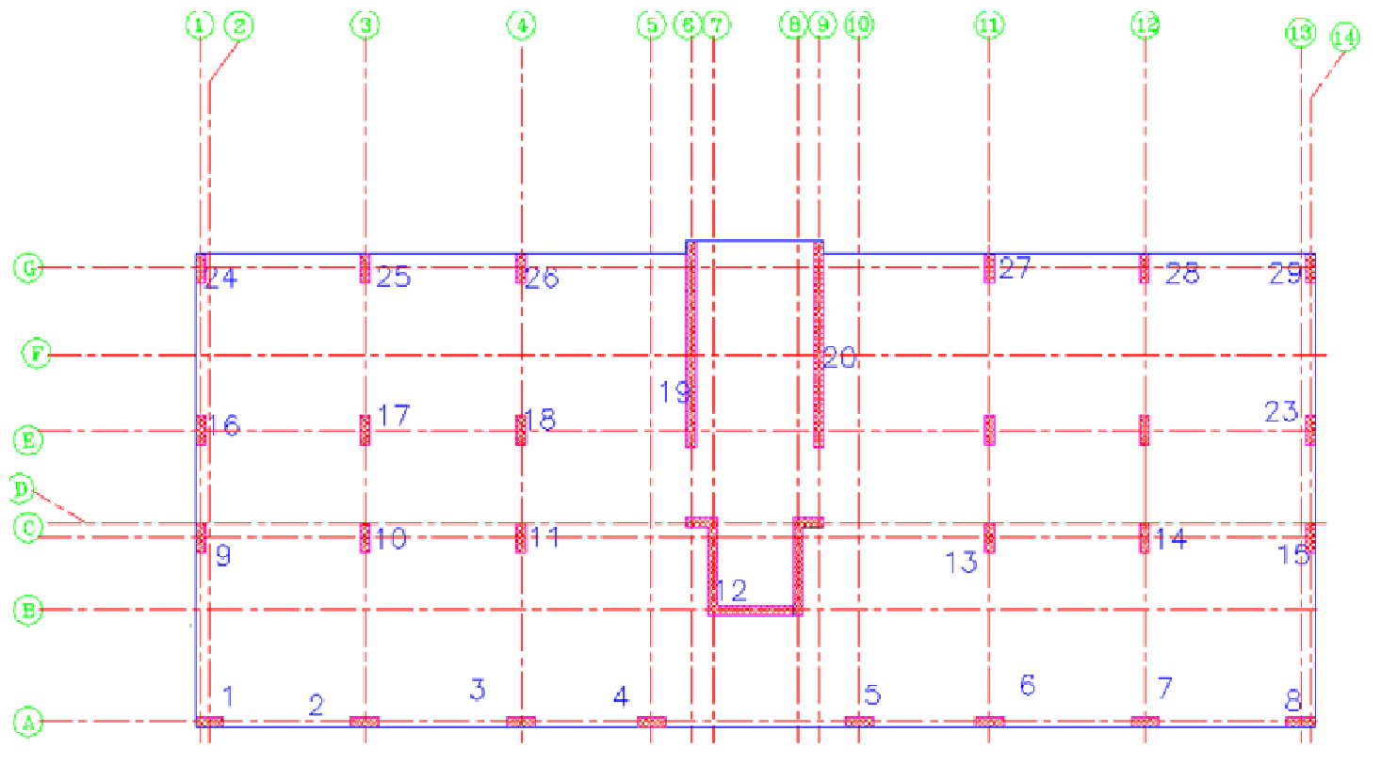
Plan for unit building

Slide 9
The loads on each column:
Wu (1.2D + 1.6 L ) Kn | Service load (Kn) | Column#
816 | 720 | 1
929.4 | 774.6 | 2
932.4 | 774 | 3
919.44 | 778.8 | 4
919.44 | 778.8 | 5
932.4 | 774 | 6
929.4 | 774.6 | 7
803.4 | 711 | 8
876 | 732 | 9
882 | 630 | 10
1134 | 810 | 11
1722 | 1230 | 12(shear wall)
1134 | 810 | 13
882 | 630 | 14
817.2 | 690 | 15
806.4 | 672 | 16

Slide 10
Wu (1.2D + 1.6 L ) Kn | Service load (Kn) | Column#
823.2 | 588 | 17
789.6 | 564 | 18
1688.4 | 1314 | 19(shear wall)
1688.4 | 1314 | 20(shear wall)
789.6 | 564 | 21
1033.2 | 738 | 22
764.4 | 642 | 23
816 | 720 | 24
996 | 828 | 25
1014.6 | 843 | 26
1014.6 | 843 | 27
996 | 828 | 28
803.4 | 711 | 29

Slide 11
Chapter five
Design mat and piles foundation
Mat foundation:
To design Mat Foundations, the thickness of the mat has to be found from punching shear equation manually. Then, the maximum moment in (X) and (Y) directions, area of steel and settlement are found from SAP.

Slide 12
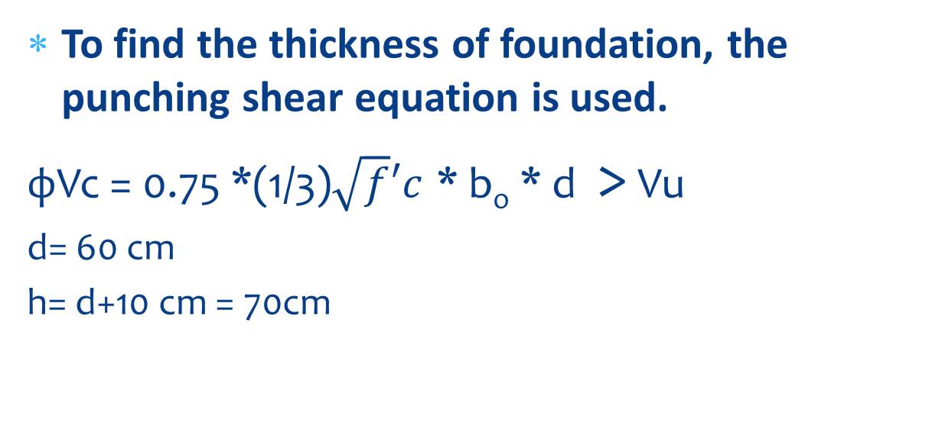
Design mat foundation
To find the thickness of foundation, the punching shear equation is used.
фVc = 0.75 *(1/3)$\sqrt{f}′c$ * b_{o} * d > Vu
d= 60 cm
h= d+10 cm = 70cm

Slide 13
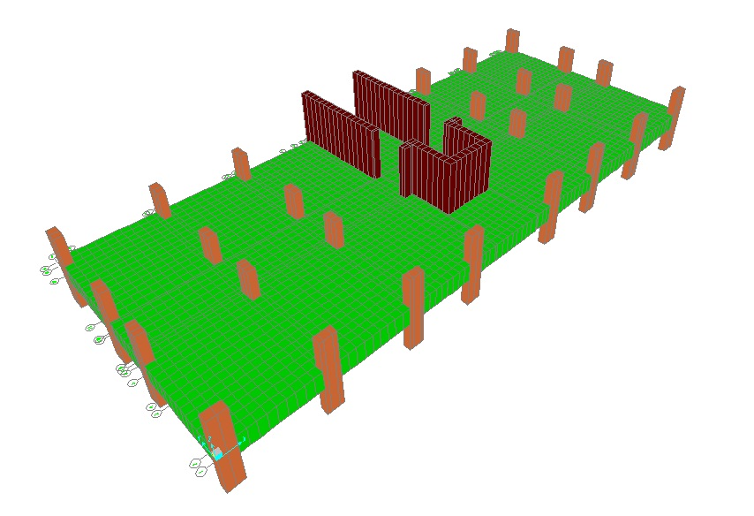
Sketch for the Mat Foundation in the SAP2000

Slide 14
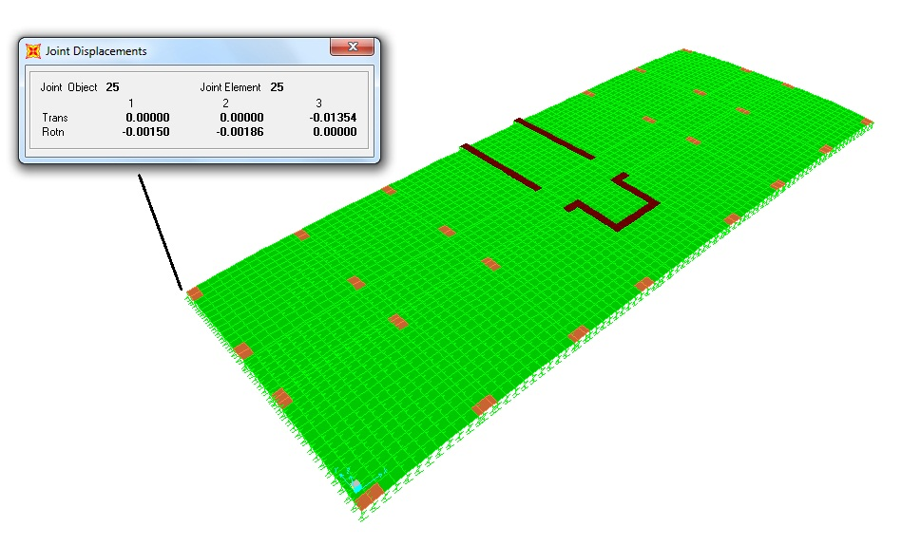
Settlement
The maximum value is 1.35 cm and this value is acceptable.

Slide 15
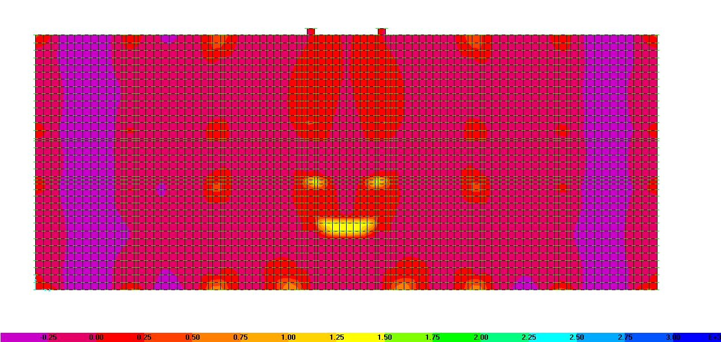
moment in (X) and (Y)directions
Moment in (x) direction M11.

Slide 16
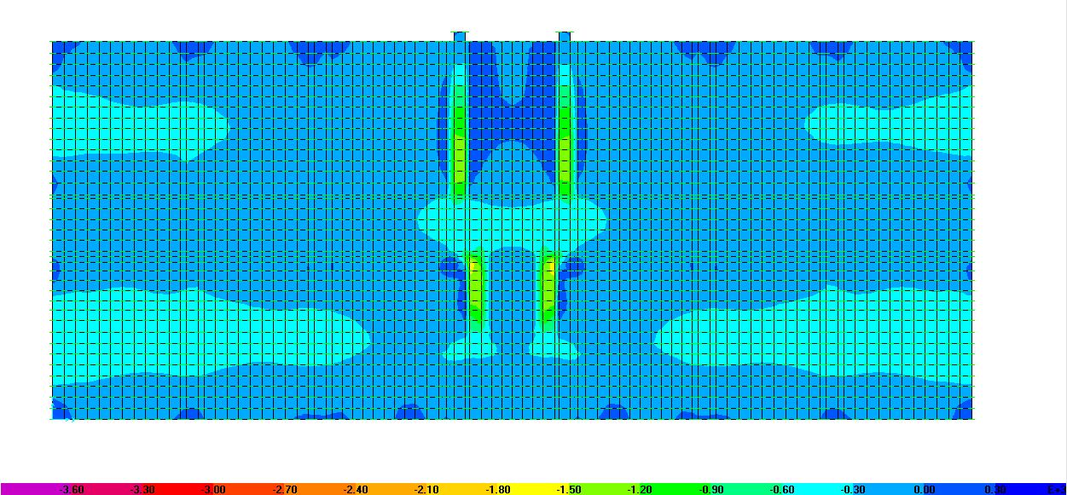
Moment in (y) direction M22.

Slide 17
Summary Of Reinforcement in Y-Direction
Reinforcement in (Y)direction
Zone # | strip width(m) | Top steel / Bottom steel | length(m) | ф
1 | 1 | Top steel | 9.75 | 5ф18
 |  | Bottom steel | 9.75 | 5ф18
2 | 1.85 | Top steel | 9.75 | 9ф18
 |  | Bottom steel | 9.75 | 9ф18
3 | 1.5 | Top steel | 9.75 | 7ф18
 |  | Bottom steel | 9.75 | 7ф18
4 | 1.8 | Top steel | 9.75 | 9ф18
 |  | Bottom steel | 9.75 | 9ф18
5 | 1.5 | Top steel | 9.75 | 7ф18
 |  | Bottom steel | 9.75 | 7ф18
6 | 1.9 | Top steel | 9.75 | 9ф18
 |  | Bottom steel | 9.75 | 9ф18
7 | 4.6 | Top steel | 9.75 | 23ф18
 |  | Bottom steel | 9.75 | 27ф20

Slide 18
Summary Of Reinforcement in X-Direction
Reinforcement in (x)direction
Zone # | strip width(m) | Top steel / Bottom steel | length(m) | ф
1 | 1 | Top steel | 3.6 | 5ф20
 |  |  | 16.5 | 5ф18
 |  |  | 3.6 | 5ф20
 |  | bottom steel | 23.7 | 5ф18
2 | 2.1 | Top steel | 23.7 | 11ф18
 |  | bottom steel | 23.7 | 11ф18
3 | 1.1 | Top steel | 23.7 | 6ф18
 |  | bottom steel | 23.7 | 6ф18
4 | 1.1 | Top steel | 23.7 | 6ф18
 |  | bottom steel | 23.7 | 6ф18
5 | 1.1 | Top steel | 23.7 | 6ф18
 |  | bottom steel | 9 | 6ф18
 |  |  | 5.8 | 7ф20
 |  |  | 9 | 6ф18
6 | 2.35 | Top steel | 23.7 | 12ф18
 |  | bottom steel | 9 | 12ф18
 |  |  | 5.8 | 14ф20
 |  |  | 9 | 12ф18
7 | 1 | Top steel | 23.7 | 5ф18
 |  | bottom steel | 23.7 | 5ф18

Slide 19
Design pile foundation
Number of piles |  |  | Pile bearing capacity (Kn) |  |  | Load(kn) | Column#
50cm | 60cm | 80cm | 50cm | 60cm | 80cm
3 | 2 | 1 | 350 | 510 | 910 | 720 | 1
3 | 2 | 1 | 350 | 510 | 910 | 774.6 | 2
3 | 2 | 1 | 350 | 510 | 910 | 774 | 3
3 | 2 | 1 | 350 | 510 | 910 | 778.8 | 4
3 | 2 | 1 | 350 | 510 | 910 | 778.8 | 5
3 | 2 | 1 | 350 | 510 | 910 | 774 | 6
3 | 2 | 1 | 350 | 510 | 910 | 774.6 | 7
3 | 2 | 1 | 350 | 510 | 910 | 711 | 8
3 | 2 | 1 | 350 | 510 | 910 | 732 | 9
2 | 2 | 1 | 350 | 510 | 910 | 630 | 10
3 | 2 | 1 | 350 | 510 | 910 | 810 | 11
4 | 3 | 2 | 350 | 510 | 910 | 1230 | 12
3 | 2 | 1 | 350 | 510 | 910 | 810 | 13
2 | 2 | 1 | 350 | 510 | 910 | 630 | 14

Slide 20
Design pile foundation
Number of piles |  |  | Pile bearing capacity (Kn) |  |  | load | Column#
50cm | 60cm | 80cm | 50cm | 60cm | 80cm
3 | 2 | 1 | 350 | 510 | 910 | 690 | 15
2 | 2 | 1 | 350 | 510 | 910 | 672 | 16
2 | 2 | 1 | 350 | 510 | 910 | 588 | 17
2 | 2 | 1 | 350 | 510 | 910 | 576 | 18
4 | 3 | 2 | 350 | 510 | 910 | 1314 | 19
4 | 3 | 2 | 350 | 510 | 910 | 1314 | 20
2 | 2 | 1 | 350 | 510 | 910 | 576 | 21
3 | 2 | 1 | 350 | 510 | 910 | 738 | 22
2 | 2 | 1 | 350 | 510 | 910 | 642 | 23
3 | 2 | 1 | 350 | 510 | 910 | 720 | 24
3 | 2 | 1 | 350 | 510 | 910 | 828 | 25
3 | 2 | 1 | 350 | 510 | 910 | 843 | 26
3 | 2 | 1 | 350 | 510 | 910 | 843 | 27
3 | 2 | 1 | 350 | 510 | 910 | 828 | 28
3 | 2 | 1 | 350 | 510 | 910 | 711 | 29

Slide 21
Design pile
Design the Pile for axial
Pd = фλ*(0.85* 𝑓c*(Ag-As) + Fy*As)
As= 25.12 cm²
So USE 10ф18 mm
Design the Pile for Shear
USE spiral ф10 mm / 10 cm

Slide 22
Design of Piles Cap
Dimensions 1.2 *1.2*0. 65 cm for all column
Design of One Pile Cap
Design for axial .
As =0.0018*b*d
Use 6ф16 mm in two directions.
Design cap for shear wall
Use 5ф16 mm/m in two directions

Slide 23
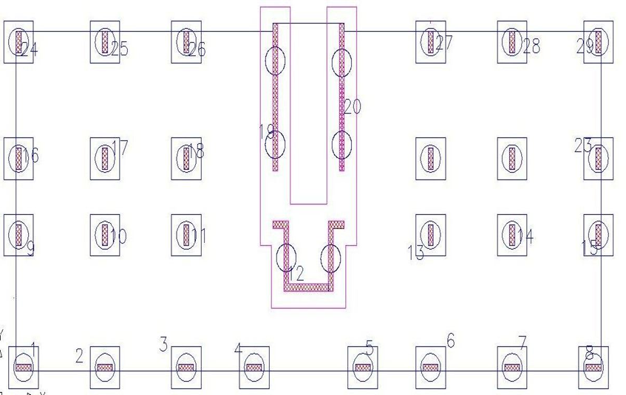
Plan for piles foundation

Slide 24
Cost of foundations
Cost of mat foundation :
Total cost =85000 NIS
Cost of pile foundation:
Total cost =101500 NIS

Slide 25
Conclusion and Recommendations
After designing the two alternative choices (Piles and Mat) and surveying the quantities for steel and concrete and drilling. find that the cost of the Mat Foundation is less than the cost of the Pile Foundation.
So it is recommend that the mat Foundation is more useful and it is cheap with respect to the cost of the piles.

Slide 26

THANKS FOR LISTENING

