Slide 1
An –Najah National University
Faculty Of Engineering
Department Of Civil Engineering
Graduation Project
Multi-Function Tower
Prepared by:
Ameed Hamarsheh
Amjad Alhasan
Mohammed Al Shalabi
Supervisor:
Dr. Isam Jaradaneh

Slide 2
Out line
Introduction.
Plat bearing test.
Unconfined compression test.
Calculation and Results.
Conclusions and Recommendations.

Slide 3
Introduction
The tests that done were field test and lab tests(plate bearing test as a filed test and unconfined compression test, Plastic Limit Test and Liquid Limit Test)
plate bearing test and unconfined compression test are the main tests in this project which were conducted to compare the results from both field and lab tests.
the sample was collected from Arab Islamic Bank located at Faisal Street of Nablus City, remolded sample.

Slide 4
Plat bearing test
According to ASTM D 1194, the plate bearing that used in the test is a circular plate of 300 mm in diameter, the plate thickness is normally 25mm.
This test checks the bearing capacity of the soil near the surface of the ground.
The Plate Bearing Test may be done at one or several spots at a site

Slide 5
Plat bearing test
Allowable Settlement:
If the soil sinks rapidly, it is deemed to have passed its ultimate bearing capacity.
The ultimate bearing capacity is sometimes considered as the load at which settlement of 25mm occurs.

Slide 6
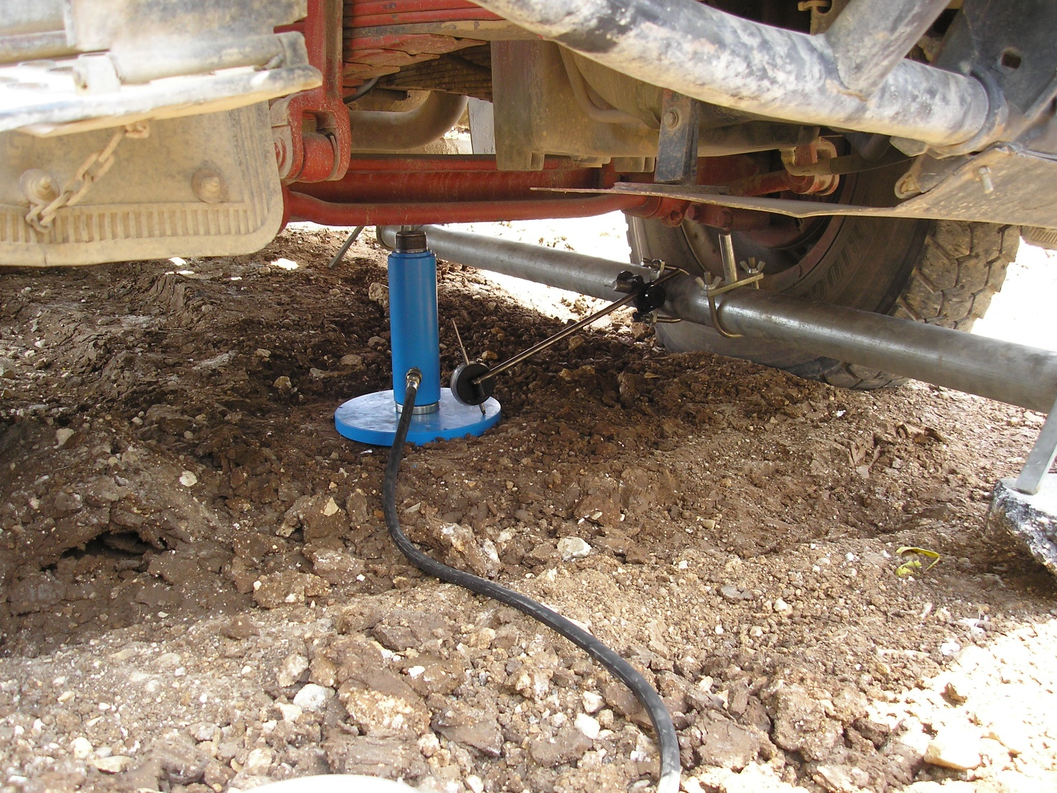
Plat bearing test

Slide 7
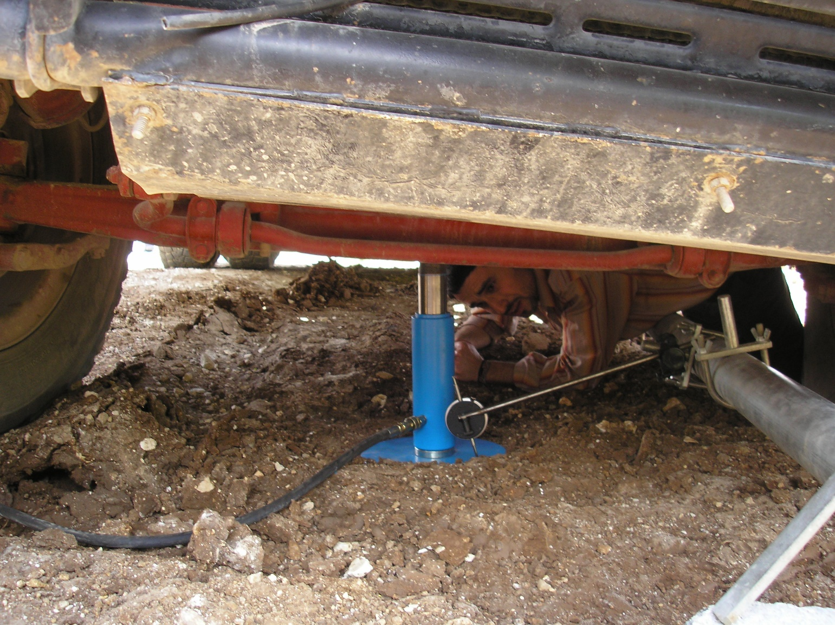
Plat bearing test

Slide 8
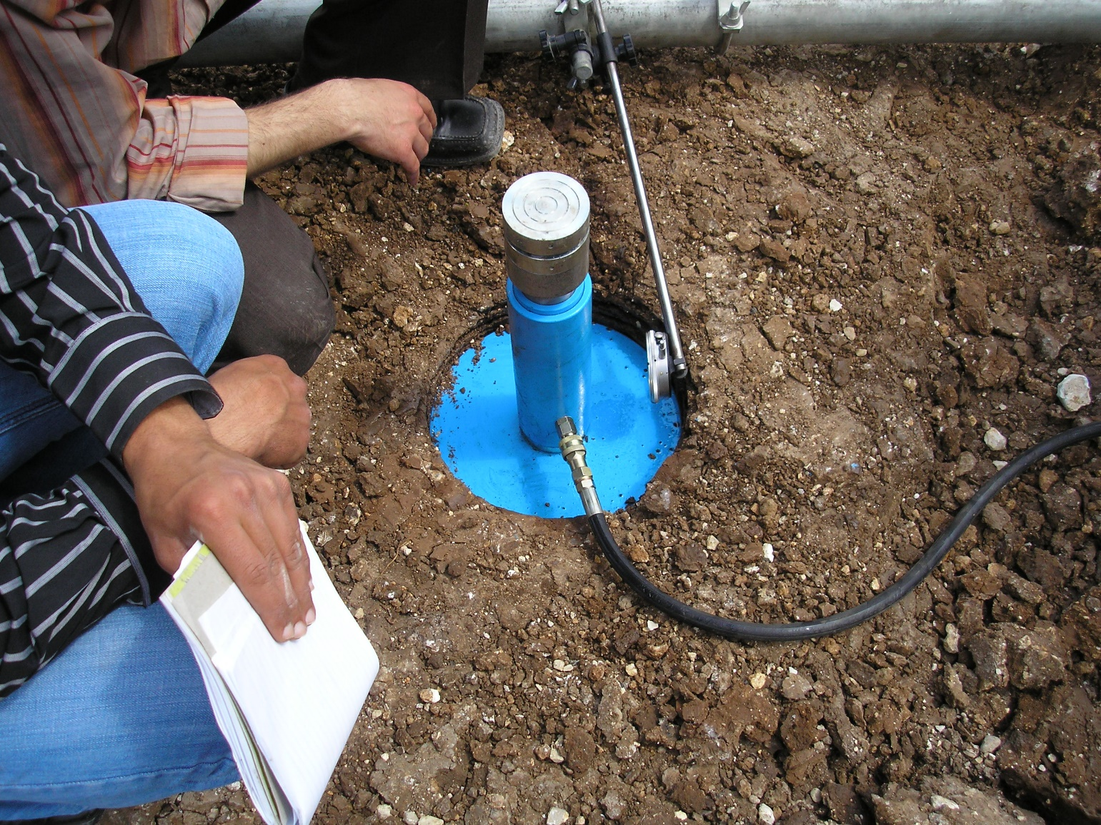
Plat bearing test

Slide 9
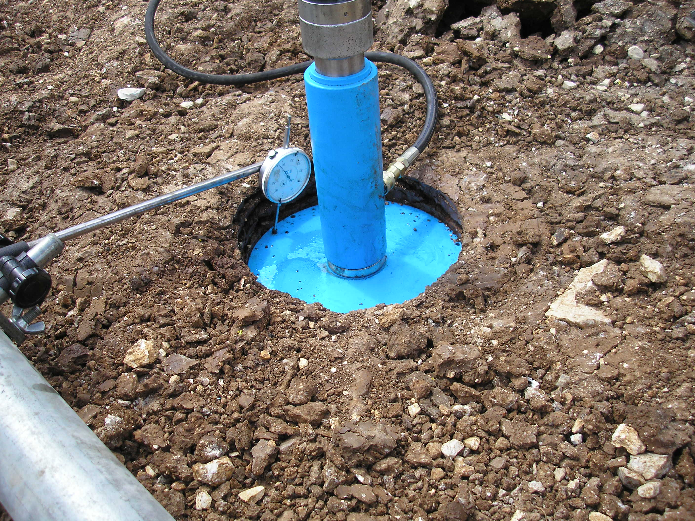
Plat bearing test

Slide 10
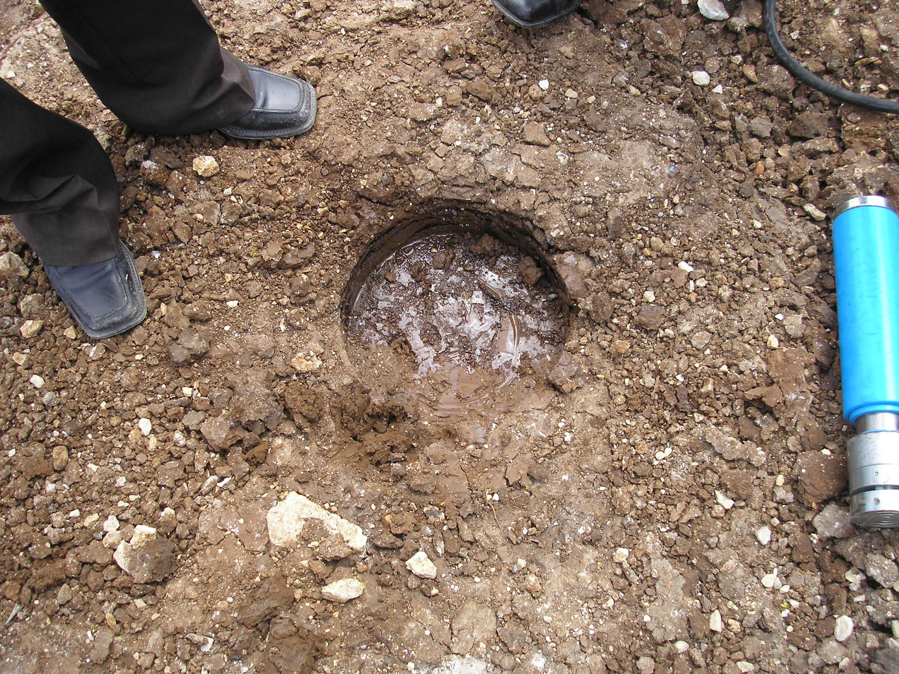
Plat bearing test

Slide 11
Unconfined compression test
A sample was collected from Arab Islamic Bank site, where Plate Bearing test was done. A remolded sample was prepared at the lab with the following dimensions:
Diameter = 38mm
Height = 76mm
Cross sectional area =1138.115mm2

Slide 12
Unconfined compression test
the unconfined compressive strength is taken as the maximum load attained per unit area, or the load per unit area at 15% axial strain, whichever occurs first during the performance of the test.

Slide 13
Unconfined compression test
Equipment:
1. Compressive device.
2. Load and deformation dial gauges.
3. Sample trimming equipment.
4. Balance.
5. Moisture can.

Slide 14
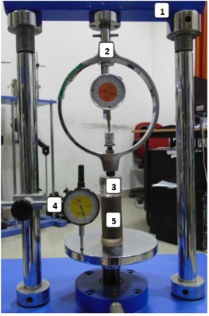
Unconfined compression test

Slide 15
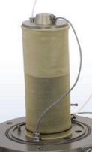
Unconfined compression test

Slide 16
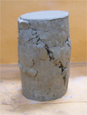
Unconfined compression test

Slide 17
Calculation and Results.
Plat bearing results
The area of the plate = (0.300)²×π/4 = 0.0707 m².
The stress = Force/Area
According to Das, 2011 (Principles of Foundation Engineering Foundation) the following equation is used:
S_{F} = S_{P} [B_{F}/B_{P}]
Mat foundation with width = 20 m
Allowable total settlement (immediate and consolidation) = 100 mm.
Using above equation, the settlement of plate bearing corresponding to 75 mm equals = 1.5 mm. From Figure 5.1 the allowable bearing capacity = 160 kN/m².
The following table (Table 5.2) shows the allowable bearing capacity for different foundation width considering with of 2, 3 and 4 m as isolated footing with allowable settlement of 25 mm and widths of 10, 15, 20, 25 and 30 m as for mat foundation with an allowable settlement of 100 mm.

Slide 18
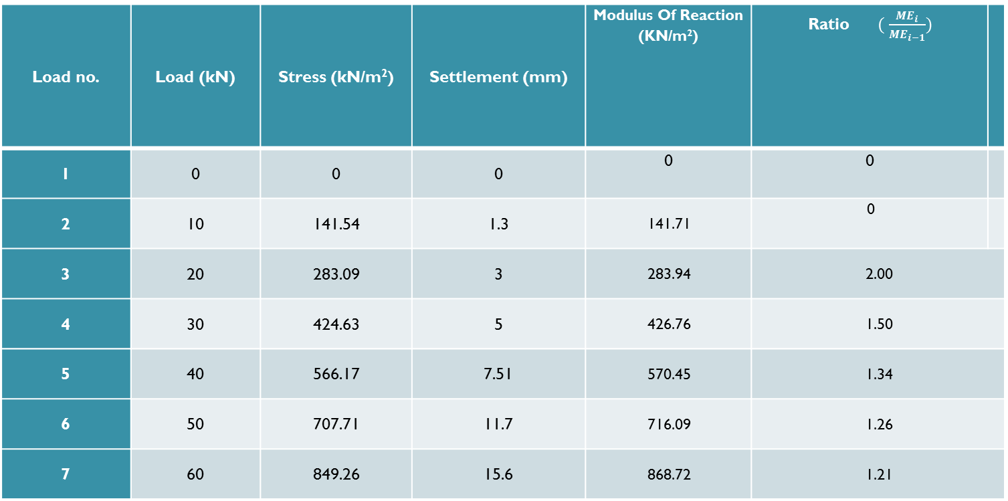
Plat bearing results
Measurements of the loads and corresponding settlement from Plate Bearing Test.
Load no. | Load (kN) | Stress (kN/m²) | Settlement (mm) | Modulus Of Reaction (KN/m²) | Ratio $( \frac{{ME}_{i}}{{ME}_{i−1}})$
1 | 0 | 0 | 0 | 0 | 0
2 | 10 | 141.54 | 1.3 | 141.71 | 0
3 | 20 | 283.09 | 3 | 283.94 | 2.00
4 | 30 | 424.63 | 5 | 426.76 | 1.50
5 | 40 | 566.17 | 7.51 | 570.45 | 1.34
6 | 50 | 707.71 | 11.7 | 716.09 | 1.26
7 | 60 | 849.26 | 15.6 | 868.72 | 1.21

Slide 19
Plat bearing results

Slide 20
Plat bearing results
No. | Foundation Width | Settlement of Foundation | Allowable Bearing Capacity
 | B m | mm | kN/m²
1 | 2 | 3.75 | 300
2 | 3 | 2.5 | 250
3 | 4 | 1.875 | 180
4 | 10 | 3 | 280
5 | 15 | 2 | 220
6 | 20 | 1.5 | 160
7 | 25 | 1.2 | 140
8 | 30 | 1 | 120

Slide 21
Plastic Limit Test
result of Plastic Limit test
According to this plastic limit our soil is Medium plastic.
Can No. | X3
Wt. of empty Can | 23.5
Wt. of Can +Wet Soil | 32.6
Wt. of can +dry soil | 30.8
P.L | 28.2

Slide 22
Liquid Limit Test
result of Liquid Limit Test using one point method
L.L = w (N/25) > 0.121 , N = 20-30
L.L = 57
Can No. | A2
Wt. of empty Can | 20.3
Wt. of Can +Wet Soil | 42.1
Wt. of can +dry soil | 34.3
W% | 55.7
No. of blows | 30

Slide 23
Classification of soil
According to the result of L.L. which equals 57 and P.L. which equals 28.2 the Plasticity index of the soil (PI) = 28.8, the soil can be classified according to USCS is MH which is Elastic Silt with Sand. According to AASHTO system the soil is A-7-6.

Slide 24
Unconfined Compression Test
the results of unconfined compression test.
Load(KN) | Deformation(mm)
0.000 | 0
0.025 | 0.2
0.030 | 0.4
0.035 | 0.6
0.045 | 0.8
0.060 | 1.2
0.105 | 1.6
0.140 | 2.0
0.180 | 2.4
0.215 | 2.8
0.234 | 3.2
0.240 | 3.6
0.233 | 4.0
0.205 | 4.8

Slide 25
Unconfined Compression Test
Initial length = 76mm
Elongation = 0.048
Initial cross sectional area = 1134.115 mm2
Cross sectional area = 1191.314mm2
Maximum load = 0.234 KN
Strength = 0.196 MPa
Unconfined strength = 0.196 MPa
Secant modulus (Es1) = 0.045 MPa
Secant modulus (Es2) = 0.056 MPa
Secant modulus (Es3) = 0.062 Mpa
From the above results, the cohesion of the soil is 90 kN/m². The silty clay soil in this case is considered undrained cohesion.

Slide 26
Unconfined Compression Test
No. | Foundation Width (B) m | Undrained Cohesion (Cu) kN/m² | Allowable Bearing Capacity kN/m²
1 | 2 | 90 | 200
2 | 3 | 90 | 200
3 | 4 | 90 | 200
4 | 10 | 90 | 180
5 | 15 | 90 | 180
6 | 20 | 90 | 180
7 | 25 | 90 | 180
8 | 30 | 90 | 180
Acording to the undrained Cohesion the Consistency is medium

Slide 27


