Slide 1

بسم الله الرحمن الرحيم
Development of a Water Master Plan for Jenin Governorate (2020-2040)
Prepared by
Yasmeen Nairat Ayah Dweikat
Isra Balati Amna Melham
Under supervision of: Dr. Anan Jayyousi

Slide 2
INTRUDUCTION
we will choose Jenin Governorate as an area to study the future problem of water lack by studying the difference between the required and existing quantity of water that Jenin need it in the next 20 years by developing a Master plan that will propose a new water resources with an investigation plan to implement the project during the next 20 years.

Slide 3
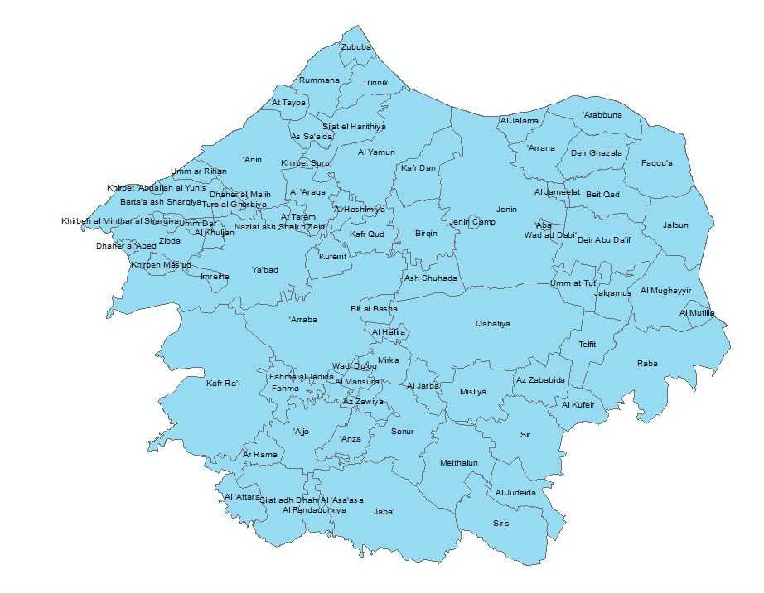
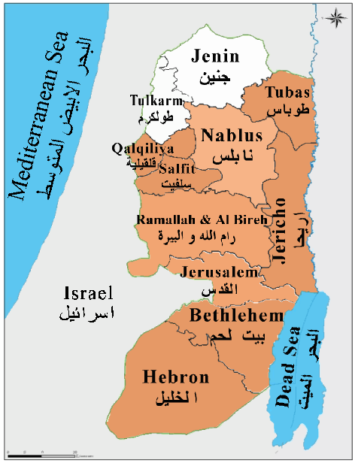
OVERVIEW OF JENIN
LOCATION , COMMUNTIES AND TOPOGRAPHY

Slide 4
Existing Water Supply System
Water Resources:
Selected Indicators for Water Statistics in the West Bank..

Slide 5
Water Produced per Basin in the West Bank For Jenin Governorate.
Palestinian Water Wells and its Annual Pumping Quantity for Jenin Governorate and Type of Use.

Slide 6
Domestic Sector, Water Consumed, Total Losses, Population and Daily Consumption per Capita in Jenin Governorate.
Needed, Supply and Consumed Quantities, Population and Deficit in Domestic Supply in Jenin Governorate.

Slide 7
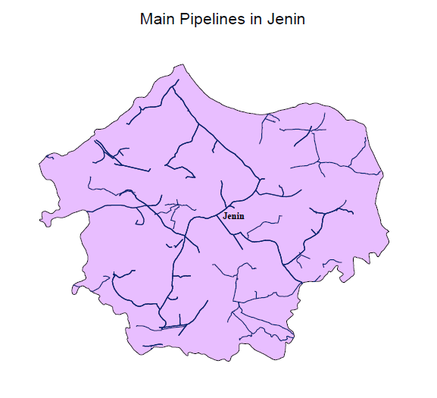
Water Networks:
In the Figure, the main pipelines in Jenin Governorate that we will work on it to develop the water plan in Jenin in the future. It’s the most important part because water reach to Jenin by it

Slide 8

Present Water Demand:
We collected data on the population and current water demand in each city, village, and cluster. This information is obtained from the Palestinian Central Bureau of Statistics and the Water Authority according to 2017 statistics.
Using the formula:
P_{future} = P_{now} * (1+r)^{n}
P_{now}: Population in 2017
P_{future}: Population in 2020.
n: No. of years, n =3 years.
r: growth rate. We take it from the following table

Slide 10
Future Water Demand:
Demand (year) = (The population (year) * Demand unit (year L/Capita/Day) * 365 (day/year) /)1000 (L/m3) * (1-loss %))
Year | Demand unit (l/c/day) | N | Loss %
2020 | 60 | 3 | 46.12
2025 | 80 | 8 | 35
2030 | 100 | 13 | 25
2040 | 120 | 23 | 15

Slide 11
Clusters in Jenin Governorate
We divided Jenin government into clusters based on several factors, and these factors are:
Some communities get water from certain sources in the present time, so we cannot separate them in the future.
Administrative divisions.
Social divisions.
Commercial divisions

Slide 12
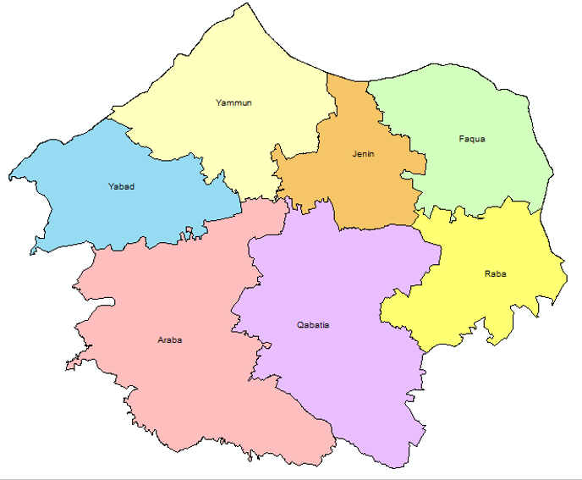
this cluster.
Qabaytia Cluster.
Arraba Cluster.
Yabad Cluster.
Jenin Cluster.
Faqquaa Cluster.
AL-Yammun Cluster.
Raba Cluster

Slide 13
Population and Supply in the years 2017, 2020, 2025, 2030 and 2040.

Slide 14
Population and Demand in the years 2020, 2025, 2030 and 2040

Slide 15
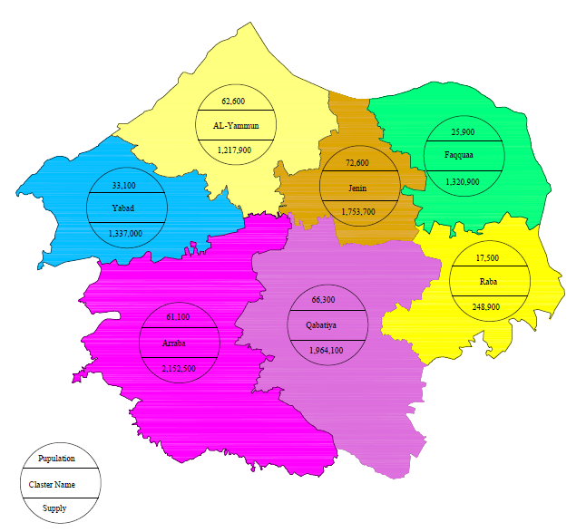
Population and Supply for the year 2020 (m³).

Slide 16
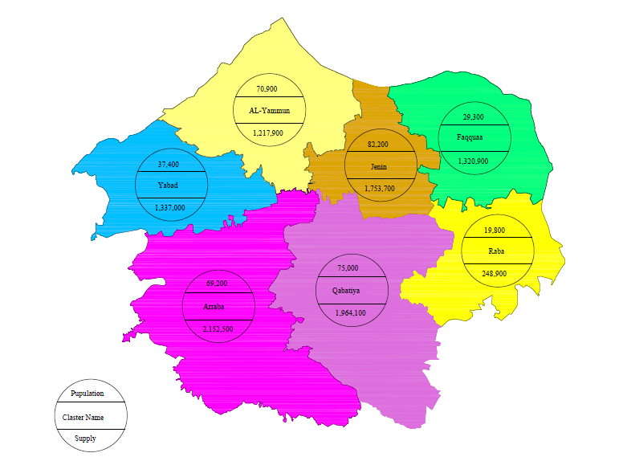
Population and Supply for the year 2025 (m³).

Slide 17
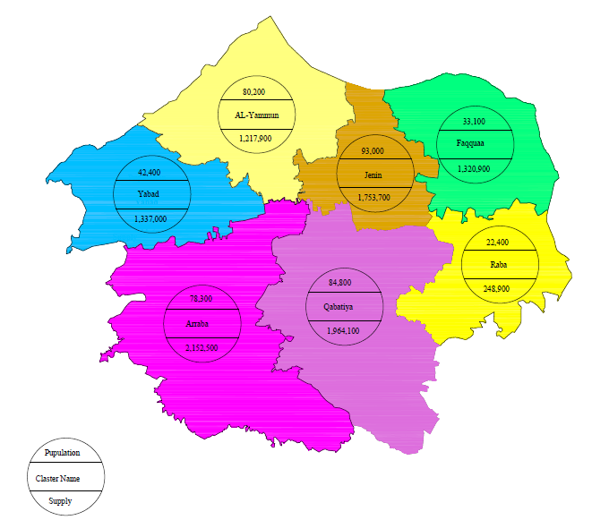
Population and Supply for the year 2030 (m³).

Slide 18
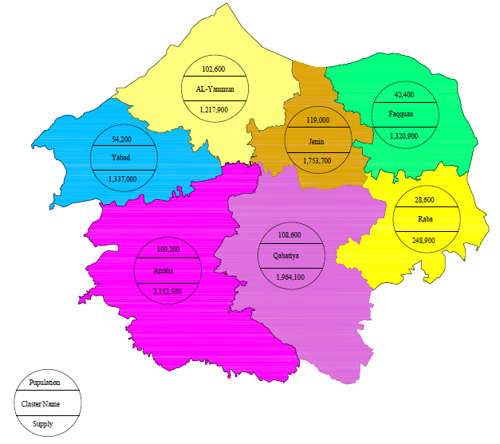
Population and Supply for the year 2040 (m³).

Slide 19
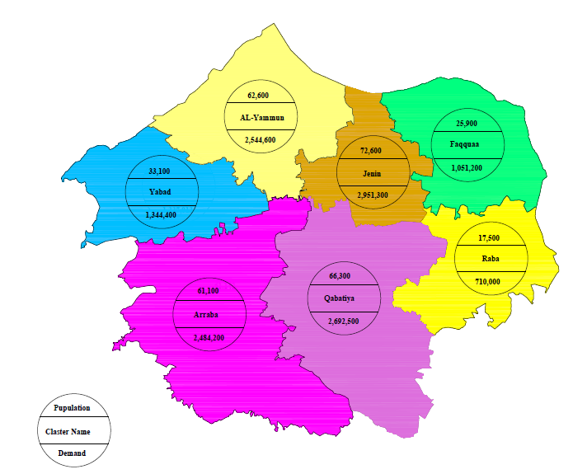
Population and Demand in the year 2020 (m³).

Slide 20
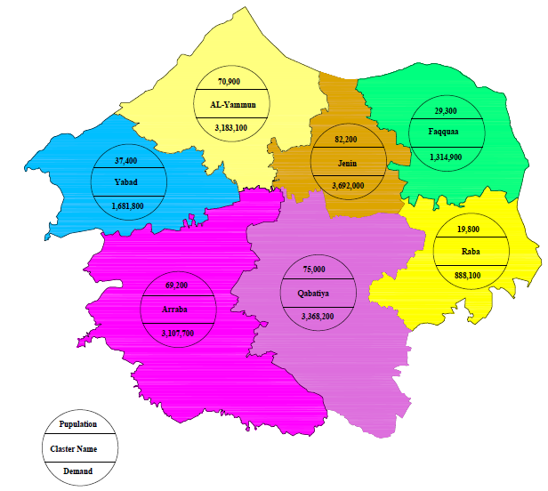
Population and Demand in the year 2025 (m³).

Slide 21
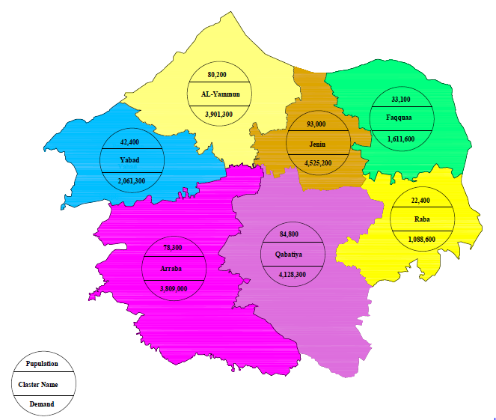
Population and Demand in the year 2030 (m³).

Slide 22
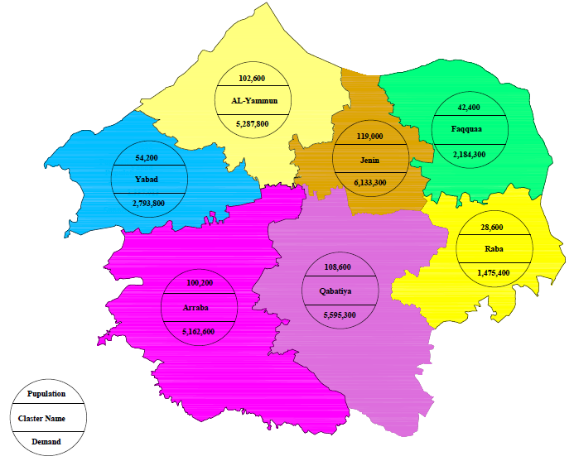
Population and Demand in the year 2040 (m³).

Slide 23
Gap of water demand in Jenin governorate
After we found population and demand in years of present and future time, and by knowing about the amount of water supply in Jenin government in 2017, we consider that the amount of water supply are constant in the next years in the future (2020-2040)
So depending on this information and assumption, we account the amount of gap of the water
We use this formula
Amount of gap = demand – supply.

Slide 24
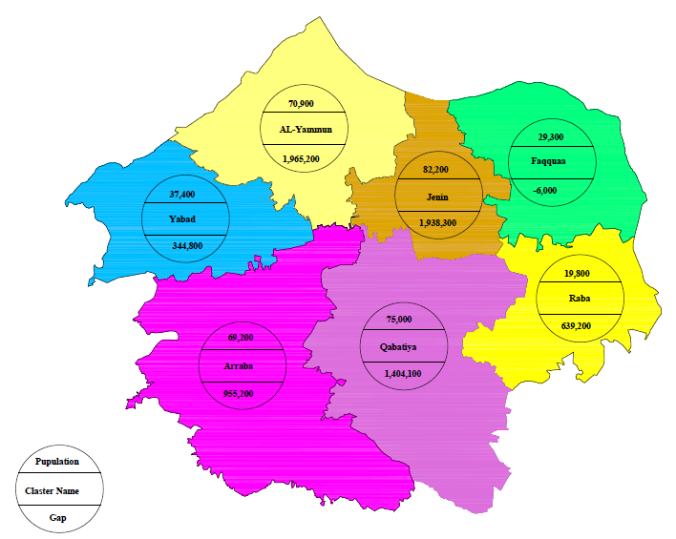
Population and Gap for the year 2025 (m³).

Slide 25
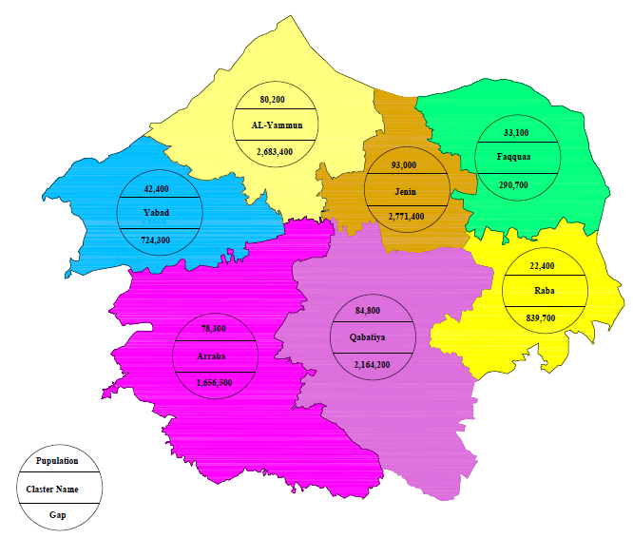
Population and Gap for the year 2030 (m³).

Slide 26
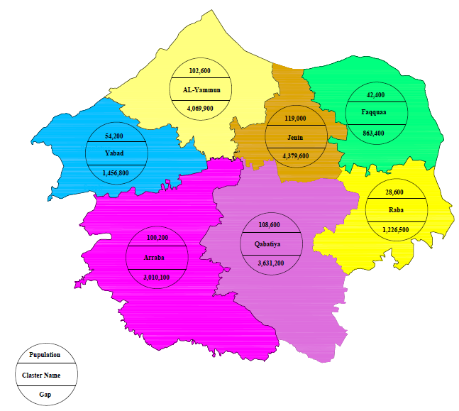
Population and Gap for the year 2040 (m³).

Slide 27
Plans to cover the Gap
The short-term solutions
Maintenance of the existing networks
Rain Water Harvesting
The long-Term Solutions:
Taking water from Jordon Valley
Construction of wells

Slide 28
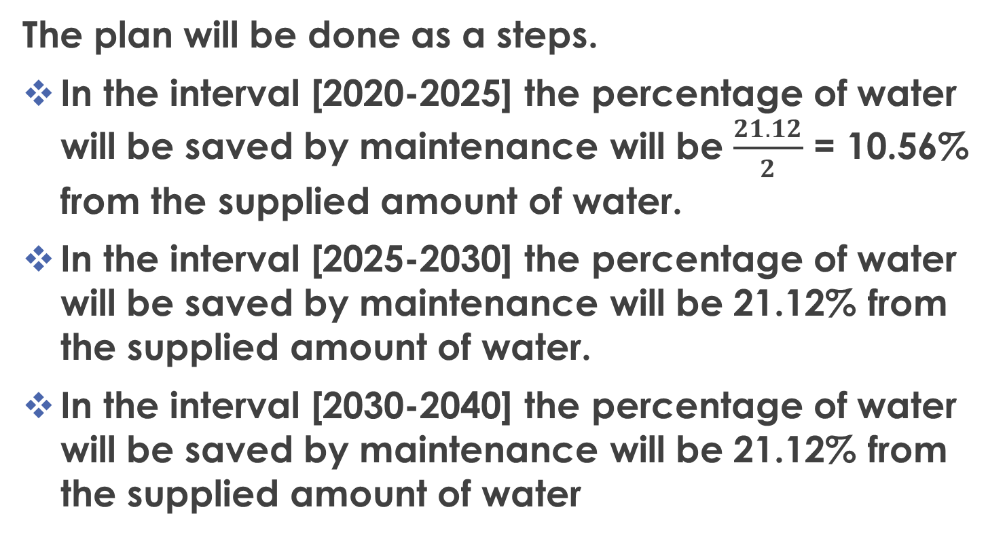
Maintenance of the existing networks
The plan will be done as a steps.
In the interval [2020-2025] the percentage of water will be saved by maintenance will be $\frac{21.12}{2}$ = 10.56% from the supplied amount of water.
In the interval [2025-2030] the percentage of water will be saved by maintenance will be 21.12% from the supplied amount of water.
In the interval [2030-2040] the percentage of water will be saved by maintenance will be 21.12% from the supplied amount of water

Slide 29
The Amount of Water Saved from Maintenances in Jenin for Each Cluster.

Slide 30
Rain-Water Harvesting
Avg. family size is 4.8 capita.
No. of floor in each building is 3 floors.
Avg. area of each apartment is 167.7 m².
Avg. annual rainfall is 528 mm.

Slide 31
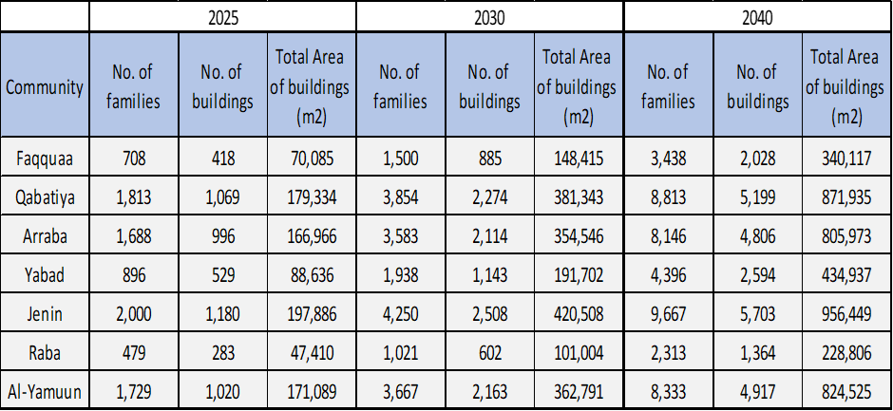
Total Area of the Rooftop Buildings in Each Cluster Due to the Intervals

Slide 32
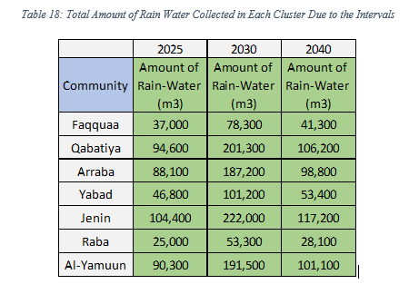

Slide 33
The amount of water saved from The short-term solutions
Total Amount of Water Provided from Two Solutions

Slide 34
Remaining Gap
The New Gap Results from Short Term Solutions

Slide 35
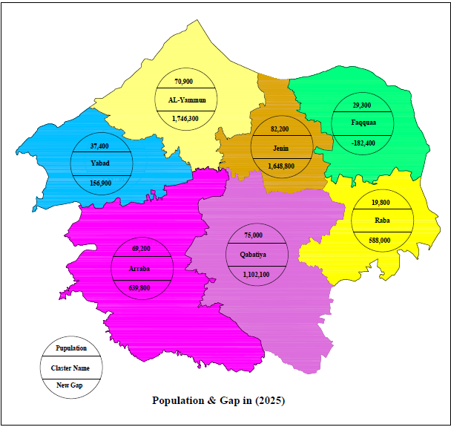
The Population and the New Gap for Jenin Governorate in 2025.

Slide 36

The Population and the New Gap for Jenin Governorate in 2030.

Slide 37

The Population and the New Gap for Jenin Governorate in 2040.

Slide 38
The long-Term Solutions:
Jordan valley
Taking water from Jordon Valley
Palestinians are allowed to use only permitted to use 40% of the water in this basin or approximately 58 mcm of water per year. Since its occupation in 1967
Based on the right of the Palestinian people to Jordan waters according to the agreements, in this project, water will be taken from the Jordan Valley for use in Jenin for agricultural uses. This is because in the project it will solve the water gap in home use. Therefore, the agricultural aspect is taken into account in the project

Slide 39
Construction of Wells
The New Gap for the Intervals of the Plan in each Cluster.

Slide 40
The Plan will take a three terms to be construct and supply water to the clusters.
Short-term Plan:
Wells will be constructed equal 1,400,000 m3
his results that 5 wells is needed to construct in Jenin Governorate through the interval until 2025.
5 wells, 3 in the North and 2 in the West of Jenin Governorate

Slide 41
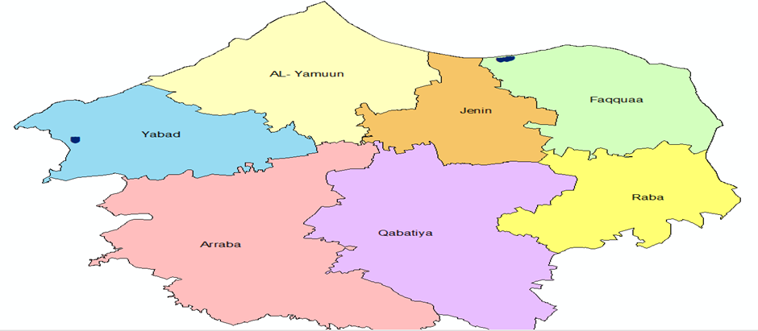
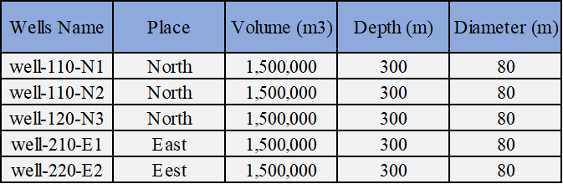
Location of wells in 2025:

Slide 42
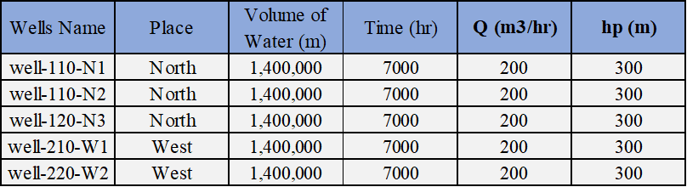
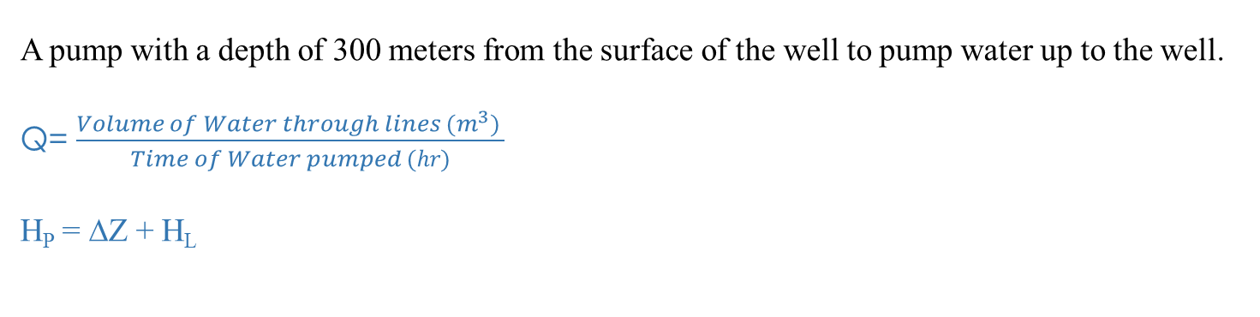
A pump with a depth of 300 meters from the surface of the well to pump water up to the well.
Q= $\frac{Volume of Water through lines (m^{3}) }{Time of Water pumped (hr)}$
H_{P} = ∆Z + H_{L}

Slide 43
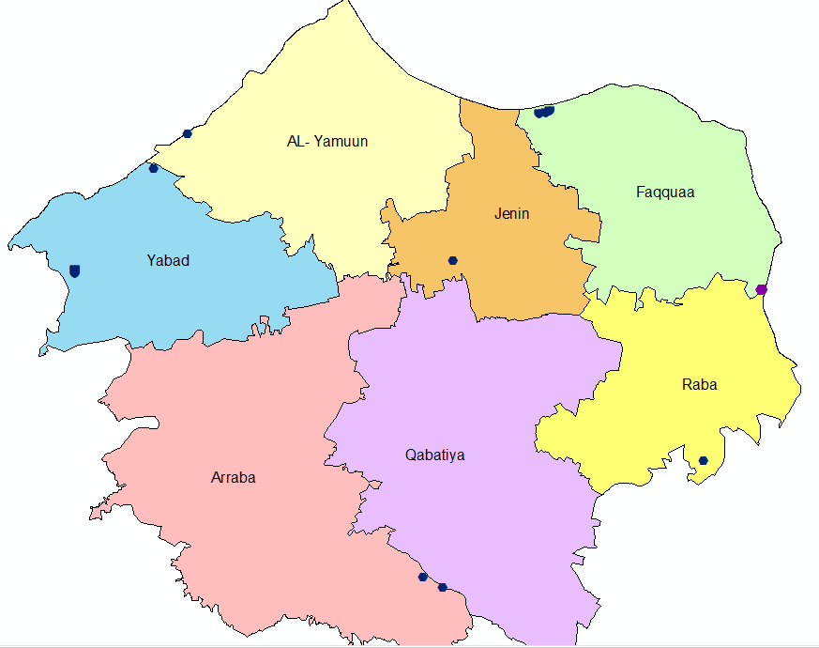
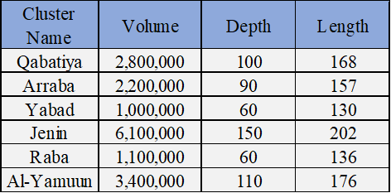
Location of wells and tanks in 2025
Diminution of cubic tanks in 2025 , we assume the depth and find the length

Slide 44
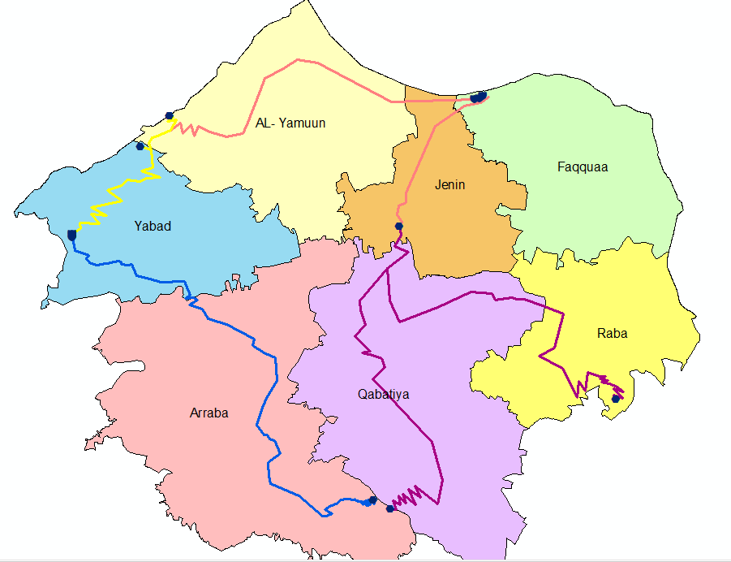
The Conveyance Network will construct in Jenin Governorate in 2025.

Slide 45
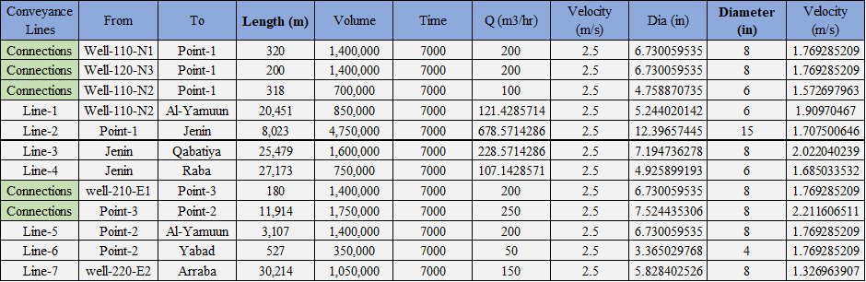
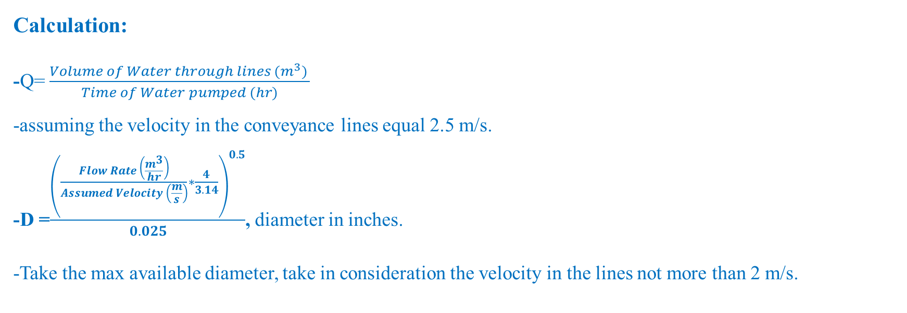
Calculation:
-Q= $\frac{Volume of Water through lines (m^{3}) }{Time of Water pumped (hr)}$
-assuming the velocity in the conveyance lines equal 2.5 m/s.
-D =$\frac{{\left(\begin{aligned}\frac{Flow Rate \left(\frac{m^{3}}{hr}\right)}{Assumed Velocity \left(\frac{m}{s}\right)}∗\frac{4}{3.14} \\ \end{aligned}\right)}^{0.5}}{0.025}$, diameter in inches.
-Take the max available diameter, take in consideration the velocity in the lines not more than 2 m/s.

Slide 46
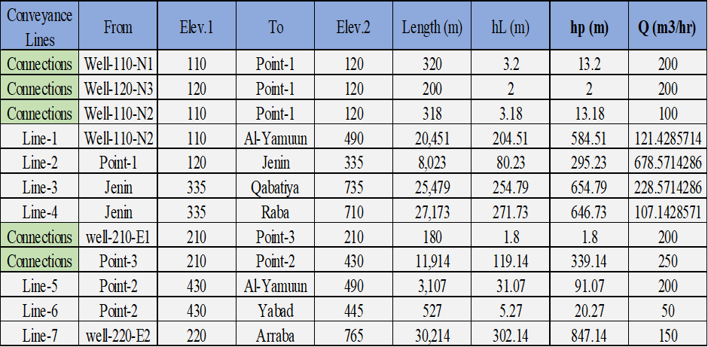
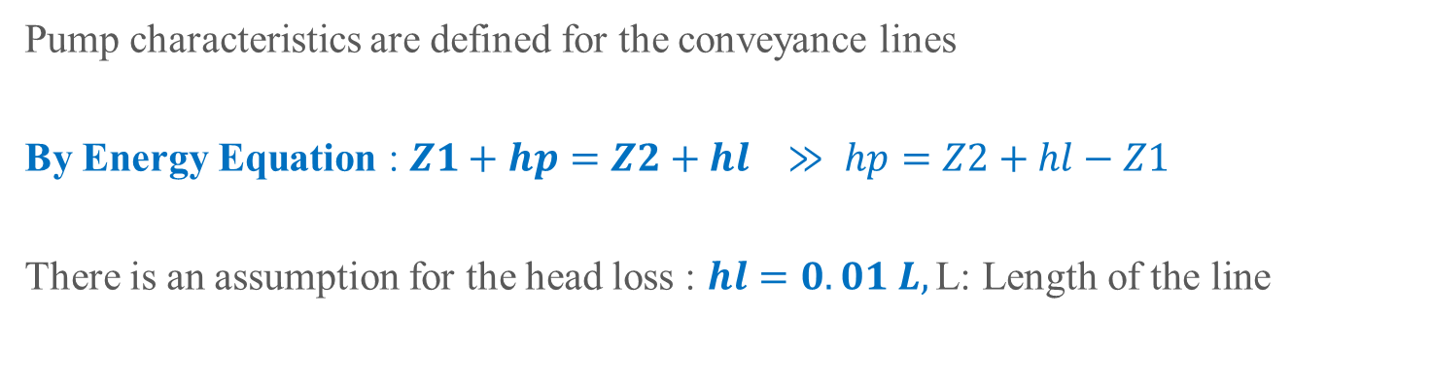
Pump characteristics are defined for the conveyance lines
By Energy Equation : $Z1+hp=Z2+hl$ $≫ hp=Z2+hl−Z1$
There is an assumption for the head loss : $hl=0.01 L,\text{L}\text{: }\text{Length} \text{of} \text{the} \text{line}$

Slide 47


Mid-term Plan:
Well will be constructed equal 1,400,000 m3
his results that 6 wells is needed to construct in Jenin Governorate through the interval until 2030.
So, we add (1) wells in the North of Jenin Governorate.

Slide 48
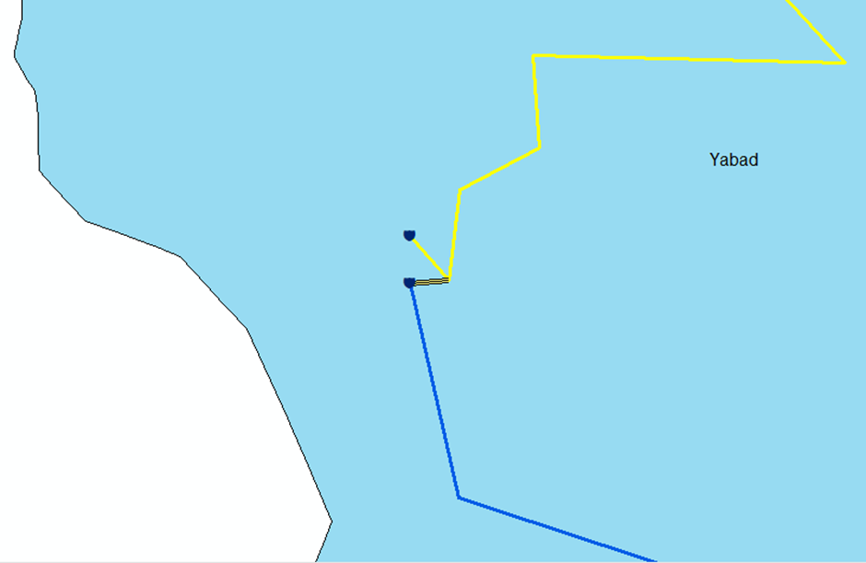
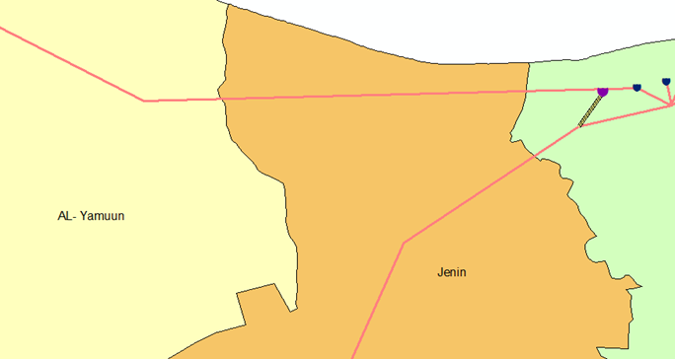
We add two connection in 2030

Slide 49
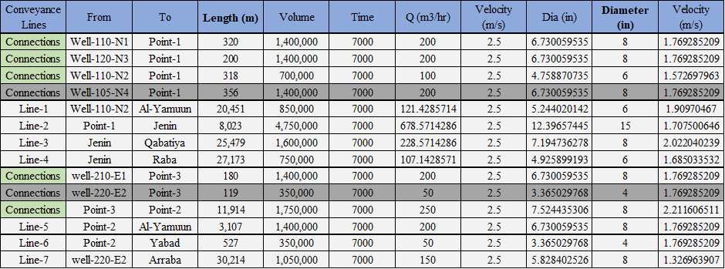
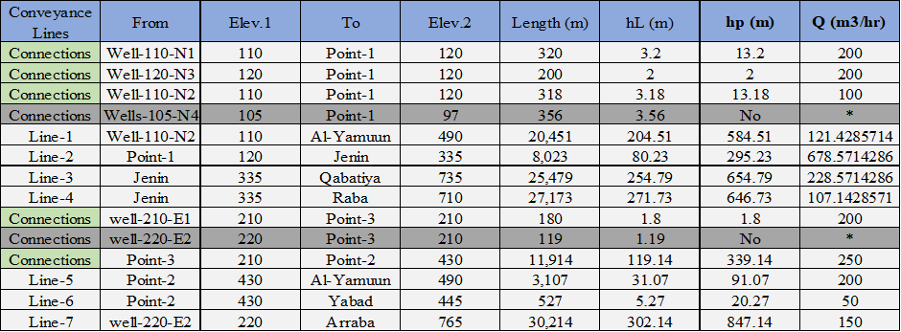
The calculation as previous term :

Slide 50
Long-Term Plan
The Number of wells needed in this interval is calculated which results that 10 wells is needed to construct in Jenin Governorate through the interval until 2040. Previously 6 wells are constructed in 2025 and 2030. So. Four additional wells should be constructed. The place will be 1 in the North part of Jenin in Faqquaa and 3 in the West of Jenin Governorate

Slide 51
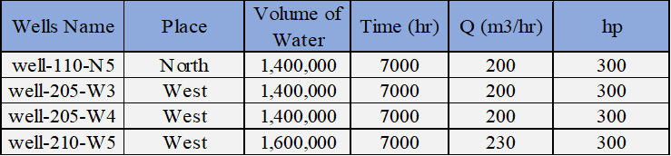
Wells Name, Volume of Water and Characteristics of the Pumps will used in 2040.

Slide 52
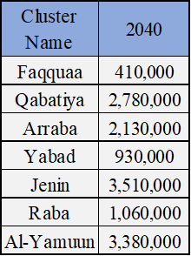
The Rounded Volume of Water needed in Each Cluster in 2040.

Slide 53
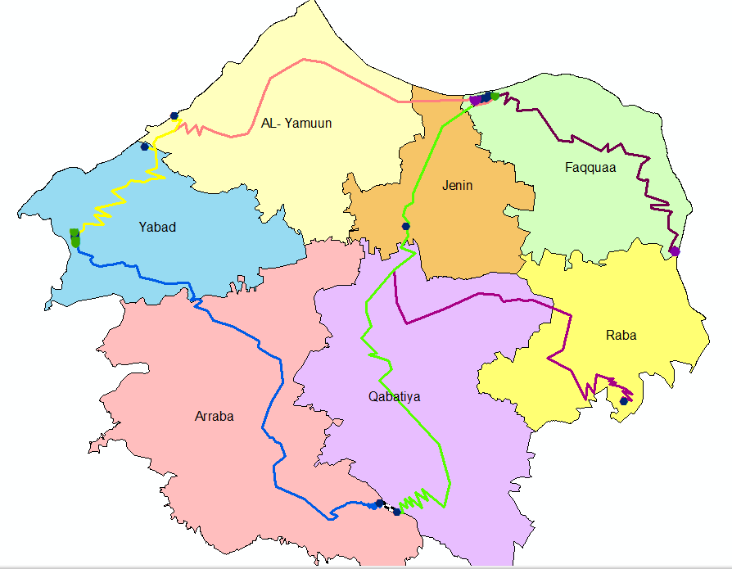
The Conveyance Lines in Jenin Governorate in 2040.

Slide 55
Price and Cash Flow or the project for 2025,2030 and 2040
  The total cost includes both an account
  Price for Drilling Wells ( 100$ for 1m Excavation)
  Price for Wells pumps (Assume = 90,000$)
Price for Tanks (Assume 1168NIS for Volume = 1500m³)
Price for Conveyance lines in the Network:
Diameter as the table
Pumps (Assume = 90,000$)

Slide 56
Total Price of the Project for each interval
(NIS)

Slide 57
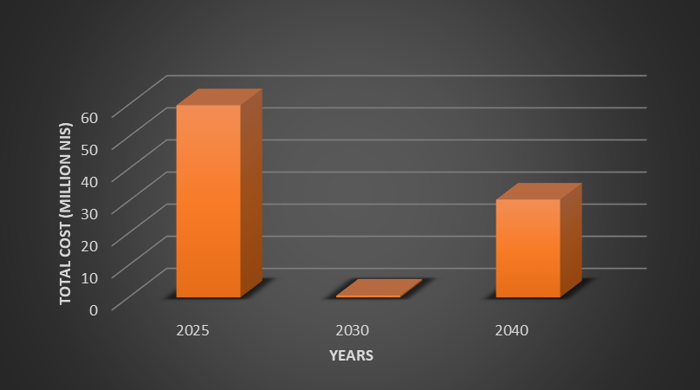
The Cash flow for the project

Slide 58
Sample of proposed Packages

Slide 60
Suggestion to cover the price of the project
The Conversion between the Future Cost and the Annual Cost.
The price from each person to collect the total price in each interval of the plan, Thus we can collect the cost of the project and solve the problem of water gap.

Slide 61
THANK YOU

