Slide 1
“Developing Forecasting Models at AL-Pinar General Trading Company’’
Prepared by:
Abdallah Mahameed
Lina Hbaisheh
Najla Assi
Rema’ Emad
Ahmad Wael
Supervisor: Dr. Yahya Saleh

Slide 2
















&

Slide 3

01
INTRODUCTION

Slide 4

Al-Pinar
Al-Pinar General Trading Company is a leading Palestinian company falls under the Food Industry sectors and specializes in the manufacture and distribution of dairy products with many products listed under six main categories.

Slide 5

The major idea
The goal of our project is to create forecasting models for Al-Pinar company, as a solution to the change of demands for products the company offers, in order to reduce returns and achieve customer satisfaction.

Slide 6
02
PROBLEM STATEMENT

Slide 7
Al-Pinar is committed to contracts to obtain daily quantities of milk, to maintain the quality of the milk and the life cycle of cow's milk.
Additionally, it adheres to the return’s strategy contracts with retail stores, causing additional costs to the company.

Slide 8
03
OBJECTIVES

Slide 9
Developing demand forecasting models for the company’s product sales, by applying time series analysis on historical data for each product.
Using the developed forecasting models to determine the quantity to be produced to meet market demand, reduction in the number of products returned.

Slide 10

04
LITERATURE REVIEW

Slide 11
Forecasting
What is forecasting:
Why we use forecasting:
Prediction is a process that can predict future events by conducting a study or analysis of previous data to find relations, patterns and systematic trends.
Operation management
Marketing
Finance and Risk Management
Economics

Slide 12
Forecasting Techniques
Qualitative
Quantitative
Coding Part

Slide 13
Qualitative Techniques
1
Jury of Executive Opinion
3
Sales Force Composite
2
4
Delphi Method
Customer Surveys

Slide 14
Quantitative Techniques
Naïve
Simple Moving Average
Exponential Smoothing
Weighted Moving Average
Holt-Winters
ARIMA
1
2
3
4
5
6

Slide 15
Coding Part
Python is a versatile and high-level programming language that is widely used for various purposes, including data analysis
Pandas
Simplicity
Python
NumPy
Readability
Matplotlib
Libraries and tools
Statsmodels

Slide 17

Accuracy measurement
We use mean absolute percent error (MAPE) to choose the most fitted model by comparing the MAPE between all models.
MAPE = $\frac{1}{n}∗\sum{\frac{|A_{t}−F_{t}|}{A_{t}}}$

Slide 18
05
Methodology

Slide 19
Data selection
01
03
02
Data Collection
Data analysis
& model building

Slide 20
06
Data Analysis
& Results

Slide 21
Data processing
Data receiving
26K weekly data point for 50 products
Products were divided into 5 families
Classification
Time plots
All products were plotted (time-plots)
Many products were removed & 24 will remain
Filtering

Slide 22
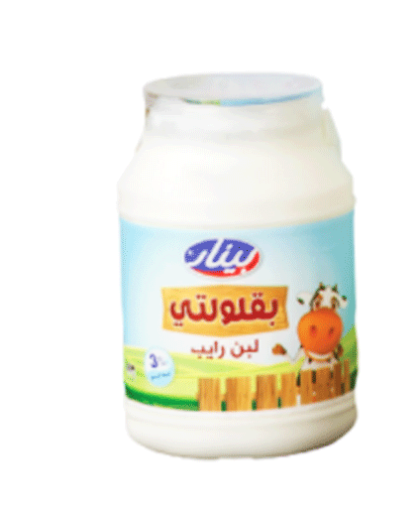
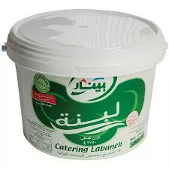



Product Families
Yogurt
Labaneh
Fresh up
Cheese
Cup sour cream

Slide 23

Each product works through these stages
01
02
03
04
Time Series Plot
Trend Analysis
Decomposition
Applying Models

Slide 24
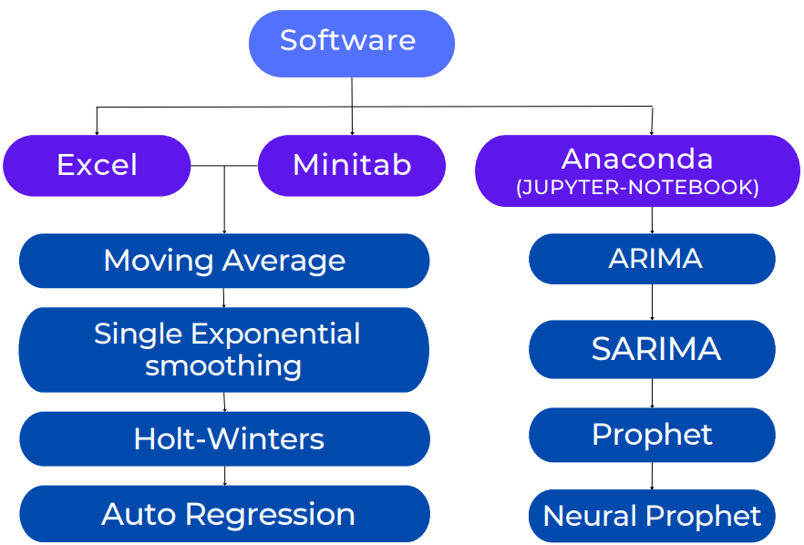
Applying Models stage done using 3 software

Slide 25
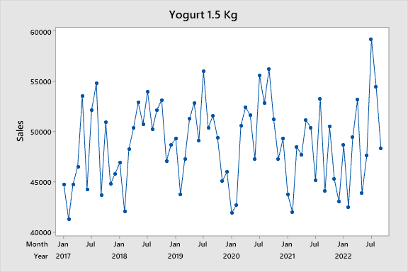
Now, Let’s start with Yogurt Family
Product: Yogurt 1.5 Kg
This figure shows the time series plot of Yogurt 1.5 kg.

Slide 26
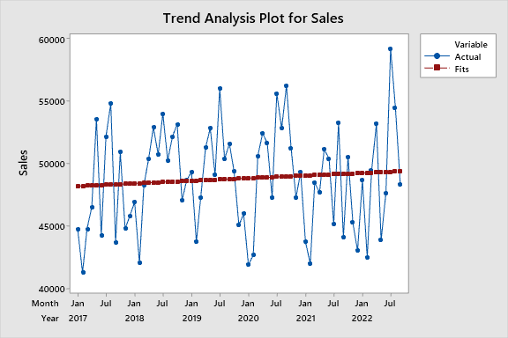
And here is the trend analysis for Yogurt 1.5 Kg

Slide 27
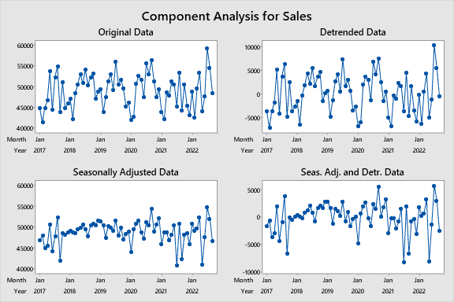
Finally with Decomposition plots

Slide 28
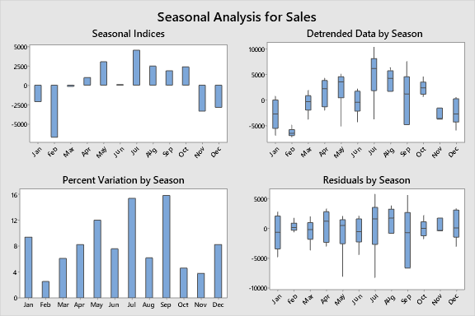

Slide 29
After applying the mentioned models, and measuring the forecasting accuracy using the mean absolute error (MAPE), here are the results.
Yogurt 1.5 kg
Models | MA 3 | MA 5 | MA 7 | SE | HW | ARIMA (1,0,0) | PROPHET | N-PROPHET | AUTO-REGRISSION | SARIMA
MAPE | 5.19 | 5.69 | 6.19 | 7.2 | 5.69 | 8.08 | 7.81 | 6.9 | - | -
α=0.15
β=0.01
γ=0.32

Slide 30
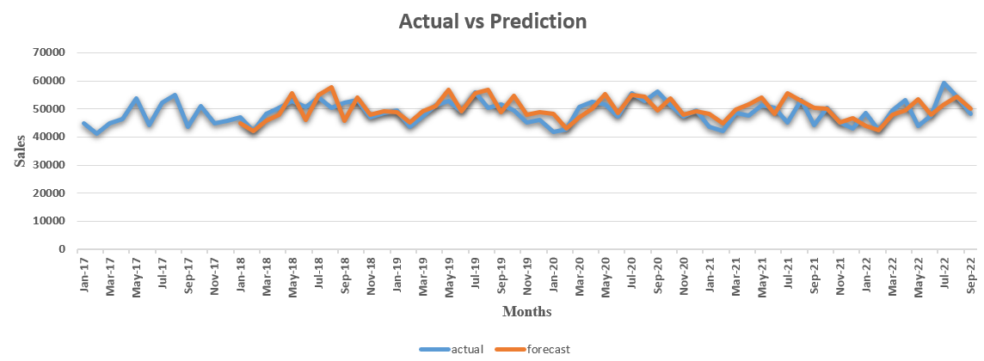
Now let’s take a snapshot of the Actual vs prediction plot for the H-W model

Slide 31
Cheese Family
Product: Soft cheese 220 gm
This figure shows the time series plot of Soft cheese 220 gm.

Slide 32
Ramadan edition Time Series Plot for Soft cheese 220 g

Slide 33
MAPE Values for each model.
Soft cheese 220 gm
Models | MA 1 | MA 2 | MA 3 | SE | HW | ARIMA | PROPHET | N-PROPHET | AUTO-REGRISSION | SARIMA
MAPE | 27.11 | 14.75 | 11.1 | - | - | - | - | - | - | -

Slide 34
The Actual vs prediction plot for the MA(3) model

Slide 35
Now, fasten your seatbelts, and get ready to go with the coding journey.

Slide 36
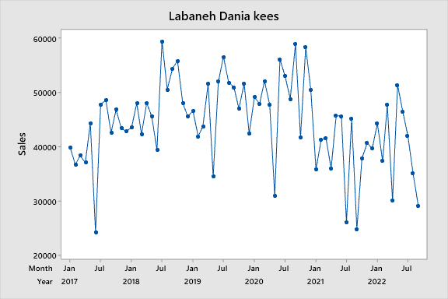
Labaneh Family
Product: Labaneh Dania kees
This figure shows the time series plot of Labaneh Dania kees

Slide 37
MAPE Values for each model.
Labaneh Dania kees
Models | MA 3 | MA 5 | MA 7 | SE | HW | ARIMA (3,0,2) | PROPHET | N-PROPHET | AUTO-REGRISSION (P=1) | SARIMA
MAPE | 10.81 | 12.76 | 13.41 | 14.55 | 18.01 | 15.9 | 24.1 | 30 | 15.17 | -

Slide 38
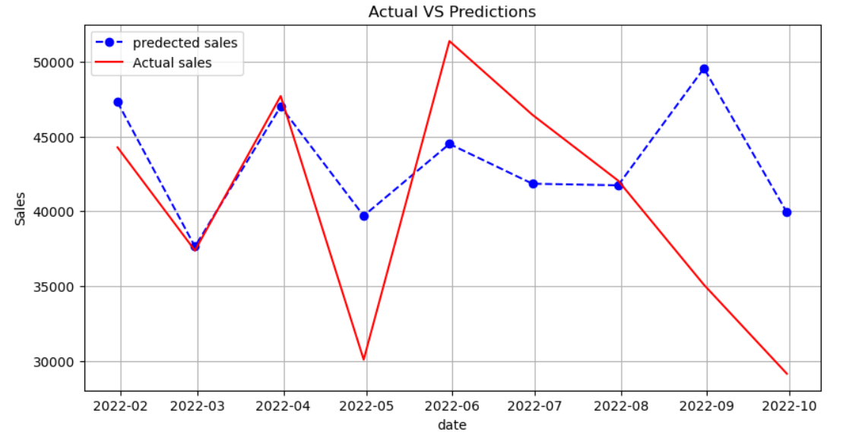
The Actual vs prediction plot for the ARIMA(3,0,2) model

Slide 39
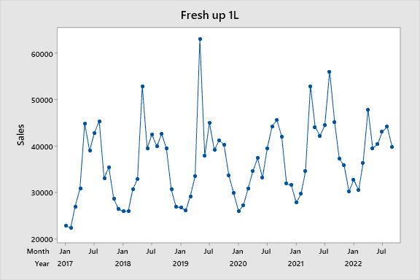
Fresh up Family
Product: Fresh up 1L
This figure shows the time series plot of Fresh up 1L

Slide 40
MAPE Values for each model.
Fresh up 1L
Models | MA 3 | MA 5 | MA 7 | SE | HW | ARIMA (1,0,0) | PROPHET | N-PROPHET | AUTO-REGRISSION | SARIMA
MAPE | 9.78 | 10.02 | 11.82 | 13.09 | 9.24 | 9.17 | 12.53 | 11.7 | - | 3.72

Slide 41
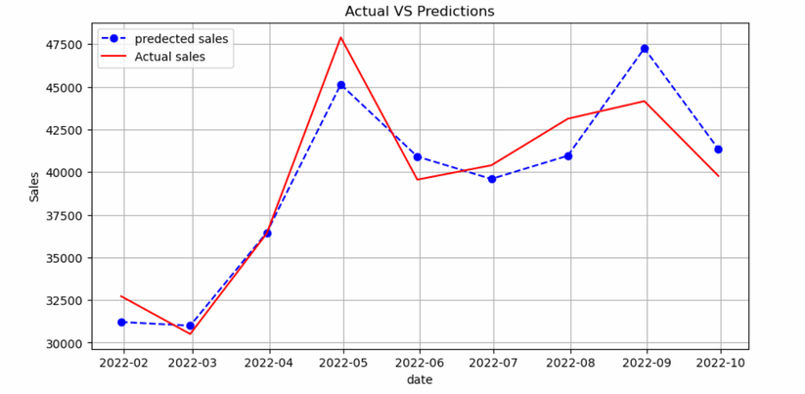
The Actual vs prediction plot for SARIMA(1,0,2) x (1,0, [],12) model

Slide 42
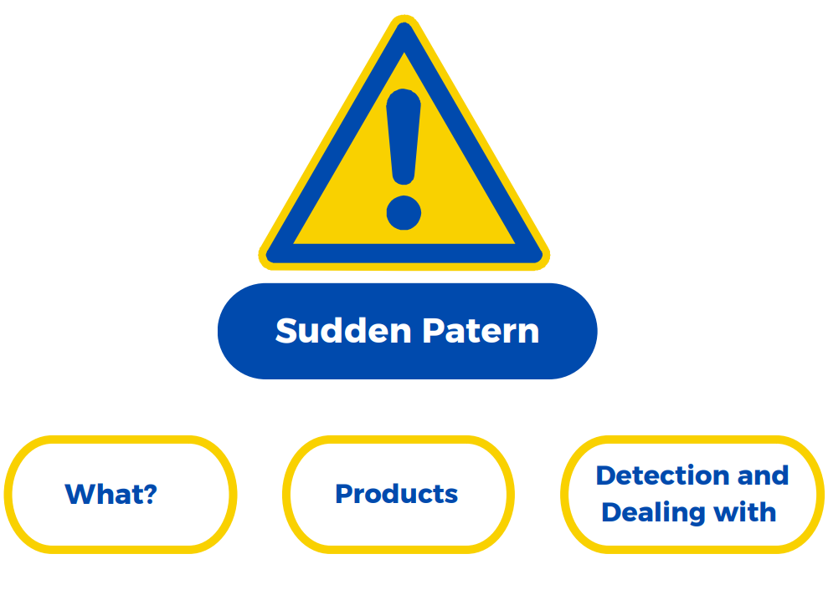

Slide 43

The problem is that for the testing period (last nine months) the behavior of the sales pattern wasn’t as it was in the training period (first five years)
For example:
so there is no Time Series model can deal with this issue.

Slide 44
Sudden
Products
1. Hay fresh strawberry 250 ml
2. Strawberry yogurt
3. Labaneh Dania shatta 200g
4. Labaneh Dania 200g
5. Labaneh 200 Shatta

Slide 45
Labaneh 200 Shatta
MAPE : 12%

Slide 46
Labaneh 200 Shatta
MAPE : 40%

Slide 47


Milk Prediction Results
Referring to the models that were built from the company’s data and using the milk data for each product, at a rate of 95%, the company needs:
9177 KL
10020.8 KL
10864 KL
Lower limit
Average
Upper limit

Slide 48
Milk quantity for one year forward
Total Milk Quantity
Month | Milk forecast | Lower | Upper
Oct-22 | 847990.31 | 776905.93 | 919074.69
Nov-22 | 843683.61 | 772556.39 | 914810.83
Dec-22 | 832547.02 | 762385.00 | 902709.04
Jan-23 | 835427.47 | 764718.68 | 906136.26
Feb-23 | 825079.10 | 755569.37 | 894588.82
Mar-23 | 841506.74 | 770469.92 | 912543.57
Apr-23 | 831955.21 | 762232.06 | 901678.36
May-23 | 838381.97 | 768342.53 | 908421.41
Jun-23 | 843781.46 | 772641.50 | 914921.43
Jul-23 | 850325.57 | 778977.17 | 921673.98
Aug-23 | 778467.75 | 712250.28 | 844685.22
Sep-23 | 851730.53 | 780655.71 | 922805.35
Total | 10020876.73 | 9177704.53 | 10864048.93

Slide 49
Conclusion &
Recommendations

Slide 50












Slide 51







Slide 52


