Slide 1
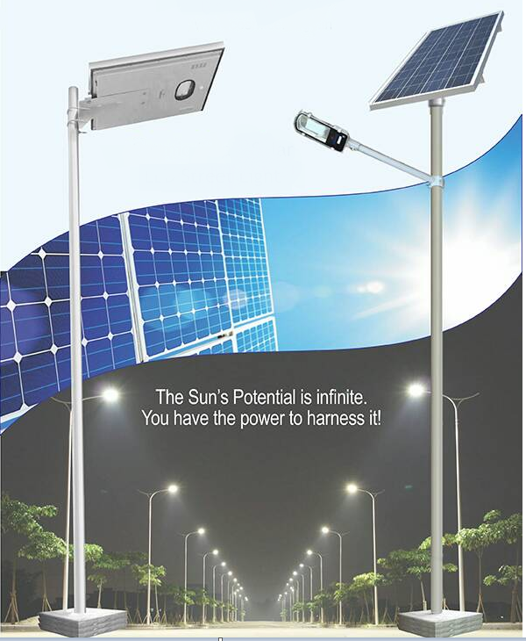
Smart street light

Slide 2
Abstract
Nowadays, street lighting is an essential part of a city’s infrastructure , and with the increase of urbanization, the number of streets increased rapidly with high traffic density. This lead to increase in number of street lights and investment associated with them. Furthermore, Power consumption is increased for street illumination purposes which engendered big energy cost for the municipal so We propose to build a smart street lights to reduce the consumption of energy, controlling the light intensity and also preventing safety issues associated with blackouts.
The proposed street lighting system consists of four individual systems. Those systems are : PV system , sun-tracking solar panel system, traffic density based light intensity control system and GSM system these systems are combined together to ensure higher energy efficiency .
The purpose of PV system is to convert sun light to electricity ,the sun-tracking system is to keep the solar-panel aligned to the sun perpendicularly all over the day to ensure maximum solar-energy storage ,we have light intensity controller to minimize the consumption And we have GSM system to reduce the danger of thief and maintenance thing .

Slide 3
Problem of statement.
The idea of designing a new system for the streetlight that do not consume huge amount of electricity and illuminate large areas with the highest intensity of light is concerning each engineer working in this field. Inefficient lighting wastes significant financial resources every year, and poor lighting creates unsafe conditions. Energy efficient technologies and design mechanism can reduce cost of the street lighting drastically.

Slide 4
System description
The system consists of four modules, solar tracking system, traffic density( based light intensity control system), fault detection(GSM system) . Solar tracking system is used to convert solar power into electrical power with high efficiency . Intensity controller is used to control the led intensity upon the motion of traffic . Any fault related to led is occurred , at that time GSM is sent the message to the control room.

Slide 5
Importance of the system
Our project, the Solar LED Street Lamp reduces electrical grid energy consumption and serves as an example to advocate for renewable energy. The Street Lamp addresses the concern for clean energy while improving the efficiency of existing systems. Our device uses LED lighting because of their low wattage ratings compared to previous lighting sources.
Overall our system is important because of it efficient consumption of power on both sides partially ( if our system depend on utility and panels) and completely ( if our system it depend only in panels for low recommendation of power) and quick maintenance for faults.

Slide 6
Aims
This project is about how to control the power consumptions at the streets and eliminating main power. It includes controlling a circuit of street lights with specific Sensors, LDR and Microcontrollers during day and night time. One can observed that there is no need of high intensity of light in peak hours, when no traffic and even in early morning by reducing the intensity in this time. Energy can be saving up to some extent. Solar energy is collected with the aid of solar cell and battery is charged during day time and this energy is used for power street lights during night time. In addition,we used a solar tracker system that attain maximum energy from the sun. This project explains the system that automatically control the intensity of street light which is design using microcontroller and LED.

Slide 7
The main objective
1 - is to provide a better solution to minimize the electrical wastage in operating street lights, in this electronic era human restless. Manual control is prone to errors and leads to energy wastages.
2- is to design and construct a solar tracker system that follows the sun direction for producing maximum out for solar powered applications. To get the maximum sunlight in a limited distance .
3 – to locate where the fault in which led exactly and get a quick maintenance help to avoid street light problems.

Slide 8
ENGINEERING STANDARDS.
here are several international standards associated with piezoelectric material:
the IEC 61724-1 Photovoltaic system performance monitoring.
Guidelines for measurement ,data exchange, and analysis.
Aims
keep measurement errors within specified limits, it does so by establishing “accuracy classes” for monitoring systems

Slide 9
DESIGN CONSTRAINTS
technical constraints
    The difficulty of choosing the best angle of the solar cells.
    Trackers are more complex system than fixed tracking.
    Low connection of network affect on GSM system because of climate change .

Slide 10
Economic constraints is the cost,
Solar trackers are slightly more expensive than their stationary counterparts, due to the more complex technology and moving parts necessary for their operation. This is usually around a $0.08 – $0.10/W increase depending on the size and location of the project.
Also require an additional focus on company stability and bankability. When it comes to getting projects financed, these systems are more complex and thus are seen as a higher risk from a financier’s viewpoint.

Slide 11
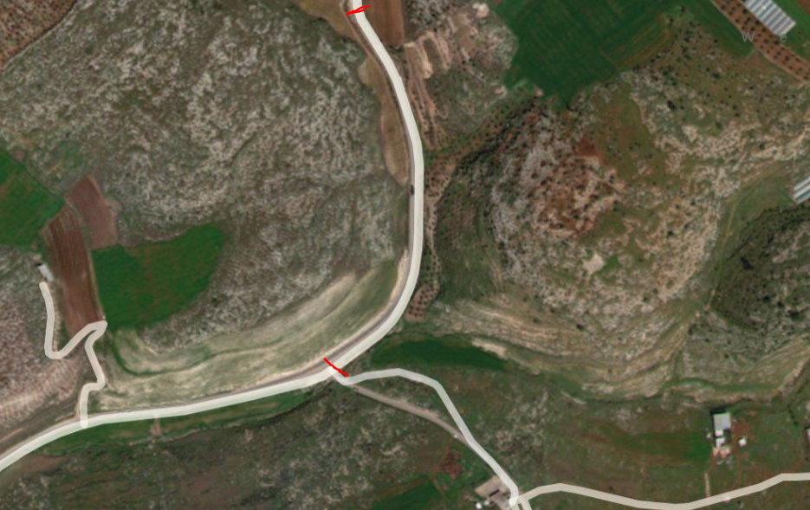
Case study
For our case we take street between Tubas and Tammun with 320m length and 12m width
street location (32,18.8.96)

Slide 12
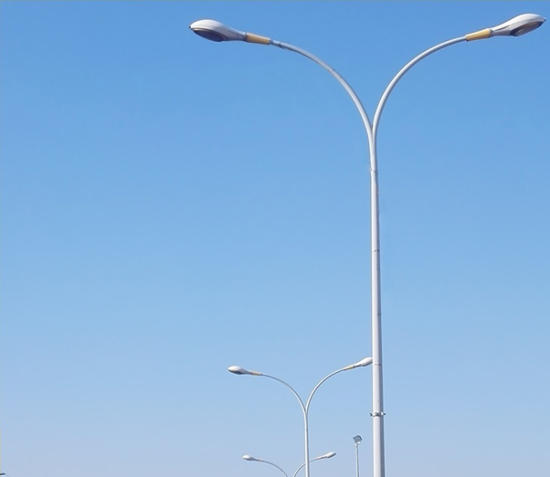
current situation (led street light )
We take data from the co. to calculate the monthly watt consumption for 160 led street light (120w for each ) in 2019
Month | Consumption KWH/monthly | Energy Cost $/KWh For 0.158$/KWh
JAN | 3251 | 515.5$
FEB | 2700 | 426.6$
MAR | 3554 | 561.53$
APR | 2587 | 408.746$
may | 3100 | 489.8$
JUN | 2679 | 423.28$
JUL | 2685 | 424.23$
AUG | 3054 | 482.53$
SEP | 2491 | 393.57$
OCT | 2640 | 417,12$
NOV | 3109 | 491.22$
DEC | 2750 | 434.5$
 | Total annual cost | 5522.62 $
LED cost for 1 led(120w) | 400$
Installation (wiring,pols,structure..etc) | 12000$

Slide 13

recommend state (solar led street light
The system consists of:
Solar cell
For solar cell to power 60w led
For LED lamp is operated for 10 hrs from dusk to dawn.
So the led consumption per day =60w*10hrs=600w/day.
PV_ avg panel size=600w/5=120w.
PV_size = 140 w.
(2) LED lamps (60 w)
(3) motor (servo motor)
(4) pole height is 9 as shown in figure below.

Slide 14
recommend state (solar led street light ):
(5) Control box (charge controller, battery ,Arduino ).
For charge controller we need 12 v/10A
For battery
PV_avg =120 w.
PV_avg=V*I
I battery(A) = 120 w/12 v.
I battery = 10 A
I battery (Ah)=100Ah.
(6) GSM
(7)intensity controlling
:

Slide 15
full system cost :
For 160 unit it cost 180$ for each unit .
So for 160 unit it will cost
Full cost =160 unit*180$= 28800$.

Slide 16
payback period :
Lighting system | Annual saving (electricity cost) | Excess investment | Payback period
Off grid solar led | 5522.62 $ | 28800$. | 5.2 year

Slide 17
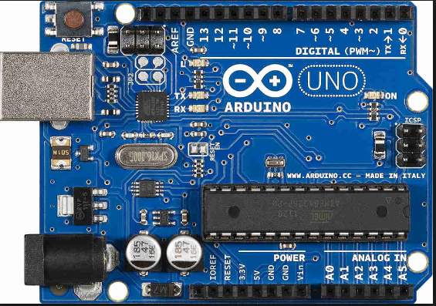
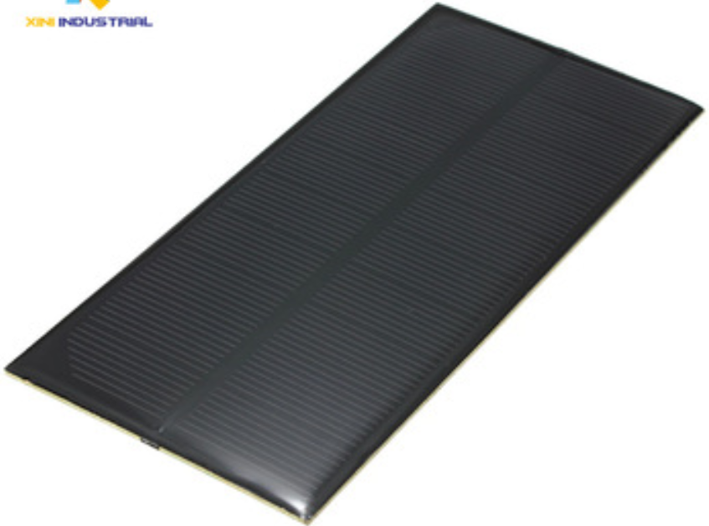
Hardware design:
The microcontroller:
the PV panel (5v)

Slide 18
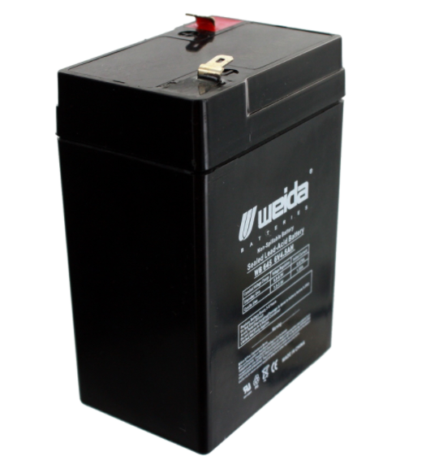
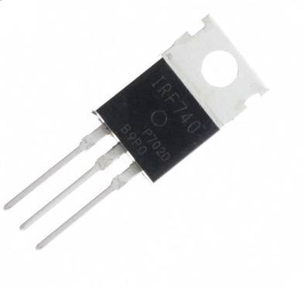
Battary (6v)
The intensity controller
switch (TIP 41C transmitter ) :
An potentiometer 10k Ω
A resistor of 100 Ω
The switch (TIP 41C transmitter ) :

Slide 19
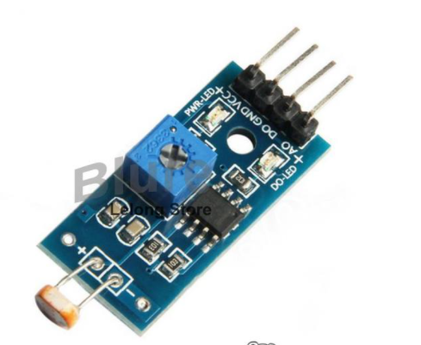
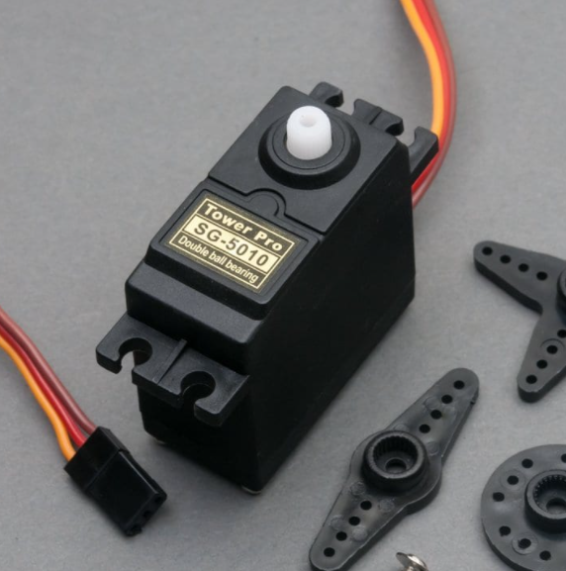
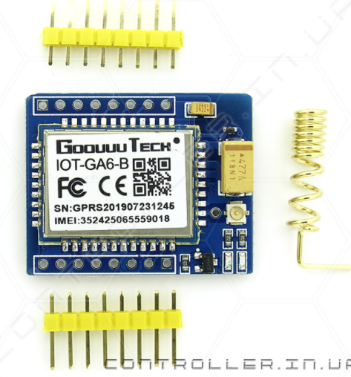
The Tracking cct
2*LDR.
Servo motor. (s3003)
The wire
The GSM cct
LDR
GSM KIT(IOT_GA6_B )

Slide 20
Full Prototype

Slide 21
Recommendations
There are several ways to improve our project, for instance:
Self-cleaning.
Tracking in two axis.

Slide 22
Conclusion

