Slide 1
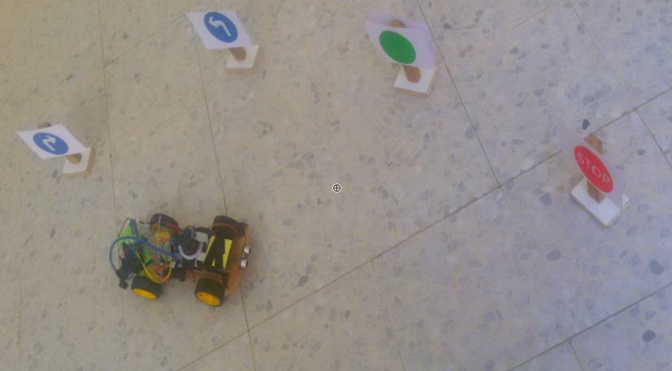
Semi-Autonomous Car
Prepared by:
Sahar Qawariq & Deema Hamdan
Supervisor: Loai Malhis

Slide 2
Outline:
The main goal of our project.
Modules of our project.
Components.
How our project works.
Project constraints.
Future work.

Slide 3
The main goal of our project:
Our project is applied to save time and effort of workers within factories, instead of delivery goods by workers, delivery it by is Semiautonomous car.

Slide 4
Modules of our project:
Arduino module :
Responsible for car movement and avoid obstacles .
Raspberry pi:
Responsible for processing the area in front of car and send suitable signal to Arduino to do suitable movement.
* this separation provides us higher reliability & accuracy.

Slide 5
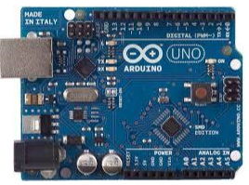
Arduino Module(Components):
Arduino Uno:

Slide 6
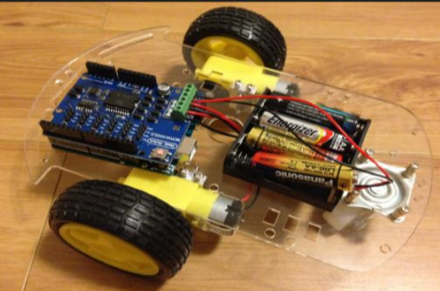
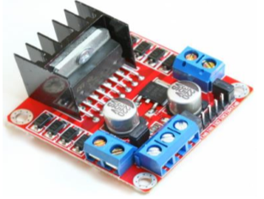
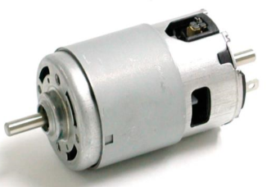
Arduino Module(Components):
Car structure :
Car Body DC motor H-bridge

Slide 7
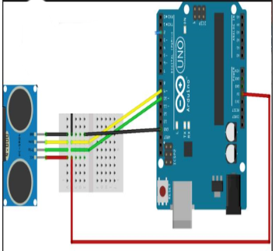
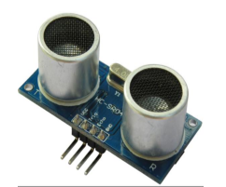
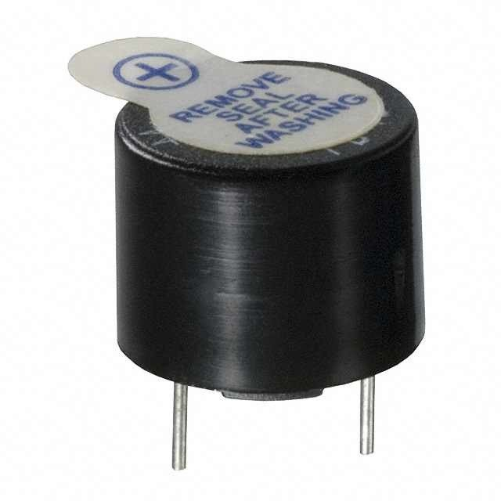
Components(con’t):
Ultrasonic:
Buzzer

Slide 8
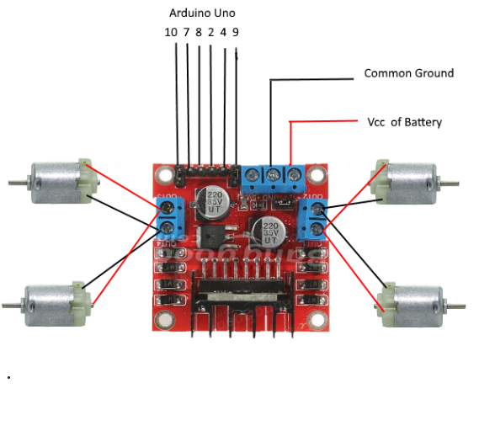
Arduino module structure:

Slide 9
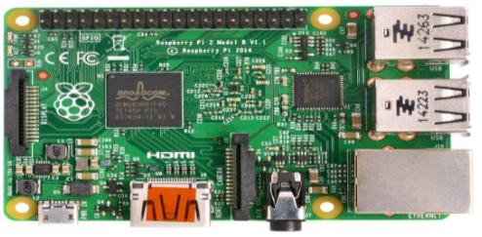
Raspberry Components :
Raspberry pi 2:

Slide 10
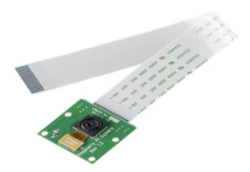
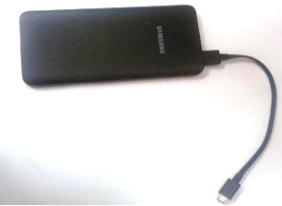
Components(con’t):
Raspberry pi camera:
Power bank:

Slide 11
Description of Image processing:
Camera takes a picture then search for a circle on it by using function
HoughCircles() in python.
apply blur filter on the taken image
If circle is not found ,raspberry will send command to Arduino to walk forward .
If circle is found , and has the specified radius:
  specify the ranges of (red ,green and blue)colors in BGR , and find these colors ,then return the coordinates of centroid .
  Detect the circle color by testing centroid coordinates ,if it is inside the circle or not.

Slide 12
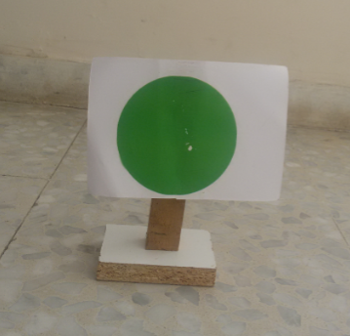
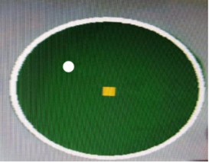
Description of Image processing(con’t):
  If there is a green circle raspberry will send command to Arduino to walk forward.

Slide 13
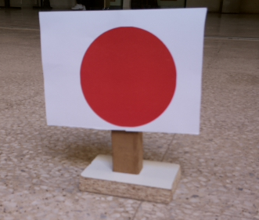
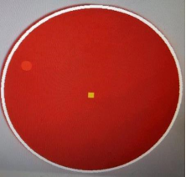
Description of Image processing(con’t):
  Red circle has two possibility either stop on red traffic sign or on the final destination .
    For red traffic sign it will stop for short time ,according to the number of white pixels in first and second quarter , in this case it will be around zero :

Slide 14
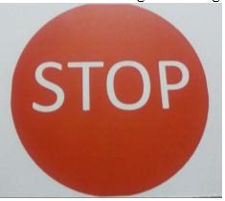
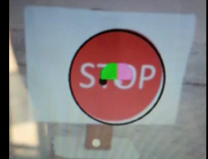
Description of Image processing(con’t):
    For final destination , the number of white pixels in first and second quarters is high , so it will send signal to Arduino to stop and buzzer will turn on.

Slide 15
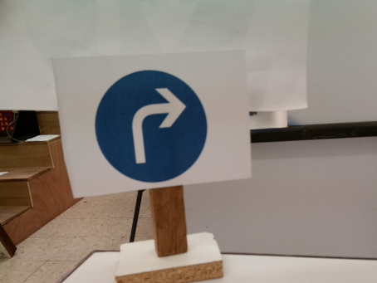
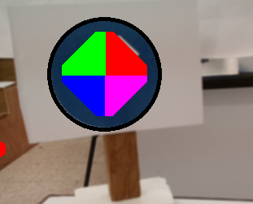
Description of Image processing(con’t):
  If there is a blue circle , there is four blue possibilities (left sign, right sign , U-turn left sign , U-turn right sign ) ,In order to distinguish between them we will divide the circle to four quarters then compute the white pixels in each quarter

Slide 16

Description of Image processing(con’t):
  Compute the difference between the number of white pixels in the first and the second quarters :

Slide 17

Description of Image processing(con’t):
    If the difference of white pixels in first and second quarters is small ,That means the sign either (U-turn left or U-turn right) to determine which sign we will check third and fourth quarters if numbers of white pixels in forth quarter is grater than third it will be U-turn right else U-turn left.

Slide 18

Description of Image processing(con’t):
    If the difference of white pixels in first and second quarters is high,That means the sign either (left or right) to determine which sign we will check third and fourth quarters if numbers of white pixels in forth quarter is grater than third it will be right sign else left sign

Slide 19
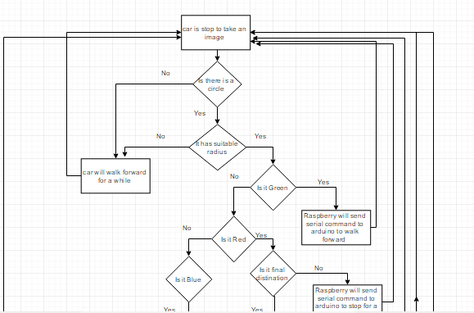
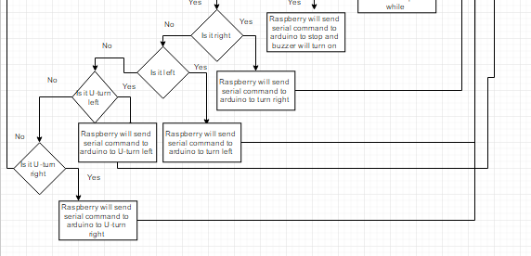

Slide 20

Project constraints:
Camera Constraint
Car movement:

Slide 21
Future work:
Add more signs and predefined destination.
Find alternative solution if road is close.
Send notification or message if there is an Emergency.
Send notification to make sure that the goods are delivered successfully.

