Slide 1

Structural Design of commercial center in the city of Tulkarm
By
Basel Ahmad Sabbah (11642595)
Hassan Osama Hamdallah(11611860)
Yusuf Khalid Matani (11643253)
Under supervision of: Dr. Riyad Abdel-Karim Awad

Slide 2
GENERAL INFORMATION
2. PRELIMINARY DESIGN
THREE-DIMENSIONAL ANALYSIS
4. DESIGN

Slide 3
The main objective of the project is:
1- Construction design work for a commercial building that does not currently exist.
2- It is economical and low cost.
3- The general specifications and standards of the building were taken into consideration.

Slide 4
project description
The building consists of 10 floors.
2. 3 floors settlement surrounded by a basement wall.
3. 7 ground floors.
The building is built on a horizontal area of 3200 square meters.
4. The Bearing capacity =200kn/m², the site class D.
The following table shows the nature of each floor.

Slide 5
Floor Name | Height ( m) | Area (m2) | Type
B3 | 3 | 3200 | garages
B2 | 3 | 3200 | garages
B1 | 3 | 3200 | garages
G | 3 | 3200 | Commercial centers
F1 | 3 | 3200 | Commercial centers
F2 | 3 | 3200 | garages
F3 | 3 | 3200 | garages
F4 | 3 | 3200 | garages
F5 | 3 | 3200 | offices
F6 | 3 | 3000 | offices

Slide 6
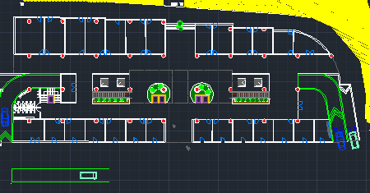
2D-plan for ground floor.

Slide 7
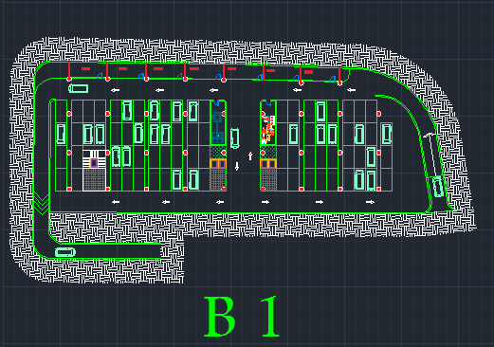
2D-plan for floorB1.

Slide 8
MaterialS
Concrete
compressive strength (f’c):24MPa
Modules of elasticity (Ec):23025.2MPa
Unit weight (γ):25
Steel
Yield strength (fy): 420MPa
Ultimate strength (fu):600MPa
Modulus of elasticity (ES):200000MPa

Slide 9
Loads
Dead load
Dead load for flat slab 7.5KN/m².
Dead load for ribbed slab 6.231 KN/m².
Superimposed dead load
Full Total SD load = 3.07 + .96 = 4.03 KN/m²
For safety we take the SD = 4.5 KN/m²
Live loads
The live load for the floors (5, 6) = 2.4 KN/m² (office)
The live load for the floors (G, 1) = 4.8 KN/m² (Commercial centers)
The live load for floors (B1, B2, B3, 2, 3, 4) = 5 KN/m² (Garages for passengers only).

Slide 10
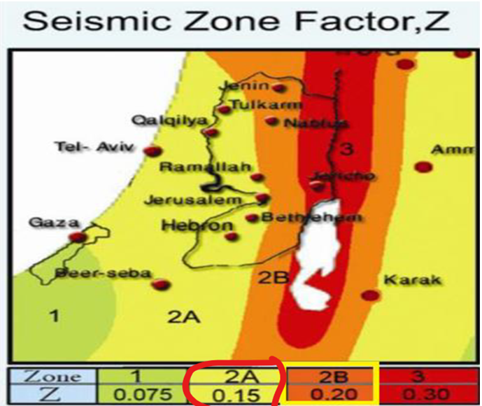
Loads
Lateral load
seismic zone 2A and seismic zone factor is equal to 0.15.
design spectral acceleration parameters S_{Ds} and S_{D1}

Slide 11
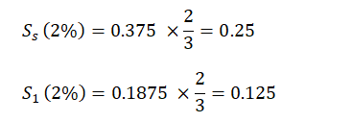
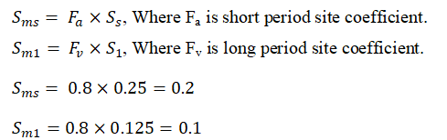
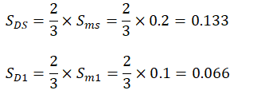
Loads
And risk category III
As the value of S_{Ds} =0.133is less than 0.167 and the value of S_{D1} =0.066 is less than 0.067, then the seismic design category is A.
Importance Factor, Ie → 1.25 , from ASCE 7-16

Slide 12
Loads
Type of lateral force resisting system → is building frame system with special reinforced concrete walls
R→6
Ωo→2.5
Cd →5
Seismic response coefficient ,Cs
Cs→ 0.0277 > Cs min =0.0147

Slide 13
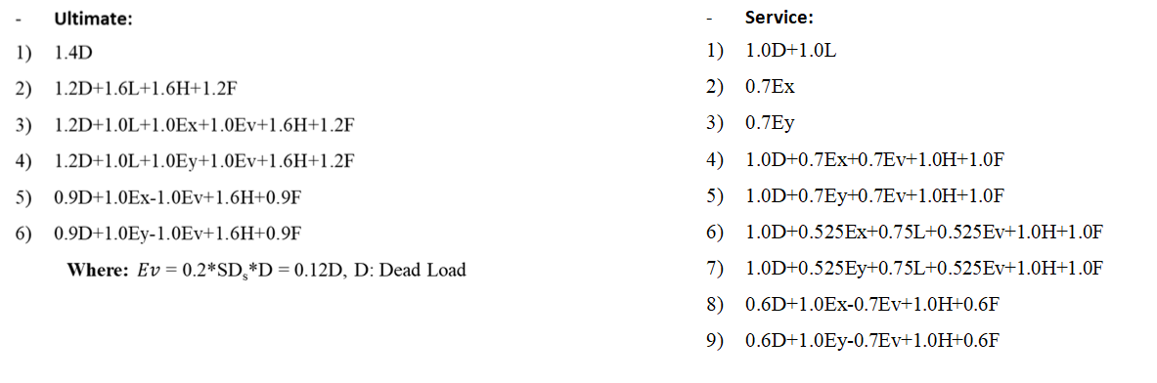
Load combination
Load combination used with according to ASCE7-16

Slide 14
Codes & Programs
-Codes
(IBC 2018)
(ASCE07-16)
(ACI318-14)
-programs
1.(Etabs)16 program
2. Safe v 12
2. AUTOCAD.
3. word.

Slide 15
Preliminary thickness of flat slab
According (ACI 318-14 Table 8.3.1.1) the minimum thickness of slab equal 25cm
So we take thickness slab =30cm,cover6cm
Vu(shear) = 51.85kn
∅ Vc=[ ∅*1/6* γ**bw*d]→[0.75*1/6*1*25*1*0.24]=146.9kn
∅ Vc≈147Kn → ∅ Vc> Vu , So it's ok.
* Punching check : We did a punching check and it was confirmed successful based on the code.

Slide 16



Preliminary thickness of ribbed slab
Assume a(fm) > 2.0, this assumption is because we want to restrict the slab panels by drop beams with high stiffness, so the minimum slab thickness can be determined by the following equation
So, try h=0.2m=200mm
B=2.5h=650mm

Slide 17






Check a(mf)
Less than 2
So, the slab thickness will be
so we take
h_{min}=300mm

Slide 18
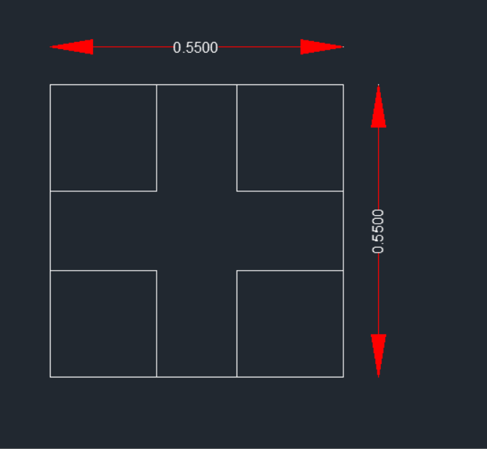
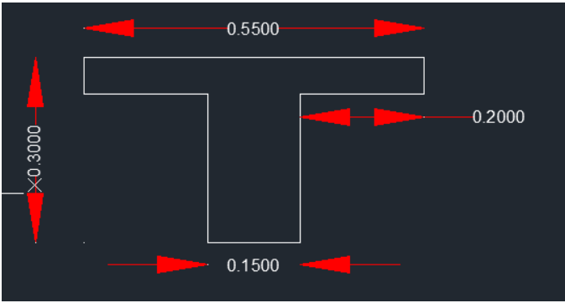
Ribbed slabs

Slide 19
Preliminary dimensions of beams
According (ACI 318-14 Table 8.3.1.1) the minimum thickness of beam equal 35cm .
In addition to the width of beams which can be determined by for the longest span in beam as a minimum value.
H= Ln/21=7.5/21=0.357 → take H= 0.65
B= L/20=8.5/20=0.425 → take B=0.45
The beams preliminary dimensions are: B1 (0.65*0.45)
The dimensions of the beams will be confirmed after entering the seismic loads.

Slide 20
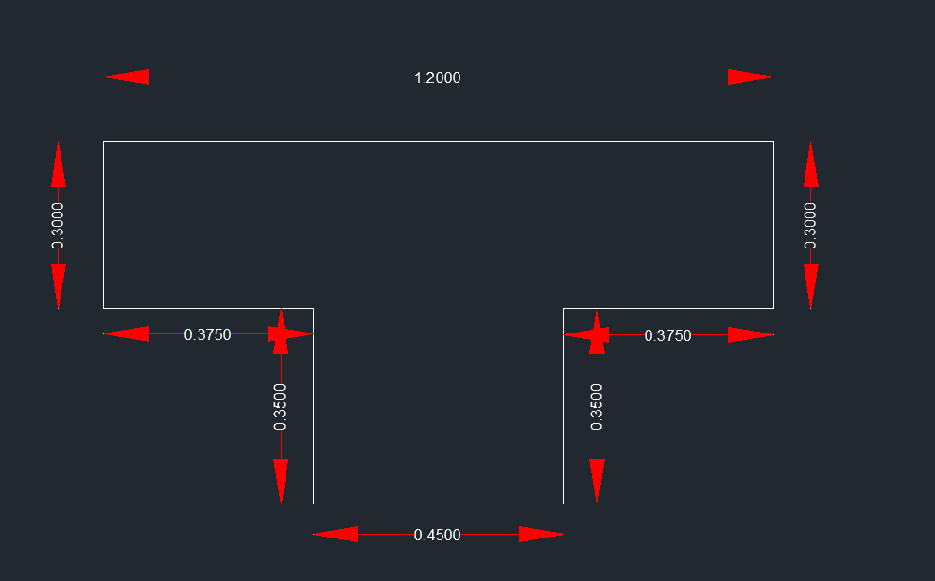
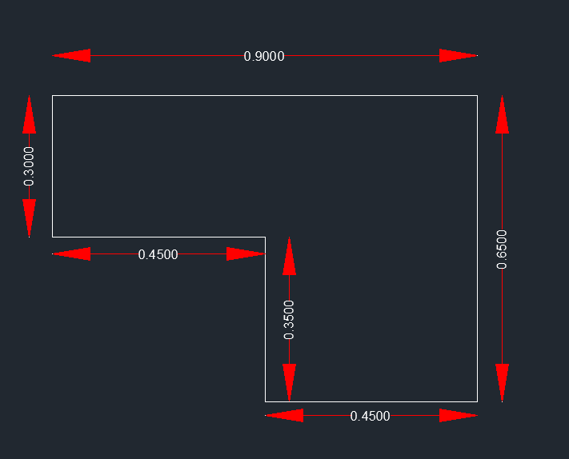

Slide 21


check the dimensions of the beam
I(T-sec)=4.6*10⁶mm⁴.
I(L-sec)=2.6*10¹ºmm⁴.
>
→ so it's ok
Check shear for slab
So
> Vu → its ok
Vu=wu*bf*(ln/2-d)=39.69kn
=

Slide 22
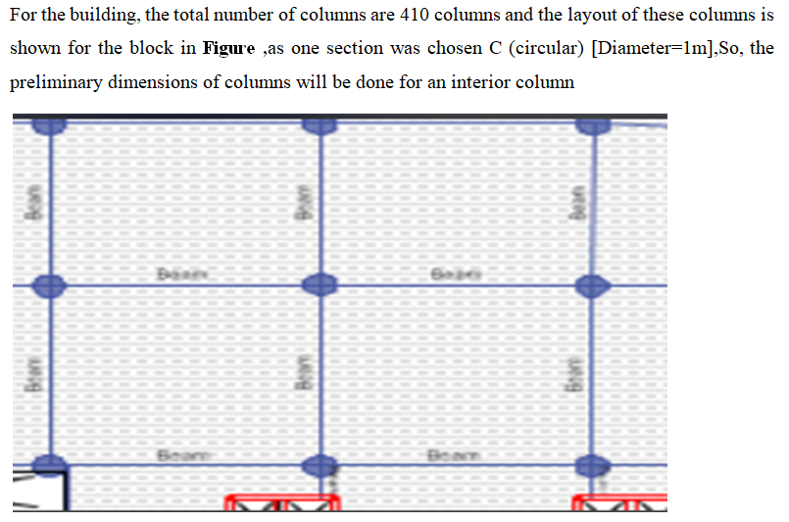
Preliminary dimensions of columns

Slide 23
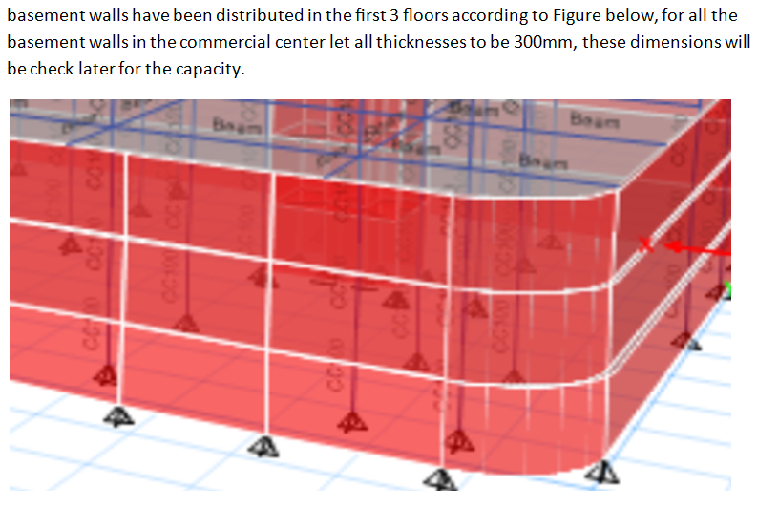
Preliminary dimensions of basement wall

Slide 24
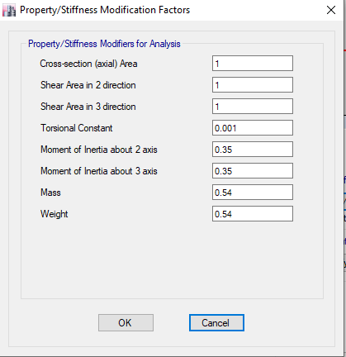
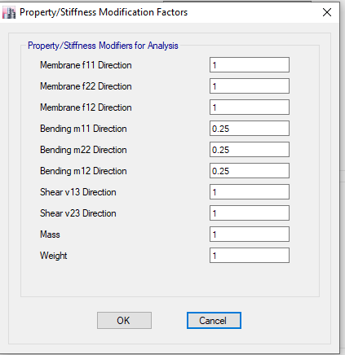
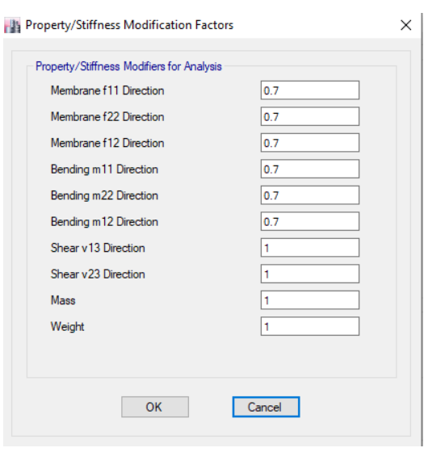
General information to 3D
Section modifiers

Slide 25
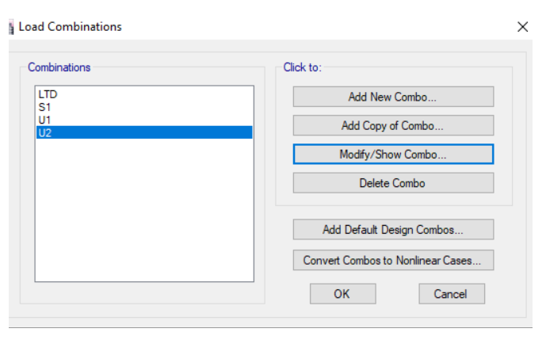
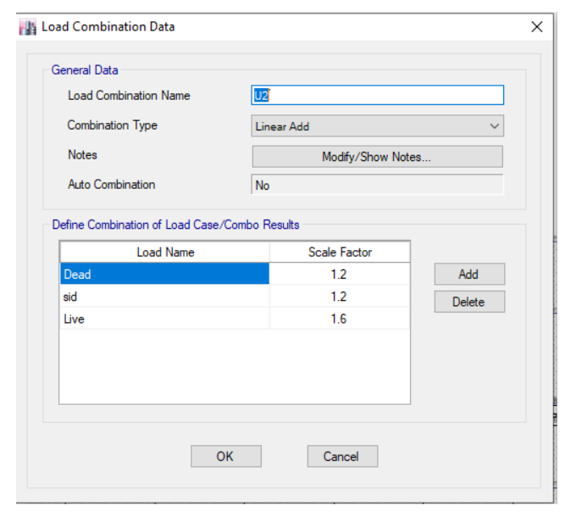
Load combinations

Slide 26
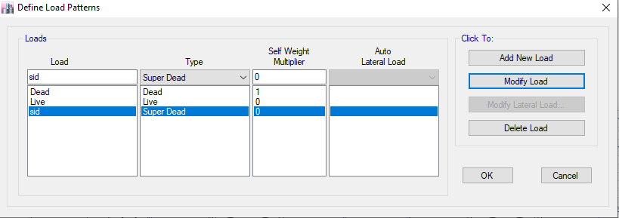
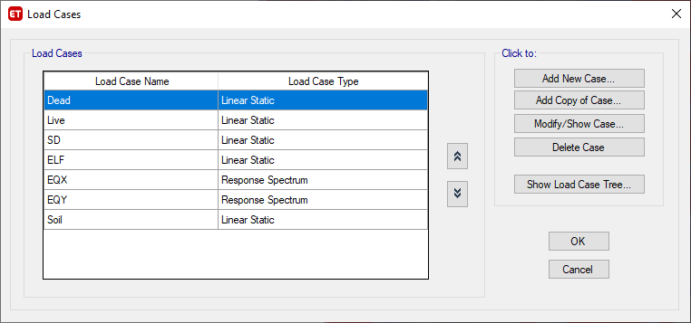
Load patterns
Load cases

Slide 27
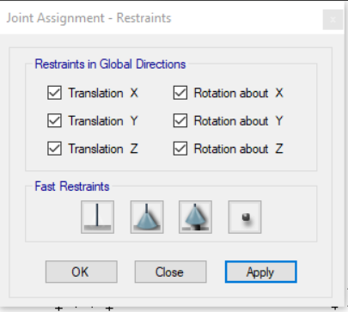
Supports

Slide 28
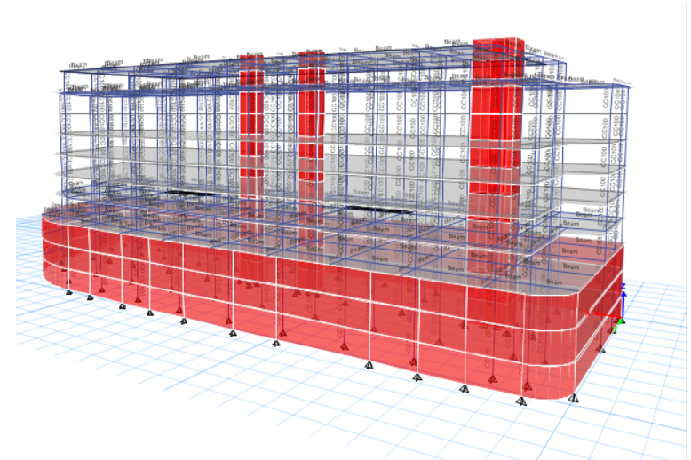
Three-dimensional modeling

Slide 29
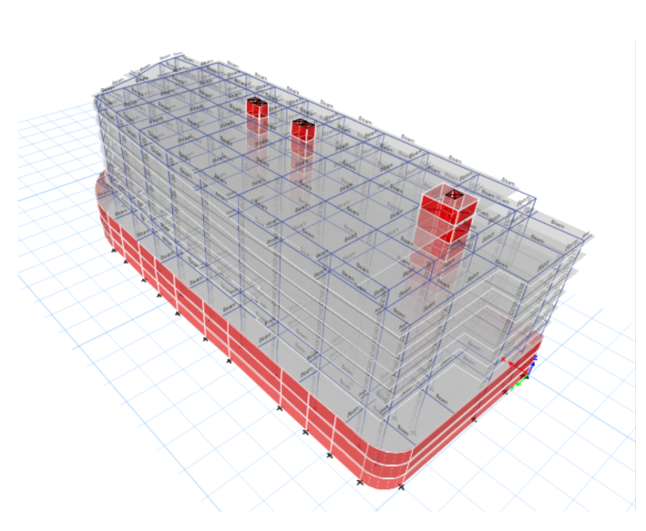

Slide 30
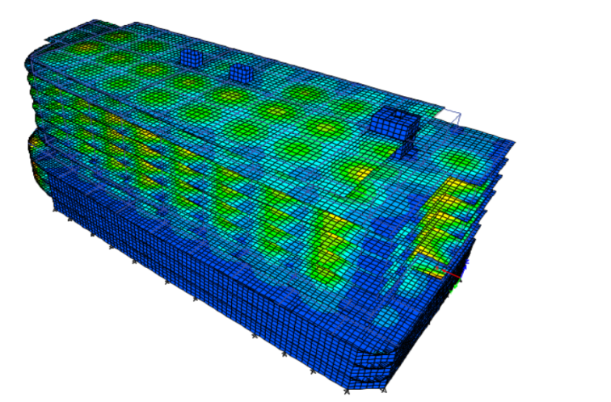
Compatibility of the structure

Slide 31
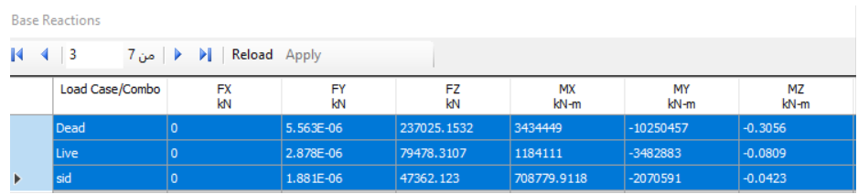
Equilibrium checks
The equilibrium checks for dead load, superimposed dead load and live load should be done, to ensure that the results from ETABS comply with manual calculations and make a comparison between them. The values of base reactions for both blocks from ETABS are shown in Figure 3.13.

Slide 32



superimposed dead load
Live load
Deal Load

Slide 33
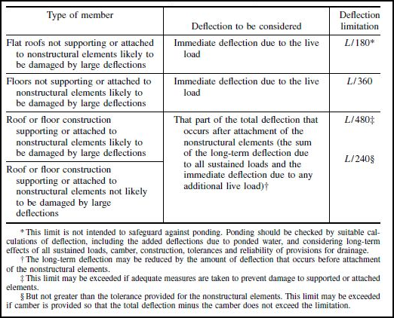
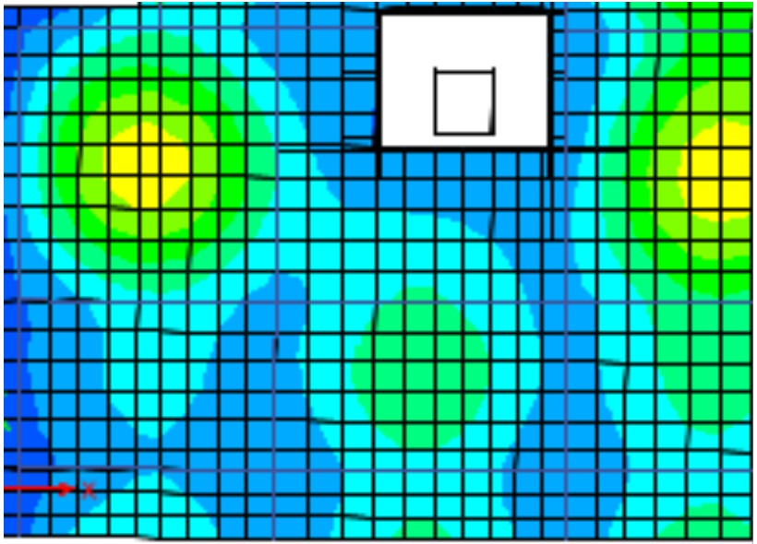
Deflection check
For slab → allowable deflection = L/40=8.5/40=0.0345m=34.5mm
For beam → allowable deflection = L/480=8.5/48=0.0177m=17.7mm
From this figure we find allowable deflection for slab and beam
Deflection check from Etabs:
For slab→ def=[54.5mm/1.4 – avg for column(6.01)]=32.92mm < 35.4 ,so it's ok .
For beam → def= 8.18 mm < 17.7 ,so it's ok

Slide 34




Stress-Strain Check
ME= M middle +
M=
=152.352KN.m²
ME=66.36+
=148.255kn.m^2
Wl =4.8*(4+2.5)=31.2kn.m
Ln=9.2m
shear slab Check
Vu(shear)=
51.85kn
∅ Vc
=146.9kn
∅ Vc> Vu , So it's ok
The check for shear is for one region we take.

Slide 35



check shear for beam
Vu=Wu * Ln/2= 670.35KN
>vc → so we need shear reinforcement
Assume 2 leg
10 → AV= 2*78.5 = 157mm²
S min → ≥150mm.
→ ≥ 16d=160
So we use Smin=150mm
S=

Slide 36
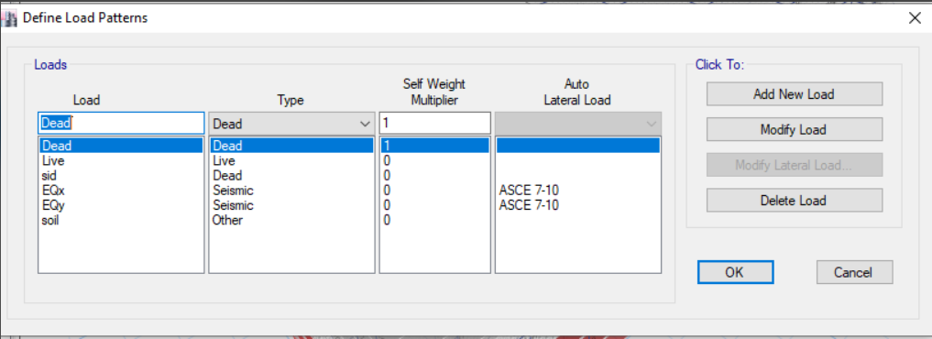
Load patterns with seismic

Slide 37
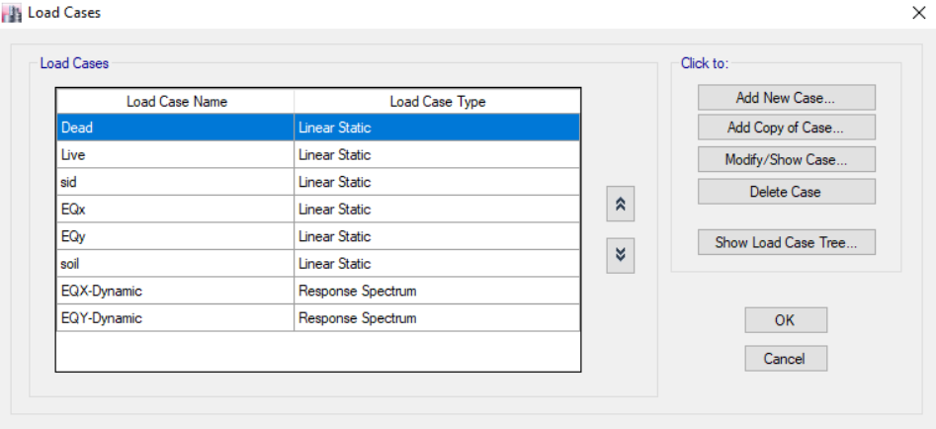
Load cases

Slide 38
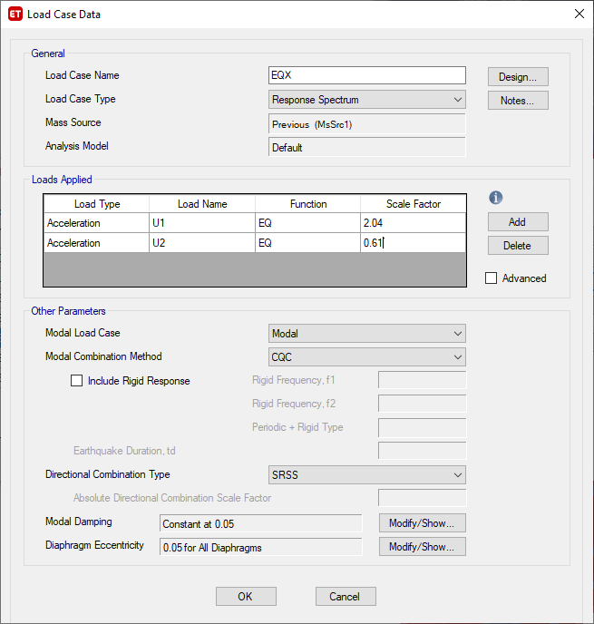
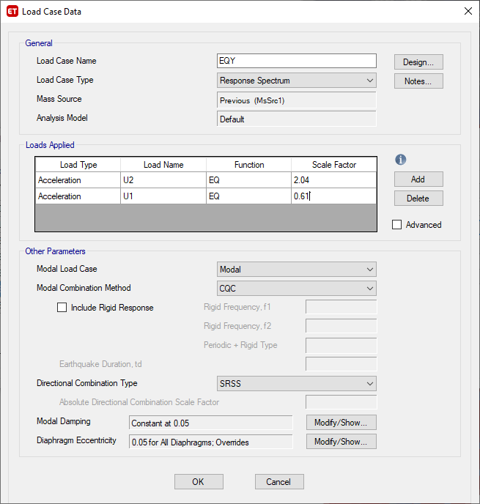
Scale factor for the cases (EQx-EQy)

Slide 39
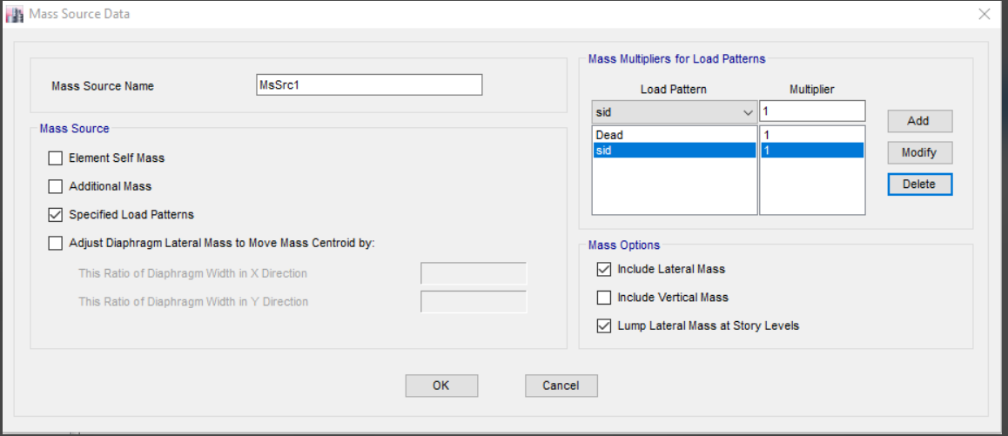
mass source

Slide 40
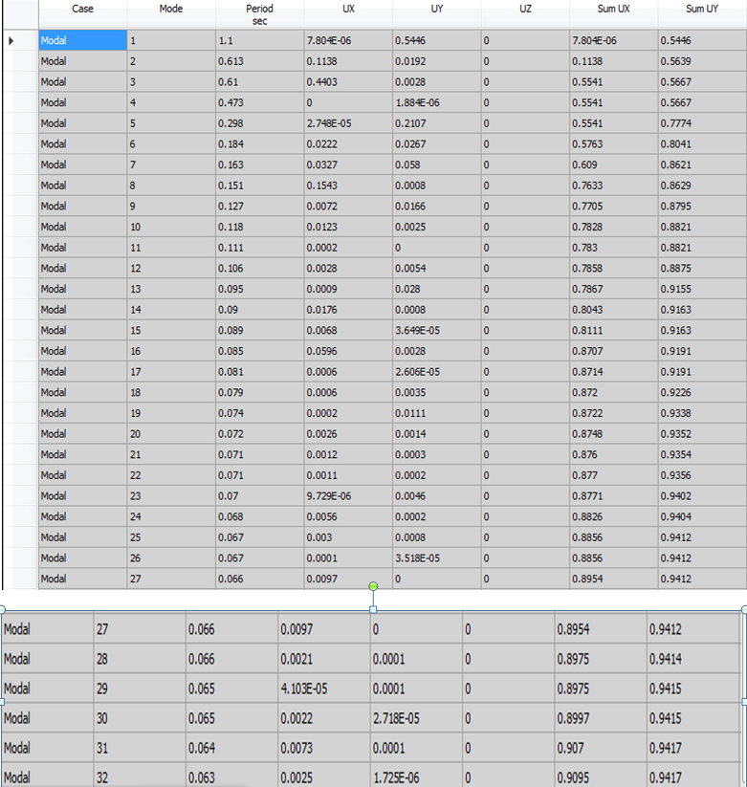
mass participation ratio for modal analysis

Slide 41
Time period , Ta
→ Ta=0.7
So, the upper limit on calculated period is 1.7×0.7=1.2sec
Ta from Etabs= 1.1 < 1.2

Slide 42
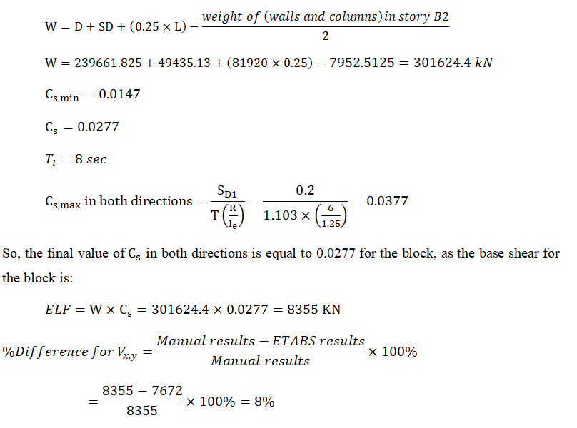
Equilibrium check for base shear

Slide 43
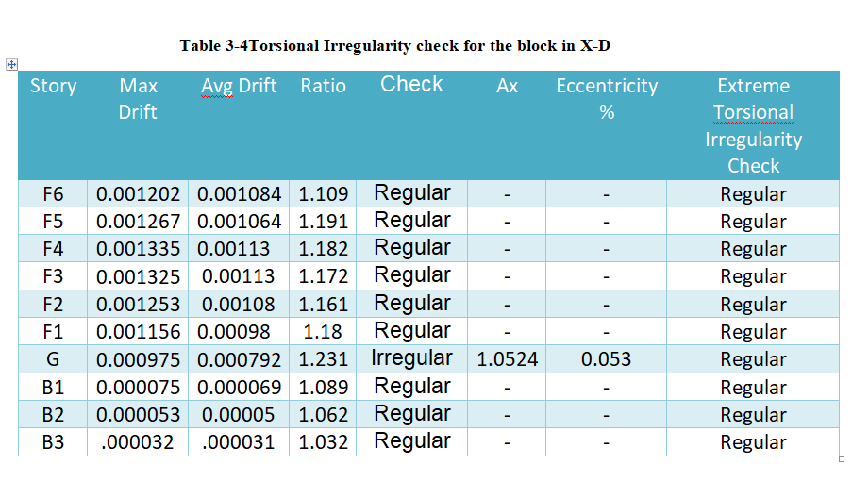
Torsional Irregularity

Slide 44
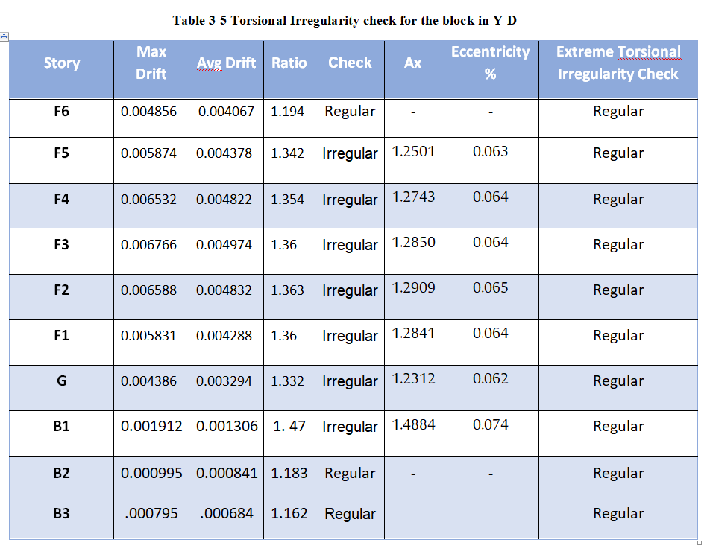

Slide 45
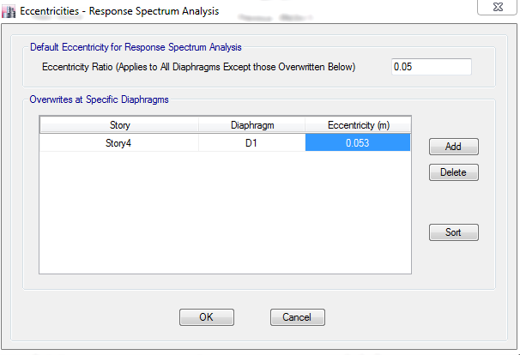
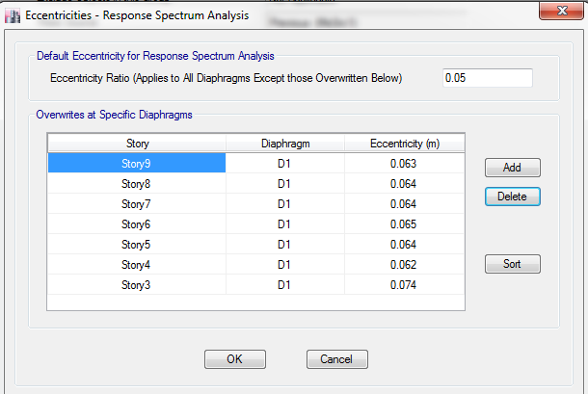

Slide 46
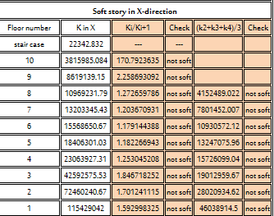
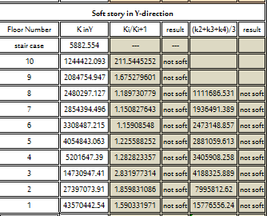
Stiffness-Soft Story Irregularity

Slide 47
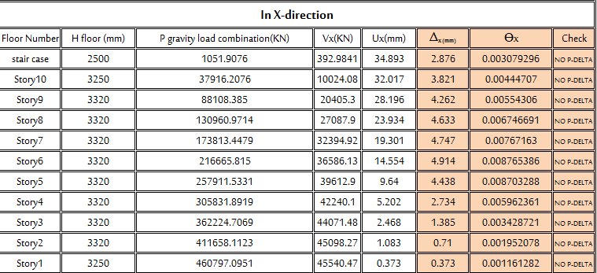
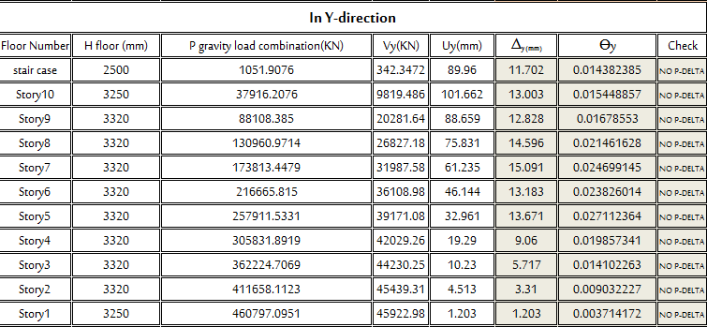
Effect of p-delta

Slide 48
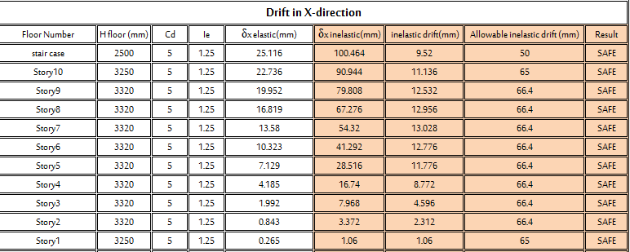
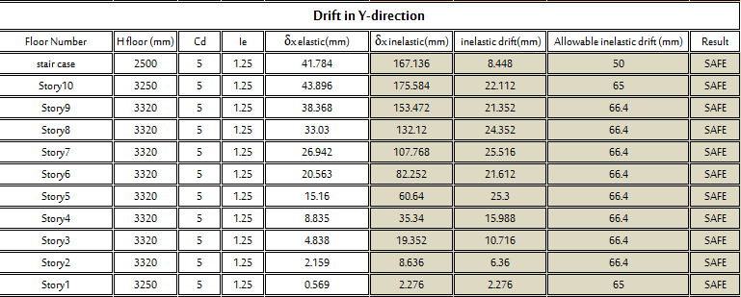
Story drift

Slide 49
DESIGN
Slab
After entering the seismic load slab thickness is 30cm (not change)
Beams
After entering the seismic load beams dimensions will be (50*70) [ B=50 cm, H=70cm ]
Basement wall
After entering the seismic load the basement wall thickness well be 35cm

Slide 50

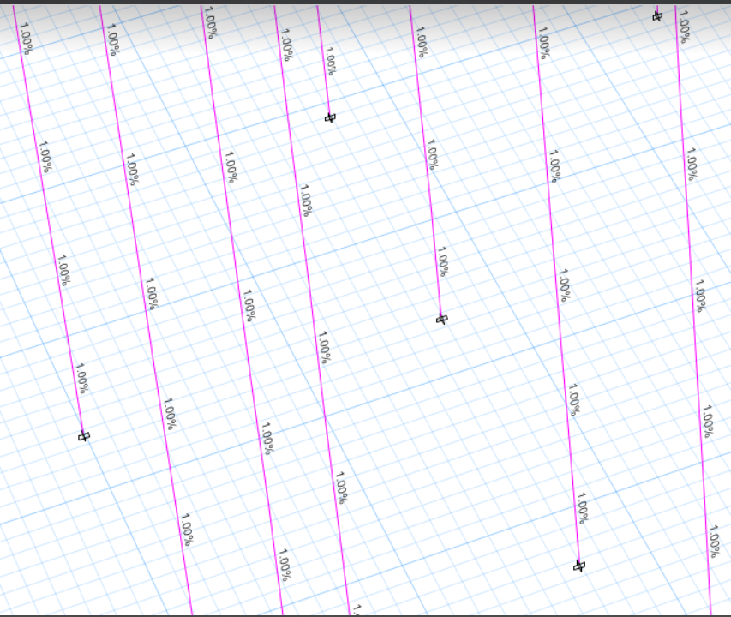
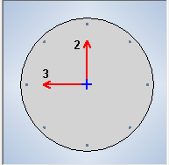
Column
The column cross-section is d=1.30 m ( CC130)
Upon receiving the project, the design of the column was given the meaning of a diameter equal to 1 meter, but after inserting the albumin loads, it became clear to us that this design was not sufficient, so the diameter was increased to 1.3 meters.
Reinforcement ratio =1% , so its ok

Slide 51

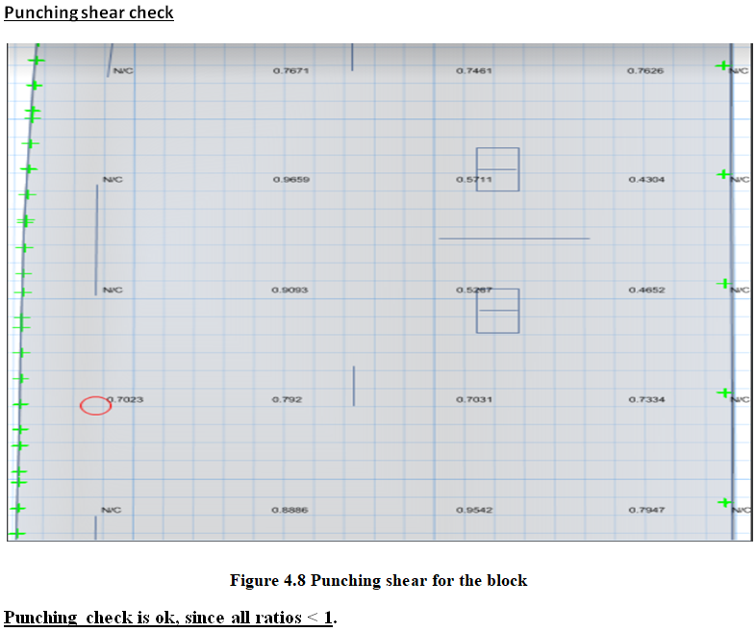
Mat foundation

Slide 52
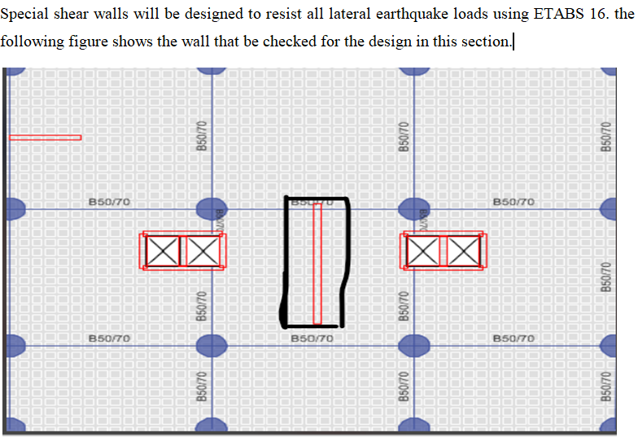
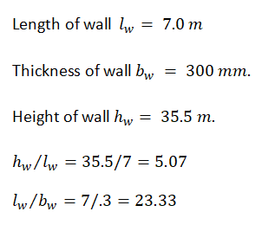
Shear wall

Slide 53
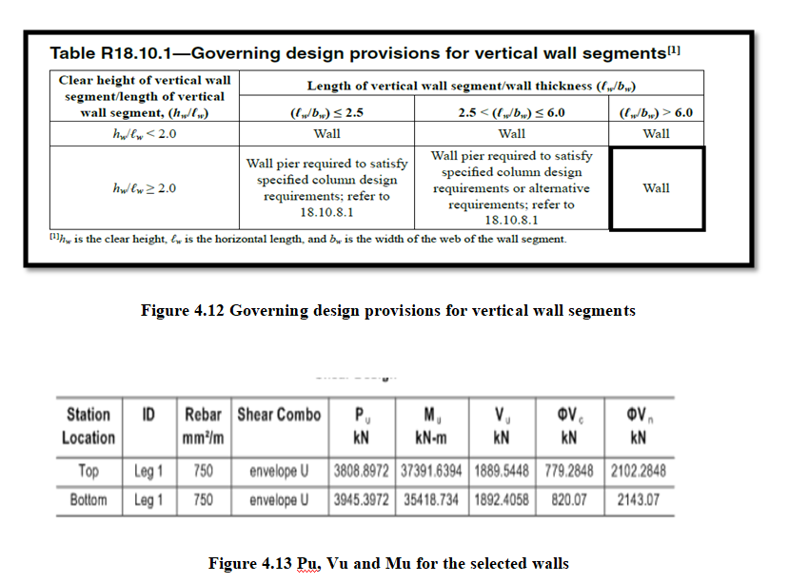

Slide 54

slab reinforcement :

Slide 55




Slide 56

Flat slab reinforcement :

Slide 57



Slide 58


Slide 59


Column reinforcement

Slide 60


Mat foundation reinforcement
From Safe 12 The reinforcement for the mar foundation will be 1 ∅ 18/15cm

Slide 61



Slide 62


Basement wall reinforcement

Slide 63



shear wall reinforcement

Slide 64
THANK YOU

