Slide 1

The Structural Design of Collage of Law and Media in An-Najah National University
Prepared By :
Haya Naeem Barhoush
Walaa Mohamad Hamad
Submitted to :
Eng. Ibrahim Arman

Slide 2
Outline
Introduction → project description, design principles, codes, materials and load combinations.
Preliminary Design → preliminary slab thickness, preliminary dimensions of beams, columns and walls.
Three dimensional analysis and design → verification of structural analysis, deflection computations and the design of structural members.

Slide 3
Project Description
The college of law and media has a location of 35 ̊13 ́11.92˝ E, 32 ̊13 ́39.95˝ N, and about 600m above the mean sea level
Its location is in An-Najah National University in Nablus next to the Korean Institute.
  This faculty consists of eight floors that have a total plan area of 6115m².

Slide 4
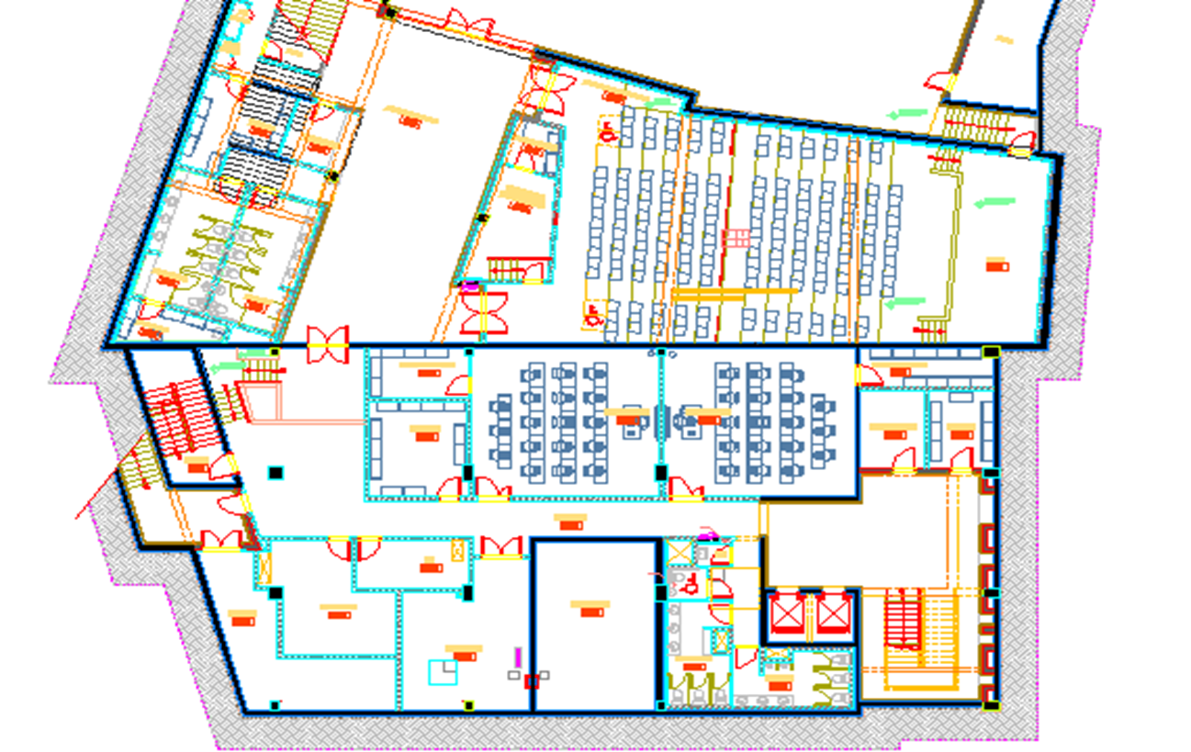
Basement Floor Architectural Plan

Slide 5
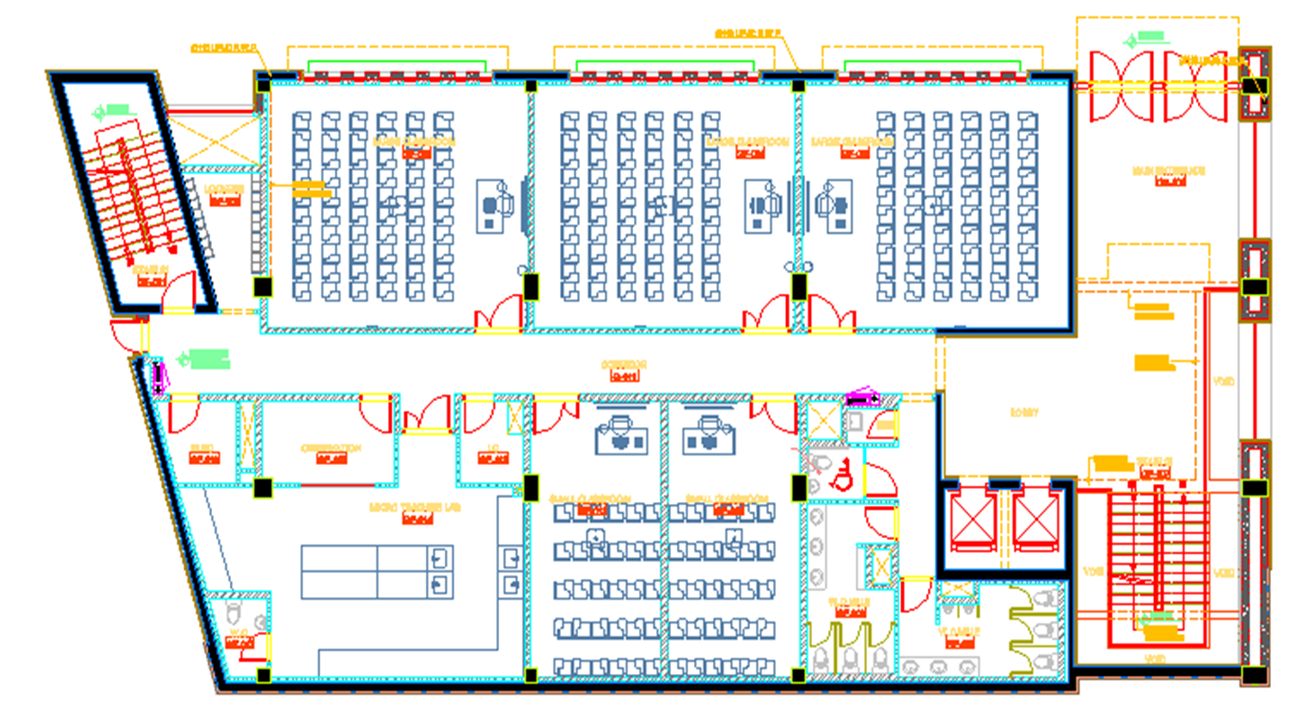
Ground Floor Architectural Plan

Slide 6
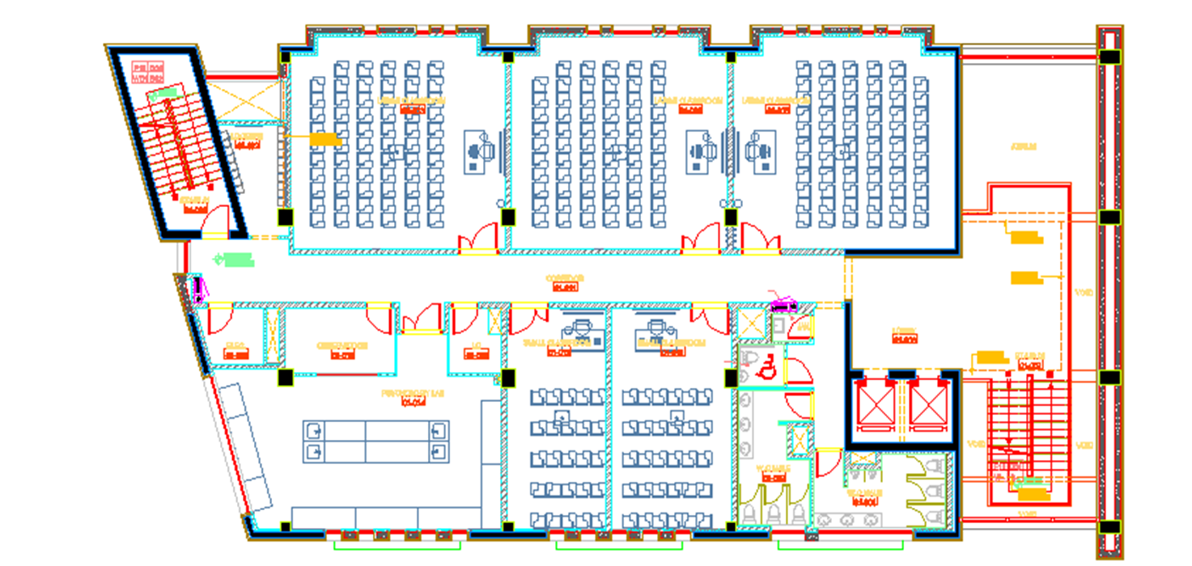
First to fifth floors Architectural Plans

Slide 7
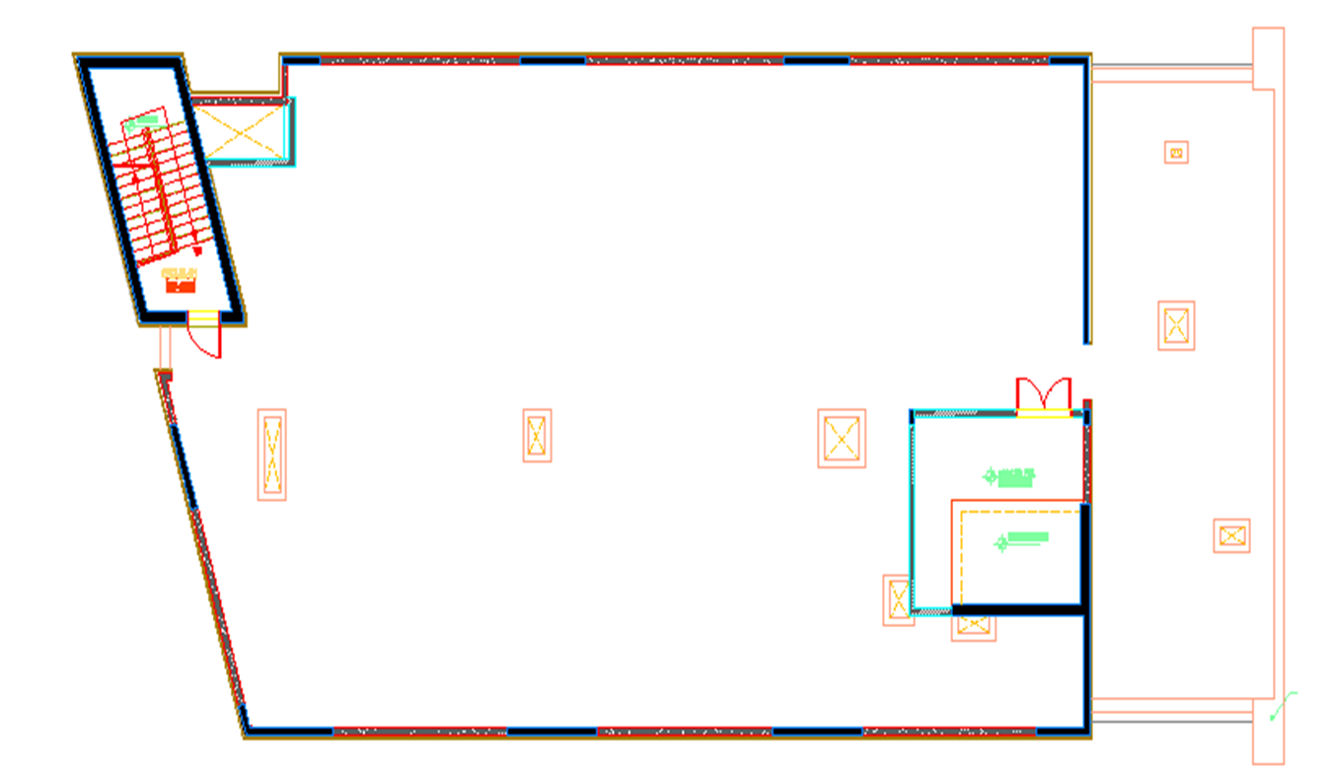
Sixth Floor ( roof) Architectural Plan

Slide 8
Objectives of Graduation Project
To form a better knowledge about the different engineering codes such as UBC-97 regarding :
  Earthquake Loads
  Wind Loads
To make a preliminary design for the structural members in the project
To analyze and design the building using a 3D structural model.

Slide 9
The Codes Used in This Project
The Codes used in this project are the following :
  Uniform Building Code ( UBC-97 )
  American concrete institute ACI 318-11
  American Society for Testing and Materials (ASTM-2013).
  Jordanian Code-2006

Slide 10
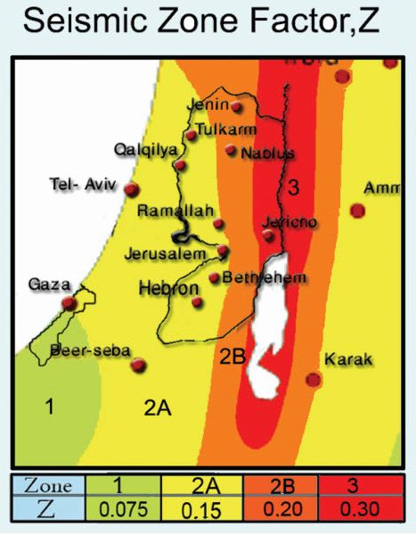
Seismic Zone Requirements (UBC-97)
Seismic Zone Map Prepared By An-Najah National University is used to determine the seismic zone factor (Z) for Nablus
Seismic Zone for
Nablus is 2B
Factor (Z) = 0.2

Slide 11
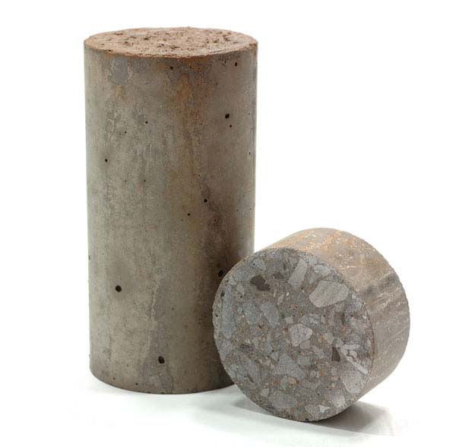
Structural Materials
Concrete:
  Used Compressive Strength (f_{c} ́) for Slabs, Beams and Footings is 28 MPa, but for Columns is 45 MPa
  Modulus of Elasticity = 24000MPa
  The estimated specific weight of reinforced concrete is 25 KN/m³
  and for plain concrete is 23 KN/m³

Slide 12
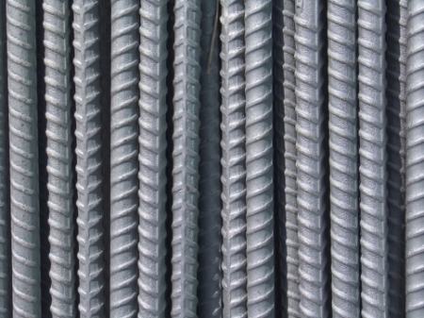
Structural Materials
Reinforcing Steel:
  Yielding Stress for reinforcing Steel is 420 MPa
  Modulus of Elasticity is 200GPa
  Steel type A 615 based on (ACI 318-11, section 3.5.2) is used in this project.

Slide 13
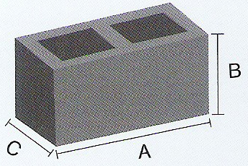
Non-Structural Materials
Concrete Blocks:
  The used blocks were of 100 mm thickness, 200mm height and 400mm length in internal partitions and external walls, having a unit weight of 12kN/m³ .
  Internal partitions are concrete block of (100mm & 200 mm thickness ).

Slide 14

Non-Structural Materials
Masonry Stones:
  The average specific weight for building stones is 26 kN/m³
  The three main shapes of the used stones are:
    Tobzeh Stone
    Mufajjar Stone
    Matabbeh Stone

Slide 15
The Principles of Design
A 3D model was constructed and analyzed using SAP2000 program taking into consideration the effects of dynamic Loads.
Columns and Beams were represented as line elements.
Slabs and shear walls were modeled as area elements.
The connections between the footings and the column necks were represented as pin connections.
Ultimate design method is used for analyzing the structure.

Slide 16
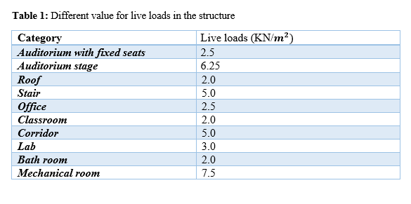
Load Types
Live Load:
The value of live load depends on the occupancy of the structure.

Slide 17
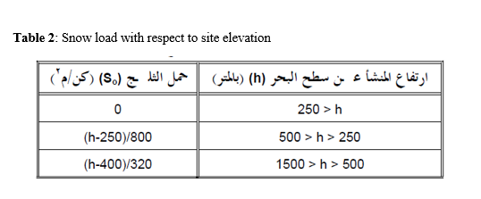
Load Types
Snow Load:
  Site Snow Load (So) = (600 – 400) / 320 = 0.625 kN/m²
  Design Snow Load on Roof = 0.625 kN/m² but this structure is important so snow load is about 1 kN/m²

Slide 18
Load Types
Super Imposed Dead Load:
  Total superimposed dead load = 5.6 kN/m²
  External wall load =4.21 kN/m²

Slide 19
Load Combinations
Using UBC 1997 the ultimate loads are:
1.4D
1.2D + 1.6L + 0.5 (Lr or S)
1.2D + 1.6 (Lr or S) + (f1 L or 0.8W)
1.2D + 1.3W + f1 L + 0.5 (Lr or S)
1.2D + 1.0E + (f1 L + f2 S)
0.9D + (1.0E or 1.3W)
E = ρ Eh + Ev
Em = Ωo Eh
f1 = 1 when live load > 4.9 kN/m2
= 0.5 for other live load
f2 = 0.7 for configurations that do not shed snow off the structure
= 0.2 for other roof configurations

Slide 20

Load Combinations
Using UBC 1997 the service loads are:
D
D + L + (Lr or S)
D+( W+$\frac{E}{1.4}$ )
.9D+$\frac{E}{1.4}$
[D+.75 [ L+( $L_{r}$ or S) + (W or $\frac{E}{1.4}$) ]

Slide 21
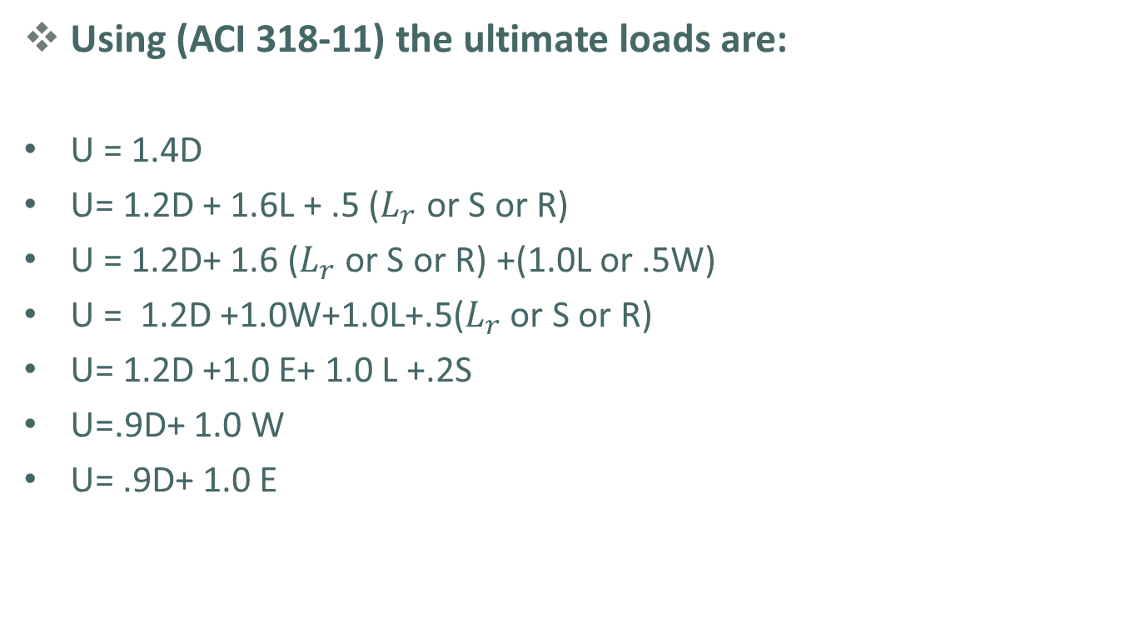
Load Combinations
Using (ACI 318-11) the ultimate loads are:
U = 1.4D
U= 1.2D + 1.6L + .5 ($L_{r}$ or S or R)
U = 1.2D+ 1.6 ($L_{r}$ or S or R) +(1.0L or .5W)
U = 1.2D +1.0W+1.0L+.5($L_{r}$ or S or R)
U= 1.2D +1.0 E+ 1.0 L +.2S
U=.9D+ 1.0 W
U= .9D+ 1.0 E

Slide 22
Preliminary Design of The Project
To do the preliminary design for the Structure the following procedures are used :
  Determine the load assigns for the structure.
  Determine the distribution of beams .
  Determine the thickness of the slab .
  Calculate the ultimate load for the slab.
  Check the shear and the reinforcement for the slab.
  Determine the dimensions of the beams.
  Determine the dimensions of the columns.

Slide 23
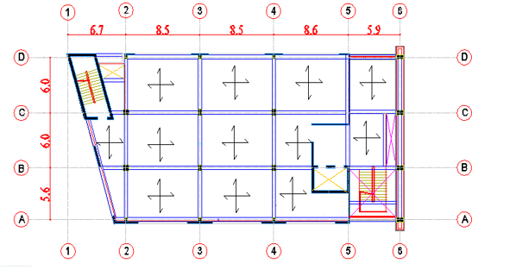

Preliminary Design of The Project

Slide 24
Preliminary Design of The Project
Assume beams of continues spans to be 400 mm width and to have thickness of 620mm .
Assume all beams with simple span to be 300 mm width and to have thickness of 500 mm.
Assume wall thickness =250 mm

Slide 25
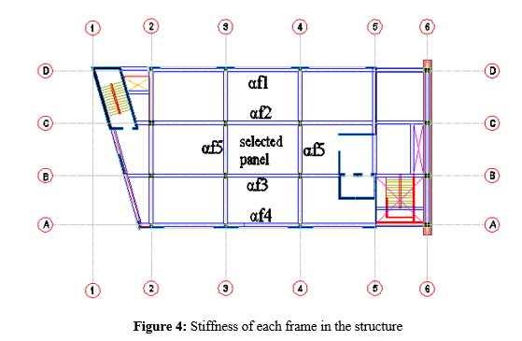
Preliminary Design of The Project
The Slab thickness:

Slide 26

Preliminary Design of The Project
→ (take panel 3_4_B_C):
Assume $α_{m}$>2 →
h= $\frac{ 7.9 (0.8+\frac{420}{1400})}{36+9( 1.46)}$= 0.18 m
So slab thickness= 220mm

Slide 27
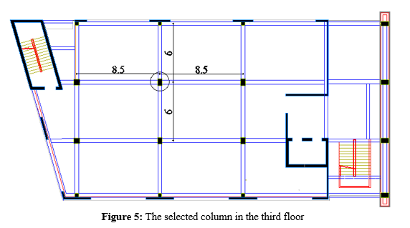
Preliminary Design of The Project
The Column Dimensions:

Slide 28
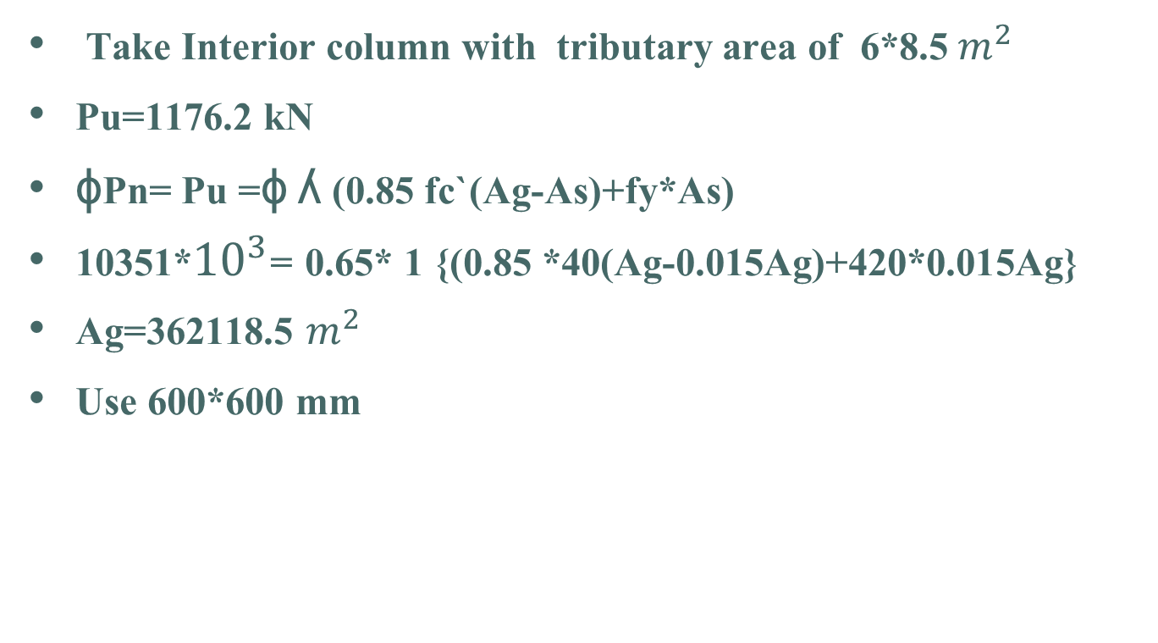
Preliminary Design of The Project
Take Interior column with tributary area of 6*8.5${ m}^{2}$
Pu=1176.2 kN
ɸPn= Pu =ɸ ʎ (0.85 fc`(Ag-As)+fy*As)
10351*${10}^{3}$= 0.65* 1 {(0.85 *40(Ag-0.015Ag)+420*0.015Ag}
Ag=362118.5 $m^{2}$
Use 600*600 mm

Slide 29
Equivalent Static Method(UBC-97)
The Following Parameters are used in the calculations :
  Seismic Zone Factor for Nablus (Zone 2B) Z = 0.2
  Soil Profile = S_{c} (UBC_97, table16_J)
  C_{a} = 0.24 (UBC_97, table16_Q)
  C_{v} = 0.32 (UBC_97, table16_R)
  Importance Factor (I) = 1.5 (UBC_97, table16_K)
  Reduction Factor (R) = 5.5 (UBC_97, table16_N)
  Effective Weight (W) = 90073.98 kN

Slide 30

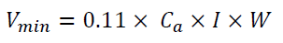

Equivalent Static Method(UBC-97)
These are the equations used for Base Shear (V) calculation :
  (Equation- 1)
  (Equation- 2)
  (Equation -3)

Slide 31
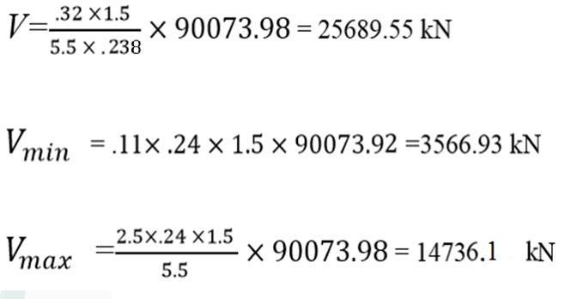
Equivalent Lateral Force (UBC-97)
Select the maximum value of base shear (V) =14736.1kN

Slide 32

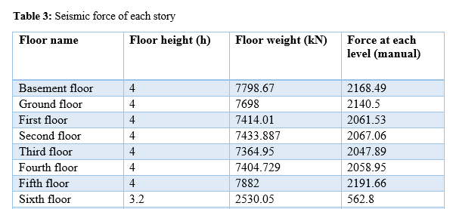
Equivalent Lateral Force (UBC-97)
The seismic Base Shear (V) is distributed according to this equation :
  Force Per Floor (Equation- 5)

Slide 33
Calculating Wind Load (UBC-97)
The Following Parameters are used in the calculations :
  Basic Wind Speed = 120 km/hr
  Exposure = C
  Importance Factor (I_{w}) = 1.15
  Wind Stagnation (qs) = 0.695 kN/m²
  Pressure Coefficient (C_{q}) =1.4 for any horizontal direction
  (UBC_97, table 16-H)

Slide 34
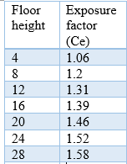
Calculating Wind Load (UBC-97)
  Combined height, importance and gust factor (C_{e}) :

Slide 35
Wind Load (UBC-97)
Windward Pressure = C_{e} C_{q} q_{s} I_{w}
= 1.06 X 1.4 X 0.695X 1.15 = 1.17kN/m²
Windward force = P X Tributary Area (h*B)
= 1.17X 4*18.3= 86.196 kN
Where :
h= height of the building
B= the width of building

Slide 36
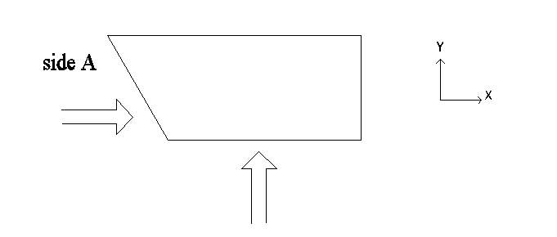
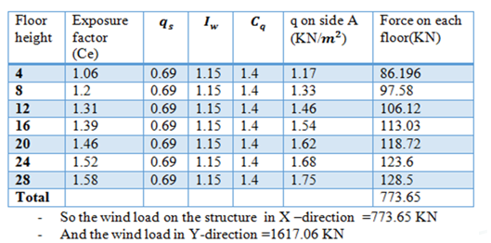
Wind Load
(UBC-97)

Slide 37
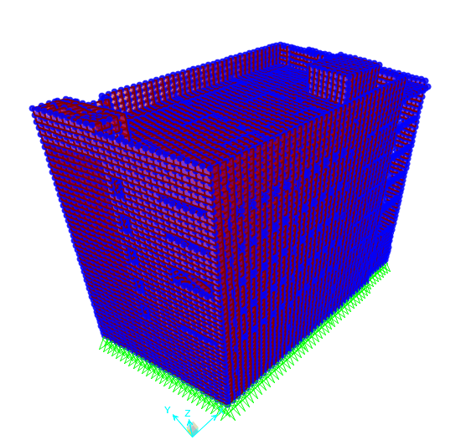
Structural 3D Modeling
The structure is modeled using SAP2000 program
All Window Openings were considered

Slide 38
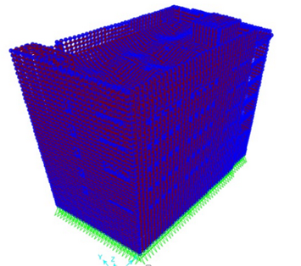
Verification of Structural Analysis
Compatibility Check :
  The following figure proves the compatibility of the model

Slide 39
Verification of Structural Analysis
Equilibrium Verification
  The Loads assigned to the model are :
  Own Weight = Calculated automatically in the SAP2000
  Super imposed dead load = 5.6 kN/m²
  Live Load = 5.0 kN/m²
  Roof Live Load =2.0kN/m²
  Earthquake Loads
  Wind Loads
  Snow Loads=1.0 kN/m²
  Soil Loads

Slide 40
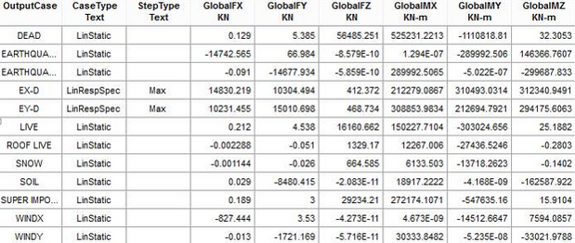
Verification of Structural Analysis
Equilibrium Verification
  The following table shows the reactions obtained from the analysis of SAP2000

Slide 41
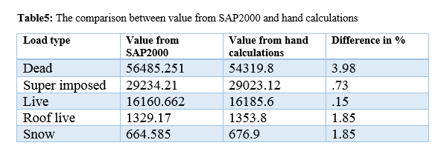
Verification of Structural Analysis
The following table shows a comparison between the value of forces obtained by hand calculation and by SAP2000.

Slide 42
Verification of Structural Analysis
Soil Load Verification:
A) In X-direction:
  Total soil load (manual) =0 kN
  Total soil load from SAP2000 = 0.029 kN
Difference in % ≈ 0
B) In Y-direction:
  Total soil load (manual) =8312.69 kN
  Total soil load from SAP2000 = 8480.415 kN
Difference in % = 2.02

Slide 43
Verification of Structural Analysis
Wind Load Verification:
  Wind X (manual) =773.65 kN
  Wind X from SAP = 827.44 kN
Difference in % = 6.95
  Wind Y (manual) =1617.06 kN
  Wind Y from SAP = 1721.169 kN
Difference in % = 6.4

Slide 44
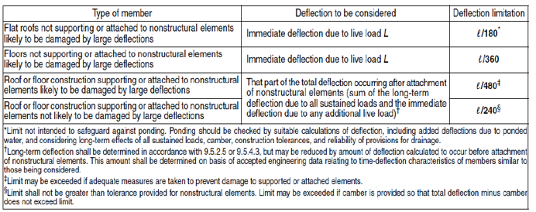
Serviceability Check
The following table shows the allowable deflection limits ((ACI 318M-08) Table 9.4(b))
  The Selected Limit to be Checked is L/240

Slide 45

Serviceability Check
The serviceability is checked in terms of long-term deflection
(Equation- 6)
  Where λ is the time factor
  Δ_{LT} = Total long term deflection
  Δ_{D} = Immediate deflections due to dead loads
  Δ_{L} = Immediate deflections due to live loads
  Δ_{LS} = Immediate deflections due to sustained live loads
  50% of Live load is assumed to be sustained forever

Slide 46
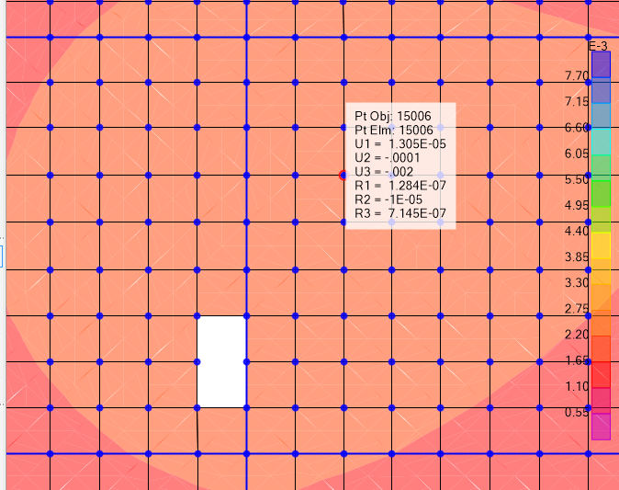
Serviceability Check
This figure shows the immediate deflection in the third floor obtained from SAP2000
From live load

Slide 47
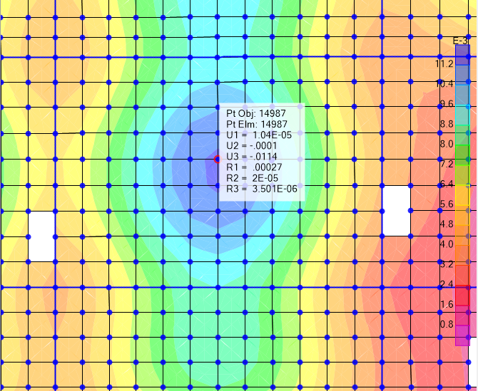
Serviceability Check
From dead load

Slide 48
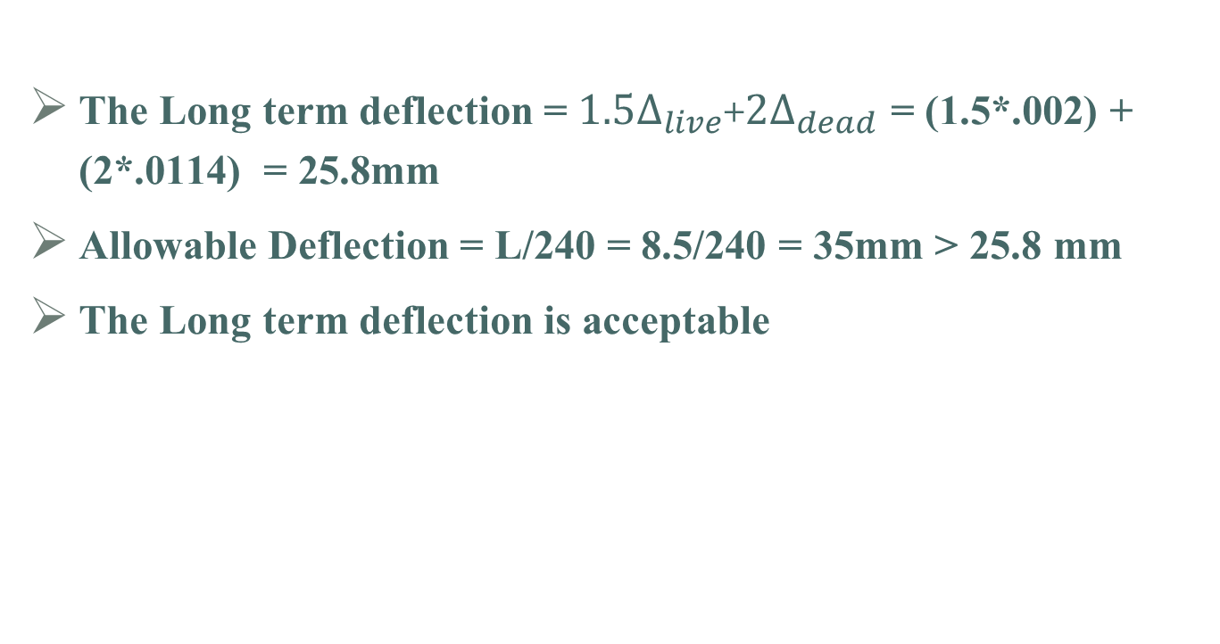
Serviceability Check
The Long term deflection = $1.5∆_{live}$+$2∆_{dead}$ = (1.5*.002) + (2*.0114) = 25.8mm
Allowable Deflection = L/240 = 8.5/240 = 35mm > 25.8 mm
The Long term deflection is acceptable

Slide 49
Structural Design of Concrete Members
The code used for design and detailing is ACI 318-11 regarding seismic and gravity loads.
Provisions were applied to all structural members including:
  Beams
  Columns
  Shear Walls
  slabs
  Foundations
  stairs

Slide 50
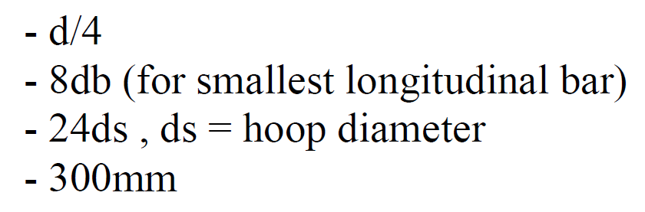
Structural Design of Concrete Members
Design and Detailing of Beams :
Positive moment strength at joints shall be at least one third the negative moment strength.
Negative and positive moment strength at any section shall be at least one fifth the moment strength at joints.
Hoops shall be provided at a distance(2h) from the joints with a spacing equals the minimum of
Other hoops shall be spaced not more than (d/2)

Slide 51
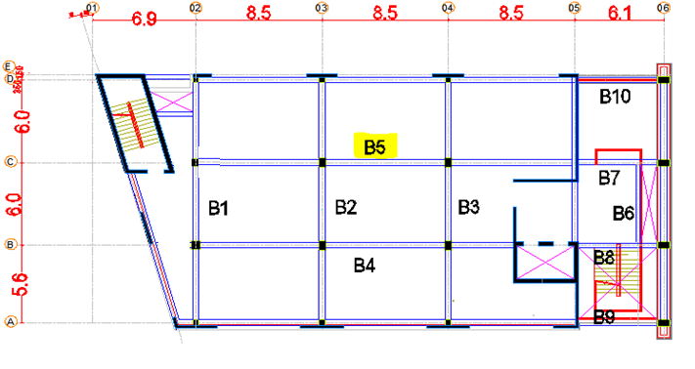
Structural Design of Concrete Members
Figure 10: The selected beam (B5) for design

Slide 52

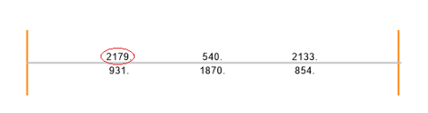
Structural Design of Concrete Members
Sample Design for Beams :
The beam to be designed is (B5) in third floor.
Dimensions : B =400mm, h =620mm, d =560mm, Span =8.5m
Ultimate Moment (M_{u})=421.6 kN.m
Reinforcement ratio
Area of steel = 0.009708 x 400 x 560 = 2174.6mm²
Design results obtained from SAP2000 are OK

Slide 53
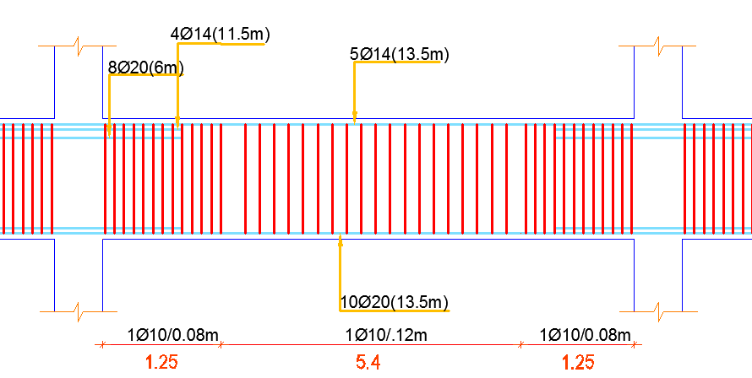
Structural Design of Concrete Members
Sample Design for Beams :
For Top Steel, 5Ø14 are provided as continuous bars A_{s}=735mm²
Cut-off bars at a distance of (l_{n}/3) = 2.6m are used for the remaining area A_{s}= 3621-735-533 = 2270mm², use 8Ø20.
For Bottom Steel, A_{s}=2967mm², use 10Ø20.
Spacing of Hoops = 80mm (at a distance 2h from joints faces).
Spacing of other Hoops = 120mm.

Slide 54
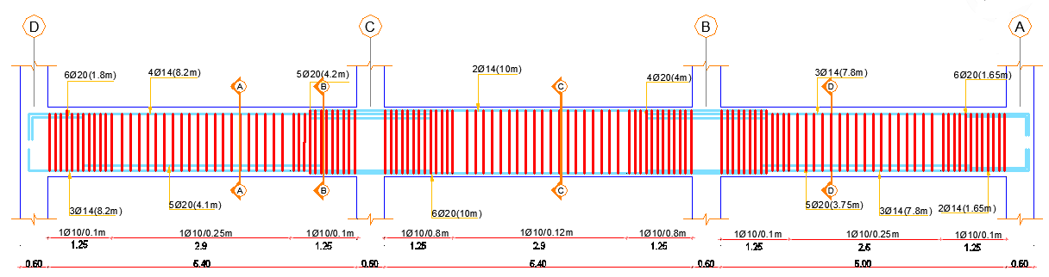
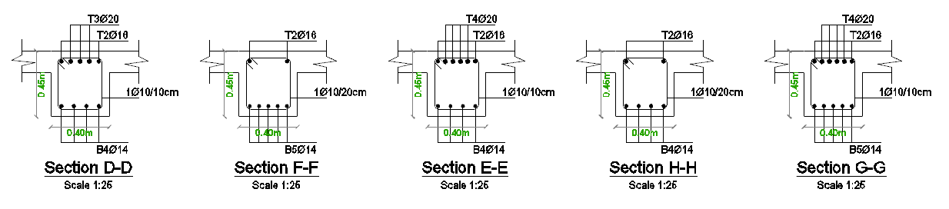
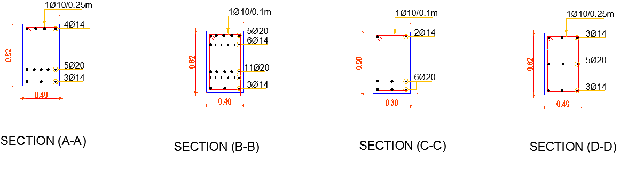
Structural Design of Concrete Members
Sample Design for Beams :
Figures below show the longitudinal section and cross sections for B2 :

Slide 55
Structural Design of Concrete Members
Design and Detailing of Shear Walls :
According to ACI315-04 section 2.10 these rules are following:
Transverse and Longitudinal rebar ratio (ρt and ρl) shall be at least 0.0025
Spacing of reinforcement shall not exceed 450mm or3h
Where:
h: the thickness of shear wall (250mm).
Two diagonal bars Ø16 shall be provided at the corners of openings
Effective depth = 80% of Shear wall length (lw)

Slide 56
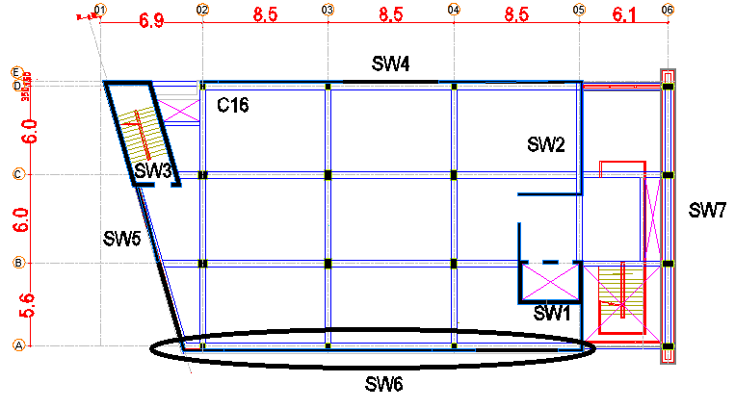
Structural Design of Concrete Members
Figure 11: The layout of shear walls

Slide 57
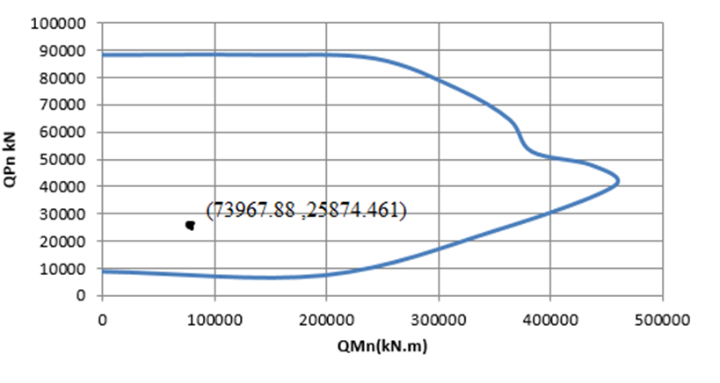
Structural Design of Concrete Members
Sample Design for Shear Walls :
The shear wall to be designed is (SW6)
Dimensions : L = 27000mm, b_{w} = 250mm, d = 21600mm
M_{u,major}= 73967.88 kN.m, M_{u,minor}= 260.57 kN.m, P_{u}=25874.46 kN,

Slide 58

Structural Design of Concrete Members
4) To account for major moment and axial force, minimum steel is assumed = 0.0025 x 27000 x 250 =16875mm²
5) To account for minor moment, additional steel is needed:
6)Total Area of Longitudinal bars = 4054.9 x 2 + 16875mm²
Use 1Ø12/150mm for each layer in the shear wall.

Slide 59
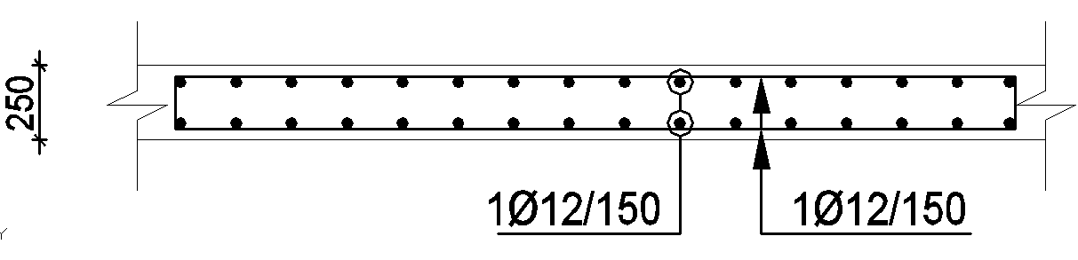
Structural Design of Concrete Members
Sample Design for Shear Walls :
Figure 13: Horizontal section in shear wall 6

Slide 60
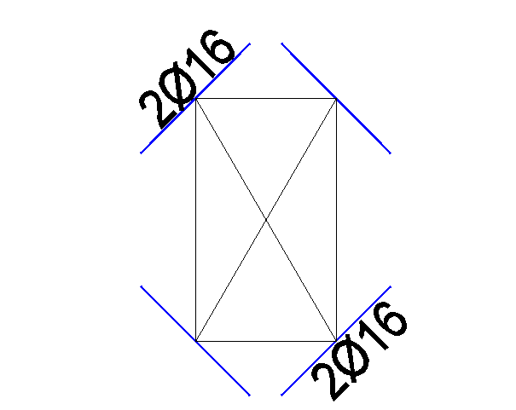
Structural Design of Concrete Members
Design and Detailing of Special Shear Walls :
Diagonal bars around openings are also provided as shown :

Slide 61
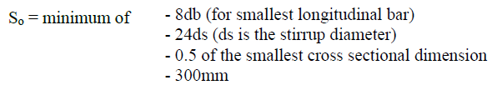


Structural Design of Concrete Members
Design and Detailing of Columns :
Spacing (S_{o}) shall be provided at both ends for length (L_{o}):
Max. vertical spacing outside(L_{o} )

Slide 62
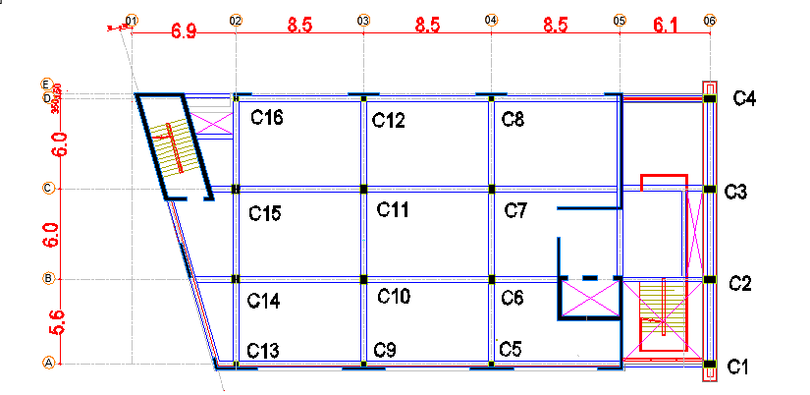
Structural Design of Concrete Members
Figure 14: The column's distribution of the basement floor

Slide 63

Structural Design of Concrete Members
Sample Design for Columns :
The Column to be designed is (C11)
Dimensions : Square (600X600)mm
Clear Length = 3.4m
Ultimate Moment (M_{u})= 87.43 kN.m
Ultimate Axial (P_{u})= 8112.52 kN
4) A_{s} = 4912 mm² (16 Ø 20)

Slide 64
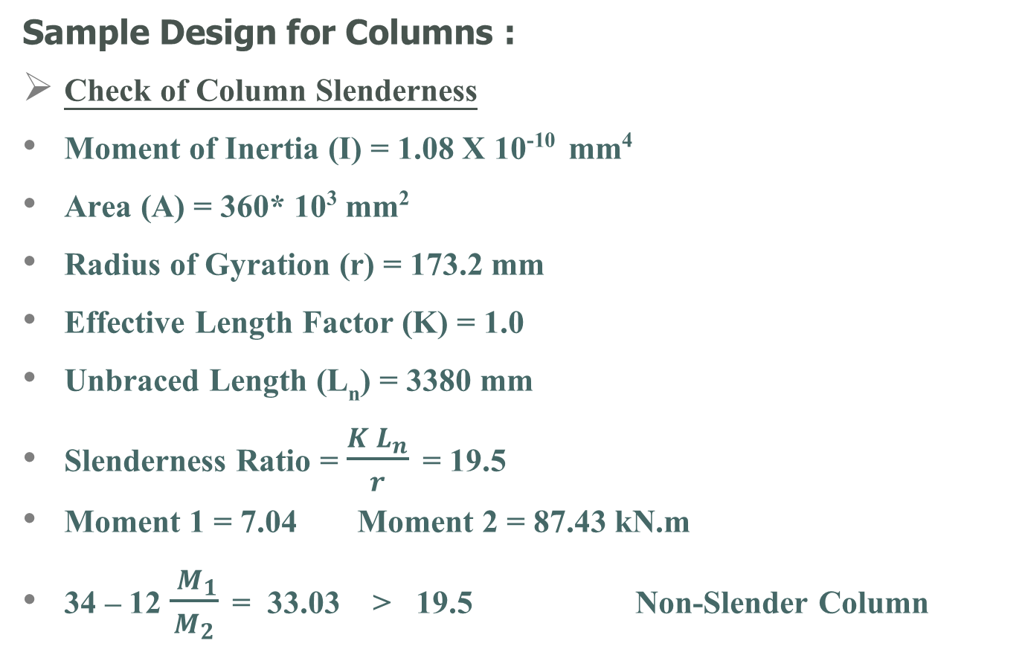
Structural Design of Concrete Members
Sample Design for Columns :
Check of Column Slenderness
Moment of Inertia (I) = 1.08 X 10⁻¹⁰ mm⁴
Area (A) = 360* 10³ mm²
Radius of Gyration (r) = 173.2 mm
Effective Length Factor (K) = 1.0
Unbraced Length (L_{n}) = 3380 mm
Slenderness Ratio = $\frac{K L_{n}}{r}$ = 19.5
Moment 1 = 7.04 Moment 2 = 87.43 kN.m
34 – 12 $\frac{ M_{1}}{M_{2}}$ = 33.03 > 19.5 Non-Slender Column

Slide 65
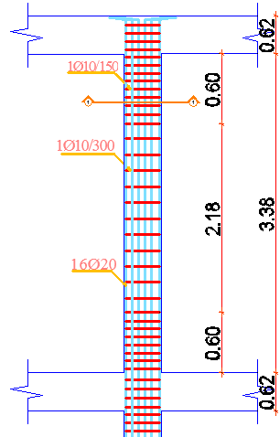
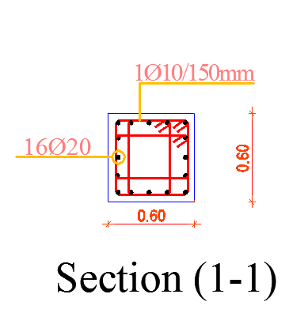
Structural Design of Concrete Members
Sample Design for Columns :
Distance (L_{o}) = 600mm
Spacing (S_{o}) = 150mm
Spacing outside (L_{o}) = 300mm

Slide 66
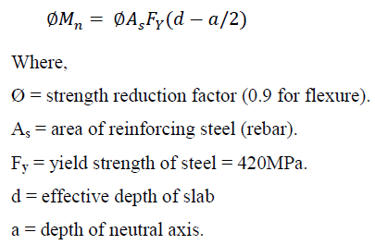
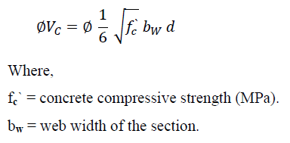
Structural Design of Concrete Members
Design and Detailing of Slabs :
Flexural Capacity of slabs is given by:
Shear Capacity of concrete is given by:

Slide 67
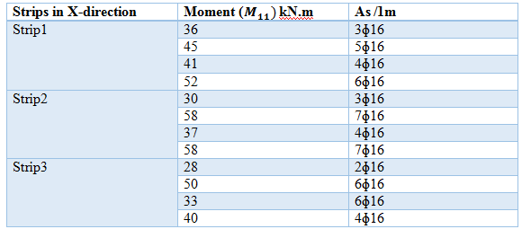
Structural Design of Concrete Members
The Third Slab is going to be designed
Dimensions : Strip width = 1000mm, h = 220mm, d = 170mm
IN X-DIRECTION
Table 9.1: The negative moment and area of steel in X-Direction

Slide 68

Structural Design of Concrete Members
The Third Slab is going to be designed
Dimensions : Strip width = 1000mm, h = 220mm, d = 170mm
IN X-DIRECTION
Table 9.2: The positive moment and area of steel in X-Direction

Slide 69

Structural Design of Concrete Members
The Third Slab is going to be designed
Dimensions : Strip width = 1000mm, h = 220mm, d = 170mm
IN Y-DIRECTION
Table 10.1: The negative moment and area of steel in Y-Direction

Slide 70

Structural Design of Concrete Members
The Third Slab is going to be designed
Dimensions : Strip width = 1000mm, h = 220mm, d = 170mm
IN Y-DIRECTION
Table 10.2: The positive moment and area of steel in Y-Direction

Slide 71
Structural Design of Concrete Members
Wide beam shear check:
Ultimate Shear (V_{u13}) = 70 kN
Ultimate Shear (V_{u23}) = 100.8 kN
Shear Capacity (ØV_{c}) =112.4kN
NO need for Shear reinforcement.

Slide 72


Structural Design of Concrete Members
Sample Design for Slabs :
1)
For Ø 16, Lap Splice = 1.3 X (L_{dt} ) = 780mm
Figure 15: longitudinal bars details in slab

Slide 73

Structural Design of Concrete Members
Sample Design for Slabs :
When the longitudinal bar ends
with a beam use 90º hook;
Development (L_{dh} ) = 180mm
Bent Radius = 64mm
Hook Length = 192mm
When the longitudinal bar ends
with a Shear Wall use 180º hook;
Development (L_{dh} ) = 180mm
Bent Radius = 64mm

Slide 74

Structural Design of Concrete Members
Sample Design for mat footings:
The area of the footing is 765.33 from (SAP)
The largest reaction (Pu) = 8147.99 kN
Checking footing deflection:
From the SAP the largest displacement (U3) =9.76 mm < 10 mm Ok
Check stress under the mat footing:

Slide 75



Structural Design of Concrete Members
Assume the depth of footing 1100 mm.
Check bunching:

Slide 76
Structural Design of Concrete Members
Design for flexure:

Slide 77



Structural Design of Concrete Members
Design of stairs:
A) Design of landing:
(M_{u11})=4.8 kN.m
(M_{u22})=3.5kN.m
Try thickness 0.15 for both (landing and flight)

Slide 78

Structural Design of Concrete Members
Check for shear:

Slide 79



Structural Design of Concrete Members
A) Design of flight:
(M_{u22})=14.1kN.m

Slide 80


Slide 81


