Slide 1
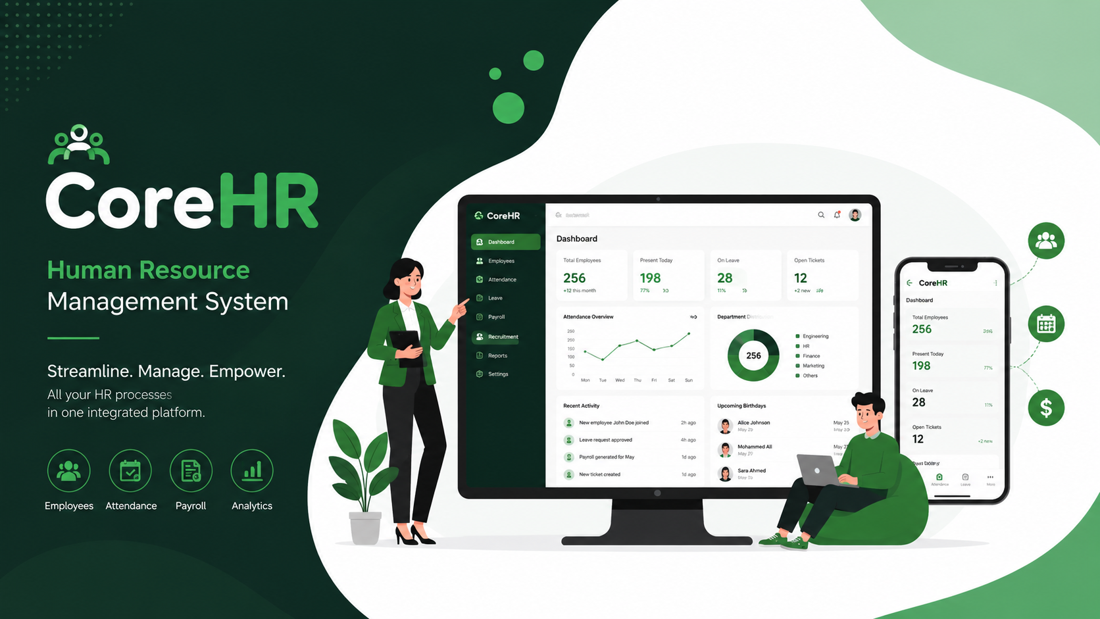
CoreHR

Slide 2
Table of contents
01
02
03
02
Roles
Introduction
Features
04
05
06
Technologies Used
Future Work
Conclusion

Slide 3
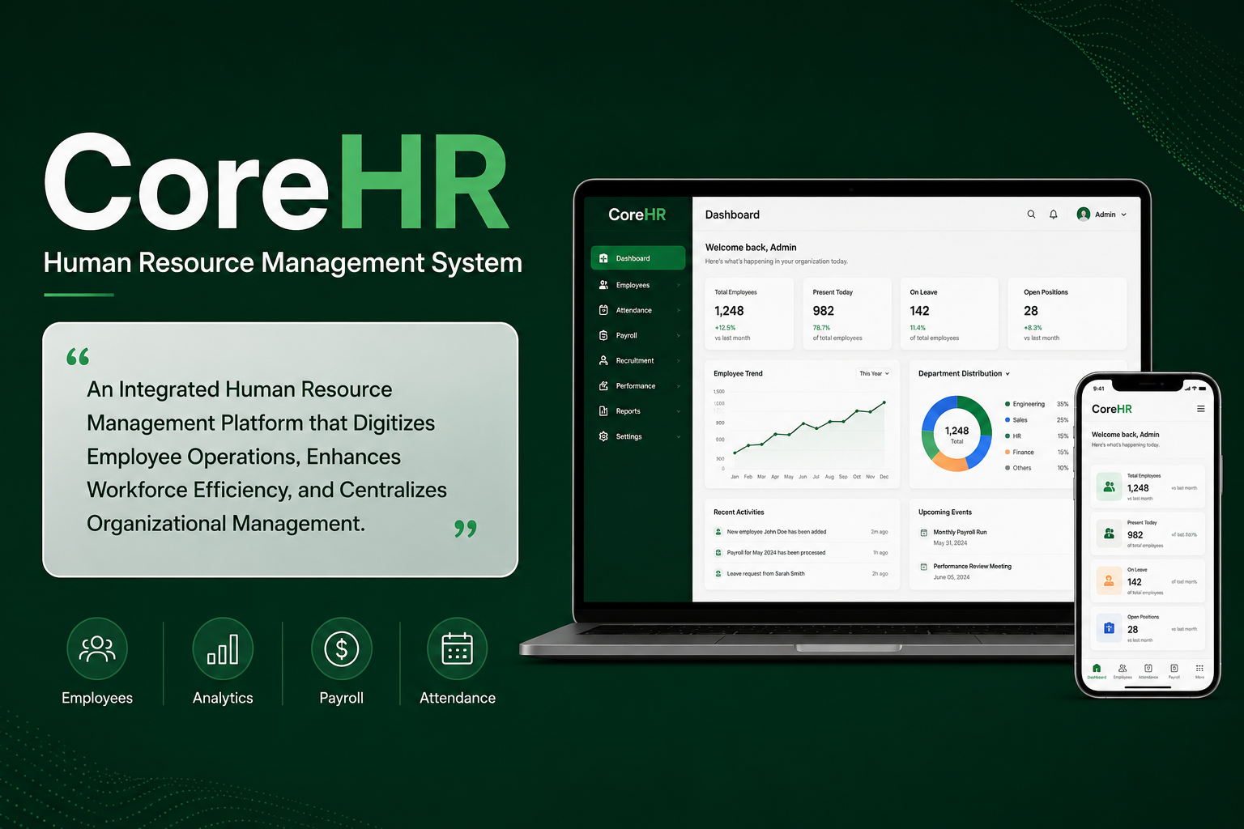

Slide 4

CoreHR
includes:
User-friendly mobile application for normal users and admin
website

Slide 5


Slide 6
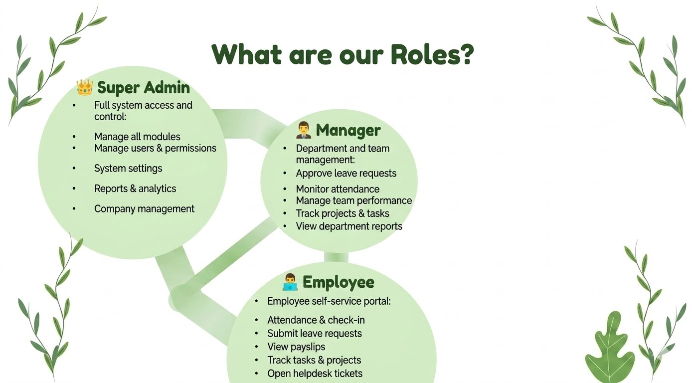

Slide 7


Slide 8
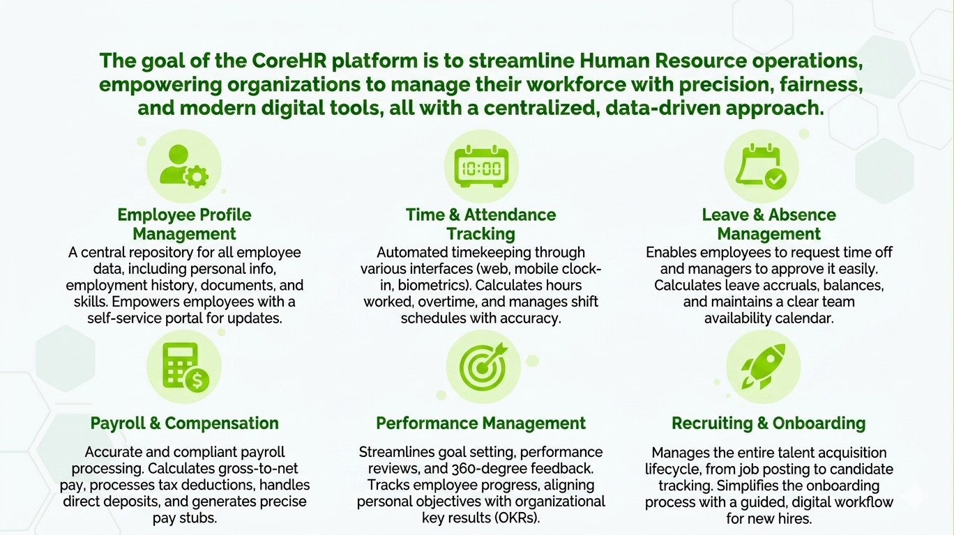

Slide 9


Slide 10
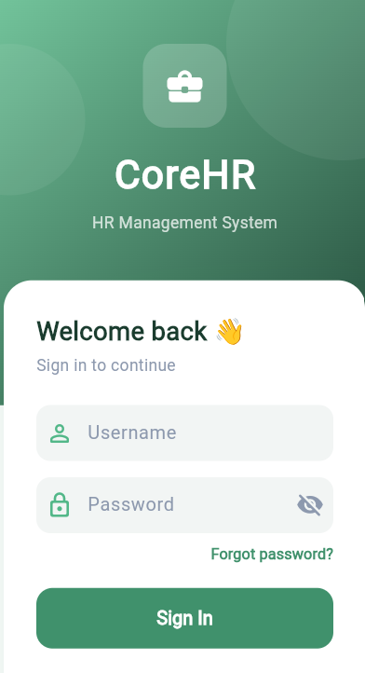
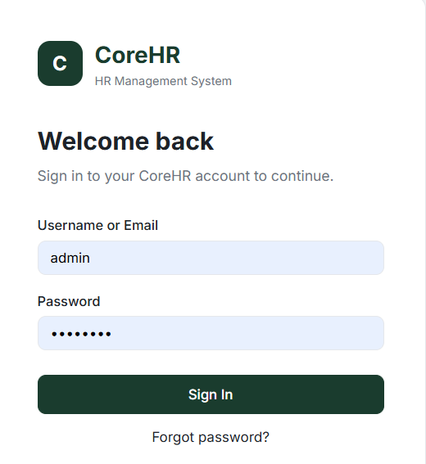
Authentication Screens
Sign-in screens

Slide 11
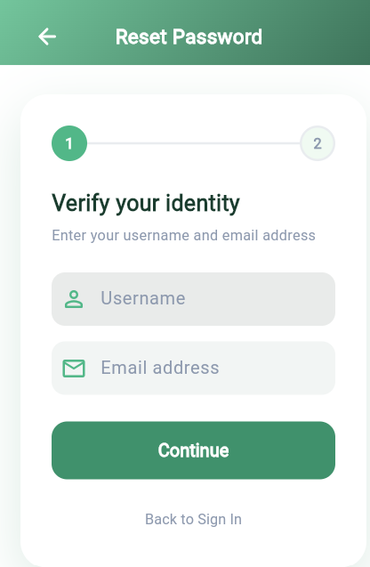
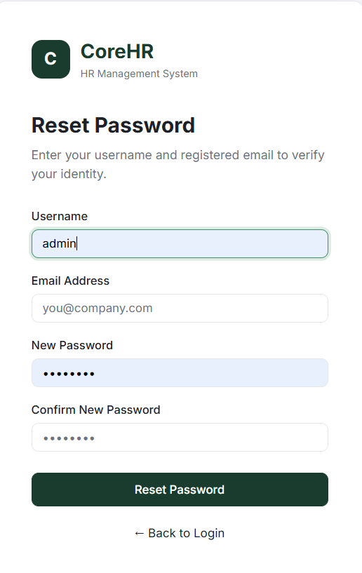
Authentication Screens
Forgot password screens

Slide 12

Employee Dashboard

Slide 13
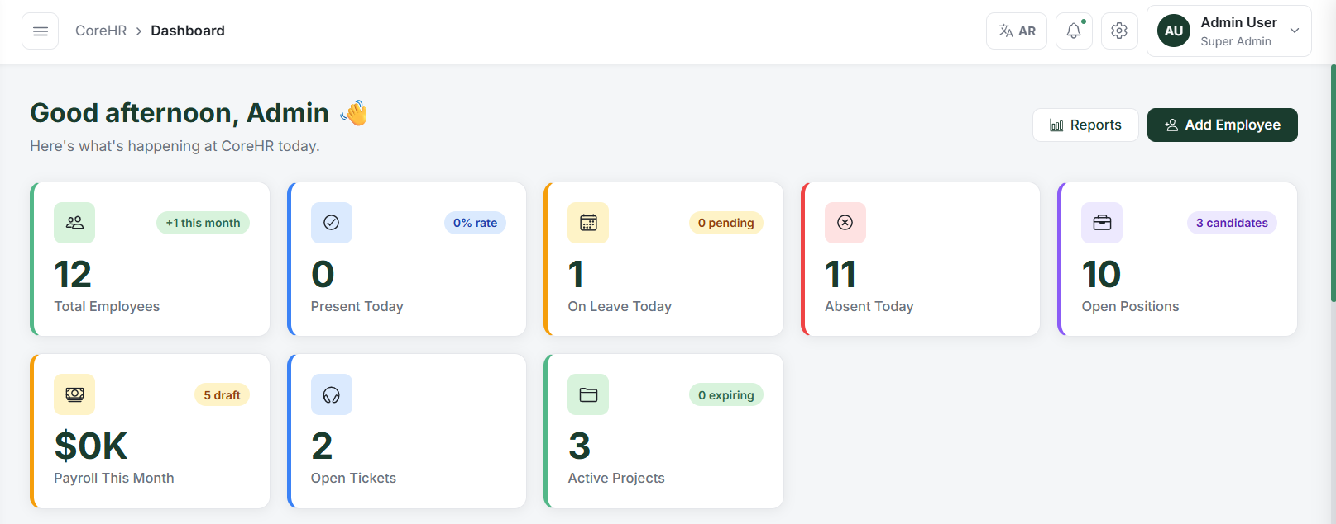
Admin Dashboard
Clock In / Clock Out

Slide 14
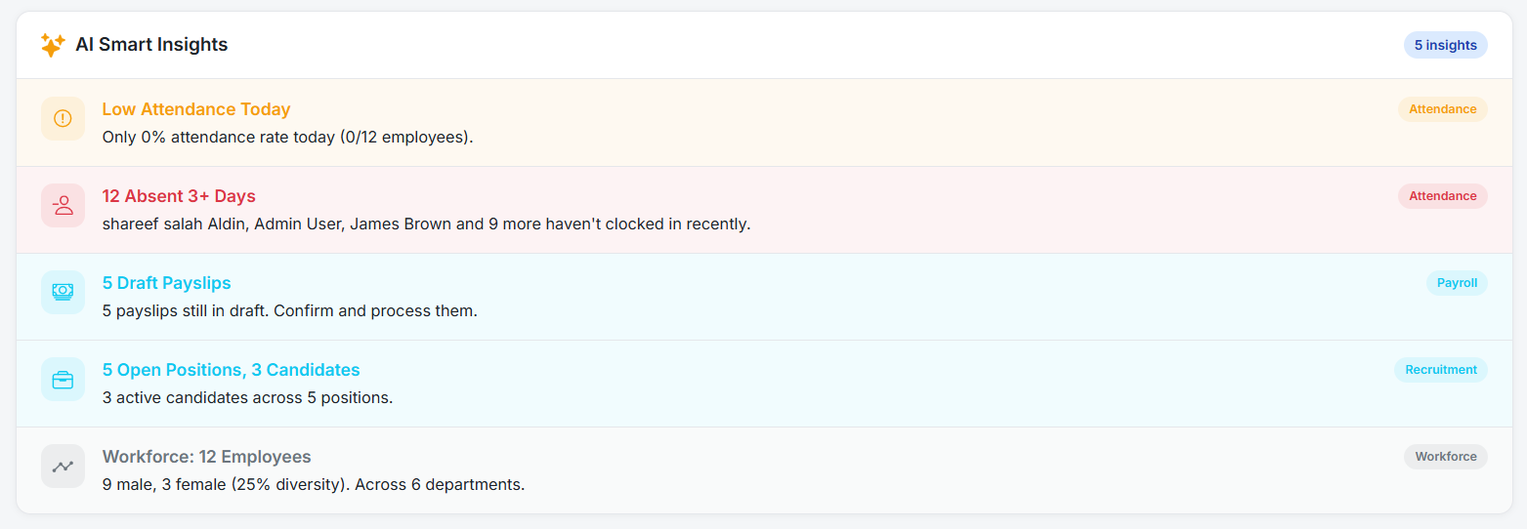
Admin Dashboard-AI Smart

Slide 15
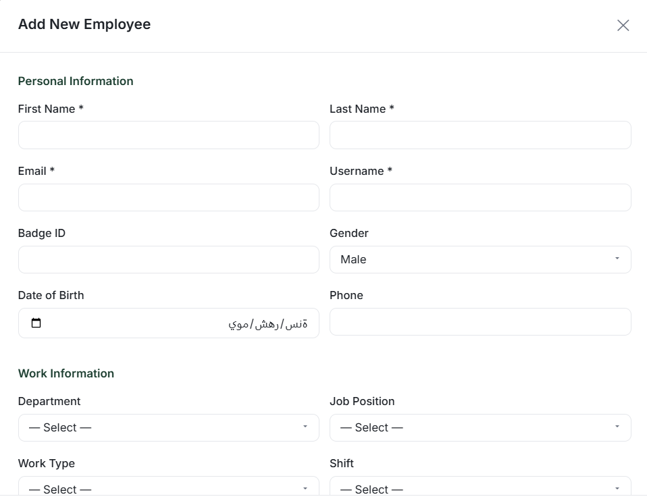
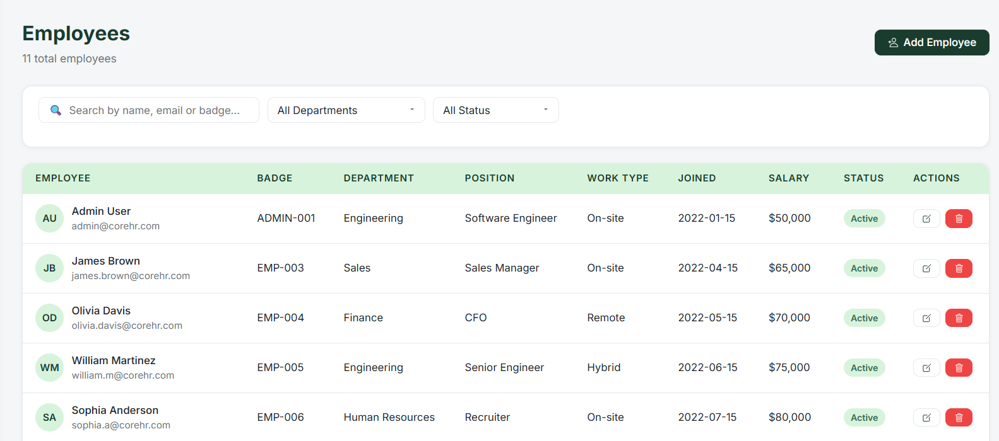
Employee Managment

Slide 16
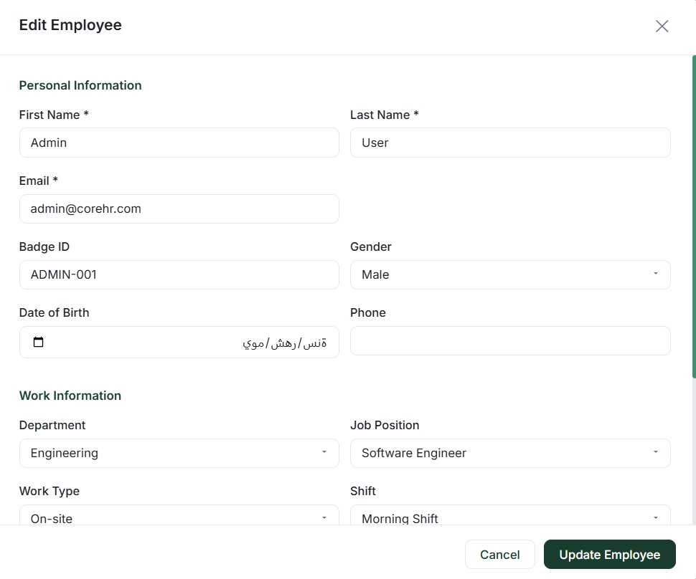
Employee Managment

Slide 17
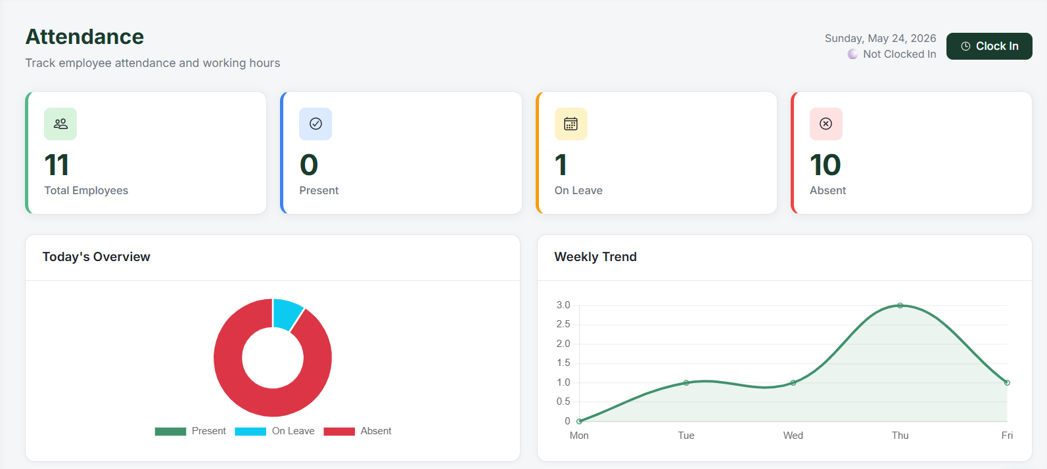
Attendece Managment

Slide 18
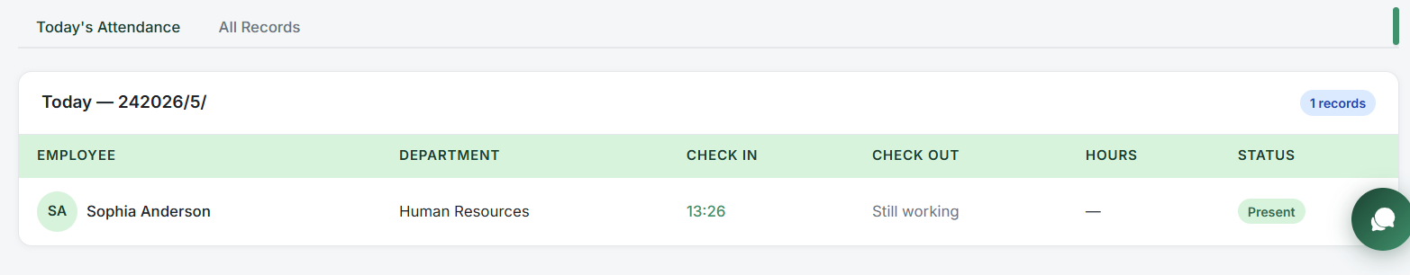
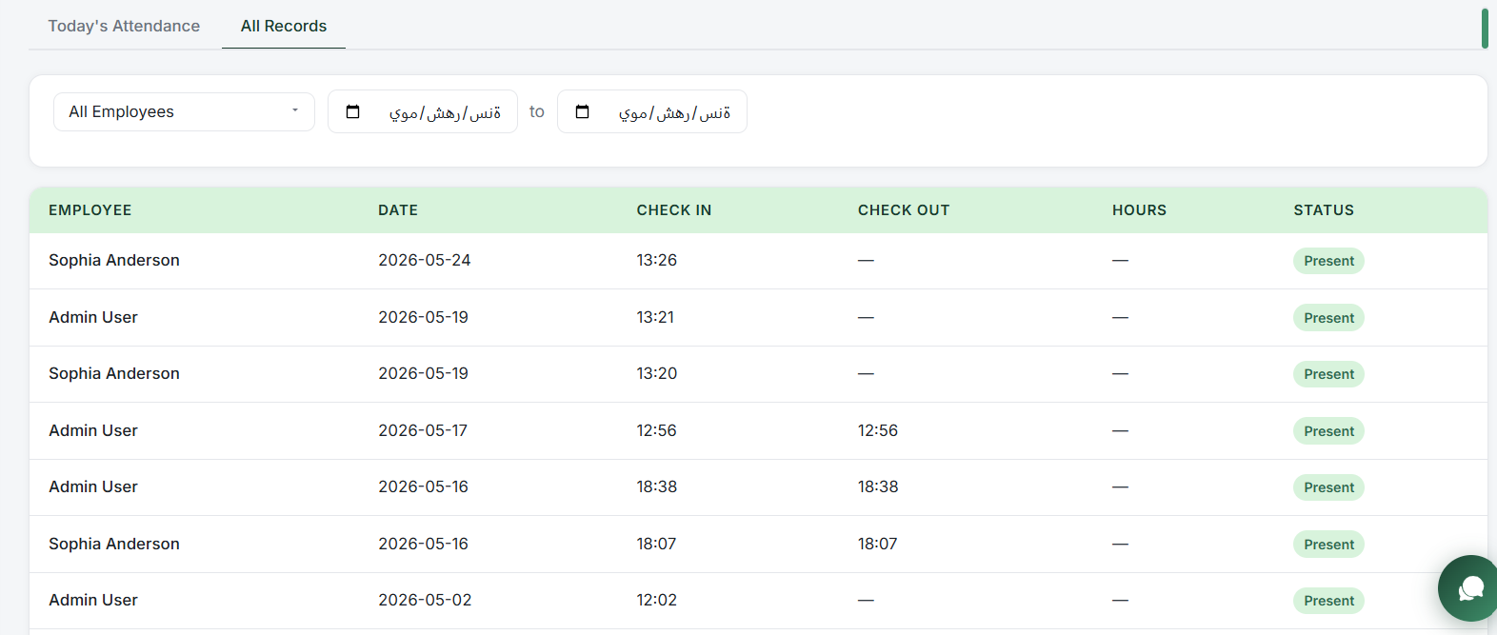
Attendece Managment

Slide 19
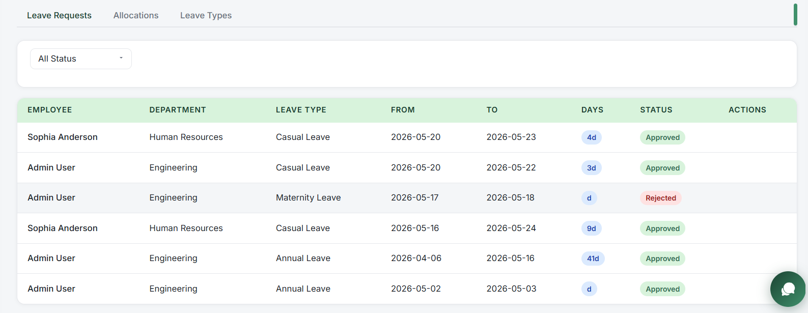
Leave Managment

Slide 20
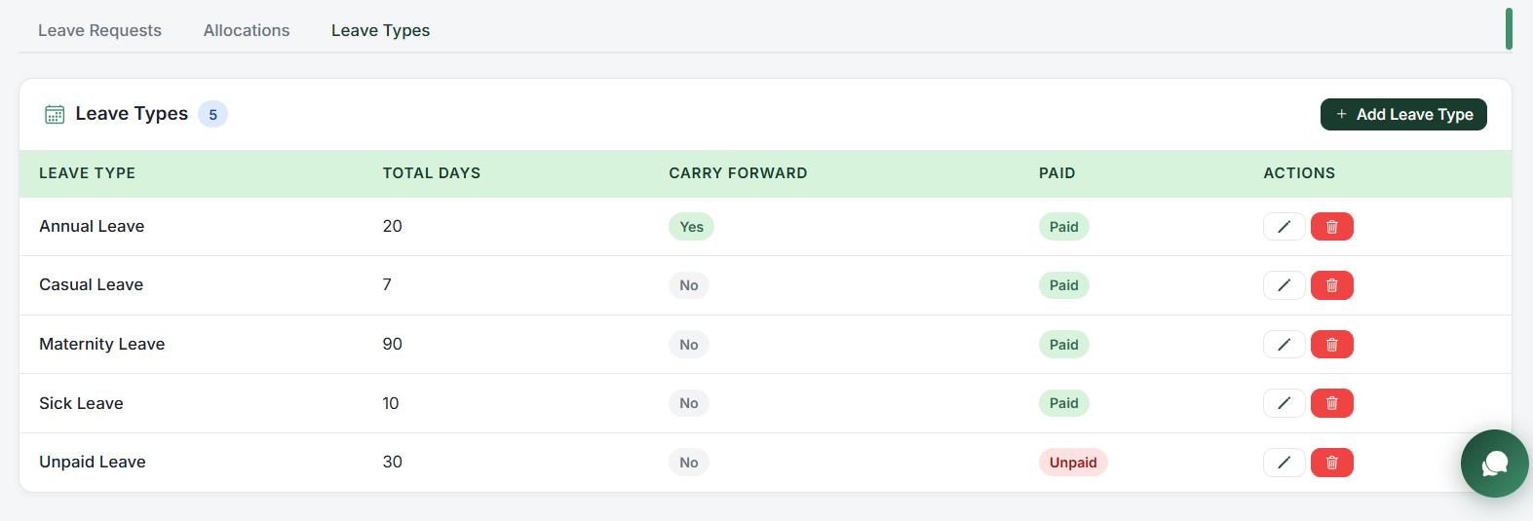
Leave Managment

Slide 21
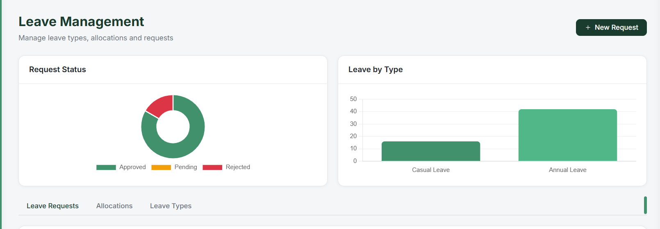
Leave Managment

Slide 22
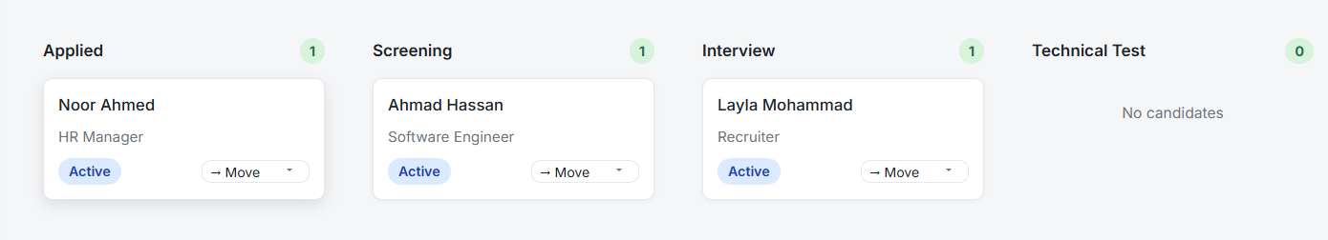

Recruitment Managment

Slide 23
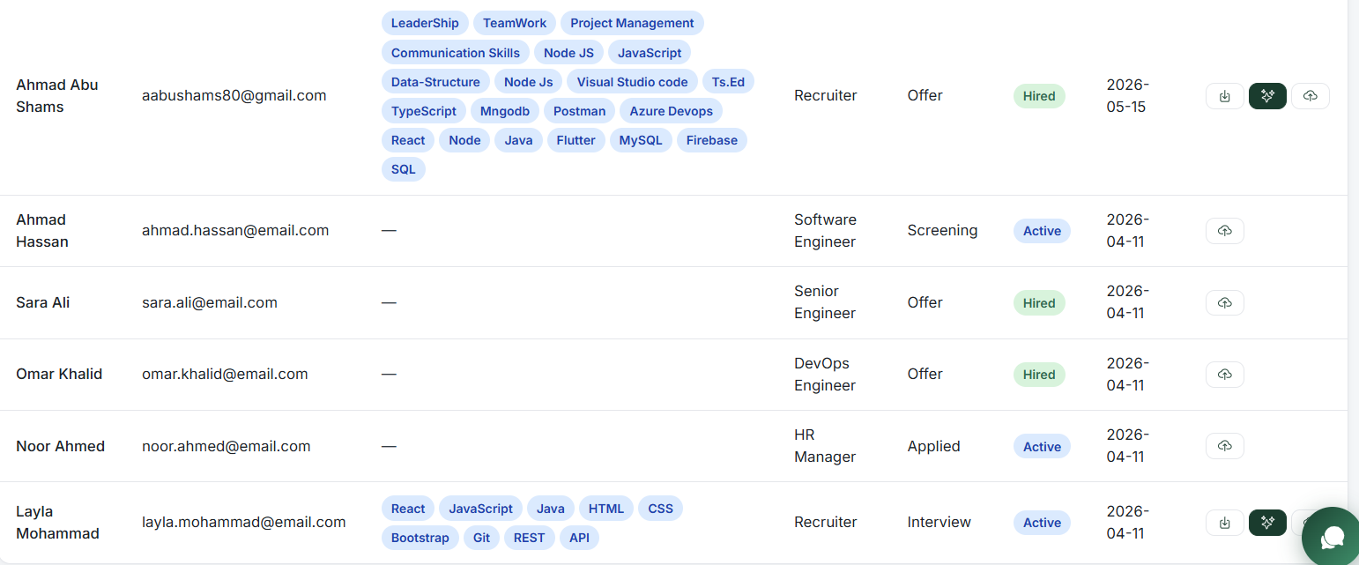
Recruitment Managment

Slide 24
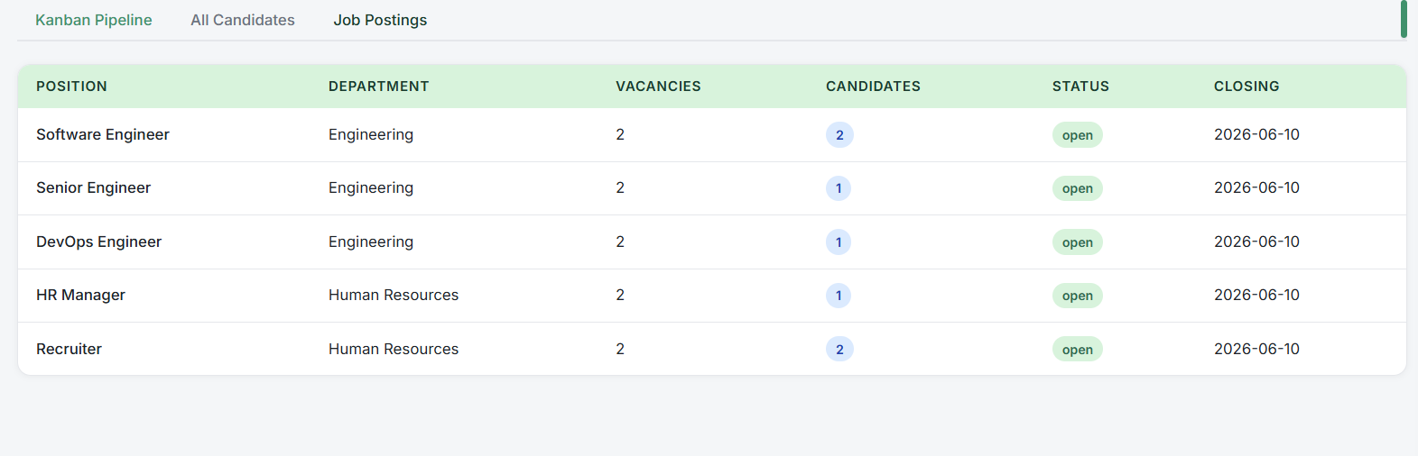
Recruitment Managment

Slide 25
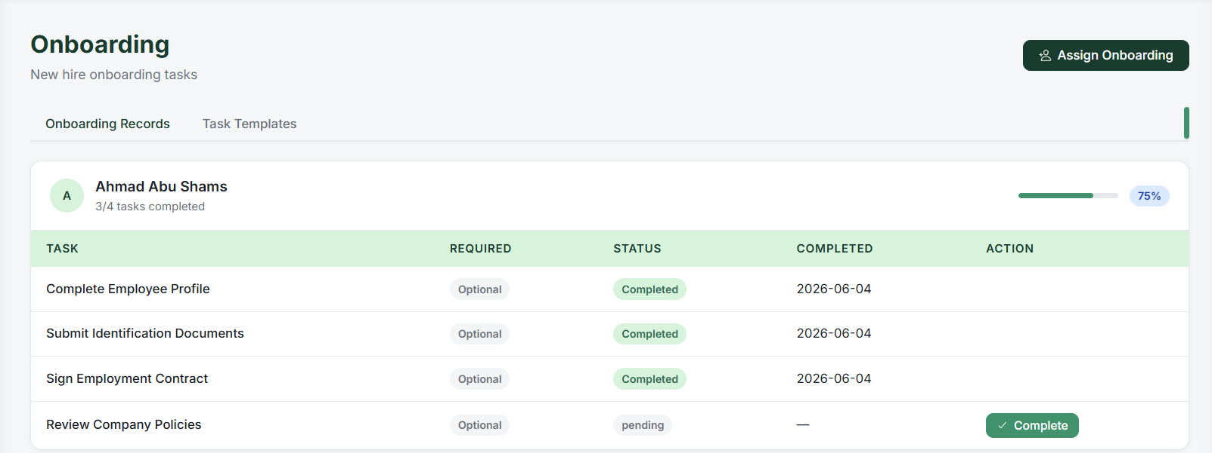
On boarding Managment

Slide 26
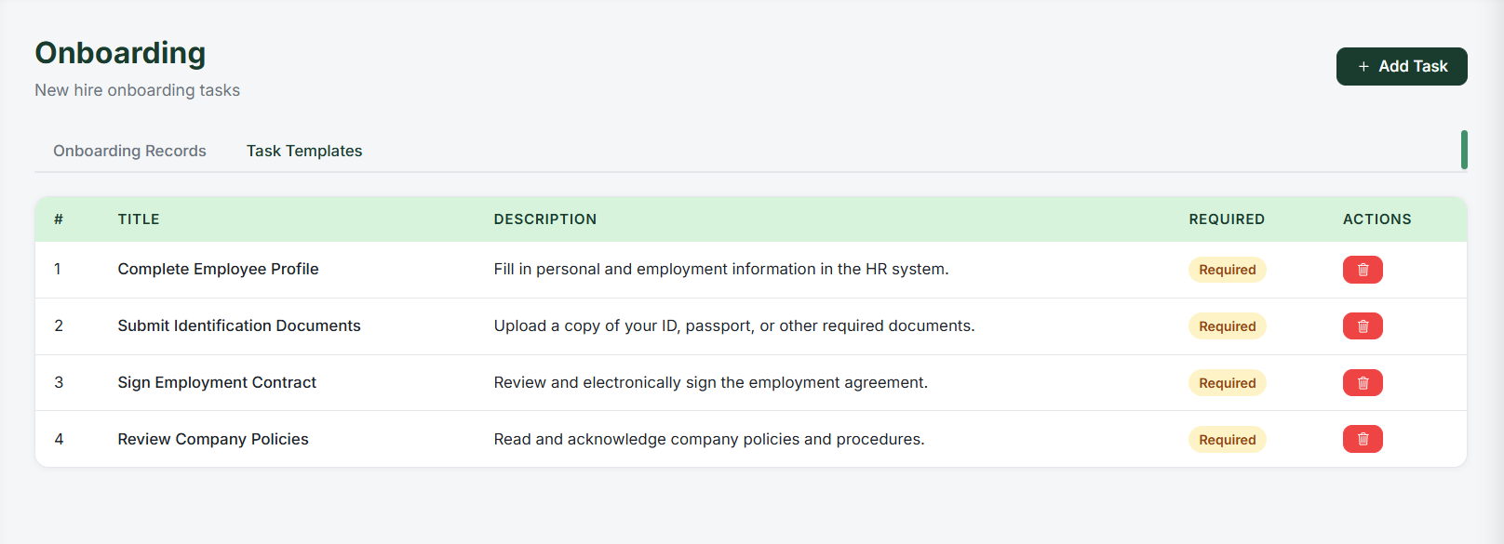
On boarding Managment

Slide 27
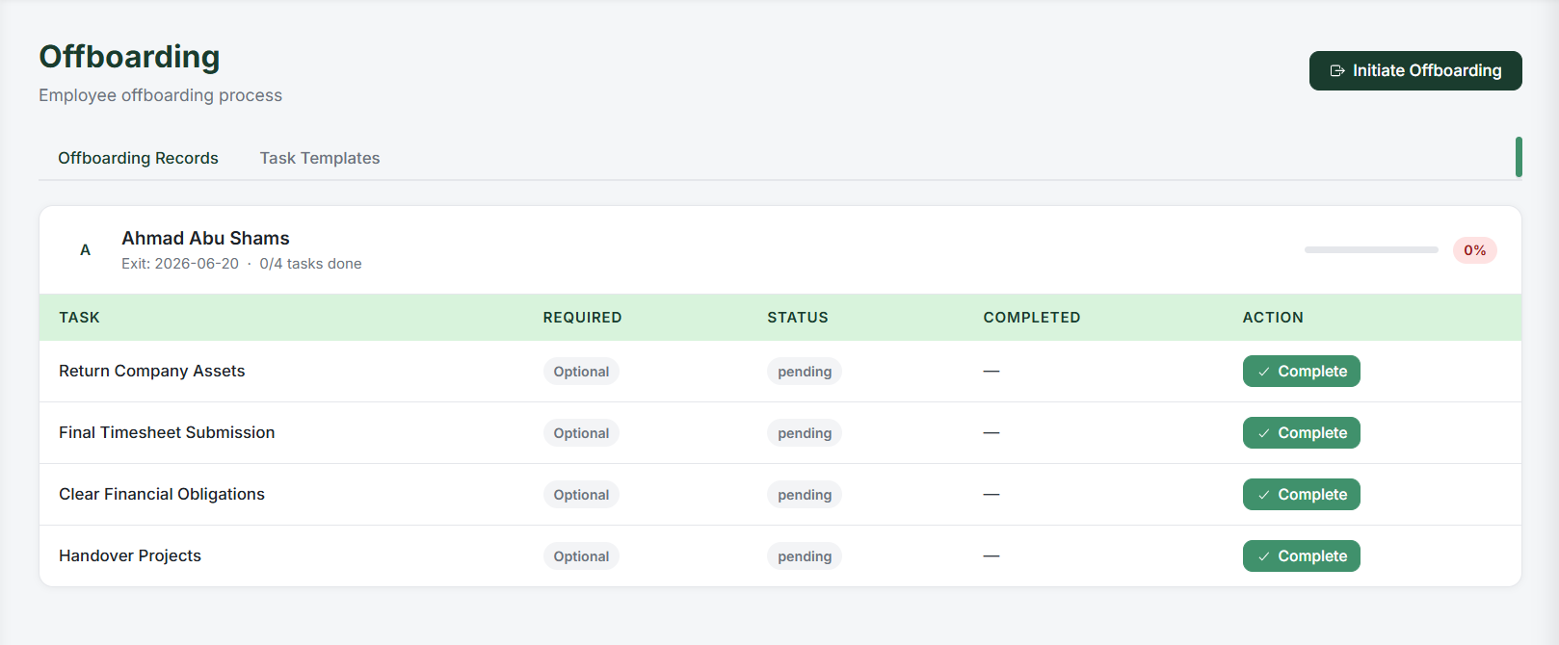
Offboarding Managment
Attendance History

Slide 28
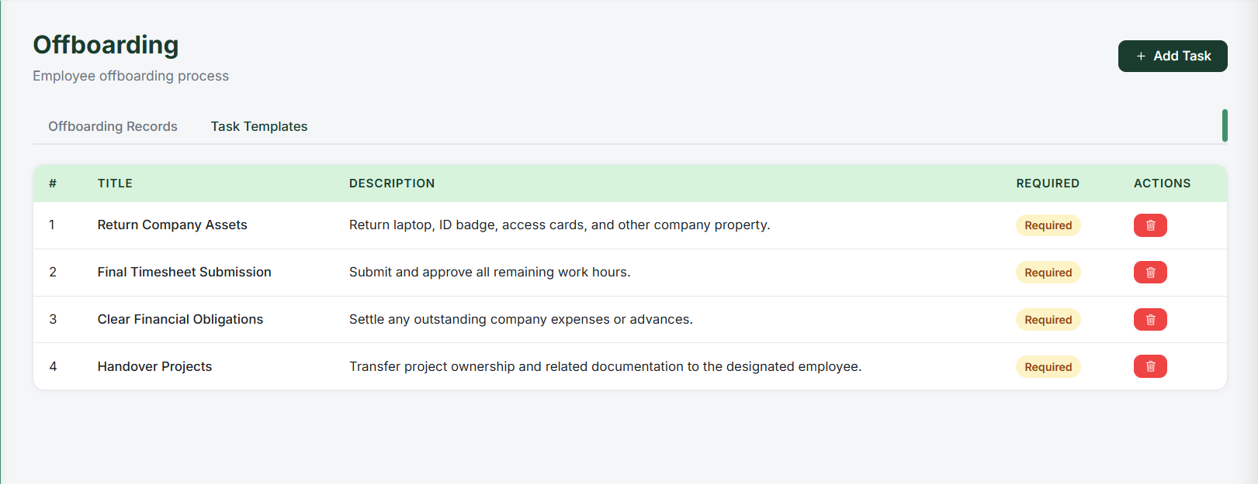
Offboarding Managment

Slide 29
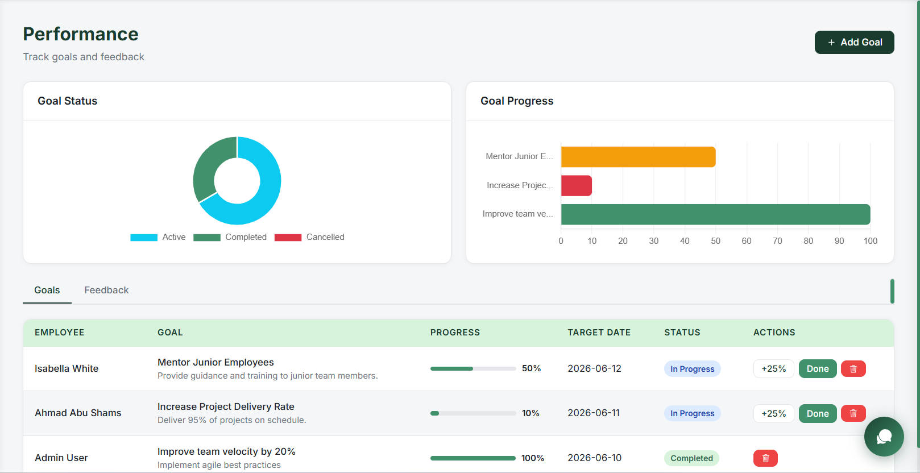
Performance Managment

Slide 30
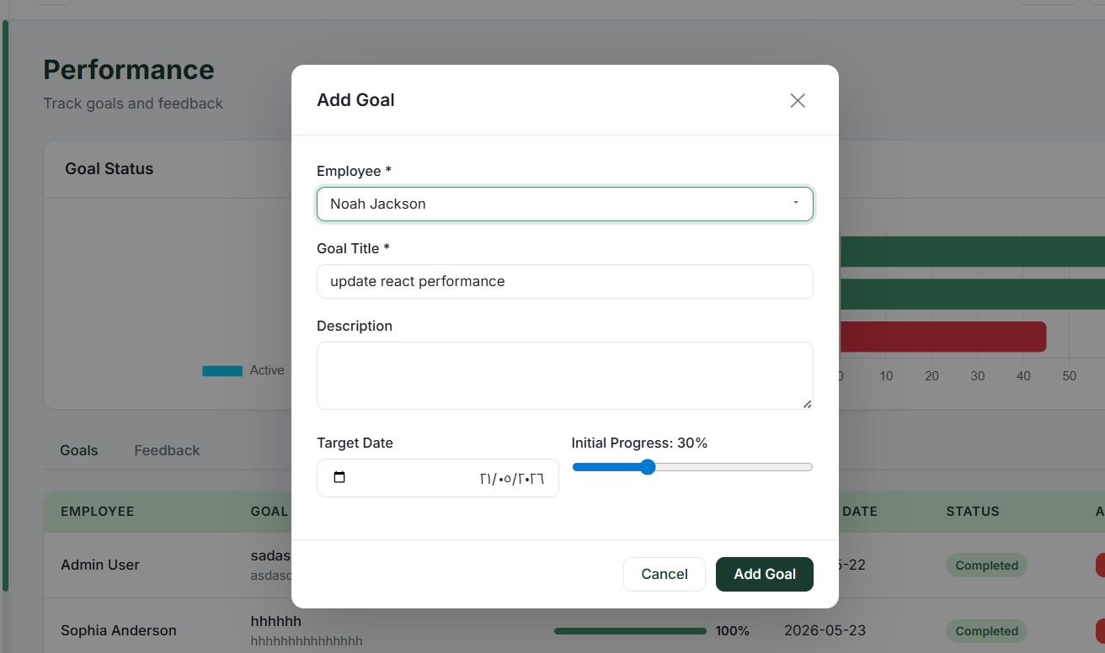
Performance Managment

Slide 31
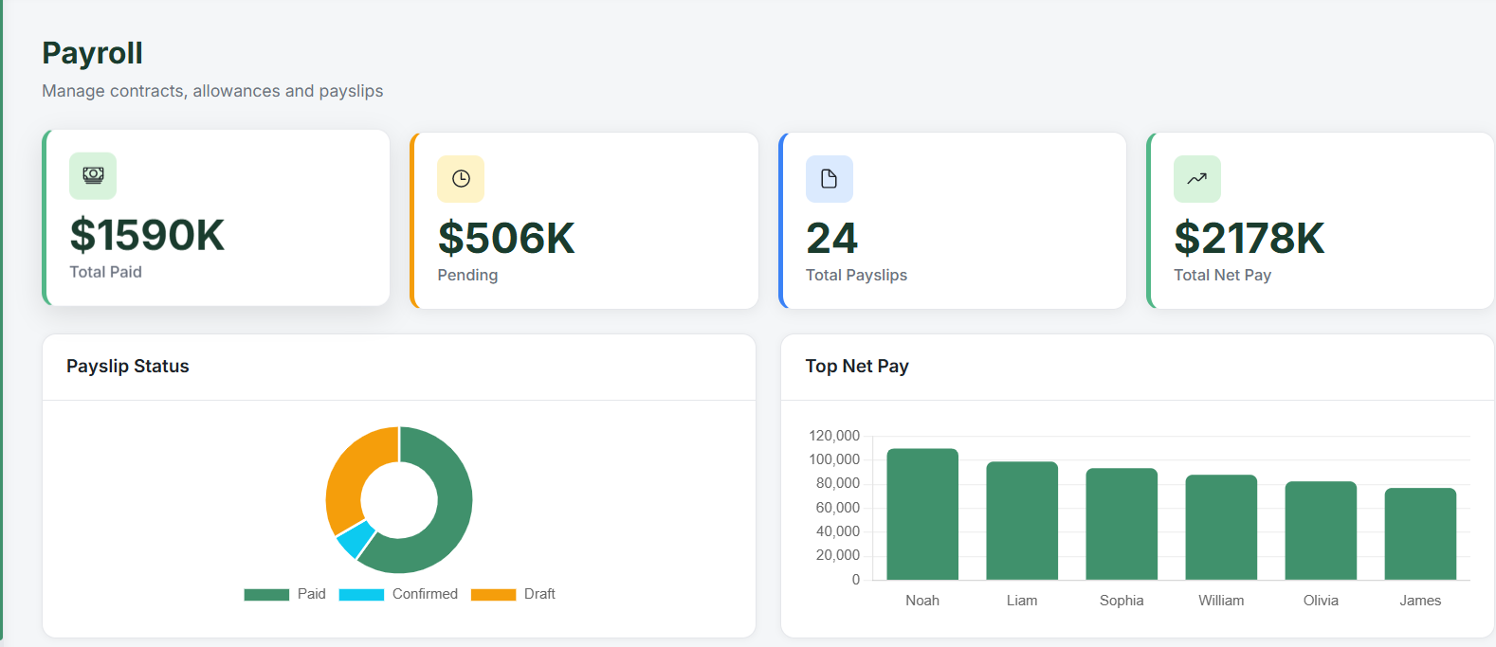
Payroll Managment

Slide 32
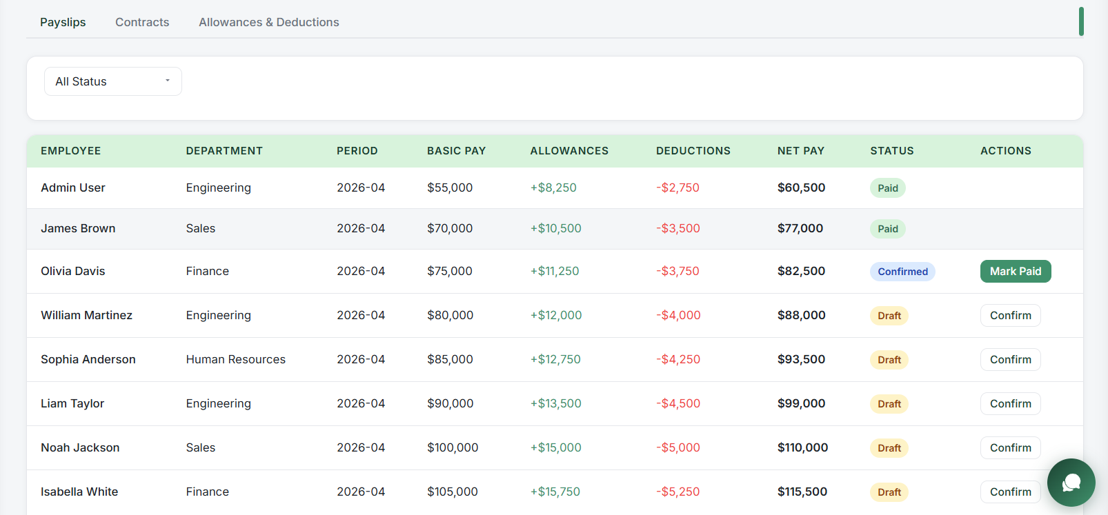
Payroll Managment

Slide 33
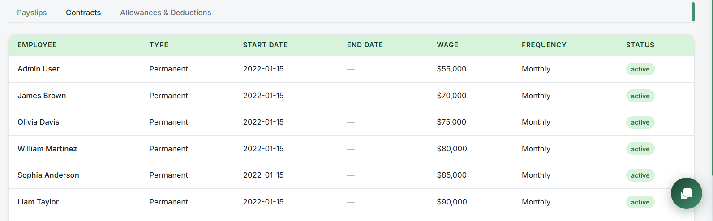
Payroll Managment

Slide 34
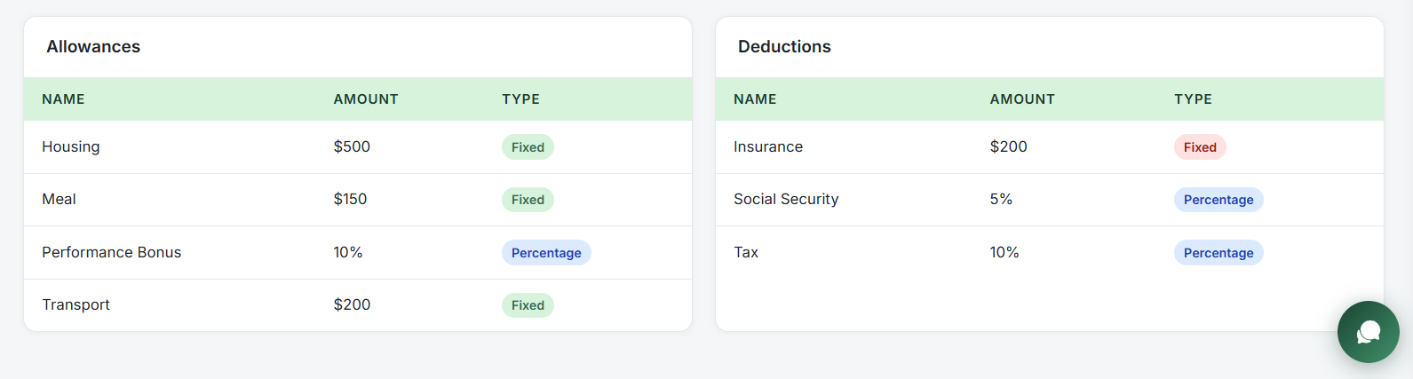
Payroll Managment

Slide 35
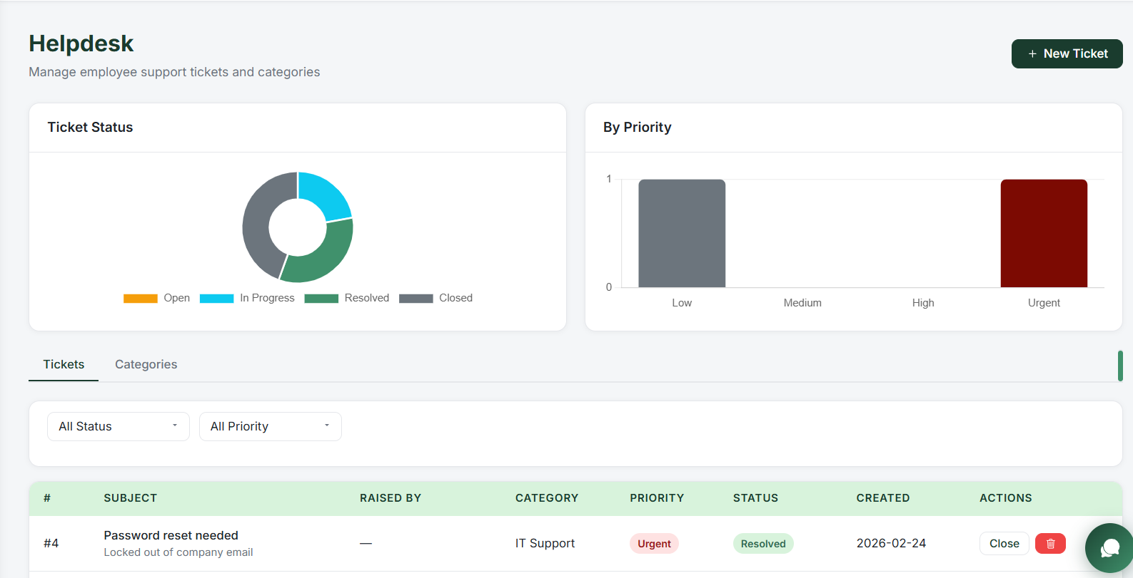
Helpdesk Managment

Slide 36
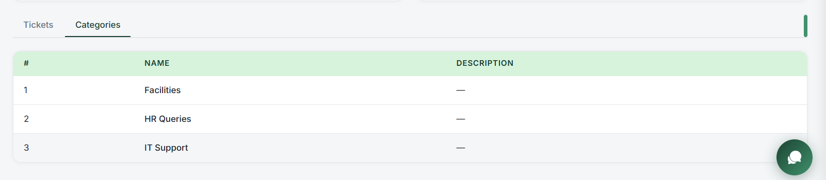
Helpdesk Managment

Slide 37
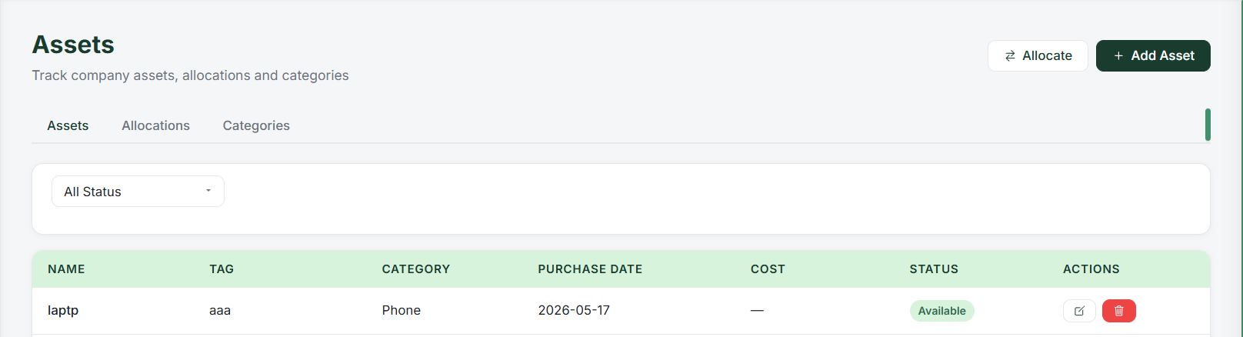
Assets Managment

Slide 38
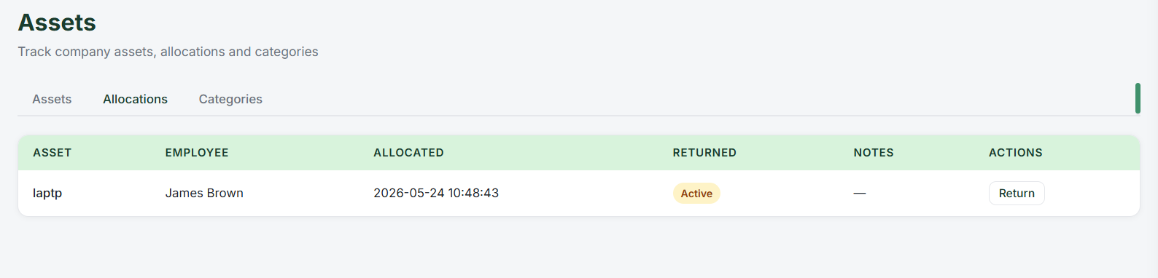
Assets Managment

Slide 39
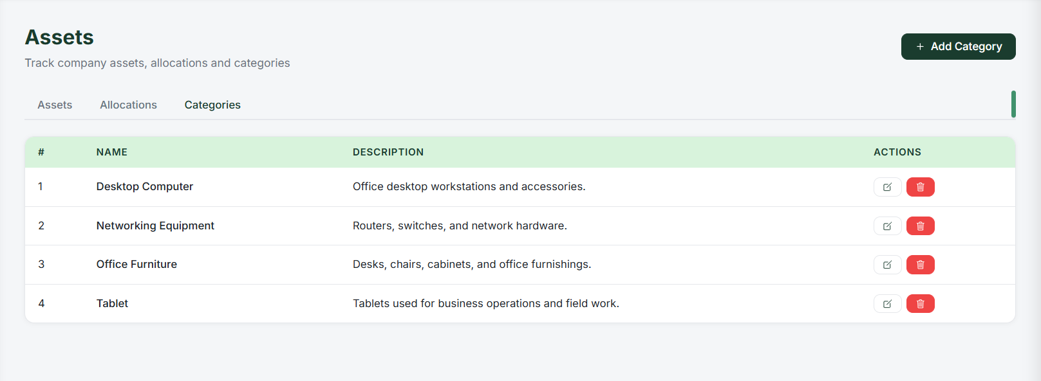
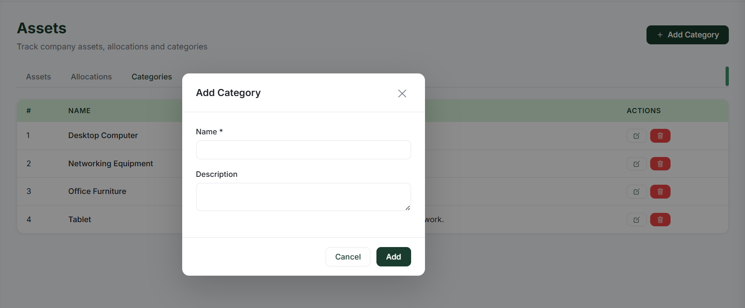
Assets Managment

Slide 40
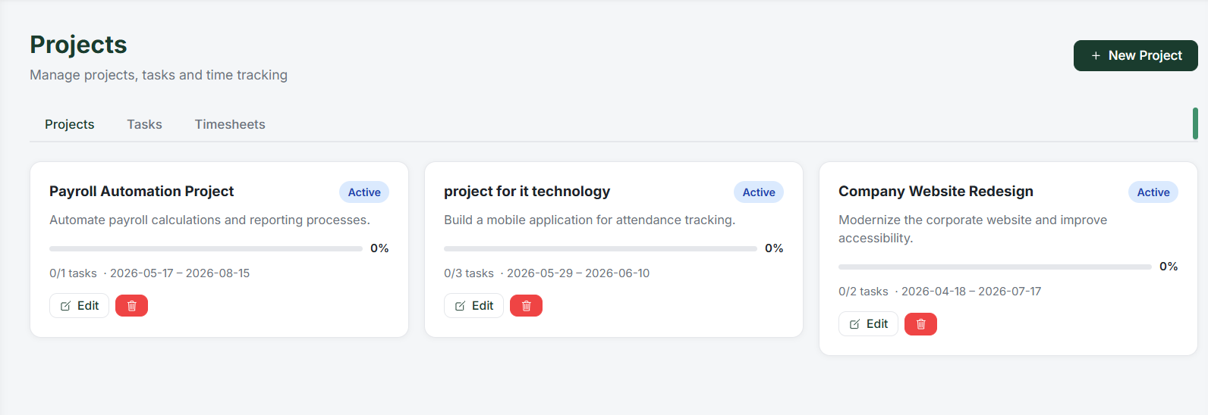
Projects Managment

Slide 41
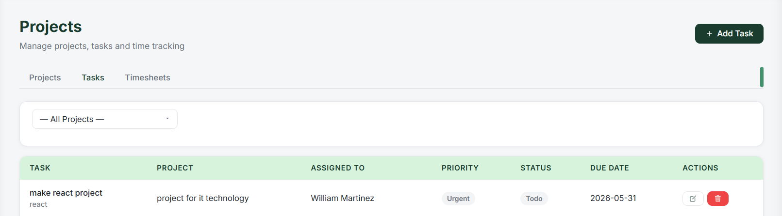
Projects Managment

Slide 42
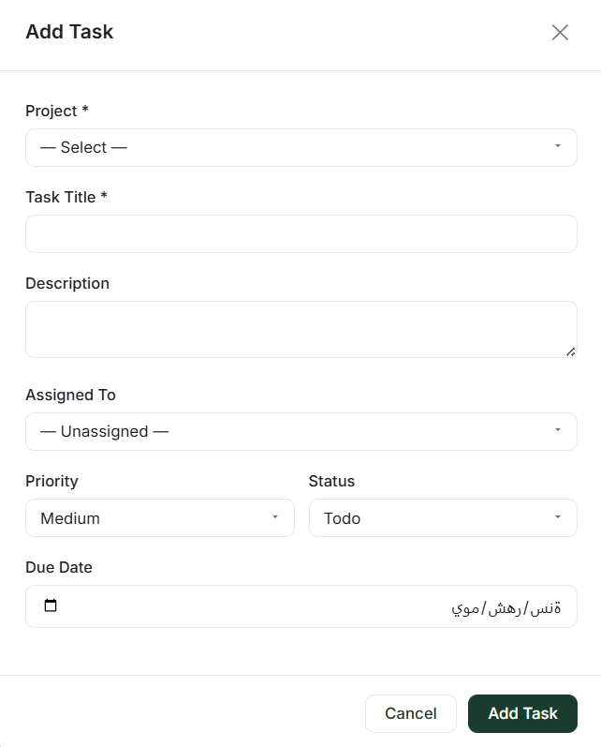
Projects Managment

Slide 43
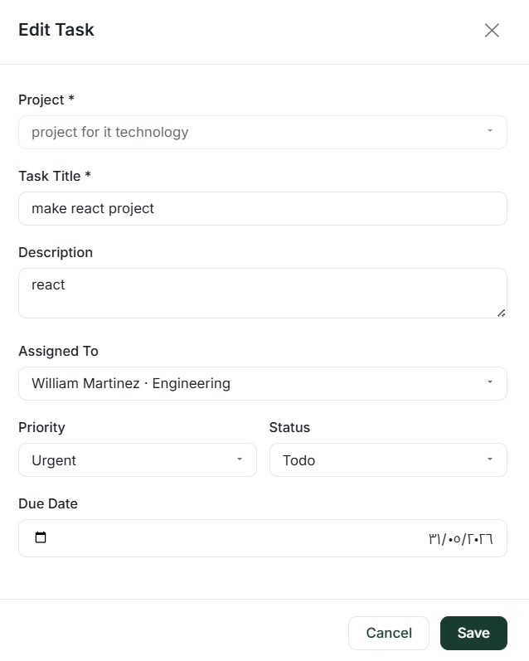
Projects Managment

Slide 44
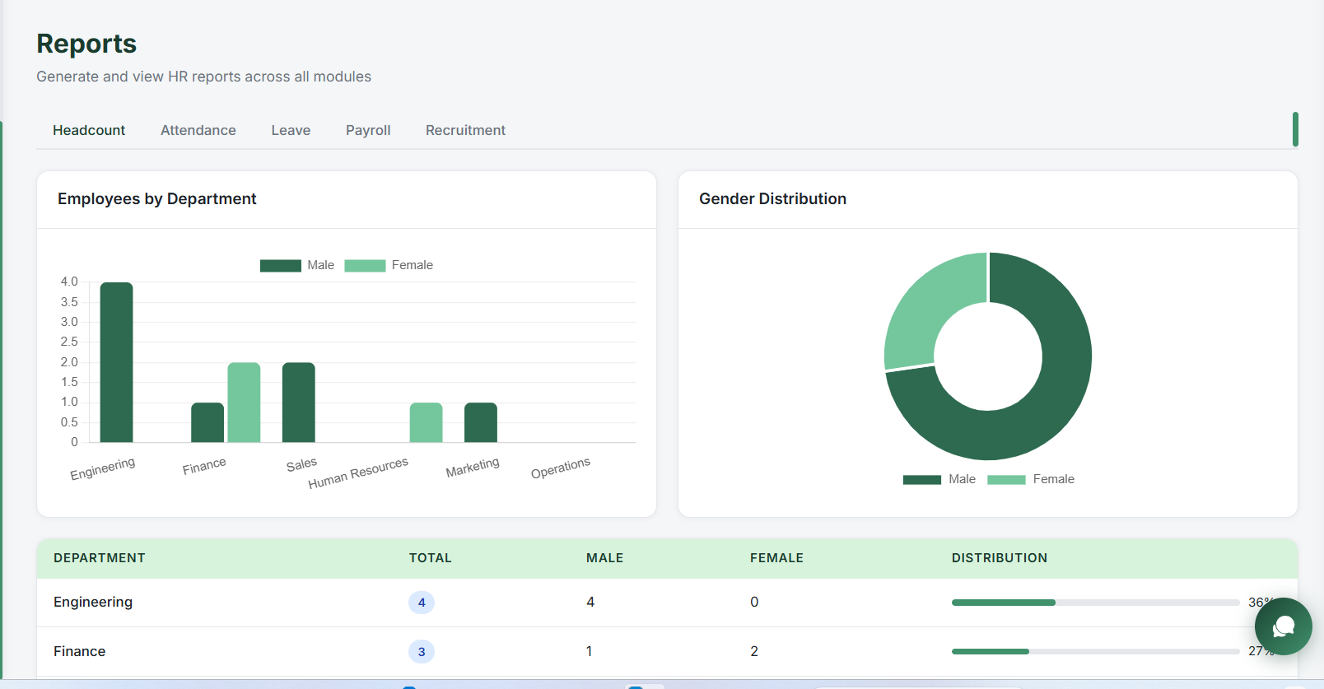
Reports Managment

Slide 45
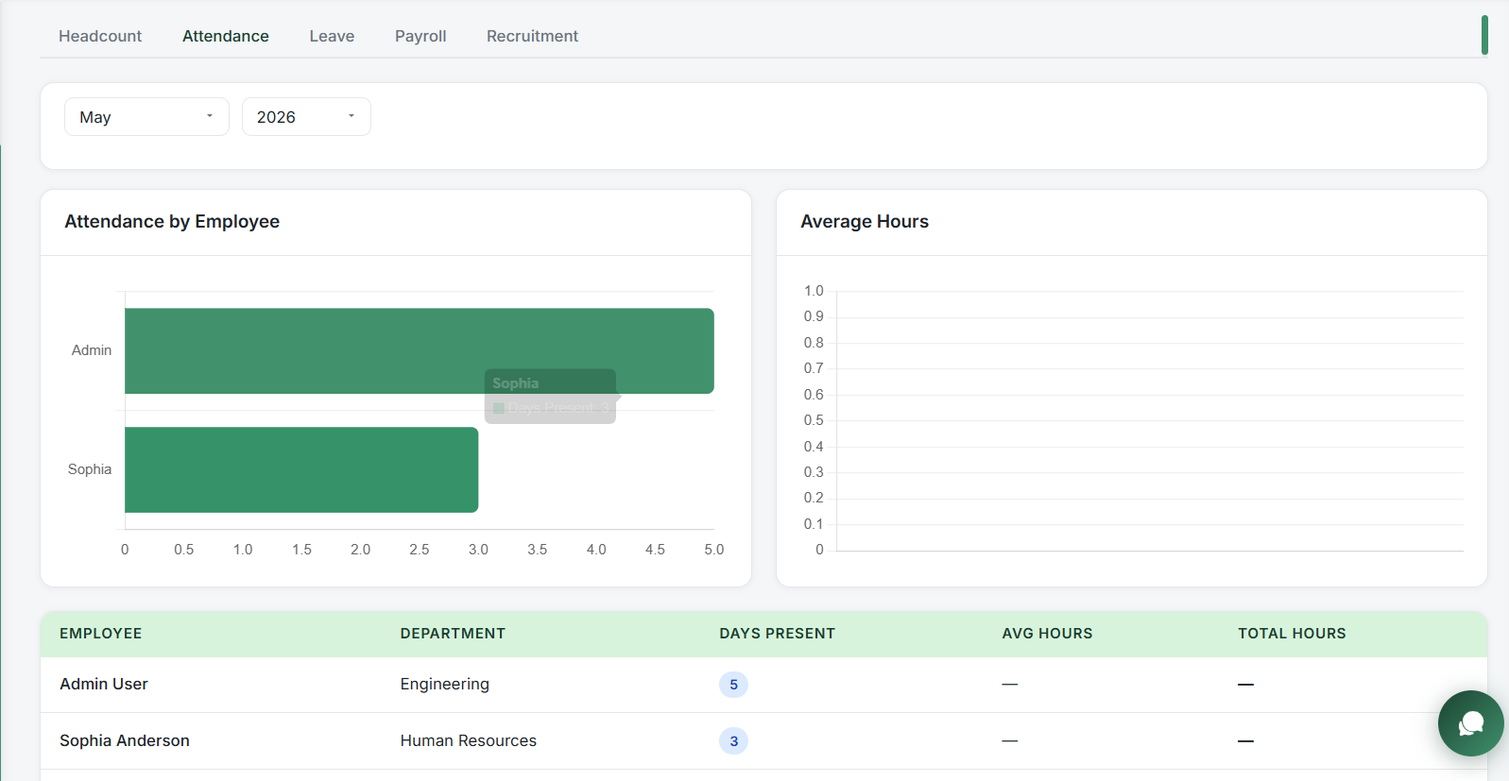
Reports Managment

Slide 46
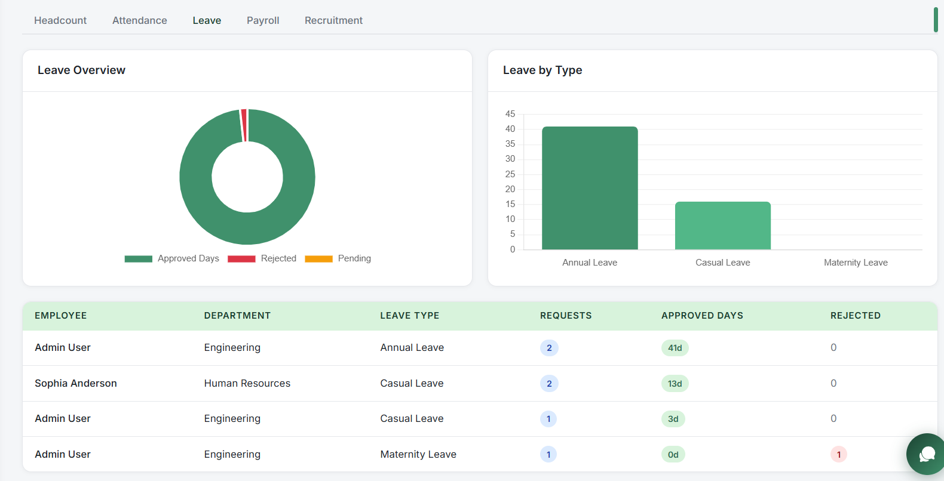
Reports Managment

Slide 47
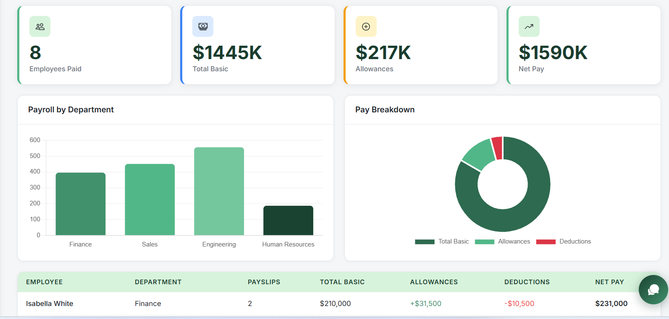
Reports Managment

Slide 48
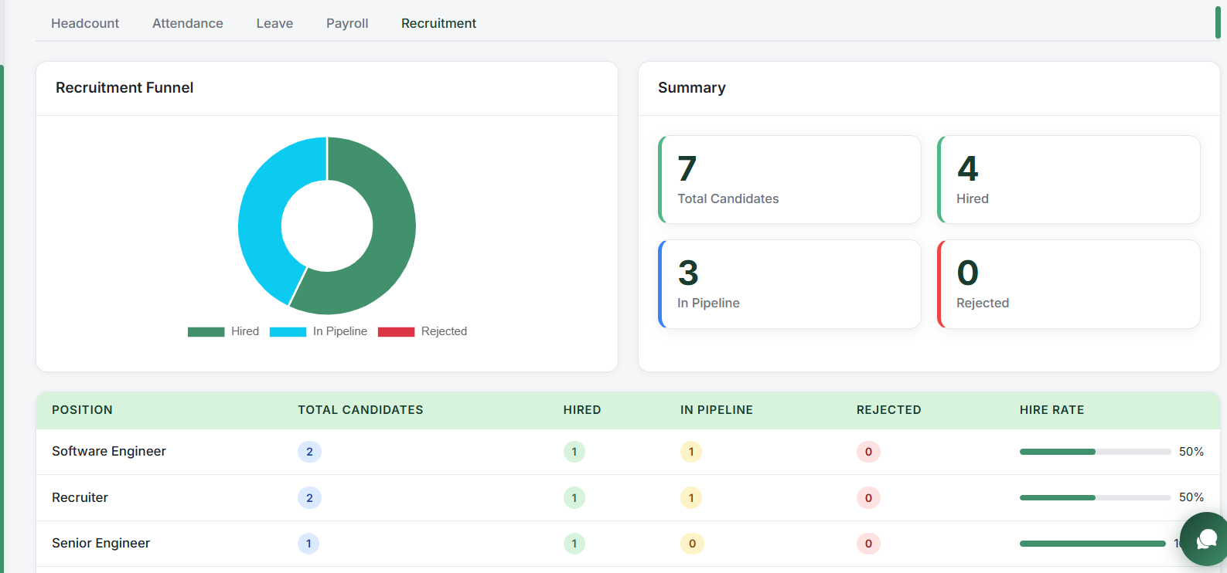
Reports Managment

Slide 49
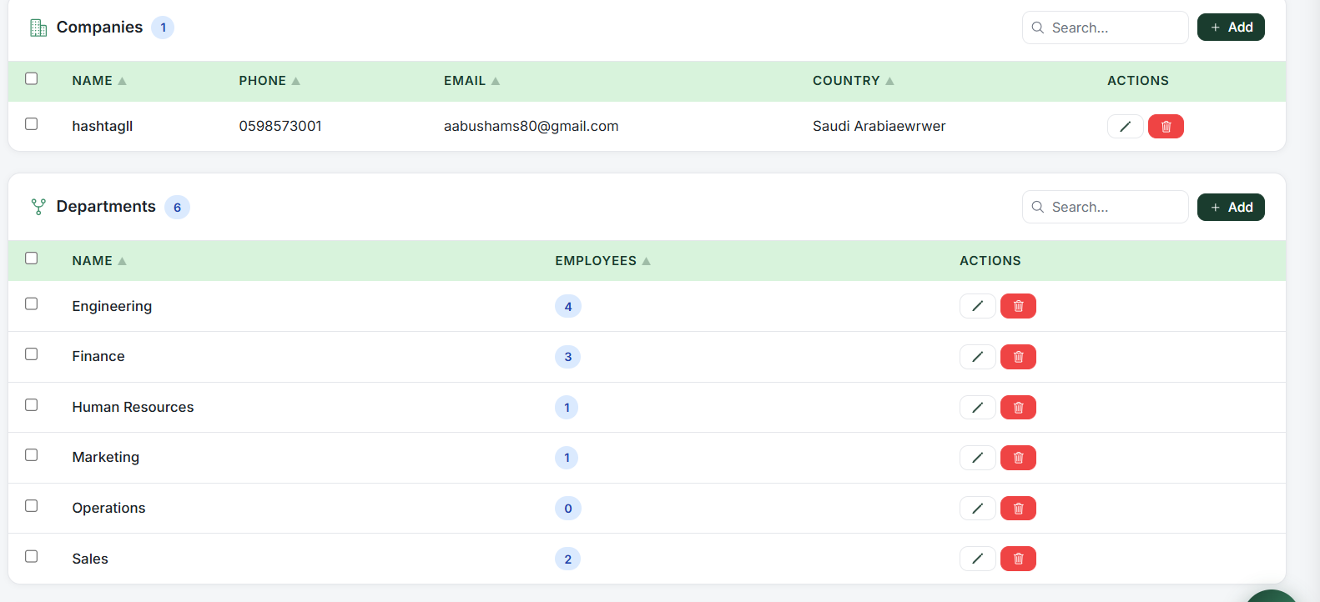
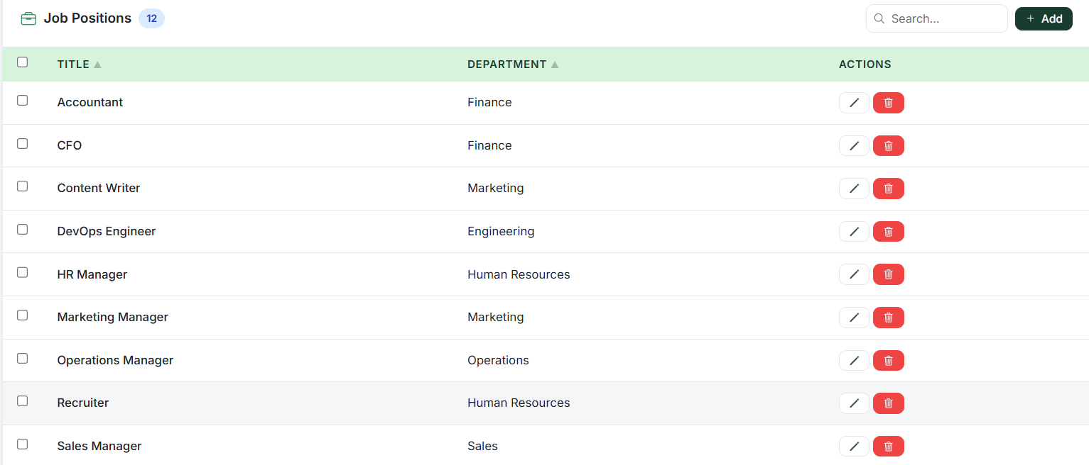
settings Managment

Slide 50
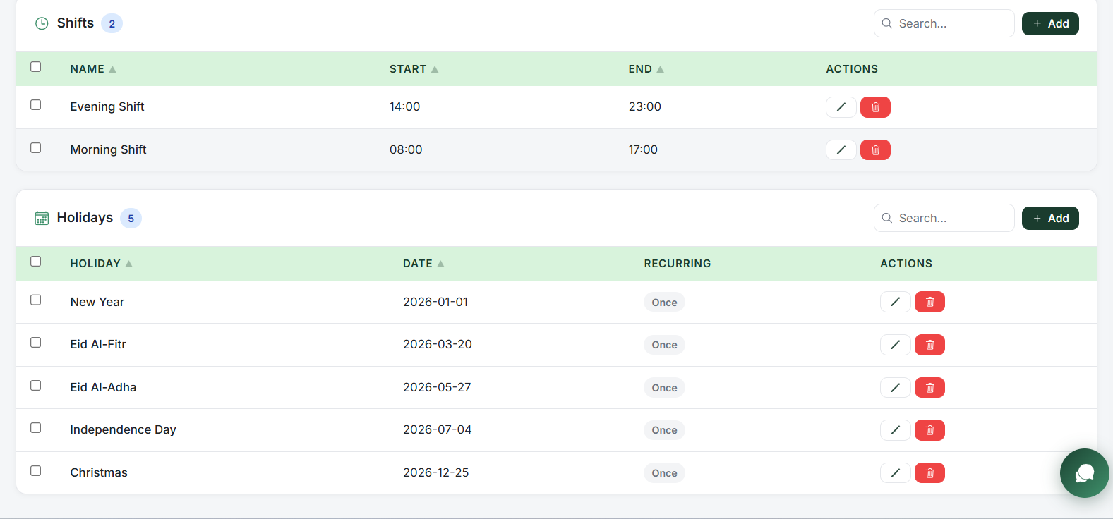
settings Managment

Slide 51

Permissions Managment

Slide 52


Slide 53

Attendece Managment

Slide 54

Leave Managment

Slide 55

Performance Managment

Slide 56

Performance Managment

Slide 57

Payroll Managment

Slide 58

Helpdesk Managment

Slide 59


Slide 60

Employee Profile (in Web)

Slide 61

Employee Profile (in mobile)

Slide 62


Slide 63

Admin Profile (in Web)

Slide 64



Admin Profile (in mobile)

Slide 65


Admin Notification

Slide 66


Employee Notification

Slide 67



Chat Assistant

Slide 68


Slide 69


Frontend Technologies
For Web
For Mobile

Slide 70

Backend Technologies

Slide 71

DBM Technologies

Slide 72


Slide 73
Constraints
1-AI & System Integration Complexity: Integrating AI-driven assistance, real-time analytics, and multiple HR modules into one centralized platform required advanced architectural planning and extensive testing.
2-Scalability & Performance Challenges: Ensuring smooth system performance while handling dynamic dashboards, charts, attendance tracking, payroll processing, and real-time organizational data was a significant challenge.
3-Advanced Role-Based Security Management: Implementing a secure and flexible Role-Based Access Control (RBAC) system for Super Admins, Managers, and Employees required complex permission handling and module-level access control

Slide 74
Future Work
1-Implement a biometric attendance system using fingerprint or face recognition.
2-Add a real-time communication system between employees and the HR department.
3-Develop more advanced analytics and intelligent reporting features.

Slide 75


Slide 76
Conclusion
CoreHR successfully provides a modern and centralized Human Resource Management solution that simplifies and automates many HR operations within organizations. The system integrates employee management, attendance tracking, leave management, recruitment, payroll, onboarding, offboarding, project management, and reporting into one unified platform.
By combining both web and mobile platforms, CoreHR improves accessibility, efficiency, transparency, and communication between employees, managers, and HR departments. In addition, the integration of smart insights and automation features helps reduce manual work and supports faster decision-making.
Overall, the project demonstrates how digital transformation can enhance HR processes and create a more organized, secure, and productive working environment for modern organizations.

Slide 77


Slide 78


