Slide 1

An-Najah National University
Engineering Collage
Civil Engineering Department
Graduation project:
Jaba’a Institution
Supervised by: Dr. Riyad Abdel-Karim Awad
Dr.Sameer El Helw
By :Fadi Hamaydi

Slide 2
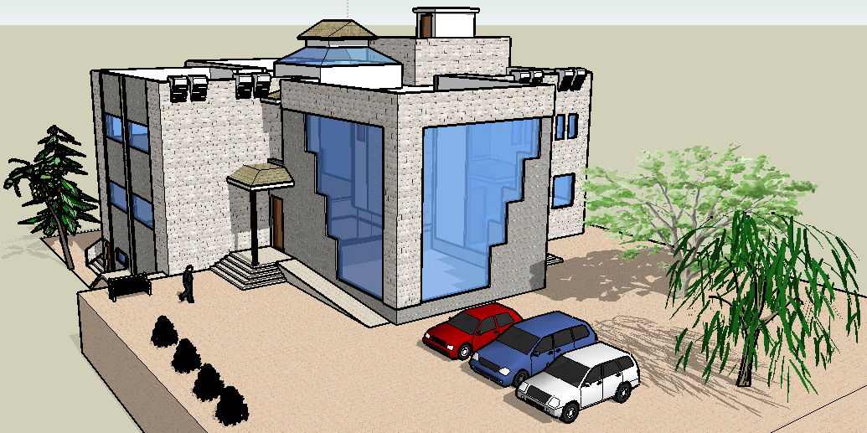
Chapter One: Introduction

Slide 3
Project description
“Jaba’a Institution" building is to be constructed in Jenin
on a 1153.16 m² area. It consists of two stories and basement, basement which has the balance tank, machine room, water tank and boilers room with an area of 61.34 m² ground floor which has a swimming pool, athletics hall, cafeteria, showers, WC, Jacuzzi, Turkish bath and sauna with an area of 511.13 m², first floor which has Multipurpose Hall, Balconies, Computer and Internet Center, Tables Tennis Hall, Library, path rooms, WC, and the Office of Management with an area of 492.15 m² and stairs with an area of 44.7 m² for the ground floor and 44.7 m² for the first floor

Slide 4
Project description
From a structural point of view the structural
elements, footings, columns, beams, and slabs will be
designed statically by hand and using SAP.
The result steel reinforcement will be drown by AutoCAD .

Slide 5
Design Determinants
Materials:
Concrete: For beams , slabs and columns:
Fc = 28 MPa , γ= 25 KN/m³
Reinforcing Steel:
Fy =420 MPa
Soil : Bearing capacity = 250 KN/m²

Slide 6
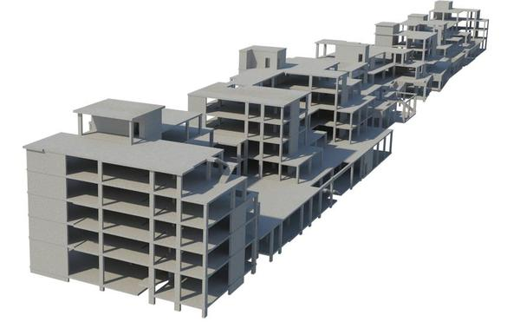
Chapter two : Preliminary design

Slide 7
2.Preliminary design
Two way raft slab

Slide 8
Preliminary design
1- Beams
Dimensions : 30cm*50cm drop main beams
20*50cm drop secondary beams
αfm = 1.67
ℓn = 9.4 m
h _{min.} = 940/21 = 45 cm
use h = 50cm
B1(30*50cm) B2(20*50cm)

Slide 9
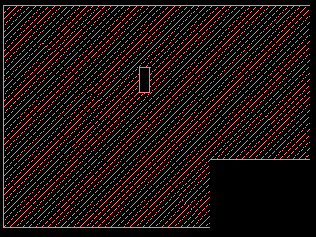
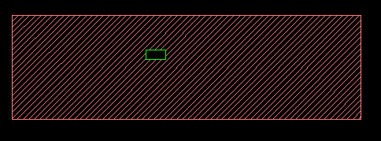
Preliminary design
2-Column :
Dimension : 30cm*60cm
Dimension : 30cm*70cm
By conceptual: 400\30= 13.3< 15 → short column.
P_{d}= λ Φ {0.85*fc (Ag – As) + (As fy)}
column #(8)
Total load on column =1415kN
Use ρ =1%, f 'c=28 N/mm²
Ag= 1470cm² →Use column of 30×70cm.
Total load on column =1120 kN
Use ρ =1%, f 'c=28 N/mm²
Ag= 980cm² →Use column of 30×60cm.
column #(14)

Slide 10
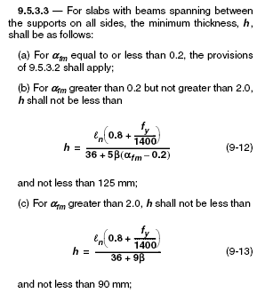
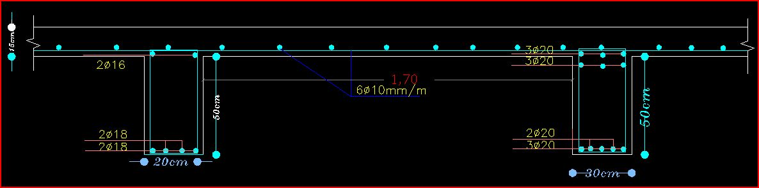
Preliminary design
    3.Slab
αfm = 1.67
ℓn = 1.75 m
h _{min.} = 12.5cm
use h = 15cm
Cross section in slab

Slide 11


Loads
DL = 3.75 KN/m²
SID = 4 KN/m²
LL = 4 KN/m²
Wu = 1.2(3.75+4)+1.6(4) = 15.7 KN/m/m`
➔ No need for shear reinforcement.

Slide 12
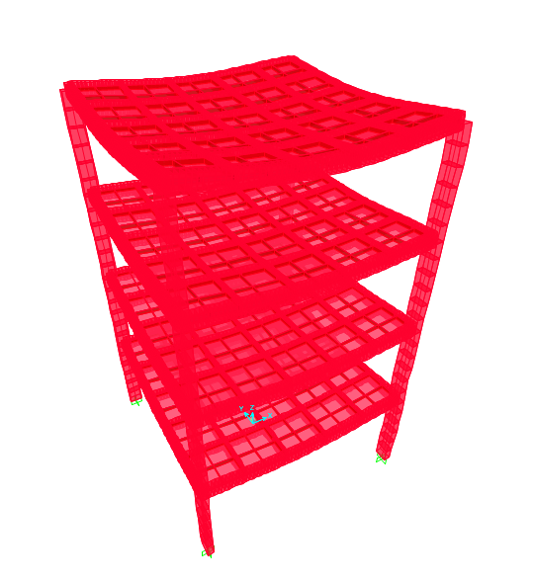
Chapter Three:3D
MODELING Design

Slide 13
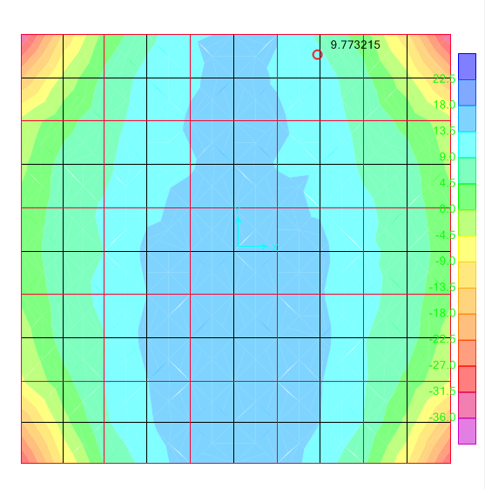
Flexure design for slab
Max moment = 17.23 KN.m
b=1000mm , d=110mm , ƒ`с=28MPa
ρ = .0039
Bending moment diagram
As = ρ b d = .0039*100*11 = 4.3 cm²
Use 6ф10/m′ in both directions

Slide 14
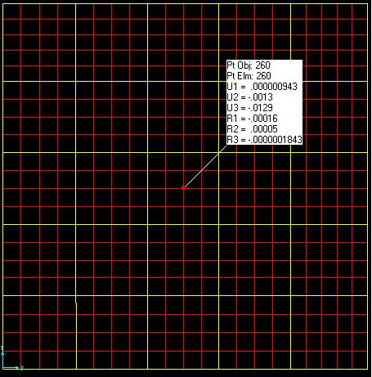
Check deflection for slab
Δ _{L} = 12.9 mm
Δ _{allowable} = L/240 = 40mm
(L: maximum span length (L= 9.6m)).
Δ _{allowable} ≥ Δ _{long-term}
₍40mm ≥ 13 mm)……………..OK.
Deflection from live load (SAP)

Slide 15

Design beam reinforcement
Main beam reinforcement B1(30/50)
Top reinforcement
Max moment= 270.1kN.m
ρ = .0133
Cover = 5cm
As = ρ b d = .0133*30*45 =17.96 cm²
Use 6ф20mm

Slide 16

Bottom reinforcement
Max moment= 204.6kN.m
ρ = .00973
Cover = 5cm
As = ρ b d = .00973*30*45 =13.14 cm²
Use 5ф20mm

Slide 17

Secondary beam reinforcement B2(20/50)
Top reinforcement
Max moment= 31.6kN.m
ρ = .0021
ρmin = = .0033
Cover = 5cm
As = ρmin b d = .0033*20*45 =3 cm²
Use 2ф16mm

Slide 18

Bottom reinforcement
Max moment= 147.6kN.m
ρ = .0106
Cover = 5cm
As = ρ b d = .0106*20*45 =9.56 cm²
Use 4ф18

Slide 19


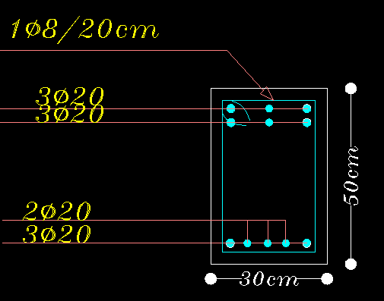
Design for shear
Shear force at distance (d) for main beams = 170 KN.
V_{n} = 170/0.75 = 226.7 KN.
=
-
= 226.7-132.3 = 94.4 KN.
= 0.5 mm²/mm.
=0.5, Using
8 mm stirrups→ A_{V} =100.48 mm²
S=
=201 mm →use S=200mm.
Use 1 Ф
8 mm stirrup/200mm.

Slide 20


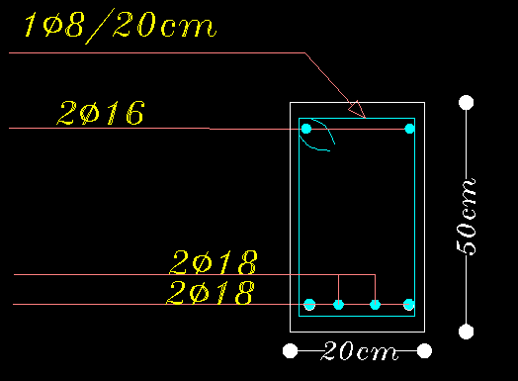
Shear force at distance (d) for secondary beams = 135 KN V_{n} = 135/0.75 = 180 KN.
=
-
= 180- 88.2 = 91.8 KN.
V_{S} < 2* V_{C} → max. Spacing =min. of (d/2, 600 mm) =min. of (450/2, 600 mm)= 225 mm.
=0.48 mm²/mm.
8 mm stirrups→ A_{V} =100.48 mm²
=0.48, Using
S=
=209 mm →use S=200mm.
Use 1
8 mm stirrup/200mm.

Slide 21
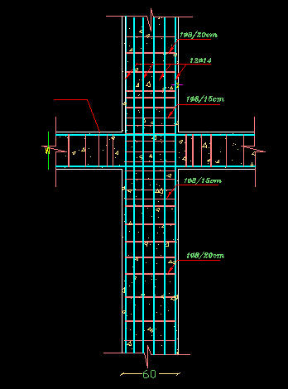
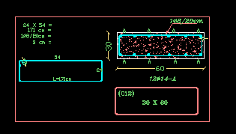
Design of column
Col. # | Col. dimension | Main steel | Stirrups
C1 (8,9) | 70*30 | 10Ф 16 | 2Ф 8 @20cm
C2 Other columns | 60*30 | 12 Ф14 | 1Ф 8 @20cm
Cross section of column C2
Longitudinal section of column C2

Slide 22
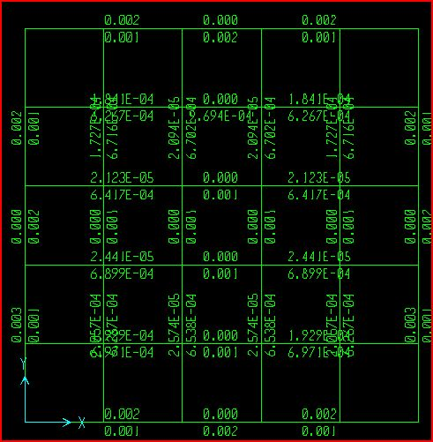
Replicating to four stories
According to preliminary design (Columns: C1 70X30 cm C2 60X30cm ,Beams:B1 50X30 cm B2 50X20cm ,
Slab: 15 cm) ,
After replicating the structure to seven stories and checking the structure by SAP
(sway ordinary)

Slide 23
Design of tie beams
Minimum thickness of beam (h_{min}):
h min = 1000/18.5= 54 cm.
However beams fail by strength not by deflection, so use beams 30cm×60cm.
The area of steel taken from SAP is less than minimum area of steel which is equal to 550 mm².
Minimum area of steel = 0.0033*b*d = 550 mm².
➔Use negative steel 550 mm².
Use 3Ф16mm bottom steel
➔Use positive steel 450 mm².
Use 3Ф14mm top steel

Slide 24

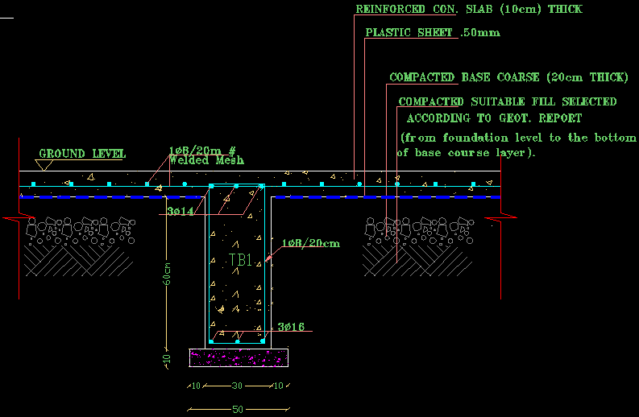
Shear design
Vu at distance (d = 55cm) = 18.5 KN.
Which is smaller than ФVc =109 KN.
Use maximum spacing S=d/2= 55/2 = 27.5cm.
Use S =20cm.
Use 1 Ф8 mm@20cm
Tie Beams Details
T.B number | Dimensions | Top steel | Bottom steel | Stirrups
T.B 1 | 30*60cm | 3Ф14mm | 3Ф16mm | 1 Ф8 mm@20cm
*Note: Top and bottom steel should be extended to the 1/4 length of the largest next span.
Tie beam section

Slide 25
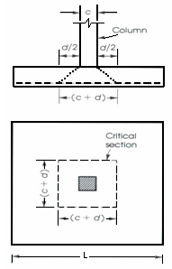




Design of footing
B.C=250KN/m²
Design of isolated footing
Footing F1:
Required area of the footing:
Ultimate pressure under the footing:
q_{u}= = = 310 KN/m².
Ultimate load = (7.75*1.2+4*1.6)(20)(3)= 950 KN.
Service load = 250 KN.
+
=
+
=
A_{freq}= 1.3 m².
B= 1.8m, L= 2.1m

Slide 26


Effective depth of footing:
Vu = q_{ult} (L – d) = 310*(.75 – d)
ØVc = 0.75*(1/6)* * 1000 *d
Vu = ØVc→ d = 0.24m →Use d= 35cm, h= 40 cm
Check for punching shear:
Ultimate shear force:
Vu = q_{ult}[B*L – (c₁+d)*(c₂+d)] = 310[(1.8*2.1) – (0.6+0.35)*(0.3+0.35)] = 980.0KN
Provided nominal strength:
ØVc = 0.33* b_{o} d
b_{o} = 2(c₁+d) + 2(c₂+d) = 2(600+350) + 2(300+350) = 3200mm
ØVc = 0.33*0.75 * 3200*350/1000 = 1467 KN> Vu → ok
Flexural design:
M_{u} = = = 87.2KN.m
ρ=0.002
A _{st} = ρ *b*d = 0.002*1000*350 = 700 mm²/m.
Use 5Ø 14mm/m' in both directions.
Shrinkage steel:
A _{shrinkage} =0.0018Ag /2
use 1 Ø 14 @50cm In both directions.

Slide 27

Footing F2:
Ultimate load = (7.75*1.2+4*1.6)(30)(3)= 1413KN.
Service load = 1058 KN.
Required area of the footing:
A_{freq}= 4.23 m².
B= 2m, L= 2.3m
Ultimate pressure under the footing:
q_{u}= = = 307.2 KN/m².
Effective depth of footing:
Vu = q_{ult} (L – d) = 307.2*(.85 – d)
ØVc = 0.75*(1/6)* * 1000 *d
Vu = ØVc→ d = 0.27m →Use d= 35cm, h= 40 cm
Check for punching shear:
Ultimate shear force:
Vu = q_{ult}[B*L – (c₁+d)*(c₂+d)] = 307.2[(2*2.3) – (0.6+0.35)*(0.3+0.35)] = 971.5KN
=

Slide 28
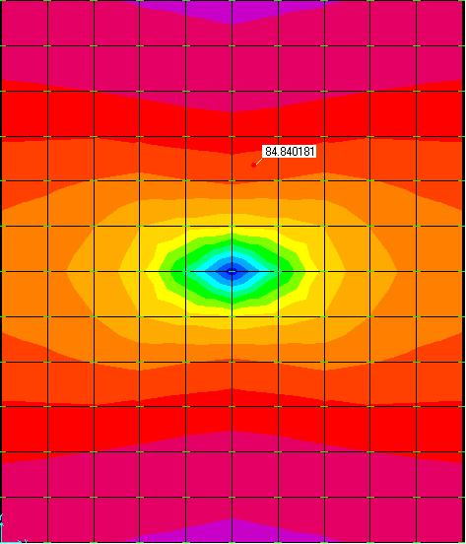

Provided nominal strength:
ØVc = 0.33* bo d
bo = 2(c1+d) + 2(c2+d) = 2(600+350) + 2(300+350) = 3200mm
ØVc = 0.33*0.75 * 3200*350/1000 = 1467 KN> Vu → ok
Flexural design:
Mu = = = 86.4KN.m
ρ=0.002
A st = ρ *b*d = 0.002*1000*350 = 700 mm2/m.
Use 5Ø 14mm/m' in both directions.
Shrinkage steel:
A _{shrinkage} =0.0018Ag /2
use 1 Ø 14 @50cm In both directions.
M11 for footing F2

Slide 29



Footing F3:
Ultimate load = (7.75*1.2+4*1.6)(23.82)(3)= 1122KN.
Service load = 840 KN.
Required area of the footing:
+
+ = 250
A_{freq}= 5.2 m².
B= 2.3m, L= 2.7m
Ultimate pressure under the footing:
q_{u}= + = + = 320 KN/m².
Effective depth of footing:
Vu = q_{ult} (L – d) = 320*(1– d)
ØVc = 0.75*(1/6)* * 1000 *d
Vu = ØVc→ d = 0.33m →Use d= 45cm, h= 50 cm
Check for punching shear:
Ultimate shear force:
Vu = q_{ult}[B*L – (c₁+d)*(c₂+d)] = 320[(2.3*2.7) – (0.6+0.45)*(0.3+0.45)] = 1735.2KN
=

Slide 30

Provided nominal strength:
ØVc = 0.33* bo d
b_{o} = 2(c₁+d) + 2(c₂+d) = 2(600+450) + 2(300+450) = 3600mm
ØVc = 0.33*0.75 * 3600*450/1000 = 2122 KN> Vu → ok
Flexural design:
Mu = = = 160KN.m
ρ=0.002 1
A st = ρ *b*d = 0.0021*1000*450 = 957 mm2/m.
Use 7Ø 14mm/m' in both directions.
Shrinkage steel:
A _{shrinkage} =0.0018Ag /2
use 1 Ø 14 @50cm In both directions.

Slide 31



Footing F4:
Ultimate load = (7.75*1.2+4*1.6)(27.97)(3)= 1347KN.
Service load = 986 KN.
Required area of the footing:
+ =
+ = 250
A_{freq}= 6.85 m².
B= 2.6m, L= 3m
Ultimate pressure under the footing:
q_{u}= + = + = 318 KN/m².
Effective depth of footing:
Vu = q_{ult} (L – d) = 318*(1.15– d)
ØVc = 0.75*(1/6)* * 1000 *d
Vu = ØVc→ d = 0.37m →Use d= 45cm, h= 50 cm
Check for punching shear:
Ultimate shear force:
Vu = q_{ult}[B*L – (c₁+d)*(c₂+d)] = 318[(2.6*3) – (0.6+0.45)*(0.3+0.45)] = 2117KN

Slide 32

Provided nominal strength:
ØVc = 0.33* bo d
b_{o} = 2(c₁+d) + 2(c₂+d) = 2(600+450) + 2(300+450) = 3600mm
ØVc = 0.33*0.75 * 3600*450/1000 = 2122 KN> Vu → ok
Flexural design:
Mu = = = 230KN.m
ρ=0.00308
A st = ρ *b*d = 0.00308*1000*450 = 1387.6mm2/m.
Use 9Ø 14mm/m' in both directions.
Shrinkage steel:
A _{shrinkage} =0.0018Ag /2
use 1 Ø 14 @50cm In both directions.

Slide 33
Design for isolated footing
shrinkage steel (top) |  | Main steel At bottom |  |  |  |  | D (m) | B (m) | L (m) | Foundation No
 | Short Direction | Long Direction |  | Short Direction | Long Direction
 | 3Ø14mm | 2Ø14mm | 11 Ø 14mm |  |  | 1 0Ø 14mm | 0.4 | 1.8 | 2.1 | F1
 | 3Ø14mm | 2Ø14mm | 12 Ø 14mm |  |  | 10 Ø 14mm | 0.4 | 2 | 2.3 | F2
 | 3Ø14mm | 2Ø14mm | 18 Ø 14mm |  |  | 1 5Ø 14mm | .5 | 2.3 | 2.7 | F3
 | 3Ø14mm | 2Ø14mm | 20 Ø 14mm |  |  | 17 Ø 14mm | .5 | 2.6 | 3 | F4

Slide 34




Design of combined footing
Footing F5:
Ultimate load = (7.75*1.2+4*1.6)(48.98)(3)= 2307KN.
Service load = 1726.5KN.
Required area of the footing:
+ =
+ = 250
A_{freq}= 13.5 m²
B= 3.6m, L= 4m
Ultimate pressure under the footing:
q_{u}= + = + = 310 KN/m²
Effective depth of footing:
Vu = q_{ult} (L – d) = 332*(1 – d)
ØVc = 0.75*(1/6)* * 1000*d
Vu = ØVc → d = 0.33m →Use d= 45cm, h= 50 cm

Slide 35

Check for punching shear:
Ultimate shear force:
Vu = q_{ult}[B*L – (c₁+d)*(c₂+d)] = 332[(3*4/2) – (0.6+0.45)*(0.3+0.45)] = 1857.5KN
Provided nominal strength:
ØVc = 0.33 *bo d
bo = 2(c1+d) + 2(c2+d) = 2(600+450) + 2(300+450) = 3600mm
ØVc = 0.33*0.75 * 3600*450/1000 = 2122 KN> Vu → ok
Flexural design:
Mu = = = 142KN.m
ρ=0.002
A st = *b*d = 0.002*1000*450 = 847.7 mm2/m.
Use 6Ø 14mm/m' in both directions.
Shrinkage steel:
A shrinkage =0.0018Ag /2
use 1 Ø 14 @50cm In both directions.

Slide 36
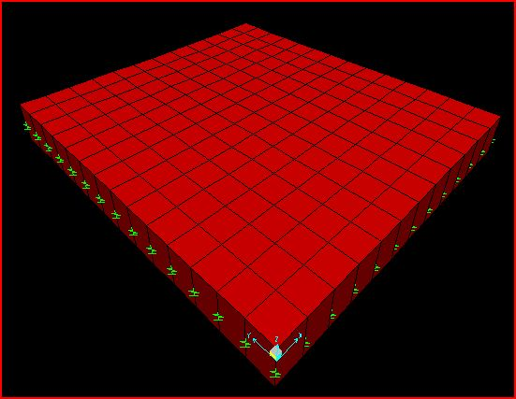
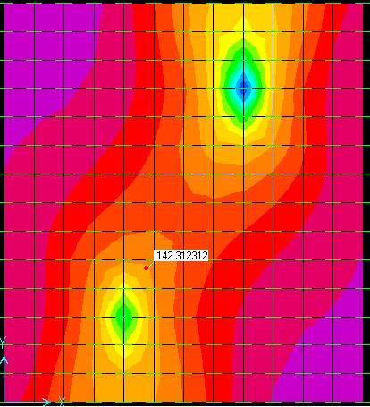
B.M.D for F5
Foundation No | L(m) | B(m) | D(m) | Bottom steel |  | Top steel
 |  |  |  | Long direction | Short direction | Long direction | Short direction
F5 | 4 | 3.5 | .5 | 17Ø 14mm | 18 Ø 14mm | 2 Ø 14mm | 3 Ø 14mm

Slide 37
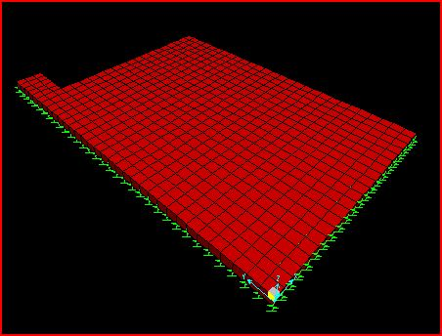
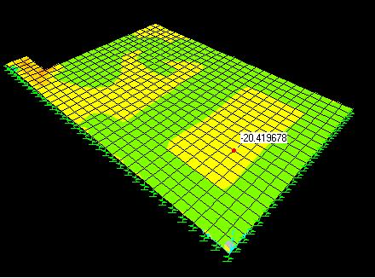
Design of mat foundation
Footing F6:
Point dead load = 15*3*7.75 =348.75KN
Point live load = 15*3*4 =180KN
Point2 dead load = 18*3*7.75 =418.5KN
Point2 live load = 18*3*4 =216KN
Moment on the point = 3.48*(706.5)*1.74 = 4278KN.m
Shear wall load = .2*25*13.5 = 67.5KN/m
Wall load = .3*25*13.5 = 101.25KN
Flexural design:
By using sap
B.M.D

Slide 38
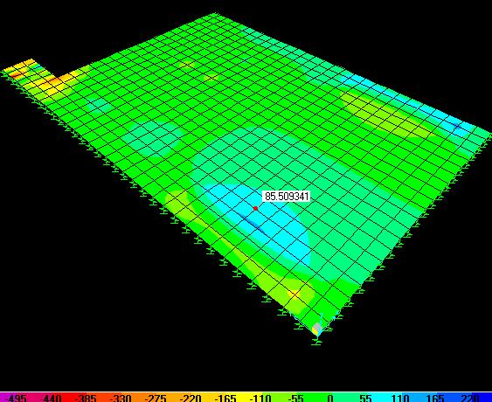
Mu = 20KN.m
ρ =0.000433
ρmin =.002
A st = ρmin *b*d = 0.002*1000*350 = 700 mm2/m.
Use 1 Ø 12mm @16cm
Check for punching shear:
Vu = 110KN
ØVc = 0.33 *b_{o} d
b_{o} = 2(c₁+d) + 2(c₂+d) = 2(600+350) + 2(300+350) = 3200mm
ØVc = 0.33*0.75 * 3200*350/1000 = 1467 KN> Vu → ok
S.F.D

Slide 39
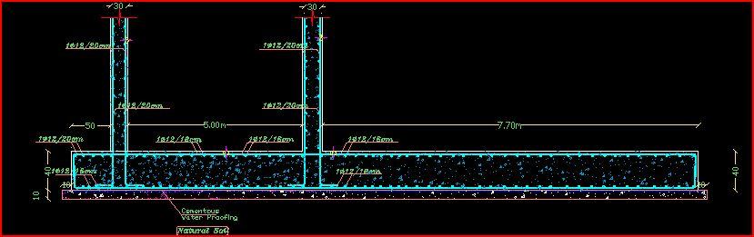
Section in the mat foundation F6

Slide 40
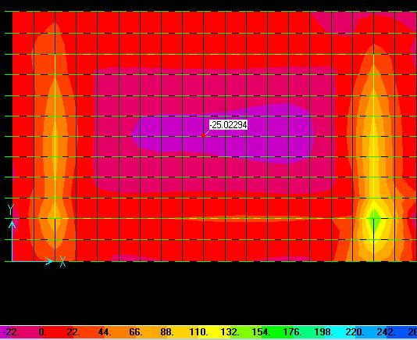
Footing F7:
Dead load on column# 8 = 48*3*7.75 = 1116KN
Live load on column# 8 = 48*3*4 = 576KN
Dead load on column# 7 = 30*3*7.75 = 697.5KN
Live load on column# 7 = 30*3*4 = 432KN
Dead load on column# 4, 3= 10*3*7.75 = 232.5KN
Live load on column# 4, 3= 10*3*4 = 120KN
Flexural design:
By using sap
Mu = 20KN.m
ρ =0.0005
ρmin =.002
A st = ρmin *b*d = 0.002*1000*350 = 700 mm2/m.
Use 1 Ø 12mm @15cm
B.M.D

Slide 41
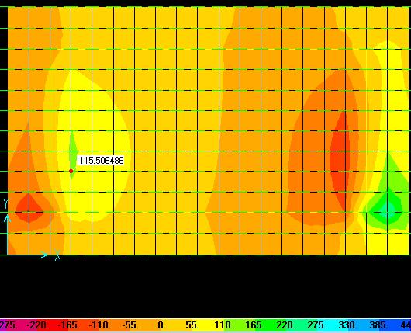
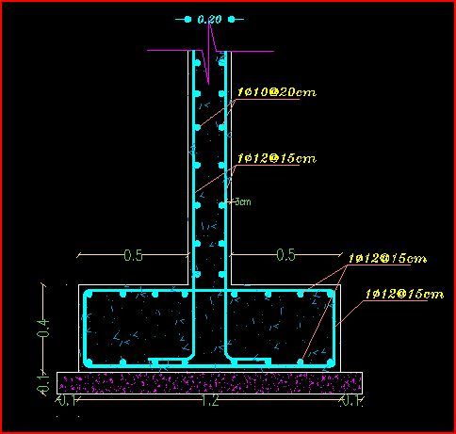
Check for punching shear:
Vu = 115KN
ØVc = 0.33 *bo d
bo = 2(c1+d) + 2(c2+d) = 2(600+350) + 2(300+350) = 3200mm
ØVc = 0.33*0.75 * 3200*350/1000 = 1467 KN> Vu → ok
S.F.D
Section of foundation F7

Slide 42
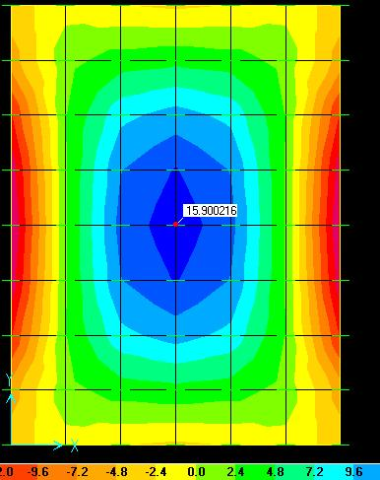
Design of the balance tank, poylars room and machines room
Thickness = 25cm
Load = ɣh = 9.81*3.35 =33KN/m²
Flexural design :
Mu = 16KN.m
ρ=0.001
ρmin =.003
A _{st} = ρmin *b*d = 0.003*1000*200 = 600 mm²/m
Use 6Ø 16mm /m’
B.M.D

Slide 43
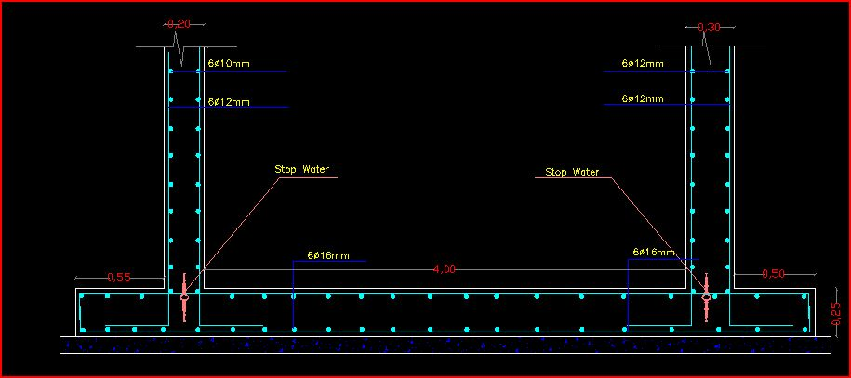
Section on the basement ground

Slide 44
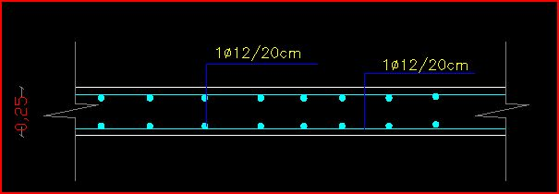
Section in poylar room slab

Slide 45
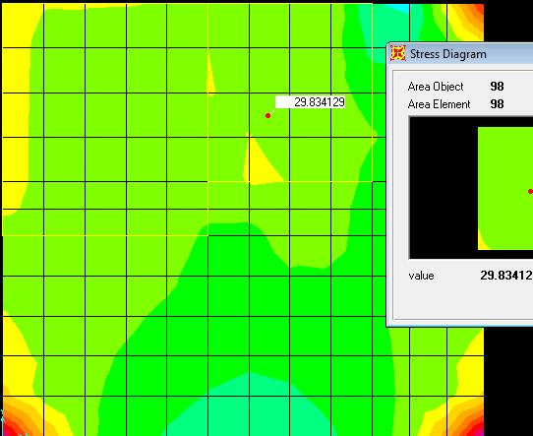
Design for swimming pool
Thickness = 25cm
Load = ɣh = 9.81*2 =20KN/m²
Flexural design :
Mu = 30KN.m
ρ=0.002
ρmin =.003
A _{st} = ρmin *b*d = 0.003*1000*200 = 600 mm²/m
Use 1Ø 12mm @15cm in both directions top & bottom
B.M.D

Slide 46
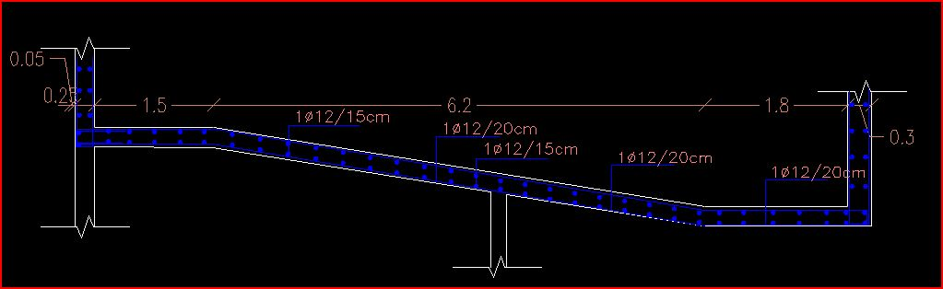
Section in the swimming pool ground

Slide 47
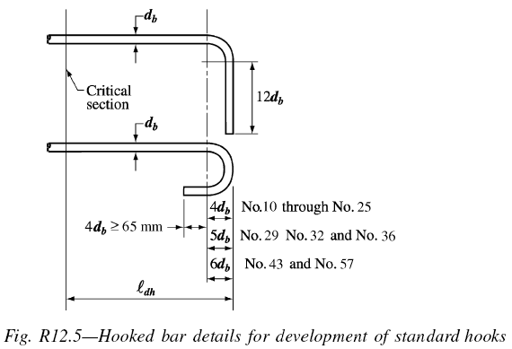
Development length

Slide 48
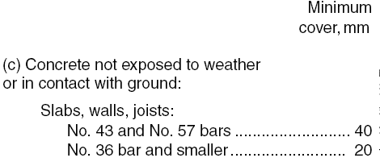

Minimum cover

Slide 49
Thank you

