Slide 1

Mini SCADA System for Monitoring PV and Wind-Installation in Meteorology stations
Prepared By:
Ahmad Khalil
Mohammad Sayeh
Supervisor:
Dr. Imad Ibir
2013-2014

Slide 2
outline
Introduction
Methodology
Calculation
MATLAB
Future Plan
Problems we faced

Slide 3
INTORDUCTION
An automatic weather station (AWS) is an automated version of the traditional weather station, either to save human labor or to enable measurements from remote areas.
It contains the data logger, rechargeable battery and the meteorological sensors with an attached solar panel or wind turbine and mounted upon a mast.

Slide 4
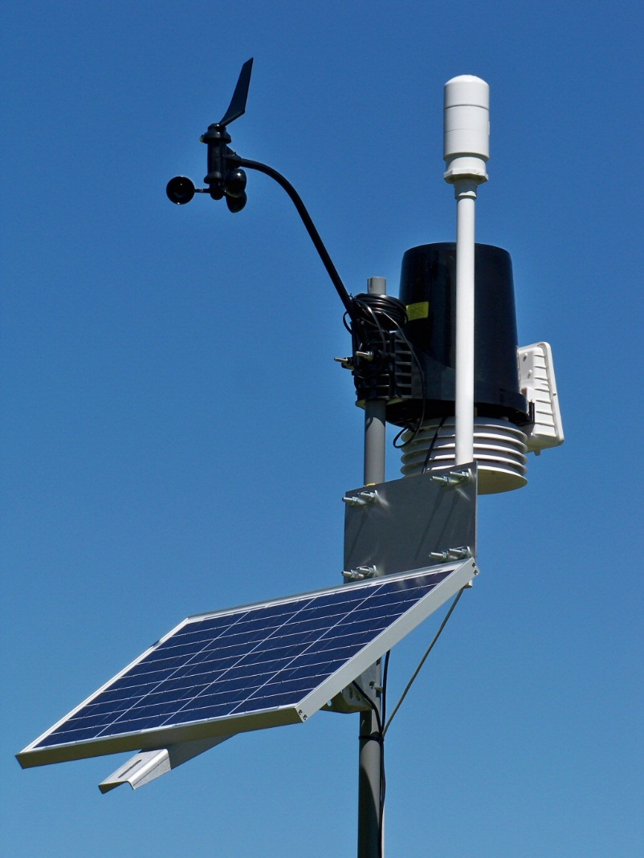
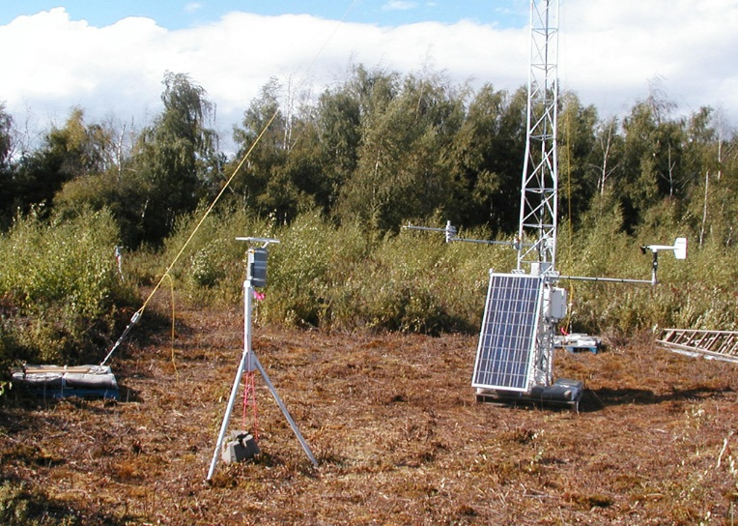
Meteorology Stations

Slide 5
Sensors in Meteorology Stations
Most automatic weather stations have:
Thermometer for measuring temperature.
Anemometer for measuring wind speed.
Wind vane for measuring wind direction.
Hygrometer for measuring humidity.
Barometer for measuring atmospheric pressure.
Some stations can also have:
Ceilometer for measuring cloud height.
Present weather sensor and/or visibility sensor.
Rain gauge for measuring liquid-equivalent precipitation.
Ultrasonic snow depth sensor for measuring depth of snow.
Pyranometer for measuring solar radiation.

Slide 6
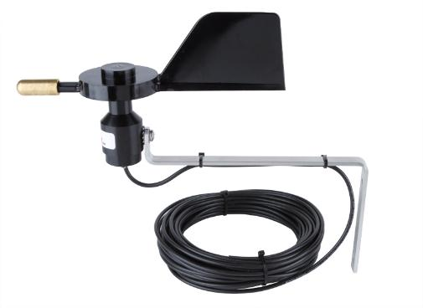
Vane for wind-Direction

Slide 7
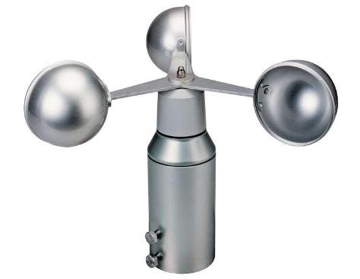
Anemometer: Wind-Speed

Slide 8
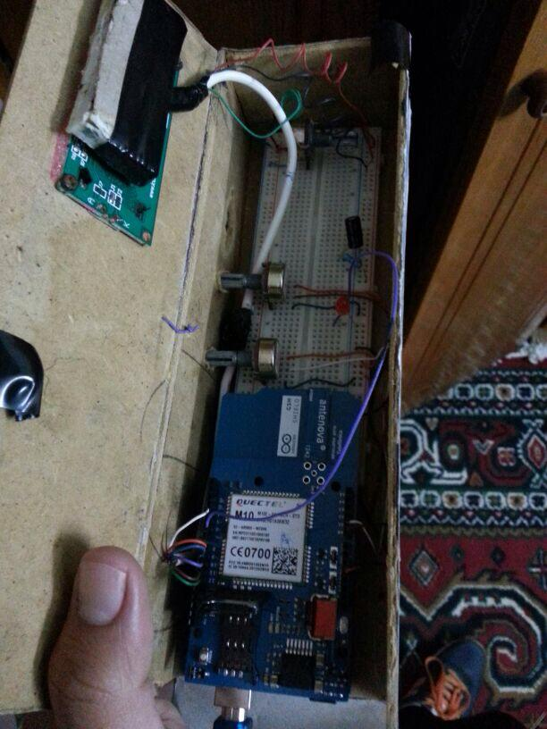
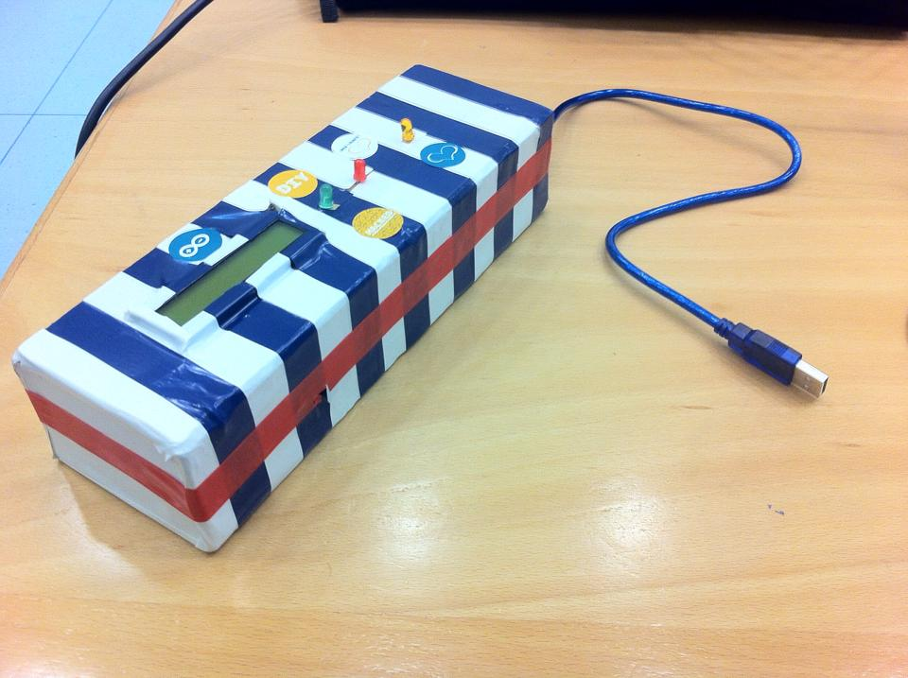
Methodology

Slide 9
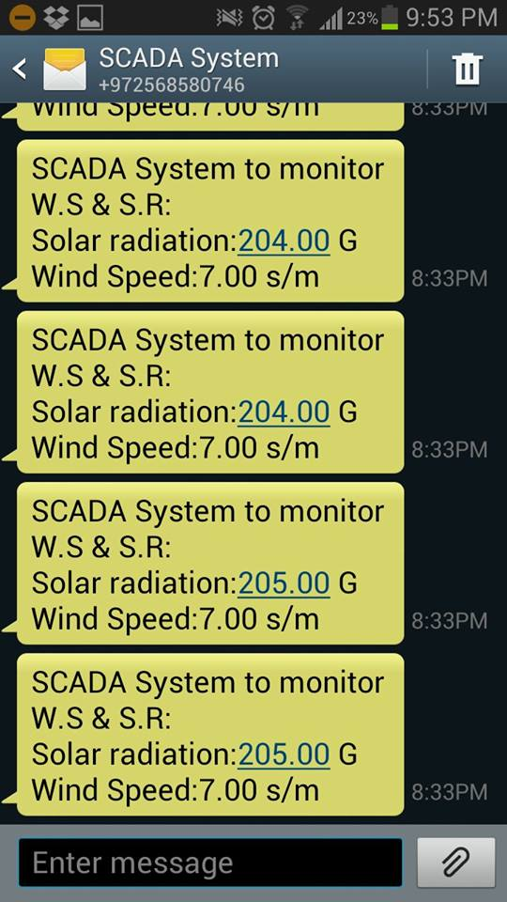
Received Data

Slide 10
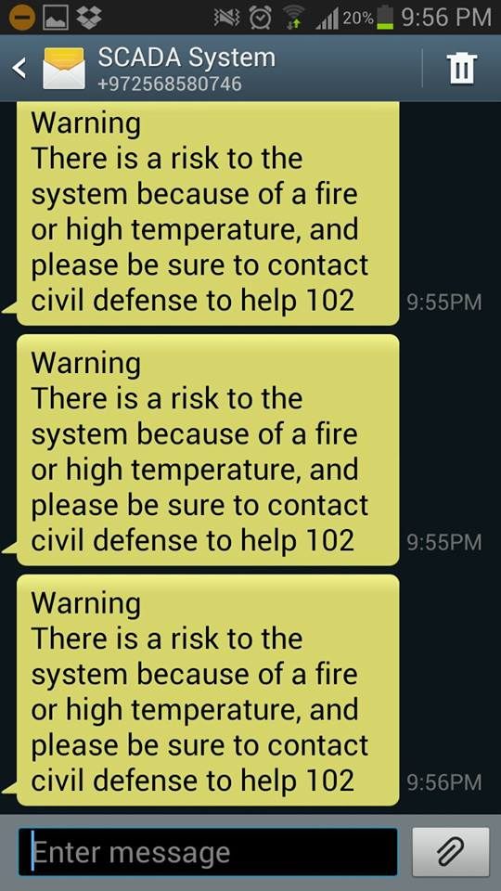
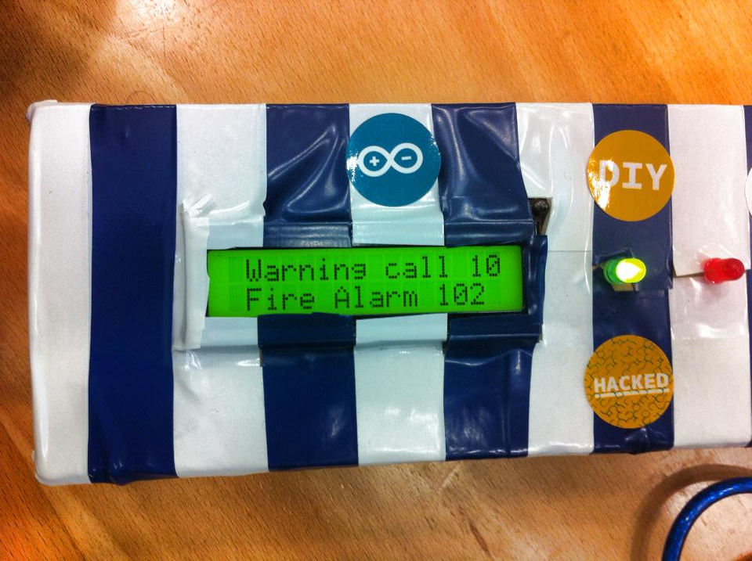
Alarm Notification

Slide 11
Control Messages
The system shut down when it receive a message that contains “c”.
The system turns on when it receive a message that contains “o”.

Slide 12
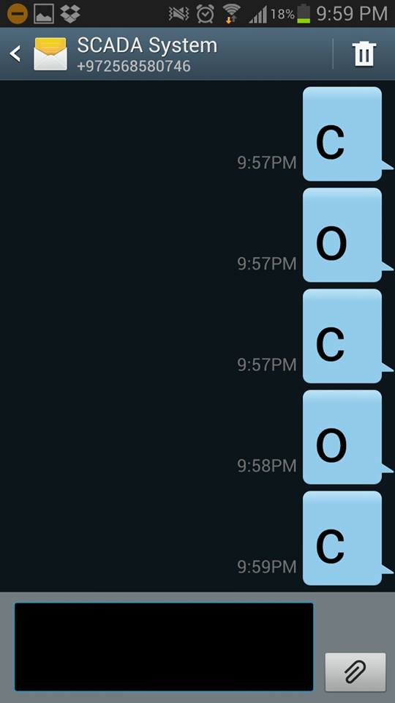
Control Messages

Slide 13

Calculation

Slide 14





Wind Turbine calculation
To calculate the output power of a wind turbine we use the following equation:

Slide 15

Calculating output power for turbines
100 KW Wind Turbine: “P21-Polaris”
Power Coefficient = 0.75
Area = 415.265 m^2
Area was calculated by using the following equation
assuming the diameter equal 21 m so r will be 11.5 m.
We have = 1.23
1 MW Wind Turbine: “WinWind Turbine”
Power Coefficient = 0.75
Area = 2826 m^2
Area was calculated by using the following equation
assuming the diameter equal 60 m so r will be 30 m.
We have = 1.23

Slide 16
100 KW Wind Turbine: “P21-Polaris”
Month | Wind Speed (m/s) | Power Generated (KW)
Jan | 4.74 | 20.39842955
Feb | 3.66 | 9.390851308
Mar | 4.16 | 13.78928348
Apr | 3.38 | 7.396253857
May | 4.42 | 16.53973382
Jun | 5.26 | 27.87526087
Jul | 5.48 | 31.52124651
Aug | 4.94 | 23.09099008
Sep | 4.57 | 18.28143607
Oct | 3.82 | 10.67706279
Nov | 2.86 | 4.480843825
Dec | 3.76 | 10.18181596

Slide 17
1 MW Wind Turbine: “WinWind Turbine”
Month | Wind Speed (m/s) | Power Generated (KW)
Jan | 4.74 | 138.81729
Feb | 3.66 | 63.90749473
Mar | 4.16 | 93.8401144
Apr | 3.38 | 50.33367464
May | 4.42 | 112.5577349
Jun | 5.26 | 189.6993178
Jul | 5.48 | 214.5113184
Aug | 4.94 | 157.1409533
Sep | 4.57 | 124.410529
Oct | 3.82 | 72.66054072
Nov | 2.86 | 30.49345514
Dec | 3.76 | 69.29024094

Slide 18
Solar energy calculation
Assuming we need to cover a load of 10000KWH
Epv = Penetration Factor * E load
= 0.2 * 10000KWh
Epv = 2000KWh
Ppv= Epv/ (P.S.H * Efficiency %)
= 2000/ (5.4*0.95)
Ppv =390 KW
Number of modules = Ppv/ Ppeak

Slide 19
Types of Solar cells
Taking P peak in two cases:
P peak = 150W -12 v- Mono type.
P peak= 200w – 24 v – Poly type.

Slide 20
P peak = 150W -12 v- Mono type.
For Mono type Number of modules needed = 390KW/150W = 2600 Modules
Taking Vdc = 400 V
Number of modules in one string = 400V/ 12V =34 Module
Number of strings = 2600/33.33= 78 String

Slide 21
P peak= 200w – 24 v – Poly type.
For Poly type Number of modules needed = 390KW/200W = 1950 Modules
Taking Vdc = 400 V
Number of modules in one string = 400V/ 24V =17 Module
Number of strings = 1950/16.67= 117 String

Slide 22
Matlab
We designed two programs by using the “guide function” in MATLAB.
The First Program “Wind Power Calculator” calculate the output power from the wind turbines
The Second Program “ Modules Calculator” calculate the photovoltaic energy, photovoltaic power, number of modules needed, number of modules per string and the number of strings

Slide 23
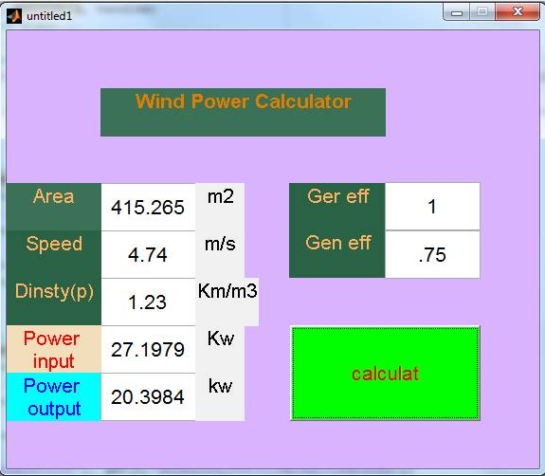
WIND POWER CALCULATOR

Slide 24
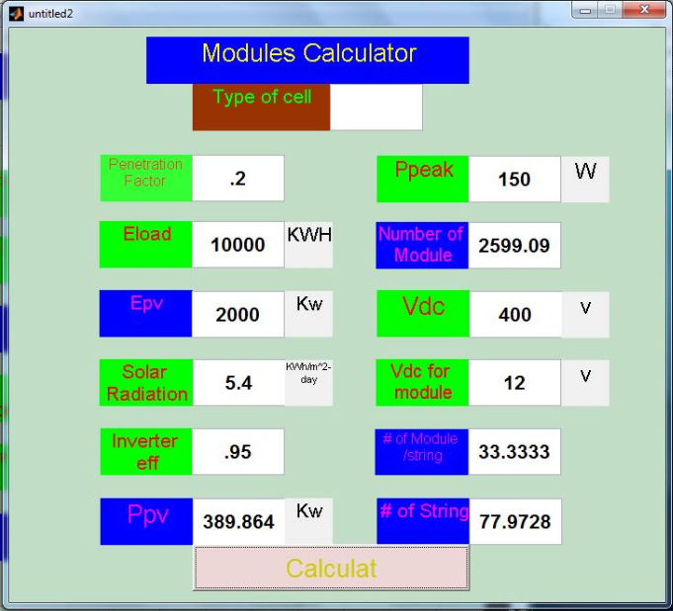
Modules Calculator

Slide 25
Problems we faced
Lack of equipment's.
Long time shipping.

Slide 26
Thanks for your attention
^_^
Questions ?

