Slide 1

An-Najah National University
Faculty Of Engineering
Telecommunication Engineering Department
Millimeter Wave Massive MIMO For Next Generation Wireless Communication
Supervisor: Prepared By:
Dr. Yousef Dama Asma’a Halbouni
Asma’a Yaish

Slide 2
Outline
Introduction, Standard And Constraints.
Massive MIMO System.
Alamouti Code.
QO-STBC.
Millimeter Wave.
NYUSIM.
S-V Model.
Conclusion.

Slide 3
Introduction:
The development and growth of wireless technologies in the past decade has led to the rapid adoption of smart phones. Consumers are expecting every device they have to be connected to the network. So that, the spectrum available for these devices will not be enough.
Utilizing unused mmWave spectrum is one key enabling solution for meeting the extreme data demand growth.
While mmWave spectrum offers a great opportunity to increase capacity, little is known about the propagation channel characteristics.

Slide 4
Channel Characteristic
There have been intensive investigations on mmWave propagation characteristics in various environments.
The construction and implementation of channel models such as channel simulators are essential for performance evaluation of communications systems, before moving forward with new technologies, such as NYUSIM for outdoor environment.

Slide 5
Standard And Constraints
Standard:
5G simply stands for fifth generation, where its standard is yet to be set.
Constraints:
mmWave due to its high frequency it suffer from small wavelength, which means small distance.
Lack of frequency and spectrum.

Slide 6
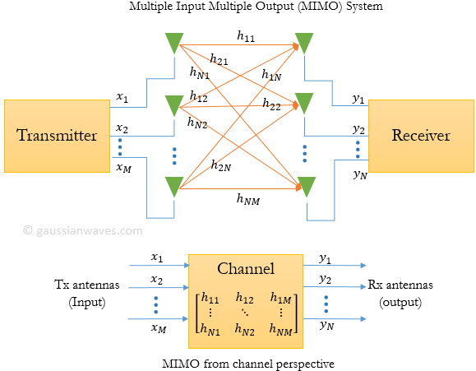
Massive MIMO
One of 5G technologies.
MIMO as shown in Figure 1 is a wireless antenna technology that uses multiple antennas on transmitter side and receiver side.
Figure 1

Slide 7
Massive MIMO
Between transmitter and receiver, the signal can take many paths. Previously these multiple paths only served to introduce interference (ISI).
By using MIMO, these additional paths can be used to provide additional robustness to the radio link by improving the bit error rate, or by increasing the link data capacity.
Massive MIMO in which number of transmitter antenna is more 64.

Slide 8
MIMO Gain
There are two main formats for MIMO system:
Diversity gain (Spatial Diversity): Equal to the number of independent channels in the system. Which will also in other words increase data rate.
Multiplexing Gain (Spatial Multiplexing): will serve the main purpose for increasing capacity by utilizing the multiple paths as additional channels to carry data.

Slide 9
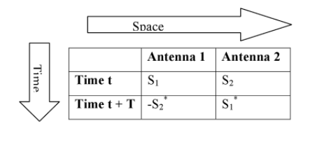
Alamouti Code
Alamouti code, is a technique used in wireless communications to transmit multiple copies of a data across a number of antennas and to make use of various received versions of the data to improve the reliability of data-transfer.
Alamouti used in 2x1 MISO mode or in a 2x2 MIMO mode.

Slide 10
Alamouti And STBC
Alamouti code, the only STBC that can achieve its full diversity gain without needing to sacrifice its data rate.
The information to be transmitted is modulated and fed to the space time encoder, which consists of two transmit antennas.
Each Tx-Rx pair has a channel, represented by different channel coefficients.

Slide 11
Quasi-Orthogonal Space Time Block Coding (QO-STBC)
To achieve full-rate transmission while maintaining much of the orthogonality benefits of OSTBC, (QO-STBC) has been proposed.
A QO-STBC can achieve full rate, but interference terms will appear from the neighboring signals during the signal detection which will increase the detection complexity and decrease the gain performance.

Slide 12
A new Approach for O-STBC and QO-STBC which based on idea of Virtual Channel
Conventional QO-STBC: The encoding matrix proposed is two (2 * 2) Alamouti codes X₁₂ and X₃₄ h
The Equivalent Virtual Channel Matrix (EVCM) Hv can be written as:

Slide 13
Virtual Channel
Hv can be described as a highly structured, equivalent, virtual (4*4) MIMO channel matrix.
Where Y= Hv*X + AWGN
In Conventional QO-STBC a detection matrix D₄ were introduced to decode the received signal,
where D₄= Hv^{H} .Hv , Hv^{H} is the Hermitian of Hv.

Slide 14
Detection Matrix
In D4, diagonal elements α represent the channel gains and β represent the interference from the neighboring signals due to un-orthogonality, for four transmit antennas.
To detect the estimate received signal:
X' = (Hv^{H} .Hv)⁻¹ . Hv^{H} .Y

Slide 15
Proposed QO-STBC
In this methodology detection matrix D₄ used to produce eigenvalues and eigenvectors.
D_{4.} V – V.D = 0
Where D = λI, λ is the eigenvalue operator, and V is eigenvectors. And the solution for the equation will give:

Slide 16
New Proposed QO-STBC Channel Matrix
So that, the new channel matrix will be H= Hv.V
H^{H} .H is diagonal matrix which can achieve simple linear decoding, because of the orthogonal characteristic of the channel matrix H.

Slide 17
Proposed Space Time Block Code From Diagonalized Hadamard Matrix (DHSTBC)
The generated codes provide full rate and full diversity when the number of the receiver antennas are at least equal to the number of transmitter antennas.
Where S4 is the
transmitted symbols
The Hadamard matrices of order four, which are used to form the new channel matrix are given next:

Slide 18
The resultant matrix X₄ is a DHSTBC and hence, the overall expression is given by
X₄ = H₄ * S₄
The detection X₄X₄ ^{H} is diagonal matrix where the interference terms have been eliminated which can achieve simple linear decoding.
New Hadamard Channel Matrix

Slide 19
Result For QO-STBC
Comparison was made to compare between Conventional, proposed Hadamard, and Proposed QO-STBC.

Slide 20
Result For QO-STBC
In this figure we used Proposed method to see effect of BER vs. SNR in MIMO system.
As shown here, we
see that as SNR
increase, BER is
decreasing, and as
number of
transmitter increase
the behavior of signal
is improved
as BER is decreasing.

Slide 21
Millimeter Wave
5G will be implemented based on mmWave.
Known as MMW, E-band, V-band or Millimeter Wave technology.
One of the greatest and most important uses of millimeter waves is in transmitting large amounts of data.
Millimeter Wave frequencies that ranging from 3 GHz to 300 GHz have much smaller wavelengths, ranging from 1 mm to 10 mm.
Provide a large bandwidth translates to better data transfer rates.

Slide 22
Path Loss Models
Many measurement studies have been conducted to characterize path loss.
The standard theoretical free space (FS) and Stanford University Interim (SUI) empirical path loss models were recently modified to fit path loss models obtained from measurements performed at 28 GHz and 38 GHz, using simple correction factors which is similar to correction factors for models at 60 GHz and 73 GHz.
By imparting slope correction factors on the FS and SUI path loss models to closely match the close-in (CI) free space reference distance path loss models.

Slide 23
Modified Models
The CI path loss model for computing path loss
PL_{CI}(f_{GHz},d)[dB] = 32.4 +20log (f_{GHz}) + 10n log ₁₀(d/1m) + Xσ
FS Path Loss Model:
PL_{FS}(d)[dB] = -10.log ₁₀(GT*GR*λ2\(4пd)^2)
For LOS environments, the PLFS path loss equation is modified with the slope correction factor α_{LOS} to best match the LOS PL_{CI} path loss model. The modiﬁed free space model is given by PL_{FS,mod} in dB:
PL_{FS,Mod}(d)[dB] = α_{LOS} * ( PL_{FS}(d) – PL_{FS}(d₀)) + PL(d₀) + Xσ
with d₀ = 1 meter.

Slide 24
Modified Models
Modified SUI Path Loss Models:
PL_{SUI} (d)[dB]= FSPL(f,1m)[dB] + 10n log ₁₀(d/1m) +X_{fc} +X_{RX}+ Xσ
For NLOS environments, the modiﬁed SUI model equation is used with a slope correction factor that results in a model that best ﬁts a close-in (CI) .The modified SUI model for NLOS is given by:
PL_{SUI,Mod}(d)[dB] = α_{LOS} * ( PL_{SUI}(d) – PL_{SUI}(d₀)) + PL(d₀) + Xσ

Slide 25
Modified Models
Directional Beam Combining Path Loss Models at millimeter Wave Bands:
A simpler and more general millimeter Wave beam combining close-in free space reference distance (BC-CI) path loss model is developed here for NLOS urban environments that accounts for the number of combined angles (beams) at the receiver. This also the same equation used in NYUSIM simulator.
PL_{BC-CI} = FSPL(f, 1m)[dB] + (10n_{(1 beam)}log₁₀(d\1m)) * (1 – A log₂(N_{r})) + Xσ

Slide 26
NYUSIM simulator
Wireless communication systems developed by researchers at New York University (NYU).
Channel simulation software named NYUSIM, can be used to generate realistic temporal and spatial channel responses to support realistic.
NYUSIM is built upon channel model for broadband millimeter-wave(mmWave).

Slide 27
Result From NYUSIM
The following parameters will be used for each scenarios.
Scenario 1: Changing frequency.
Scenario 2: Changing Humidity.
Environment | T-R separation | TX-power | Rain rate | N-Tx, N-Rx
LOS | 10-30m | 30dBm | 0 | 4,1
Frequency (GHz) | Power received (dBm) | Path loss(dB)
28 | -25.5 | 104.7
60 | -25.6 | 104.9
73 | -26.9 | 106.1
Frequency | Humidity
Path Loss | 20% | 50% | 90%
28 GHz | 95.1 | 97.5 | 98.5
60 GHz | 98.1 | 102.4 | 107.7
73 GHz | 102 | 103.1 | 106.5
Notes:
when increasing the frequency will decrease the power received and increase the path loss. certainly this result is true based on friis equation .

Slide 28
A new comparison were made between T-R separation and path loss when changing the frequency and (nTX ,nRX)
Results

Slide 29
A comparison were made to see effect of Path Loss compare to frequency and when change the rain rate at 60Ghz.
Results

Slide 30
Saleh -Valenzuela (S-V) Channel Model
S-V model is based on a clustering phenomenon observed in experimental data. Saleh and Valenzuela found from the indoor channel.
As SNR increase,
BER will decrease
and increasing
number of
transmitter and
receiver will reduce BER.

Slide 31
Conclusion
Studied concept of mmWave, and Massive MIMO.
A new approach for QO-STBC for four transmitter antennas, based on Virtual channel
Detection matrix in Proposed method to eliminate the interference terms.
Modified Models and NSYUSIM.
S-V Model

Slide 32
Future Work
Studying the other technologies of 5G:
Massive MIMO.
Beamforming.
Spatial Modulation.

