Slide 1

Graduation Project (2)
Integrated Four stars hotet
Prepared by :
Angham Abdat
Nida’a Odeh
Reem Halaweh
Wa’d Amarneh
Supervisor: Dr.Monther Dweikat

Slide 2
Outline
Introduction
Site analysis
Architectural design
Environmental design
Structural design
Electrical design
Mechanical design
Safety
Quantity Survey

Slide 3
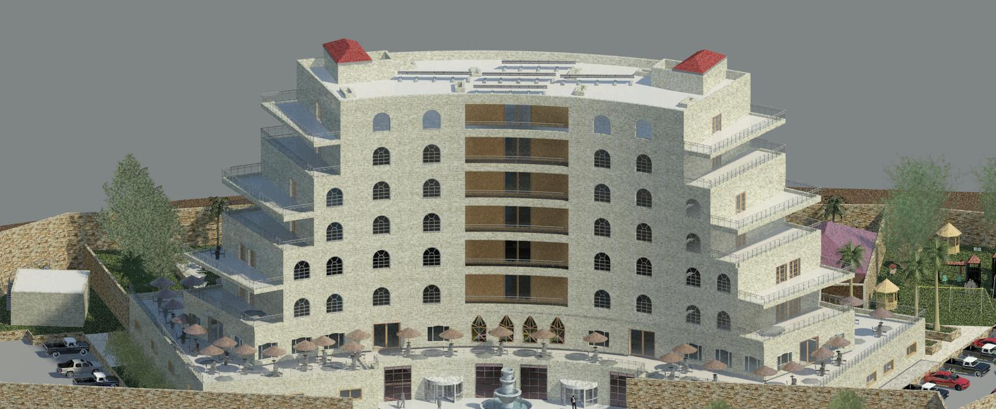
Introduction

Slide 4
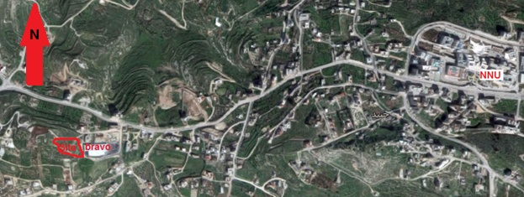
SITE ANALYSIS
The proposed land was chosen to be in Bait-wazan, which west Nablus

Slide 5
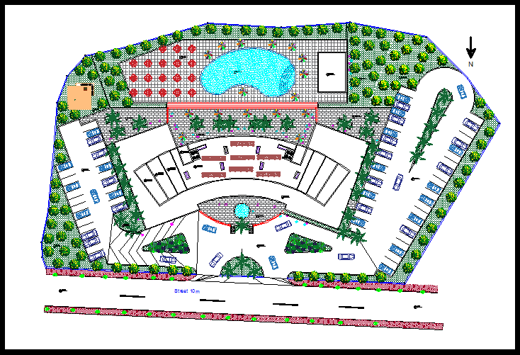
Architectural Design
Site Plan

Slide 6
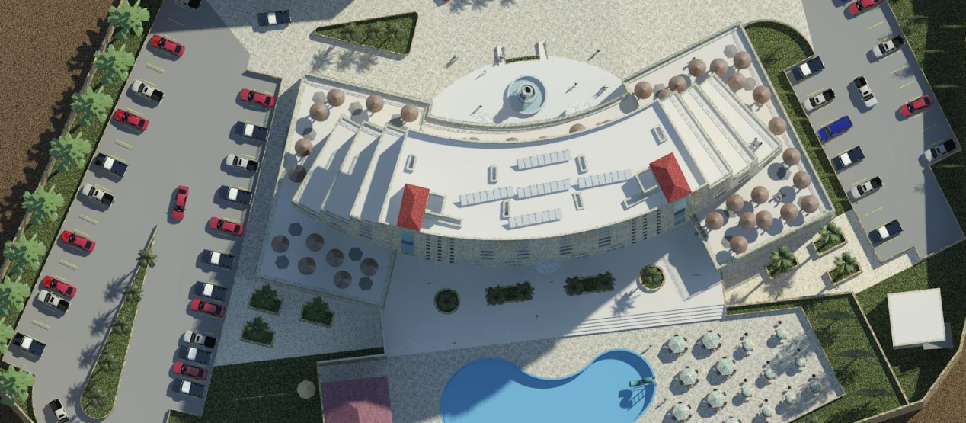
Site plane

Slide 7
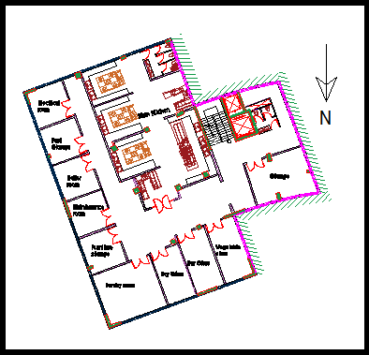
Architectural Design
Basement floor
769.7 m² which contains spaces that used for storage, maintenance, food preparation and spaces for electrical and mechanical control .

Slide 8
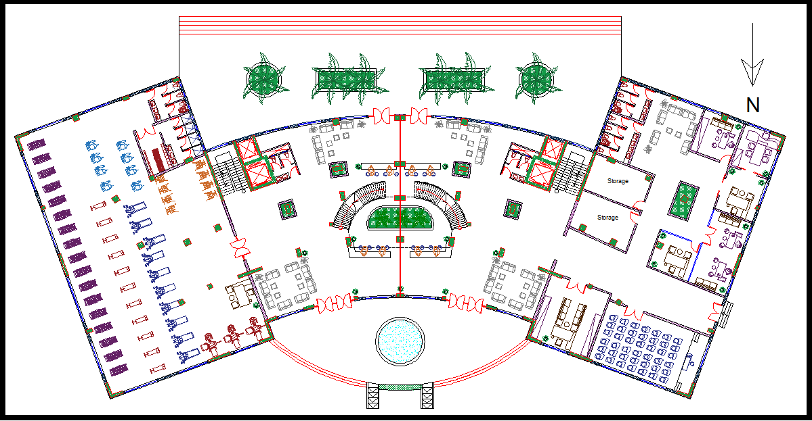
Architectural Design
Ground floor
2006.5 m² which contains entrance, gym, offices, conference hall, loopy, reception and waiting areas.

Slide 9
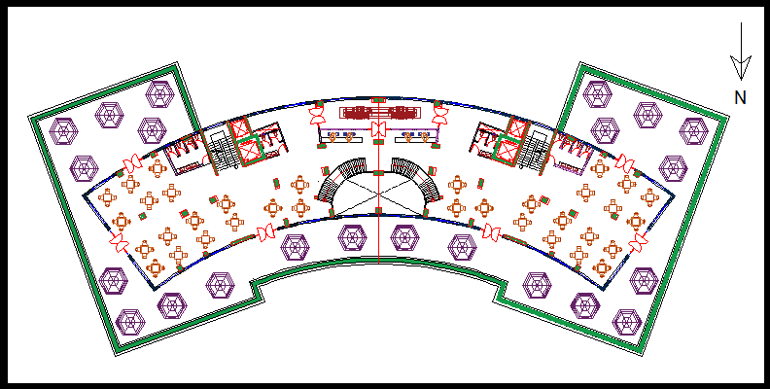
Architectural Design
first floor
2006.5 m² which contains restaurant & terraces.

Slide 10
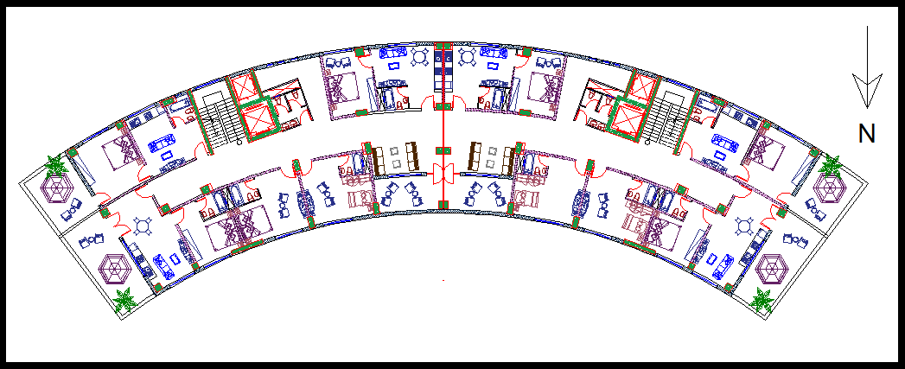
Architectural Design
Second & third floor (for guest room ).
Area 1000.5m²

Slide 11
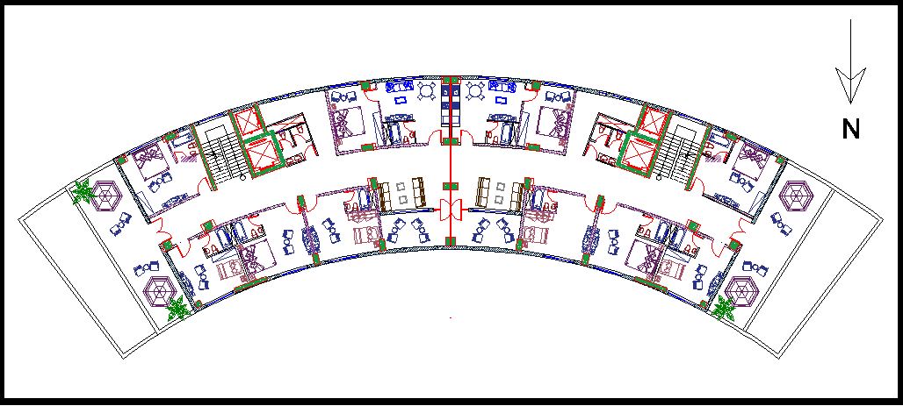
Architectural Design
fourth & fifth floor (for guest room ).
Area 878.5m²

Slide 12
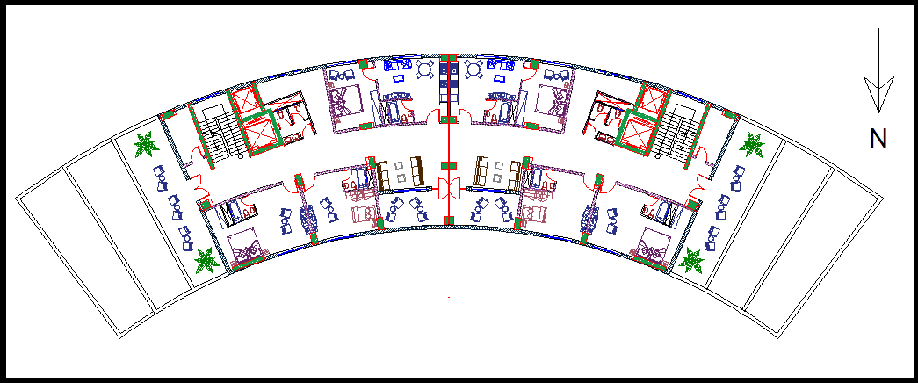
Architectural Design
6th + 7th floor (for guest room ).
Area 754.7 m²

Slide 13
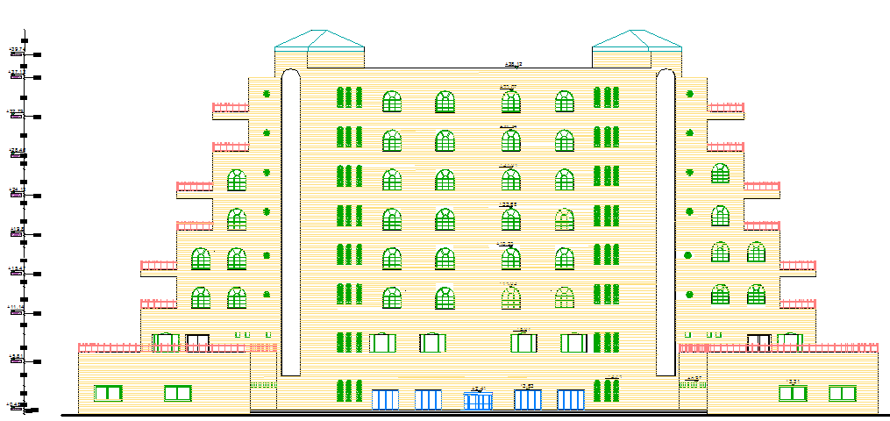
Elevations
NORTH ELEVATION

Slide 14
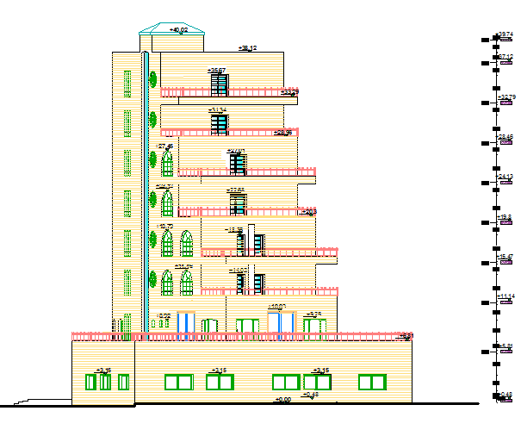
Elevations
EAST ELEVATION

Slide 15
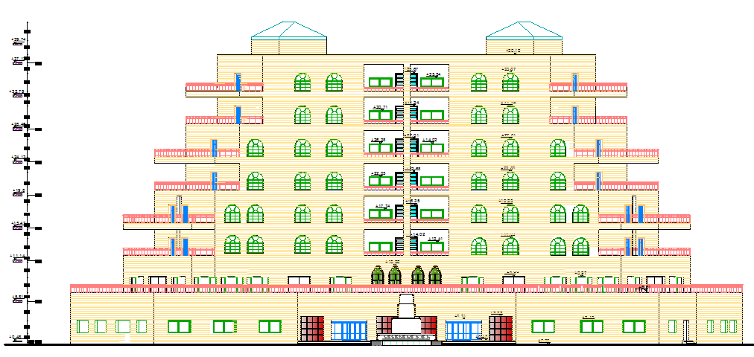
Elevations
SOUTH ELEVATION

Slide 16
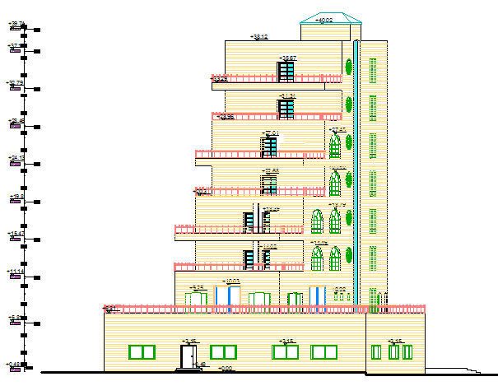
Elevations
WEST ELEVATION

Slide 17
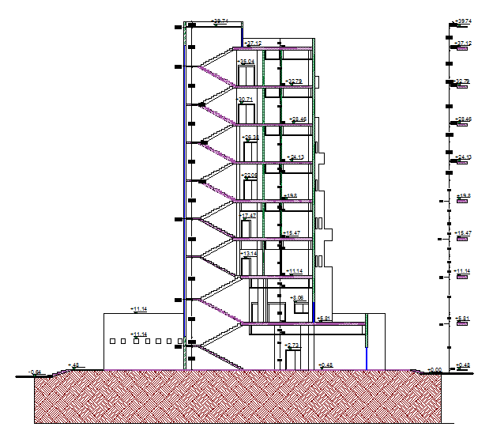
SECTIONS
SEC A-A

Slide 18
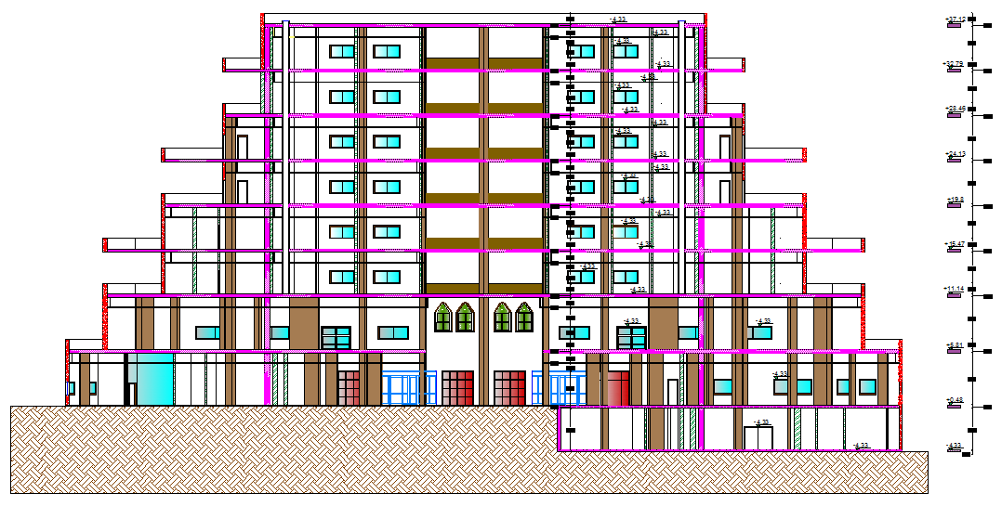
SECTIONS
SEC B-B

Slide 19
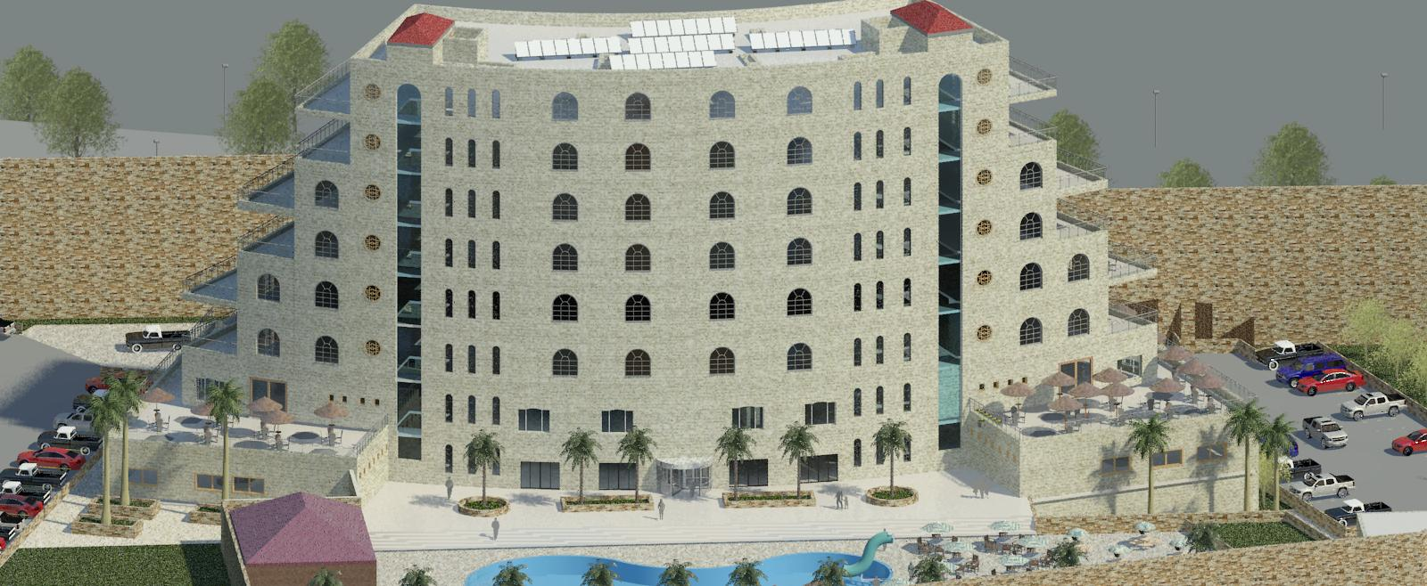
3D RENDER
3D

Slide 20
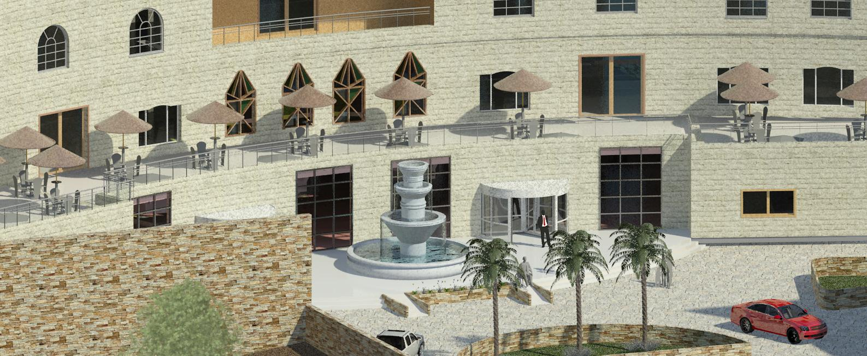
3D RENDER
ENTEANCE

Slide 21
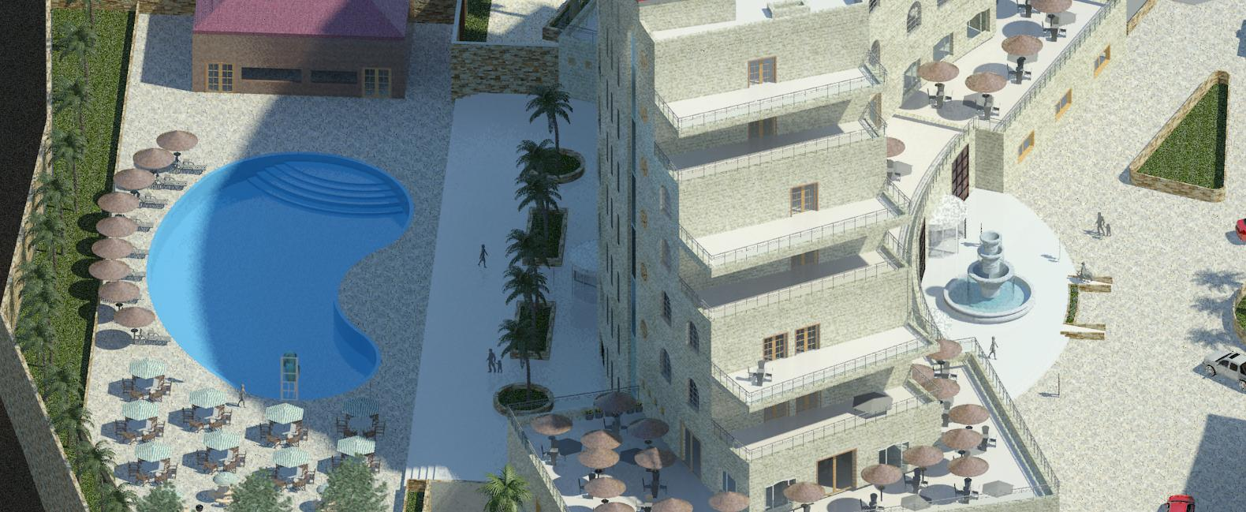
3D RENDER
3D

Slide 22
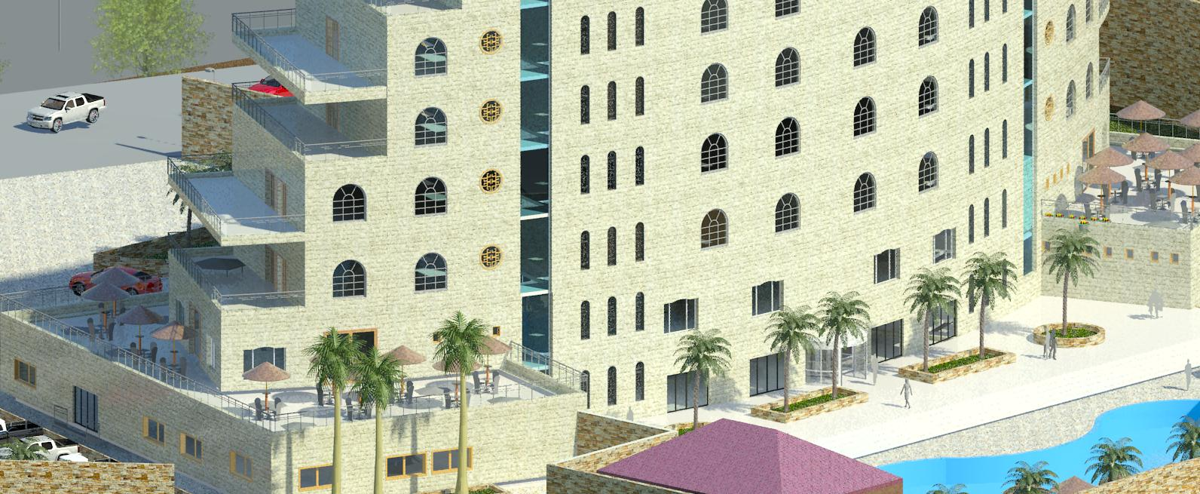
3D RENDER
3D

Slide 23
Environmental Design.
Material used.
Thermal design.
Artificial lighting.
Acoustical design.

Slide 24
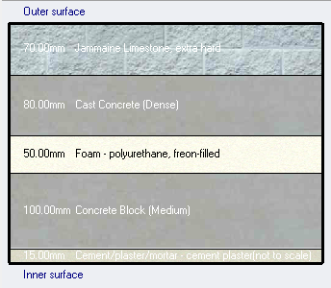

Environmental Design.
Materials.
External wall layers.
(7) cm jamaine lime stone.
(8) cm cast concrete.
(5) cm Foam-polyurethane.
(10) cm concrete block.
(1.5) cm cement plaster.
U-value= 0.468 W/ $m^{2}.k$

Slide 25
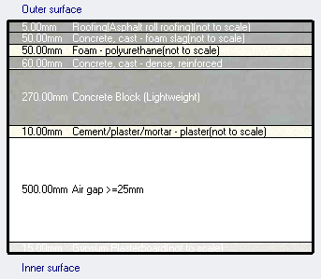
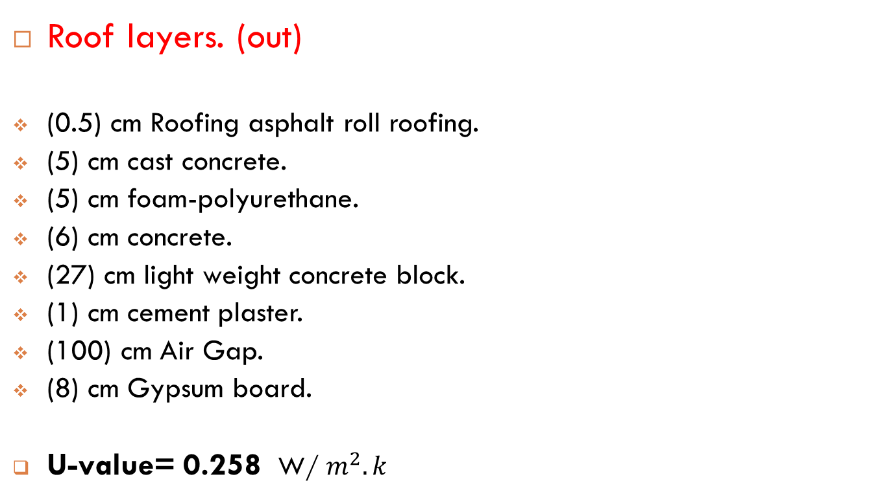
Environmental Design.
Roof layers. (out)
(0.5) cm Roofing asphalt roll roofing.
(5) cm cast concrete.
(5) cm foam-polyurethane.
(6) cm concrete.
(27) cm light weight concrete block.
(1) cm cement plaster.
(100) cm Air Gap.
(8) cm Gypsum board.
U-value= 0.258 W/ $m^{2}.k$

Slide 26
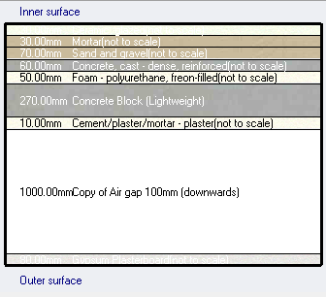

Environmental Design.
Internal floors layers.
(3) cm ceramic tile.
(3) cm mortar.
(7) cm sand and gravel.
(6) cm light weight concrete.
(5) cm foam-polyether.
(27) cm concrete block.
(1) cm cements plaster.
(100) cm Air Gap.
(8) cm Gypsum plaster.
U-value= 0.251 W/ $m^{2}.k$

Slide 27
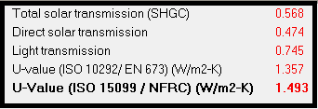
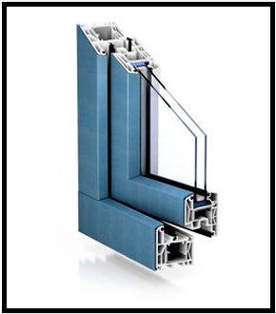
Environmental Design.
Glass Prosperities.
Double LoE (e2=0.1) clear glass with 6mm/13 mm Argon gas.

Slide 28
Environmental Design.
Heating and cooling loads.
Site energy Vs base line energy.
Heating design capacity. | 207 KW
Cooling design capacity. | 332 KW
Total site energy. | 156.22 KWh/m²
Energy intensify baseline | 231.2 KWh/m²

Slide 29
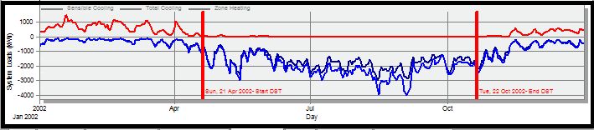
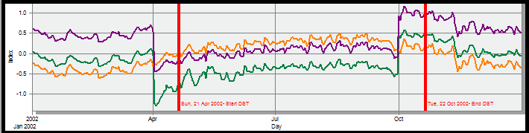
Environmental Design.
Simulation.
heating and cooling load analysis.

Slide 30
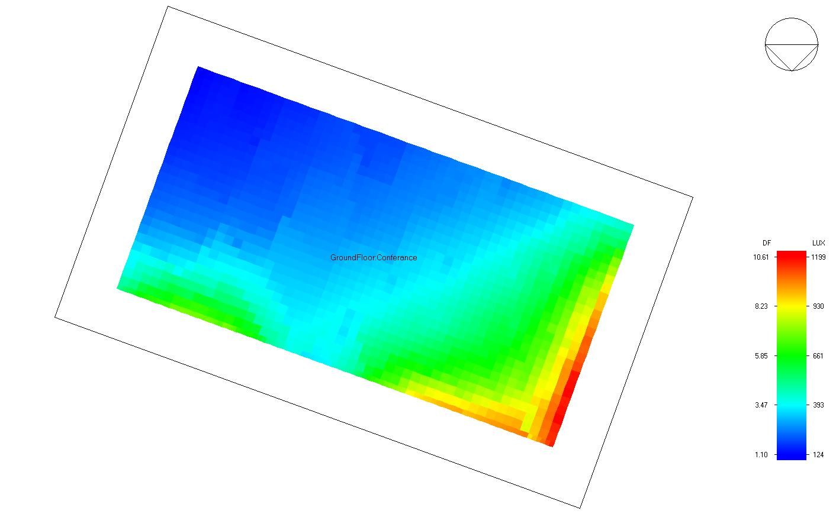
Environmental Design.
Natural daylight analysis.
Function | D.F
Restaurant | 3.3
Conference room | 3.7
Quest bedroom | 2.169
Office | 2.3

Slide 31
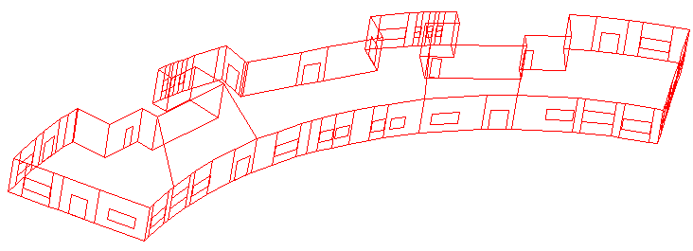
Acoustic Design
Reverberation Time(RT60):
We used ECOTECT Analysis Program in the calculation and testing of the reverberation time.

Slide 32
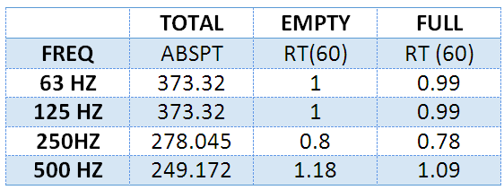
Reverberation time
Note : RT60 range for restaurant is (0.8 – 1.2), does not achieve the requirements . so we need to do some modifications
We used decorative sound absorption materials such as Acoustical board to meet the requirement

Slide 33
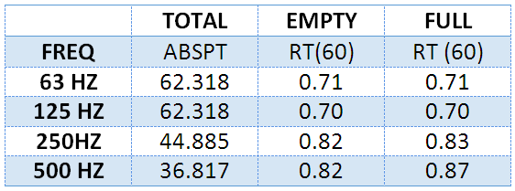
Reverberation time
For conference room:
RT60 value ranges from( 0.6-1.20) , this room achieves requirements

Slide 34
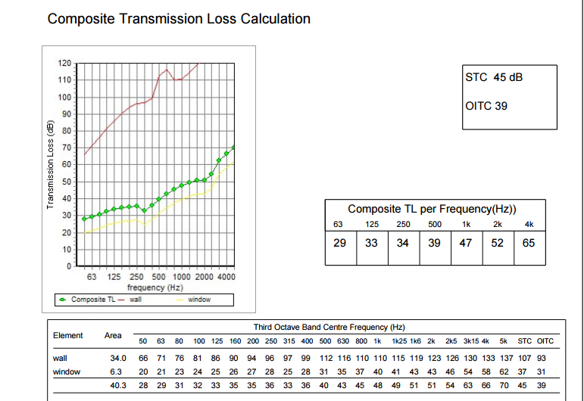
Acoustic Design
The STC for partition must =45 dB Improvement in STC by add to basic partition staggered studs

Slide 35
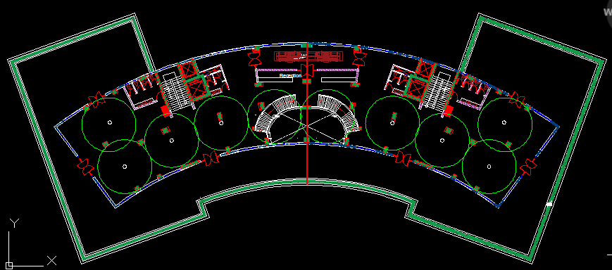
Loud Speakers
SI 26CT :
(211 mm H x 251 mm diameter) :Enclosure outer dimensions 110° conical coverage Nominal coverage angle :

Slide 36
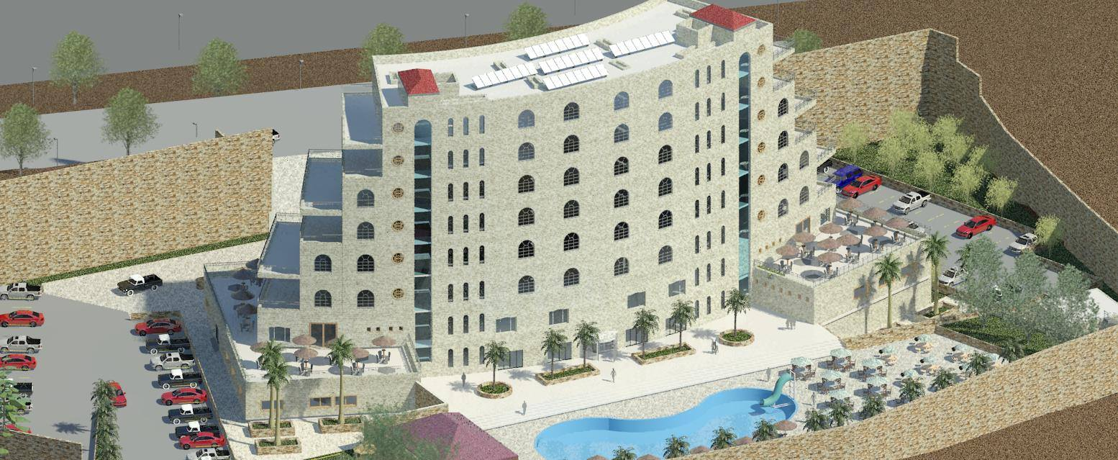
Structural Design
The hotel 9 floors are made completely of reinforced concrete.
The hotel has one on ground water tank.

Slide 37
Structural Design
Codes and Standards:
ACI -318-11 for reinforced concrete structural design.
UBC -97 for earthquake design.
ASCE 7 2010 for load combinations
For the design of the structure and its elements ETABS , SAP and hand calculations were used .

Slide 38
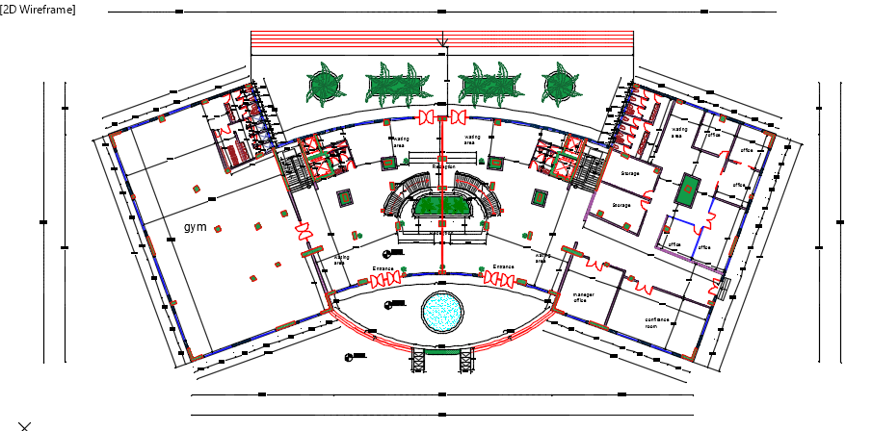
Structural Design

Slide 39
Structural Design
Design data:
Concrete strength, f’_{c}=28 MPa.
Steel yield strength f_{y}=420 MPa.
Bearing capacity for soil = 250 kN/m²

Slide 40
Structural Design
Vertical Loads:
Load Type | Public spaces | Others
Live Load (kN/m² ) | 5 kN / m² | 3 kN / m²
SID ( kN /m² ) | 5 kN / m² | 5 kN / m²

Slide 41
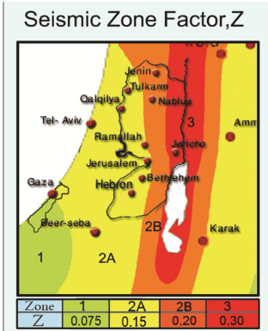
Structural Design
Seismic Design data :
The city of structure is Nablus.
The seismic zone factor. Z=0.2.
The soil profile is type Sc.
The acceleration seismic coefficient Ca=0.24
The velocity seismic coefficient Cv=0.32.
The Seismic importance factor is 1.
The structural design type is intermediate, R=5.5

Slide 42
Sections Dimensions
Structural Element | Dimensions
Ribbed Slab | 33 cm thickness
Solid Slab | 25 cm thickness
Columns | (70X40) , ( 40 X 40 ) , ( 70X70) , ( 100 X 50 ) and ( 60 X 60 )
Beams | ( 50X50) , ( 40 X 40 ) , ( 70 X 90 )

Slide 43
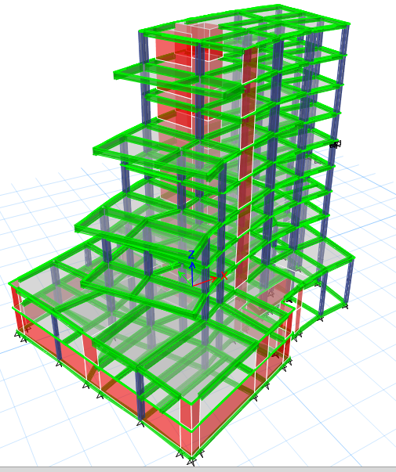
Modeling

Slide 44
Verification of the model
Compatibility check
Equilibrium check
Internal force check

Slide 45
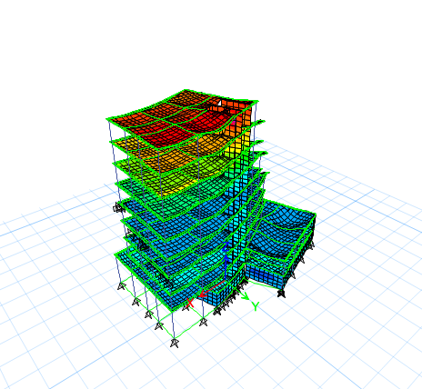
Verification of the model
Compatibility check

Slide 46
Verification of the model
Equilibrium Check
 | Live load ( kN) | SID (kN) | Dead load (kN)
Manual | 18480 | 42736 | 52326
By ETABS | 18461 | 42556 | 51153
% Error | 0.1% | 0.62% | 4.3%

Slide 47
Verification of the model
Internal force check
 | Manual | By ETABS | %Error
Column 9 | 5821 kN | 5647 kN | 3.06%
Main beam | 667 kN.m | 626 kN kN.m | 6.5%
Span of the slab | 10.38 kN.m | 11.01 kN.m | 5.9%

Slide 48
Design checks
Period Check
0.805 < 1.13 sec
Drift Check
97mm < 100 mm
Deflection check
13.3mm < 14.8mm
Modal participating mass ratio check
0.91 > 0.90
Base shear check
7023kN > 6972kN
7041kN > 6972kN

Slide 49
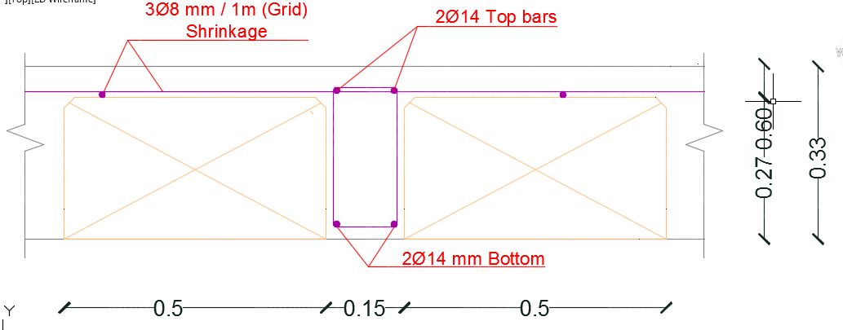
Slab Reinforcement

Slide 50
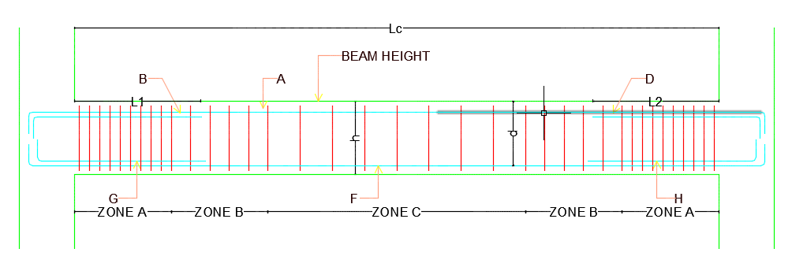
Beams Reinforcement

Slide 51
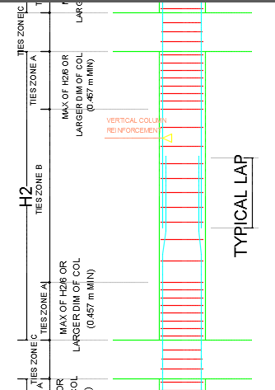
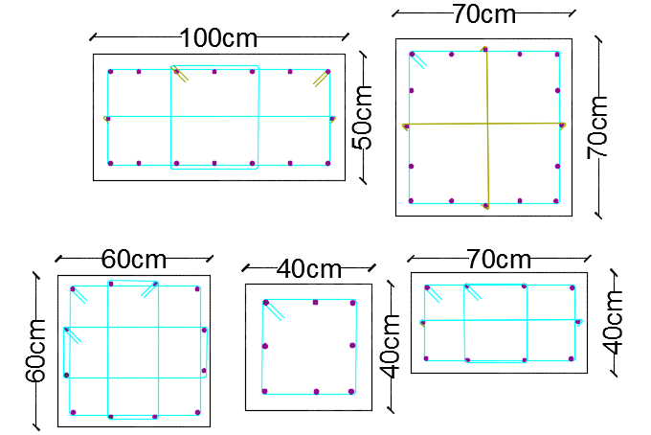
Columns Reinforcement

Slide 52
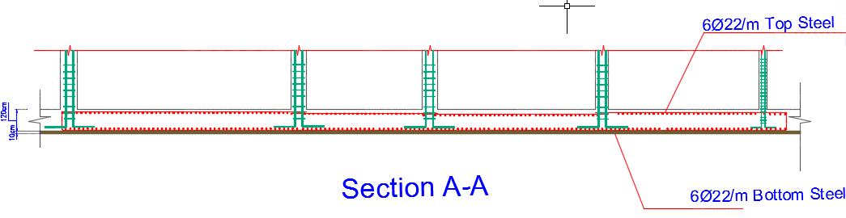
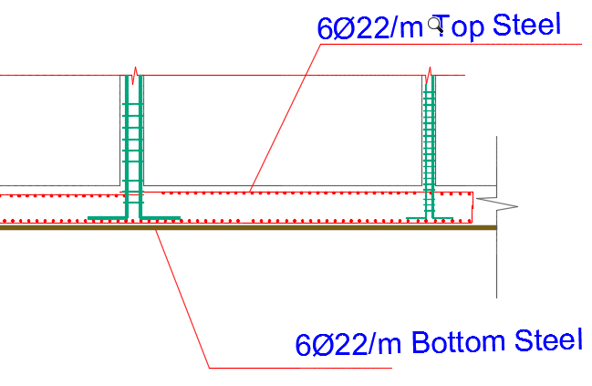
Footing Reinforcement

Slide 53
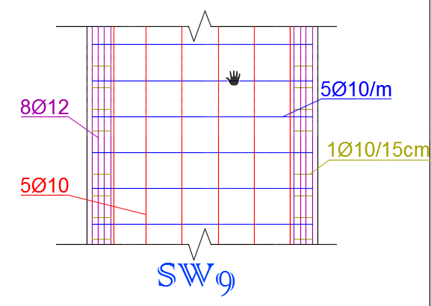
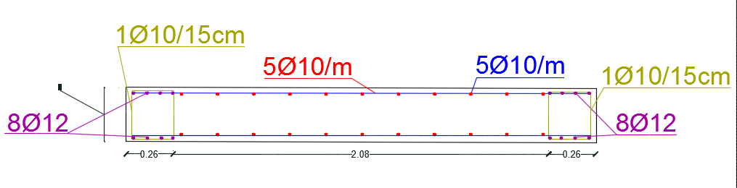
Shear Wall Reinforcement

Slide 54
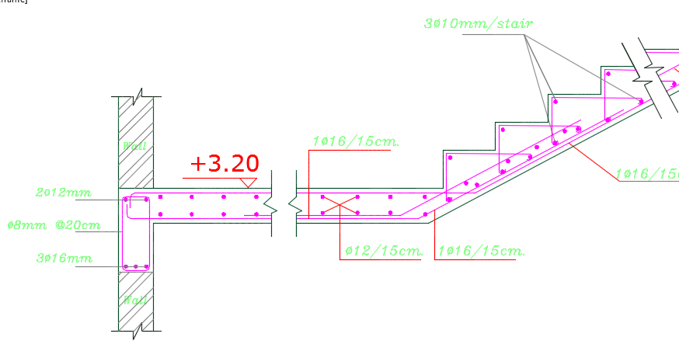


Stair Reinforcement

Slide 55


Water Tank Reinforcement(Seismic Design)

Slide 56
Electrical Design.

Slide 57


Electrical design.
Recommended illumination.
Reflection factor.

Slide 58

Electrical design.
Artificial lighting.
Quest Bedroom.
E(lux) | U | UGR | D.F
177 | 63 | 18.6 | 2.169

Slide 59



Electrical design.
Bed room selected luminaires.

Slide 60

Electrical design.
Artificial lighting.
Conference room.
E(lux) | U | UGR | D.F
350 | 0.57 | 16.8 | 3.7

Slide 61

Electrical design.
Conference room selected luminaires.

Slide 62

Electrical design.
Lighting arrangement.

Slide 63

Electrical design.
Lighting arrangement.
Lighting arrangement.

Slide 64

Electrical design.
Sockets arrangement.
Function | Minimum quantity of sockets
Kitchen | 6
Master Bedroom | 6
Dining room | 4
Single bedroom | 4
Bath room | 1-double insulated

Slide 65

Electrical design.
Circuit breaker branches.

Slide 66

Electrical design.
Main distribution board.

Slide 67
Mechanical design.

Slide 68
Mechanical design
1- Water Supply System
2-Drainage System
3-H-VAC System

Slide 69

Mechanical design
Water supply design

Slide 70

Mechanical design
Water distribution System

Slide 71

Domestic hot water
We need almost 10000 L DHW
we will use evacuated tube to heat water

Slide 72

Rain Water Drainage

Slide 73

Drainage roof design

Slide 74


Safety design
Fire resistance system

Slide 75
Mechanical design.
HVAC systems.
Systems used are :
Centralized system( Chilled water ) → in Basement, Ground and first floor.
Split Units (VRF) → in Guest floors.
Main components of centralized system are :
Chiller (for cooling and heating).
A.H.U
Ducts.
Diffusers.

Slide 76

Mechanical design.
Centralized system.
Cooling load = 153 KW = 44 ton .
Selected chiller is EWWD-4-XS-369

Slide 77


Mechanical design.
Centralized system.
Air handling unit.
Selected air handling unit is ADT-F/B from
Daikin.
Diffusers.

Slide 78

Mechanical design.
Ducts and diffusers arrangement in restaurant.

Slide 79

Mechanical design.
Chiller location.

Slide 80


Mechanical design.
Split units system(VRF).
Indoor units.
Cooling load for guest floors is 179 KW= 51 TR.
TIWM1012B21S
YIDM006B21S

Slide 81


Mechanical design.
Outdoor unit.

Slide 82

Mechanical design.
Split units system(VRF).

Slide 83

Quantities and Survey
Total Cost of the Project | 43,033,325 NIS
Cost Per m² | 3100 NIS / m²

Slide 84



