Slide 1
CPU LAB SIMULATOR
Presented By : Mohammad Abu Salah & Nael Kilani.
Supervisor: Dr. Luai Malhis.
Graduation Project Presentation.

Slide 2
Agenda:
Introduction.
Unity and C#.
Overview.
CPU Lab Simulator.
Limitations.
Future Work.

Slide 3
Introduction:
  Where did the idea come from ?
  • Students face many difficulties in the connection stage.
  • Poor understanding of the data flow.

Slide 4
Unity and C#:
  Unity Game Engine : (+) Free Source.
  (+) Cross-Platform.
  C# over Java Script : (+) Performance.
  (+) Almost all skilled Unity coders are using C#.

Slide 5
Overview:
  • Connections Checker.
  • ALU’s Binary File Checker.
  • CPU Data Flow.
  • Controller’s Signals.

Slide 6
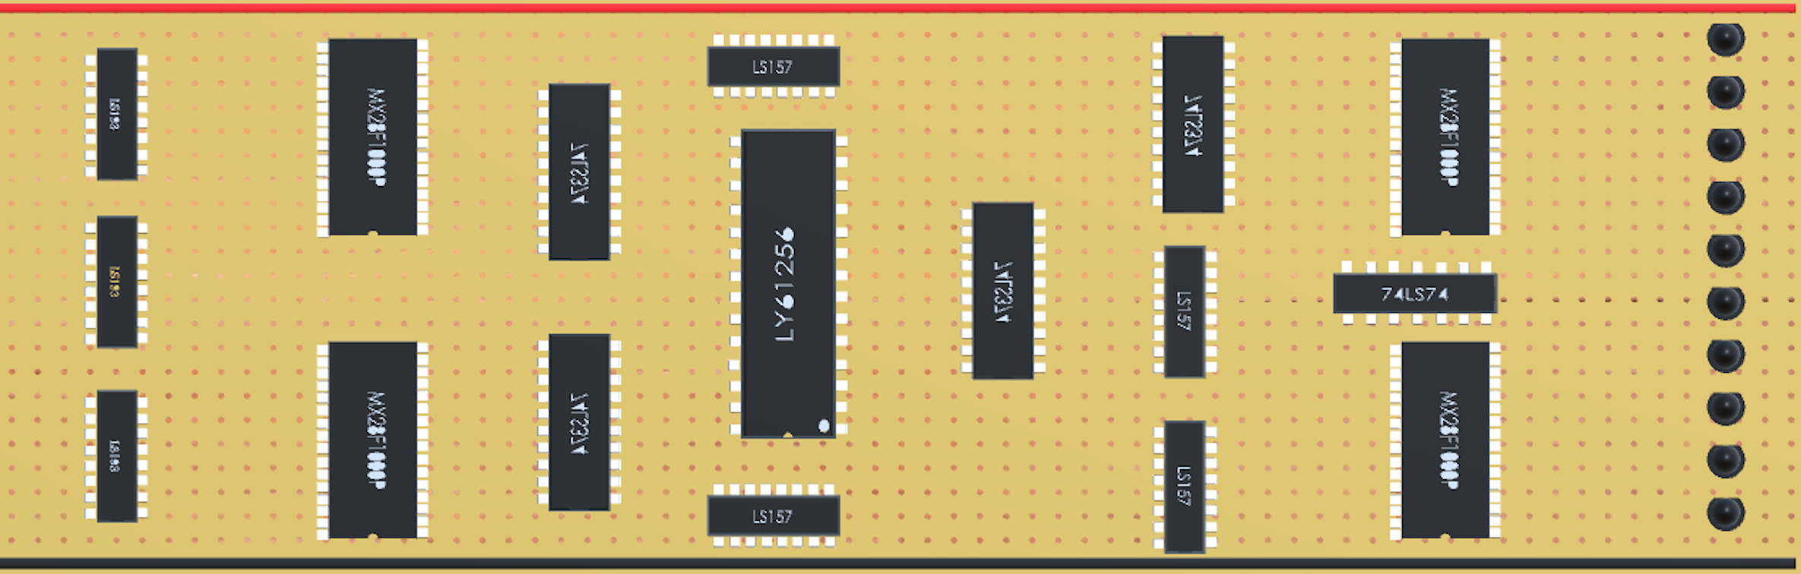
Simulator:
Main Scene :

Slide 7
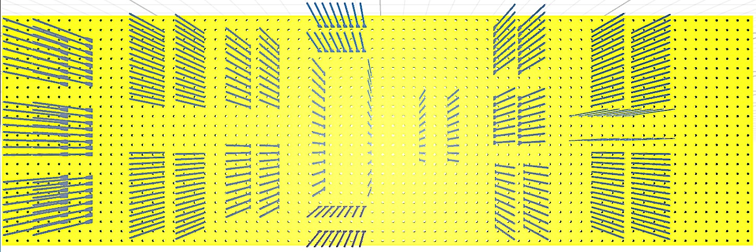
Simulator(cont..):
Back Scene :

Slide 8
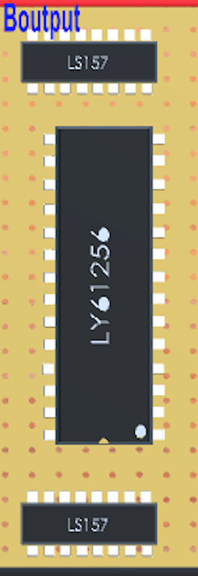
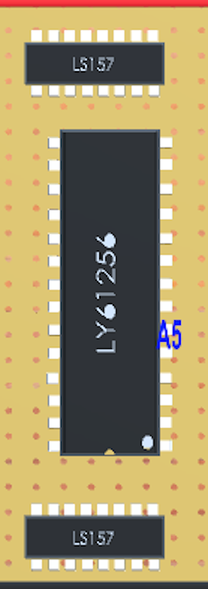
Connections Checker:
Pin identification:

Slide 9
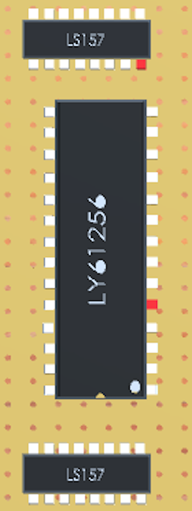
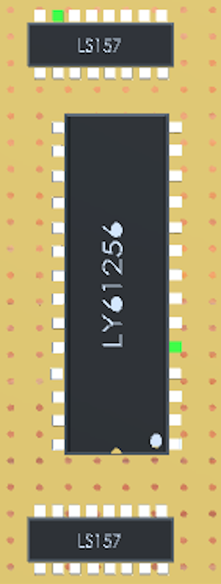
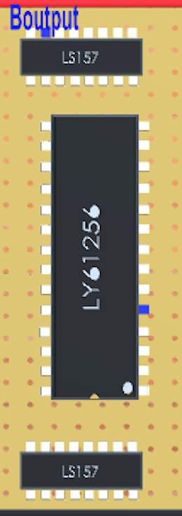
Connections Checker(cont..):
Wrong connection
Right connection
Connection identification

Slide 10
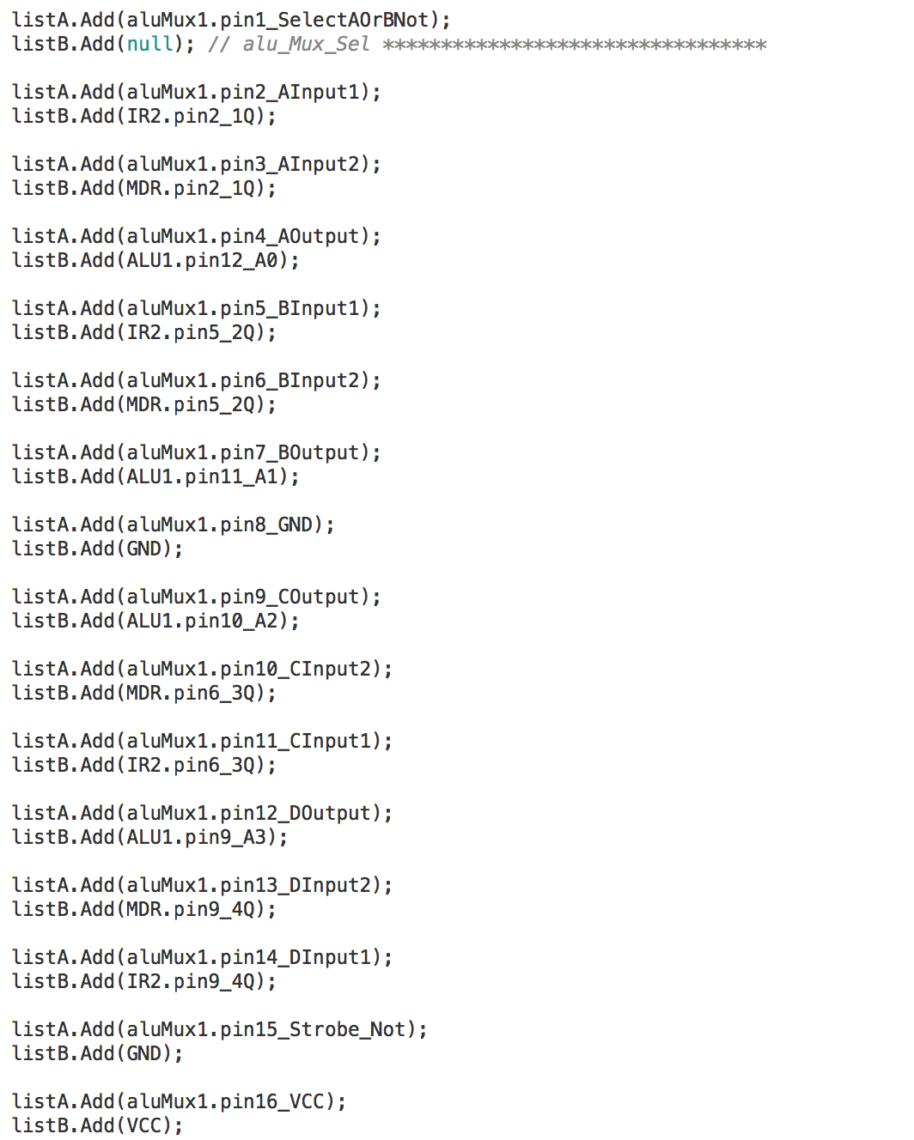
Correct connections of ALU MUX I:

Slide 11
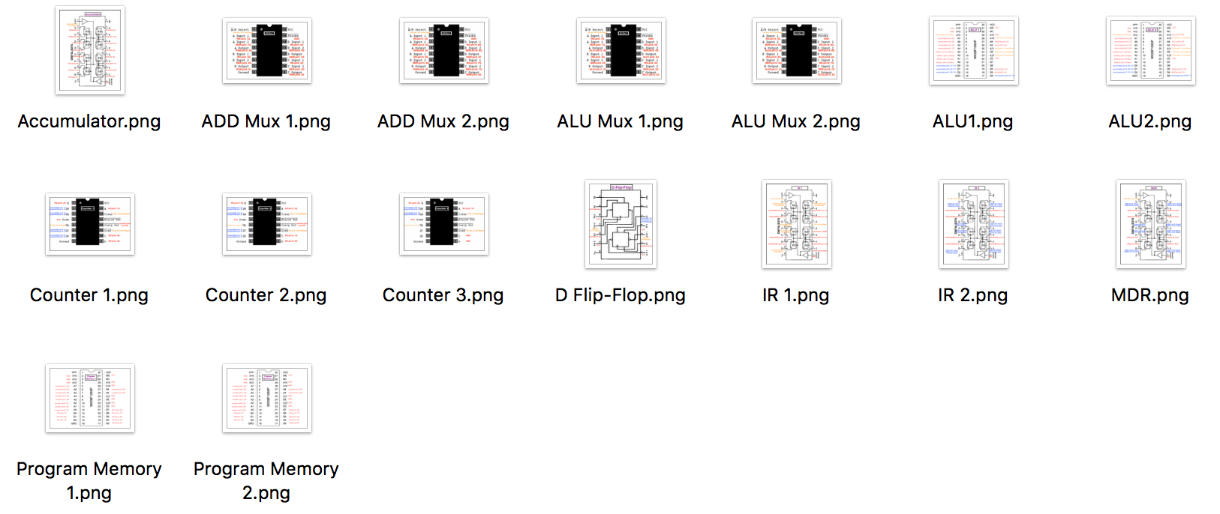
Connections Checker(cont..):
Connections’ Pictures:

Slide 12
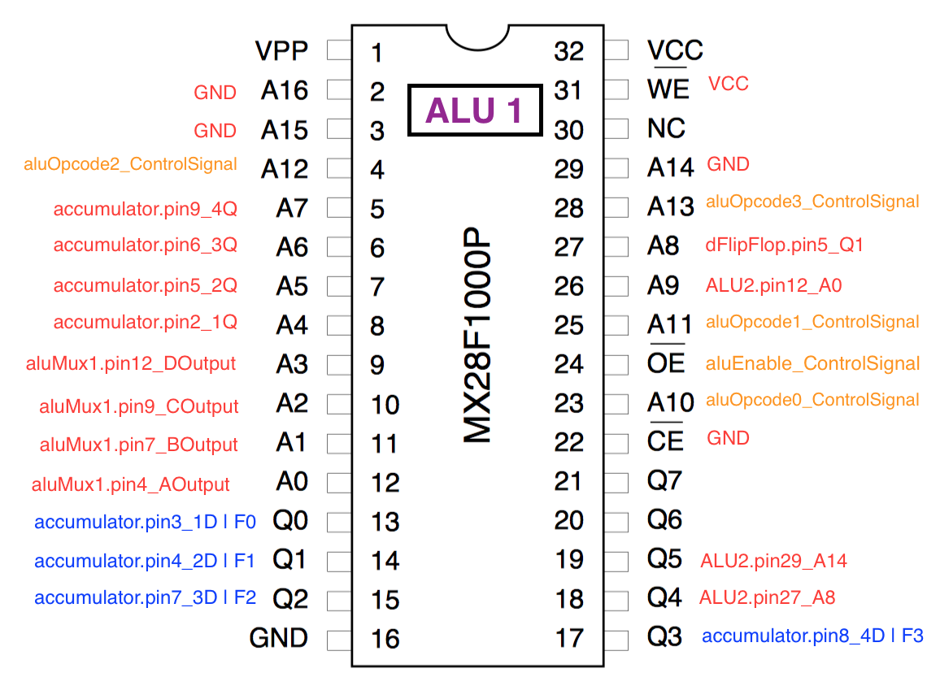
Correct connections of ALU I:

Slide 13
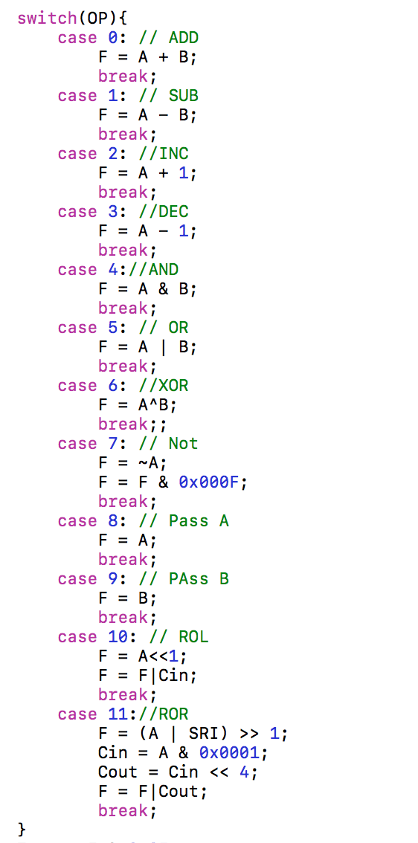
ALU’s Binary File Checker:
ALU’s Sub-Code:

Slide 14
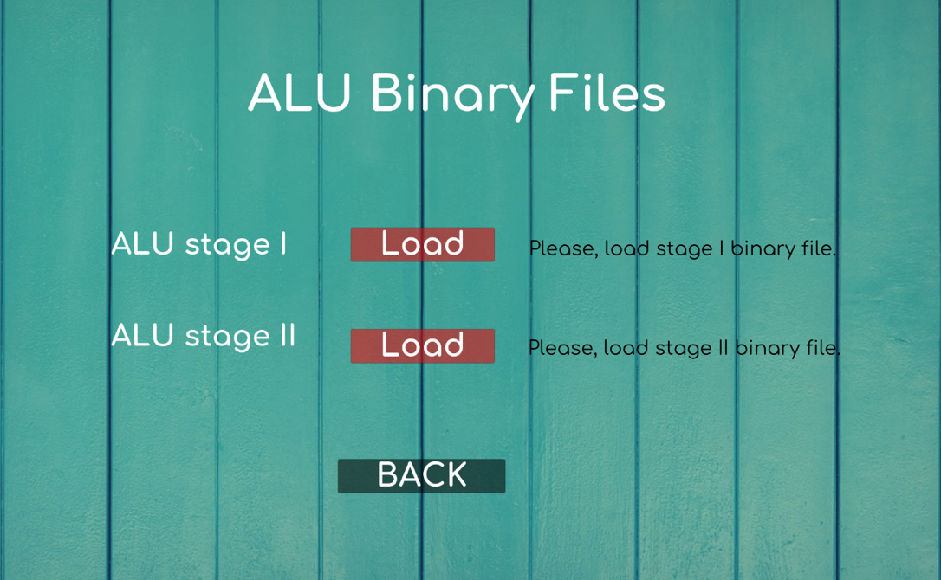
ALU’s Binary File Checker(cont..):

Slide 15
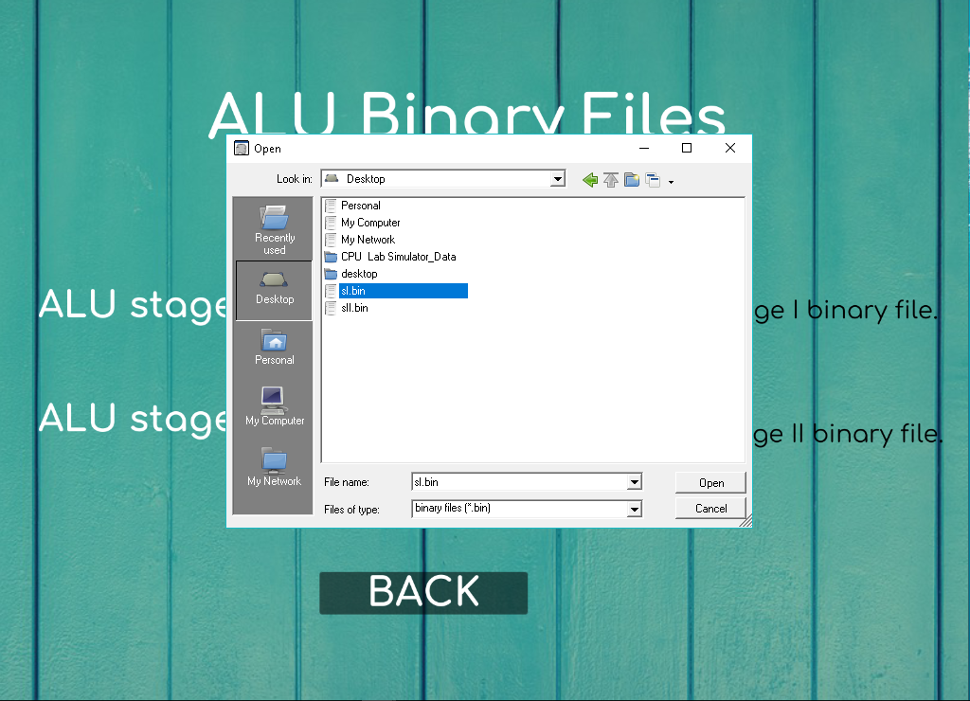
ALU’s Binary File Checker(cont..):

Slide 16
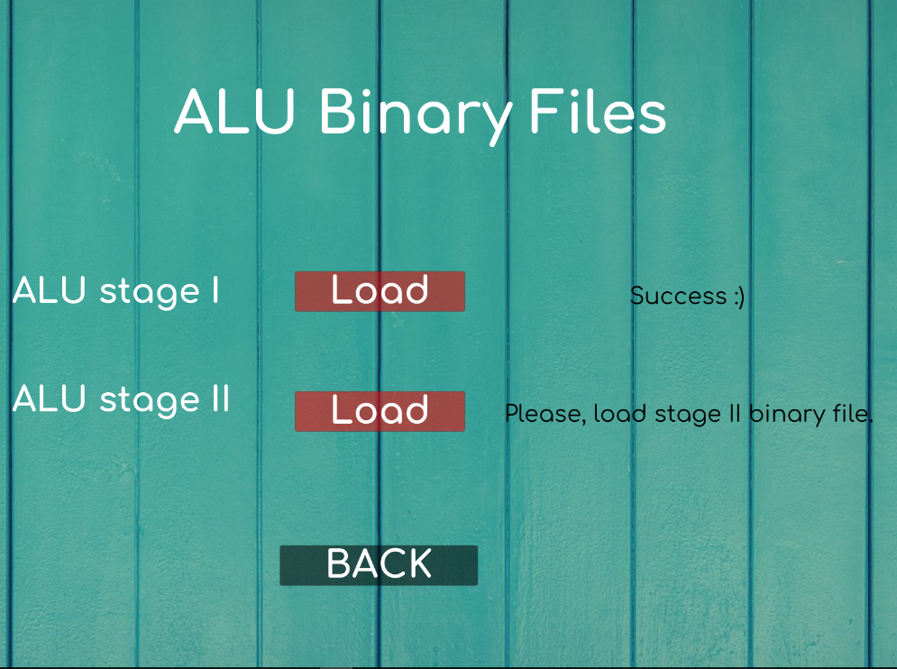
ALU’s Binary File Checker(cont..):

Slide 17
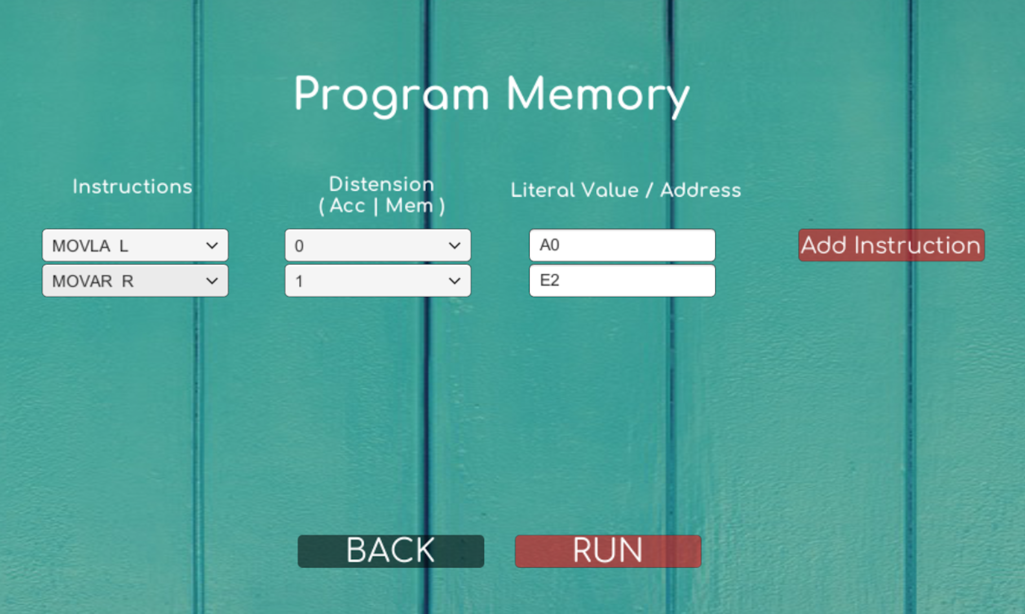
CPU Data Flow:
Programming Memory:

Slide 18
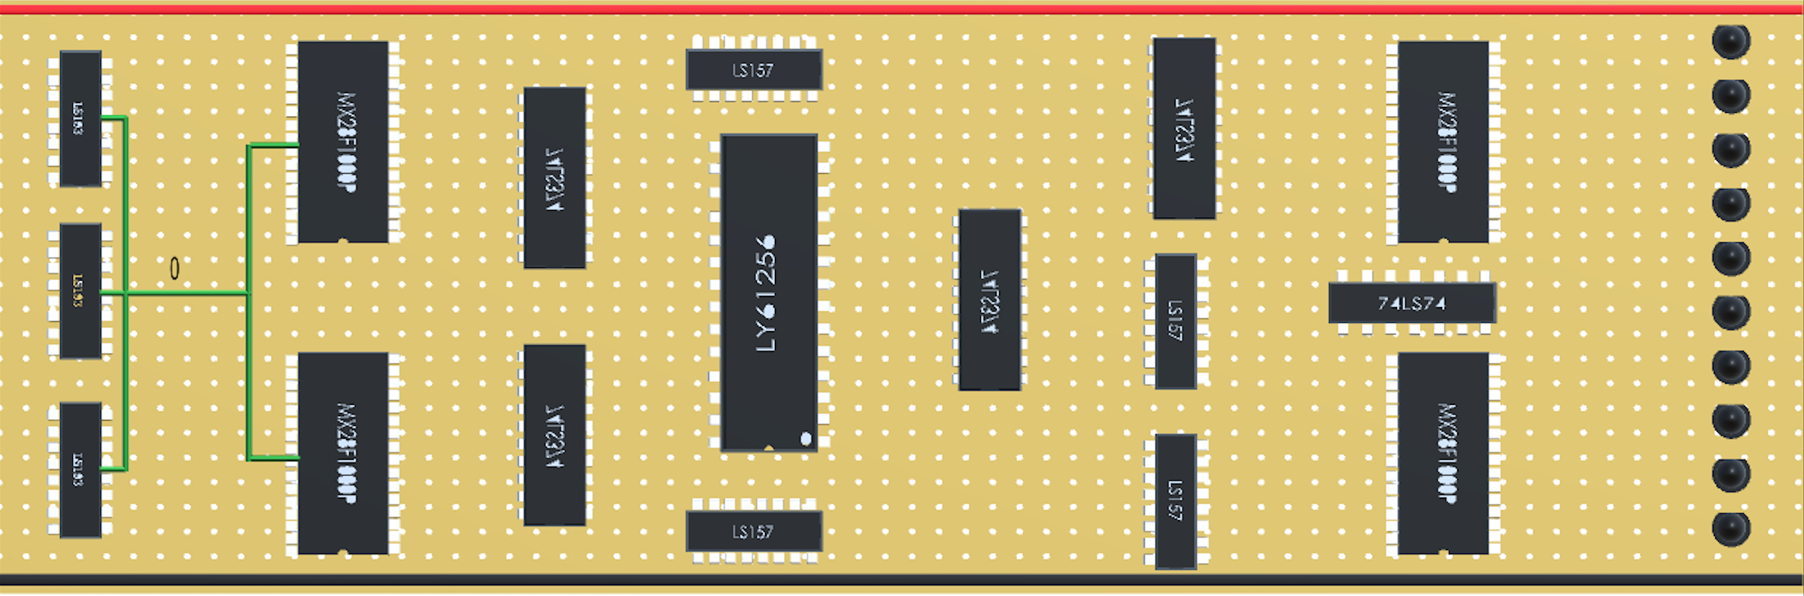
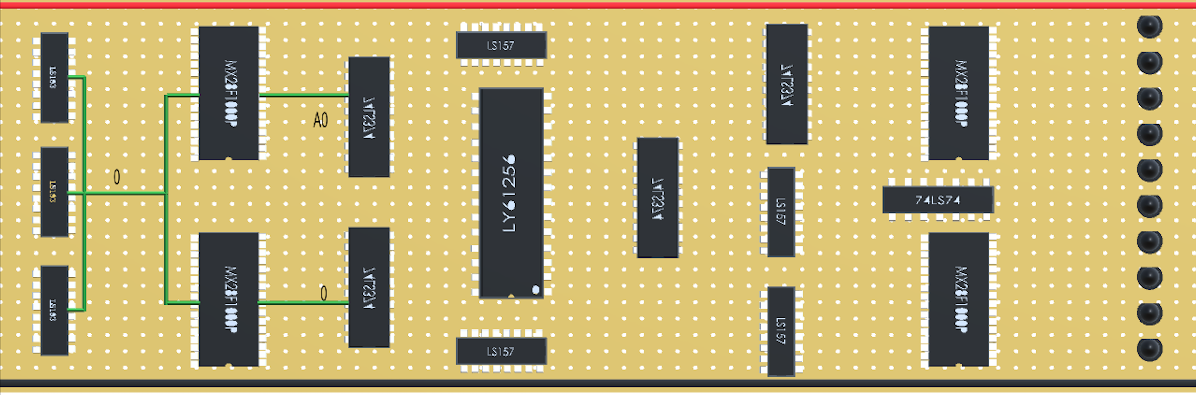
CPU Data Flow(cont..):

Slide 19
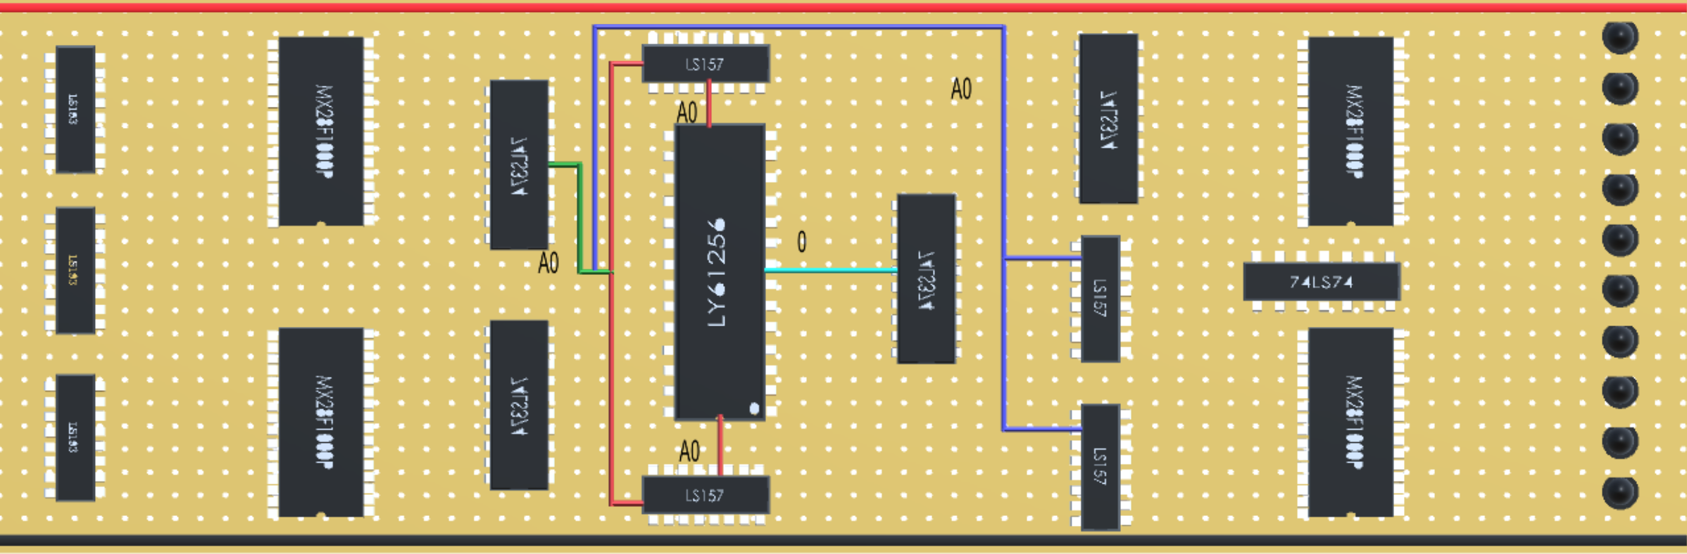
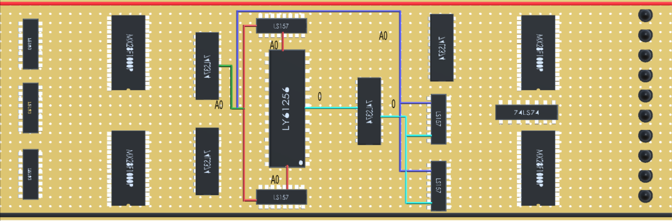
CPU Data Flow(cont..):

Slide 20
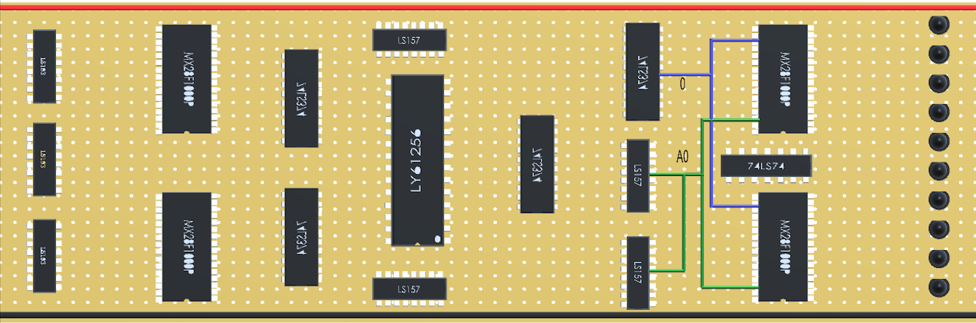
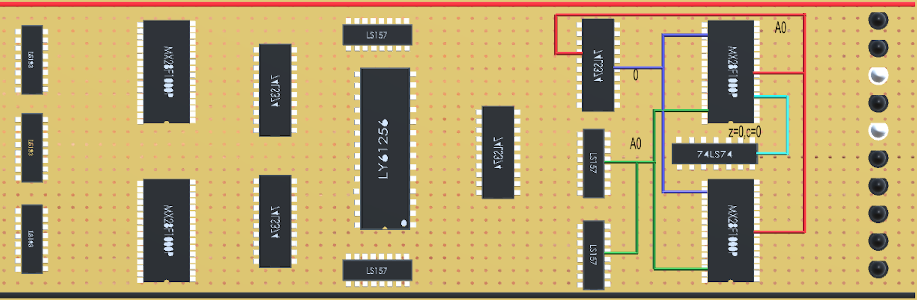
CPU Data Flow(cont..):

Slide 21
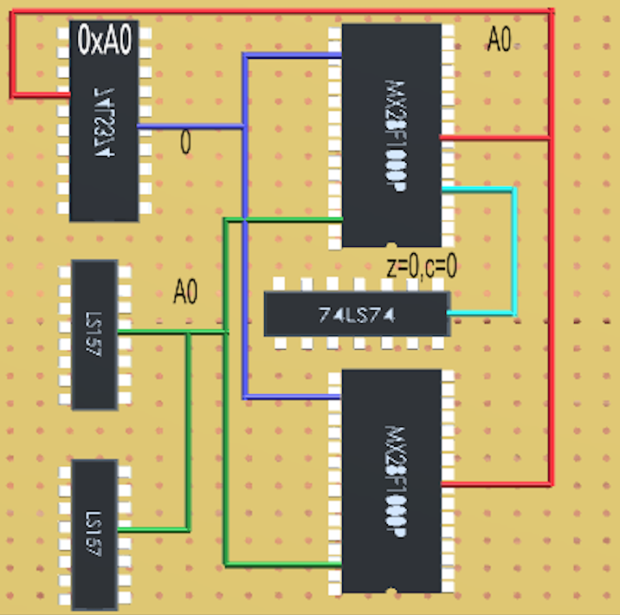
CPU Data Flow(cont..):
Data in Accumulator:

Slide 22
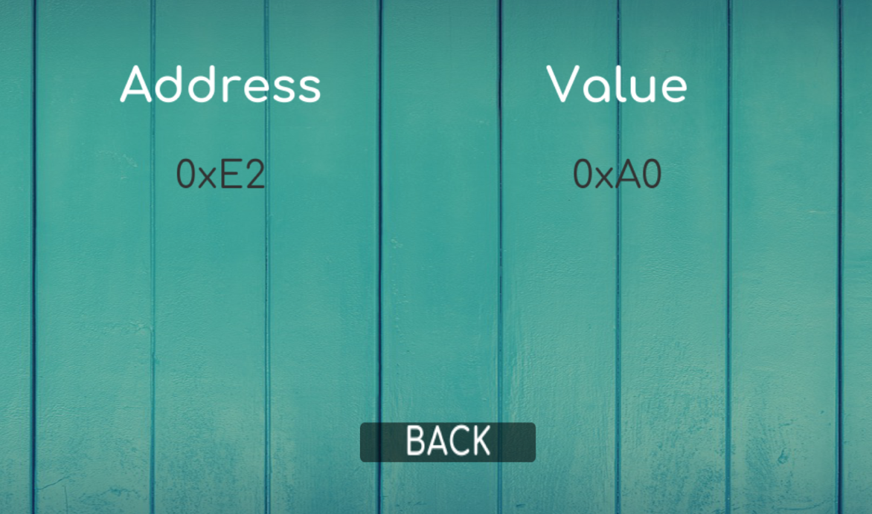
CPU Data Flow(cont..):
Data in RAM:

Slide 23
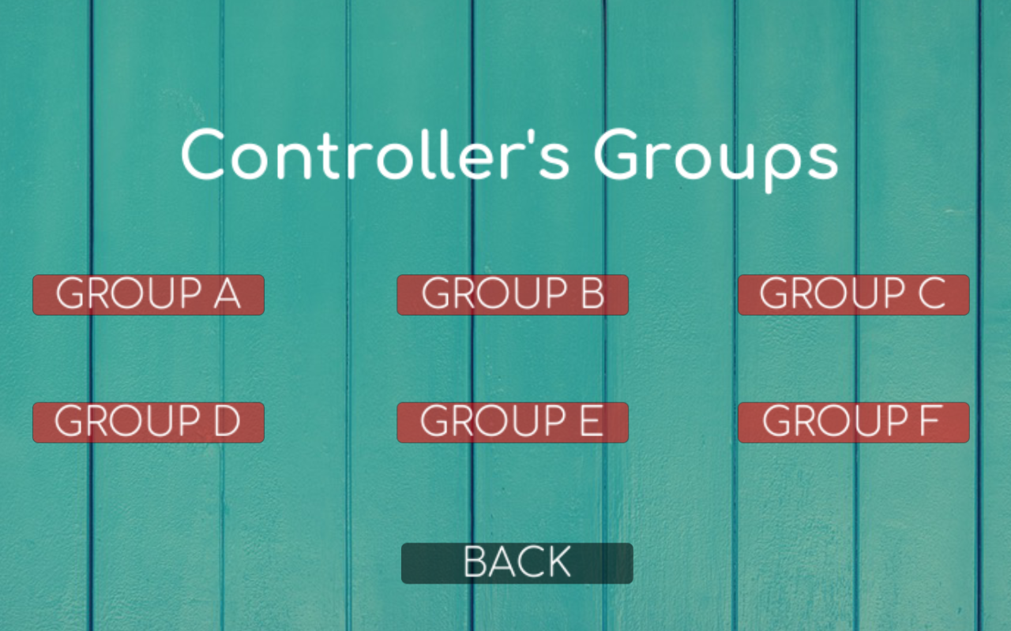
Controller’s Signals:

Slide 24
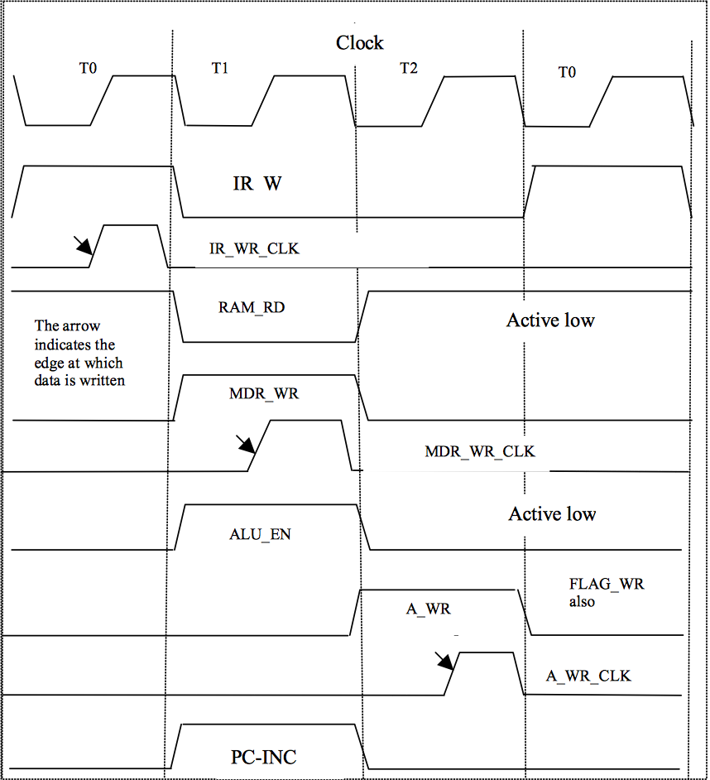
Controller’s Signals(cont..):
Timing Diagram for (Group A) Instructions:

Slide 25
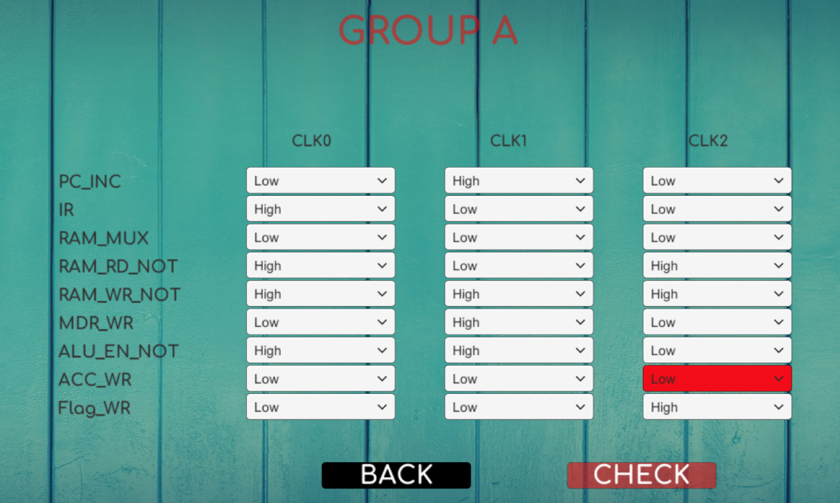
Controller’s Signals(cont..):

Slide 26
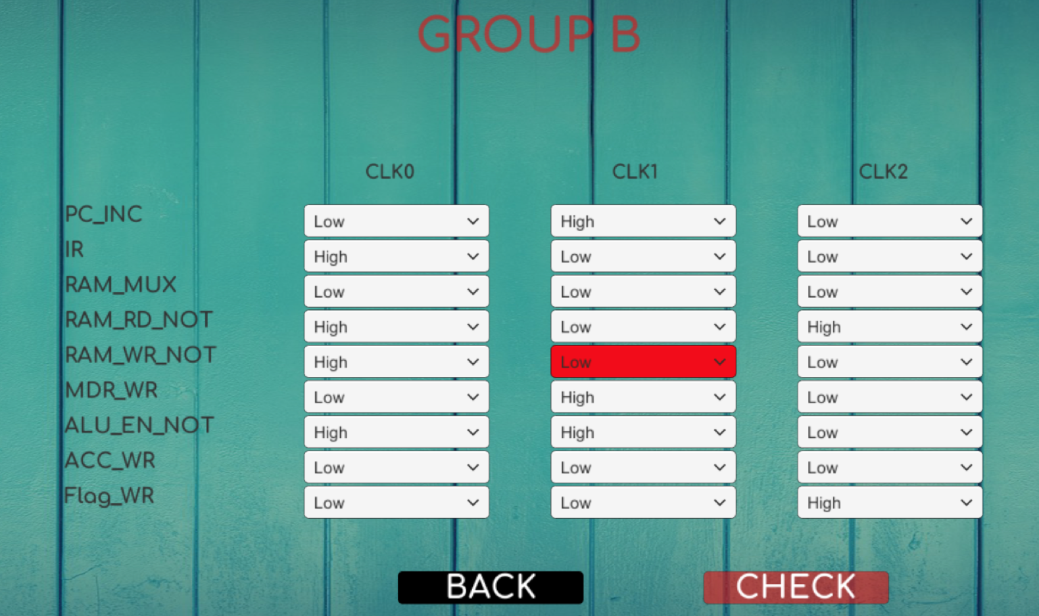
Controller’s Signals(cont..):

Slide 27
Limitations:
• Weak knowledge about unity game engine was a bit of a struggle.
• The idea is original and no similar projects were found to help us out.
• Lack of time.

Slide 28
Future Work:
• 3D version of our simulator.
• Releasing a version to help lab's supervisors with their evaluation of student's work.
• Controller’s implementation Code (VHDL).

Slide 29
Thank You ☺

