Slide 1

An-Najah National University
College of Engineering and Information Technology
Management Information Systems
23-may-2023

Slide 2
Human Resource Planning For
Gatoh Libnan Company By Using Odoo
Supervised by:
Dr. Najwan Al-Daleq
Prepared By:
Hala Hamdan Rahaf Dashoun
Leen Aboaisheh

Slide 3
Table of Contents
Introduction
Current State
Solution
Comparison
Modules
EFFY.AI
Reports

Slide 4

Introduction
Founded in Nablus in 1987
consists of 4 branches.
This store is managed by 5 partners Dashoun brothers.
It employs approximately 70 employees.
Our project aims to implement Human Resource Planning For Gatoh Libnan Company

Slide 5
Current State
Paper based system
Communication Limitations
Limited information of employee
No reporting

Slide 6
Solutions
Employees' files
Attendance management
Performance management and evaluation
Salary and benefits management

Slide 7
Comparsion between odoo and Hesabate
Odoo
حساباتي
HR modules
Integration
Cloud offer Available
Security
Reporting

Slide 8
Why Odoo ?
Odoo
Daftara
WebHR
Customization
High
Low
Low
Function scope
All Modules
HR
HR
Price
24$/M
26$/M
27$/M

Slide 9
Modules In Odoo
Employees
Contracts
Payroll
Planning
5) Attendance
6) Time off
7) Appraisal
8) Recruitment
9) Website
10) Approvals
11) Dashboard

Slide 10

Modules In Odoo
Let’s start with Employees module

Slide 11
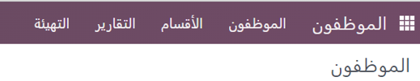
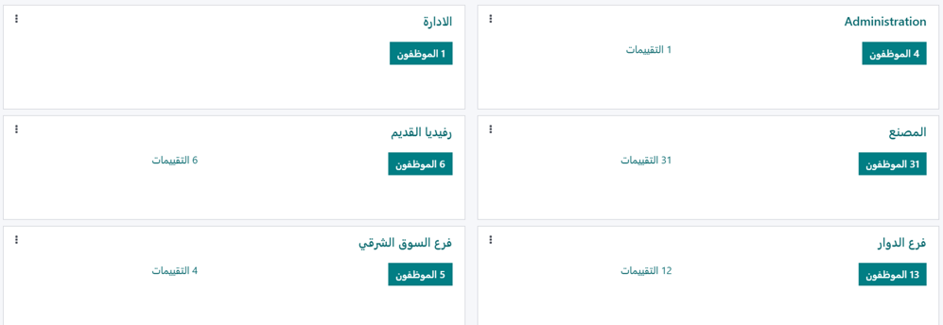

Slide 12
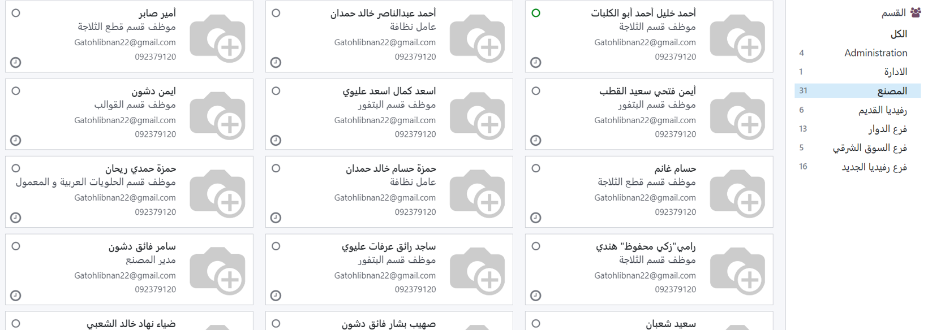

Slide 13
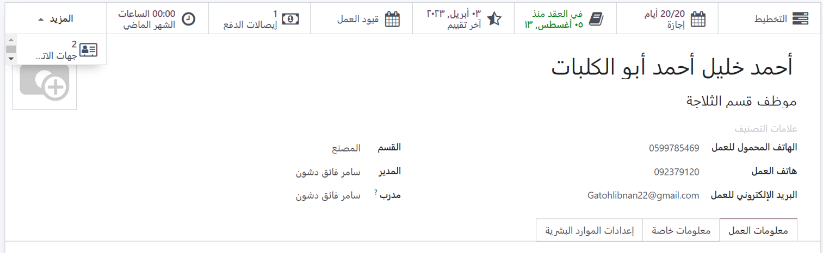
2
1

Slide 14
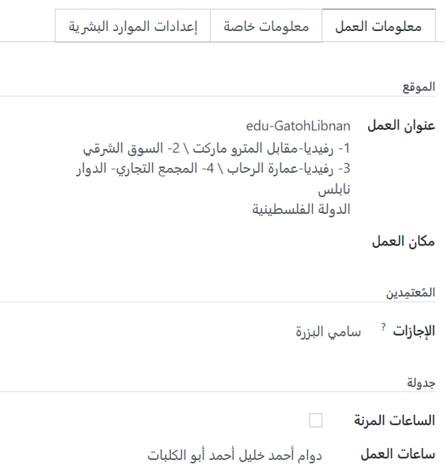
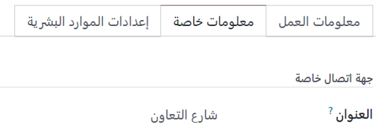
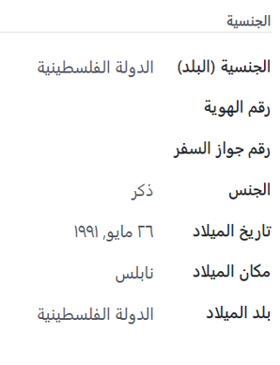
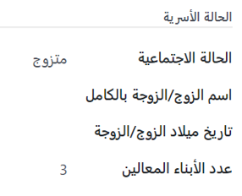

1
2
3
4

Slide 15
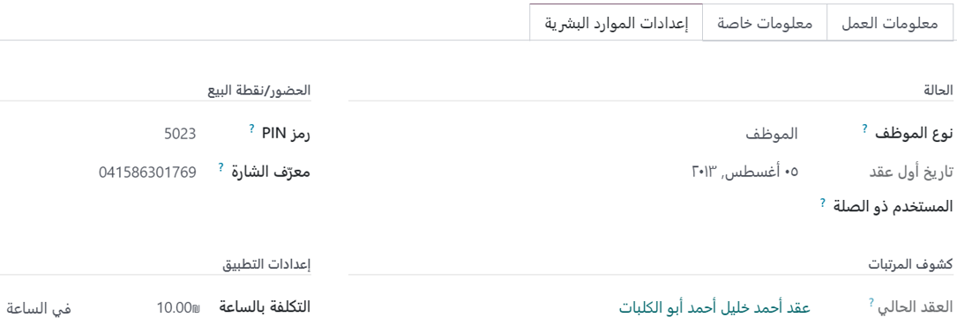

Slide 16
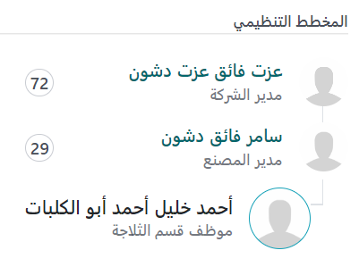
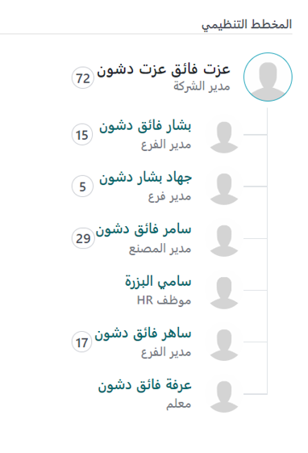
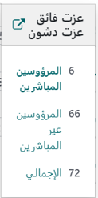
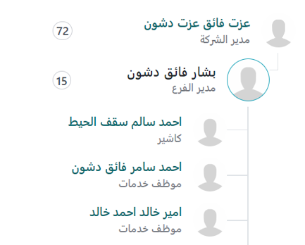

Slide 17
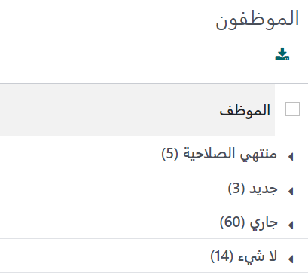
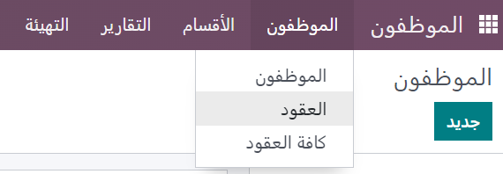
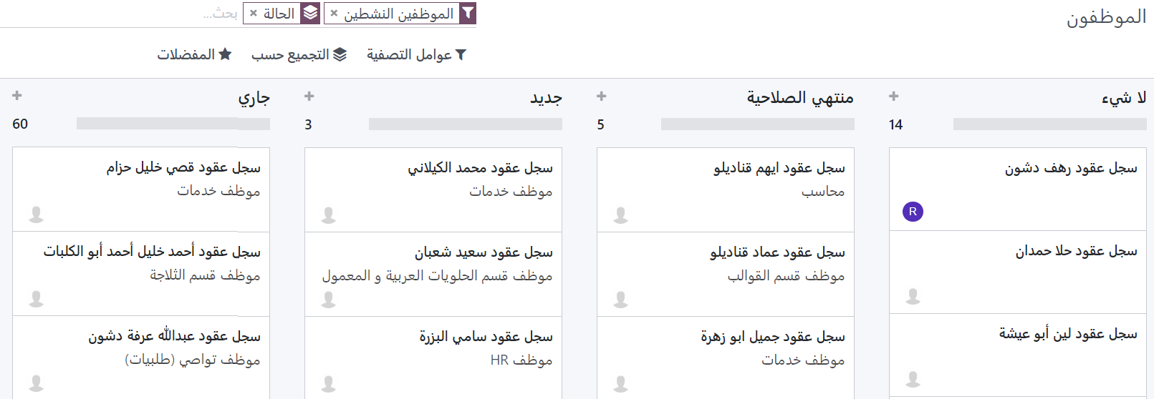
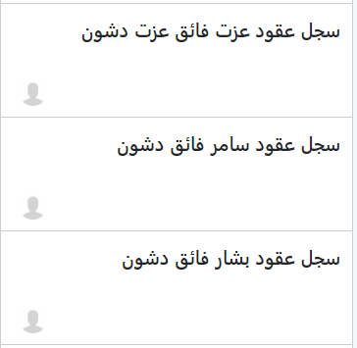
Contracts

Slide 18
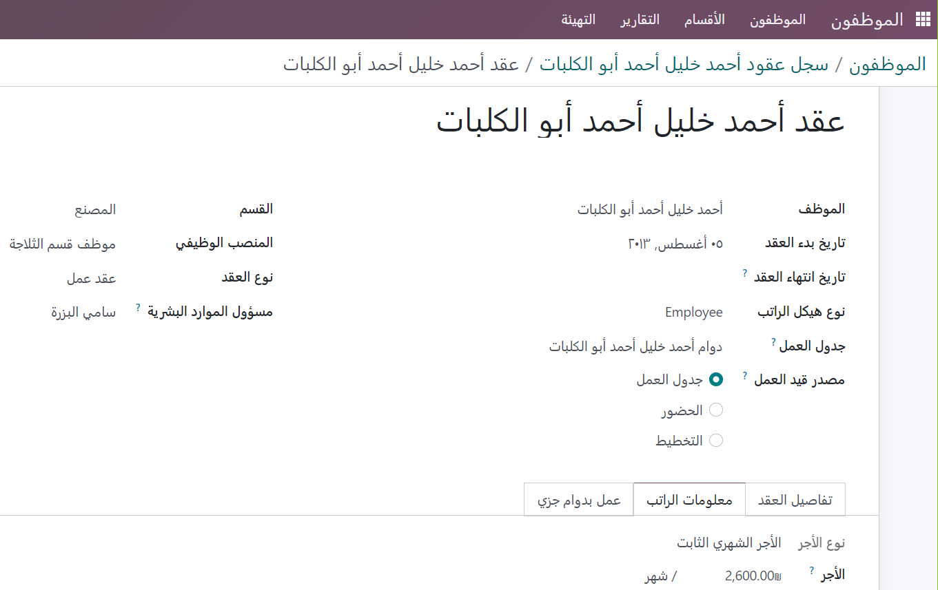
Contracts

Slide 19

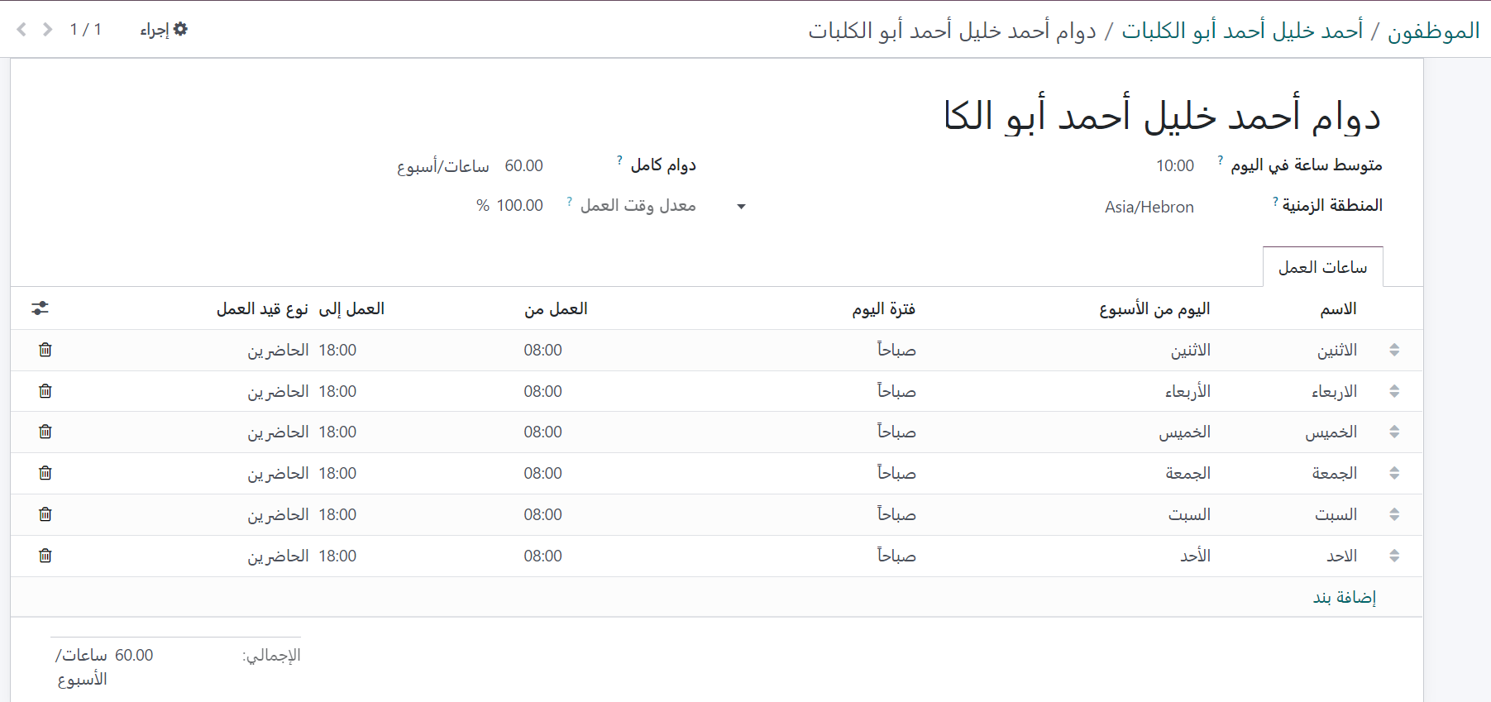
Contracts
The contract contain :
Work Time
Salary

Slide 20

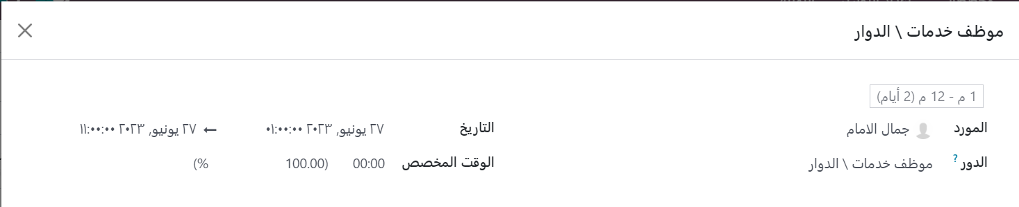

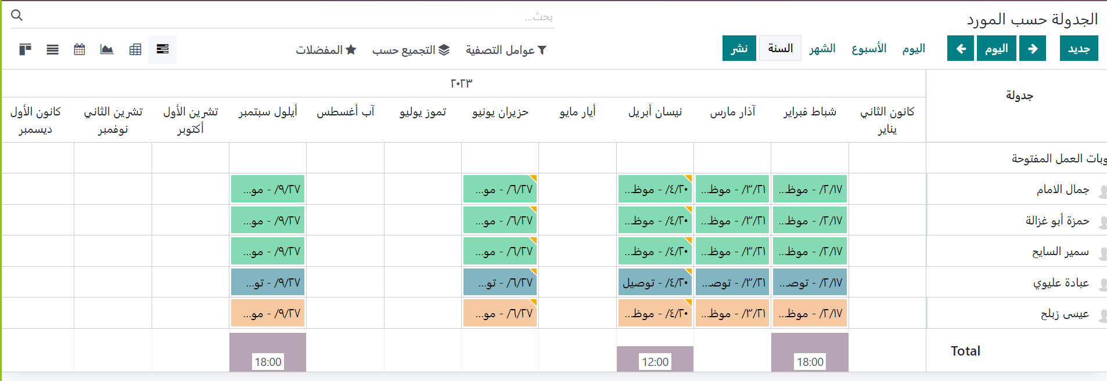

Slide 21

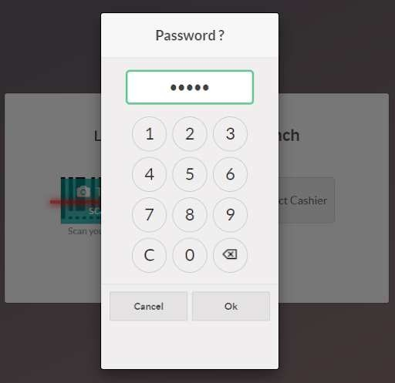
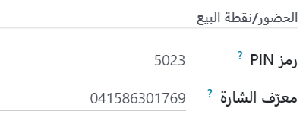
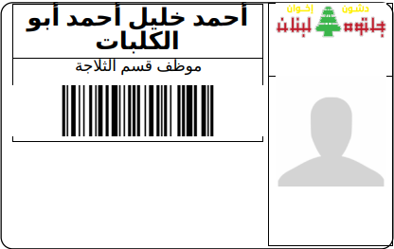

Slide 22

But using Pin or Card is not effective
So after research we found out that the company can ask for a customization (Fingerprint) .
It cost $650 - $1000

Slide 23

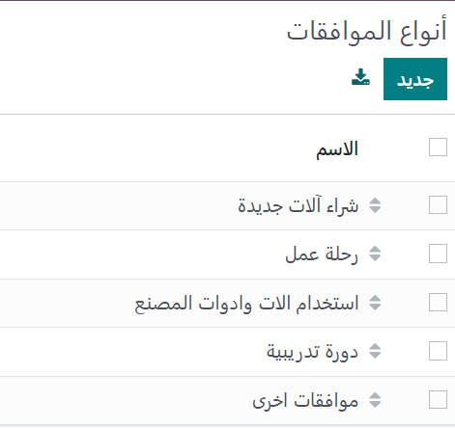

Types of approvals

Slide 24
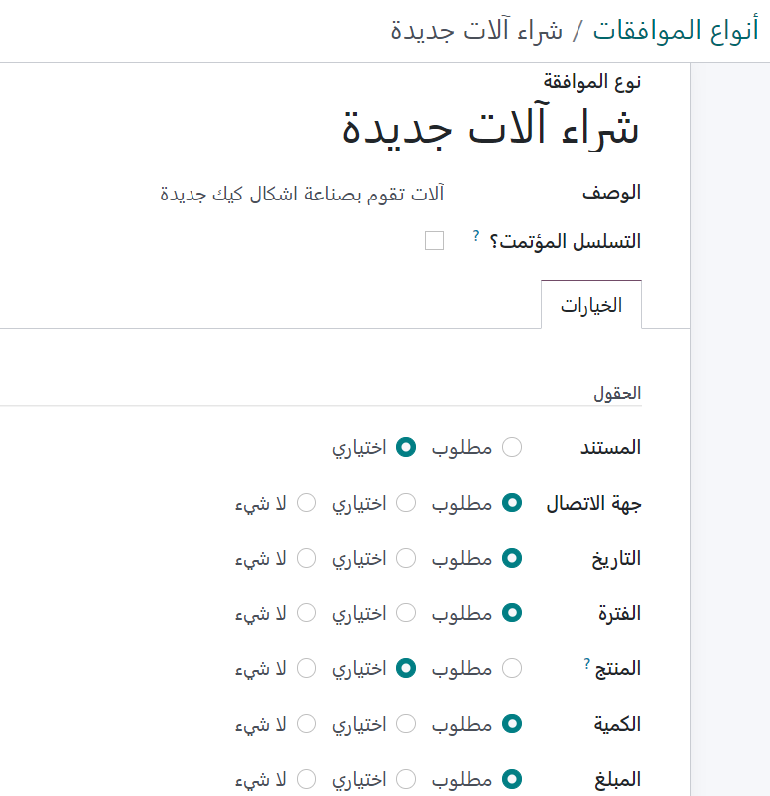
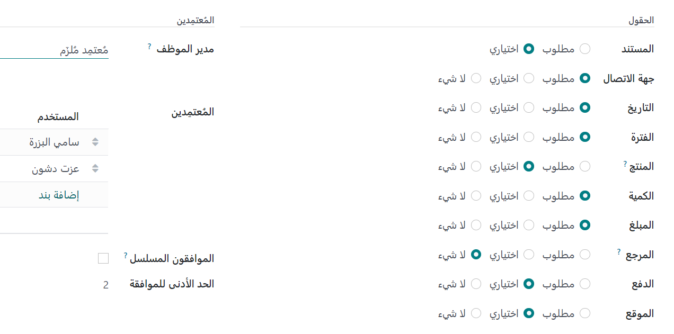
Identify a new approval

Slide 25
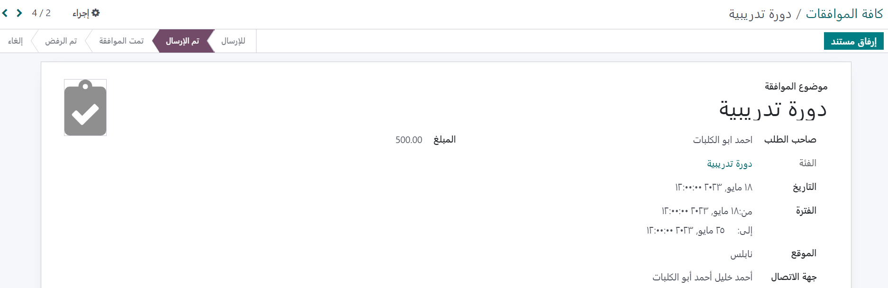
Ask for approval

Slide 26
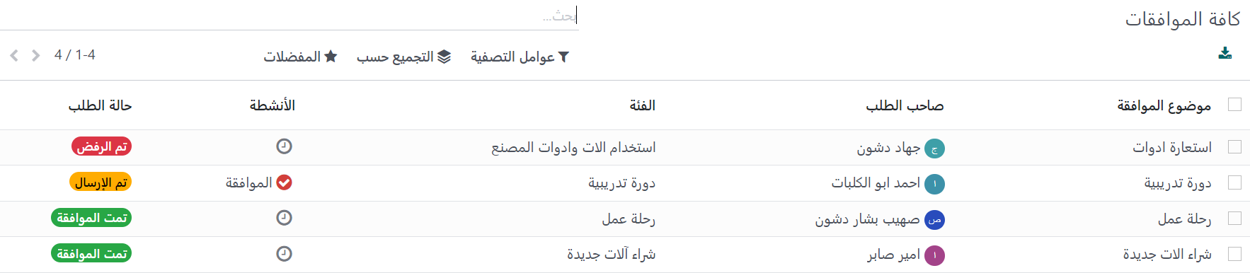
All Approvals

Slide 27

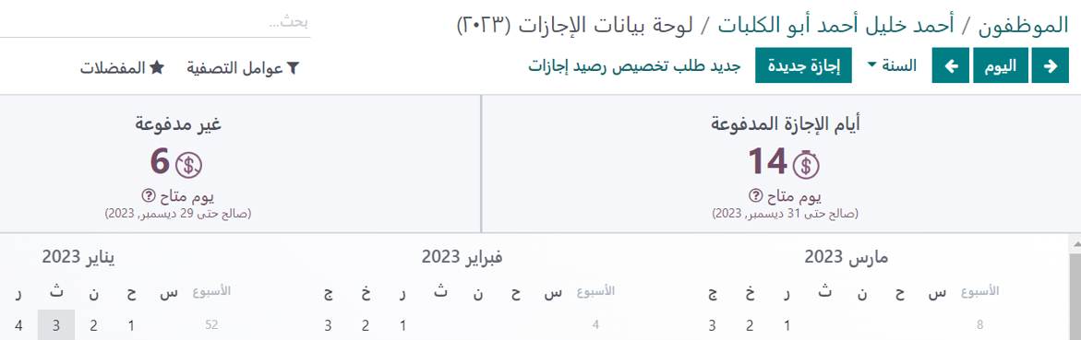
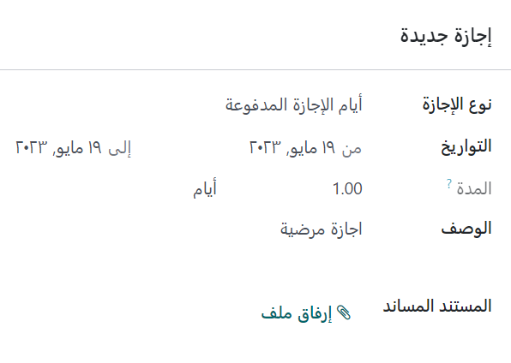
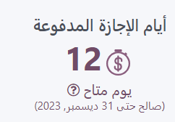

Slide 28
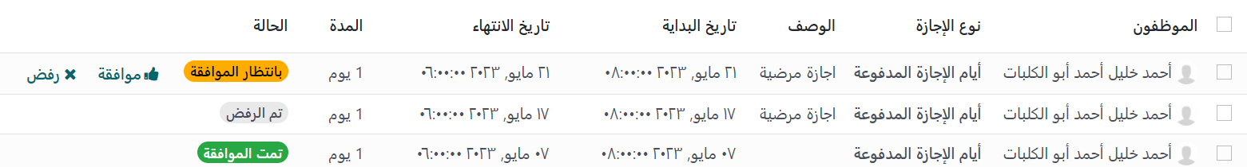
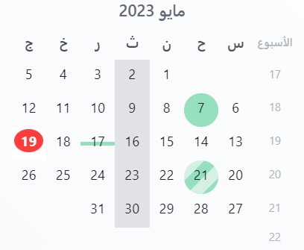
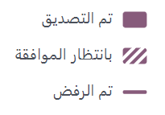
19

Slide 29



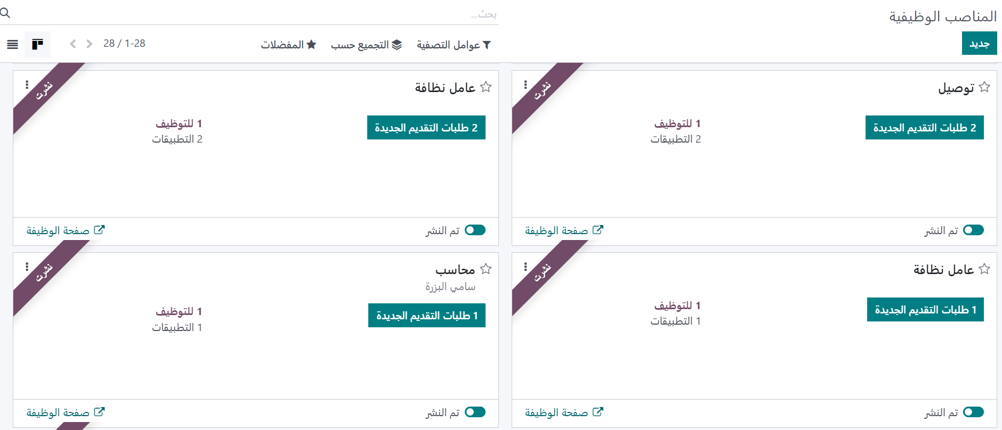

Slide 30




Slide 31
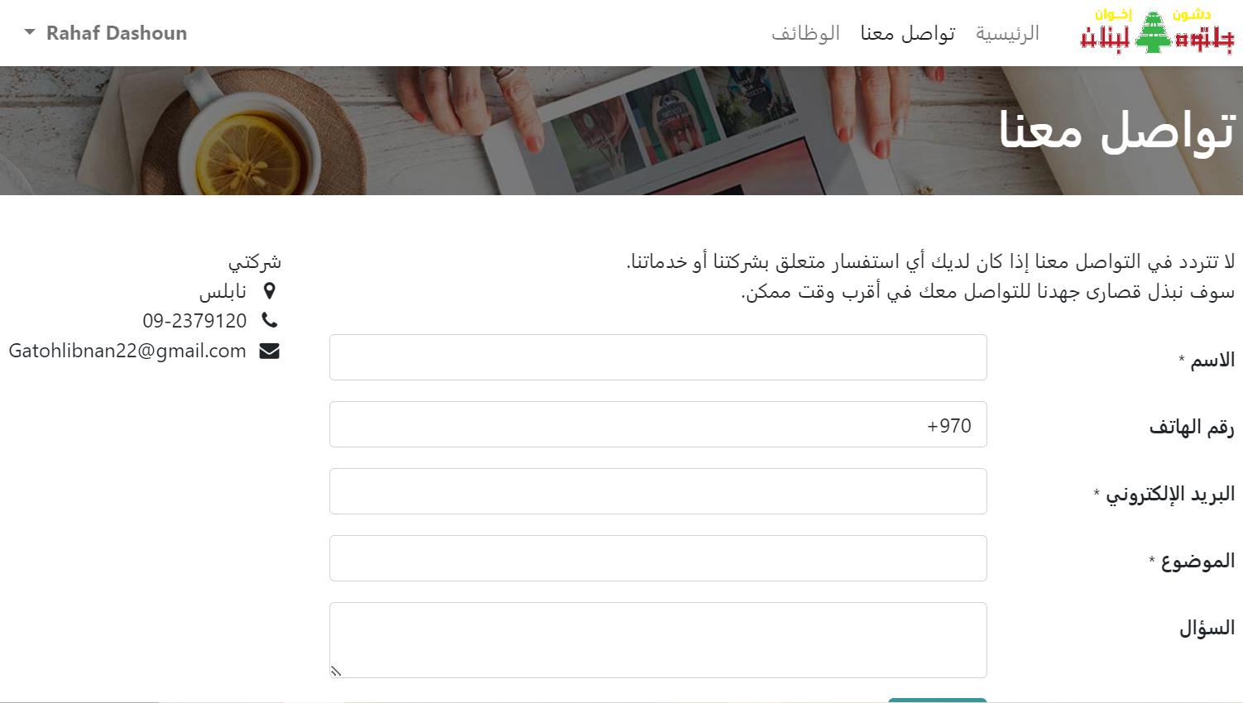

Slide 32
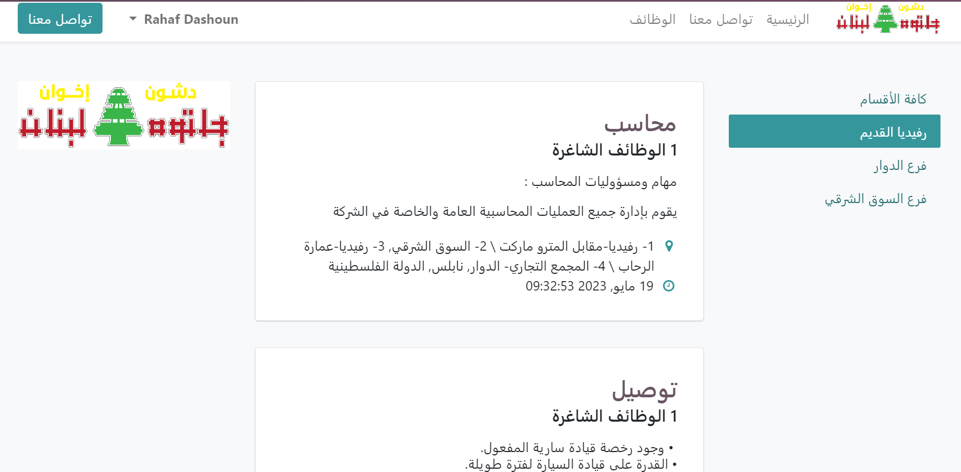

Slide 33
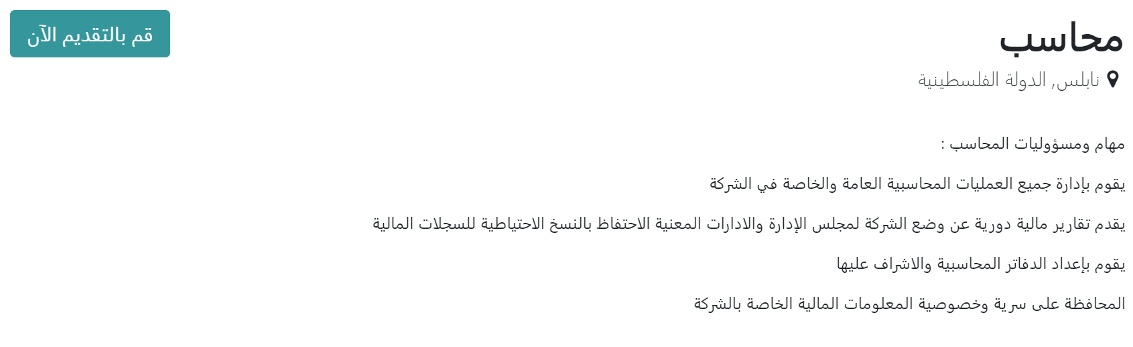

Slide 34
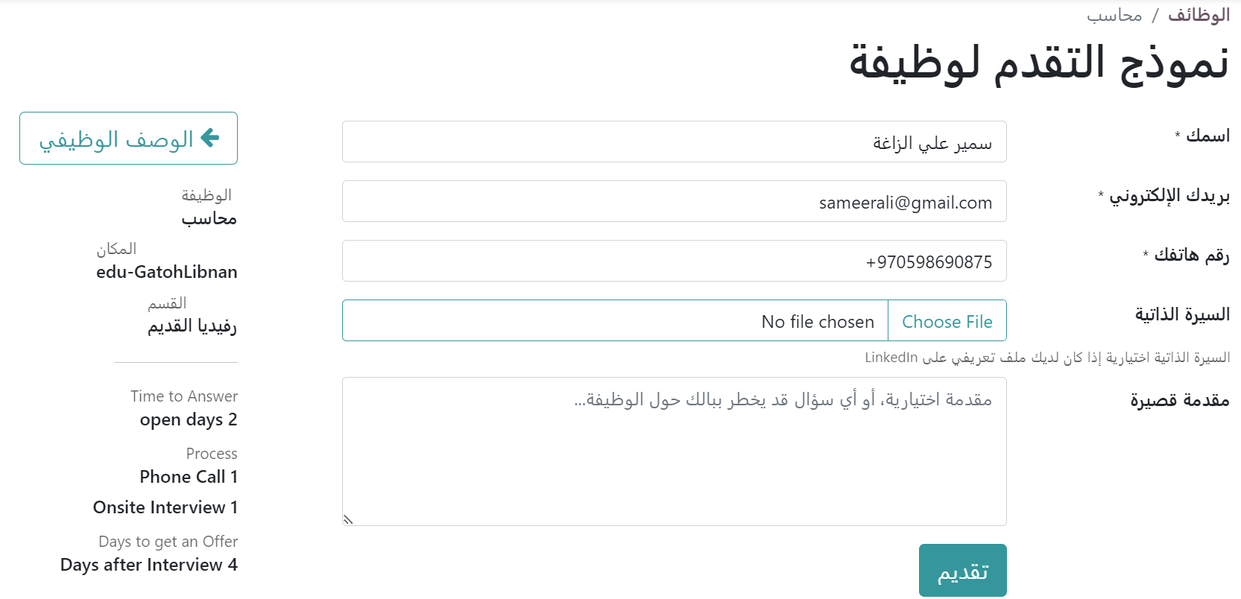


Slide 35
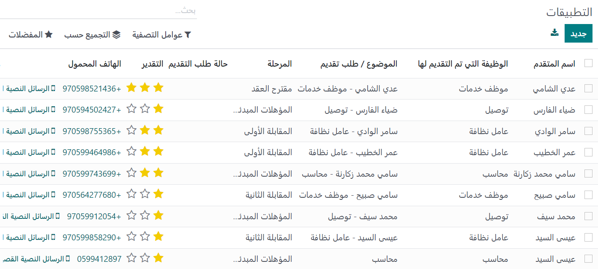

Slide 36

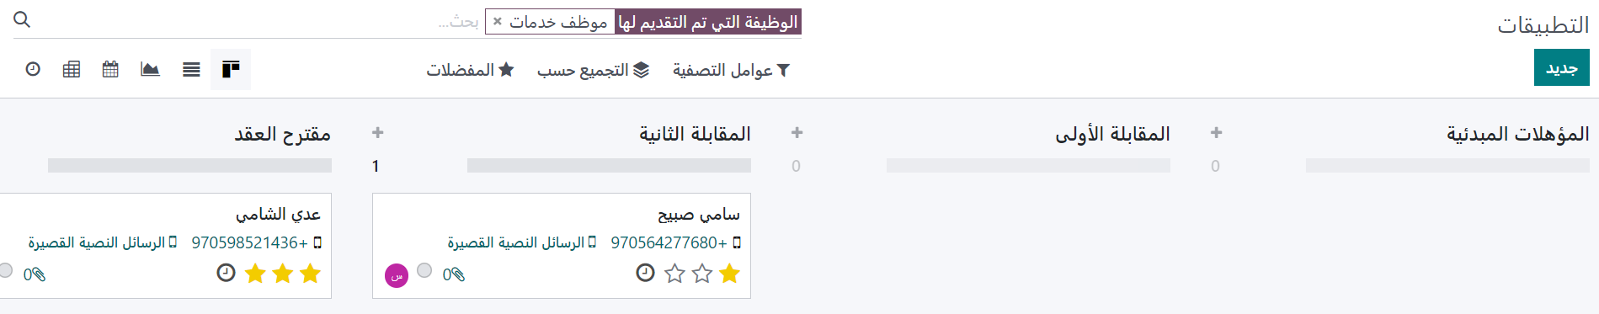

Slide 37


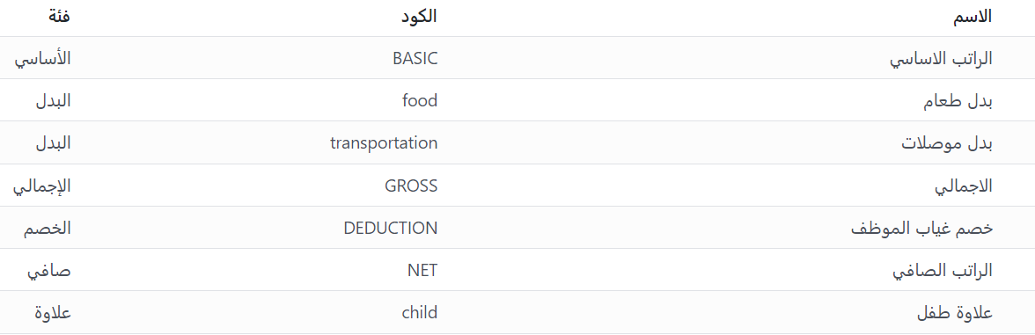
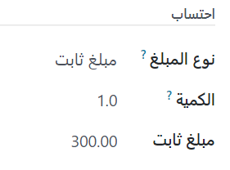
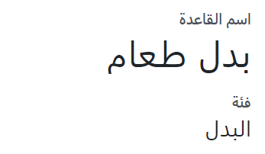
1. Define payroll structure

Slide 38
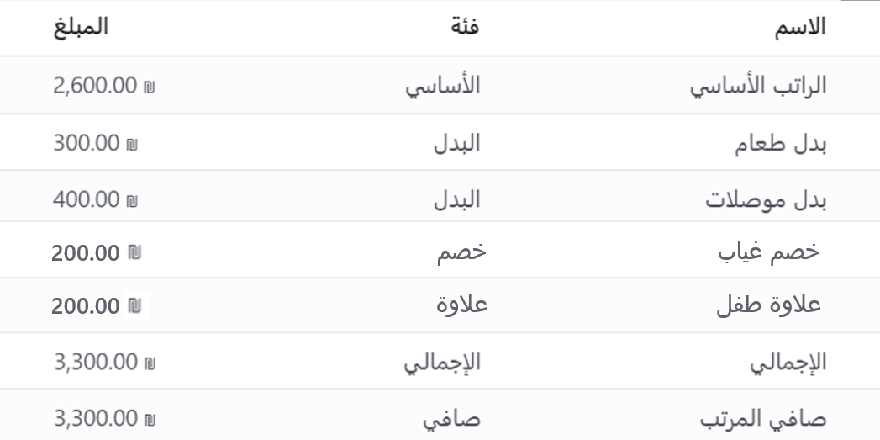

Slide 39
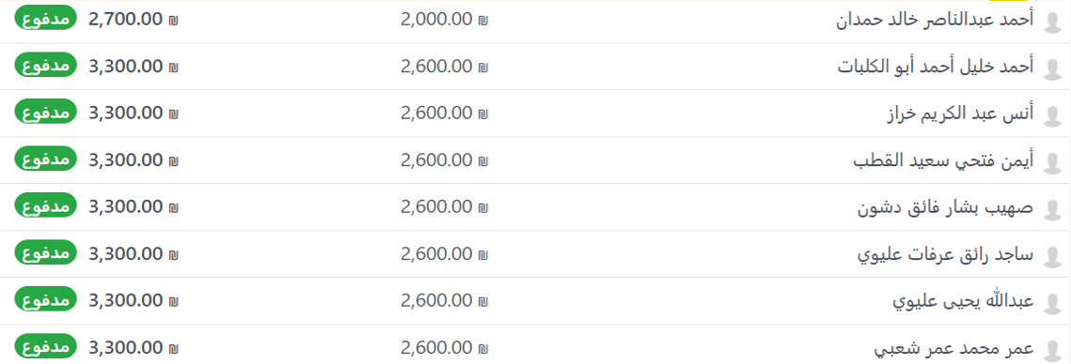

Slide 40

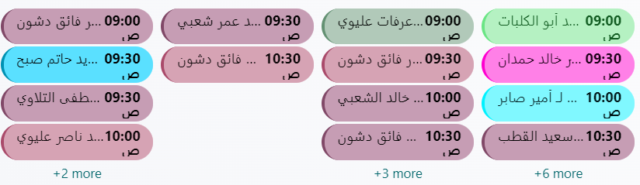
Appraisals Calendar

Slide 41


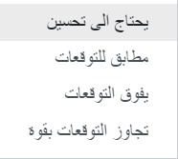


Slide 42
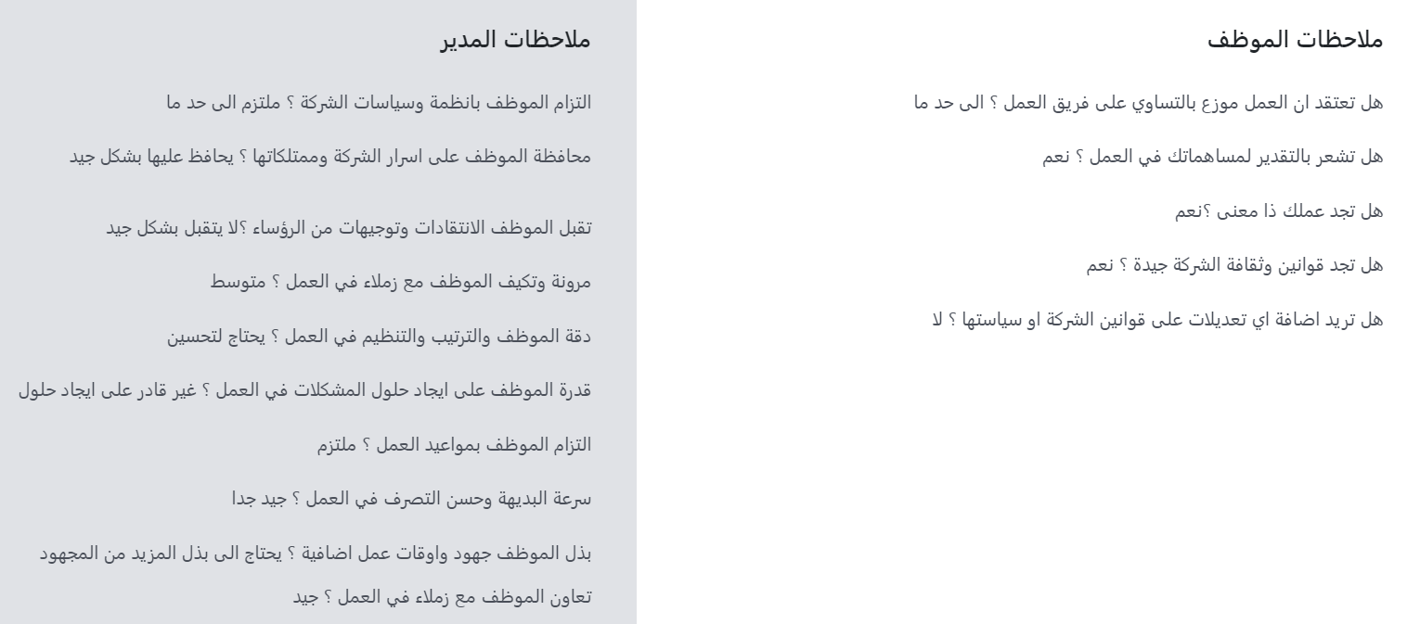

Slide 43


Slide 44


Slide 45




EFFY.AI Tool
Using AI for performance evaluation

Slide 46


Slide 47






Slide 48




Slide 49






Slide 50






Slide 51


2
1

Slide 52







146,500

Slide 53



Thank you!
Any questions?

