Slide 1

AN-NAJAH NATIONAL UNIVERSITY
FACULTY OF ENGINEERING
DEPARTMENT OF MECHANICAL ENGINEERING

Slide 2

Students name :
Fadi ghssan foqha.
Tareq Mousa.
Ayman abo alshwareb.
Motaz ‘abed .
Supervisor:
Dr :ahmed al ramahe
Five star hotel in Nablus

Slide 3
MECHANICAL SYSTEMS IN BUILDINGS
Five star hotel in Nablus
Five star hotel in Nablus

Slide 4
The aim of this project is to design the Following Mechanical Systems to five star hotel in Nablus:
Heating Ventilation and air conditioning (HVAC).
Plumping system (Sanitary drainage system& potable water system).
Fire Fighting system.
choosing elevators for the hotel.
Five star hotel in Nablus

Slide 5
Note :
We discus the Plumping system (Sanitary drainage system and potable water system)
in project 1 .
Five star hotel in Nablus

Slide 6
HVAC System
The main objective of air conditioning is to maintain the environment in enclosed space at conditions that induce the feeling of comfort to human.
Five star hotel in Nablus

Slide 7
WINTER INSIDE AND OUTSIDE DESIGN CONDITIONS
Outside temperature To=4.7 ˚C.
Inside temperature Ti=21 ˚C.
Outside Relative humidity Ф_{o}=72% .
Inside Relative humidity Ф_{i}=50%.
Outside Moisture content W_{o} =8.4 g of water/ Kg of dry air.
Inside Moisture content W_{i} =4 g of water/ Kg of dry air.
temperature for the unconditioned spaces Tun=13.35 ˚C.
Temperature for the ground Tg=12 ˚C.
Five star hotel in Nablus

Slide 8
HEATING LOAD EQUATIONS:
Qs,cond = U A (Tin – To) .
Q S,vent = 1.2 Vvent (Tin – To).
Q L,vent = 3 Vvent (Wi- W o).
Qtotal = Qs,cond + Qs,vent +QL,vent.
Five star hotel in Nablus

Slide 9
HEATING LOAD RESULTS:
Floor | Q)total .(w) | Q)total .(kw) | Q)total .(ton)
Under ground Floor | 145986.66 | 145.987 | 41.73
Ground Floor | 118910.3 | 118.91 | 33.97
First Floor | 129917.3 | 129.91 | 33.97
identical Floor)9 )Floor | 141972.25 | 141.97 | 40.564
Five star hotel in Nablus

Slide 10
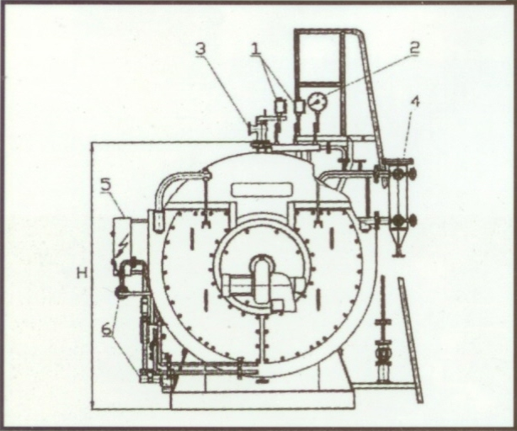
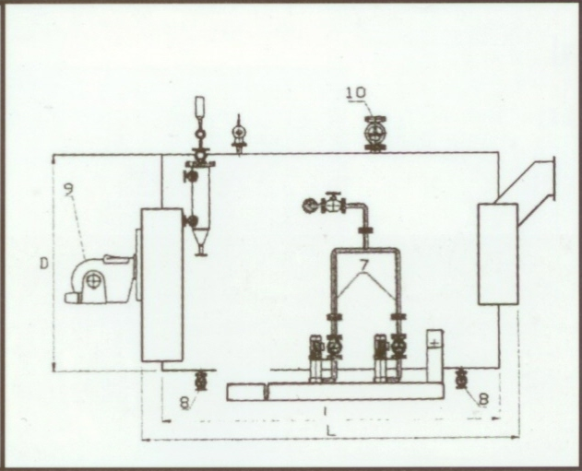
The boiler is the main source of heating process, selection of boiler depends on its capacity. selection of boilers from Mansur company.
The total amount of heat in our project equal to 2508.8 KW. Use catalog then the selected boiler according to catalog is MS30 found in the under ground floor in mechanical room .
Where: H=2.45 m, D=2.05m ,L=3.38m, I=2.98m

Slide 11
SUMMER INSIDE AND OUTSIDE DESIGN CONDITIONS
Outside temperature (To) be 30˚C.
Inside temperature (Ti) be 24 ˚C.
Outside Relative humidity (Ф_{o}) is 44%.
Inside Relative humidity (Ф_{i}) is 50%.
Outside Moisture content (W_{o}) is 12.5 g of water/ Kg of dry air.
Inside Moisture content (W_{i}) is 9.4 g of water/ Kg of dry air
temperature for the unconditioned spaces Tun=28˚C.
Temperature for the ground Tg=26 ˚C.

Slide 12
COOLING LOAD EQUATIONS
Qs = U × A × CLTD corr. For Wall And Ceiling.
CLTD corr = ( CLTD + LM ) K +( Tin -25.5 ) + ( To – 29.4 ).
Qs) conduction)glass = A × SHG × SC × CLF . For glass.
Qs) convection)glass = U × A × ( CLTD ) correction.
Qs)ven = 1.2 × A × ( To – T in ) .
Q latent)ven = 3 × A ×( W o –W in ).
Qs) people = sensible heat gain/person × number of person × CLF
Ql) people = number of person × latent heat gain/person
Qs) lighting = watt/m2 × CLF × Area
Qs) equipment = qs * CLF
Ql) equipment = ql
Ventilation
people

Slide 13
COOLING LOAD RESULTS
Floor. No | Q(Total) (Kw) | Q(Total) (Ton)
Under ground floor | 146.08336 | 41.738
Ground floor | 231 | 66
second Floor | 434 | 124
Identical Floor)9 )Floor | 276.5 | 79

Slide 14
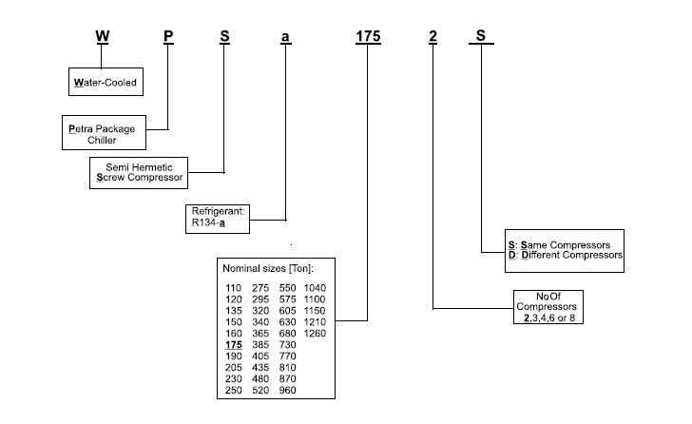
The chiller is the main source of cooling process, our selection depends on PETRA COMPANY.
The cooling load in our project is 942.74 Ton. . So we select 960 ton R 134-a chiller it's manufactured with three compressors and with the same compressors type.
The Chiller Code is: WPS a 960 3 S

Slide 15
DUCT DESIGN
There are two methods for duct design :
Equal pressure drop method.
Velocity method.
All the results of duct design based on equal pressure drop method .

Slide 16
PIPES DESIGN
The total cooling load was calculated for the floor.
The mass flow rate for the water calculated (m).
The pressure head was estimated in (Kpa) .
The longest loop from the boiler to the farthest fan coil unit and return to the boiler was calculated multiplying by (1.5) due to fittings.
The pressure head per unit length is calculated and it should be between range from (200< ∆p/L<550).
Then the diameter of pipe entering to the floor is estimated .

Slide 17
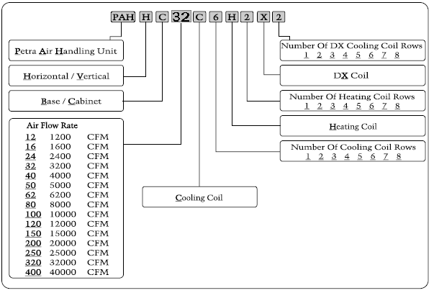
AIR HANDLING UNIT SELECTION
The Air Handling Units were selected from PETRA COMPANY using PETRA catalogue:
The ahu in this project are choosing according to the above code as in the following table:

Slide 18
Underground floor
Name | Load(WATT) | CFM | module number
#1 | 21441 | 4100 | PAH HC 50 C 6 H2 X2
# 2 | 17105 | 3020 | PAH HC 30 C 6 H2 X2
#3 | 20242 | 3574.4 | PAH HC 40 C 6 H2 X2
# 4 | 17715 | 1611.17 | PAH HC 24 C 6 H2 X2
# 5 | 9124.1 | 3128.2 | PAH HC 32 C 6 H2 X2
#6 | 9857 | 1740.6 | PAH HC 24 C 6 H2 X2
GROUND FLOOR
Name | Load(WATT) | CFM | module number
1 | 119000 | 21013.4 | PAH HC 250 C 6 H2 X2
SECOND FLOOR
Name | Load(WATT) | CFM | module number
2 | 161000 | 28430 | PAH HC 320 C 6 H 2X2
3 | 98000 | 17305 | PAH HC 200 C 6 H 2X2
4 | 42000 | 7417 | PAH HC 80 C 6 H 2X2
IDENTICAL FLOORS
Name | Load(WATT) | CFM | module number
0 | 73500 | 1298.9 | PAH HC 150 C 6 H 2X2

Slide 19
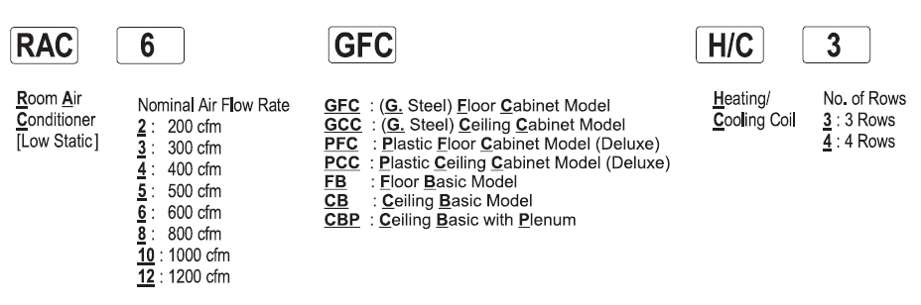
FAN COIL UNIT SELECTION
In Our project we need Ducted FCU and to ensure the high level of comfort we need the filtered FCU our selection from Petra catalogs is CBP type.
The FCU in this project are choosing according to the above code as in the following table(for the identical floors):
Identical floor FCU
Application | Q _{TOTAL} (KW) | # 0f FCU | Model # of FCU
Bed room | 7 | 29 | RAC 12 CBP H/C 3

Slide 20
Pump selection:
Our selection for pump depends on Evrot company
For the building the selection of pumps were been as the following:
Pumps for HVAC system
for chiller and boiler FCE-FCS series: 65-1602/220
[Qb= 1134L/min, H= 95 m].
[Qchiller=1558.7L/min, H=67.5m] .

Slide 21
Fire Fighting system:
We use in this project type of Wet Pipe System because wet standpipes may be used by building occupants may fight fires quickly.
We used both of landing valve and cabins , and use
( NFPA) Code to be followed through designing .
Main pipe passes with water flow of up to 500 gpm. And (4”) the main sizing pipe .
Designed for landing valve and cabinet ,the designing on the farthest landing valve ,Is the supply line leading to it take ( 250gpm) and the Pipe leading to it were (2.5’’).
The cabinet branch pipe (1.5”) , the flow rate (100gpm).

Slide 22
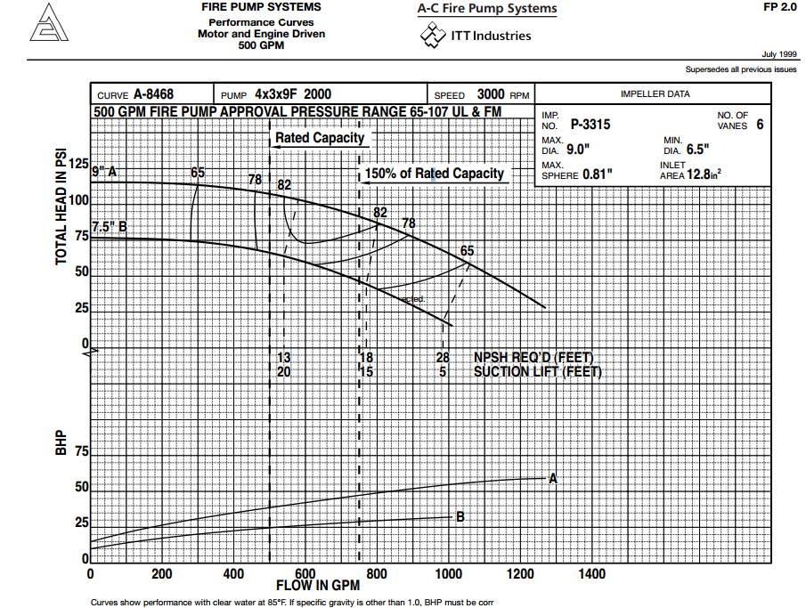
Pump selection:
For our project firefighting pump was selected as a flow rate = 150m³/h, head= 14PSI, the model no. is from A-C Fire Pump Systems and pump series is 2000 model 4x3x9f.

Slide 23
ELEVATORS:
Elevators Type in hotel is Geared-traction elevator.
the speed is 450 feet per minute Gearless-traction
The size of elevators in hotel is 6 feet8 inches wide by
5 feet5 inches deep; 3,500 pounds .

