Slide 1
WELCOME!
Thank you for coming today!

Slide 2
The Correlation Between the Academic Achievements Of Students In Both School And University Stages
Notes:
No slide master

Slide 3

Problem Specification
Academic Failure
Inadequate

Slide 4





TIMELINE
Working Mechanism
Introduction
Methodology
Model Implementation
Future Work
Conclusion

Slide 5

Introduction
Scope
Goals
Requirement

Slide 6
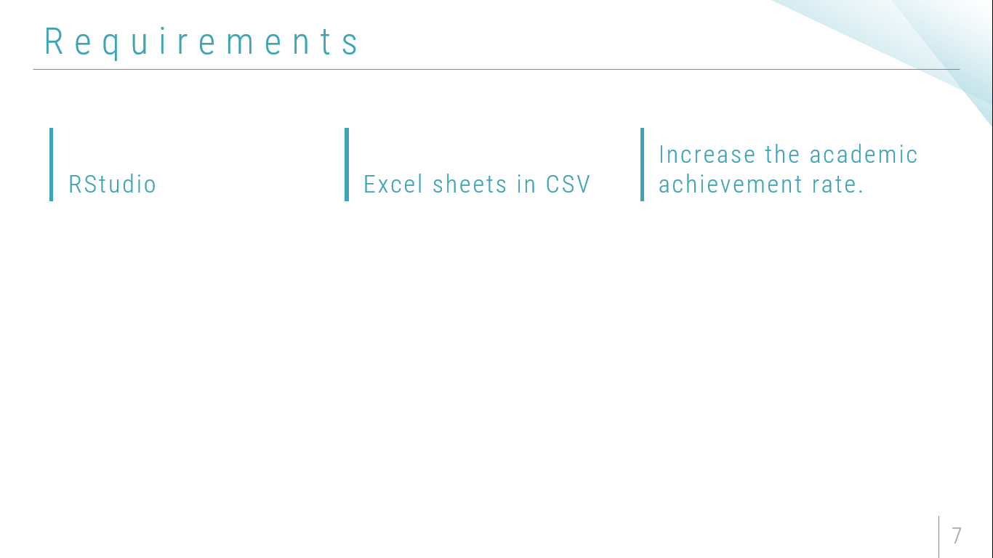
Goals
Changing The Acceptance Process
Provide a better opportunity
Increase the academic achievement rate.

Slide 7

Working Mechanism
Data Collection
Data Preparation
Model Building

Slide 8

Data Collection
Collecting school grades
Collecting university grades

Slide 9
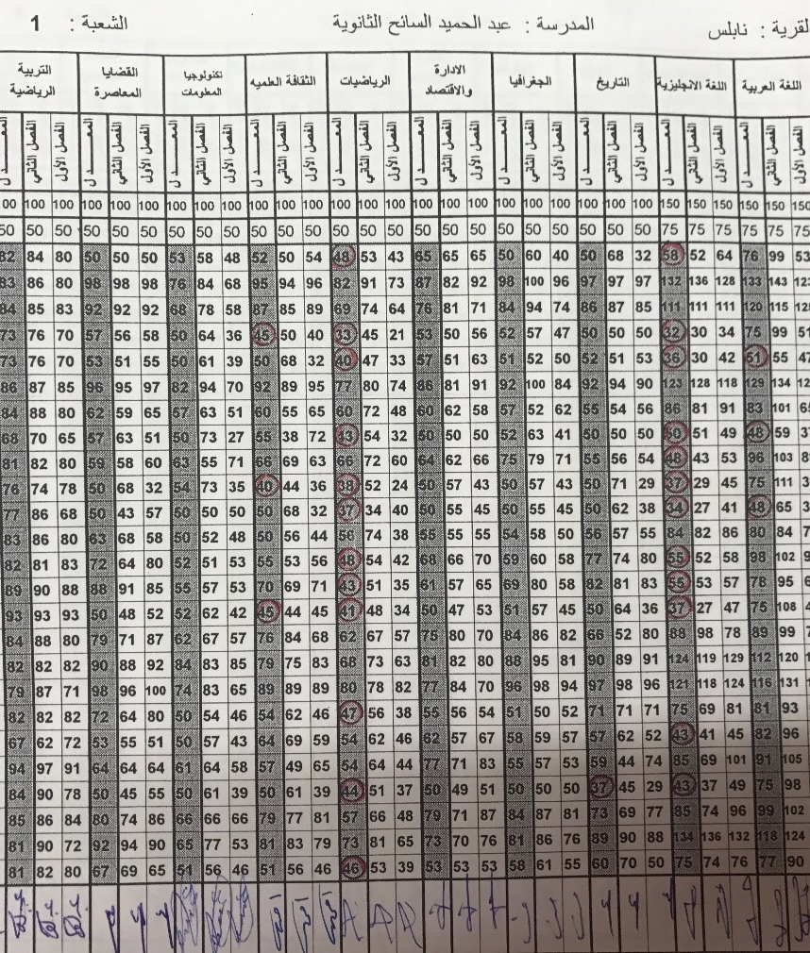
Difficulties encountered during collecting school grades
1. Intensive privacy measures by schools and the Ministry of Education on students’ grades.
2. The lack of computerized copies in schools
3. The problem of linking students' marks in the three grades

Slide 10
Difficulties encountered during collecting University grades
Intensive privacy measures by the University on students’ grades.
The significant decline in the number of students who were admitted for the obtained.

Slide 11
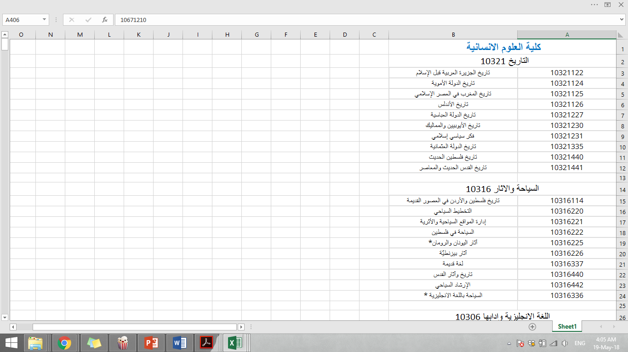
For security and privacy reasons, the computer center in the university did not agree to give us all student marks in all courses, so we had to choose some of the courses to be sent to the computer center.

Slide 12
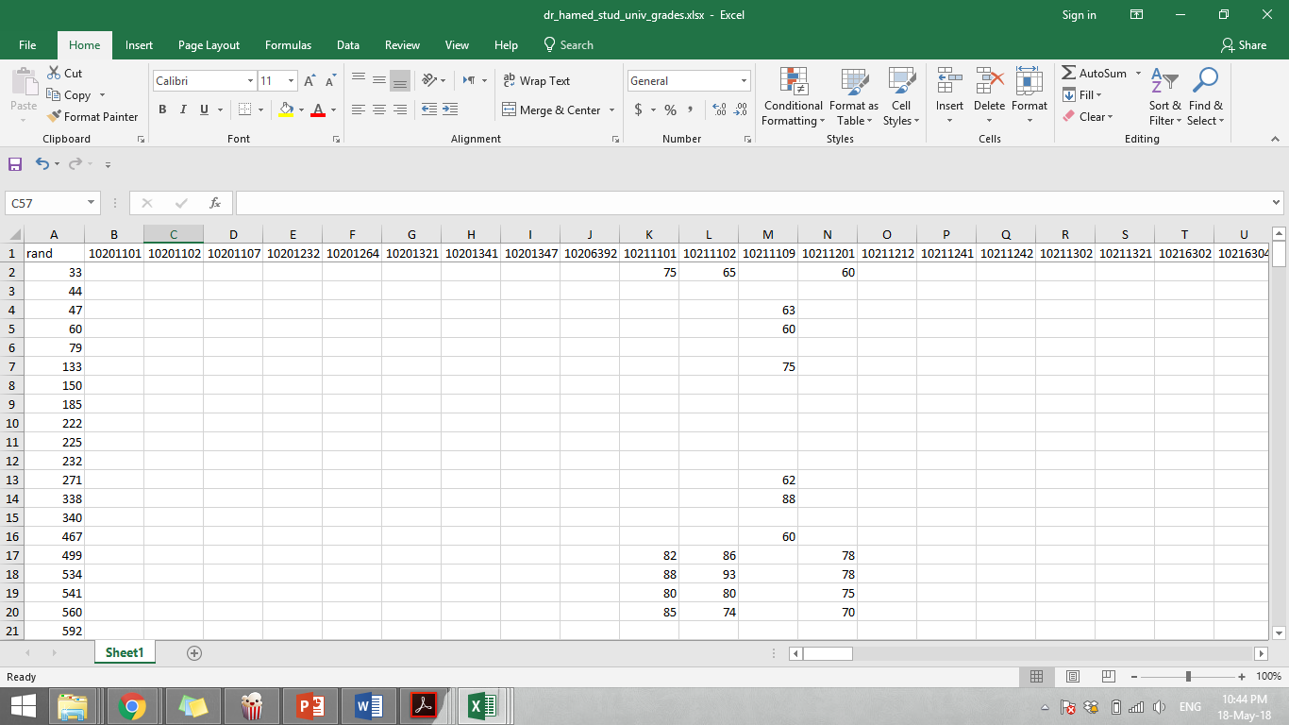
University Courses and grades as sent by the computer center

Slide 13
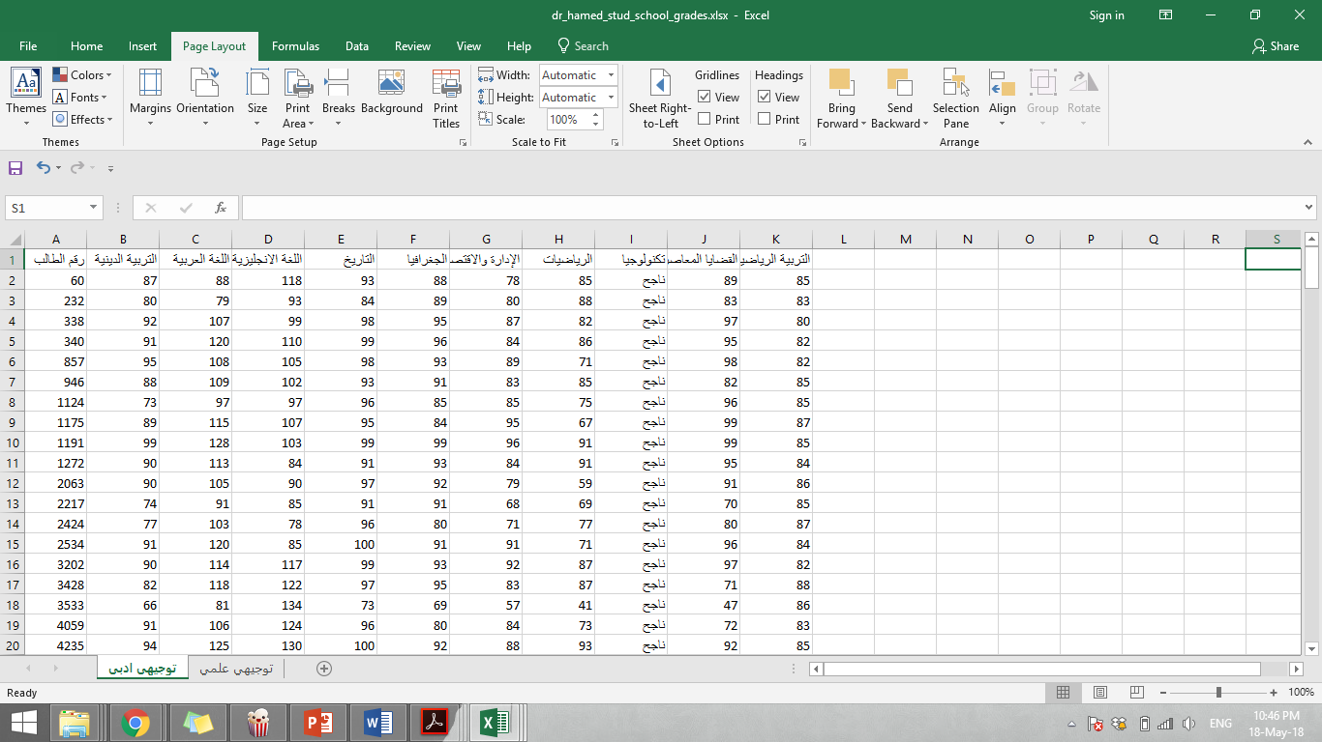
School Grades with random numbers linked to university grades as sent by the computer center

Slide 14

Data Preparation
The number of classes to include in the training set depends on the number of school classes plus other variables
01
Data editing:
02
Data cleansing
03
Data reduction
04
Data wrangling

Slide 15
The average between the 3 school Grades.
1
Eu iudicabit definiebas vim. Ad his amet dicant perfecto, pri ex case prodesset, his meliore invenire et.
Student Id | Math | Technology | English | Physics | Chemistry | Biology | Arabic | Religion
1 | 44 | 58 | 50 | 82 | 70 | 83 | 65 | 78
1 | 59 | 60 | 52 | 83 | 81 | 89 | 66 | 70
1 | 63 | 70 | 54 | 89 | 88 | 85 | 80 | 84
AVG: | 55 | 63 | 52 | 84 | 79 | 85 | 70 | 77
2
Te ridens prompta pri, ne nam dicat mandamus, quaestio senserit an mei.
4

Slide 16
Merging Scientific and literary stream dataset
1
Student Id | Math | Technology | English | Physics | Chemistry | Biology | Arabic | Religion | Science | Geographic | History | Administration and economy
1 | 69 | 65 | 55 | 60 | 70 | 72 | 80 | 83 | 50 | 50 | 50 | 89
2 | 72 | 92 | 95 | 50 | 50 | 50 | 88 | 86 | 65 | 66 | 78 | 83
4

Slide 17
Multiple target variables problem
Student Id | Math | Technology | English | Data Structure | Design and Analysis of Algorithms | Computer Organization and Assembly Language | Linear Algebra for Computer Science | Calculus I | Calculus II
1 | 67 | 65 | 55 | 50 | 53 | 51 | 55 | 58 | 59
1
Student Id | Math | Technology | English | UNI | Course Name | Course Name
1 | 67 | 65 | 53 | 50 | 10671210 | Data Structure
1 | 67 | 65 | 55 | 53 | 10671212 | Design and Analysis of Algorithms
1 | 67 | 65 | 55 | 51 | 10671243 | Assembly Language
1 | 67 | 65 | 55 | 55 | 10671244 | Linear Algebra
1 | 67 | 65 | 55 | 58 | 10211101 | Calculus I
1 | 67 | 65 | 55 | 59 | 10211102 | Calculus II
1 | 67 | 65 | 55 | 62 | 10671321 | Computer Architecture
1 | 67 | 65 | 55 | 60 | 10671353 | Database Systems Design
1 | 67 | 65 | 55 | 61 | 10671102 | Principles of Programming II
1 | 67 | 65 | 55 | 62 | 10671204 | Web Programming

Slide 18
Solution to the problem which is having the same independent variables leading to different dependent variables, which is not reasonable for the regression model
Memorization | Perception | Language | Analysis

Slide 19
Model Building
Datasets
Regression

Slide 20
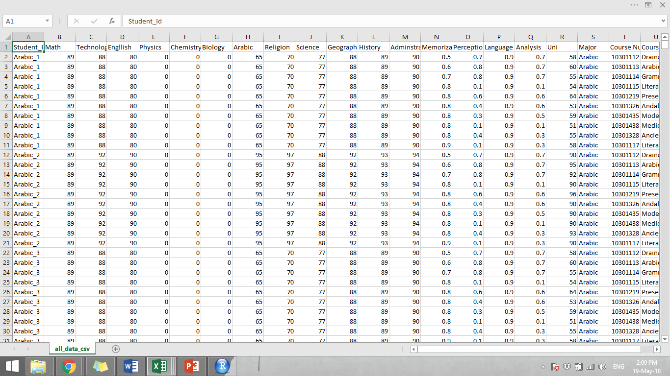
    A complete dataset for one model that includes all majors
Notes:
No slide master

Slide 21
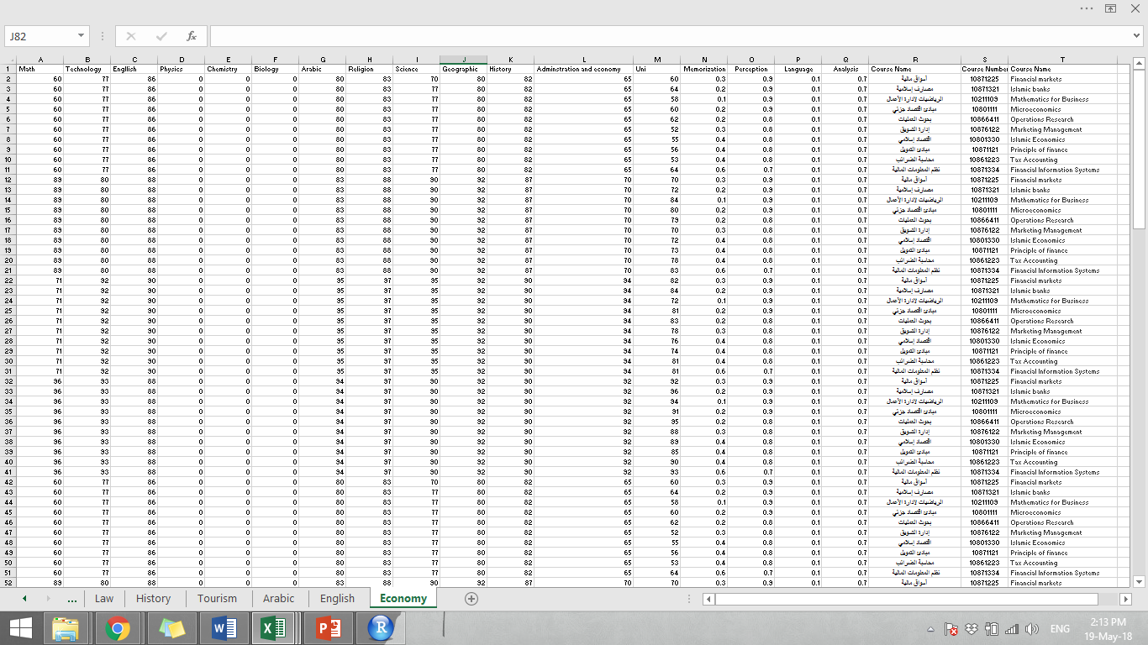
    A dataset that for 24 different model- each major was built
    a different regression model
Notes:
No slide master

Slide 22
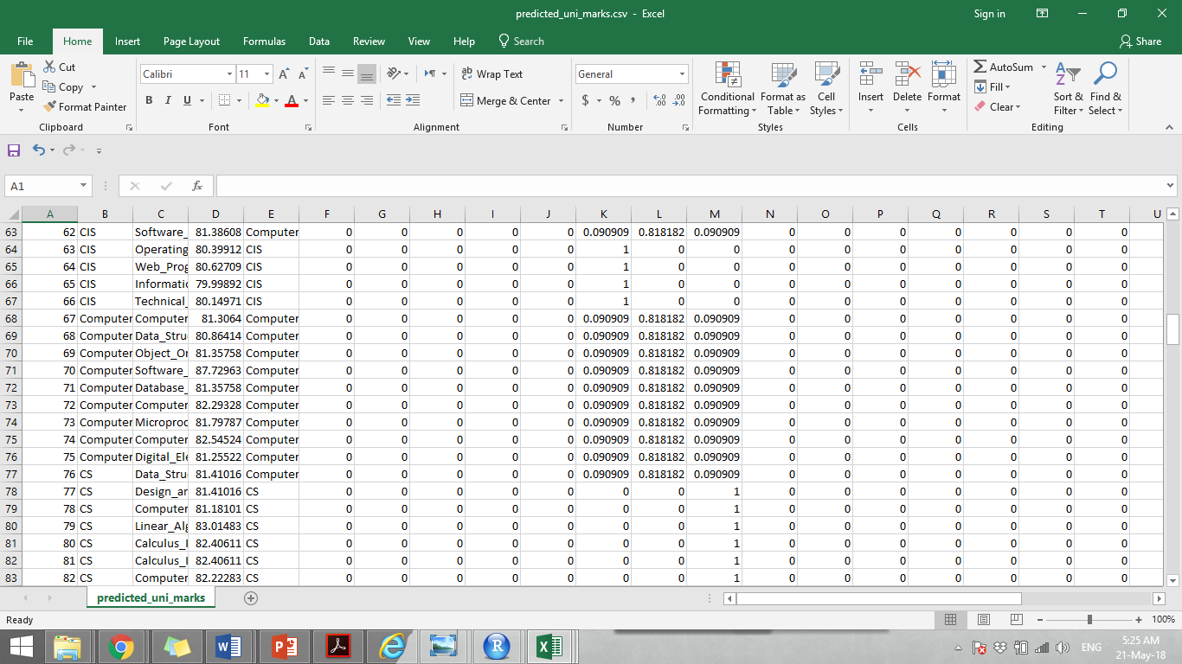
    Predicted University Marks and the Probability of each major
Notes:
No slide master

Slide 23
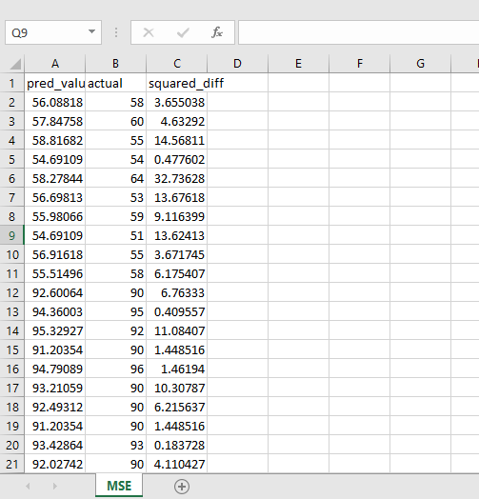
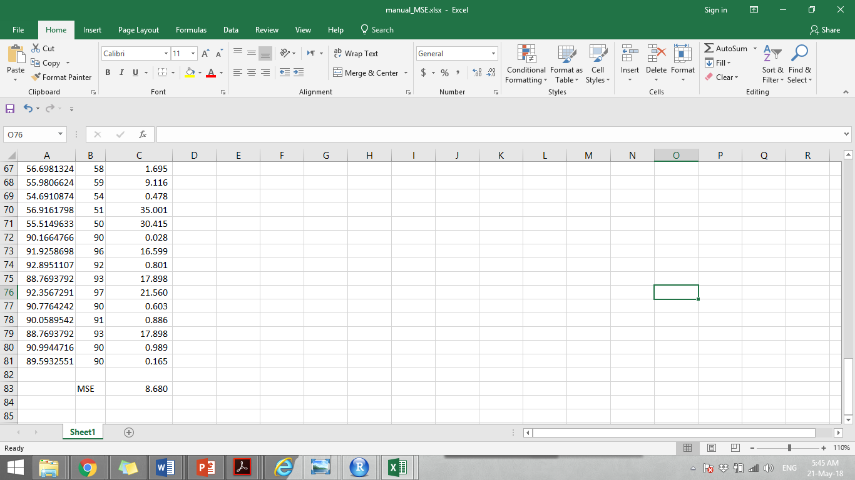
Calculate MSE

Slide 24
Future Work
Cooperating with the Ministry of Labor to obtain the results of the examination of abilities, skills, competencies and tendencies. And use them as attributes in the regression model to increase accuracy
Include all university Majors

Slide 25

Conclusion
Student's High School marks in some particular subjects are a strong predictor of their achievement
Students’ University marks can be predicted using their highschool marks
A number of other factors play a significant role on their achievement that might affected our study

Slide 26
THANK YOU!

