Slide 1
Investigating the presence and implementation of safety rules and regulations in the construction projects in Palestine
prepared by:
Ammar Abu-Saleh
Hussam Malhas
Under supervision of: ENG . Reema Nassar

Slide 2
Contents
INTRODUCTION
Importance of Project
Objective of the Project
METHODOLOGY
Questionnaires
Data analysis
Results
Conclusion
Recommendations

Slide 3
INTRODUCTION
The application of safety measures at work sites is the responsibility of all parties in the project, and therefore it is imperative to know the extent of the commitment of each category of project parties to the application of safety measures at work sites, and to work on developing guidelines and recommendations directed to all parties in the project.

Slide 4

Importance of Project
Safety in construction projects is important as they affect the lives of workers, so it is necessary to maintain safety at construction sites by taking safety measures and work to implement them in order to preserve the reputation of the company and the lives of workers.

Slide 5

Objective of the Project
Analyzing the questionnaires and results and coming up with recommendations that would increase awareness among the three parties of the importance of applying safety measures at construction sites.

Slide 6

METHODOLOGY
We distributed the questionnaires to workers, contractors and owners, where 300 workers, 30 contractors and 30 owners responded to us.
After collecting the questionnaires, we analyzed the information provided to us by the three parties in order to come up with results to analyze the reality of implementing safety at construction sites, and accordingly we made recommendations that would improve the safety reality on construction sites.

Slide 7
Questionnaires
contractors
owners
Laborers

Slide 8
Data analysis
The necessary analyzes were carried out, which were the result of the collected data, in order to calculate the degree of awareness of owners, contractors and workers in the construction industry.
Each participant was evaluated by the study tools, which ensured higher validity and reliability. The data were carefully executed and after completing the data collection the data sheets were reviewed and any missing data added.

Slide 9
Results

Slide 10
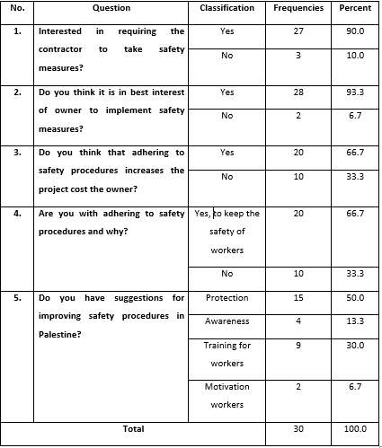
Results Related to Owners
Results related to Owners' responses

Slide 11
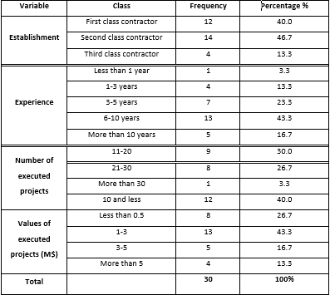
Results Related to Contractors
The Demographical characteristics of the contractors

Slide 12
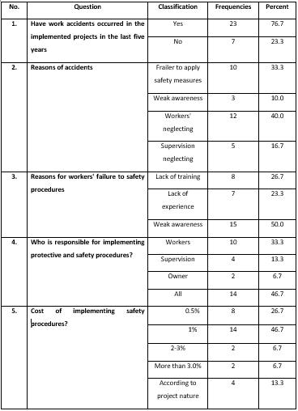
Results Related to Contractors
Results of the questions of accidents reasons, results and costs

Slide 13
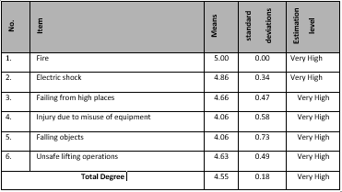
Results Related to Contractors
The most important hazards in the work site
(More than 4 is very high hazard factor)

Slide 14
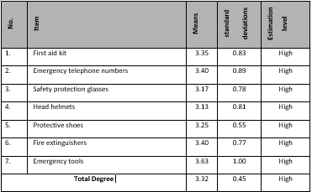
Results Related to Contractors
The degree of provision of safety tools
(More than 3 is high degree of provision)

Slide 15
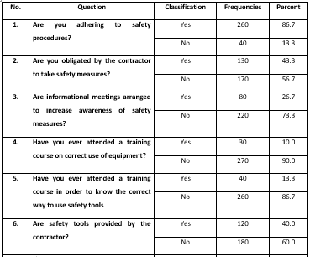
Results Related to Workers
Results of the the study questions

Slide 16
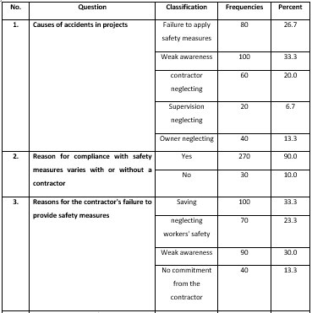
Results Related to Workers
Results of causes of accidents

Slide 17
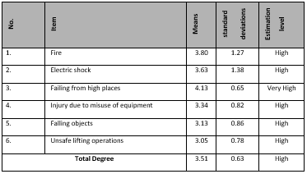
Results Related to Workers
The most important hazards in the work site
(More than 4 is very high hazard factor and 3-4 is high )

Slide 18
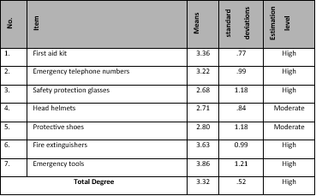
Results Related to Workers
The degree of provision of safety tools
(More than 3 is high degree of provision)

Slide 19
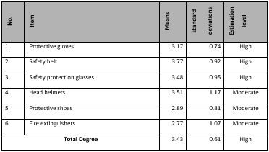
Results Related to Workers
The degree of workers adhering to safety measures (More than 3 is high degree of provision)

Slide 20
Recommendations

Slide 21

for owners:
Holding training courses aimed to increasing awareness of the importance of adhering to safety procedures on construction sites.
Obliging contractors to give training courses to the workers who work with them and under their supervision.
Imposing penalties on contractors who do not comply with these procedures, such as: Financial fines, and the downgrading of the contracting company.
Contractors are required to provide a safety engineer.
Ensure that work accidents are recorded and investigated.

Slide 22

for contractors:
Giving workers courses aimed at increasing their awareness of the importance of safety procedures and the correct way to do these procedures.
Imposing penalties on non-compliant workers.
Providing a safety engineer in construction projects to follow up the workers and ensure their commitment to safety procedures.
Providing a safe and comfortable environment for workers, especially when working in high places.
Providing high quality and appropriate safety equipment for workers.

Slide 23

for workers:
Ensure that you attend training courses on a permanent basis.
Focus on taking appropriate safety measures always and in all stages of construction.
Avoid working in unsafe places.
Requesting the necessary safety equipment from the contractor, and informing the responsible authorities in case the required equipment is not provided.
Refusing to perform acts that endanger their lives.

Slide 24

Thank you for your attention

