Slide 1

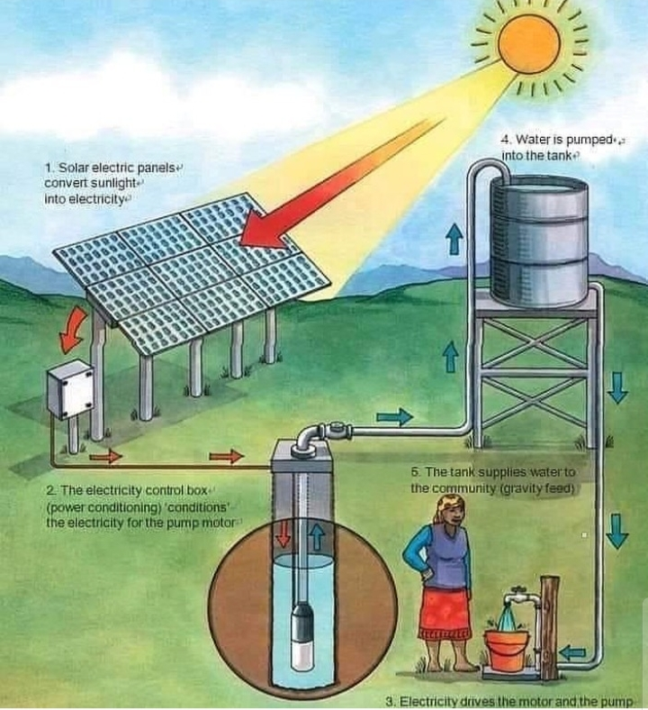
Graduation Project 2
Solar-powered water pumping system
Students | Supervisor
Abdelrahman Braik | Eng. Salameh Abdelfattah
Bisan Nazzal

Slide 2
TABLE OF CONTENTS
Introduction.
Literature review.
Methodology.
Results.

Slide 3
Objective of project
Design of solar pumping system and studying the feasibility of using solar PV water pumping systems instead of diesel generator for each well in Nablus/Tulkarm
Yearly saving (cost)
Emissions CO2
Studding the maximum power water production using tilt angle changes for each well in Nablus/Tulkarm
Using PVsyst analysis program.

Slide 4
Literature review
Designing, sizing and modeling of Photovoltaic Water Pumping Systems.
Economic Analysis of using Solar Energy.
Feasibility of Energy Supply of Water Pumping in Palestine.
Simulation of Photovoltaic Water Pumping System for small scale Irrigation.
Electrification by using PVsyst,
Exploration of an Economic Photovoltaic well to Storage Pumping System based on PVsyst Simulation.

Slide 5
PV system
Monthly Solar Radiation in
Nablus, Tulkarm and Jenin.
Schematic diagram for a
Typical PV pumping system

Slide 6
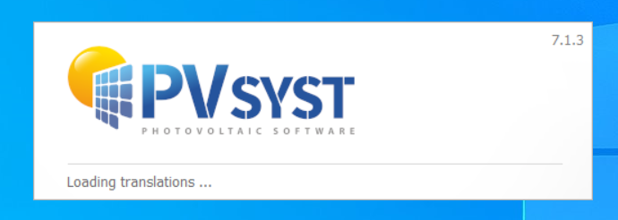
Case study
Tulkarm & Nablus
Software

Slide 7
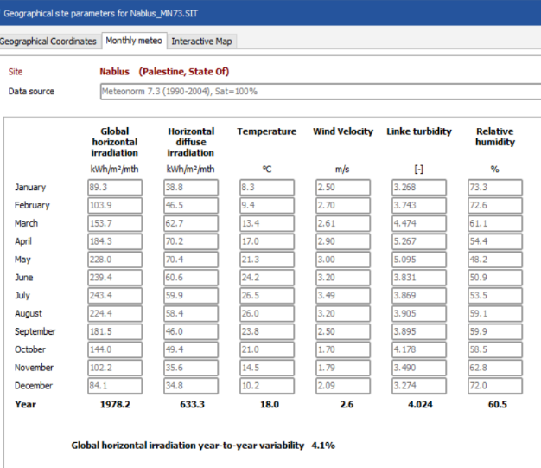
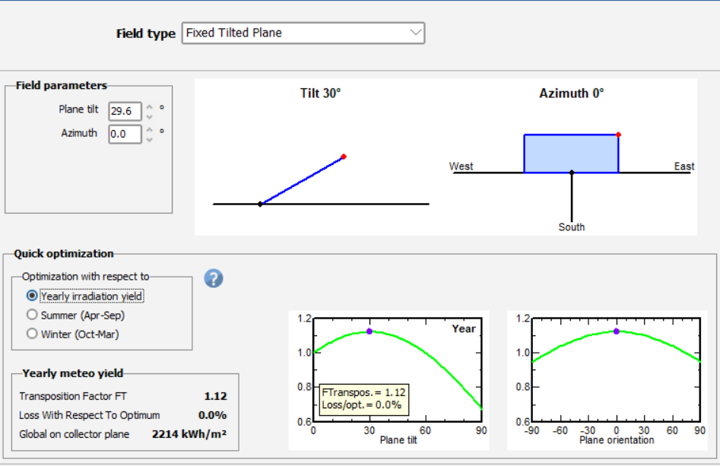
Geographical and climatic Resources
Orientation

Slide 8
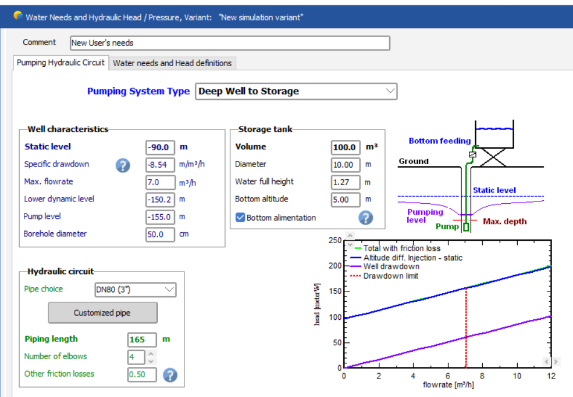
Pumping Hydraulic System

Slide 9
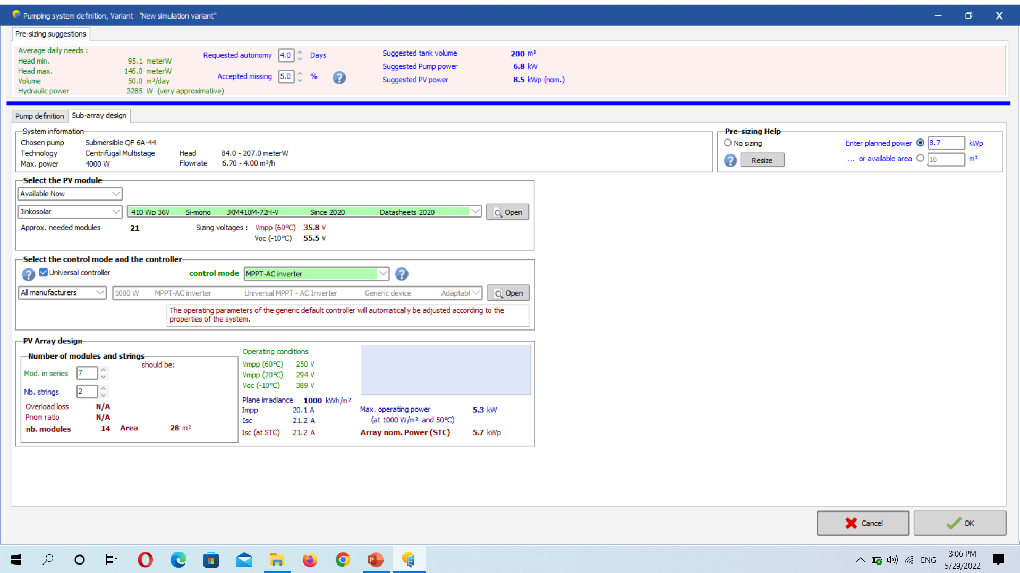
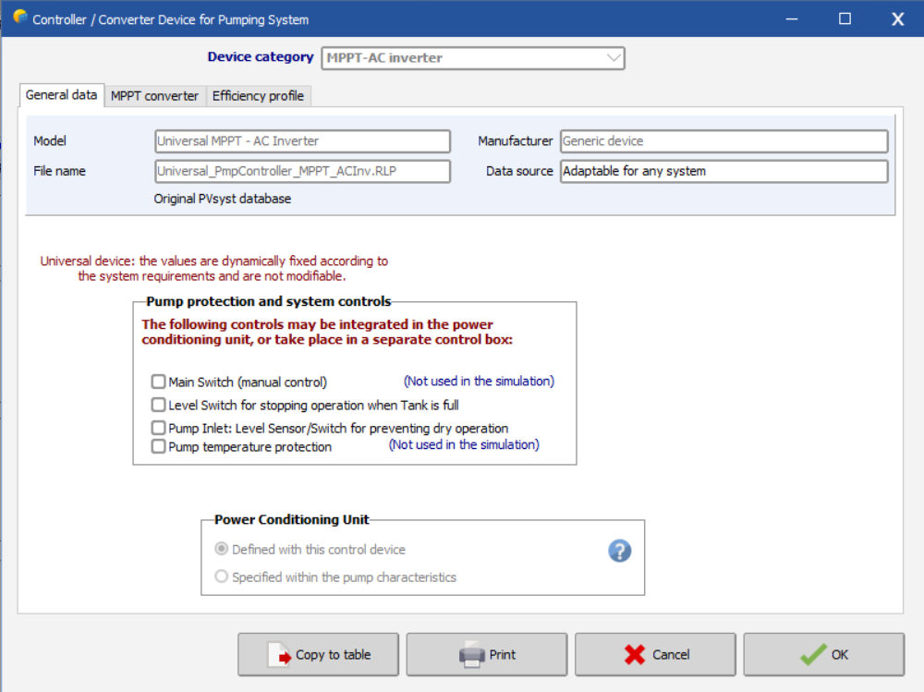
Photovoltaic PV Panel
Inverter
Number of modules and strings
Converter device for pump system

Slide 10
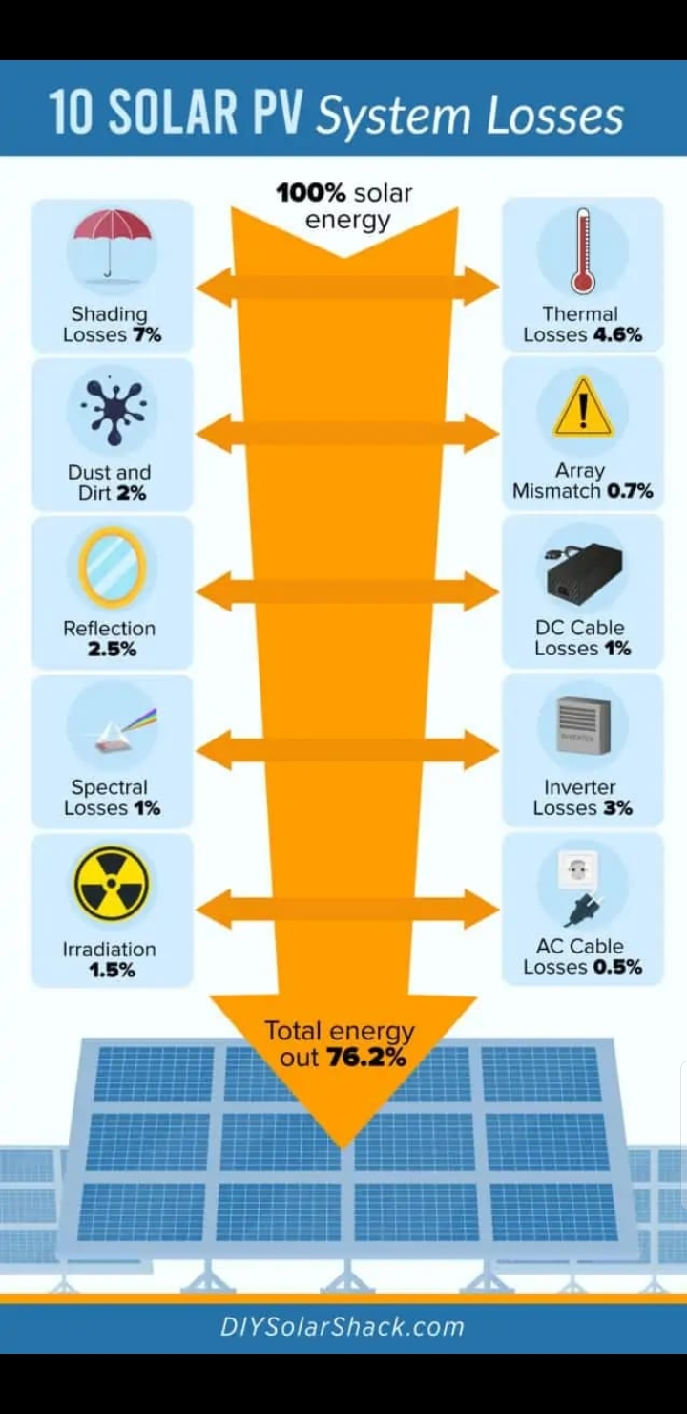
Detailed losses

Slide 11
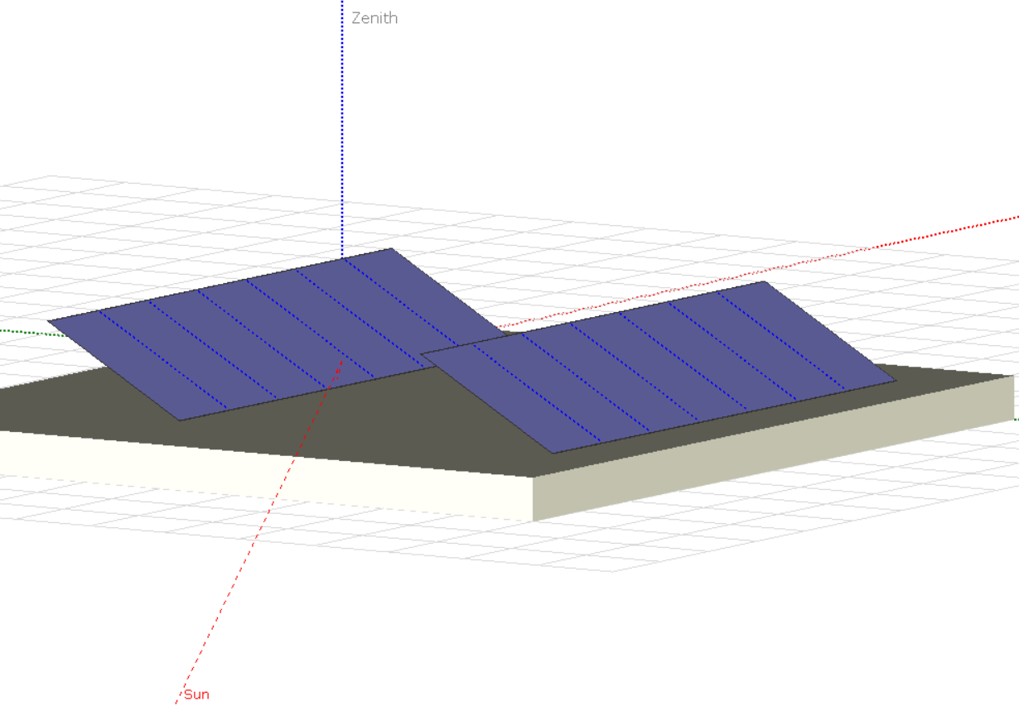
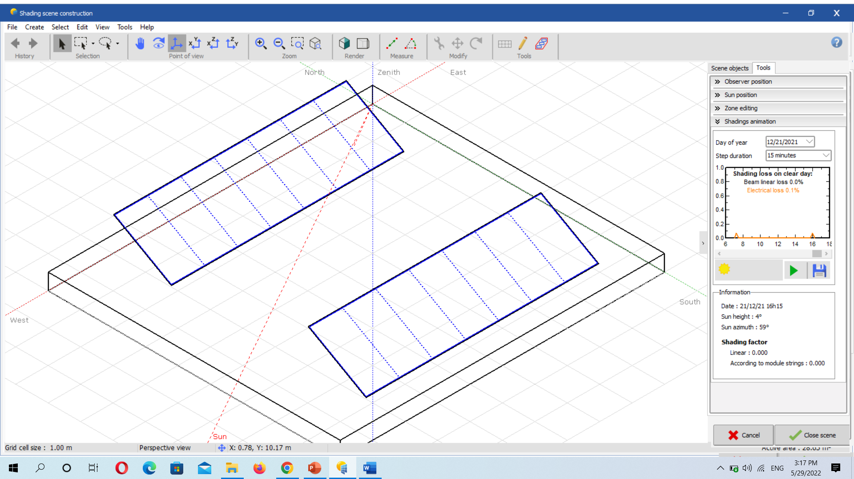
Near shading

Slide 12
Results
Water volume pumped for Nablus
Water volume power VS fixed tilt angle for Nablus

Slide 13
Results
Water volume pumped for Tulkarm
Water volume power VS fixed tilt angle for Tulkarm

Slide 14
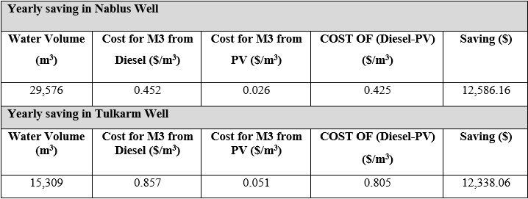
Energy cost
Yearly saving in Nablus & Tulkarm Well

Slide 15
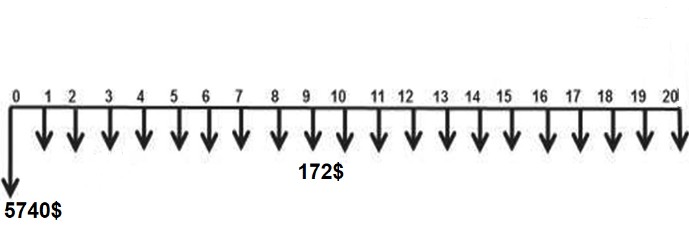
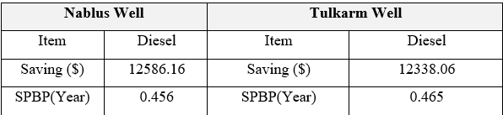
Cash flow of photovoltaic (PV) system
Simple payback period (SPBP)

Slide 16
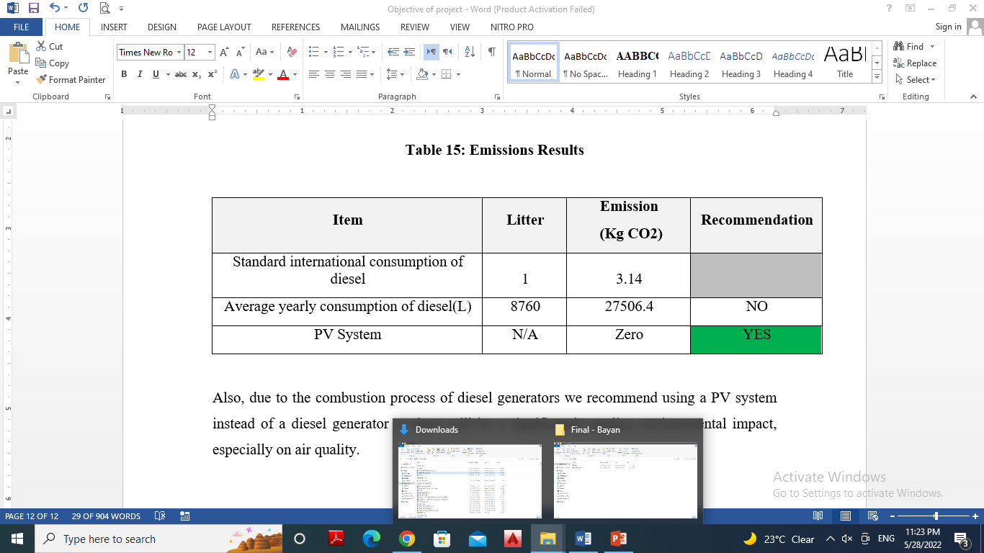
Emissions

Slide 17
THE END
THANK YOU

