Slide 1



Graduation project
Logic
Sama Shawa
Samah Qaradeh

Slide 2
Project idea
The educational platform is a mobile and web application designed to teach logical thinking . It will have two roles: the admin, who can add questions and approve the questions submitted by users, and the users, who can solve questions and submit new ones for approval. Each question will have tags (such as math, probability, logic, graphs) and will be assigned a difficulty level and a specific number of attempts. After exceeding the number of attempts, the solution will be displayed. Users will have personal accounts that include their name, picture, country, and the number of questions they've solved. Users can rate questions and leave comments on them. Additionally, contests will be created by the admin, where users compete in live contests with questions of varying difficulties, and each contest will have a time limit and score multiplier. After the contest ends, the final leaderboard will be displayed, and the scores will be saved in the user profile as charts. The platform will use MongoDB for the backend, Flutter for the frontend, and Firebase for chat and notifications.

Slide 3
Development Process
Collecting data.
Designing the database.
UI decision making.

Slide 4


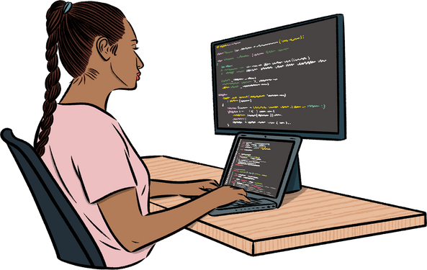
Development Tools
Flutter
Node js
MongoDB
Firebase

Slide 5


User UI Pages

Slide 6

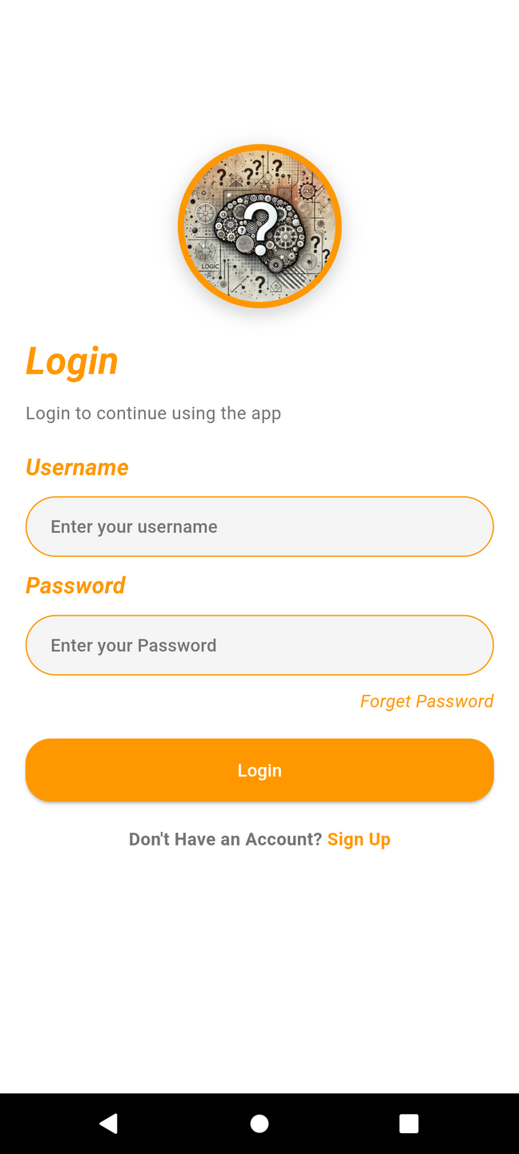
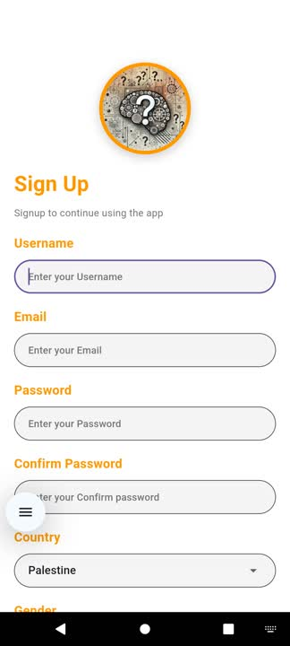
Login PAGE
Signup PAGE

Slide 7
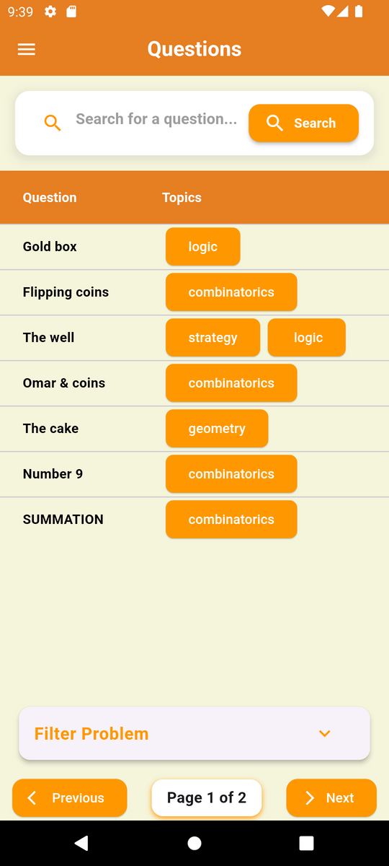
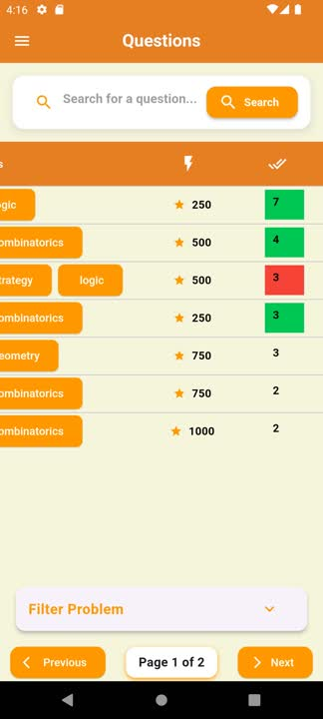
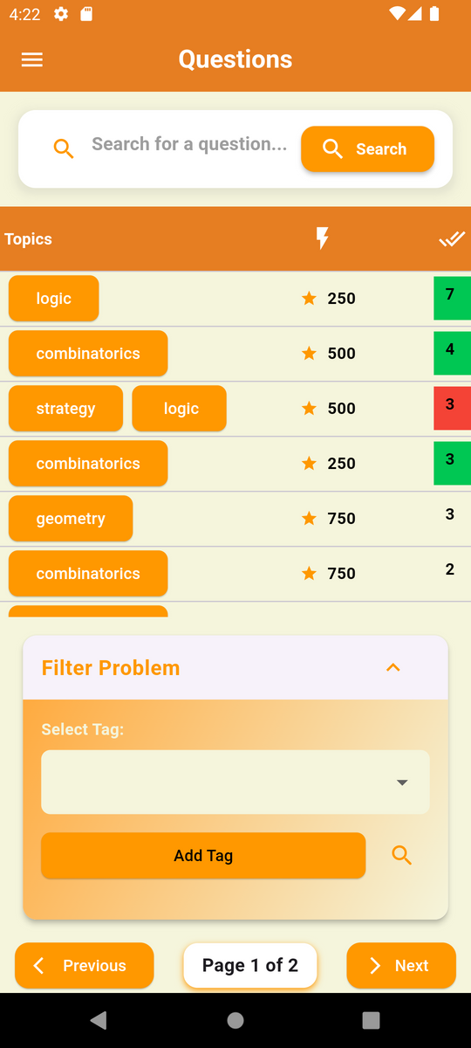
Questions

Slide 8
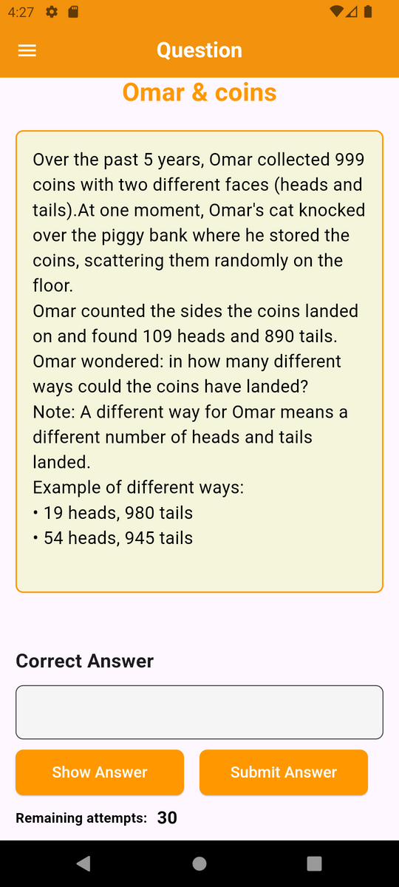
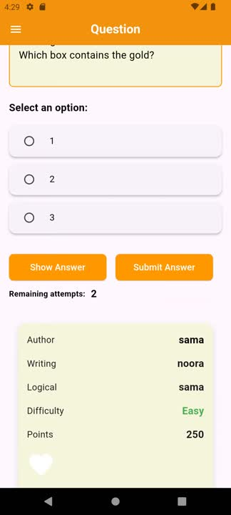
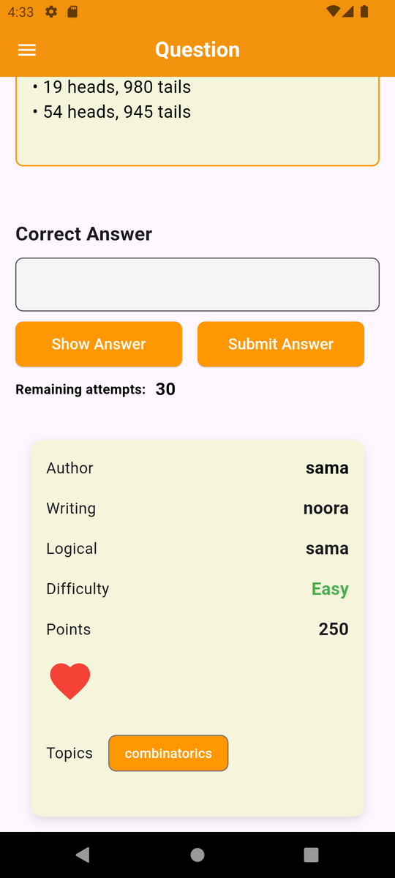

Slide 9
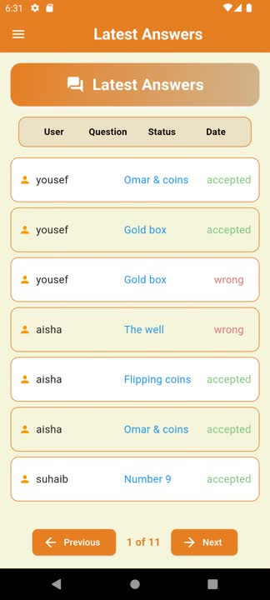
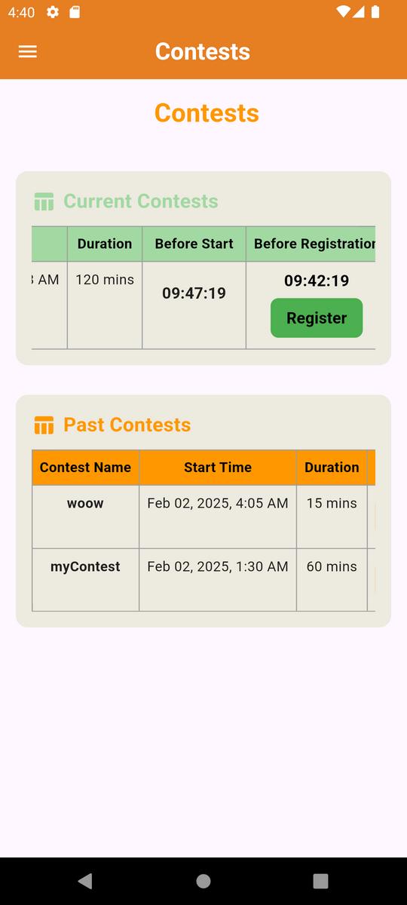
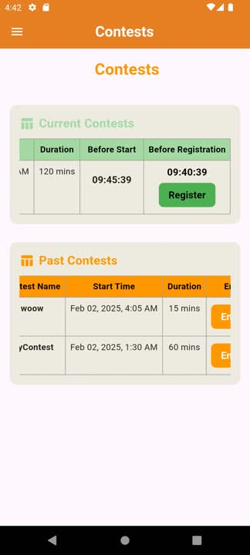

Slide 10
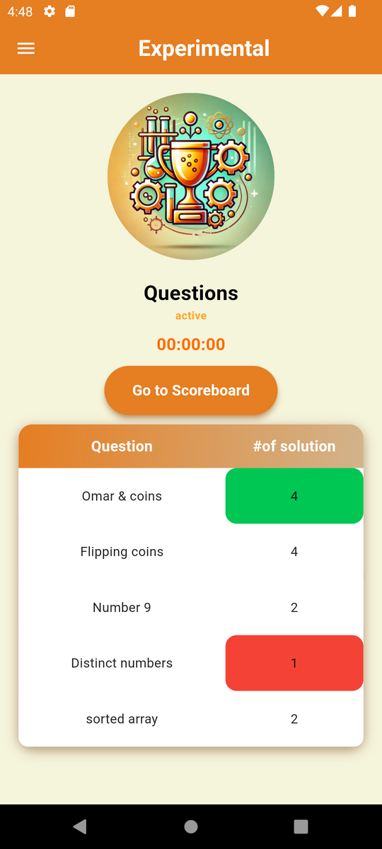
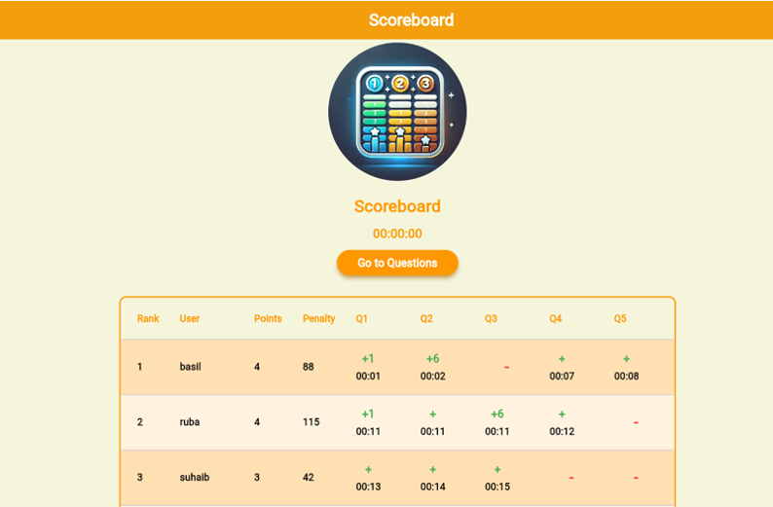

Slide 11
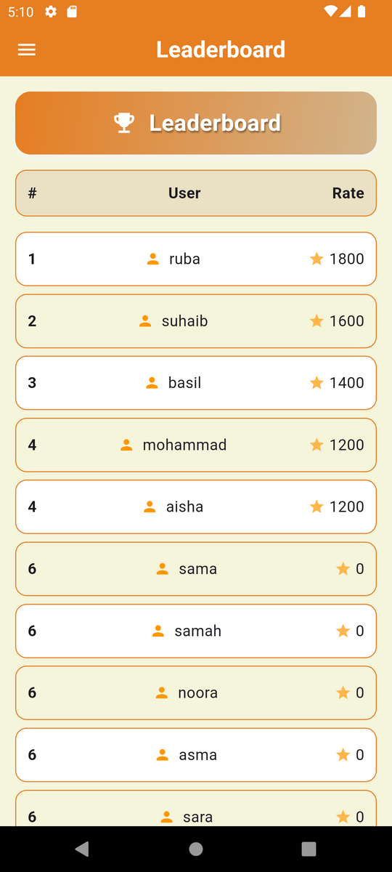
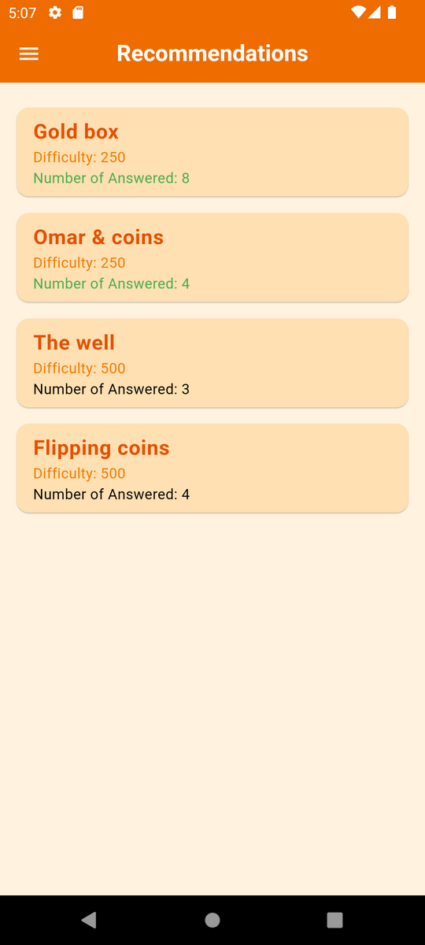

Slide 12
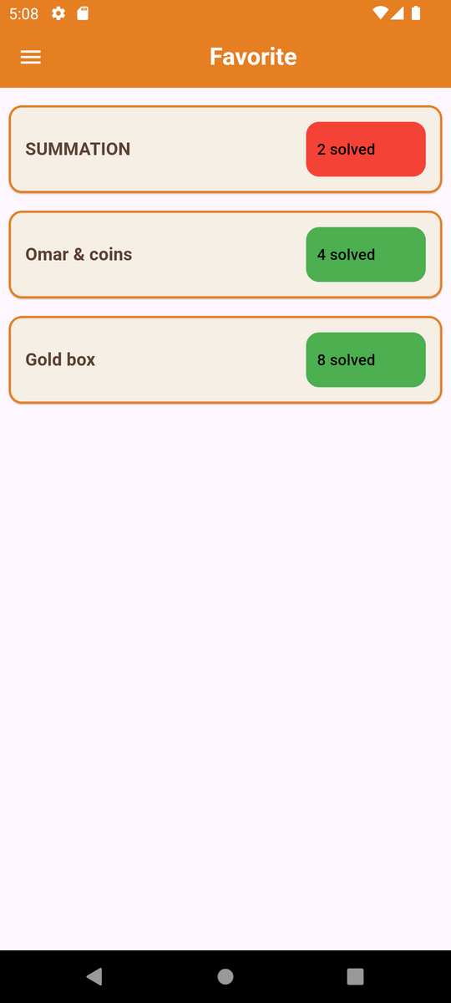
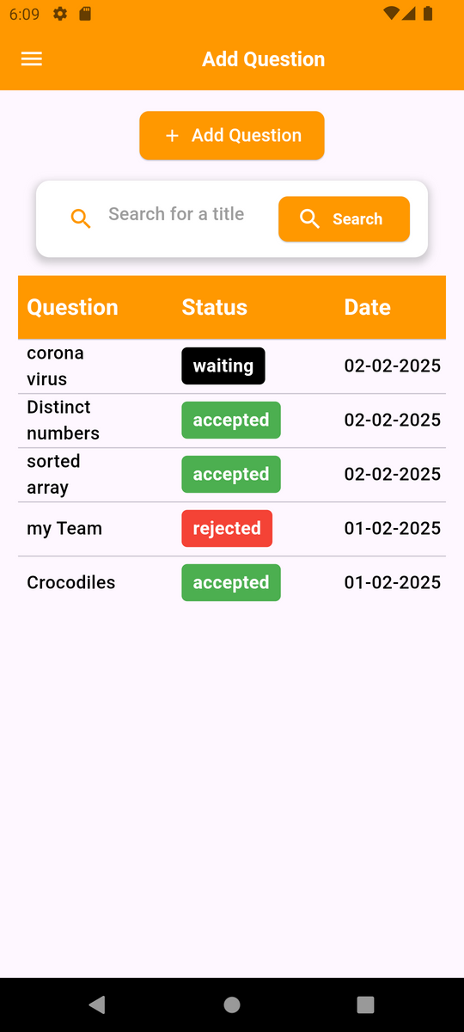
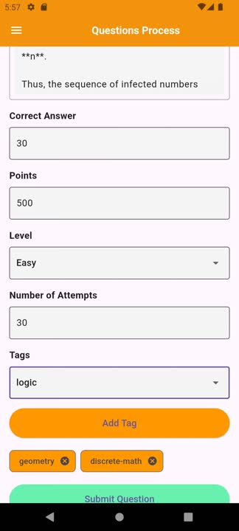

Slide 13
Admins UI Pages

Slide 14
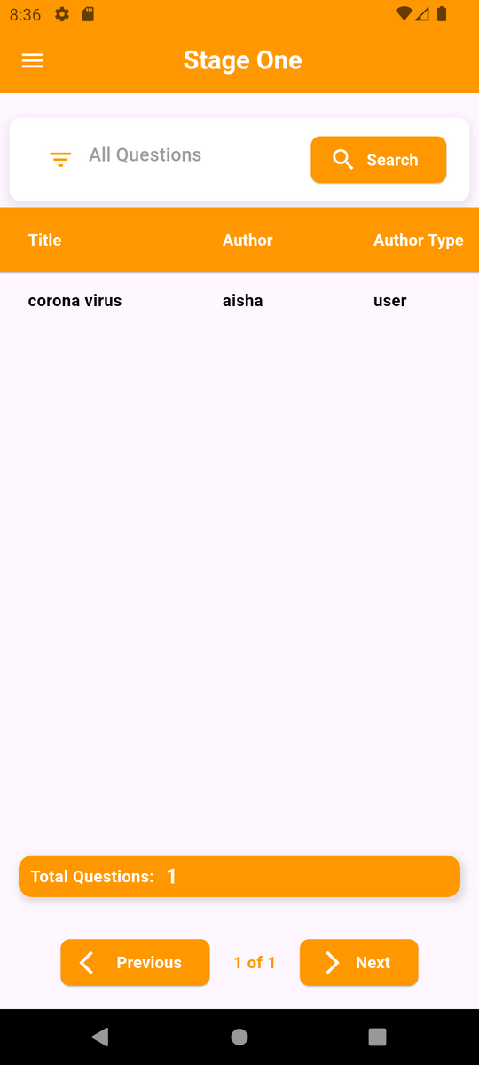
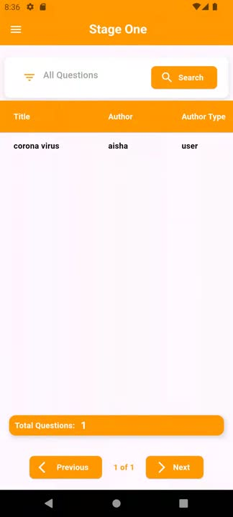

Slide 15

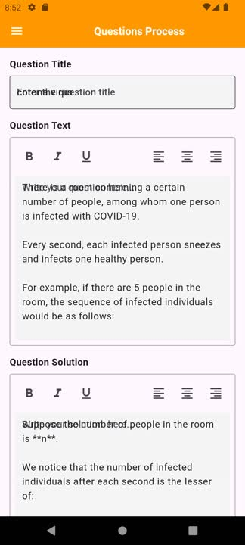

Slide 16

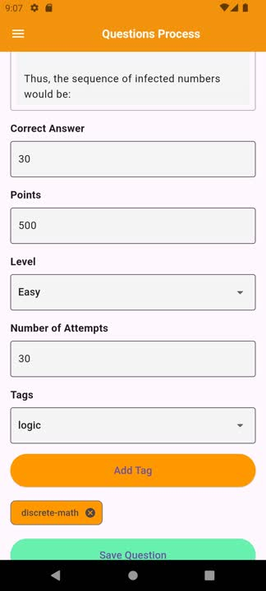

Slide 17
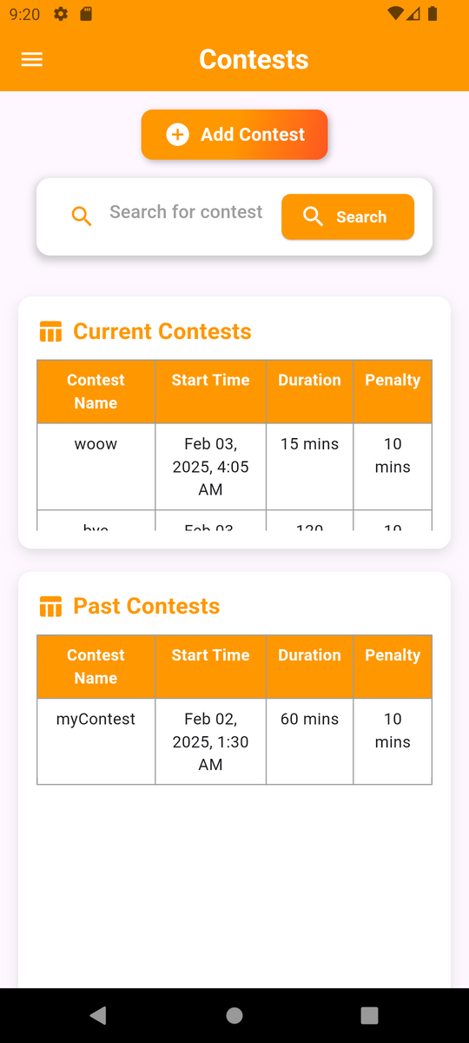
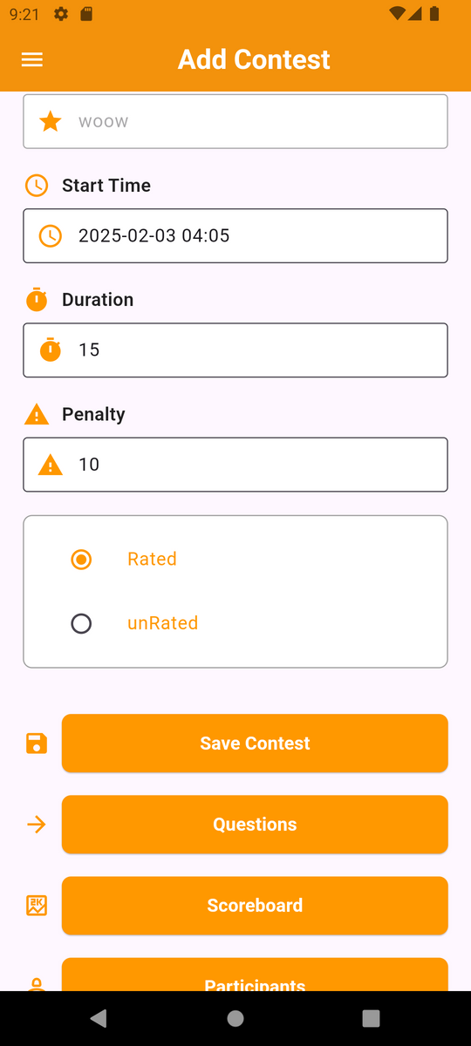
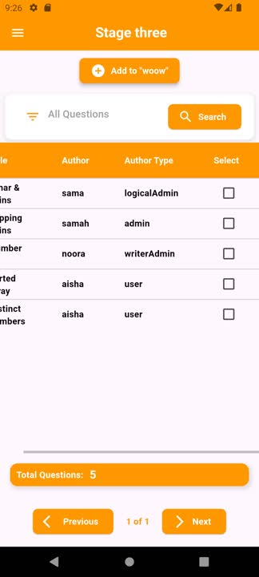

Slide 18
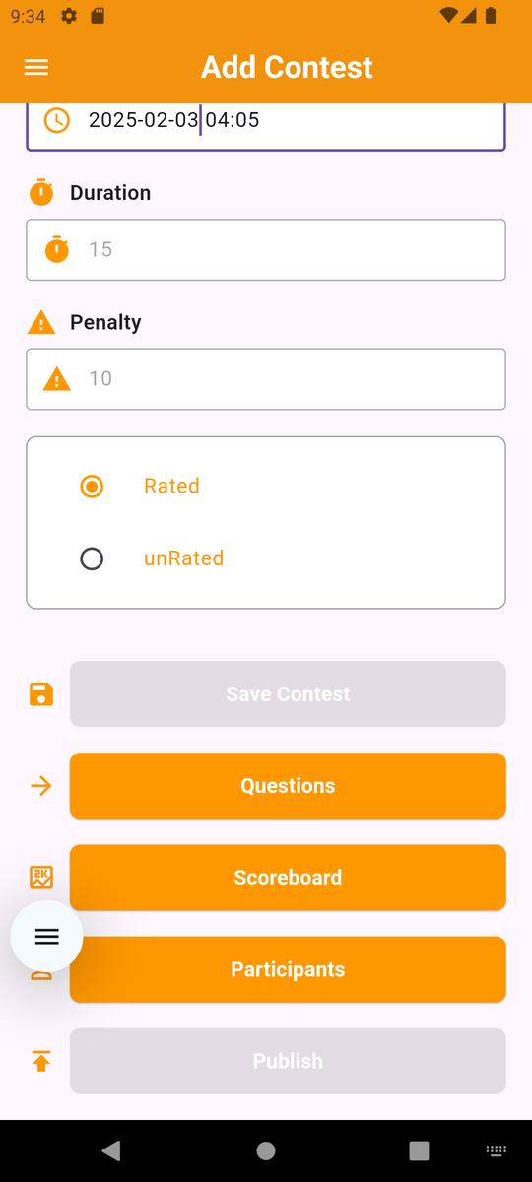
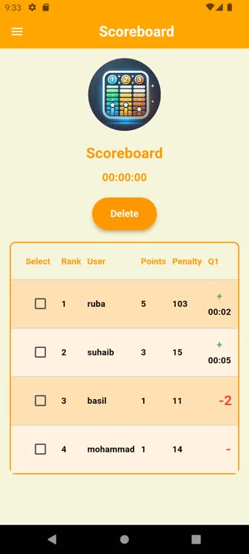

Slide 19
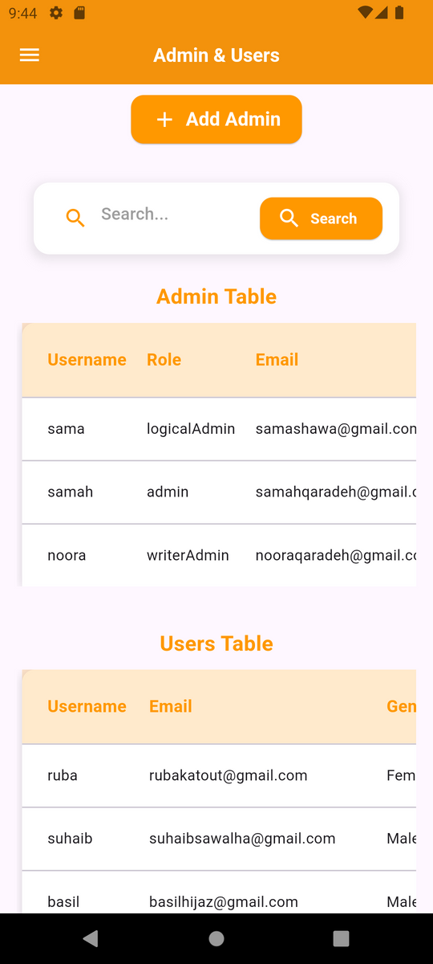
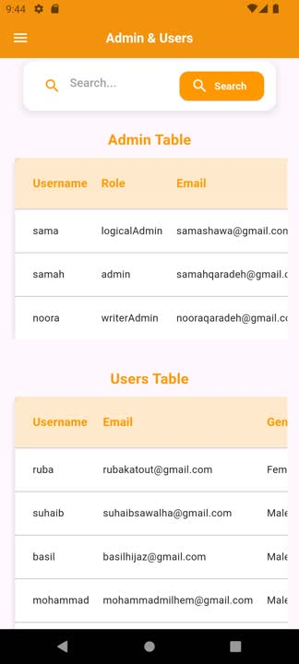
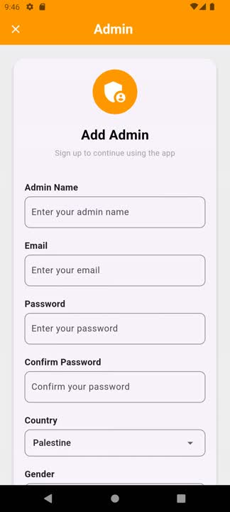

Slide 20
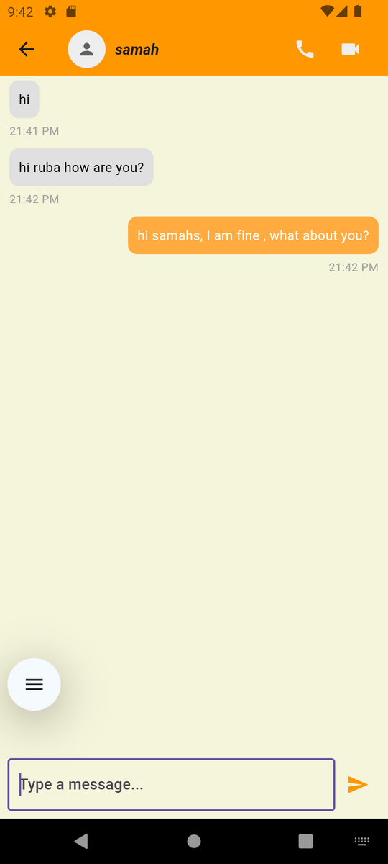
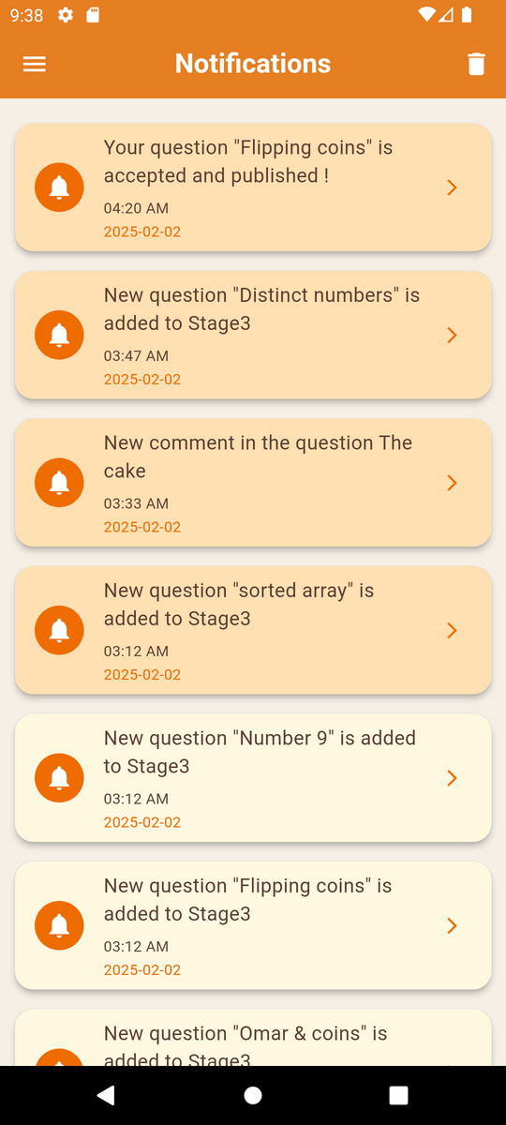
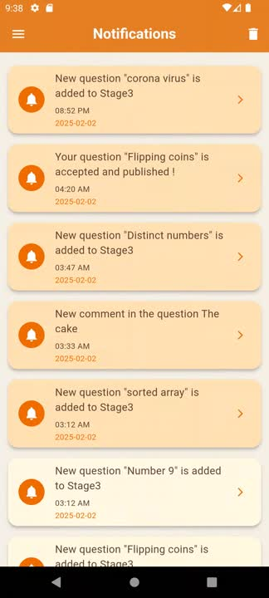

Slide 21
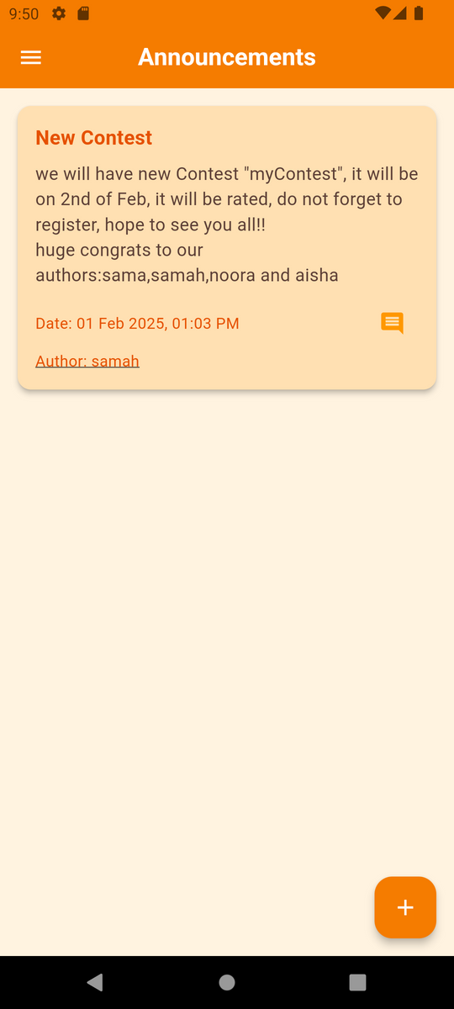
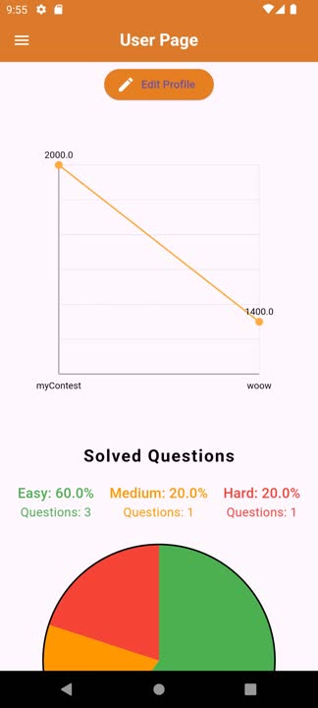
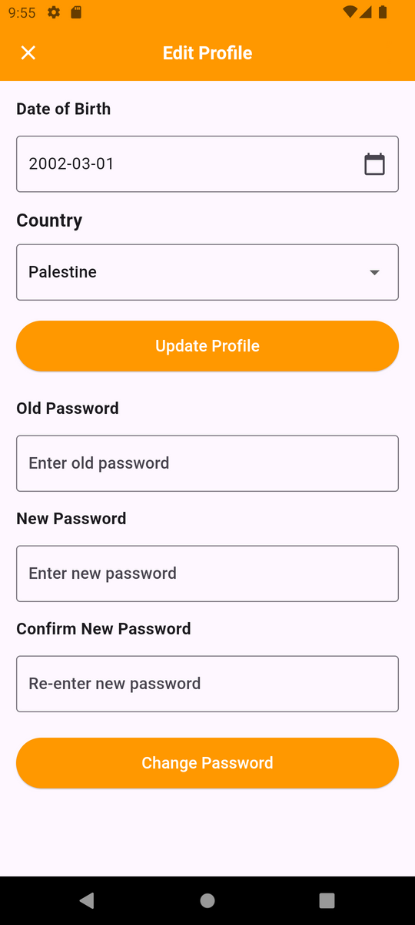

Slide 22
Project constraints:

Slide 23



constraints:
1
Accuracy in contest for the Time

Slide 24
Future Work:

Slide 25
Future Work
1
virtual Contest
2
Divisions in Contest
3
Colors

Slide 26



Thank you for listening
Made by:
•Sama shawa.
•Samah Qaradeh.
Supervised by:
•Suleiman Naeem Abu Kharmeh.
Asmaa Afifi

